Slide 1


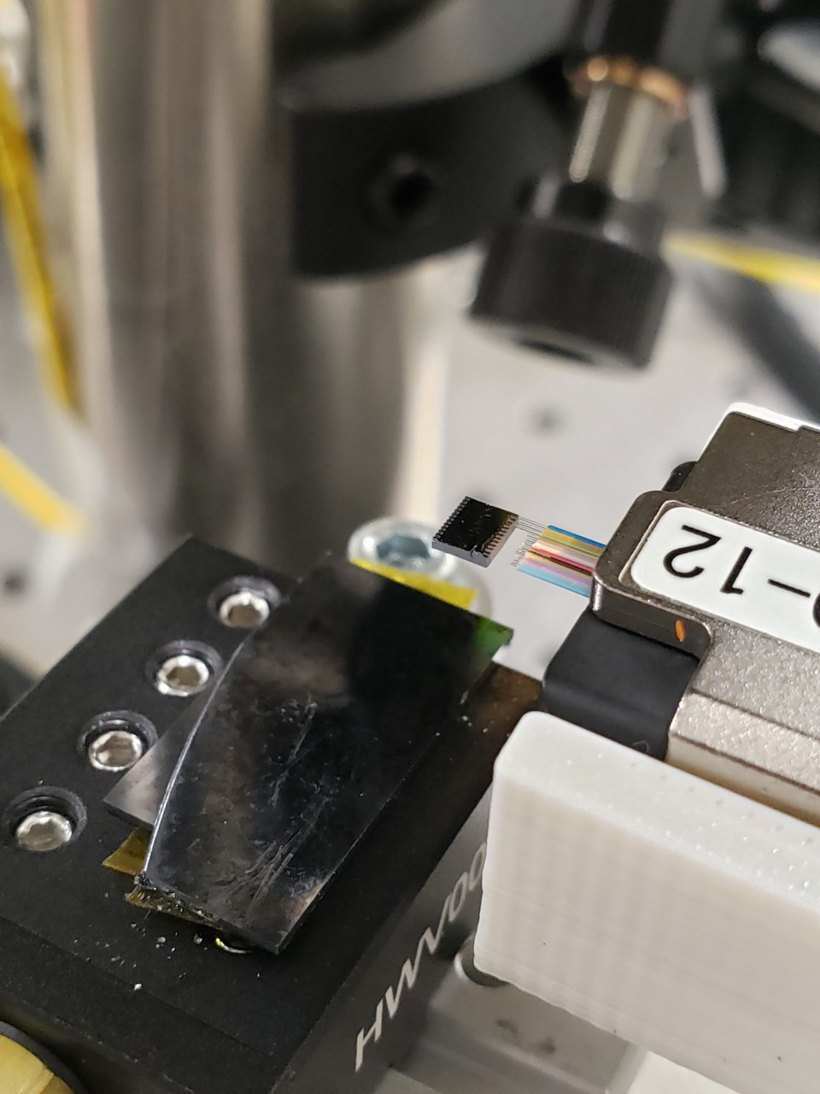
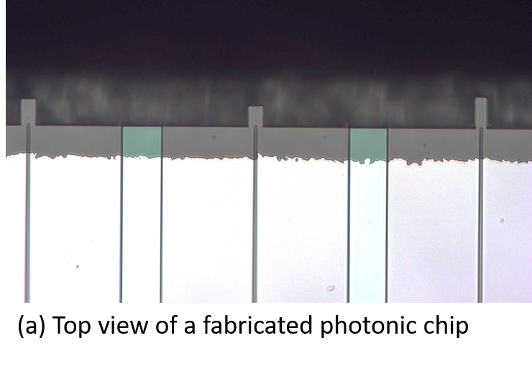

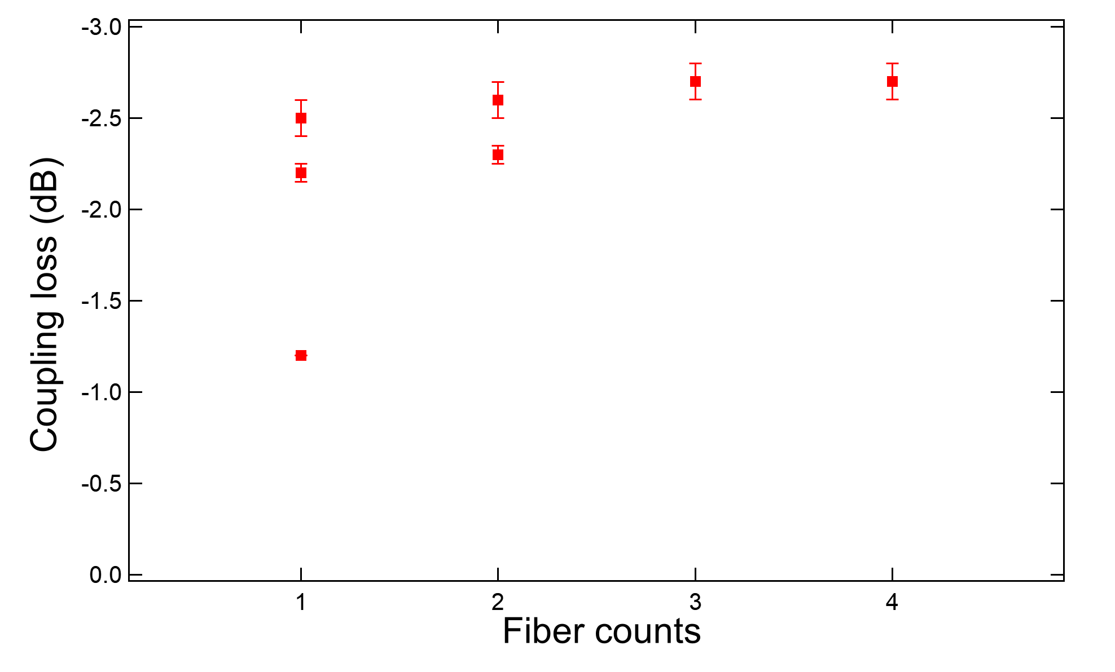
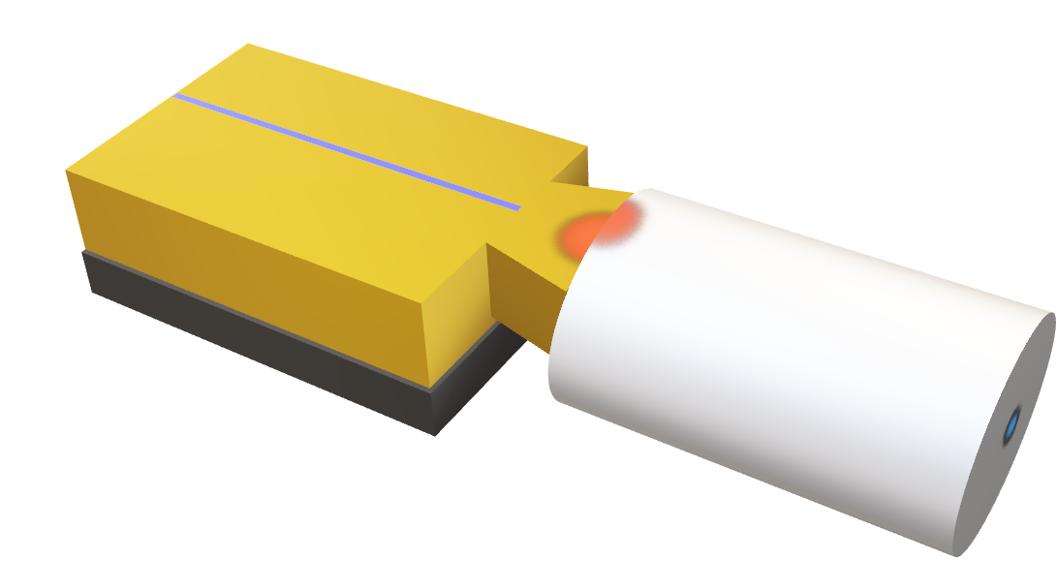
Fiber to chip packaging with low loss for quantum applications
Juniyali Nauriyal, Meiting Song, Marissa Granados-Baez, Yi Zhang , Jaime Cardenas
ABSTRACT
METHODS
One of the remaining challenges to achieve manufacturing scalability of silicon nanophotonic devices is a low cost, highly efficient, and mechanically robust method to optically couple multiple optical fibers to a photonic chip at once. We present a robust, low-loss packaging technique of permanent optical edge coupling for quantum applications between a single/multiple fibers and a chip using fusion splicing that is low-cost and scalable for high-volume manufacturing. We fuse the fiber array to the chip via a CO2 laser and reinforce it with an optical adhesive. We demonstrate a minimum loss of 1.0 dB per facet with 0.6 dB penalty over a 160 nm bandwidth from 1480 to 1640 nm for single fiber. We measure a minimum loss of 2.5dB per facet with a variation of +/-0.1dB across a 4-fiber array. We also compared losses with a 2 fiber and a single fiber which is 2.2dB and 1.0dB respectively.
Device fabrication and fusion process
TOP VIEW
SiO₂Mode
Converter
14μm
Fiber array
BACKGROUND
12μm
Photonic
chip
Silicon photonics faces a major challenge in terms of manufacturing scalability due to its high packaging cost, tight alignment tolerance of the fiber to chip and coupling inefficiency[1,2].
80-90% of the cost of the photonic device comes from packaging and testing.
We fusion splice a fiber to a chip using a CO₂ laser with low loss, low cost and large misalignment tolerance of +/-2.5um.
Nitride
taper
Undercut silicon
substrate
APPROACH
Fig 3) Microscope image of the fabricated device, with oxide mode converter, silicon nitride waveguide taper and undercut silicon substrate(left). Photograph of a packaged photonic device with 3 fibers fused to the photonic chip using fusion splicing(right). The packaged device does not require adhesive or ferrules for support and stability.
As the beam is focused into a line, it is aligned at the fiber to mode converter interface for an exposure of 1 sec at 10W +/-2W of laser power. The width (3mm) is selected to enable fusing a 12-fiber array in a single shot for future applications.
Single fiber splicing
CO2 Laser fusing
Waveguide Taper
Laser light
at 30֯
Optical Fiber
MFD= 10.4um
Fusion Spot
RESULTS
Photonic chip
Oxide Mode
Converter
Fig 1) Fiber attach process for a single fiber (MFD 10.4um) to a photonic chip with an oxide mode converter. The red spot shows the splicing area between the optical fiber and the photonic chip.
Fiber array splicing
TOP VIEW
Nitride
tapers
Mode converter
Photonic chip
Fusion Spot from laser
Fig 4) Coupling loss of single fiber, 2 fiber and 4 fiber array was measured as 1.2dB, 2.2dB and 2.5dB per-facet respectively.
125µm
250µm
We fuse a cleaved 1,2 and 4-fiber array to the oxide mode converter using a single shot from the CO₂ laser and measure a coupling loss of 1.2dB, 2.2dB and 2.5dB per-facet respectively. A waveguide propagation loss of 0.4dB was subtracted from the measured loss. We expect to see a decrease in the coupling loss after the application of an optical adhesive is applied after the fusion to optimize mode matching [3]. We measure variation of +/- 0.1dB across a 4 fiber-array at 1550nm and +/-0.05dB across a 2-fiber array at 1550nm as shown in figure 4.
4-fiber array
U-grooves
Fig 2) Schematic representation of the top view of the method shows the fusion splicing spot from the CO₂ laser and the u-grooves for aligning fiber arrays to the photonic chip.
The fiber arrays have a pitch of 125um and MFD of 10.4um. The laser beam is elliptical to fuse multiple fibers in a single shot.
REFERENCES
The single fiber attach technology[3] shown in figure 1 is then applied to a fiber array of 2 and 4 fibers with the mode field diameter(MFD) of 10.4um.
The fusion is done using an elliptical beam of the CO₂ laser which helps in splicing the fiber array to the chip in a single shot, see figure 2.
The multiple splicing technology does not require any additional ferrules or adhesives to package the device and the fiber.
Barwicz, Tymon, et al. "A Novel Approach to Photonic Packaging Leveraging Existing High-Throughput Microelectronic Facilities." IEEE Journal of Selected Topics in Quantum Electronics 22.6 (2016): 455-466.
Shimizu, N. (Mar. 1984). Fusion splicing between deposited silica waveguides and optical fibers. Electronics and Communications in Japan (Part I: Communications), 67(9), 115-122. doi:10.1002/ecja.4400670914;
J. Nauriyal, M. Song, R. Yu, and J. Cardenas, “Fiber-to-chip fusion splicing for low-loss photonic packaging,” Optica, OPTICA, vol. 6, no. 5, pp. 549–552, May 2019, doi: 10.1364/OPTICA.6.000549
Acknowledgement
We would like to thank Hajim School of Engineering and Applied Sciences, AIM Photonics and Cornell NanoScale Science & Technology Facility
Order online at https://www.postersession.com/order/

