Slide 1
CTI 8200 Compressor Compatibility Notes
Valerie Fleischauer
RIT CfD
4/17/2019

Slide 2
Purpose/Comments
This document provides notes on the compatibility of our 8200 water cooled compressor relating to the possibility of using it with our larger cold head model
Upon calling the GUTS customer service, they indicated to me that the compressor was indeed compatible with the larger cold head, we might see slower cooling times but nothing is going to explode
However some of the information within this summary conflicts with what customer service said

Slide 3
Sources
8200 manual
  \\hawk\RIDL\products\manuals\CTI\chiller8200.pdf
8200 installation guide
  \\hawk\RIDL\products\manuals\CTI\8040353.pdf
Cold head data sheet (all models)
  \\hawk\RIDL\products\manuals\CTI\CTI-CryogenicsCryodyneRefrigerationSystemDataSheet.sflb.pdf
1020/1050 Cold head installation, operation, and servicing instructions
  \\hawk\RIDL\products\manuals\CTI\8040273_Cryodyne 1020 and 1050.pdf
Trillium US (pump repair)
  https://trilliumus.com/?s=cti+8200+

Slide 4
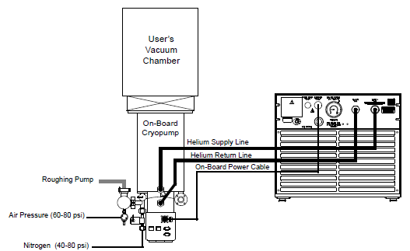
8200 manual
(below) Typical 8200 Compressor Installation
Entire document references “the cold head” or “the cryopump” but doesn’t specify which model

Slide 5
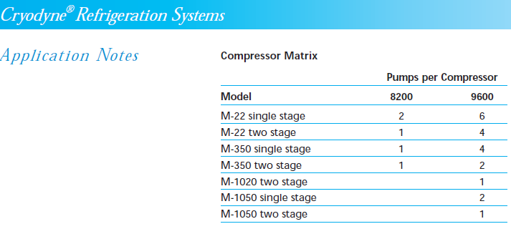
Cold head data sheet (all models)
The only location in our documents where it lists anything specific about which compressor/coldhead go together

Slide 6
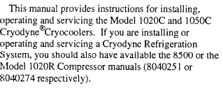
Cold head installation document
8500 compressor is an old model that appears to have the specs of the current 9600’s that we have

Slide 7
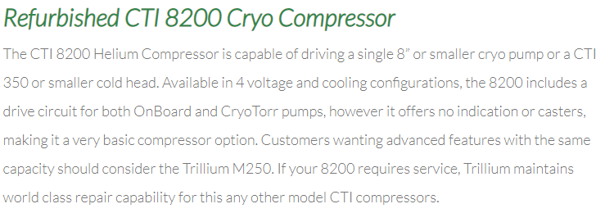
Third party site
https://trilliumus.com/?s=cti+8200+

