Slide 1
Cable management for lab
Evan Jorgensen
1/30/13

Slide 2
24 ft. long cable tray
Lab table
Cabinets
Table 3
PC
Holes cut through cabinets
Table 2
PC
Table 1
PC

Slide 3
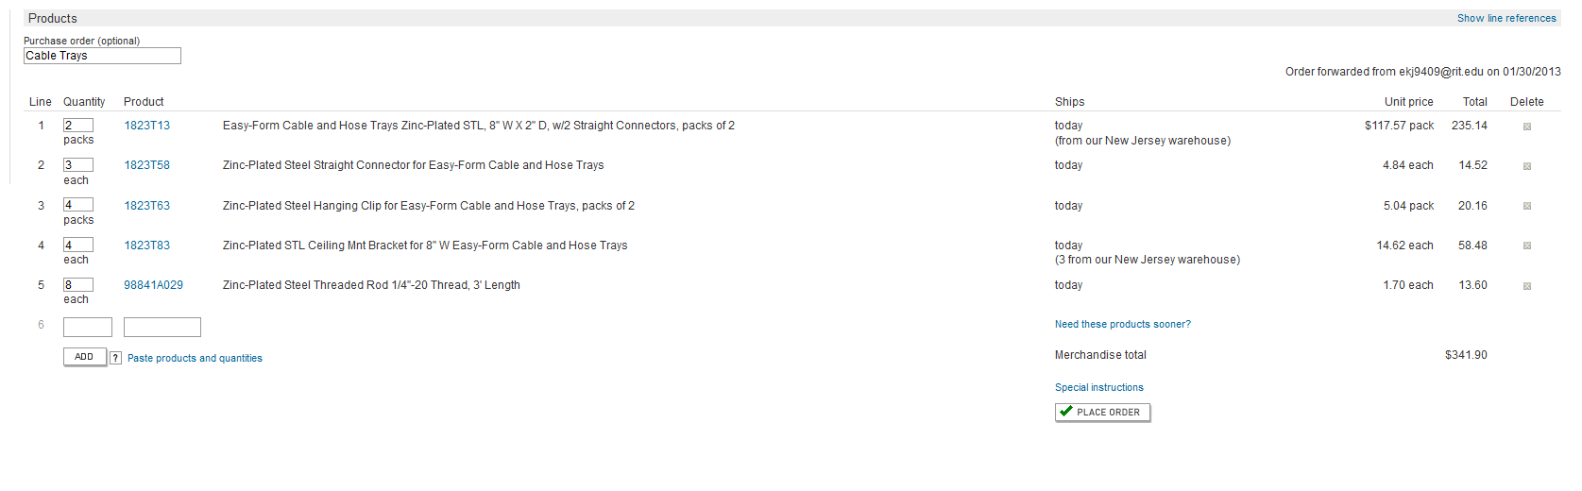
McMaster and Carr shopping cart

