Slide 1
Other Algorithms Follow Up
June 22, 2016
Kevin Moser

Slide 2
Problem Statement
Large number of false positives from crfilter
Need to be more discerning in selection process
View various methods of removing problem cosmic rays and hot pixels
Need to compare our algorithm to other past results
Combine useful techniques into final code
Use of histogram to look for large gaps in image
Use of Laplacian filter to find sharp edges in image

Slide 3
Histogram Method
A Fast Algorithm for Cosmic-Ray Removal from Single Images by Wojtek Pych
Takes small neighborhoods
Computes histograms
Looks for gaps between digital counts
Replaces pixels if gap is greater than threshold times standard deviation and pixels is greater than median
Marks fewer false positives than crfilter

Slide 4
Sample 10x10 square with hot pixels

Slide 5
Blue Histogram

Slide 6
Green Histogram

Slide 7
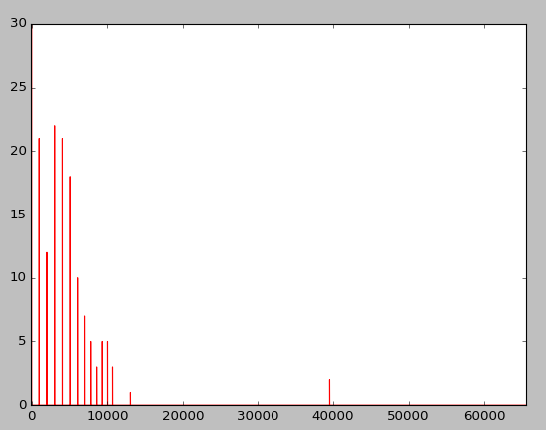
Red Histogram

Slide 8
Problems with histogram
Increases runtime because more calculation in each section of image
Takes around 60 seconds for full image
Will need to process at every single pixel
Try to figure out how to do with convolution or similar method to improve run time

Slide 9
Laplacian Edge Detection
Cosmic-Ray Rejection by Laplacian Edge Detection by Pieter G. van Dokkum
Convolve image with Laplacian kernel to determine edges
The sharp edges correspond with cosmic rays
Many objects will still have sharp edges, so divide by the difference between two median blurs of the image which gives us the size of the object
If it has a sharp edge but is a very small object, it is most likely a cosmic ray

Slide 10
Laplacian Image
Gives an indication of the edges in an image
Replaces center pixel value with the result of multiplying this kernel to the neighborhood and summing the results
Returns high result for single hot pixel on dark background

Slide 11
Laplacian Edges
Calculates the difference between the Laplacian and the median to remove large objects
Divides by a difference between a small median kernel and a large median kernel
Returns bad results currently
Seems to be extremely weighted in dark areas and with noise
Need to understand their noise reduction to cut back false positives
Trying a second technique of crfilter weighted or thresholded by Laplacian image

Slide 12
Laplacian Image
Calculates results using crfilter
Multiplies by Laplacian image to remove false positives
Or uses second threshold value for Laplacian
Creates new false positives due to other noise or objects
Weights by Laplacian image minus the 3x3 median image to help remove influence by large objects
Need to determine how thresholding will change on wide variety of images

Slide 13
Pure Intensity Threshold
Tries to perform a simple threshold by pixel value
Observes what kind of results produced for false positives and negatives
Compares to crfilter, histogram, and edges
Should be extremely bad but interesting test

Slide 14
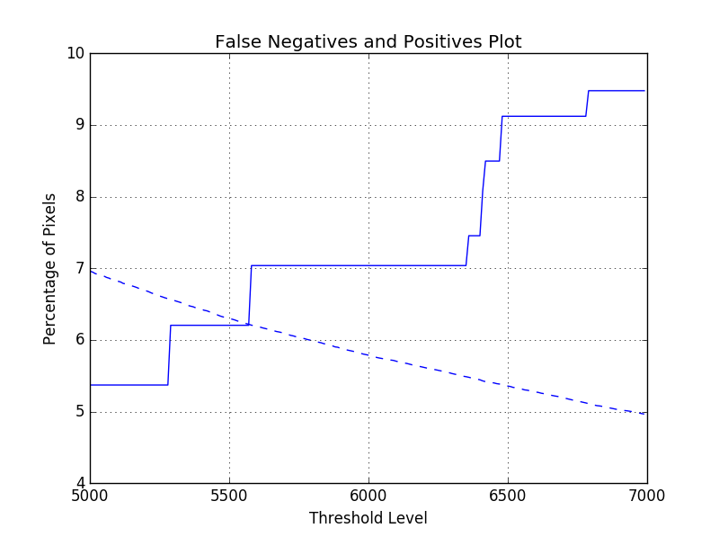
Intensity Thresholding

Slide 15
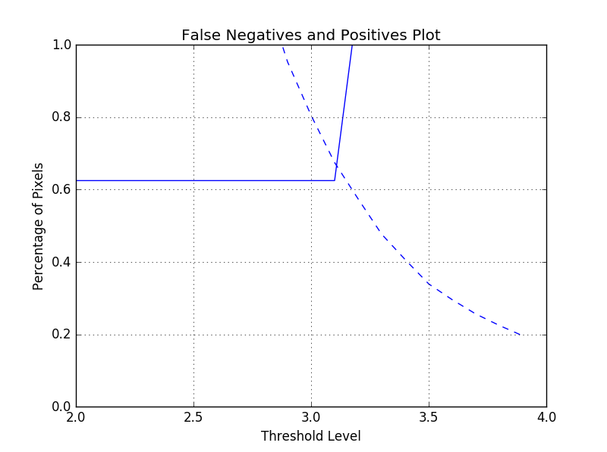
Crfilter

Slide 16
Histogram

Slide 17
Crfilter weighted with Laplacian

Slide 18
Attempt at Recreating Pure Laplacian Detection

Slide 19
Summary of Results
Shows surprisingly good results for the weighted crfilter with Laplacian
Indicates good method but also good test images for that method
Had test images with single pixel cosmic rays
Need more work with cosmic rays on various background and near edges such as the planet
Need to compare how effective with larger cosmic rays

Slide 20
Summary of Results
Demonstrates the histogram method could also be viable
Returns low number of false positives across range of thresholds
Improving runtime would make this technique much more promising
Use crfilter for best general case
Employs easy fast code that is fairly unaffected by variety of images
Could use better testing method for all techniques

Slide 21
Graphs
Create many crops from a variety of images from Peter
Contain cosmic rays of different sizes and intensity compared to background
Test with different methods
Need a better way of showing this data and labeling all the lines

Slide 22
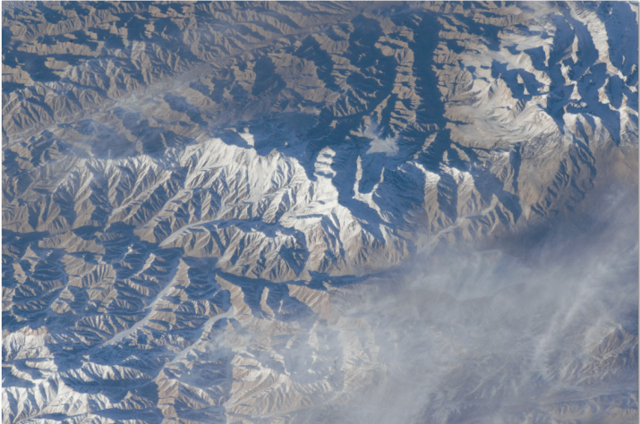
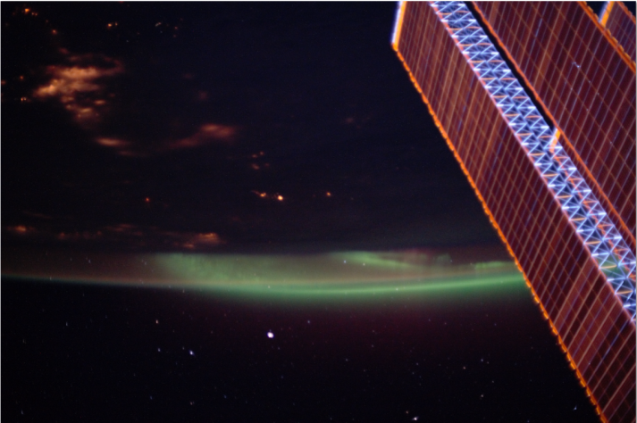
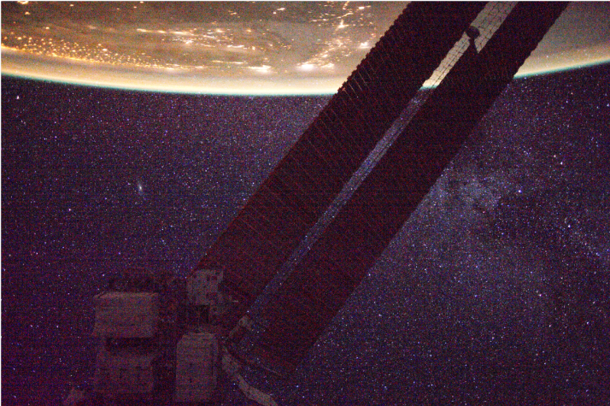
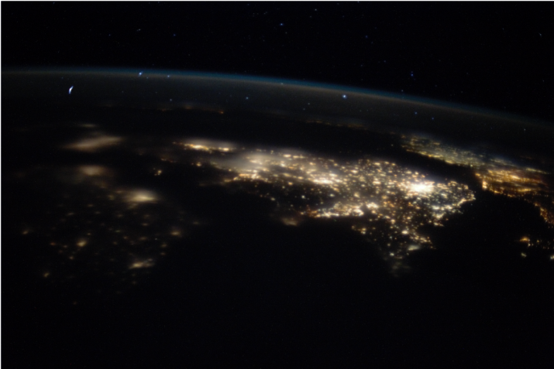
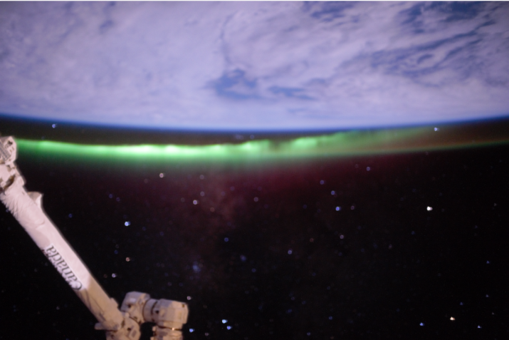
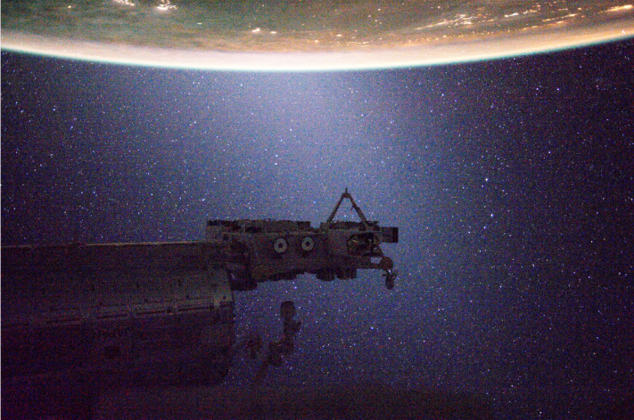
Selection of Test Images
/i124E6987 /i125H8217 /iss031e152913
/i125H7665 /i125I1428 /iss031e168197

Slide 23
Legend
Green - Average
Cyan - \i124E6987
Red - \i125H7665
Black - \i125H8217
Yellow - \i125I1428
Magenta - \iss031e152913
Gray - \iss031e168197

Slide 24
Basic Crfilter Results

Slide 25
Basic Crfilter Results
Shows a different intersection for red than others
Demonstrates overall similar response across images with most intersection between 2.5 and 3
Displays still high percentage of false positives

Slide 26
Laplacian Image Multiplied with Crfilter

Slide 27
Separate Crfilter and Laplacian Thresholds

Slide 28
Basic Crfilter Results

Slide 29
Laplacian Results
Reduces all the false positives except for gray and magenta
Demonstrates issues with stars and the background noise in those images
Multiplying by Laplacian spreads out the threshold values for each image
Shows the secondary threshold can help with most other images
Need a closer look at specific problem areas to remove false positives

Slide 30
Small Crop with Blue Hot Pixels and Star

Slide 31
Crfilter 3.2

Slide 32
Small Crop with Blue Hot Pixels and Star

Slide 33
Laplacian 50000

Slide 34
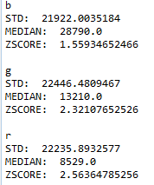
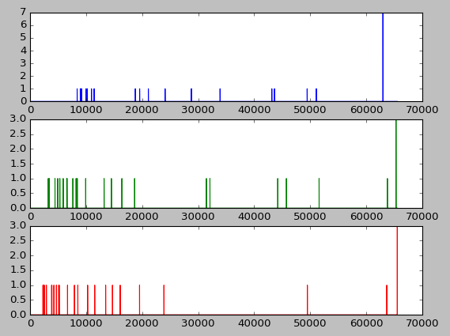
Small Star

Slide 35
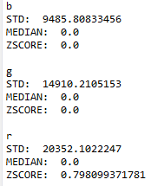
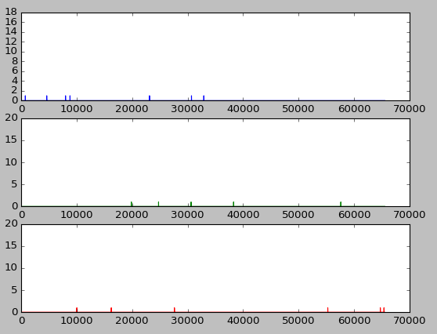
Small Star (Laplacian-3x3Median)

Slide 36
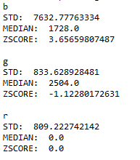
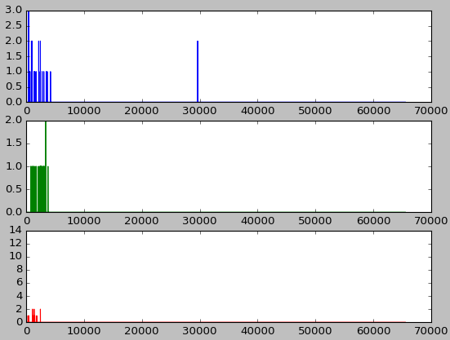
Hot Pixel

Slide 37
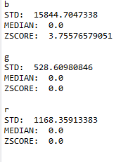
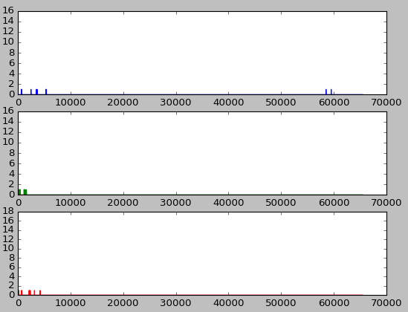
Hot Pixel(Laplacian-3x3Median)

Slide 38
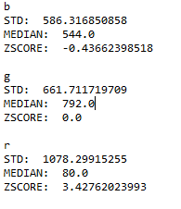
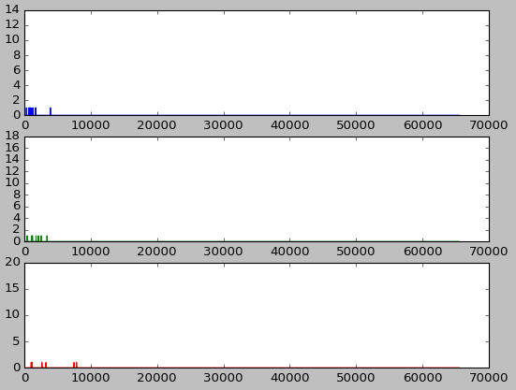
Noise

Slide 39
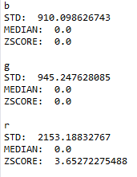
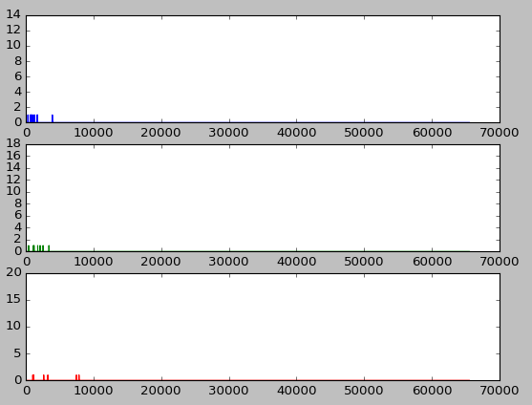
Noise(Laplacian-3x3Median)

Slide 40
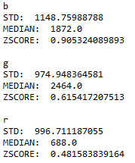
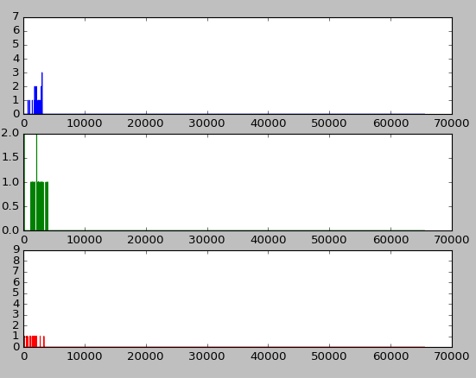
Dark

Slide 41
Trying to Solve the Problem of False Positives
Multiplying by Laplacian – 3x3Median removes noise issues but increases removal from stars
Need to use Laplacian as secondary threshold value
Can clip standard deviation at minimum value, help remove falsely high zscores
Try to remove all values past 3 standard deviation and recalculate standard deviation see if that help
Attempt Median Absolute Deviation to provide a better center mark

Slide 42
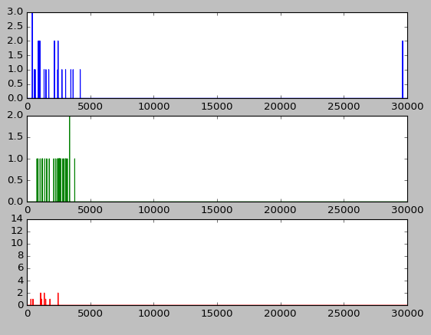
Comparison of Histograms
Noise - red
Hot Pixel - Blue

Slide 43
Small Crop with Blue Hot Pixels and Star

Slide 44
Single Laplacian Blue Channel

Slide 45
Two Pixel Laplacian Blue Channel

Slide 46
Expanded Laplacian Blue Channel

Slide 47
Problem with Noisy Images
\iss031e152913 and \iss031e168197 have two pixels connected from cosmic rays and many false positives
Looking at metadata show a very high ISO compared to other images
36,864 ISO on iss images
6,400 or 8,063 on other images

Slide 48
Cosmic rays and noise
Similarity of hot pixels to impulse noise: random value or salt and pepper
Deals with certain adaptive median filters to look for edge properties
Ignore edges in pixel replacement
Unsure if the two pixel pattern will trigger as edge
Potential wavelet solution by looking at high frequency and replacing
Can lead to effects across the entire image

Slide 49
Classification
Could use marked hot pixels, stars and random dark areas to try and train a machine learning classification
Use small image crops, histogram of gradients, laplacian, etc. as classification data
Still very subjective training data
Longer runtime for final output images
Area with least expertise

