Slide 1
CRDIR Project
June 14, 2016
Kevin Moser

Slide 2
Problem Statement
Problem “hot” pixels on ISS imagery
Additional dark current caused by cosmic rays
Results in false signal
Replace problem pixel values
Avoid false positives

Slide 3
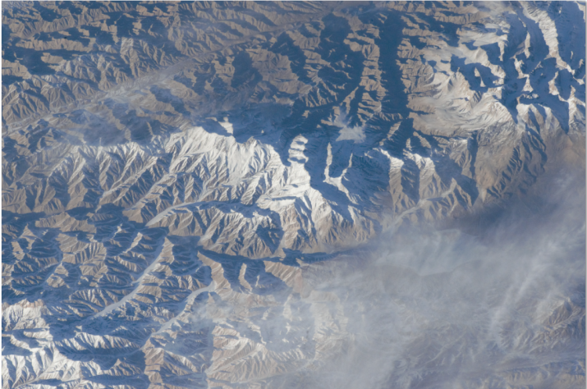
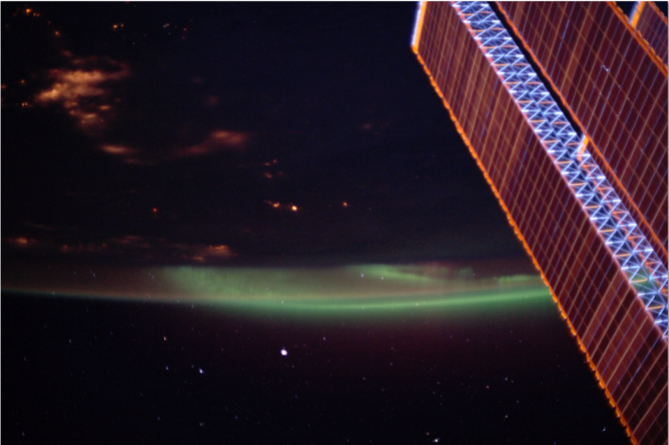
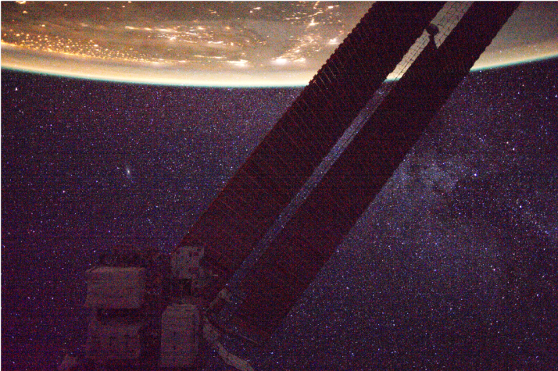
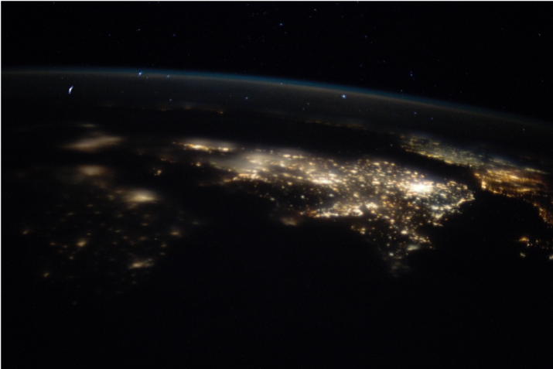
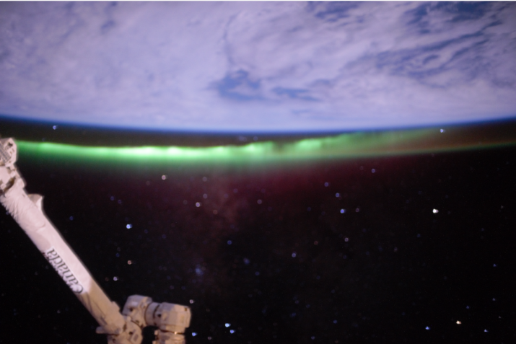
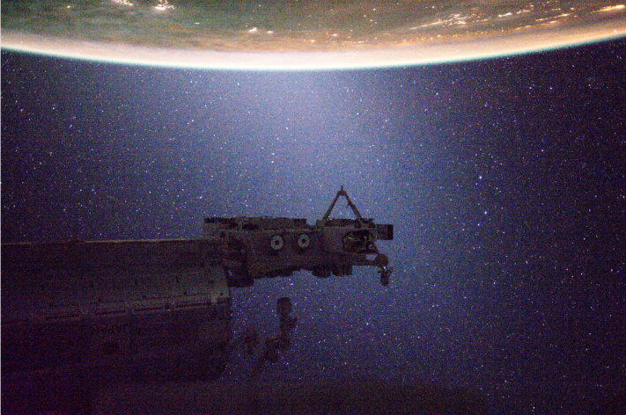
ISS Imagery
/i124E6987 /i125H8217 /iss031e152913
/i125H7665 /i125I1428 /iss031e168197

Slide 4
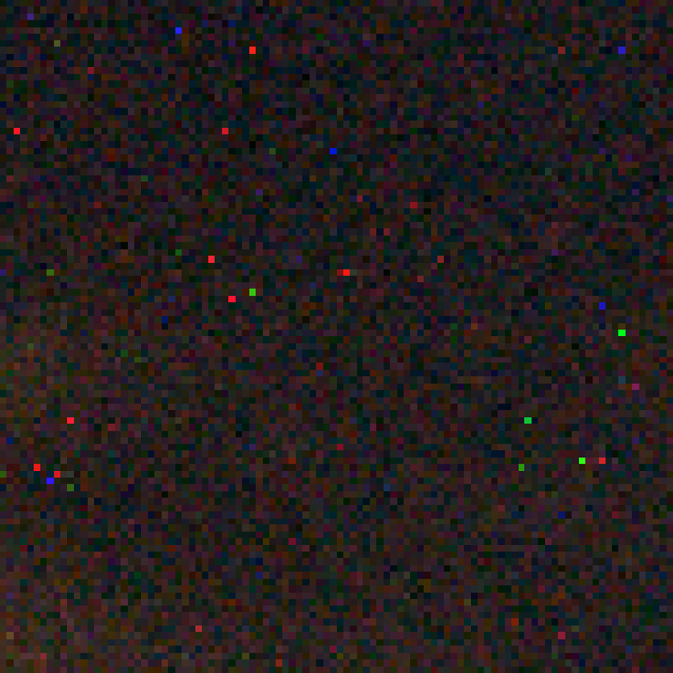
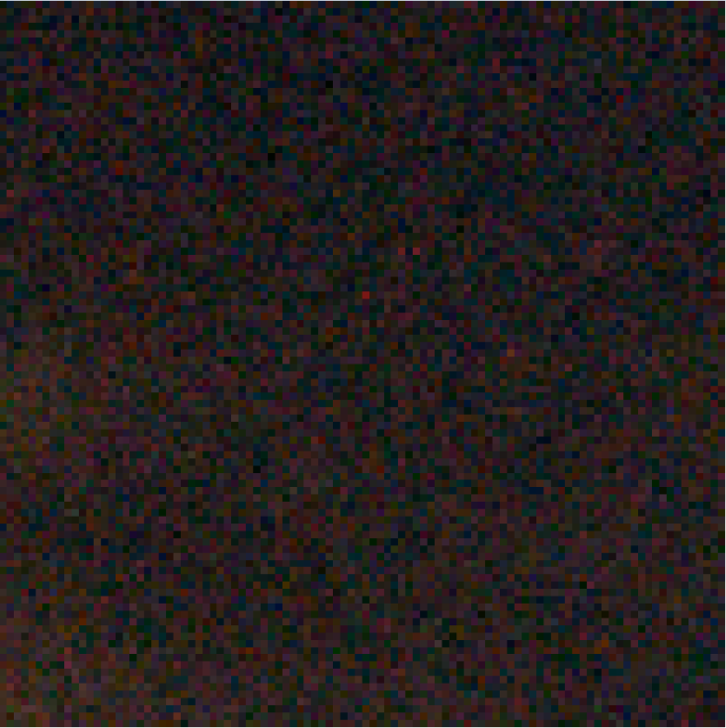
Problem Statement (Images)
Initial image, colored marks are signal from hot pixels
Cleaned image, colored marks are replaced with median of nearby pixels

Slide 5
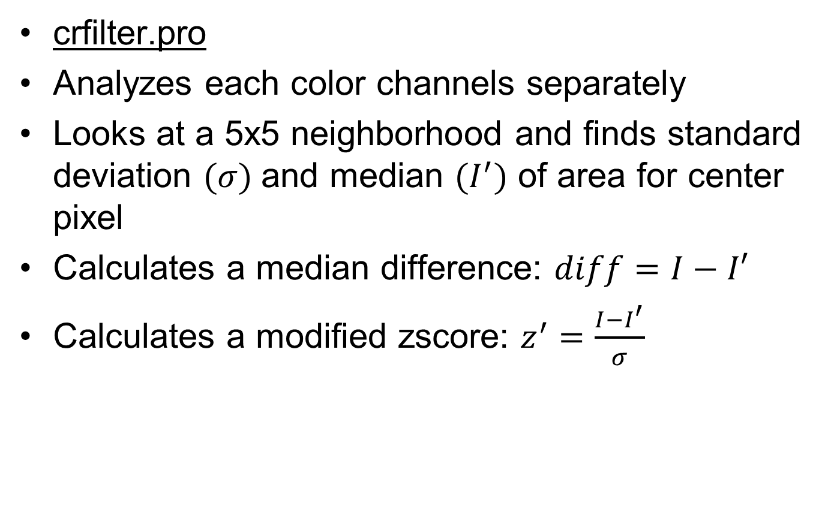
Current Algorithms
crfilter.pro
Analyzes each color channels separately
Looks at a 5x5 neighborhood and finds standard deviation $(σ)$and median $(I^{′})$ of area for center pixel
Calculates a median difference: $diff=I−I′$
Calculates a modified zscore: $z^{′}=\frac{I−I^{′}}{σ}$

Slide 6
Current Algorithms - Zscore
Combine the difference of a pixel’s intensity to the median and the standard deviation of the neighborhood to get the zscore
Indicates a bright pixel with difference
Indicates how spread out the digital counts are in the neighborhood with standard deviation
Combined indicates a bright pixel compared to the surrounding pixels
Mark the pixel with zscore above a threshold to be replaced with the median

Slide 7
Current Algorithms – Median Difference
Can have standard deviation be close to zero
Leading to falsely high zscore for noise or other artifacts from extremely low standard deviation
Conversion from 8-bit to 16-bit image can also leads to pixels having increased differences in output digital counts which affects zscore
Create a median difference minimum threshold a pixel must be brighter than compared to the neighborhood median
Must be above thresholds on both median difference and zscore to be replaced at a pixel

Slide 8
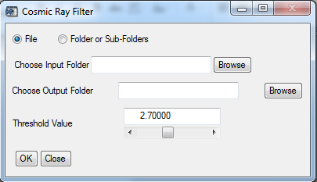
Current Algorithms
crfilter_GUI.pro – provide an easy user experience
Select images, folder of images, or folder with many subfolders of images
Set the threshold value
Output cleaned images in selected location
Report cleaning with progress bar

Slide 9
Visual Truth Data
Need to determine the algorithms effectiveness
Locate real hot pixels in image
Unable to check sensor itself for real values
Visually identify hot pixels in an image
Look for distinct bright pixels of red, green, or blue on plain background

Slide 10
Creating Visual Truth Data
Create a series of small random crops for test data
Allows user to see hot pixels
Use program to record mouse click selected points and create visual mask for truth data
Run crops through crfilter and compare the output masks to the visual masks to find false negatives and positives
Graph the false results at a range of thresholds

Slide 11
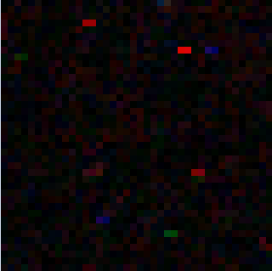
Example Crop with Hot Pixels

Slide 12
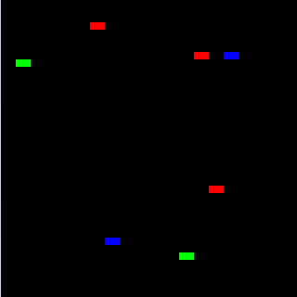
Visual Mask

Slide 13
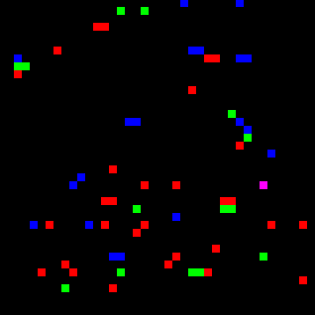
crfilter Output mask (2.7 threshold)

Slide 14
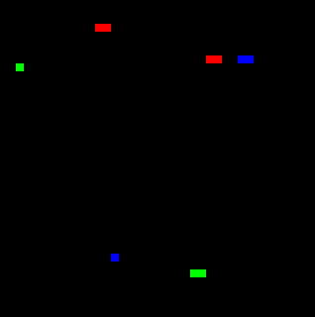
crfilter Output mask (3.5 threshold)

Slide 15
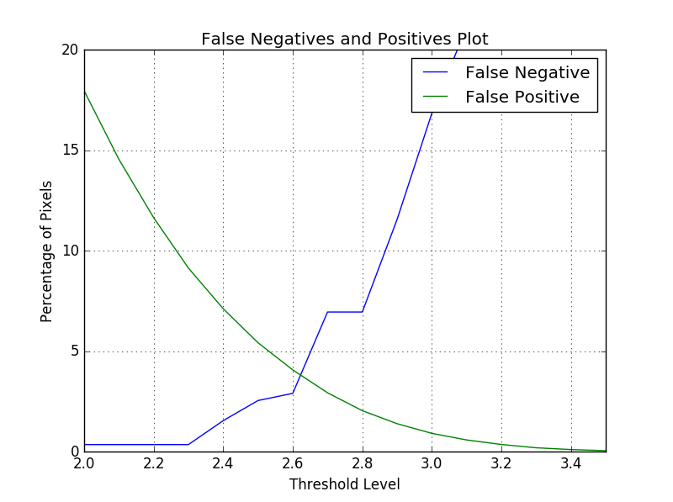
Intersection Plot

Slide 16
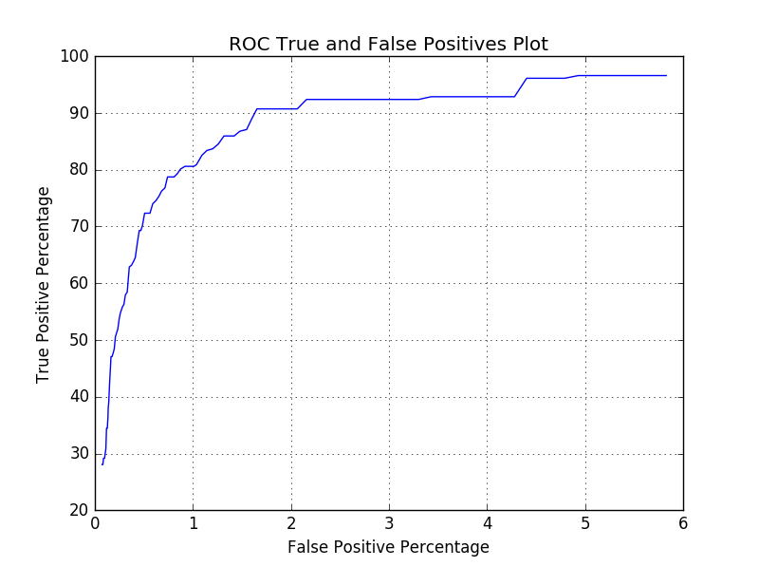
Receiver Operating Characteristic Curve

Slide 17
Plot Analysis
Want at least 90% of hot pixels correctly replaced
2% of the other pixels will also be replaced
2% False Positives corresponds to a threshold level of 2.8
Point of Intersection around 4% false positives and negatives with threshold level of 2.6
Calculated using iss031e168171.tiff using dcraw settings to white balance and gamma correct
Compare various settings for converting to TIFF from NEF for false positives and negatives

Slide 18
DCraw Options Default
Use program dcraw to convert from raw NEF file to readable file for IDL
Use without changing options to set these defaults
Writes PGM/PPM/PAM
8-bit samples
BT.709 2.222 4.5 gamma curve
Histogram-based white level
No metadata

Slide 19
Our DCraw Choices
-h: create half sized color image by turning a 4x4 square into 1 pixel with red, blue and an averaged green data
-T: save out as TIFF file with metadata, easy to read in IDL
- o 0: output with no color management, get basic electron count
-6: write sixteen bits per sample instead of eight
-4: linear 16-bit, uses fixed white level and 1 to 1 gamma
-r 1111: perform no white balancing

Slide 20
Our DCraw Choices
Use –h –T –o 0 for all images
Could look into using full image instead of half but currently more difficult to observe results
Use -6 for visually pleasing image with white balance and gamma correction
Use -4 –r1111 for pure untouched pixel values

Slide 21
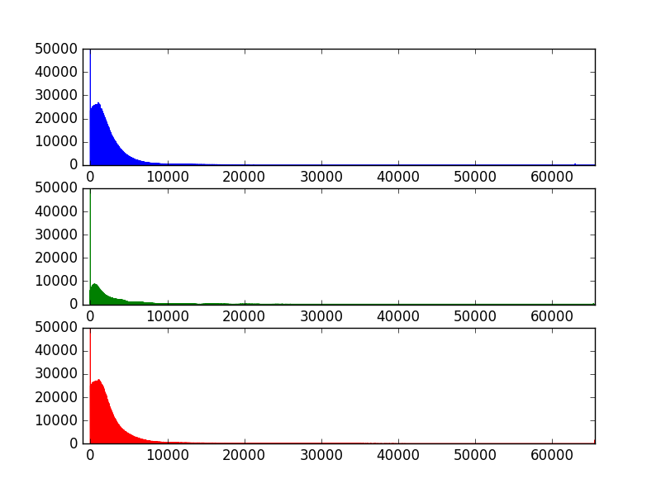
Image after Dcraw Conversion with only Raw Pixel Values (-4 –r1111)

Slide 22
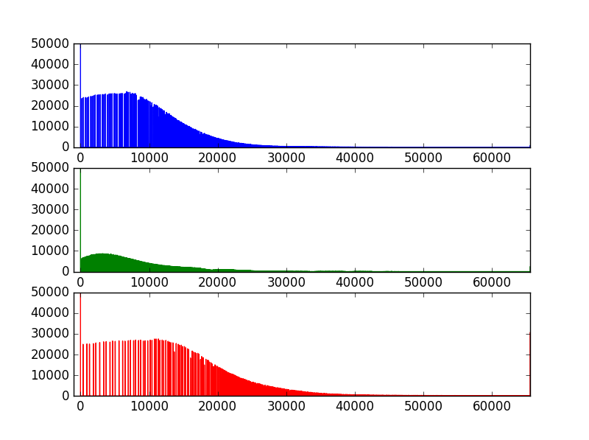
Image after DCraw Conversion using White Balance and Gamma Correction (-6)

Slide 23
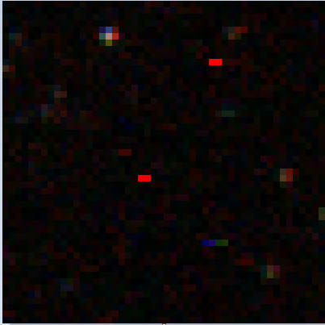
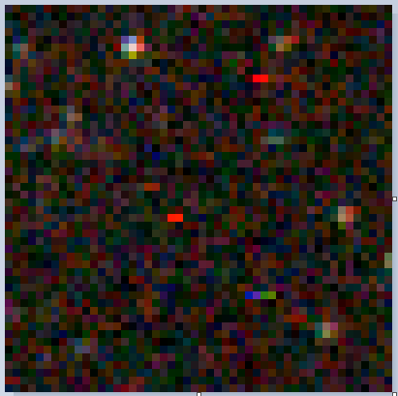
Crops of Image with Hot Pixels
Untouched Pixel Values (-4 –r1111)
White Balanced and Gamma Corrected (-6)

Slide 24
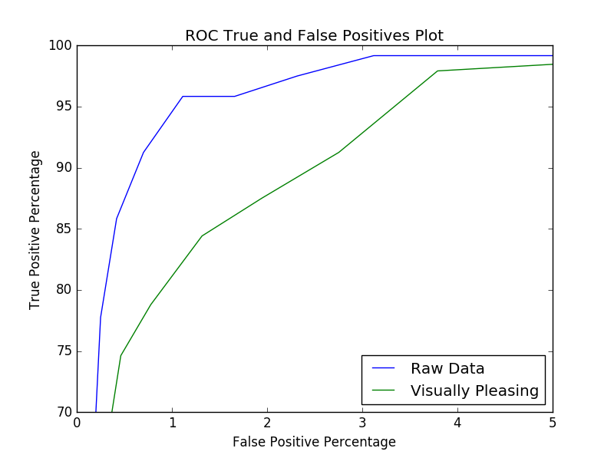
Receiver Operating Characteristic Curve
White Balance and Gamma corrected
Raw Data

Slide 25
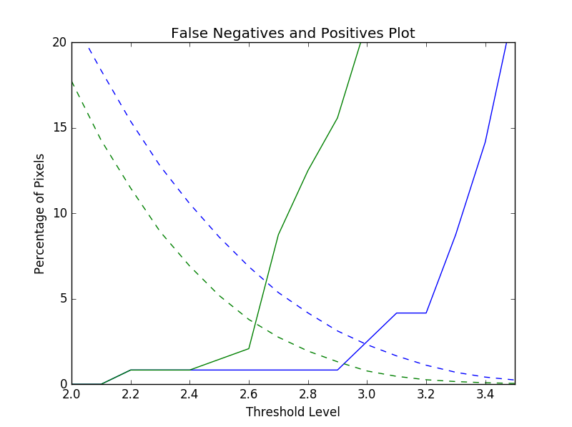
Intersection Plot
White Balance and Gamma corrected
False Positives
False Negatives
Raw Data
False Positives
False Negatives

Slide 26
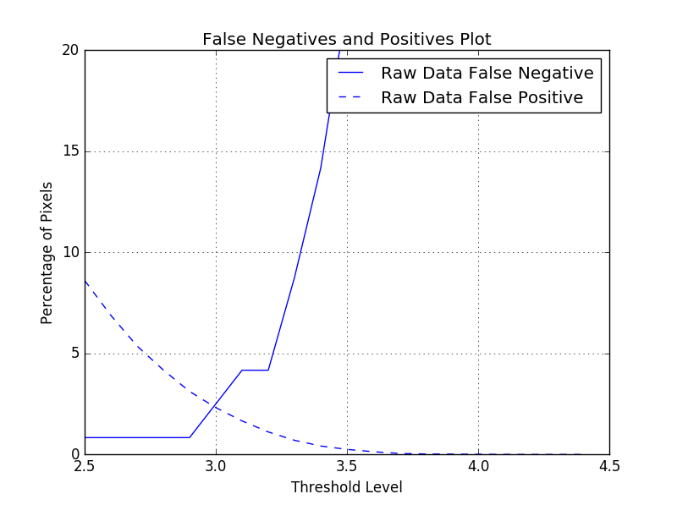
Intersection Plot without Median Difference Threshold

Slide 27
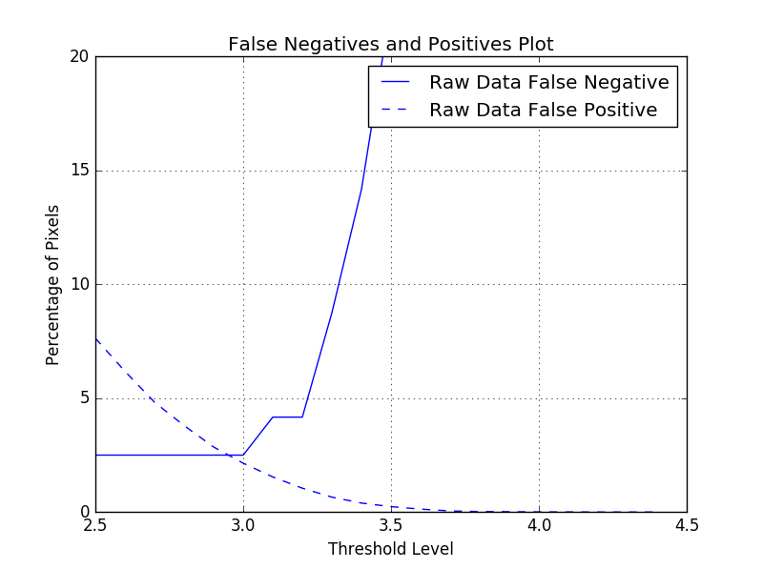
Intersection Plot with Median Difference Threshold

Slide 28
Results
Need to use the pure raw data image
Provides more access to untouched pixel values
Shows better on both the intersection and ROC curves
May require the adjustment of the image after cleaning to make it more visible
Changing gamma correction and white balance by user
Use of median difference threshold lowers the number of false positives but increases the number of false negatives
Leaves intersection remaining around the same point

Slide 29
False Positive Discussion
1% False positive is percentage of entire image size
Affecting a small percentage is still a large number of actual pixels
4 real hot pixels with 25 false positives in a 50x50 crop
Need to preserve stars, planet, and the station

Slide 30
Forward Progress With Code
Attempt to reduce the number of false positives
Looking at integrating other star detection code to avoid false positives in key areas
White balance and gamma correct images after processing
Update GUI to work with changes in crfilter
Output an executable able to run on any computer

