Slide 1
University Astronomy
Professor Don Figer
Scale of the Universe

Slide 2
Aims and outline for this lecture
explore distance scales in astronomy
  solar system
  stars
  galaxies
  universe
relate distance to lookback time

Slide 3
hierarchical universe

Slide 4
Hierarchical Universe
Smaller structures are embedded in larger ones.
Earth is part of the Solar system, which is part of the Milky Way Galaxy, which is part of the Local Group of galaxies, etc.
See graphic on next slide.

Slide 5
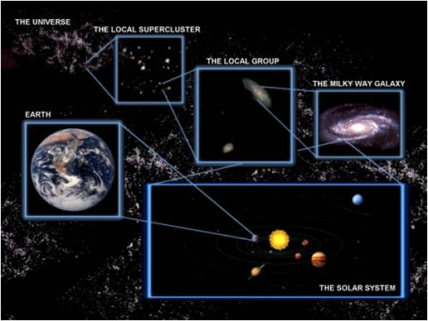
Hierarchical Universe

Slide 6
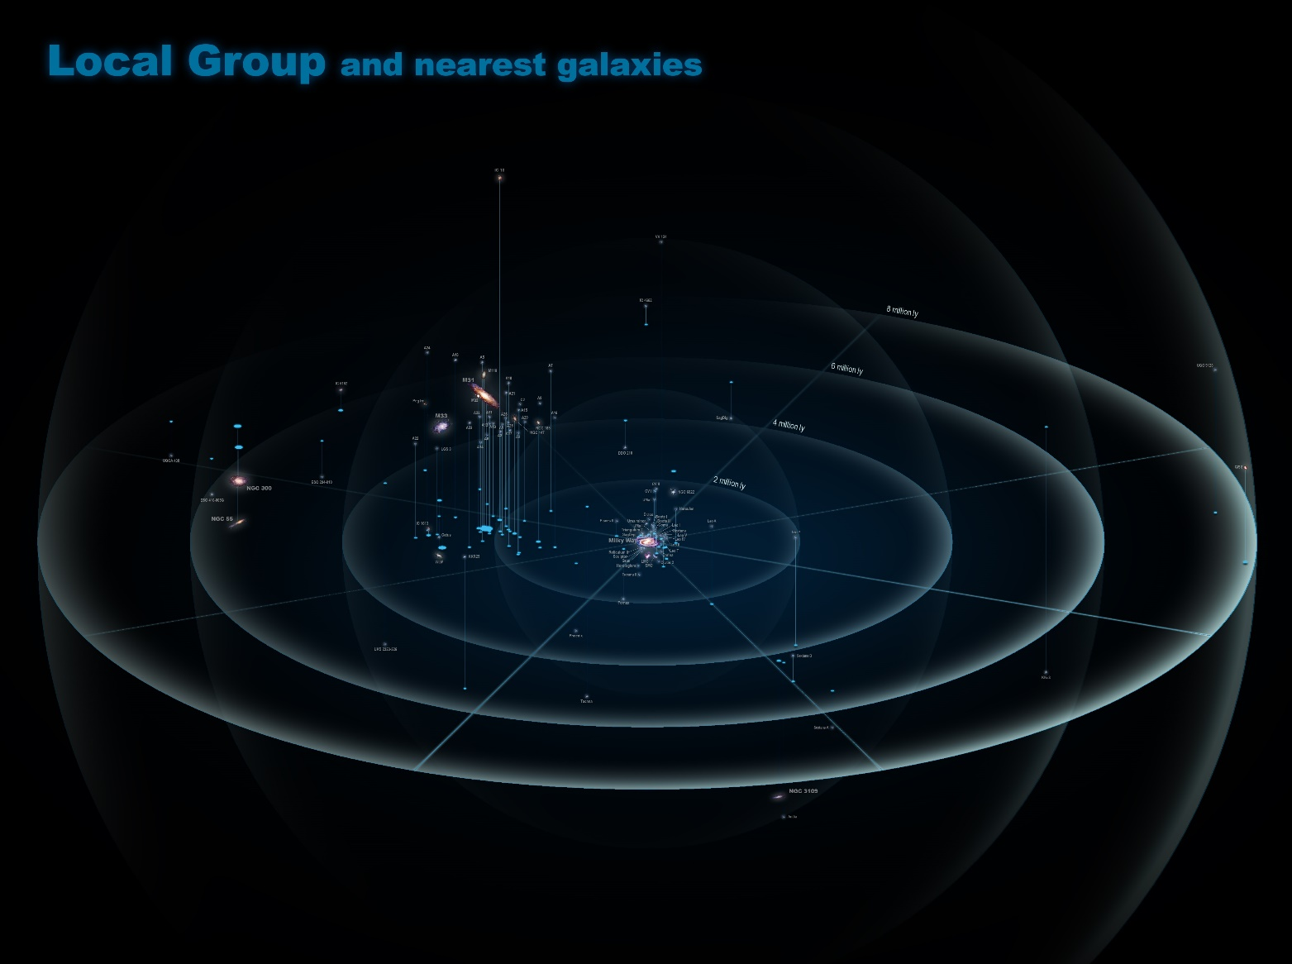
Local Group (~50 Galaxies)

Slide 7
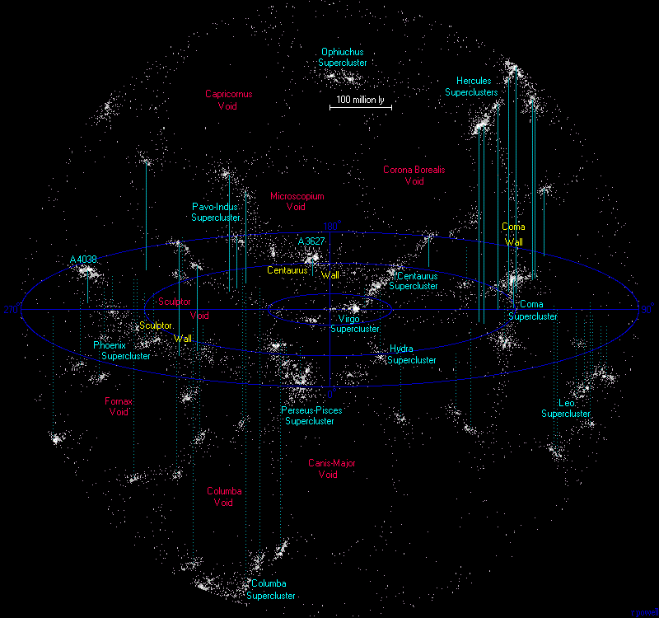
Local Supercluster (~50K Galaxies)

Slide 8
Group Discussion
In groups of ~4, discuss your impressions of the websites you visited before class.
Report your observations.

Slide 9
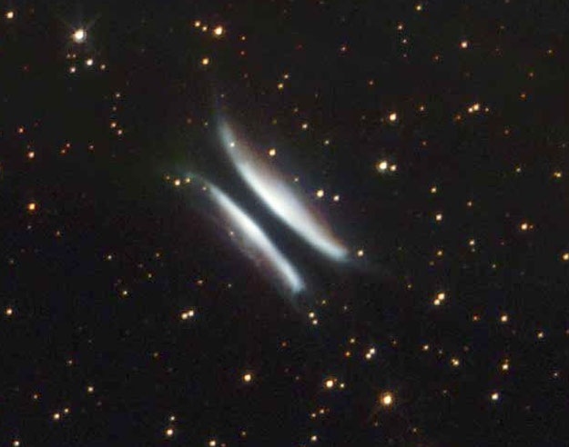
My Observations
An Oak tree looks like broccoli (if I didn’t have a way to compare its size to other things).
The Eiffel Tower is much bigger than I thought.
White dwarfs are small (Sirius B).
I don’t play Minecraft.
A few Jupiters could fit between the Earth and the Moon.
Gomez’ Hamburger makes me hungry.

Slide 10
sizes and distances

Slide 11
Scale Model
Objects in the Universe are much larger and much further away than objects that we encounter in everyday life.
How can we comprehend sizes and distances in our Universe?
One useful method is to build a scale model.
In this way, we can relate huge numbers that seem very foreign to smaller numbers that are more familiar.

Slide 12
Questions
What is an Astronomical Unit (AU)?
What is a Light Year (ly)?
What is a Parsec (pc)?

Slide 13
Units of Distance
Astronomical Unit (AU)
  distance between Earth and Sun
  150 million km, 92 million miles
Light Year (ly)
  distance light travels in a year
  5.9(10¹²) miles
  9.5(10¹²) km
Parsec (pc)
  distance at which an AU subtends one arcsecond
  3.26 ly
  3.086(10¹³) km
  206,265 AU in one parsec
  Kpc, Mpc, Gpc, etc.

Slide 14
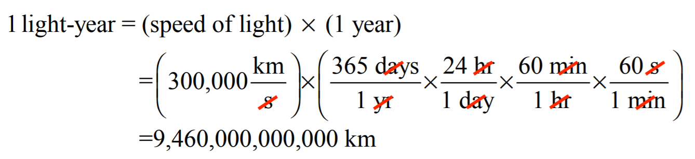
Distance in a Light Year

Slide 15
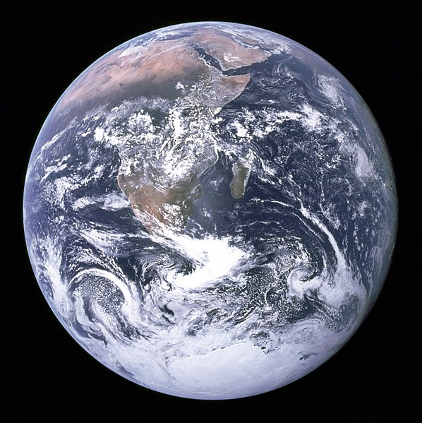
The Earth
Diameter is 12,756 km.
In our scale model, let the Earth be 1 foot across.

Slide 16
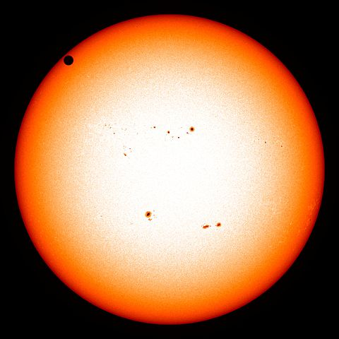
The Sun
Diameter is 1,390,000 km.
The diameter of the Sun looks similar to the diameter of the Earth, except with a few extra zeroes.

Slide 17
Question
How large is the Sun in our scale model?

Slide 18
Answer
In our scale model, the Sun would be 100 feet across.

Slide 19
Question
How far is an AU in our scale model?

Slide 20
Answer
150,000,000 km / 12,756 km = 11,759.
11,759 feet = 2.2 miles.
So, if Earth is a foot in diameter, then Sun would be 2.2 miles away.

Slide 21
Another Way to Calculate
10 Earths span Jupiter.
10 Jupiters span the Sun.
So, 100 Earth’s span the Sun.
Roughly 100 Sun’s would fit between the Sun and Earth. (It’s actually 108)
So, 100X100 = 10,000 Earth’s would fit between the Sun and the Earth. (It’s actually 11,621)
If, in our model, the Earth is represented by 1 foot, then there would be 10,000 feet between the Earth and the Sun.
10,000 feet is roughly 2 miles.

Slide 22
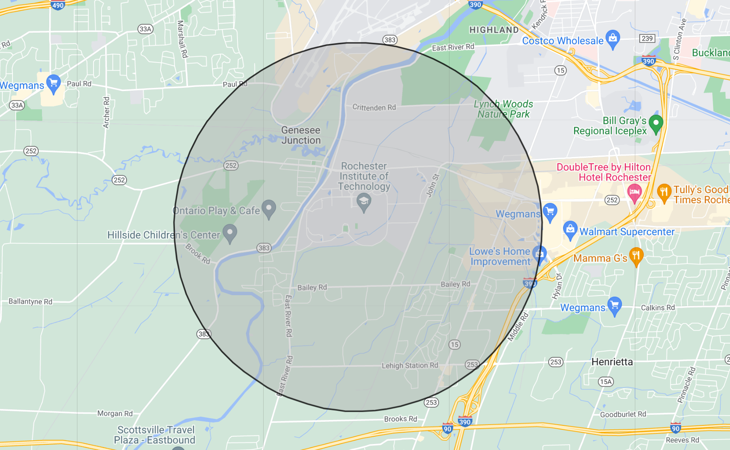
Distance from Sun to Earth – 2.2 miles (~1 AU)

Slide 23
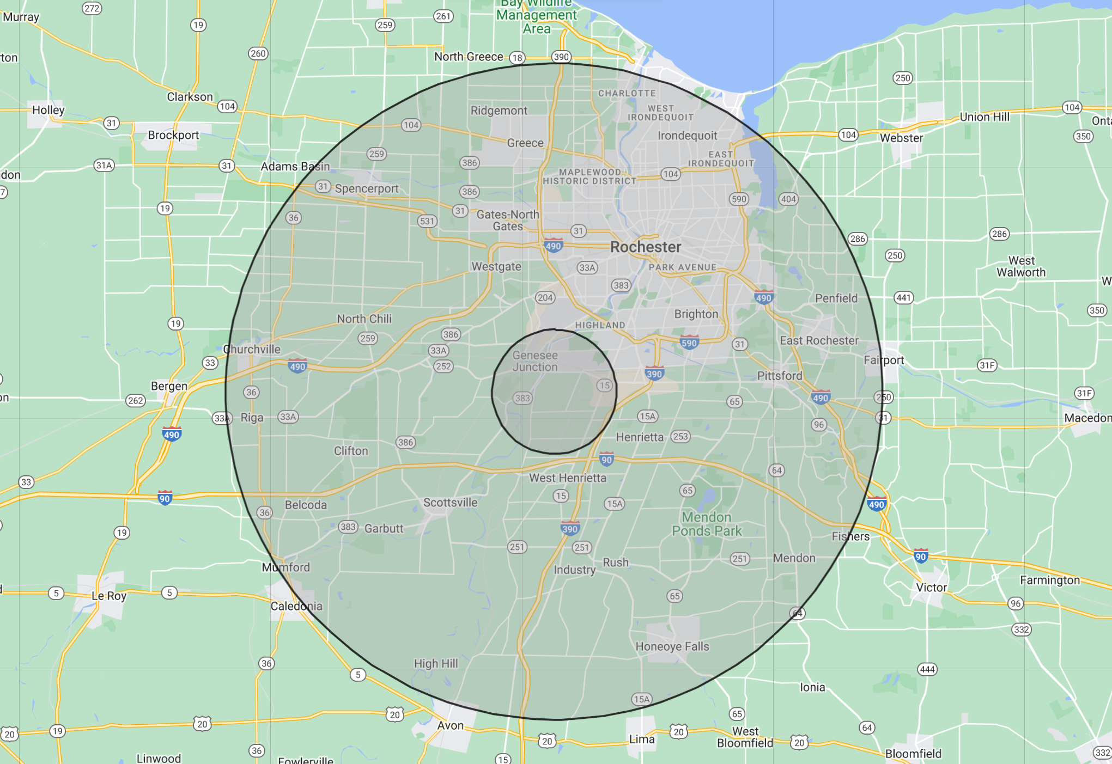
Distance Between Sun and Jupiter – 11.6 miles (~5 AU)

Slide 24
Question
How many Suns would fit between the Sun and Jupiter?

Slide 25
Answer
Roughly 500 (actually 540).

Slide 26
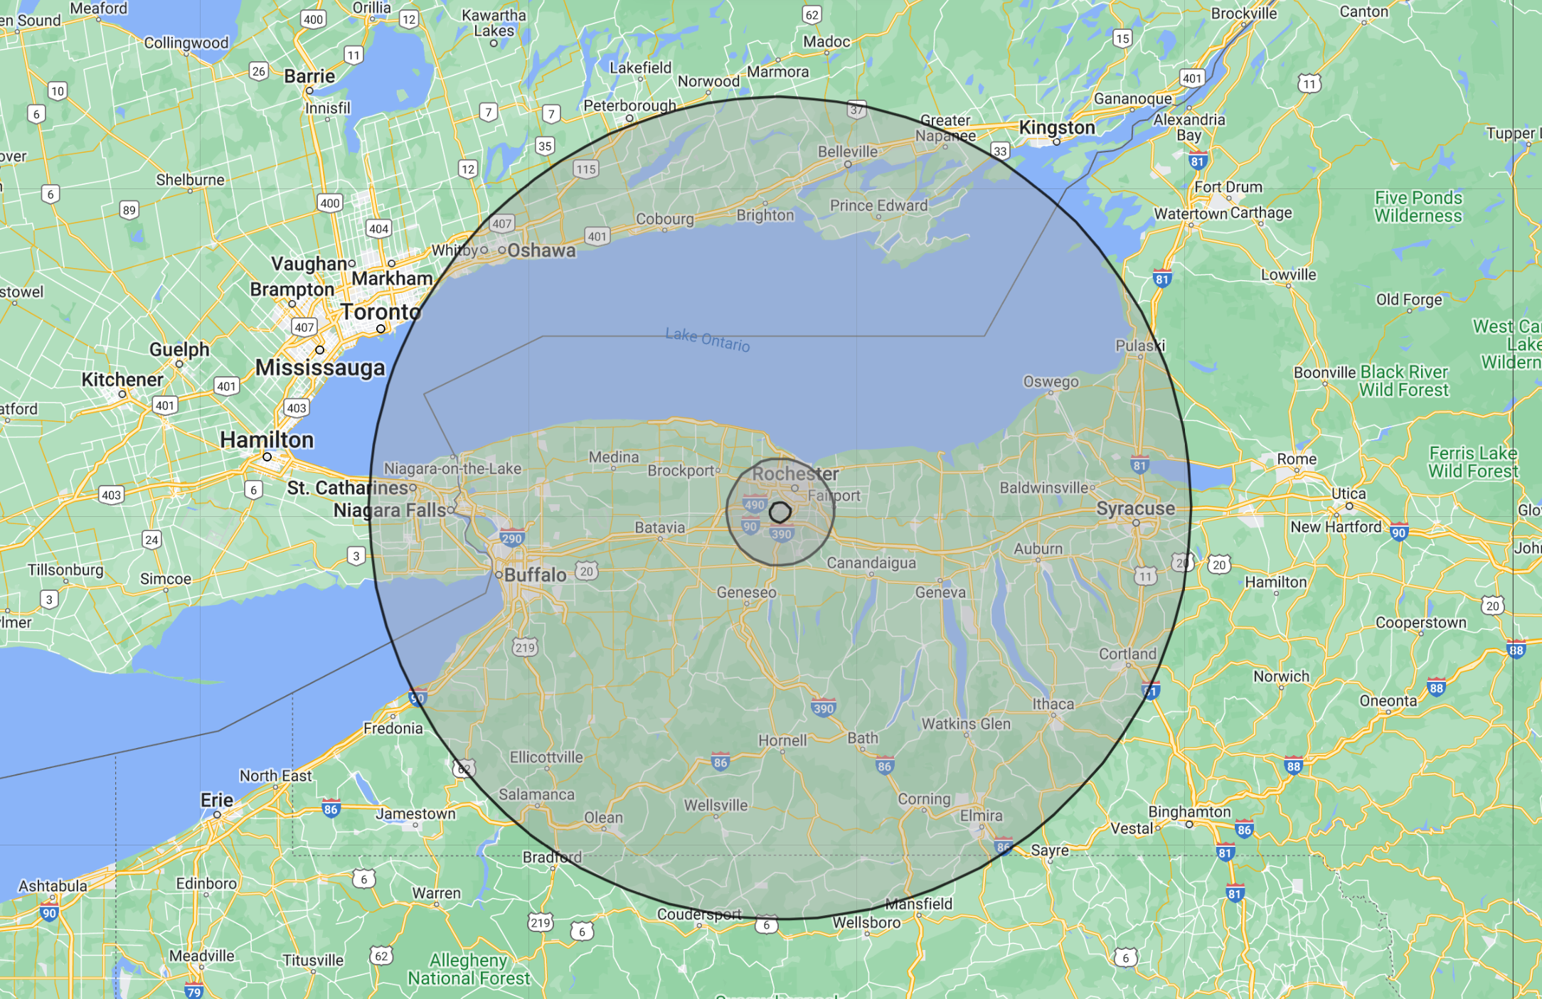
Distance Between Sun and Pluto – 89 miles (39 AU)

Slide 27
Distance to Nearest Star
The nearest star is Proxima Centauri at 4.2 ly, 1.3 pc, or 270,000 AU.
One could fit approximately 10,000 Earth’s in an AU, as we saw earlier.
So, one could fit about 3 billion Earth’s between the Sun and the nearest star. This is equal to 30 million solar diameters.
In our scale model, the Earth is a foot in size, so the nearest star would be 3 billion feet away (~568,000 miles), or about twice the distance to the Moon.
Even the distance to the nearest star involves large numbers of typical units of length (feet, miles, km, etc.).
This is why astronomers tend to use light years, or parsecs.

Slide 28
galaxies

Slide 29
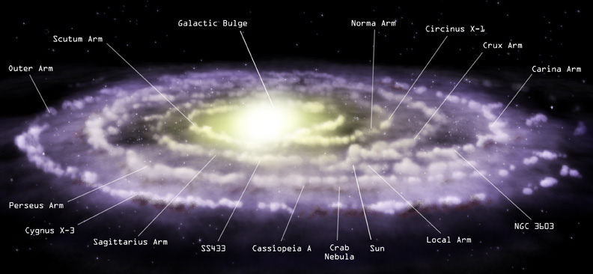
Milky Way – Side View

Slide 30
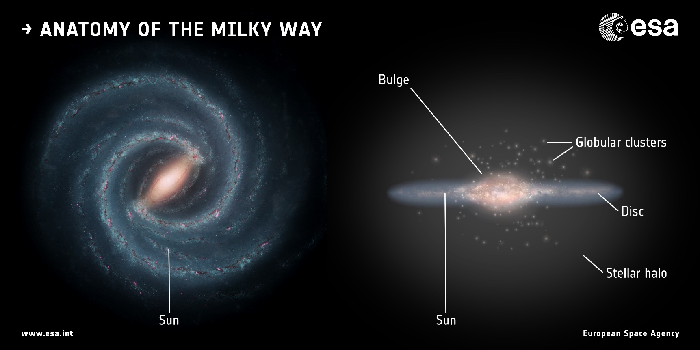
Milky Way – Alternative View

Slide 31
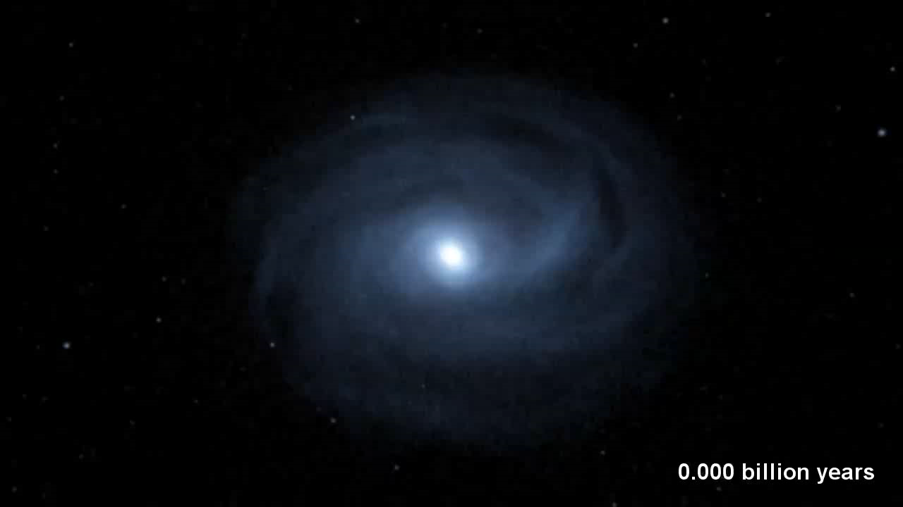
Milky Way and Andromeda

Slide 32
Merger Script
Milky way and andromeda collide
triangulum watches and eats popcorn
Milkdromeda forms
Milkdromeda : What a nice day!
Triangulum laughs
Milkdromeda: I will get revenge one day.
5 billion years later
Milkdromeda kills triangulum
The end﻿

Slide 33
Other Galaxies
The Milky Way is part of 50 galaxies in the Local Group.
The Milky Way is part of 50,000 galaxies in the Local Supercluster.
In all, there are a few hundred billion galaxies in the Universe.
Galaxies contain a few hundred billion stars each on average.
So, there are ~10²² stars in the Universe.
That is roughly the number of grains of sand on all the beaches on Earth.

Slide 34
time and distance

Slide 35
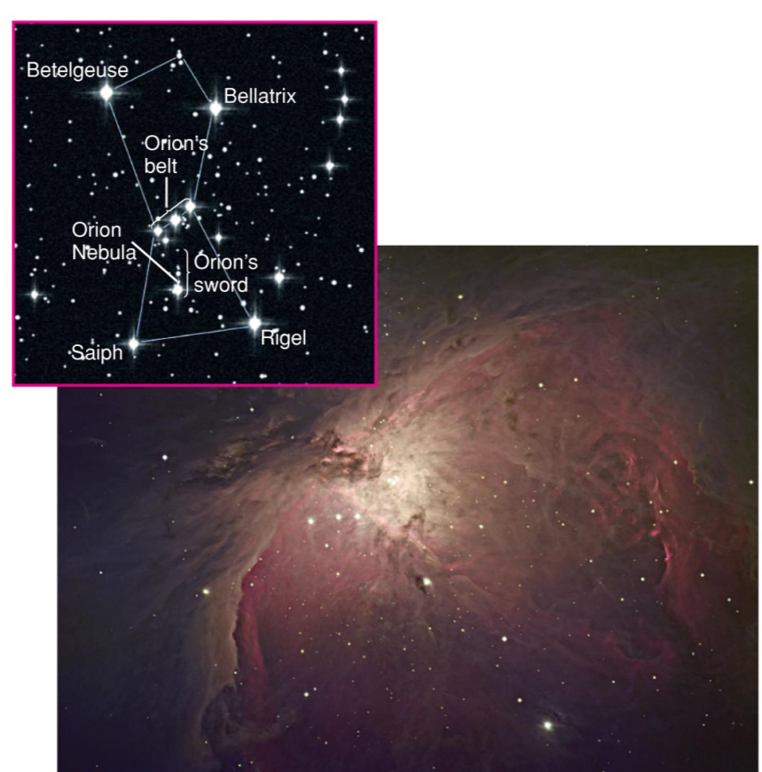
Time and Distance
Since the speed of light is finite, it takes time for light to travel.
We observe objects as they were in the past!
The farther away we look, the further back in time we see (for that object).
We see the Orion Nebula as it looked 1500 years ago.

Slide 36
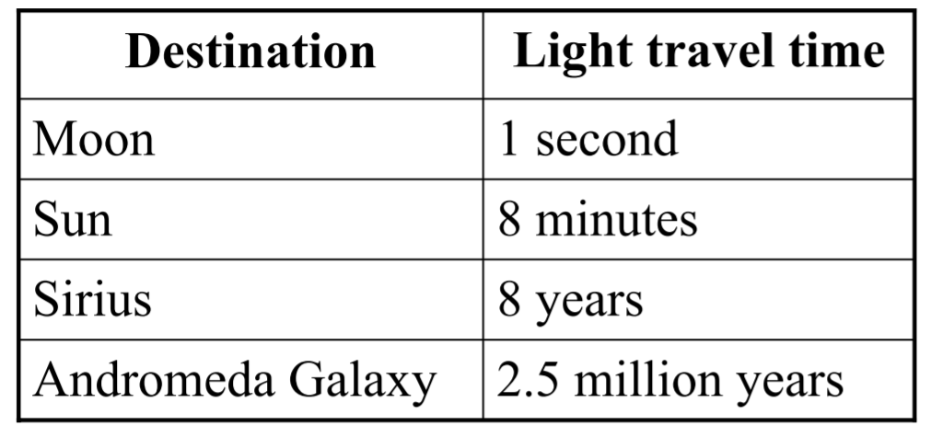
Time of Flight

Slide 37
Expansion of the universe

Slide 38
Expansion of the Universe
Hubble discovered that
  all galaxies (outside of the local group) are moving away from us
  the farther away the galaxy, the faster it is moving away
The expansion rate is roughly 70 km/s per Mpc of distance.
A measurement of velocity gives a measurement of distance.

Slide 39
Question
What is the expansion rate per unit distance in the raisin bread model?
Hint: units should be cm/hour per cm.

Slide 40
Answer
Raisin #1 goes from 1 to 3 cm in one hour -> 2 cm/hr.
Raisin #2 goes from 2 to 6 cm in one hour -> 4 cm/hr.
Raisin #3 goes from 3 to 9 cm in one hour -> 6 cm/hr.
velocity=rate*distance
rate=2 cm/hr per cm.

Slide 41
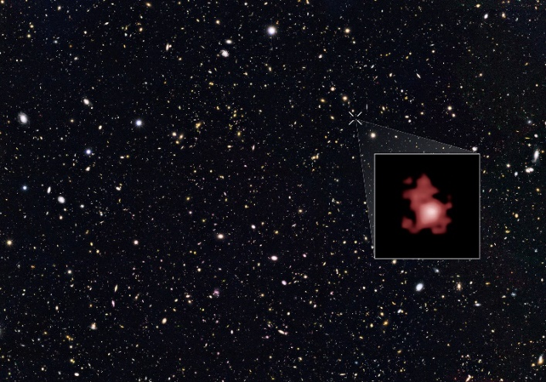
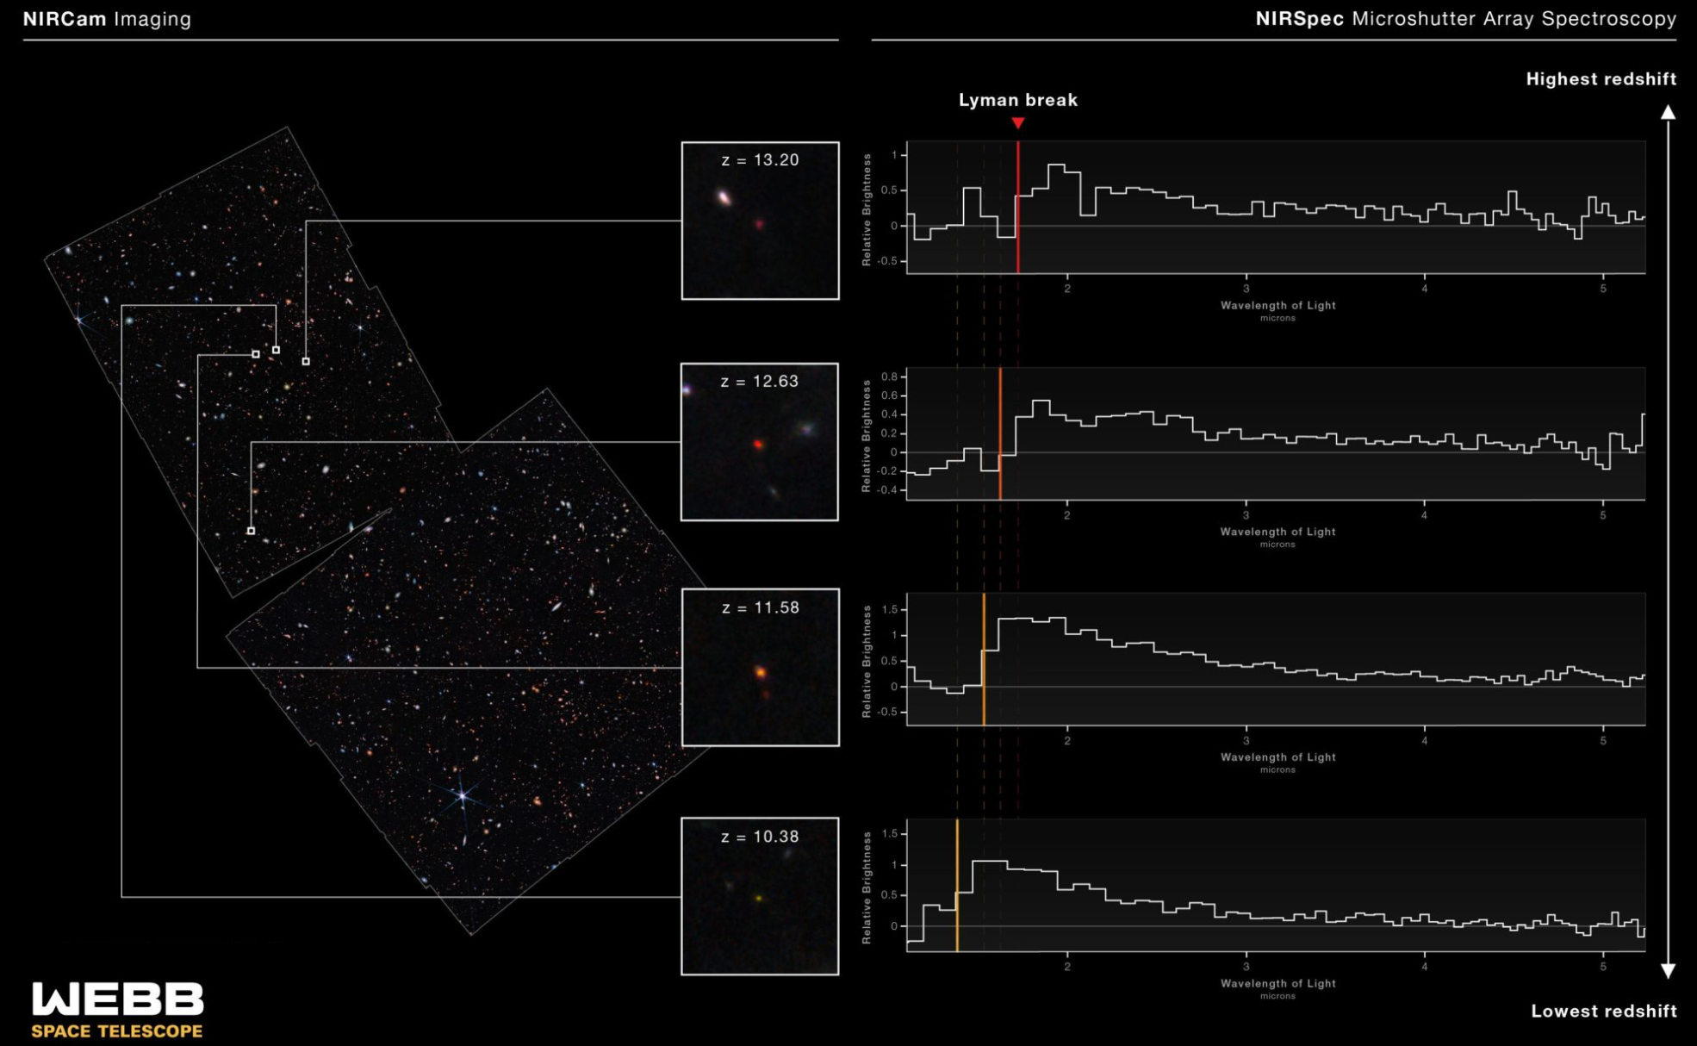
Most Distant Galaxy
GN-z11
Discovered in 2016
Redshift of 11.1
13.4 Gly
Universe was 400 Myr old.
GS-z13-0
Discovered by JWST in 2022
Redshift of 13.2
Universe 350 Myr old
Small galaxies

Slide 42
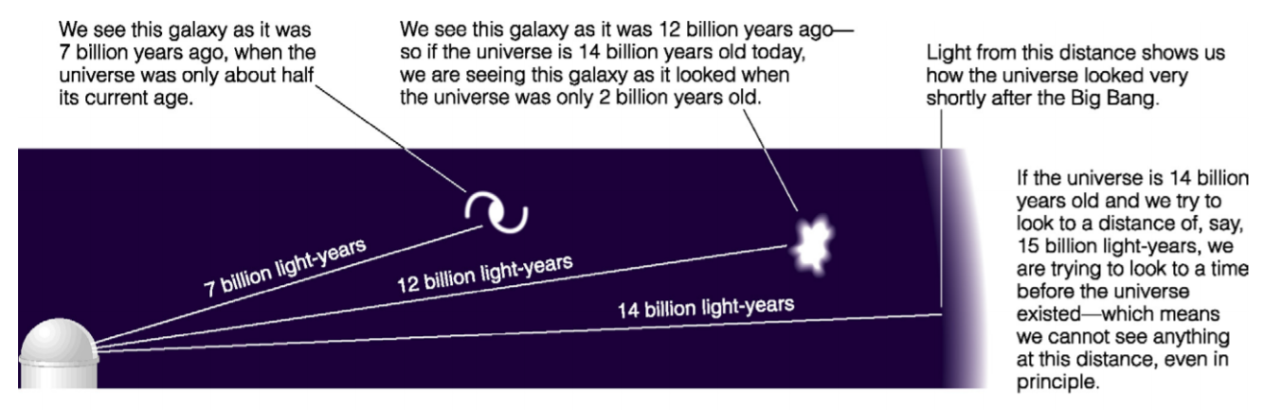
Looking at Early Universe

Slide 43
Question
Assuming that the Universe is around 14 billion years old, why can’t we see a galaxy that is 15 billion light-years away from us?
a) because no galaxies exist at that distance
b) galaxies at that distance would be too faint to see
c) because looking 15 billion light-years away means looking to a time before the Universe existed

Slide 44
Answer
Assuming that the Universe is around 14 billion years old, why can’t we see a galaxy that is 15 billion light-years away from us?
a) because no galaxies exist at that distance
b) galaxies at that distance would be too faint to see
c) because looking 15 billion light-years away means looking to a time before the Universe existed

Slide 45
The cosmic calendar

Slide 46
The Scale of Time
If the entire age of the Universe were represented by one calendar year…
Jan 1 – Big Bang
Dec 31 11:59:59 PM – Today
Modern humans evolved at 11:52 PM!
We have existed for a tiny fraction of the age of the Universe.

Slide 47
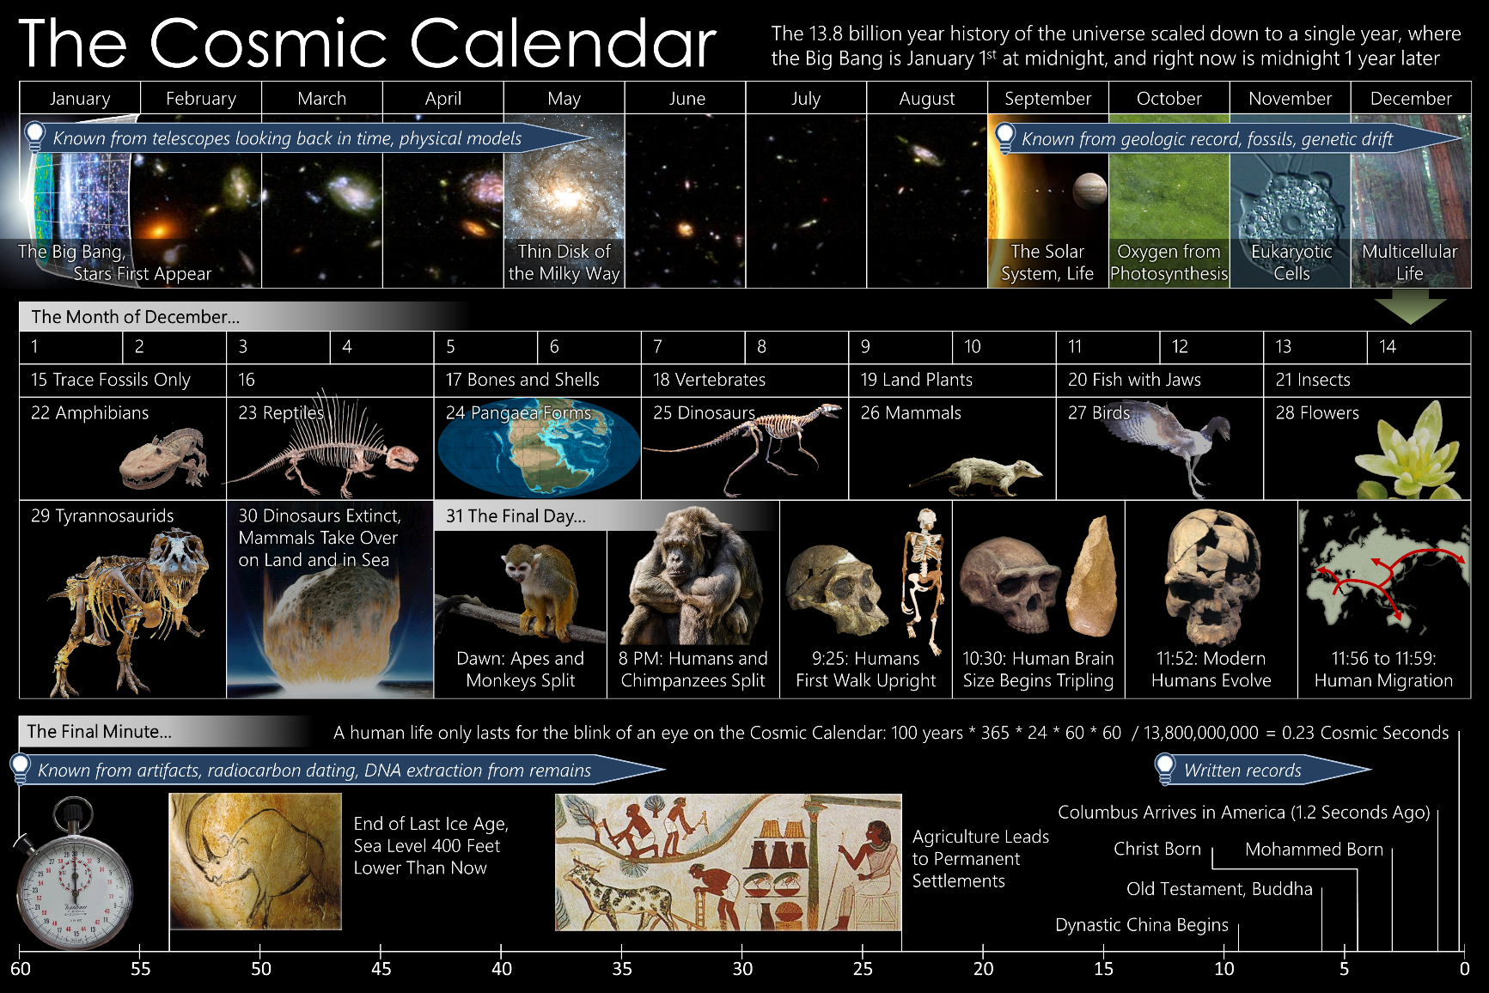
The Cosmic Calendar

Slide 48
The Cosmic Calendar “Recent” History
The Solar System formed in early September on the Cosmic Calendar.
4.5 billion years old
Dinosaurs appeared and became extinct on a single day near the end of the calendar (65 million years ago).
Our entire civilization has taken place in the last 30 seconds of the calendar.

Slide 49
Things to Do
Watch this guy build a scale model of the Solar System:
  Google: youtube guy builds solar system
Watch this video on the cosmic calendar:
  Google: youtube cosmic calendar

