Slide 1
University Astronomy
Professor Don Figer
Imaging

Slide 2
Aims and outline for this lecture
derive resolution and sensitivity requirements for astronomical imaging
  spatial resolution
  optical design
  abberations
  sensitivity
review noise
  shot noise from signal
  shot noise from background
  detector noise

Slide 3
spatial resolution

Slide 4
Spatial Resolution
Spatial resolution is the minimum distance between two objects that can be distinguished with an imaging system.
Note that the definition depends on the algorithm for “distinguishing” two objects.
  Rayleigh criterion
  Sparrow criterion
  model-dependent algorithms
  others?
It can be limited by a number of factors.
  diffraction
  optical design aberrations
  optical fabrication errors
  optical scattering
  atmospheric turbulence
  detector blur (pixel-to-pixel crosstalk)
  pixel size

Slide 5
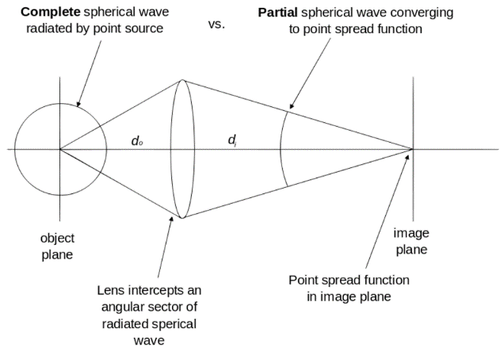
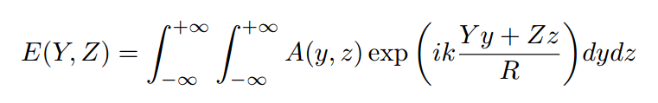
Image Formation
The electric field in the image plane (YZ) is a function of the wave-vector amplitude integrated over the pupil plane (yz). R is distance between pupil and image plane.
The electric field at the image plane is the Fourier transform of the pupil.
The image intensity is the square of the amplitude of the electric field.
Notes:
Interesting derivation:
http://www.ita.uni-heidelberg.de/~dullemond/lectures/obsastro_2010/Chapter_Diffraction.pdf

Slide 6
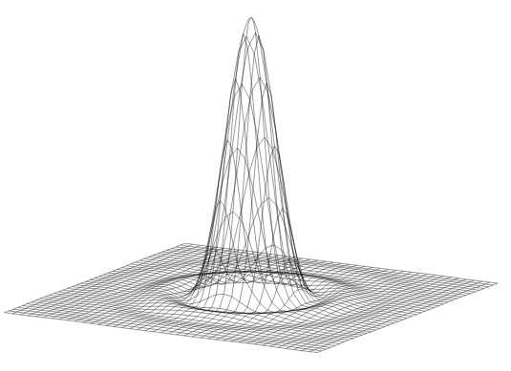
Airy Pattern
An Airy pattern is the image intensity pattern at a focal plane for an optical system that has a circular aperture.
It looks like a central peak surrounded by rings.
A central obscuration has the effect of moving some of the light from the central peak into the outer rings.

Slide 7
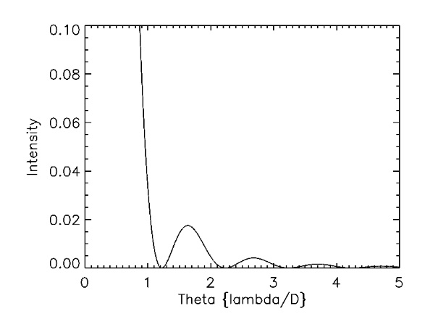
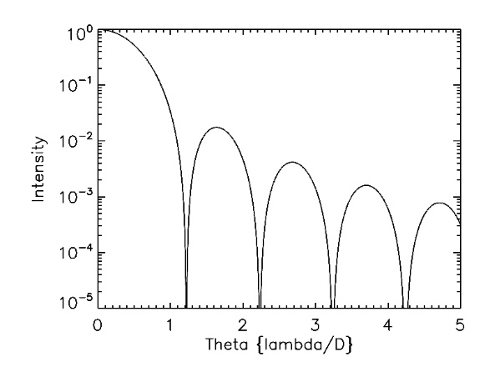
Airy Pattern
The Airy pattern is one type of point spread function (PSF) at the focal plane of an instrument for a point source.
The intensity pattern is given by the order 1 Bessel function of the first kind.
The radius of the first dark ring is 1.22 and the FWHM is at 1.028 (all in units of lambda/D).

Slide 8
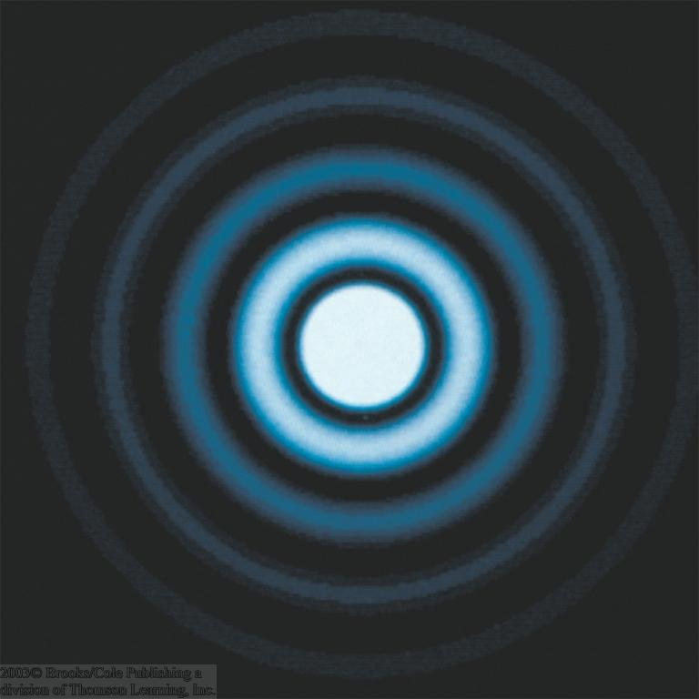
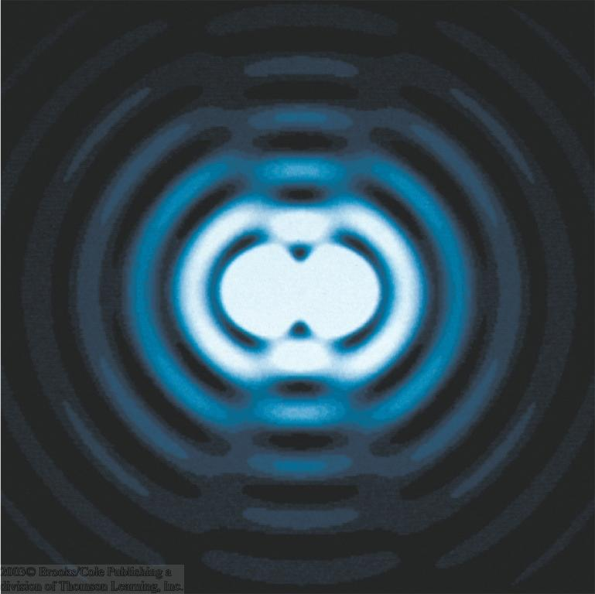
Diffraction: Rayleigh Criterion
The telescope aperture produces fringes (Airy disc) that set a limit to the resolution of the telescope.
Angular resolution is minimum angular distance between two objects that can be separated.
Rayleigh criterion is satisfied when first dark ring produced by one star is coincident with peak of nearby star.
α_{min}

Slide 9
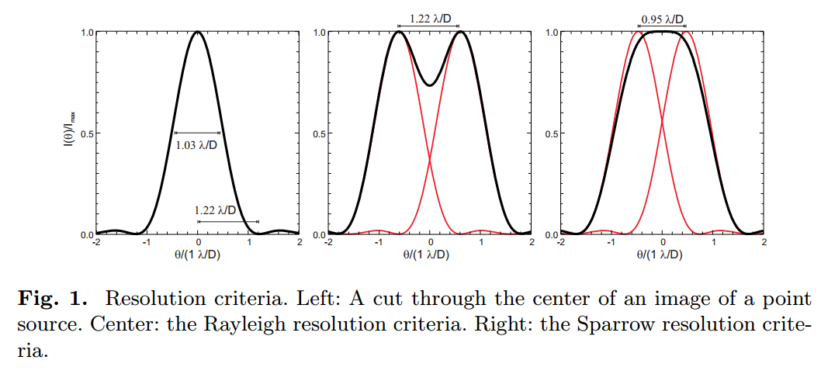
Spatial Resolution Criteria

Slide 10
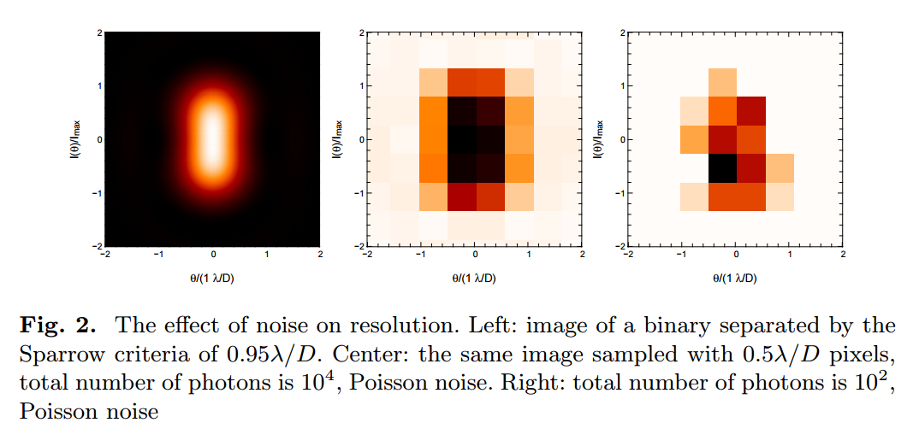
Spatial Resolution and Sampling

Slide 11
optical design

Slide 12
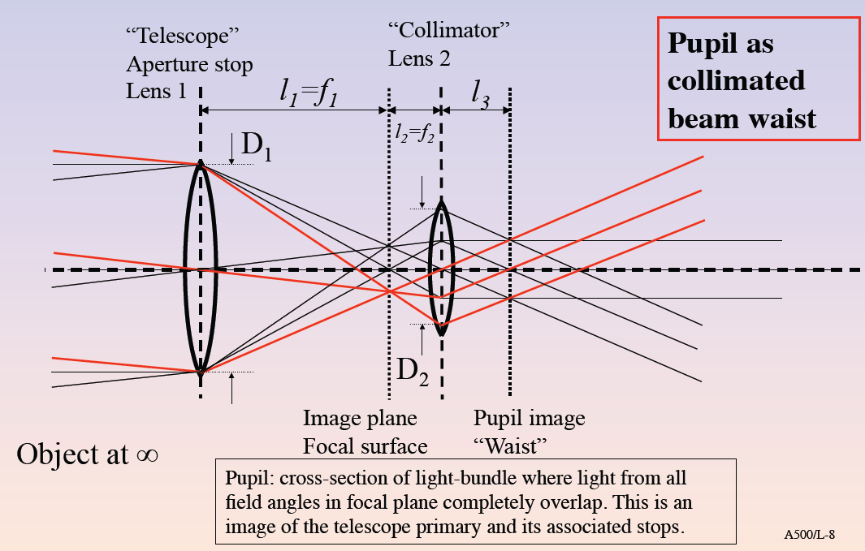
Optical System Design

Slide 13
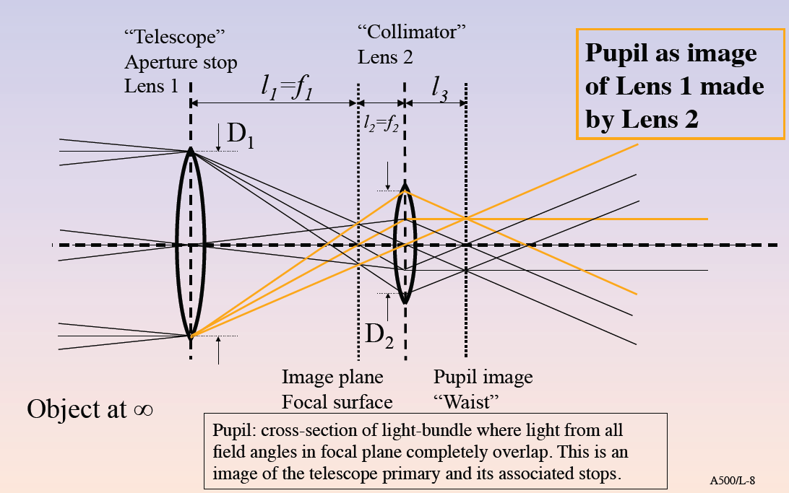
Optical System Design

Slide 14
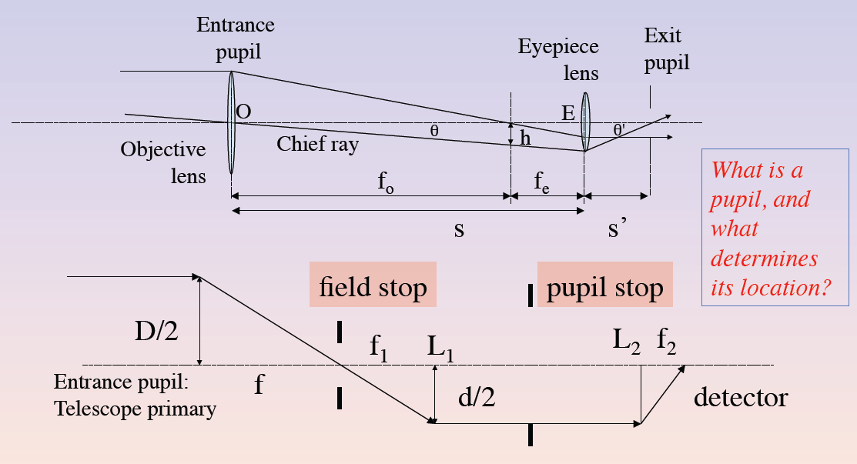
Optical System Design

Slide 15
optical abberations

Slide 16
Optical Design Aberrations
primary aberrations
  spherical (original HST)
  coma
  astigmatism
  chromatic
other aberrations (that do not affect resolution)
  distortion
  anamorphic magnification

Slide 17
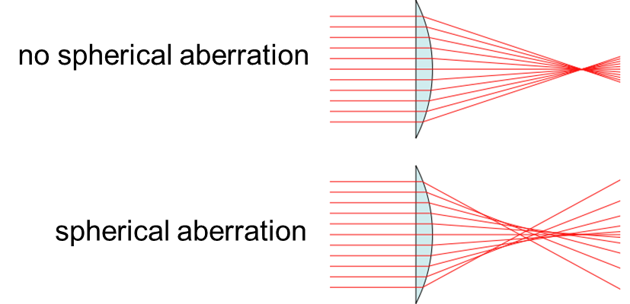
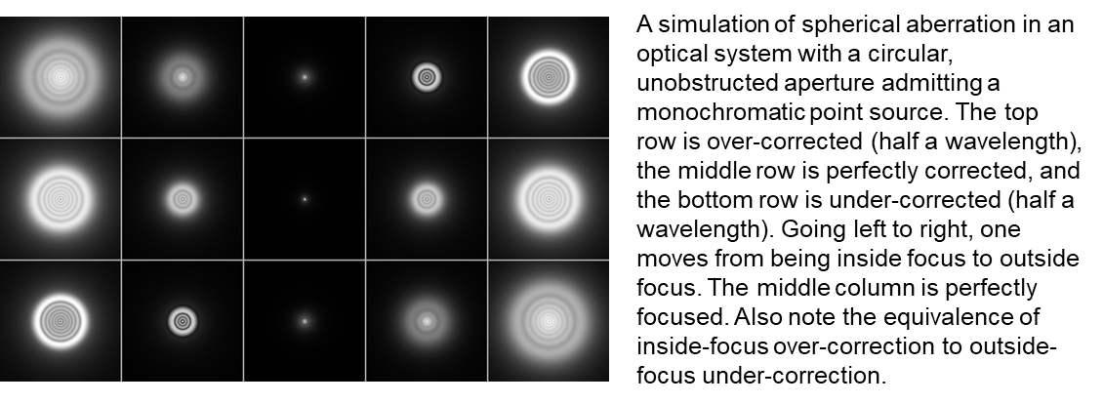
Optical Design Aberrations: Spherical
Notes:
Conceptual ray diagrams of ideal and spherically aberrated lenses. A perfect lens (top) focuses all incoming rays to a single point on the optic axis, but a real lens with spherical surfaces (bottom) focuses different rays to different points along the optic axis, depending on the radial position of each incoming ray.
A simulation of spherical aberration in an optical system with a circular, unobstructed aperture admitting a monochromatic point source. The top row is over-corrected (half a wavelength), the middle row is perfectly corrected, and the bottom row is under-corrected (half a wavelength). Going left to right, one moves from being inside focus to outside focus. The middle column is perfectly focused. Also note the equivalence of inside-focus over-correction to outside-focus under-correction. See the corresponding longitudinal sections.

Slide 18
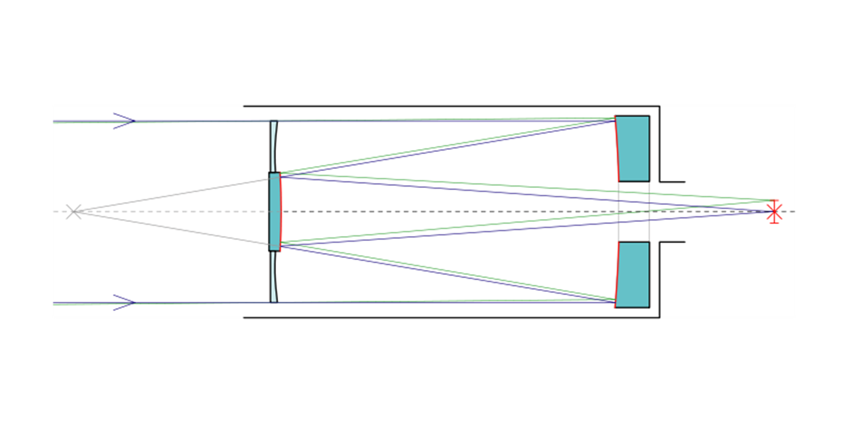
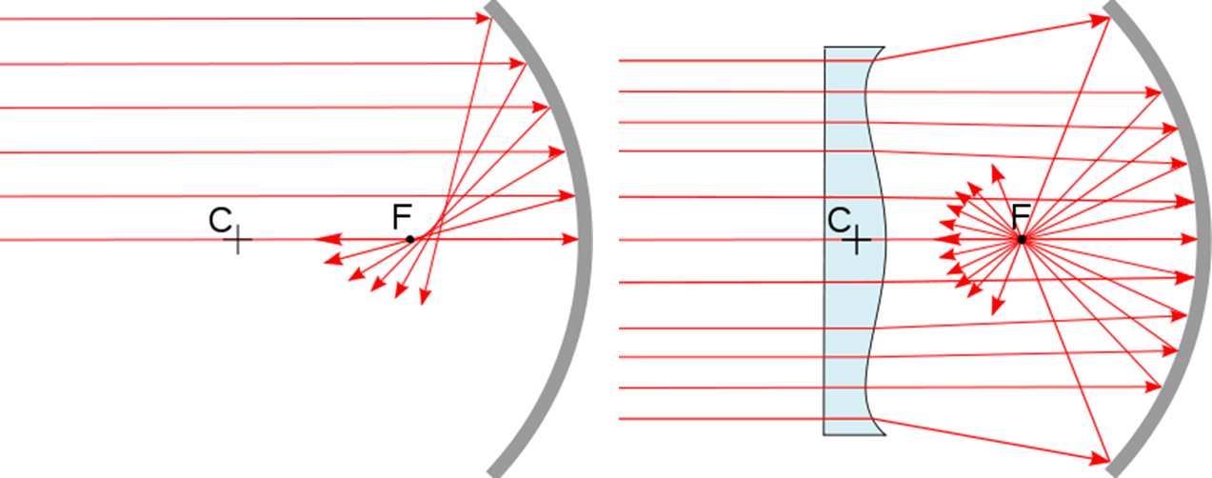
Optical Design Aberrations: Spherical, Corrector Plate
Notes:
Spherical mirrors are inexpensive to make because they can be polished with a simple rotary tool. To correct for spherical aberration, it is relatively inexpensive to add a corrector plate.

Slide 19
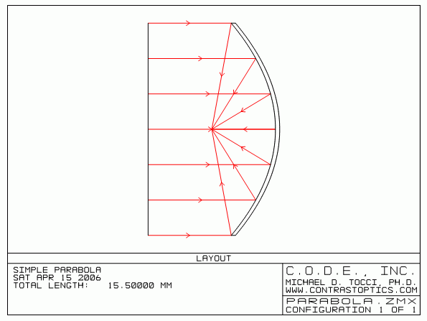
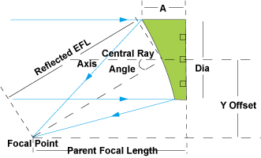
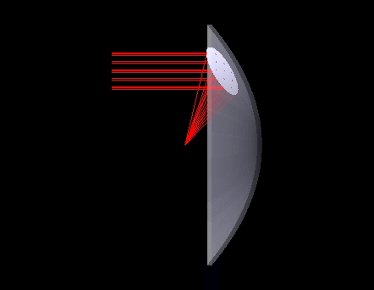
Optical Design Aberrations: Spherical, Off-axis Parabola
Parabola has perfect imaging for on-axis field points.
A section of a parabola will produce perfect imaging when illuminated with an off-axis beam.
This “off-axis parabola (OAP)” is useful because it moves the focal plane from the incoming beam.

Slide 20
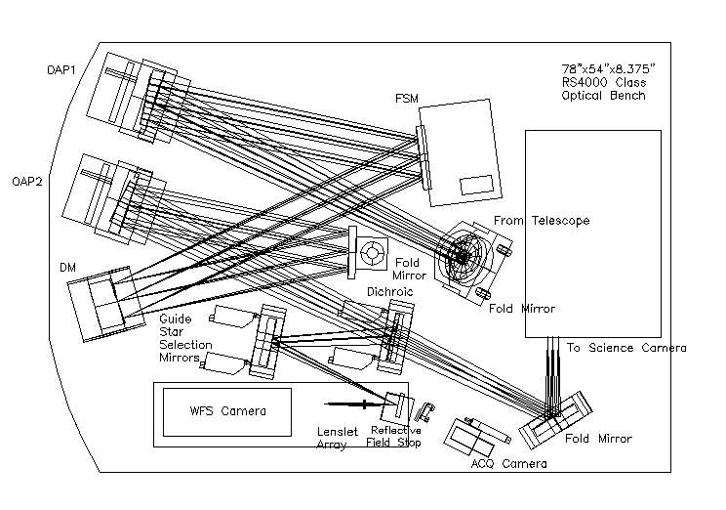
Optical Design Aberrations: Spherical, Off-axis Parabola in AO System
Notes:
OAP1 produces an image of the pupil at the DM. OAP2 focuses the beam onto the science and WFS cameras.

Slide 21
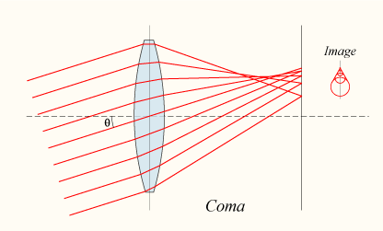
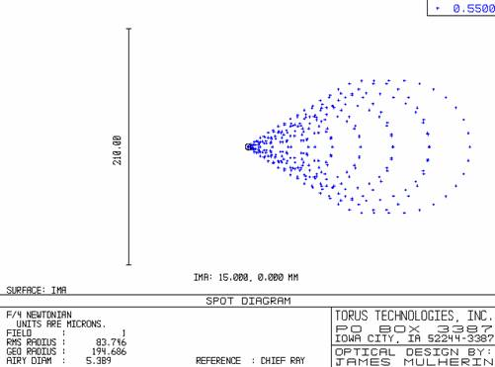
Optical Design Aberrations: Coma
Coma is defined as a variation in magnification over the entrance pupil. In refractive or diffractive optical systems, especially those imaging a wide spectral range, coma can be a function of wavelength.
Coma is an inherent property of telescopes using parabolic mirrors. Light from a point source (such as a star) in the center of the field is perfectly focused at the focal point of the mirror. However, when the light source is off-center (off-axis), the different parts of the mirror do not reflect the light to the same point. This results in a point of light that is not in the center of the field looking wedge-shaped. The further off-axis, the worse this effect is. This causes stars to appear to have a cometary coma, hence the name.
Notes:
In optics (especially telescopes), the coma (aka comatic aberration) in an optical system refers to aberration inherent to certain optical designs or due to imperfection in the lens or other components which results in off-axis point sources such as stars appearing distorted. Specifically, coma is defined as a variation in magnification over the entrance pupil. In refractive or diffractive optical systems, especially those imaging a wide spectral range, coma can be a function of wavelength.
Coma is an inherent property of telescopes using parabolic mirrors. Light from a point source (such as a star) in the center of the field is perfectly focused at the focal point of the mirror (unlike a spherical mirror, where light from the outer part of the mirror focuses closer to the mirror than light from the center--spherical aberration). However, when the light source is off-center (off-axis), the different parts of the mirror do not reflect the light to the same point. This results in a point of light that is not in the center of the field looking wedge-shaped. The further off-axis, the worse this effect is. This causes stars to appear to have a cometary coma, hence the name. Schemes to reduce spherical aberration without introducing coma include Schmidt, Maksutov and Ritchey-Chrétien optical systems.
Coma of a single lens or a system of lenses can be minimised (and in some cases eliminated) by choosing the curvature of the lens surfaces to match the application. Lenses in which both spherical aberration and coma are minimised at a single wavelength are called bestform or aplanatic lenses.

Slide 22
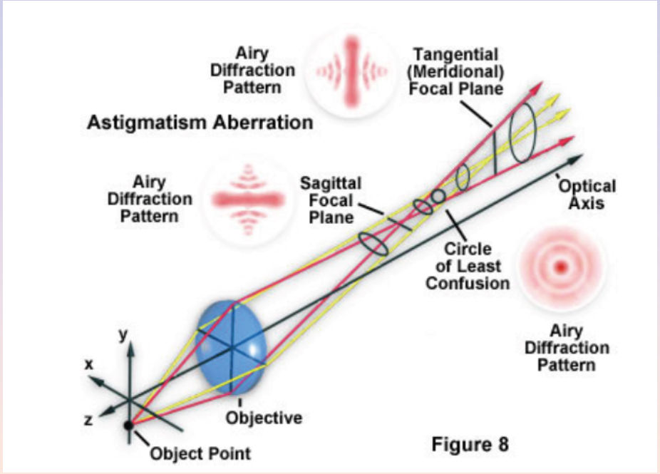
Optical Design Aberrations: Astigmatism
Notes:
In optics, astigmatism is when an optical system has different foci for rays that propagate in two perpendicular planes. If an optical system with astigmatism is used to form an image of a cross, the vertical and horizontal lines will be in sharp focus at two different distances.

Slide 23
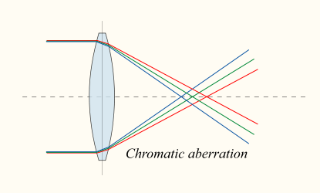
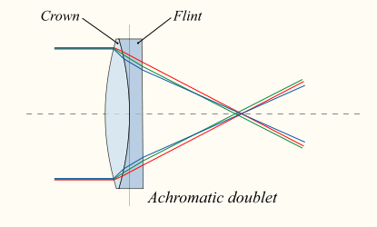
Optical Design Aberrations: Chromatic
Notes:
In optics, chromatic aberration is caused by a lens having a different refractive index for different wavelengths of light (the dispersion of the lens). The term "purple fringing" is commonly used in photography, although not all purple fringing can be attributed to chromatic aberration.

Slide 24
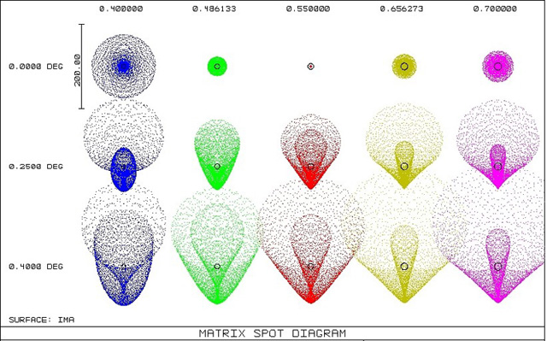
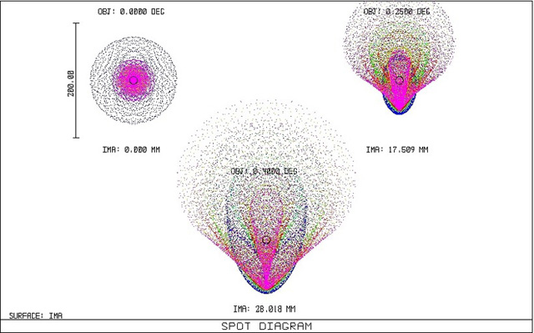
Optical Design Aberrations: Chromatic Aberration Spot Diagrams
wavelengths
field positions
Notes:
In optics, chromatic aberration is caused by a lens having a different refractive index for different wavelengths of light (the dispersion of the lens). The term "purple fringing" is commonly used in photography, although not all purple fringing can be attributed to chromatic aberration.

Slide 25
Optical Fabrication Errors
Fabrication errors are the differences between the design and the fabricated part.
These errors can be defined by their frequency across the part:
  figure errors: low frequency undulations that can sometimes be corrected by focus compensation
  mid-frequency errors: generally affect wavefront error, resulting in degraded image quality and SNR
  high-frequency errors: produce scattering, increased background, loss of contrast

Slide 26
Optical Scattering
Optical scattering is the deviation of light produced by optical material imhomogeneities.
  direction of deviation does not follow the law of reflection or refraction for the geometry of the light and the optic
  often occurs at an optical surface due to surface roughness
  general effect is to produce additional apparent background flux
Scattering scales as roughness size divided by the square of the wavelength.
BRDF is the bidirectional reflectance distribution function, and it is often used to describe optical scattering.

Slide 27
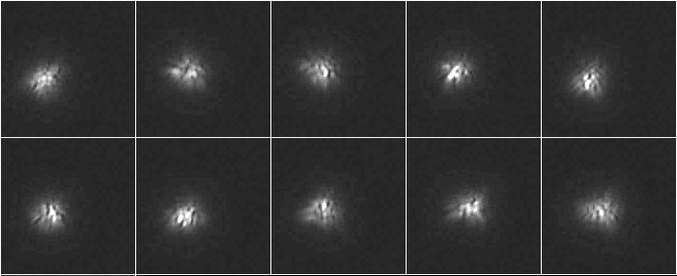
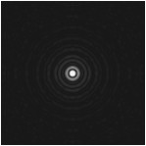
Atmospheric Turbulence
The atmosphere is an inhomegeneous medium with varying index of refraction in both time and space.
  thermal gradients
  humidity gradients
  bulk wind shear
Seeing is the apparent random fluctuation in size and position of a point spread function.
Scintillation is the apparent random fluctuation in the intensity, i.e. “twinkling.”

Slide 28
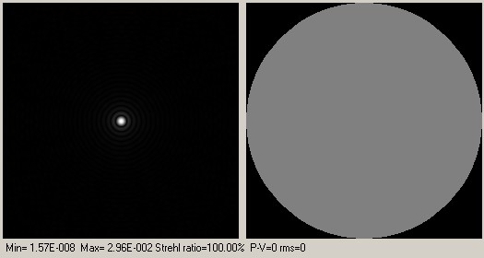
Atmospheric Turbulence: Wavefront Maps
Notes:
This section deals with software simulation. The turbulence effect can be simulated by degrading the entrance wavefront, and computing the star shape or PSF built by the telescope+wavefront. Zernikes polynoms have been used for this simulation. As shown hereafter, wavefront is the right circular shape (figure 6), the variation of image intensity within this disk shows (in Z) the wavefront phase shifts.
Very nice PSF can be calculated according the wavefront, provinding strhel ratios and L/... wavefront errors (ptv and rms)
This demonstrates quickly that Lambda/30 PTV mirrors are not really usefull (!) Lambda/5-10 ptv mirrors are good enough, and more likely, the telescope will never see calm an quiet turbulence conditions to be able to notice a difference between a L/4 and L/30 mirror.

Slide 29
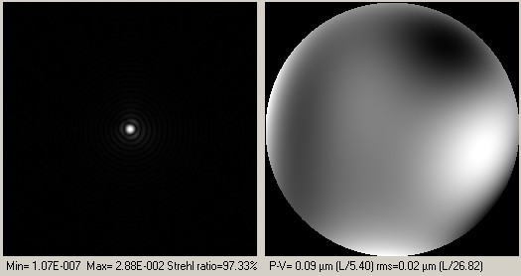
Atmospheric Turbulence: Wavefront Maps
Notes:
This section deals with software simulation. The turbulence effect can be simulated by degrading the entrance wavefront, and computing the star shape or PSF built by the telescope+wavefront. Zernikes polynoms have been used for this simulation. As shown hereafter, wavefront is the right circular shape (figure 6), the variation of image intensity within this disk shows (in Z) the wavefront phase shifts.
Very nice PSF can be calculated according the wavefront, provinding strhel ratios and L/... wavefront errors (ptv and rms)
This demonstrates quickly that Lambda/30 PTV mirrors are not really usefull (!) Lambda/5-10 ptv mirrors are good enough, and more likely, the telescope will never see calm an quiet turbulence conditions to be able to notice a difference between a L/4 and L/30 mirror.

Slide 30
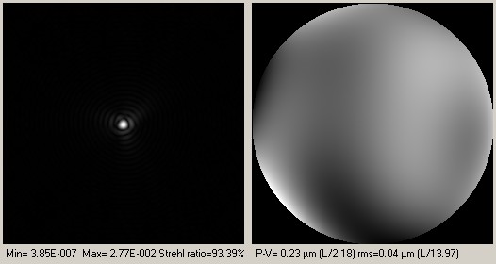
Atmospheric Turbulence: Wavefront Maps
Notes:
This section deals with software simulation. The turbulence effect can be simulated by degrading the entrance wavefront, and computing the star shape or PSF built by the telescope+wavefront. Zernikes polynoms have been used for this simulation. As shown hereafter, wavefront is the right circular shape (figure 6), the variation of image intensity within this disk shows (in Z) the wavefront phase shifts.
Very nice PSF can be calculated according the wavefront, provinding strhel ratios and L/... wavefront errors (ptv and rms)
This demonstrates quickly that Lambda/30 PTV mirrors are not really usefull (!) Lambda/5-10 ptv mirrors are good enough, and more likely, the telescope will never see calm an quiet turbulence conditions to be able to notice a difference between a L/4 and L/30 mirror.

Slide 31
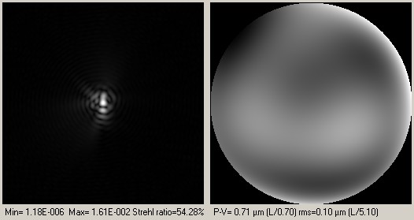
Atmospheric Turbulence: Wavefront Maps
Notes:
This section deals with software simulation. The turbulence effect can be simulated by degrading the entrance wavefront, and computing the star shape or PSF built by the telescope+wavefront. Zernikes polynoms have been used for this simulation. As shown hereafter, wavefront is the right circular shape (figure 6), the variation of image intensity within this disk shows (in Z) the wavefront phase shifts.
Very nice PSF can be calculated according the wavefront, provinding strhel ratios and L/... wavefront errors (ptv and rms)
This demonstrates quickly that Lambda/30 PTV mirrors are not really usefull (!) Lambda/5-10 ptv mirrors are good enough, and more likely, the telescope will never see calm an quiet turbulence conditions to be able to notice a difference between a L/4 and L/30 mirror.

Slide 32
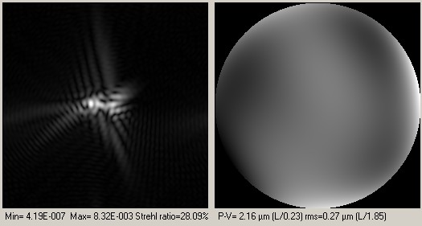
Atmospheric Turbulence: Wavefront Maps
Notes:
This section deals with software simulation. The turbulence effect can be simulated by degrading the entrance wavefront, and computing the star shape or PSF built by the telescope+wavefront. Zernikes polynoms have been used for this simulation. As shown hereafter, wavefront is the right circular shape (figure 6), the variation of image intensity within this disk shows (in Z) the wavefront phase shifts.
Very nice PSF can be calculated according the wavefront, provinding strhel ratios and L/... wavefront errors (ptv and rms)
This demonstrates quickly that Lambda/30 PTV mirrors are not really usefull (!) Lambda/5-10 ptv mirrors are good enough, and more likely, the telescope will never see calm an quiet turbulence conditions to be able to notice a difference between a L/4 and L/30 mirror.

Slide 33
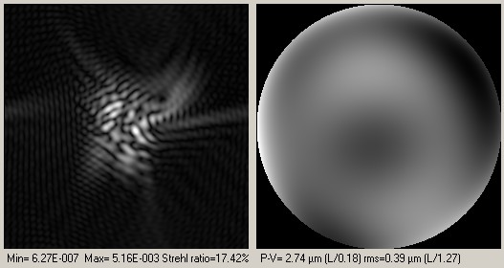
Atmospheric Turbulence: Wavefront Maps
Notes:
This section deals with software simulation. The turbulence effect can be simulated by degrading the entrance wavefront, and computing the star shape or PSF built by the telescope+wavefront. Zernikes polynoms have been used for this simulation. As shown hereafter, wavefront is the right circular shape (figure 6), the variation of image intensity within this disk shows (in Z) the wavefront phase shifts.
Very nice PSF can be calculated according the wavefront, provinding strhel ratios and L/... wavefront errors (ptv and rms)
This demonstrates quickly that Lambda/30 PTV mirrors are not really usefull (!) Lambda/5-10 ptv mirrors are good enough, and more likely, the telescope will never see calm an quiet turbulence conditions to be able to notice a difference between a L/4 and L/30 mirror.

Slide 34
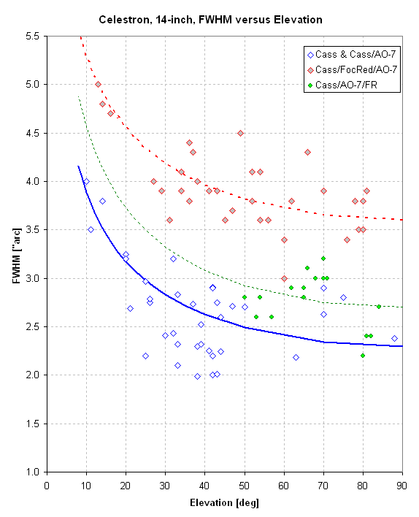
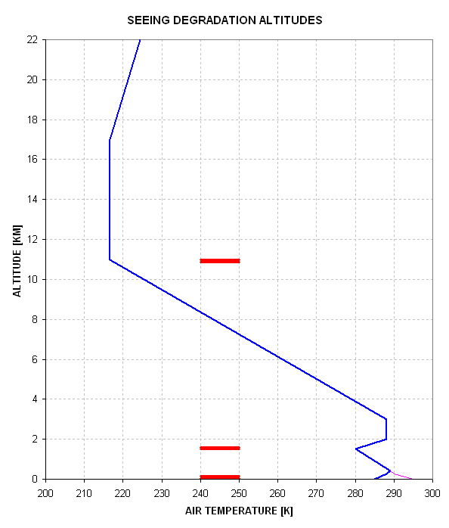
Atmospheric Turbulence: Seeing
Seeing is worse at low elevations because light traverses more turbulent atmospheric cells. Most seeing degradation is generated at the interfaces between air of different temperatures.
Scintillation is worse at low elevations for the same reason, thus twinkling stars on the horizon.

Slide 35
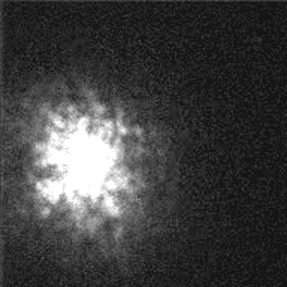
Atmospheric Turbulence: Seeing Video

Slide 36
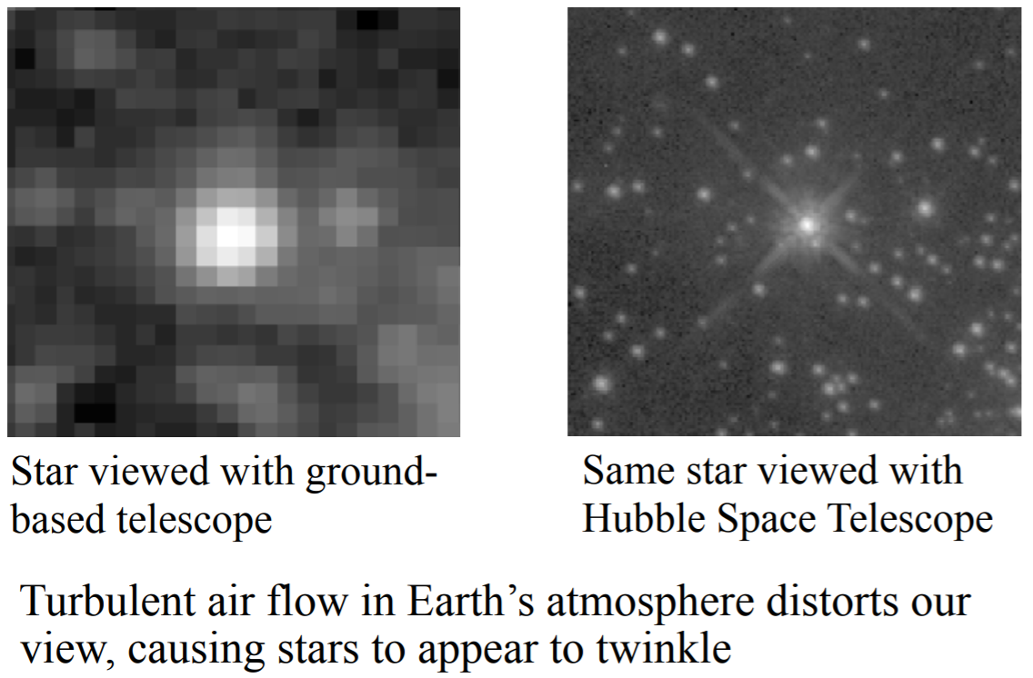
Atmospheric Blurring

Slide 37
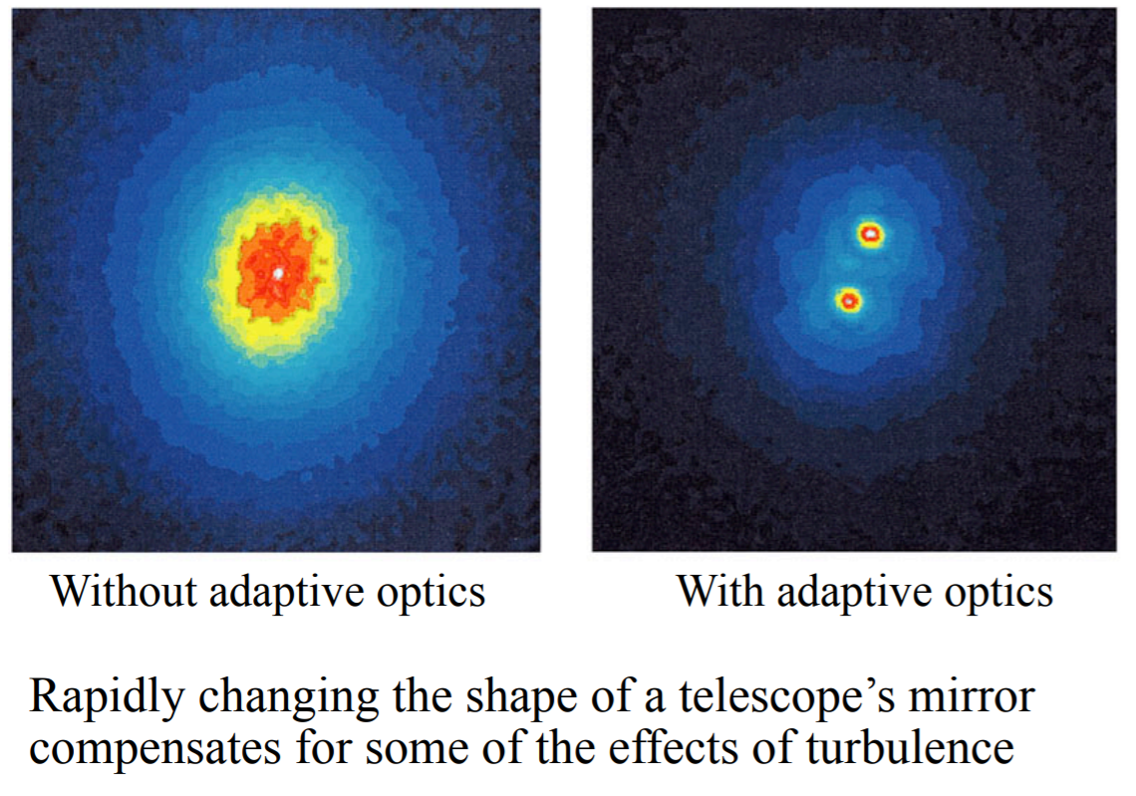
Adaptive Optics

Slide 38
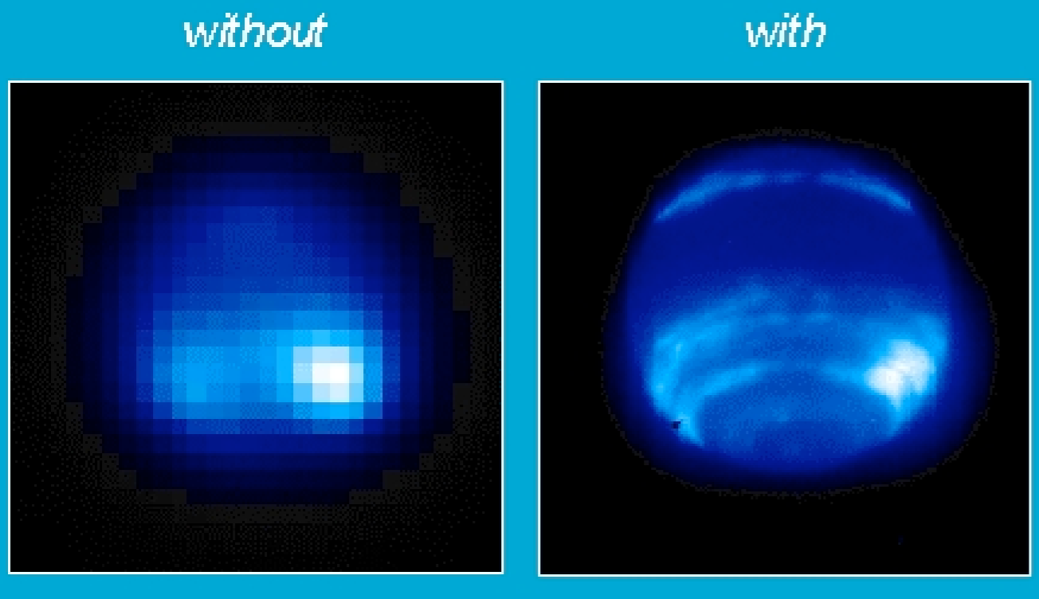
Adaptive Optics

Slide 39
sensitivity and snr

Slide 40
What is Signal? What is Noise?

Slide 41
Sensitivity
Combination of signal and noise
signal
  brightness of source
  absorption of intervening material
    gas, dust
    atmosphere
    optics
  size of telescope
  sensitivity of detector
noise
  detector read noise
  detector dark current
  background (zodiacal light, sky, telescope, instrument)
  shot noise from source
  imperfect calibrations

Slide 42
Sensitivity vs. Dynamic Range
Sensitivity
  ability to measure faint brightnesses
  often expressed as flux_{minimum}
  Smaller is better!
Dynamic Range
  ability to image “bright” and “faint” sources in same system
  often expressed as flux_{maximum}/noise.

Slide 43
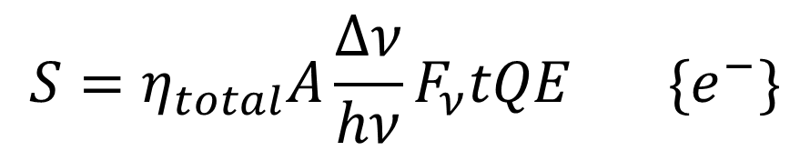
Signal: definition
Signal is that part of the measurement which is contributed by the source of interest.
where, A=area of telescope, QE=quantum efficiency of detector, F_{ν}=source flux, η_{total}=total transmission, and t=integration time
$$S=η_{total}A\frac{Δν}{hν}F_{ν}tQE \{e^{−}\}$$
$$η_{total}=η_{atmosphere}η_{telescope}η_{instrument}$$

Slide 44
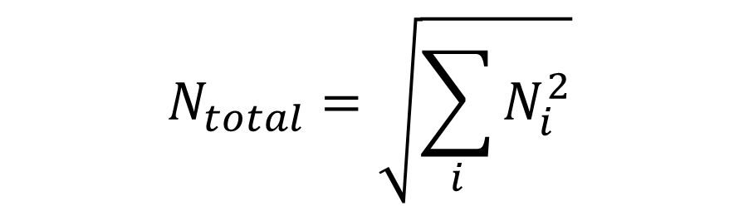
Noise - definition
Noise is the uncertainty in the signal measurement.
In sensitivity calculations, the “noise” is usually equal to the standard deviation.
Random noise adds in quadrature (square root of the sum of the squares).
$$N_{total}=\sqrt{\sum_{i}{N_{i}^{2}}}$$

Slide 45

“Shot Noise” and the DOT
The Department of Transportation asks you to count cars as they drive by you standing on the shoulder of the highway.
On average, there are 100 cars per minute that drive by you.
During any given minute, you count totals that are a bit different than 100. For instance, during the first minute, you count 96, then 103, then 108, then 99, etc.
If you count enough times and take an average, you will get a number near 100. In face, the more times you do the count, your average gets closer to 100.
If you take the standard deviation of all your counts, you will get something like $\sqrt{100}=10$.
This is the uncertainty for each individual measurement.
The uncertainty in the mean is $\frac{\overline{σ}}{\sqrt{N}}=\frac{10}{\sqrt{N}}$, where N is the number of measurements. This is “shot noise.”

Slide 46
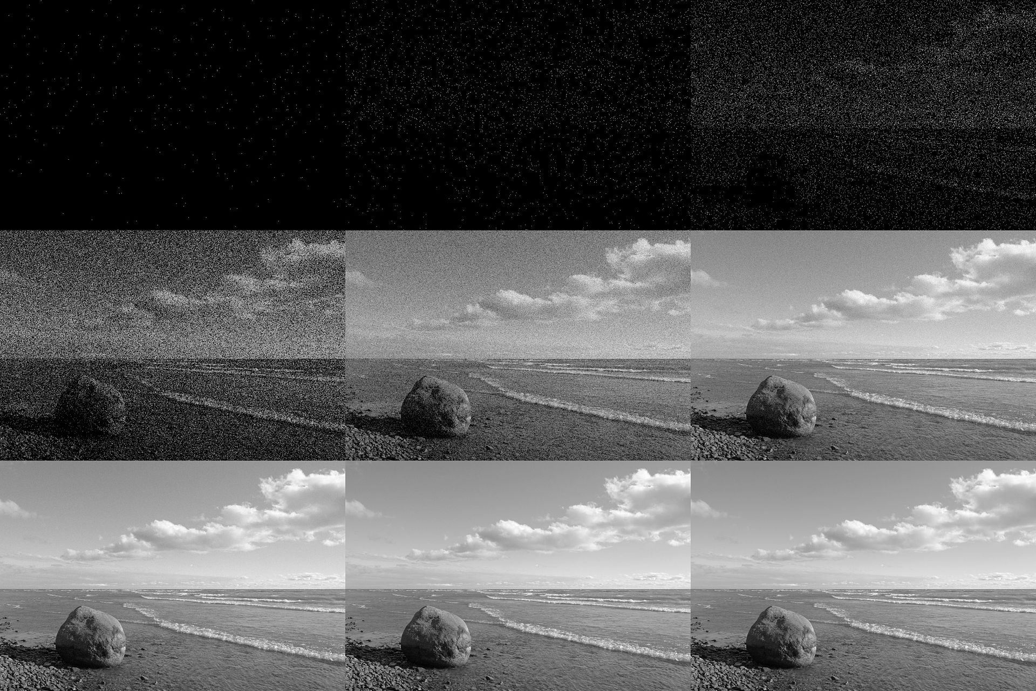
Shot Noise Example

Slide 47
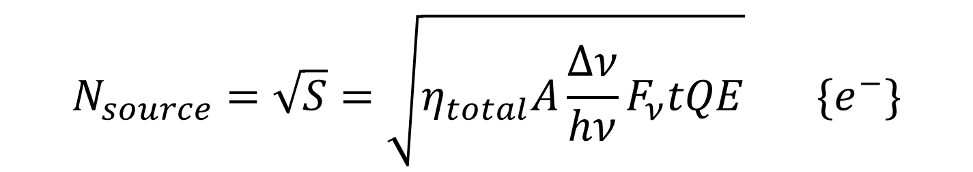
Noise - sources: Shot noise from source
The uncertainty in the source charge count is simply the square root of the collected charge. This is called “shot” noise.
Note that if this were the only noise source, then S/N would scale as t^{1/2}. (Also true whenever noise dominated by a steady photon source.)
$$N_{source}=\sqrt{S}=\sqrt{η_{total}A\frac{Δν}{hν}F_{ν}tQE} \{e^{−}\}$$

Slide 48
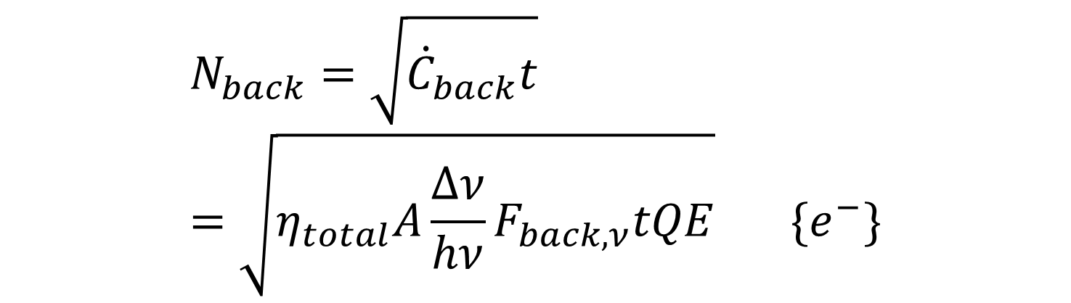
Noise - sources: Shot noise from background
Background is everything but signal from the object of interest!
Background noise is shot noise from the background flux that is left over after subtraction.
$$N_{back}=\sqrt{{\dot{C}}_{back}t}=\sqrt{η_{total}A\frac{Δν}{hν}F_{back,ν}tQE} \{e^{−}\}$$

Slide 49
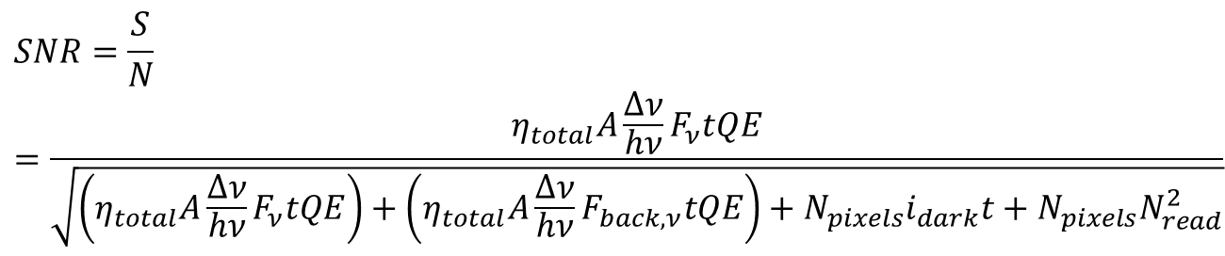
Signal-to-Noise Ratio
Background is everything but signal from the object of interest!
$$SNR=\frac{S}{N}=\frac{η_{total}A\frac{Δν}{hν}F_{ν}tQE}{\sqrt{\left(η_{total}A\frac{Δν}{hν}F_{ν}tQE\right)+\left(η_{total}A\frac{Δν}{hν}F_{back,ν}tQE\right)+N_{pixels}i_{dark}t+N_{pixels}N_{read}^{2}}}$$

Slide 50
Improving SNR
Optical effects
  Throughput: bigger aperture, anti-reflection coatings
  Background: low scatter materials, cooling
Detector effects
  Dark current: high purity material, low surface leakage
  Read Noise: multiple sampling, in-pixel digitization, photon-counting
  QE: thickness optimization, anti-reflection coatings, depleted
Atmospheric effects
  Atmospheric absorption: higher altitude
  OH emission: OH suppression instruments
  Turbulence: adaptive optics
  Ultimate “fix” is to go to space!

Slide 51
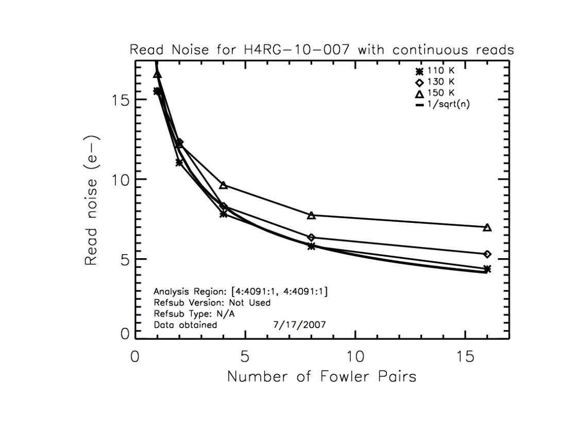
Improving SNR: multiple sampling

Slide 52
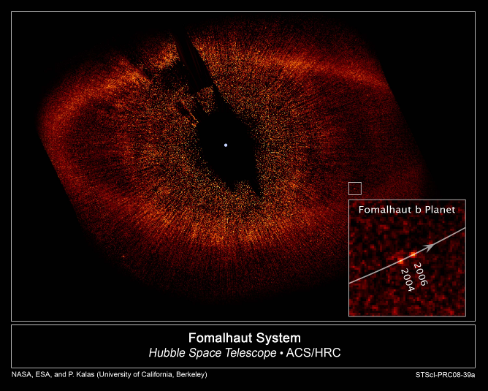
Direct Imaging of Exoplanet Example
52

Slide 53
Exoplanet Example
53

Slide 54

Detectivity Metric
54

