Slide 1
University Astronomy
Professor Don Figer
Telescopes I

Slide 2
Aims and outline for this lecture
describe
  history of telescopes
  optics
  properties of telescopes
  modern telescope systems

Slide 3
telescope systems

Slide 4
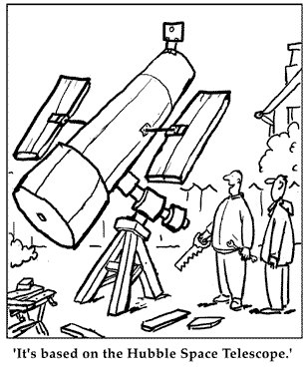
Backyard Telescope

Slide 5
The First Telescopes
Hans Lippershey got the patent for the telescope.
Galileo first used telescope for astronomy.
He was first to see sunspots, moons of Jupiter, phases of Venus.
Most astronomical discoveries since have involved telescopes.

Slide 6
Modern Telescope System
Opto-mechanical and thermal control
Acquisition & guiding
Telemetry and sensing
Instrumentation and instrument interfaces (ports)
Software for telescope and instrument control
Technical support and maintenance
Data storage and transfer
Software pipelines for data reduction and analysis
Environment for observer and operator
Personnel management, technical and scientific leadership

Slide 7
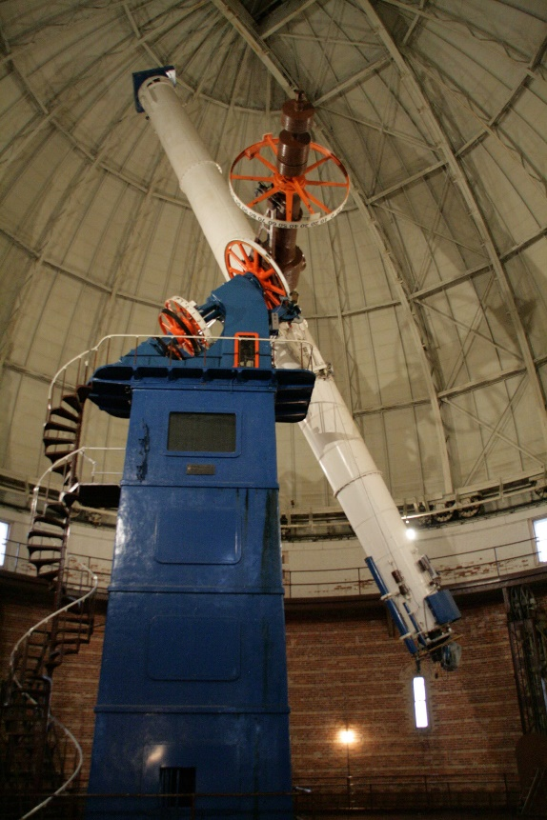
Telescope Parameters
Collecting area is most important parameter, and scales as aperture diameter squared (A=πr²).
Length is a practical parameter that impacts mass and dome size.
Delivered image quality (DIQ) is a function of optical design, manufacturing aberrations, and observing site.
f/ratio determines plate scale and field of view.
Notes:
The photo shows the Yerkes 40 inch refractor. Note that the floor has been raised to nearly the highest level. If one is not careful, it is possible to drive the telescope into the ground.

Slide 8

Question
How does the collecting area of a 10-meter telescope compare with that of a 2-meter telescope?
a) 5 times greater
b) 10 times greater
c) 25 times greater
d) 50 times greater
vote!

Slide 9
Answer
How does the collecting area of a 10-meter telescope compare with that of a 2-meter telescope?
a) 5 times greater
b) 10 times greater
c) 25 times greater
d) 50 times greater
vote!

Slide 10
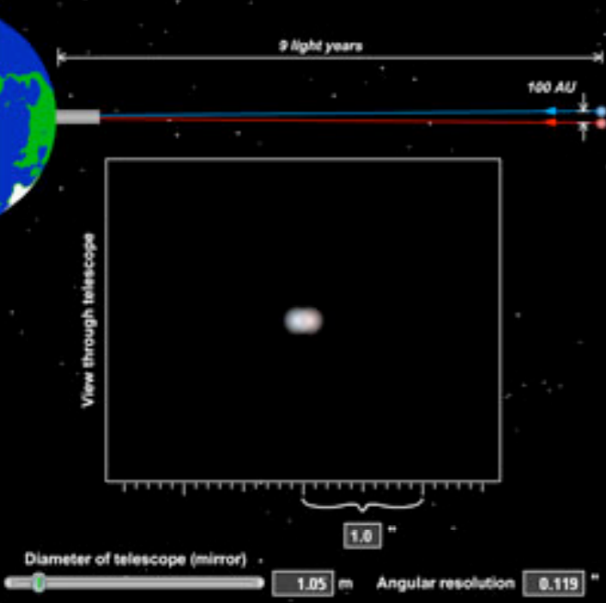
Telescope Size and Angular Resolution
Ultimate limit to resolution comes from interference of light waves within a telescope.
Larger telescopes are capable of greater resolution because there’s less interference.

Slide 11
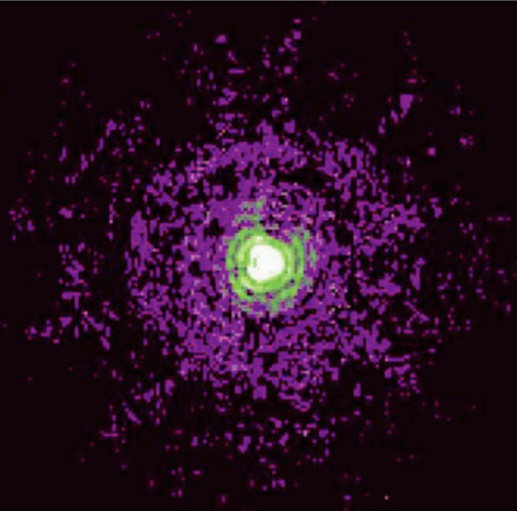
Telescope Size and Angular Resolution
The rings in this image of a star come from interference of light waves.
This limit on angular resolution is known as the diffraction limit.

Slide 12
Question
Suppose two stars are separated in the sky by 0.1 arc-second. If you look at them with a telescope with an angular resolution of 0.01 arcsecond, what do you see?
a) two distinct stars
b) one point of light that is the blurred image of both stars
c) nothing at all
vote!

Slide 13
Answer
Suppose two stars are separated in the sky by 0.1 arc-second. If you look at them with a telescope with an angular resolution of 0.01 arcsecond, what do you see?
a) two distinct stars
b) one point of light that is the blurred image of both stars
c) nothing at all
vote!

Slide 14
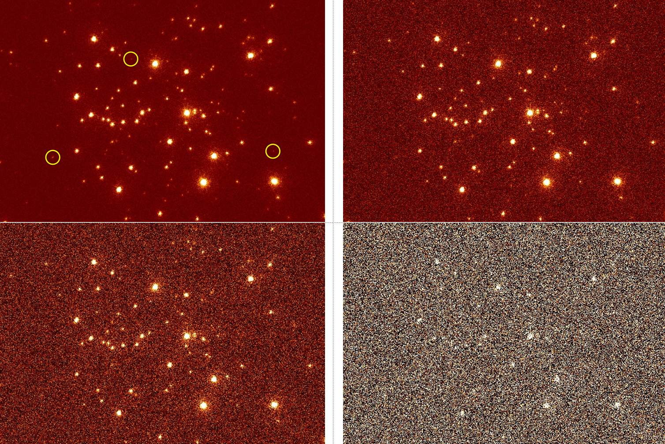
Telescope Size and SNR
The ability to detect an object with a telescope is related to the signal to noise ratio (SNR).
The higher the SNR, the easier it is to detect the object.
In source shot noise limited case, SNR goes as telescope diameter.
For faint sources, i.e., read noise limited case, SNR goes as telescope diameter squared.

Slide 15
Bending light

Slide 16
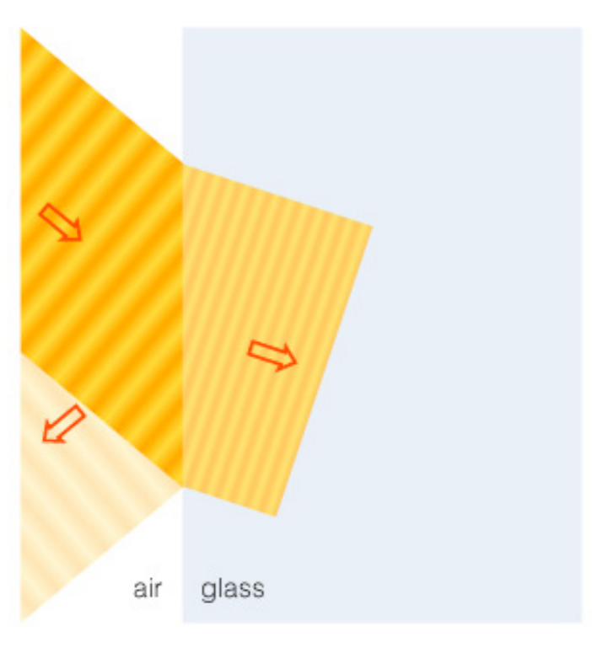
Refraction
Refraction is the bending of light when it passes from one substance into another
Your eye uses refraction to focus light

Slide 17
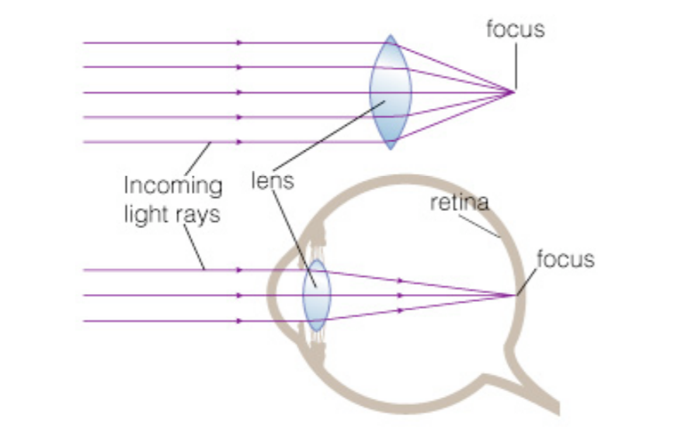
Focusing Light
Refraction can cause parallel light rays to converge to a focus

Slide 18
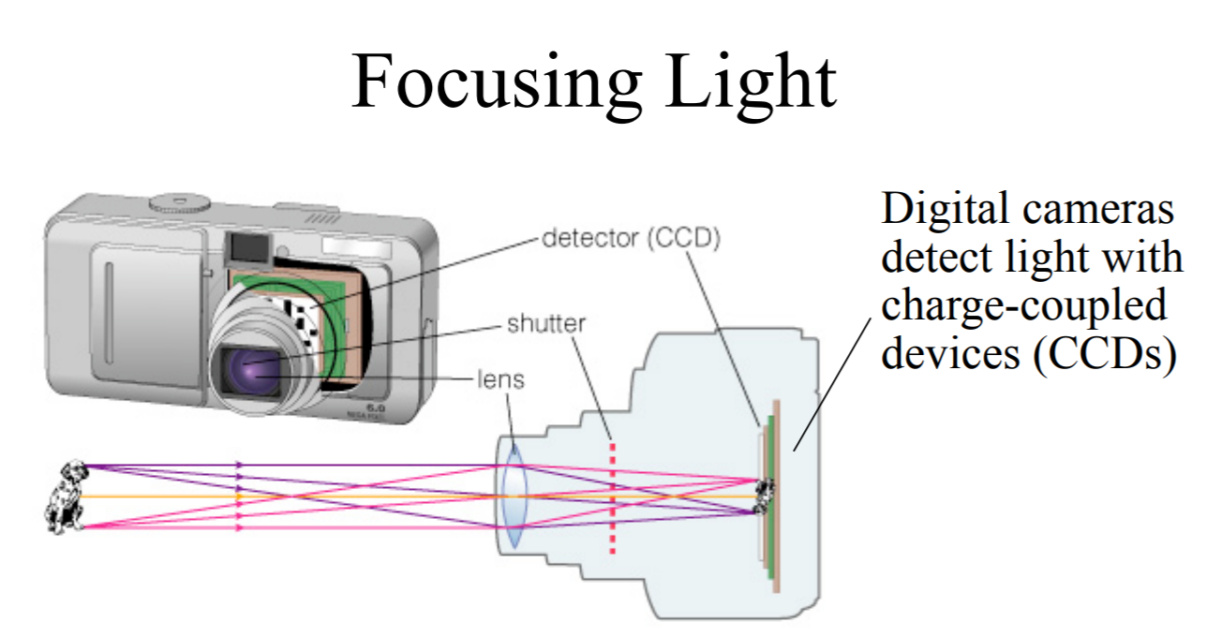
Digital Cameras
A camera focuses light like an eye and captures the image with a detector
The CCD detectors in digital cameras are similar to those used in modern telescopes

Slide 19
refracting and reflecting telescopes

Slide 20
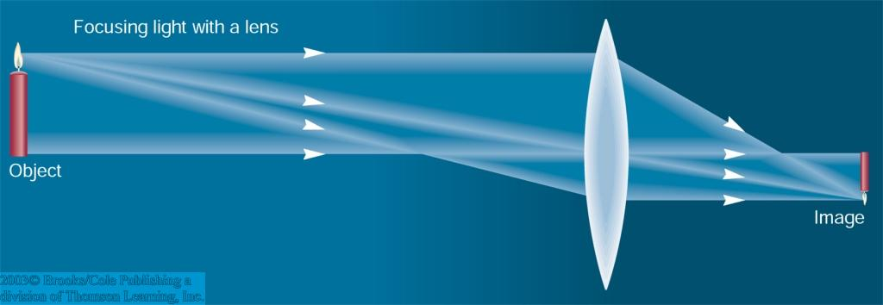
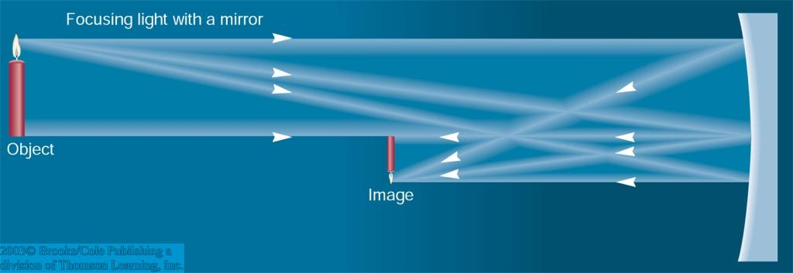
Refracting/Reflecting Telescopes
Refracting Telescope: Lens focuses light onto the focal plane.
Reflecting Telescope: Concave mirror focuses light onto the focal plane.
Almost all modern telescopes are reflecting telescopes.

Slide 21
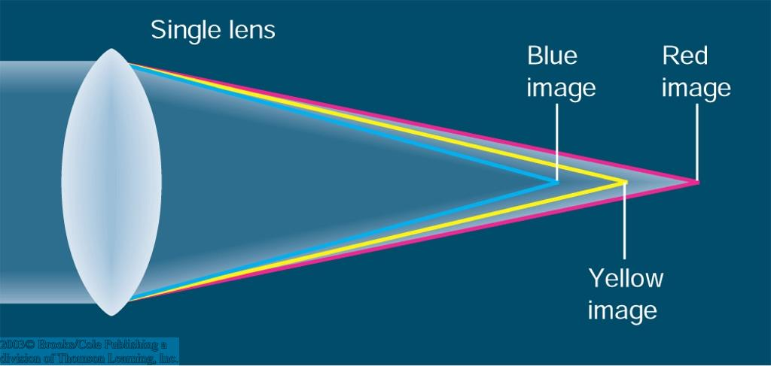
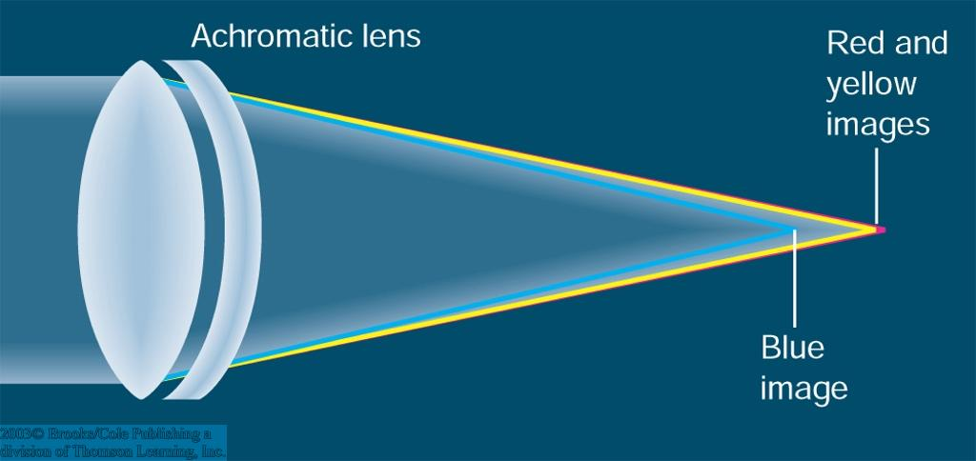
Disadvantages of Refracting Telescopes
Their lenses sag.
They need long tubes.
Chromatic aberration: Different wavelengths are focused at different focal lengths (prism effect).
Can be corrected, but not eliminated by second lens out of different material.
Difficult and expensive to produce: All surfaces must be perfectly shaped; glass must be flawless; lens can only be supported at the edges

Slide 22
Reflecting Telescopes
Most modern telescopes use mirrors, they are “reflecting telescopes.”
Chromatic aberrations eliminated, i.e. they are “achromatic.”
Fabrication techniques continue to improve.
Mirrors may be supported from behind.
Mirrors may be light-weighted, and thus may be made much larger than refractive lenses.

Slide 23
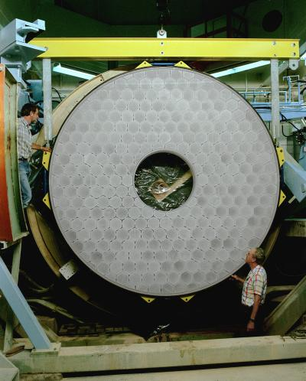
Lightweight Mirrors
Telescope primary mirrors can be made lighter by removing material from the back.
Once made thinner, the mirrors can easily be deformed by pushing on the back side.
These mirrors are easier to point and reach thermal equilibrium more quickly.

Slide 24
optical configurations

Slide 25
Basic Designs of Optical Reflecting Telescopes
Prime focus: light focused by primary mirror alone
Newtonian: use flat, diagonal secondary mirror to deflect light out side of tube
Cassegrain: use convex secondary mirror to reflect light back through hole in primary
Nasmyth (or Coudé) focus (coudé ⇒ French for “bend” or “elbow”): uses a tertiary mirror to redirect light to external instruments (e.g., a spectrograph)

Slide 26
Prime Focus
Sensor
F
Mirror diameter must be large to ensure that
obstruction does not cover a significant fraction of
the incoming light.

Slide 27
Newtonian Reflector
Sensor

Slide 28
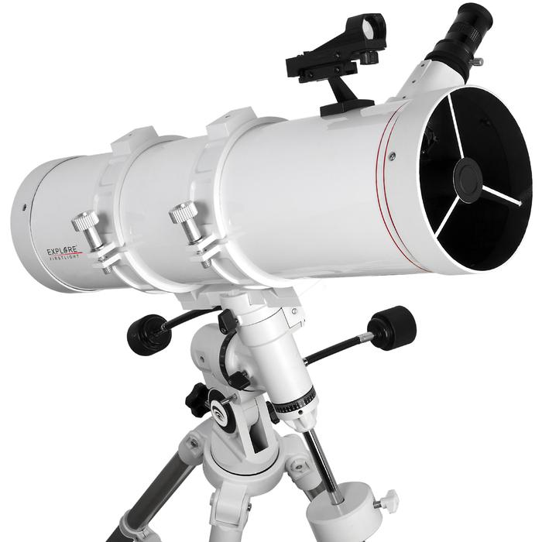
Newtonian Reflector

Slide 29
Cassegrain Telescope
Sensor
Secondary
Convex Mirror

Slide 30
Feature of Cassegrain Telescope
Long Focal Length in Short Tube
f
Location of
Equivalent Thin Lens
Tube

Slide 31
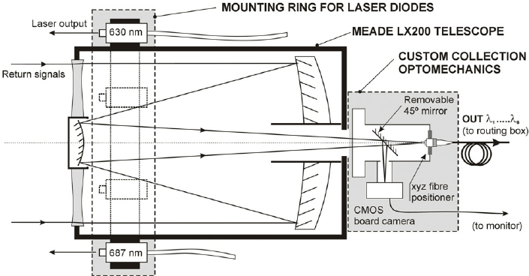
Schmidt-Cassegrain Telescope

Slide 32
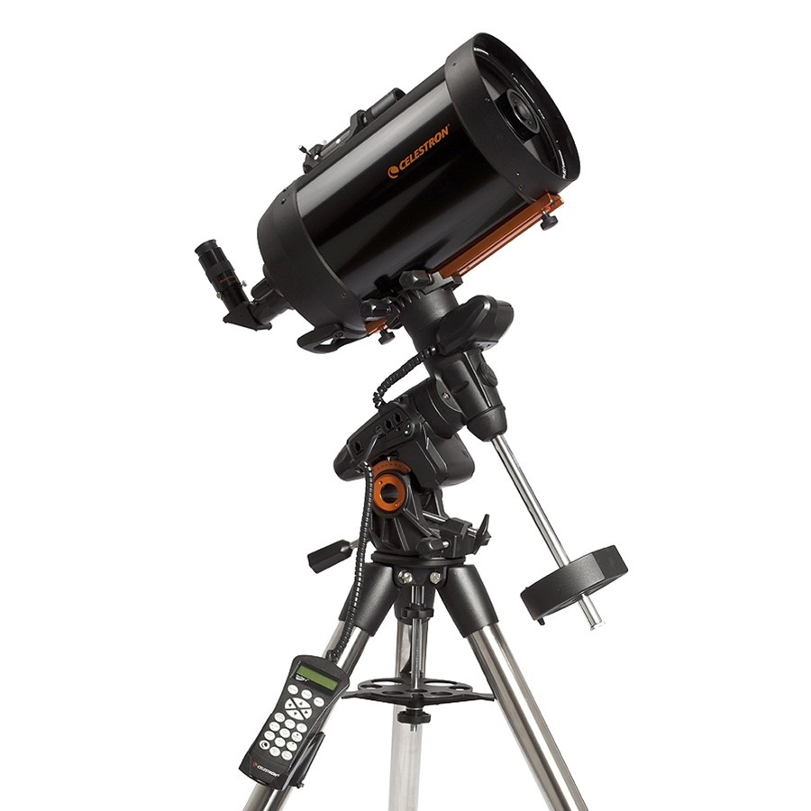
Schmidt-Cassegrain Telescope

Slide 33
Coudé or Nasmyth Telescope
Sensor

Slide 34
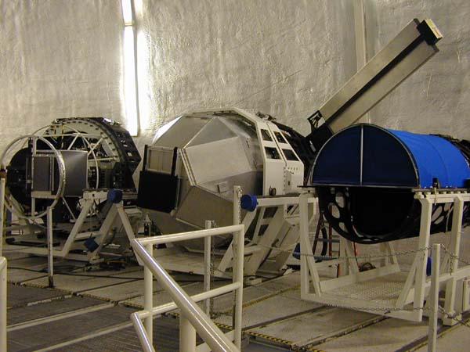
Nasmyth Mount

Slide 35
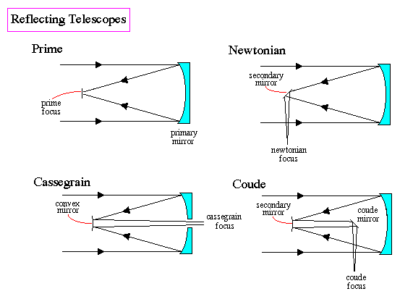
Reflecting Telescopes

Slide 36
Plate Scale
θ
x
F=focal length

Slide 37
Field of View
Two telescopes with same diameter, different F#, and same detector have different “Fields of View”:
large Δθ
small Δθ
Small F#
Large F#

Slide 38
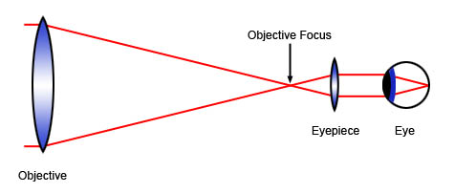
Eyepieces

Slide 39
big telescopes

Slide 40
Big Telescopes
Collecting power scales as the square of the diameter, so big telescopes can see fainter things.
The ability to see fine detail scales as the diameter of the telescope, so bigger telescopes can see objects that are closer together (although, the atmosphere can mess that up).
Because of these two factors, astronomers always want to build bigger telescopes.

Slide 41
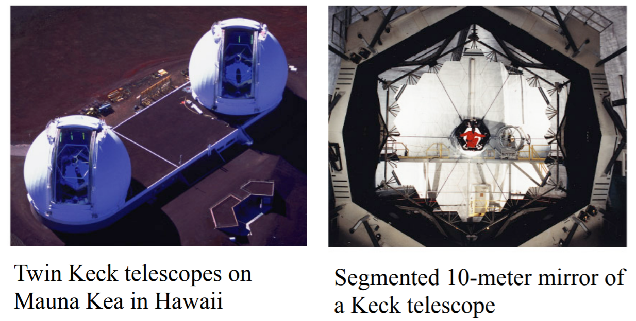
Big Telescopes Sometimes have Segmented Mirrors

Slide 42
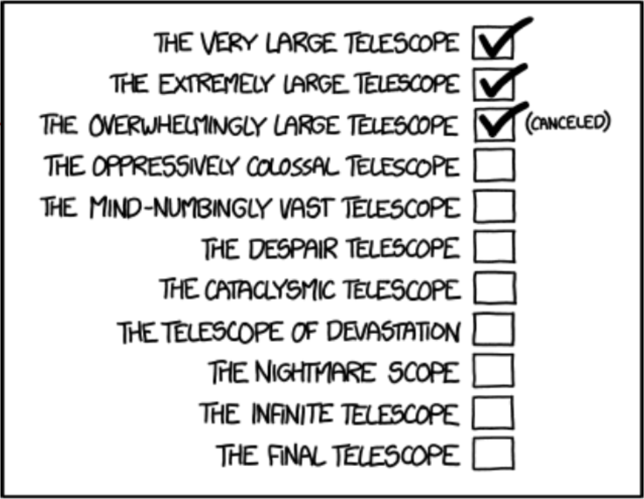
Big Telescopes Have Absurd Names

Slide 43
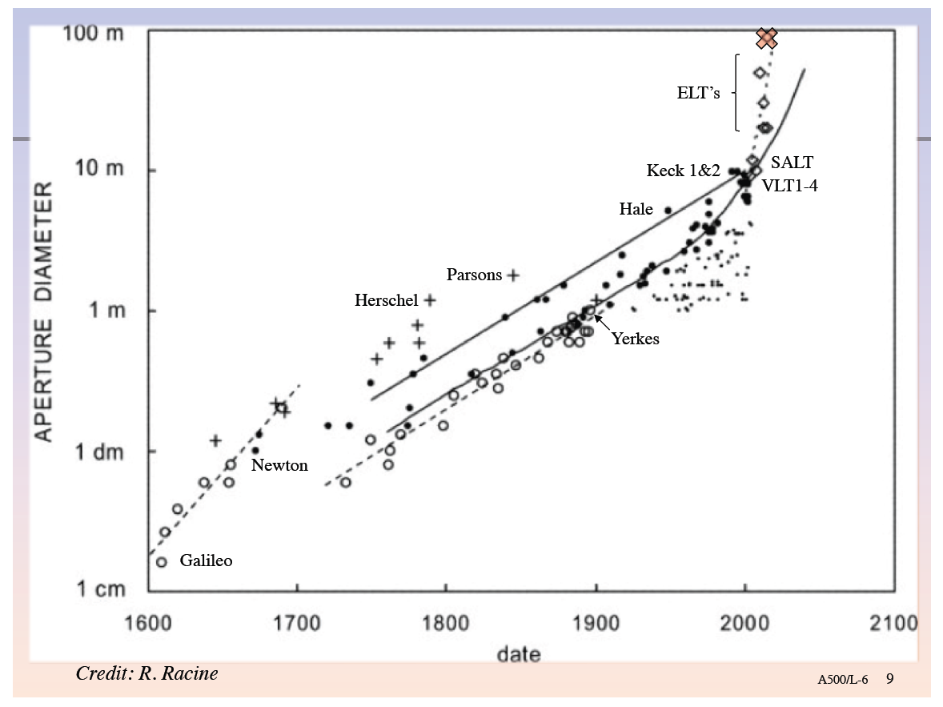
History and Future of Telescope Size

Slide 44
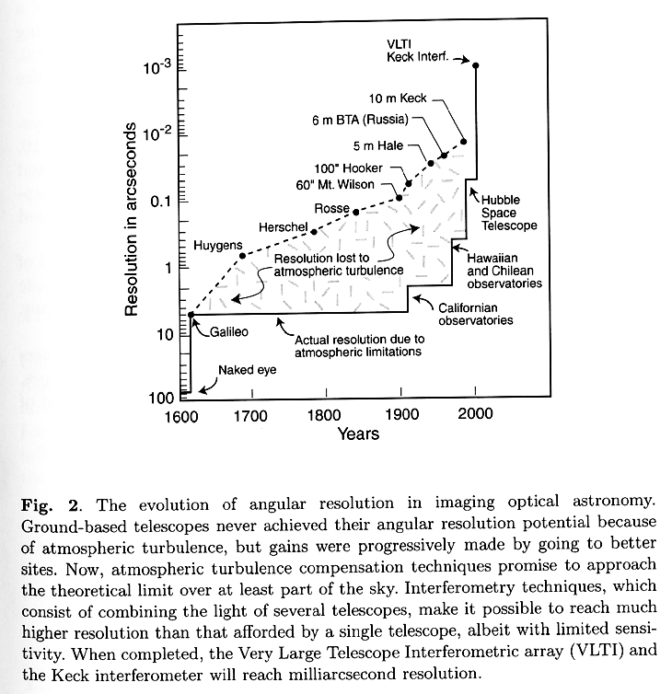
Optical Telescopes: Resolution

Slide 45
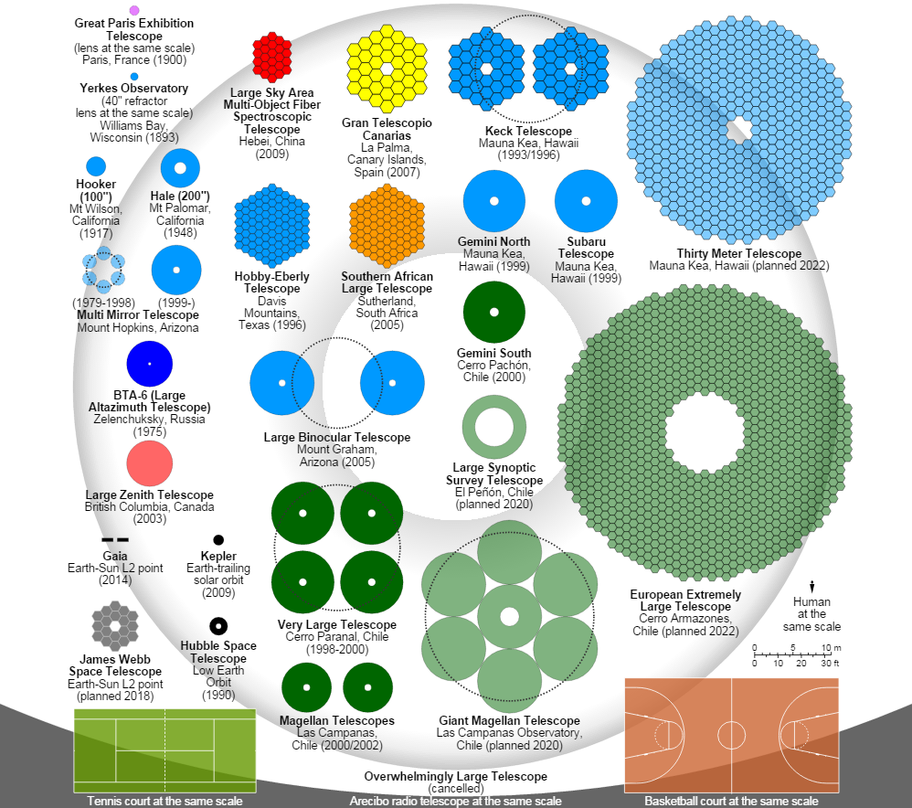
Optical Telescopes: Collecting Area
Notes:
ORM is now the Gran Canary Telescope (GTC).

