Slide 1
University Astronomy
Professor Don Figer
Cosmology

Slide 2
Aims and outline for this lecture
describe cosmological observations (23.1)
describe the big bang theory and its predictions (24.3)
show evidence for acceleration of the Universe (24.1)
speculate on fate of the Universe

Slide 3
what is cosmology?

Slide 4
Definition of Cosmology
Cosmology is the study of the Universe. More precisely it is the study of causes and effects related to the largest structures in the Universe.
  formation of matter/energy (from subatomic particles)
  distribution of matter/energy (into galaxies)
  evolution of matter/energy (from subatomic particles to heavy elements in stars)
The word cosmology comes from the Greek words “kosmo” (world) and “logia” (study of).
Motivating questions include:
  Was there a beginning to the Universe?
  Will there be an end to the Universe?
  Why does matter exist?

Slide 5
Elements of Cosmology
spatial extent
  finite (with edges)
  finite (unbounded)
  infinite
our location
  Earth at center
  Sun at center
  solar system near center
  solar system far from center
  no center
history
  both finite
  (creation, future destruction)
  both infinite
  (no beginning, no end)
  finite past, infinite future
motion
  static
  expanding
  cyclic

Slide 6
history of cosmology

Slide 7
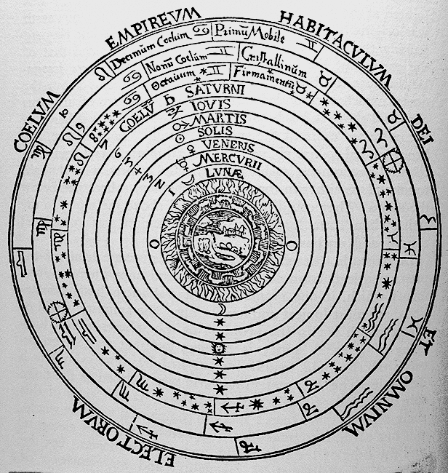
Aristotle’s Cosmology

Slide 8
History of Cosmology to Newton
Ptolemy thought that the Earth was the center of Universe that orbited around it.
Copernicus thought that the Sun was center of the Universe.
Newton proposed that celestial bodies obeyed the law of gravitation, just as do bodies on Earth.

Slide 9
Newtonian Cosmology
Newton’s Philosophiae Naturalis Principia Mathematica, 1687
Newtonian gravity, F = GMm/r², and second law, F = ma
Approximate size of solar system from parallax of Mars (Cassini, 1672)
Finite speed of light from timing of Jupiter’s moons (Ole Rømer, 1676)
Did not have distances to stars
Did not know about galaxies

Slide 10
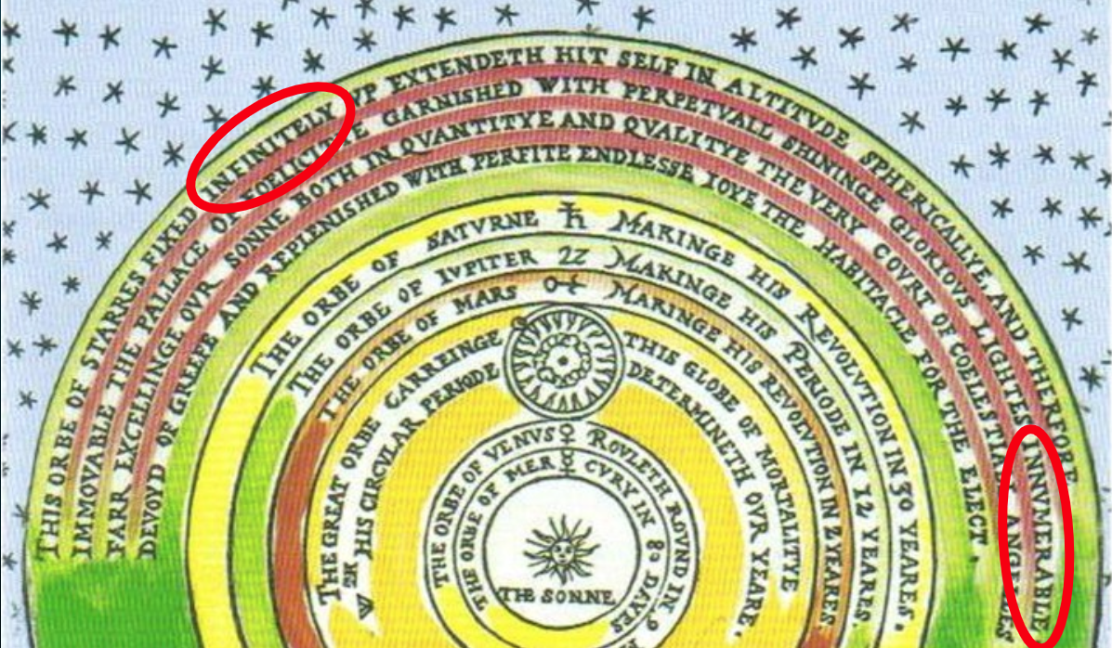
It’s Full of Stars

Slide 11
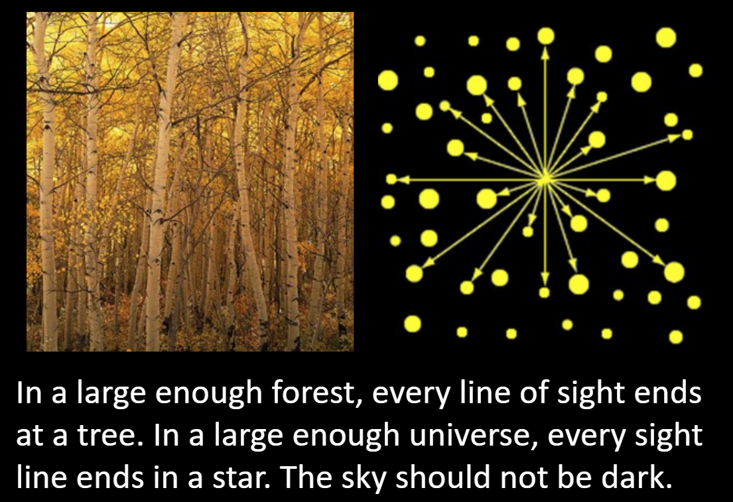
Should the Night Sky be Dark?

Slide 12

Olbers’ Paradox
Heinrich Olbers wrote a paper in 1826 asking why the night sky is dark.
An infinite number of stars should produce an infinitely bright night (and day!) sky.
The resolution comes from the fact that there aren’t an infinite number of stars that we can see and that some of the starlight is redshifted.
This is one of the earliest cosmological observations.

Slide 13
History of Cosmology to Shapley
Einstein extended Newton’s idea by proposing that all laws of nature are the same everywhere. This means that the speed of light is constant.
de Sitter, Schwarzschild, Eddington, and Friedmann introduced an expanding/accelerating Universe with matter in it.
Shapley thought the Universe consisted only of just the Milky Way, but Curtis disagreed (and was right).

Slide 14
History of Cosmology to Now
Lemaitre proposed the Big Bang Theory (but not the TV show, thus severely limiting his royalties/residuals).
Hubble discovered his redshift-distance law.
Penzias and Wilson discovered background radiation leftover from the Big Bang, but thought it was bird poop at first.
It was not poop, so they won a Nobel Prize!
COBE measured the background radiation – another Nobel Prize!
Schmidt, Riess, and Perlmutter detected that the expansion of the Universe is increasing – another Noble Prize!

Slide 15
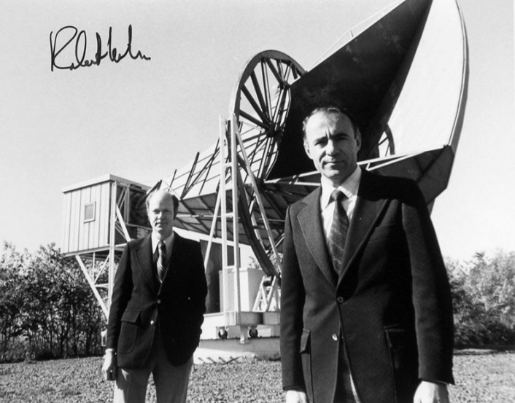
Penzias and Wilson

Slide 16
cosmic microwave background

Slide 17
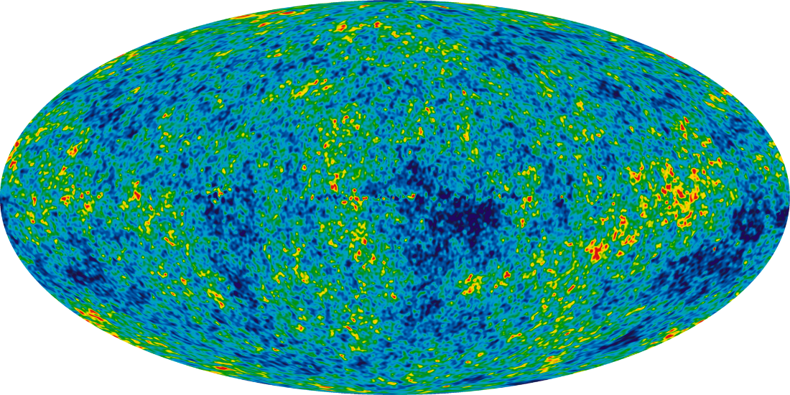
CMB
The Cosmic Microwave Background (CMB) is background radiation observed from all directions in the sky.
Penzias and Wilson found it in 1965.
The radiation is fit by a black body with T=2.725 K.
The average energy of a CMB photon is ~meV and the peak wavelength is ~1 mm.

Slide 18
Recombination
At one point in the early Universe, the temperature was high enough so that all the hydrogen was ionized.
This means that the Universe was flooded with free electrons.
Free electrons scatter photons, so the photons were constantly being redirected.
The effect of this is that the Universe was opaque.
At a certain temperature (~3,000 K), the electrons and protons recombined.
Thus, the Universe became transparent.
At this point, photons “decoupled” from matter and freely traveled to space, where we now see them as the cosmic microwave background (redshifted to mm wavelengths).

Slide 19
Last Scattering
The CMB photons that we now see were last scattered at the time of recombination.
This corresponds to a redshift of 1,100.
According to the most accepted model, the Universe was about 400,000 years old at this time.

Slide 20
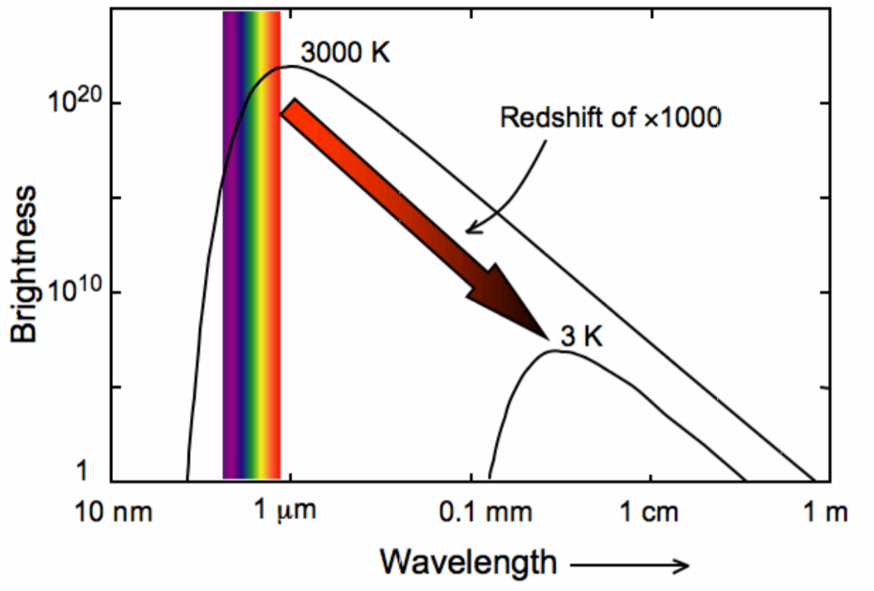
CMB Cooling

Slide 21
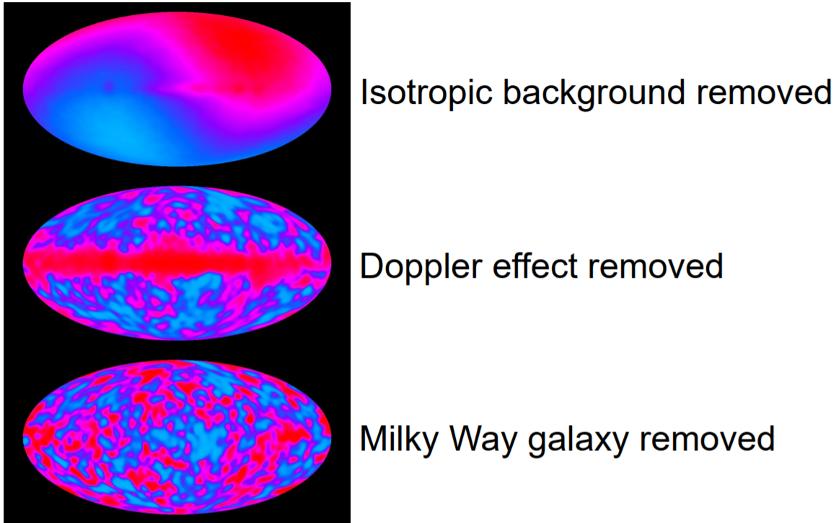
COBE Map

Slide 22
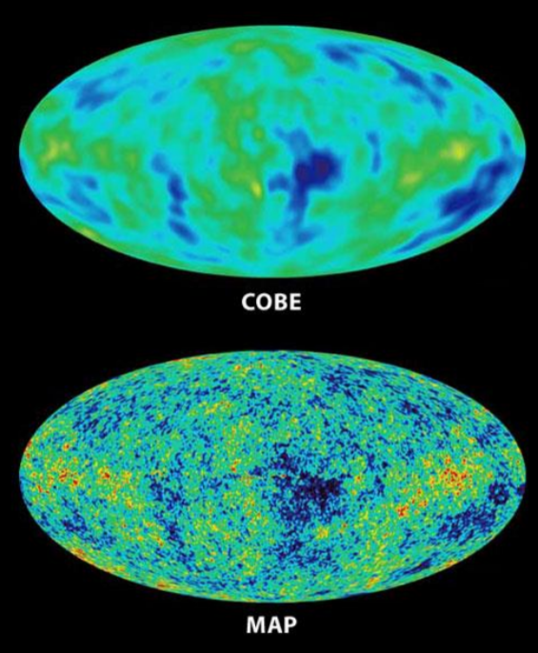
WMAP vs. COBE

Slide 23
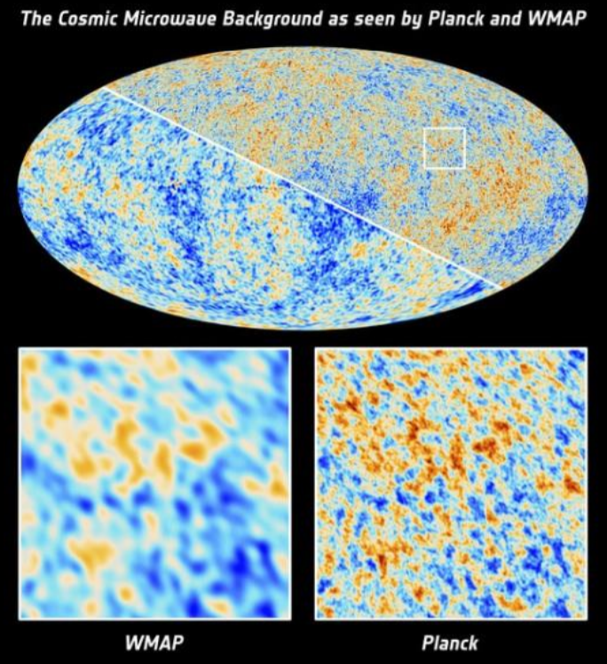
Planck vs. WMAP

Slide 24
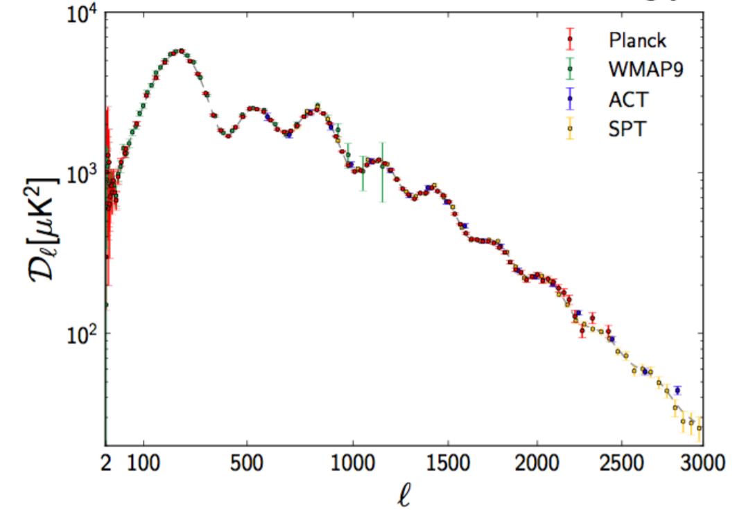
Acoustic Oscillations

Slide 25
Expansion of the Universe and the big bang theory

Slide 26
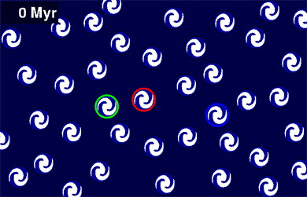
The Universe is Expanding

Slide 27
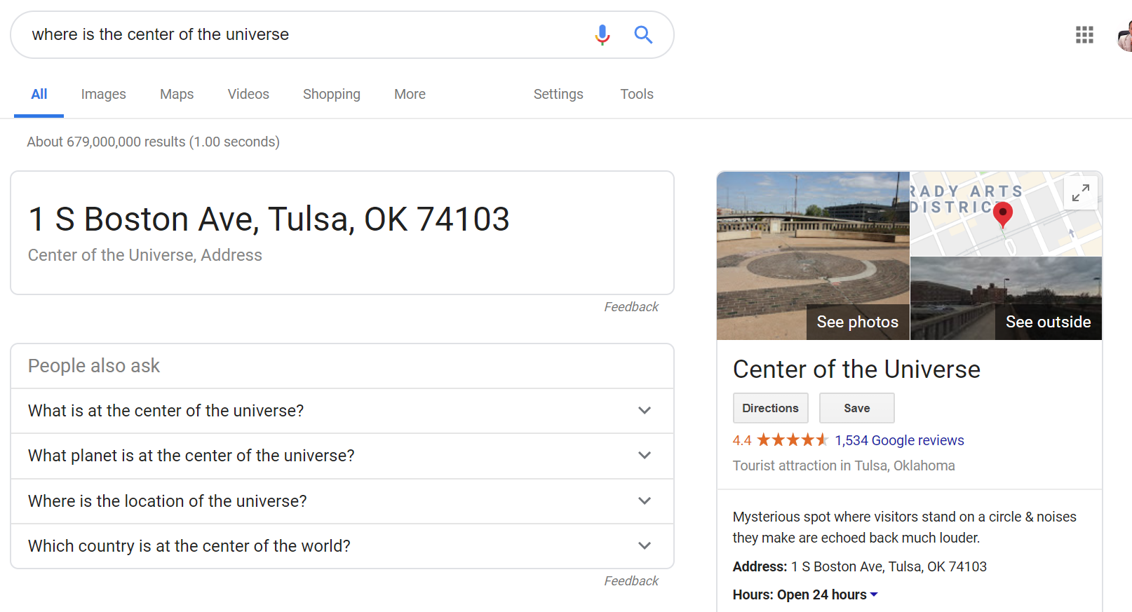
Center of the Universe

Slide 28
Galactic Redshifts

Slide 29
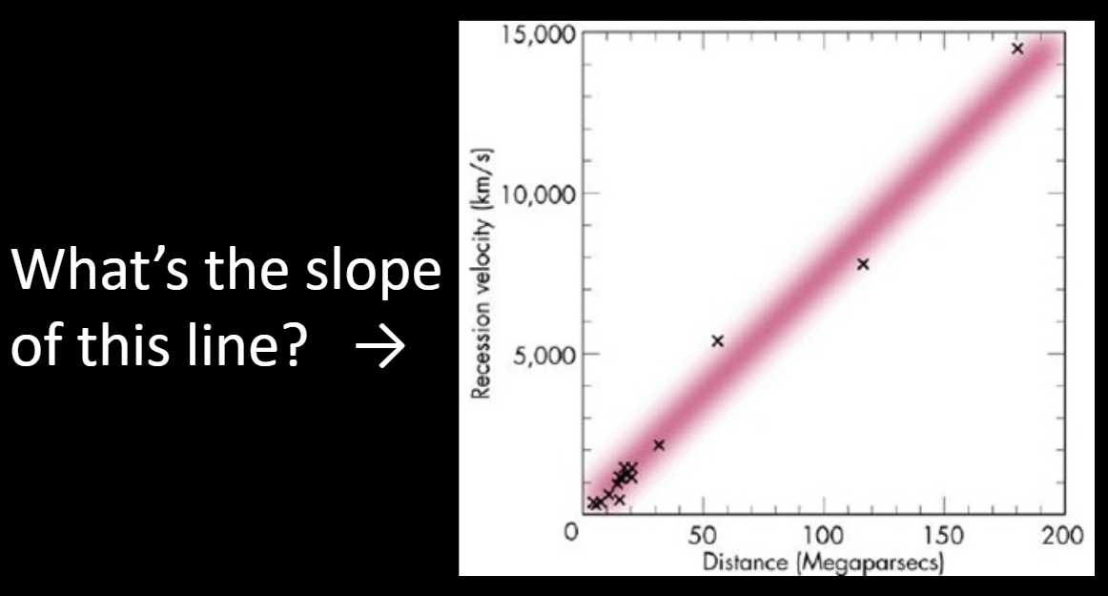
Hubble’s Plot – Bigger Scale

Slide 30
Hubble’s Law
Hubble estimated distances to galaxies in his sample (underestimating them considerably) and saw that the velocities were proportional to the distances.
Hubble’s law is the relationship between distance and redshift for a galaxy.
Recall that redshift is z=Δλ/λ₀=v/c.
The law is cz=H₀d=v, where c is the speed of light, H₀ is “Hubble’s constant,” and d is the distance to the galaxy.
H₀ is ~70 +/-5 km/s/Mpc.
(There appears to be a discrepancy between estimates for the Hubble Constant from two different methods, but they are similar to within ~5%.)

Slide 31
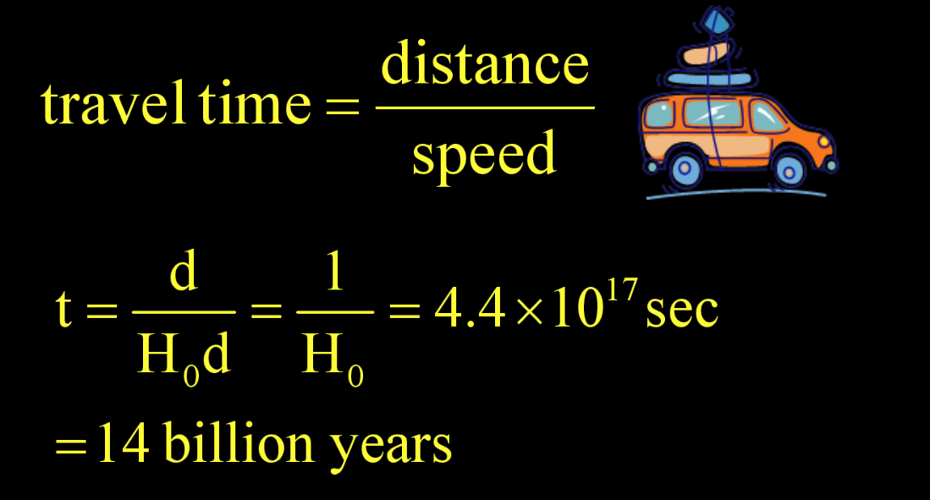
How Long Ago Were Galaxies Touching?

Slide 32
Big Bang
This calculation is the basis for a “big bang” theory.
That is, by projecting the expansion backward, we can imagine that there was a time when all matter was in a dense state.
We call the quantity, 1/H₀ the “Hubble time.”
It is the approximate age of the Universe.

Slide 33
big bang nucleosynthesis

Slide 34
Big Bang Nucleosynthesis
The Universe was so hot around the time of the Big Bang that atomic nuclei did not exist.
Matter existed as a sea of protons and neutrons.
This matter built up light elements as it cooled (allowing protons and neutrons to recombine).
The standard model predicts that the Big Bang produced 75% H and 24% He and very little of anything else.
Those ratios are generally observed, representing a great success for the Big Bang standard model.

Slide 35
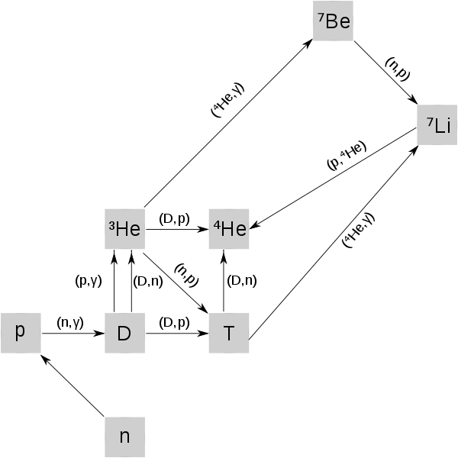
BBN Reactions

Slide 36
BBN Nuclei (Figure 24.9)

Slide 37
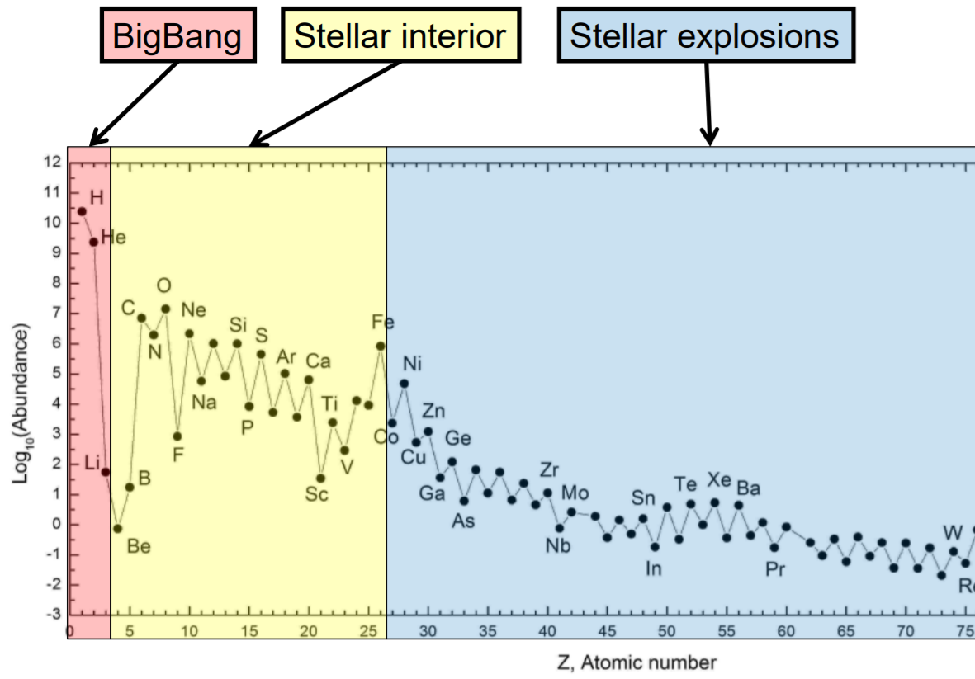
Abundance Observations

Slide 38
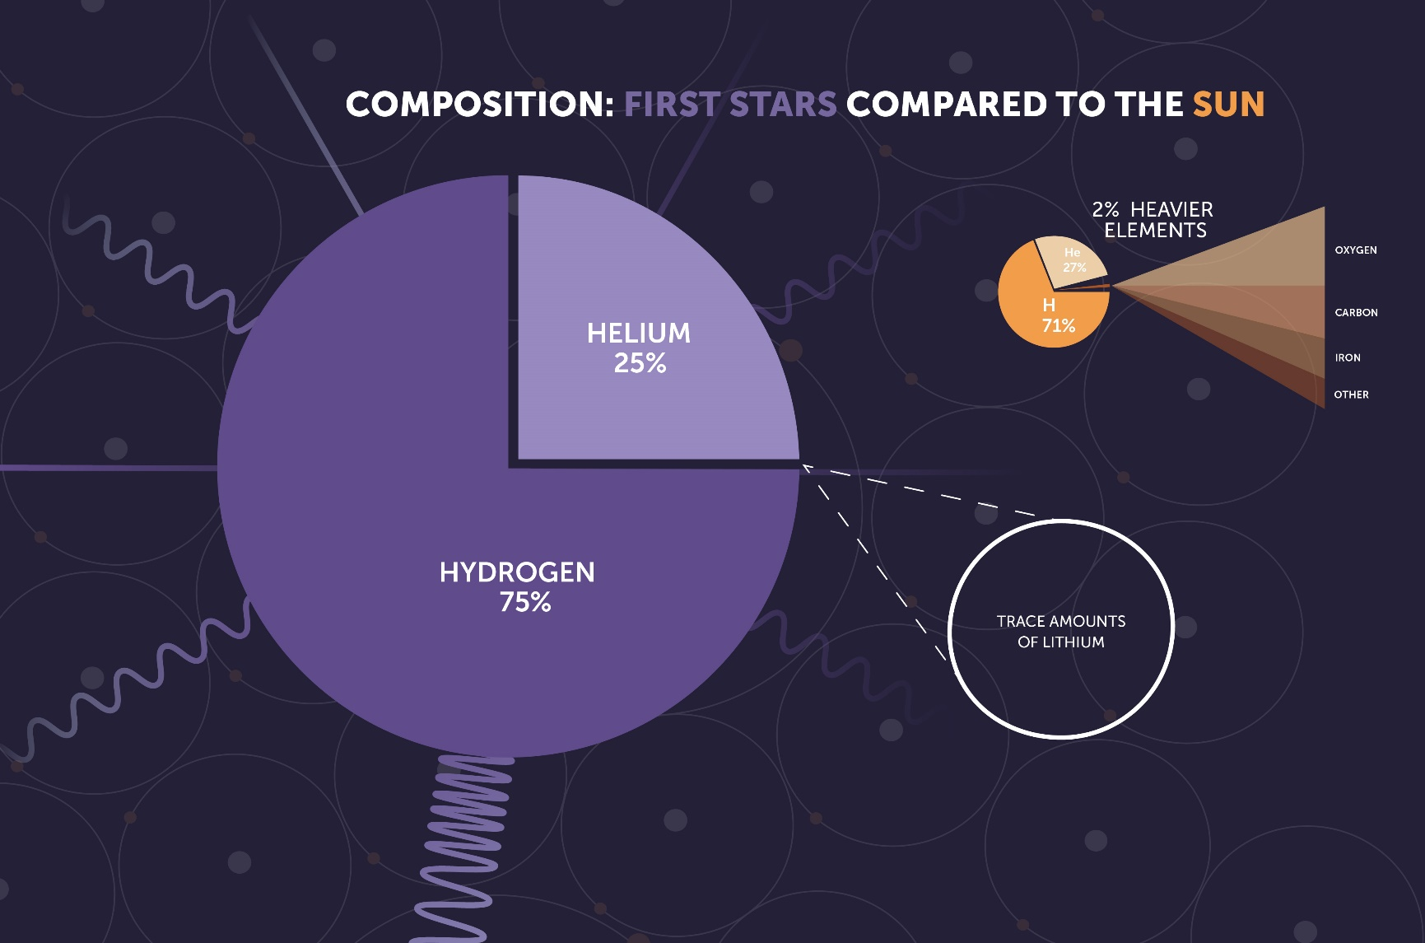
The First Stars

Slide 39

You Are Big Bang and Stars

Slide 40
acceleration of the universe

Slide 41
Acceleration
The universe is expanding at a higher rate with time.
This effect was discovered during 1998, by two independent projects, the Supernova Cosmology Project and the High-Z Supernova Search Team.
Both teams used distant Type Ia supernovae to measure the acceleration.
The technique measures brightness and z for each supernova. Assuming that Type Ia are the same everywhere (“standard candle”), then the distance modulus should simply be a function of distance. If z is only a function of distance, then the relation between m-M and z should be linear.
Unexpectedly, the relation is not linear.
Confirmatory evidence has been found in baryon acoustic oscillations, and in analyses of the clustering of galaxies.
The accelerated expansion of the universe is thought to have begun since the universe entered its dark-energy-dominated era roughly 5 billion years ago.

Slide 42

Dark Energy
“Dark Energy” is the name given to the “thing” that is causing the Universe to accelerate.
Einstein originally included it in his equations, but set it to zero, presuming that such a thing could not exist.
Dark energy makes up the majority of the energy in the Universe.
It is generally labelled as capital lambda, “Λ.”
Perlmutter, Riess, Schmidt win Nobel Prize.

Slide 43
SNe Ia Observations
best fit
z~v/c

Slide 44
Consensus Fit

Slide 45
history of the universe

Slide 46
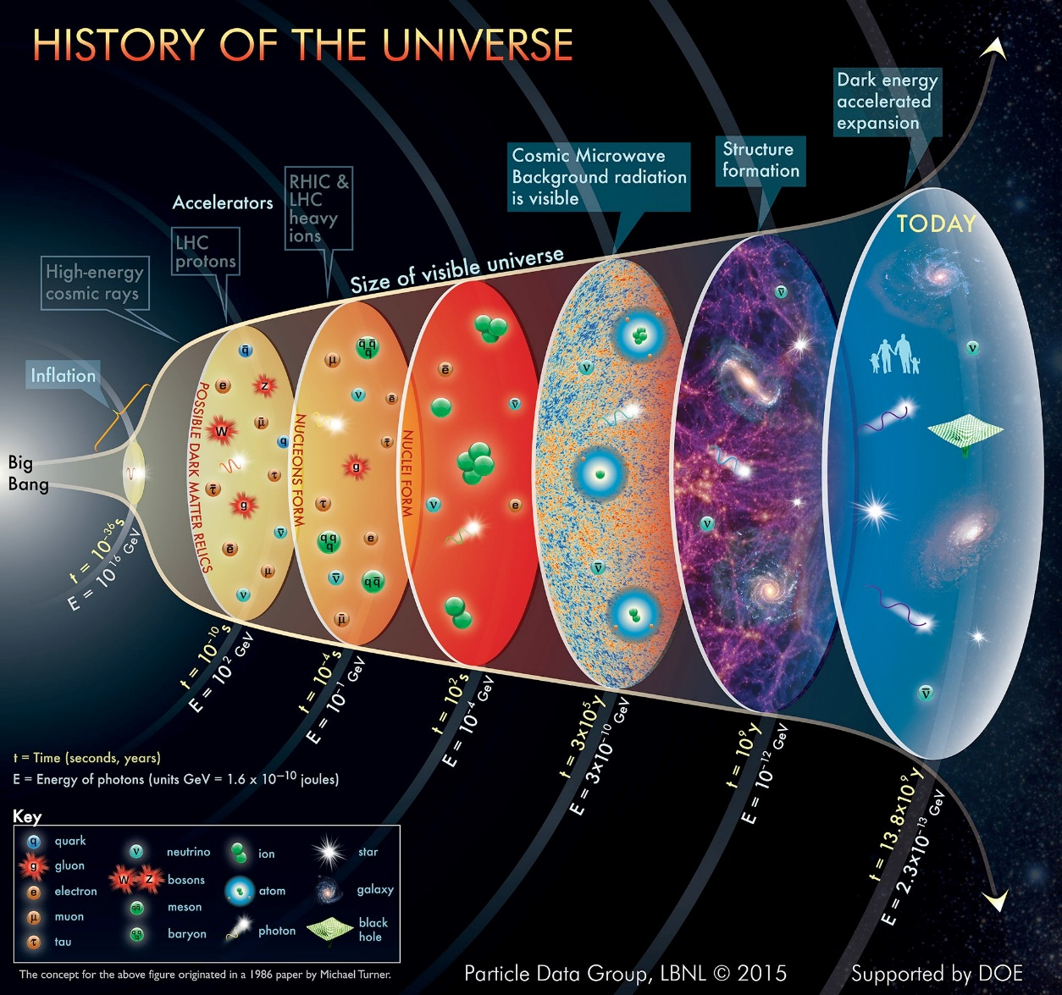
History Graphic

Slide 47
Galaxies in Early Universe

Slide 48
fate of universe

Slide 49
The End of Days
The Universe could expand forever or it could stop expanding at some point and collapse on itself (the “Big Crunch”).
It is similar to what you might expect for a ball thrown up in the air. Either it has enough energy to overcome gravity and fly away forever, or it doesn’t, in which case it falls back down.
If there is enough matter in the Universe, then it will collapse.
Dark Energy provides a repulsive force that suggests that the Universe will expand forever.

Slide 50
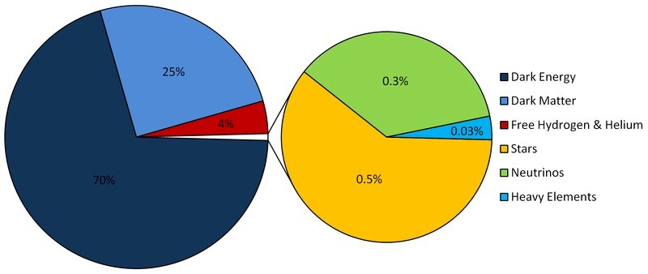
Present-Day Fractions

Slide 51
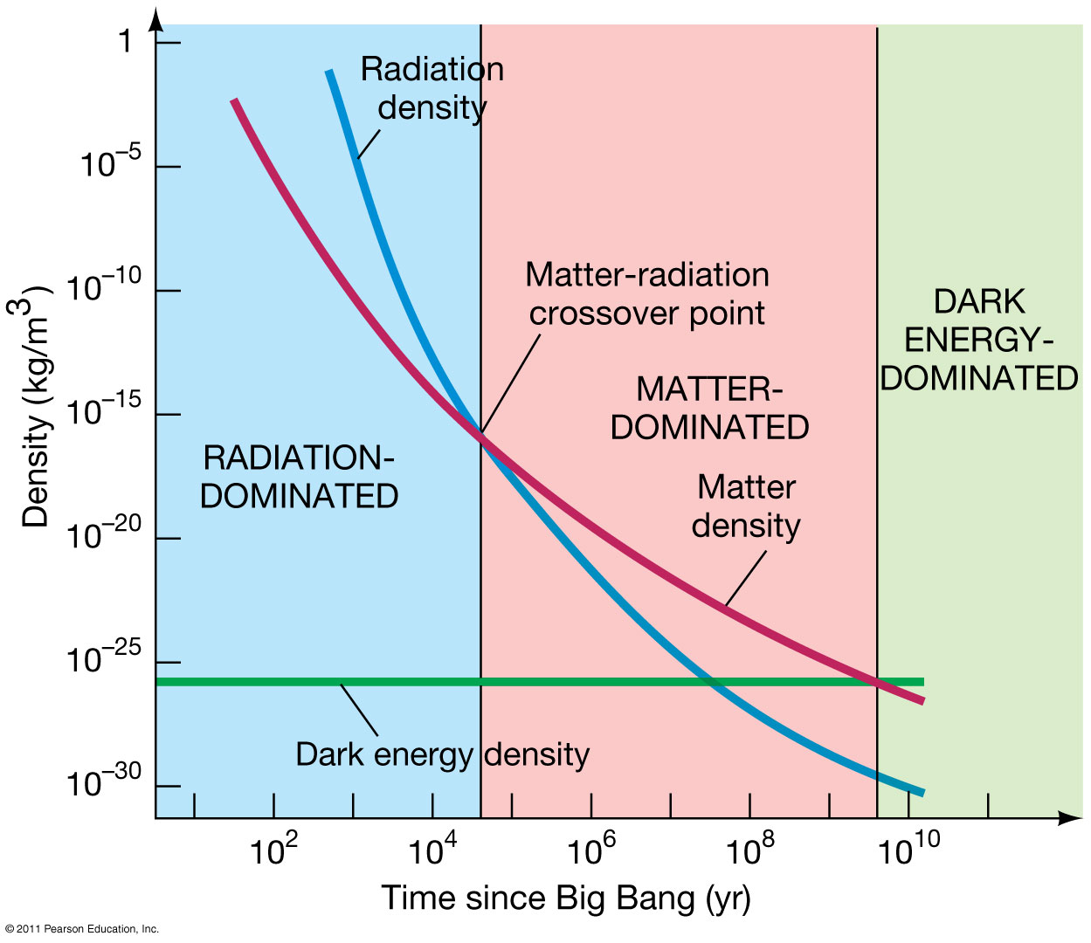
Energy Density vs. Time

Slide 52
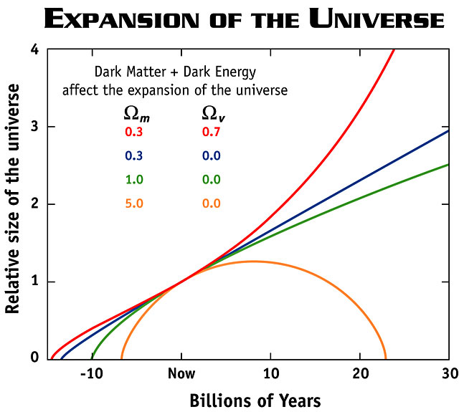
Expansion Forever
Dark energy suggests that the Universe will expand forever.
This case corresponds to the red curve, where the fractional matter density is 0.3 and dark energy density is 0.7.
The yellow curve represents the case where there is enough matter to force the Universe to collapse.

