Slide 1
University Astronomy
Professor Don Figer
Instruments and Detectors II

Slide 2
Lecture Outline
Photon Detection in PN Junctions
  review semiconductors
  PN Junction
  charge collection in PN junctions
Review of CCDs
  definition
  design
  operation
  performance
Review of Infrared CMOS Detectors

Slide 3
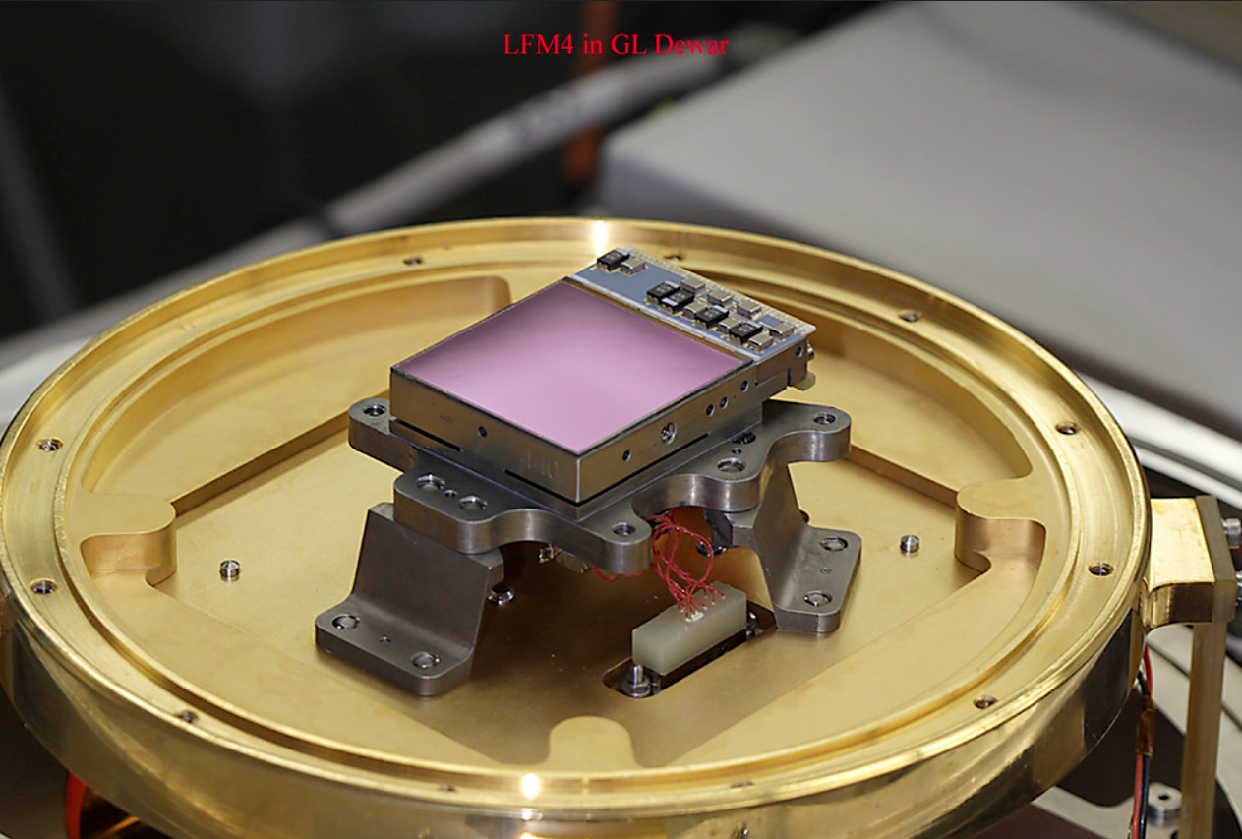
What do Detectors do?
Convert a physical phenomenon into a signal
Store the signal
Read the signal

Slide 4
semiconductors and pn junctions

Slide 5
Semiconductor Detectors
Convert light into free electrons
Store the free electrons in PN junctions
Transduce the electrons into voltage

Slide 6
Semiconductors
A conductor has free (unbound) electrons that can flow in the presence of an electric field.
An insulator impedes the flow of electrons.
A semiconductor becomes a conductor if the electrons are excited to high enough energies, otherwise it is an insulator.
  allows for a “switch” which can be on or off
  allows for photo-sensitive circuits (photon absorption adds energy to electron)
Minimum energy to elevate an electron into the conduction band is the “band gap energy”

Slide 7
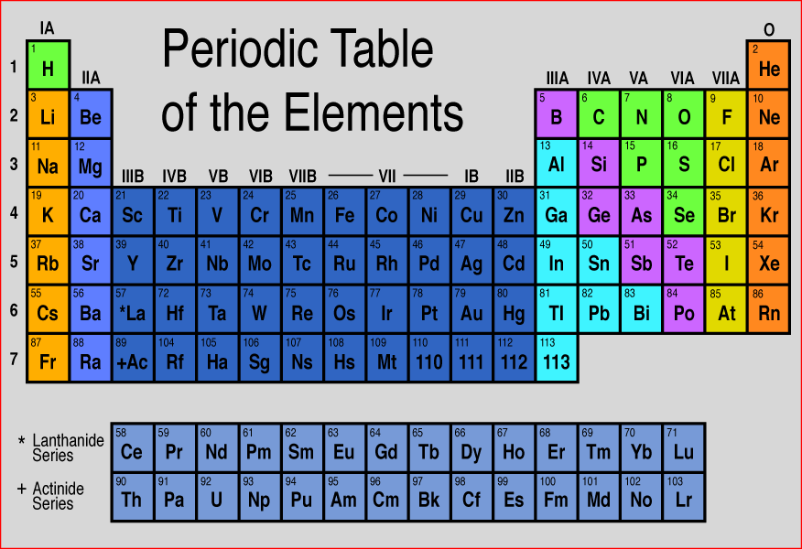
Periodic Table
Semiconductors occupy column IV of the Periodic Table.
Outer shells have four empty valence states.
An outer shell electron can leave the shell if it absorbs enough energy.

Slide 8
Simplified Silicon Band Diagram
Conduction band
E_{g} bandgap
um
Valence band

Slide 9
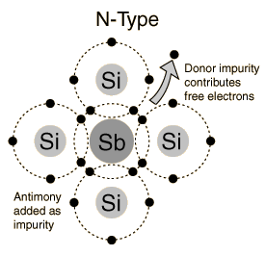
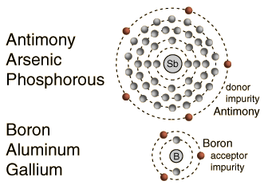
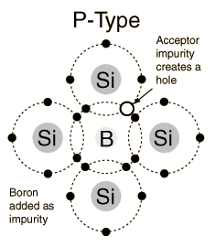
Semiconductor Dopants

Slide 10
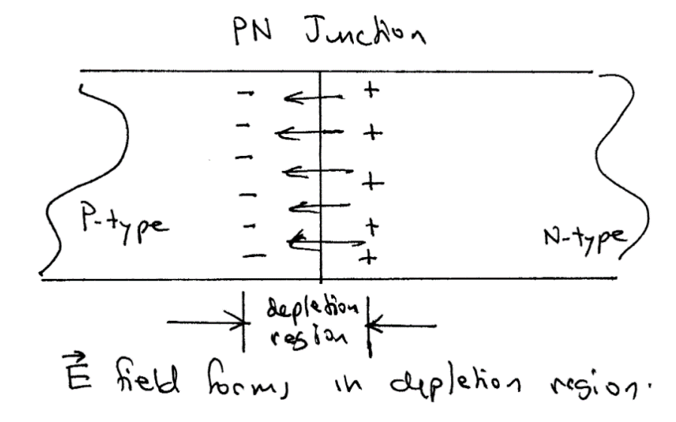
PN Junctions
In a PN junction, positively charged holes diffuse into the n-type material. Likewise, negatively charged electrons diffuse into the p-type material.
This process is halted by the resulting E-field.
The affected volume is known as a “depletion region”.
The charge distribution in the depletion region is electrically equivalent to a 2-plate capacitor.

Slide 11
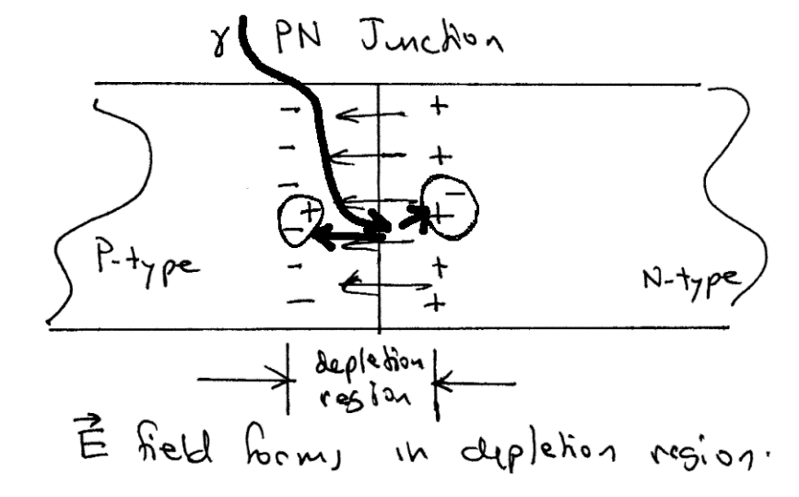
Photon Detection in PN Junctions
A photon can interact with the semiconductor to create an electron-hole pair.
The electron will be drawn to the most positively charged zone in the PN junction, located in the depletion region in the n-type material.
Likewise, the positively charged hole will seek the most negatively charged region.
Each photon thus removes one unit of charge from the capacitor. This is how photons are detected in both CCDs and most IR arrays.

Slide 12
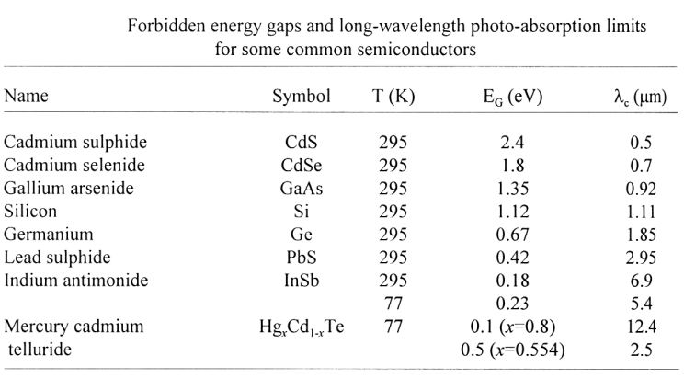
The Band Gap Determines the Red Limit

Slide 13
ccds

Slide 14
CCD Definition
A CCD is a two-dimensional array of metal-oxide-semiconductor (MOS) capacitors.
The charges are stored in the depletion region of the MOS capacitors.
Charges are moved in the CCD circuit by manipulating the voltages on the gates of the capacitors so as to allow the charge to spill from one capacitor to the next (thus the name “charge-coupled” device).
An amplifier provides an output voltage that can be processed.
The CCD is a serial device where charge packets are read one at a time.

Slide 15
CCD Pixels
Image area
(exposed to light)
Parallel (vertical) registers
Charge motion
Pixel
Serial (horizontal) register
Output amplifier
masked area
(not exposed to light)
Charge motion

Slide 16
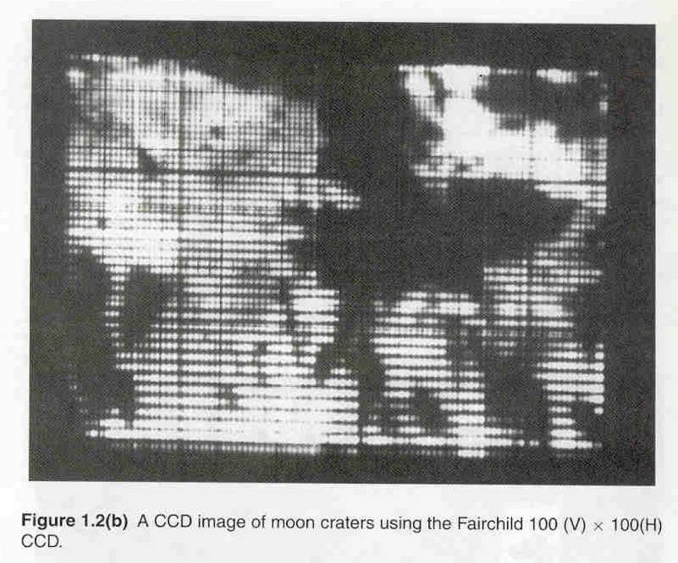
What is This?
Notes:
16

Slide 17
First Astronomical CCD image
1974 on an 8” telescope
Notes:
17

Slide 18
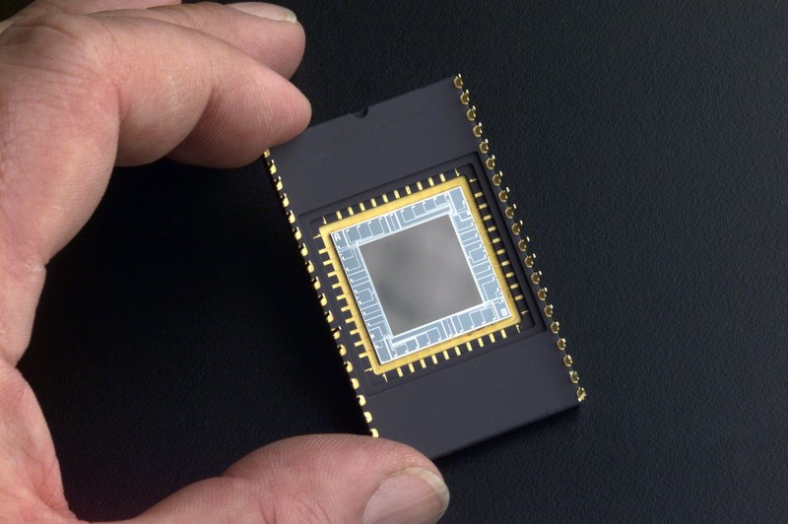
CCD in a Dual-Inline Package
Notes:
Delta-Doped Charged Coupled Devices (CCD) for Ultra-Violet and Visible Detection
CCDs allow scientists to study one of the least explored windows of the electromagnetic spectrum - the extreme ultraviolet. Until recently, scientists believed there was little point to exploring this spectral region. They thought that the mixture of hydrogen gas and other less abundant gases, which fill the space between stars and is commonly called the "interstellar medium," would absorb virtually all extreme ultraviolet radiation before it became detectable from Earth. Consequently, this region became known as the "unobservable ultraviolet."
This is where stable ultraviolet CCDs step in for crucial space and ground-based astronomy to detect younger, hotter objects. Because of the high quantum efficiency of these devices, very faint objects can potentially be observed. Stability of the device makes it possible to gather reliable data in space-based astronomy.
Scientists will learn much more about hot white dwarf stars - extremely dense stars that represent a final stage of stellar evolution - and young massive stars that are characterized by outflowing, shock-heated winds. Moreover, they will learn about cataclysmic variable stars, binary star systems in which the mass of one star is transferred to the other, causing dramatic changes in extreme ultraviolet brightness. They may even have a chance to probe the enigmatic cores of distant galaxies."

Slide 19
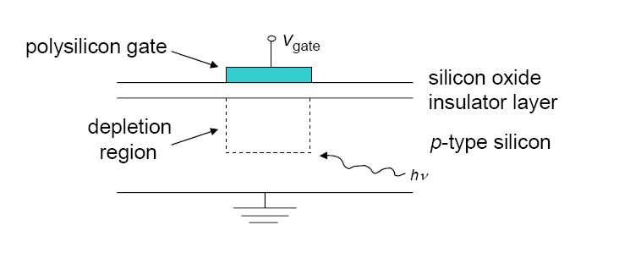
MOS Capacitor Geometry
A Metal-Oxide-Semiconductor (MOS) capacitor has a potential difference between two metal plates separated by an insulator.
Notes:
19

Slide 20
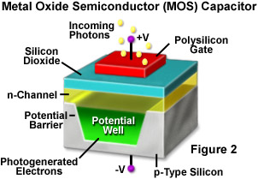
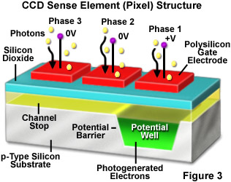
CCD Clocking

Slide 21
Photons entering the CCD create electron-hole pairs. The electrons are then attracted towards the most positive potential in the device where they create ‘charge packets’. Each packet corresponds to one pixel
incoming
photons
pixel
boundary
pixel
boundary
n-type silicon
Electrode Structure
Charge packet
p-type silicon
SiO2 Insulating layer

Slide 22
+5V
0V
-5V
2
+5V
0V
-5V
1
+5V
0V
-5V
3
1
2
3
Time-slice shown in diagram

Slide 23
+5V
0V
-5V
2
+5V
0V
-5V
1
+5V
0V
-5V
3
1
2
3

Slide 24
+5V
0V
-5V
2
+5V
0V
-5V
1
+5V
0V
-5V
3
1
2
3

Slide 25
+5V
0V
-5V
2
+5V
0V
-5V
1
+5V
0V
-5V
3
1
2
3

Slide 26
+5V
0V
-5V
2
+5V
0V
-5V
1
+5V
0V
-5V
3
1
2
3

Slide 27
+5V
0V
-5V
2
+5V
0V
-5V
1
+5V
0V
-5V
3
1
2
3

Slide 28
CCD Performance Metrics
Charge generation
  quantum efficiency (QE)
  dark current
Charge collection
  full well capacity
  pixels size
  pixel uniformity
  defects
  diffusion (Modulation Transfer Function, MTF)
Charge transfer
  charge transfer efficiency (CTE)
  defects
Charge detection
  readout noise (RON)
  linearity

Slide 29
Well Capacity
Spillage
Spillage
pixel
boundary
pixel
boundary
Overflowing
charge packet
Photons
Photons
Blooming

Slide 30
Saturation
CCD pixels have a linear response of measured output voltage to a value quite close to the full well capacity of the pixel. The number of electrons which can be stored is given by:
Q = CV
V is the voltage, and C is the capacitance of the pixel, given approximately by:
C ≈ Aκε₀/d
A is the area of the pixel, d is the thickness of the SiO₂ layer, κ is the dielectric constant of SiO₂ (about 4.5) and ε₀ is the permittivity of free space.
Notes:
30
We look at the charge capacity or full well capacity of a CCD pixel. CCds have a linear response, I.e. charge is proportional to radiation, to close to this capacity. We can work out the capacitance of a pixel and thus thus the full well capacity. A few things to note, the capacity of proportional to the area of the pixel, so our drive to get smaller pixels for better resolution has a drawback. The capacity is also proportional to the Voltage, MPP chips have a lower voltage difference between the central phase and surrounding phases.

Slide 31
Linearity and Saturation
Typically, the full well capacity of a CCD pixel 25 μm square is 500,000 electrons.
  If the charge in the well exceeds about 80% of this value the response will be non-linear.
  This is because the filled pn junction region will have a weaker and weaker field.
  If it exceeds this value, charge will spread through the barrier phase to surrounding pixels.
This charge blooming occurs mainly vertically, as there is little horizontal bleeding because of the permanent doped channel stops.
Readout register pixels are larger, so there is less saturation effect in the readout register.
Notes:
31
We can work this number out, and there is a problems on this. If we exceed the capacity then charge tends to spread up and down the columns. Not across because of the permanent channel stops, and not in the readout register where we increase the pixel area to increase the charge capacity.

Slide 32
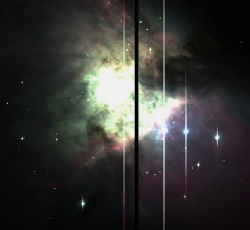
Blooming
Bloomed star images
Blooming

Slide 33
Dark Current
Dark current is generated when thermal photon-induced vibrations cause an electron to move from the valence band to the conduction band.
The majority of dark current is created near the interface between the Si and the SiO₂, where interface states at energy between the valence and conduction bands act as a stepping stone for electrons. These are sometimes referred to as “mid-band” states.
CCDs can be operated at temperatures down to around 140K, to reduce thermal effects.
Notes:
33
The dark current is background signal generated by thermal effects. Because of the dark current CCds are run cooled, to reduce the possibility of thermal excitation of electrocs across the band gap.

Slide 34
Dark Current vs. Temperature
Thermally generated electrons are indistinguishable from photo-generated electrons : “Dark Current” (noise)
Cool the CCD down!!!

Slide 35
Charge Transfer Efficiency
When the wells are nearly empty, charge can be trapped by impurities in the silicon. So faint images can have tails in the vertical direction.
Modern CCDs can have a charge transfer efficiency (CTE) per transfer of 0.9999995, so after 2000 transfers only 0.1% of the charge is lost.
Notes:
35
Charge can be trapped as you read it out, although with modern buried channel CCDs this is much less of a problems than it used to be.

Slide 36
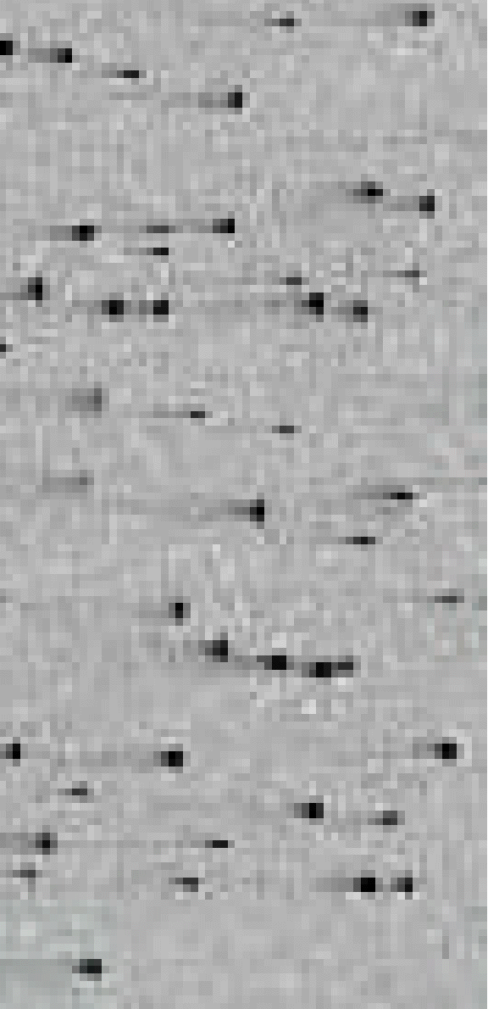
Example:
X-ray events with charge smearing in an
irradiated CCD (from GAIA-LU-TN01)
In the simplest picture (“linear CTI”) part of the
original image is smeared with an exponential
decay function, producing “tails”:
original image
after n transfers
direction of charge transfer
36
Notes:
36

Slide 37
Read-Out Noise
Mainly caused by thermally induced motions of electrons in the output amplifier.
These cause small noise voltages to appear on the output.
This noise source, known as Johnson Noise, can be reduced by cooling the output amplifier or by decreasing its electronic bandwidth. Decreasing the bandwidth means that we must take longer to measure the charge in each pixel, so there is always a trade-off between low noise performance and speed of readout.
The graph below shows the trade-off between noise and readout speed for an EEV4280 CCD.

Slide 38
CCD readout noise
Reset noise: there is a noise associated with recharging the output storage capacitor, given by σ_{res}= √ (kTC) where C is the output capacitance in Farads.
This is removed by correlated double sampling, where the reset voltage is measured after reset and again after readout. The first value is subtracted from the second, as this voltage will not change.
The output Field Effect Transistor also contributes noise. This is the ultimate limit to the readout noise, at a level of 2-3 electrons
Notes:
38
Surface state noise is akin to charge transfer problems, and like those is much reduced in buried channel CCDs.
The largest source of noise in the best modern CCDs is the FET noise from the previous slide.

Slide 39
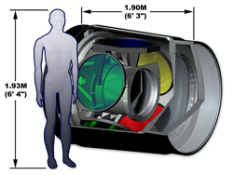
LSST Has a Big Camera

Slide 40
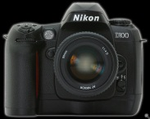
LSST Has a Big Focal Plane
Wavefront Sensors (4 locations)
Guide Sensors (8 locations)
3.5 degree Field of View (634 mm diameter)

Slide 41
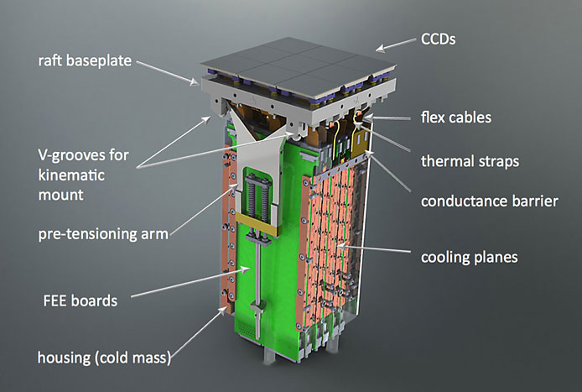
LSST CCD Raft

Slide 42
infrared detectors

Slide 43
History
Herschel’s detection of IR from Sun in 1800
Johnson’s IR photometry of stars (PbS) mid 60’s
Neugebauer & Leighton: 2um Sky Survey (PbS), late 60’s
Development of bolometer (Low) late 60’s
Development of InSb (mainly military) early 70’s
IRAS 1983
Arrays (InSb, HgCdTe, Si:As IBCs) mid-80’s
NICMOS, 2MASS, IRTF, UKIRT, KAO, common-user instruments, Gemini, etc.
JWST and the search for cosmic origins

Slide 44
Historical Motivation
Exploration & discovery
  Neugebauer, Leighton, Low, Fazio, Townes
Technological opportunities
  Bolometer (Low)
  PbS (Neugebauer)
  balloons (Fazio)
  IR lasers & interferometry (Townes)
A few, key problems
  Bolometric luminosities (Herschel, Johnson)
  The Galactic Center (Becklin)
  Star formation

Slide 45
Current Motivation
High redshift objects
  λ_{obs} = λ₀ (1+z) 5000 Å → >1 μm for z > 1
  Classical problems require infrared data
Obscuration by dust
  A_{λ} ~ λ^{α} → A_{2.2μm} ~ 0.1 A_{V} (Mathis 1990, ARAA, 28, 37)
  Now important for:
    Galactic nuclei, esp. AGN (unified model)
    Starburst galaxies
    Young stars
Very low mass objects & extrasolar planets
  T_{planet} ~ 50 to 500 K λ_{peak} ~ 5 – 50 μm
  T_{BD} ~ 900 – 2000 K λ_{peak} ~ 1 – 5 μm

Slide 46
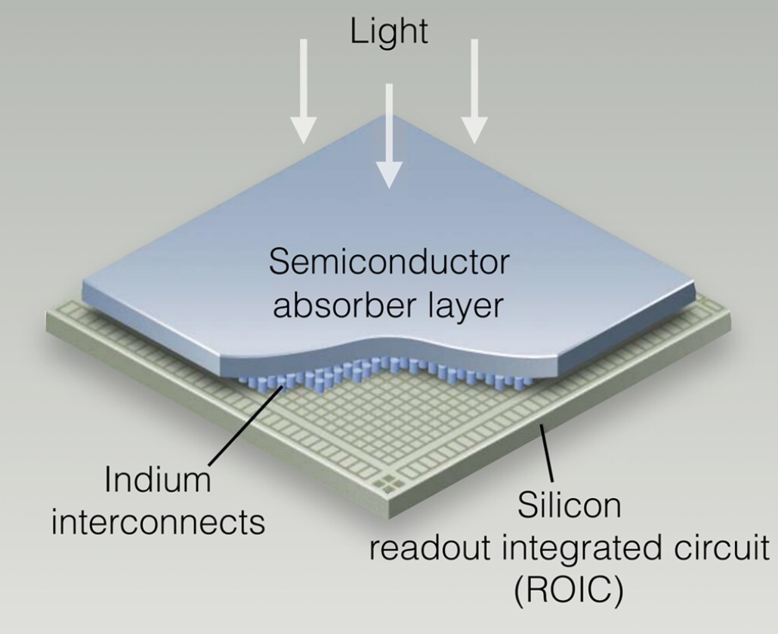
Infrared Hybrid Array
Infrared arrays use light-sensitive material that can detect infrared photons, wavelengths beyond ~1 um.
Therefore, silicon cannot be used as the light-sensitive layer.
This poses a problem because the readout circuit is most easily implemented in silicon.
Therefore, infrared arrays are “hybrids” – they use one material to detect light and silicon for the readout circuit.

Slide 47
Periodic Table
Semiconductors occupy column IV of the Periodic Table
Outer shells have four empty valence states
An outer shell electron can leave the shell if it absorbs enough energy

Slide 48
Periodic Table Continued
The column number gives the number of valence electrons per atom. Primary semiconductors have 4.
Compounds including elements from neighboring columns can be formed. These alloys have semiconductor properties as well (e.g. HgCdTe & InSb).
Mercury-cadmium-telluride (HgCdTe; used in NICMOS) and indium-antimonide (InSb; used in SIRTF) are the dominant detector technologies in the near-IR.

Slide 49
The Band Gap Determines the Red Limit

Slide 50
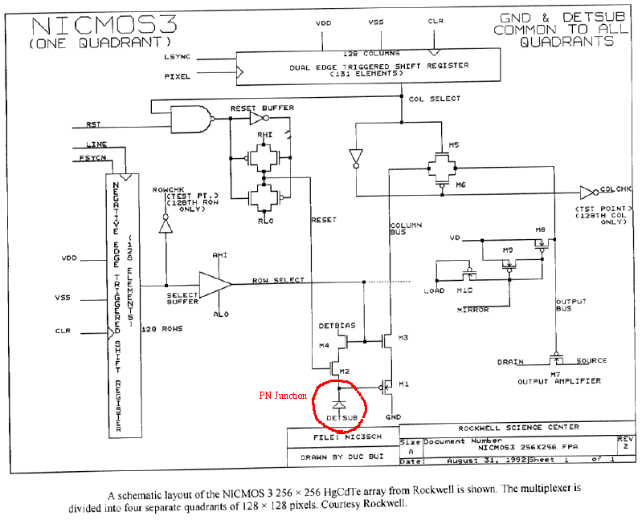
NICMOS Multiplexer (MUX)

Slide 51
Dark Current
Like a CCD, IR arrays are affected by dark current and a variety of noise mechanisms.
Dark current is the signal that is seen in the absence of any light. For the near-IR (1-2.5 μm), the dominant components are diffusion, thermal generation-recombination (G-R) of charges within the semiconductor, and leakage currents. Combining these, it can be shown that
where V is the voltage across the detector and R_{0diff} and R_{0GR} are the detector impendences at zero bias for diffusion and G-R.

Slide 52
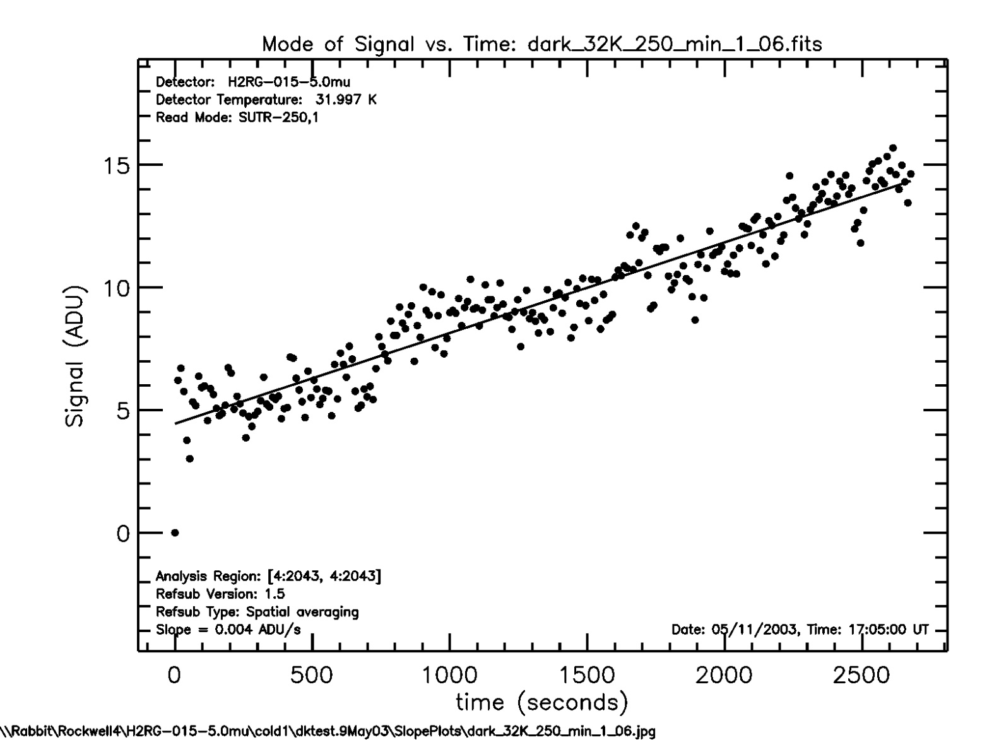
Dark Current Example

Slide 53
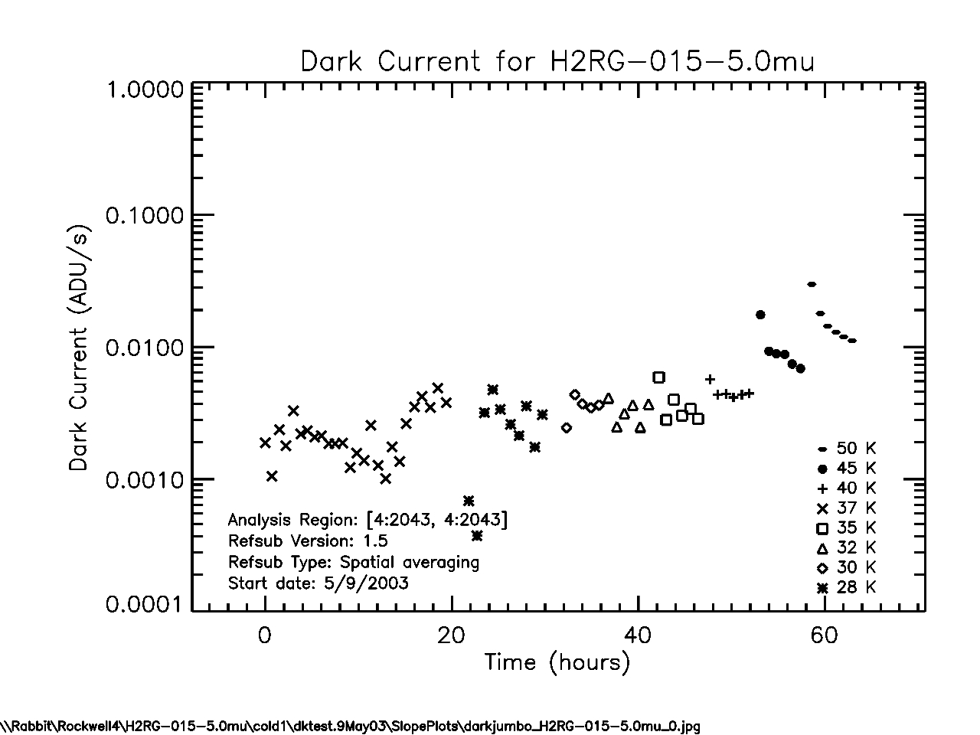
Dark Current vs. Temperature

Slide 54
Read Noise
Read noise is the uncertainty in the measured signal.
It is associated with the readout electronics.
Some common sources of read noise include thermal noise in resistive elements (Johnson noise), kTC noise in capacitors, and interference coupled into ground loops.
Read noise can be reduced
  better electronics system design
  subtracting the reset level to remove kTC noise
  reading the same signal multiple times and averaging
The effect of read noise can be reduced to increase signal-to-noise ratio by increasing the signal (increasing the exposure time).

Slide 55
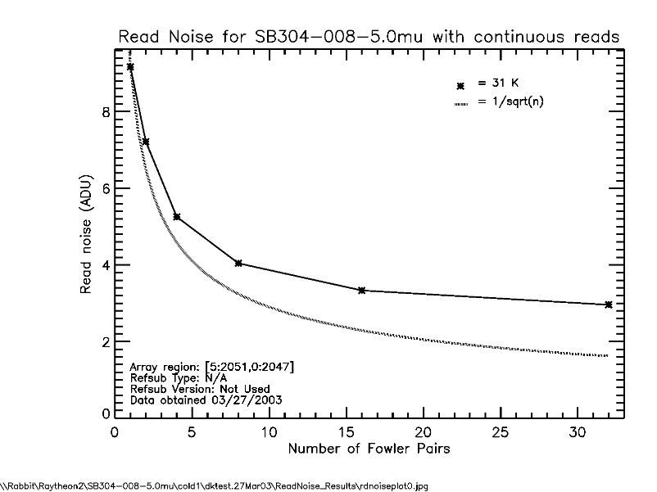
Multiple Sampling for Noise Reduction
By being a bit clever about reading out the array, one can minimize or eliminate some of these noise modes.
During an exposure, typically each pixel is sampled several times.
The measurements are averaged to reduce noise.

Slide 56
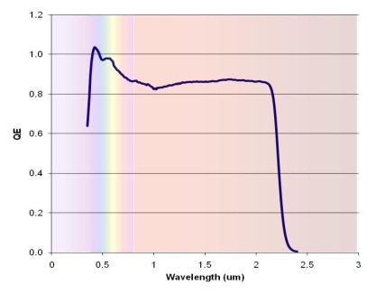
QE Example
Relative QE for Bepi-Colombo device, at 293 K, of RVS MCT array after substrate removal. High response in the UV region is due to charge gain. The QE reduces by ~8% at 190 K.

Slide 57
Persistence
Persistence is the tendency of a detector to capture charge liberated in one exposure and then release it later in another exposure.
It is produced by charge traps.
Persistence introduces a noise source into images.

Slide 58
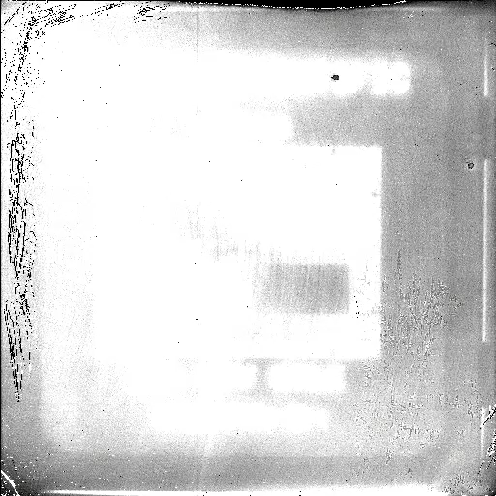
Persistence Movie

Slide 59
Teledyne JWST Detector
H2RG HgCdTe array

Slide 60
Raytheon Family Arrays

Slide 61
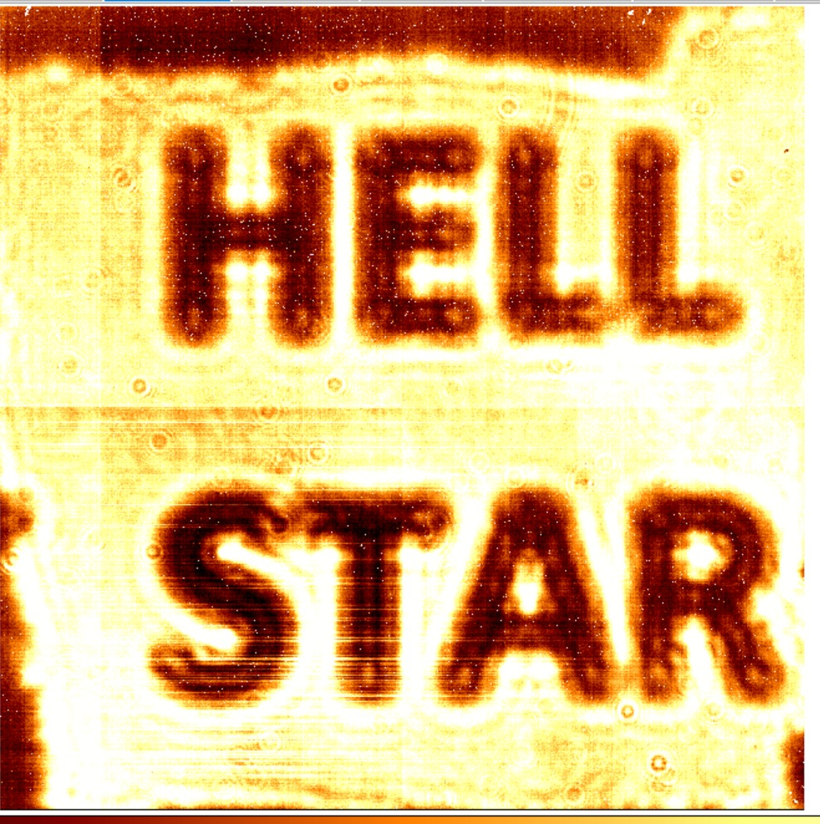
RIT/Raytheon HELLSTAR

