Slide 1
University Astronomy
Professor Don Figer
Galaxies

Slide 2
Aims and outline for this lecture
review how galaxies were first discovered
introduce Hubble’s law (20.5)
show morphologies of galaxies (20.1)
review AGN (21.3)
describe quasars (21.1.2)
describe galaxy merger systems (22.2)
show galaxy clusters (22.1)

Slide 3
island universes

Slide 4
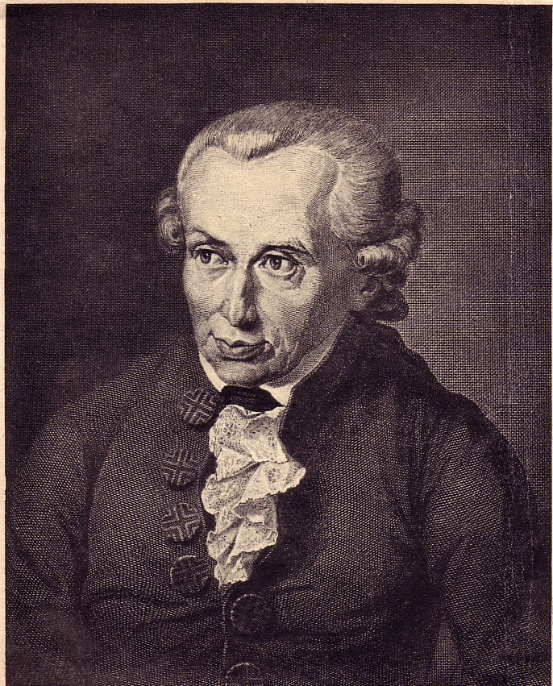
Island Universes
When other galaxies were first observed, they were called nebulae since they were fuzzy patches of light in the sky.
Immanuel Kant was the first, in the 18th century, to suggest that these nebulae might be similar to our own Milky Way.
He called these nebulae “island universes.”

Slide 5
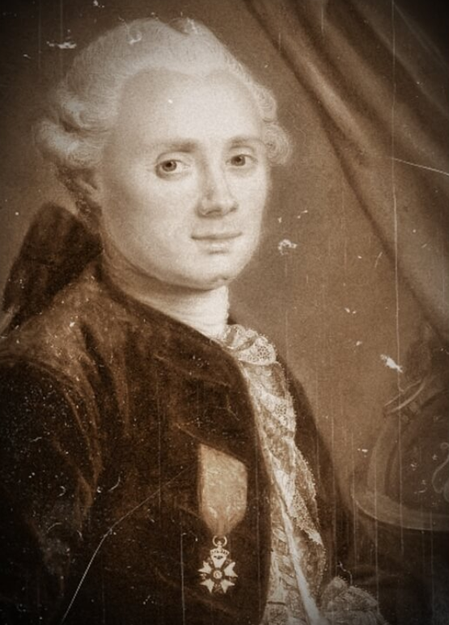
Charles Messier (1730-1817)
Messier hunted comets.
Comets are fuzzy.
Some fuzzy objects that were not comets (known because they did not move) distracted him.
So, he made a catalog of about a hundred non-comet fuzzy things.
These fuzzy things in his catalog include galaxies.

Slide 6
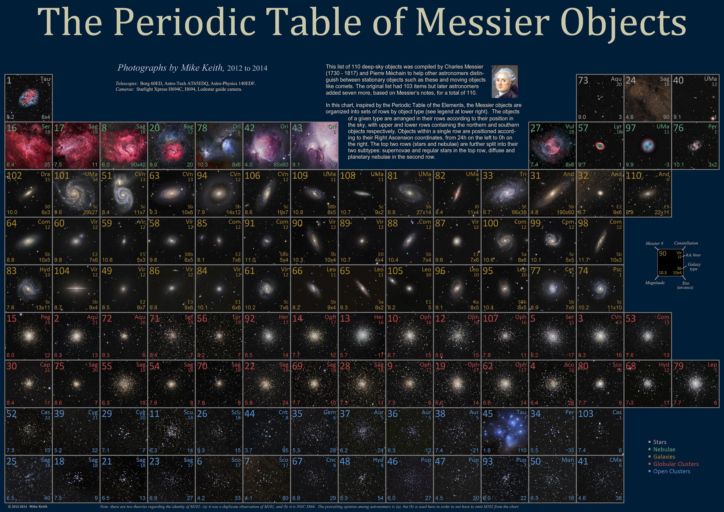

Slide 7
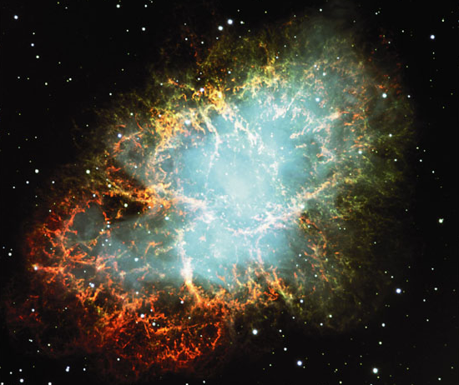

Slide 8
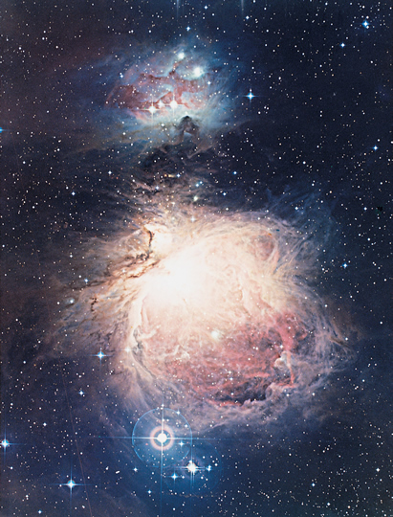

Slide 9
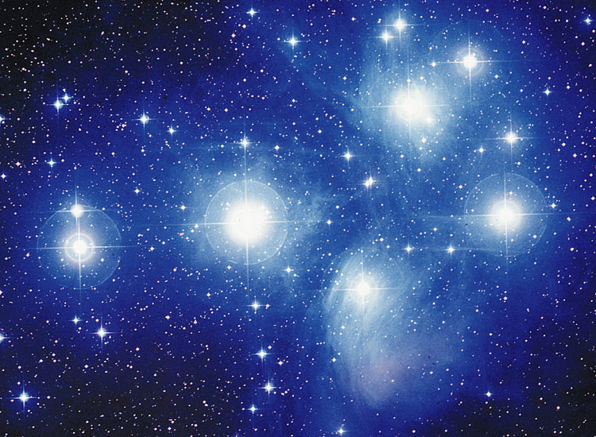

Slide 10
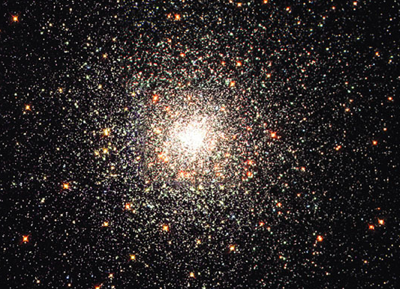

Slide 11
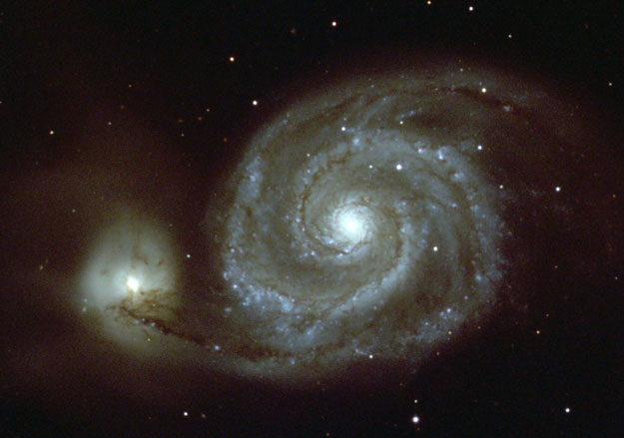

Slide 12
New General Catalog: NGC….
William Herschel produced a new catalog that included the southern hemisphere.
John Louis Emil Dreyer published the New General Catalog of Nebulae and Clusters of Stars in 1888.
It contained nearly 8000 objects.
It contained clusters and nebulae (some of which turned out to be galaxies).
Many objects were of uncertain nature.
Dreyer also published two supplemental “Index Catalogues” containing another 5,000 objects.

Slide 13
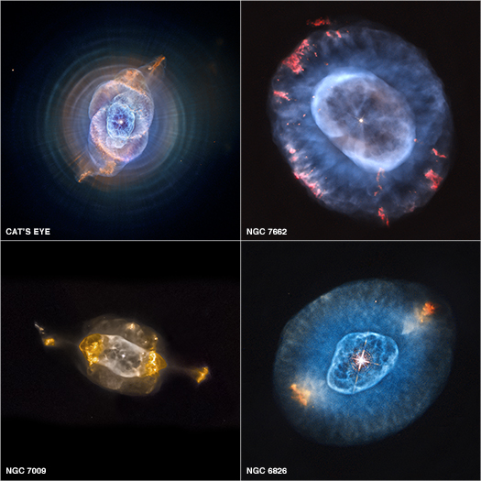
Planetary Nebulae in NGC

Slide 14
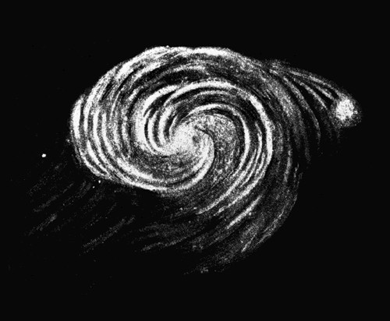
Spiral Nebulae
As technology improved, better telescopes were built.
Using the new 1.8 m telescope built in 1845, spiral structure was first observed.
  It was built by William Parsons, 3rd Earl of Rosse, in Parsonstown, Ireland.
  He drew a picture of M51 (on the right).
Slipher (1875-1969) realized that these spiral nebulae were rotating by measuring their Doppler shifts.
Some claimed to see a galaxy (M51) actually rotating! But, that was bogus.

Slide 15
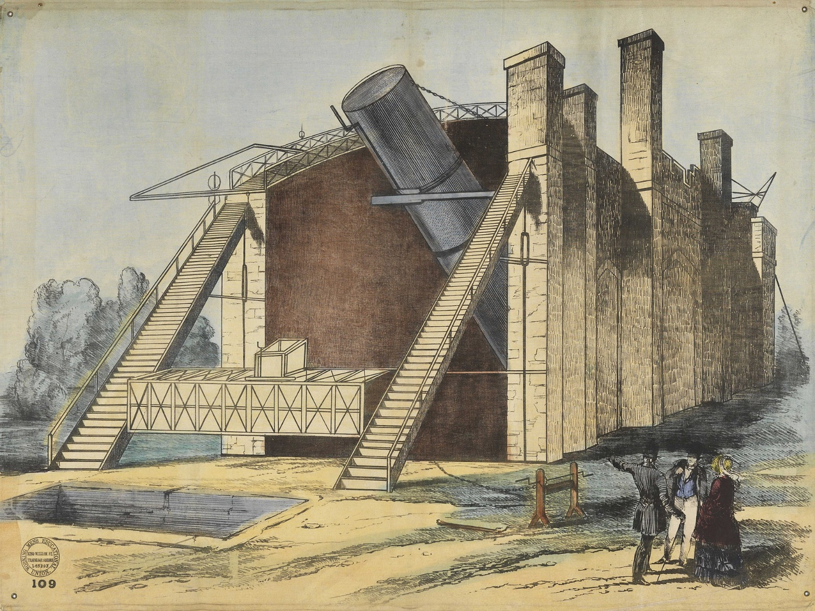
The Leviathan of Parsonstown

Slide 16
hubble’s law

Slide 17
How Far Away Are They?
The big question about these nebulae was their distance.
Some thought they were in the Milky Way (and therefore close and small).
Others thought they were farther away (and therefore very big) and favored the “island universe” idea.
This lead to a meeting in 1920 which has become known as the Great Debate in astronomy. It was also known as the Shapley-Curtis debate.
Shapley believed that distant nebulae were relatively small and lay within the outskirts of Earth's home galaxy.
Curtis held that they were in fact independent galaxies, implying that they were exceedingly large and distant.

Slide 18
The Great Debate
Harlow Shapley
  He thought that the “spiral nebulae” were part of the Milky Way.
  If Andromeda were as large as the Milky Way, it’s distance would mean the novae observed there to bright to accept.
  The distances required were hard to fathom.
Heber Curtis
  He believed they were like the Milky Way.
  Noted that there were more novae in Andromeda than in Milky Way; therefore, it would not make sense if the former was just a piece of the latter.
  No proper motions (motion across the sky) detected.

Slide 19
The Great Debate
Debate was settled in 1923 by Edwin Hubble
(1889 – 1953).
He measured the distance to Andromeda using Cepheid variable stars.
He measured a distance of over 900,000 light years, meaning that Andromeda had to be outside of the Milky Way!
Today’s value for the distance to Andromeda is 2.5 million light years away.

Slide 20
hubble’s law

Slide 21
Galactic Redshifts

Slide 22
Hubble’s Plot

Slide 23
Hubble’s Law
Hubble estimated distances to galaxies in his sample, underestimating them considerably, and saw that the velocities were proportional to the distances.
Hubble’s law is the relationship between distance and redshift for a galaxy.
Recall that redshift is z=Δλ/λ₀=(λ−λ₀)/λ₀=v/c, where λ is the observed wavelength and λ₀ is the rest wavelength.
The law is cz=H₀d=v, where c is the speed of light, H₀ is “Hubble’s constant,” and d is the distance to the galaxy.
H₀ is ~70 +/-5 km/s/Mpc.
As an example, consider the case where we measure a velocity of 10,000 km/s. We would predict that such an object would have a distance of 143 Mpc, and a z of 0.03.

Slide 24
galaxy morphology

Slide 25
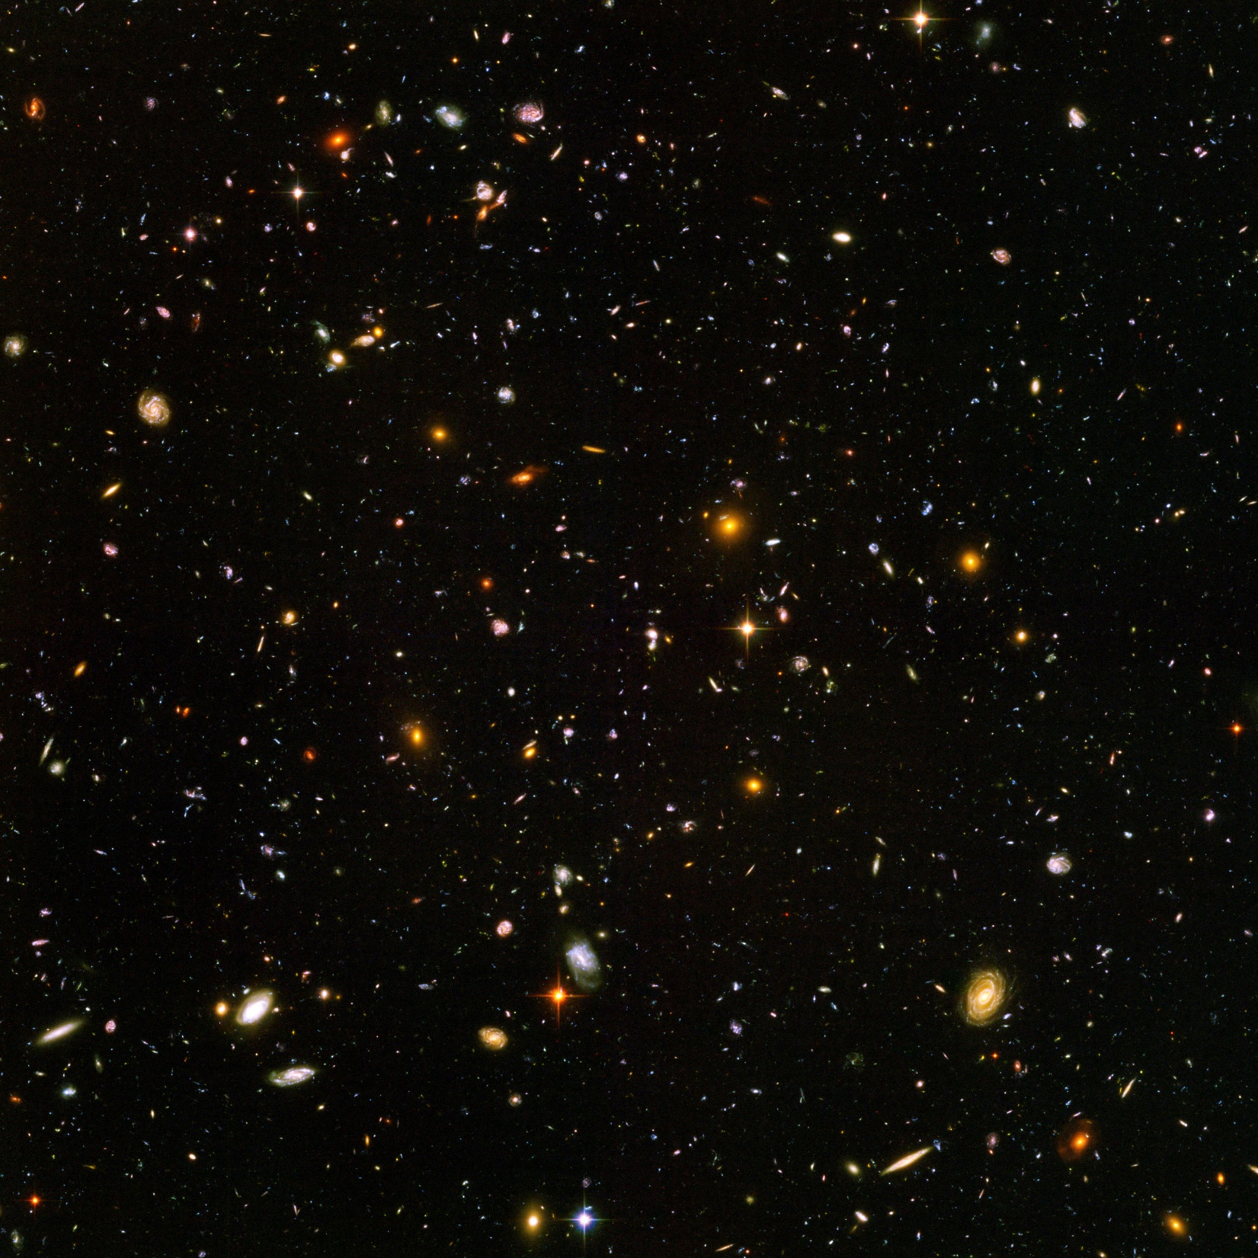
Hubble Ultra Deep Field
11.5 square arcmin
3.4 arcmin on a side
The full moon is 30 arcmin across, so this field is about 1/10 the size of the moon!

Slide 26

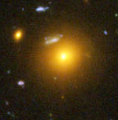
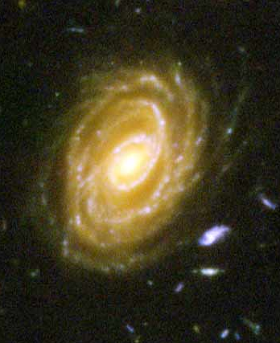
Hubble Ultra Deep Field
Elliptical Galaxy
Irregular Galaxies
Spiral Galaxy
Spiral Galaxy

Slide 27
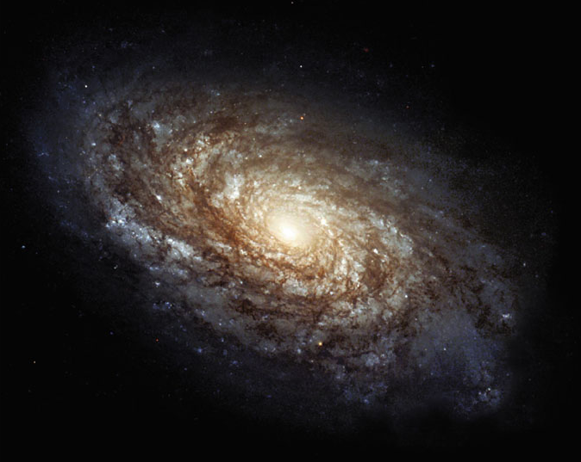
Spiral Galaxy
halo
disk
bulge
Spiral Galaxy

Slide 28
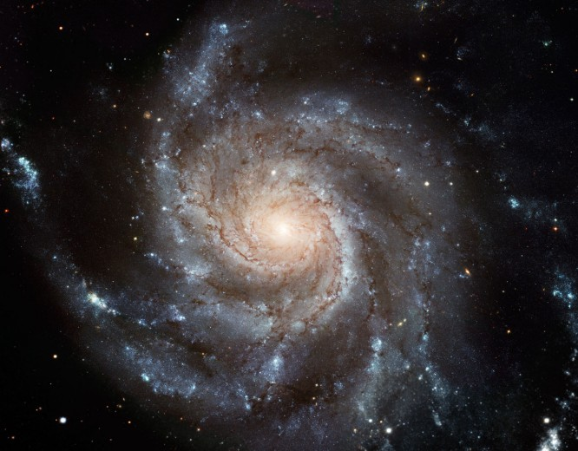
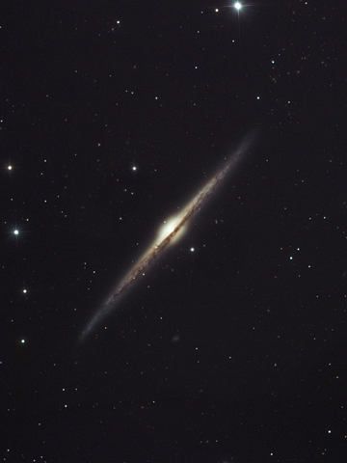
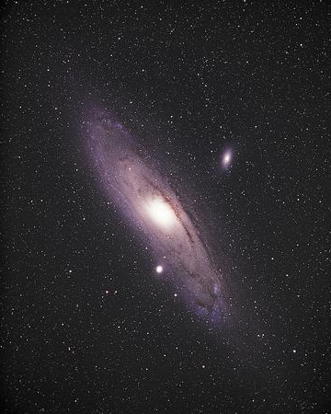
Spiral Galaxies

Slide 29
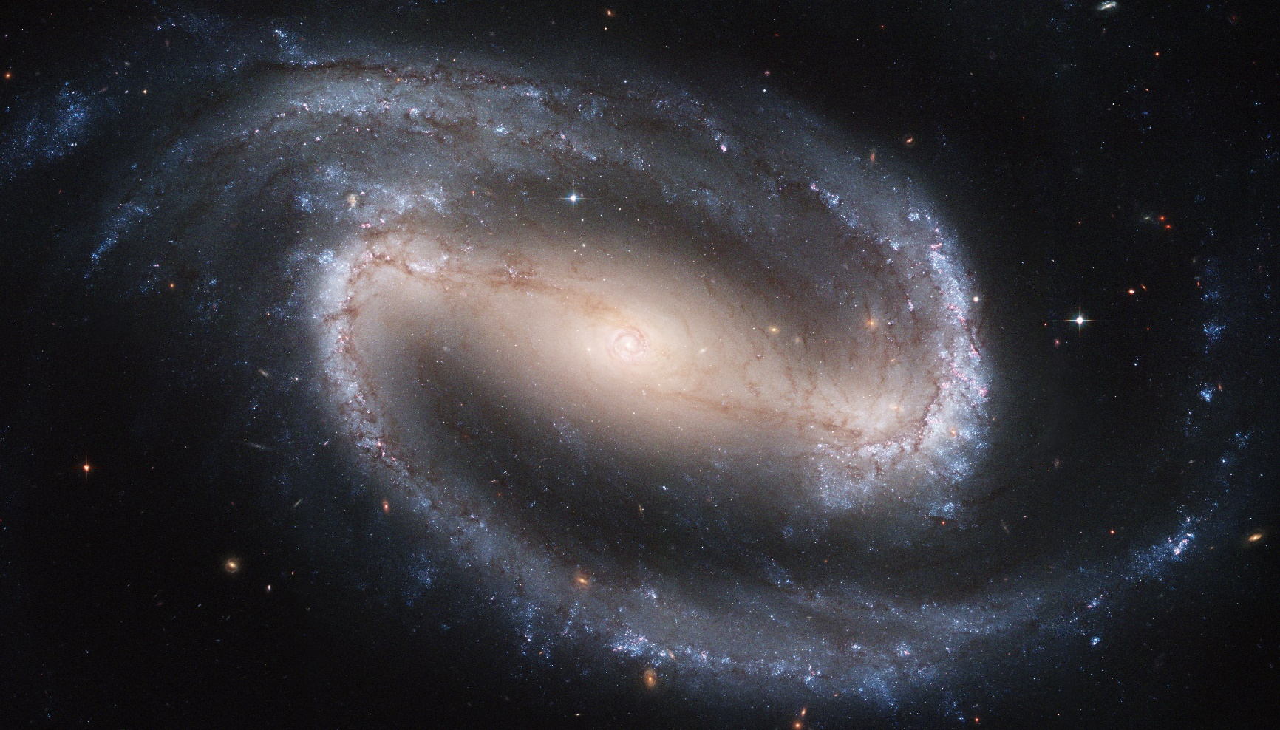
Barred Spiral Galaxy

Slide 30
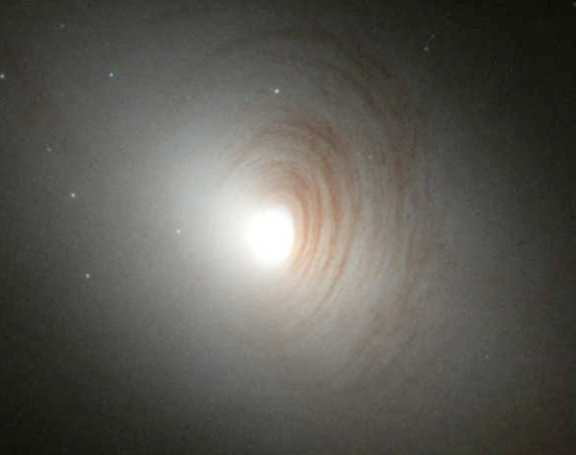
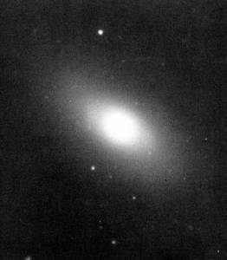
Lenticular Galaxies
Lenticular galaxies have disk and spheroidal components, but lack spiral arms
Intermediate class between spirals and ellipticals

Slide 31
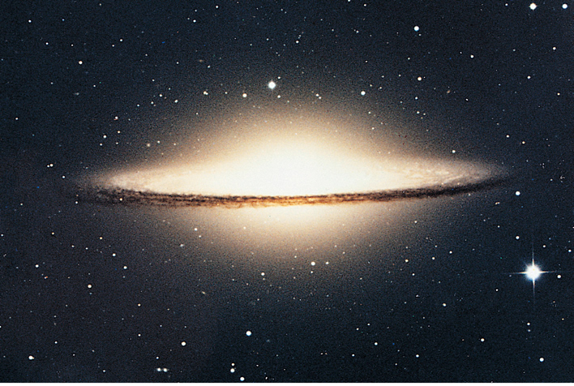
Spiral Galaxies
Disk Component:
stars of all ages,
many gas clouds
Spheroidal Component:
bulge & halo, old stars,
few gas clouds

Slide 32
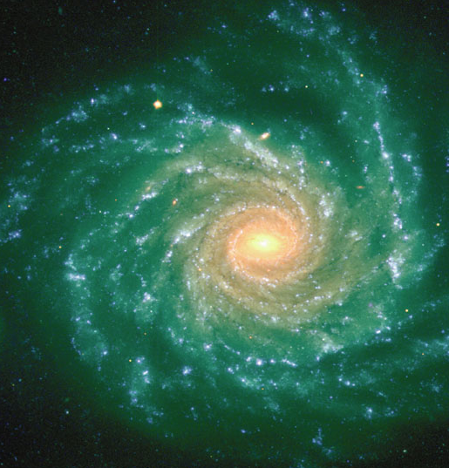
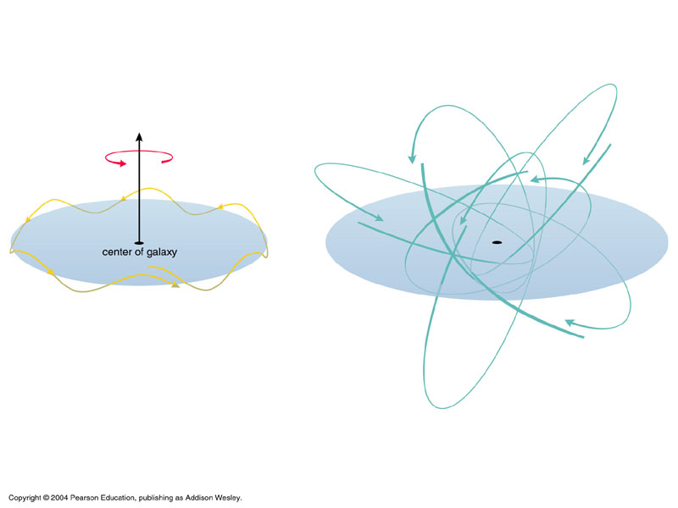
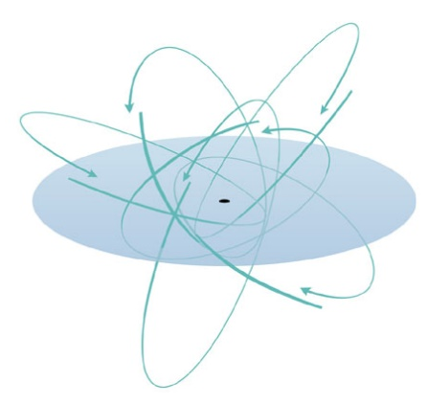
Blue-white color indicates ongoing star formation
Disk Component:
stars of all ages,
many gas clouds
Spheroidal Component:
bulge & halo, old stars,
few gas clouds
Red-yellow color indicates older star population

Slide 33
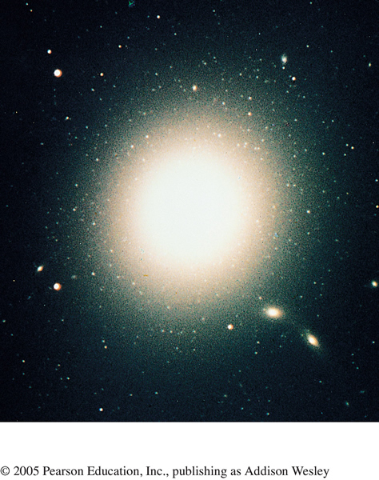
Elliptical Galaxy

Slide 34
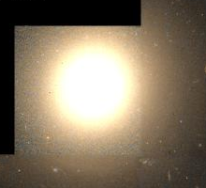
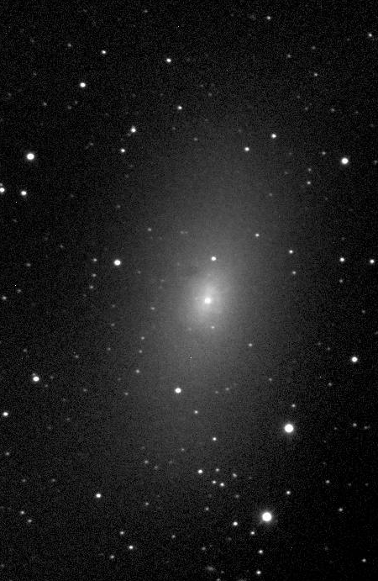
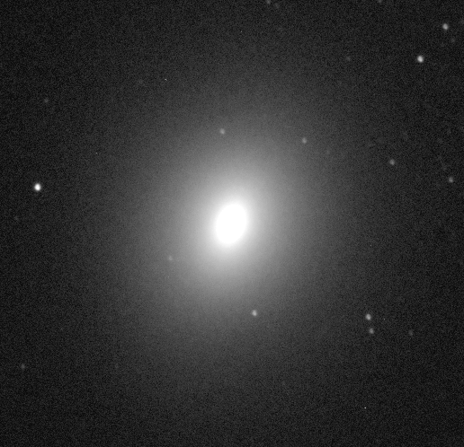
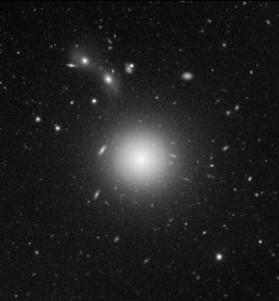
Elliptical Galaxies

Slide 35
Elliptical Galaxy
All spheroidal component, virtually no disk component
Red-yellow color indicates older star population

Slide 36
Elliptical Galaxies
Ellipticals come in a wide variety of sizes.
Giant ellipticals are some of the largest galaxies in the universe.
  trillions of stars
  contain very hot gas
Dwarf ellipticals are very small and very common
  less than a billion stars
  often found near large spirals
  about 10 in the local group

Slide 37
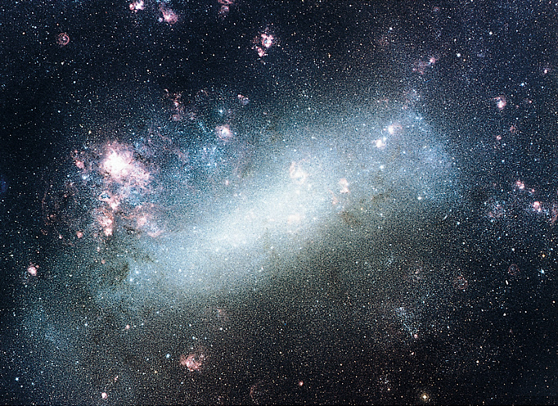
Irregular Galaxy
LMC: blue-white color indicates ongoing star formation

Slide 38
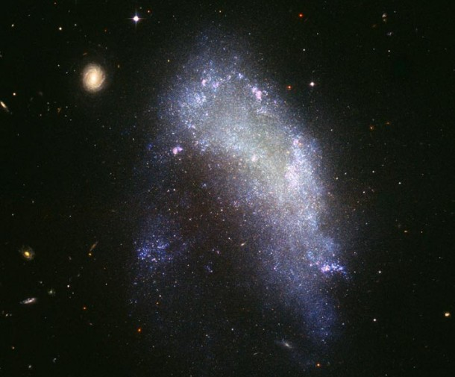
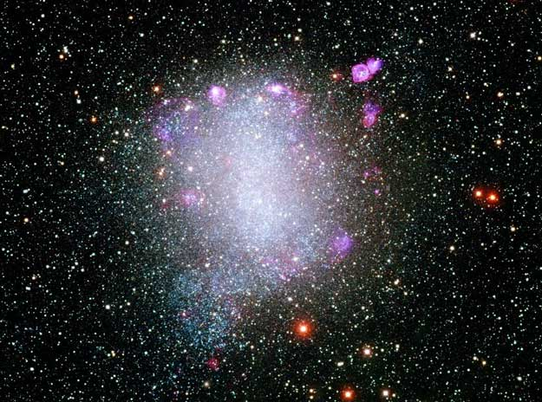
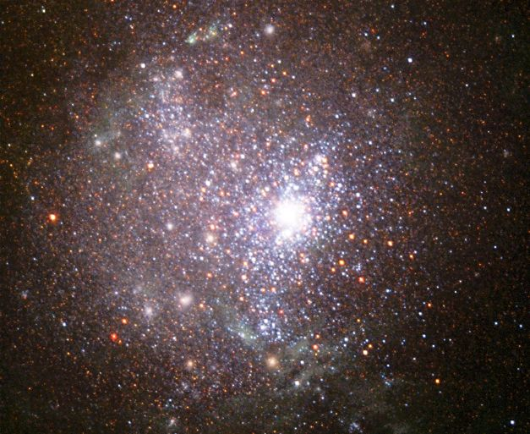
Irregular Galaxies

Slide 39
Irregular Galaxies
Neither spiral nor elliptical
  Miscellaneous class (e.g. the Magellanic Clouds)
Usually white, dusty, and forming stars
Nearby, only a small percentage of galaxies are irregular
Larger percentage of distant galaxies are irregular
  Irregular galaxies were more common in the early universe

Slide 40
Types of Galaxies
Spirals
  Blue/white flat disks of gas and dust
  Red/yellow spheroidal component
  Spiral arms
Ellipticals
  Redder than spirals
  More rounded
  Little cool gas and dust
Irregular
  Unusual
  Neither disk-like or rounded

Slide 41
The Hubble Classification Scheme

Slide 42
agn

Slide 43
AGN
AGN are Active Galactic Nuclei.
They are named as such because they have extraordinarily large amounts of flux emitted from their centers, i.e., they are “active.”
The appearance of an AGN depends strongly on the vantage point of the observer.

Slide 44
Seyfert’s Are AGN

Slide 45
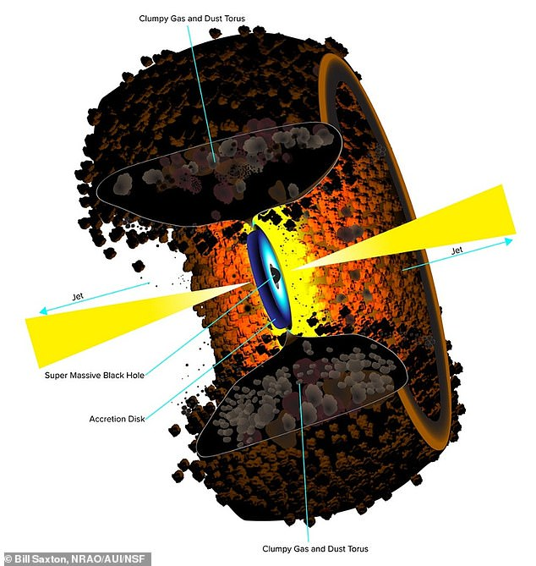
AGN

Slide 46
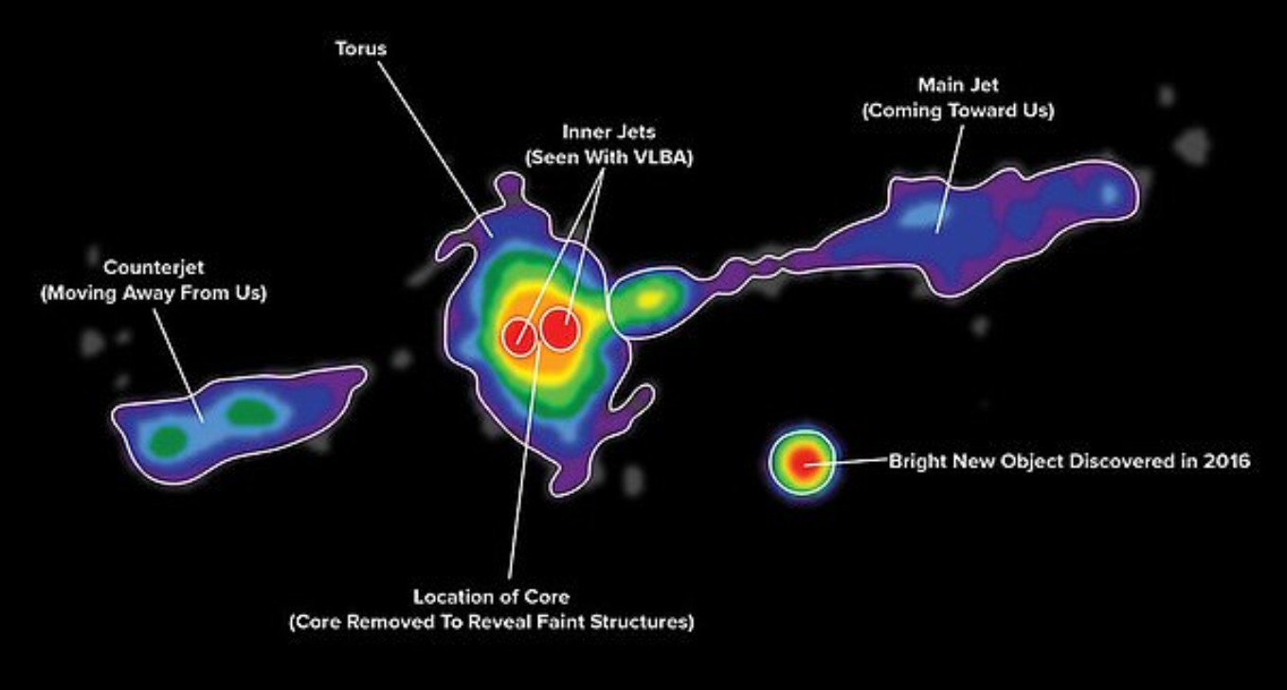
AGN

Slide 47
quasars

Slide 48
Quasars
“Quasars” are “quasi-stellar objects.”
They are said to be quasi-stellar because they are have a point-like appearance.
They represent galaxies with very bright nuclei (that drowns out the light from all the surrounding stars in the galaxy).
They are very luminous, ~10⁴ times the luminosity of the Milky Way.

Slide 49
Galaxy mergers

Slide 50
Galaxy Mergers
Some galaxies seem to be combinations of two (or more).
These galaxies represent merging systems.
When two spirals merge, the final product could look much more like an elliptical galaxy.
It is possible the elliptical galaxies were built by successive mergers of spirals and other ellipticals.
It is especially suggestive that there is often an elliptical galaxy at the centers of galaxy cluster and that galaxy often has more mass than the other galaxies in the cluster.
Notes:
2
Stellar Spectra
Comparison of spectra observed for seven different stars having a range of surface temperatures. The hottest stars, at the top, show lines of helium and multiply ionized heavy elements. In the coolest stars, at the bottom, helium lines are not seen, but lines of neutral atoms and molecules are plentiful. At intermediate temperatures, hydrogen lines are strongest. The actual compositions of all seven stars are about the same. ><*Recently, some astronomers have proposed the addition of two new spectral classes—L and T—for low-mass, low-temperature stars whose odd spectra distinguish them from the M-class stars in the current scheme. For now, at least, the new classification has not been widely adopted. Astronomers are still uncertain whether these new objects are “true” stars, fusing hydrogen into helium in their cores, or if they are “brown dwarfs” that never achieved high enough central temperatures for fusion to begin.

Slide 51
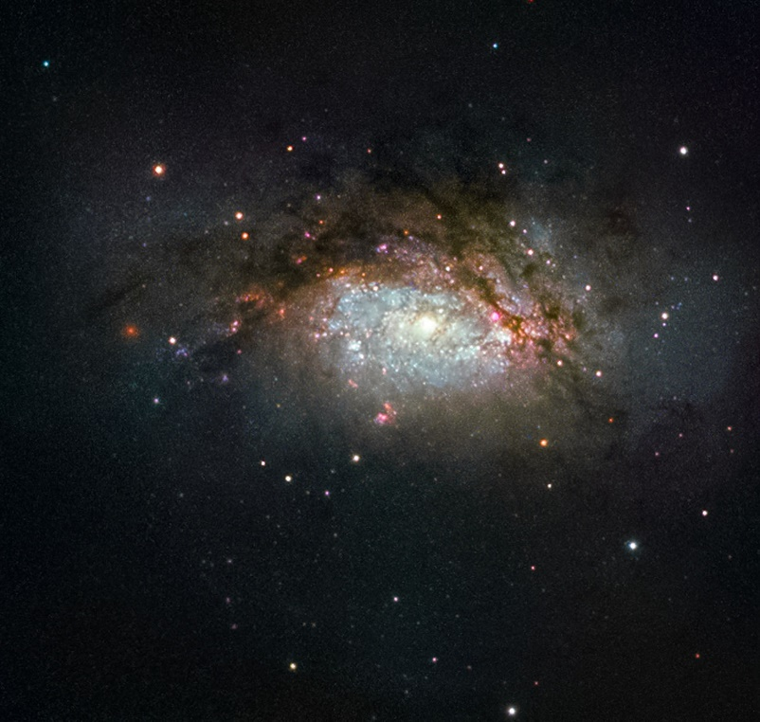
Galaxy Mergers
NGC 3597 is the product of a collision between two galaxies, and is slowly evolving to become a giant elliptical galaxy.
Notes:
2
Stellar Spectra
Comparison of spectra observed for seven different stars having a range of surface temperatures. The hottest stars, at the top, show lines of helium and multiply ionized heavy elements. In the coolest stars, at the bottom, helium lines are not seen, but lines of neutral atoms and molecules are plentiful. At intermediate temperatures, hydrogen lines are strongest. The actual compositions of all seven stars are about the same. ><*Recently, some astronomers have proposed the addition of two new spectral classes—L and T—for low-mass, low-temperature stars whose odd spectra distinguish them from the M-class stars in the current scheme. For now, at least, the new classification has not been widely adopted. Astronomers are still uncertain whether these new objects are “true” stars, fusing hydrogen into helium in their cores, or if they are “brown dwarfs” that never achieved high enough central temperatures for fusion to begin.

Slide 52
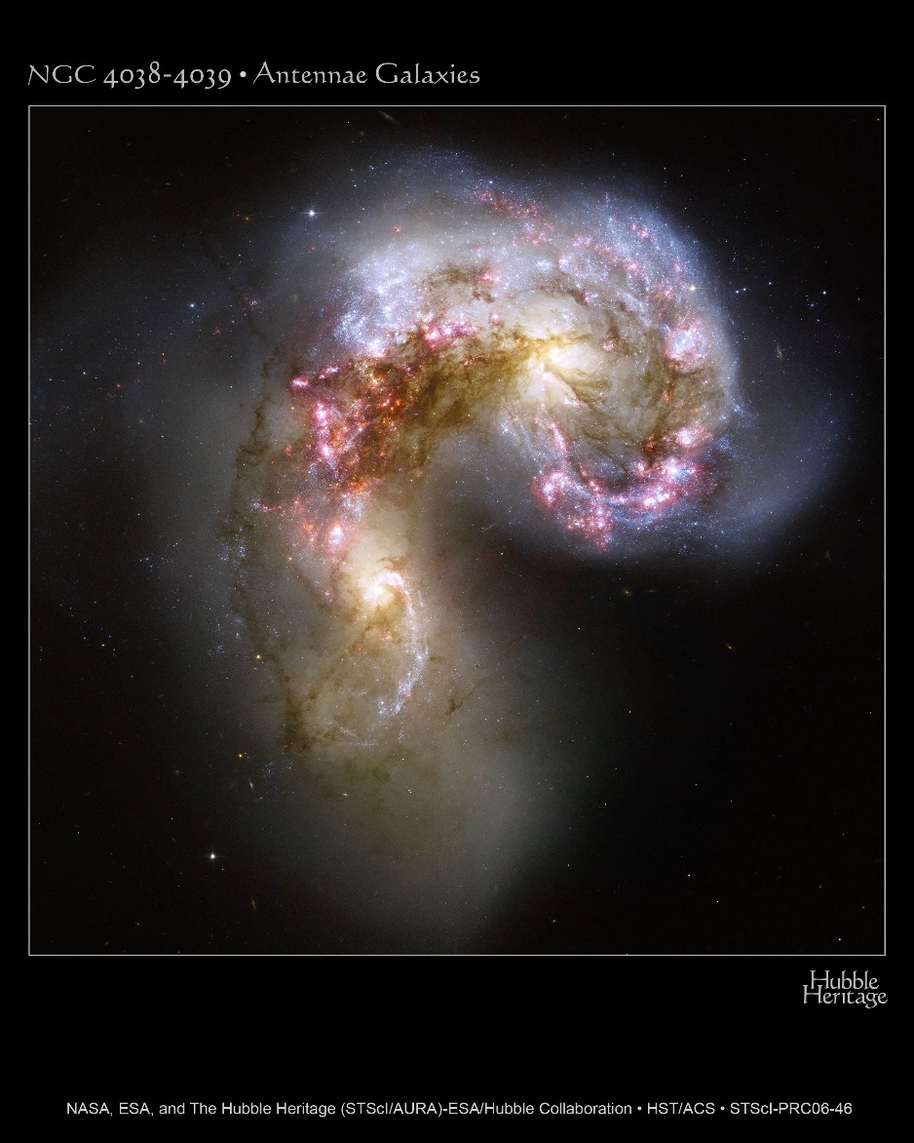
Antennae Galaxies
Notes:
2
Stellar Spectra
Comparison of spectra observed for seven different stars having a range of surface temperatures. The hottest stars, at the top, show lines of helium and multiply ionized heavy elements. In the coolest stars, at the bottom, helium lines are not seen, but lines of neutral atoms and molecules are plentiful. At intermediate temperatures, hydrogen lines are strongest. The actual compositions of all seven stars are about the same. ><*Recently, some astronomers have proposed the addition of two new spectral classes—L and T—for low-mass, low-temperature stars whose odd spectra distinguish them from the M-class stars in the current scheme. For now, at least, the new classification has not been widely adopted. Astronomers are still uncertain whether these new objects are “true” stars, fusing hydrogen into helium in their cores, or if they are “brown dwarfs” that never achieved high enough central temperatures for fusion to begin.

Slide 53
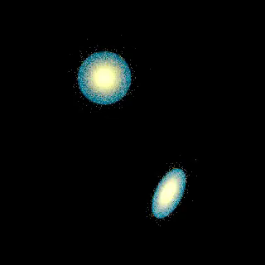
Antennae Simulation
Notes:
2
Stellar Spectra
Comparison of spectra observed for seven different stars having a range of surface temperatures. The hottest stars, at the top, show lines of helium and multiply ionized heavy elements. In the coolest stars, at the bottom, helium lines are not seen, but lines of neutral atoms and molecules are plentiful. At intermediate temperatures, hydrogen lines are strongest. The actual compositions of all seven stars are about the same. ><*Recently, some astronomers have proposed the addition of two new spectral classes—L and T—for low-mass, low-temperature stars whose odd spectra distinguish them from the M-class stars in the current scheme. For now, at least, the new classification has not been widely adopted. Astronomers are still uncertain whether these new objects are “true” stars, fusing hydrogen into helium in their cores, or if they are “brown dwarfs” that never achieved high enough central temperatures for fusion to begin.

Slide 54
galaxy clusters

Slide 55
Galaxy Clusters
Galaxies are found in clusters.
A typical cluster has ~50 galaxies.
Clusters are also part of larger clusters (superclusters).
The Milky Way is part of the “local group.”
The local group also contains the Andromeda Galaxy.
The next nearest cluster is the Virgo Cluster.

Slide 56

Galaxy Cluster Abell 2744

Slide 57
The Local Group

Slide 58
Cosmic Web

Slide 59
Cosmic Web and Expansion
Several large-area surveys obtained spectra of millions of galaxies. Examples are 2dF and SDSS.
The spectra yield redshifts.
The redshifts were converted into distances. Recall that v=H₀d, so d=v/H₀, where v/c=Δλ/λ.
When plotting the positions of the galaxies, it becomes clear that they are clumped into a web-like pattern surrounding relatively empty regions (“voids”).
The void size is approximately 500 Mly now, but was smaller earlier in the Universe.
The void size vs. time relation gives a measure of the expansion rate of the Universe.

