Slide 1
University Astronomy
Professor Don Figer
The Galactic Center

Slide 2
Galactic center environment

Slide 3
Aims and outline for this lecture
give an overview and tour of the Galactic center

Slide 4
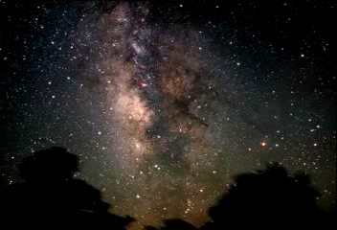

Slide 5
Galactic Center Fast Facts
radius_{CMZ} = 500 pc, thickness_{CMZ} = 60 pc (“CMZ” = central molecular zone, a region of extraordinary amounts of molecular gas)
volume_{CMZ} = ~0.03% of Volume_{disk}
T_{cloud} = 70 K
turbulent velocities of Δv_{FWHM} ~ 25 km/s over small scales (0.3 pc)
L_{Lyman continuum} = 1-3(10⁵²) photons/second
10% of Galactic star formation
10% of Galactic molecular clouds
25% of all (known) clusters with M>10,000 M_{Sun}

Slide 6
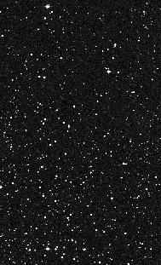
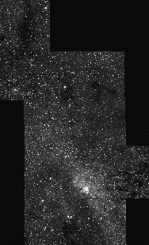
Why Near-infrared?
V band
K band
60 pc

Slide 7
Extinction to GC
Trumpler found 2 mag per kpc of extinction in the V-band to the Galaxy.
The GC is located 8 kpc from the Sun.
That suggests extinction of 16 magnitudes of extinction to the GC in the V-band.
The actual value is 30 magnitudes.
Why?
About half of the extinction is due to extra dust in the GC.

Slide 8
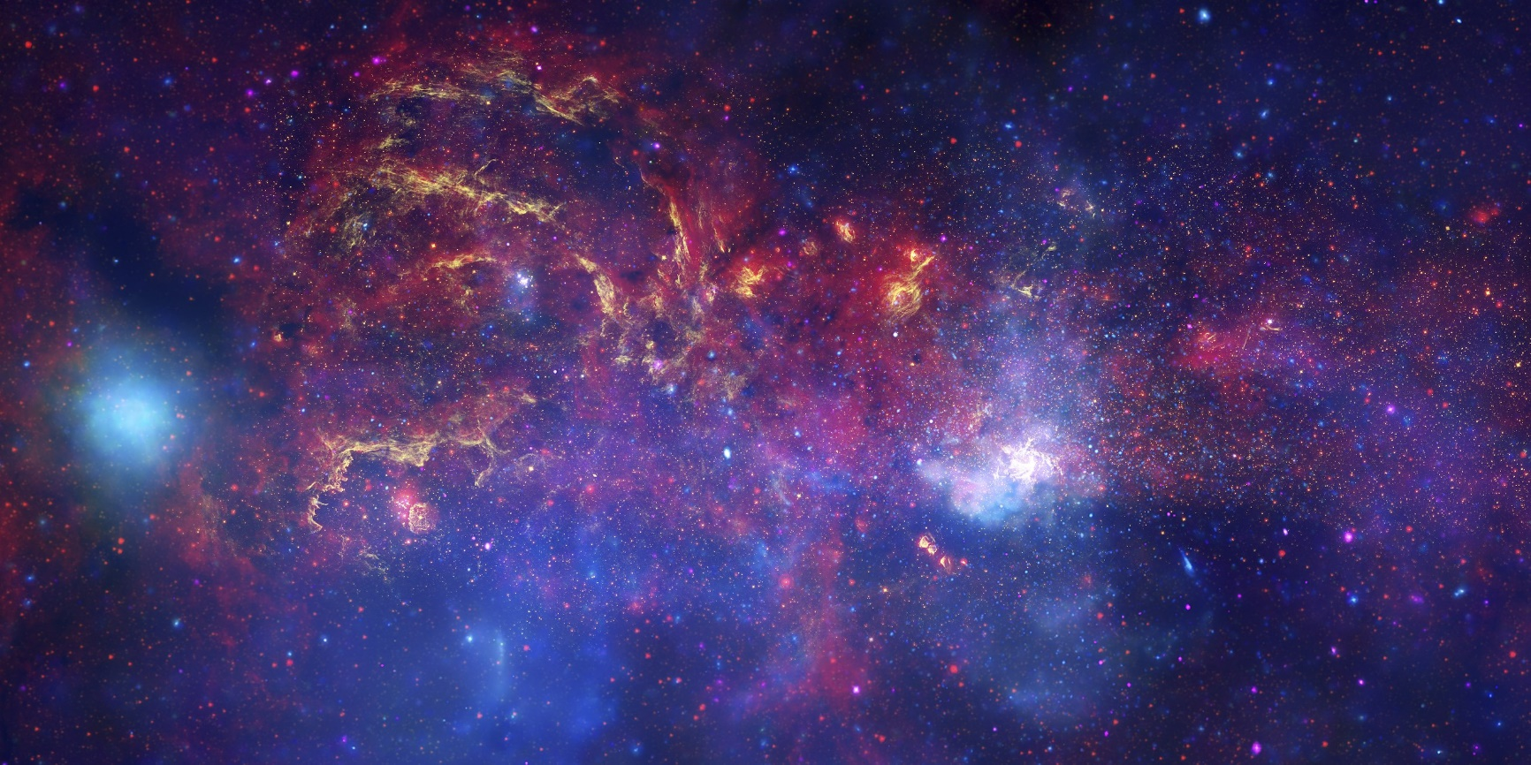
GC Color Composite
HST IR (Y), Chandra X-ray (B), Spitzer Far IR (R)

Slide 9
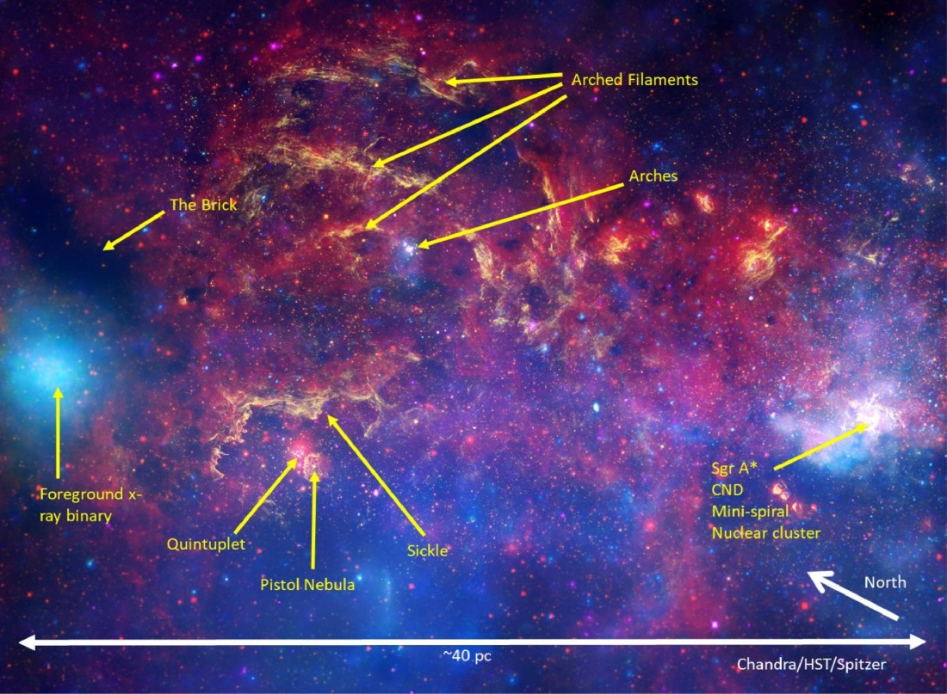
GC Color Composite
HST IR (Y), Chandra X-ray (B), Spitzer Far IR (R)

Slide 10
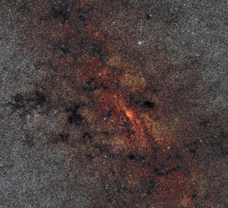
The GC in NIR - Wide View
350 pc
N
2MASS
E

Slide 11
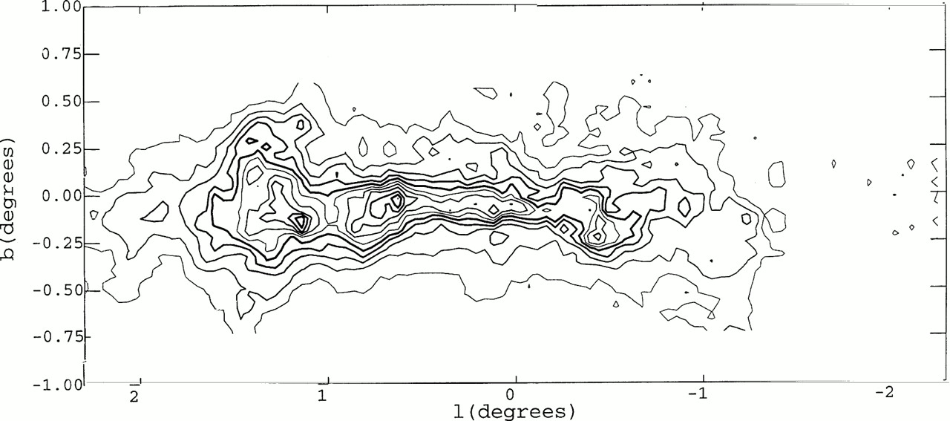
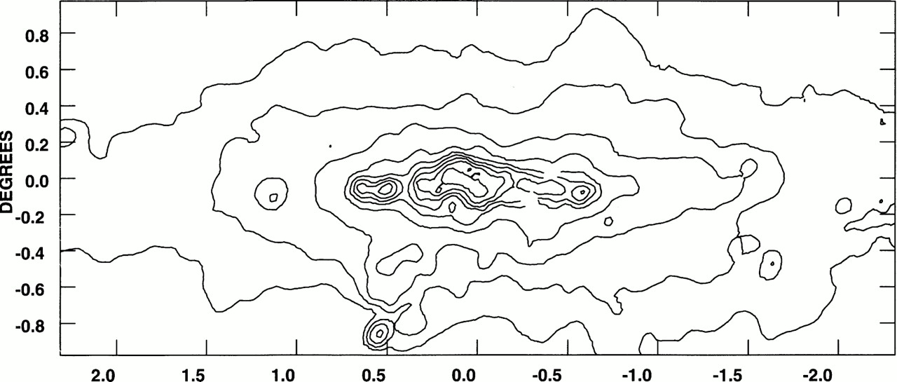
Our Galaxy’s Central Molecular Zone
¹²CO_{J=1–0} emission, from the AT&T Bell Labs survey
60-µm emission, as measured by IRAS.
Morris & Serabyn 1996, ARAA, 34, 645

Slide 12
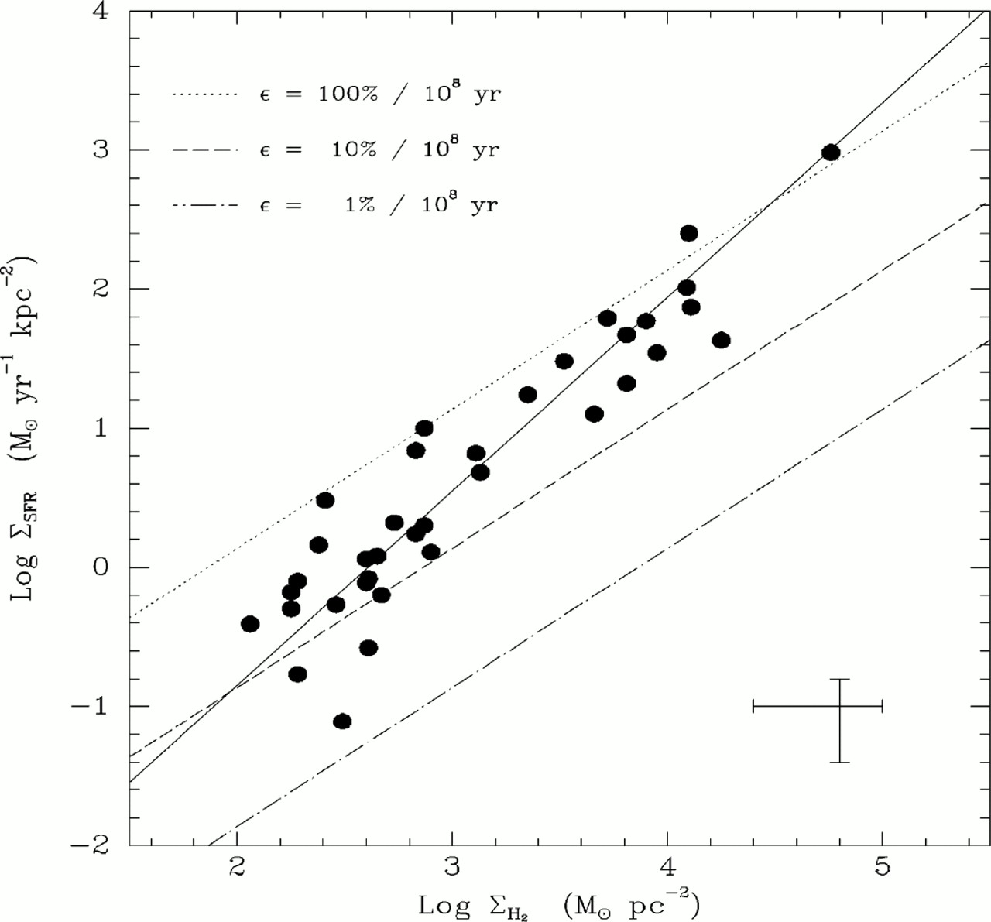
Schmidt Law Kennicutt 1998, ARAA, 36, 189
Schmidt law:
SFR ∝ Σ^{β}, β ≅ 1.4
The Milky Way fits roughly on this law
A high Σ enhances the effect of cloud collisions
The value of Σ is a direct consequence of a high accretion rate onto the nuclear regions
Milky Way GC
IR-selected circumnuclear starburst

Slide 13
Magnetic Fields
Dipole field (mGauss) strength in ~100 pc.
  evidenced by synchrotron filaments
  origin: concentration of protogalactic field by mass inflow over the lifetime of the Galaxy (Chandran, Cowley, Morris 1999).
  model should apply to all spiral galaxies.
Magnetic Jeans mass ∝ B³/ρ²

Slide 14
Metallicity
The inferred metallicity (Fe) is solar.
A number of studies have reached this conclusion based on quantitative absolute and relative analyses of red supergiants (Ramirez et al. 2000), WN stars (Najarro et al. 2005), and LBVs (Najarro et al. 2006).

Slide 15
Tidal Forces Shear Clouds
Star-forming clouds are sheared by the tidal force in the Galactic center.
Stability requires (Güsten & Downes 1980):
  n_{H2} > 10⁷ cm⁻³ (1.6 pc/R)^{1.8}
  Parent cloud of Arches Cluster, at R=30 pc:
    n_{H2} > 5(10⁴) cm-3
But there is also a compressive force for clouds on radial orbits

Slide 16
supermassive black hole

Slide 17
Black Hole in the GC
Stellar motions suggest a 4(10⁶) M_{Sun} black hole.
The first piece of evidence was from infalling gas (~late 1980s).
The second piece of evidence came from stellar motions (~late 1990s).
The final piece of evidence came from individual stellar orbits (~early 2000s).

Slide 18
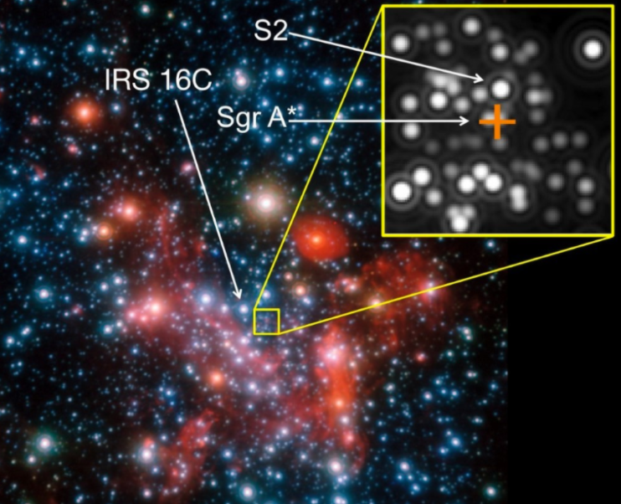
The Central Parsec

Slide 19
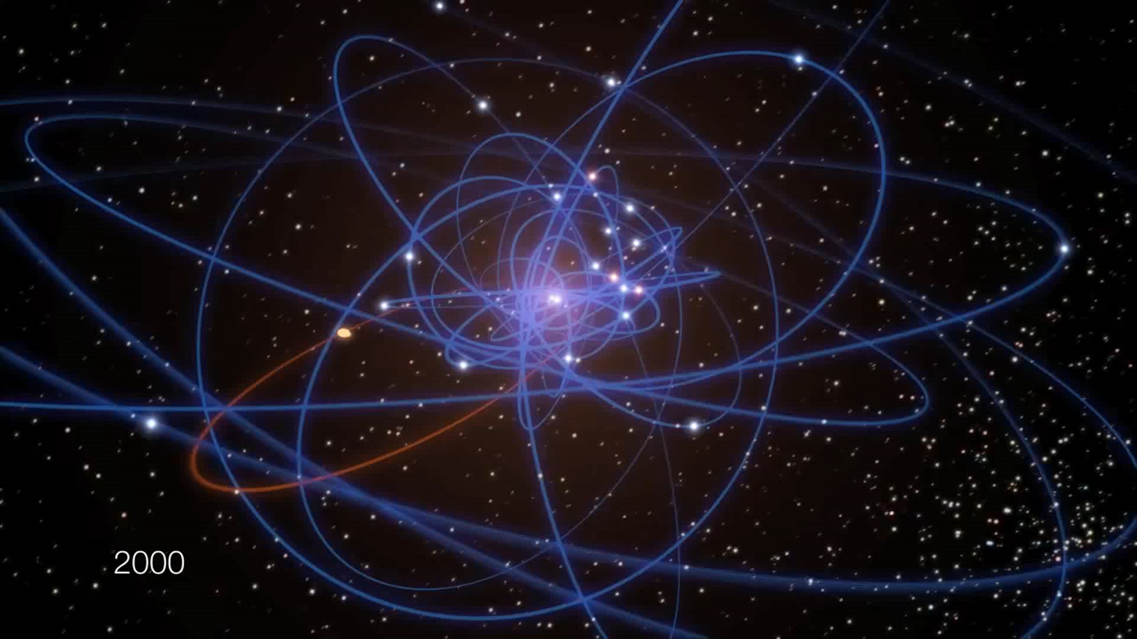
Stellar Orbits Near the GC
Credit: ESO/MPE/M. Schartmann/L. Calçada

Slide 20

2020 Nobel Prize in Physics

Slide 21
Historical Context
1931, Jansky, Sgr A
1968, Becklin & Neugebauer, IR
1973, Rieke & Low, IR
1974, Balick & Brown, Sgr A*
1980-1985, Serabyn & Lacy, gas - M_{BH}=3-4(10⁶) M_{Sun}
1996, Eckart & Genzel, stars - M_{BH}=3(10⁶) M_{Sun}
1998, Ghez et al., stars - M_{BH}=2.6(10⁶) M_{Sun}
2002, Schoedel et al., S2, M_{BH}=4.1(10⁶) M_{Sun}
2003, Ghez et al., S2, M_{BH}=4.6(10⁶) M_{sun}
2009, Gillessen et al., M_{BH}=4.3(10⁶) M_{Sun}
2018, Genzel et al., S2 gravitational redshift
2019, Ghez et al., S2 gravitational redshift
2020, Abuter et al., S2 orbit precession
2020, Nobel Prize

Slide 22
Measuring Mass
Find “test particles” orbiting another object.
Measure position and velocity.
Infer mass using Kepler and Newton.

Slide 23
Kepler and Newton
Kepler (1610)
  orbits are ellipses
  equal areas are swept in equal time
  square of the period is cube of the radius
Newton (1687)
  objects remain in motion unless there is a force
  force equals mass times acceleration
  force exerted by one body is equal to force on that body
  gravity is proportional to the product of the masses divided by the square of the distance

Slide 24



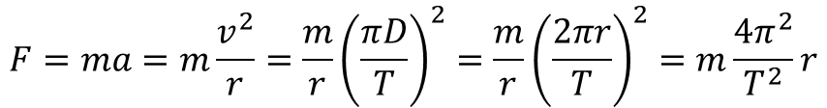
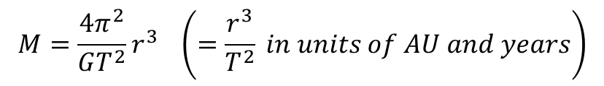
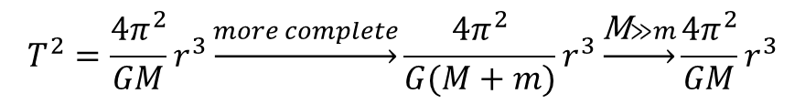

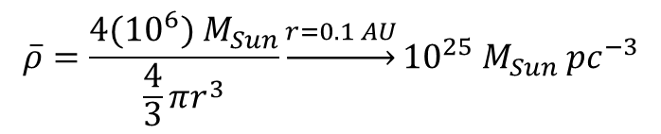
Calculating the Mass
$$F=ma=m\frac{v^{2}}{r}=\frac{m}{r}{\left(\frac{πD}{T}\right)}^{2}=\frac{m}{r}{\left(\frac{2πr}{T}\right)}^{2}=m\frac{4π^{2}}{T^{2}}r$$
$$F=G\frac{Mm}{r^{2}}$$
$$m\frac{4π^{2}}{T^{2}}r=G\frac{Mm}{r^{2}}$$
$$T^{2}=\frac{4π^{2}}{GM}r^{3}\underset{→}{more complete}\frac{4π^{2}}{G(M+m)}r^{3}\underset{→}{\text{M}≫m}\frac{4π^{2}}{GM}r^{3}$$
$$M=\frac{4π^{2}}{GT^{2}}r^{3} \left(=\frac{r^{3}}{T^{2}} in units of AU and years\right)$$
$$M\underset{→}{r=1 AU, T=1 year}=1 M_{Sun}$$
$$M\underset{→}{r=1000 AU, T=16 years}=4({10}^{6}) M_{Sun}$$
$$\overline{ρ}=\frac{4({10}^{6}) M_{Sun}}{\frac{4}{3}πr^{3}}\underset{→}{r=0.1 AU}{10}^{25} M_{Sun} {pc}^{−3}$$

Slide 25
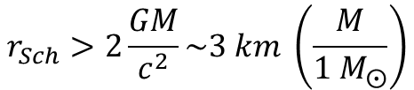
Schwarzchild Radius
Recall equation 18.54, which gives the Schwarzchild radius as
For M~4(10⁶) M_{Sun}, r_{Sch}~0.07 AU.
This corresponds to approximately 0.009 arcseconds, or significantly smaller than the angular resolution of the largest telescopes, including Keck and VLA.
Recall that the EHT resolution is ~0.21 AU at the Galactic center, so it will barely resolve the black hole “shadow.”
Stars with masses like the Sun, would be ripped apart before going into the event horizon and thus would be shredded into a disk.
$$r_{Sch}>2\frac{GM}{c^{2}}\sim 3 km \left(\frac{M}{{1 M}_{⨀}}\right)$$

Slide 26
Technologies
Big telescope mirrors
  Jerry Nelson (Keck)
  Roger Angel (VLT)
Adaptive optics
  Peter Wizinowich (Caltech)
  Claire Max (UCSC)
Infrared detectors
  Don Hall (HgCdTe, UH)
  Al Fowler, Judy Pipher, Bill Forrest (InSb, U of R)
Instruments

Slide 27
massive stars in the galactic center

Slide 28
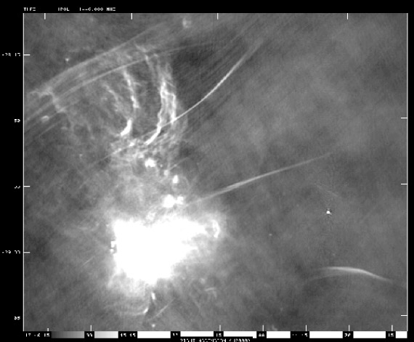
The GC in Radio - Wide View
20 cm
big clusters
UCHII regions
N
E
Lang, Morris, Echevarria 1999

Slide 29
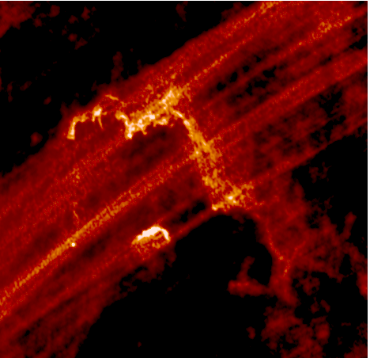
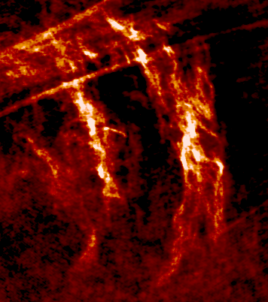
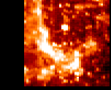

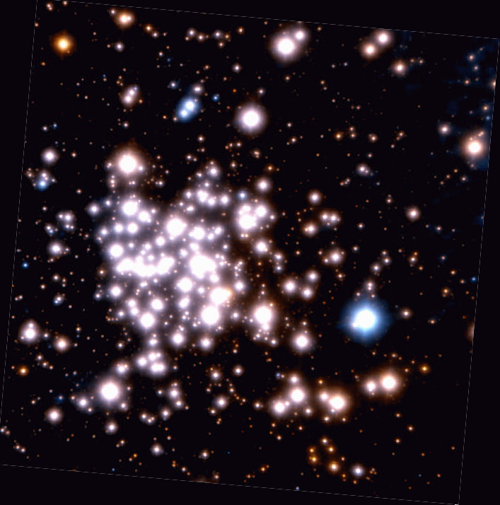
Giant HII Regions: Massive Star Signposts
Quintuplet 6 cm
Arches 6 cm
Center Br-γ
N
E

Slide 30
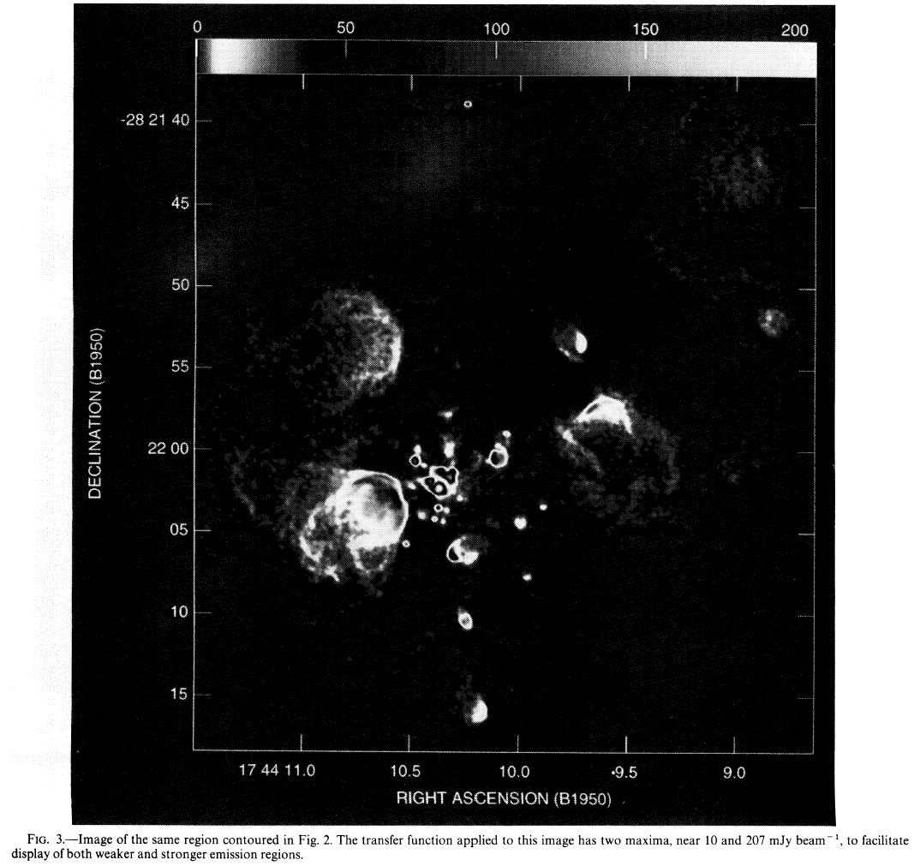
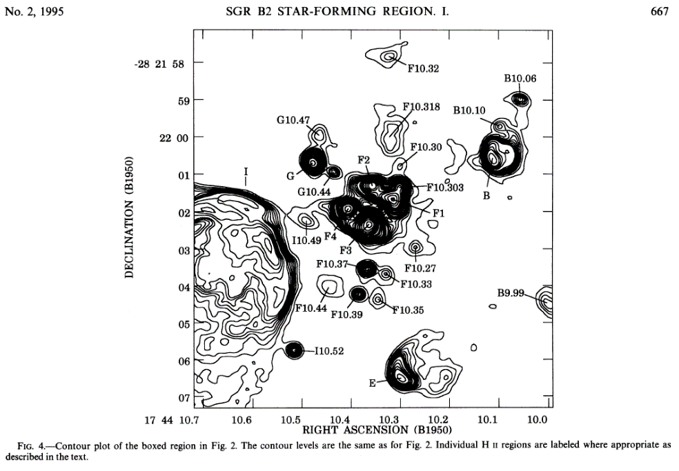
HCHII Regions in Sgr B2
There are ~100 HCHII regions in Sgr B2.

Slide 31
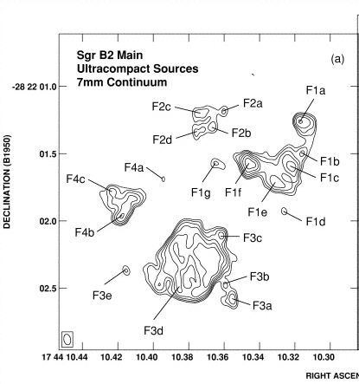
HCHII Regions in Sgr B2
The clumps break up into even smaller clumps with sizes ~100 AU and densities >10⁷ cm⁻³.
Each clump contains an OB star.

Slide 32
Young Clusters in the Galactic Center
There are three massive young clusters in the Galactic center.
They each have about a few times 10⁴ M_{sun} in stars.
They are about 2 to 5 Myr old.
They are the Quintuplet, Arches, and Central clusters.

Slide 33
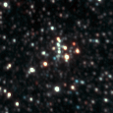

Galactic Center Clusters
1 pc
Pistol Star
Arches
Cluster
Central
Cluster
Quintuplet Cluster

Slide 34
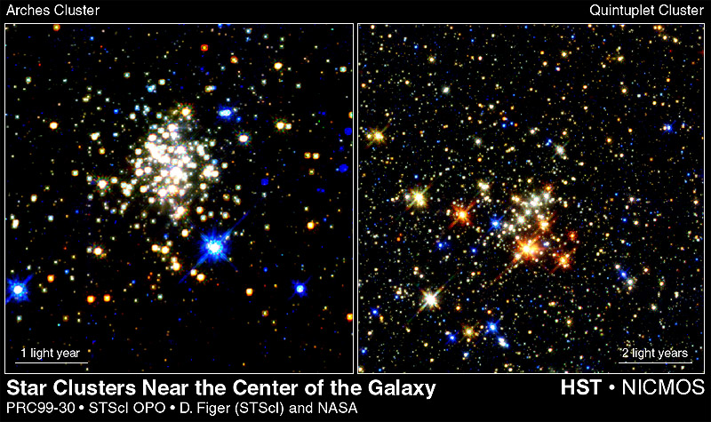
Galactic Center Clusters

Slide 35
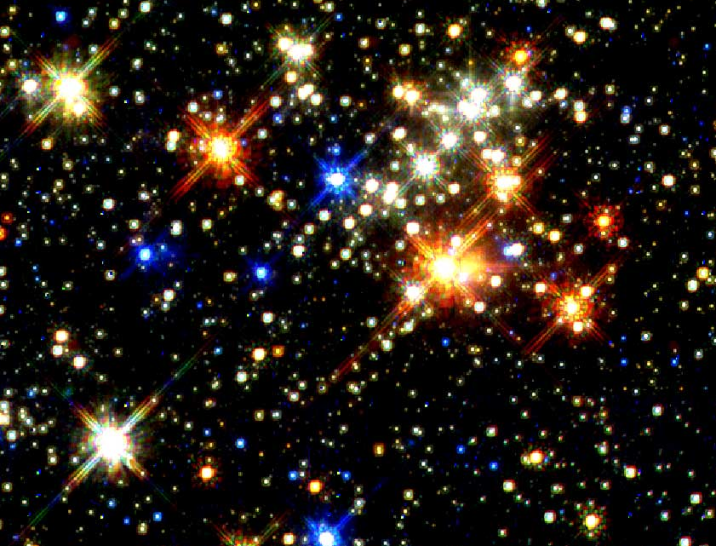
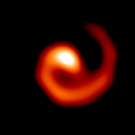
Quintuplet-proper Members: DWCLs?
L~10^{4.6} L
T~700 K
R~250 AU
WR Movie from Monnier, Tuthill, & Danchi 2002, ApJ, 567, L137

Slide 36
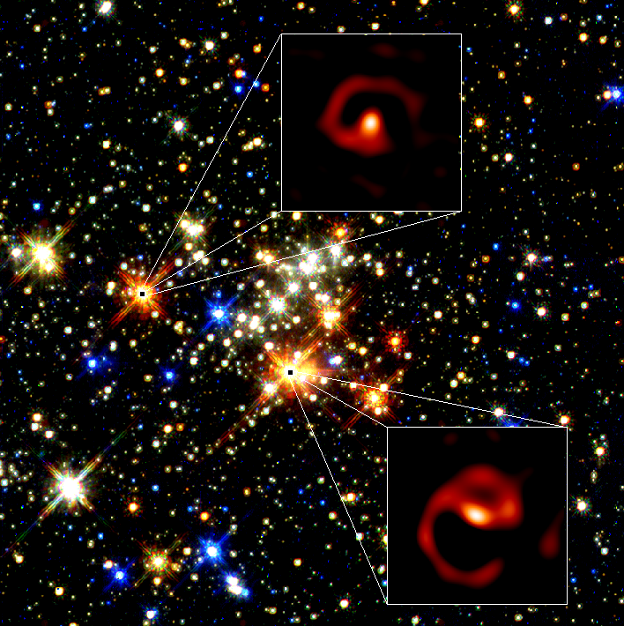
Quintuplet-proper Members: DWCLs?
Tuthill et al. (2006)

Slide 37
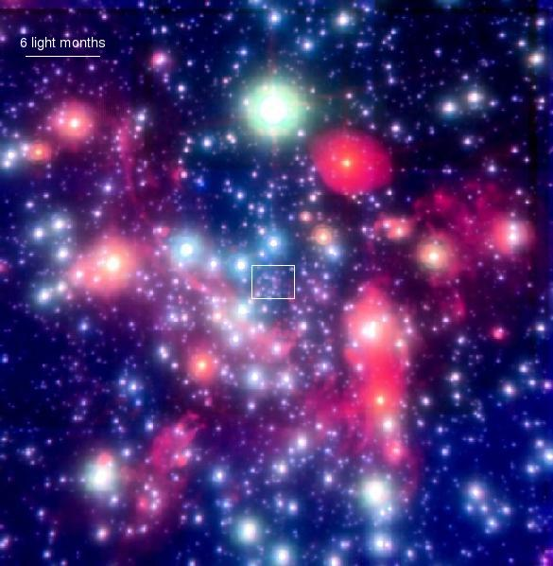
The Central Cluster
Genzel, Eckart et al.

Slide 38
Star Formation Near the Black Hole?
The stars appear younger than 20 Myr.
Merger rate probably too low.
Unlikely to have drifted inward via dynamical friction.
Tidal forces require > 4(10)¹¹ cm⁻³ for star formation.
Must find a way to compress 20 M clumps.

Slide 39
Massive Stars in GC
Note that there are ~450 O-stars with 2.5 kpc of the Sun.

Slide 40
Massive Cluster Properties

Slide 41
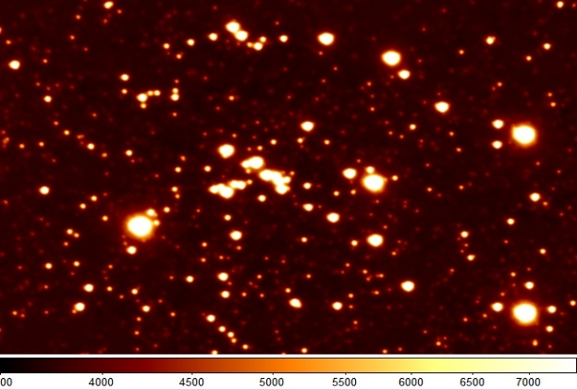
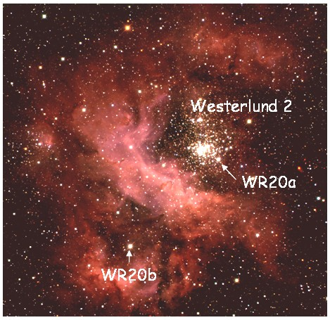
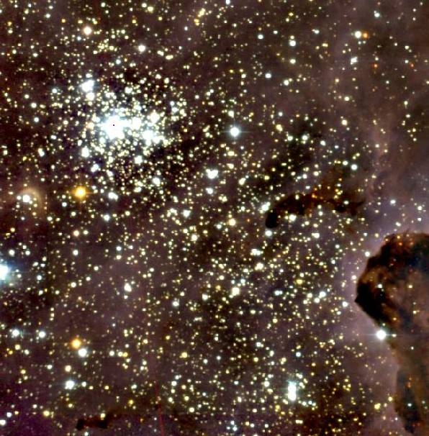
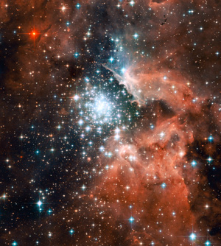
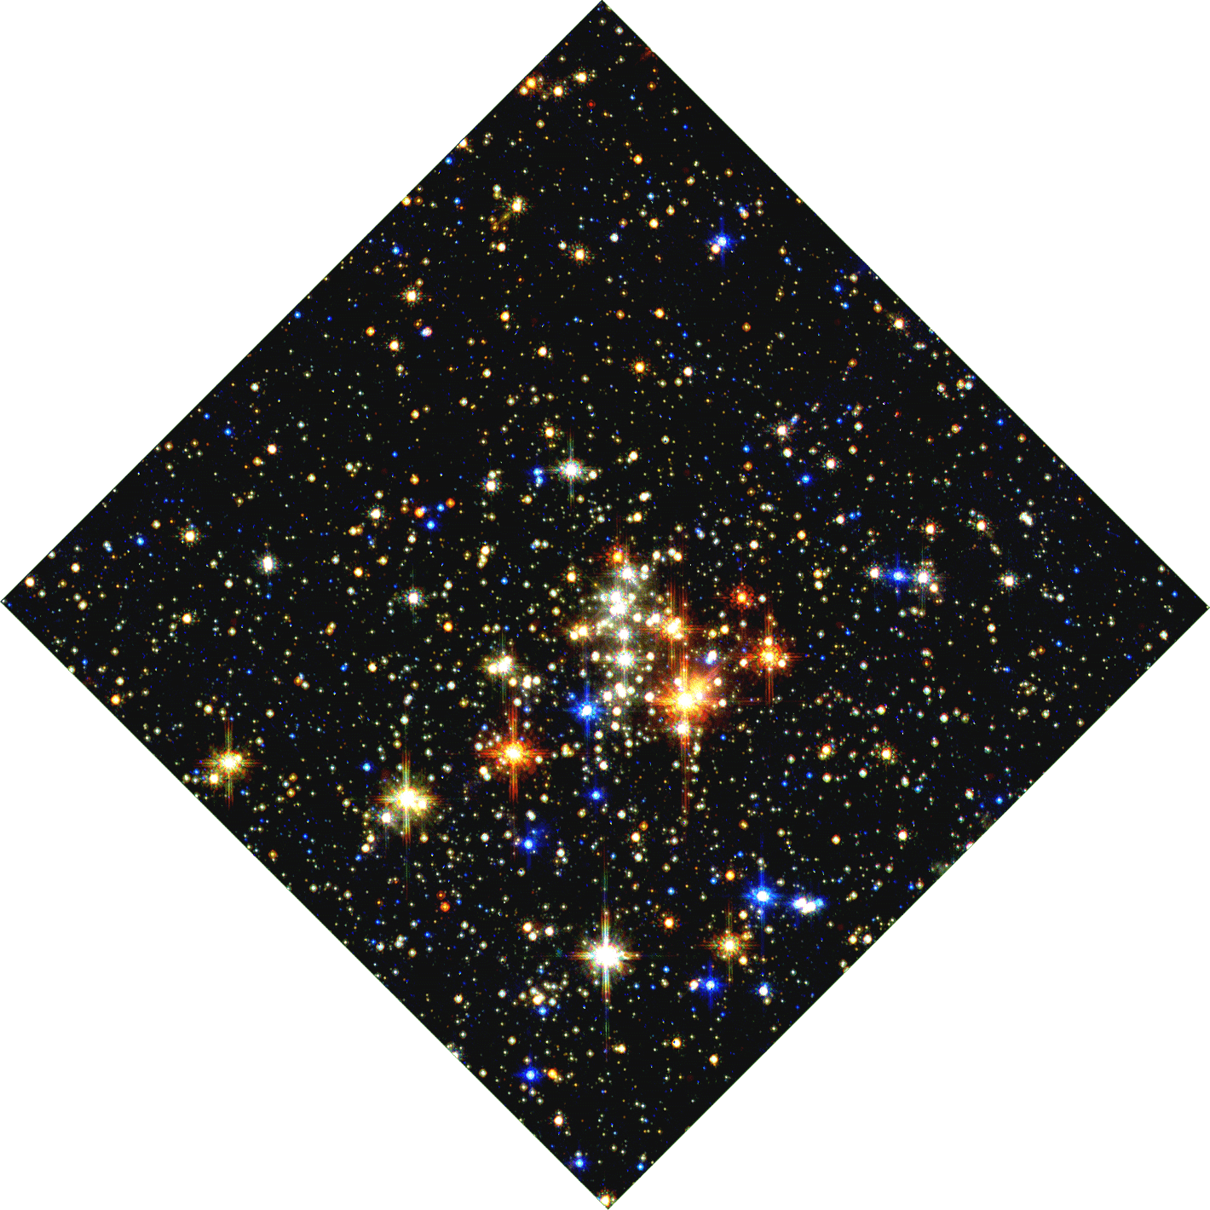
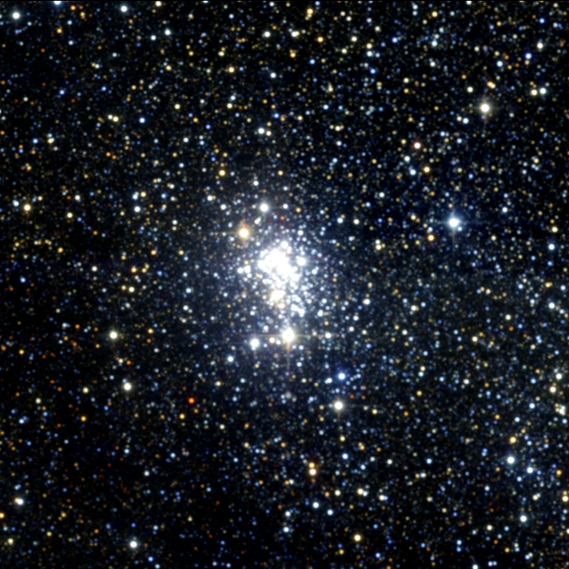
Massive Galactic Young Clusters
Cl 1806-20
NGC3603
Westerlund 2
Trumpler 14
GC
Pistol Star
1 pc
Quintuplet
Arches
Westerlund 1

Slide 42
star formation history

Slide 43
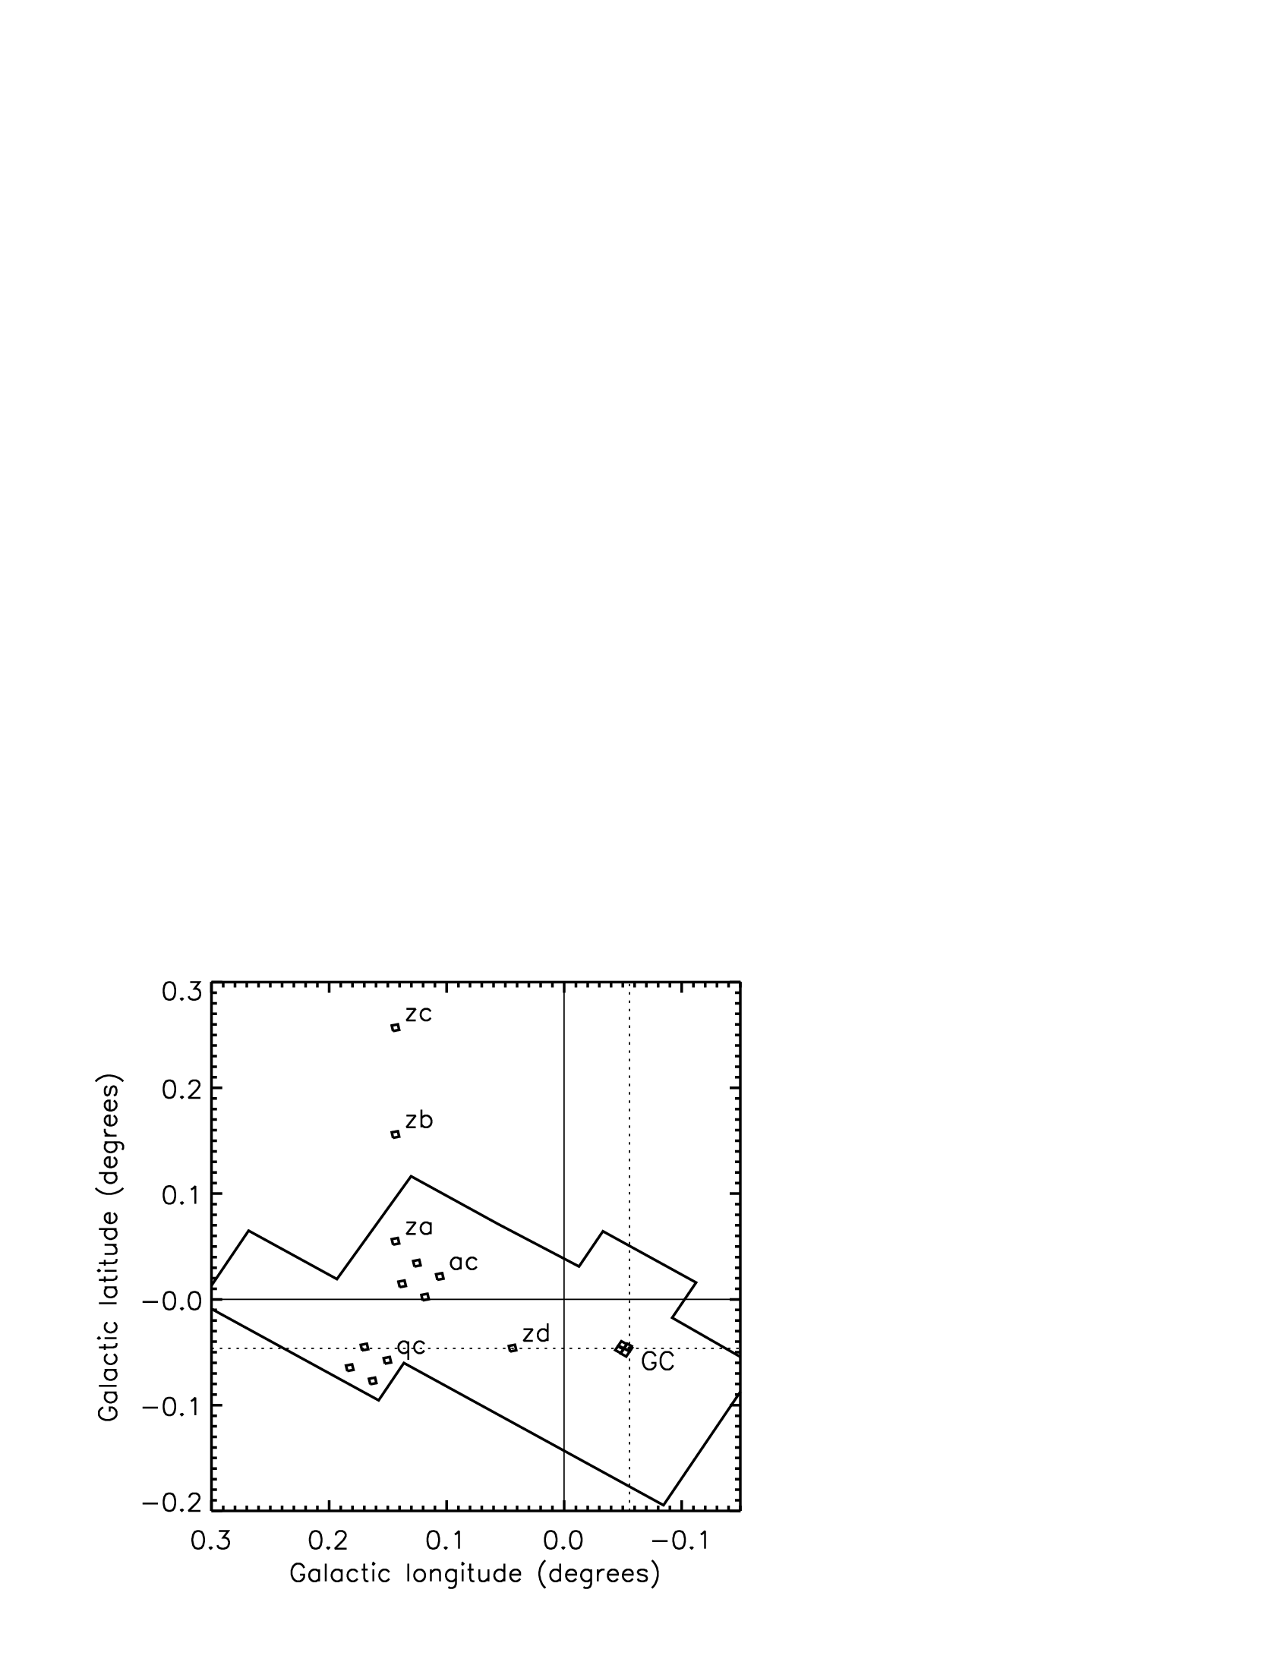
Star formation survey

Slide 44
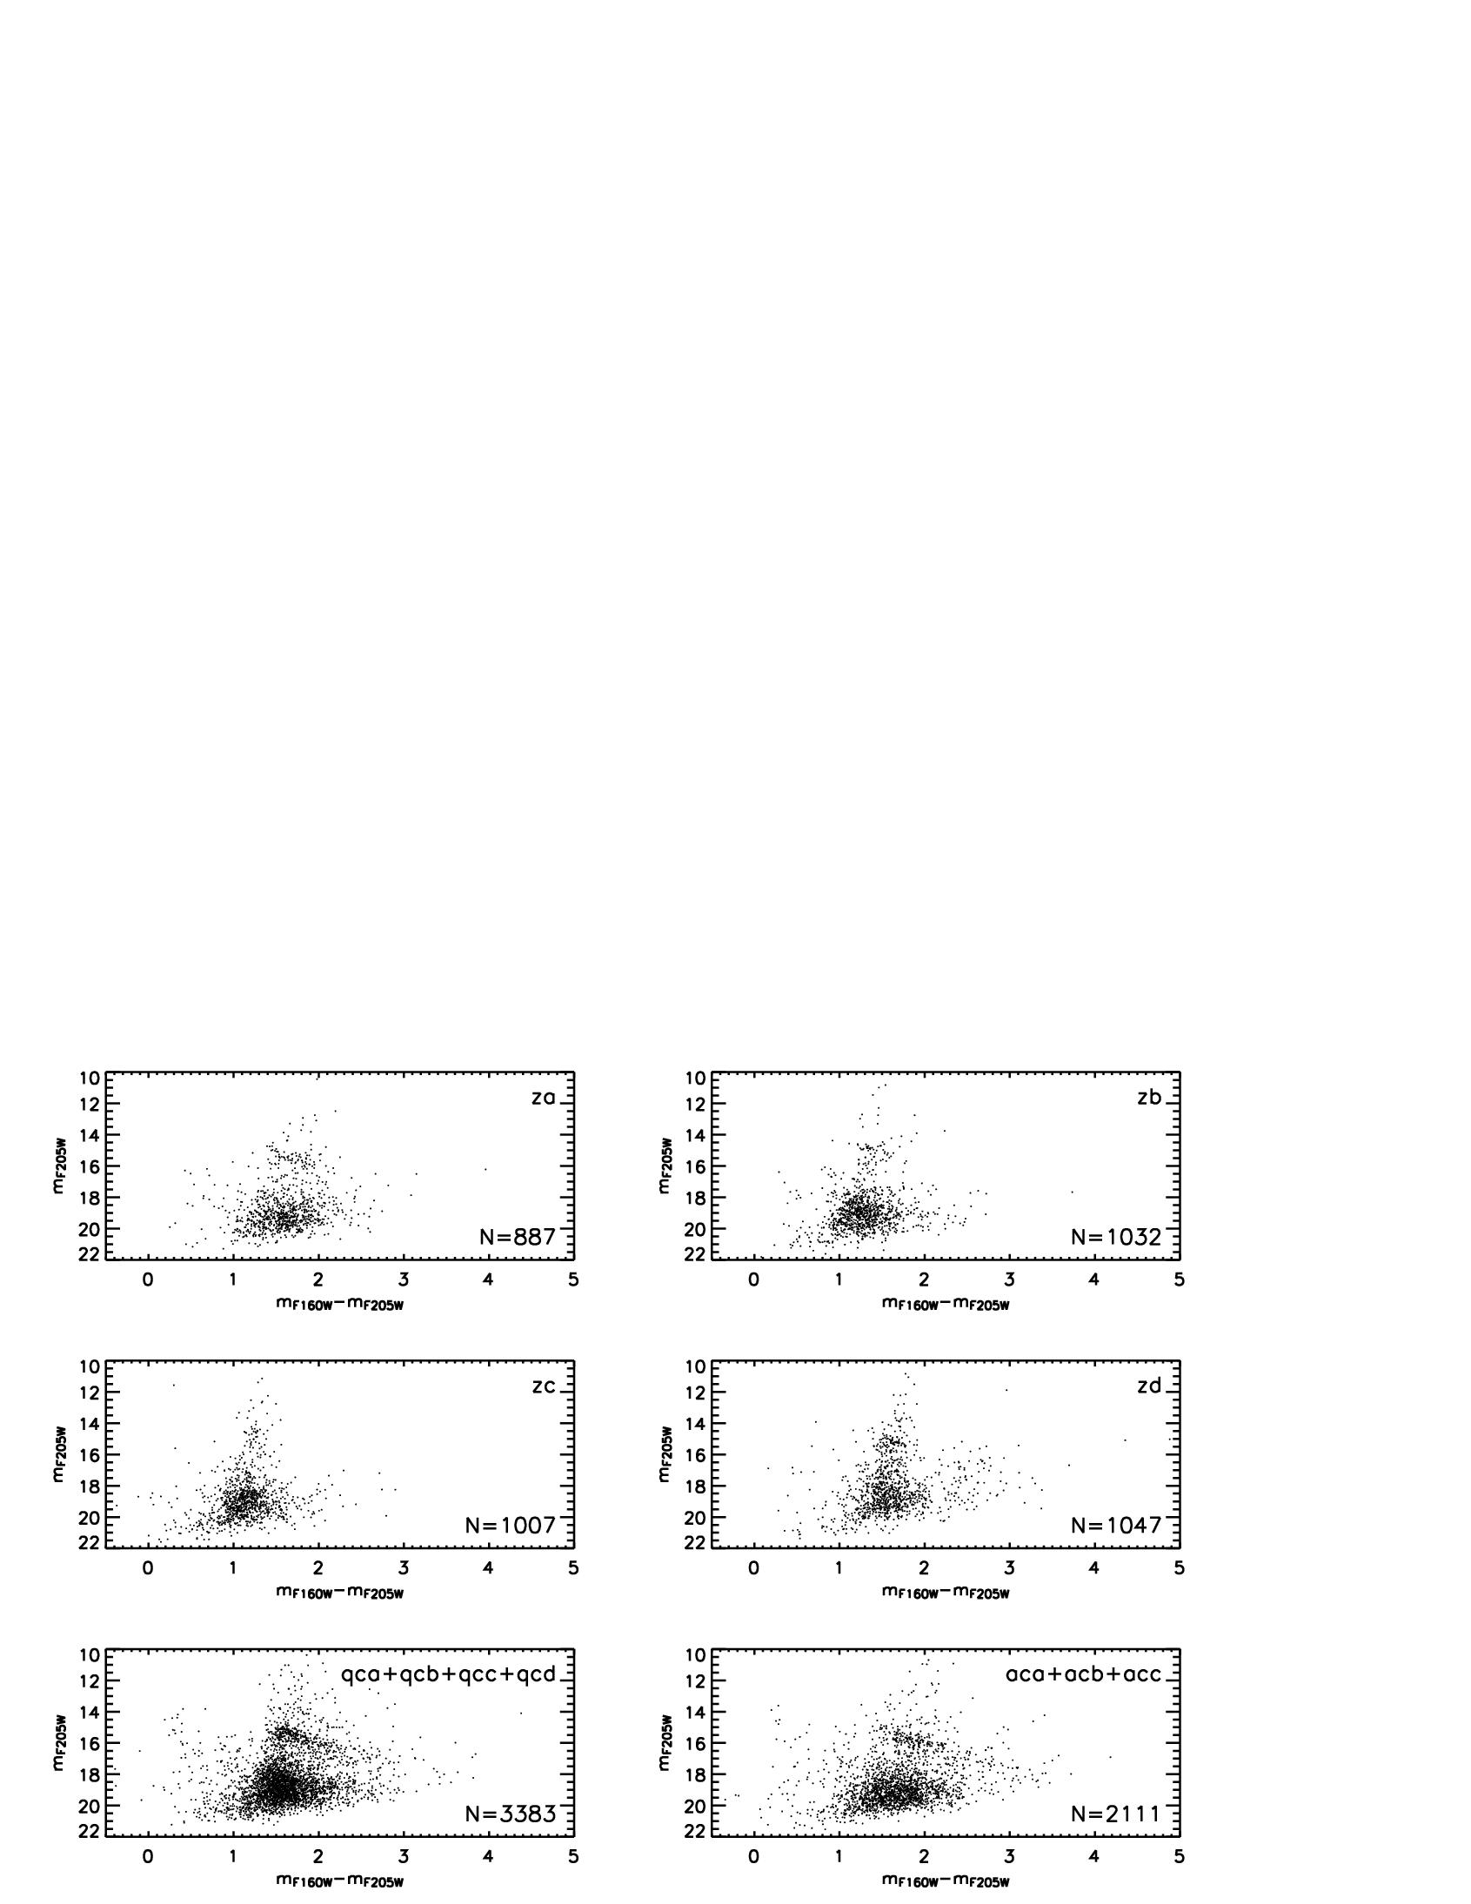
Individual CMD

Slide 45
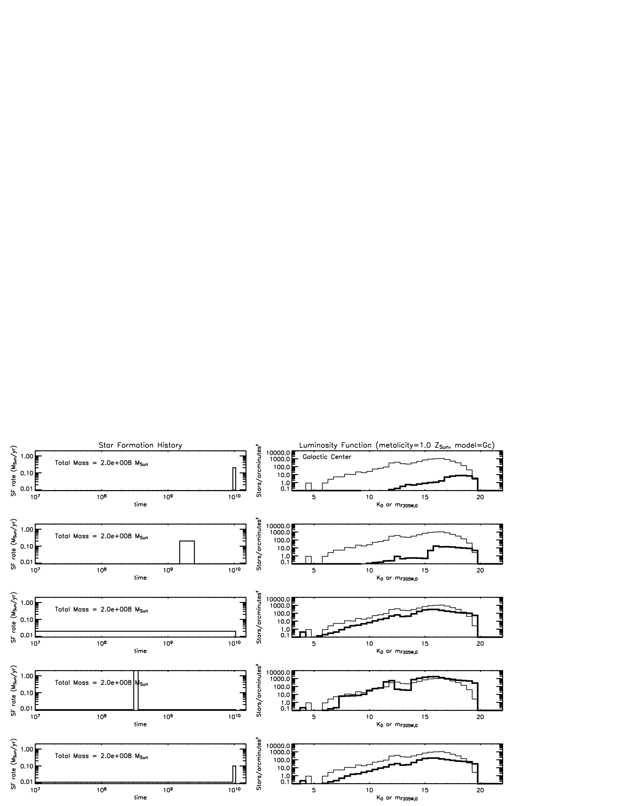
Star formation models

Slide 46
Upper mass cutoff in the galactic center

Slide 47
Understanding SF through the IMF
The IMF is a probe of the star formation process.
There are at least three diagnostics in the IMF:
  The slope
  The upper mass cutoff
  The lower mass rollover

Slide 48
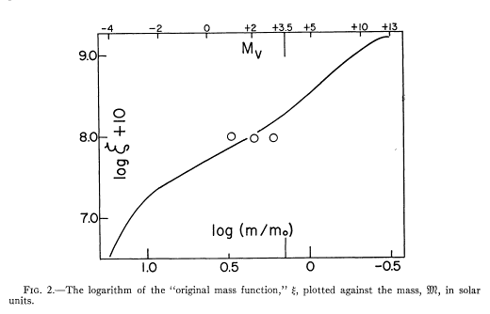
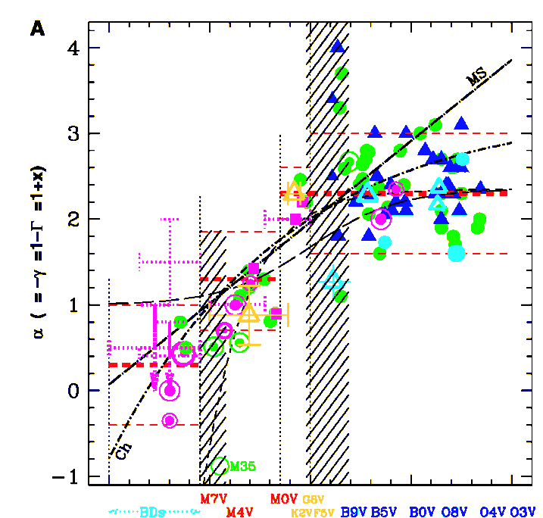
The “Standard” IMF
Γ=−1.35
Γ=−1.35
1-120 M
Salpeter 1955
Kroupa 2002
The IMF slope is usually observed to be the Salpeter value of Γ=−1.35.

Slide 49
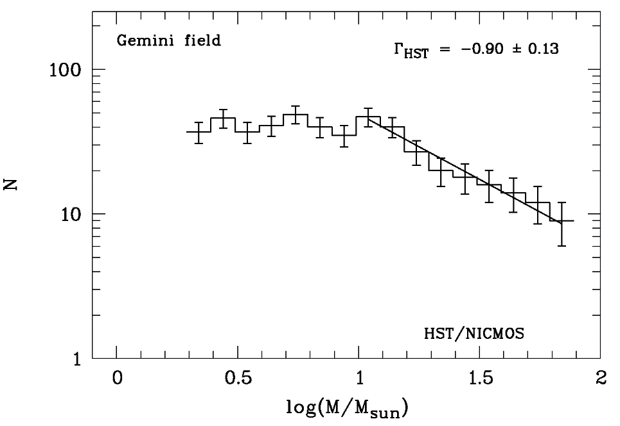
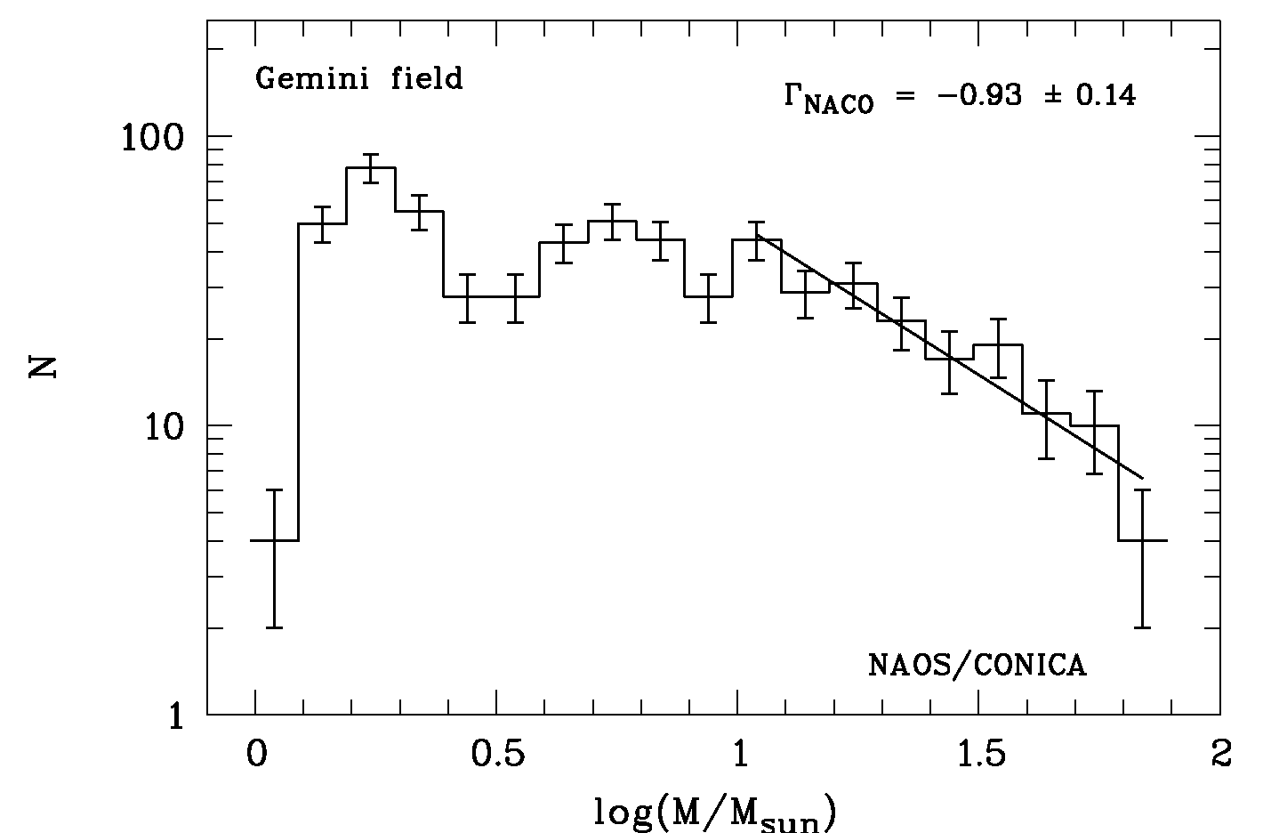
IMF in Arches Cluster
HST•NICMOS
VLT•NAOS•CONICA
Flat Mass Function in the Arches Cluster
The only direct measurement of the IMF in the Galactic Center indicates that it is shallow.

Slide 50
An upper mass limit has been elusive
There is no accepted upper mass limit for stars.
Theory: incomplete understanding of star formation/destruction.
  accretion may be inhibited by opacity to radiation pressure/winds
  formation may be aided by collisions of protostellar clumps
  destruction may be due to pulsational instability
Observation: incompleteness in surveying massive stars in the Galaxy.

Slide 51
The Upper Mass Cutoff Sample
Stars with M>150 M_{sun} can only be observed in clusters with total stellar mass >10⁴ M_{sun}.
This requirement limits the potential sample of stellar clusters that can constrain the upper mass limit to only a few in the Galaxy.

Slide 52
Upper mass limit: theoretical predictions
Ledoux (1941) | radial pulsation, e- opacity, H | 100 M
Schwarzchild & Härm (1959) | radial pulsation, e- opacity, H and He, evolution | 65-95 M
Stothers & Simon (1970) | radial pulsation, e- and atomic | 80-120 M
Larson & Starrfield (1971) | pressure in HII region | 50-60 M
Cox & Tabor (1976) | e- and atomic opacity Los Alamos | 80-100 M
Klapp et al. (1987) | e- and atomic opacity Los Alamos | 440 M
Stothers (1992) | e- and atomic opacity Rogers-Iglesias | 120-150 M

Slide 53
Upper mass limit: observation
R136 | Feitzinger et al. (1980) | 250-1000 M
Eta Car | various | 120-150 M
R136a1 | Massey & Hunter (1998) | 136-155 M
Pistol Star | Figer et al. (1998) | 140-180 M
Eta Car | Damineli et al. (2000) | ~70+? M
LBV 1806-20 | Eikenberry et al. (2004) | 150-1000 M
LBV 1806-20 | Figer et al. (2004) | 130 (binary?) M
HDE 269810 | Walborn et al. (2004) | 150 M
WR20a | Bonanos et al. (2004) Rauw et al. (2004) | 82+83 M
R136 a1 | Crowther et al. (2010) | 300 M

Slide 54
Upper mass limit: an observational test
Target sample must satisfy many criteria.
  massive enough to populate massive bins
  young enough to be pre-supernova phase
  old enough to be free of natal molecular material
  close enough to discern individual stars
  at known distance
  coeval enough to constitute a single event
  of a known age
Number of "expected" massive stars given by extrapolating observed initial mass function.

Slide 55

Goldilocks and the stellar upper mass limit: Westerlund 1
Westerlund 1
Too old!

Slide 56
Goldilocks and the stellar upper mass limit: Sgr B2
Sgr B2
Too young!

Slide 57
Goldilocks and the stellar upper mass limit: Arches cluster
Arches cluster
just right!

Slide 58
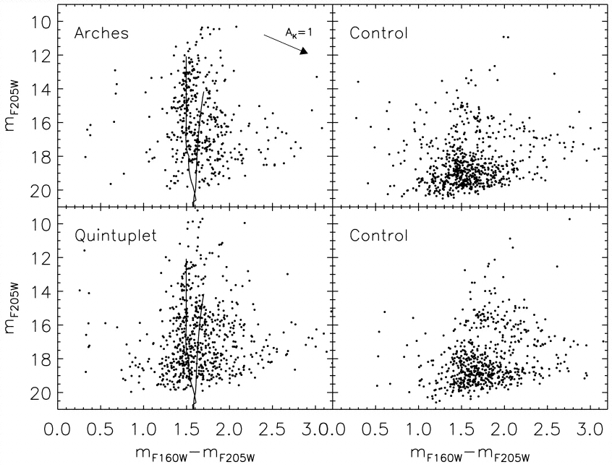
Arches Cluster CMD: Young Stars!
Figer et al. 1999, ApJ, 525, 750

Slide 59
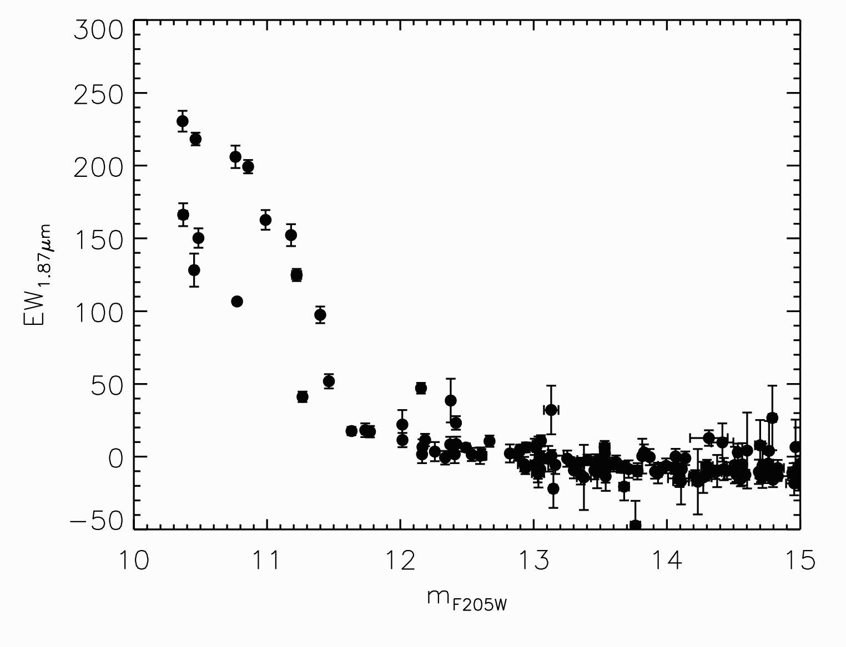
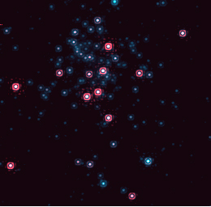
Arches Cluster: Paschen-α
No WNE
or WC!
Figer et al. 2002, ApJ, 581, 258

Slide 60
Arches Cluster CMD
Figer et al. 1999, ApJ, 525, 750

Slide 61
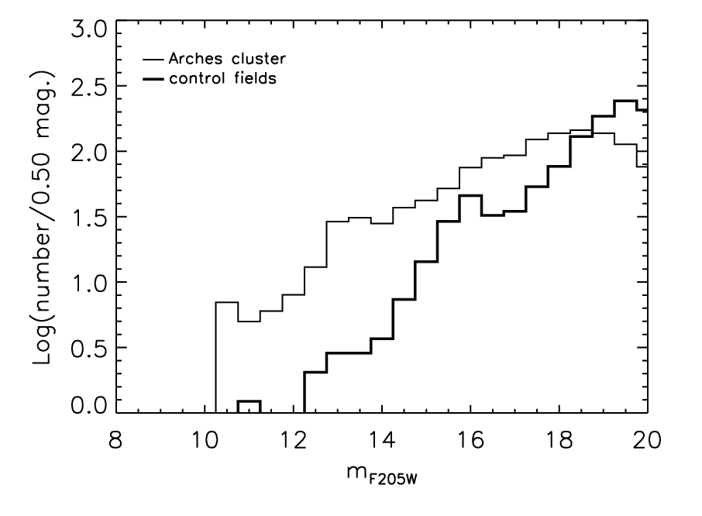
Luminosity function

Slide 62
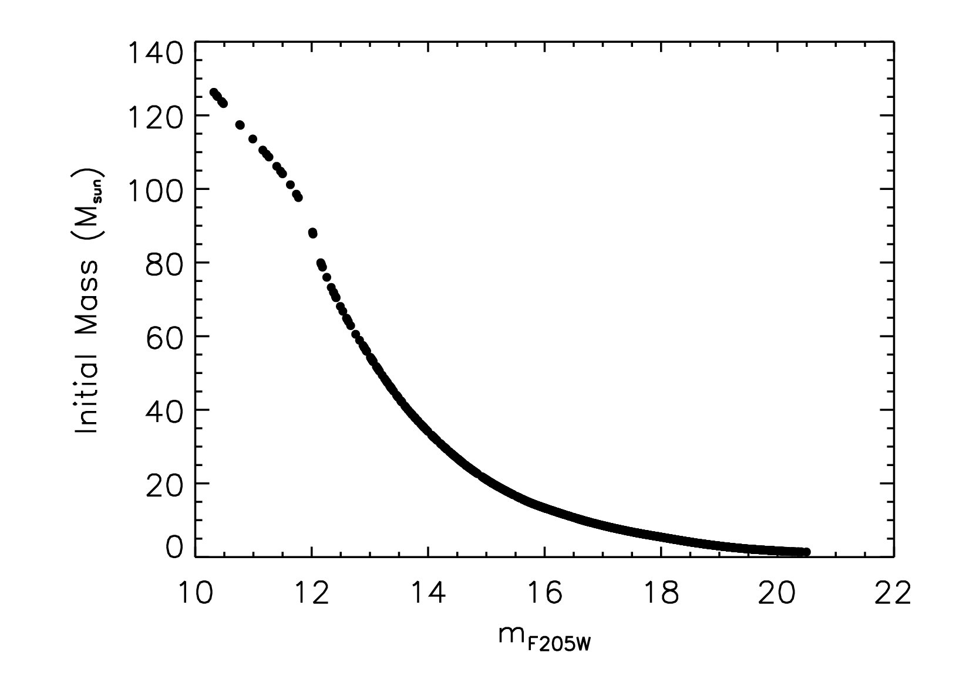
Mass vs. magnitude for t=2 Myr

Slide 63
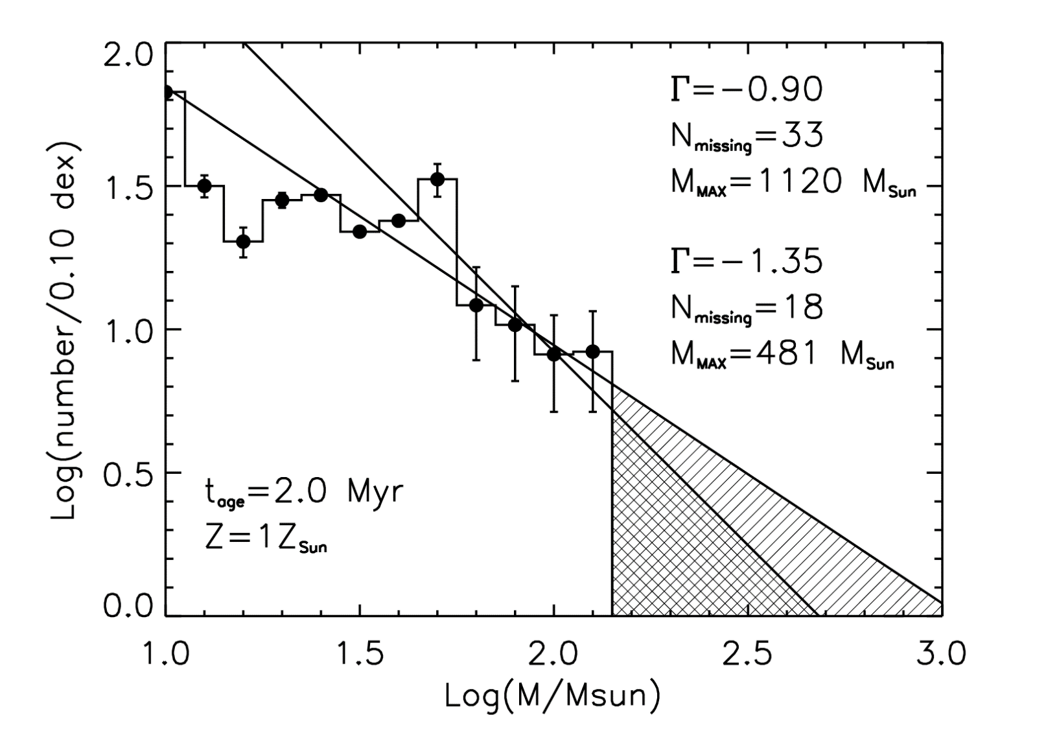
Initial mass function

Slide 64
Summary
The Galactic center has a supermassive black hole.
The GC contains a substantial fraction of the massive star population in the Galaxy.
The Arches Cluster has a shallow slope and upper mass cutoff of ~150 M.
The cloud heating and ionization in the GC is dominated by massive stars.
The GC is presently producing new massive clusters and likely has done so for the past 10 Gyr.
Massive stars may form in “challenging” environments, i.e. near a supermassive black hole.

