Slide 1
University Astronomy
Professor Don Figer
The Interstellar Medium

Slide 2
Aims and outline for this lecture
describe components of the interstellar medium
explain the source and effects of extinction

Slide 3
components of the ism

Slide 4
The ISM
The ISM is the interstellar medium, also known as “the stuff between the stars.”
It contains atoms and molecules in the form of gas and grains of dust.
“Gas” refers to single atoms and molecules.
“Dust” refers to conglomerations of atoms/molecules in particles that are hundreds/thousands of nm in size.
By mass, there is 100 times more gas than dust.
The material varies in density with the densest parts representing gas/dust clouds.
The temperature and ionization states of the material depend on the local photon radiation field and matter-matter collisions.

Slide 5
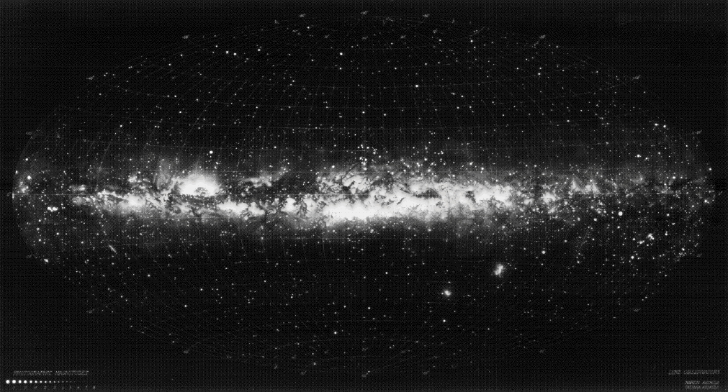
The Stuff Between Stars
Space isn’t empty, but is nearly so.
All the interstellar gas and dust in a volume the size of the Earth only yields enough matter to make a pair of dice.

Slide 6
Gas and Dust
Gas is atoms and small molecules, mostly hydrogen and helium for the atoms, and mostly H₂ and CO for the molecules.
Dust is more like soot or smoke, larger clumps of particles.
Dust absorbs light and reddens light that gets through.

Slide 7
Nebulae
Nebula is a general term used for fuzzy objects in the sky.
The term was used to name things that we now know are actually galaxies and star clusters, so we no longer use this word for those objects.
We continue to use the word to describe gas/dust that reflects or emits radiation.
  Emission nebula: glows, due to hot stars
  Reflection nebula: light from star bounces off of cloud particles
Nebulae are clear evidence that gas and dust exists.

Slide 8
Emission Nebulae
Emission nebulae emit their own light.
The emission can come from bound-bound transitions as electrons recombine and cascade to lower energy levels. This means that the electrons were ionized initially, telling us that there is an ionizing source (hot star) nearby.
The emission can also be in the form of blackbody radiation from warm dust.
Line emission is evidence of the existence of gas.
Blackbody radiation is evidence of the existence of dust.

Slide 9
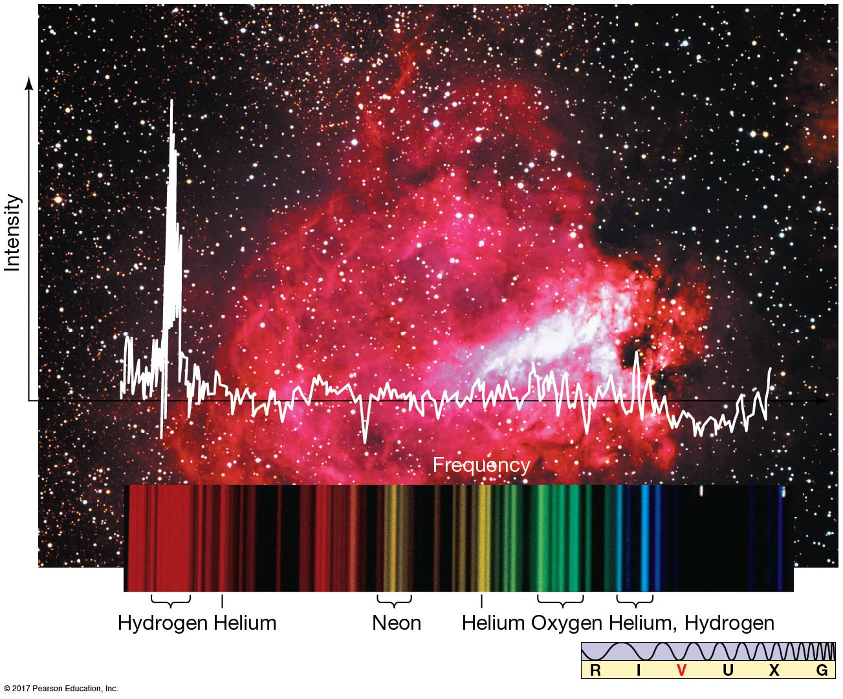
M17 Emission Nebula

Slide 10
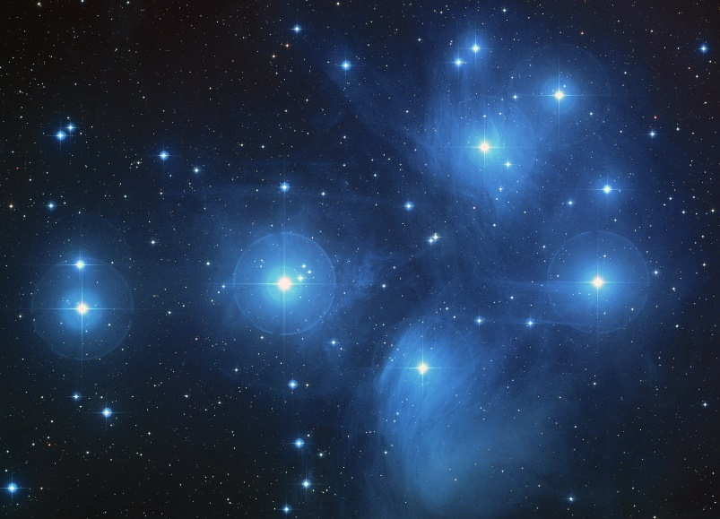
Reflection Nebulae
Reflection nebulae appear to emit light, but they actually reflect light from a nearby source.
The spectrum of the reflected light is the same as the spectrum of the source.
Dust in the nebula provides the reflective surfaces.
Reflection nebulae are evidence of the existence of dust.

Slide 11
Molecular Clouds
Molecular clouds contain molecular gas and dust.
They can sometimes be seen because they are blocking background light.
Some of the clouds are dense enough to fragment and collapse into stars.
They also emit radiation, such as molecular lines and blackbody continuum radiation.
The molecular lines are evidence of gas.
The blackbody radiation is evidence of dust.

Slide 12
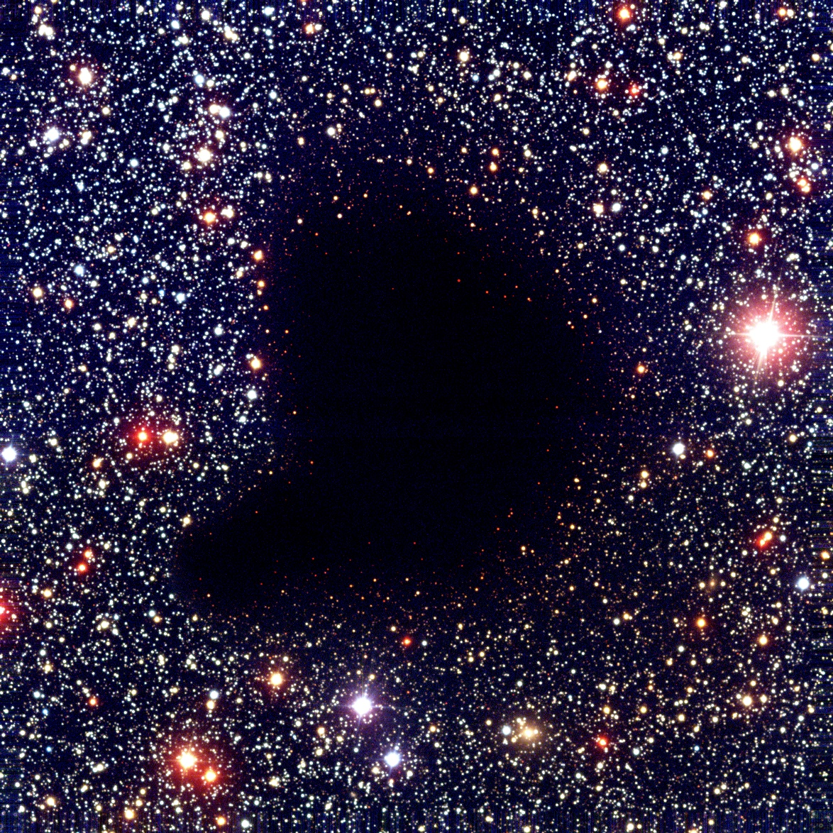
Barnard 68

Slide 13
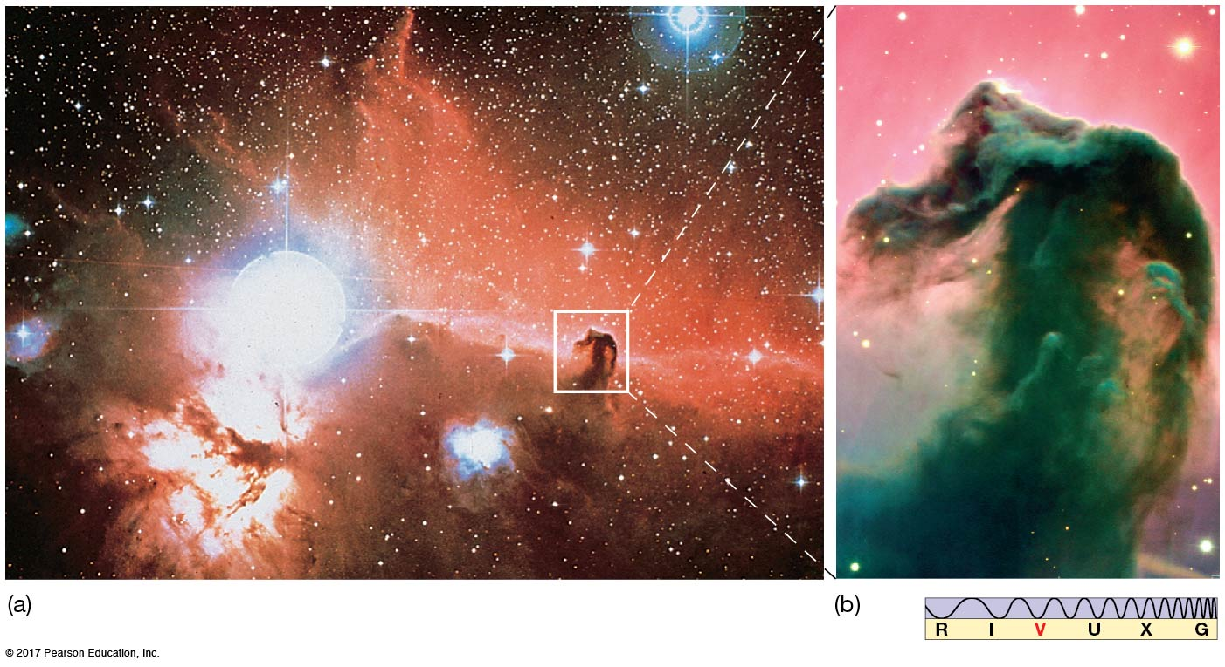
Horsehead Nebula

Slide 14
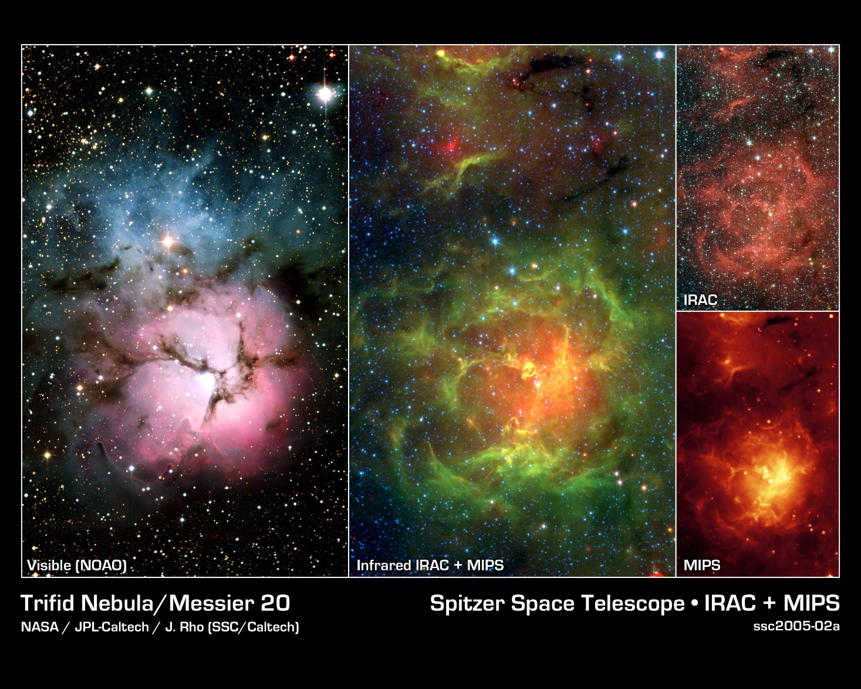
Trifid Nebula
Reflection Nebula
Dust Lanes
Emission Nebula

Slide 15
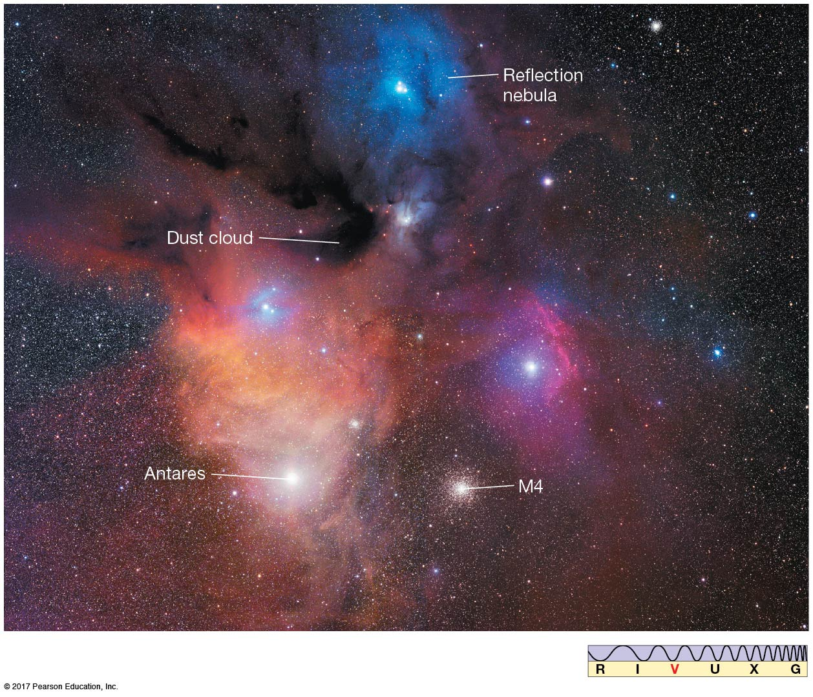
Region Near M4
The central portion of this cloud is very dark and can be seen only by its obscuration of the background stars. Nearby are reflection and emission nebulae; M4 is a globular star cluster.

Slide 16
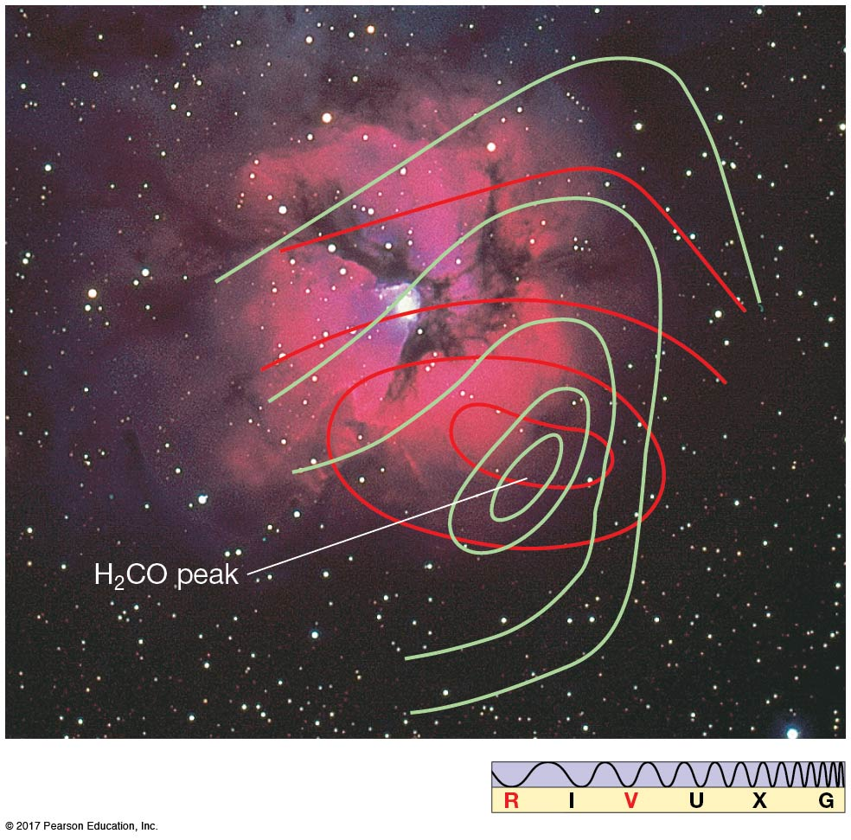
Molecular Lines
This is a contour map of H₂CO near the M20, the Trifid Nebula.
Here, the red and green lines correspond to different rotational transitions.
Other molecules that can be useful for mapping out these clouds are CO₂ and H₂O.

Slide 17
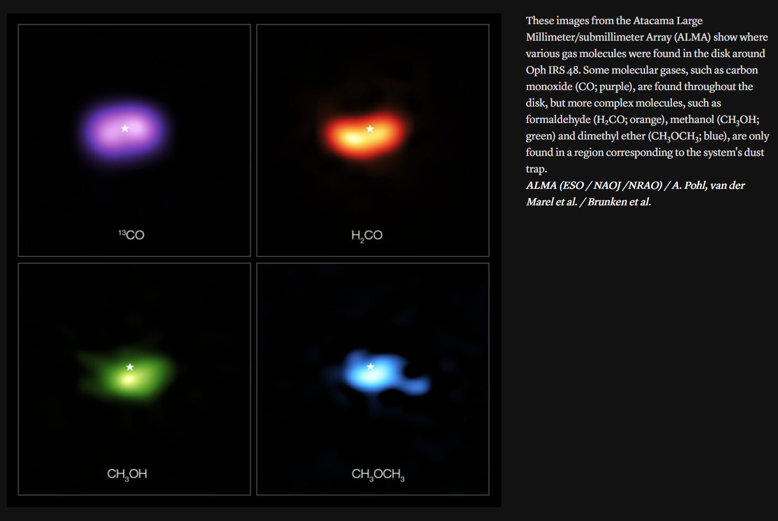
Complex Molecules

Slide 18
radiation field

Slide 19
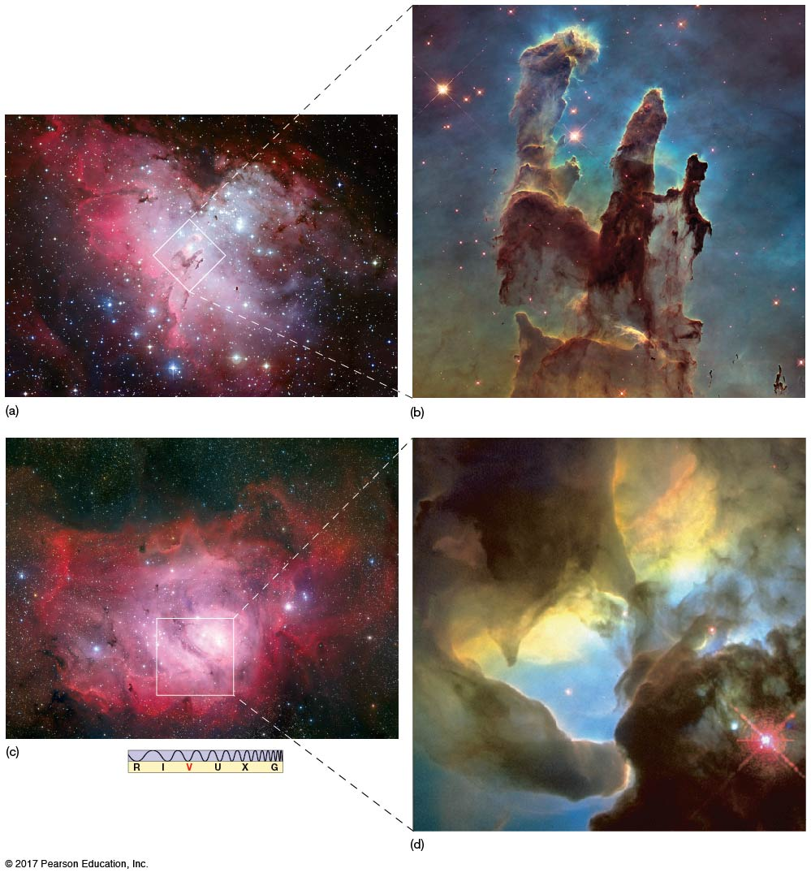
Photoionization
There is a strong interaction between the nebula and the stars within it.
The fuzzy areas near the pillars are due to photoevaporation.
The Eagle Nebula (Pillars of Creation) and the Lagoon Nebula (M8) are shown on the right.

Slide 20
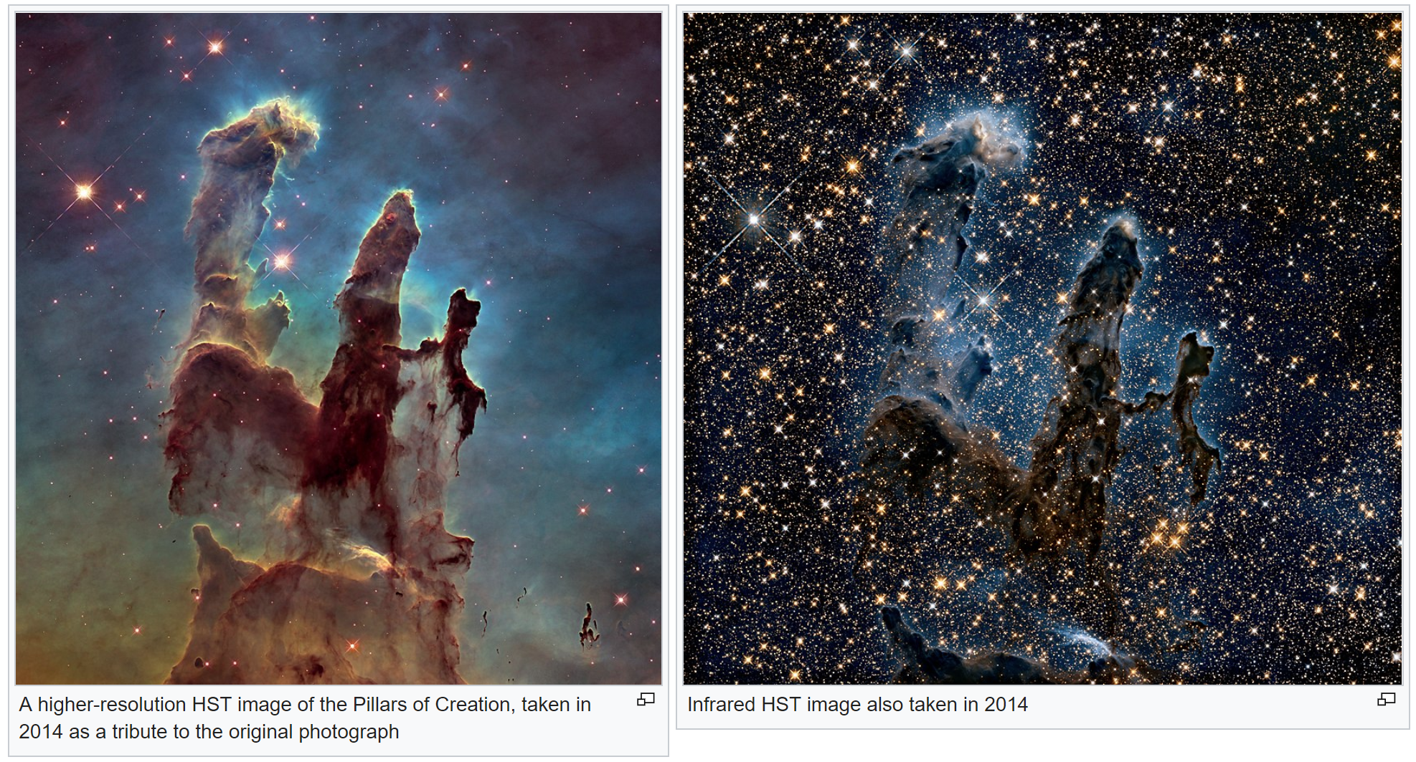
Pillars of Creation Closeup

Slide 21
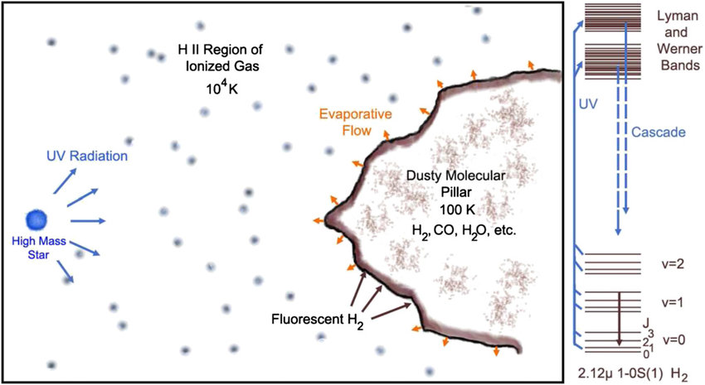
Ionization
Schematic of an H II/photodissociation region

Slide 22
Photodissociation Regions
Photons with energies greater than 13.6 eV ionize hydrogen.
Photons with slightly less energies can ionize other atoms with lower ionization potentials and can also break apart molecules.
Photodissociation regions (PDRs) are interstellar gas phases in which far-ultraviolet (FUV; 6 eV < hν < 13.6 eV) radiation plays a role in the heating and or chemistry.
These include the diffuse atomic interstellar medium, and the surfaces of molecular clouds exposed to the interstellar radiation field and to intense radiation from nearby OB stars.

Slide 23
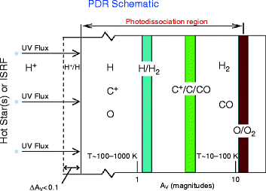
PDR Schematic

Slide 24
extinction

Slide 25
Extinction
Why are sunsets red?
Light is absorbed or scattered by objects the same size or smaller than its wavelength.
Whenever there is a lot of dust between you and the Sun, the blue light is absorbed or scattered leaving the only the red light.
Dust grains have a size approximately equal to a wavelength of blue light.
Dust clouds:
  Opaque to blue light (UV, X-rays)
  Transparent to red light (IR, radio)
Dust is in space. When it absorbs/scatters light, one calls that “extinction.” Think about something “extinguishing” light.

Slide 26
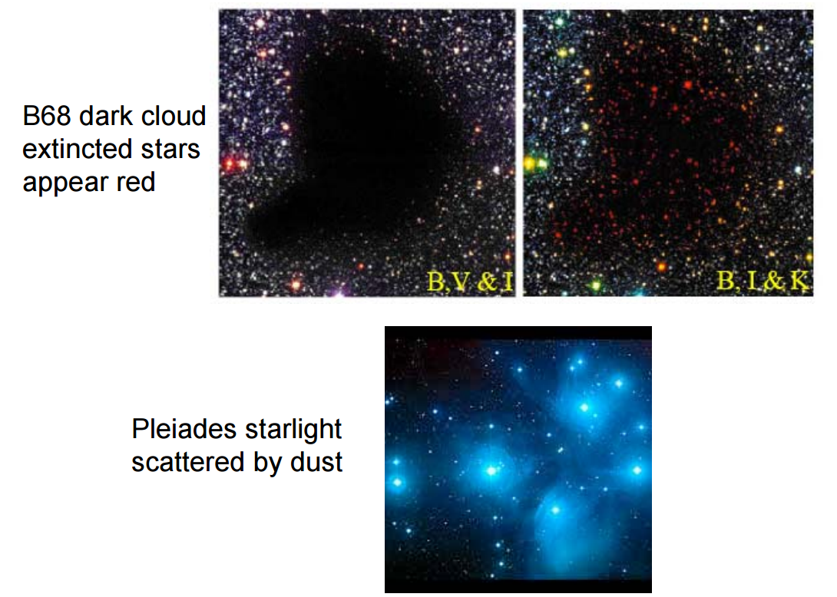
Examples of the Effects of Dust

Slide 27
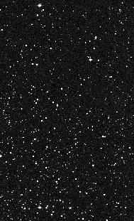
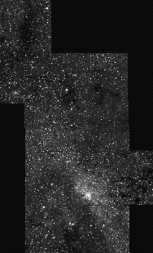
Where is the Center of the Galaxy?
optical
infrared
Digitized Sky Survey
Figer 1995

Slide 28
Proof of Dust
The existence of dust was controversial until ~100 years ago.
William Herschel showed that star counts were fewer in some directions.
Barnard’s images (B68!) showed reduction in star counts.
Trumpler conclusively demonstrated interstellar absorption by observing star clusters and estimated 2 mag/kpc in V-band.
Starlight is polarized in regions of high extinction with one polarization state selectively removed by scattering from small elongated conducting or dielectric particles aligned in the Galactic magnetic field.
Reflection nebulae contain dust.

Slide 29
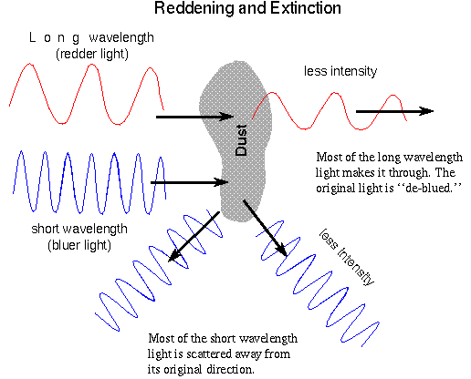
Extinction by Dust: Wavelength Dependence
Notes:
Blue light scatters more strongly than red light.

Slide 30
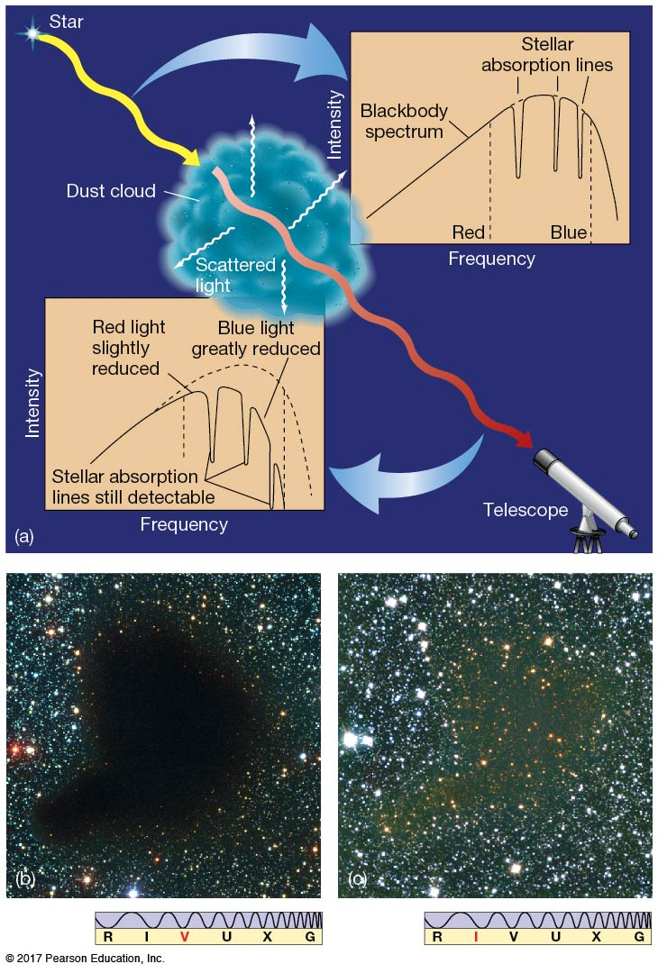
Extinction by Dust: Wavelength Dependence

Slide 31
Extinction
Extinction is often symbolized with the letter “A” and is measured in magnitudes.
It is a function of wavelength and is bigger for shorter wavelengths. A_{λ} symbolizes extinction at a wavelength of λ.
m_{obs,λ}=m_{0,λ}+A_{λ}, where m₀ is called the “dereddened” magnitude, and A_{λ}=-2.5log(F_{λ}/F_{λ,0}).
The distance modulus, m−M needs to be modified to account for extinction when using the apparent “reddened” magnitude.
m_{obs,λ}−M_{λ}=5log(d)−5+A_{λ}
Without taking account of the extinction, one will mistakenly calculate distances that are too far compared to the real distances (as was done by Shapley).

Slide 32
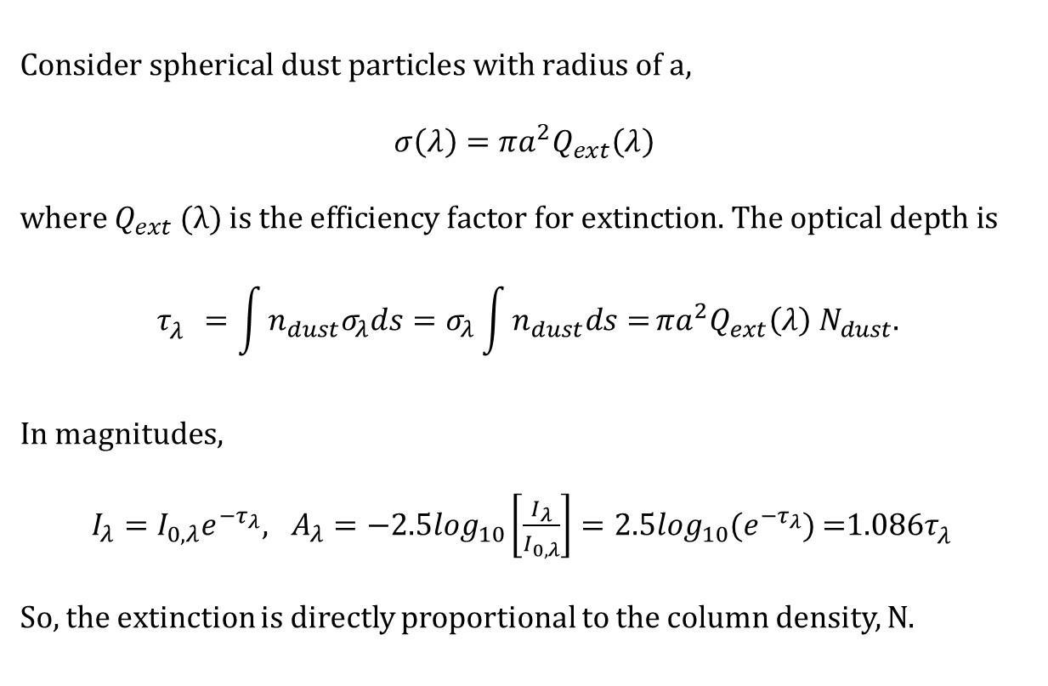
Extinction and Optical Depth
$$\text{Consider} \text{spherical} \text{dust} \text{particles} \text{with} \text{radius} \text{of} \text{a}\text{,}$$
$$σ\left(λ\right)=πa^{2}Q_{ext}\left(λ\right)$$
$$\text{where} Q_{ext}\text{ (}λ\text{) }\text{is} \text{the} \text{efficiency} \text{factor} \text{for} \text{extinction}\text{. }\text{The} \text{optical} \text{depth} \text{is}$$
$$τ_{λ}^{}=\int{n_{dust}σ_{λ}ds=σ_{λ}\int{n_{dust}ds=}}πa^{2}Q_{ext}\left(λ\right) N_{dust}.$$
In magnitudes,
$I_{λ}=I_{0,λ}e^{−τ_{λ}}, A_{λ}=−2.5\log_{10}\left[\frac{I_{λ}}{I_{0,λ}}\right]=2.5\log_{10}(e^{−τ_{λ}})$=1.086$τ_{λ}^{}$
So, the extinction is directly proportional to the column density, N.

Slide 33
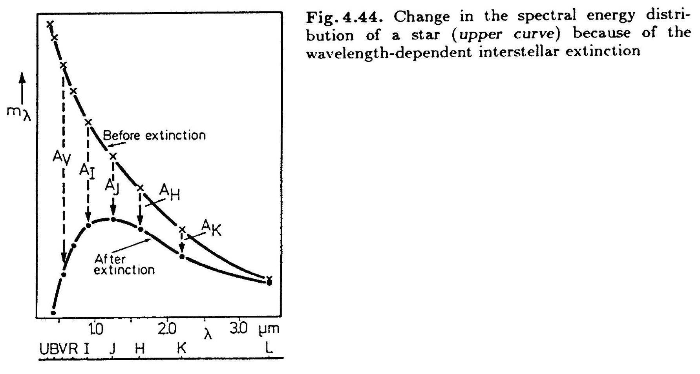
Extinction by Dust: Effect on Spectrum
Notes:
Dust will tend to redden a spectral energy distribution from a star.

Slide 34
Color Excess (16.1.2)
The color excess is written as E(λ₁−λ₂), where the lambda symbols are often replaced by the filter names.
It represents the component of color for a star that is due to the reddening effects of extinction by dust.
E(B-V)=(m_{B}−m_{V}) −(m_{B,0}−m_{V,0})=(m_{B}−m_{B,0})−(m_{V}−m_{V,0})=A_{B}−A_{V}. Recall that “B” is the blue filter, centered near 440 nm and “V” is the visible light filter, centered near 550 nm.
This quantity is useful for estimating extinction.
To calculate it, one must know the intrinsic colors, (m_{B,0}−m_{V,0}), of an object.
This is possible if one knows the spectral type of the star.
Once one has the color excess, it is possible to estimate the absolute value of the extinction at any wavelength, assuming an appropriate extinction law.

Slide 35

Extinction Law
The extinction law describes the amount of extinction as a function of wavelength.
It is often expressed as a power law as a function of wavelength, λ.
Extinction decreases at longer wavelengths, given that the power law has a negative exponent.
It is generally the same in all directions.
$$A_{λ}∝λ^{α}, where α\sim −1.6$$

Slide 36


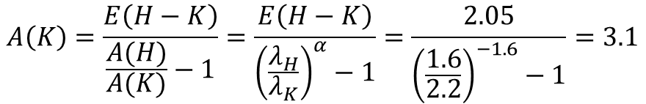
Example Calculating Extinction
Imagine that we observe star near the Galactic Center and find H=14 and K=12. Remember that H is shorthand for m_{H}.
We take a spectrum and find that it is an O-star.
We look up the intrinsic color of an O-star in H−K and find that it is (H−K)₀=−0.05. Remember that (H-K)₀ is shorthand for (m_{H,0}−m_{K,0}).
So, E(H−K)=(H−K)−(H−K)₀=14−12− −0.05=2.05.
$$E\left(H−K\right)=A\left(H\right)−A(K)$$
$$\frac{E\left(H−K\right)}{A(K)}=\frac{A\left(H\right)−A(K)}{A(K)}=\frac{A(H)}{A(K)}−1$$
$$A\left(K\right)=\frac{E\left(H−K\right)}{\frac{A(H)}{A(K)}−1}=\frac{E\left(H−K\right)}{{\left(\frac{λ_{H}}{λ_{K}}\right)}^{α}−1}=\frac{2.05}{{\left(\frac{1.6}{2.2}\right)}^{−1.6}−1}=3.1$$

Slide 37
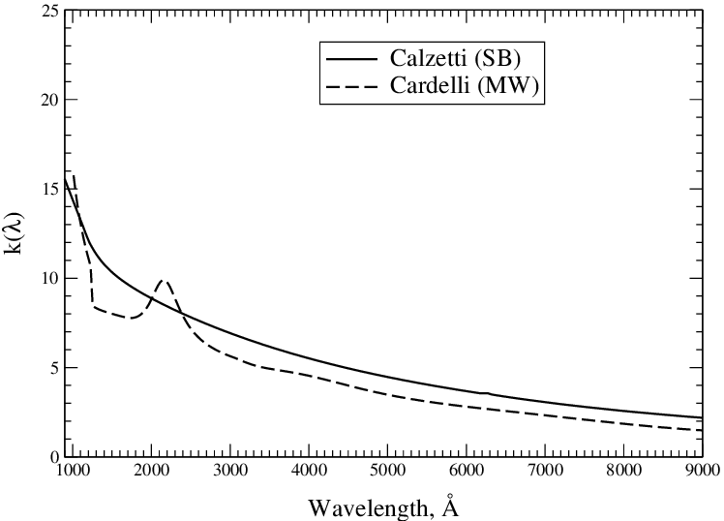
Schematic Plot vs. λ
Extinction increases at shorter wavelengths.
The “MW” curve is an average in the Milky Way.
The “SB” curve is an average for starburst galaxies.
The bump at 220 nm is due to carbon dust grains.
There are bumps near 10 μm due to silicate (SiO molecules).
Notes:
Dust will tend to redden a spectral energy distribution from a star.

Slide 38
Extinction by dust
  J. S. Mathis 1990, ARAA, 28, 37.

Slide 39
Silicates and Ices in Interstellar Medium: W3
Notes:
Complete 2.4-25 um SWS flux spectrum of W33A. The observations were made in mode S01 (speed 4) with a resolving power of 500 1000. The principal identified and unidentified spectral features are labelled. Detections of NH3 and CH3OH features near 10 m are reported in § 4.
http://www.journals.uchicago.edu/ApJ/journal/issues/ApJ/v536n1/50933/50933.html

Slide 40
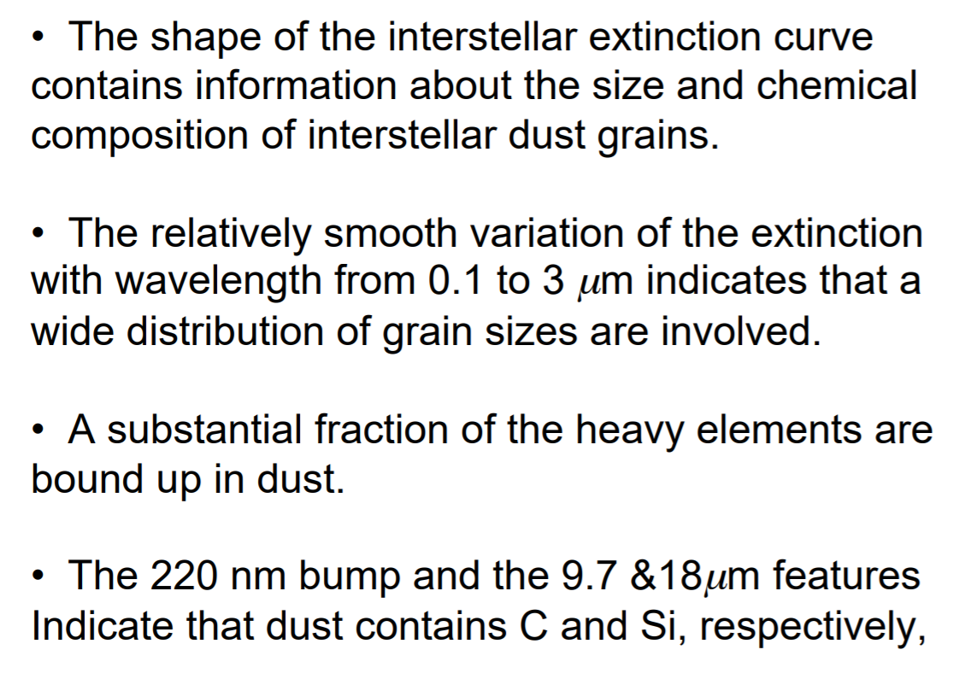
Properties of Dust Grains

