Slide 1
University Astronomy
Professor Don Figer
Black Holes and Variable Stars

Slide 2
Aims and outline for this lecture
describe properties of black holes (18.3)
review variable stars (17.3)

Slide 3
Black holes

Slide 4
Black Holes
Black holes are the end states of stars that have so much mass that they collapse beyond the neutron star state.
Their gravity is so strong that light cannot escape beyond a certain radius, called the “event horizon.” This is why they are called “black.”
It is generally thought that stars with initial masses greater than about 20 solar masses become black holes.
Note that such stars lose much of their masses so that they only have ~3-5 solar masses at the ends of their lives.
Supermassive black holes have been identified in the centers of galaxies, such as our own.

Slide 5

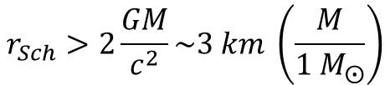
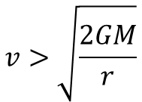
Escape Velocity
The escape velocity corresponds to the velocity a particle must have in order to escape from the gravity of another object.
We can calculate this by requiring that the kinetic energy of the particle exceed the gravitational potential energy of the object.
$$KE=\frac{1}{2}mv^{2}>G\frac{M}{r}m$$
$$v>\sqrt{\frac{2GM}{r}}$$
Setting v=c, we find the “size” of the object that would be able to “pull” light inward.
$$r_{Sch}>2\frac{GM}{c^{2}}\sim 3 km \left(\frac{M}{{1 M}_{⨀}}\right)$$
r_{Sch} is the “Schwarzchild” radius. This is equation 18.54.
Notes:
2

Slide 6
Event Horizon
The event horizon is the surface around the black hole that separates the region for which nothing can escape from the rest of the Universe. It is the point of no return!
It is located at the Schwarzchild radius.
An object near (but outside) the event horizon appears red-shifted and slows down when viewed by an external observer due to relativity. The object does not sense these effects.
The material just outside the event horizon accretes on to the black hole in a disk. This generates friction and high temperatures. In turn, the material radiates energy that can be seen at high energies, such as x-rays and gamma rays.
Notes:
2

Slide 7
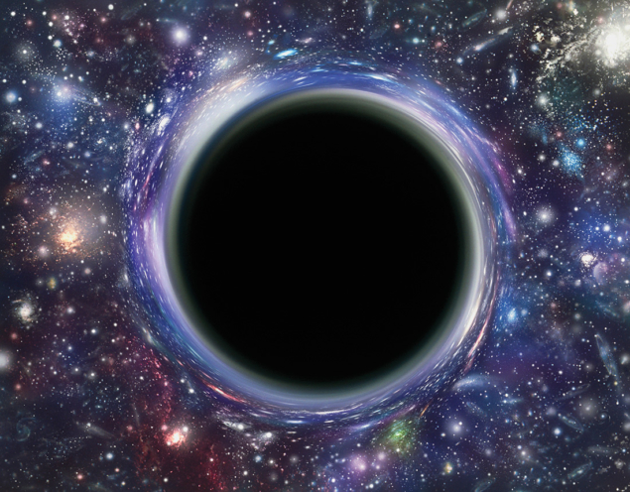
Black Holes Bend Light

Slide 8
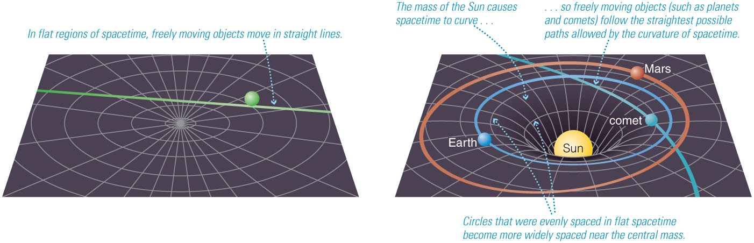
Spacetime Curvature
In Einstein’s Theory of General Relativity space & time are treated as a continuous 4-dimensional ‘spacetime.’
  Mass curves spacetime
  Spacetime curvature dictates how masses move
Gravity is a manifestation of curvature in spacetime due to the presence of mass.

Slide 9
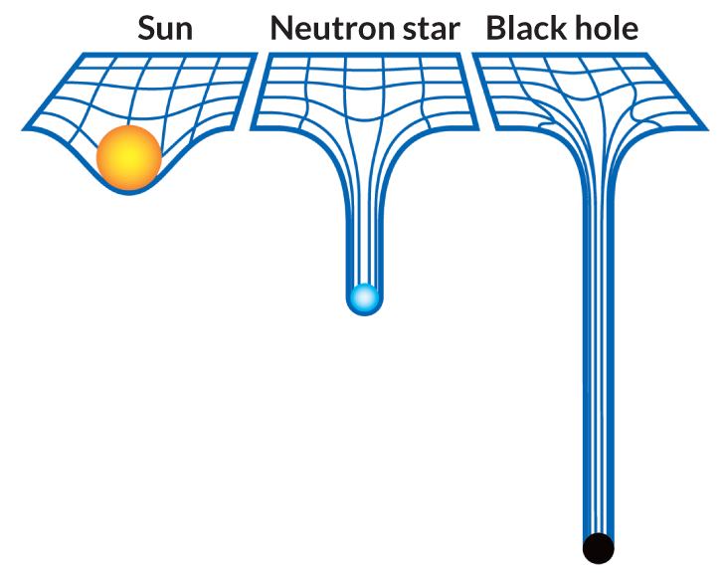
Gravitational Field

Slide 10
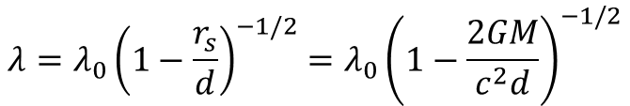
Gravitational Redshift
A photon shifts to longer wavelengths when it propagates into a region of smaller gravitational field.
The new wavelength is given by,
$$λ=λ_{0}{\left(1−\frac{r_{s}}{d}\right)}^{−1/2}=λ_{0}{\left(1−\frac{2GM}{c^{2}d}\right)}^{−1/2}$$
where r_{s} is the Schwarzchild radius and d is the distance between where the photon is emitted and the center of the black hole.
This effect is important for GPS.

Slide 11
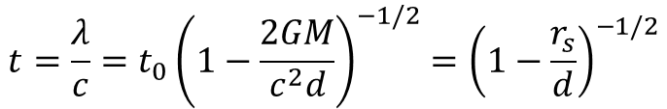
Gravitational Time Dilation
Consider the time between waves as measured at the point of photon emission and also at the point of a distant observer.
The gravitational redshift tells us that it will take more time for a wave to propagate one full wavelength at the location of the distant observer as compared to at the point of emission because the wavelength has been stretched.
$$t=\frac{λ}{c}=t_{0}{\left(1−\frac{2GM}{c^{2}d}\right)}^{−1/2}{=\left(1−\frac{r_{s}}{d}\right)}^{−1/2}$$
Notice what happens at d=r_{s}.
The wavelength becomes infinite. The light never arrives. It appears that time becomes infinite.

Slide 12
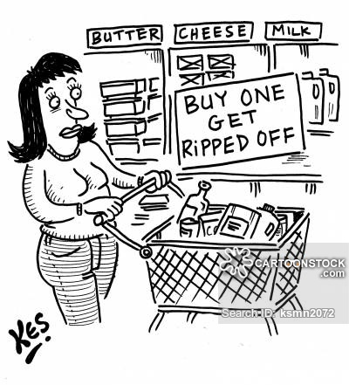
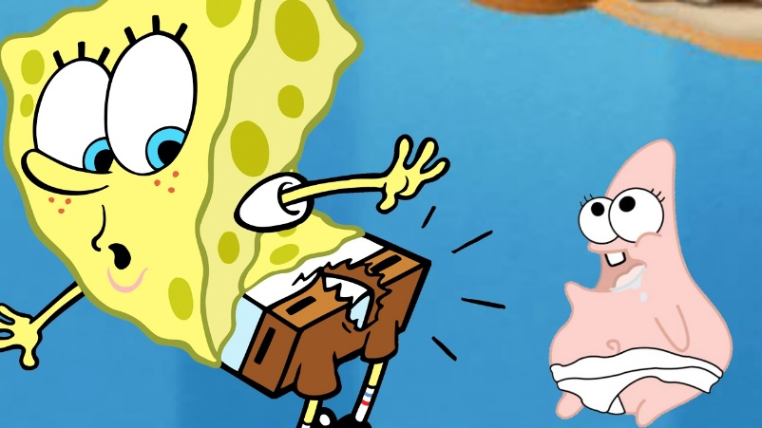
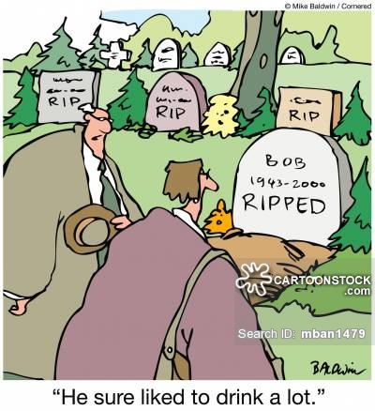

Black Holes Will Rip You
Notes:
2

Slide 13
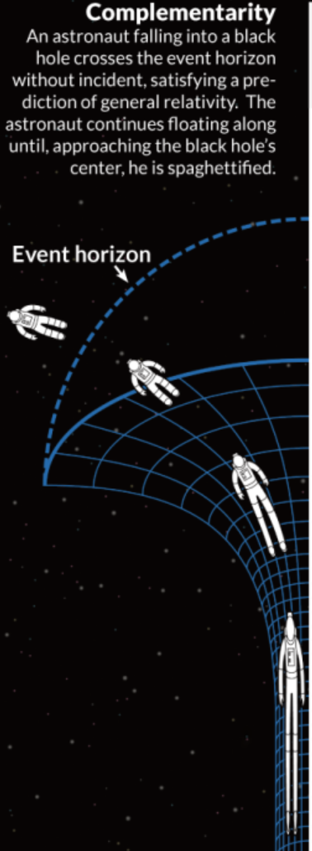
Spaghettification
Spaghettification is the technical term when a black hole rips you apart.
This can happen when the tidal force across your body exceeds the force required to keep your body together.
The force on the part of your body nearest the black hole will exceed that on your body furthest from the black hole.
This will stretch your body along a direction toward the black hole.

Slide 14

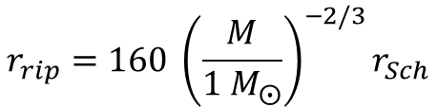
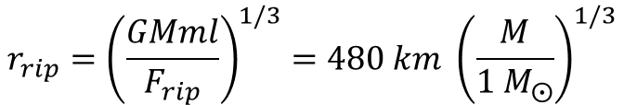
Rip Radius
We can calculate the point of getting ripped apart through the tidal force equation.
$$ΔF=\frac{GMm}{r^{3}}l, where l is body length$$
Inverting this equation, and guessing at the differential force that will rip your body apart (~10⁵ N?), we find equation 18.56:
$$r_{rip}={\left(\frac{GMml}{F_{rip}}\right)}^{1/3}=480 km {\left(\frac{M}{1 M_{⨀}}\right)}^{1/3}$$
Recalling that r_{Sch}=$3 km \left(\frac{M}{{1 M}_{⨀}}\right)$, we find equation 18.58:
$$r_{rip}=160 {\left(\frac{M}{1 M_{⨀}}\right)}^{−2/3}r_{Sch}$$
So, r_{rip} is outside event horizon for M<2,000 M_{Sun}.
Notes:
2

Slide 15
Combined Effects
As an object approaches the event horizon,
  Light would get redshifted to larger and larger wavelengths.
  Redder and redder IR, to radio, to undetectable.
  Time would appear to slow down.
  Would freeze at the event horizon.
What would the astronaut see looking back at us?
  For them, time proceeds normally.
  Would see time running fast for us.
  Light from us would be blueshifted.

Slide 16
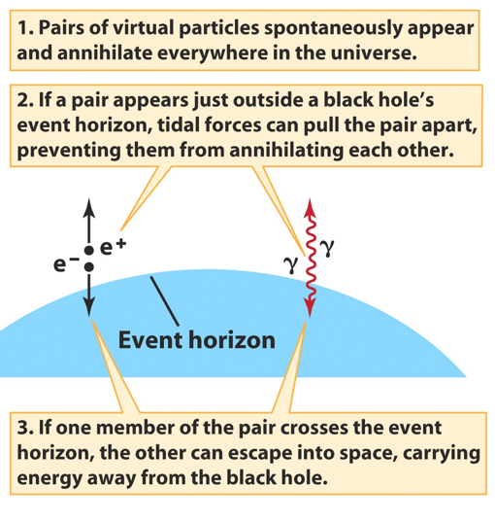
Hawking Radiation
Hawking radiation is the radiation that the region around a black hole emits due to particle-antiparticle creation.
It is generated just outside the event horizon.
The antiparticle falls into the black hole, whereas the particle is emitted.
The particle has positive energy, so the antiparticle has negative energy.
The antiparticle reduces the energy of the black hole.
Ultimately, the black hole will end up with no energy. That is, it will “evaporate.” This takes a long time, ~10¹⁰⁰ yr.
Notes:
2
Stellar Spectra
Comparison of spectra observed for seven different stars having a range of surface temperatures. The hottest stars, at the top, show lines of helium and multiply ionized heavy elements. In the coolest stars, at the bottom, helium lines are not seen, but lines of neutral atoms and molecules are plentiful. At intermediate temperatures, hydrogen lines are strongest. The actual compositions of all seven stars are about the same. ><*Recently, some astronomers have proposed the addition of two new spectral classes—L and T—for low-mass, low-temperature stars whose odd spectra distinguish them from the M-class stars in the current scheme. For now, at least, the new classification has not been widely adopted. Astronomers are still uncertain whether these new objects are “true” stars, fusing hydrogen into helium in their cores, or if they are “brown dwarfs” that never achieved high enough central temperatures for fusion to begin.

Slide 17
Supermassive Black Holes
There is evidence for black holes that have masses that far exceed what would be expected if they formed from a single star.
These are called supermassive black holes.
They have been found in the centers of many galaxies.
They have masses of ~10⁶ to 10¹⁰ M_{Sun}.
The Galaxy has a supermassive black hole with M=4(10⁶) M_{Sun}.
There is a controversy as to whether these objects accrete their mass steadily over long time-scales or if they were created with such large masses during the time of galaxy formation.
Notes:
2
Stellar Spectra
Comparison of spectra observed for seven different stars having a range of surface temperatures. The hottest stars, at the top, show lines of helium and multiply ionized heavy elements. In the coolest stars, at the bottom, helium lines are not seen, but lines of neutral atoms and molecules are plentiful. At intermediate temperatures, hydrogen lines are strongest. The actual compositions of all seven stars are about the same. ><*Recently, some astronomers have proposed the addition of two new spectral classes—L and T—for low-mass, low-temperature stars whose odd spectra distinguish them from the M-class stars in the current scheme. For now, at least, the new classification has not been widely adopted. Astronomers are still uncertain whether these new objects are “true” stars, fusing hydrogen into helium in their cores, or if they are “brown dwarfs” that never achieved high enough central temperatures for fusion to begin.

Slide 18
Question
If black holes are black, how can we hope to see evidence of their existence?
Notes:
2
Stellar Spectra
Comparison of spectra observed for seven different stars having a range of surface temperatures. The hottest stars, at the top, show lines of helium and multiply ionized heavy elements. In the coolest stars, at the bottom, helium lines are not seen, but lines of neutral atoms and molecules are plentiful. At intermediate temperatures, hydrogen lines are strongest. The actual compositions of all seven stars are about the same. ><*Recently, some astronomers have proposed the addition of two new spectral classes—L and T—for low-mass, low-temperature stars whose odd spectra distinguish them from the M-class stars in the current scheme. For now, at least, the new classification has not been widely adopted. Astronomers are still uncertain whether these new objects are “true” stars, fusing hydrogen into helium in their cores, or if they are “brown dwarfs” that never achieved high enough central temperatures for fusion to begin.

Slide 19
Answer
Look for stars orbiting around an unseen massive object
Look for X-rays emitted by gas that is superheated as it falls into a black hole.
Notes:
2
Stellar Spectra
Comparison of spectra observed for seven different stars having a range of surface temperatures. The hottest stars, at the top, show lines of helium and multiply ionized heavy elements. In the coolest stars, at the bottom, helium lines are not seen, but lines of neutral atoms and molecules are plentiful. At intermediate temperatures, hydrogen lines are strongest. The actual compositions of all seven stars are about the same. ><*Recently, some astronomers have proposed the addition of two new spectral classes—L and T—for low-mass, low-temperature stars whose odd spectra distinguish them from the M-class stars in the current scheme. For now, at least, the new classification has not been widely adopted. Astronomers are still uncertain whether these new objects are “true” stars, fusing hydrogen into helium in their cores, or if they are “brown dwarfs” that never achieved high enough central temperatures for fusion to begin.

Slide 20
Black Hole Candidates
Currently 20 confirmed black hole candidates in our Galaxy:
  First was Cygnus X-1: M = 7-13 M_{Sun}
  Largest is GRS1915+105: M = 10-18 M_{Sun}
  Most are in the range 4-10 M_{Sun}
It is estimated to be as many as 1 billion stellar-mass black holes in our Galaxy, which points out how very hard it is to find something that does not emit any radiation of its own.
Notes:
2
Stellar Spectra
Comparison of spectra observed for seven different stars having a range of surface temperatures. The hottest stars, at the top, show lines of helium and multiply ionized heavy elements. In the coolest stars, at the bottom, helium lines are not seen, but lines of neutral atoms and molecules are plentiful. At intermediate temperatures, hydrogen lines are strongest. The actual compositions of all seven stars are about the same. ><*Recently, some astronomers have proposed the addition of two new spectral classes—L and T—for low-mass, low-temperature stars whose odd spectra distinguish them from the M-class stars in the current scheme. For now, at least, the new classification has not been widely adopted. Astronomers are still uncertain whether these new objects are “true” stars, fusing hydrogen into helium in their cores, or if they are “brown dwarfs” that never achieved high enough central temperatures for fusion to begin.

Slide 21
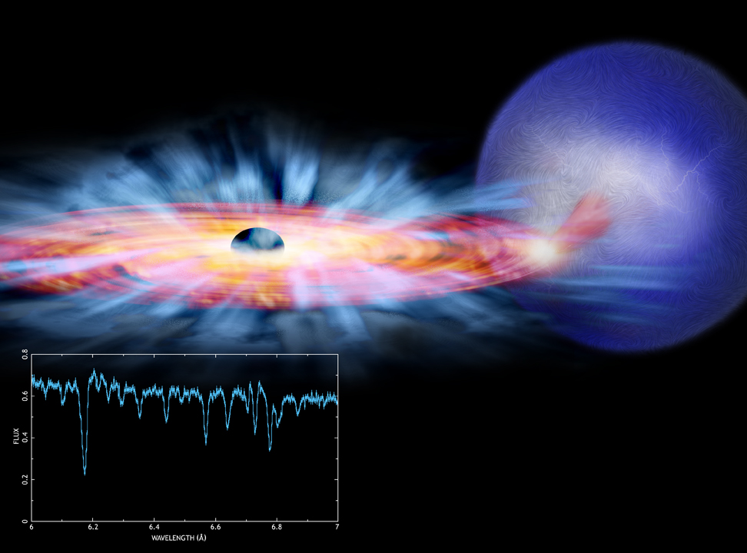
X-Ray Binaries
Binary systems containing a normal star and a compact object – neutron star or black hole
Hot accretion disks form around around the compact object – these are strong and variable X-ray sources
Companion star
Accretion disk
X-ray spectrum showing absorption lines from a highly ionized “disk wind”
Notes:
2
Stellar Spectra
Comparison of spectra observed for seven different stars having a range of surface temperatures. The hottest stars, at the top, show lines of helium and multiply ionized heavy elements. In the coolest stars, at the bottom, helium lines are not seen, but lines of neutral atoms and molecules are plentiful. At intermediate temperatures, hydrogen lines are strongest. The actual compositions of all seven stars are about the same. ><*Recently, some astronomers have proposed the addition of two new spectral classes—L and T—for low-mass, low-temperature stars whose odd spectra distinguish them from the M-class stars in the current scheme. For now, at least, the new classification has not been widely adopted. Astronomers are still uncertain whether these new objects are “true” stars, fusing hydrogen into helium in their cores, or if they are “brown dwarfs” that never achieved high enough central temperatures for fusion to begin.

Slide 22
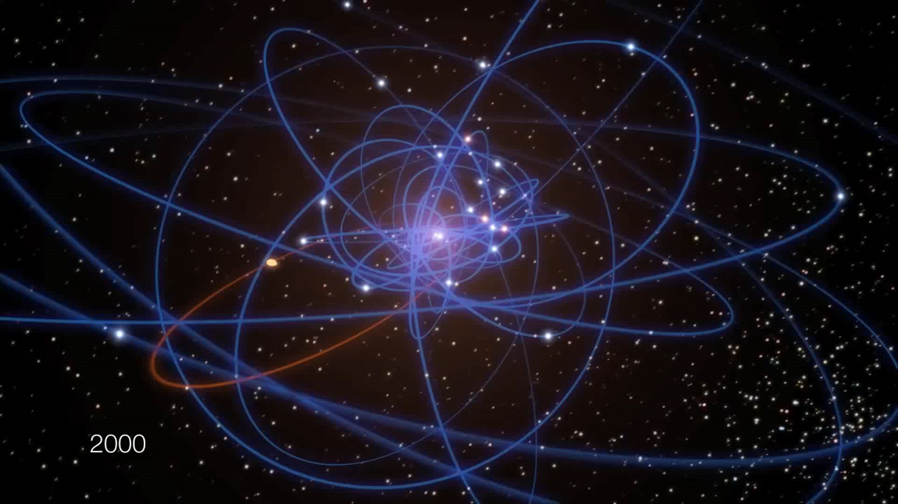
Supermassive Black Hole in GC
Notes:
2
Stellar Spectra
Comparison of spectra observed for seven different stars having a range of surface temperatures. The hottest stars, at the top, show lines of helium and multiply ionized heavy elements. In the coolest stars, at the bottom, helium lines are not seen, but lines of neutral atoms and molecules are plentiful. At intermediate temperatures, hydrogen lines are strongest. The actual compositions of all seven stars are about the same. ><*Recently, some astronomers have proposed the addition of two new spectral classes—L and T—for low-mass, low-temperature stars whose odd spectra distinguish them from the M-class stars in the current scheme. For now, at least, the new classification has not been widely adopted. Astronomers are still uncertain whether these new objects are “true” stars, fusing hydrogen into helium in their cores, or if they are “brown dwarfs” that never achieved high enough central temperatures for fusion to begin.

Slide 23
Wormholes
“Wormholes” refer to a mathetimatical possibility in Einstein’s General Theory of Relativity in which two points in space time can be connected.
It is not clear that they exist in nature.
If they do exist, then it could be possible to travel from one side of the point to the other side, thus traversing possibly large distances.
Notes:
2
Stellar Spectra
Comparison of spectra observed for seven different stars having a range of surface temperatures. The hottest stars, at the top, show lines of helium and multiply ionized heavy elements. In the coolest stars, at the bottom, helium lines are not seen, but lines of neutral atoms and molecules are plentiful. At intermediate temperatures, hydrogen lines are strongest. The actual compositions of all seven stars are about the same. ><*Recently, some astronomers have proposed the addition of two new spectral classes—L and T—for low-mass, low-temperature stars whose odd spectra distinguish them from the M-class stars in the current scheme. For now, at least, the new classification has not been widely adopted. Astronomers are still uncertain whether these new objects are “true” stars, fusing hydrogen into helium in their cores, or if they are “brown dwarfs” that never achieved high enough central temperatures for fusion to begin.

Slide 24
event horizon telescope

Slide 25
Event Horizon Telescope
The Event Horizon Telescope (EHT) is a project to create a large telescope array consisting of a global network of radio telescopes and combine data from several very-long-baseline interferometry (VLBI) stations around the Earth.
The aim is to observe the immediate environment of the supermassive black hole Sagittarius A* at the center of the Milky Way.
It also seeks to observe an even larger black hole in the supergiant elliptical galaxy Messier 87, with angular resolution comparable to the black hole's event horizon.
The telescopes contributing to the first result were ALMA, APEX, the IRAM 30-meter telescope, the James Clerk Maxwell Telescope, the Large Millimeter Telescope Alfonso Serrano, the Submillimeter Array, the Submillimeter Telescope, and the South Pole Telescope.
Notes:
2
Stellar Spectra
Comparison of spectra observed for seven different stars having a range of surface temperatures. The hottest stars, at the top, show lines of helium and multiply ionized heavy elements. In the coolest stars, at the bottom, helium lines are not seen, but lines of neutral atoms and molecules are plentiful. At intermediate temperatures, hydrogen lines are strongest. The actual compositions of all seven stars are about the same. ><*Recently, some astronomers have proposed the addition of two new spectral classes—L and T—for low-mass, low-temperature stars whose odd spectra distinguish them from the M-class stars in the current scheme. For now, at least, the new classification has not been widely adopted. Astronomers are still uncertain whether these new objects are “true” stars, fusing hydrogen into helium in their cores, or if they are “brown dwarfs” that never achieved high enough central temperatures for fusion to begin.

Slide 26
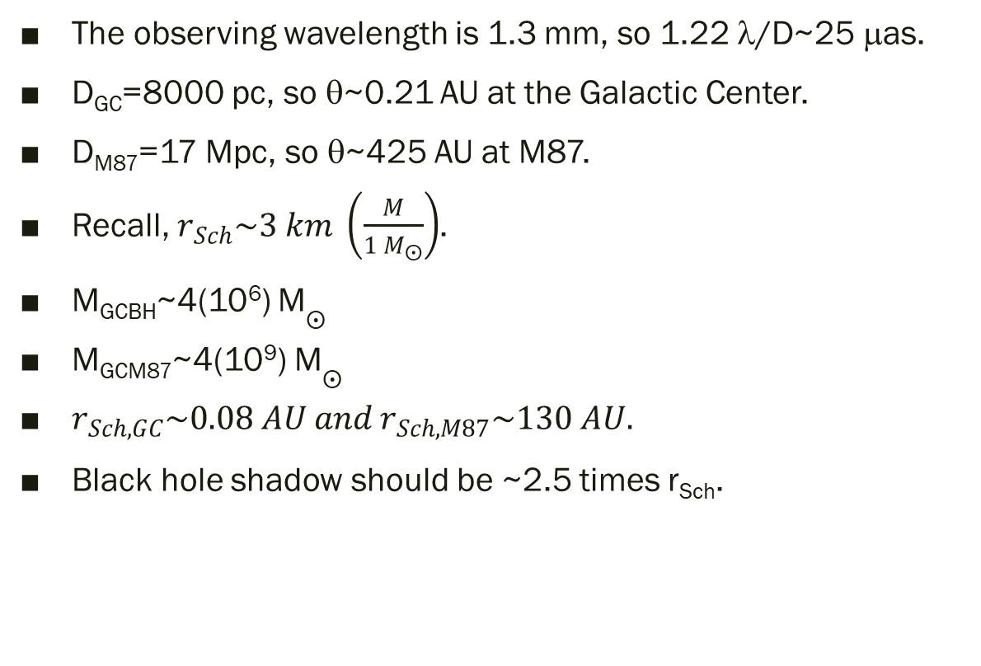
EHT Resolution
The observing wavelength is 1.3 mm, so 1.22 λ/D~25 μas.
D_{GC}=8000 pc, so θ~0.21 AU at the Galactic Center.
D_{M87}=17 Mpc, so θ~425 AU at M87.
Recall, $r_{Sch}\sim 3 km \left(\frac{M}{{1 M}_{⨀}}\right)$.
M_{GCBH}~4(10⁶) M$⨀$
M_{GCM87}~4(10⁹) M$⨀$
$r_{Sch,GC}\sim 0.08 AU and r_{Sch,M87}\sim 130 AU.$
Black hole shadow should be ~2.5 times r_{Sch}.
Notes:
2
Stellar Spectra
Comparison of spectra observed for seven different stars having a range of surface temperatures. The hottest stars, at the top, show lines of helium and multiply ionized heavy elements. In the coolest stars, at the bottom, helium lines are not seen, but lines of neutral atoms and molecules are plentiful. At intermediate temperatures, hydrogen lines are strongest. The actual compositions of all seven stars are about the same. ><*Recently, some astronomers have proposed the addition of two new spectral classes—L and T—for low-mass, low-temperature stars whose odd spectra distinguish them from the M-class stars in the current scheme. For now, at least, the new classification has not been widely adopted. Astronomers are still uncertain whether these new objects are “true” stars, fusing hydrogen into helium in their cores, or if they are “brown dwarfs” that never achieved high enough central temperatures for fusion to begin.

Slide 27
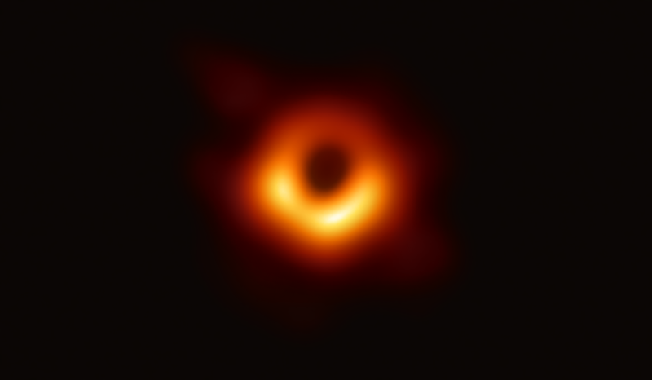
EHT Detection
Scientists have obtained the first image of a black hole, using Event Horizon Telescope observations of the center of the galaxy M87. The image shows a bright ring formed as light bends in the intense gravity around a black hole that is 6.5 billion times more massive than the Sun. This long-sought image provides the strongest evidence to date for the existence of supermassive black holes and opens a new window onto the study of black holes, their event horizons, and gravity. Credit: Event Horizon Telescope Collaboration
Notes:
2
Stellar Spectra
Comparison of spectra observed for seven different stars having a range of surface temperatures. The hottest stars, at the top, show lines of helium and multiply ionized heavy elements. In the coolest stars, at the bottom, helium lines are not seen, but lines of neutral atoms and molecules are plentiful. At intermediate temperatures, hydrogen lines are strongest. The actual compositions of all seven stars are about the same. ><*Recently, some astronomers have proposed the addition of two new spectral classes—L and T—for low-mass, low-temperature stars whose odd spectra distinguish them from the M-class stars in the current scheme. For now, at least, the new classification has not been widely adopted. Astronomers are still uncertain whether these new objects are “true” stars, fusing hydrogen into helium in their cores, or if they are “brown dwarfs” that never achieved high enough central temperatures for fusion to begin.

Slide 28
variable stars

Slide 29
Variable Stars
Variable stars are stars that appear to vary in their light output.
Notes:
2
Stellar Spectra
Comparison of spectra observed for seven different stars having a range of surface temperatures. The hottest stars, at the top, show lines of helium and multiply ionized heavy elements. In the coolest stars, at the bottom, helium lines are not seen, but lines of neutral atoms and molecules are plentiful. At intermediate temperatures, hydrogen lines are strongest. The actual compositions of all seven stars are about the same. ><*Recently, some astronomers have proposed the addition of two new spectral classes—L and T—for low-mass, low-temperature stars whose odd spectra distinguish them from the M-class stars in the current scheme. For now, at least, the new classification has not been widely adopted. Astronomers are still uncertain whether these new objects are “true” stars, fusing hydrogen into helium in their cores, or if they are “brown dwarfs” that never achieved high enough central temperatures for fusion to begin.

Slide 30
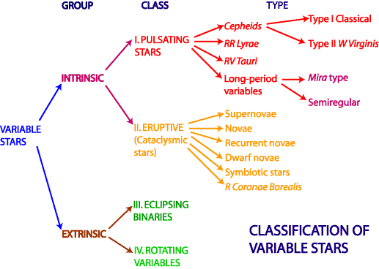
Classification of Variable Stars
Notes:
2
Stellar Spectra
Comparison of spectra observed for seven different stars having a range of surface temperatures. The hottest stars, at the top, show lines of helium and multiply ionized heavy elements. In the coolest stars, at the bottom, helium lines are not seen, but lines of neutral atoms and molecules are plentiful. At intermediate temperatures, hydrogen lines are strongest. The actual compositions of all seven stars are about the same. ><*Recently, some astronomers have proposed the addition of two new spectral classes—L and T—for low-mass, low-temperature stars whose odd spectra distinguish them from the M-class stars in the current scheme. For now, at least, the new classification has not been widely adopted. Astronomers are still uncertain whether these new objects are “true” stars, fusing hydrogen into helium in their cores, or if they are “brown dwarfs” that never achieved high enough central temperatures for fusion to begin.

Slide 31
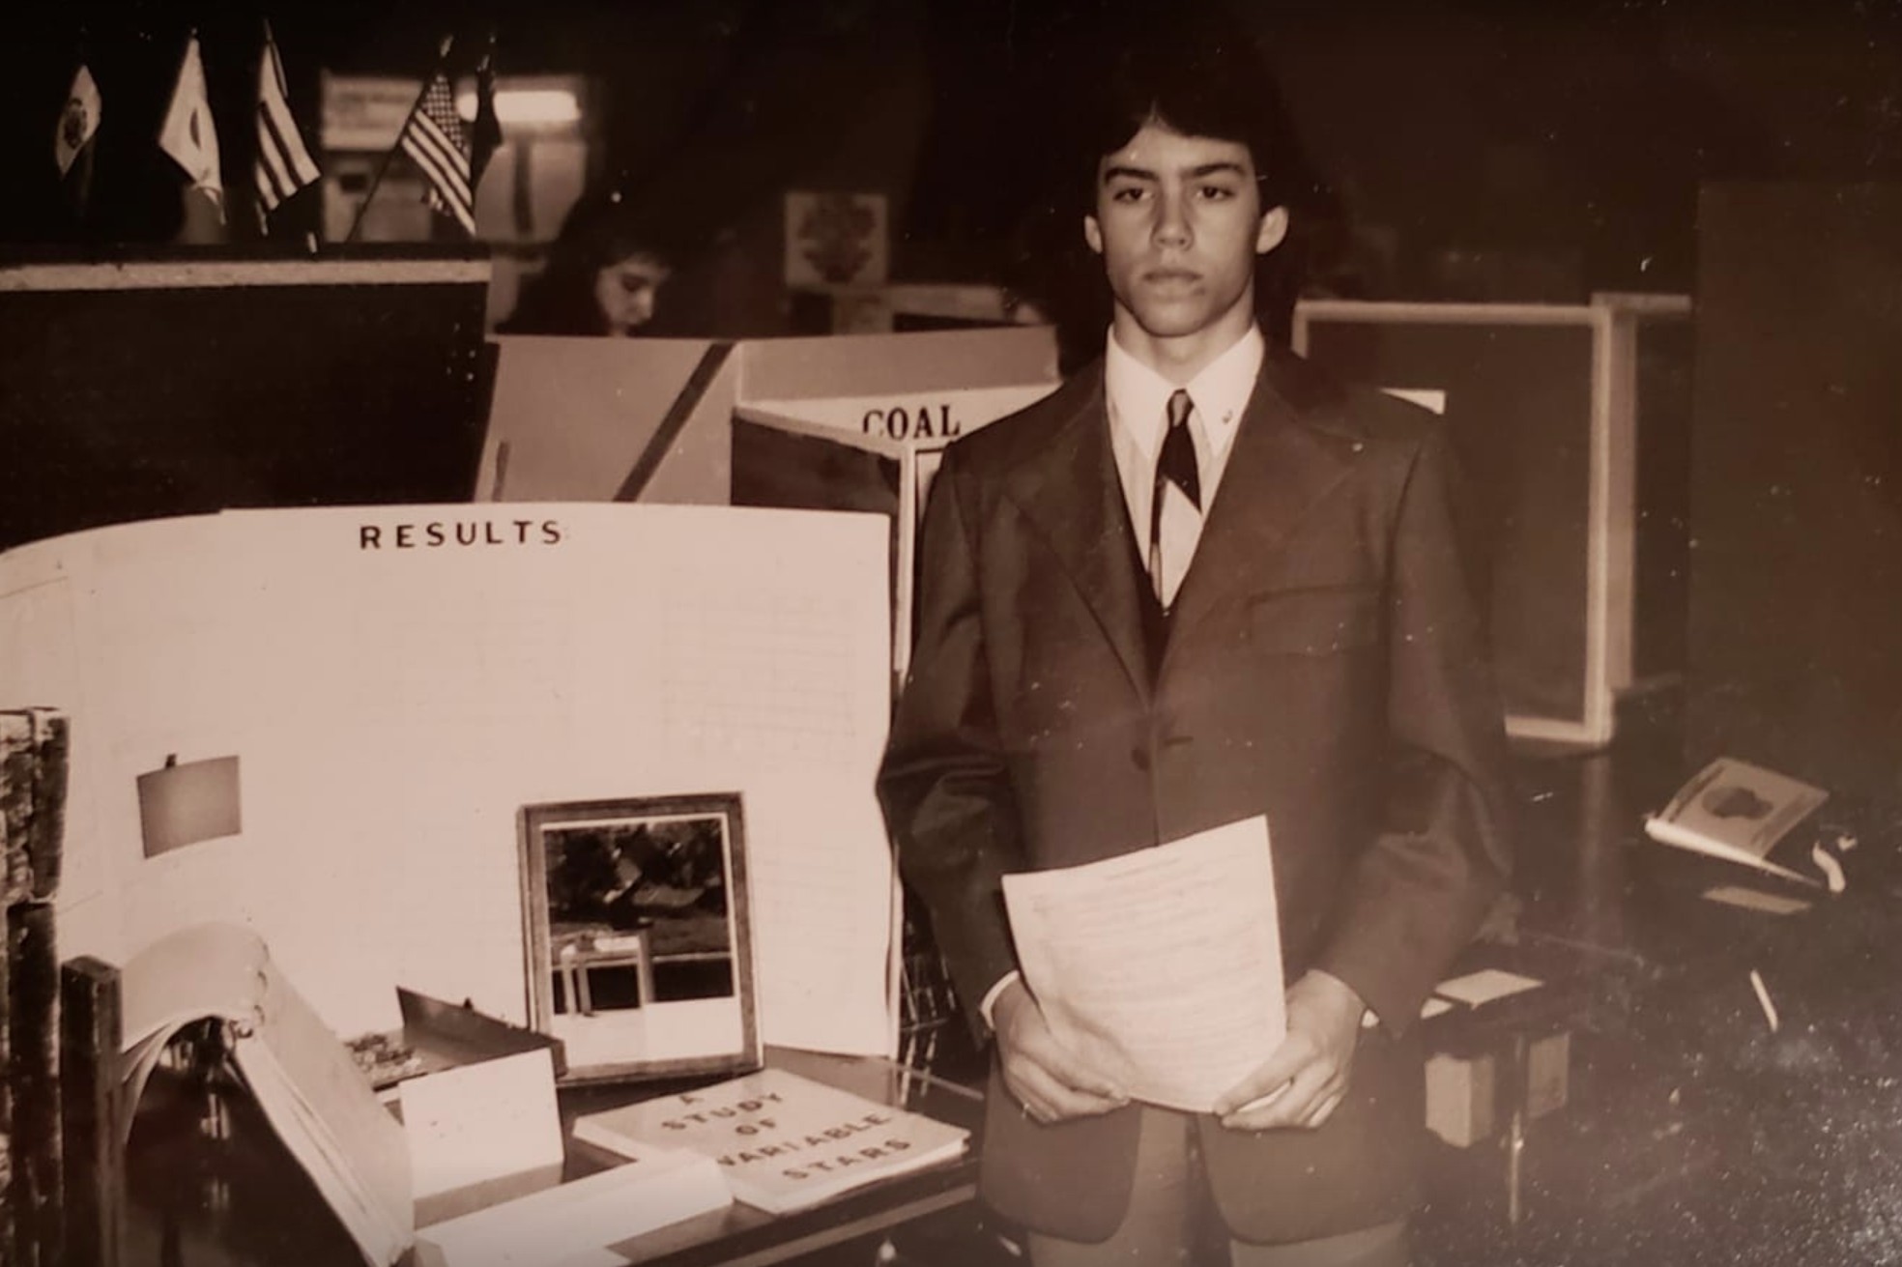
A Study of Variable Stars
Notes:
2
Stellar Spectra
Comparison of spectra observed for seven different stars having a range of surface temperatures. The hottest stars, at the top, show lines of helium and multiply ionized heavy elements. In the coolest stars, at the bottom, helium lines are not seen, but lines of neutral atoms and molecules are plentiful. At intermediate temperatures, hydrogen lines are strongest. The actual compositions of all seven stars are about the same. ><*Recently, some astronomers have proposed the addition of two new spectral classes—L and T—for low-mass, low-temperature stars whose odd spectra distinguish them from the M-class stars in the current scheme. For now, at least, the new classification has not been widely adopted. Astronomers are still uncertain whether these new objects are “true” stars, fusing hydrogen into helium in their cores, or if they are “brown dwarfs” that never achieved high enough central temperatures for fusion to begin.

Slide 32
Intrinsically variable stars

Slide 33
Pulsating Variables (17.3)
Pulsating variable stars expand and contract.
The pulsation is due to an interplay between radiation pressure and opacity.
There are two main types of pulsating variables.
  Cepheids (3-18 M_{Sun}, FGK, P~1-50 days)
  RR Lyrae (0.5-0.7 M_{Sun}, AF, P~1-24 hours)
They appear to be located in the “instability strip” in the HR diagram.
They are important as standard candles because their period of pulsation is related to their absolute magnitudes.
By measuring the period, one can know the luminosity, compare that to the apparent magnitude, and then estimate the distance.
Notes:
2
Stellar Spectra
Comparison of spectra observed for seven different stars having a range of surface temperatures. The hottest stars, at the top, show lines of helium and multiply ionized heavy elements. In the coolest stars, at the bottom, helium lines are not seen, but lines of neutral atoms and molecules are plentiful. At intermediate temperatures, hydrogen lines are strongest. The actual compositions of all seven stars are about the same. ><*Recently, some astronomers have proposed the addition of two new spectral classes—L and T—for low-mass, low-temperature stars whose odd spectra distinguish them from the M-class stars in the current scheme. For now, at least, the new classification has not been widely adopted. Astronomers are still uncertain whether these new objects are “true” stars, fusing hydrogen into helium in their cores, or if they are “brown dwarfs” that never achieved high enough central temperatures for fusion to begin.

Slide 34
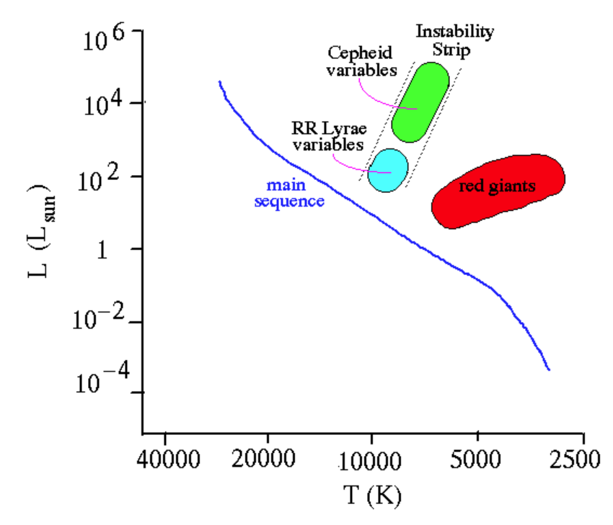
Pulsating Variables in HRD
Notes:
2
Stellar Spectra
Comparison of spectra observed for seven different stars having a range of surface temperatures. The hottest stars, at the top, show lines of helium and multiply ionized heavy elements. In the coolest stars, at the bottom, helium lines are not seen, but lines of neutral atoms and molecules are plentiful. At intermediate temperatures, hydrogen lines are strongest. The actual compositions of all seven stars are about the same. ><*Recently, some astronomers have proposed the addition of two new spectral classes—L and T—for low-mass, low-temperature stars whose odd spectra distinguish them from the M-class stars in the current scheme. For now, at least, the new classification has not been widely adopted. Astronomers are still uncertain whether these new objects are “true” stars, fusing hydrogen into helium in their cores, or if they are “brown dwarfs” that never achieved high enough central temperatures for fusion to begin.

Slide 35
Stellar Pulsation
One mechanism behind intrinsic variable stars is pulsation.
In normal stars, the internal pressure balances the force of gravity.
However, post main sequence stars experience changes in their energy generation and surface temperatures.
With high enough temperature near the photosphere (~40,000 K), He⁺ becomes He⁺⁺, producing more free electrons for scattering opacity.
Much like pushing a swing, radiation pushes the outer layers of a star until the material cools and the electrons recombine.
This leads to dramatically lower opacity which leads to contraction.
The gas heats up again, and the cycle repeats.
Notes:
2
Stellar Spectra
Comparison of spectra observed for seven different stars having a range of surface temperatures. The hottest stars, at the top, show lines of helium and multiply ionized heavy elements. In the coolest stars, at the bottom, helium lines are not seen, but lines of neutral atoms and molecules are plentiful. At intermediate temperatures, hydrogen lines are strongest. The actual compositions of all seven stars are about the same. ><*Recently, some astronomers have proposed the addition of two new spectral classes—L and T—for low-mass, low-temperature stars whose odd spectra distinguish them from the M-class stars in the current scheme. For now, at least, the new classification has not been widely adopted. Astronomers are still uncertain whether these new objects are “true” stars, fusing hydrogen into helium in their cores, or if they are “brown dwarfs” that never achieved high enough central temperatures for fusion to begin.

Slide 36
Cepheid Pulsating Variables
Cepheids are named after δ Cephei, a variable star in Cepheus.
They have luminosities of ~1,000 to 100,000 times that of the Sun.
Their periods are on the order of days.
Their periods are related to their luminosities, making them excellent distance indicators.
They are an important step in the cosmic distance ladder.
Notes:
2
Stellar Spectra
Comparison of spectra observed for seven different stars having a range of surface temperatures. The hottest stars, at the top, show lines of helium and multiply ionized heavy elements. In the coolest stars, at the bottom, helium lines are not seen, but lines of neutral atoms and molecules are plentiful. At intermediate temperatures, hydrogen lines are strongest. The actual compositions of all seven stars are about the same. ><*Recently, some astronomers have proposed the addition of two new spectral classes—L and T—for low-mass, low-temperature stars whose odd spectra distinguish them from the M-class stars in the current scheme. For now, at least, the new classification has not been widely adopted. Astronomers are still uncertain whether these new objects are “true” stars, fusing hydrogen into helium in their cores, or if they are “brown dwarfs” that never achieved high enough central temperatures for fusion to begin.

Slide 37
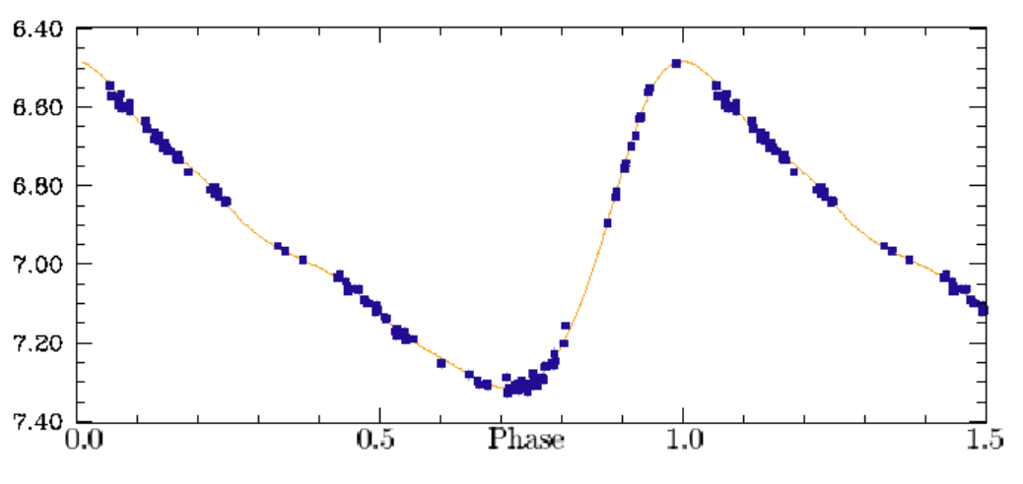
Cepheid Light Curve
Notes:
2
Stellar Spectra
Comparison of spectra observed for seven different stars having a range of surface temperatures. The hottest stars, at the top, show lines of helium and multiply ionized heavy elements. In the coolest stars, at the bottom, helium lines are not seen, but lines of neutral atoms and molecules are plentiful. At intermediate temperatures, hydrogen lines are strongest. The actual compositions of all seven stars are about the same. ><*Recently, some astronomers have proposed the addition of two new spectral classes—L and T—for low-mass, low-temperature stars whose odd spectra distinguish them from the M-class stars in the current scheme. For now, at least, the new classification has not been widely adopted. Astronomers are still uncertain whether these new objects are “true” stars, fusing hydrogen into helium in their cores, or if they are “brown dwarfs” that never achieved high enough central temperatures for fusion to begin.

Slide 38
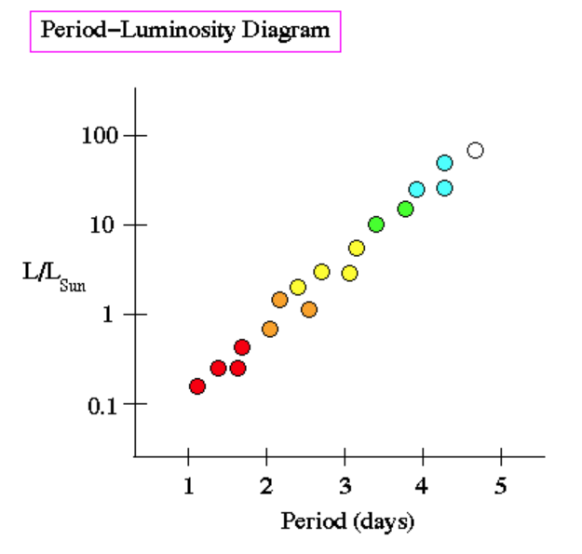
Period-Luminosity Relation
Notes:
2
Stellar Spectra
Comparison of spectra observed for seven different stars having a range of surface temperatures. The hottest stars, at the top, show lines of helium and multiply ionized heavy elements. In the coolest stars, at the bottom, helium lines are not seen, but lines of neutral atoms and molecules are plentiful. At intermediate temperatures, hydrogen lines are strongest. The actual compositions of all seven stars are about the same. ><*Recently, some astronomers have proposed the addition of two new spectral classes—L and T—for low-mass, low-temperature stars whose odd spectra distinguish them from the M-class stars in the current scheme. For now, at least, the new classification has not been widely adopted. Astronomers are still uncertain whether these new objects are “true” stars, fusing hydrogen into helium in their cores, or if they are “brown dwarfs” that never achieved high enough central temperatures for fusion to begin.

Slide 39
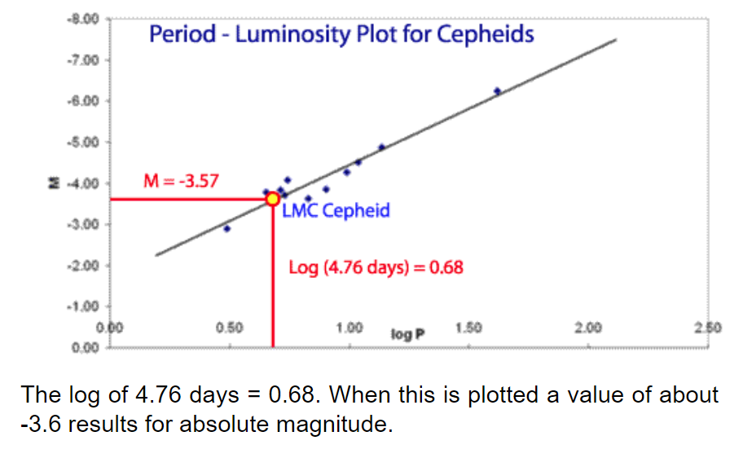
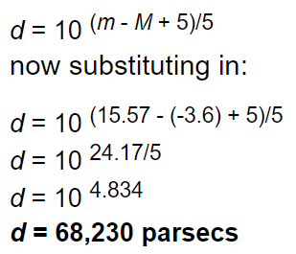
PLR and Distance (Equ 17.25)
Notes:
2
Stellar Spectra
Comparison of spectra observed for seven different stars having a range of surface temperatures. The hottest stars, at the top, show lines of helium and multiply ionized heavy elements. In the coolest stars, at the bottom, helium lines are not seen, but lines of neutral atoms and molecules are plentiful. At intermediate temperatures, hydrogen lines are strongest. The actual compositions of all seven stars are about the same. ><*Recently, some astronomers have proposed the addition of two new spectral classes—L and T—for low-mass, low-temperature stars whose odd spectra distinguish them from the M-class stars in the current scheme. For now, at least, the new classification has not been widely adopted. Astronomers are still uncertain whether these new objects are “true” stars, fusing hydrogen into helium in their cores, or if they are “brown dwarfs” that never achieved high enough central temperatures for fusion to begin.

Slide 40
RR Lyrae Pulsating Variables
RR Lyrae stars are named after RR Lyrae.
They are lower mass versions of Cepheids.
They have short periods, usually about 1.5 hours to a day and have a brightness range of 0.3 to 2 magnitudes.
Spectral classes range from A7 to F5. RR Lyrae stars are less massive than Cepheids but they also follow their own period - luminosity relationship, with a mean absolute magnitude of +0.6.
They are useful in determining distances.
Notes:
2
Stellar Spectra
Comparison of spectra observed for seven different stars having a range of surface temperatures. The hottest stars, at the top, show lines of helium and multiply ionized heavy elements. In the coolest stars, at the bottom, helium lines are not seen, but lines of neutral atoms and molecules are plentiful. At intermediate temperatures, hydrogen lines are strongest. The actual compositions of all seven stars are about the same. ><*Recently, some astronomers have proposed the addition of two new spectral classes—L and T—for low-mass, low-temperature stars whose odd spectra distinguish them from the M-class stars in the current scheme. For now, at least, the new classification has not been widely adopted. Astronomers are still uncertain whether these new objects are “true” stars, fusing hydrogen into helium in their cores, or if they are “brown dwarfs” that never achieved high enough central temperatures for fusion to begin.

Slide 41
Long Period Variables (LPVs)
The first pulsating variable discovered was the long-period variable Mira (1638).
They are cool red giants or supergiants and have periods of months to years. Their luminosities can range from 10 to 10,000 L_{Sun}.
Long-period variables are further classified according to whether they exhibit regular periodicity, such as the Miras or more irregular behaviour,
Notes:
2
Stellar Spectra
Comparison of spectra observed for seven different stars having a range of surface temperatures. The hottest stars, at the top, show lines of helium and multiply ionized heavy elements. In the coolest stars, at the bottom, helium lines are not seen, but lines of neutral atoms and molecules are plentiful. At intermediate temperatures, hydrogen lines are strongest. The actual compositions of all seven stars are about the same. ><*Recently, some astronomers have proposed the addition of two new spectral classes—L and T—for low-mass, low-temperature stars whose odd spectra distinguish them from the M-class stars in the current scheme. For now, at least, the new classification has not been widely adopted. Astronomers are still uncertain whether these new objects are “true” stars, fusing hydrogen into helium in their cores, or if they are “brown dwarfs” that never achieved high enough central temperatures for fusion to begin.

Slide 42
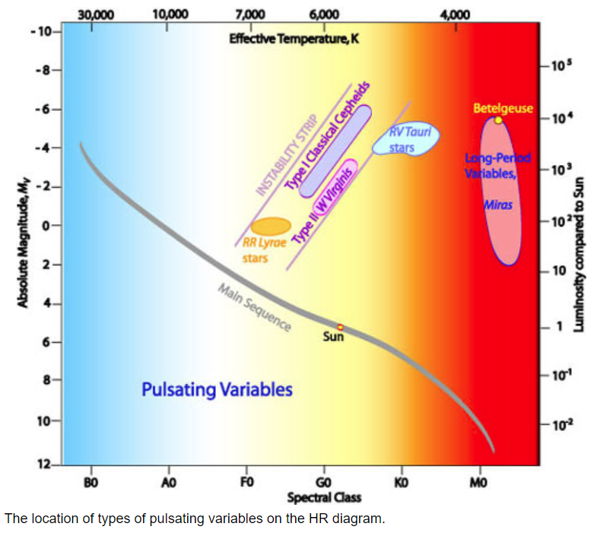
HR Diagram for Pulsating Stars
Notes:
2
Stellar Spectra
Comparison of spectra observed for seven different stars having a range of surface temperatures. The hottest stars, at the top, show lines of helium and multiply ionized heavy elements. In the coolest stars, at the bottom, helium lines are not seen, but lines of neutral atoms and molecules are plentiful. At intermediate temperatures, hydrogen lines are strongest. The actual compositions of all seven stars are about the same. ><*Recently, some astronomers have proposed the addition of two new spectral classes—L and T—for low-mass, low-temperature stars whose odd spectra distinguish them from the M-class stars in the current scheme. For now, at least, the new classification has not been widely adopted. Astronomers are still uncertain whether these new objects are “true” stars, fusing hydrogen into helium in their cores, or if they are “brown dwarfs” that never achieved high enough central temperatures for fusion to begin.

Slide 43
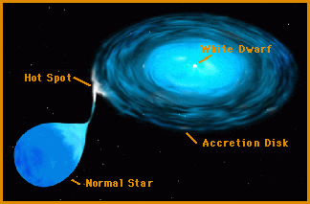
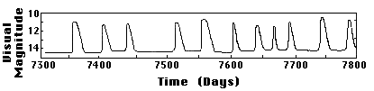
Cataclysmic Variables
Cataclysmic variables have dramatic changes in brightness, upwards of a million times their original brightness
We call these objects “novae.” See 18.4.
The increase in brightness comes from hydrogen fusion on the surface of a white dwarf.
The additional hydrogen comes from accretion from a nearby companion.
Based on measurements of the energy in the events, and the known energy-generation rate of the proton-proton chain, it appears that the amount of matter that ignites is approximately the mass of the Moon.
This cycle can repeat many times (until the mass of the object exceeds the limit for white dwarfs).
Notes:
2
Stellar Spectra
Comparison of spectra observed for seven different stars having a range of surface temperatures. The hottest stars, at the top, show lines of helium and multiply ionized heavy elements. In the coolest stars, at the bottom, helium lines are not seen, but lines of neutral atoms and molecules are plentiful. At intermediate temperatures, hydrogen lines are strongest. The actual compositions of all seven stars are about the same. ><*Recently, some astronomers have proposed the addition of two new spectral classes—L and T—for low-mass, low-temperature stars whose odd spectra distinguish them from the M-class stars in the current scheme. For now, at least, the new classification has not been widely adopted. Astronomers are still uncertain whether these new objects are “true” stars, fusing hydrogen into helium in their cores, or if they are “brown dwarfs” that never achieved high enough central temperatures for fusion to begin.

Slide 44
extrinsically variable stars

Slide 45
Extrinsic Variables
Extrinsic variable stars have light variations that are solely related to the geometry of how they are observed.
For instance, a star might appear to dim when another object, like a planet, passes in front of it.
Another example is when the object rotates and has an asymmetric distribution of sunspots.
Notes:
2
Stellar Spectra
Comparison of spectra observed for seven different stars having a range of surface temperatures. The hottest stars, at the top, show lines of helium and multiply ionized heavy elements. In the coolest stars, at the bottom, helium lines are not seen, but lines of neutral atoms and molecules are plentiful. At intermediate temperatures, hydrogen lines are strongest. The actual compositions of all seven stars are about the same. ><*Recently, some astronomers have proposed the addition of two new spectral classes—L and T—for low-mass, low-temperature stars whose odd spectra distinguish them from the M-class stars in the current scheme. For now, at least, the new classification has not been widely adopted. Astronomers are still uncertain whether these new objects are “true” stars, fusing hydrogen into helium in their cores, or if they are “brown dwarfs” that never achieved high enough central temperatures for fusion to begin.

Slide 46
Rotating Variables
Stars can vary as their “Sunspots” rotate in and out of our view.
Other causes can include dust spots that are rotating around the star which block some of the light from the star.
Notes:
2
Stellar Spectra
Comparison of spectra observed for seven different stars having a range of surface temperatures. The hottest stars, at the top, show lines of helium and multiply ionized heavy elements. In the coolest stars, at the bottom, helium lines are not seen, but lines of neutral atoms and molecules are plentiful. At intermediate temperatures, hydrogen lines are strongest. The actual compositions of all seven stars are about the same. ><*Recently, some astronomers have proposed the addition of two new spectral classes—L and T—for low-mass, low-temperature stars whose odd spectra distinguish them from the M-class stars in the current scheme. For now, at least, the new classification has not been widely adopted. Astronomers are still uncertain whether these new objects are “true” stars, fusing hydrogen into helium in their cores, or if they are “brown dwarfs” that never achieved high enough central temperatures for fusion to begin.

Slide 47
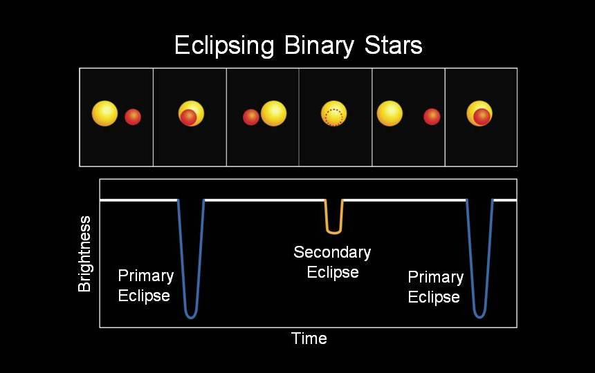
Eclipsing Binaries
Notes:
2
Stellar Spectra
Comparison of spectra observed for seven different stars having a range of surface temperatures. The hottest stars, at the top, show lines of helium and multiply ionized heavy elements. In the coolest stars, at the bottom, helium lines are not seen, but lines of neutral atoms and molecules are plentiful. At intermediate temperatures, hydrogen lines are strongest. The actual compositions of all seven stars are about the same. ><*Recently, some astronomers have proposed the addition of two new spectral classes—L and T—for low-mass, low-temperature stars whose odd spectra distinguish them from the M-class stars in the current scheme. For now, at least, the new classification has not been widely adopted. Astronomers are still uncertain whether these new objects are “true” stars, fusing hydrogen into helium in their cores, or if they are “brown dwarfs” that never achieved high enough central temperatures for fusion to begin.

Slide 48
Planetary Transits
These are similar to eclipsing binaries, except that planets emit negligible light.
The planets reflect light from the star, so there is a small dip in the flux when the planet is blocked.
Notes:
2
Stellar Spectra
Comparison of spectra observed for seven different stars having a range of surface temperatures. The hottest stars, at the top, show lines of helium and multiply ionized heavy elements. In the coolest stars, at the bottom, helium lines are not seen, but lines of neutral atoms and molecules are plentiful. At intermediate temperatures, hydrogen lines are strongest. The actual compositions of all seven stars are about the same. ><*Recently, some astronomers have proposed the addition of two new spectral classes—L and T—for low-mass, low-temperature stars whose odd spectra distinguish them from the M-class stars in the current scheme. For now, at least, the new classification has not been widely adopted. Astronomers are still uncertain whether these new objects are “true” stars, fusing hydrogen into helium in their cores, or if they are “brown dwarfs” that never achieved high enough central temperatures for fusion to begin.

Slide 49
hr diagram

Slide 50
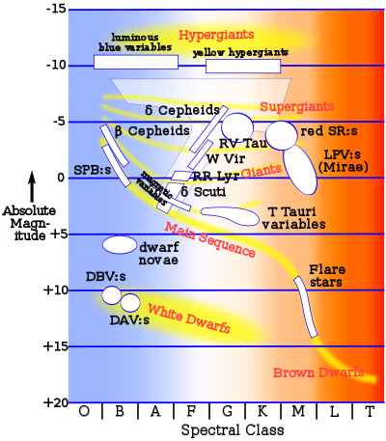
HR Diagram for Variable Stars
Notes:
2
Stellar Spectra
Comparison of spectra observed for seven different stars having a range of surface temperatures. The hottest stars, at the top, show lines of helium and multiply ionized heavy elements. In the coolest stars, at the bottom, helium lines are not seen, but lines of neutral atoms and molecules are plentiful. At intermediate temperatures, hydrogen lines are strongest. The actual compositions of all seven stars are about the same. ><*Recently, some astronomers have proposed the addition of two new spectral classes—L and T—for low-mass, low-temperature stars whose odd spectra distinguish them from the M-class stars in the current scheme. For now, at least, the new classification has not been widely adopted. Astronomers are still uncertain whether these new objects are “true” stars, fusing hydrogen into helium in their cores, or if they are “brown dwarfs” that never achieved high enough central temperatures for fusion to begin.

