Slide 1
University Astronomy
Professor Don Figer
Celestial Sphere

Slide 2
Aims and outline for this lecture
introduce concepts for navigating the sky
  constellations
  the celestial sphere
  coordinate systems on Earth
  coordinate systems in the sky
  altitude and azimuth
  right ascension and declination
  Galactic latitude and longitude
describe diurnal motion

Slide 3
constellations

Slide 4
Constellations
Originally, constellations were patterns in the sky recognized and named by ancient cultures.
This evolved into 88 regions of the sky with well documented borders.

Slide 5
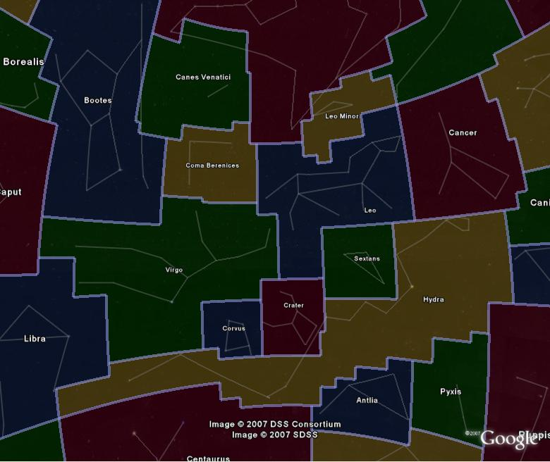
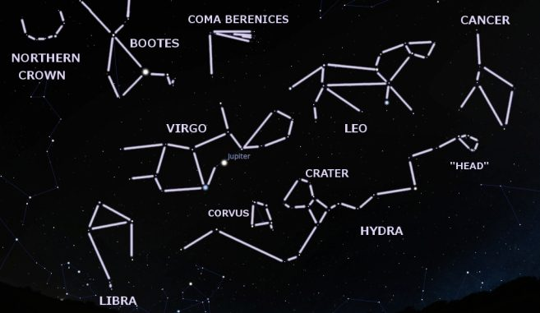
Constellation Pictures

Slide 6
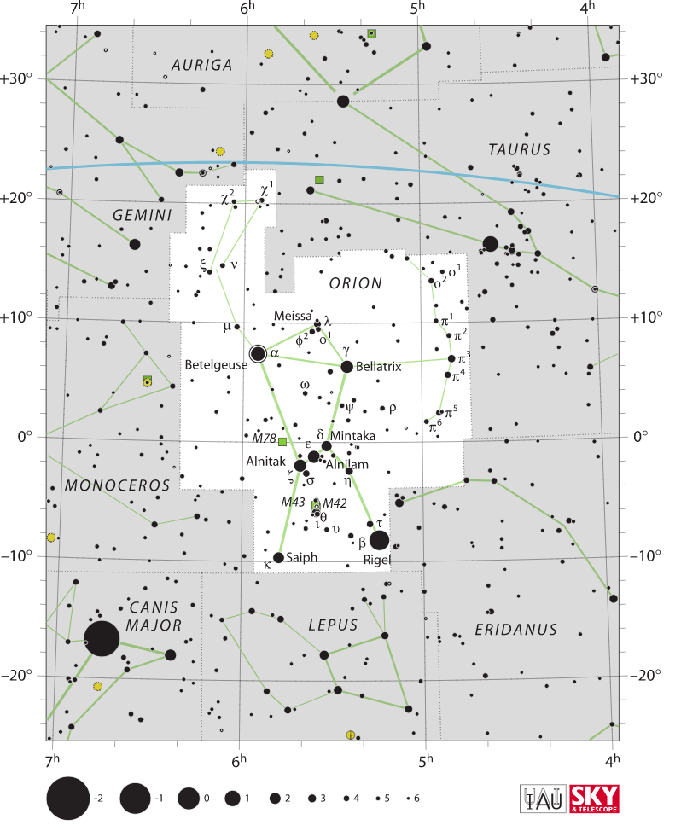
Orion – Simple Version

Slide 7
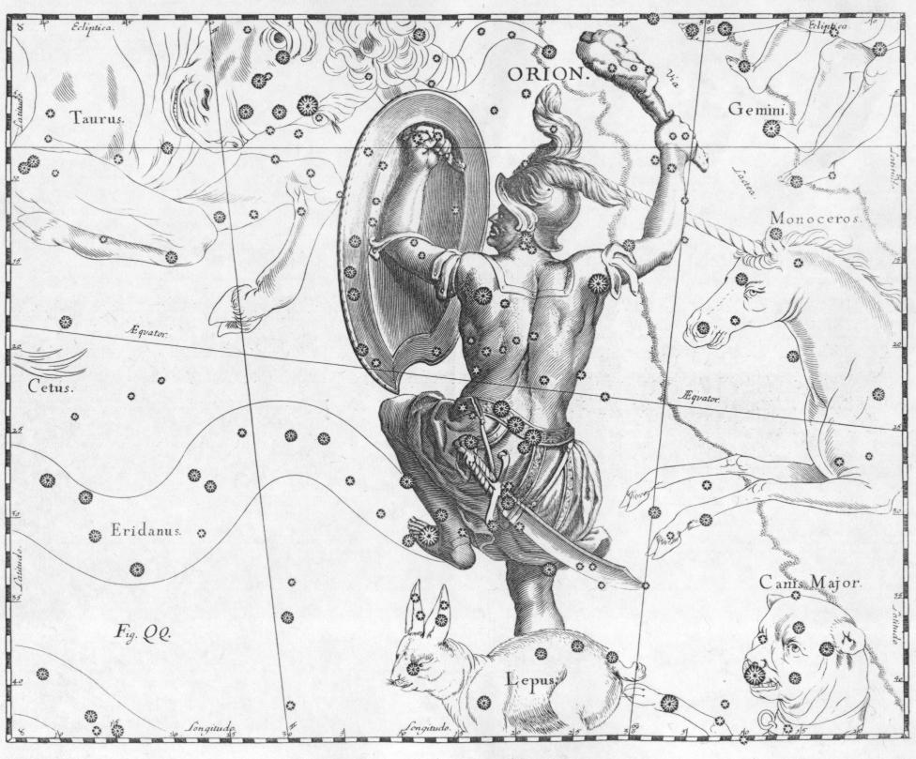
Orion – Fancy Version

Slide 8

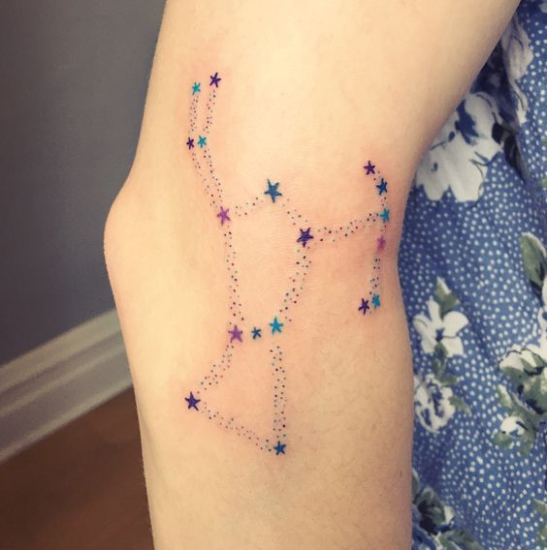
Orion – Tattoo Versions

Slide 9
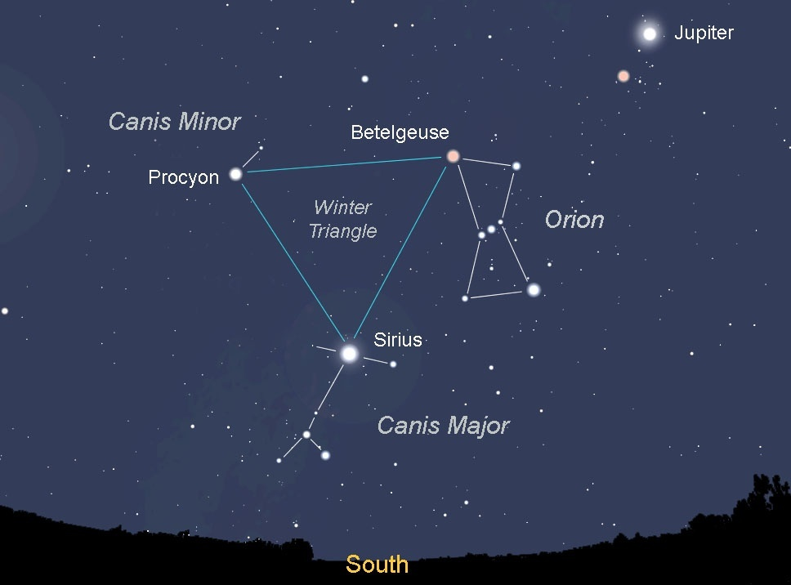
Star Hopping - Orion

Slide 10
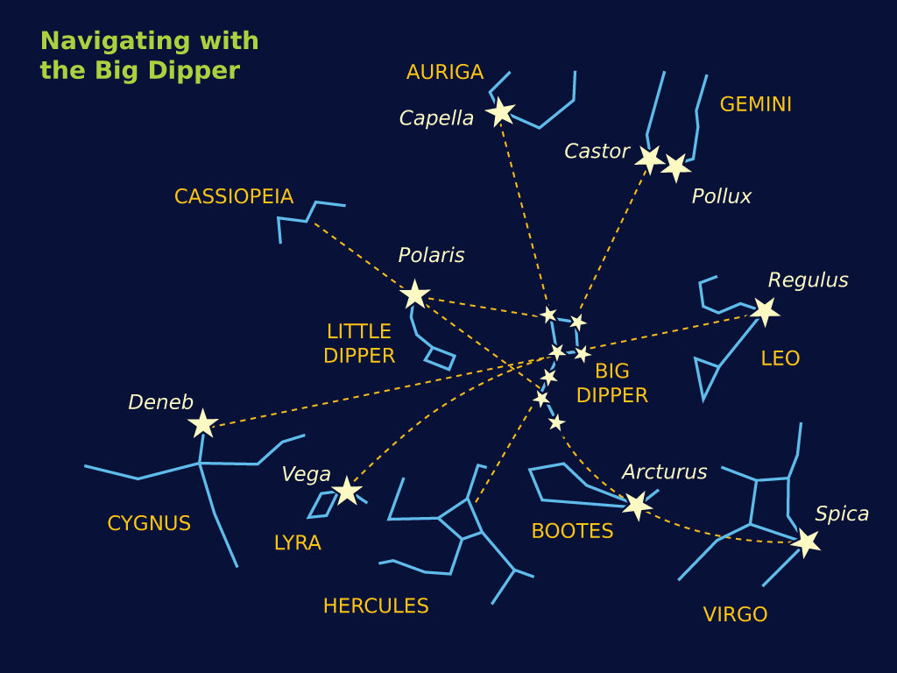
Star Hopping – Big Dipper

Slide 11
celestial sphere

Slide 12
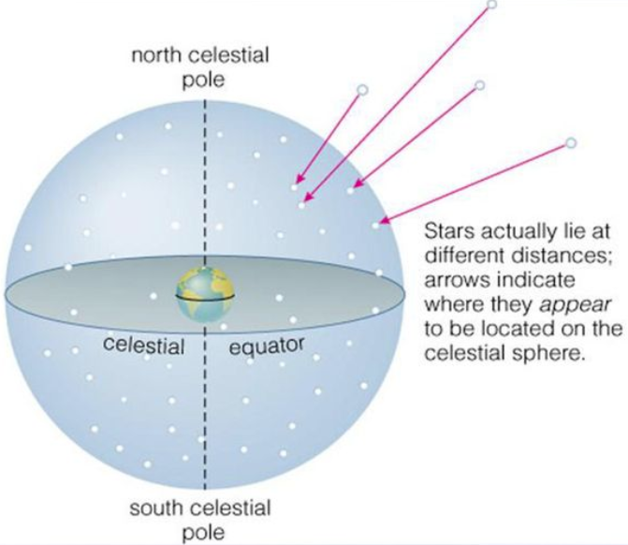
The Celestial Sphere
It is useful to think of the sky as a sphere centered on Earth and to then project stars and other objects onto this surface.
The stars are at different distances.

Slide 13
The Celestial Sphere and Local Directions

Slide 14
celestial coordinates

Slide 15
Coordinate Systems on Earth
Latitude and longitude uniquely identify locations on Earth.
Longitude is measured west of Greenwich.
Latitude is measured from the equator.

Slide 16
Coordinates
Angular coordinates can be expressed in several ways.
For instance, we could say that RIT is at:
  latitude 43.0758 degrees North, longitude 77.6647 degrees West of Greenwich
Or using degrees, minutes and seconds:
  latitude 43:04:33 North, longitude 77:39:53 West
Or, using hours for longitude:
  latitude 43:04:33 North, longitude 05 hours 11 minutes West

Slide 17
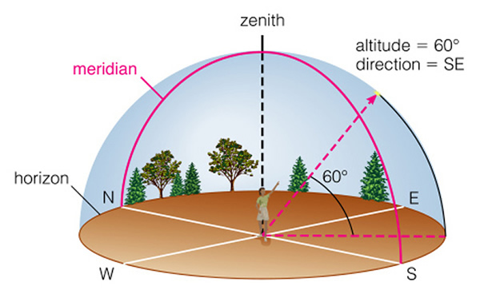
Local Coordinates on Earth
An object can be found by its altitude and azimuth.
Altitude is the angle above horizon.
Azimuth is angle along horizon east of north.
Zenith is point overhead.
Nadir is point below.
Meridian is the arc that connects north and south and goes directly overhead.

Slide 18
Celestial Coordinate Systems
Celestial coordinate systems provide unique identifiers for every location in the sky.
Objects have unique locations.
The coordinates for each location on the sky are expressed as angles from a designated origin (0,0).
The most common celestial coordinate system is the equatorial coordinate system.
Another coordinate system used by professional astronomers is the galactic coordinate system.

Slide 19
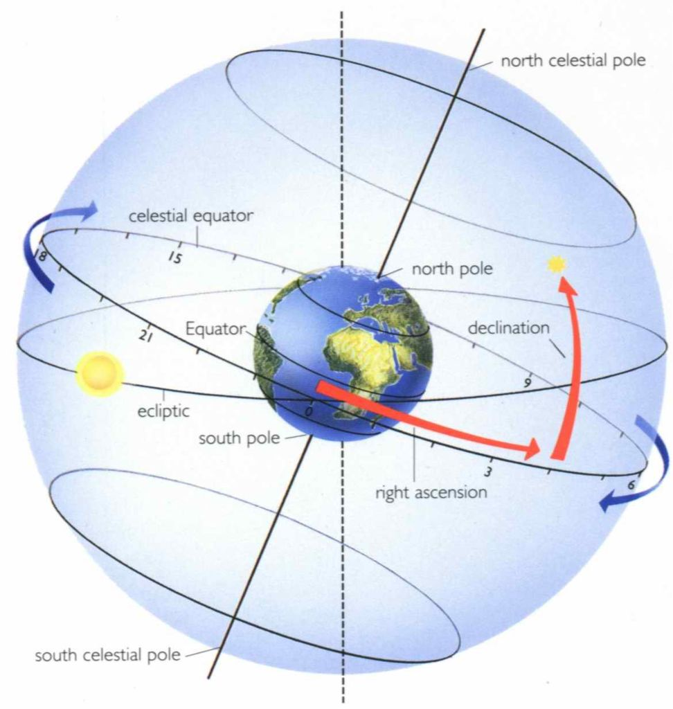
Equatorial Coordinate System
Similar to latitude and longitude on Earth, objects in the celestial sphere are located by two angles.
Right ascension is similar to longitude.
Declination is similar to latitude.

Slide 20
Right Ascension
Just like Greenwich for longitude, there is an arbitrarily located line connecting the north to the south celestial poles through a zero point.
Right ascension (RA) increases to the east of this point.
RA goes from zero to 24 hours.
Time is used as the unit for RA as a practical matter because objects in the sky appear to drift by one hour of RA for every one hour of time.
As an example, if objects having an RA of 4 hours are overhead now, then objects having an RA of 5 hours will be overhead in an hour.
You can relate angular units to RA by noting that there are 15 degrees per hour along a full circle.

Slide 21
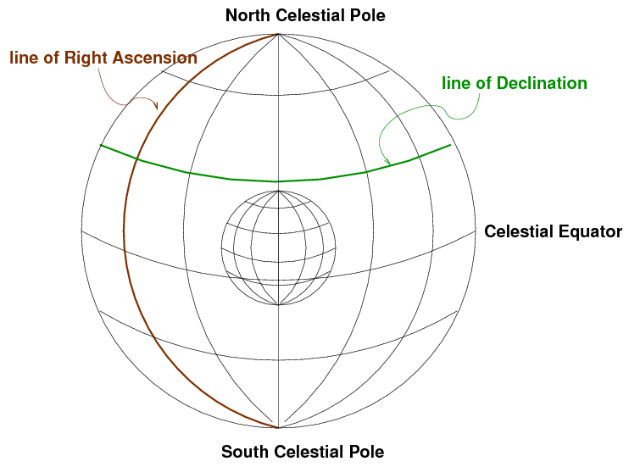
Declination
Just like latitude on Earth, declination is measured from the celestial equator.
It is positive to the north and negative to the south.
DEC goes from zero to +/-90 degrees.
Lines of declination do not drift during the night.

Slide 22
Question
What is the declination of Polaris?
  a) 0 degrees
  b) 30 degrees
  c) 90 degrees
  d) 43 degrees

Slide 23
Answer
What is the declination of Polaris?
  a) 0 degrees
  b) 30 degrees
  c) 90 degrees
  d) 43 degrees
Vote!

Slide 24
Question
Where would Polaris be for an observer at the North Pole?
  a) on the horizon
  b) straight up
  c) below the horizon
  d) in an igloo
Vote!

Slide 25
Answer
Where would Polaris be for an observer at the North Pole?
  a) on the horizon
  b) straight up
  c) below the horizon
  d) in an igloo
What is the astronomical name for “straight up?”

Slide 26
Question
Where would Polaris be for an observer at the equator?
  a) on the horizon
  b) straight up
  c) below the horizon
  d) in an grass hut

Slide 27
Answer
Where would Polaris be for an observer at the equator?
  a) on the horizon
  b) straight up
  c) below the horizon
  d) in an grass hut
Vote!

Slide 28
Question
What is the altitude of Polaris as seen by us in Rochester?
  a) 0 degrees
  b) 30 degrees
  c) 90 degrees
  d) 43 degrees

Slide 29
Answer
What is the altitude of Polaris as seen by us in Rochester?
  a) 0 degrees
  b) 30 degrees
  c) 90 degrees
  d) 43 degrees

Slide 30
galactic coordinates

Slide 31
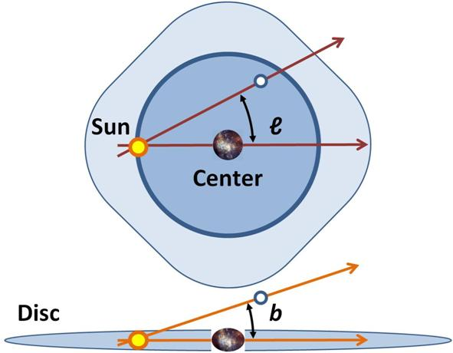
Galactic Coordinates

Slide 32
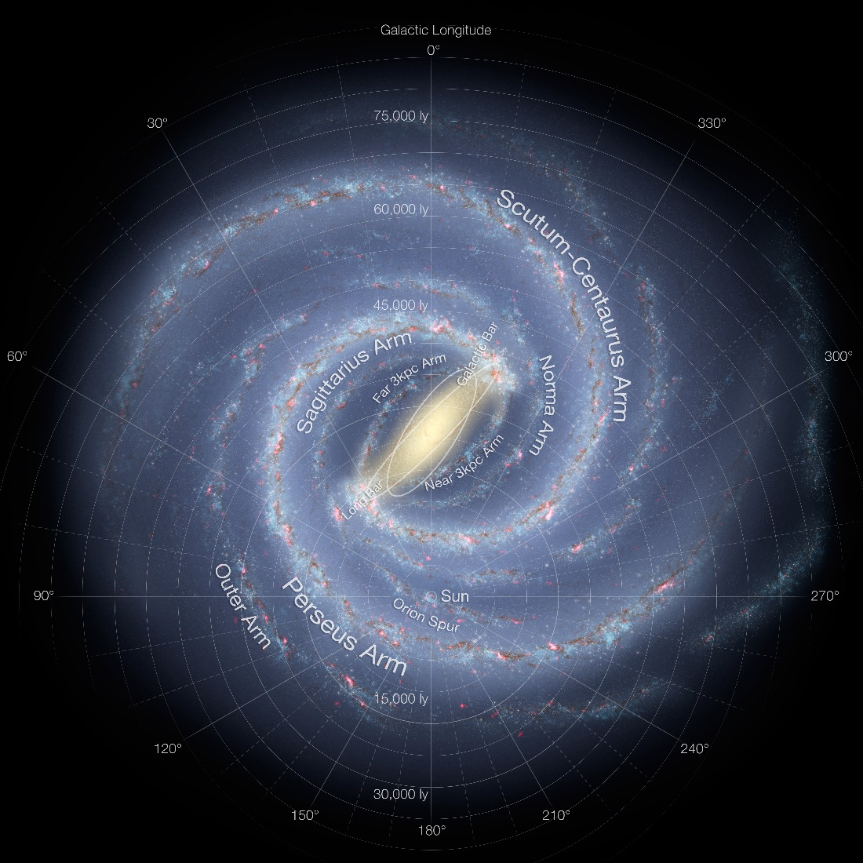
Galactic Longitude

Slide 33
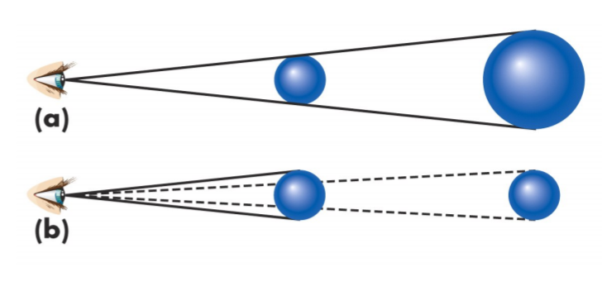
Angular Sizes
Apparent sizes of objects or separations on the sky are measured as angles
Angular distances are measured in degrees (°), minutes (’), and seconds (”) of arc.
1° = 60 arcminutes
1 arcminute = 60 arcseconds
Sun and Moon are ½ degree

Slide 34
Question
The Sun is about 400 times further away from us than the Moon. In a solar eclipse, the Moon appears to just barely cover the Sun. What is the size of the Sun compared to the Moon?

Slide 35
motion on the sky

Slide 36
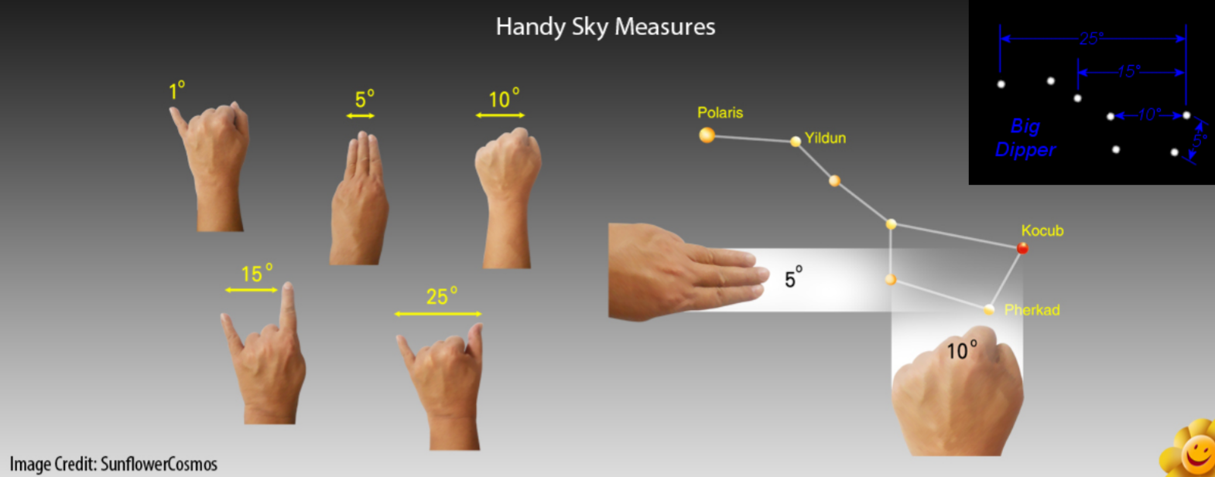
“Handy” Measures

Slide 37
Motions in the Sky

Slide 38
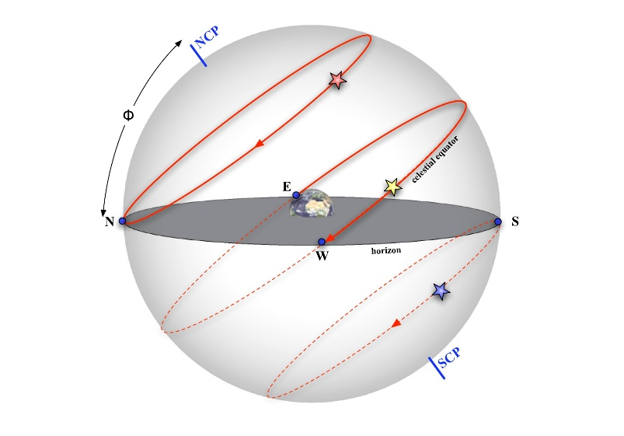
Circumpolar Stars
Stars which never set are said to be circumpolar.
It depends on your latitude.
At the north pole, all stars with positive declination are circumpolar.

Slide 39
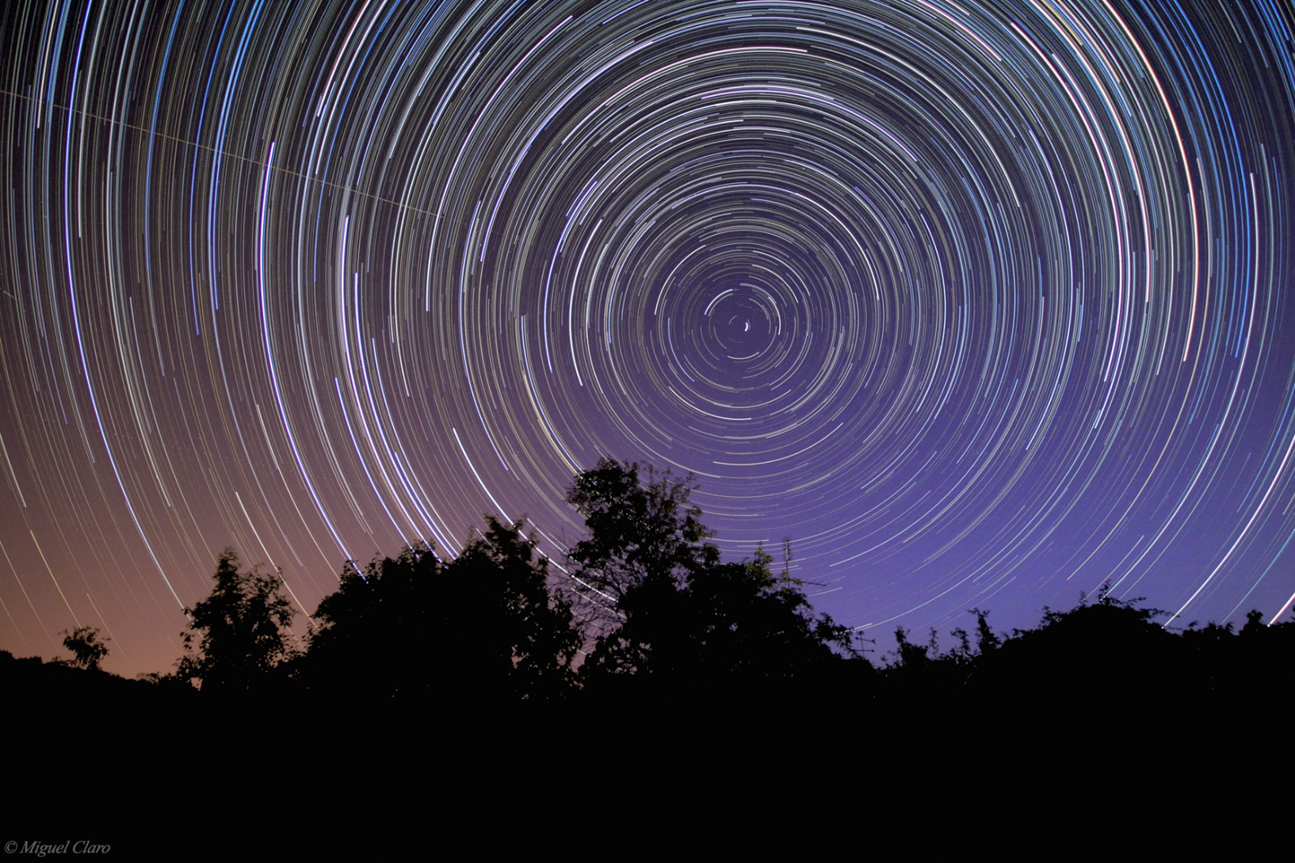
Circumpolar Stars Image

Slide 40
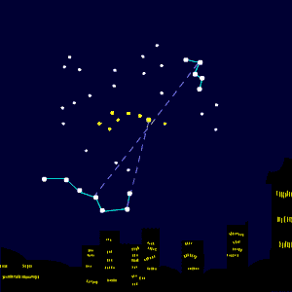
Circumpolar Stars Animation

Slide 41
Motion of Stars Across the Sky
Motion of stars depends on your latitude!
What is the latitude of Rochester?
Fact: The altitude of the North Celestial Pole is always equal to your latitude.
What is the highest altitude that the celestial equator reaches?
Let’s look at how stars move across the sky in Rochester
Useful online tool
http://astro.unl.edu/naap/motion2/animations/ce_hc.html

Slide 42
The Sky in Northern Latitudes

Slide 43
The Sky at the North Pole

Slide 44
The Sky at the Equator

Slide 45
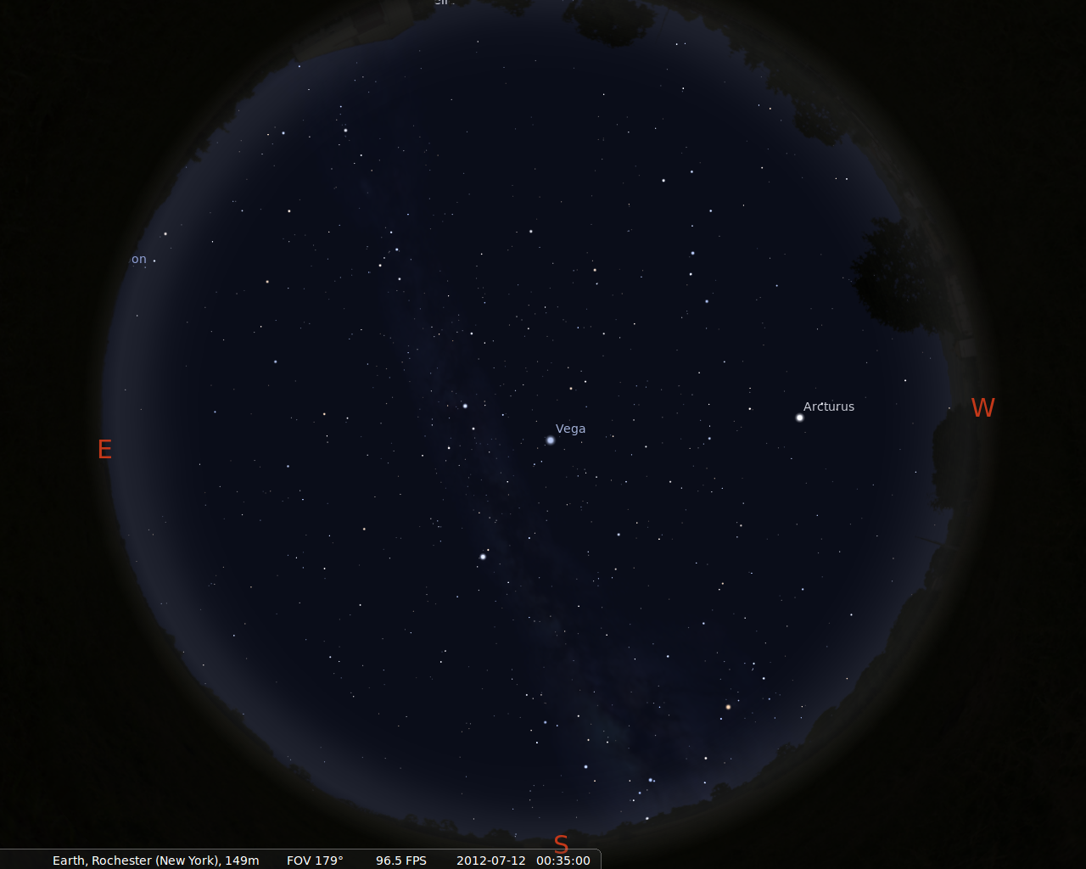
Summer in Rochester

Slide 46
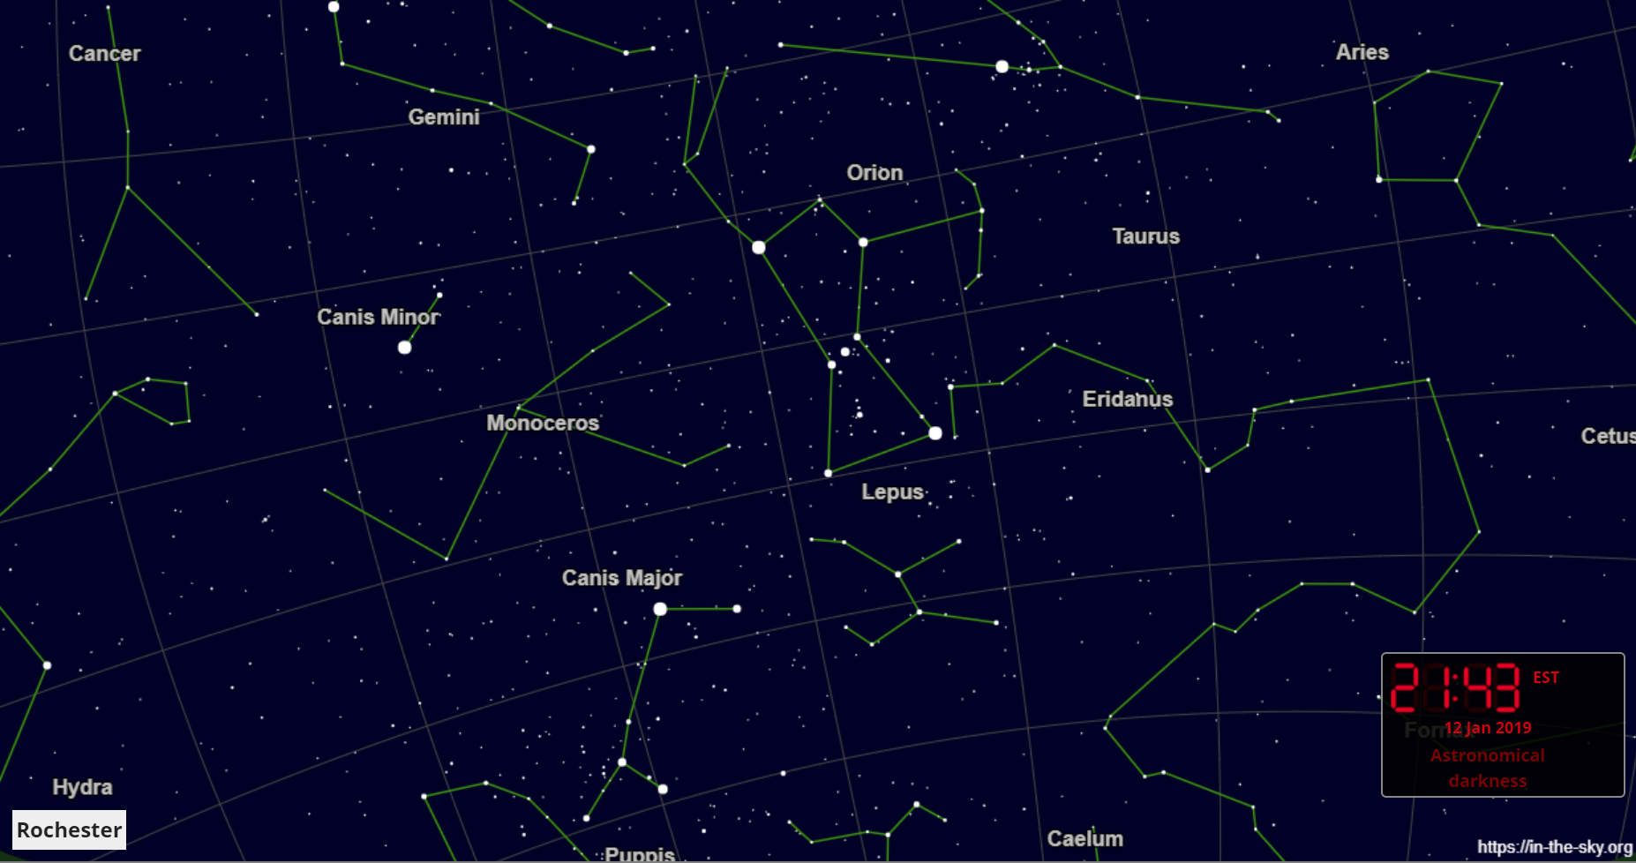
Winter in Rochester

Slide 47
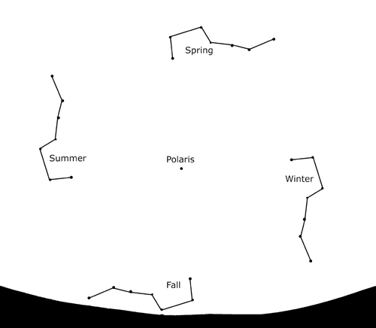
Big Dipper Always Visible

