Slide 1
University Astronomy
Professor Don Figer
Star Clusters

Slide 2
Aims and outline for this lecture
describe types of stellar clusters
review stellar cluster properties
give examples of stellar clusters
demonstrate how stellar clusters are used to probe stellar evolution

Slide 3
introduction to star clusters

Slide 4
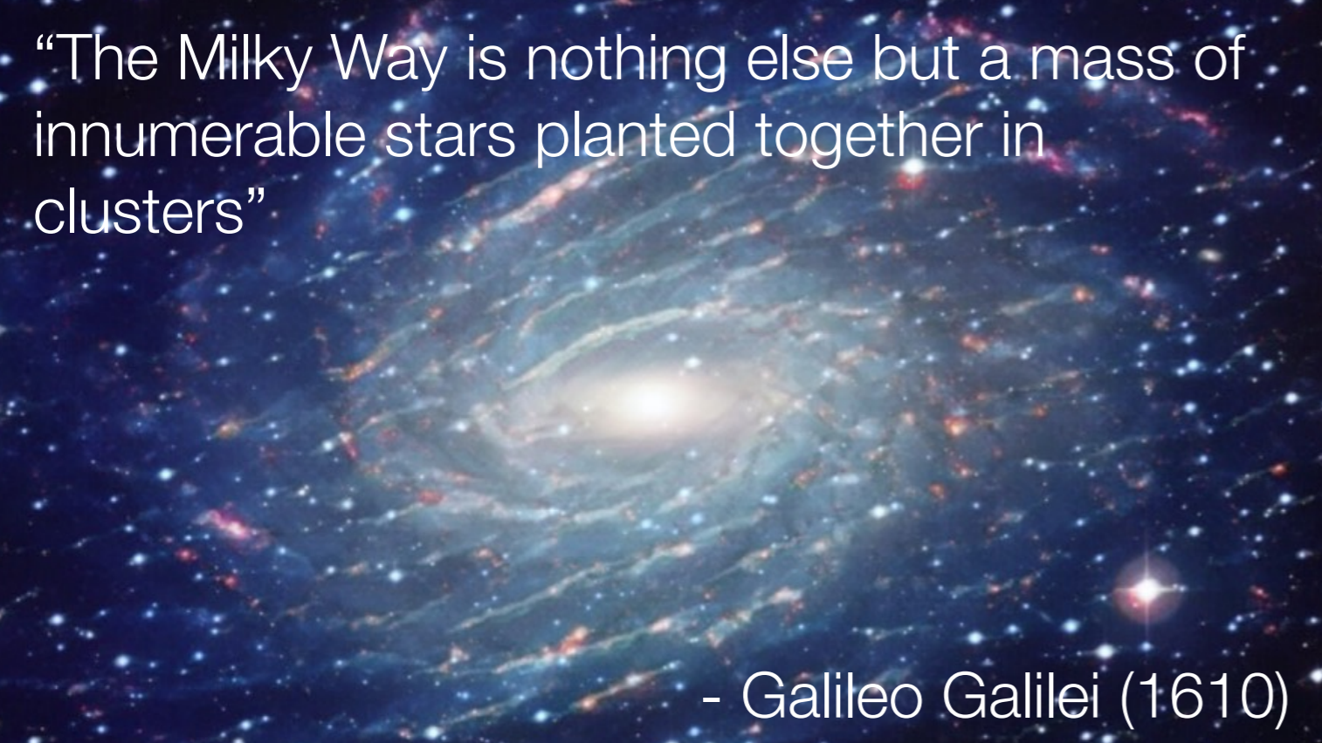
What is a Cluster?
Nora Lützgendorf

Slide 5
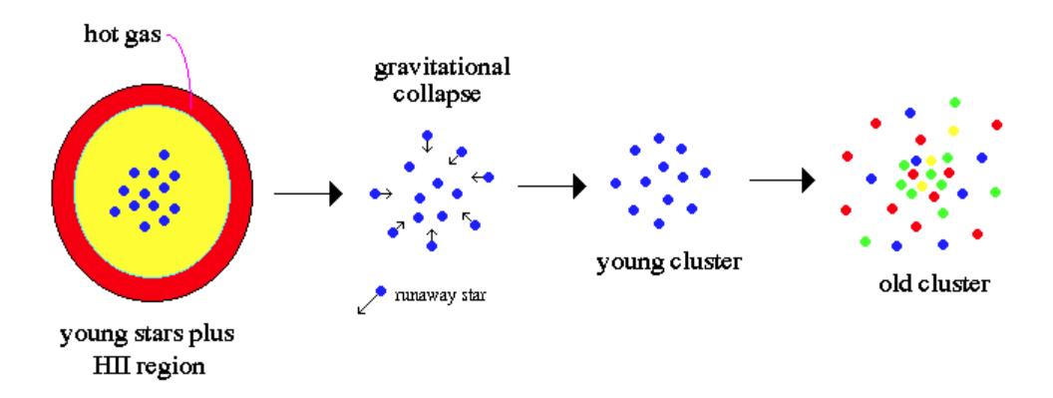
Stars Form in Clusters

Slide 6
Star Clusters and Stellar Evolution
Star clusters are very useful for understanding stellar evolution.
It is not possible to watch a star from birth to death because that process takes billions of years but astronomers only live on order of a hundred years.
One could look at a sample of stars having the same exact initial mass but at different ages and then construct a evolutionary picture.
This is hard to do because it is not always possible to tell if stars had the same initial mass.
Another technique is to observe stars in clusters. This ensures that all the stars have the same age, distance, and composition.
The next step is to calibrate the mass-magnitude relationship for that cluster to be able to measure properties of each star versus mass.
The final step is to observe many clusters of differing age to create an evolutionary sequence versus mass.

Slide 7
Kinds of Star Clusters
There appear to be two kinds of star clusters.
Globular clusters
Galactic clusters

Slide 8
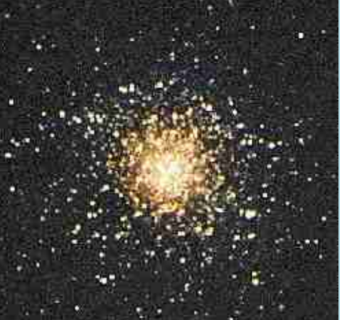
Globular Clusters
10⁵ to 10⁶ stars
round
size of 10-100 pc
stellar density ~10³⁻⁶ stars/pc³
spherically distributed in the halo
old
metal poor (Population II)
bound
stars of a few solar masses and less
~150 in the Galaxy
Examples: M13, M15, M3

Slide 9
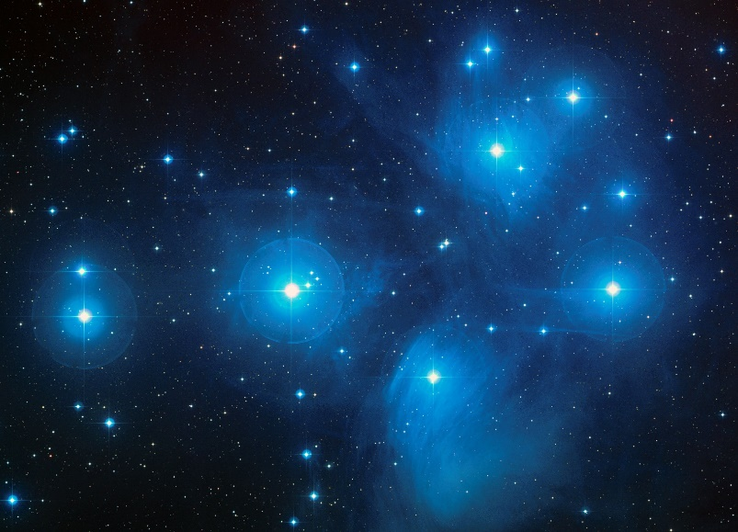
Galactic Clusters
a few to 10⁵ stars
size ~a few to 10 pc
stellar density is usually small, 0.1-10 stars/pc³, but can be much higher
located in the disk
young
include massive stars
often unbound (“open”)
metal rich (Population I)
a few thousand in the Galaxy
Examples: Pleiades, Hyades

Slide 10
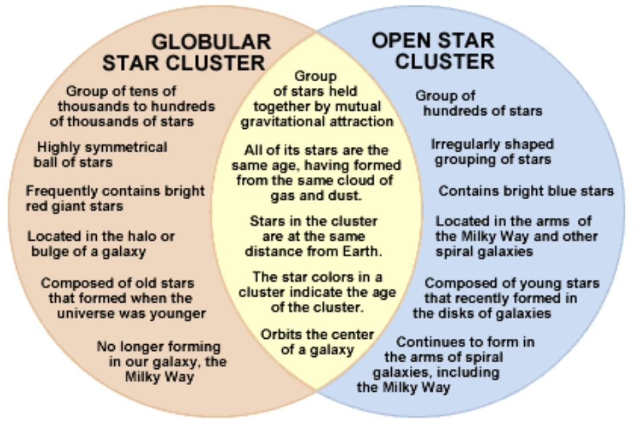
Stars Form in Clusters

Slide 11
globular clusters

Slide 12
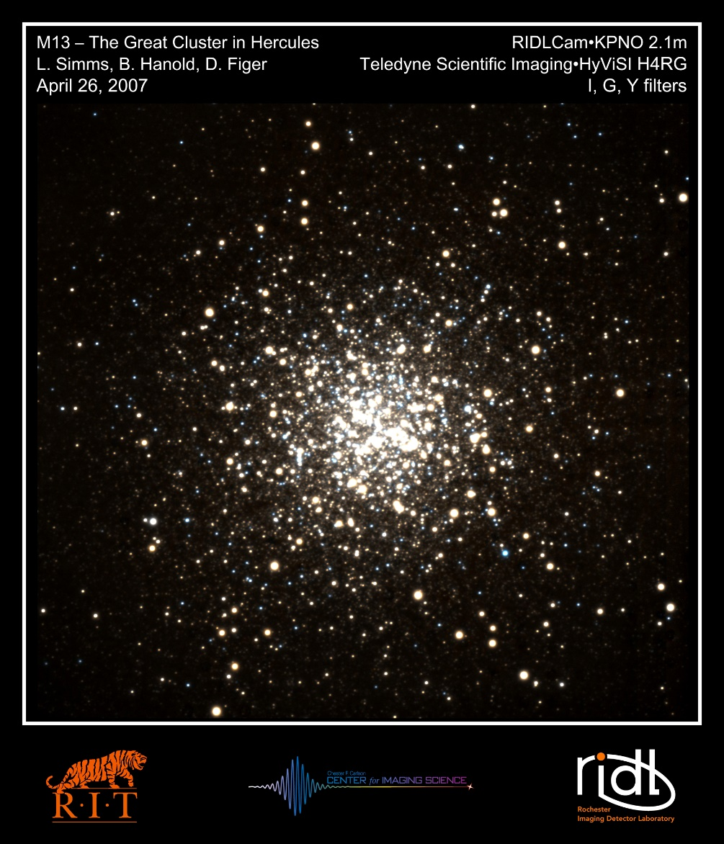
Globular Cluster Example

Slide 13
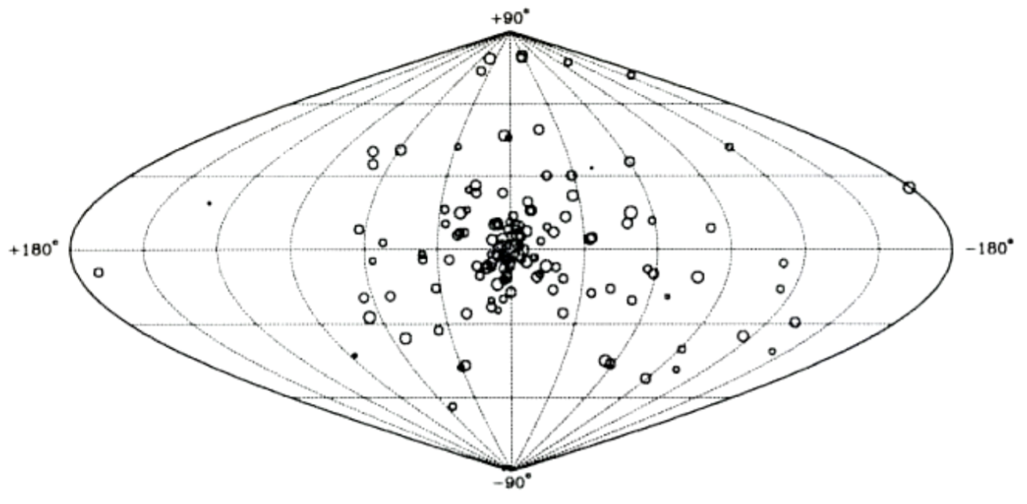
Globular Cluster Distribution

Slide 14
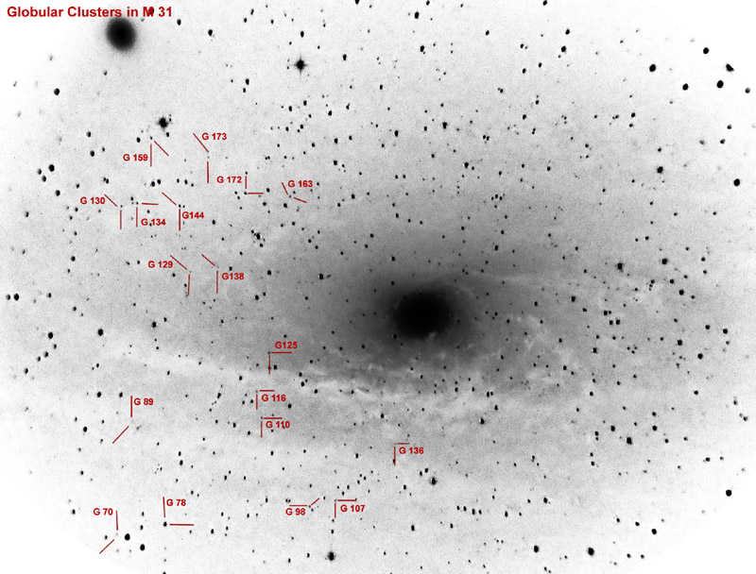
Globular Clusters Around Other Galaxies

Slide 15
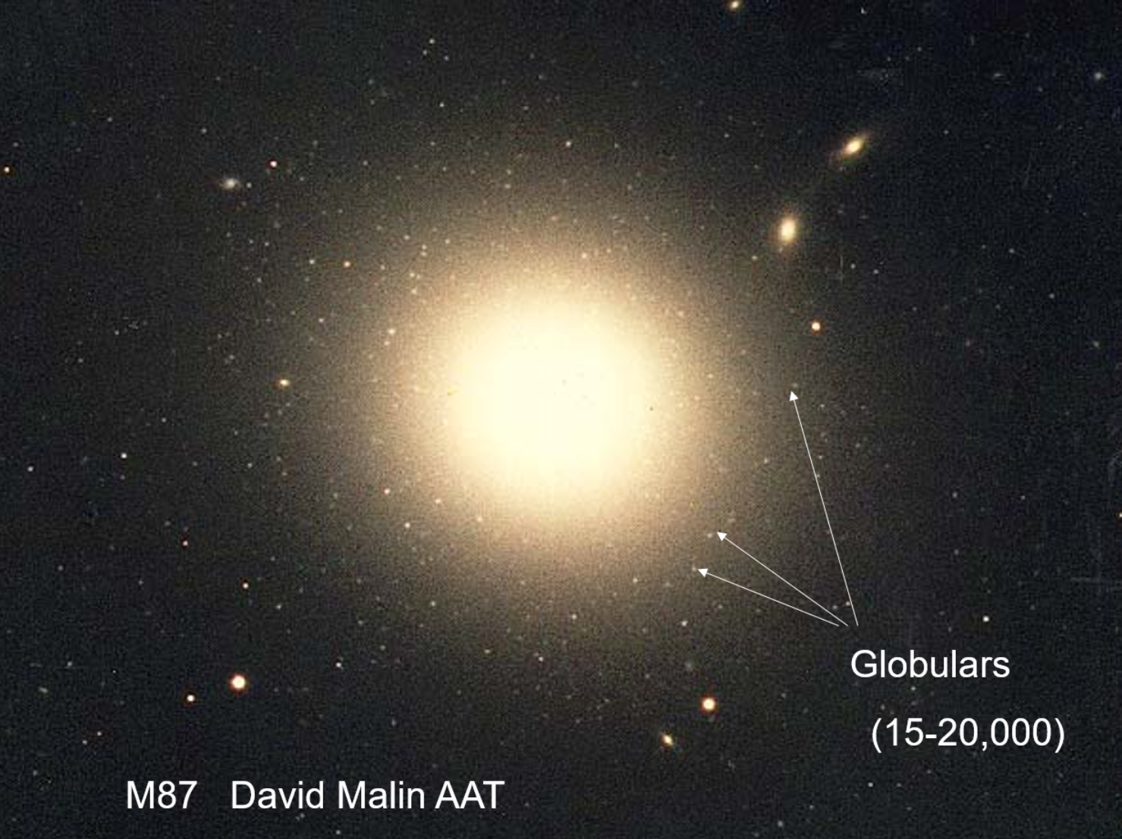
Globular Clusters Around Other Galaxies

Slide 16
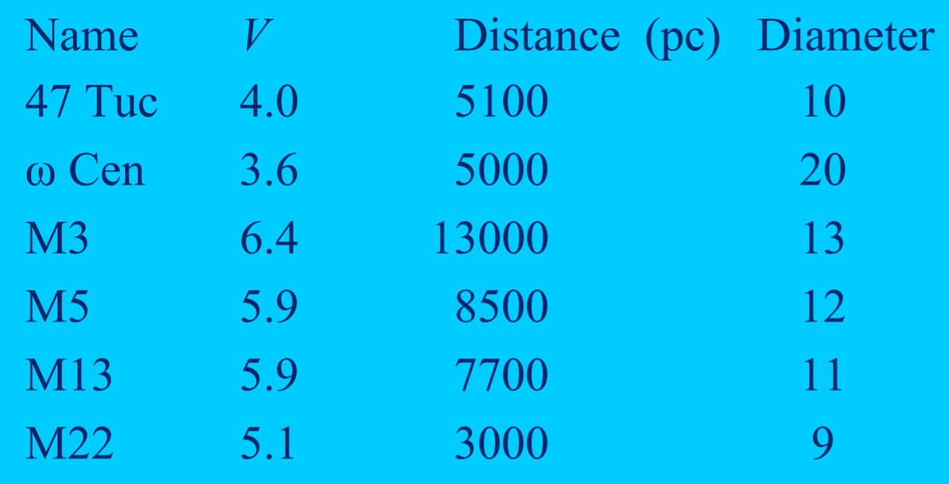
Globular Cluster Properties

Slide 17
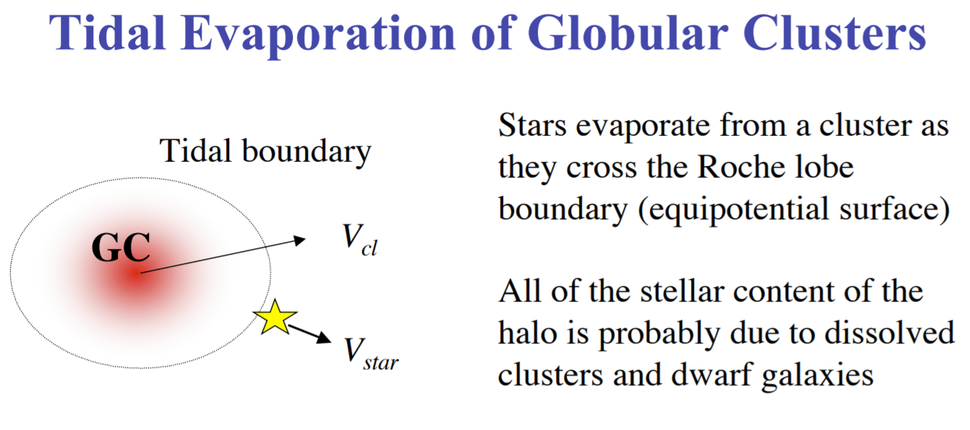
Tidal Stripping

Slide 18
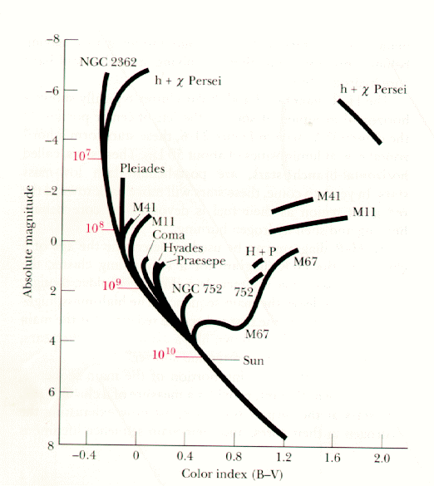
Main Sequence Turnoff
The “Main Sequence Turnoff” (MSTO) is the location in the HR diagram where stars are just now turning off the main sequence as they evolve into other phases, such as the red giant phase.
The location of the MSTO tells us the age of the cluster.
A lower MSTO indicates an older age.

Slide 19
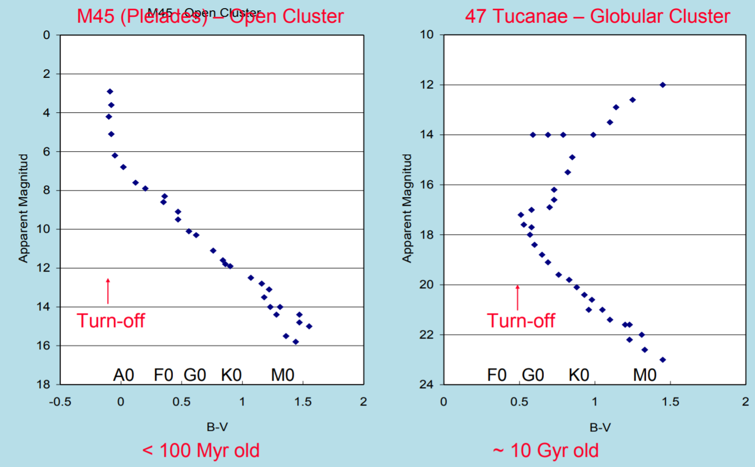
Main Sequence Turnoff
M45 (Pleiades)
47 Tucanae

Slide 20
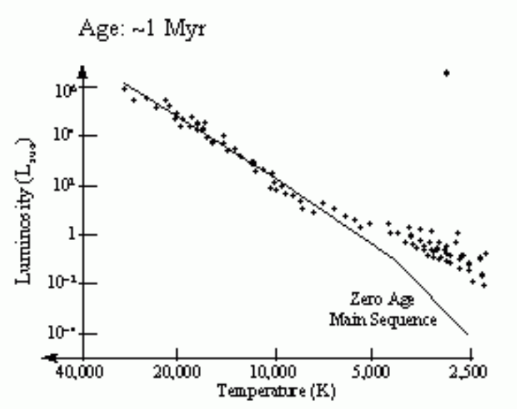
Main Sequence Turnoff

Slide 21
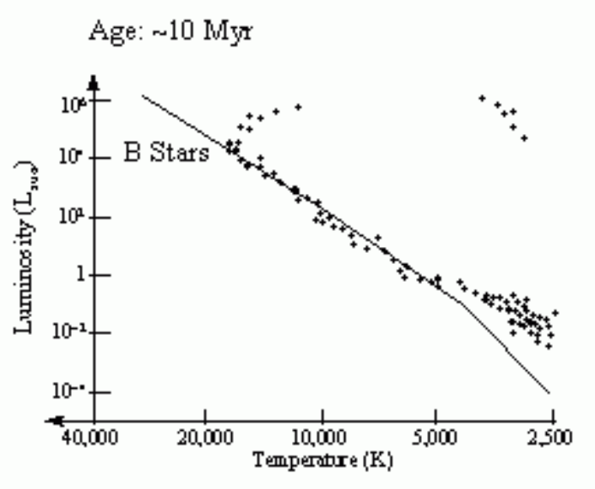
Main Sequence Turnoff

Slide 22
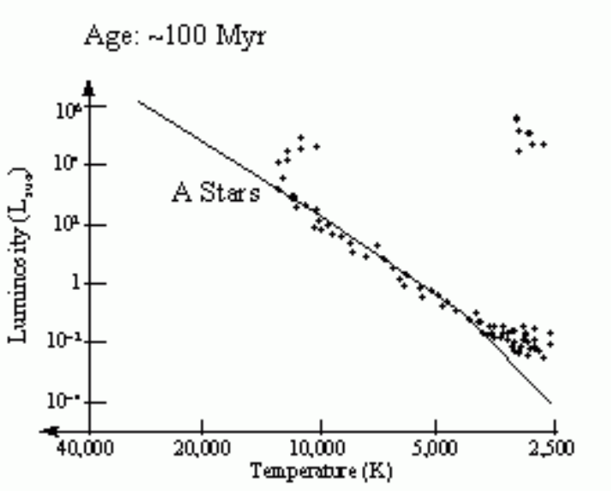
Main Sequence Turnoff

Slide 23
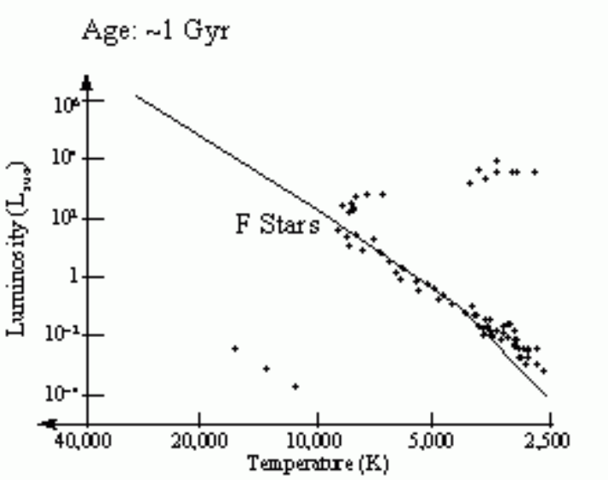
Main Sequence Turnoff

Slide 24
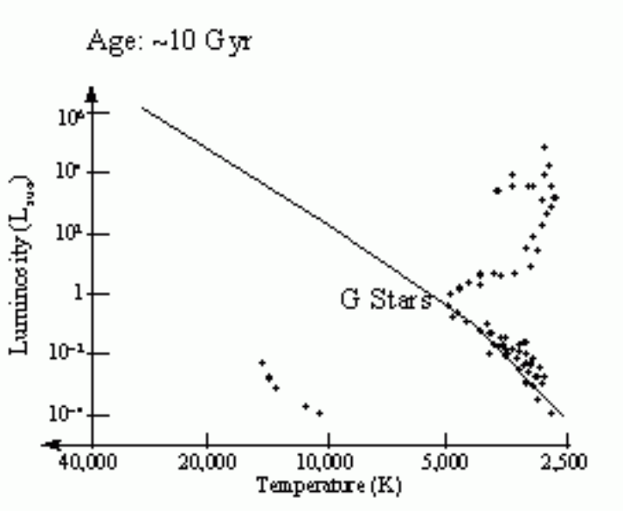
Main Sequence Turnoff

Slide 25
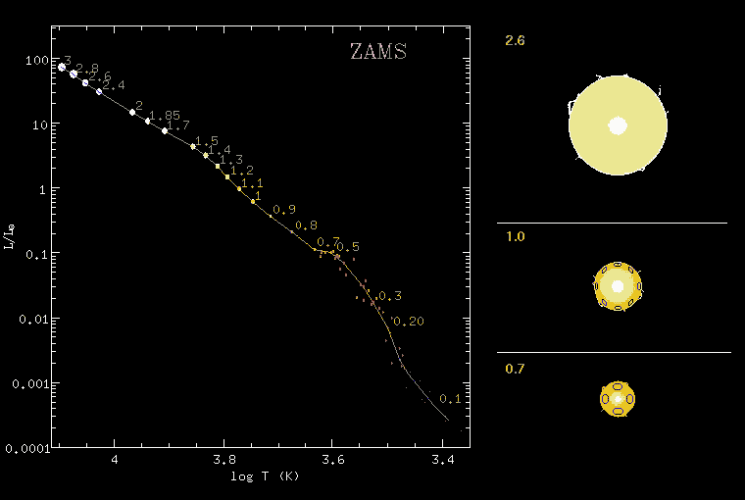
Animation

Slide 26
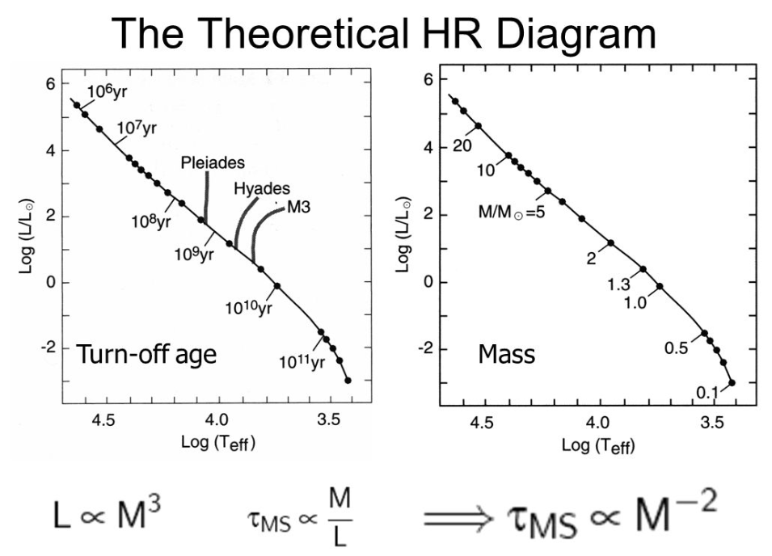
Main Sequence Turnoff

Slide 27
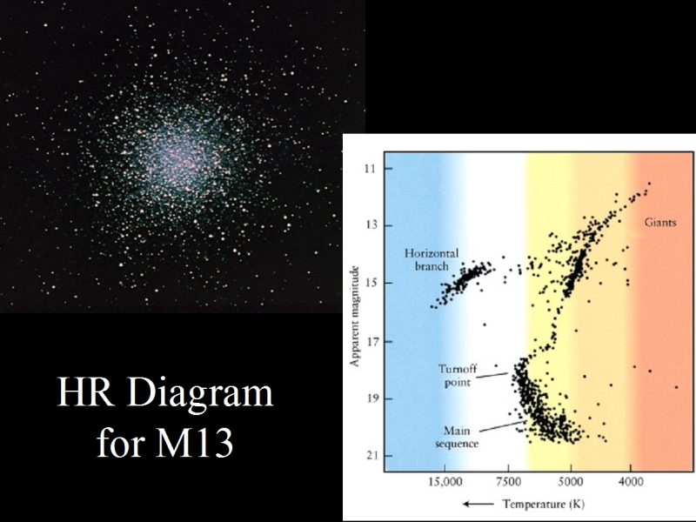
HRD of Globular Clusters

Slide 28
galactic clusters

Slide 29

Galactic Clusters

Slide 30
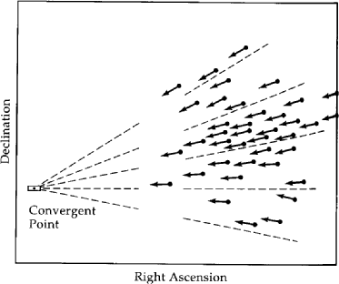
Loose Associations
Sometimes we recognize clusters by the common motion of their stars.
We can trace the motion back to a common point.
This tells us that all the stars were born at the same time, same place, and with the same chemical composition.

Slide 31
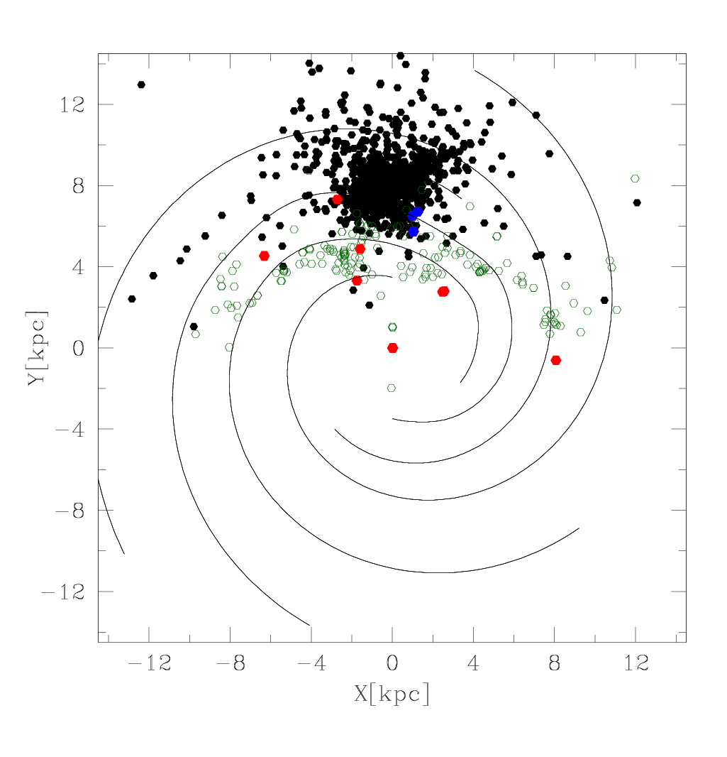
Distribution Of Known Open Clusters
black – WEBDA (optically identified)
green – 2MASS candidates
red – massive clusters
blue – candidate massive clusters
Spiral arms are from Cordes & Lazio (2003).

Slide 32
Massive Galactic Young Clusters: 1997
THIS PAGE INTENTIALLY LEFT BLANK

Slide 33
Massive Galactic Young Clusters: Now

Slide 34
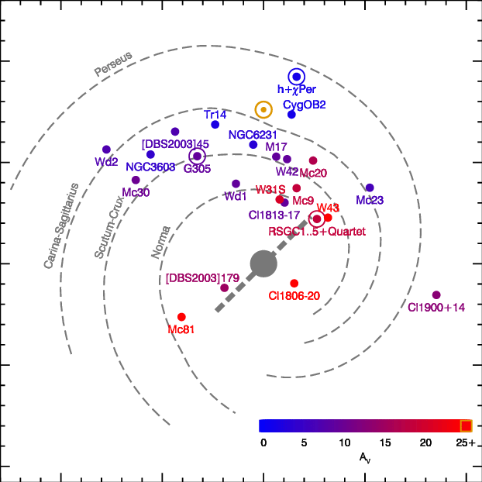
Young Massive Clusters

Slide 35
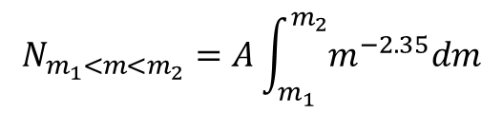
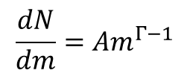
Initial Mass Function
There are many more low mass stars than high mass stars.
Nobody really knows why.
The most commonly observed distribution can be described by a power law.
$$\frac{dN}{dm}=Am^{Γ−1}$$
Gamma, Γ, is a negative number.
The “Salpeter” IMF has Γ=−1.35.
One can integrate to find the total number of stars having masses between m₁ and m₂.
$$N_{m_{1}<m<m_{2}}=A\int_{m_{1}}^{m_{2}}{m^{−2.35}dm}$$

Slide 36
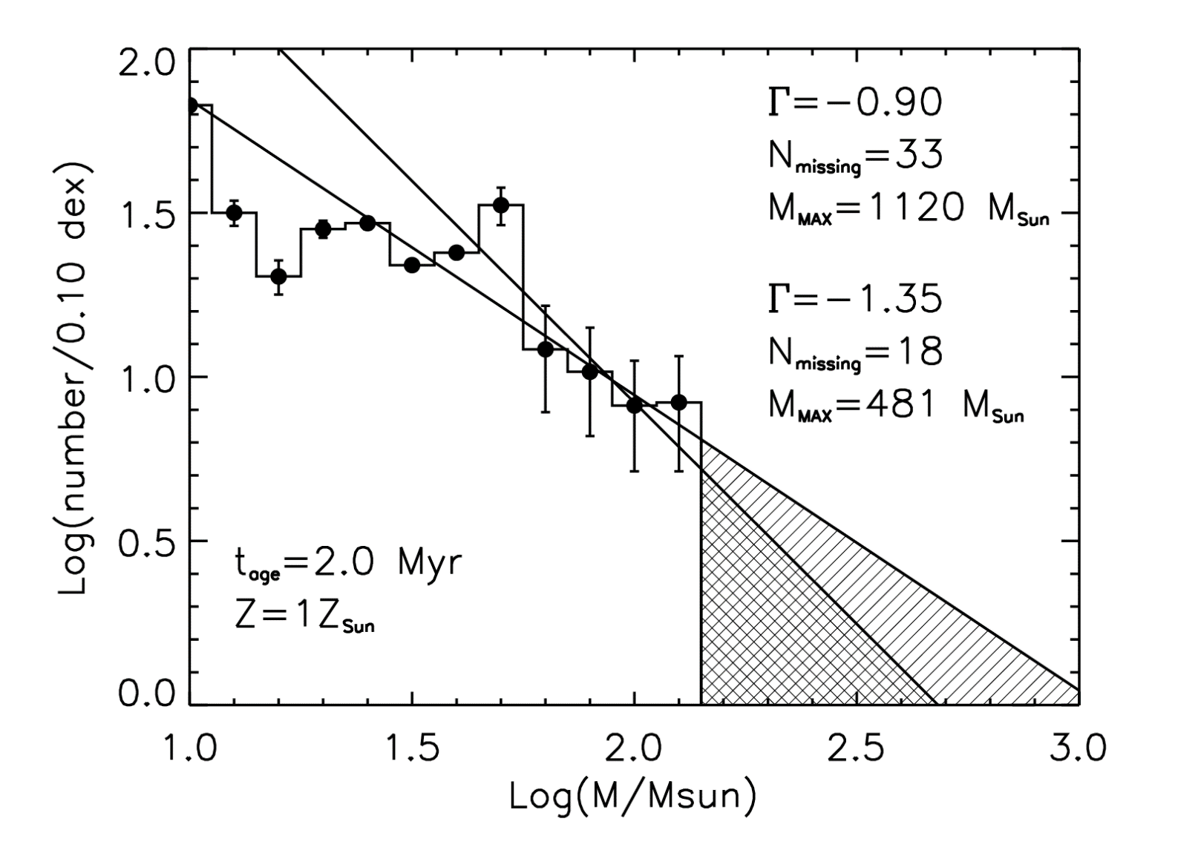
IMF Example

Slide 37
An upper mass limit has been elusive
There is no accepted upper mass limit for stars.
Theory: incomplete understanding of star formation/destruction.
  accretion may be inhibited by opacity to radiation pressure/winds
  formation may be aided by collisions of protostellar clumps
  destruction may be due to pulsational instability
Observation: incompleteness in surveying massive stars in the Galaxy.
  the most massive stars known have M~150 M
  most known clusters are not massive enough

Slide 38
The Upper Mass Cutoff Sample
Stars with M>150 M can only be observed in clusters with total stellar mass >10⁴ M.
This requirement limits the potential sample of stellar clusters that can constrain the upper mass limit to only a few in the Galaxy.

Slide 39
Upper mass limit: theoretical predictions
Ledoux (1941) | radial pulsation, e- opacity, H | 100 M
Schwarzchild & Härm (1959) | radial pulsation, e- opacity, H and He, evolution | 65-95 M
Stothers & Simon (1970) | radial pulsation, e- and atomic | 80-120 M
Larson & Starrfield (1971) | pressure in HII region | 50-60 M
Cox & Tabor (1976) | e- and atomic opacity Los Alamos | 80-100 M
Klapp et al. (1987) | e- and atomic opacity Los Alamos | 440 M
Stothers (1992) | e- and atomic opacity Rogers-Iglesias | 120-150 M

Slide 40
Upper mass limit: observation
R136 | Feitzinger et al. (1980) | 250-1000 M
Eta Car | various | 120-150 M
R136a1 | Massey & Hunter (1998) | 136-155 M
Pistol Star | Figer et al. (1998) | 140-180 M
Eta Car | Damineli et al. (2000) | ~70+? M
LBV 1806-20 | Eikenberry et al. (2004) | 150-1000 M
LBV 1806-20 | Figer et al. (2004) | 130 (binary?) M
HDE 269810 | Walborn et al. (2004) | 150 M
WR20a | Bonanos et al. (2004) Rauw et al. (2004) | 82+83 M
R136 a1 | Crowther et al. (2010) | 300 M

Slide 41
Upper mass limit: Goldilocks Scenario
Target sample must satisfy many criteria.
  massive enough to populate massive bins
  young enough to be pre-supernova phase
  old enough to be free of natal molecular material
  close enough to discern individual stars
  at known distance
  coeval enough to constitute a single event
  of a known age
Number of "expected" massive stars given by extrapolating observed initial mass function.

Slide 42
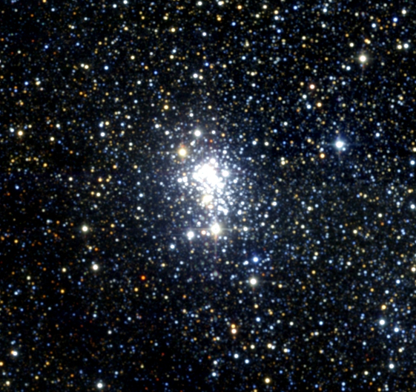

Goldilocks and the stellar upper mass limit: Westerlund 1
Westerlund 1
Too old!

Slide 43
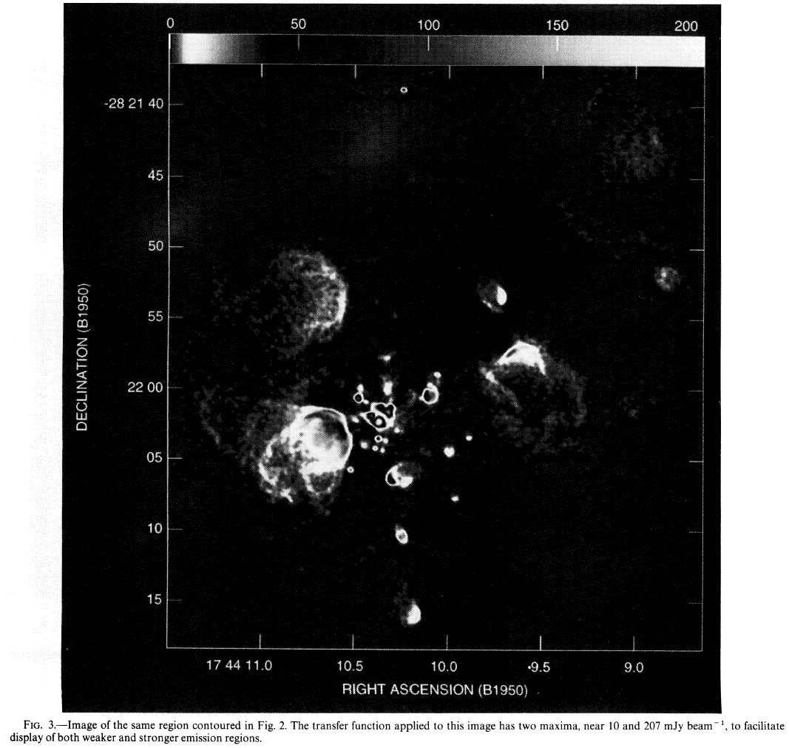
Goldilocks and the stellar upper mass limit: Sgr B2
Sgr B2
Too young!

Slide 44
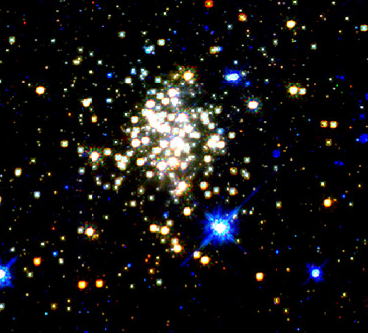
Goldilocks and the stellar upper mass limit: Arches cluster
Arches cluster
just right!

Slide 45

Initial mass function

Slide 46
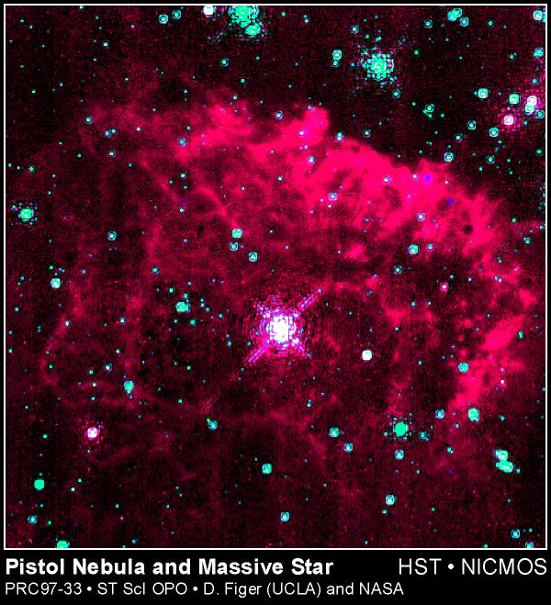
Pistol Star
Figer et al. 1999, ApJ, 525, 759

Slide 47
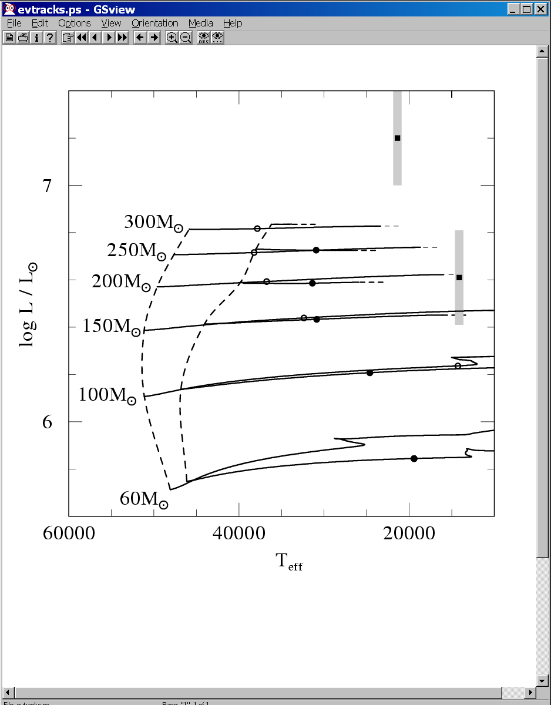
Is the Pistol Star "too" massive?
tracks by Langer
Figer et al. 1998, ApJ, 506, 384

Slide 48
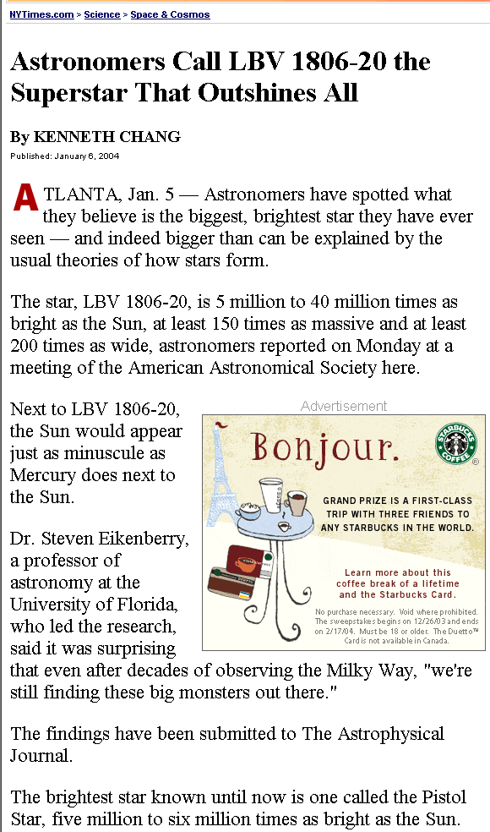
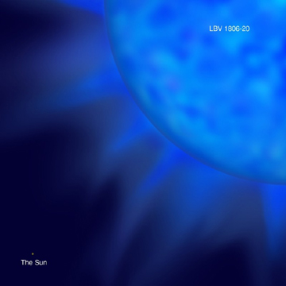
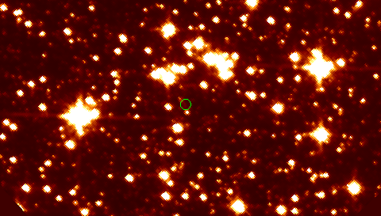
LBV 1806-20
Claim
  1-7 L_{Pistol*}
  150-1000 M⊙
Primary uncertainties
  distance
  temperature
  singularity
LBV
SGR

Slide 49
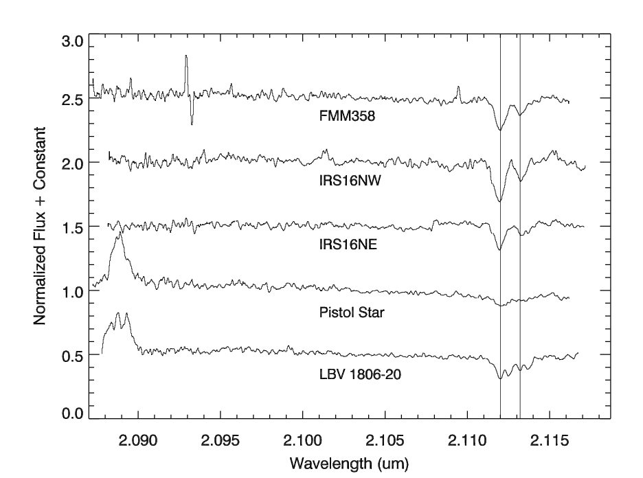
LBV 1806-20 is a binary?
double lines
Figer, Najarro, Kudritzki 2004, ApJ, 610, L109

Slide 50
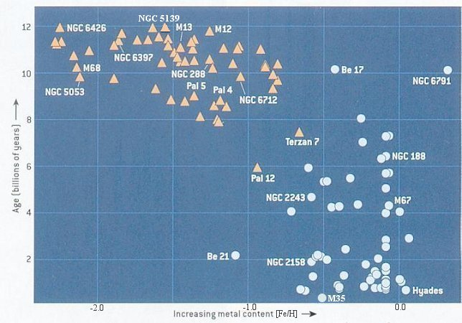
Chemical Composition
globulars
young

