Slide 1
University Astronomy
Professor Don Figer
Stellar Evolution

Slide 2
Aims and outline for this lecture
describe the stages of stellar evolution
explain why stars occupy regions off the main sequence in the HR diagram
review nucleosynthesis for evolved stars
give examples of post main sequence objects

Slide 3
Life stages of a star

Slide 4
Life Stages of Star
star formation
life on the main sequence
post-main sequence evolution
death

Slide 5
Star Formation
Matter collapses due to gravity.
The gravitational potential energy is converted to kinetic energy.
The kinetic energy is radiated like a blackbody.
The central temperature is hot enough to fuse hydrogen into helium.
A star is formed.

Slide 6
The Main Sequence
The Main Sequence is defined as the collection of stars on an HR diagram that are burning hydrogen in their cores.
The star burns hydrogen until it runs out.
This process comprises the majority of the star’s lifetime.
When the hydrogen runs out in the core, the star readjusts and begins burning hydrogen in a shell.
This marks the time when the star leaves the main sequence.

Slide 7
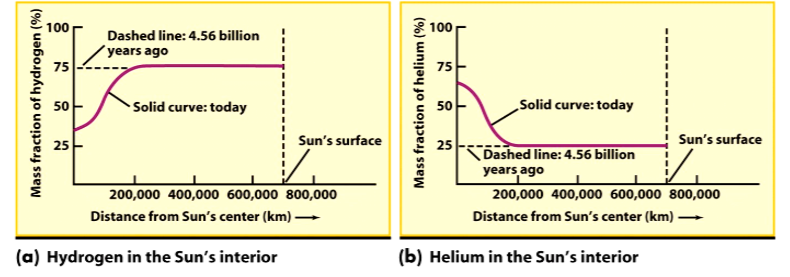
Nucleosynthesis

Slide 8
Post Main Sequence
The post main sequence stages for the star depend on stellar mass.
For stars like the Sun, the star begins burning hydrogen in a shell surrounding the core.
The outer layers of the star expand to create a red giant star.
After all burning sources are depleted the star collapses.

Slide 9
Stellar Death
A star “dies” when it no longer is burning fuel through nucleosynthesis.
The star attains its final configuration that depends on the mass.
For a solar mass star, the final configuration is a white dwarf.
The white dwarf is supported by electron degeneracy.
For a heavier star, the electrons fuse with the protons to create neutrons, producing a neutron star.
For a more massive star, the gravity is so strong that light cannot escape, thus producing a black hole.

Slide 10
evolution of sun

Slide 11
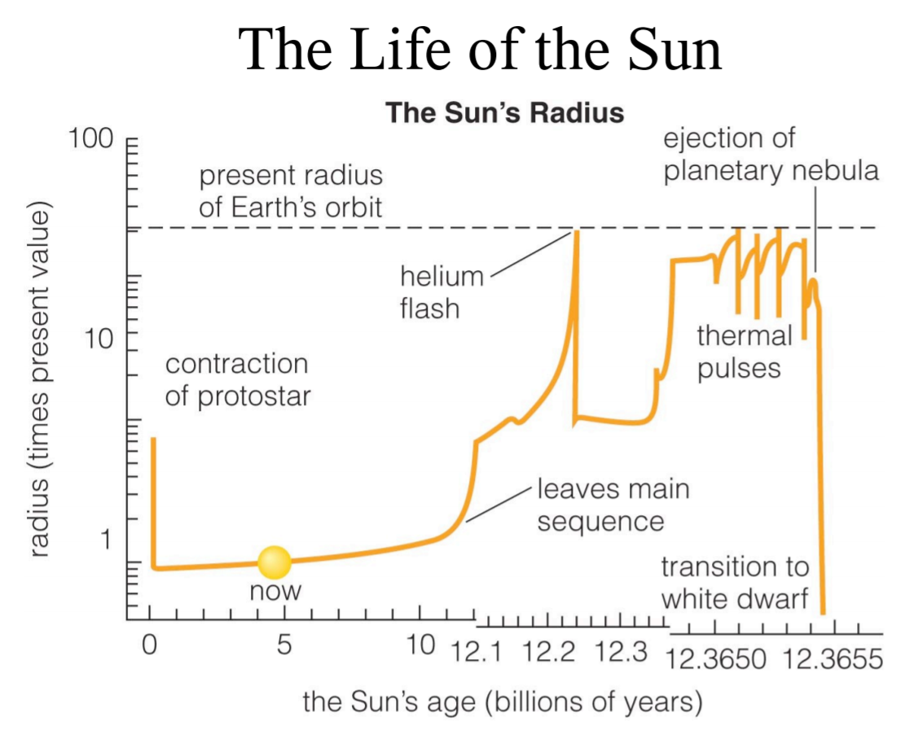
Size of the Sun
100
10
1

Slide 12
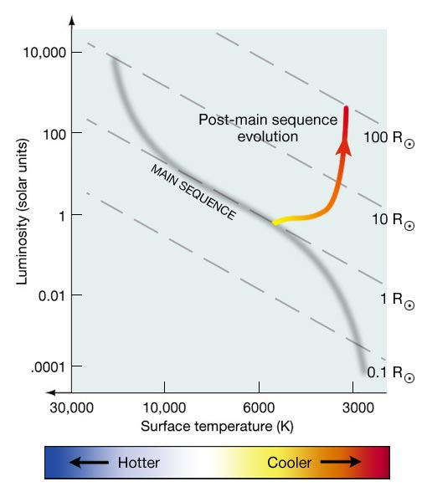
Helium Burning
At the end of the main sequence, the core is composed of helium. See Figure 17.2.
The helium nuclei do not fuse together because the temperature is not high enough.
There is no process to halt the collapse of the core until the temperature rises enough to fuse helium.
The triple-alpha process fuses three helium nuclei into carbon.
The temperature is ~100 MK.

Slide 13
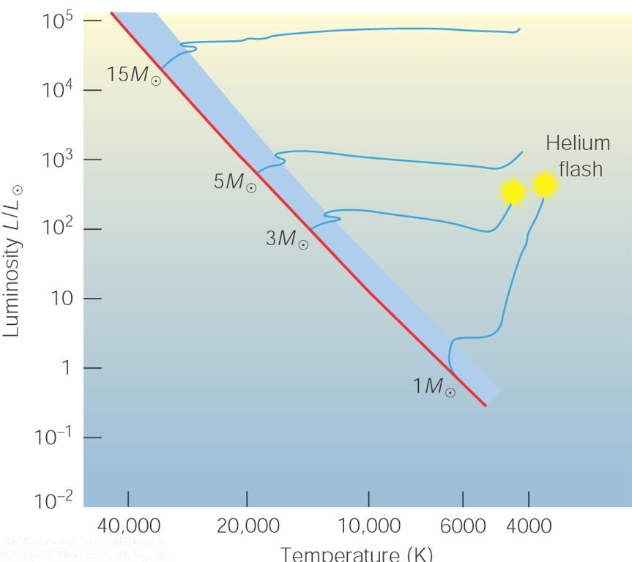
Helium Flash
The time when helium begins fusing is called the “helium flash.” See Figure 17.3.
The heat is transported by conduction, a process that was not important during the main sequence lifetime of the star.
Conduction carries heat because particles are tightly packed.
This begins hydrostatic equilibrium again.

Slide 14
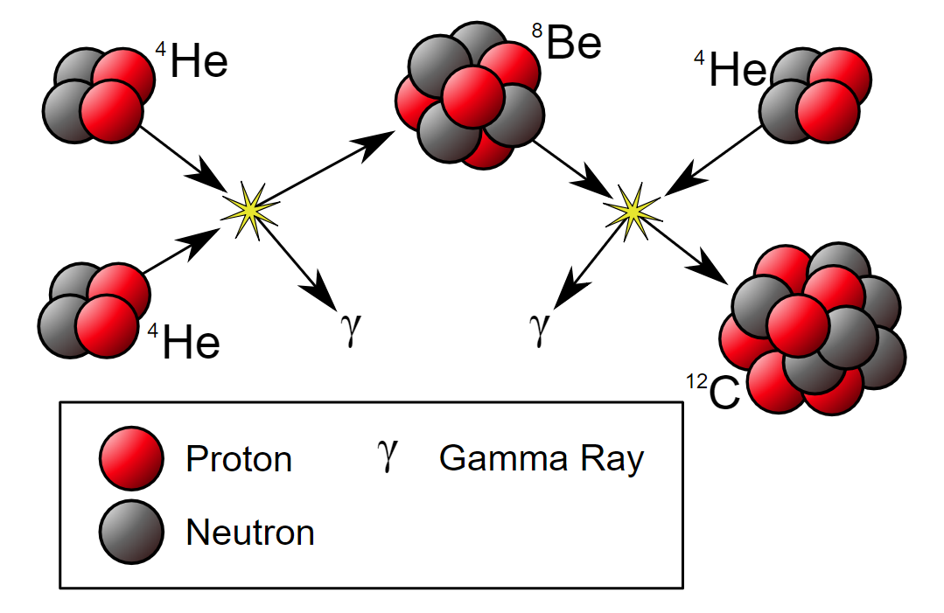
Triple Alpha Process

Slide 15
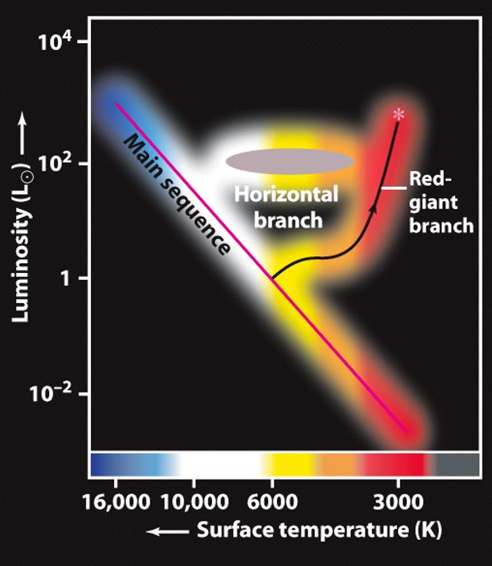
Evolutionary Track for Sun
At the end of the main sequence, the Sun has no more hydrogen in its core.
The core contracts and remaining hydrogen around the core attains the temperature to begin shell hydrogen burning.
The star expands and cools on to the red giant branch.
When all the hydrogen around the shell has been used, the core contracts enough to begin helium burning.

Slide 16
Helium Burning
The triple-alpha ignition creates a “helium flash” that releases an enormous amount of energy in the core.
In a matter of a few seconds, 60-80% of the helium in the core is burned into carbon (and some oxygen).
At some point, the temperature increases enough to lift the core material out of degeneracy and to begin helium burning.
The temperature rises so much that the thermal pressure becomes strong enough to expand the core.
This expansion cools the hydrogen burning shell.
This decreases the fusion rate and luminosity reduces.
The outer layers contract and surface temperature increases.
The star is now a helium burning star.

Slide 17
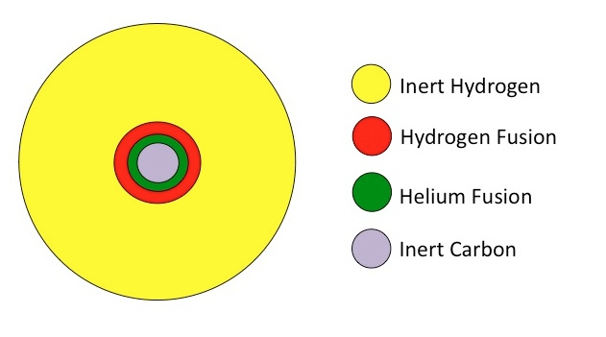
Helium Exhaustion
At some point the helium will be gone.
The core will consist of carbon.
Helium will burn in a shell.
Hydrogen will burn in an outer shell.
The core will contract, along with the shells.
The outer layers expand again to a greater size and luminosity.

Slide 18
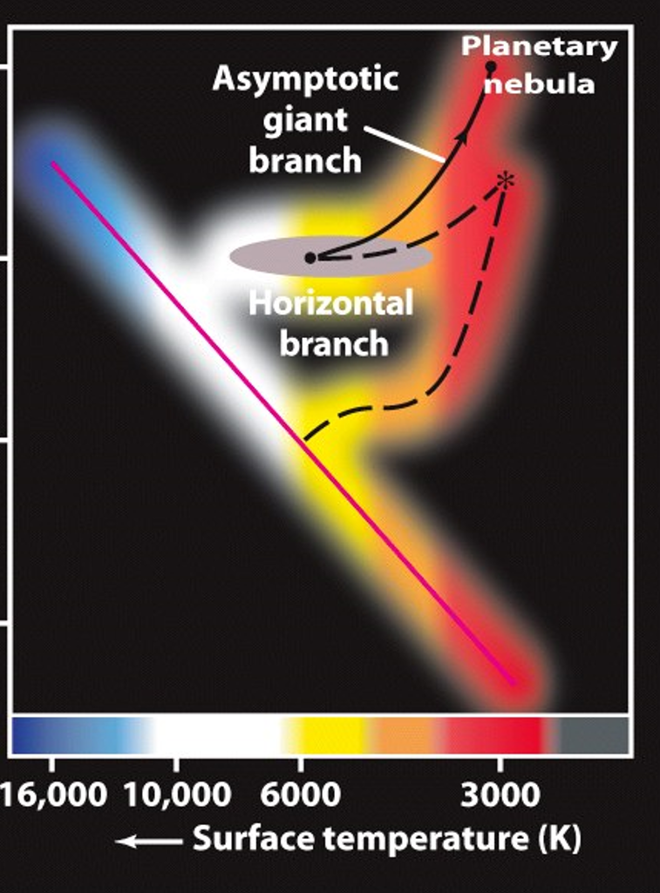
AGB
Once the helium is exhausted in the core, fusion continues in a shell around the core.
This stage corresponds to the Asymptotic Giant Branch (AGB) in the HR diagram.
See Figures 17.4 and 17.5.

Slide 19
Post-AGB
After the AGB phase, the star contracts.
Carbon fusion requires much higher temperatures of ~600 MK.
There is not enough gravitational force to create these temperatures in a low mass star like the Sun.
The core will contract until degeneracy pressure halts the infall.

Slide 20
Planetary Nebulae
As the star expands, the surface gravity decreases.
There is less force at the surface holding the outer layers on to the star.
At some point, the radiation pressure is enough to push the outer layers of the star into the interstellar medium.
This results in the expansion of a shell of gas billowing into the region around the star.
The ionizing radiation from the star ionizes the gas in this shell.
The result is a “ring” that creates a planetary nebula.

Slide 21
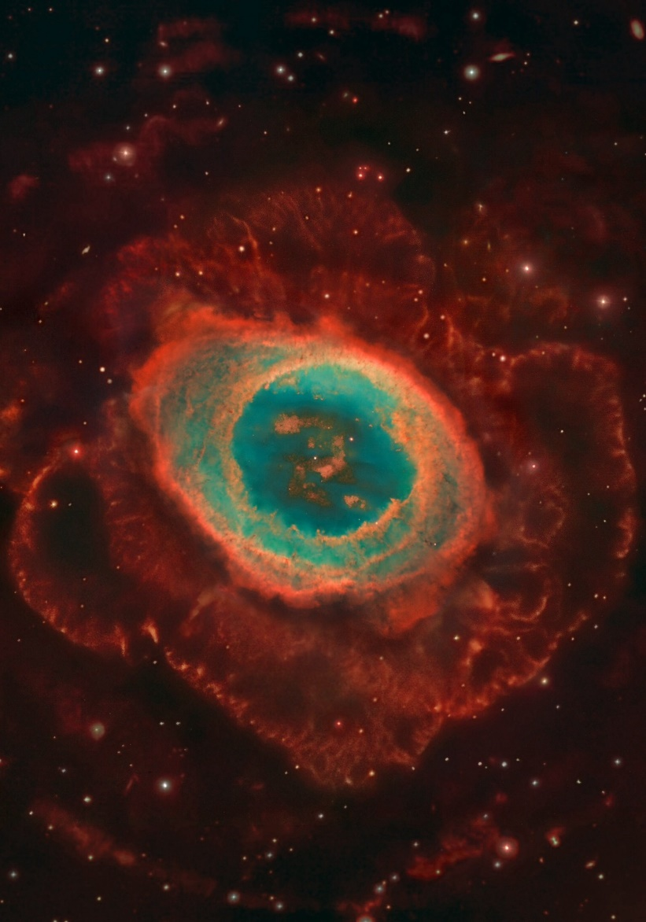
M57

Slide 22
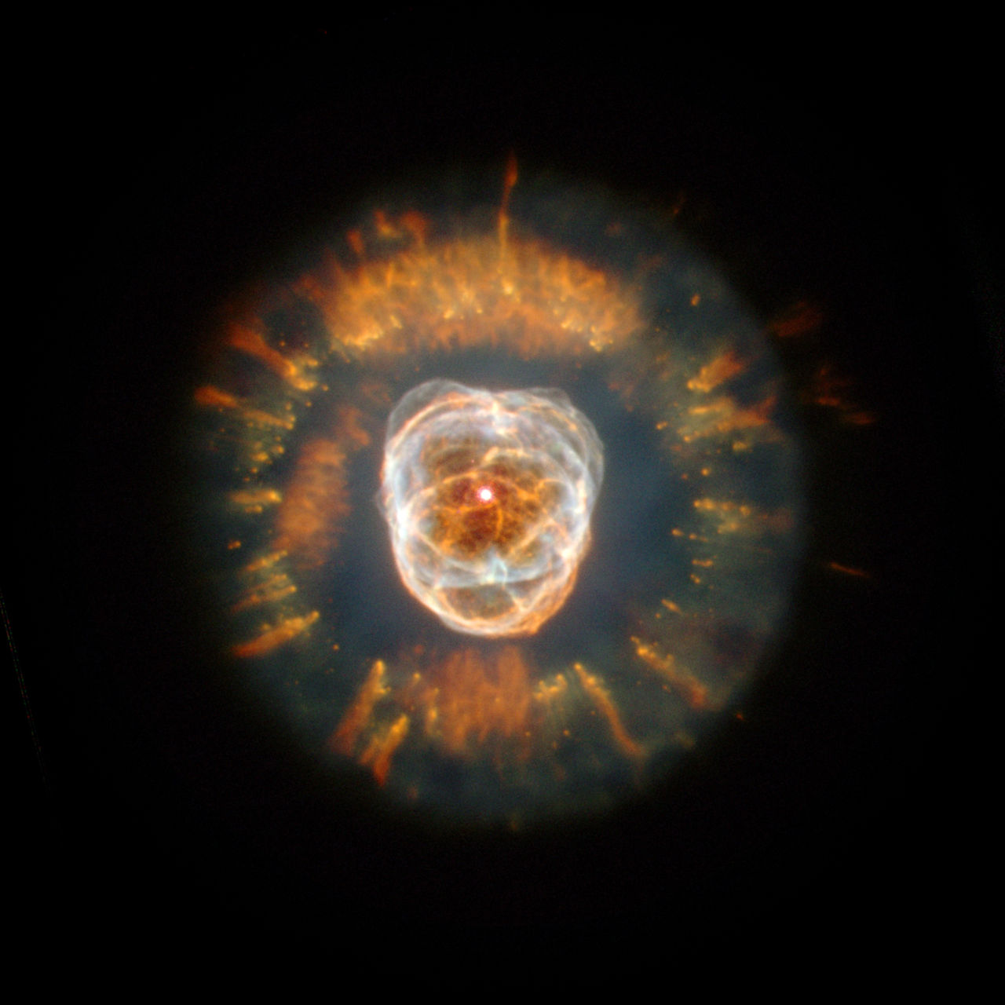
Eskimo Nebula

Slide 23
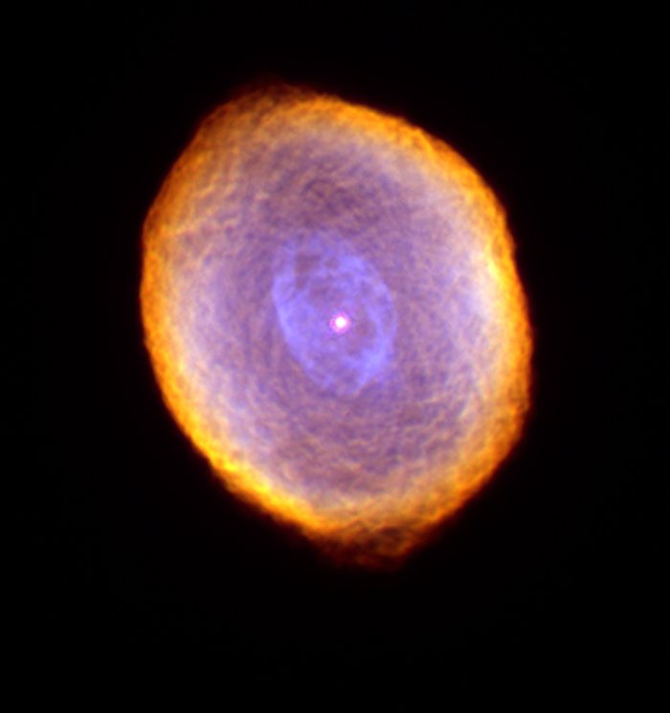
Spirograph Nebula

Slide 24
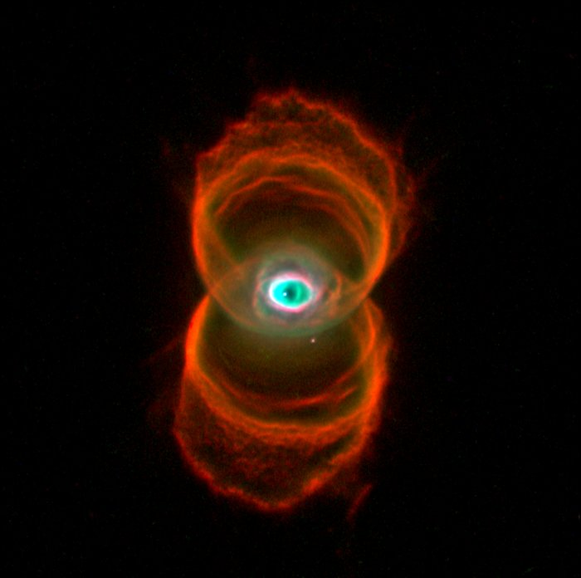
Hourglass Nebula

Slide 25
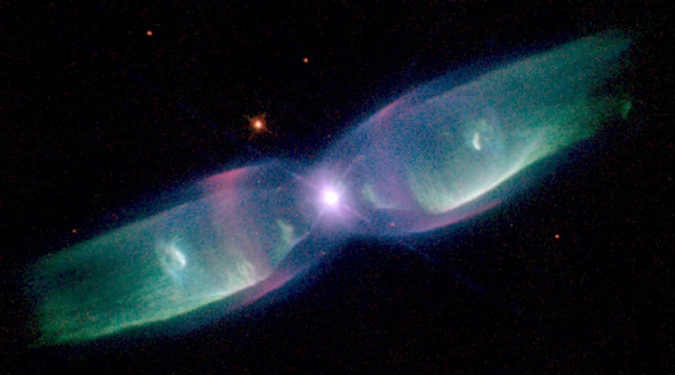
Butterfly Nebula

Slide 26
evolution of high and low mass stars

Slide 27
End State of Low Mass Star
The planetary nebula will continue to expand, cool, and fade.
What is left behind is the carbon core that is called a white dwarf.
They are roughly the size of Earth.
They continue to cool over long timescales (billions of years).

Slide 28
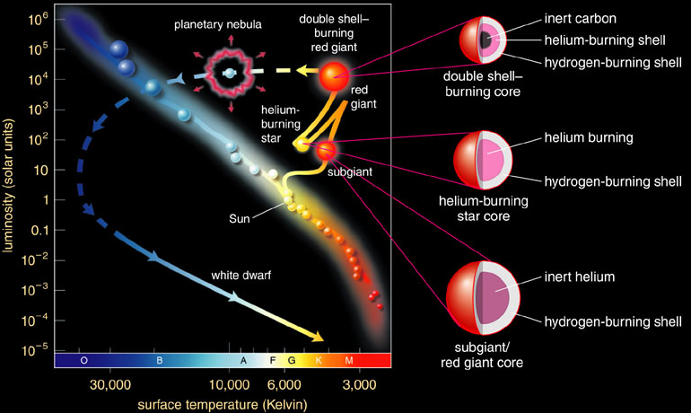
Full Evolutionary Track

Slide 29
High Mass Star Evolution
Stars with mass less then the Sun do not have enough mass to create the temperatures in their cores that would fuse helium.
Higher mass stars do produce high enough temperatures.
The early stages of post-main sequence evolution for high mass stars are similar to those of low mass stars.
The steps are quicker.

Slide 30
Early Stages
During the main sequence, high mass stars fuse hydrogen into helium via the CNO cycle.
When a high mass star evolves off the main sequence, it burns hydrogen in its shell.
It has enough luminosity to be classified as a “supergiant.”
It is referred to as a red supergiant during this phase, as opposed to a red giant for a low mass star.
There is no helium flash because the gas pressure is high enough to stratify the temperatures. Therefore, the whole core does not attain the temperature to burn helium at the same time.

Slide 31
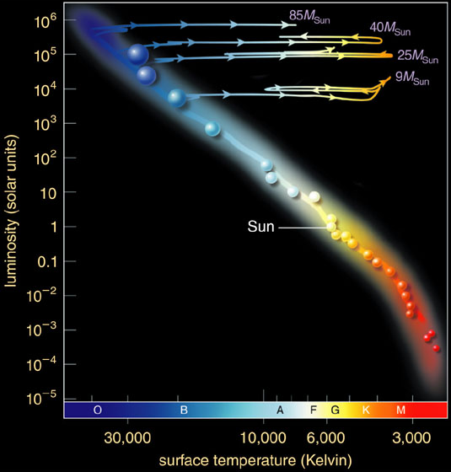
Evolutionary Track for High Mass Star
High-mass stars can be supergiants on the main sequence.
They evolve rightward in the HR diagram as they expand and cool.
The yellow supergiant phase is extremely rare, so there are few of them in the Galaxy.
The winds in massive star atmospheres carry much of their mass away.

Slide 32
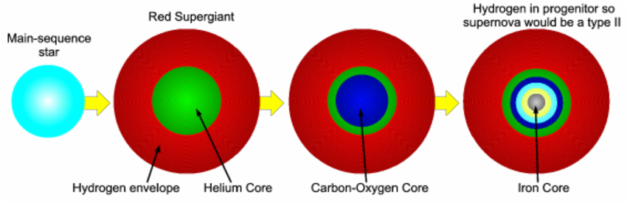
Evolutionary Stages of High Mass Star

Slide 33
Wolf-Rayet Stars
Wolf and Rayet notice stars with odd colors (1867).
They are the evolved descendants of O stars.
They have little/no hydrogen.
Their spectra have strong emission lines formed in their winds.
There are ~1000 in the Galaxy.
Their mass loss rates are ~10⁻⁴⁻⁵ M_{Sun}/yr.
WN stars are rich in nitrogen and reveal products of CNO burning.
WC stars are rich in carbon and reveal products of helium burning.

Slide 34
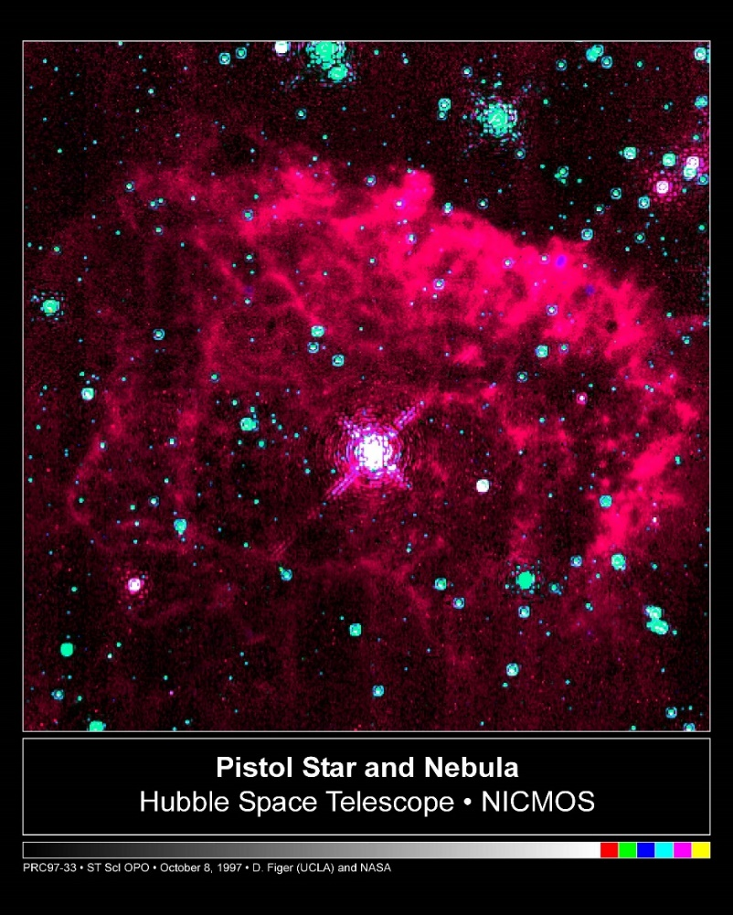
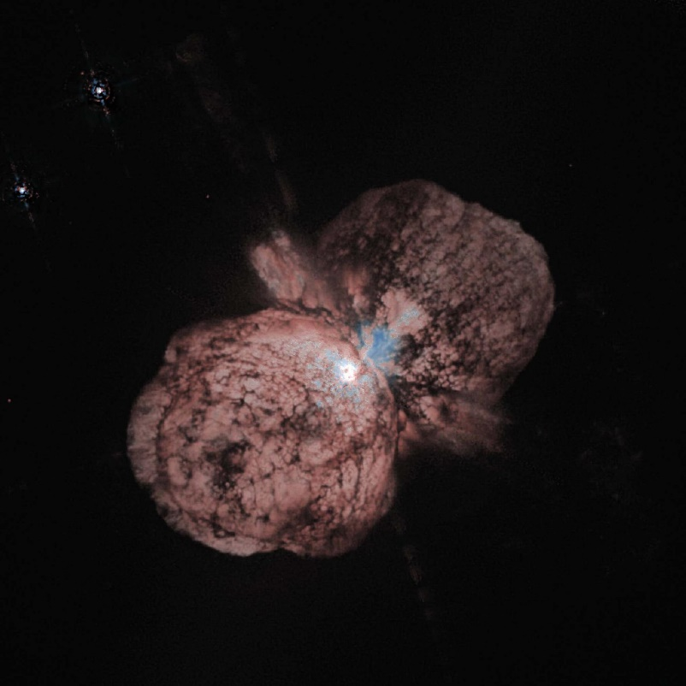
Luminous Blue Variables

Slide 35
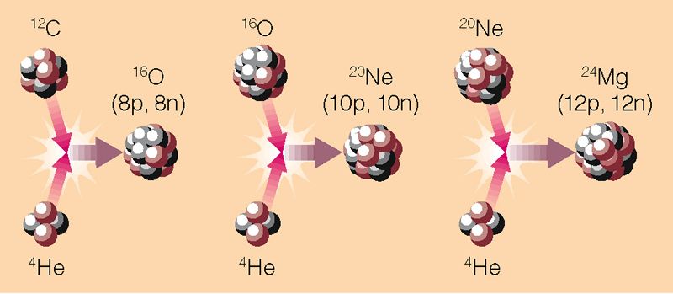
Carbon Fusion
Carbon can start to fuse once the temperature of the core reaches 600 MK.
When carbon is depleted, core contracts once again until heavier elements can fuse.

Slide 36
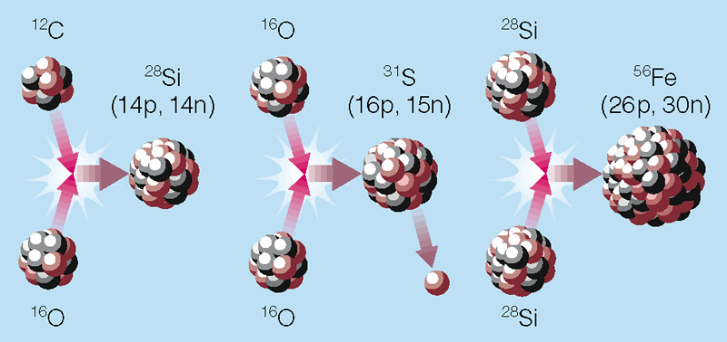
Higher Mass Nucleosynthesis
At very high temperatures, two heavy nuclei can fuse together (e.g. carbon and oxygen can combine to form silicon).
Free neutrons can also fuse with atoms to make rare elements. Neutrons are red below.

Slide 37
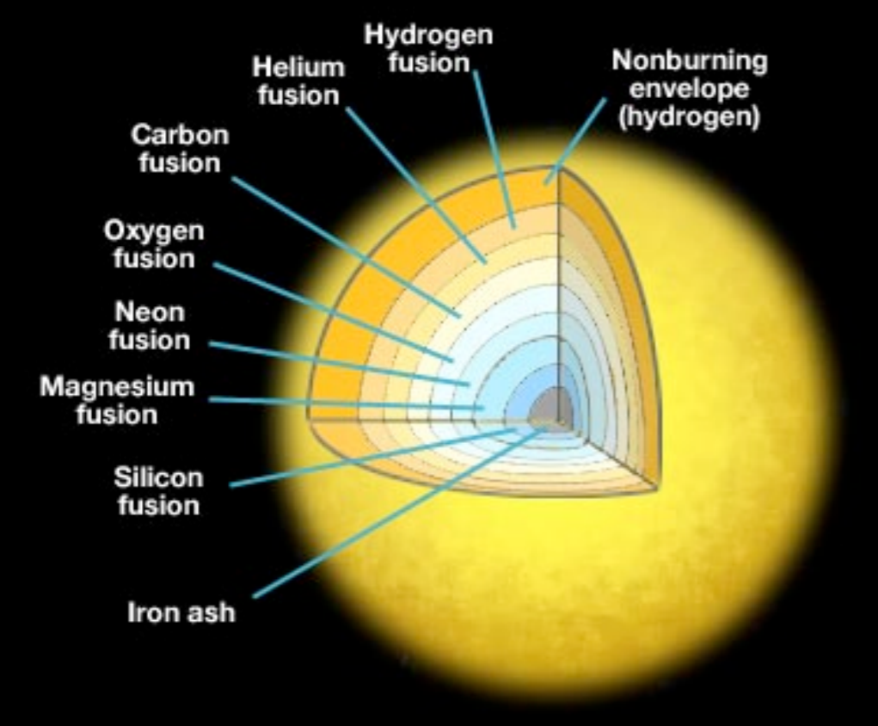
Advanced Stages
Each stage occurs more quickly than the one before.
Carbon core burning takes a few hundred years. Silicon burning lasts a few days.
New type of shell burning ignites at each between each stage.
The center of the star resembles an onion with many layers.

Slide 38
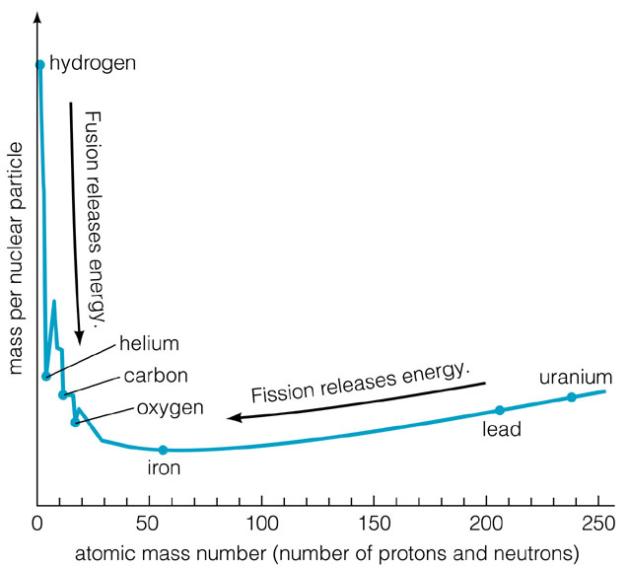
Energy Yields
Fusion continues to produce new elements until it reaches iron.
Elements heavier than iron do not release energy when they fuse.
No more energy can be generated in the star.

Slide 39
Fusion Summary
M < 0.08 M: No fusion, brown dwarfs, Type: L, T
0.08 M < M < 0.5 M: Fusion of H into He only, never hot enough for He to fuse, Type: M on main sequence
0.5 M < M < 5 M: Fusion of H into He, He to C and O, never hot enough to fuse heavier elements, Type: A, F, G, and K
5 M < M < 7 M: Fusion up to Ne and Mg, Type: B
M > 7 M: Fusion up to iron, Type: O

Slide 40
End State for High Mass Star
A high mass star will fuse elements until the core becomes iron.
Iron fusion does not yield energy.
What happens next?

Slide 41
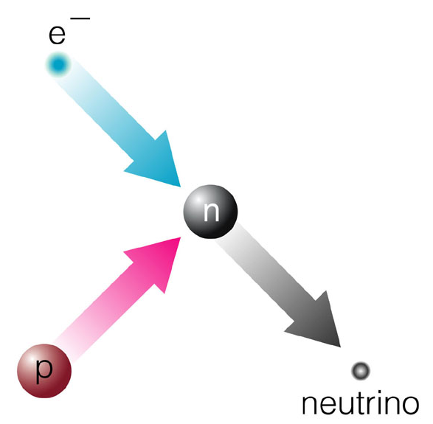
End State for High Mass Star
With iron in its core that it can’t fuse, the star stops generating the energy needed to support it against gravity.
At first, electron degeneracy pressure supports the star.
Eventually, the mass becomes so dense that the electrons combine with the protons to form neutrons.
Electron degeneracy pressure vanishes and gravity causes the star to collapse to a neutron star.

Slide 42
Supernovae
Collapse of the core releases a huge amount of energy.
Collapse takes a fraction of a second.
This energy goes into driving out the outer layers of the star in a huge explosion.
Shock wave sends the material moving out at a speed of 10,000 km/s.
For a short period of time, the explosion makes the star and surrounding material incredibly bright – about as bright as 10 billion Suns.

Slide 43
Supernovae
Over time, the ejected gas fades.
Continues to expand into space, mixing with other gas.
All of the elements produced in stars are dispersed this way.
Elements heavier than iron are created during the supernova explosion.
This mixed material someday forms new stars.
This is where all of the heavy elements in our solar system came from.

Slide 44
Post Supernovae
The star’s core is composed of neutrons and is left over after the outer layers are blown off.
A neutron star is
  Ball of neutrons
  ~ the mass of the Sun compressed into a ball a few km across
  Supported by neutron degeneracy pressure
If the mass is large enough, it can overcome neutron degeneracy pressure
  Nothing can stop gravity from compressing the core
  Core becomes a black hole

