Slide 1
University Astronomy
Professor Don Figer
Stellar Structure III

Slide 2
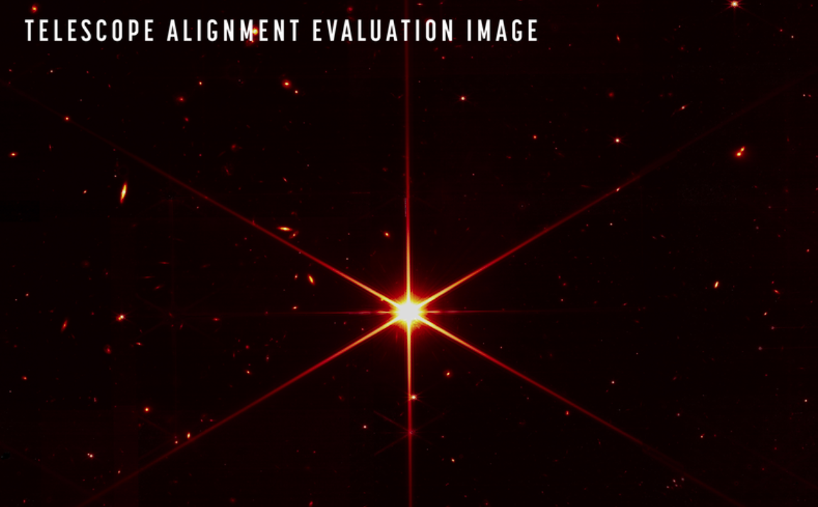
JWST After Final Phasing

Slide 3
Review
There are four equations of stellar structure
  conservation of mass, m(r)
  conservation of energy, L(r)
  hydrostatic equilibrium, ρ(r)
  energy transport, T(r)
There are three additional ingredients
  equation of state, P(ρ,T)
  optical depth (τ)
  energy generation rate, ε(ρ,T)
We can combine the ingredients and equations to determine the stellar structure under a set of simplifying assumptions.

Slide 4
heat transport

Slide 5
Schwarzchild Criterion
Consider a parcel of gas in a star.
If the temperature of the parcel exceeds that of its surroundings, then the gas in the parcel will have less density than its surroundings.
The parcel will be buoyant.
It will drift upwards to a location of even cooler (and more dense) gas.
If it transfers its energy to its surroundings more quickly than it rises, then it will sink back down. If not, it will continue to rise.
The balance between these two effects (rising and transferring heat) is at the “adiabatic limit,” where heat is transferred without bulk motion.

Slide 6
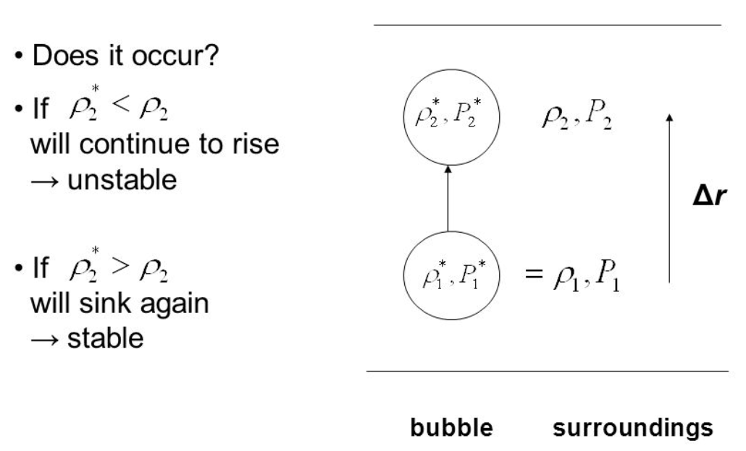
Schwarzchild Criterion

Slide 7
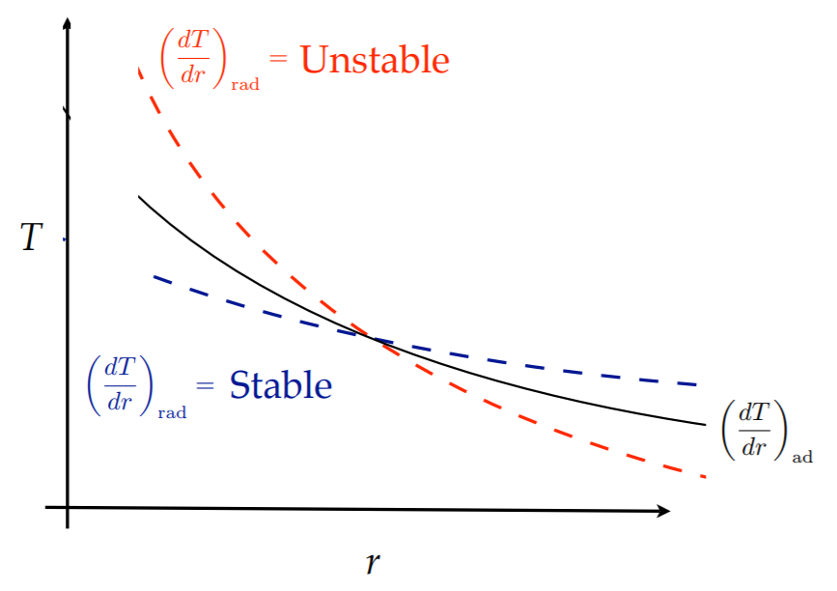
Schwarzchild Criterion
(convection)

Slide 8
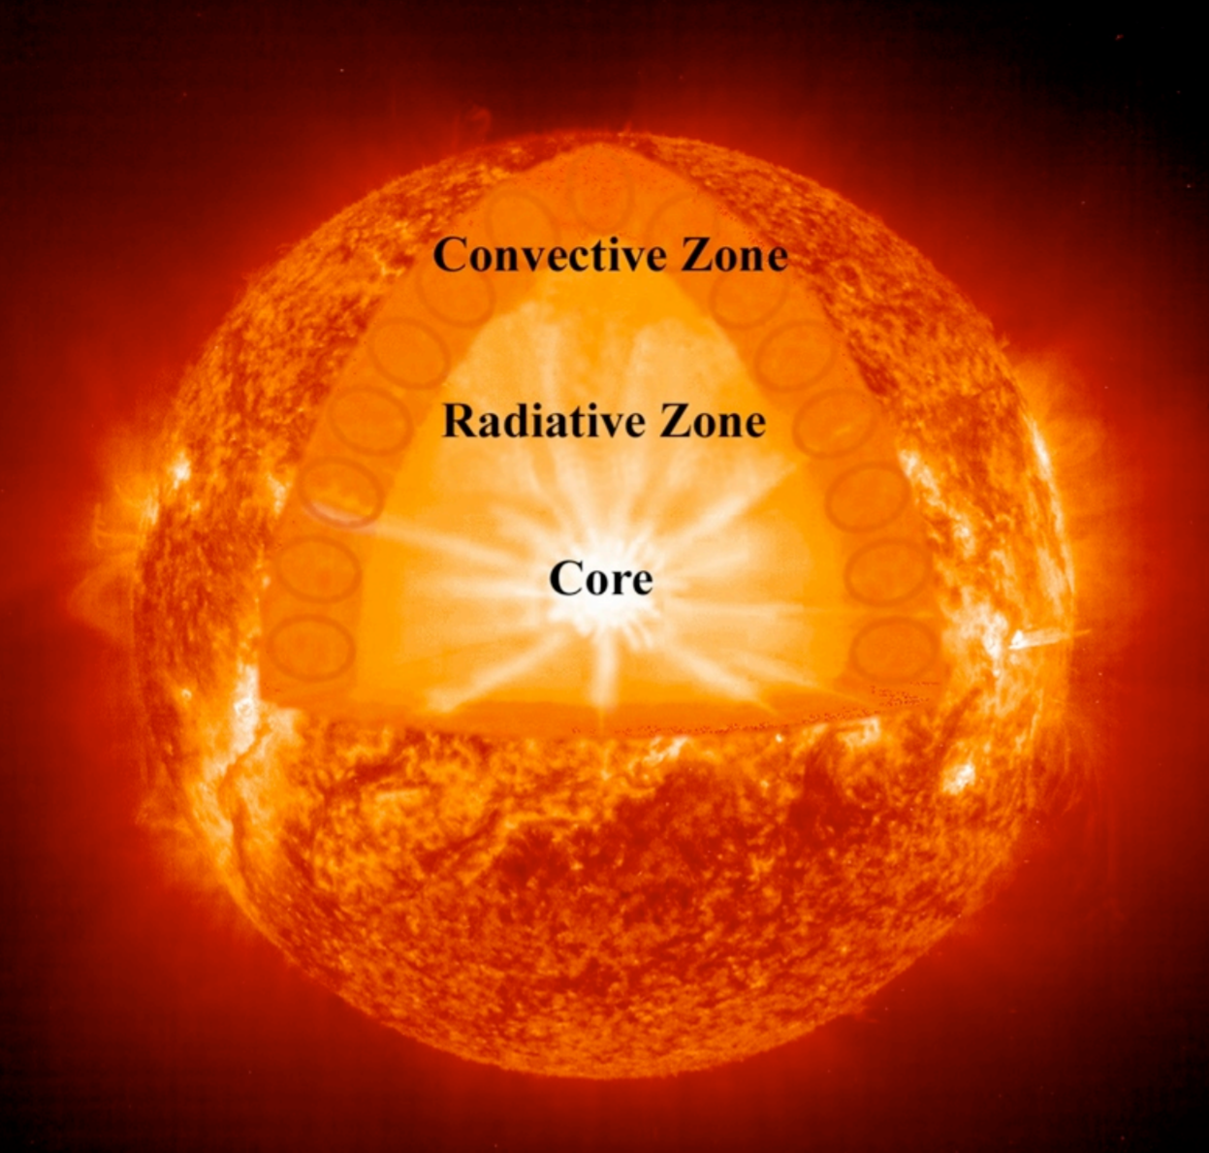
Transport in the Sun

Slide 9
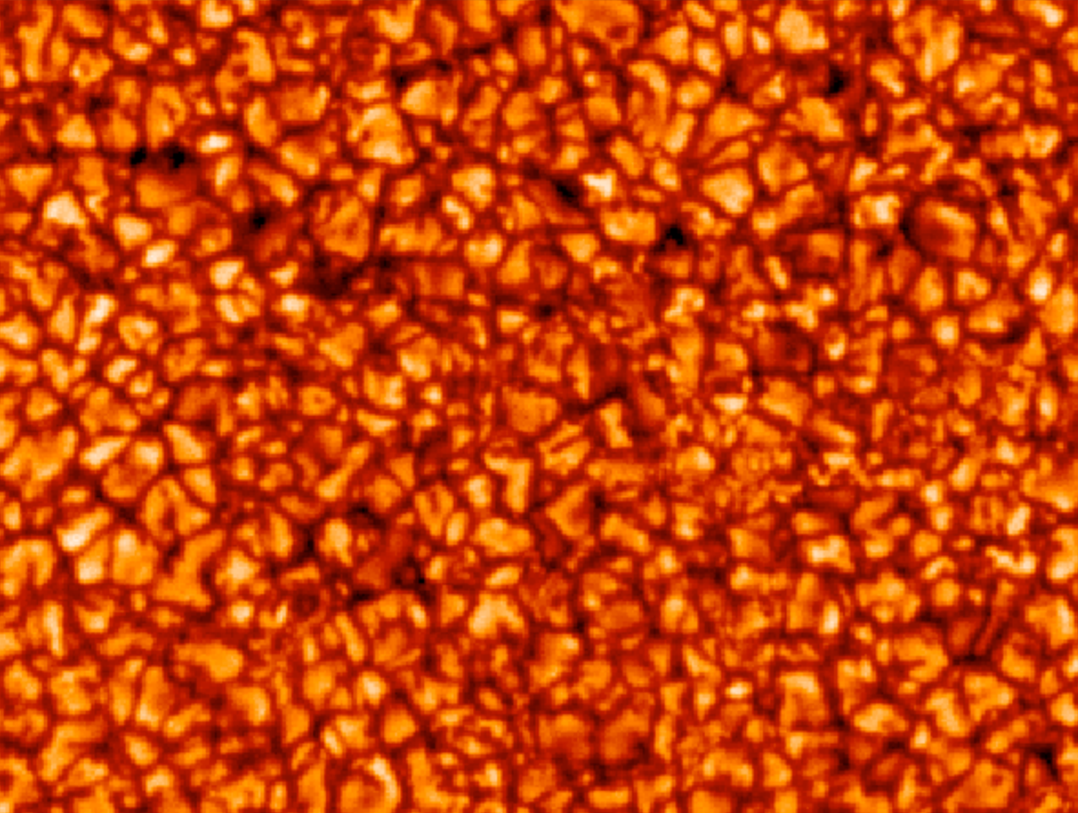
Convection and Granules

Slide 10
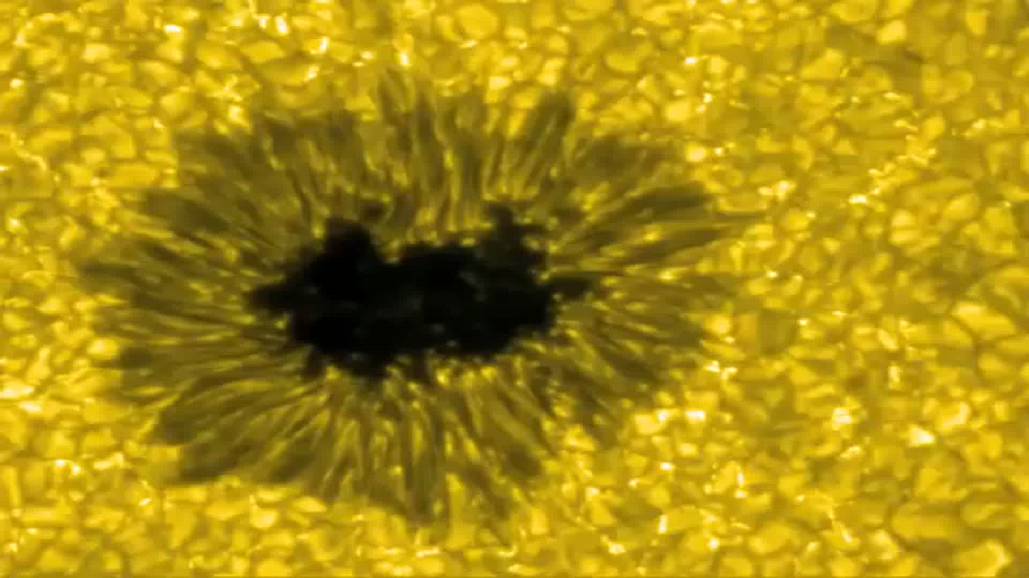
Convection Movie

Slide 11
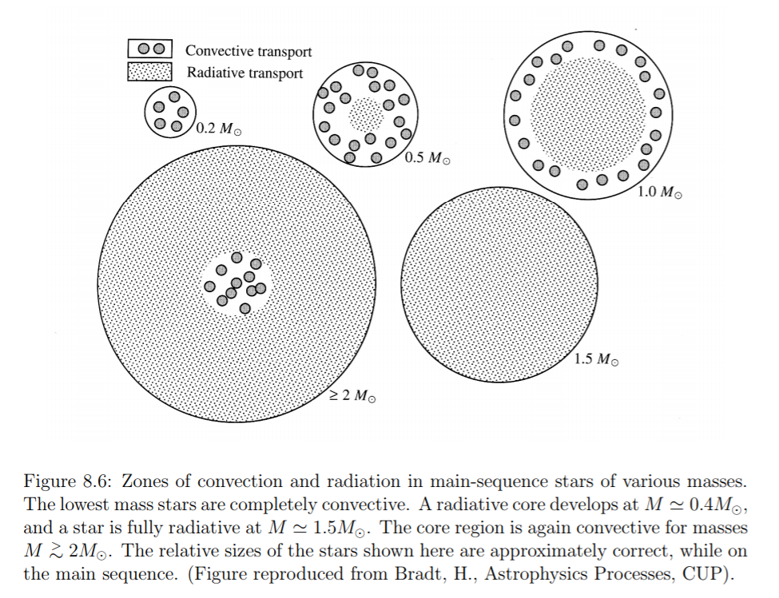
Radiative vs. Convection Transport

Slide 12
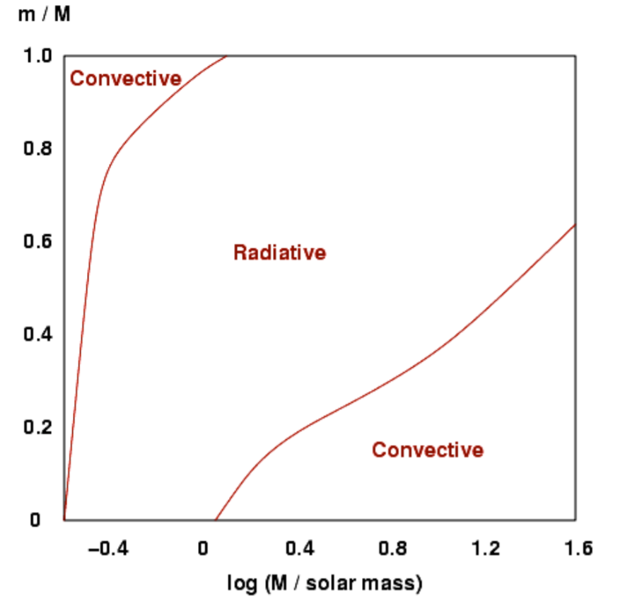
Heat Transfer vs. Mass

Slide 13
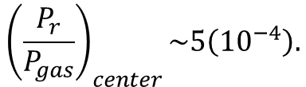
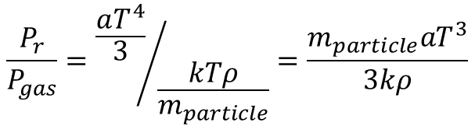
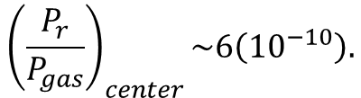
Is Radiation Pressure Small?
Earlier, we assumed that P_{r}<<P_{gas}. Was that a reasonable assumption?
$$\frac{P_{r}}{P_{gas}}={\frac{aT^{4}}{3}}/{\frac{kTρ}{m_{particle}}}=\frac{m_{particle}aT^{3}}{3kρ}$$
In center of the Sun, T~15(10⁶) K, ρ~10⁵ kg/m³, m=m_{p}/2.
$${\left(\frac{P_{r}}{P_{gas}}\right)}_{center}\sim 5\left({10}^{−4}\right).$$
At photosphere, T~5800 K, ρ~10⁻² kg/m³, m=m_{p}.
$${\left(\frac{P_{r}}{P_{gas}}\right)}_{center}\sim 6\left({10}^{−10}\right).$$

Slide 14
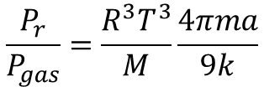


Radiation Pressure vs. Mass
Replace density with average density of star.
$$ρ_{average}=M/V=M/{\left({4πR}^{3}/3\right)}$$
$$\frac{P_{r}}{P_{gas}}=\frac{R^{3}T^{3}}{M}\frac{4πma}{9k}$$
Virial Theorem give T~M/R.
$$\frac{P_{r}}{P_{gas}}∝M^{2}$$
So, radiation pressure is more important for more massive stars.

Slide 15
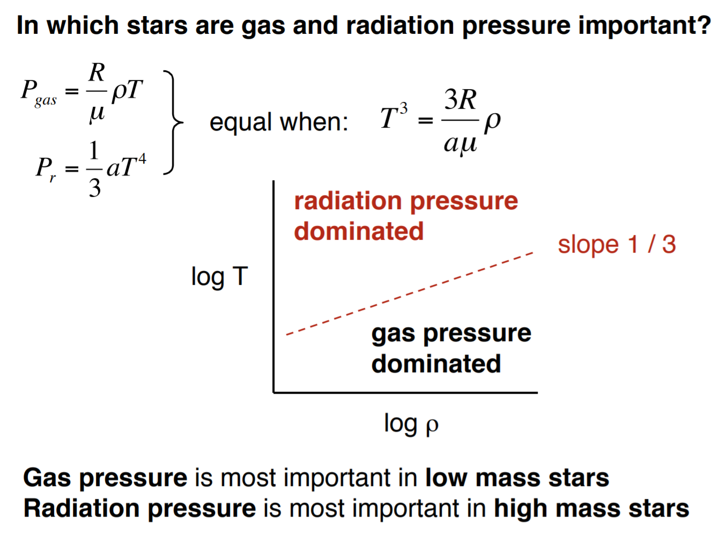
Radiation Pressure vs. Mass

Slide 16
energy generation

Slide 17
Energy Generation in Stars
Stars typically generate energy by converting hydrogen into helium.
The liberated energy is equivalent to 27 MeV, which is equal to the difference in rest mass energy of a helium nucleus and four hydrogens.
ΔE=ΔMc²=(4*1.0081 AMU*1.67(10⁻²⁷ kg) − 4.0039 AMU*1.67(10⁻²⁷ kg))*c²=27 MeV.
The total initial rest mass energy is 4*938.3 MeV, so ΔE/E=0.007=0.7%.

Slide 18
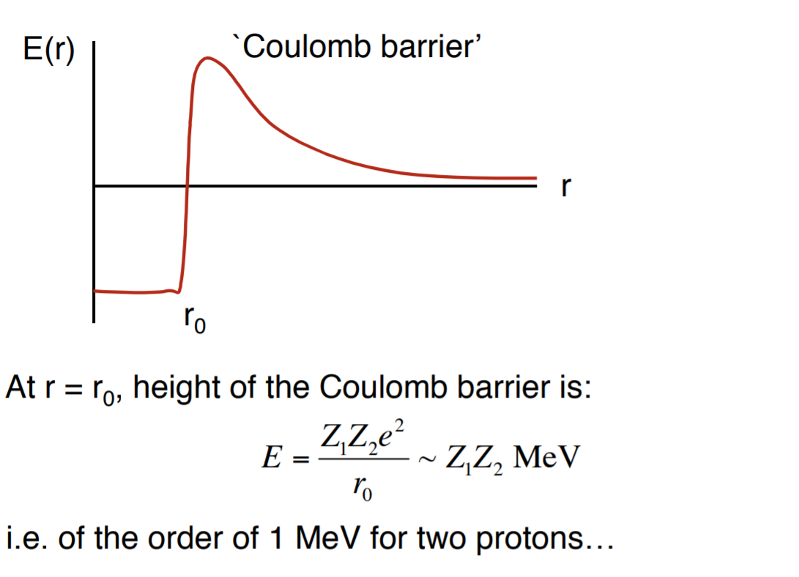
Quantum Tunneling

Slide 19
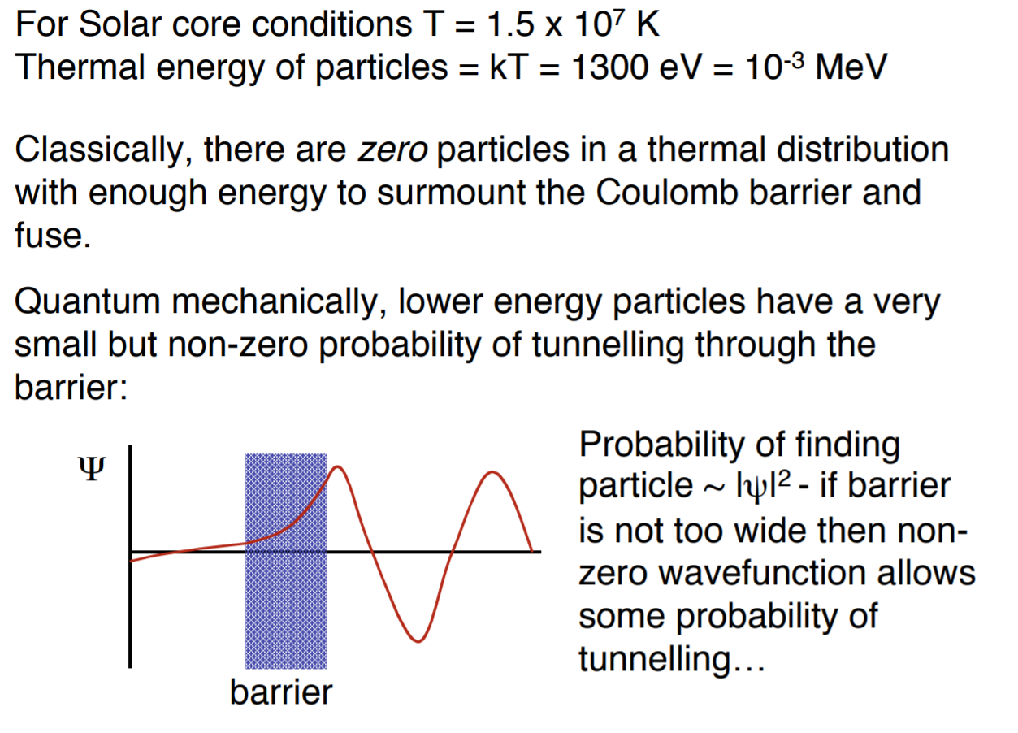
Quantum Tunneling

Slide 20
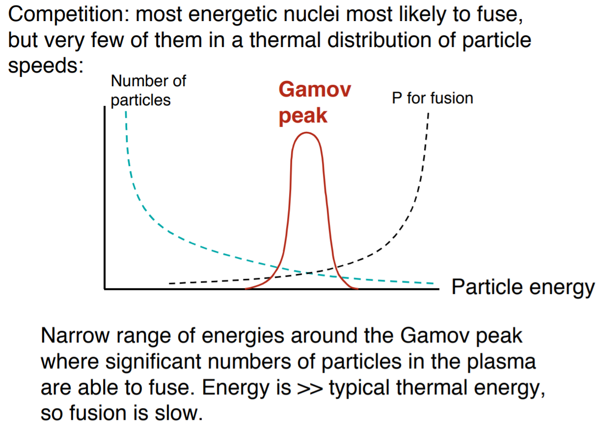
Gamov Peak

Slide 21
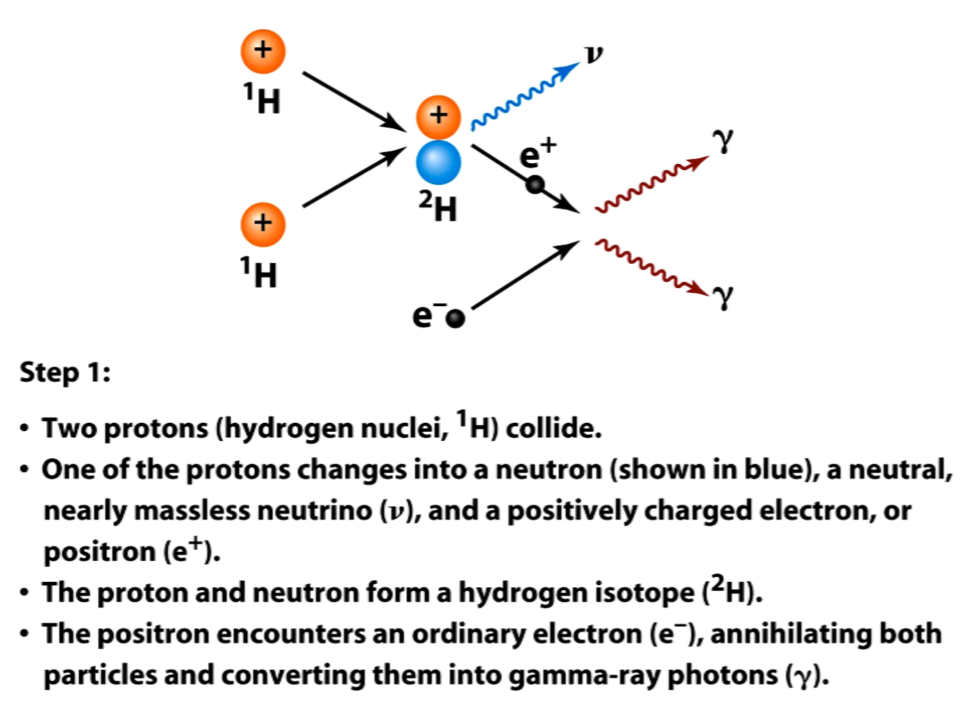
PP Chain

Slide 22
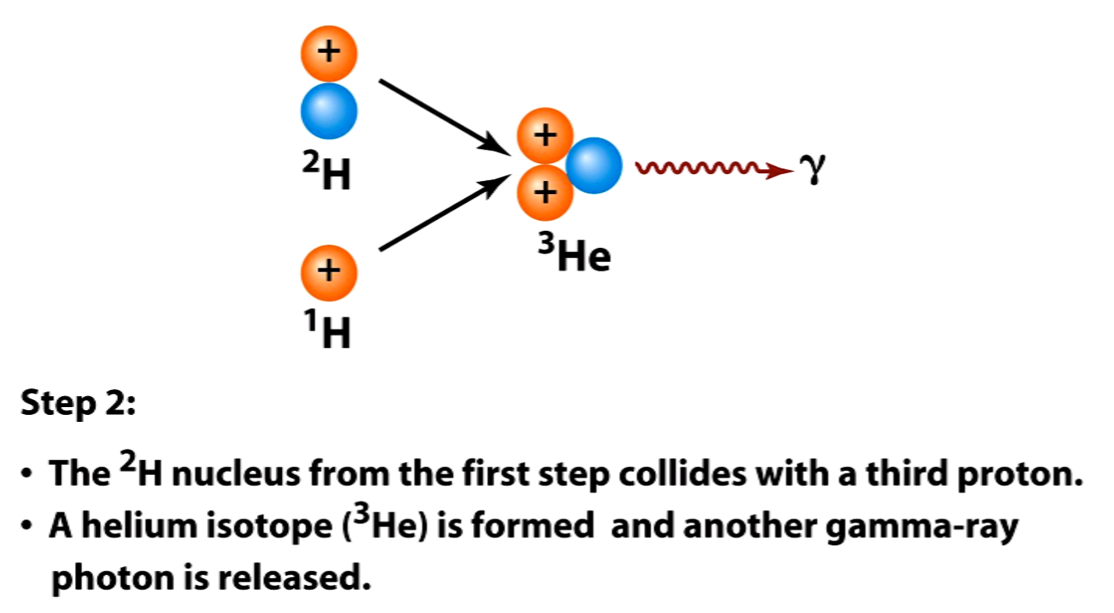
PP Chain

Slide 23
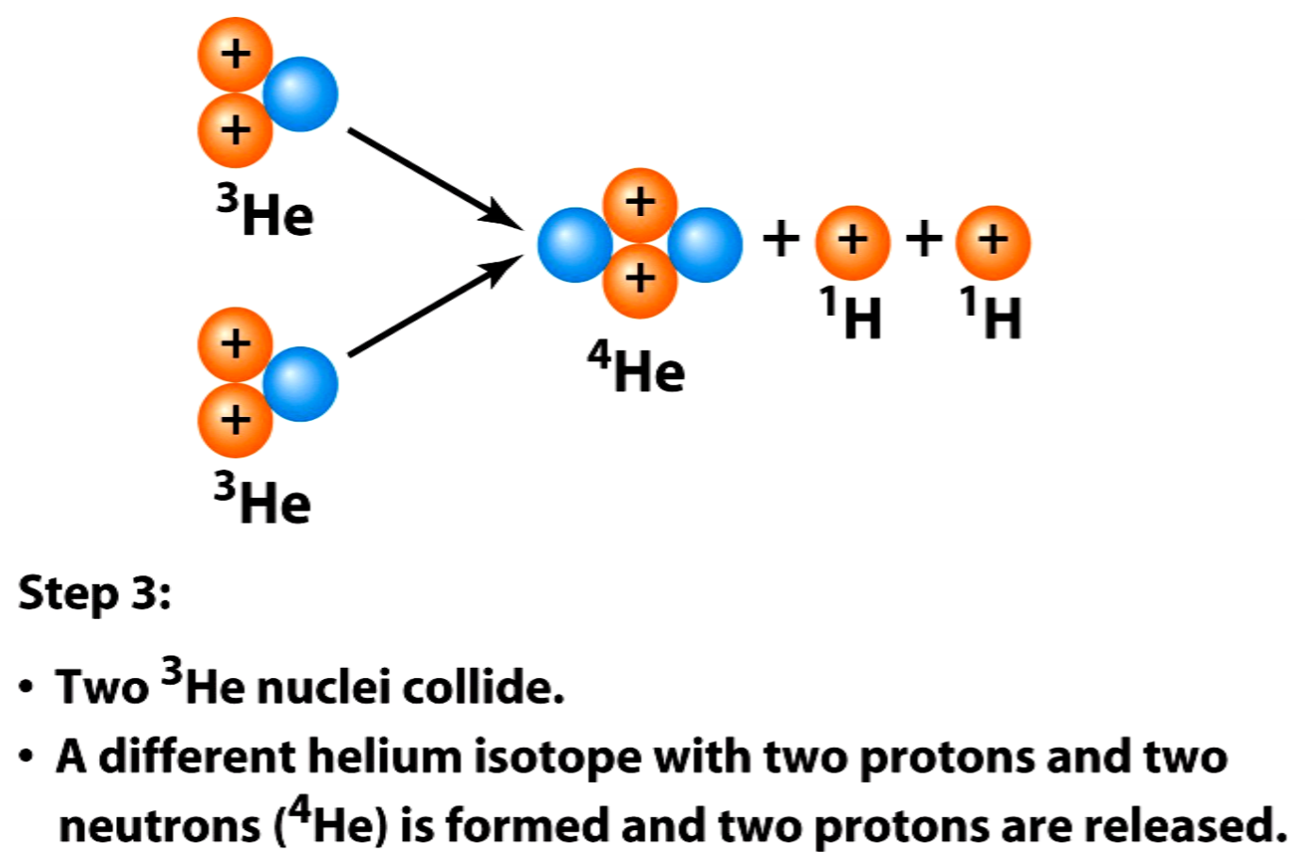
PP Chain

Slide 24
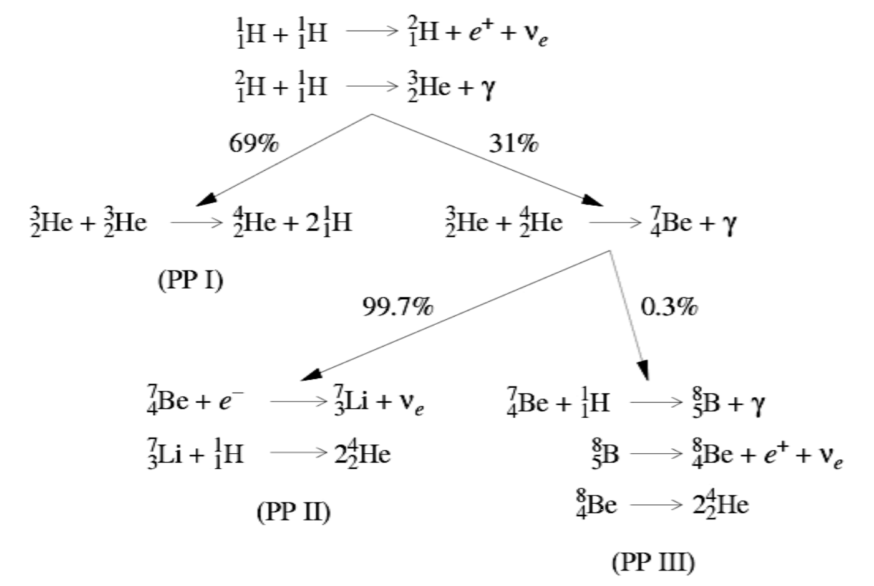
PP Chain

Slide 25
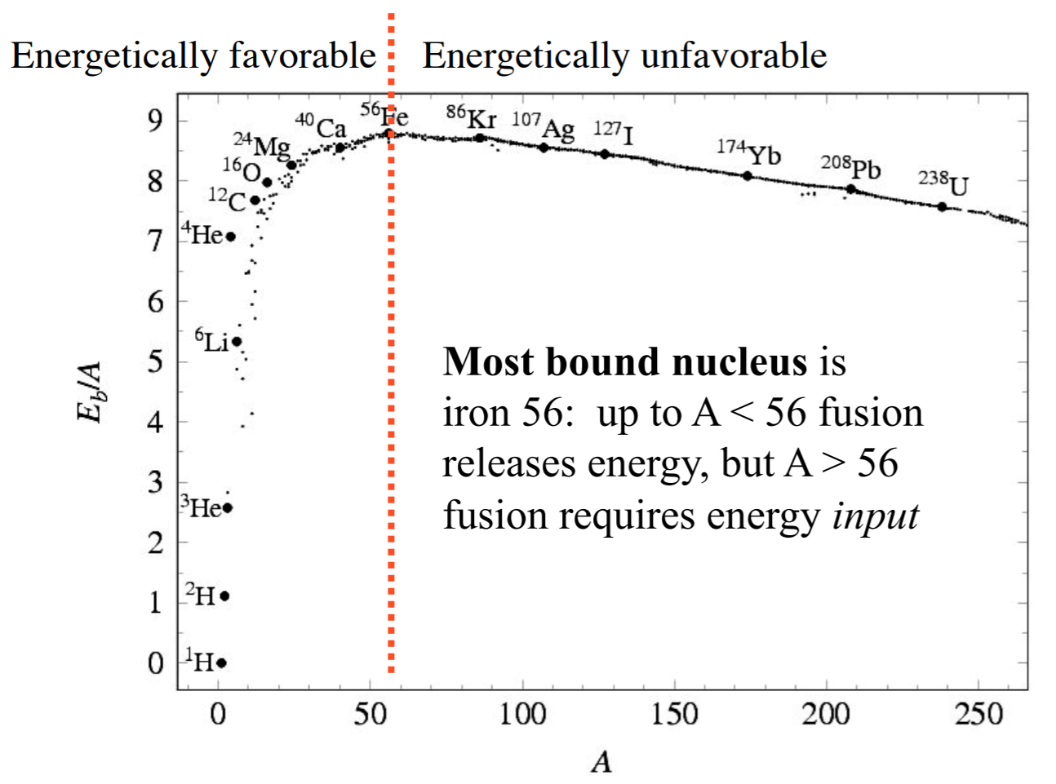
Binding Energy
Fusion liberates energy to the left of the red line. Iron is the most bound nucleus. Energy has to be added to fuse Fe to heavier elements.
Fusing H to He liberates the majority of the energy from H to Fe.

Slide 26
assumptions

Slide 27
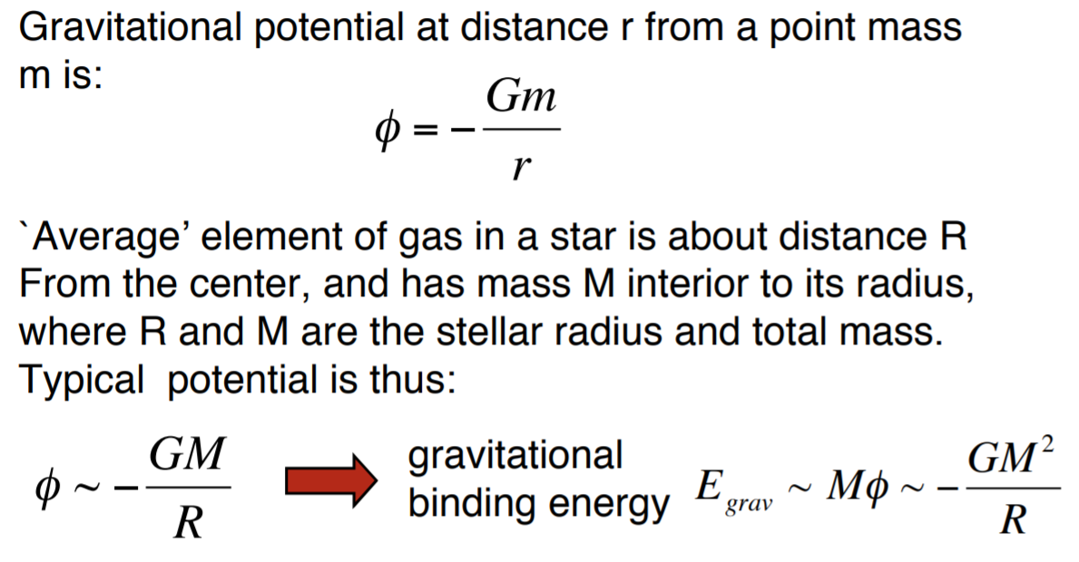
Rotation Not Important?

Slide 28
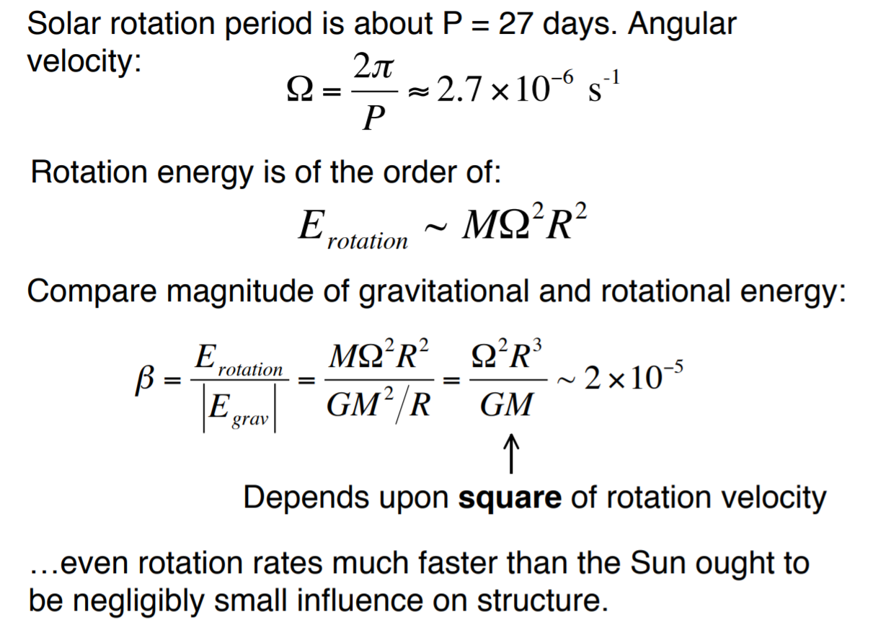
Rotation Not Important?

Slide 29
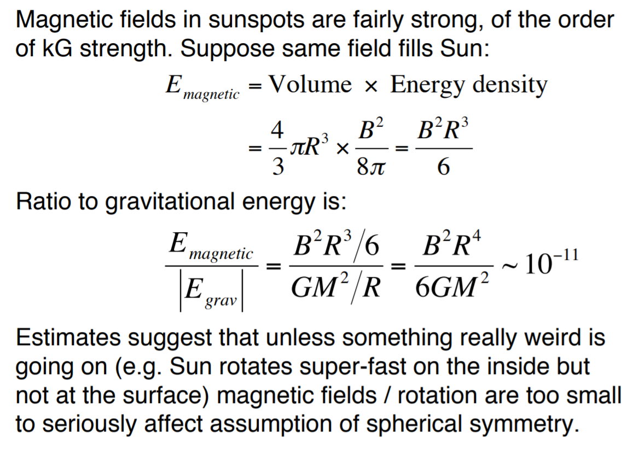
B Field Not Important?

Slide 30
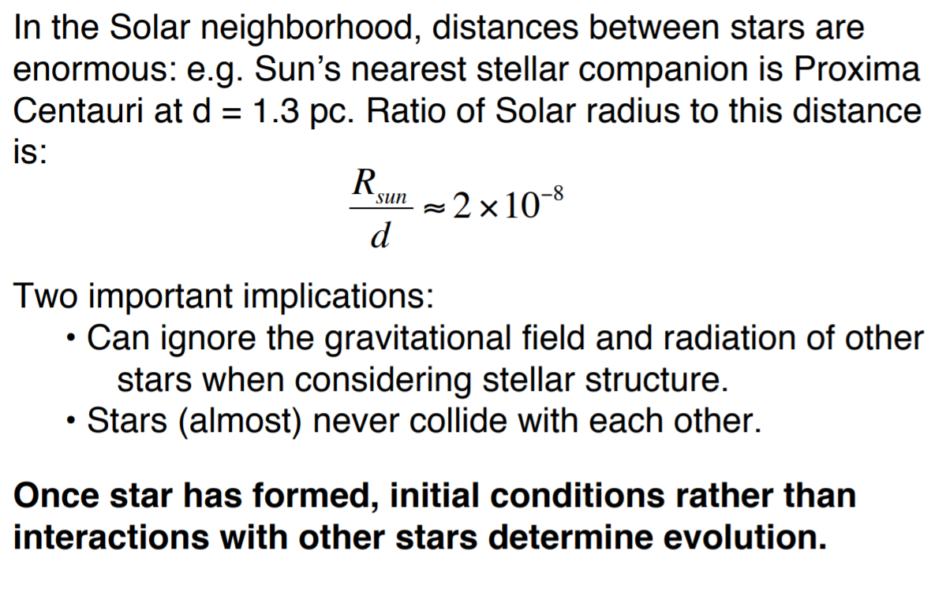
Nearby Stars Not Important?

Slide 31
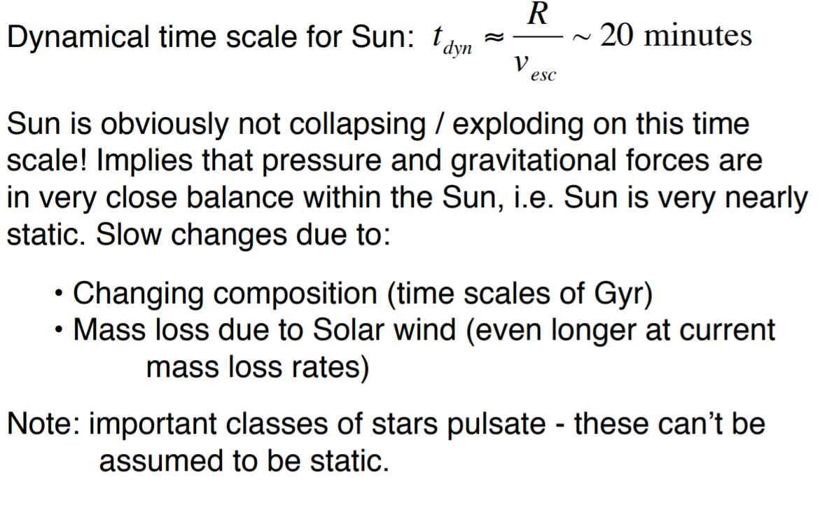
Dynamics Not Important?

Slide 32
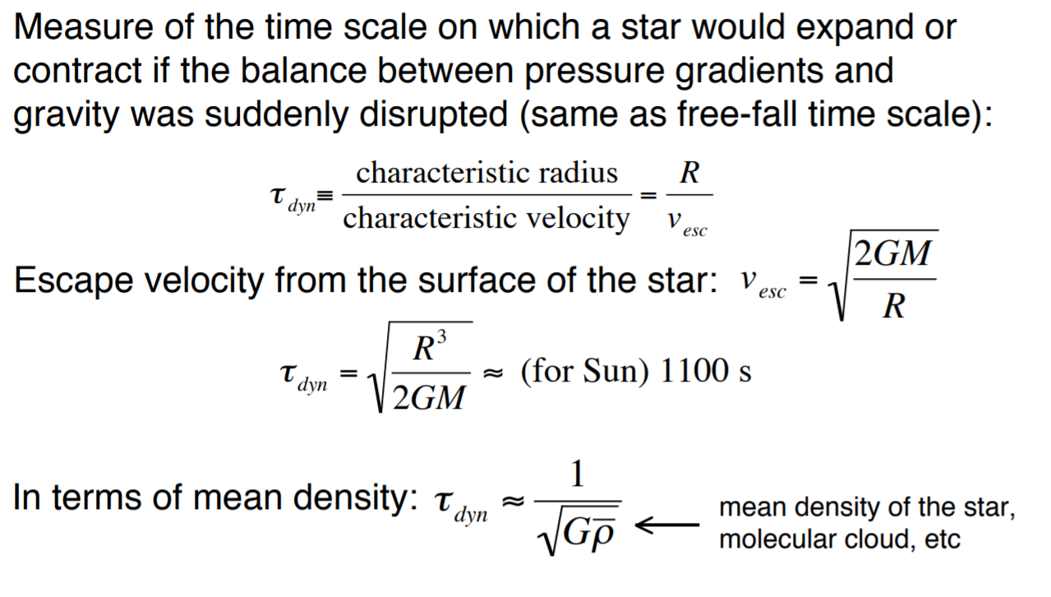
Dynamical Timescale

Slide 33
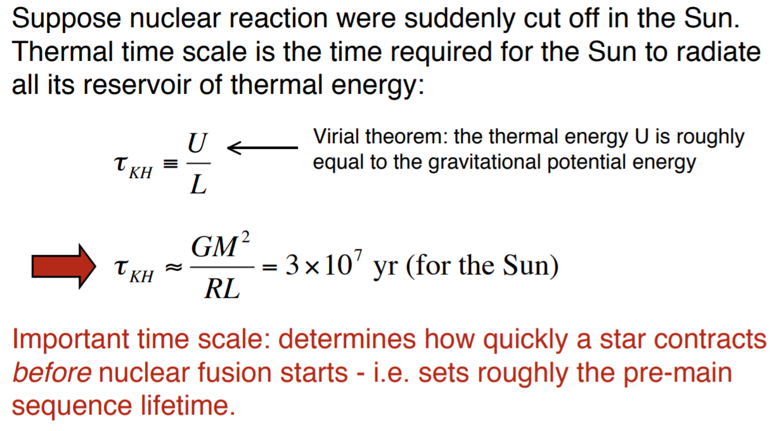
Kelvin-Helmoltz Timescale

Slide 34
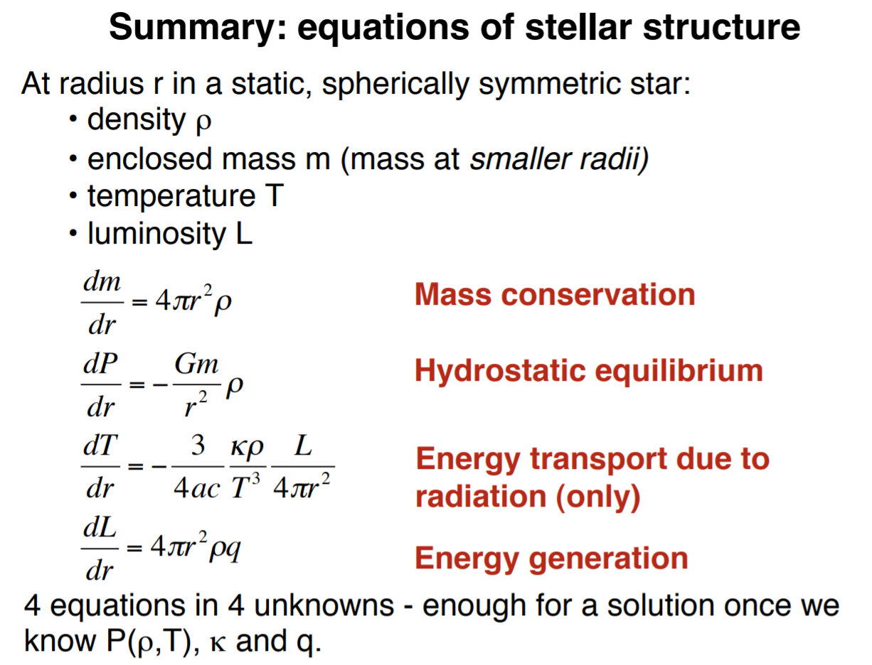
Review

