Slide 1
University Astronomy
Professor Don Figer
Stellar Structure II

Slide 2
Review
There are four equations of stellar structure
  conservation of mass, m(r)
  conservation of energy, L(r)
  hydrostatic equilibrium, ρ(r)
  energy transport, T(r)
There are three additional ingredients
  equation of state, P(ρ,T)
  optical depth (τ)
  energy generation rate, ε(ρ,T)
We can combine the ingredients and equations to determine the stellar structure under a set of simplifying assumptions.

Slide 3
heat transport

Slide 4
Radiative vs. Convection Transport
Energy is generally transported via radiation and convection in a star.
The dominant transport mechanism depends on the temperature gradient and the opacity.
For large opacities, the temperature gradient is high and the energy will be transported by convection.

Slide 5
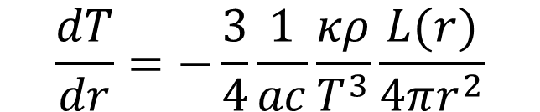
Equation of Radiative Transport
The diffusion of radiative energy is given by the equation of radiative transport (a.k.a. Eddington’s equation).
$$\frac{dT}{dr}=−\frac{3}{4}\frac{1}{ac}\frac{κρ}{T^{3}}\frac{L(r)}{4πr^{2}}$$
κ is the opacity, where κ=τ/ρl, l is the path length, and it has units of cm²/g.
  Think of it as the effective cross section for absorption/scattering per unit mass of material.
  It is a property of the material that varies with wavelength.

Slide 6
What Happens to a Photon?
What happens to photons in a star?

Slide 7
opacity

Slide 8
Opacity
The opacity depends on the interactions between photons and particles.
Common sources of opacity are:
  molecular transitions and dissociation (e.g. H₂O and CO)
  excitation and de-excitation of atoms and ions (bound-bound)
  ionization (bound-free)
  electron scattering off protons/ions
  photon scattering off electrons (Thomson)
  photoionization of H⁻
The total opacity is the sum of all opacities, integrated over all wavelengths.

Slide 9
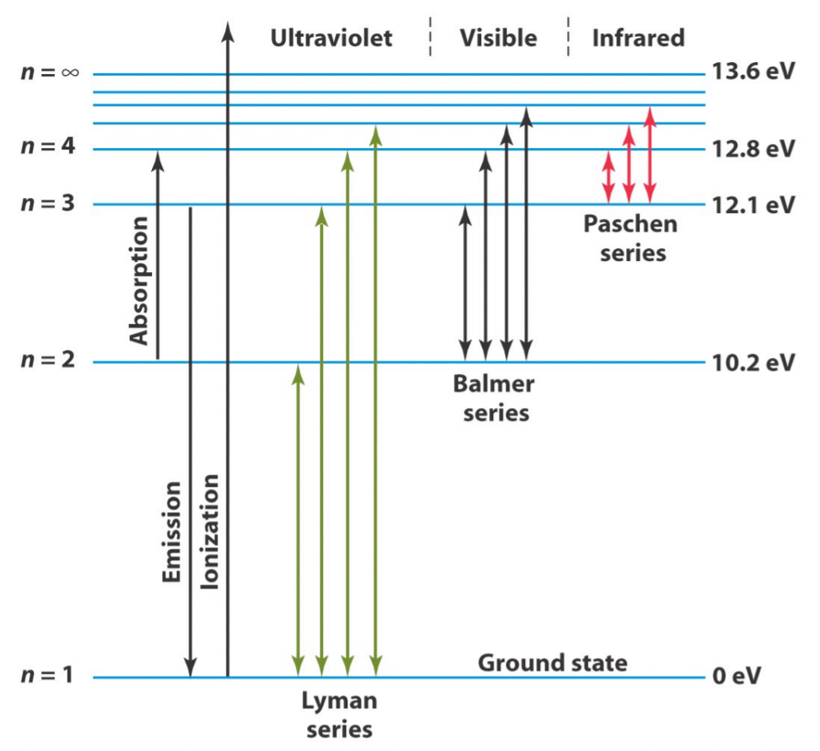
Atomic Transitions

Slide 10
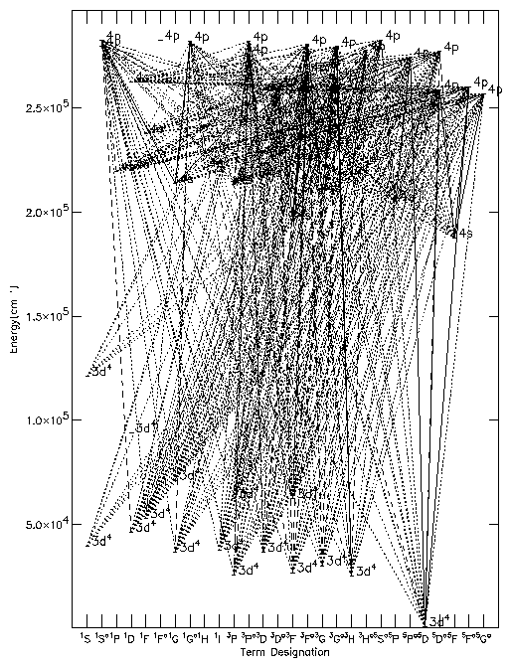
Iron (FeV)

Slide 11
H⁻ Opacity
What is H⁻?
Where does the extra electron come from?

Slide 12
H⁻ Opacity
H⁻ forms when there are excess free electrons that can combine with neutral hydrogen.
The free electrons come from ionized metals, such as Na, K, Ca, and Al.
Note that these metals have relatively low ionization potentials, so they do not require very high energy photons.
This means that they can readily be ionized by starts with “average” temperatures. (κ_{Η}⁻∝T^{7.7})
H⁻ has a very low ionization potential, corresponding to a wavelength of ~1.6 μm.
There is a “sweet spot” in temperature where it is high enough to ionize metals, providing free electrons, and low enough so that HI and H⁻ are not ionized.
This temperature range is 3000 to 10000 K.

Slide 13
Dominant Opacity
In the coolest stars, molecules provide the dominant source of opacity.
Stars cooler than 7300 K (F0) have significant amounts of H⁻, so that is the dominant contributor to opacity.
For somewhat hotter stars (A and B stars), photoionization is dominant.
In O stars, He ionization and free-free absorption are dominant.

Slide 14
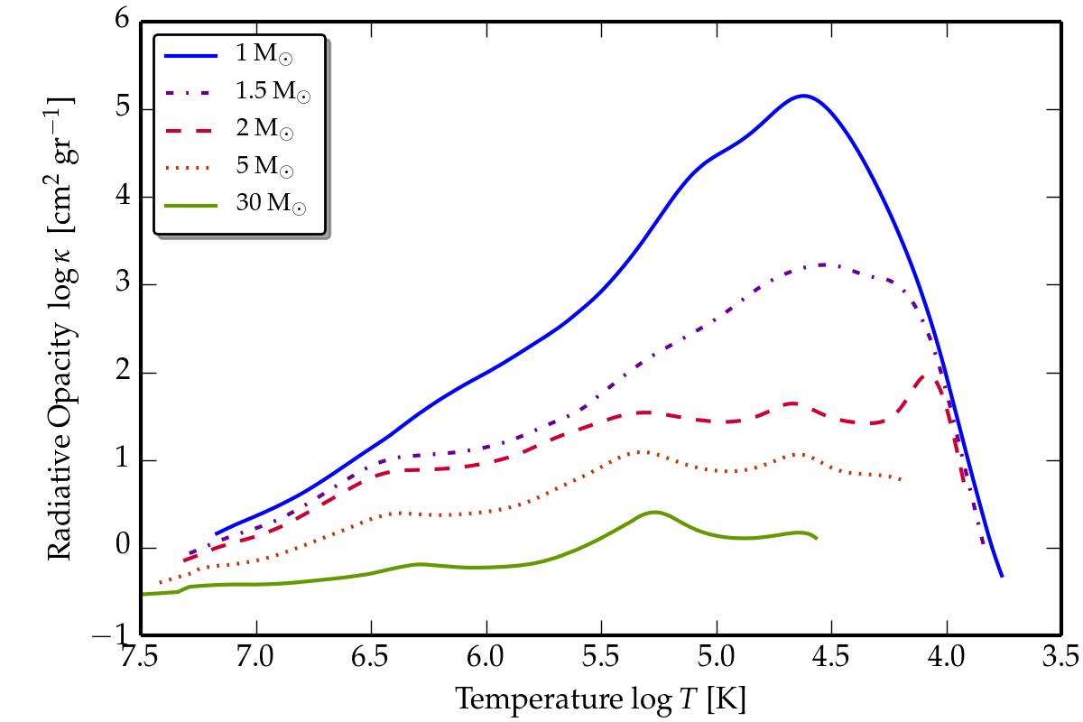
Opacity vs. Mass

Slide 15
Derivation of Equation of Radiative Transport

Slide 16
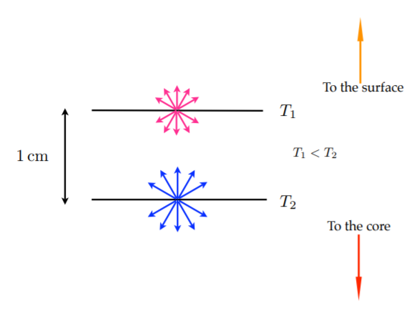
Derivation of Equation of Radiative Transport

Slide 17
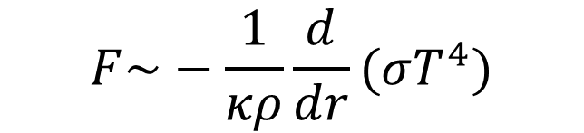
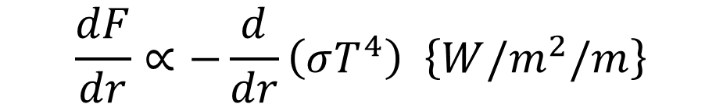

Derivation of Equation of Radiative Transport
We can relate the radiative flux through a volume element in a star to the temperature difference across that element.
$$\frac{dF}{dr}∝−\frac{d}{dr}\left(σT^{4}\right) \left\{W/m^{2}/m\right\}$$
Some of the flux is lost through absorption.
$$F\sim −\frac{1}{κρ}\frac{d}{dr}(σT^{4})$$
The flux is related to the luminosity at a given radius.
$$F=−\frac{L(r)}{4πr^{2}}$$

Slide 18

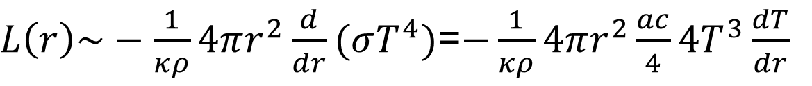
Derivation of Equation of Radiative Transport
Rearranging terms,
$L\left(r\right)\sim −\frac{1}{κρ}4πr^{2}\frac{d}{dr}(σT^{4})$=$−\frac{1}{κρ}4πr^{2}\frac{ac}{4}4T^{3}\frac{dT}{dr}$
Inverting, we find,
$$\frac{dT}{dr}\sim −\frac{1}{ac}\frac{κρ}{T^{3}}\frac{L(r)}{4πr^{2}}$$
Proper integration of angles gives the exact equation which differs by a factor of ¾ with respect to the one above.

Slide 19
convection vs. radiation and the sun

Slide 20
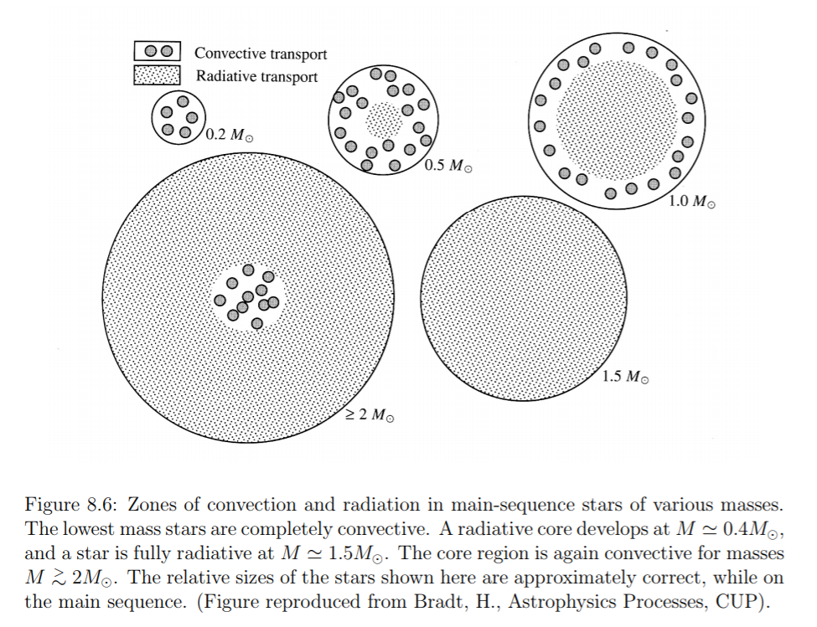
Radiative vs. Convection Transport

Slide 21
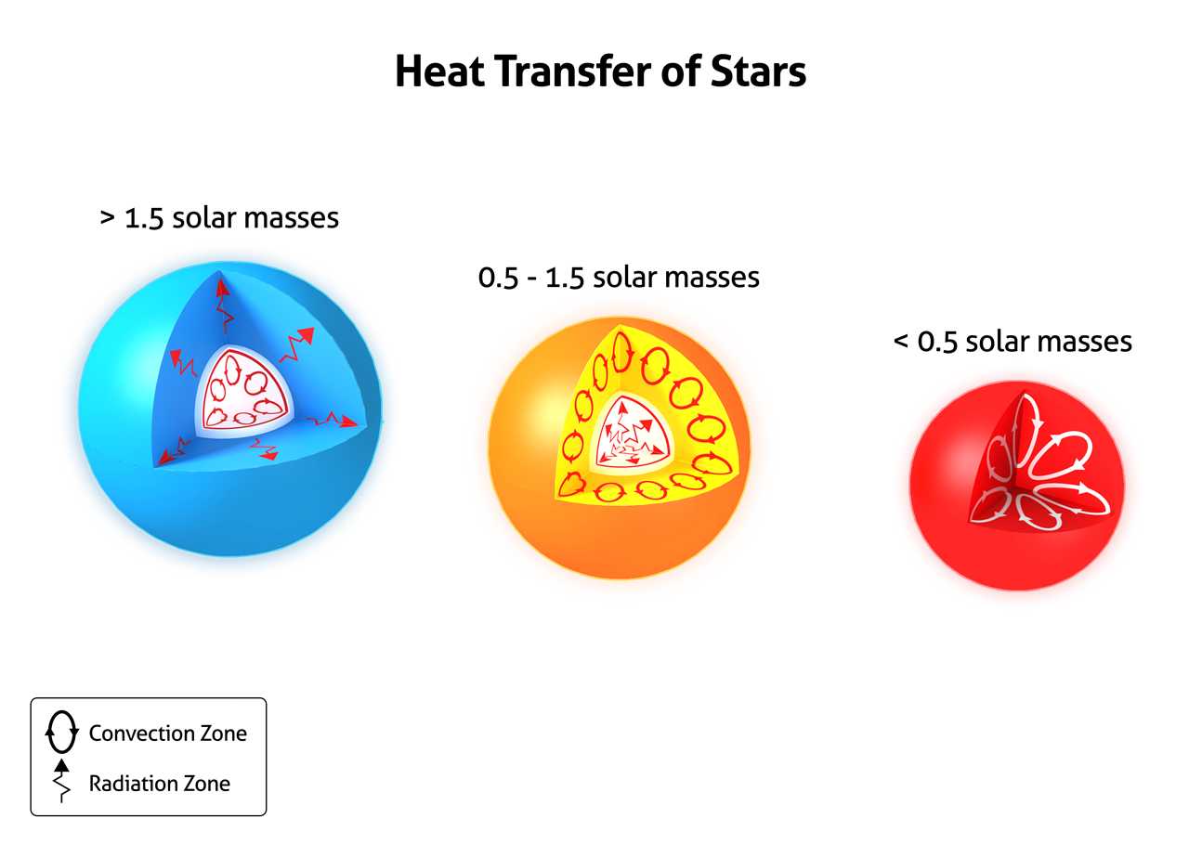
Radiative vs. Convection Transport

Slide 22
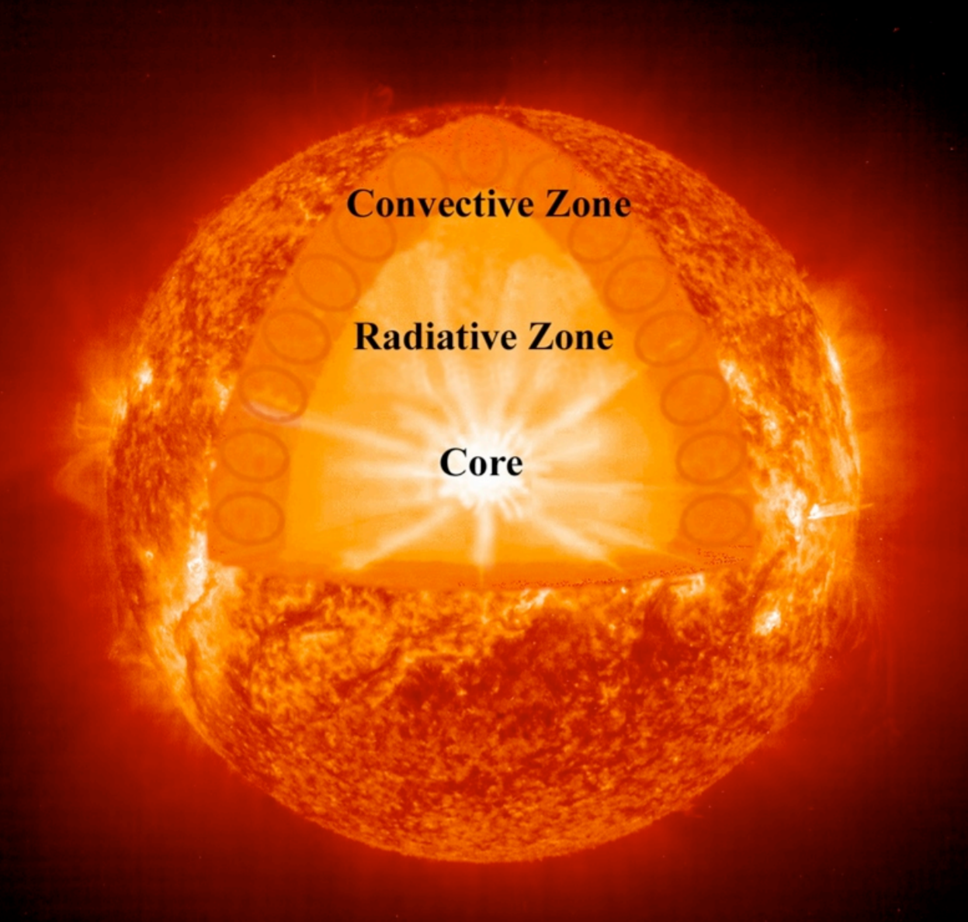
Transport in the Sun

Slide 23
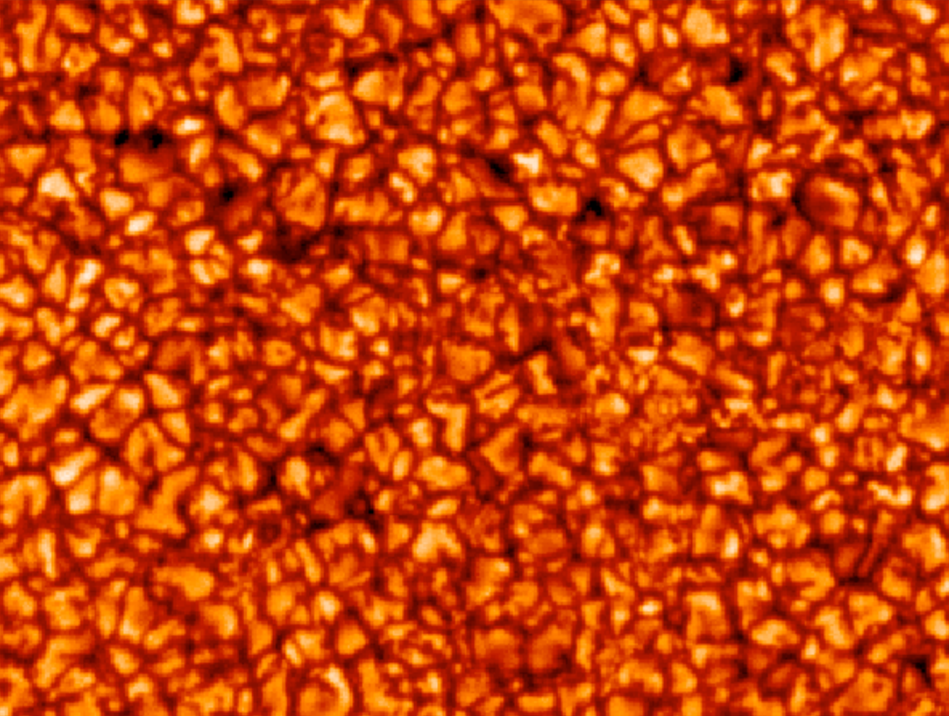
Convection and Granules

Slide 24
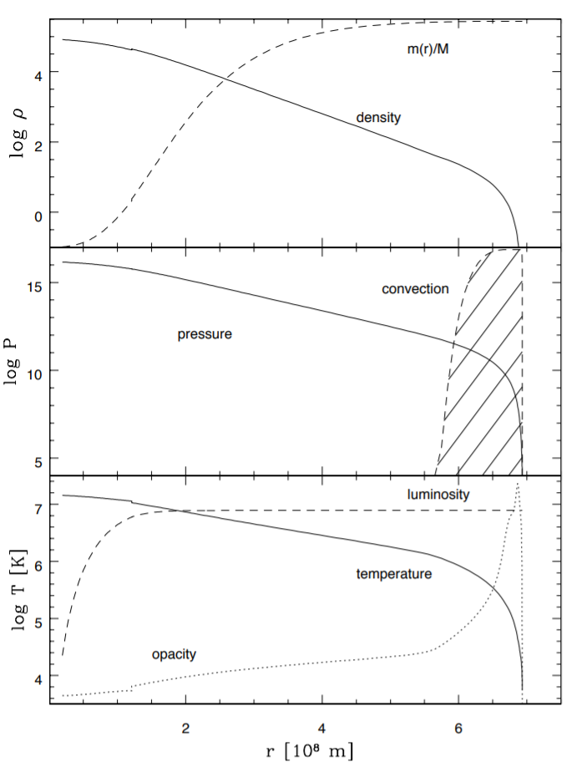
Detailed Model for 1 M_{Sun}

Slide 25
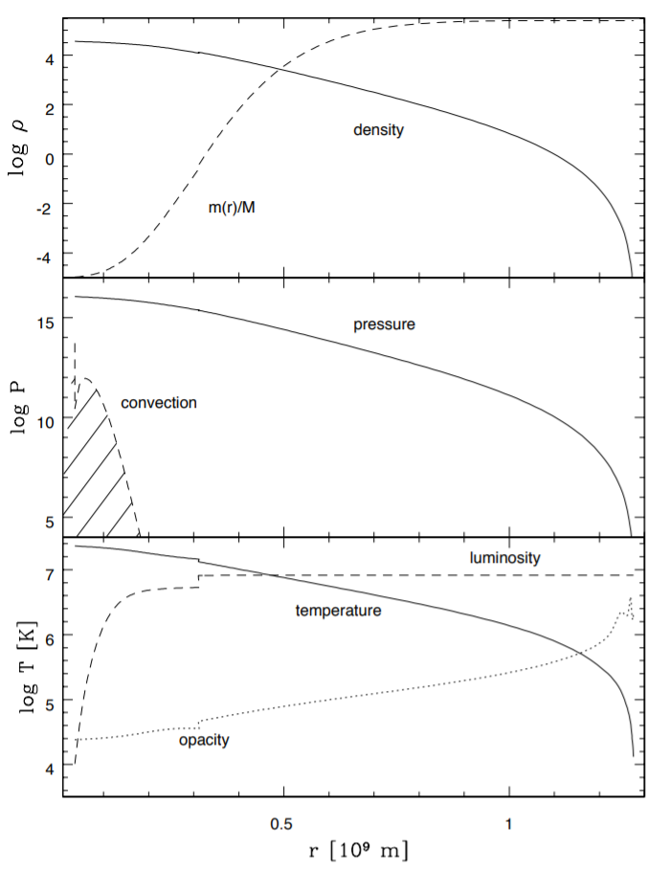
Detailed Model for 3 M_{Sun}

Slide 26
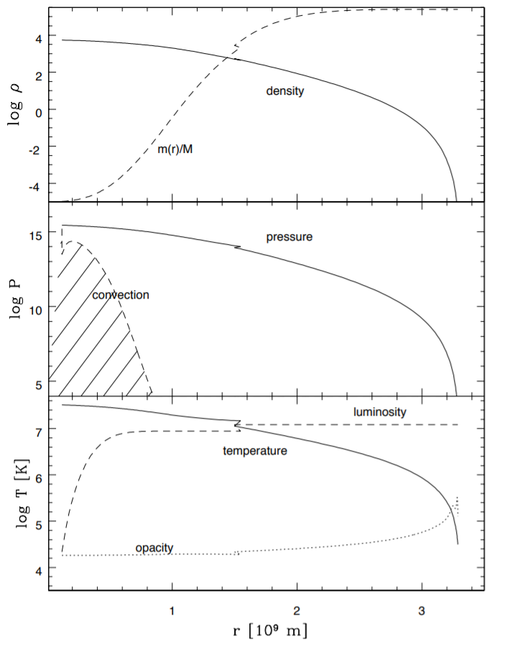
Detailed Model for 15 M_{Sun}

Slide 27
