Slide 1
University Astronomy
Professor Don Figer
Properties of Stars II

Slide 2
Aims and outline for this lecture
more properties of stars
  mass
  radius
  binarity
  composition
  proper motion
  names

Slide 3
How are Properties Measured?
Luminosity: distance combined with apparent brightness.
Distance: trigonometric parallax, standard candles (luminosity combined with apparent brightness).
Temperature: Spectra.
Diameter: Luminosity combined with temperature.
Mass: Binary star orbits and Kepler's Laws.
Composition: Spectra.

Slide 4
mass

Slide 5
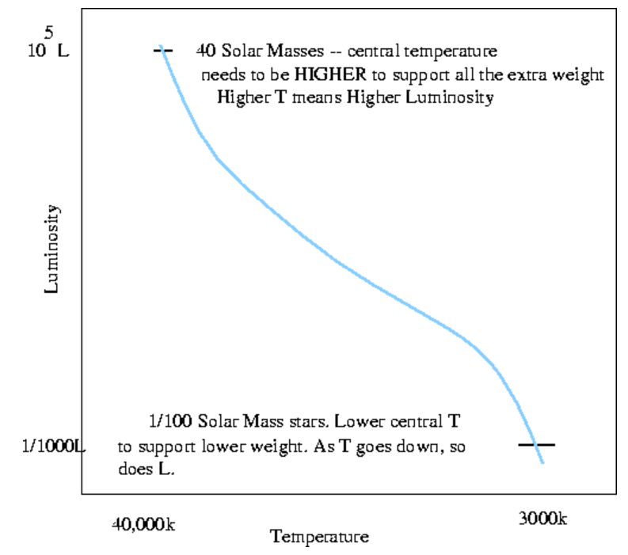
Stellar Mass
Stars are “born” with a mass that determines most of their observed properties throughout their lifetimes (unlike humans!).
More massive stars have higher internal pressures and temperatures.
A higher internal temperature leads to higher energy generation rates and thus higher luminosities.

Slide 6
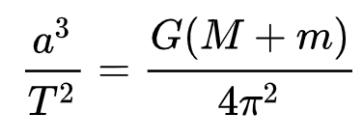
Measuring Stellar Mass
Kepler’s 3rd law relates separation (a) to orbital period (T) through a constant.
That constant involves the mass of the system.
If we are lucky, we can see both stars in some binary star systems at known distances to measure a and T.
This gives the combined mass.
Can convert to individual masses by noting that the mass ratio is the ratio of distances between the stars and the center of mass.

Slide 7
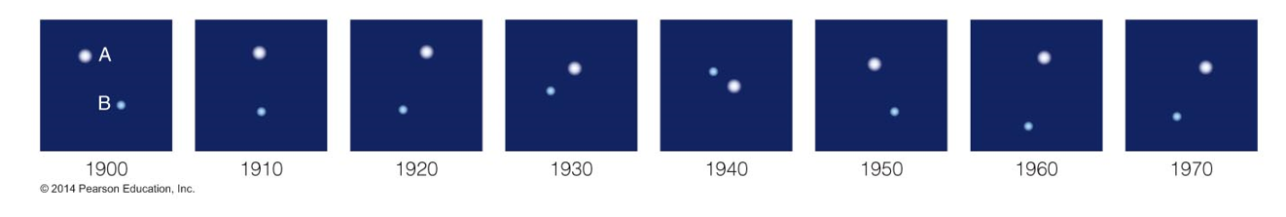
Binary Stars
Many stars in the sky appear to have companions.
If two companions orbit a common center, they are called binary stars.
Most stars are binary.
A visual binary is one in which both stars can be seen in an image. See graphic below for Sirius A and B. What is the period?
Other types include eclipsing and spectroscopic binaries.

Slide 8
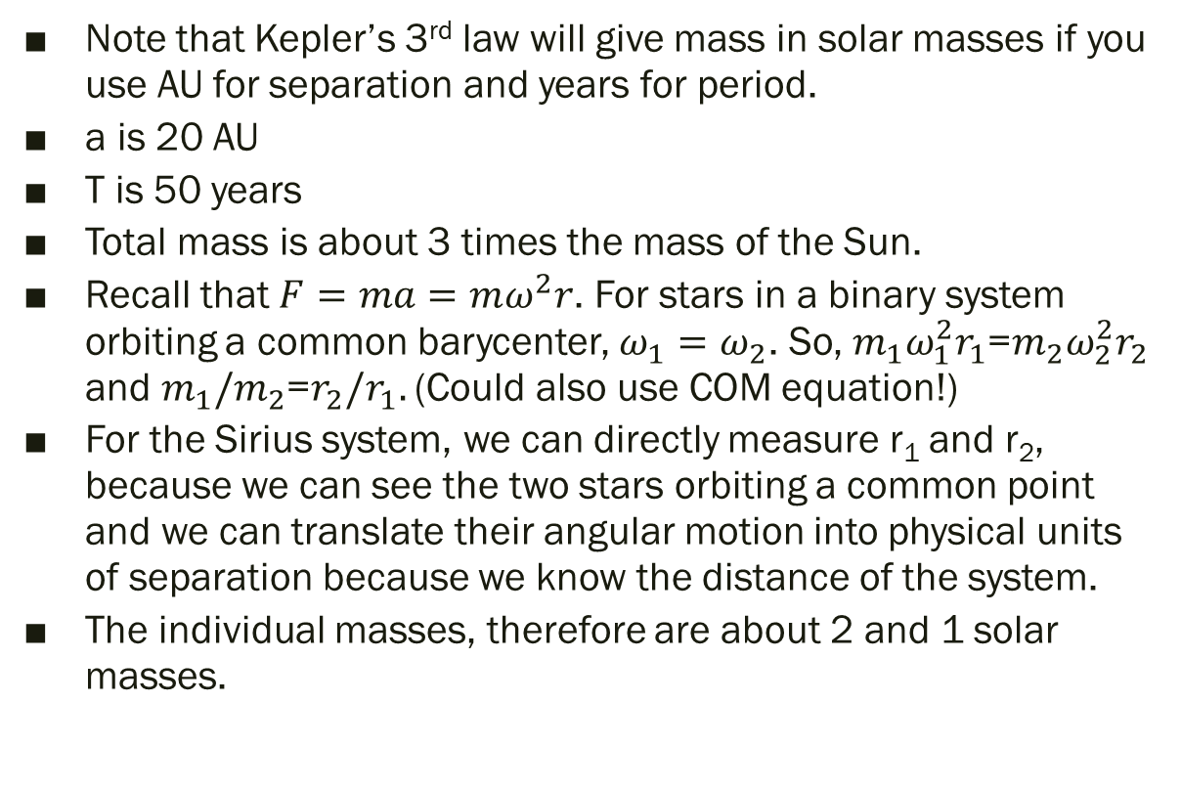
Sirius A and B
Note that Kepler’s 3rd law will give mass in solar masses if you use AU for separation and years for period.
a is 20 AU
T is 50 years
Total mass is about 3 times the mass of the Sun.
Recall that $F=ma=mω^{2}r$. For stars in a binary system orbiting a common barycenter, $ω_{1}=ω_{2}$. So, $m_{1}ω_{1}^{2}r_{1}$=$m_{2}ω_{2}^{2}r_{2}$ and $m_{1}/m_{2}$=$r_{2}{/r}_{1}.$ (Could also use COM equation!)
For the Sirius system, we can directly measure r₁ and r₂, because we can see the two stars orbiting a common point and we can translate their angular motion into physical units of separation because we know the distance of the system.
The individual masses, therefore are about 2 and 1 solar masses.

Slide 9
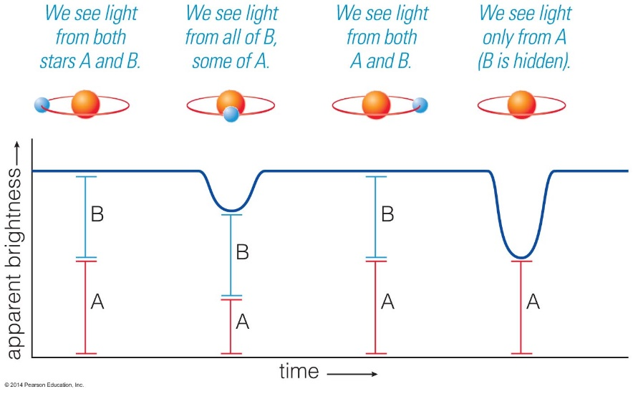
Eclipsing Binary
As the name suggests, an eclipsing binary is a system in which one star passes in front of the other.
These eclipses change the brightness of the system of what appears to be a single star.
Through long-term monitoring, we can determine properties of the orbits and stars.

Slide 10
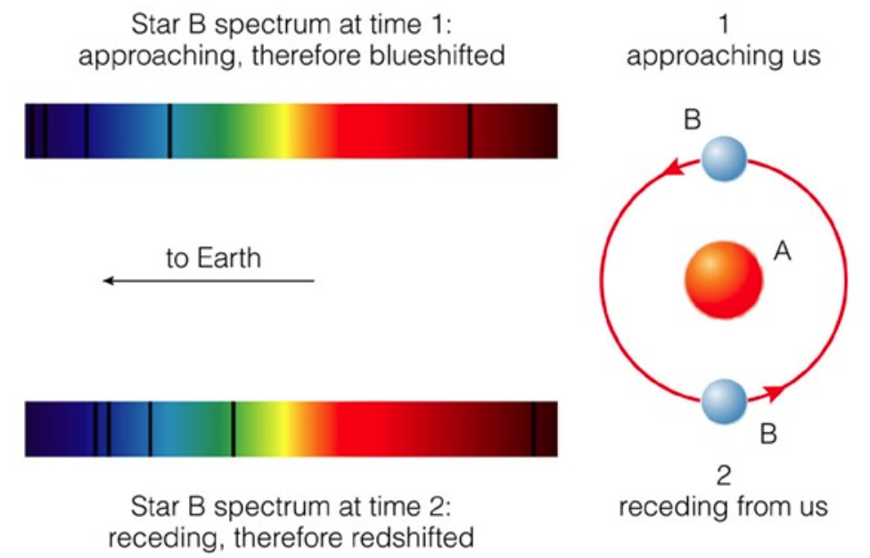
Spectroscopic Binary
As the name suggests, an spectroscopic binary is a system that is determined to be binary from its spectrum.
The two stars produce spectral features that have varying Doppler shift as the stars move in their orbit.
Through long-term monitoring, we can determine properties of the orbits and stars.

Slide 11
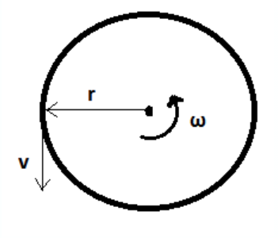
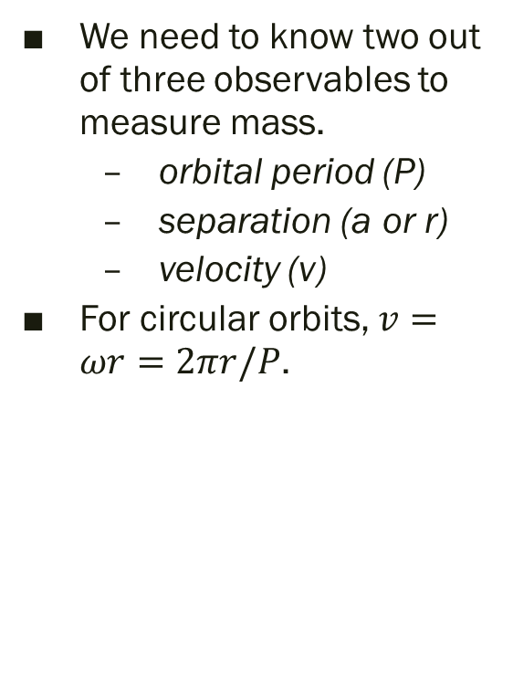
Measuring Mass
We need to know two out of three observables to measure mass.
  orbital period (P)
  separation (a or r)
  velocity (v)
For circular orbits, $v=ωr=2πr/P$.

Slide 12
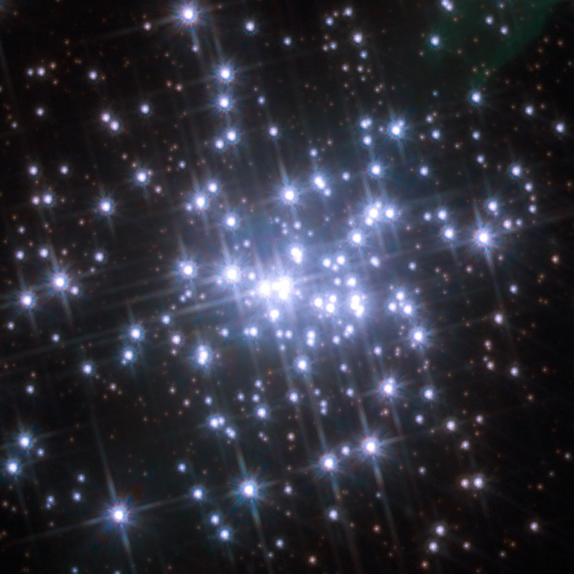
Most Massive Stars via Binaries
The masses of A1a and A1b in NGC3603 are determined from the orbital parameters and are 116±31 M☉ and 89±16 M☉.
This makes them the two most massive stars directly measured, i.e. with their masses determined (using Keplerian orbits), and not estimated from models.
The masses estimated from analysis of the physical properties are slightly higher at 120 M☉ and 92 M☉.

Slide 13
Other Ways to Measure Mass
There are other ways of measuring stellar mass, but they are less direct (and less reliable).
One is to determine the spectral type and luminosity and then simply assume that the star must have the same mass as other similar stars.
Another way is to use a stellar model to fit the observed spectral energy distribution. If it fits, then the mass of the star is assumed to be the same as the assumed mass of the model.

Slide 14
Stellar Masses
The most massive stars have masses around 150 to 300 times the mass of the Sun (using models).
Do we know the real limit?
The least massive stars have a mass of around 0.08 times the mass of the Sun.

Slide 15
Question
Why would there be an upper limit to the masses of stars?
Notes:
Apparent Magnitude This graph illustrates the apparent magnitudes of some astronomical objects. The original magnitude scale was defined so that the brightest stars in the night sky had magnitude 1, and the faintest stars visible to the naked eye had magnitude 6. It has since been extended to cover much brighter and much fainter objects. An increase of 1 in apparent magnitude corresponds to a decrease in apparent brightness by a factor of approximately 2.5.

Slide 16
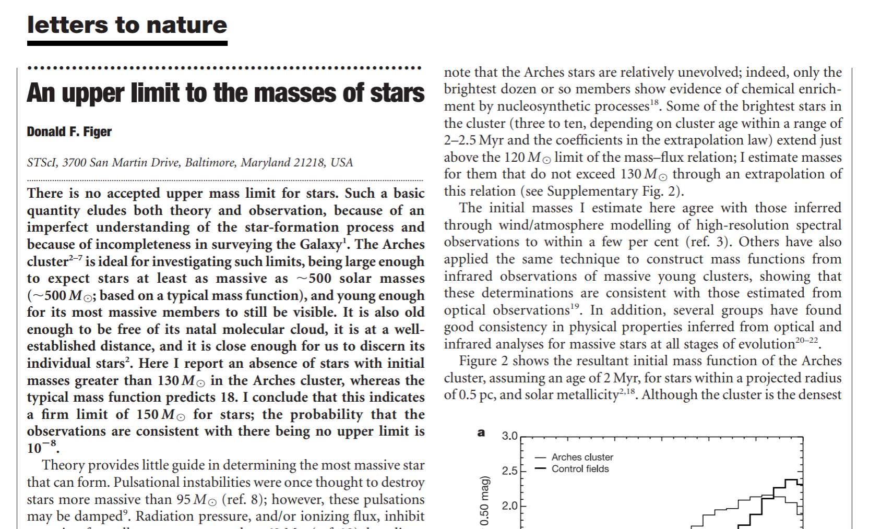
Upper Mass Paper
Notes:
Apparent Magnitude This graph illustrates the apparent magnitudes of some astronomical objects. The original magnitude scale was defined so that the brightest stars in the night sky had magnitude 1, and the faintest stars visible to the naked eye had magnitude 6. It has since been extended to cover much brighter and much fainter objects. An increase of 1 in apparent magnitude corresponds to a decrease in apparent brightness by a factor of approximately 2.5.

Slide 17
Question
Why would there be an lower limit to the masses of stars?
Notes:
Apparent Magnitude This graph illustrates the apparent magnitudes of some astronomical objects. The original magnitude scale was defined so that the brightest stars in the night sky had magnitude 1, and the faintest stars visible to the naked eye had magnitude 6. It has since been extended to cover much brighter and much fainter objects. An increase of 1 in apparent magnitude corresponds to a decrease in apparent brightness by a factor of approximately 2.5.

Slide 18
radius

Slide 19
Stellar Radius
Distance can be measured through parallax.
By knowing distance, and measuring apparent magnitudes, we can estimate luminosity.
By fitting the apparent magnitudes in several filters, we can estimate temperature.
We can estimate radius by using the temperature and luminosity.

Slide 20
Sirius A and B
Sirius A:
  L = 26 L_{sun}
  T = 10,000 Kelvin = 1.72 T_{sun}
  R is computed to be 1.7 R_{sun} (Work this out for yourself!)
Sirius B:
  L = 0.0024 L_{sun}
  T = 15,000 Kelvin = 2.59 T_{sun}
  R is computed to be 0.007 R_{sun} (Work this out for yourself!)
One square meter of Sirius B is 2.59 x 2.59 x 2.59 x 2.59 = 45 times more luminous than one square meter of the Sun.
Sirius B has low total luminosity because it's tiny - even smaller than the Earth.

Slide 21
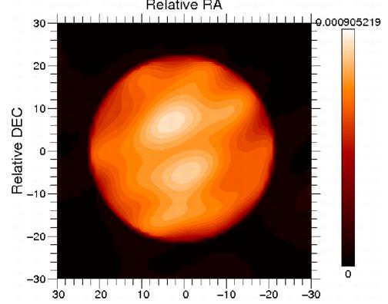
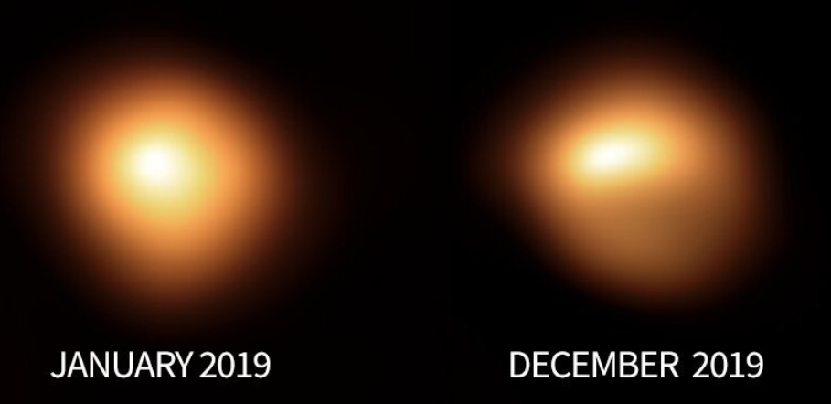
Radius – Direct Measurement
It is possible to measure the size of a star directly by taking an image of it and measuring the extent of it.
The star must be big enough and/or close enough to resolve it.
For Betelgeuse, the size is about 0.1 arcseconds.
At its distance, this size suggests a diameter of about 10 AU.
If located at the position of the Sun, Betelgeuse would extend to Saturn’s orbit.

Slide 22
Mass-Radius Relationship
Once mass and radius are known, one can plot the mass-radius relationship, as seen on the right.
The points in the plot are for stars on the main sequence.
There appears to be a change in the slope where heavier stars burn using the CNO cycle.

Slide 23
Mass-Luminosity Relationship
Luminosity increases with mass.
The plot on the right shows that luminosity goes as mass to approximately the 3.5 power.
This means that twice the mass gives around 10 times the luminosity.
The most massive stars produce the same luminosity as a million Suns!

Slide 24
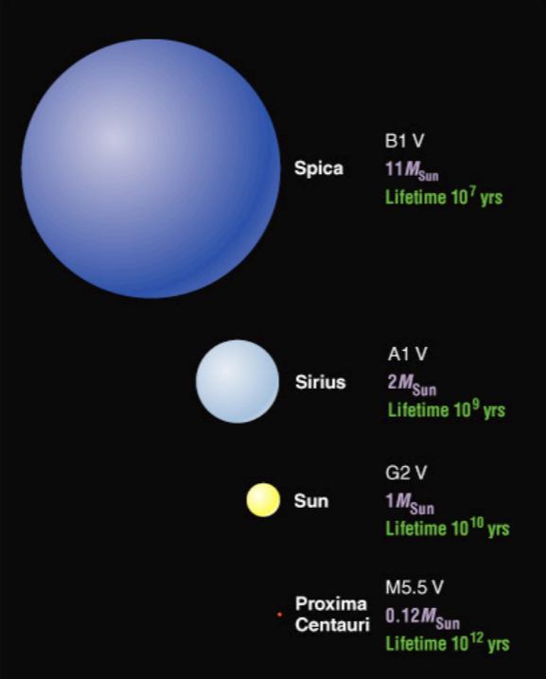
Main Sequence
Stars spend most of their lives on the so-called “main sequence.”
The mass-radius and mass-luminosity relation are positive and monotonic, meaning bigger mass gives bigger radius and luminosity.

Slide 25
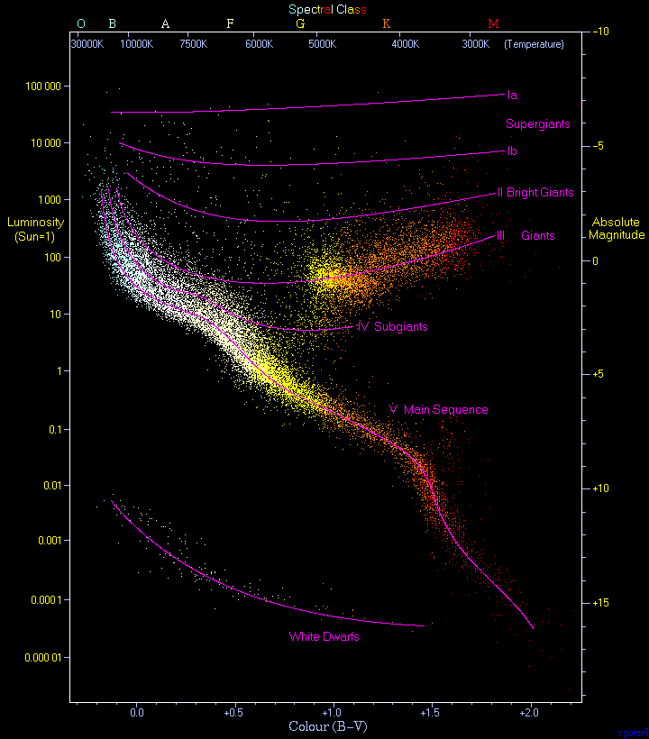
Main Sequence

Slide 26
lifetime

Slide 27

Lifetime
The mass of a star determines its amount of fuel it can burn during its lifetime.
The luminosity is the rate at which the fuel is being used.
The lifetime, therefore, is proportional to mass divided by luminosity.
Give the mass-luminosity relation, then, the lifetime scales as mass to the minus 2.5 power.
The most massive stars will die millions of times faster than the Sun.
$lifetime∝\frac{energy}{power}∝\frac{M}{L}$
$L∝M^{3.5}$
$lifetime∝M^{−2.5}$

Slide 28
composition

Slide 29
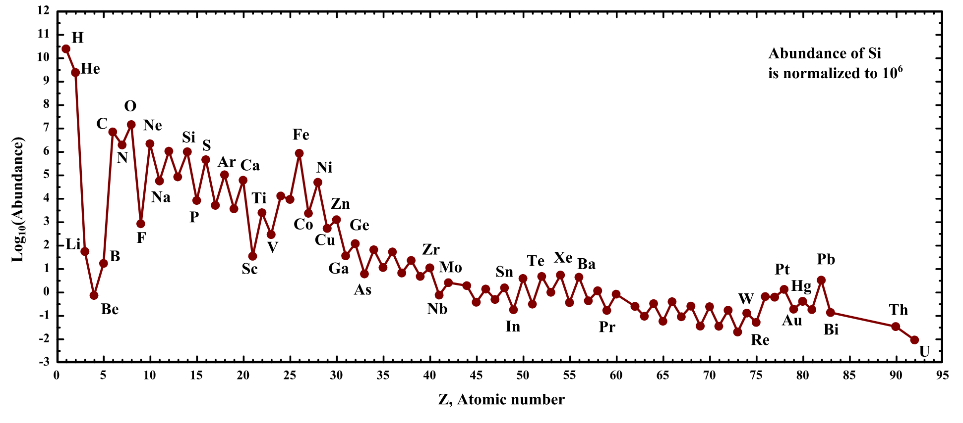
Composition
Stars are mostly hydrogen.
They are about ¾ hydrogen and ¼ helium and a few percent of everything else (by mass).
They have little B, Li, and Be because stars and Big Bang make little of those elements.
Notice peaks on even numbers of Z due to He capture.

Slide 30
motion

Slide 31
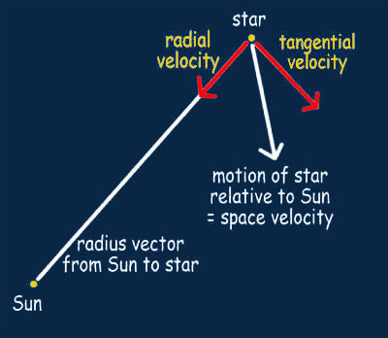
Space Motion

Slide 32
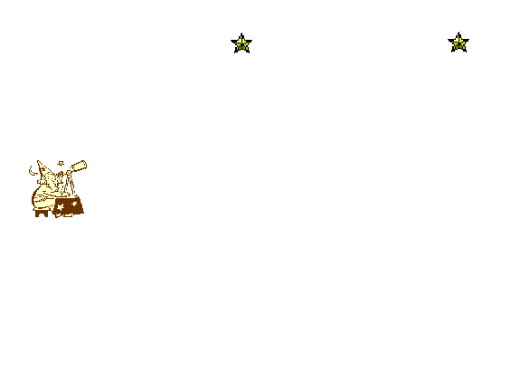
Proper Motion
Proper motion is the motion of a star due to its own velocity and the velocity of the Sun.
It is usually expressed in arcseconds/year.
Stars that are nearby tend to appear to have higher proper motion.
Barnard's Star has the largest proper motion of all stars, moving at 10.3 arcseconds per year.
(Animation Credit: George Rieke)

Slide 33
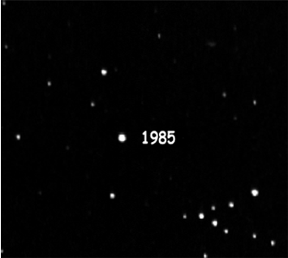
Barnard’s Star
It has a high proper motion because it is close and moving in a different direction than Sun around the Galaxy.
Most stars near the Sun are moving in the same direction with nearly the same speed, and have relative motions that are only about 10 to 15 percent of their actual motion
It is ~5 light years away, a bit further than Alpha Centauri, and is the closest star north of the Celestial Equator.
Barnard's Star will pass less than 4 light years from us about ten thousand years from now, and for some time before and after that will be the closest star to the solar system.

Slide 34
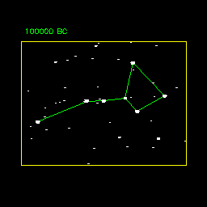
Proper Motion and Big Dipper

Slide 35
Hydrostatic equilibrium

Slide 36
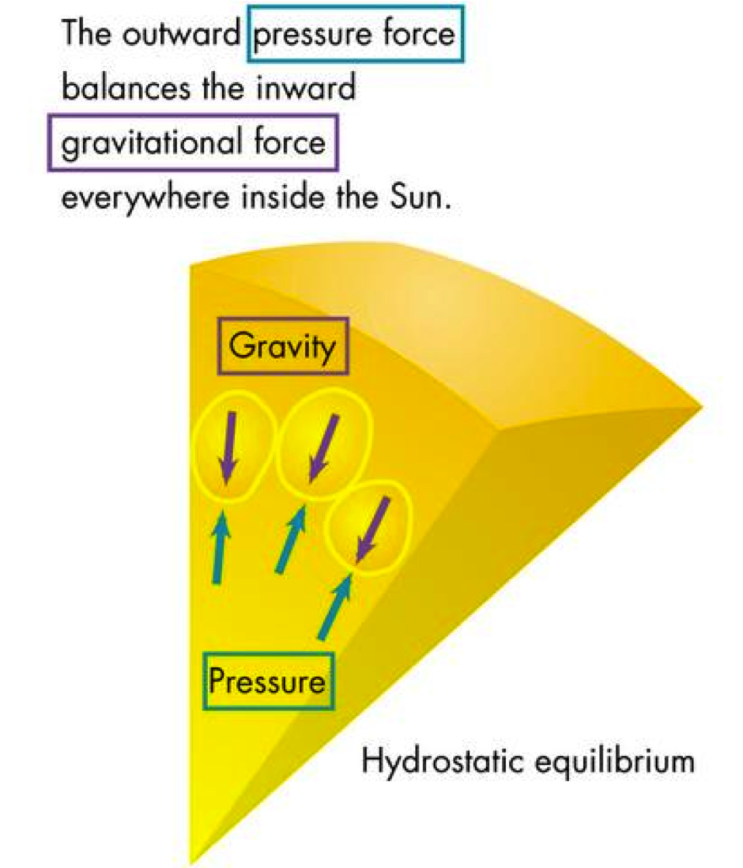
Hydrostatic Equilibrium
Stars are generally stable, that is, they are not expanding or contracting.
They are said to be in hydrostatic equilibrium.
The outward pressure balances the inward gravity.
The pressure is provided by gas with a characteristic temperature.

Slide 37
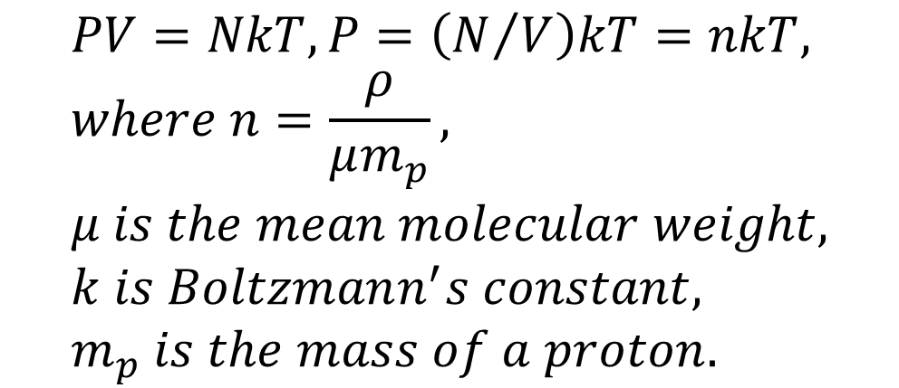
Thermal Pressure
Particles in a star can be approximated as an ideal gas.
The ideal gas law relates pressure to temperature and number of particles per volume.
The number of particles is related to the density divided by the mean mass per particles, also called the mean molecular weight.
$$PV=NkT, P=\left(N/V\right)kT=nkT, \\ where n=\frac{ρ}{μm_{p}}, \\ μ is the mean molecular weight, \\ k is Boltzmann^{′}s constant, \\ m_{p} is the mass of a proton.$$

Slide 38
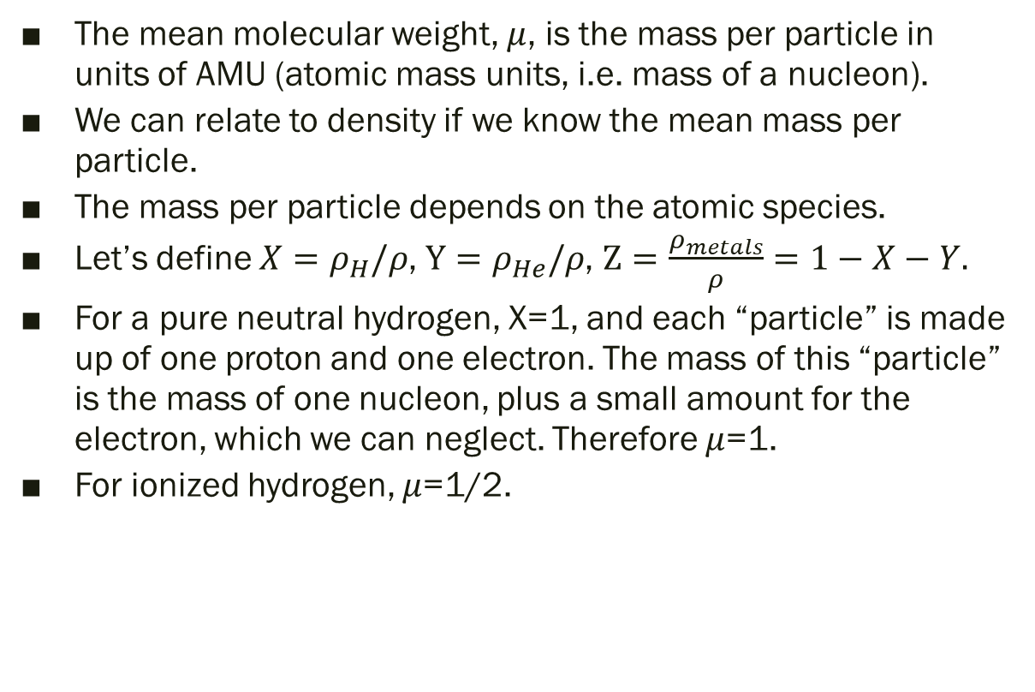
Mean Molecular Weight
The mean molecular weight, $μ$, is the mass per particle in units of AMU (atomic mass units, i.e. mass of a nucleon).
We can relate to density if we know the mean mass per particle.
The mass per particle depends on the atomic species.
Let’s define $X=ρ_{H}/ρ$, $Y=ρ_{He}/ρ$, $Z=\frac{ρ_{metals}}{ρ}=1−X−Y.$
For a pure neutral hydrogen, X=1, and each “particle” is made up of one proton and one electron. The mass of this “particle” is the mass of one nucleon, plus a small amount for the electron, which we can neglect. Therefore $μ$=1.
For ionized hydrogen, $μ$=1/2.

Slide 39
Question
What is the mean molecular weight of pure neutral helium?
a) ½
b) 4
c) ¾
d) 1

Slide 40
Answer
What is the mean molecular weight of pure neutral helium?
a) ½
b) 4
c) ¾
d) 1
Each helium atom has two protons, two neutrons, and two electrons. The protons and neutrons have the mass of four protons (approximately), and the mass of the electrons is negligible.

Slide 41
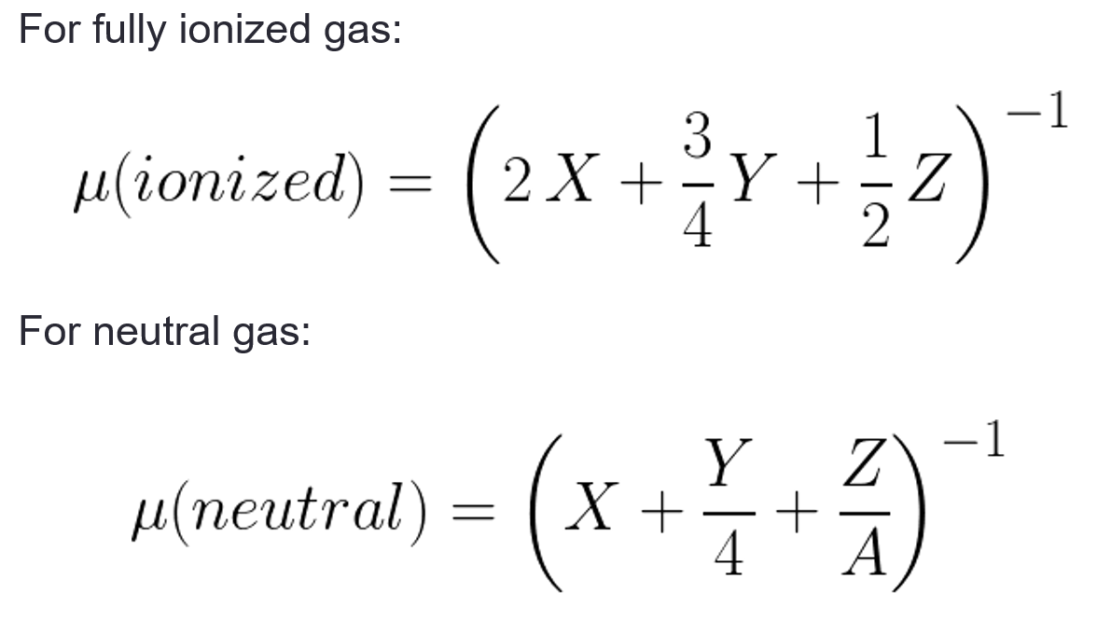
μ in Terms of Mass Fractions
where A is the atomic weight in AMU for species Z.

Slide 42
star names

Slide 43
Star Names
Stars often go by many names – Vega has 60!
Bayer (1603) made an atlas and named each star using Greek letters in each constellation from brightest to faintest, e.g. α Lyrae is Vega.
Running out of Greek letters, Flamsteed (1712) numbered stars from west to east in each constellation, e.g. 3 Lyrae is Vega.
Bonn Survey (1859) found more stars, down to magnitude 9.5, e.g. BD+383238 is Vega, the 3,238th star from right ascension of zero between declination 38 and 39 degrees.
There are many catalogs now. Faint stars usually are named by their position, e.g. Vega is J18365633+3847012.
Variable stars are named with letters, starting with R, in order of discovery in each constellation, to Z, then RR, RS to RZ, then SS to SZ, up to ZZ, then AA to QZ. Then, they switch to V numbers, e.g. V5112 Sagittarii.
Naming a star is a hoax. Lady Diana star?

Slide 44
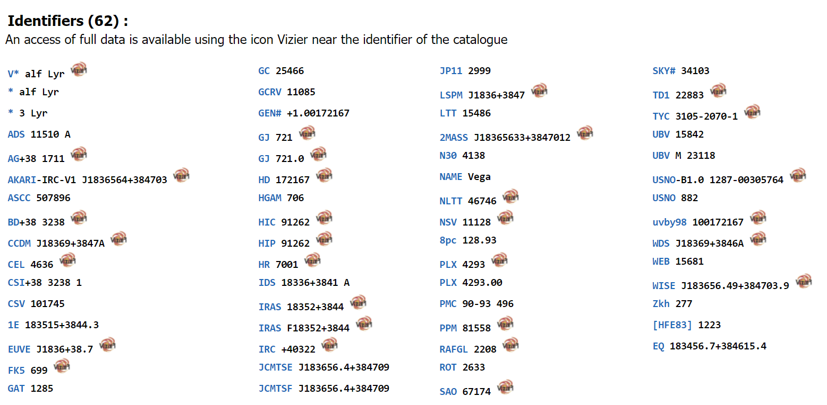
A Vega by any Other Name

