Slide 1
University Astronomy
Professor Don Figer
Exoplanets I

Slide 2
Aims and outline for this lecture
review the methods for identifying exoplanets
  radial velocity
  transit
  direct imaging
  microlensing
determine if exoplanets are in habitable zone
examine Kepler discoveries
discuss Starshot
TESS mission
JWST
Project Blue and Proxima Centauri b

Slide 3
background

Slide 4
Exoplanet Definition
An exoplanet is a planet that does not orbit our Sun.
  usually is meant to mean planets that orbit other stars
  could include free-floating planets, such as “failed stars,” aka brown dwarfs
The term is short for “extrasolar planet,” where solar means Sun.

Slide 5
Known Exoplanets
Exoplanets were the stuff of science fiction when I was a student!
The few people who were searching for exoplanets were operating outside the established field of astronomy.
Discovery of the first extrasolar planet was announced Oct. 6, 1995, at a meeting in Florence, Italy, by Michel Mayor and Didier Queloz of the Geneva Observatory in Switzerland, and confirmed a week later by Geoff Marcy and Paul Butler at Lick Observatory.
There are now over 4,000 confirmed exoplanets and a similar number of candidates. Over 600 are in multiple planet systems.
Keep up with the latest at:
  http://exoplanetarchive.ipac.caltech.edu/
  http://exoplanets.org/

Slide 6
Exoplanet Questions
How common are planets?
Are habitable planets common?
Do other planetary systems look like ours?
Are planetary systems different around different types of stars?
Do all planetary systems have similar formation histories?
Is there life elsewhere?

Slide 7
detection techniques

Slide 8
Planet Detection Techniques
radial velocity
transit
direct imaging
gravitational microlensing

Slide 9
radial velocity technique

Slide 10
Stellar Reflex Motion
A star orbited by a planet will move in response to the gravitational pull of the planet.
The velocity of this motion depends on the ratio of the masses, that is, a big planet will pull the star harder than a small planet.
The two bodies orbit a common point, called the barycenter.
The barycenter is located at the center of mass of the system.

Slide 11
Stellar Reflex Motion Speed
According to Newton’s 3rd Law, the gravitational force on the star is equal, but opposite, to the gravitational force on the planet.
So, F_{star,planet}=-F_{planet,star}.
According to Newton’s 2nd Law, the force on each body is the mass of that body times the acceleration.
m_{star}a_{star}=m_{planet}a_{planet}, or, assuming circular orbits,
m_{star}(v²_{star}/r_{star})=m_{planet}(v²_{planet}/r_{planet}), where r is the distance between the body and the common point of rotation.
Because m_{star}>>m_{planet}, and r_{planet}>r_{star}, v_{planet}>v_{star}

Slide 12
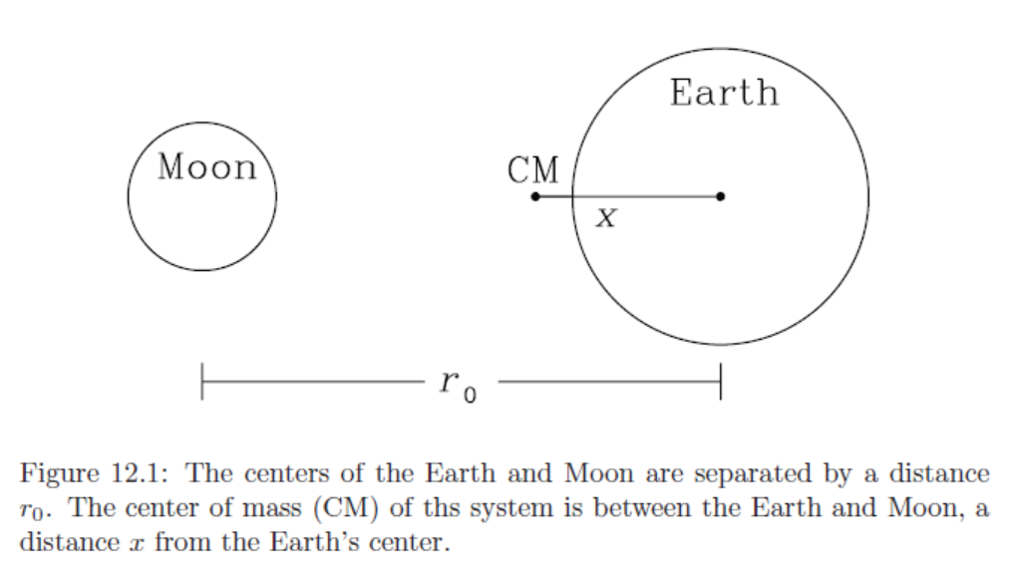
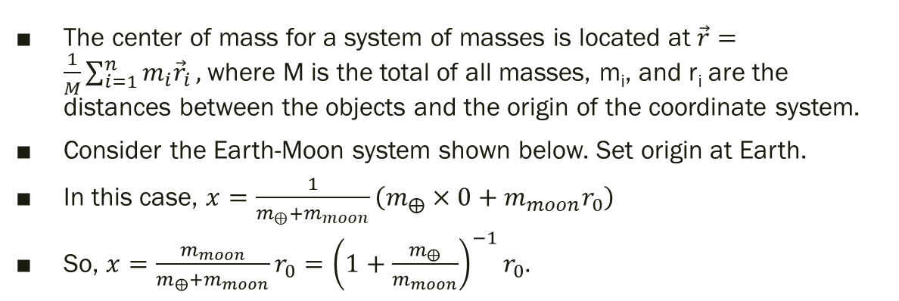
Center of Mass
The center of mass for a system of masses is located at $\vec{r}=\frac{1}{M}\sum_{i=1}^{n}{m_{i}{\vec{r}}_{i}},$where M is the total of all masses, m_{i}, and r_{i} are the distances between the objects and the origin of the coordinate system.
Consider the Earth-Moon system shown below. Set origin at Earth.
In this case, $x=\frac{1}{m_{⨁}+m_{moon}}\left(m_{⨁}×0+m_{moon}r_{0}\right)$
So, $x=\frac{m_{moon}}{m_{⨁}+m_{moon}}r_{0}={\left(1+\frac{m_{⨁}}{m_{moon}}\right)}^{−1}r_{0}.$

Slide 13
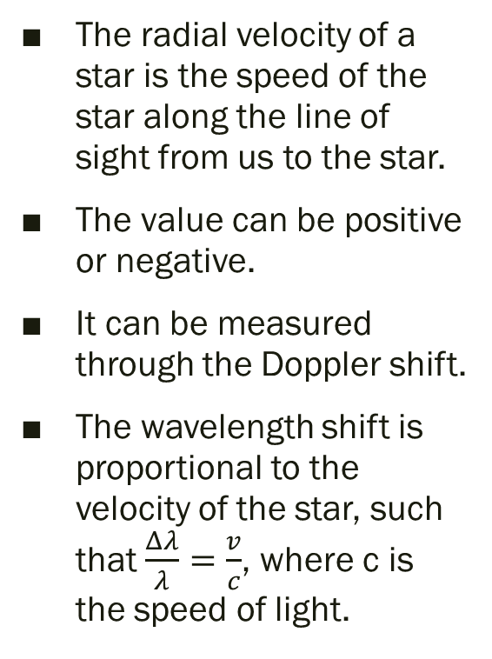
Radial Velocity Method
The radial velocity of a star is the speed of the star along the line of sight from us to the star.
The value can be positive or negative.
It can be measured through the Doppler shift.
The wavelength shift is proportional to the velocity of the star, such that $\frac{Δλ}{λ}=\frac{v}{c}$, where c is the speed of light.

Slide 14
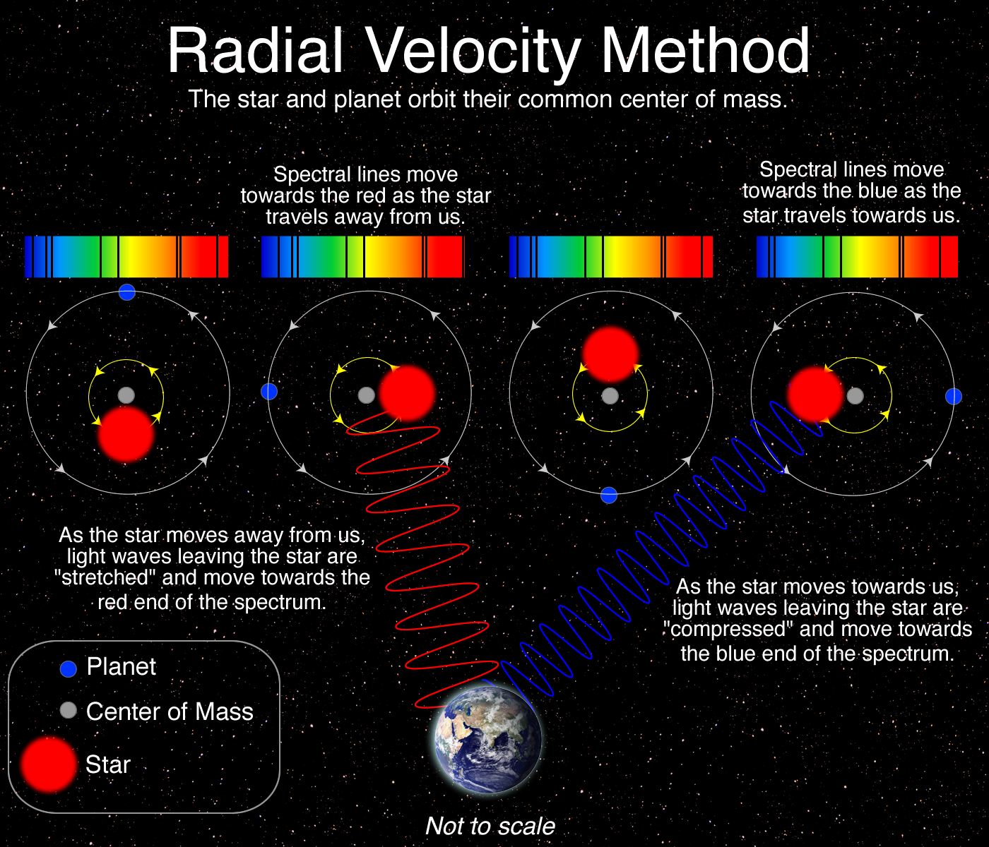
Doppler Shift

Slide 15
Radial Velocity Curve
If a planet is present, then the radial velocity varies in a sinusoidal shape with a period of P.
In the diagram below, the solid orbit is for the star and the dashed is for the planet.
The plot shows the variation of the velocities with an amplitude of v_{A} for the star. v_{cm} is the common motion of the system.
For inclinations not equal to 90 degrees, we measure v_{A}sini.

Slide 16
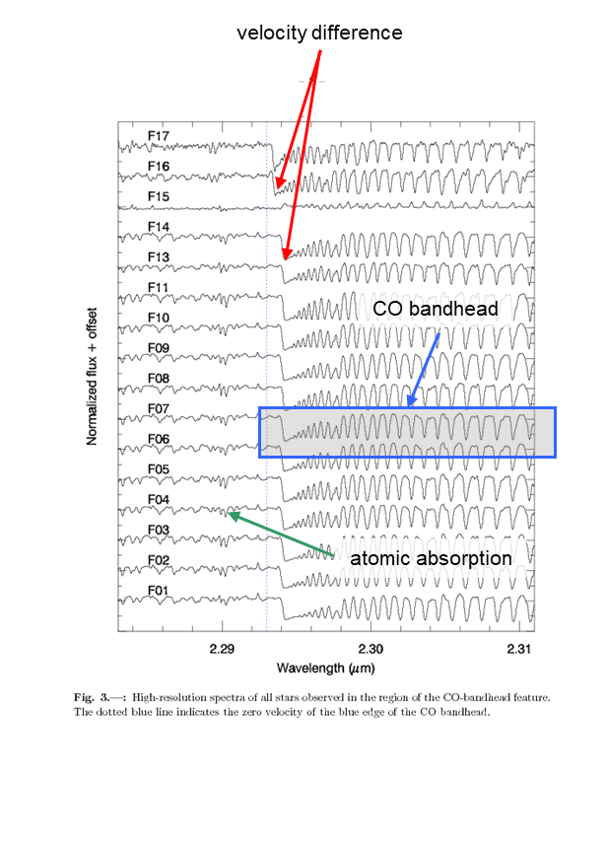
Radial Velocity from Spectra
A spectrum is used to measure the velocity.
The figure on the right shows spectra of 17 nearly identical stars in a cluster.
The CO bandhead appears to be shifted slightly for some of the stars, indicating that they have different radial velocities than the others.
For detecting exoplanets, the shift is very small, about a thousand times smaller than in the figure, requiring very high spectral resolution.

Slide 17
Curve for 51 Peg
The radial velocity curve for 51 Pegasi has a period of approximately 4 days and an amplitude of 50 m/s, or around just one six millionth the speed of light.
With such a short period, planet must be close to the star.
The planet has a mass similar to Jupiter (~M_{J}).

Slide 18
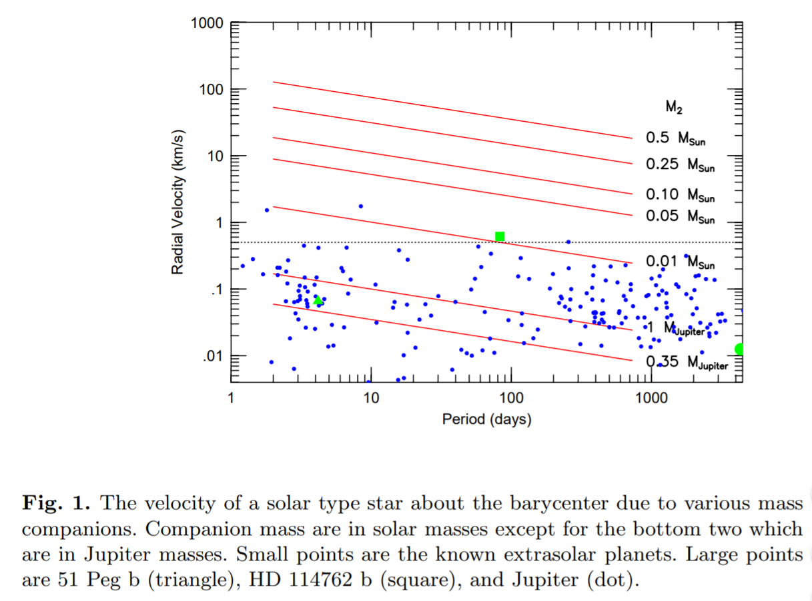
Velocities for some Examples

Slide 19
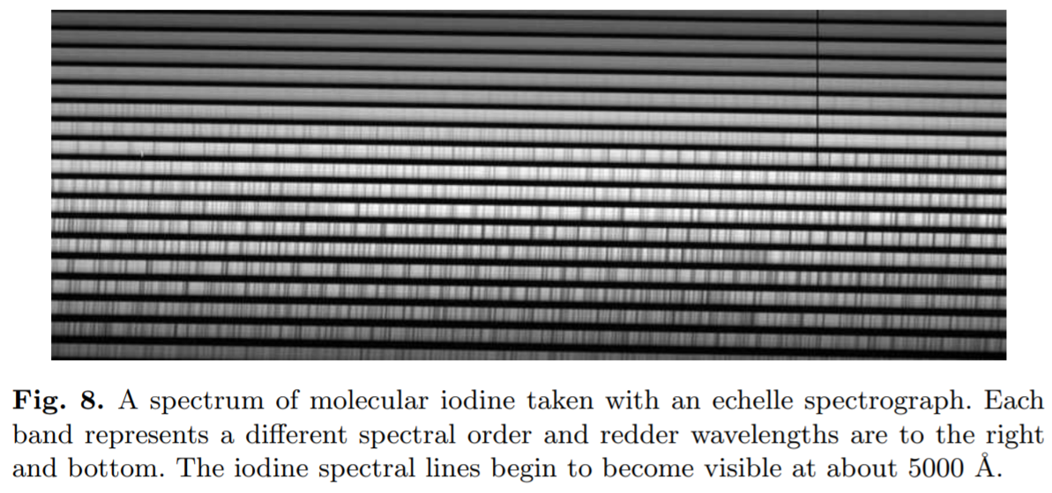
Gas Cell as a Reference

Slide 20
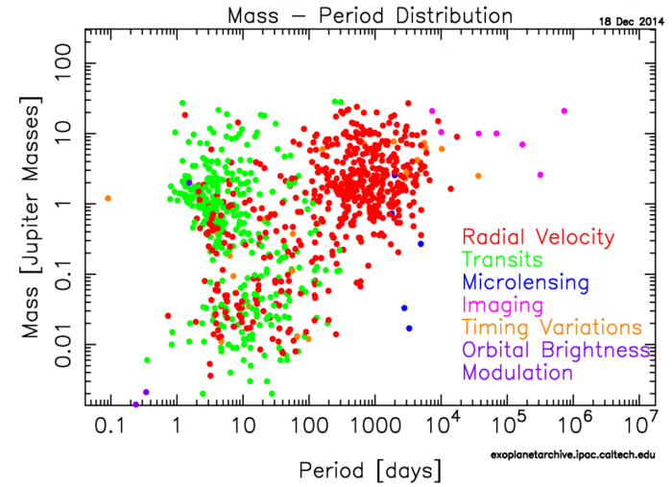
Best Radial Velocity Targets
This method generally detects planets that
  orbit edge on
  are massive compared to star
  have a short period
Notes:
30 protoplanetary disks, or proplyds, as imaged by Hubble in the Orion Nebula. Hubble is a brilliant resource for identifying these disk signatures in the optical, but has little power to probe the internal features of these disks, even from its location in space. (NASA/ESA AND L. RICCI (ESO))

Slide 21
transit technique

Slide 22
Transit Method
In this method, the planet transits in front of the star, thereby blocking some of its light.
A light curve shows the dip in the total light observed from the star.
The figure on the right shows Venus transiting the Sun.
(don’t look at the Sun)
Notes:
These 20 protoplanetary disks, as they appear in the most recent ApJ letters paper (in press), showcase the diversity and intricate details found in both face-on and tilted protoplanetary disks imaged by the DSHARP team. (S. M. ANDREWS ET AL. AND THE DSHARP COLLABORATION, ARXIV:1812.04040)

Slide 23
Transit Light Curve
The figure on the right shows a planet transiting a star.
As the planet “ingresses” into eclipse, the brightness of the star appears to dim.
The shape of the dip can tell us about the size of the planet, the orbital inclination, and the presence of an atmosphere around the planet.

Slide 24
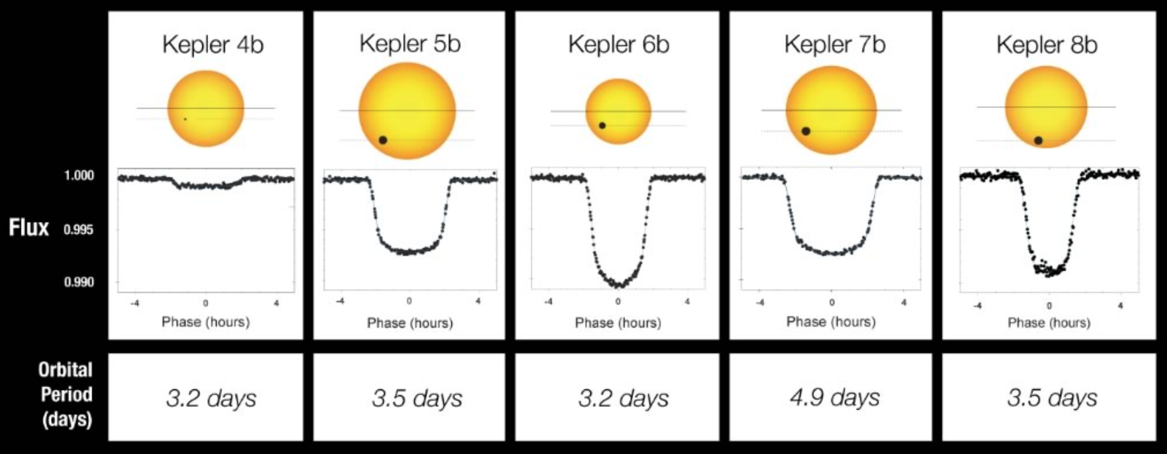
Sample Transit Light Curves

Slide 25
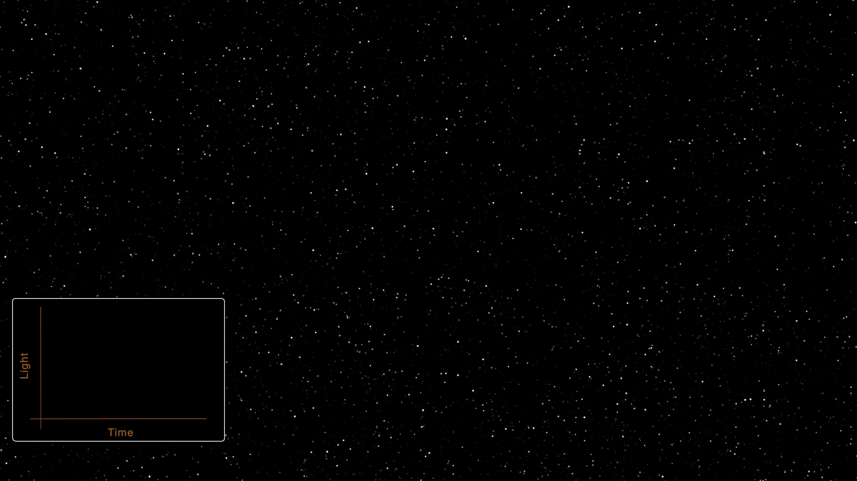
Transit Animation

Slide 26
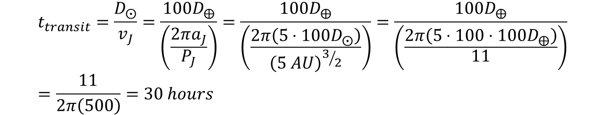
Example for Jupiter Transit
Jupiter has a diameter that is roughly one tenth that of the Sun.
The apparent flux from the Sun, as Jupiter eclipses it, will be reduced by the ratio of areas of the two objects.
So, the reduction is (1/10)²=0.01=1%.
How long would it take for Jupiter to transit all the way across the Sun, as seen from afar?
t=d/v, where d is diameter of the Sun and v is Jupiter’s orbital velocity and is equal to circumference/period.
$$t_{transit}=\frac{D_{⨀}}{v_{J}}=\frac{{100D}_{⨁}}{\left(\frac{2πa_{J}}{P_{J}}\right)}=\frac{{100D}_{⨁}}{\left(\frac{2π\left(5⋅100D_{⨀}\right)}{{\left(5 AU\right)}^{3/2}}\right)}=\frac{{100D}_{⨁}}{\left(\frac{2π\left(5⋅100⋅{100D}_{⨁}\right)}{11}\right)}=\frac{11}{2π\left(500\right)}=30 hours$$

Slide 27
Measuring Sizes
Size of planet can be inferred from ingress (time between first and second contact).
Size of star can be inferred from time between second and fourth contact.
Ingress is the phase between 1st and 2nd contact.
Egress is the phase between 3rd and 4th contact.

