Slide 1
University Astronomy
Professor Don Figer
Solar System I

Slide 2
Aims and outline for this lecture
introduce the Solar System
review historical models for the Solar System
introduce orbital mechanics
review characteristics of planets

Slide 3
solar system size

Slide 4
The Solar System
As its name implies, the Solar System is the collection of bodies that are gravitationally bound by the Sun.
Gravitationally bound means that objects don’t fly away.
It consists of the Sun, planets, asteroids, comets, dust, solar wind, etc.

Slide 5
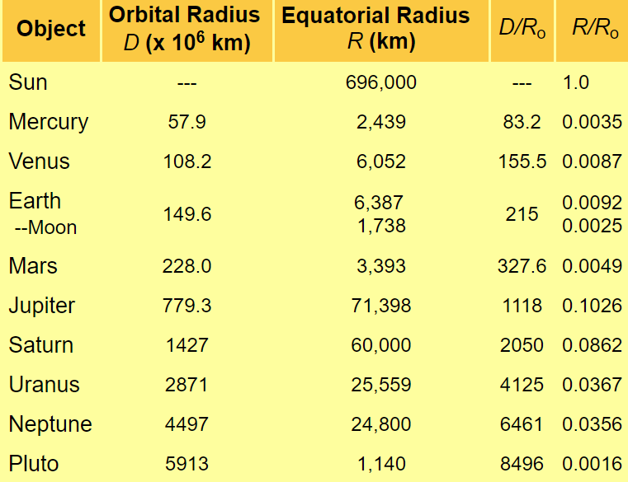
Solar System Size Scales

Slide 6
Solar System Size Scales
Most visualizations of the Solar System are not to scale.
For instance, the picture on the following slide preserves the relationships between the sizes of the planets and Sun but not their distances.

Slide 7
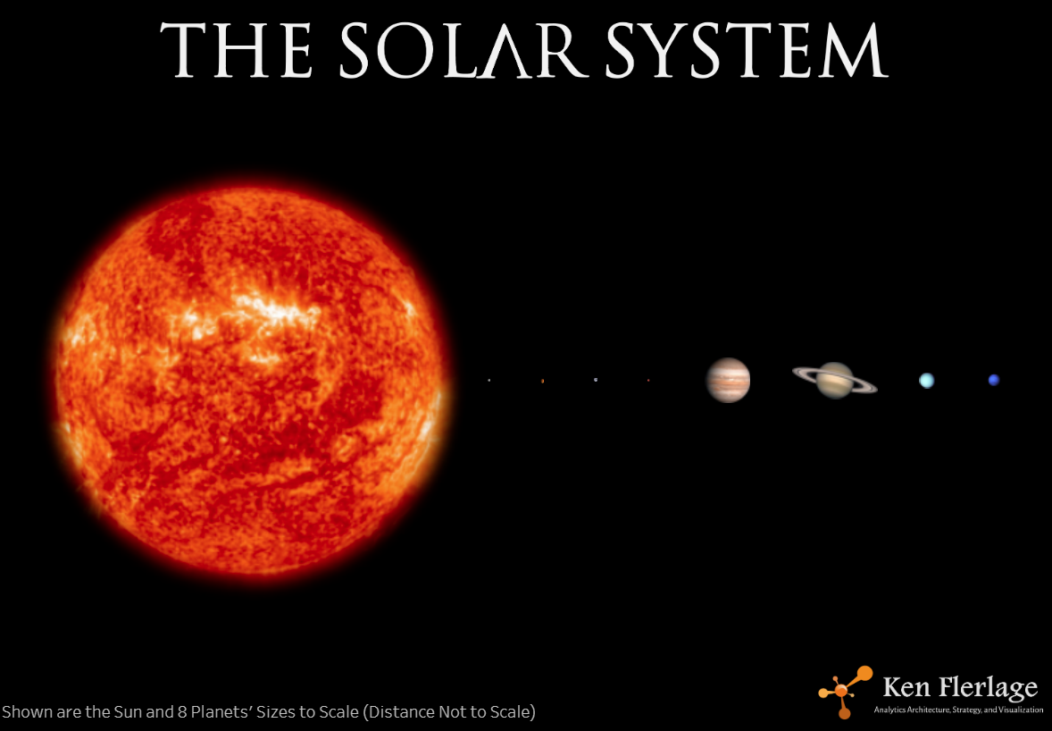
Solar System Visualization

Slide 8
Watch this Video
Cool Video About the Scale of the Solar System
https://www.youtube.com/watch?v=zR3Igc3Rhfg

Slide 9
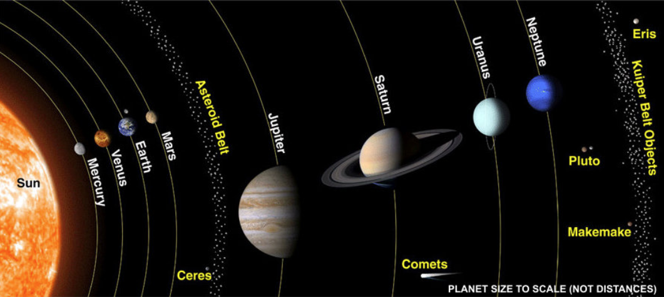
Solar System Geography

Slide 10
solar system models

Slide 11
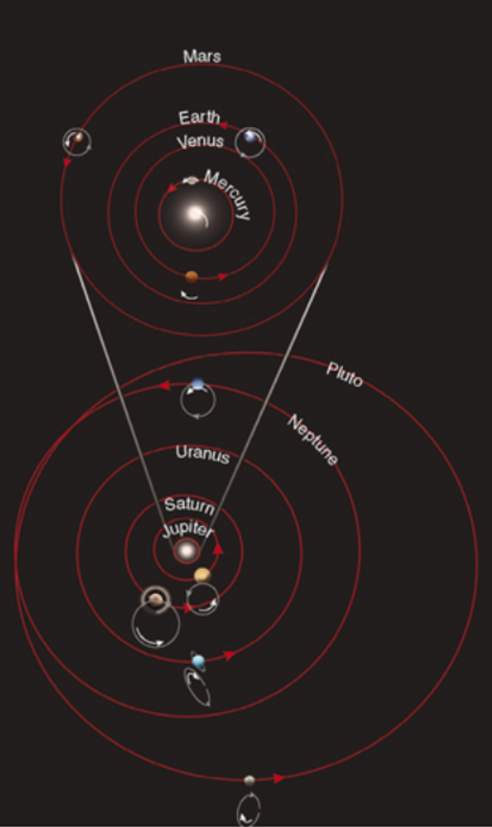
Motions
Objects in the Solar System orbit the Sun.
The orbits are nearly circular, roughly in the same plane, and are in the same direction.
Most planets rotate in the same direction of their orbital motion.
Moons are similar, yet orbit other bodies.

Slide 12
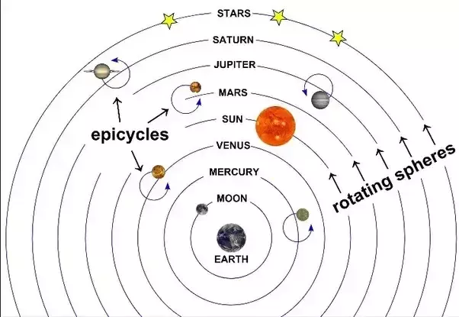
Historical Models
Ancient Greeks thought Earth was at the center of the Solar System (Ptolemy).

Slide 13
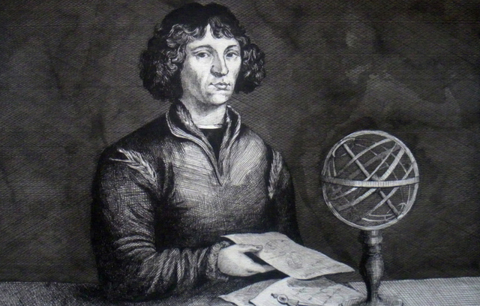
Copernican Model
Copernicus (1543) put the Sun at the center (heliocentric) of the Solar System (and the Universe!).
The model had several features that are different than the geocentric Ptolemaic model.
  Planets orbit around Sun.
  Earth rotates, revolves, and is on a tilted axis.
  Retrograde is caused by Earth motion.
Notes:
B68 is thought to be in hydrostatic equilibrium, such that the outward radiation pressure balances the inward force of gravity. The cloud should contract as it radiates gravitational energy converted into kinetic energy.
The green contours are measurements of Av estimated by NIR color excesses (Alves et al. 2001).
The molecular line widths are very small, ~0.1 km/s, suggesting T~10 K. For the molecular maps, the color scale corresponds to thermal emission, and the contours correspond to molecular emission.
https://www.cfa.harvard.edu/~clada/pubs_html/b68_vel.html

Slide 14
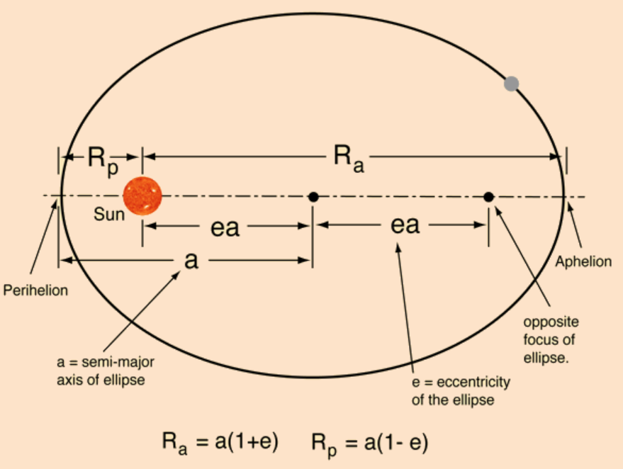
Keplerian Model
Kepler realized that orbits are elliptical (1st law).
Planets sweep equal areas in equal time (2nd law).
The square of the orbital period is proportional to the cube of the distance to the Sun (3rd law).
Notes:
B68 is thought to be in hydrostatic equilibrium, such that the outward radiation pressure balances the inward force of gravity. The cloud should contract as it radiates gravitational energy converted into kinetic energy.
The green contours are measurements of Av estimated by NIR color excesses (Alves et al. 2001).
The molecular line widths are very small, ~0.1 km/s, suggesting T~10 K. For the molecular maps, the color scale corresponds to thermal emission, and the contours correspond to molecular emission.
https://www.cfa.harvard.edu/~clada/pubs_html/b68_vel.html

Slide 15
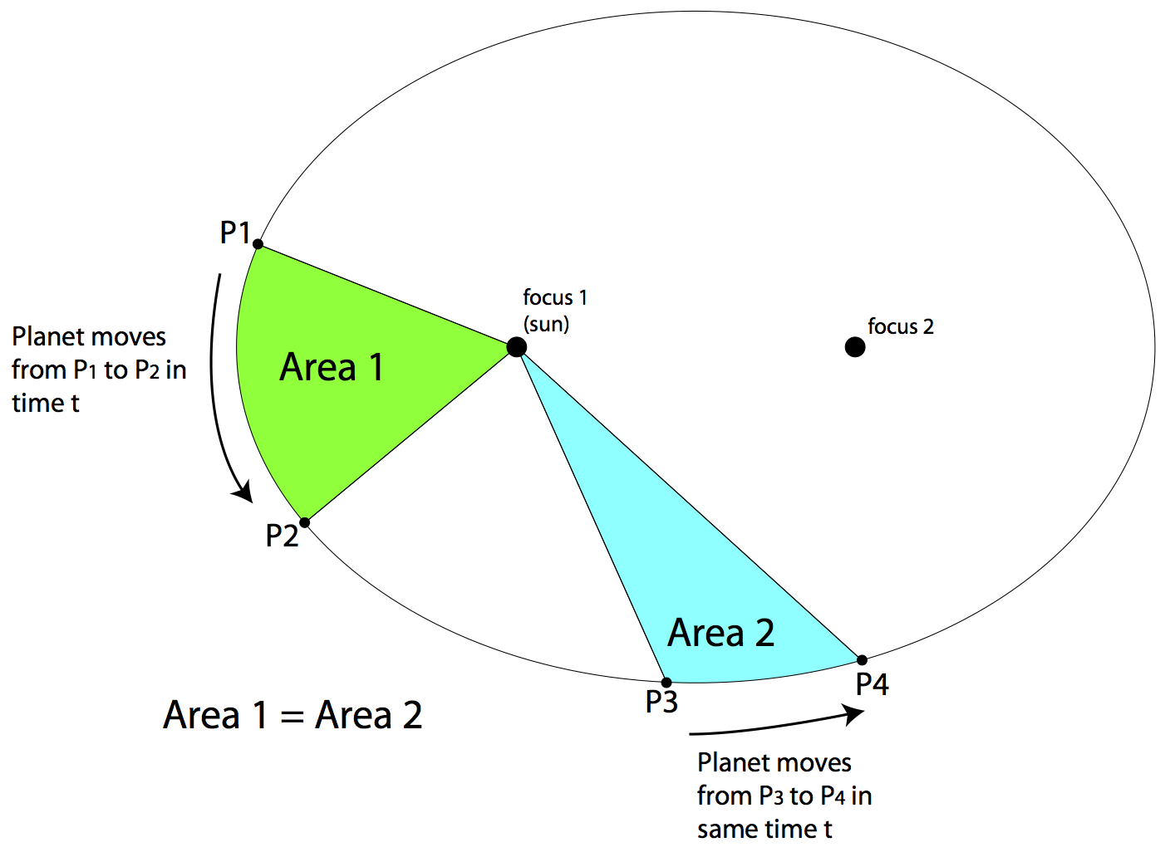
Kepler’s 2nd Law
Notes:
B68 is thought to be in hydrostatic equilibrium, such that the outward radiation pressure balances the inward force of gravity. The cloud should contract as it radiates gravitational energy converted into kinetic energy.
The green contours are measurements of Av estimated by NIR color excesses (Alves et al. 2001).
The molecular line widths are very small, ~0.1 km/s, suggesting T~10 K. For the molecular maps, the color scale corresponds to thermal emission, and the contours correspond to molecular emission.
https://www.cfa.harvard.edu/~clada/pubs_html/b68_vel.html

Slide 16
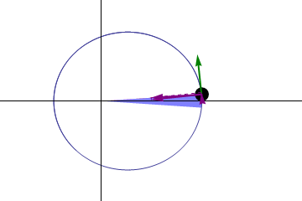
Kepler’s 2nd Law
Notes:
B68 is thought to be in hydrostatic equilibrium, such that the outward radiation pressure balances the inward force of gravity. The cloud should contract as it radiates gravitational energy converted into kinetic energy.
The green contours are measurements of Av estimated by NIR color excesses (Alves et al. 2001).
The molecular line widths are very small, ~0.1 km/s, suggesting T~10 K. For the molecular maps, the color scale corresponds to thermal emission, and the contours correspond to molecular emission.
https://www.cfa.harvard.edu/~clada/pubs_html/b68_vel.html

Slide 17
Kepler’s 3rd Law
Notes:
B68 is thought to be in hydrostatic equilibrium, such that the outward radiation pressure balances the inward force of gravity. The cloud should contract as it radiates gravitational energy converted into kinetic energy.
The green contours are measurements of Av estimated by NIR color excesses (Alves et al. 2001).
The molecular line widths are very small, ~0.1 km/s, suggesting T~10 K. For the molecular maps, the color scale corresponds to thermal emission, and the contours correspond to molecular emission.
https://www.cfa.harvard.edu/~clada/pubs_html/b68_vel.html

Slide 18
Question
Asteroids are about 4 AU away from the Sun. What is their orbital period?
  a) 4 years
  b) 8 years
  c) 16 years
  d) 64 years
Notes:
B68 is thought to be in hydrostatic equilibrium, such that the outward radiation pressure balances the inward force of gravity. The cloud should contract as it radiates gravitational energy converted into kinetic energy.
The green contours are measurements of Av estimated by NIR color excesses (Alves et al. 2001).
The molecular line widths are very small, ~0.1 km/s, suggesting T~10 K. For the molecular maps, the color scale corresponds to thermal emission, and the contours correspond to molecular emission.
https://www.cfa.harvard.edu/~clada/pubs_html/b68_vel.html

Slide 19
Answer
Asteroids are about 4 AU away from the Sun. What is their orbital period?
  a) 4 years
  b) 8 years
  c) 16 years
  d) 64 years
Distance cubed is 4*4*4=64. The square root of that number is 8.
Notes:
B68 is thought to be in hydrostatic equilibrium, such that the outward radiation pressure balances the inward force of gravity. The cloud should contract as it radiates gravitational energy converted into kinetic energy.
The green contours are measurements of Av estimated by NIR color excesses (Alves et al. 2001).
The molecular line widths are very small, ~0.1 km/s, suggesting T~10 K. For the molecular maps, the color scale corresponds to thermal emission, and the contours correspond to molecular emission.
https://www.cfa.harvard.edu/~clada/pubs_html/b68_vel.html

Slide 20
Newton’s Laws
1st law: An object either remains at rest or continues to move at a constant velocity, unless acted upon by a force.
2nd law: The vector sum of the forces F on an object is equal to the mass m of that object multiplied by the acceleration a of the object: F = ma.
3rd law: When one body exerts a force on a second body, the second body simultaneously exerts a force equal in magnitude and opposite in direction on the first body.
Notes:
B68 is thought to be in hydrostatic equilibrium, such that the outward radiation pressure balances the inward force of gravity. The cloud should contract as it radiates gravitational energy converted into kinetic energy.
The green contours are measurements of Av estimated by NIR color excesses (Alves et al. 2001).
The molecular line widths are very small, ~0.1 km/s, suggesting T~10 K. For the molecular maps, the color scale corresponds to thermal emission, and the contours correspond to molecular emission.
https://www.cfa.harvard.edu/~clada/pubs_html/b68_vel.html

Slide 21
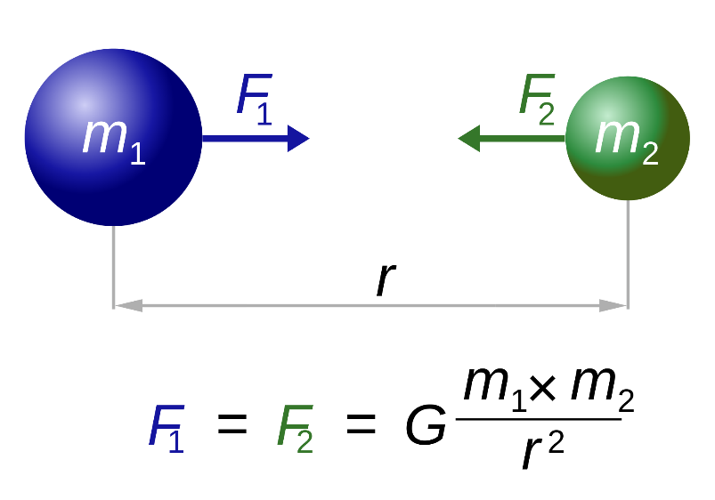
Newton’s Law of Gravitation
Every point mass attracts every single other point mass by a force acting along the line intersecting both points.
The force is proportional to the product of the two masses and inversely proportional to the square of the distance between them.
G=6.67(10⁻¹¹) m³/kg/s²
Notes:
B68 is thought to be in hydrostatic equilibrium, such that the outward radiation pressure balances the inward force of gravity. The cloud should contract as it radiates gravitational energy converted into kinetic energy.
The green contours are measurements of Av estimated by NIR color excesses (Alves et al. 2001).
The molecular line widths are very small, ~0.1 km/s, suggesting T~10 K. For the molecular maps, the color scale corresponds to thermal emission, and the contours correspond to molecular emission.
https://www.cfa.harvard.edu/~clada/pubs_html/b68_vel.html

Slide 22
the planets

Slide 23
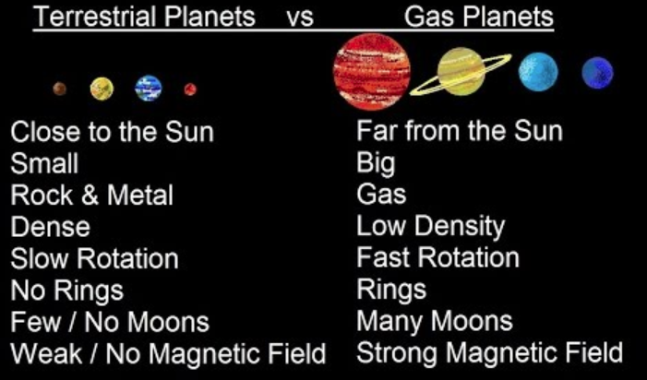
Rocky and Gas Planets
Rocky planets are like the Earth, and are thus sometimes called “terrestrial planets.” They are small and close to the Sun.
Gas planets are like Jupiter, and are thus sometimes called “Jovian planets.” They are large and far from the Sun.
Notes:
B68 is thought to be in hydrostatic equilibrium, such that the outward radiation pressure balances the inward force of gravity. The cloud should contract as it radiates gravitational energy converted into kinetic energy.
The green contours are measurements of Av estimated by NIR color excesses (Alves et al. 2001).
The molecular line widths are very small, ~0.1 km/s, suggesting T~10 K. For the molecular maps, the color scale corresponds to thermal emission, and the contours correspond to molecular emission.
https://www.cfa.harvard.edu/~clada/pubs_html/b68_vel.html

Slide 24
Notes:
B68 is thought to be in hydrostatic equilibrium, such that the outward radiation pressure balances the inward force of gravity. The cloud should contract as it radiates gravitational energy converted into kinetic energy.
The green contours are measurements of Av estimated by NIR color excesses (Alves et al. 2001).
The molecular line widths are very small, ~0.1 km/s, suggesting T~10 K. For the molecular maps, the color scale corresponds to thermal emission, and the contours correspond to molecular emission.
https://www.cfa.harvard.edu/~clada/pubs_html/b68_vel.html

Slide 25
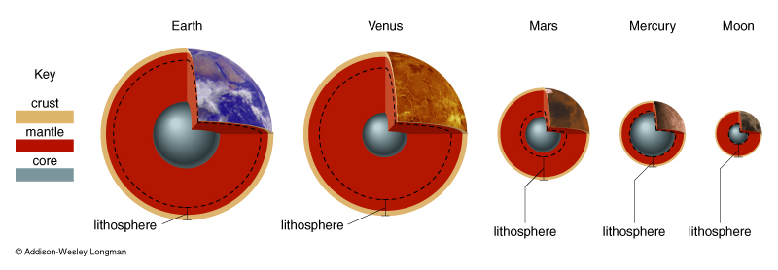
Terrestrial Planet Interiors

Slide 26
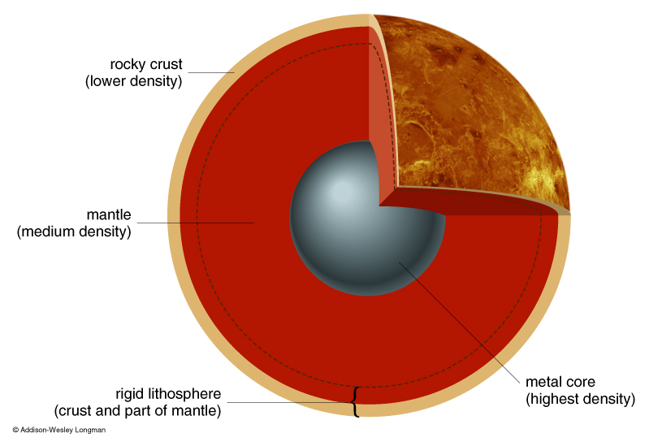
Terrestrial Planet Layers
Interiors differentiated early in the planet’s history when the material was molten.
The highest density materials sank to the center.
Heat of formation dissipates more quickly for small objects, such as Mercury and the Moon.
Some heat is still leftover from formation, thus driving geological activity.

Slide 27
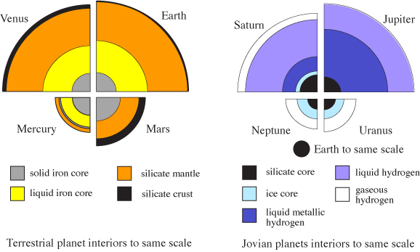
Jovian Planets
Jovian planets are big (~4 to 10 times size of Earth).
They are less dense than rocky planets, roughly density of water.
They are mostly gas (hydrogen and helium).
They have many moons.
Central pressures not high enough to fuse hydrogen, such that they are not stars.

Slide 28
JS vs. UN
JS are massive enough to have pressure sufficient to make metallic hydrogen.
N has internal heat that drives atmospheric contrasts, like JS.

Slide 29
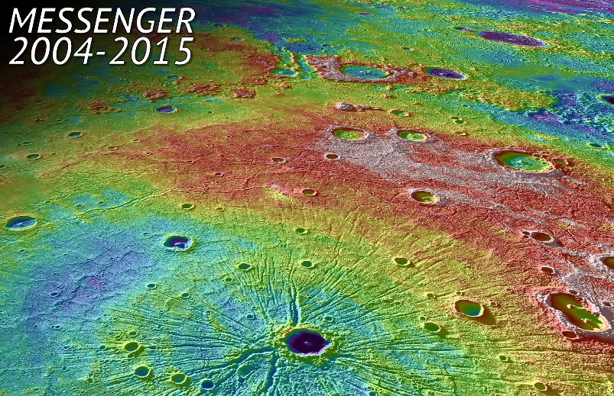
Mercury
Mercury is made of metal and rock with an iron core.
It rotates three times every two years.
The surface toward the Sun is hot (430 C), the night side is cold (-170 C).
Poles are constantly cold (-100 C) because the axis is not tilted.
Mariner 10 (1974) and Messenger (2011) visited.

Slide 30
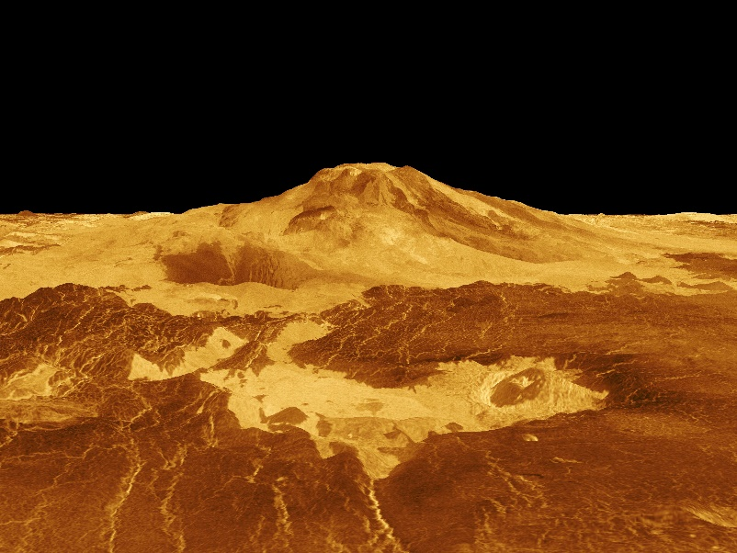
Venus
Venus is similar to size of Earth but covered by clouds.
It is hotter than Mercury and the heat is distributed.
The atmospheric pressure is very high.
It is volcanically active with little evidence of erosion.
Venera landed (1975) and Magellan mapped (1990).

Slide 31
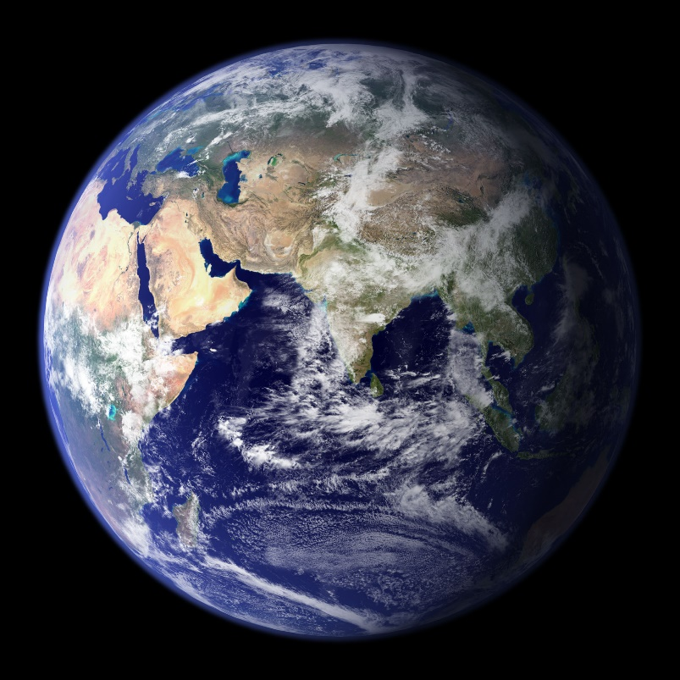
Earth
Earth is where you are right now.
It has abundant water and abundant semi-intelligent life.
The Moon is relatively large.
The Earth is round (not flat).

Slide 32
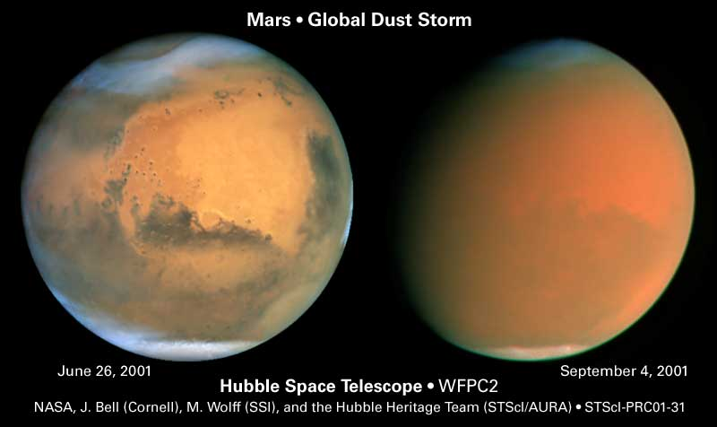
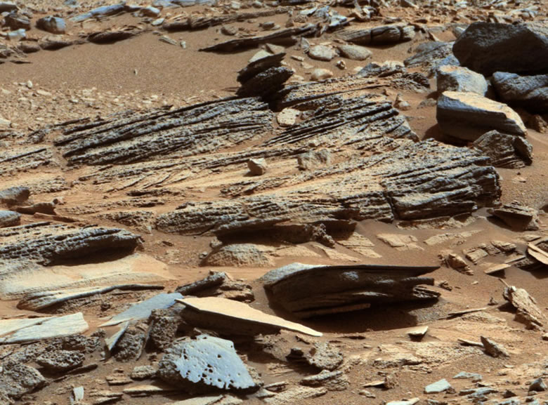
Mars
Mars has a thin atmosphere of CO₂.
It has dormant volcanoes, a large canyon, evidence of water in the past, and frozen water now.
It has no protection from UV light nor cosmic rays.
Many spacecraft visited, e.g. Viking (1976), Pathfinder, rovers, etc.
There is evidence of present-day water.

Slide 33
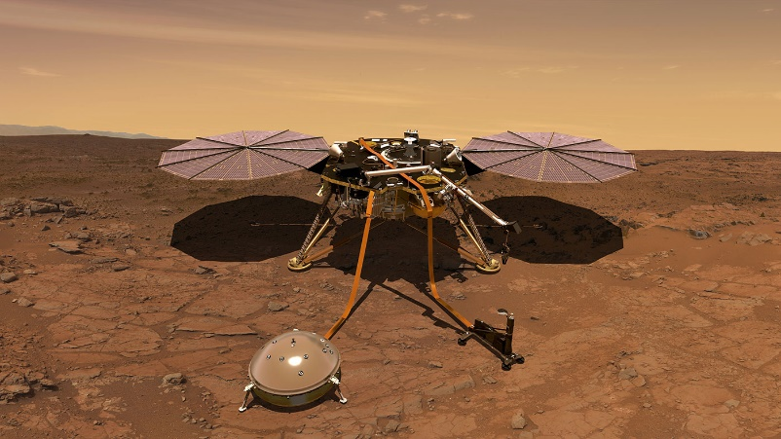
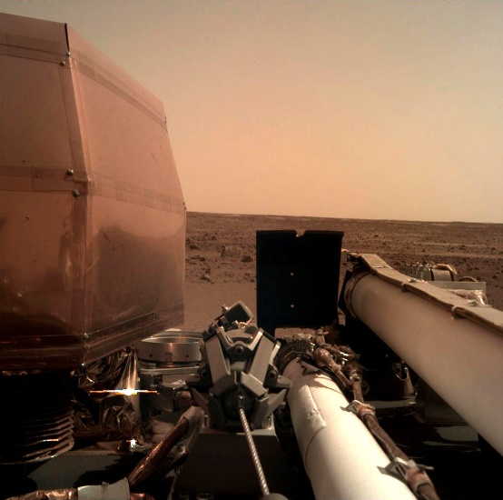
NASA InSight Mission
InSight (Interior Exploration using Seismic Investigations, Geodesy and Heat Transport) landed on Mars in late 2018.
It’s primary mission is to determine the interior structure of Mars using seismometers.

Slide 34
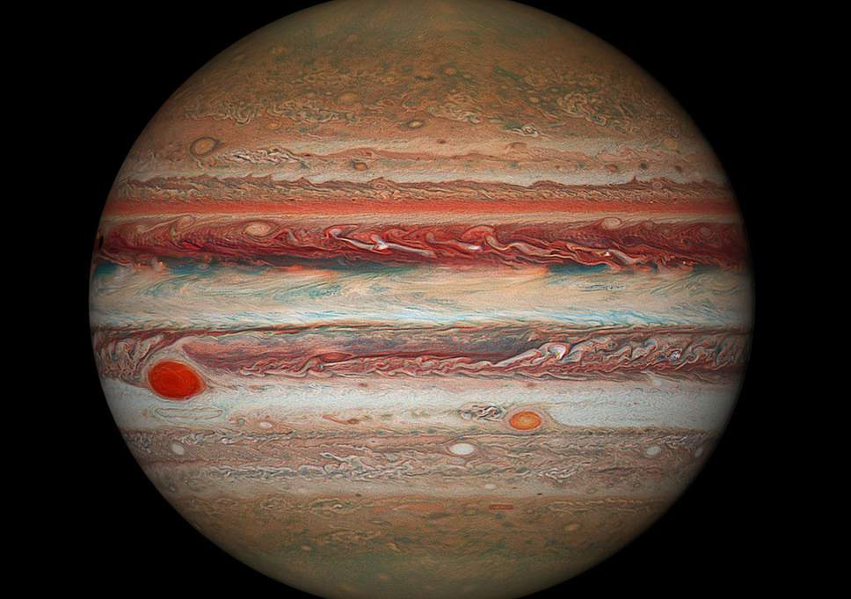
Jupiter
Jupiter is over a thousand times bigger in volume than the Earth, yet is only ~300 times more massive.
It has ~0.001 the mass of the Sun, too little to become a star.
Its composition is similar to the Sun.
It has many moons (>70) and a faint ring.
It has a strong magnetic field, aurora, and lightning.
Its bands formed by winds. Spots are storms.
It has been visited by Voyager (1970s), Galileo, and Juno.

Slide 35
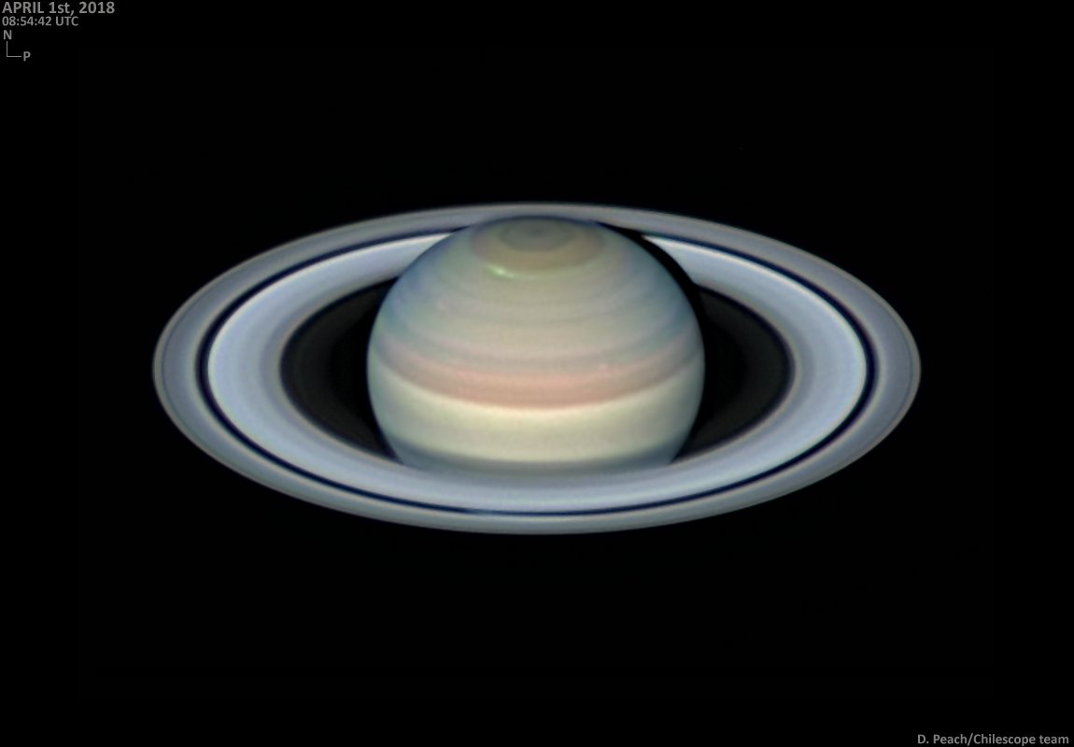
Saturn
Saturn is similar to Jupiter, but with a huge ring system.
It has many moons (>62), including Titan that is covered in clouds.
Saturn’s rings are made of mostly chunks of water ice up to a few meters in size.
It was visited by Voyager and Cassini spacecraft.

Slide 36
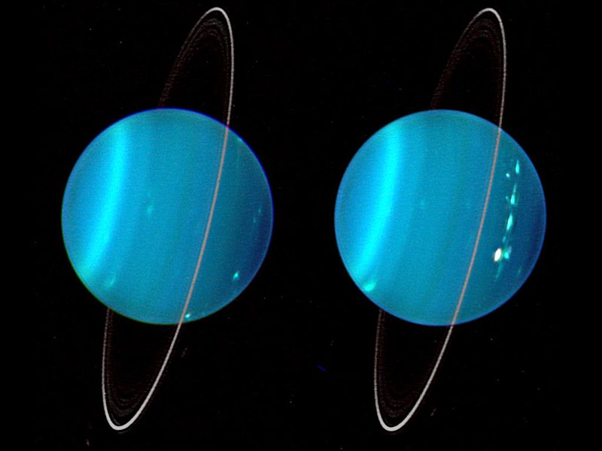
Uranus
Uranus is an icy planet.
Its rotation axis is tilted nearly 90 degrees.
It is barely visible with naked eye. (Sir William Herschel first tracked it, thinking it was a comet – he earned a few hundred bucks from the King!).
It has a ring system (discovered on an airplane!).
Its moons orbit in the plane of the rings.

Slide 37
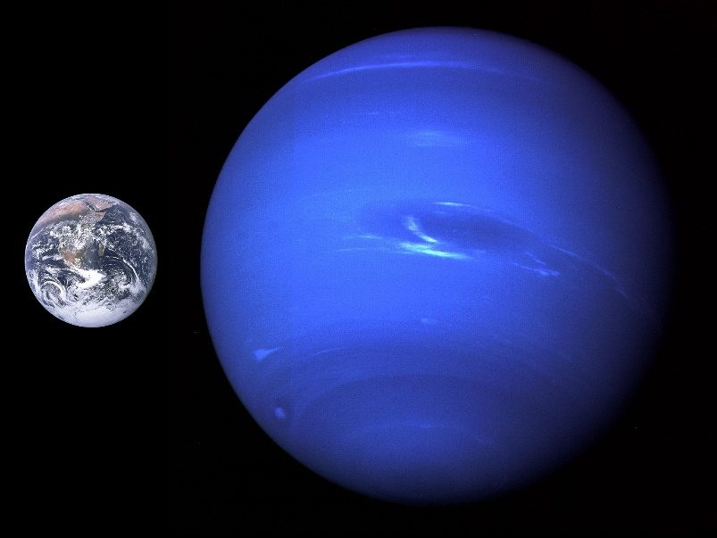
Neptune
Neptune is similar to Uranus.
It was discovered after a prediction by Alexis Bouvard based on the orbit of Uranus. (Galileo thought it was a star.)
It has 14 moons, with Triton being the largest and which rotates retrograde.

Slide 38
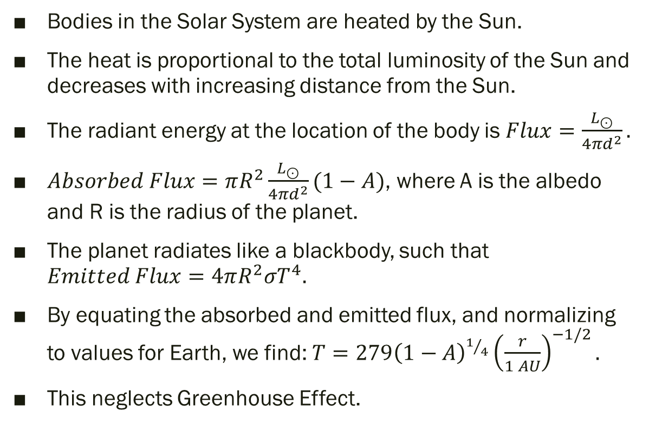
Temperatures
Bodies in the Solar System are heated by the Sun.
The heat is proportional to the total luminosity of the Sun and decreases with increasing distance from the Sun.
The radiant energy at the location of the body is $Flux=\frac{L_{⊙}}{4πd^{2}}.$
$Absorbed Flux=πR^{2}\frac{L_{⊙}}{4πd^{2}}(1−A)$, where A is the albedo and R is the radius of the planet.
The planet radiates like a blackbody, such that $Emitted Flux=4πR^{2}{σT}^{4}.$
By equating the absorbed and emitted flux, and normalizing to values for Earth, we find: $T=279{\left(1−A\right)}^{1/4}{\left(\frac{r}{1 AU}\right)}^{−1/2}.$
This neglects Greenhouse Effect.

