Slide 1
University Astronomy
Professor Don Figer
Energy Sources

Slide 2
Some review

Slide 3
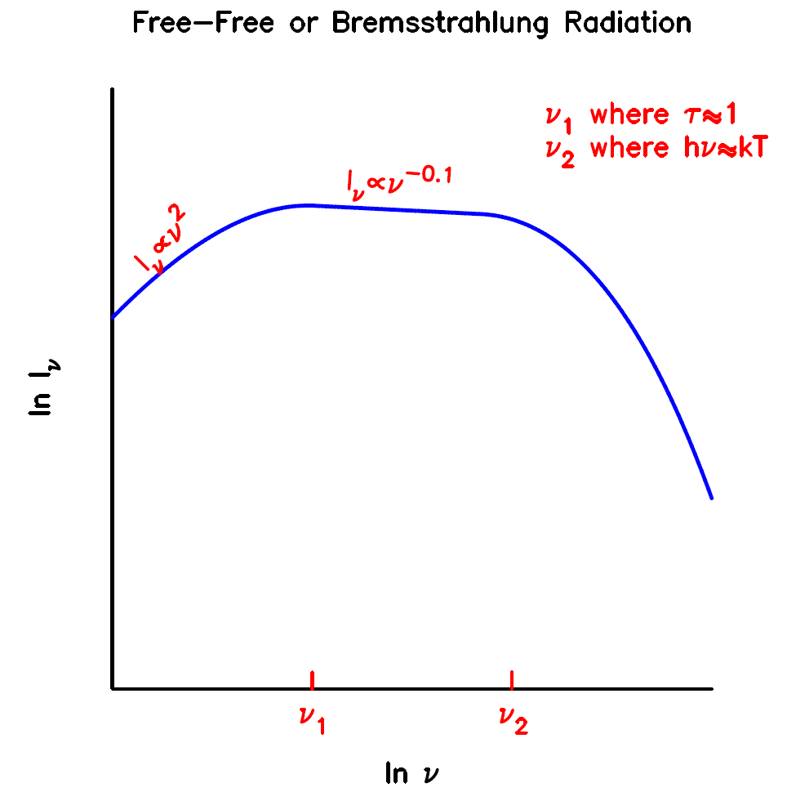
Question
What emission mechanism produces this type of energy distribution?
  a) free-free
  b) blackbody
  c) synchrotron
  d) Bremsstrahlung
  e) inverse-Compton
vote!

Slide 4
Answer
What emission mechanism produces this type of energy distribution?
  a) free-free
  b) blackbody
  c) synchrotron
  d) Bremsstrahlung
  e) inverse-Compton

Slide 5
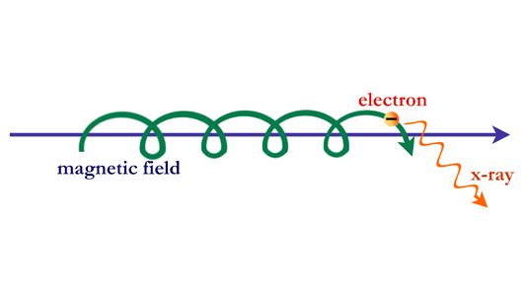
Question
What type of radiation is emitted by this system?

Slide 6
Answer
synchrotron

Slide 7
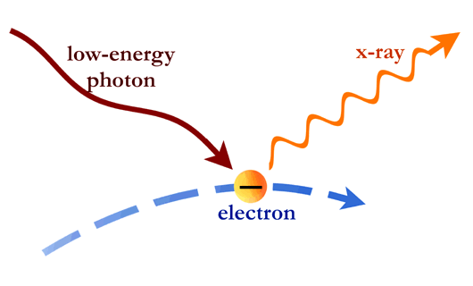
Question
What type of radiation is emitted by this system?

Slide 8
Answer
inverse Compton

Slide 9
energy sources

Slide 10
Aims and outline for this lecture
describe energy sources of astronomical objects
  stars: nuclear reactions
  protostars: gravitational energy
  nebulae/clouds: stellar heating and ionizing radiation
  Active Galactic Nuclei (AGN)
  galaxy clusters: shocks

Slide 11
stars

Slide 12
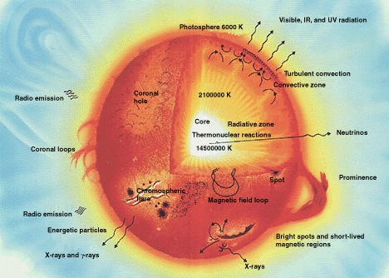
Stars

Slide 13
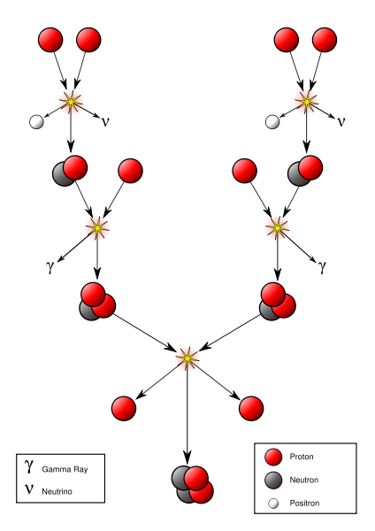
Proton-proton Chain
Notes:
The first step involves the fusion of two hydrogen nuclei 1H (protons) into deuterium 2H, releasing a positron and a neutrino as one proton changes into a neutron.
1H + 1H → 2H + e+ + νe
with the neutrinos released in this step carrying energies up to 0.42 MeV.
This first step is extremely slow, because it depends on an endoergic beta positive decay, which requires energy to be absorbed, to convert one proton into a neutron. In fact this is the limiting step, with a proton waiting an average of 109 years before fusing into deuterium[citation needed].
The positron immediately annihilates with an electron, and their mass energy is carried off by two gamma ray photons.
e+ + e− → 2γ + 1.02 MeV
After this, the deuterium produced in the first stage can fuse with another hydrogen to produce a light isotope of helium, 3He:
2H + 1H → 3He + γ + 5.49 MeV
From here there are three possible paths to generate helium isotope 4He. In pp1 helium-4 comes from fusing two of the helium-3 nuclei produced; the pp2 and pp3 branches fuse 3He with a pre-existing 4He to make Beryllium. In the Sun, branch pp1 takes place with a frequency of 86%, pp2 with 14% and pp3 with 0.11%. There is also an extremely rare pp4 branch.

Slide 14
PP Chain, Three Branches
PPI (85% for Sun):
H1 + H1 -> D2 + e+ + nu(1) (1.442 MeV)
D2 + H1 -> He3 + gamma (5.493 MeV)
He3 + He3 -> He4 + 2H1 (12.859 MeV)
PPII (15%):
H1 + H1 -> D2 + e+ + nu(1) (1.442 MeV)
D2 + H1 -> He3 + gamma (5.493 MeV)
He3 + He4 -> Be7 + gamma (1.586 MeV)
Be7 + e- -> Li7 + nu(2) (0.861 MeV)
Li7 + H1 -> He4 + He4 (17.347 MeV)
PPIII (0.01%):
H1 + H1 -> D2 + e+ + nu(1) (1.442 MeV)
D2 + H1 -> He3 + gamma (5.493 MeV)
He3 + He4 -> Be7 + gamma (1.586 MeV)
Be7 + H1 -> B8 + gamma (0.135 MeV)
B8 -> Be8 + e+ + nu(3) (followed by spontaneous decay...)
Be8 -> 2He4 (18.074 MeV)
Notes:
The pp I branch
3He +3He → 4He + 1H + 1H + 12.86 MeV
The complete pp I chain reaction releases a net energy of 26.7 MeV when one considers that the first two steps must be done twice to obtain the two He3 nuclei. Also, note that the energies in parentheses are total yields and could be apportioned to any of the products. For instance, in the first step, the 1.442 MeV comes from 0.42 MeV from the neutrino and 1.02 MeV from the positron (when it immediately annihilates with an electron). The pp I branch is dominant at temperatures of 10 to 14 megakelvins (MK). Below 10 MK, the PP chain does not produce much 4He.
The pp II branch
3He + 4He→7Be + γ 7Be + e−→7Li + νe 7Li + 1H→4He + 4He
The pp II branch is dominant at temperatures of 14 to 23 MK.
90% of the neutrinos produced in the reaction 7Be(e−,νe)7Li* carry an energy of 0.861 MeV, while the remaining 10% carry 0.383 MeV (depending on whether lithium-7 is in the ground state or an excited state, respectively).
The pp III branch
3He + 4He→7Be + γ 7Be + 1H→8B + γ 8B→8Be + e+ + νe 8Be↔4He + 4He
The pp III chain is dominant if the temperature exceeds 23 MK.
The pp III chain is not a major source of energy in the Sun (only 0.11%), but was very important in the solar neutrino problem because it generates very high energy neutrinos (up to 14.06 MeV).
The pp IV or Hep
This reaction is predicted but has never been observed due to its great rarity (about 0.3 parts per million in the Sun). In this reaction, Helium-3 reacts directly with a proton to give helium-4, with an even higher possible neutrino energy (up to 18.8 MeV).
3He + 1H → 4He + νe + e+

Slide 15
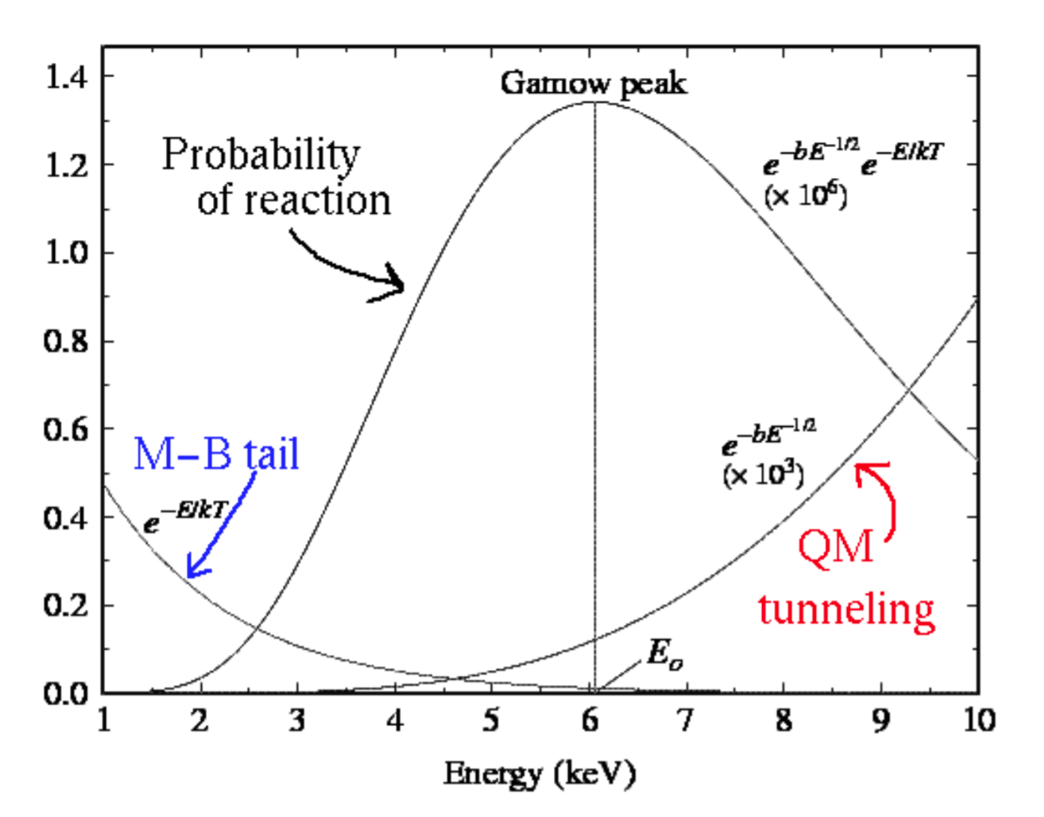
Gamow Peak
Protons in center of star
  have high energies
  have the same charge (they repel each other)
At sufficiently high energy, particles will fuse.
The Gamow peak is the location in energy where the product of tunneling probabilities and particle distribution coincide to create the maximum rate.
Notes:
The Gamow peak is the product of the Maxwell-Boltzmann distribution with the tunnelling probability of the nuclei through their Coulomb barrier. This is the energy region where the reaction is more likely to take place: at higher energies, the number of particles becomes insignificant while at lower energies the tunnelling through the Coulomb barrier makes the reaction improbable. The dimension of the Maxwell-Boltzmann distribution and of the Gamow peak is keV-1, while the tunnelling probability is dimensionless.

Slide 16
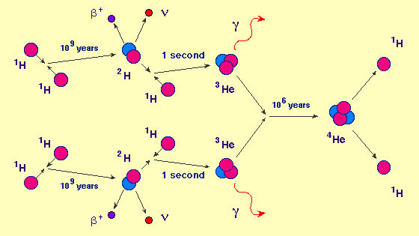
PP Chain Timescales
Notes:
Rates for the PP Chain
The average time required for a nucleus to undergo each step of this sequence in a typical stellar interior is indicated in the figure shown above. Thus, for example, a hydrogen nucleus waits on the average 1 billion years before it undergoes an interaction with another hydrogen nucleus to initiate the sequence! Since all other steps require much less time than this, it is this initial step that controls the rate of the reaction. This incredibly small rate nevertheless accounts for the luminosities of normal stars because there are so many hydrogen atoms in the core of a star that at any one instant many are undergoing the reactions of the PP chain.

Slide 17
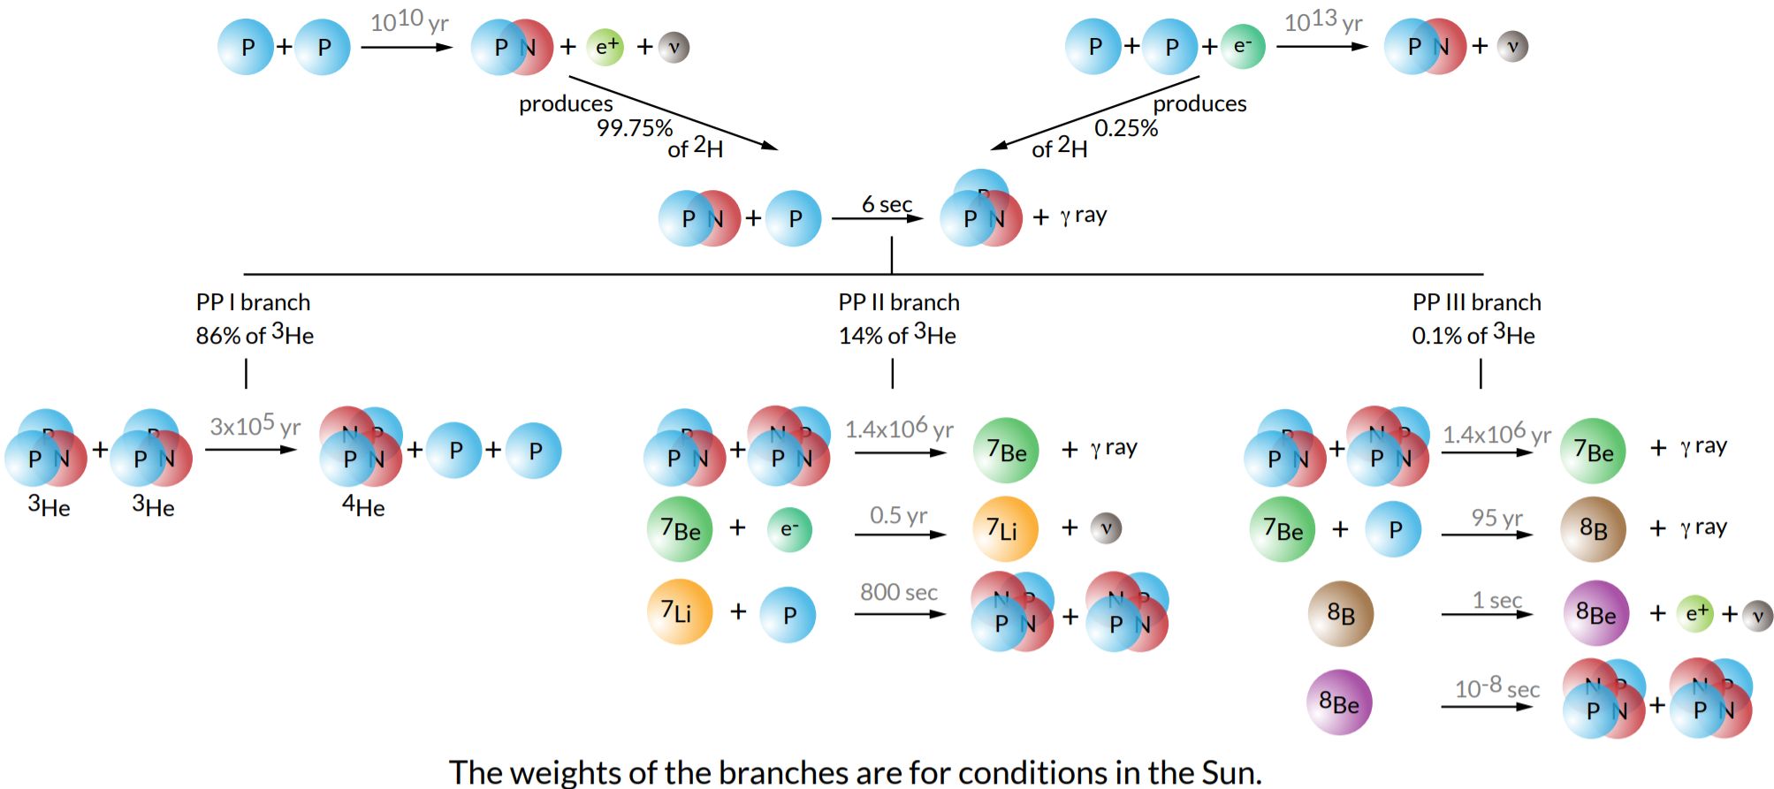
PP Chain Branch Timescales
Notes:
The pp I branch
3He +3He → 4He + 1H + 1H + 12.86 MeV
The complete pp I chain reaction releases a net energy of 26.7 MeV when one considers that the first two steps must be done twice to obtain the two He3 nuclei. Also, note that the energies in parentheses are total yields and could be apportioned to any of the products. For instance, in the first step, the 1.442 MeV comes from 0.42 MeV from the neutrino and 1.02 MeV from the positron (when it immediately annihilates with an electron). The pp I branch is dominant at temperatures of 10 to 14 megakelvins (MK). Below 10 MK, the PP chain does not produce much 4He.
The pp II branch
3He + 4He→7Be + γ 7Be + e−→7Li + νe 7Li + 1H→4He + 4He
The pp II branch is dominant at temperatures of 14 to 23 MK.
90% of the neutrinos produced in the reaction 7Be(e−,νe)7Li* carry an energy of 0.861 MeV, while the remaining 10% carry 0.383 MeV (depending on whether lithium-7 is in the ground state or an excited state, respectively).
The pp III branch
3He + 4He→7Be + γ 7Be + 1H→8B + γ 8B→8Be + e+ + νe 8Be↔4He + 4He
The pp III chain is dominant if the temperature exceeds 23 MK.
The pp III chain is not a major source of energy in the Sun (only 0.11%), but was very important in the solar neutrino problem because it generates very high energy neutrinos (up to 14.06 MeV).
The pp IV or Hep
This reaction is predicted but has never been observed due to its great rarity (about 0.3 parts per million in the Sun). In this reaction, Helium-3 reacts directly with a proton to give helium-4, with an even higher possible neutrino energy (up to 18.8 MeV).
3He + 1H → 4He + νe + e+

Slide 18
PP Chain Versus Temperature
Notes:
The pp I branch
3He +3He → 4He + 1H + 1H + 12.86 MeV
The complete pp I chain reaction releases a net energy of 26.7 MeV when one considers that the first two steps must be done twice to obtain the two He3 nuclei. Also, note that the energies in parentheses are total yields and could be apportioned to any of the products. For instance, in the first step, the 1.442 MeV comes from 0.42 MeV from the neutrino and 1.02 MeV from the positron (when it immediately annihilates with an electron). The pp I branch is dominant at temperatures of 10 to 14 megakelvins (MK). Below 10 MK, the PP chain does not produce much 4He.
The pp II branch
3He + 4He→7Be + γ 7Be + e−→7Li + νe 7Li + 1H→4He + 4He
The pp II branch is dominant at temperatures of 14 to 23 MK.
90% of the neutrinos produced in the reaction 7Be(e−,νe)7Li* carry an energy of 0.861 MeV, while the remaining 10% carry 0.383 MeV (depending on whether lithium-7 is in the ground state or an excited state, respectively).
The pp III branch
3He + 4He→7Be + γ 7Be + 1H→8B + γ 8B→8Be + e+ + νe 8Be↔4He + 4He
The pp III chain is dominant if the temperature exceeds 23 MK.
The pp III chain is not a major source of energy in the Sun (only 0.11%), but was very important in the solar neutrino problem because it generates very high energy neutrinos (up to 14.06 MeV).
The pp IV or Hep
This reaction is predicted but has never been observed due to its great rarity (about 0.3 parts per million in the Sun). In this reaction, Helium-3 reacts directly with a proton to give helium-4, with an even higher possible neutrino energy (up to 18.8 MeV).
3He + 1H → 4He + νe + e+

Slide 19
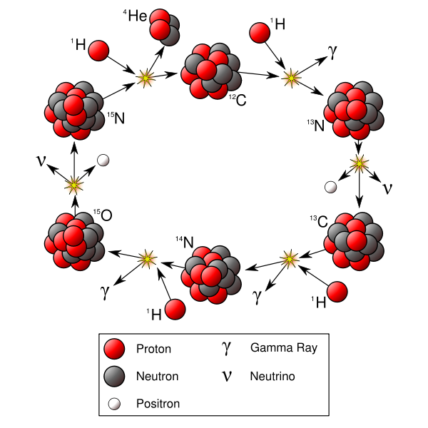
CNO cycle
Notes:
The CNO cycle (for carbon-nitrogen-oxygen), or sometimes Bethe-Weizsäcker-cycle, is one of two fusion reactions by which stars convert hydrogen to helium, the other being the proton-proton chain.
The proton-proton chain is more important in stars the mass of the sun or less. Only 1.7% of 4He nuclei being produced in the Sun are born in the CNO cycle. However theoretical models show that the CNO cycle is the dominant source of energy in heavier stars. The CNO process was proposed by Carl von Weizsäcker[1] and Hans Bethe[2] independently in 1938 and 1939, respectively.

Slide 20
CNO cycle
¹²C + ¹H | → | ¹³N + γ | +1.95 MeV
¹³N | → | ¹³C + e⁺ + ν_{e} | +2.22 MeV
¹³C + ¹H | → | ¹⁴N + γ | +7.54 MeV
¹⁴N + ¹H | → | ¹⁵O + γ | +7.35 MeV
¹⁵O | → | ¹⁵N + e⁺ + ν_{e} | +2.75 MeV
¹⁵N + ¹H | → | ¹²C + ⁴He | +4.96 MeV
Notes:
The net result of the cycle is to fuse four protons into an alpha particle plus two positrons (annihilating with electrons and releasing energy in the form of gamma rays) plus two neutrinos which escape from the star carrying away some energy. The carbon, oxygen, and nitrogen nuclei serve as catalysts and are regenerated.
While the total number of "catalytic" CNO nuclei is conserved in the cycle, in stellar evolution the relative proportions of the nuclei are altered. When the cycle is run to equilibrium, the ratio of the 12C/13C nuclei is driven to 3.5, and 14N becomes the most numerous nucleus, regardless of initial composition. During a star's evolution, convective mixing episodes bring material in which the CNO cycle has operated from the star's interior to the surface, altering the observed composition of the star. Red giant stars are observed to have lower 12C/13C and 12C/14N ratios than main sequence stars, which is considered to be proof of nuclear energy generation in stars by hydrogen fusion.

Slide 21
CNO cycle
The CNO cycle has several branches that are favored based on temperature.
Notes:
The CNO cycle has several branches that are favored based on temperature.

Slide 22
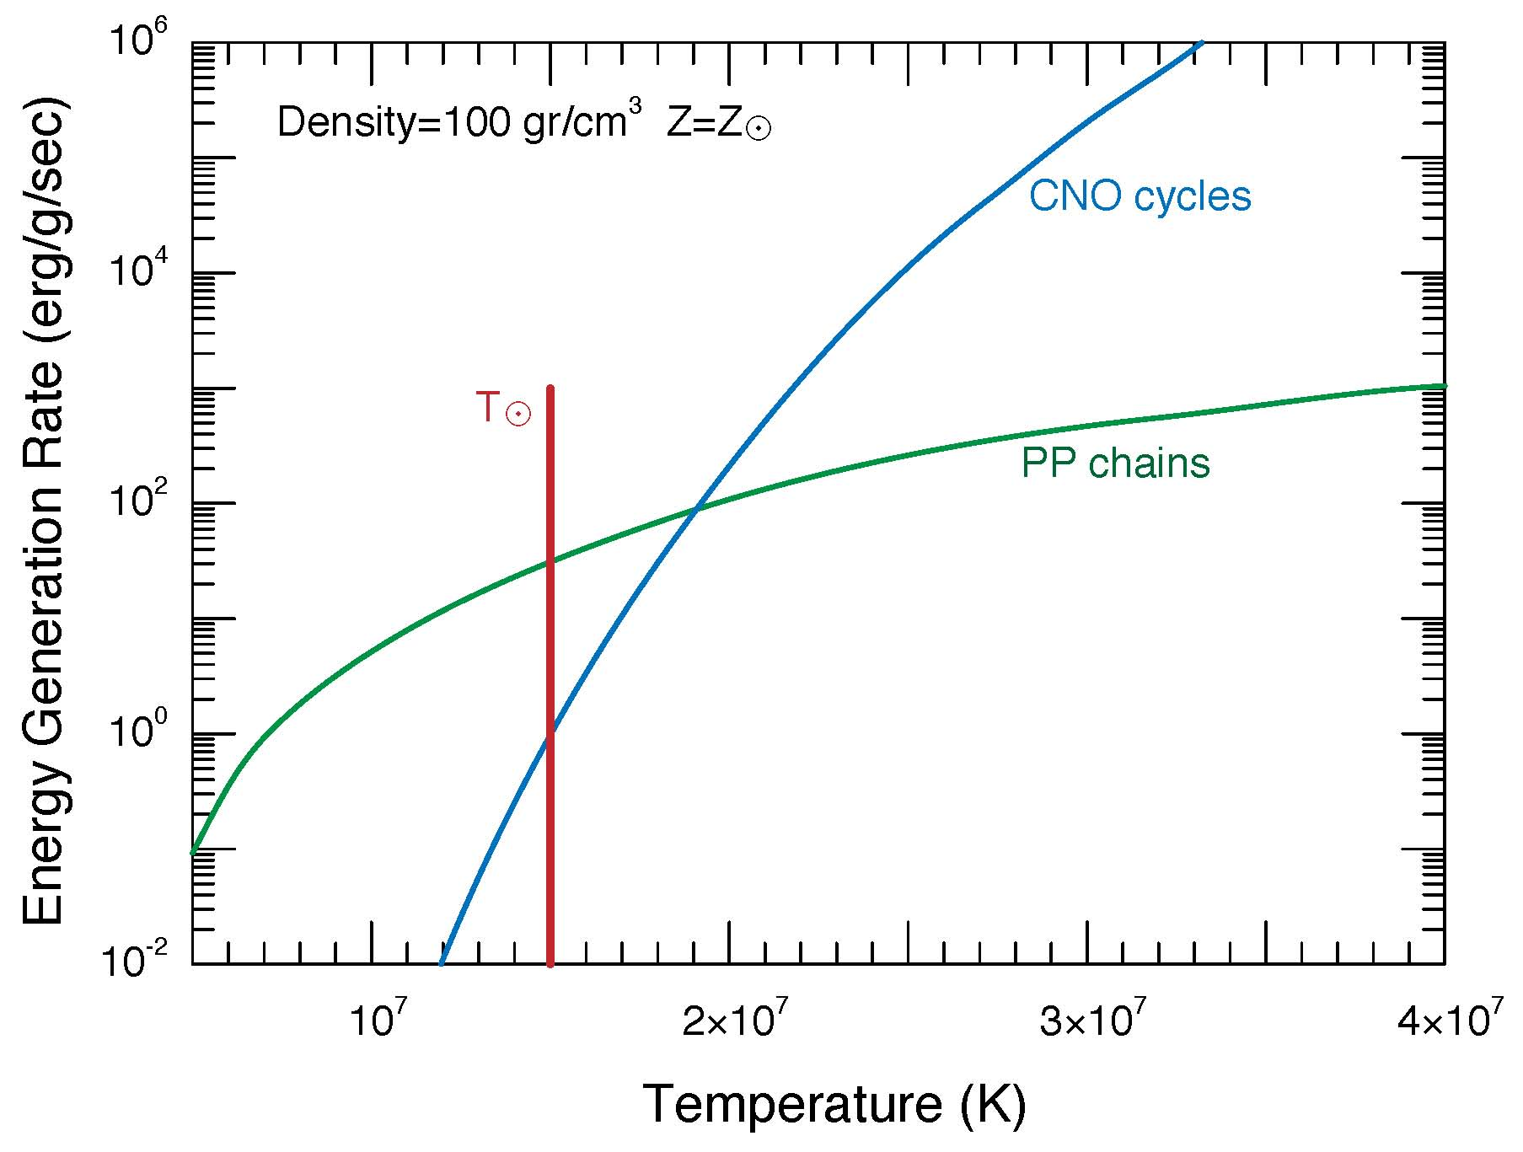
CNO vs PP
The CNO cycle produces more energy than the PP chain at higher temperatures.
Notes:
The coulombic repulsion of a Carbon nucleus is much greater than that in a hydrogen nucleus, so it takes higher temperatures to start the CNO cycle.
The mass at which stellar burning begins to favor the CNO cycle is ~1.5 Msun.

Slide 23
protostars

Slide 24
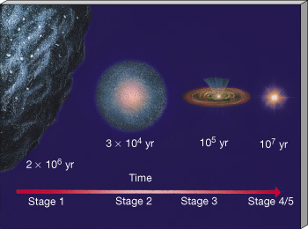
Protostars
Notes:
Interstellar Cloud Evolution Artist’s conception of the changes in an interstellar cloud during the early evolutionary stages outlined in Table 19.1. Shown are a stage 1 interstellar cloud; a stage 2 fragment; a smaller, hotter stage 3 fragment; and a stage 4/stage 5 protostar. (Not drawn to scale.) The duration of each stage, in years, is also indicated.

Slide 25
Gravitational Energy
As molecular cloud contracts, gravitational potential energy of particles is converted into kinetic energy.
With higher kinetic energies, the collision rate between particles increases, i.e. temperature and thermal radiation increase.
At sufficiently high density, the gas becomes opaque to escaping radiation at shorter wavelengths, making it difficult to observe the star formation process.
The radiation generated by gravitational energy cannot counterbalance the force of gravity of the overlying material.
Temperature increase until nuclear fusion turns on.

Slide 26
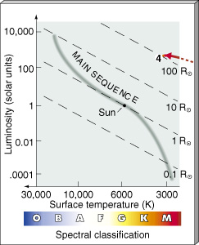
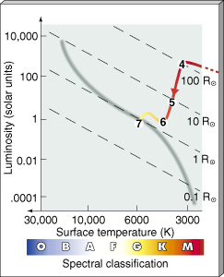
Hayashi Track
hydrostatic equilibrium
gravitational energy
nuclear fusion
100,000 years from 4 to 6
10 million years from 6 to 7
timescales depend heavily on mass
Notes:
Protostar on the H–R Diagram Diagram of the approximate evolutionary track followed by an interstellar cloud fragment before reaching the end of the Kelvin–Helmholtz contraction phase as a stage 4 protostar.
Newborn Star on the H–R Diagram The changes in a protostar’s observed properties are shown by the path of decreasing luminosity, from stage 4 to stage 6, often called the Hayashi track. At stage 7, the newborn star has arrived on the main sequence.
This is a good link:
http://lifeng.lamost.org/courses/astrotoday/CHAISSON/AT319/HTML/AT31902.HTM

Slide 27
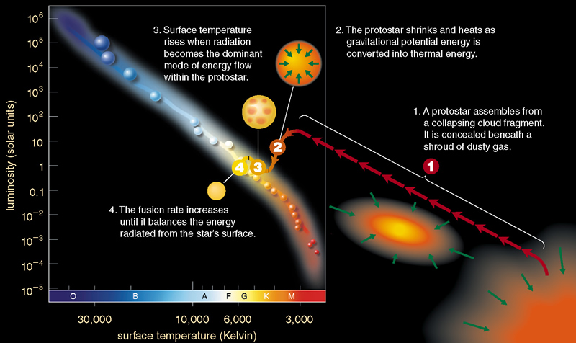
Stages of Star Formation on the H-R Diagram

Slide 28
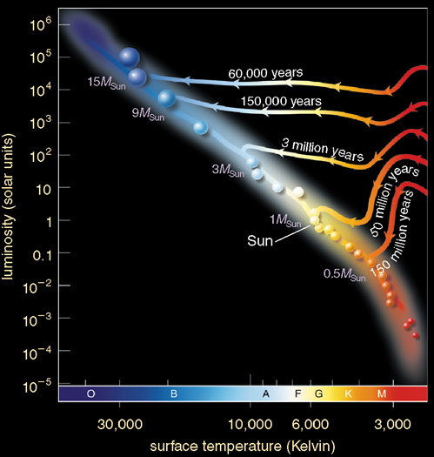
Arrival on the Main Sequence
The mass of the protostar determines:
  how long the protostar phase will last
  where the new-born star will land on the MS
  i.e., what spectral type the star will have while on the main sequence

Slide 29
Protostar Luminosity

Slide 30
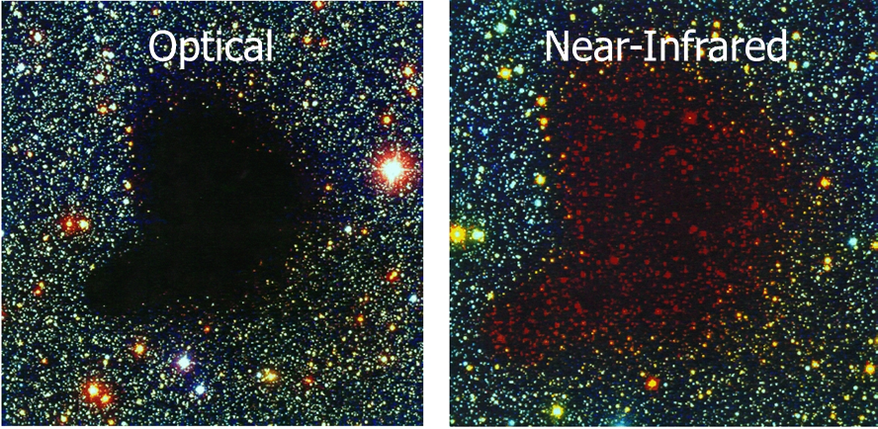
Gravitational Energy: B68
B68 is thought to be in hydrostatic equilibrium, such that the outward pressure balances the inward force of gravity. The cloud should contract as it cools/radiates gravitational energy converted into kinetic energy.
Notes:
B68 is thought to be in hydrostatic equilibrium, such that the outward radiation pressure balances the inward force of gravity. The cloud should contract as it radiates gravitational energy converted into kinetic energy.
The green contours are measurements of Av estimated by NIR color excesses (Alves et al. 2001).
The molecular line widths are very small, ~0.1 km/s, suggesting T~10 K. For the molecular maps, the color scale corresponds to thermal emission, and the contours correspond to molecular emission.
https://www.cfa.harvard.edu/~clada/pubs_html/b68_vel.html

Slide 31
Disks & infrared emission
10²
RY Tau x 10
10⁴
Vega
1
DL Tau x 2
10²
νF_{ν} (10⁻¹² W m⁻²)
10⁻²
9700 K
1
10⁻⁴
GM Aur / 20
10⁻²
β Pic x 0.1
0.1
1
10
100
1000
0.1
1
10
100
1000
Wavelength (μm)
Wavelength (μm)
Beckwith & Sargent 1996, Nature, 383, 139-144.

Slide 32
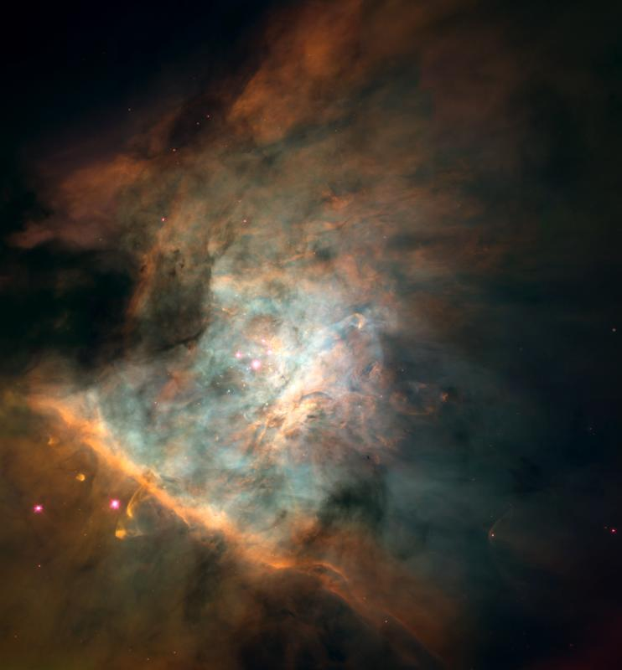
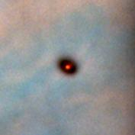

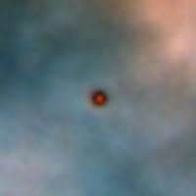
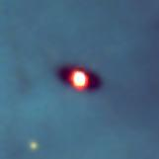
Spectrum of Protoostar
McCaughrean et al. 1996

Slide 33
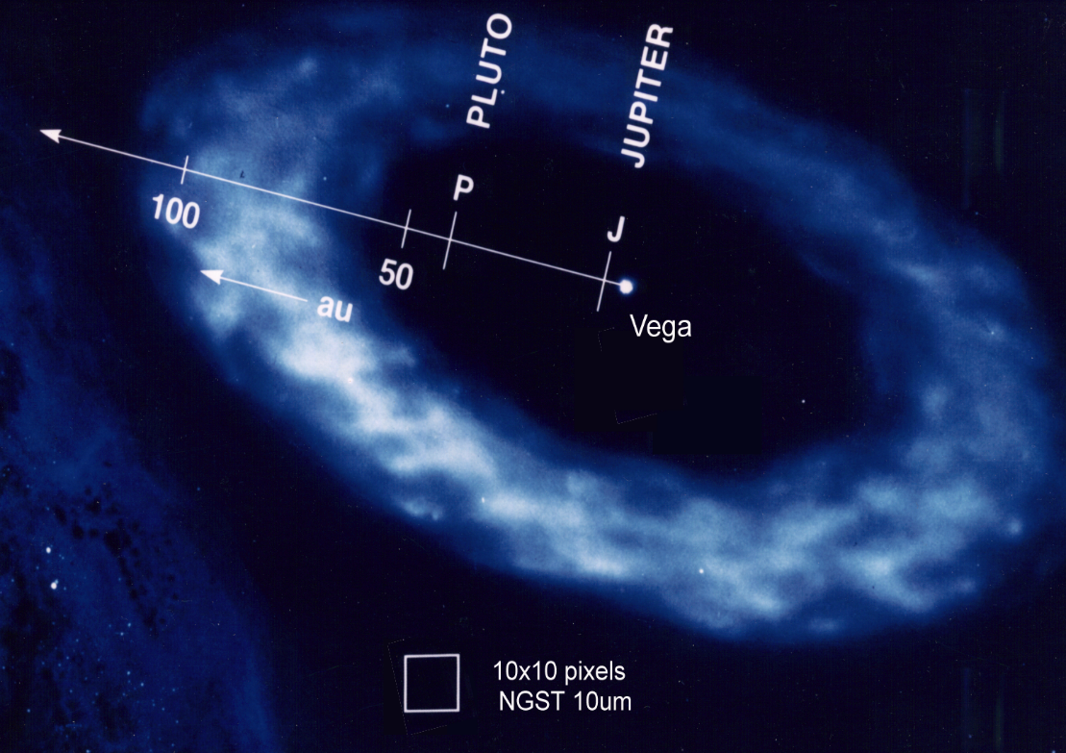
Circumstellar Dust
Vega Disk Detection
λ Flux* Contrast (μm) (μJy) Star/Disk
11μm 2.4 1.5x10⁷
22μm 400 2x10⁴
33μm 1300 3x10³
Reflected & emitted light detected with a simple coronograph.
*per Airy disk

Slide 34
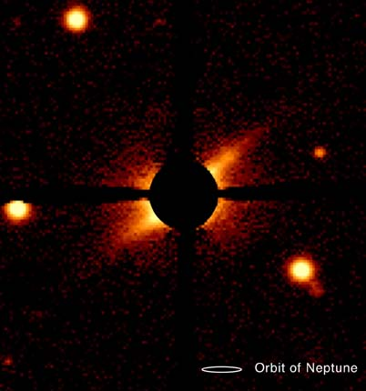
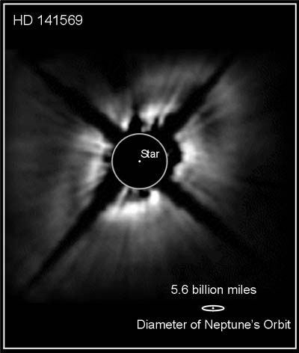
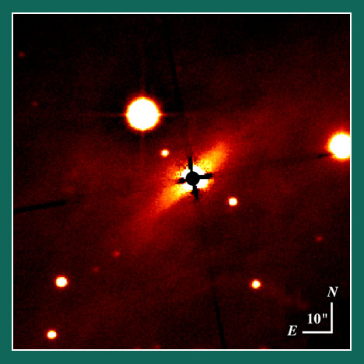
Debris Disks
BD+31643

Slide 35
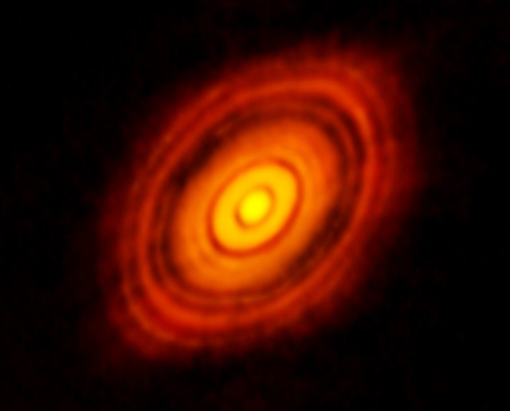
HL Tau

Slide 36
dust clouds and nebulae

Slide 37
Dust Clouds Energy Source
Dust clouds usually emit radiation that they absorb from stars (internal or external).
Young stars are often the internal heat source for star forming dust clouds, e.g. Sgr B2, W49, W51.

Slide 38
Sgr B2

Slide 39
Sgr B2

Slide 40
Dust Clouds Examples

Slide 41
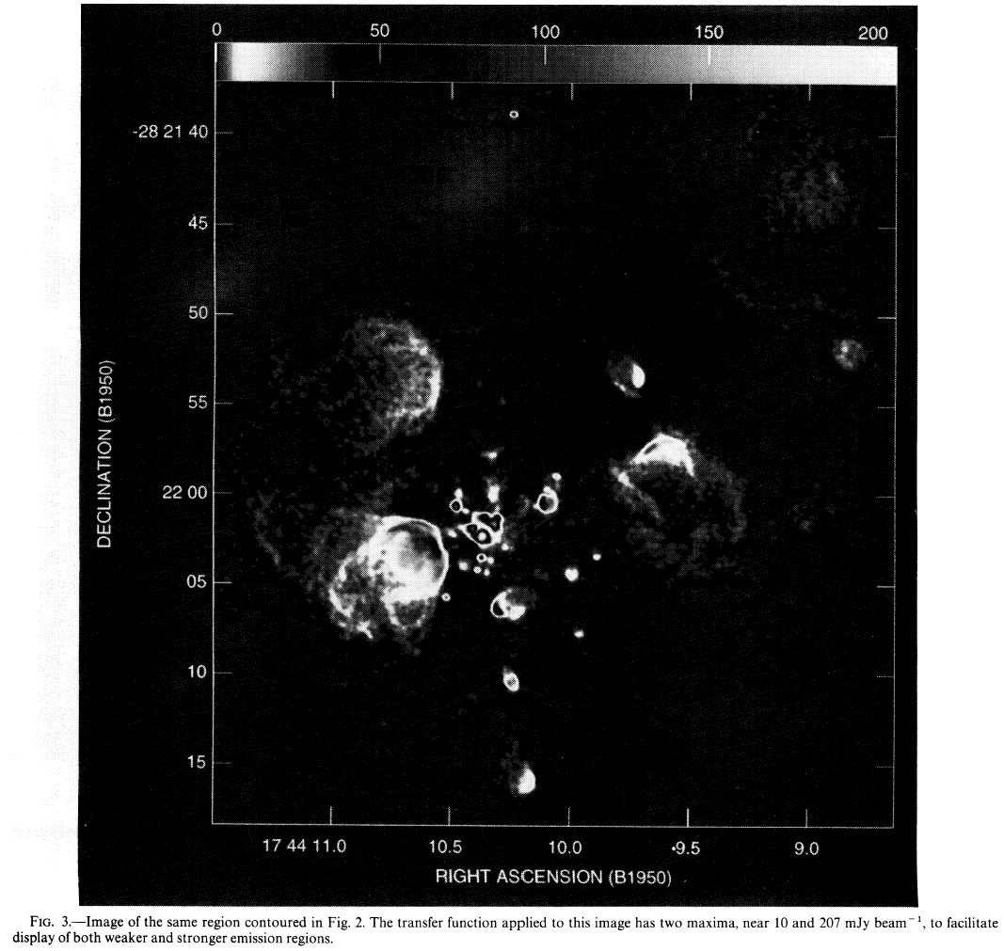
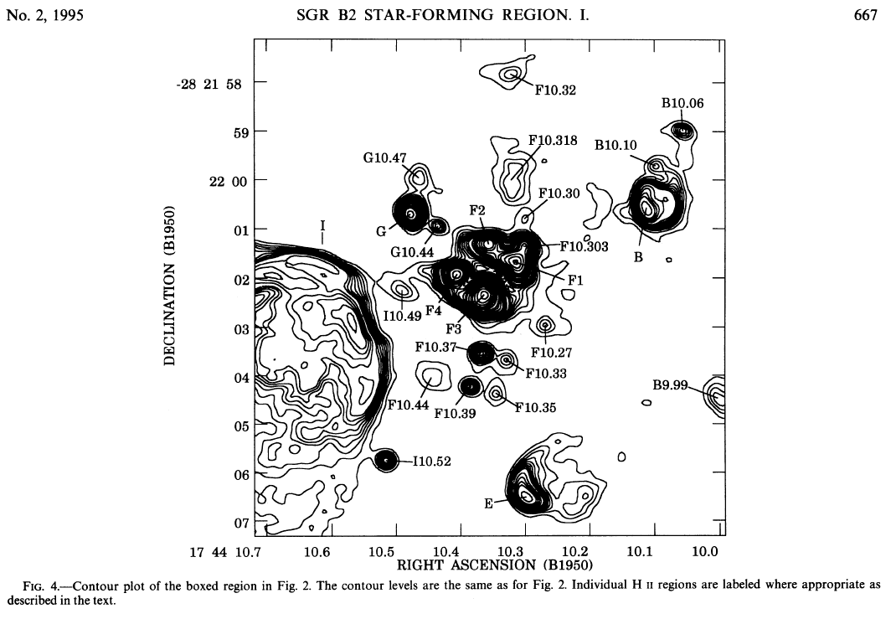
HCHII Regions in Sgr B2
There are ~100 HCHII regions in Sgr B2.

Slide 42
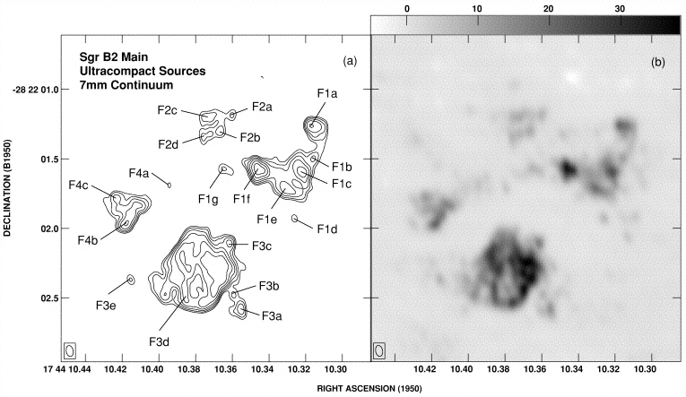
HCHII Regions in Sgr B2
The clumps break up into even smaller clumps with sizes ~100 AU and densities >10⁷ cm⁻³.
Each clump contains an OB star.

Slide 43
Eexternal Heating
M0.20-0.033 molecular cloud is warm (molecular emission in contours)
Notice that its surface is ionized (free-free emission in greyscale).
Pistol nebula is also ionized and heated.

Slide 44
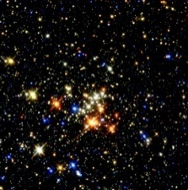
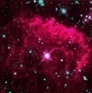
External Heating in Galactic Center
M0.20-0.033 is externally heated by nearby Quintuplet cluster of massive stars.
Notice that its surface is ionized by the nearby hot stars.
Pistol is ejecta that is ionized/heated by Pistol star.

Slide 45
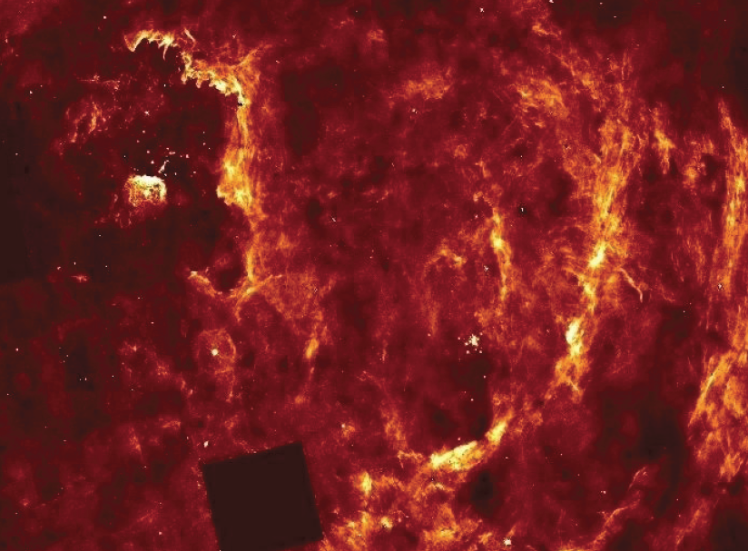
External Heating: Pa-α

Slide 46
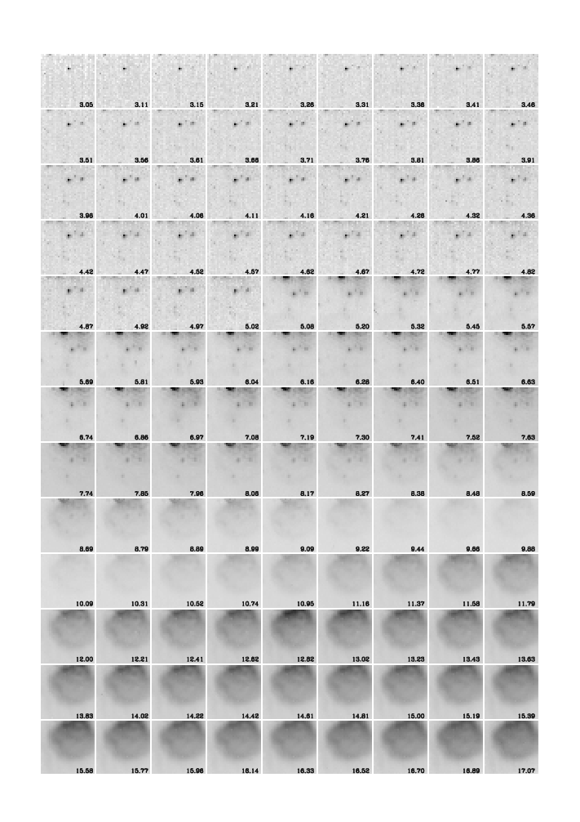
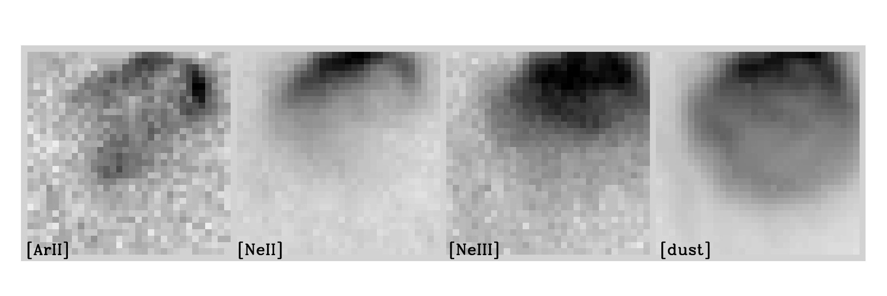
Pistol Star/Nebula
3 um
The Pistol nebula is heated by the Pistol star that resides at its center.
Note in the figure that the dust thermal emission peaks in the mid-infrared, indicating temperature of a few 100 K.
The starlight fades in relative intensity at longer wavelengths.
Ionized gas emission suggest an external energy source (other hot stars in Quintuplet).
17 um
Notes:
Luminosity of dust is around a few 10^6 Lsun, comparable to Pistol star. However, the ionizing rate is far higher than what the Pistol star contributes. Note that the morphology is assymetric with more intensity to the north. This is in the direction of the hot Quintuplet stars, and they ionize the surface of the expanding ejecta.

Slide 47
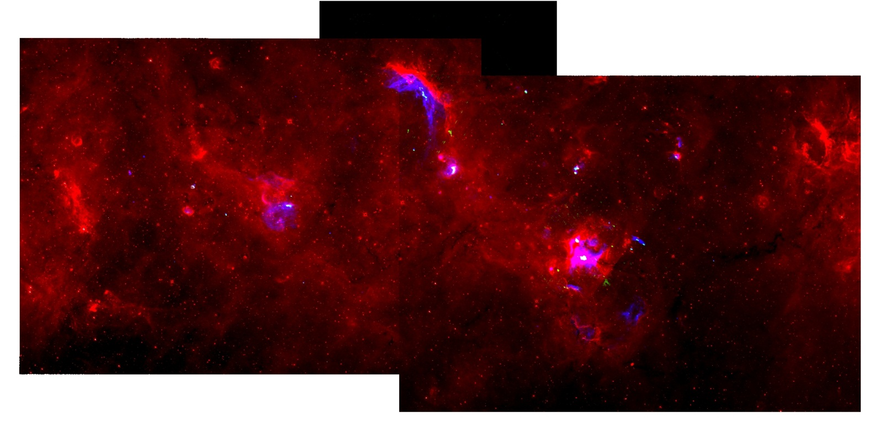
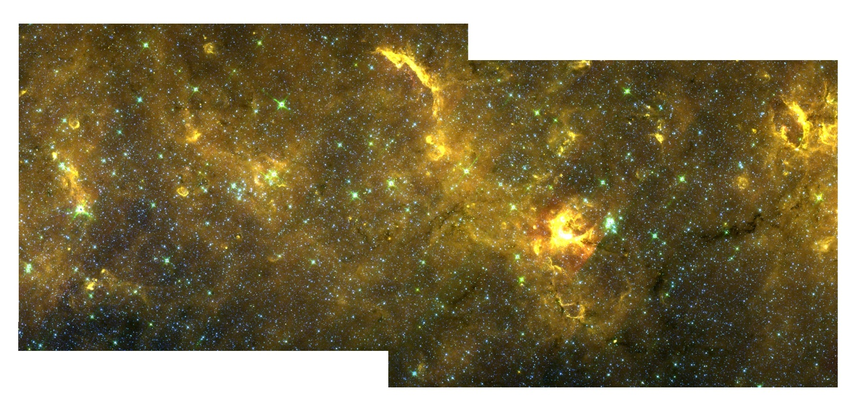
red=8um
green=6 cm
blue=20 cm
red=8um
green=5.8um
blue=3.6um

Slide 48
agn

Slide 49
AGN and Quasars
Active Galactic Nuclei and Quasars are terms used to describe activity in galaxies that is likely produced by accretion of material on to a central supermassive black hole (SMBH).
The various classifications of these objects likely represent different viewpoints of the same thing.
Galaxies that are not active could have been active in the past if they have a SMBH.
There is evidence of past activity in our own Galaxy that might be related to the SMBH in its center.

Slide 50
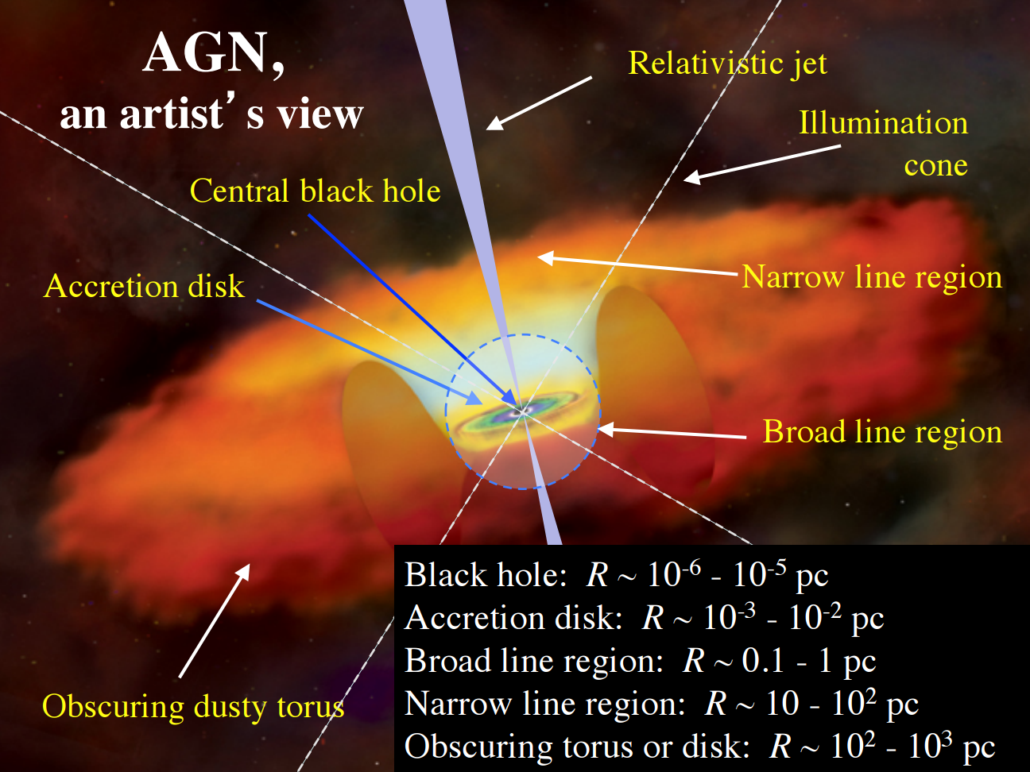
AGN and Quasars: Standard Model

Slide 51
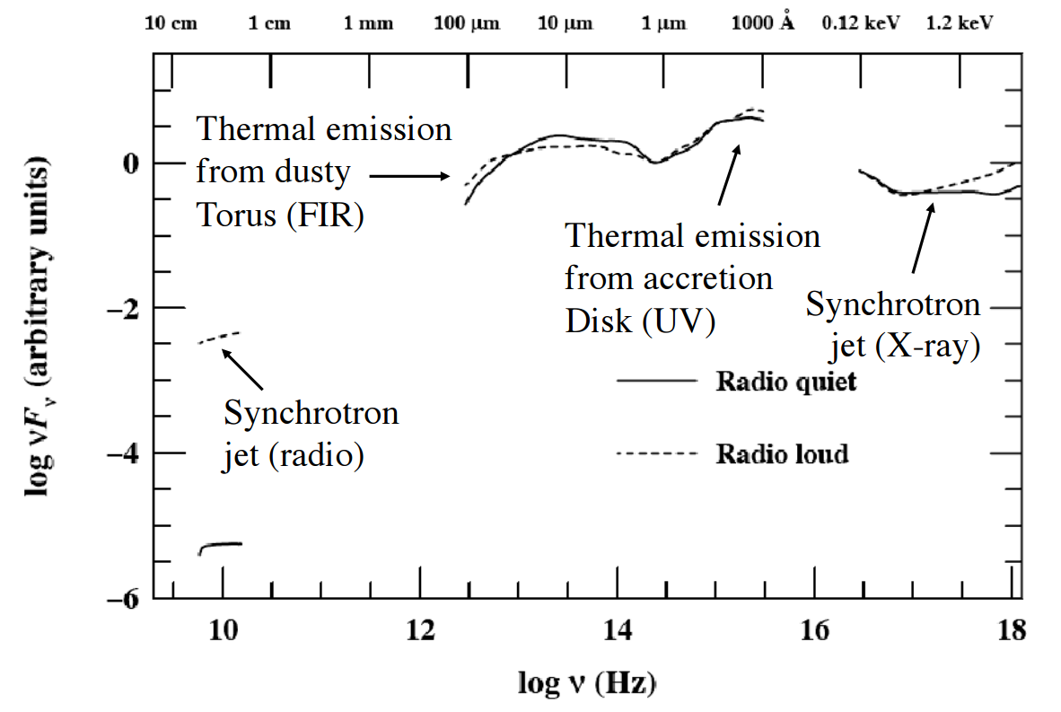
AGN and Quasars: Emission Mechanisms

Slide 52
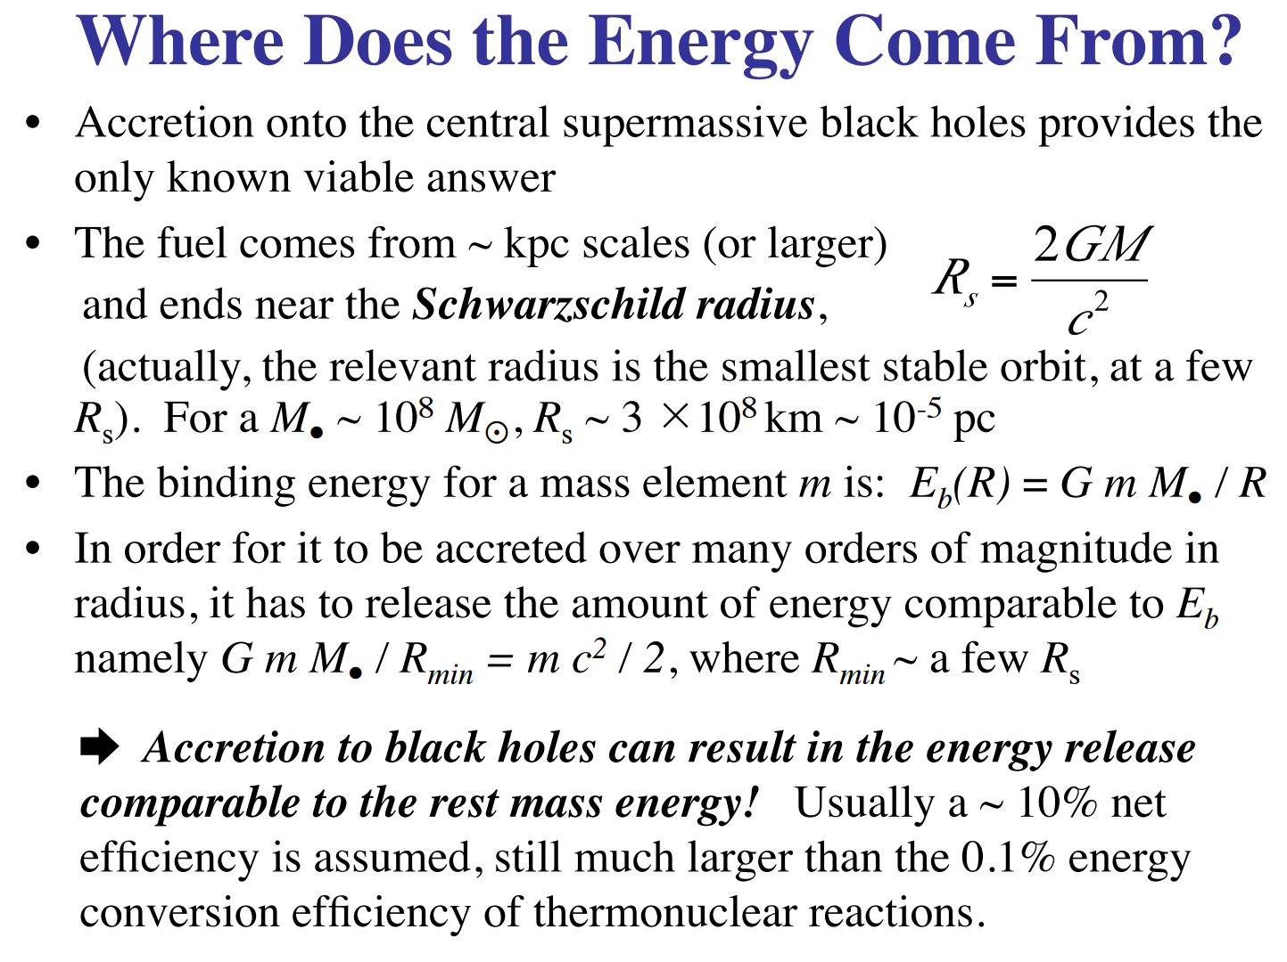
AGN and Quasars: Energy Sources

Slide 53
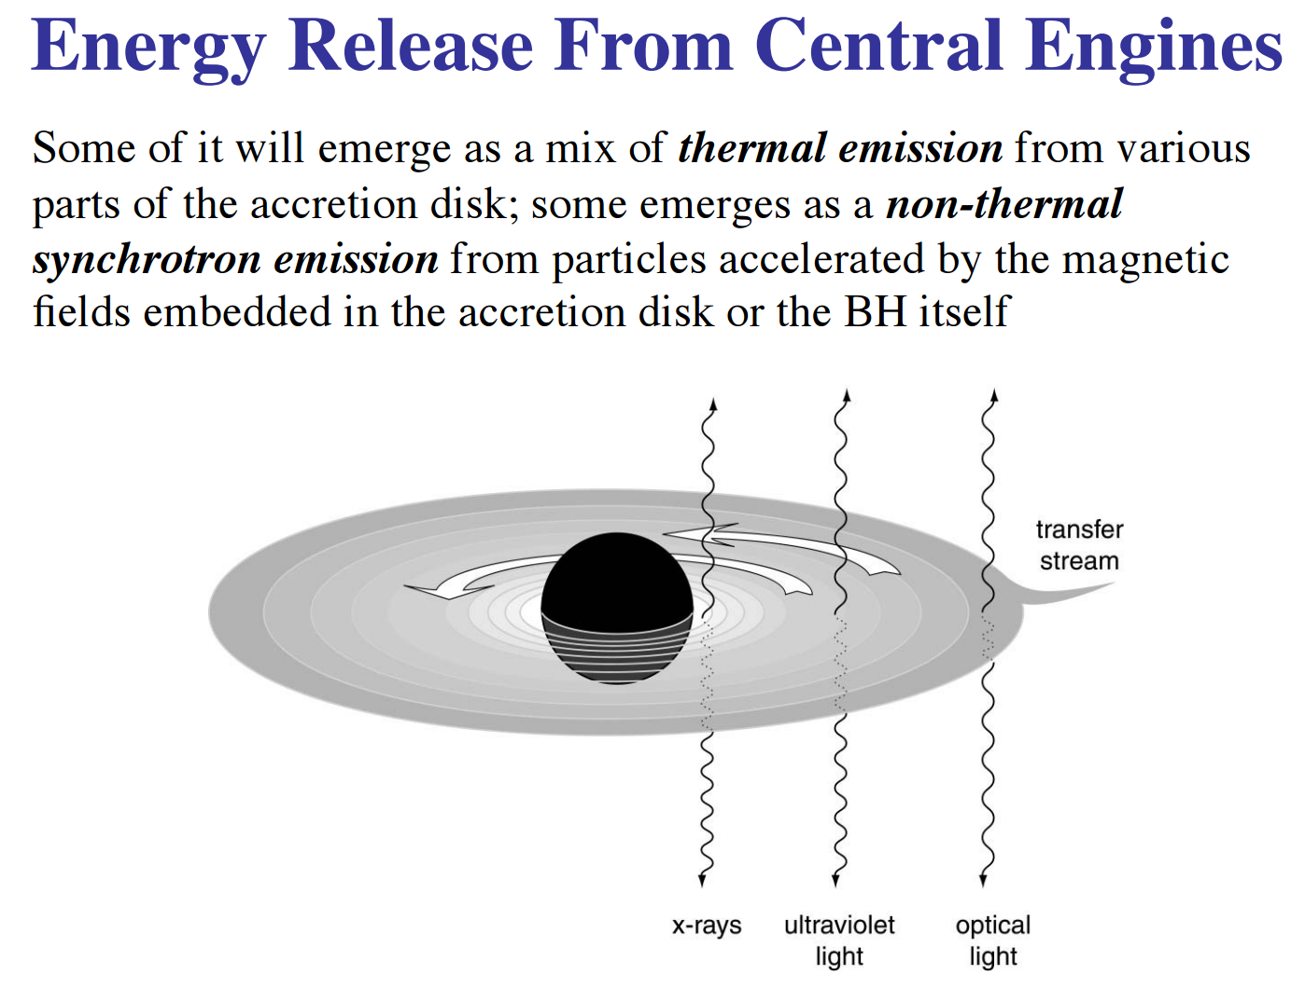
AGN and Quasars: Energy Release

Slide 54
galaxy clusters

Slide 55
Galaxy Clusters: energy source: Shock Heating
Over last 10 Billion years there have been many galaxy collisions in galaxy clusters.
When two galaxies pass through each other stars will continue on their original path – more or less.
Interstellar gas clouds collide and cannot pass through each other.
They get stripped and pass into the gravitational well of the cluster.
This fills with very hot shocked gas over time.
So hot it emits x-rays.
Shows matter distribution. (Mostly dark matter again.)

Slide 56
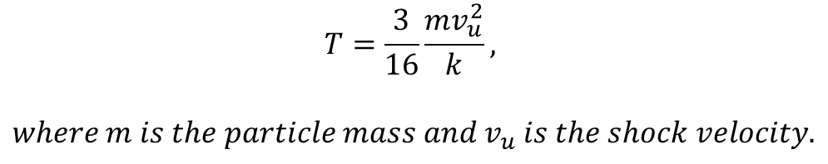
Galaxy Clusters: energy source: Shock Heating
Material in the relativistic jet collides with the surrounding medium
This induces a shock that increases the gas temperature.
A shock increases the gas temperature:
$$T=\frac{3}{16}\frac{mv_{u}^{2}}{k},$$
$$where m is the particle mass and v_{u} is the shock velocity.$$

Slide 57
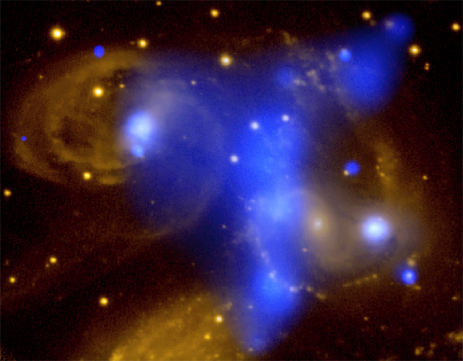
Galaxy Clusters: energy source: Shock Heating
blue=x-ray
Notes:
Stephan's Quintet is a picturesque but clearly troubled grouping of galaxies about 300 million light-years away toward the high-flying constellation Pegasus. Spanning over 200,000 light-years at that distance, this composite false-color image illustrates the powerful nature of this multiple galaxy collision, showing x-ray data from the Chandra Observatory in blue superposed on optical data in yellow. The x-rays from the central blue cloud running vertically through the image are produced by gas heated to millions of degrees by an energetic shock on a cosmic scale. The shock was likely the result of the interstellar gas in the large spiral galaxy, seen immediately to the right of the cloud, colliding with the quintet's tenuous intergalactic gas as this galaxy plunged through group's central regions. In fact, over billions of years, repeated passages of the group galaxies through the hot intergalactic gas should progressively strip them of their own star forming material. In this view, the large spiral galaxy just seen peeking above the bottom edge is an unrelated foreground galaxy a mere 35 million light-years distant.

