Slide 1
University Astronomy
Professor Don Figer
Spectroscopy

Slide 2
Aims and outline for this lecture
describe system requirements for spectral resolution and wavelength coverage
describe atmospheric effects on observations
summarize primary background sources and effects on observations

Slide 3

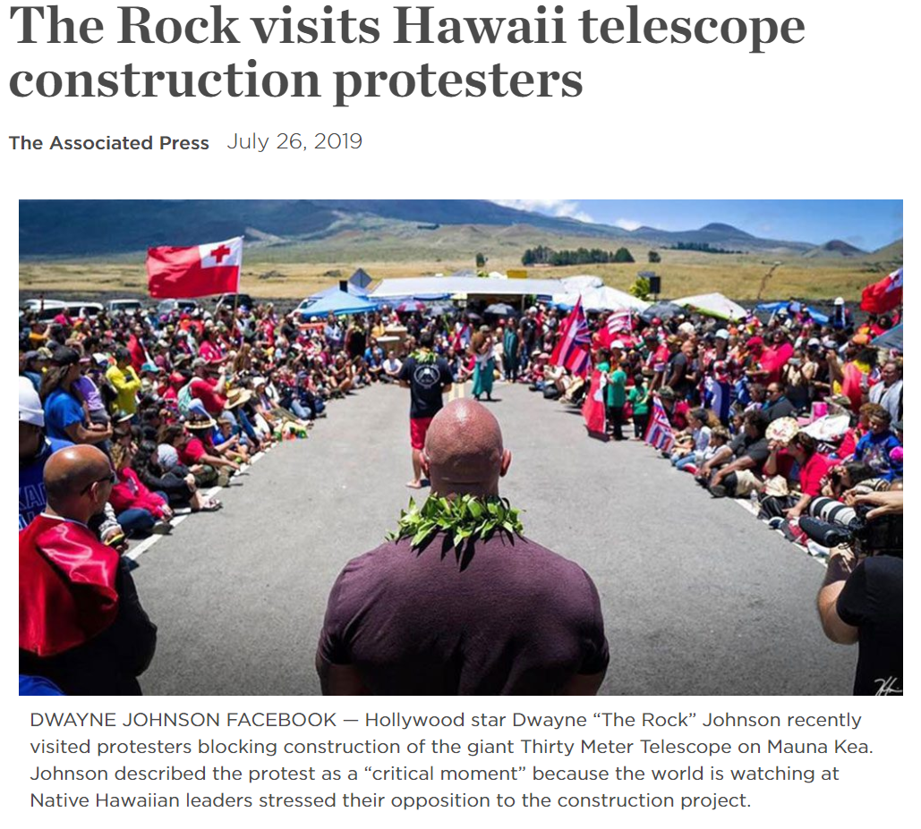



Slide 4
motivation for spectroscopy

Slide 5
Need for Spectral Information
“A picture is worth a thousand words.” --Barnard
“A spectrum is worth a thousand pictures.” --an astronomer
A spectrum is the distribution of flux versus wavelength.
Spectra are critical for making measurements of physical properties of astronomical objects.
  low resolution spectra reveal spectral energy distribution (SED)
  high resolution spectra reveal emission/absorption features

Slide 6
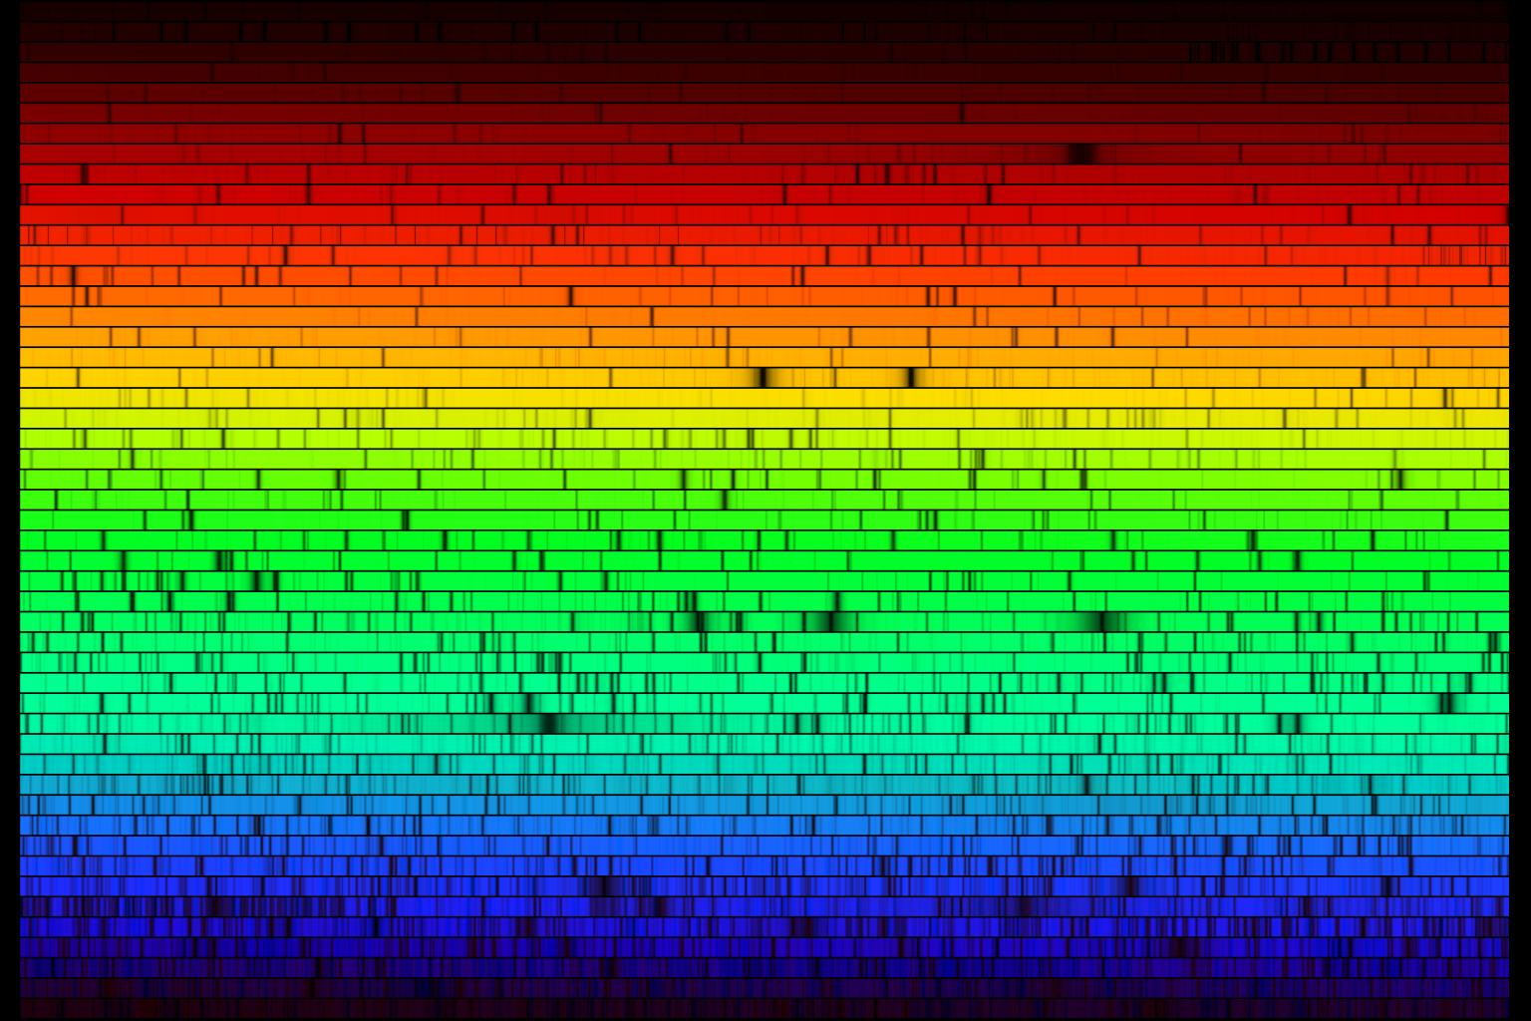
Spectrum of Sun
Notes:
A high resolution version of the spectrum of our Sun, this image was created from a digital atlas observed with the Fourier Transform Spectrometer at the McMath-Pierce Solar Facility at the National Solar Observatory on Kitt Peak, near Tucson, Arizona (‘Solar Flux Atlas from 296 to 1300 nm’ by Robert L. Kurucz, Ingemar Furenlid, James Brault, and Larry Testerman: National Solar Observatory Atlas No. 1, June 1984.). The images shown here were created to mimic an echelle spectrum, with wavelength increasing from left to right along each strip, and from bottom to top. Each of the 50 slices covers 60 angstroms, for a complete spectrum across the visual range from 4000 to 7000 angstroms. The Sun is a G2 star, and this image covers the same wavelength range in the same format as the spectrum of Procyon, type F5, and the spectrum of Arcturus, type K1 (or K2). Note: NSO/Kitt Peak FTS data used here were produced by NSF/NOAO. (Note for interested users: because this was made from digital data, we can create any size or shape on request, but please give us plenty of time. The images here have the correct aspect ratio for a 35mm slide. We do however have a square version available immediately.)

Slide 7
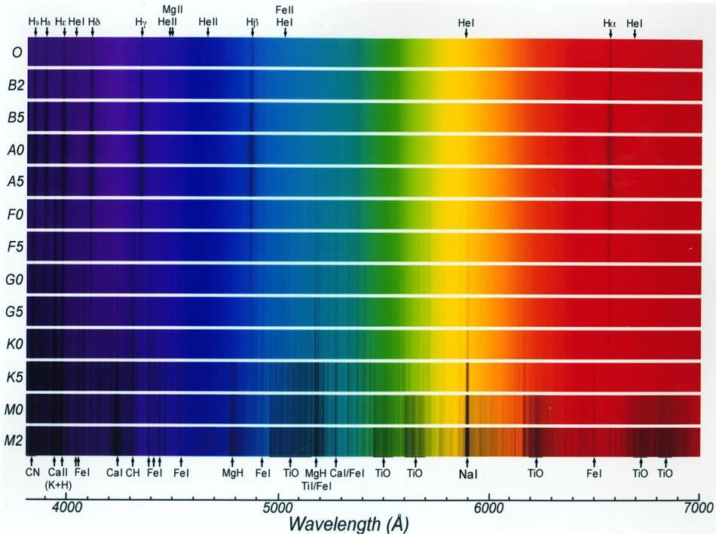
Spectra of Stars

Slide 8
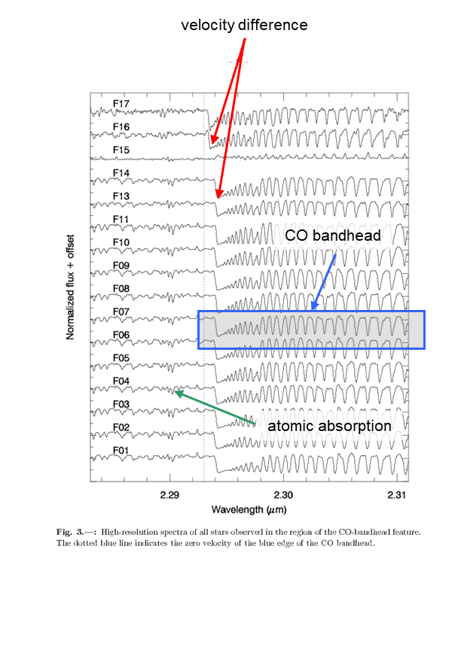
High Resolution Spectroscopy
High resolution spectroscopy can yield
  velocity
  abundances
  temperature
  virial mass (through integrated light)
  molecular excitation
  interstellar absorption
  ionization state
  others
The example on the right shows high resolution infrared spectra of red supergiants.
Note the many CO rotational-vibrational absorption lines.
The slight translations in the wavelength axis from star to star show velocity differences.
Weaker features to the left reflect atomic absorption and can be used for abundance analysis.

Slide 9
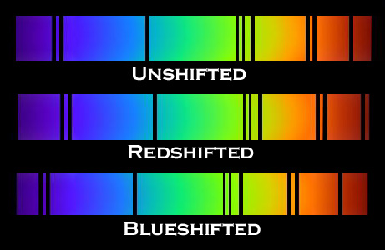
Doppler Effect

Slide 10
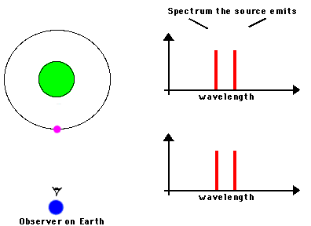
Doppler Effect

Slide 11
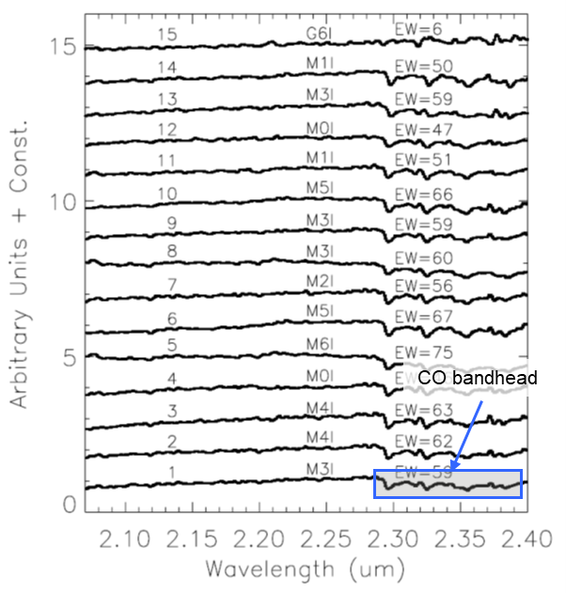
Low Resolution Spectroscopy
Low resolution spectroscopy can yield
  emission mechanism (via spectral index)
  temperature
  molecular content
  interstellar molecular absorption
The example on the right shows low resolution infrared spectra of red supergiants.
Note the CO bandhead.
The depth of the bandhead indicates that these stars are cool.
For this application, it might be just as well to obtain a high resolution spectrum over this waveband.
In some cases, a low resolution spectrum can reveal curvature over a broad range of wavelengths – something difficult to detect in high resolution spectra.

Slide 12
spectrographs

Slide 13
Spectrograph/spectrometer
A spectrograph/spectrometer is an instrument that can measure intensity versus wavelength.
  dispersive
    prism
    grating
  nondispersive
    filters, circular variable filter (CVF)
    Fabry-Perot

Slide 14
Spectroscopy System Design Criteria
Efficiency: amount of light directed into the spectrum
Resolution: minimum spatial and spectral separation between resolved features
Scattering: light directed out of the spectrum or in undesired locations in the spectrum
Stability and calibration accuracy: ability of system to maintain or reproduce wavelength versus pixel relationship
Background: light from all sources other than target, might be sky, telescope, optics, baffles, etc.
Packaging: compactness of layout

Slide 15
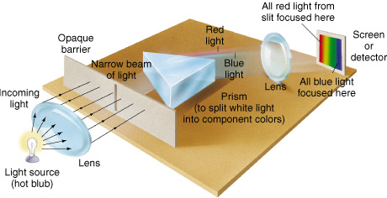
Spectrograph Cartoon
Notes:
Spectroscope Diagram of a simple spectroscope. A small slit in the mask on the left allows a narrow beam of light to pass. The light passes through a prism and is split up into its component colors. The resulting spectrum can be viewed through an eyepiece or simply projected onto a screen.

Slide 16
spectroscopic features

Slide 17
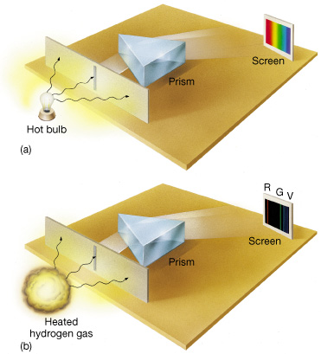
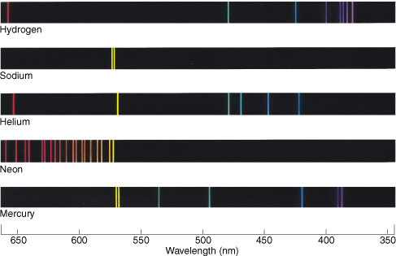
Continuum and Emission Lines
Notes:
Continuous and Emission Spectra When passed through a slit and split up by a prism, light from a source of continuous radiation (a) gives rise to the familiar rainbow of colors. By contrast, the light from excited hydrogen gas (b) consists of a series of distinct bright spectral lines called emission lines. (The focusing lenses have been omitted for clarity.)
Elemental Emission The emission spectra of some well-known elements. In accordance with the convention adopted throughout this text, frequency increases to the right. (Wabash Instrument Corp.)

Slide 18
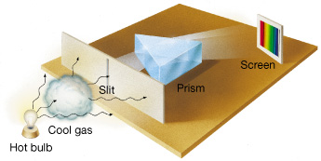
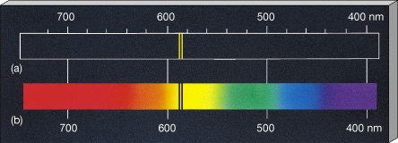
Absorption Lines
Notes:
Absorption Spectrum When cool gas is placed between a source of continuous radiation, such as a hot lightbulb, and a detector, the resulting spectrum consists of a continuous spectrum crossed by a series of dark absorption lines. These lines are formed when the intervening gas absorbs certain wavelengths (colors) from the original beam. The absorption lines appear at precisely the same wavelengths as the emission lines that would be produced if the gas were heated to high temperatures.
Sodium Spectrum (a) The characteristic emission lines of sodium. The two bright lines in the center appear in the yellow part of the spectrum. (b) The absorption spectrum of sodium. The two dark lines appear at exactly the same wavelengths as the bright lines in the sodium emission spectrum.

Slide 19
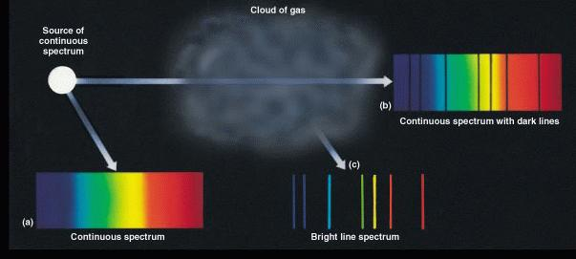
Three Kinds of Spectra
Notes:
Absorption Spectrum When cool gas is placed between a source of continuous radiation, such as a hot lightbulb, and a detector, the resulting spectrum consists of a continuous spectrum crossed by a series of dark absorption lines. These lines are formed when the intervening gas absorbs certain wavelengths (colors) from the original beam. The absorption lines appear at precisely the same wavelengths as the emission lines that would be produced if the gas were heated to high temperatures.
Sodium Spectrum (a) The characteristic emission lines of sodium. The two bright lines in the center appear in the yellow part of the spectrum. (b) The absorption spectrum of sodium. The two dark lines appear at exactly the same wavelengths as the bright lines in the sodium emission spectrum.

Slide 20
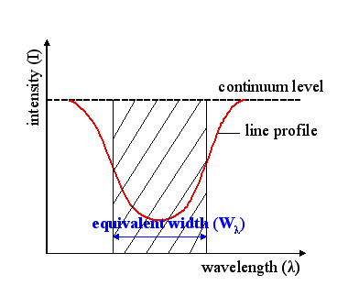

Equivalent Width
Equivalent width is a measure of flux in a line.
It is independent of instrument parameters, so it is a property of the observed object.
Notes:
Absorption Spectrum When cool gas is placed between a source of continuous radiation, such as a hot lightbulb, and a detector, the resulting spectrum consists of a continuous spectrum crossed by a series of dark absorption lines. These lines are formed when the intervening gas absorbs certain wavelengths (colors) from the original beam. The absorption lines appear at precisely the same wavelengths as the emission lines that would be produced if the gas were heated to high temperatures.
Sodium Spectrum (a) The characteristic emission lines of sodium. The two bright lines in the center appear in the yellow part of the spectrum. (b) The absorption spectrum of sodium. The two dark lines appear at exactly the same wavelengths as the bright lines in the sodium emission spectrum.

Slide 21
Question
What is the equivalent width of this line?
1
0
1.1
1.2
1.3
1.4
1.5
1.6
1.7
1.8
Wavelength (microns)
Notes:
Absorption Spectrum When cool gas is placed between a source of continuous radiation, such as a hot lightbulb, and a detector, the resulting spectrum consists of a continuous spectrum crossed by a series of dark absorption lines. These lines are formed when the intervening gas absorbs certain wavelengths (colors) from the original beam. The absorption lines appear at precisely the same wavelengths as the emission lines that would be produced if the gas were heated to high temperatures.
Sodium Spectrum (a) The characteristic emission lines of sodium. The two bright lines in the center appear in the yellow part of the spectrum. (b) The absorption spectrum of sodium. The two dark lines appear at exactly the same wavelengths as the bright lines in the sodium emission spectrum.

Slide 22
Answer
What is the equivalent width of this line? 0.1 microns.
1
0
1.1
1.2
1.3
1.4
1.5
1.6
1.7
1.8
Wavelength (microns)
Notes:
Absorption Spectrum When cool gas is placed between a source of continuous radiation, such as a hot lightbulb, and a detector, the resulting spectrum consists of a continuous spectrum crossed by a series of dark absorption lines. These lines are formed when the intervening gas absorbs certain wavelengths (colors) from the original beam. The absorption lines appear at precisely the same wavelengths as the emission lines that would be produced if the gas were heated to high temperatures.
Sodium Spectrum (a) The characteristic emission lines of sodium. The two bright lines in the center appear in the yellow part of the spectrum. (b) The absorption spectrum of sodium. The two dark lines appear at exactly the same wavelengths as the bright lines in the sodium emission spectrum.

Slide 23
spectroscopic system design

Slide 24
Spectroscopy System Design Form Example
grating normal
telescope
detector
lens
slit
grating
collimator

Slide 25
Spectral Resolution
Spectral resolution is a measure of the ability to separate nearby features in wavelength space.
Delta lambda
  often set to the full-width at half-maximum of an unresolved line
  can be measured in the data
  depends on data analysis
  can be limited by diffraction, slit width, detector sampling
$$R=\frac{λ}{Δλ}, Δλ=minimum wavelength separation of two resolved features.$$

Slide 26
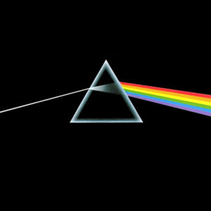
Spectral Resolution: Prism
A prism disperses light with a transmissive optic that has chromatic index of refraction.
Index of refraction is usually higher for shorter wavelengths.
Shorter wavelength light bends more.
*
*Oh, by the way, which one’s Pink?

Slide 27
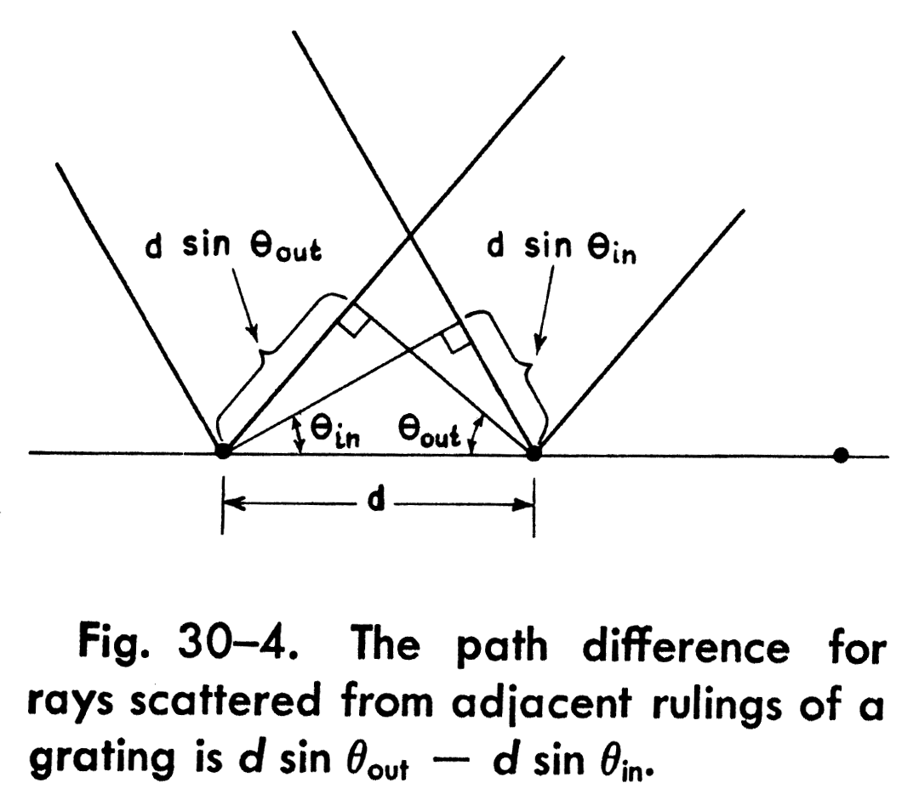
Gratings: Grating Equation
The grating equation gives the geometry for constructive interference between facets of a grating.
The equation can be derived by setting the optical path difference between light scattering from two adjacent facets to an integer multiple of the wavelength.
In more standard nomenclature,
where, m is the order number and T is the groove density.
Note that the equation reduces to the law of reflection for m=0.

Slide 28
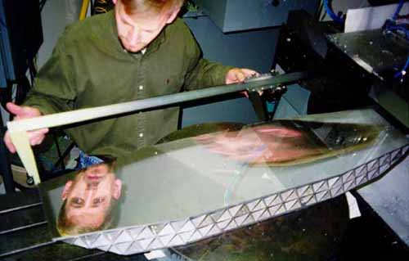
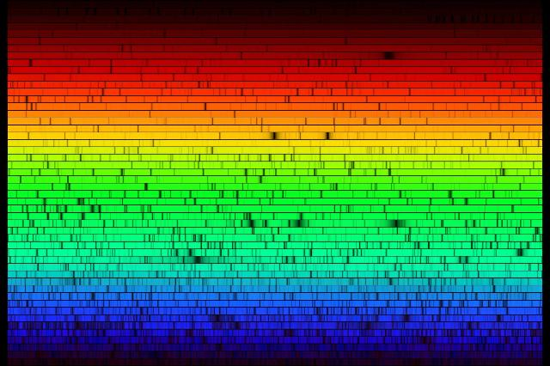
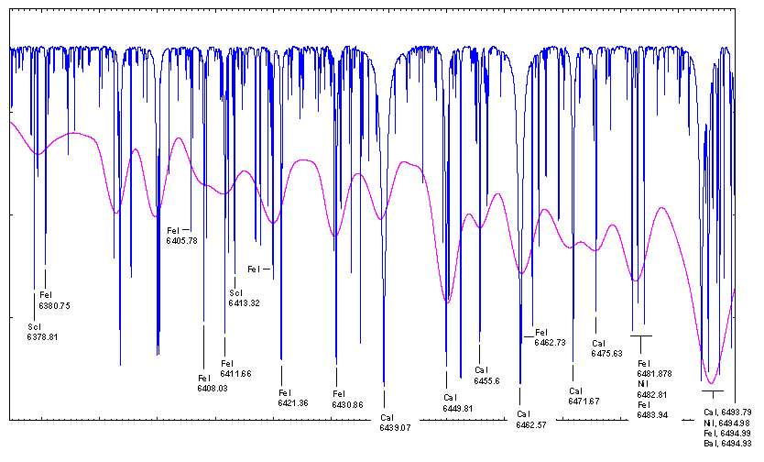
Gratings: Echellogram
+λ
+λ
HIRES order format showing the solar spectrum
(note that color was artificially added for illustrative purposes)
Notes:
This “echellogram” shows the data format on the detector in the HIRES optical spectrograph on Keck. The solar spectrum shows numerous absorption lines. Note in the inset photograph the very large dimension of the grating. The resolution depends on slit width and is in the range of 25,000-100,000.
http://grus.berkeley.edu/~jrg/ins/node3.html

Slide 29
atmospheric features in spectra

Slide 30
Atmospheric effects
Absorption
  reduced flux from source
  difficult calibrations
Emission
  increased background noise
  reduced integration times
  difficult calibrations (subtracting time-varying components)
Turbulence
  increased object size (“seeing”)
Varies with wavelength, time, altitude, line-of-sight

Slide 31
atmospheric absorption

Slide 32
Atmospheric absorption
Molecules are the dominant absorbers (H₂O, CO₂, O_{x})
Strong function of:
  wavelength, atmospheric wavebands
  time, frequent calibration (hour timescales)
  altitude, mountain-top observing sites
  line-of-sight, limited target access and frequent calibration

Slide 33
Atmospheric absorption versus λ
Sharp cutoffs
  defined primarily by H₂O
  shape wavebands
Higher transmission between lines with higher resolution
Can introduce large calibration errors for low resolution observations (MNRAS, 1994, 266, 497)

Slide 34
Wavelength Regimes: near/mid-infrared: Atmospheric Transmission
Notes:
Like all other forms of electromagnetic radiation, infrared is utilised by astronomers to learn more about the universe. As infrared is essentially heat radiation, infrared telescopes (which include most major optical telescopes as well as a few dedicated infrared telescopes) need to have their detectors shielded from heat and chilled with liquid nitrogen in order to actually form images. This is particularly important in the mid infrared and far infrared regions of the spectrum. The principle limitation on infrared sensitivity from ground-based telescopes is the water vapour in the Earth's atmosphere, which absorbs a significant amount of infrared radiation. For this reason most infrared telescopes are built in very dry places at high altitude (above most of the water vapour in the atmosphere).

Slide 35
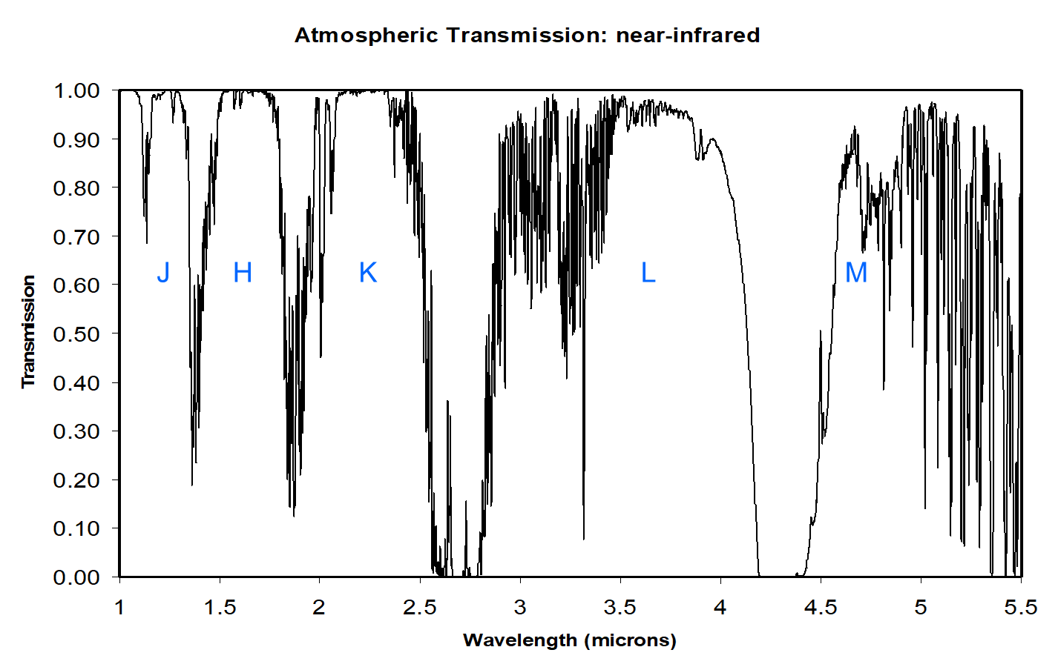
Wavelength Regimes: near-infrared: Atmospheric Transmission
Notes:
Like all other forms of electromagnetic radiation, infrared is utilised by astronomers to learn more about the universe. As infrared is essentially heat radiation, infrared telescopes (which include most major optical telescopes as well as a few dedicated infrared telescopes) need to have their detectors shielded from heat and chilled with liquid nitrogen in order to actually form images. This is particularly important in the mid infrared and far infrared regions of the spectrum. The principle limitation on infrared sensitivity from ground-based telescopes is the water vapour in the Earth's atmosphere, which absorbs a significant amount of infrared radiation. For this reason most infrared telescopes are built in very dry places at high altitude (above most of the water vapour in the atmosphere).

Slide 36
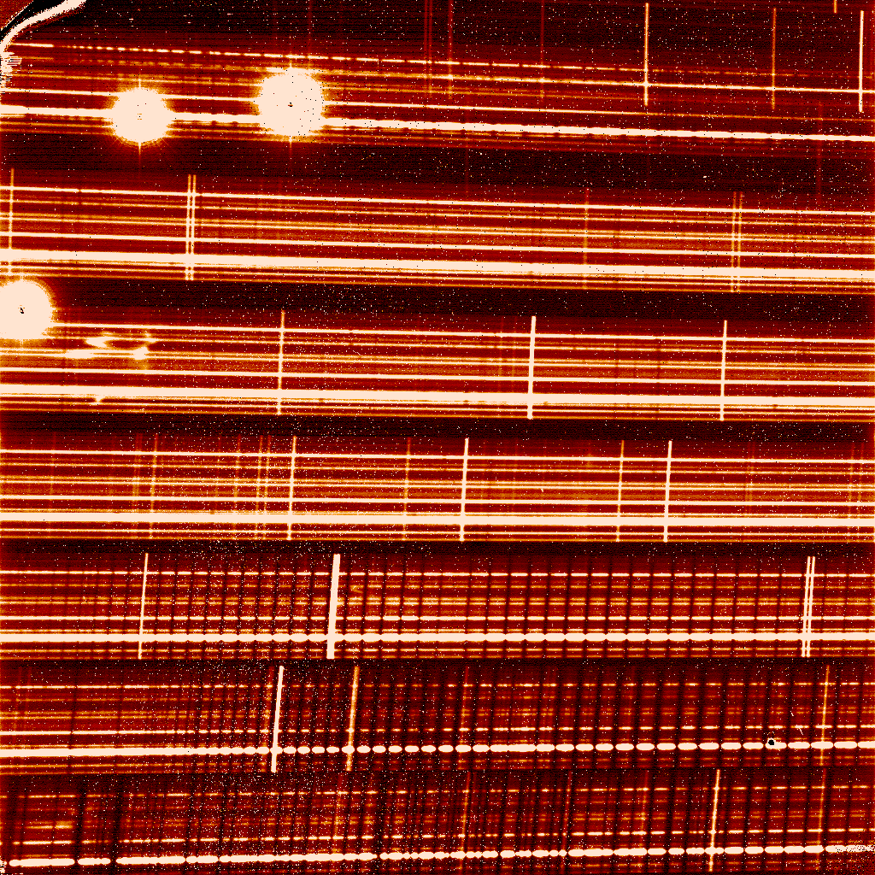
Atmospheric absorption versus λ - high resolution
⎫
Array defects
CO₂ absorption lines
R = λ/Δλ ∼ 23,000
⎭
+λ
+λ
Keck II 10-m

Slide 37
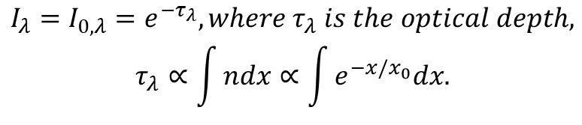
Atmospheric absorption versus altitude
Particle number densities (n) for most absorbers fall off rapidly with increasing altitude.
Density of atmospheric constituents modeled as exponential.
x_{0,H20} ~ 2 km, x_{0,CO2} ~ 7 km, x_{0,O3} ~ 15-30 km
So, 95% of atmospheric water vapor is below the altitude of Mauna Kea.
$$I_{λ}=I_{0,λ}=e^{−τ_{λ}}, where τ_{λ} is the optical depth,$$
$$τ_{λ}∝\int{ndx∝\int{e^{−x/x_{0}}dx.}}$$

Slide 38
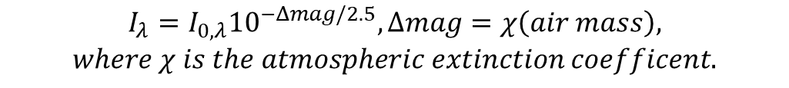
Atmospheric absorption versus airmass
The amount of absorbed radiation depends upon the number of absorbers along the line of sight
AM=1
Atmosphere
AM=2
$$I_{λ}=I_{0,λ}{10}^{−Δmag/2.5}, Δmag=χ\left(air mass\right),$$
$$where χ is the atmospheric extinction coefficent.$$

Slide 39
atmospheric emission

Slide 40
Atmospheric emission
Blackbody (thermal)
  obeys Planck’s blackbody equation
  has a peak that depends on temperature
  is continuum in nature
Molecular (OH)
  is produced by the OH molecule in the Earth’s atmosphere
  depends on the excitation of OH molecules
  is emitted at discrete wavelengths that correspond to energy transitions of the OH molecule

Slide 41
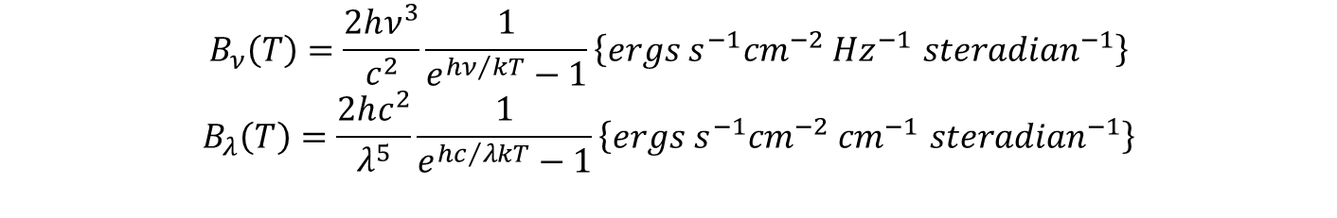
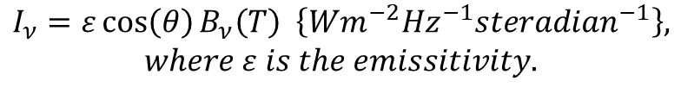
Thermal emission
spectral radiance, brightness, specific intensity:
θ
$$I_{ν}=ε\cos\left(θ\right)B_{ν}\left(T\right) \left\{Wm^{−2}{Hz}^{−1}{steradian}^{−1}\right\},$$
$$where ε is the emissitivity.$$
Planck (blackbody) function:
$$B_{ν}\left(T\right)=\frac{2hν^{3}}{c^{2}}\frac{1}{e^{{hν}/{kT}}−1}\left\{ergs s^{−1}{cm}^{−2} {Hz}^{−1} {steradian}^{−1}\right\}$$
$$B_{λ}\left(T\right)=\frac{2hc^{2}}{λ^{5}}\frac{1}{e^{{hc}/{λkT}}−1}\left\{ergs s^{−1}{cm}^{−2} {cm}^{−1} {steradian}^{−1}\right\}$$

Slide 42

Atmospheric emission: Blackbody
Total power onto a detector
$$P=ηAΩΔνε_{sky}B_{ν}\left(T_{sky}\right) \{Watts\}$$
η: transmission of all optics x Q.E.
ε_{sky}: emissivity of sky
A: telescope area
Ω: solid angle subtended by focal plane aperture
Δν: bandwidth
B_{ν}(T_{sky}): Planck function
$$At 10 μm, typically: η\sim 0.2, ε\sim 0.1, AΩ\sim 3\left({10}^{−10}\right) m^{2} steradian,$$
$$Δν\sim 1.5\left({10}^{13}\right) Hz \left(10 μm filter\right), and T\sim 270 K.$$
$$So, P\sim {10}^{−9} W, or \sim 4\left({10}^{10}\right) photons/second$$

Slide 43
Atmospheric emission: OH lines
OH emission comes from fluorescing molecules at 85 km altitude that are pumped by UV radiation from the Sun.
It is the primary sky background between 0.85 and 2.5 um.
It is spatially and time varying.
It is possible to reduce the effects of OH emission by dispersing the light at high spectral resolution and then only analyzing the light in between the OH lines.
Some have made attempts to “suppress” the OH light by dispersing the light, masking out the OH lines, and then reimaging the light. This technique has not yielded all the potential gains that it promises.
This movie describes airglow (mostly from other molecules, but still similar): https://upload.wikimedia.org/wikipedia/commons/2/20/Airglow_ESO.webm

Slide 44
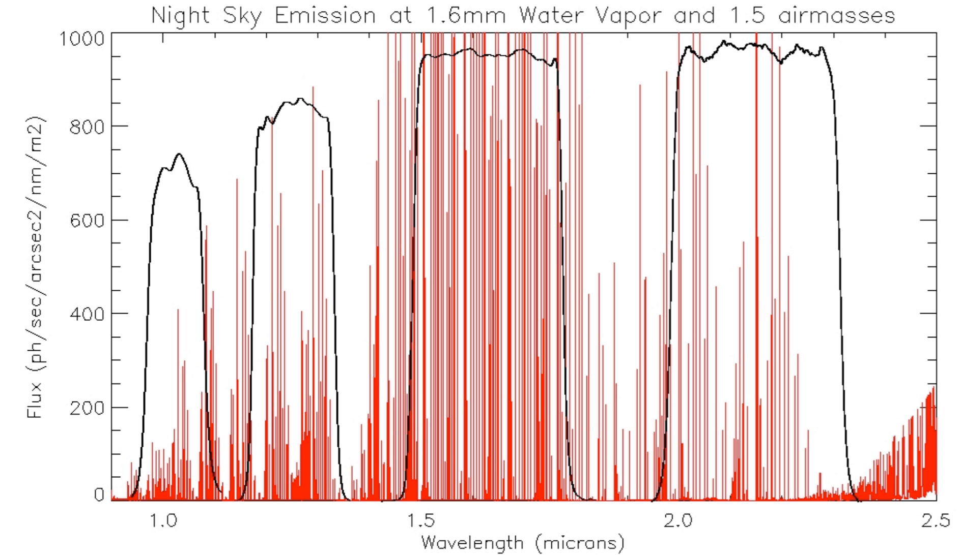
OH Lines in the Infrared

Slide 45
atmospheric turbulence

Slide 46
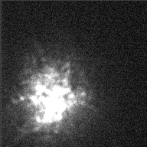
Atmospheric Turbulence
Static atmosphere bends light (n=1.000273)
Dynamic atmosphere distorts the wavefront.
Data from the William Herschel 4.2 metre Telescope in La Palma. Wavelength 689.3 nm, Exposure time 30 ms per frame. The data sets were taken with the Speckle Imaging group at Cardiff University.

Slide 47

Atmospheric Turbulence
Recall, that a diffraction-limited point spread function (PSF) has a full-width at half-maximum (FWHM) of:
In reality, atmospheric turbulence smears the image:
r₀ is the radius of the “Isoplanatic patch,” the area on sky over which phase is relatively constant.
At Mauna Kea, r₀=0.2 m at λ=0.5 μm.
$$θ_{FWHM}=1.22\frac{λ\{m\}}{D\{m\}} \left\{radians\right\}=0.25\frac{λ\{μm\}}{D\{m\}} \left\{arcseconds\right\}.$$
$$θ_{FWHM}=0.25\frac{λ\{μm\}}{r_{0}\{m\}} \left\{arcseconds\right\}, where r_{0}∝λ^{6/5}.$$

Slide 48

Lick 3-m (1994)

Slide 49
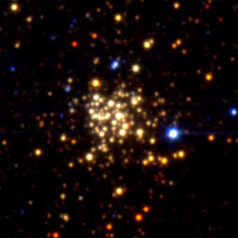
Keck 10-m (1997)

Slide 50
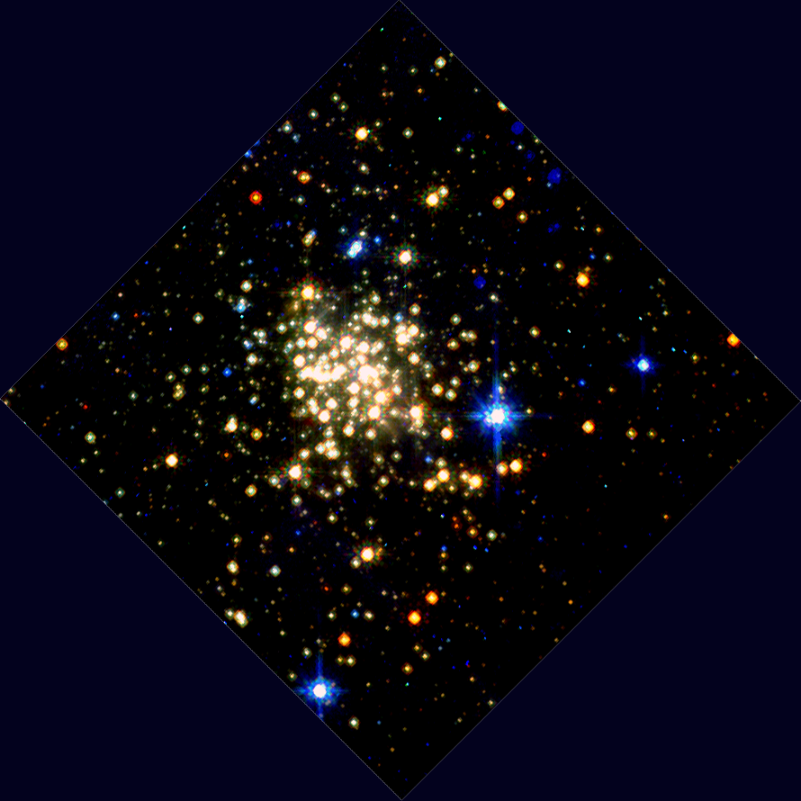
HST/NICMOS (1997)

Slide 51
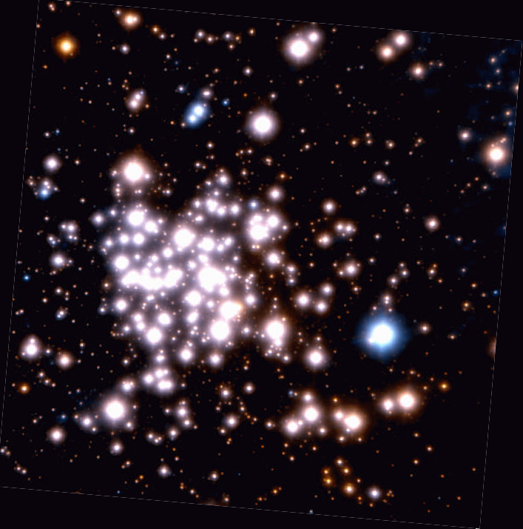
VLT/AO (2002)

Slide 52
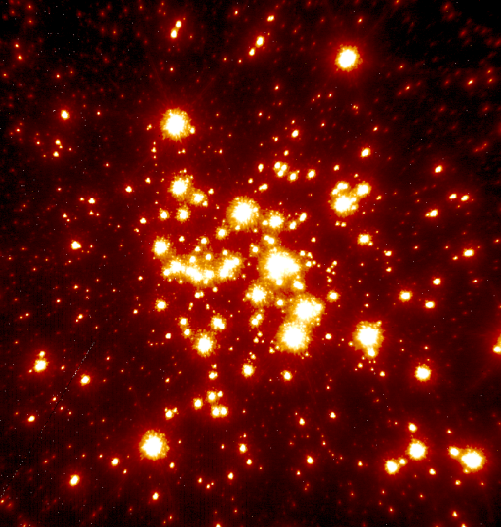
Keck/LGSAO (2006)

Slide 53

60 Seconds of Shrek

Slide 54
background sources

Slide 55
Background Sources
Atmosphere
  thermal
  molecular
Telescope
  thermal
  scattering
Zodiacal light
Astronomical sources

Slide 56
Background Sources: Atmosphere
Thermal
OH
  The average OH line intensity is approximately 25,000 photons s⁻¹ m⁻² asec⁻² μm⁻¹. See Maihara et al. 1993.
  The continuum between lines is about 50 times lower than this value (in the H band).
$${\dot{C}}_{sky,thermal}=η_{instrument}η_{telescope}AΩ\frac{Δν}{hν}ε_{sky}B_{ν}\left(T_{sky}\right)QE \{e^{−}s^{−1}\}$$

Slide 57
Background Sources: Astronomical
Astronomical objects can be objects of interest or noise contributors, depending on the project.
  Sunlight, moonlight
  Light scattered by solar system dust (“zodiacal”)
  Light emitted (thermal) by solar system dust (“zodiacal”)
  Stars (especially in a crowded field)
  Light emitted by interstellar dust (“cirrus”)

Slide 58
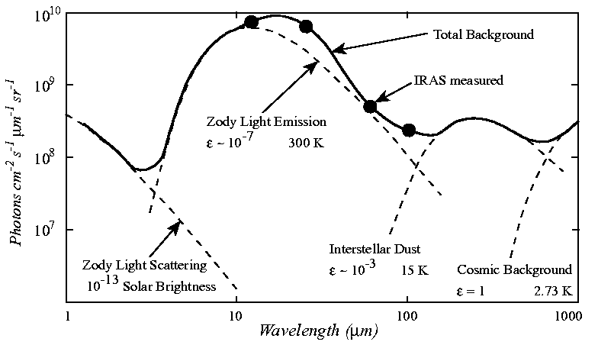
Background Sources: Astronomical

Slide 59
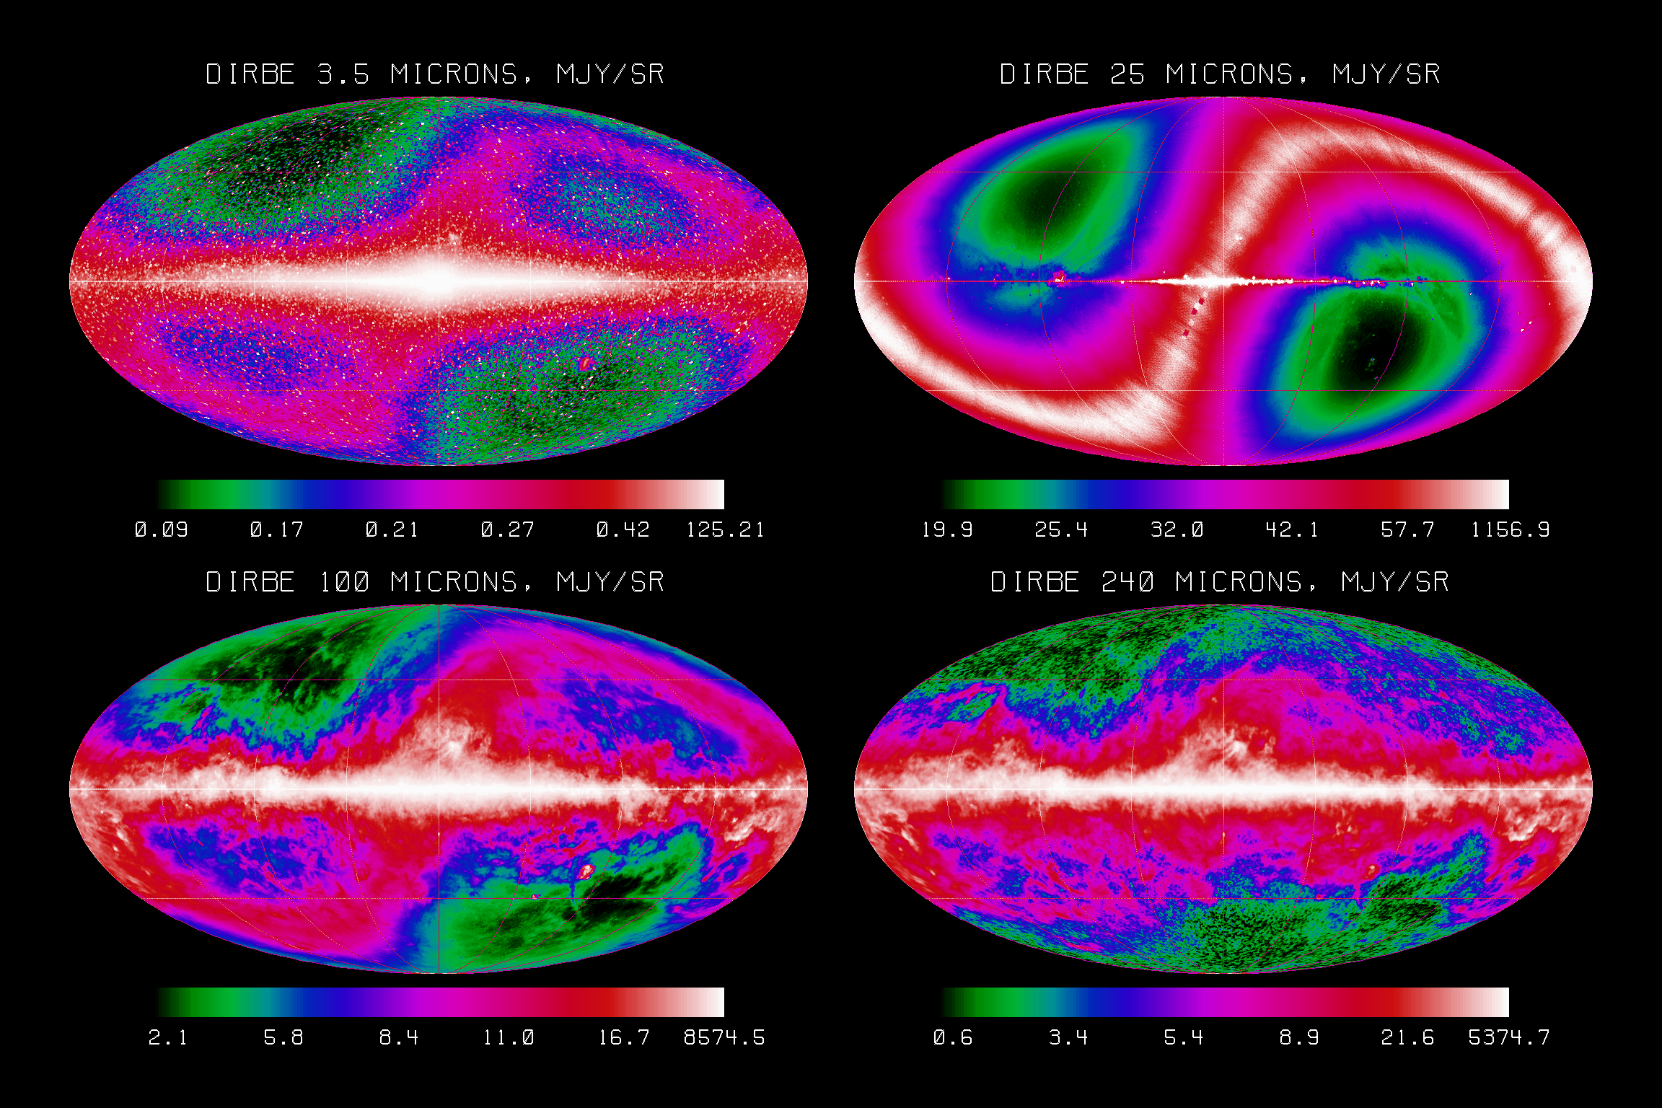
Background Sources: COBE data
zodiacal dust

Slide 60
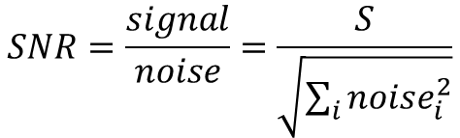
Background and Signal-to-Noise Ratio
Recall the expression for SNR.
$$SNR=\frac{signal}{noise}=\frac{S}{\sqrt{\sum_{i}{{noise}_{i}^{2}}}}$$
The noise is the quadrature sum of uncorrelated noise sources.
$$N_{total}={noise}_{total}=\sqrt{N_{source}^{2}+N_{background}^{2}+N_{read}^{2}+N_{dark}^{2}}$$
Background noise is the quadrature sum of shot noise for each background source.
$N_{background}^{2}=N_{sky,OH}^{2}$+$N_{sky,thermal}^{2}$+$N_{telescope,thermal}^{2}$+$N_{zodiacal light}^{2}$+$N_{other}^{2}$

Slide 61
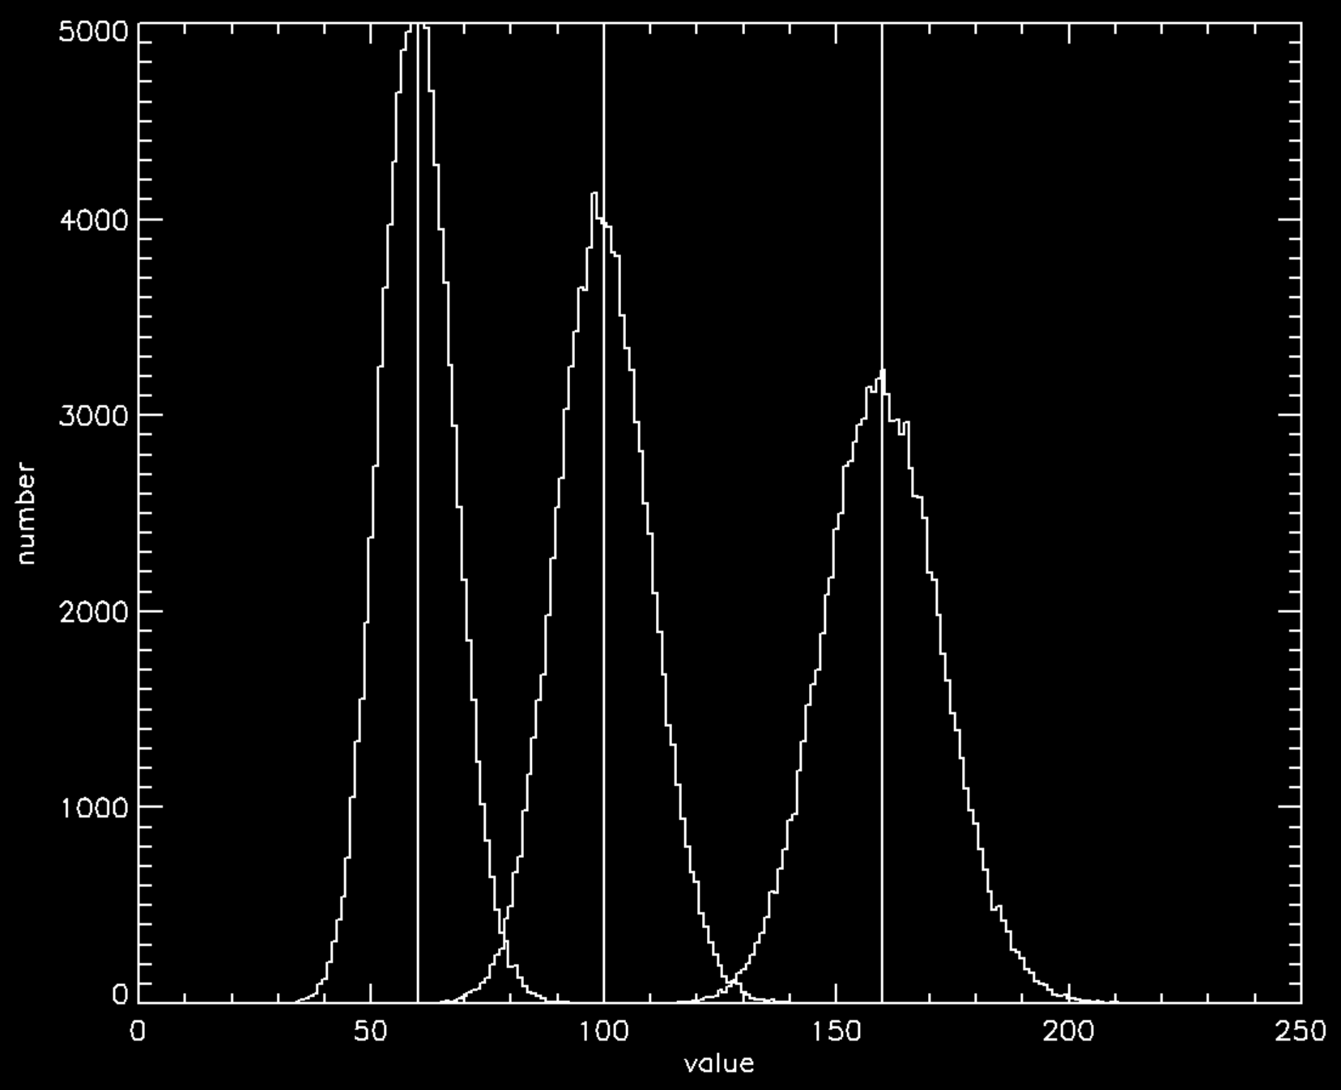
Adding Uncorrelated Noise Sources

Slide 62
Adding Uncorrelated Noise Sources
mean1=100
mean2=60
nelts=100000
z1=randomn(134,nelts,poisson=mean1)
z2=randomn(135,nelts,poisson=mean2)
n1=histogram(z1,locations=x1,binsize=1)
n2=histogram(z2,locations=x2,binsize=1)
plot,x1,n1,psym=10,xrange=[0,240],xtitle='value',ytitle='number',thick=2.,xthick=2,ythick=2 ,charthick=2.,charsize=2.
oplot,[mean1,mean1],[0,nelts],thick=2
oplot,x2,n2,psym=10 ,thick=2.
oplot,[mean2,mean2],[0,nelts],thick=2
; the standard deviations appear to be sqrt(means)! this is shot noise!
print,stddev(z1)
print,sqrt(mean1)
print,stddev(z2)
print,sqrt(mean2)
; now, let's add the two Gaussians
sum=z1+z2
meansum=mean1+mean2
nsum=histogram(sum,locations=xsum,binsize=1)
oplot,xsum,nsum,psym=10,thick=2.
oplot,[meansum,meansum],[0,nelts],thick=2
; the standard deviation of the summed sample is:
print,stddev(sum)
; the quadrature sum of the standard deviations is:
print,sqrt(stddev(z1)^2+stddev(z2)^2)
; They are the same number!
; So, when we add two Gaussians, the result is another Gaussian with a mean equal to the sum
; of the two means, and a standard deviation that is the quadrature sum of the two standard deviations.

Slide 63
homework

Slide 64
Homework Note!
I often work on the lecture slides, including the homework assignment slide up until the time of the lecture.
If you download the lecture before it is given, be sure to re-download it after the lecture, as you will likely see more slides and, perhaps, different homework questions!

Slide 65
Homework
5.1, 5.8 (see last slide)
What is the signal to noise ratio for a source that generates 100 electrons in a detector if the observation is limited by shot noise from the source?
What is the equivalent width of the following absorption line?
What is the wavelength of the Brackett-gamma (HI 7-4) line?
In which waveband does the Bracket-gamma line appear?
1
0
1.1
1.2
1.3
1.4
1.5
1.6
1.7
1.8
Wavelength (microns)

Slide 66
Homework
At which wavelength, observed by the DIRBE instrument on COBE, does zodiacal emission appear most prominent?
At which wavelength is the maximum flux for a blackbody of temperature=1000 K?
What is the wavelength of a photon emitted by a hydrogen atom with the electron in the ground state when it flips from a spin that is aligned with the spin of the proton to a spin that is anti-aligned with the spin of the proton?
What is the spectral resolution for a spectrograph that can separate features by 0.01 μm at a wavelength of 2 μm?
What is the distance of a star that appears to shift by one arcsecond when observed 6 months apart?

Slide 67
Homework
What is the spectral index for free-free (Bremsstrahlung) radiation on the flat part of its curve?
What type of radiation is emitted by charged particles rotating around a magnetic field?

Slide 68
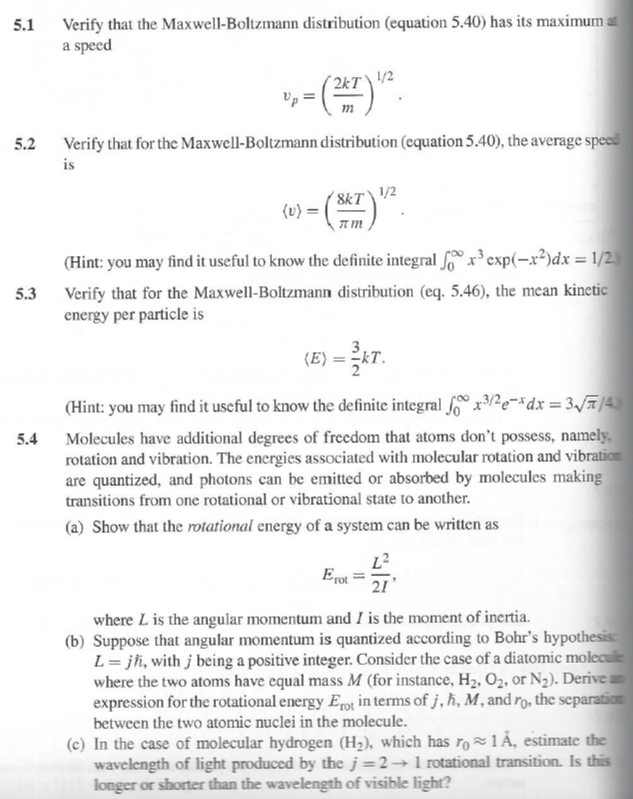
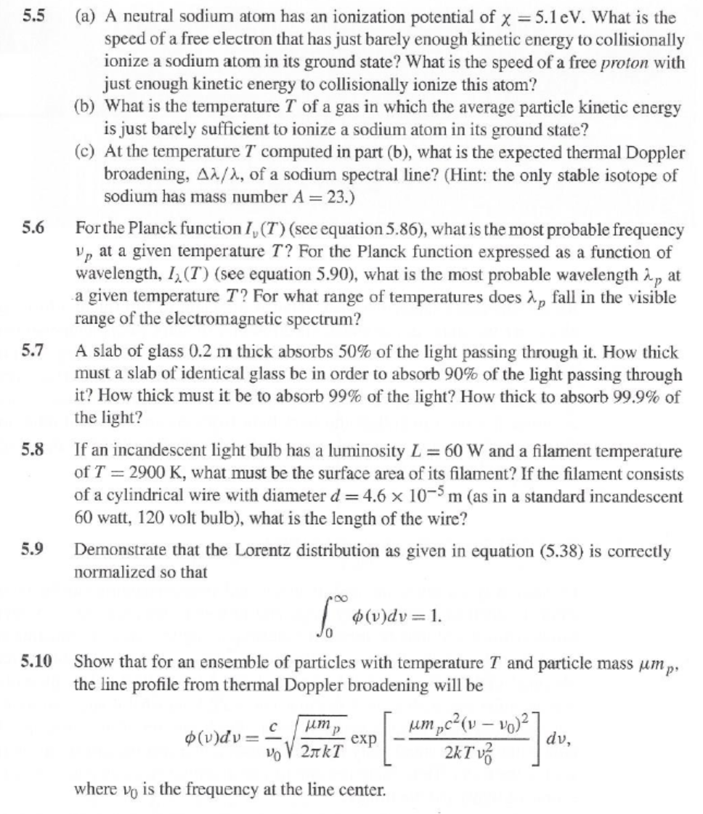
Homework

