Slide 1
University Astronomy
Professor Don Figer
The Eye and Wavelength Regions

Slide 2
Aims and Outline for this Lecture
review capabilities of eye
describe wavelength regimes

Slide 3
the electromagnetic spectrum

Slide 4
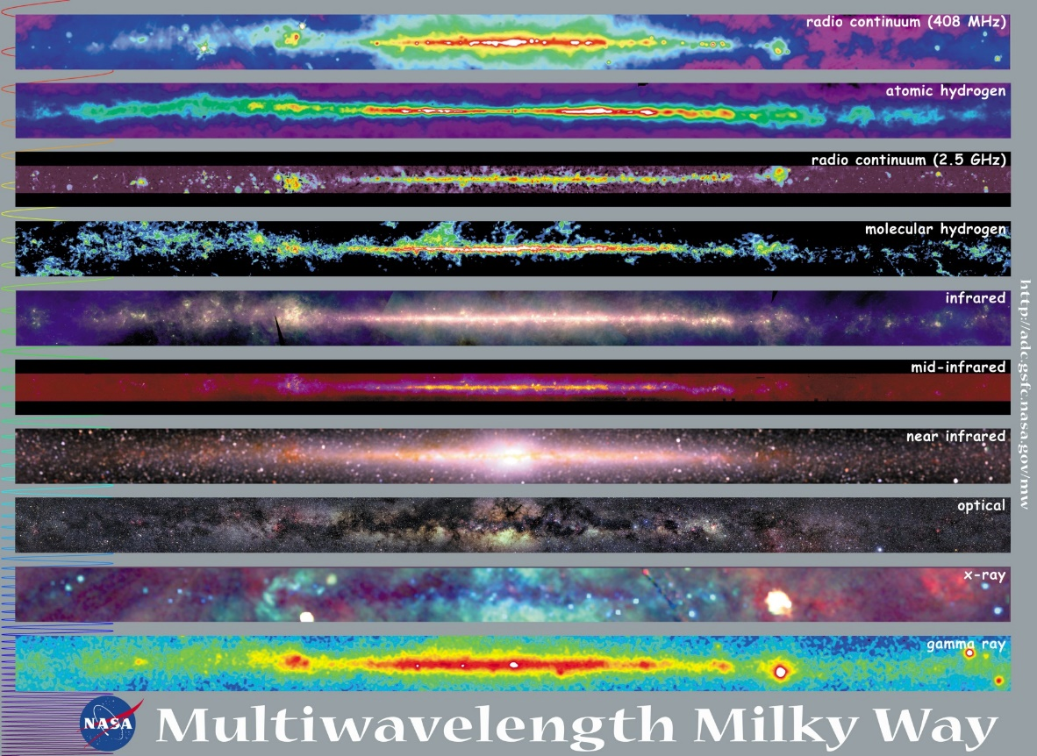
Notes:
Maps of the Milky Way at ten wavelengths, from radio waves to gamma rays. One of the outcomes of this course is that the student should be able to associate each map with a physical emission mechanism, instrument, detector, and scientific results.

Slide 5
Map of Milky Way - notes
Radio Continuum (408 MHz). Intensity of radio continuum emission from surveys with ground-based radio telescopes (Jodrell Bank MkI and MkIA, Bonn 100 meter, and Parkes 64 meter). At this frequency, most of the emission is from the scattering of free electrons in interstellar plasmas (hot, ionized interstellar gas). Some emission also comes from electrons accelerated in strong magnetic fields. The large arc apparent near the center of the image is known as the North Polar Spur or Loop I, and is the remnant plasma from a supernova explosion that occurred thousands of years ago relatively close to the Sun (on the scale of the Milky Way).
Atomic Hydrogen. Column density of neutral atomic hydrogen from radio surveys of the 21-cm transition of hydrogen. The 21-cm emission traces the "warm" interstellar medium, which on a large scale is organized into diffuse clouds of gas and dust that have sizes of up to hundreds of light years. The data shown here are a composite of several surveys with ground-based telescopes in the northern and southern hemispheres.
Molecular Hydrogen. Column density of molecular hydrogen (H2) inferred from the intensity of the J = 1-0 line of carbon monoxide (CO). H2 is difficult to observe directly. The ratio of CO to H2 is fairly constant, so it is used instead to trace the cold, dense molecular hydrogen gas. Such gas is concentrated in the spiral arms in discrete "molecular clouds," which are often sites of star formation. The data shown here are a composite of surveys taken with twin 1.2-m millimeter-wave telescopes, one in New York City and the other on Cerro Tololo in Chile.
Infrared. Composite of mid and far-infrared intensity images taken by the Infrared Astronomical Satellite (IRAS) in 12, 60, and 100 micron wavelength bands. Most of the emission is thermal, from interstellar dust warmed by absorbed starlight, including star-forming regions embedded in interstellar clouds. Emission from interplanetary dust in the solar system, the "zodiacal emission", was modeled and subtracted in the production of the images. The broad, sideways S-shaped curve traces the ecliptic plane and is the residual from the subtraction.
Near Infrared. Composite near-infrared intensity observed by the Diffuse Infrared Background Experiment (DIRBE) instrument on the Cosmic Background Explorer (COBE) in the 1.25, 2.2, and 3.5 micron wavelength bands. Most of the emission is from cool, low-mass K stars in the disk and bulge of the Milky Way. Interstellar dust does not strongly obscure emission at these wavelengths; the maps trace emission all the way through the Galaxy, although absorption in the 1.25 µm band is evident toward the Galactic center region.
Optical. Intensity of red-band (0.6 micron) visible light from a photomosaic taken with a very wide-field camera at northern and southern observatories. Owing to the strong obscuration by interstellar dust the light is primarily from stars within a few thousand light-years of the Sun, nearby on the scale of the Milky Way, which has a diameter on the order of 100,000 light years. Nebulosity from hot, low-density gas is widespread in the image. Dark patches are due to absorbing dust clouds, which are evident in the Molecular Hydrogen and Infrared maps as emission regions. The photographs do not cover the entire sky, and coordinate distortions in this image have not been corrected.
X-Ray. Composite X-ray intensity observations by an instrument on the Roentgen Satellite (ROSAT) in three broad, X-ray bands centered at 0.25 keV, 0.75 keV, and 1.5 keV. Shown is extended soft X-ray emission from tenuous hot gas. At the lower energies the cold interstellar gas strongly absorbs X-rays, and clouds of gas are seen as shadows against background X-ray emission. Color variations indicate variations of the absorption or of the temperatures of the emitting regions. The Galactic plane appears blue because only the highest-energy X-rays can pass through the large column densities of gas. The large loop near the center of the image is the North Polar Spur, an old supernova remnant. Many of the white sources are younger, more compact and more distant supernova remnants.
Gamma Ray. Intensity of high-energy gamma-ray emission observed by the Energetic Gamma-Ray Experiment Telescope (EGRET) instrument on the Compton Gamma-Ray Observatory (CGRO). The map includes all photons with energies greater than 100 MeV. At these extreme energies, most of the celestial gamma rays originate in collisions of cosmic rays with nuclei in interstellar clouds, and hence the Milky Way is a diffuse source of gamma-ray light. Superimposed on the diffuse light of the Milky Way are several gamma-ray pulsars, e.g., the Crab, Geminga, and Vela pulsars along the Galactic plane on the right-side of the image. Away from the plane, many of the sources are known to be active Galactic nuclei.
Notes:
These are explanatory notes for some of the maps in the image on the previous slide.

Slide 6
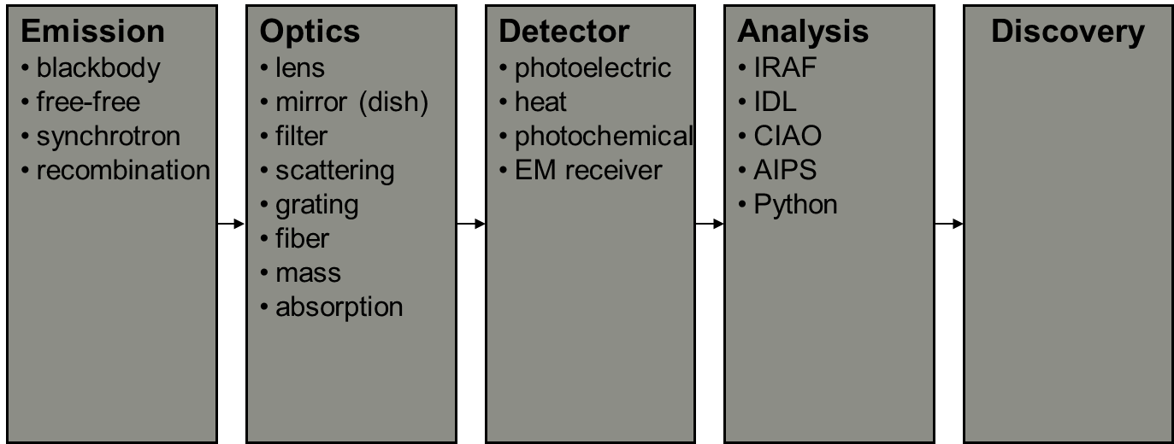
Basic Concepts - The Data Chain
Notes:
The path from object to data is generic. To start, energy must be emitted by some physical mechanism. This usually produces photons of light. The light travels from the object and is sometimes affected in space by dust or gravitational lenses. Once the light arrives at the instrument, it is further conditioned by optics which focus the light on to a detector. The detector, and associated electronics, transform the energy into digital form. The data can then be analyzed which can lead to discovery.

Slide 7
the eye

Slide 8

Human Eye
Notes:
While the eye is an excellent optical detector for many terrestrial applications, it has severe limitations for scientific applictions in low light, e.g. in astronomy.

Slide 9
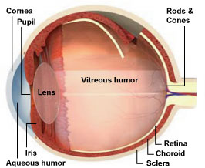
Human Eye
Ciliary Muscle
Sclera
Ear (Temporal)
Iris
Vitreous Humor
Pupil
Eyelens
Fovea
Retina
Optic Nerve
Cornea
Aqueous Humor
Nose (Nasal)
Suspensory ligament
Choroid
Notes:
The human eye is quite similar to a photographic camera. The cornea and the eye lens are the optical elements responsible for forming an image in the back of the eye. The iris is like the diaphragm of the camera, where the opening (or the aperture) controls the amount of light entering the eye. The retina, located at the back of the eye, is like the film, detecting the photons that entered the eye and then turning them into electrical impulses that exits out to the brain through the optic nerve. Now let us look at each part of the eye in detail.

Slide 10
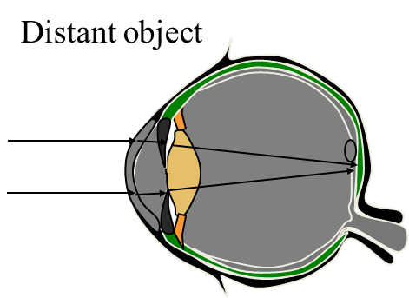
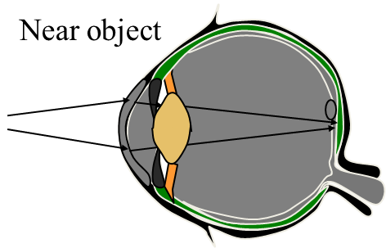
The Eye Lens has Variable Focal Length
The suspensory ligaments attach the lens to the ciliary muscle.
When the muscle contracts, the lens bulges out in the back, decreasing its focal length.
The process by which the lens changes shape to focus is called accommodation.
Notes:
The process in which the eye focuses is called accommodation. The muscle contracts, the shape of the lens deforms. The back of the lens bulges out to increase the power of the lens (decreasing the focal length) so that the eye can focus on a near object. When the ciliary muscle relaxes, the ligament tightens up, decreasing the curvature of the back of the lens.

Slide 11
Myopia - Near sightedness
Far object
Myopic eye relaxed
Blurry
Near object
Myopic eye relaxed
In focus
Far object
Myopia corrected with a negative lens
The virtual image from the diverging lens appears to be closer.
Notes:
Recall that the human eye focuses by flexing the clilary muscles which change the power of the eye lens. Relaxed eye has the least refractive power. However, in myopia, the relaxed eye is still too strong to focus the object located afar, so that the image is focused before the retina. Near objects are in focus because the eye is at focus without accommodation.
To correct for myopia, a negative lens is used. Remember that the negative lens diverges rays. So for a far object, the negative lens diverges the parallel rays so that it looks as though it is coming from a closer object. The image is smaller in size, but the distant object is now in focus.

Slide 12
Hyperopia - Far sightedness
Far object
Hyperopic eye
Partially accommodated
In focus
Near object
Hyperopic eye
Fully accommodated
Blurry
Near object
Hyperopia corrected with a positive lens
Notes:
Hyperopic eye is too weak for its own good. The far objects are in focus because the eye can accommodate slightly to focus. However, for near objects, the eye cannot accommodate any farther, resulting in a blurry image. Hyperopia is corrected with a positive lens; the rays from near objects are diverging, but the positive lens converges the rays so that it looks as though it is coming from the distance.

Slide 13
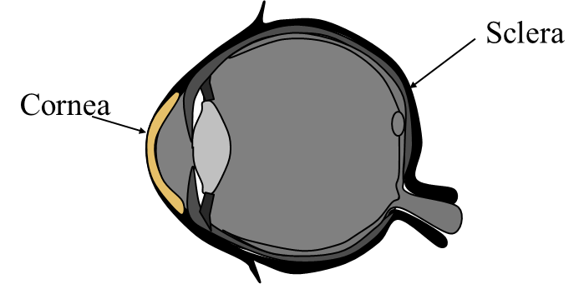
Cornea
The outer wall of the eye is formed by the sclera.
Cornea is the clear portion of the sclera.
2/3 of the refraction takes place at the cornea.
Notes:
The eye is encased in a white rigid outer wall called sclera. Sclera is the “white” of the eye. The front portion of the sclera is clear, and this is called the cornea. The cornea is responsible for 2/3 of the total refraction, since the greatest change in the index of refraction occurs between the air and the surface of the cornea. This is why you can’t see very clear under water without goggles.

Slide 14
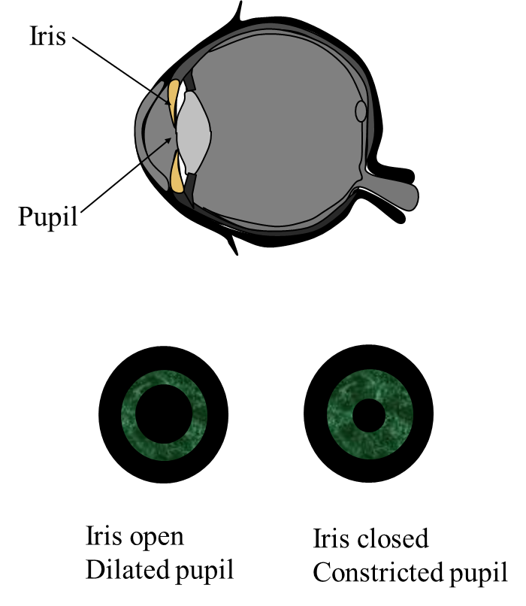
Iris and Pupil
Colored iris controls the size of the opening (pupil) where the light enters.
Pupil determines the amount of light, like the aperture of a camera.
Notes:
Iris is muscle that contracts and dilates to determine the pupil size. Iris is brightly colored, and this is the “color” of the eye. The pupil is the opening where the light enters.

Slide 15
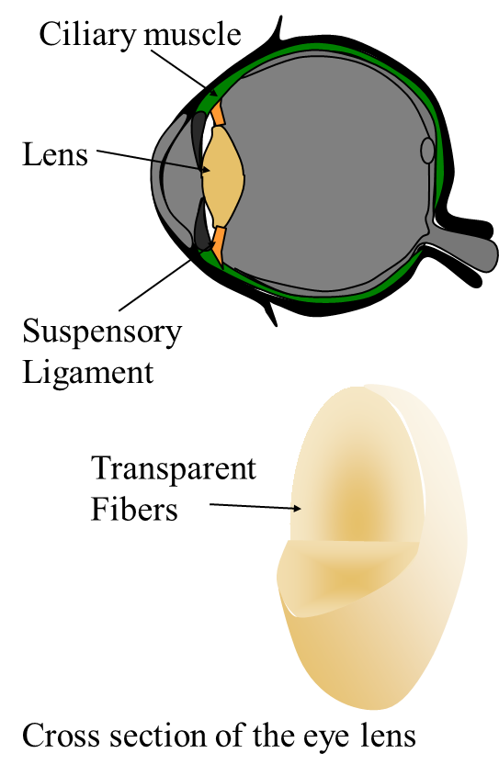
Lens
Eye lens is made of transparent fibers in a clear membrane.
Suspended by suspensory ligament.
Used as a fine focusing mechanism by the eye; provides 1/3 of eye’s total refracting power.
Gradient index of refraction.
Notes:
Eye lens is located just behind the iris. The eye lens is made of transparent fibers encased in a clear membrane. The lens is suspended by a suspensory ligament, which attaches to muscle known as ciliary muscle. The eye lens is quite flexible unlike a lens made out of glass. The ciliary muscle can actually change the shape of the back of the lens by flexing; and this is how the lens is used to focus between near and far objects.
In addition, the index of refraction of the lens is different from the middle of the lens to the edge of the lens.

Slide 16
Human Vision
  Human Cone Response to Color
    three cone types (S,M,L) roughly correspond to B,G,R
S
M
L
Relative response
400
460
490
500
530
600
650
700
Wavelength (nm)
Blue
Cyan
Green
Red
Notes:
This is a graph of the individual cone sensitivity for different wavelengths.
“S” (short) cones mainly detect in the blue region of the spectrum. Likewise, the “M” (mid) cones that peak in the green region, and the “L” (long) cones respond mostly to the red region.

Slide 17
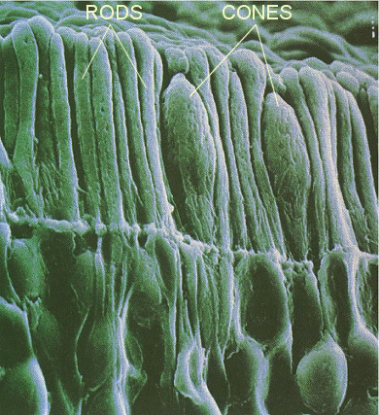
Rods and Cones
Synaptic endings
Cell nucleus
Inner segments
Outer segments
Rod
Cone
Highly sensitive to low light level or scotopic conditions.
Black and white.
Dispersed in the periphery of the retina.
Sensitive to high light level or photopic conditions.
Three types of cones responsible for color vision.
Concentrated in the fovea.
Notes:
The rods and cones are a special type of nerve cells sensitive to light. The rod is called a rod because it looks like a rod in reality. It is highly sensitive to low light level or scotopic conditions. The rod is sensitive to all the visible wavelengths, and it is dispersed in the periphery of the retina.
The cone is sensitive to high light level or photopic conditions. There are three types of cones responsible for the color vision. More on color vision in the later sections. The cones is concentrated in the fovea.
SEM of rod and cone cells. Rods are used for night vision and are sensitive only to one color (deep violet). Cones come in three flavors (red, green, and blue).

Slide 18
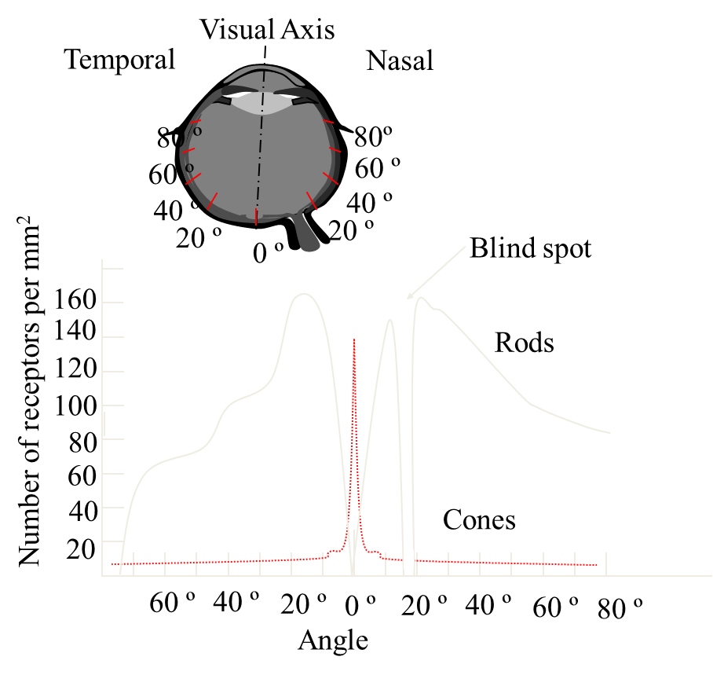
Distribution of Photoreceptors
Cones are concentrated in the fovea.
Rods predominate the periphery.
There is a blind spot where there are no photoreceptors, at the point where the nerves exit the eye (optic nerve).
Notes:
The receptors are not equally distributed in the retina. The cones are concentrated in the fovea, where the photopic vision is the most acute. The rods predominate the periphery. This is why the stars seem to disappear if you stare at it- the rods are much more sensitive to low level of light and they are concentrated off axis about 20 degrees.
In addition, the eye has a large blind spot where there is no photo receptors. This is where all the nerve endings from the retina bundles and exits the eye. So how come we don’t see a big hole in the scenes we see? The visual cortex which is the part of brain responsible for processing vision fills the hole. More on perception later.

Slide 19
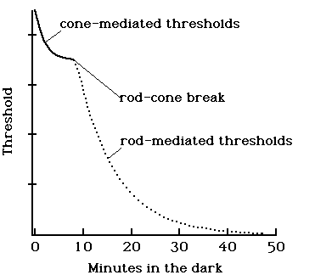
Adaptation: The Rod/Cone Break
Maximum sensitivity requires ~40 minutes, though a measurable change is still evident after 24 hours.
Sensitivity range is ~100,000,000 : 1, (sunlight → moonless night).
Rods respond to single photons, but neural filters only transmit signal if several photons arrive within a 100 ms time interval.
Notes:
This is why you can’t see immediately after you enter a dark movie theater from outside where it is light out.
The photoreceptors had adapted to the light level outside, so the sensitivity of the receptors became very low. It takes several minutes for the receptors to replenish the bleached rhodopsin disks.
It generally takes about 7 minutes for the eye to switch from the photopic vision to scotopic vision.

Slide 20
specific wavelength regions

Slide 21
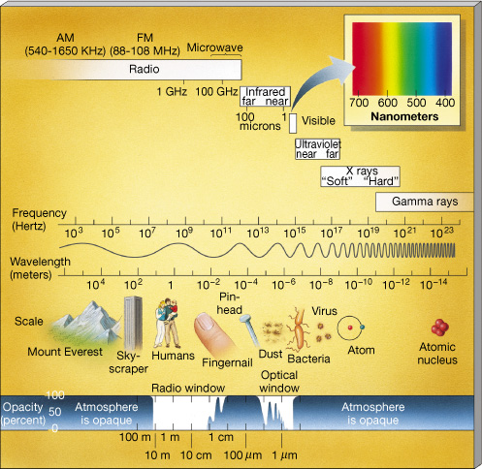
Wavelength Regions
The electromagnetic spectrum can be split up into regions that each have their own emission mechanisms, optics, instruments, detectors, and analysis techniques.
Notes:
Electromagnetic Spectrum The entire electromagnetic spectrum, running from long-wavelength, low-frequency radio waves, to short-wavelength, high-frequency gamma rays.

Slide 22
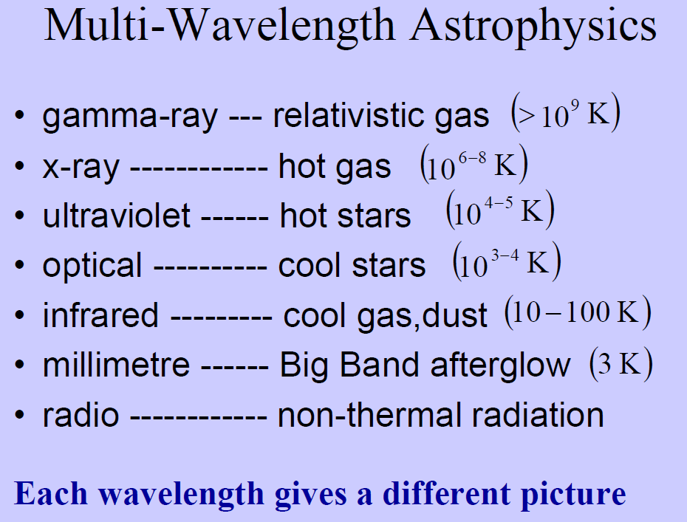
Wavelength Regions: Sources
Notes:
Electromagnetic Spectrum The entire electromagnetic spectrum, running from long-wavelength, low-frequency radio waves, to short-wavelength, high-frequency gamma rays.

Slide 23
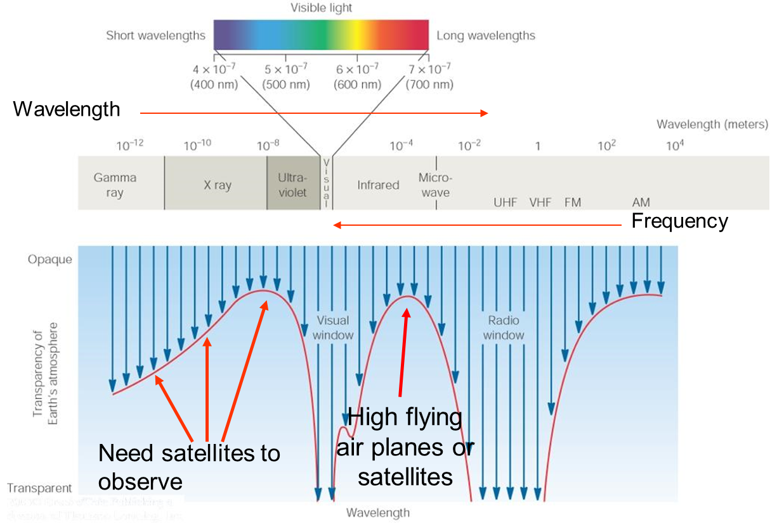
Wavelength Regimes: the atmosphere

Slide 24
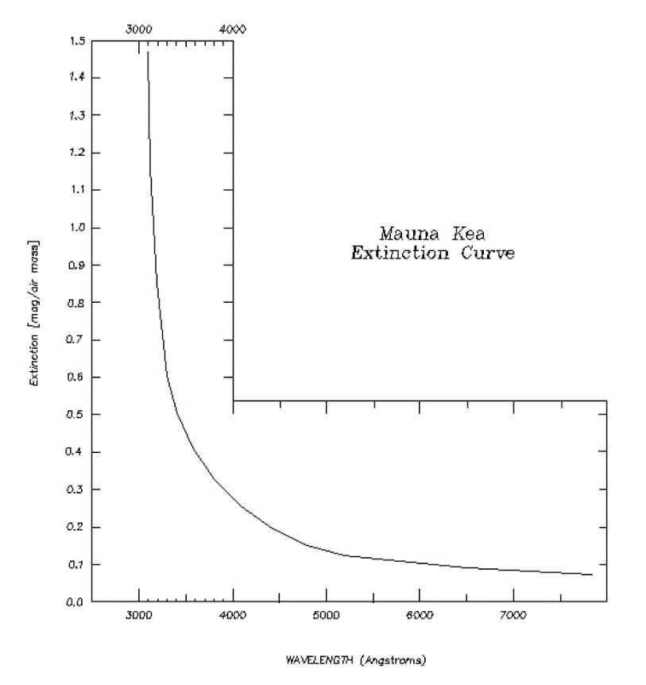
Wavelength Regimes: the atmosphere

Slide 25
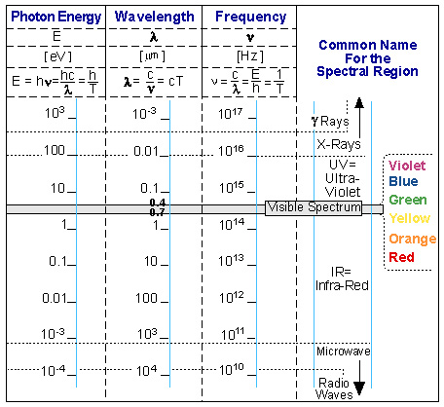
Some Useful Relations
1 eV = 1.6x10⁻¹⁹ J
c = 3x10⁸ m/s
1 Angstrom = 10⁻¹⁰ m
Speed of light in matter:
c_{m} = c/n, where
n is refractive index
Note: n is a function of λ

Slide 26
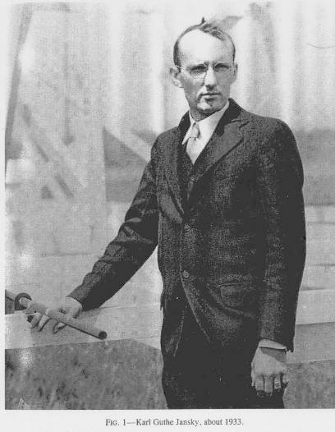
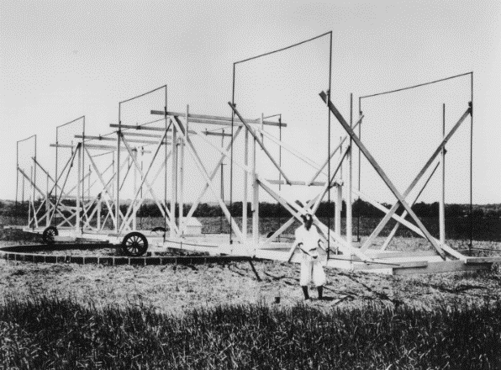
Wavelength Regimes: radio
Radio (>1 cm)
visible from Earth
first astronomical observations from non-optical wavelengths (Karl Jansky antenna)
used in discovery of massive (“radio”) galaxies and Galactic center
  Jansky saw nearby thunderstorms, distant thunderstorms, and a weaker signal.
  Weak signal repeated every 23h56m -> Galactic center.
unite of flux measurement is the Jansky: 10-26 W / m2 / Hz
Jansky and his antenna
Notes:
Jansky built an antenna designed to receive radio waves at a frequency of 20.5 MHz (wavelength about 14.6 meters). It was mounted on a turntable that allowed it to rotate in any direction, earning it the name "Jansky's merry-go-round". It had a diameter of approximately 100 ft. and stood 20 ft. tall. By rotating the antenna on a set of four Ford Model-T tires, the direction of a received signal could be pinpointed. A small shed to the side of the antenna housed an analog pen-and-paper recording system.
After recording signals from all directions for several months, Jansky eventually categorized them into three types of static: nearby thunderstorms, distant thunderstorms, and a faint steady hiss of unknown origin. He spent over a year investigating the source of the third type of static. The location of maximum intensity rose and fell once a day, leading Jansky to initially surmise that he was detecting radiation from the Sun.
After a few months of following the signal, however, the brightest point moved away from the position of the Sun. Jansky also determined that the signal repeated on a cycle of 23 hours and 56 minutes. This four-minute lag is a typical astronomical characteristic of any "fixed" object located far from our solar system (see sidereal day). By comparing his observations with optical astronomical maps, Jansky concluded that the radiation was coming from the Milky Way and was strongest in the direction of the center the galaxy, in the constellation of Sagittarius.
His discovery was widely publicized, appearing in the New York Times of May 5, 1933. He published his classic paper "Electrical disturbances apparently of extraterrestrial origin" in Proc. IRE in 1933. This paper was re-printed in Proc. IEEE in 1984 (for their centennial issue, where they note the research most likely would have won a Nobel prize, had not the author died young) and again in 1998, for the first centennial of radio. Jansky wanted to follow up on this discovery and investigate the radio waves from the Milky Way in further detail. He submitted a proposal to Bell Labs to build a 30 meter diameter dish antenna with greater sensitivity that would allow more careful measurements of the structure and strength of the radio emission. Bell Labs, however, rejected his request for funding on the grounds that the detected emission would not significantly affect their planned transatlantic communications system. Jansky was re-assigned to another project and did no further work in the field of astronomy.

Slide 27
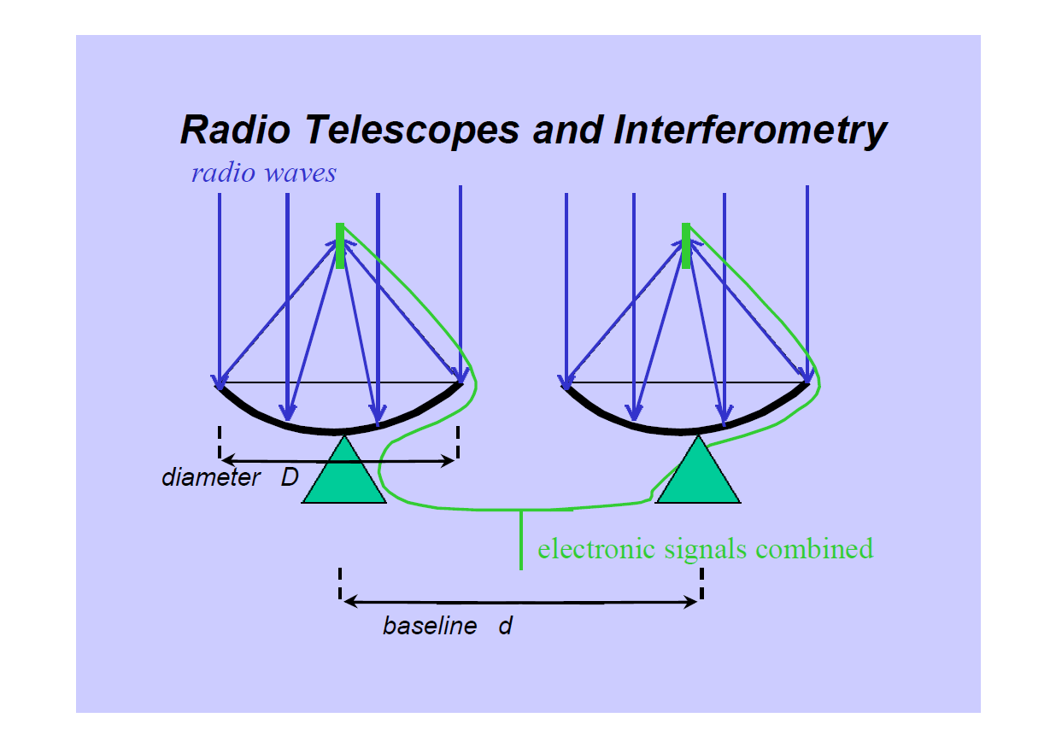
Wavelength Regimes: radio telescopes

Slide 28
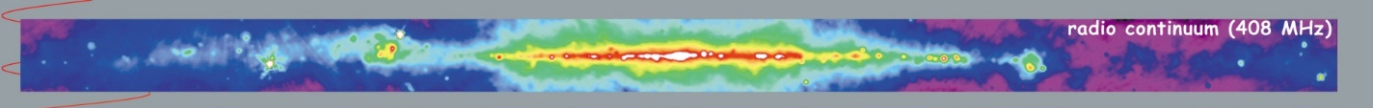
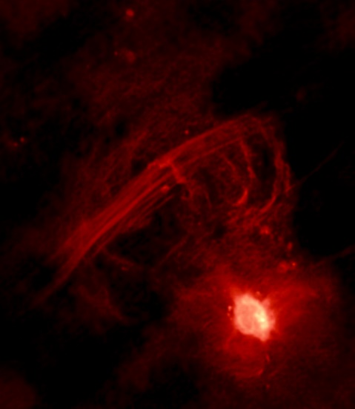
Wavelength Regimes: radio observations
Galaxy and Galactic center in radio continuum light
Notes:
Intensity of radio continuum emission from surveys with ground-based radio telescopes (Jodrell Bank MkI and MkIA, Bonn 100 meter, and Parkes 64 meter). At this frequency, most of the emission is from the scattering of free electrons in interstellar plasmas (hot, ionized interstellar gas). Some emission also comes from electrons accelerated in strong magnetic fields. The large arc apparent near the center of the image is known as the North Polar Spur or Loop I, and is the remnant plasma from a supernova explosion that occurred thousands of years ago relatively close to the Sun (on the scale of the Milky Way).
The long parallel rays slanting across the top of the above radio image are known collectively as the Galactic Center Radio Arc and jut straight out from the Galactic plane. The Radio Arc is connected to the Galactic center by strange curving filaments known as the Arches. The bright radio structure at the bottom right likely surrounds a black hole at the Galactic center and is known as Sagittarius A*. One origin hypothesis holds that the Radio Arc and the Arches have their geometry because they contain hot plasma flowing along lines of constant magnetic field. Recent images from the Chandra X-ray Observatory appear to show this plasma colliding with a nearby cloud of cold gas.

Slide 29
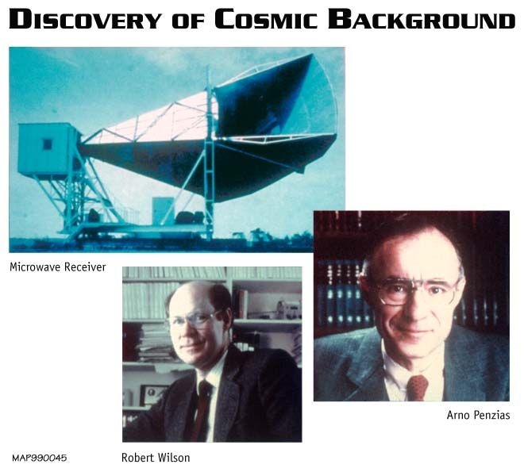
Wavelength Regimes: millimeter (microwave)
Microwaves (1 mm to 1 cm)
most important form of microwave radiation in astronomy is Cosmic Microwave Background
discovered in 1965
comes from all parts of the Universe with the same intensity
solid evidence for the 'Big Bang' theory
COBE, MAP, Planck
Notes:
In 1964, on building their most sensitive antenna/receiver system, Penzias and Wilson encountered radio noise which they could not explain. It was far less energetic than the radiation given off by the Milky Way, and it was isotropic, so they assumed their instrument was subject to interference by terrestrial sources. They tried, and then rejected, the hypothesis that the radio noise emanated from New York City. An examination of the microwave horn antenna showed it was full of pigeon droppings (which Penzias described as "white dielectric material"). After the pair removed the guano buildup, and the pigeons were shot (each physicist says the other ordered the deed), the noise remained. Having rejected all sources of interference, the pair published a paper announcing their findings. This was later identified as the cosmic microwave background radiation (CMB), the radio remnant of the Big Bang. This allowed astronomers to confirm the Big Bang, and to correct many of their previous assumptions about it.
The horn antenna on which Penzias and Wilson discovered the cosmic microwave background.

Slide 30
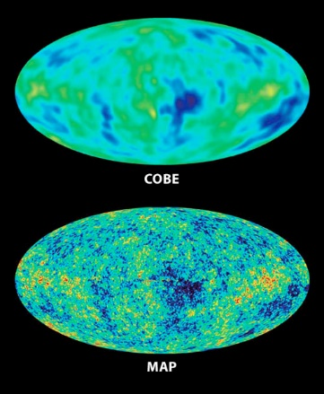
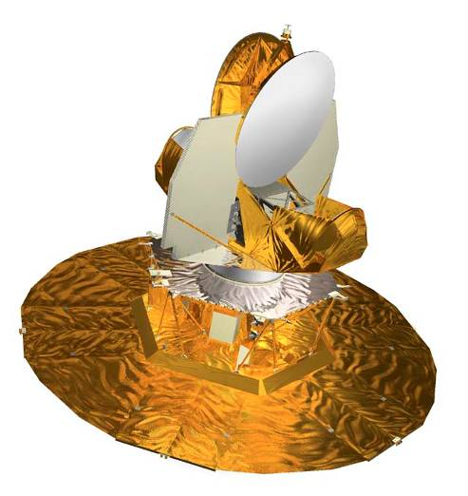
Wavelength Regimes: millimeter observations
The COBE mission mapped the cosmic microwave background.
It led to the Nobel Prize (John Mather is now Project Scientist for JWST).
The MAP made higher resolution maps.
MAP
Notes:
Artist's conception of the COBE satellite in orbit, annotated with locations of scientific instruments, dewar, etc.
All-sky images of the infant Universe, 380,000 years after the Big Bang, over 13 billion years ago. In 1992, NASA's COBE mission first detected patterns in the oldest light in the universe (shown as color variations). WMAP brings the COBE picture into sharp focus.The features are consistent and 35 times more detailed than COBE's.
(bottom) The new, detailed image provides firm answers to age-old questions.
WMAP observers the first light of the universe- the afterglow of the Big Bang. This light emerged 380,000 years after the Big Bang. Patterns imprinted on this light encode the events that happened only a tiny fraction of a second after the Big Bang. In turn, the patterns are the seeds of the development of the structures of galaxies we now see billions of years after the Big Bang.

Slide 31
Wavelength Regimes: sub-mm/far-infrared
Infrared (0.1 mm to 1 mm)
mostly absorbed by Earth’s atmosphere, although accessible from very dry locations or airborne platforms
primary source is heat emitted by dust
observing platforms include
  IRAS (Infrared Astronomical Satellite) which detected about 350,000 sources
  Infrared Space Observatory (ISO) which made important studies of the dusty regions of the Universe
  COBE/MAP
  Spitzer
  IRTF, KAO, SOFIA, Herschel
  ALMA, SMA
Notes:
Submillimetre astronomy or submillimeter astronomy (see spelling differences) is the branch of observational astronomy that is conducted at submillimetre wavelengths. It is often described as residing in the far-infrared or between the infrared and radio wavebands. Astronomers place the submillimetre waveband between the far-infrared and microwave wavebands, typically taken to be between a few hundred micrometres and a millimetre. It is still common in submillimetre astronomy to quote wavelengths in 'microns', the old name for micrometer.
Using submillimetre observations, astronomers examine molecular clouds and dark cloud cores with a goal of clarifying the process of star formation from earliest collapse to stellar birth. Space-based observations of these dark clouds will attempt to determine chemical abundances and cooling mechanisms for the molecules which comprise them. In addition, submillimetre observations will attempt to determine the mechanisms for the formation and evolution of galaxies.

Slide 32
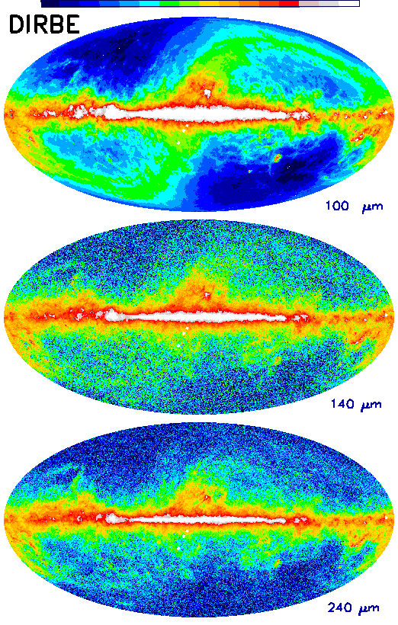
Wavelength Regimes: sub-mm/far-infrared observations
Notes:
Thermal emission from relatively cool interstellar dust warmed by stars in the Milky Way dominates at these wavelengths. At high Galactic latitudes, interstellar "cirrus" clouds are apparent. Emission from the solar system dust ("zodiacal emission") is strongest at 25 microns but remains in evidence in the 100 micron image, and to a lesser degree at the longer wavelengths.

Slide 33
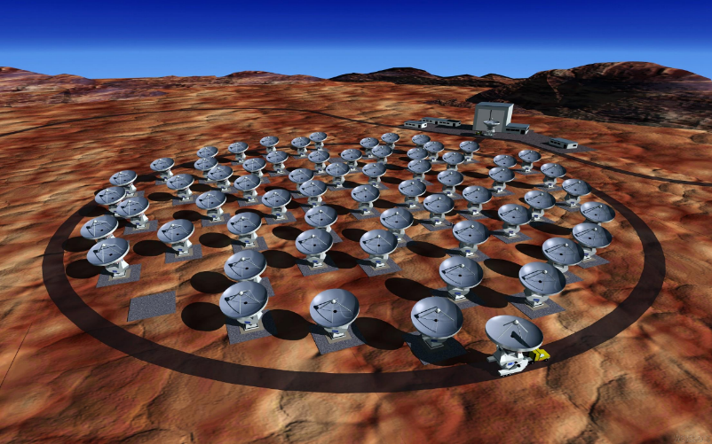

Wavelength Regimes: sub-mm/far-infrared platforms
ALMA
Notes:
The Atacama Large Millimeter/submillimeter Array (ALMA) is an international astronomy project that consists of an astronomical interferometer formed from an array of radio telescopes, located at Llano de Chajnantor Observatory in the Atacama desert in northern Chile. The telescope is expected to revolutionise modern astronomy by providing an insight on star formation in the early universe and imaging local star and planet formation in great detail. With a cost in excess of 1 billion US dollars, it is the most ambitious ground-based telescope currently under construction.
SOFIA is a Boeing 747SP airliner, formerly flown commercially by United Airlines and Pan Am, modified to carry a 2.5 meter diameter reflecting telescope for infrared astronomy observations at altitudes of about 41,000 feet (~12 km) in the stratosphere. Its flight capability will allow it to rise above almost all of the water vapor in the Earth's atmosphere (allowing observations at some infrared wavelengths which are blocked by the atmosphere before reaching ground-based facilities), as well as travel to almost any point on the earth's surface for observations. The telescope looks out of a large door in the side of the fuselage near the airplane's tail, and will initially carry nine instruments for infrared astronomy at wavelengths from 1–655 micrometres and high-speed optical astronomy at wavelengths from 0.3–1.1 micrometres.

Slide 34

Wavelength Regimes: sub-mm/far-infrared platforms
Notes:
The Atacama Large Millimeter/submillimeter Array (ALMA) is an international astronomy project that consists of an astronomical interferometer formed from an array of radio telescopes, located at Llano de Chajnantor Observatory in the Atacama desert in northern Chile. The telescope is expected to revolutionise modern astronomy by providing an insight on star formation in the early universe and imaging local star and planet formation in great detail. With a cost in excess of 1 billion US dollars, it is the most ambitious ground-based telescope currently under construction.
SOFIA is a Boeing 747SP airliner, formerly flown commercially by United Airlines and Pan Am, modified to carry a 2.5 meter diameter reflecting telescope for infrared astronomy observations at altitudes of about 41,000 feet (~12 km) in the stratosphere. Its flight capability will allow it to rise above almost all of the water vapor in the Earth's atmosphere (allowing observations at some infrared wavelengths which are blocked by the atmosphere before reaching ground-based facilities), as well as travel to almost any point on the earth's surface for observations. The telescope looks out of a large door in the side of the fuselage near the airplane's tail, and will initially carry nine instruments for infrared astronomy at wavelengths from 1–655 micrometres and high-speed optical astronomy at wavelengths from 0.3–1.1 micrometres.

Slide 35
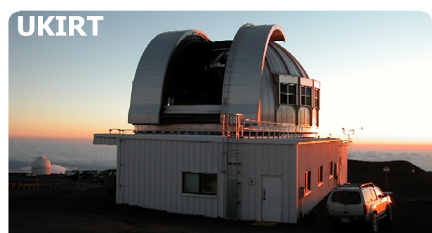
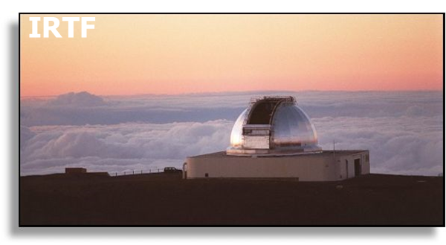
Wavelength Regimes: near/mid-infrared
Infrared (700 nm to 0.1 mm)
accessible on Earth through atmospheric windows, i.e. JHKLMNQ
stars, very hot dust, red-shifted optical light
observed on ground and in space from optical telescopes
  IRTF, UKIRT, Keck, VLT, many more
  IRAS, COBE, HST, JWST, WISE
Notes:
Like all other forms of electromagnetic radiation, infrared is utilised by astronomers to learn more about the universe. As infrared is essentially heat radiation, infrared telescopes (which include most major optical telescopes as well as a few dedicated infrared telescopes) need to have their detectors shielded from heat and chilled with liquid nitrogen in order to actually form images. This is particularly important in the mid infrared and far infrared regions of the spectrum. The principle limitation on infrared sensitivity from ground-based telescopes is the water vapour in the Earth's atmosphere, which absorbs a significant amount of infrared radiation. For this reason most infrared telescopes are built in very dry places at high altitude (above most of the water vapour in the atmosphere).

Slide 36
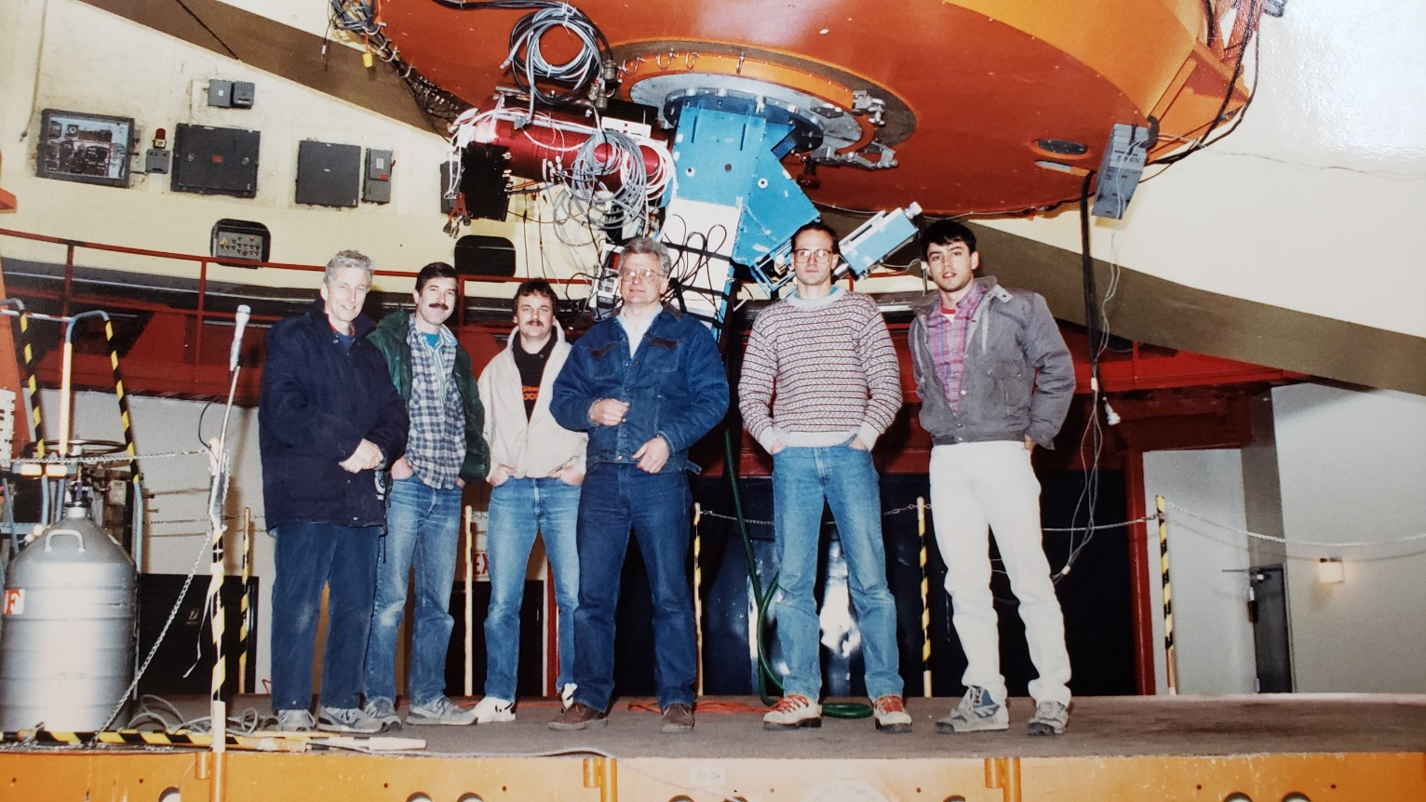
Wavelength Regimes: near/mid-infrared
Notes:
Like all other forms of electromagnetic radiation, infrared is utilised by astronomers to learn more about the universe. As infrared is essentially heat radiation, infrared telescopes (which include most major optical telescopes as well as a few dedicated infrared telescopes) need to have their detectors shielded from heat and chilled with liquid nitrogen in order to actually form images. This is particularly important in the mid infrared and far infrared regions of the spectrum. The principle limitation on infrared sensitivity from ground-based telescopes is the water vapour in the Earth's atmosphere, which absorbs a significant amount of infrared radiation. For this reason most infrared telescopes are built in very dry places at high altitude (above most of the water vapour in the atmosphere).

Slide 37
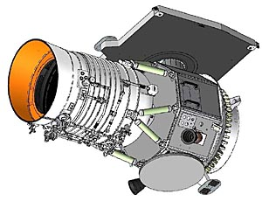
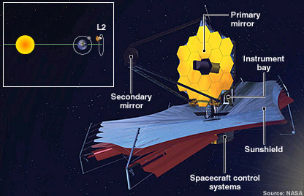
Wavelength Regimes: near/mid-infrared
WISE is an all-sky survey mission that was launched in 2009. It covers 3 to 22 um wavelengths in four bands.
JWST is an imaging and spectroscopic mission that will launch ~201718192021. It covers 0.6 to 28 um.
Notes:
WISE is a NASA-funded Explorer mission that will provide a vast storehouse of knowledge about the solar system, the Milky Way, and the Universe. Among the objects WISE will study are asteroids, the coolest and dimmest stars, and the most luminous galaxies.

Slide 38
Wavelength Regimes: near/mid-infrared: Atmospheric Transmission
Notes:
Like all other forms of electromagnetic radiation, infrared is utilised by astronomers to learn more about the universe. As infrared is essentially heat radiation, infrared telescopes (which include most major optical telescopes as well as a few dedicated infrared telescopes) need to have their detectors shielded from heat and chilled with liquid nitrogen in order to actually form images. This is particularly important in the mid infrared and far infrared regions of the spectrum. The principle limitation on infrared sensitivity from ground-based telescopes is the water vapour in the Earth's atmosphere, which absorbs a significant amount of infrared radiation. For this reason most infrared telescopes are built in very dry places at high altitude (above most of the water vapour in the atmosphere).

Slide 39
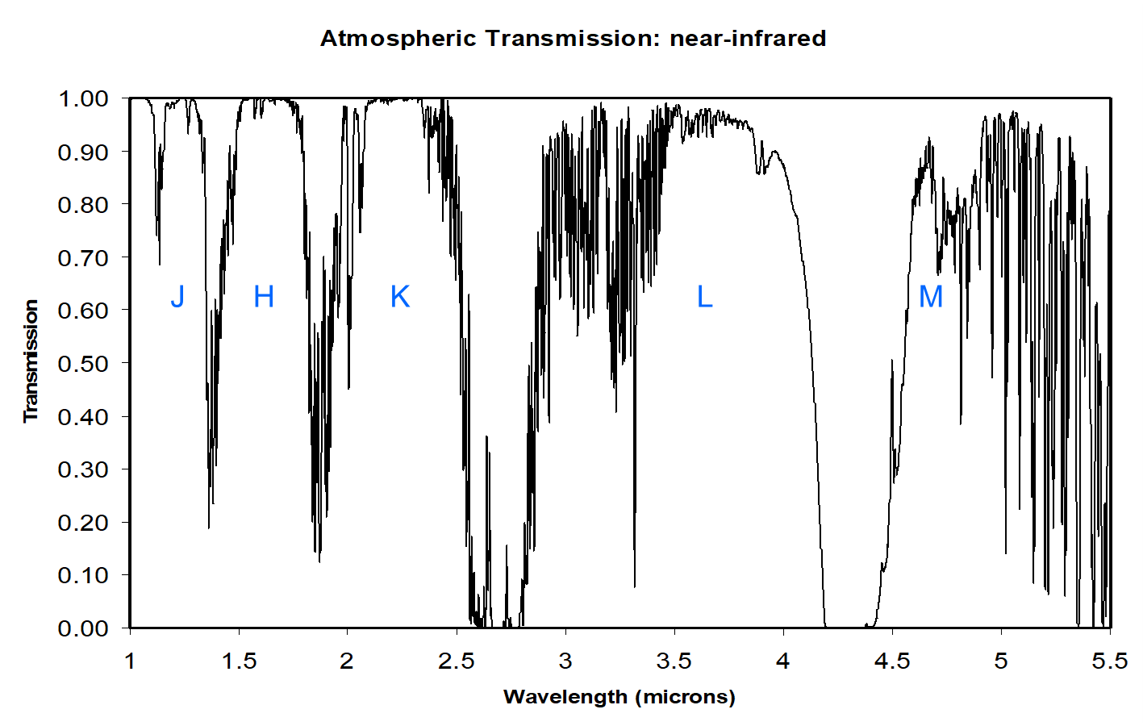
Wavelength Regimes: near-infrared: Atmospheric Transmission
Notes:
Like all other forms of electromagnetic radiation, infrared is utilised by astronomers to learn more about the universe. As infrared is essentially heat radiation, infrared telescopes (which include most major optical telescopes as well as a few dedicated infrared telescopes) need to have their detectors shielded from heat and chilled with liquid nitrogen in order to actually form images. This is particularly important in the mid infrared and far infrared regions of the spectrum. The principle limitation on infrared sensitivity from ground-based telescopes is the water vapour in the Earth's atmosphere, which absorbs a significant amount of infrared radiation. For this reason most infrared telescopes are built in very dry places at high altitude (above most of the water vapour in the atmosphere).

Slide 40
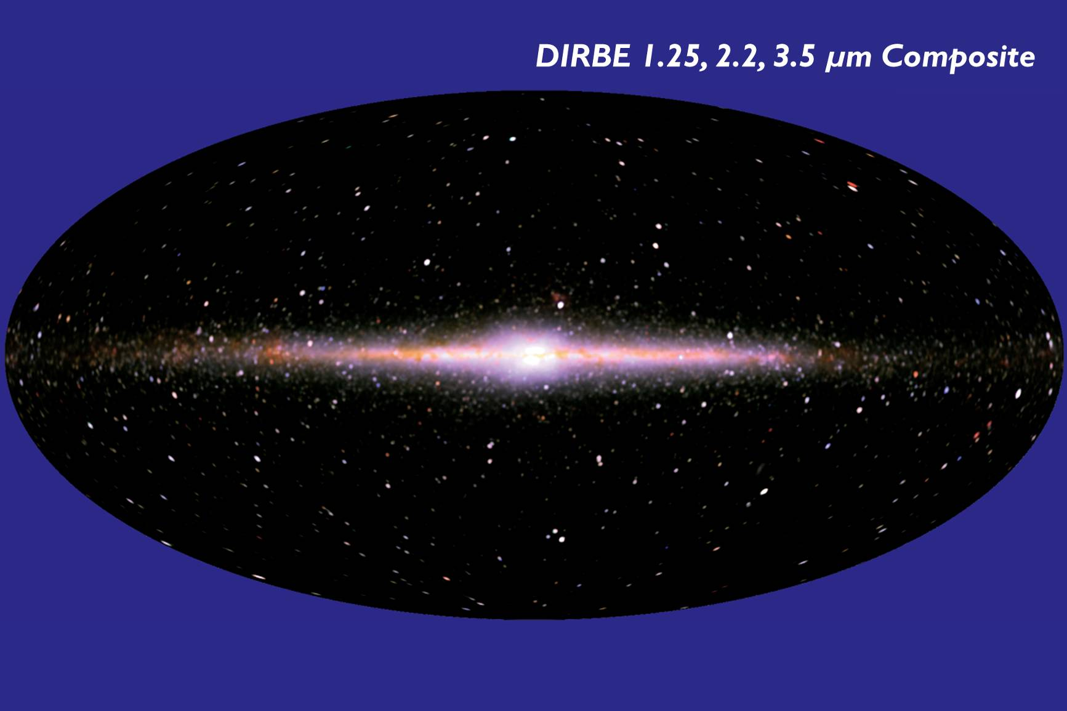
Wavelength Regimes: near/mid-infrared observations
Notes:
False-color image of the near-infrared sky as seen by the DIRBE. Data at 1.25, 2.2, and 3.5 µm wavelengths are represented respectively as blue, green and red colors. The image is presented in Galactic coordinates, with the plane of the Milky Way Galaxy horizontal across the middle and the Galactic center at the center. The dominant sources of light at these wavelengths are stars within our Galaxy. The image shows both the thin disk and central bulge populations of stars in our spiral galaxy. Our Sun, much closer to us than any other star, lies in the disk (which is why the disk appears edge-on to us) at a distance of about 28,000 light years from the center. The image is redder in directions where there is more dust between the stars absorbing starlight from distant stars. This absorption is so strong at visible wavelengths that the central part of the Milky Way cannot be seen. DIRBE data will facilitate studies of the content, energetics and large scale structure of the Galaxy, as well as the nature and distribution of dust within the Solar System. The data also will be studied for evidence of a faint, uniform infrared background, the residual radiation from the first stars and galaxies formed following the Big Bang. For more information about the Milky Way at wavelengths ranging across the entire electromagnetic spectrum, see the Multiwavelength Milky Way web site.

Slide 41
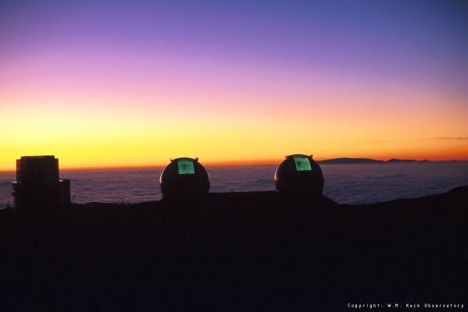
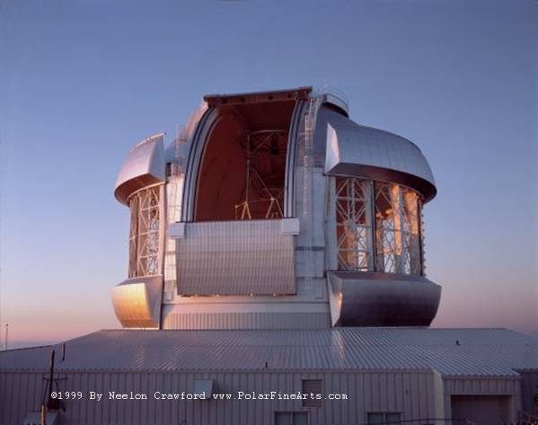
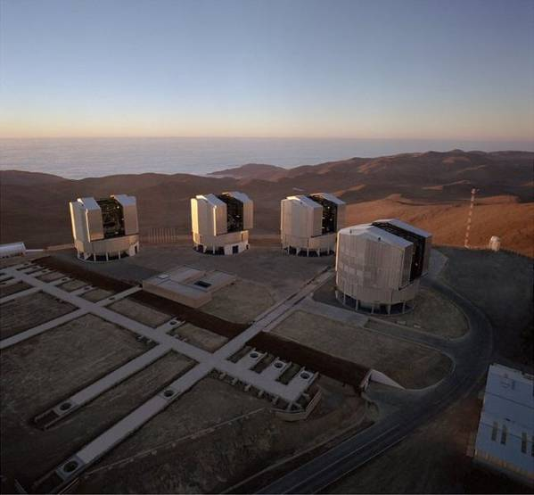
Wavelength Regimes: optical
Visible (400 to 700 nm)
first observed astronomical wavelength range (because of human eye)
stars, galaxies (stars)
optical telescopes on ground and in space
  Present: HST, Keck, Gemini, VLT, many many telescopes
  Future: TMT, ELT?
KECK
GEMINI
VLT

Slide 42
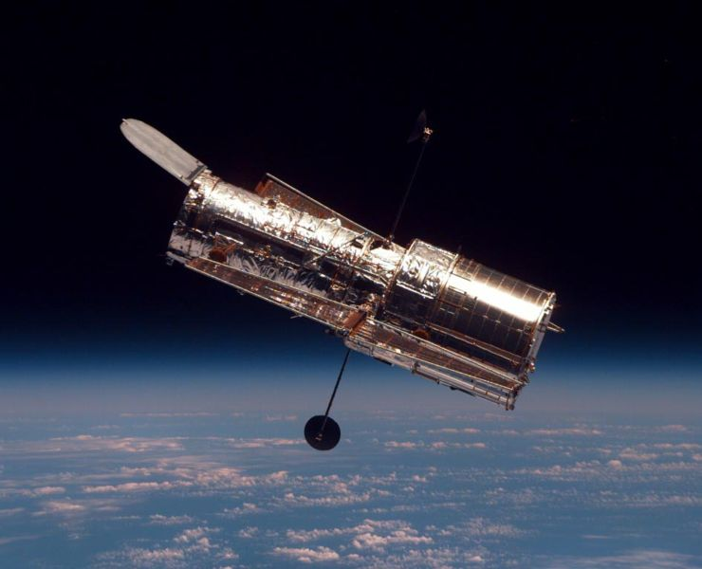
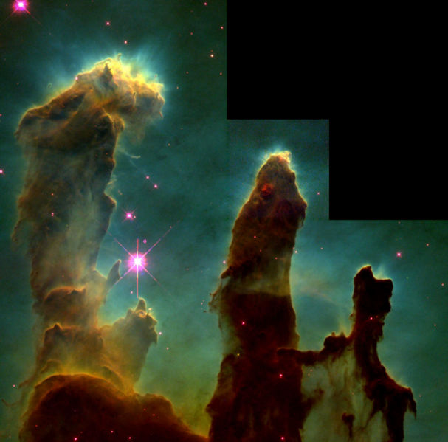
Wavelength Regimes: optical observations
Notes:
Hubble Space Telescope as seen from the Space Shuttle Discovery on mission STS-82.
Image of Pillars of Creation.

Slide 43
Wavelength Regimes: ultraviolet
Ultraviolet (10 to 400 nm)
completelly obscurred by atmosphere, so requires space or upper-atmosphere platforms
hot/massive stars, atomic absorption lines
observing platforms include
  Past: OAO, IUE
  Present: HST, FUSE, GALEX
Notes:
Ultraviolet astronomy is generally used to refer to observations at ultraviolet wavelengths between approximately 100 and 3200 Å.[1] Light at these wavelengths is absorbed by the Earth's atmosphere, so observations at these wavelengths must be performed from the upper atmosphere or from space.[1]
Ultraviolet line spectrum measurements are used to discern the chemical composition, densities, and temperatures of the interstellar medium, and the temperature and composition of hot young stars. UV observations can also provide essential information about the evolution of galaxies.
The ultraviolet Universe looks quite different from the familiar stars and galaxies seen in visible light. Most stars are actually relatively cool objects emitting much of their electromagnetic radiation in the visible part of the spectrum. Ultraviolet radiation is the signature of hotter objects, typically in the early and late stages of their evolution. If we could see the sky in ultraviolet light, most stars would fade in prominence. We would see some very young massive stars and some very old stars and galaxies, growing hotter and producing higher-energy radiation near their birth or death. Clouds of gas and dust would block our vision in many directions along the Milky Way.

Slide 44
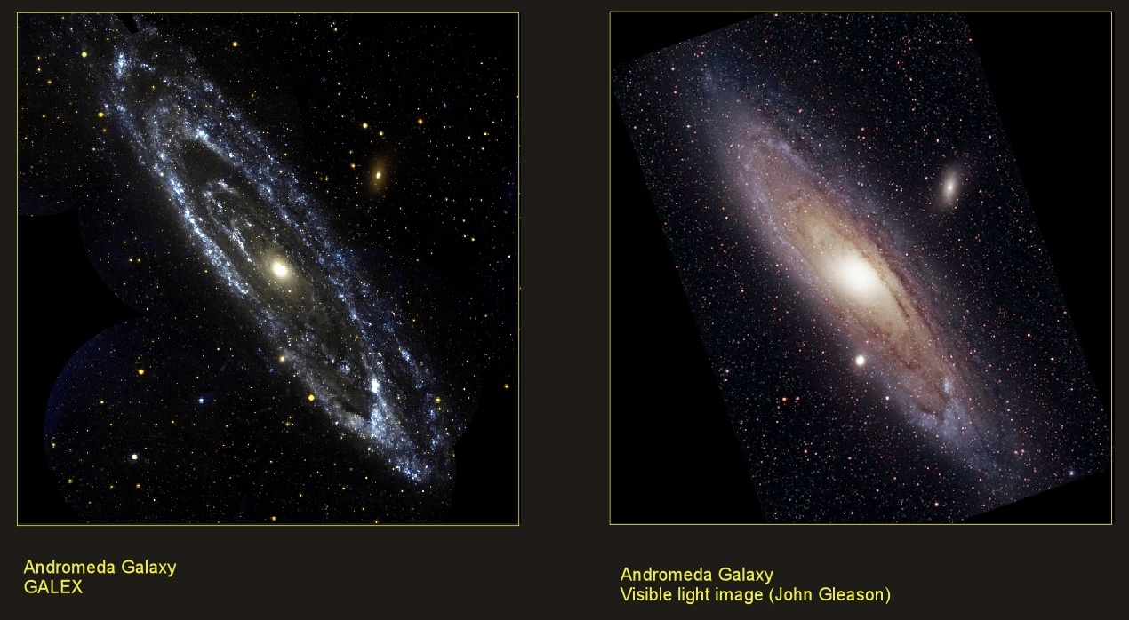
Wavelength Regimes: ultraviolet observations
Notes:
The image above shows a comparison of the GALEX mosaic image of M31 taken in ultraviolet light with an image in visible light that human eyes can see (courtesy of John Gleason).
The star forming arms of Messier 31 are unusual in being quite circular rather than the usual spiral shape. Many other regions of star formation can be seen far outside the main body of the galaxy.

Slide 45
Wavelength Regimes: x-ray
X-rays (0.01 to 10 nm)
completelly obscurred by atmosphere, so requires space or sounding rockets/balloons
hot plasmas (galaxy clusters, AGN), matter falling into deep gravity wells
observing platforms include
  Past: ROSAT, Einstein, ASCA, Beppo-SAX
  Present: XMM, INTEGRAL, Chandra, SWIFT
Notes:
Several types of astrophysical objects emit X-rays, from galaxy clusters, through black holes in active galactic nuclei (AGN) to galactic objects such as supernova remnants, stars, and binary stars containing a white dwarf (cataclysmic variable stars), neutron star or black hole (X-ray binaries). Some solar system bodies emit X-rays, the most notable being the Moon, although most of the X-ray brightness of the Moon arises from reflected solar X-rays. A combination of many unresolved X-ray sources is thought to produce the observed X-ray background, which is occulted by the dark side of the Moon.
Black holes give off radiation because matter falling into them loses gravitational energy which may result in the emission of radiation before the matter falls into the event horizon. The infalling matter has angular momentum, which means that the material cannot fall in directly, but spins around the black hole. This material often forms an accretion disk. Similar luminous accretion disks can also form around white dwarfs and neutron stars, but in these the infalling gas releases additional energy as it slams against the high-density surface with high speed. In case of a neutron star, the infall speed can be a sizeable fraction of the speed of light.
In some neutron star or white dwarf systems, the magnetic field of the star is strong enough to prevent the formation of an accretion disc. The material in the disc gets very hot because of friction, and emits X-rays. The material in the disc slowly loses its angular momentum and falls into the compact star. In neutron stars and white dwarfs, additional X-rays are generated when the material hits their surfaces. X-ray emission from black holes is variable, varying in luminosity in very short timescales. The variation in luminosity can provide information about the size of the black hole.
Clusters of galaxies are formed by the merger of smaller units of matter, such as galaxy groups or individual galaxies. The infalling material (which contains galaxies, gas and dark matter) gains kinetic energy as it falls into the cluster's gravitational potential well. The infalling gas collides with gas already in the cluster and is shock heated to between 107 and 108 K depending on the size of the cluster. This very hot gas emits X-rays by thermal bremsstrahlung emission, and line emission from metals (in astronomy, 'metals' often means all elements except hydrogen and helium). The galaxies and dark matter are collisionless and quickly become virialised, orbiting in the cluster potential well.

Slide 46
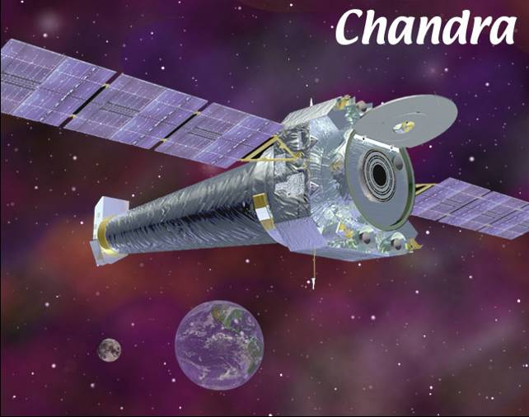
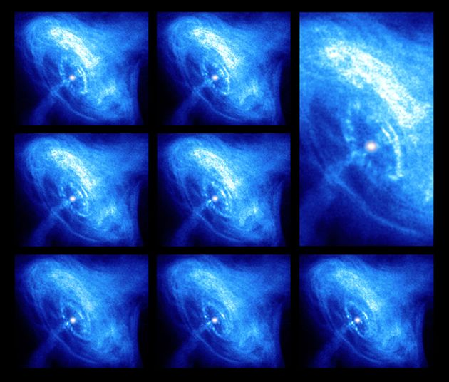
Wavelength Regimes: x-ray observations
Notes:
Chandra telescope.
The still images in this collage of the Crab nebula were made over a span of several months (ordered left to right, except for the close-up). They provide a stunning view of the activity in the inner region around the Crab Nebula pulsar, a rapidly rotating neutron star seen as a bright white dot near the center of the images.
A wisp can be seen moving outward at half the speed of light from the upper right of the inner ring around the pulsar.

Slide 47
Wavelength Regimes: gamma ray
Gamma rays (0.01 to 0.00001 nm)
obscurred by atmosphere, so requires space or sounding rockets/balloons to observe primary radiation; secondary Cherenkov radiation can be observed on ground through air shower arrays
gamma-ray bursts, pulsar wind nebulae
observing platforms
  Fermi GLAST, Compton GRO, INTEGRAL, STACEE, CELESTE
  Whipple, HESS, VERITAS, MAGIC, CANGAROO III

Slide 48
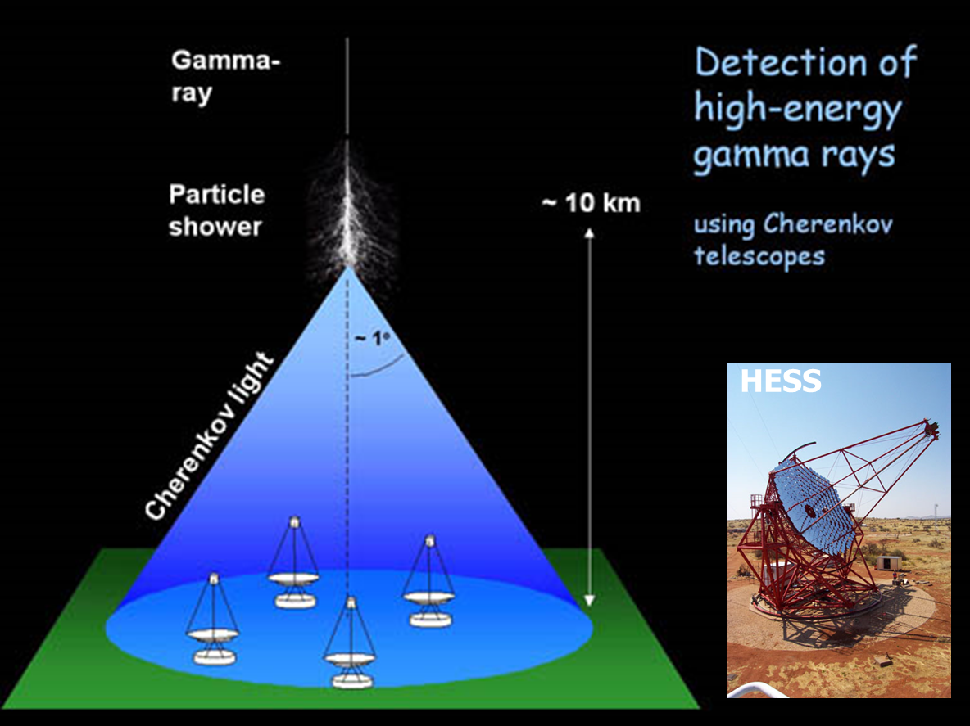
Cherenkov Telescopes

Slide 49
Wavelength Regimes: high energy cosmic rays
The term "Cosmic Rays" refers to elementary particles, nuclei, and electro-magnetic radiation of extra-terrestrial origin.
They can be observed on Earth through air showers.
The particles have been observed with energies up to 10²⁰ eV, but most are between 10⁷ and 10¹⁰ eV.
They consist of:
  ~50% protons
  ~25% alpha particles
  ~13% C/N/O nuclei
  <1% electrons
  <0.1% gammas
The three main questions concerning UHECR's are:
  How are UHE cosmic rays accelerated to such extreme energies?
  Where do UHE cosmic rays come from?
  What is the composition of the UHE cosmic rays?
Observing platforms include:
  Fly’s Eye, balloons

Slide 50
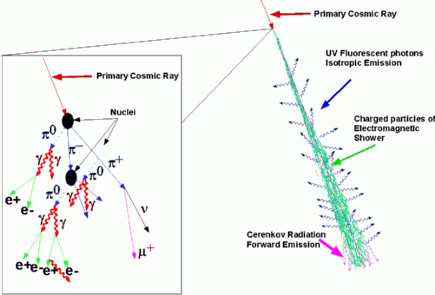
Wavelength Regimes: UHECR detection

Slide 51
Wavelength Regimes: UHECR spectrum

Slide 52
Wavelength Regimes: UHECR source
Notes:
Astronomers have long speculated
that the bulk of galactic
cosmic rays—those with energies
below about 1016 eV—originate
with supernovae. A compelling
reason for this theory is that the
power required to maintain the
observed supply of cosmic-ray
nuclei in our Milky Way galaxy
is only slightly less than the average
kinetic energy delivered to the galactic medium by the
three supernova explosions that occur every century. There are
few, if any, other sources of this amount of power in our galaxy.

Slide 53
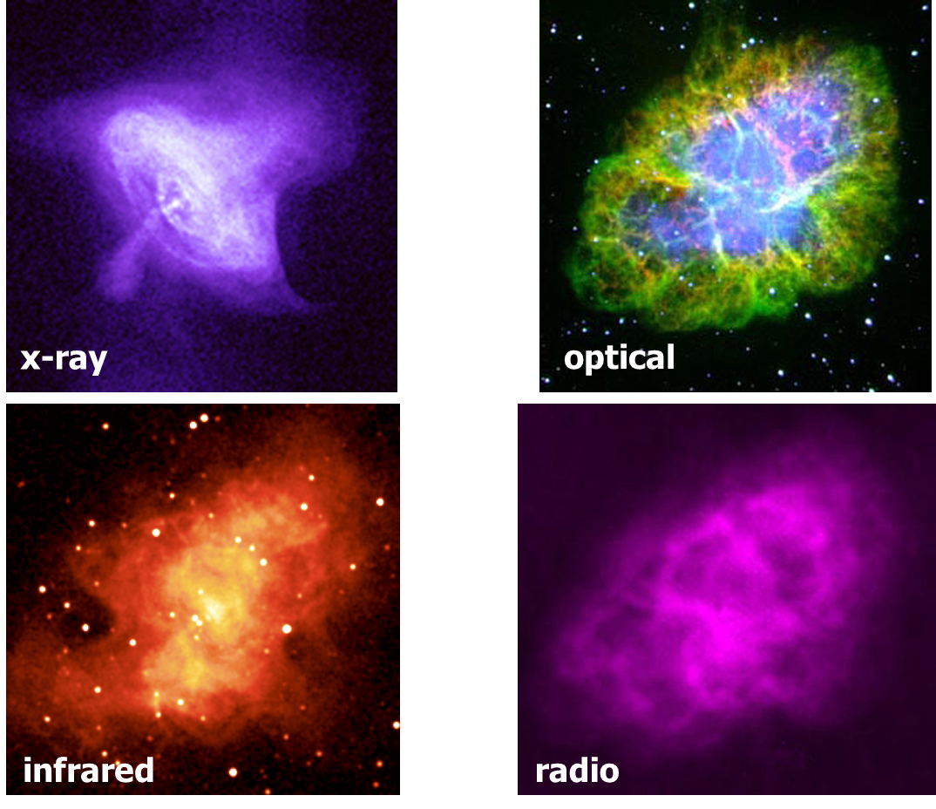
Multiwavelength case study: the Crab Nebula
Notes:
x-ray
Chandra's X-ray image of the Crab Nebula directly traces the most energetic particles being produced by the pulsar. This amazing image reveals an unprecedented level of detail about the highly energetic particle winds and will allow scientists to probe deep into the dynamics of this cosmic powerhouse.
Optical
As time goes on, and the electrons move outward, they lose energy to radiation. The diffuse optical light comes from intermediate energy particles produced by the pulsar. The optical light from the filaments is due to hot gas at temperatures of tens of thousands of degrees.
Infrared
The infrared radiation comes from electrons with energies lower than those producing the optical light. Additional infrared radiation comes from dust grains mixed in with the hot gas in the filaments.
Radio
Radio waves come from the lowest energy electrons. They can travel the greatest distance and define the full extent of the nebula. The Crab's central pulsar was discovered in 1968 by radio astronomers. The pulsar was then identified as a source of periodic optical and X-ray radiation. The periodic flashes of radiation are caused by a beam from the rapidly rotating neutron star.

Slide 54
Examples of Non-EM Information Carriers
Interplanetary spacecraft for in-situ sampling
Meteorites (including from Mars & the Moon)
Terrestrial isotopic abundances
Interplanetary/interstellar dust grains
Dust deposition on Earth: >150 tons/day
Cosmic rays
Solar wind
Geophysical evidence: L(t); SN irradiation?; impact
Craters
Neutrinos
Tides
Gravitational waves? (no more question mark!!!)
Dark matter particles??
Notes:
x-ray
Chandra's X-ray image of the Crab Nebula directly traces the most energetic particles being produced by the pulsar. This amazing image reveals an unprecedented level of detail about the highly energetic particle winds and will allow scientists to probe deep into the dynamics of this cosmic powerhouse.
Optical
As time goes on, and the electrons move outward, they lose energy to radiation. The diffuse optical light comes from intermediate energy particles produced by the pulsar. The optical light from the filaments is due to hot gas at temperatures of tens of thousands of degrees.
Infrared
The infrared radiation comes from electrons with energies lower than those producing the optical light. Additional infrared radiation comes from dust grains mixed in with the hot gas in the filaments.
Radio
Radio waves come from the lowest energy electrons. They can travel the greatest distance and define the full extent of the nebula. The Crab's central pulsar was discovered in 1968 by radio astronomers. The pulsar was then identified as a source of periodic optical and X-ray radiation. The periodic flashes of radiation are caused by a beam from the rapidly rotating neutron star.

Slide 55
Bonus

Slide 56
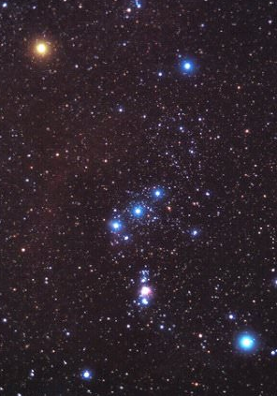
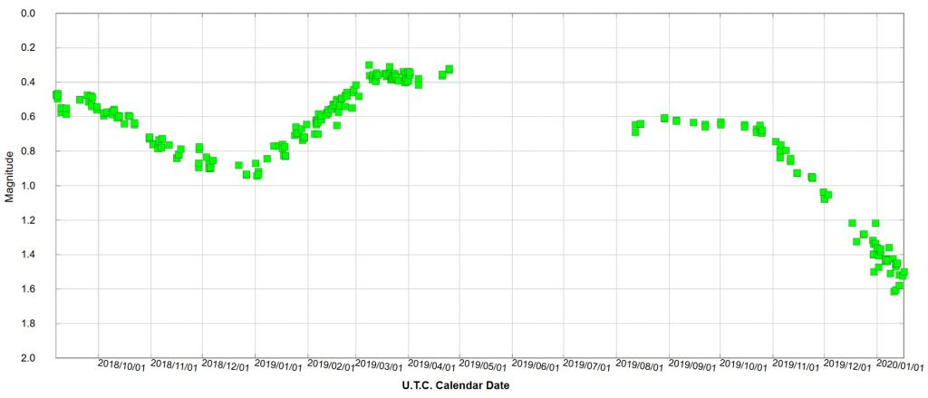
Betelgeuse!

