Slide 1
University Astronomy
Professor Don Figer
Instruments and Detectors II

Slide 2
Lecture Outline
Photon Detection in PN Junctions
  review semiconductors
  PN Junction
  charge collection in PN junctions
Review of CCDs
  definition
  design
  operation
  performance
Review of Infrared Detectors

Slide 3
pn junctions

Slide 4
Semiconductors
A conductor has free (unbound) electrons that can flow in the presence of an electric field.
An insulator impedes the flow of electrons.
A semiconductor becomes a conductor if the electrons are excited to high enough energies, otherwise it is an insulator.
  allows for a “switch” which can be on or off
  allows for photo-sensitive circuits (photon absorption adds energy to electron)
Minimum energy to elevate an electron into the conduction band is the “band gap energy”

Slide 5
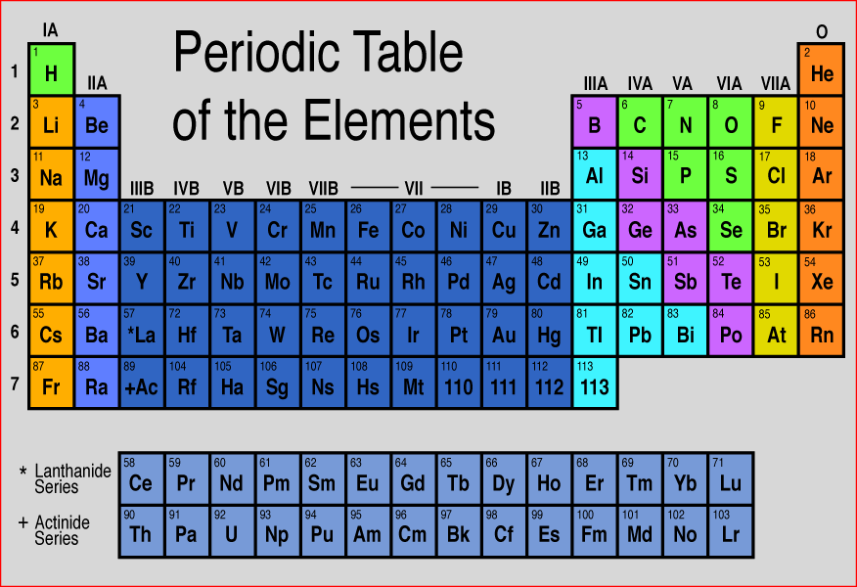
Periodic Table
Semiconductors occupy column IV of the Periodic Table
Outer shells have four empty valence states
An outer shell electron can leave the shell if it absorbs enough energy

Slide 6
Simplified Silicon Band Diagram
Conduction band
E_{g} bandgap
um
Valence band

Slide 7
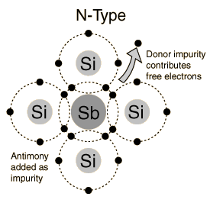
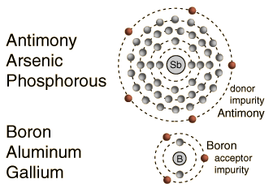
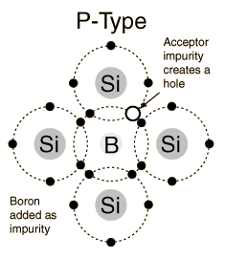
Semiconductor Dopants

Slide 8
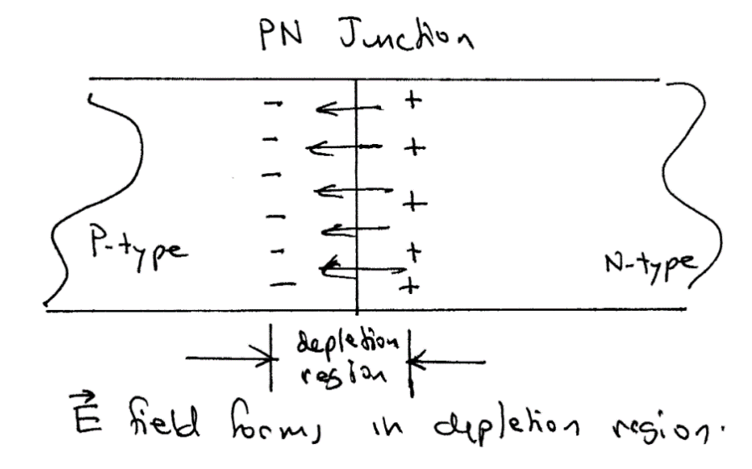
PN Junctions
In a PN junction, positively charged holes diffuse into the n-type material. Likewise, negatively charged electrons diffuse in the the p-type material.
This process is halted by the resulting E-field.
The affected volume is known as a “depletion region”.
The charge distribution in the depletion region is electrically equivalent to a 2-plate capacitor.

Slide 9
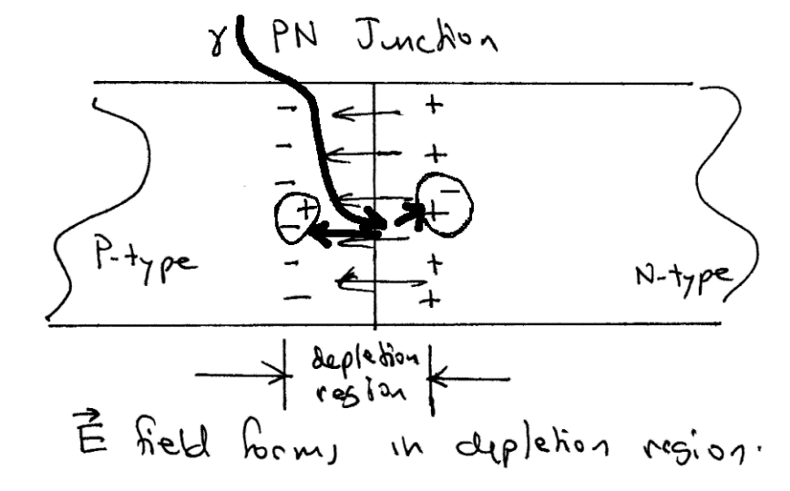
Photon Detection in PN Junctions
A photon can interact with the semiconductor to create an electron-hole pair.
The electron will be drawn to the most positively charged zone in the PN junction, located in the depletion region in the n-type material.
Likewise, the positively charged hole will seek the most negatively charged region.
Each photon thus removes one unit of charge from the capacitor. This is how photons are detected in both CCDs and most IR arrays.

Slide 10
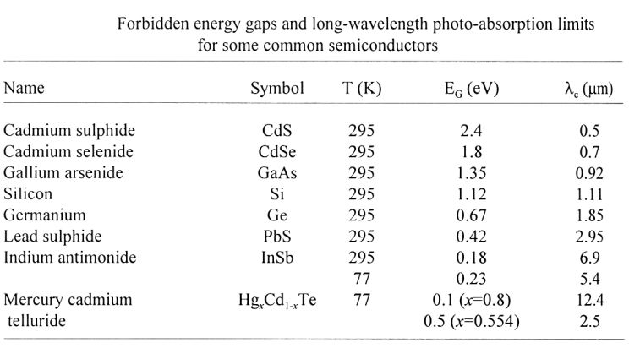
The Band Gap Determines the Red Limit

Slide 11
ccds

Slide 12
CCD Definition
A CCD is a two-dimensional array of metal-oxide-semiconductor (MOS) capacitors.
The charges are stored in the depletion region of the MOS capacitors.
Charges are moved in the CCD circuit by manipulating the voltages on the gates of the capacitors so as to allow the charge to spill from one capacitor to the next (thus the name “charge-coupled” device).
An amplifier provides an output voltage that can be processed.
The CCD is a serial device where charge packets are read one at a time.

Slide 13
CCD Pixels
Image area
(exposed to light)
Parallel (vertical) registers
Charge motion
Pixel
Serial (horizontal) register
Output amplifier
masked area
(not exposed to light)
Charge motion

Slide 14
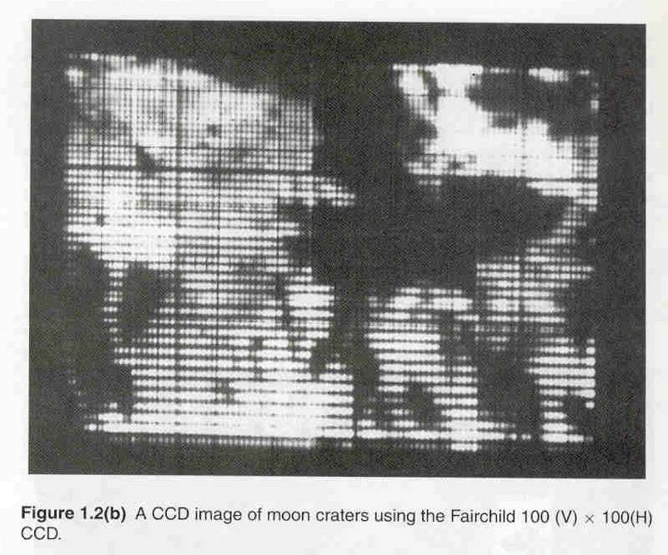
What is This?
Notes:
14

Slide 15
First Astronomical CCD image
1974 on an 8” telescope
Notes:
15

Slide 16
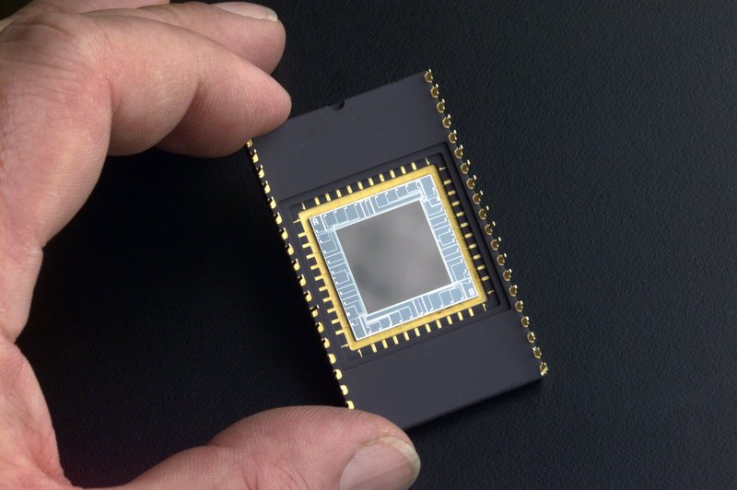
CCD in a Dual-Inline Package
Notes:
Delta-Doped Charged Coupled Devices (CCD) for Ultra-Violet and Visible Detection
CCDs allow scientists to study one of the least explored windows of the electromagnetic spectrum - the extreme ultraviolet. Until recently, scientists believed there was little point to exploring this spectral region. They thought that the mixture of hydrogen gas and other less abundant gases, which fill the space between stars and is commonly called the "interstellar medium," would absorb virtually all extreme ultraviolet radiation before it became detectable from Earth. Consequently, this region became known as the "unobservable ultraviolet."
This is where stable ultraviolet CCDs step in for crucial space and ground-based astronomy to detect younger, hotter objects. Because of the high quantum efficiency of these devices, very faint objects can potentially be observed. Stability of the device makes it possible to gather reliable data in space-based astronomy.
Scientists will learn much more about hot white dwarf stars - extremely dense stars that represent a final stage of stellar evolution - and young massive stars that are characterized by outflowing, shock-heated winds. Moreover, they will learn about cataclysmic variable stars, binary star systems in which the mass of one star is transferred to the other, causing dramatic changes in extreme ultraviolet brightness. They may even have a chance to probe the enigmatic cores of distant galaxies."

Slide 17
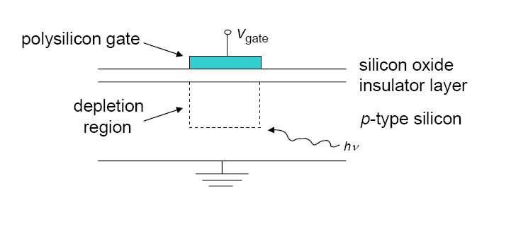
MOS Capacitor Geometry
A Metal-Oxide-Semiconductor (MOS) capacitor has a potential difference between two metal plates separated by an insulator.
Notes:
17

Slide 18
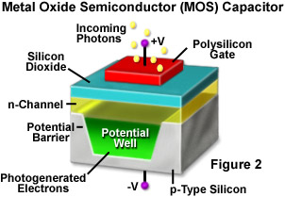
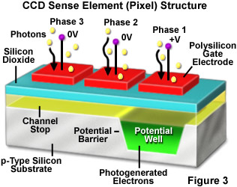
CCD Clocking

Slide 19
Photons entering the CCD create electron-hole pairs. The electrons are then attracted towards the most positive potential in the device where they create ‘charge packets’. Each packet corresponds to one pixel
incoming
photons
pixel
boundary
pixel
boundary
n-type silicon
Electrode Structure
Charge packet
p-type silicon
SiO2 Insulating layer

Slide 20
+5V
0V
-5V
2
+5V
0V
-5V
1
+5V
0V
-5V
3
1
2
3
Time-slice shown in diagram

Slide 21
+5V
0V
-5V
2
+5V
0V
-5V
1
+5V
0V
-5V
3
1
2
3

Slide 22
+5V
0V
-5V
2
+5V
0V
-5V
1
+5V
0V
-5V
3
1
2
3

Slide 23
+5V
0V
-5V
2
+5V
0V
-5V
1
+5V
0V
-5V
3
1
2
3

Slide 24
+5V
0V
-5V
2
+5V
0V
-5V
1
+5V
0V
-5V
3
1
2
3

Slide 25
+5V
0V
-5V
2
+5V
0V
-5V
1
+5V
0V
-5V
3
1
2
3

Slide 26
CCD Performance Metrics
Charge generation
quantum efficiency (QE), dark current
Charge collection
full well capacity, pixels size, pixel uniformity, defects, diffusion (Modulation Transfer Function, MTF)
Charge transfer
charge transfer efficiency (CTE), defects
Charge detection
readout noise (RON), linearity

Slide 27
Well Capacity
Spillage
Spillage
pixel
boundary
pixel
boundary
Overflowing
charge packet
Photons
Photons
Blooming

Slide 28
Saturation
CCD pixels have a linear response of measured output voltage to a value quite close to the full well capacity of the pixel. The number of electrons which can be stored is given by:
Q = CV
V is the voltage, and C is the capacitance of the pixel, given approximately by:
C ≈ Aκε₀/d
A is the area of the pixel, d is the thickness of the SiO₂ layer, κ is the dielectric constant of SiO₂ (about 4.5) and ε₀ is the permittivity of free space.
Notes:
28
We look at the charge capacity or full well capacity of a CCD pixel. CCds have a linear response, I.e. charge is proportional to radiation, to close to this capacity. We can work out the capacitance of a pixel and thus thus the full well capacity. A few things to note, the capacity of proportional to the area of the pixel, so our drive to get smaller pixels for better resolution has a drawback. The capacity is also proportional to the Voltage, MPP chips have a lower voltage difference between the central phase and surrounding phases.

Slide 29
Linearity and Saturation
Typically, the full well capacity of a CCD pixel 25 μm square is 500,000 electrons.
  If the charge in the well exceeds about 80% of this value the response will be non-linear.
  This is because the filled pn junction region will have a weaker and weaker field.
  If it exceeds this value, charge will spread through the barrier phase to surrounding pixels.
This charge blooming occurs mainly vertically, as there is little horizontal bleeding because of the permanent doped channel stops.
Readout register pixels are larger, so there is less saturation effect in the readout register.
Notes:
29
We can work this number out, and there is a problems on this. If we exceed the capacity then charge tends to spread up and down the columns. Not across because of the permanent channel stops, and not in the readout register where we increase the pixel area to increase the charge capacity.

Slide 30
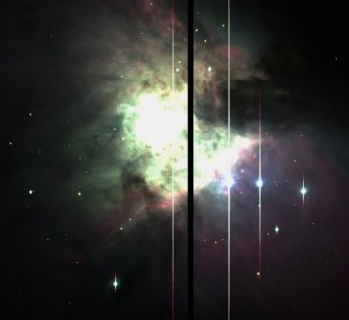
Blooming
Bloomed star images
Blooming

Slide 31
Dark Current
Dark current is generated when thermal photon-induced vibrations cause an electron to move from the valence band to the conduction band.
The majority of dark current is created near the interface between the Si and the SiO₂, where interface states at energy between the valence and conduction bands act as a stepping stone for electrons. These are sometimes referred to as “mid-band” states.
CCDs can be operated at temperatures down to around 140K, to reduce thermal effects.
Notes:
31
The dark current is background signal generated by thermal effects. Because of the dark current CCds are run cooled, to reduce the possibility of thermal excitation of electrocs across the band gap.

Slide 32
Dark Current vs. Temperature
Thermally generated electrons are indistinguishable from photo-generated electrons : “Dark Current” (noise)
Cool the CCD down!!!

Slide 33

Defects: Dark Columns
Dark columns: caused by ‘traps’ that block the vertical transfer of charge during image readout.
Traps can be caused by crystal boundaries in the silicon of the CCD or by manufacturing defects.
Although they spoil the chip cosmetically, dark columns are not a big problem (removed by calibration).

Slide 34
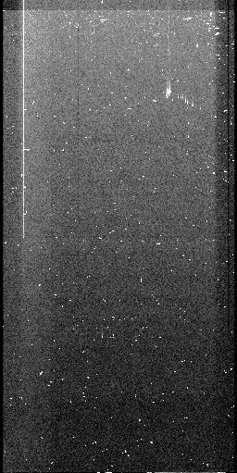
Defects: Bright Columns
Bright columns are also caused by traps. Electrons contained in such traps can leak out during readout causing a vertical streak.
Hot pixels are pixels with higher than normal dark current. Their brightness increases linearly with exposure times
Somewhat rarer are light-emitting defects which are hot pixels that act as tiny LEDS and cause a halo of light on the chip.
Bright
column
Cluster of
hot pixels
Cosmic rays

Slide 35
Charge Transfer Efficiency
When the wells are nearly empty, charge can be trapped by impurities in the silicon. So faint images can have tails in the vertical direction.
Modern CCDs can have a charge transfer efficiency (CTE) per transfer of 0.9999995, so after 2000 transfers only 0.1% of the charge is lost.
Notes:
35
Charge can be trapped as you read it out, although with modern buried channel CCDs this is much less of a problems than it used to be.

Slide 36
Charge Transfer Efficiency
CTE = Charge Transfer Efficiency (typically 0.9999 to 0.999999)
= fraction of electrons transferred from one pixel to the next
CTI = Charge Transfer Inefficiency = 1 – CTE (typically 10^{– 6} to 10^{– 4})
= fraction of electrons deferred by one pixel or more
Cause of CTI:
charges are trapped (and later released) by defects in the silicon crystal lattice
CTE of 0.99999 used to be thought of as pretty good but ….
Think of a 9K x 9K CCD
Notes:
36

Slide 37
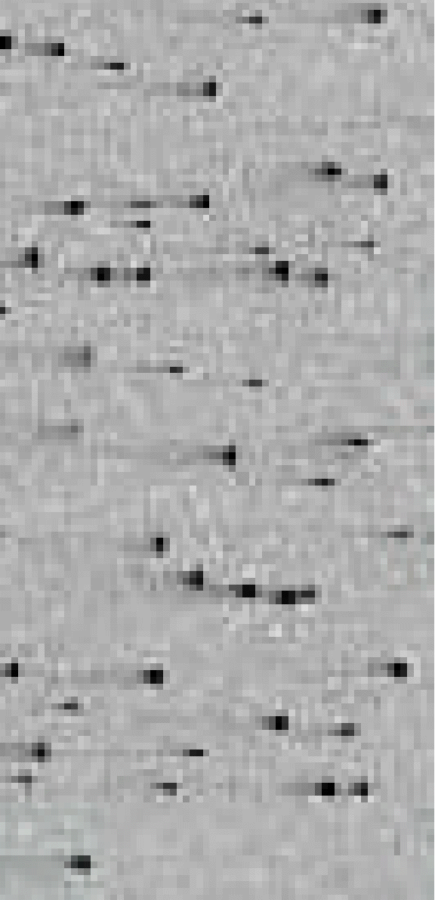
Example:
X-ray events with charge smearing in an
irradiated CCD (from GAIA-LU-TN01)
In the simplest picture (“linear CTI”) part of the
original image is smeared with an exponential
decay function, producing “tails”:
original image
after n transfers
direction of charge transfer
37
Notes:
37

Slide 38
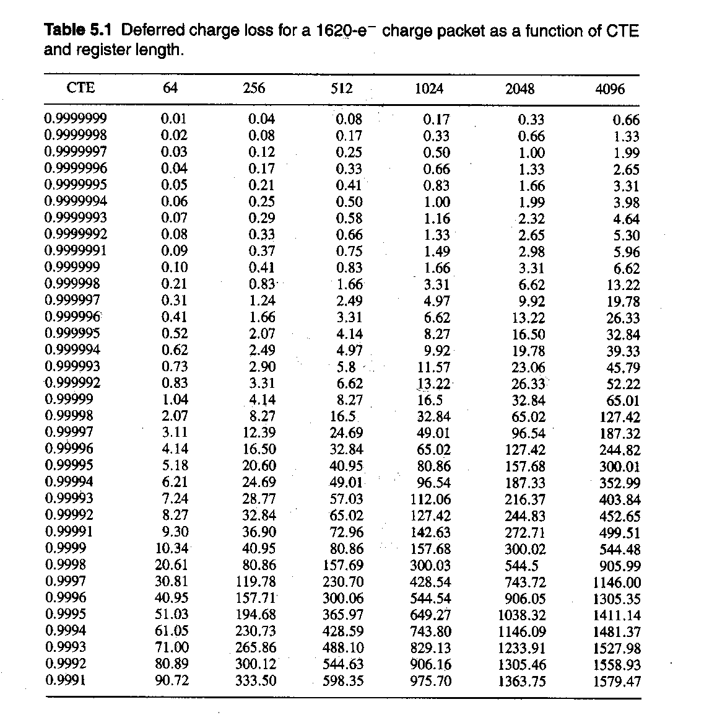
CTE
Percentage of charge which is really transferred.
“n” 9s: five 9s = 99,99999%

Slide 39
Read-Out Noise
Mainly caused by thermally induced motions of electrons in the output amplifier.
These cause small noise voltages to appear on the output.
This noise source, known as Johnson Noise, can be reduced by cooling the output amplifier or by decreasing its electronic bandwidth. Decreasing the bandwidth means that we must take longer to measure the charge in each pixel, so there is always a trade-off between low noise performance and speed of readout.
The graph below shows the trade-off between noise and readout speed for an EEV4280 CCD.

Slide 40
CCD readout noise
Reset noise: there is a noise associated with recharging the output storage capacitor, given by σ_{res}= √ (kTC) where C is the output capacitance in Farads.
This is removed by correlated double sampling, where the reset voltage is measured after reset and again after readout. The first value is subtracted from the second, as this voltage will not change.
The output Field Effect Transistor also contributes noise. This is the ultimate limit to the readout noise, at a level of 2-3 electrons
Notes:
40
Surface state noise is akin to charge transfer problems, and like those is much reduced in buried channel CCDs.
The largest source of noise in the best modern CCDs is the FET noise from the previous slide.

Slide 41
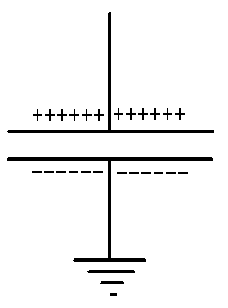
kTC Noise
Consider the thermal equipartition of charge on a capacitor.
Boltzmann statistics apply
We are counting charges, so the variance is given by Poisson statistics.

Slide 42
Other noise sources
Fixed pattern noise. The sensitivity of pixels is not the same, for reasons such as differences in thickness, area of electrodes, doping. However these differences do not change, and can be calibrated out by dividing by a flat field, which is an exposure of a uniform light source.
Bias noise. The bias voltage applied to the substrate causes an offset in the signal, which can vary from pixel to pixel. This can be removed by subtracting the average of a number of bias frames, which are readouts of zero exposure frames. Modern CCDs rarely display any fixed pattern bias noise
Notes:
42
Fixed pattern noise can be quite serious, but is calibrated out with a flat field.

Slide 43
Interference Fringes
In thinned CCDs there are interference effects caused by multiple reflections within the silicon layer, or within the resin which holds the CCD to a glass plate to flatten it.
These effects are classical thin film interference (Newton’s rings).
Only visible if there is strong line radiation in the passband, either in the object or in the sky background.
Visible in the sky at wavelengths > 700nm.
Corrected by subtracting off a scaled exposure of blank sky.
Notes:
43
Fringing can dominate the noise in the redder photometric bands, or in narrow bands, and can sometimes force us back to using thick CCDs despite the loss in RQE.

Slide 44
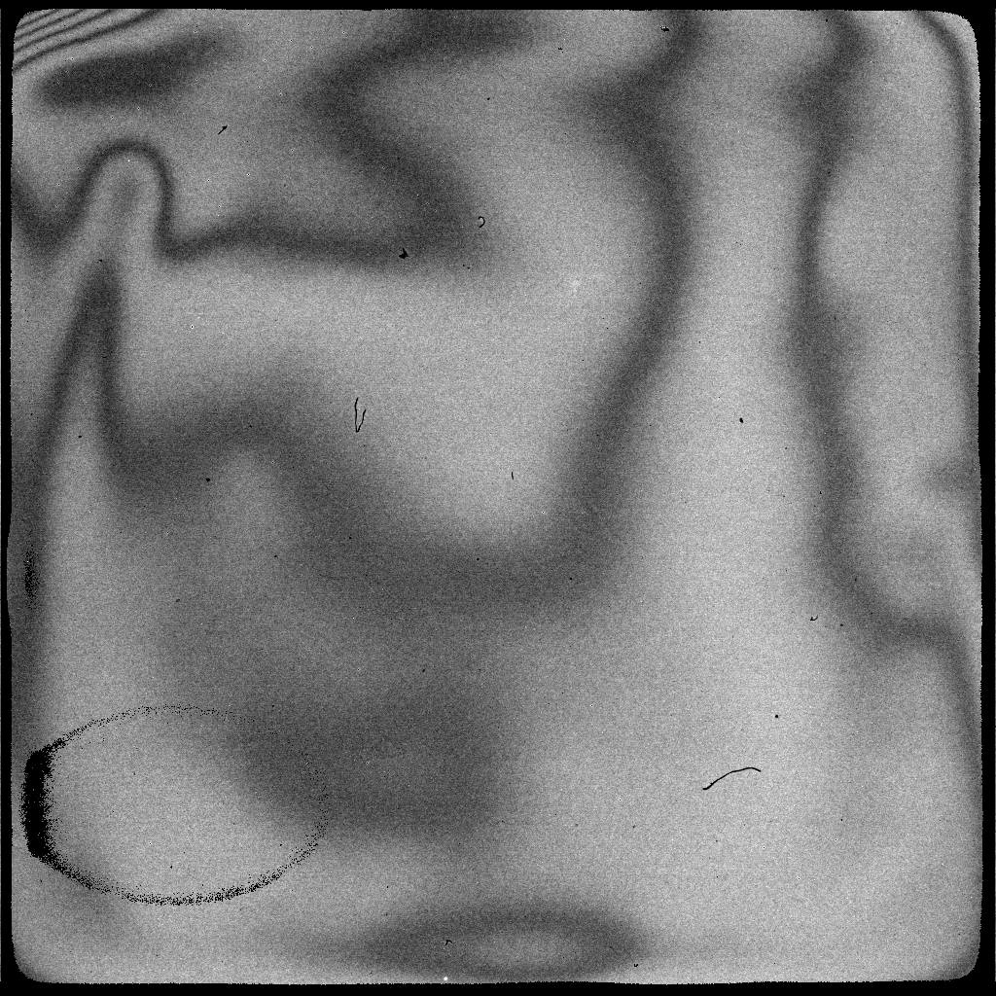
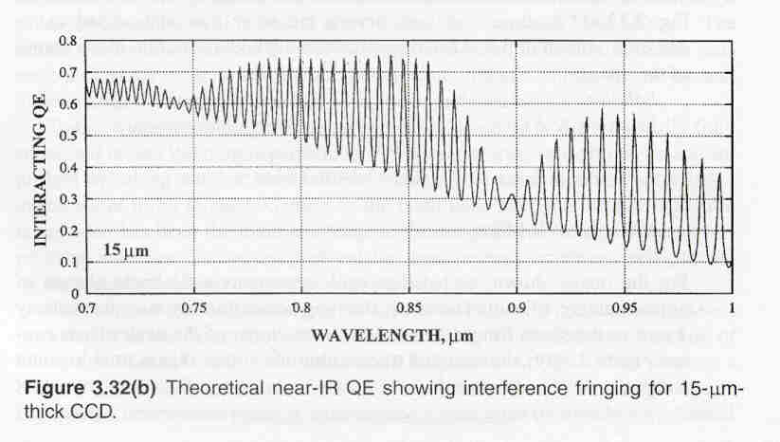
Examples of fringing
Fringing on H1RG SiPIN device at 980nm
Notes:
44

Slide 45
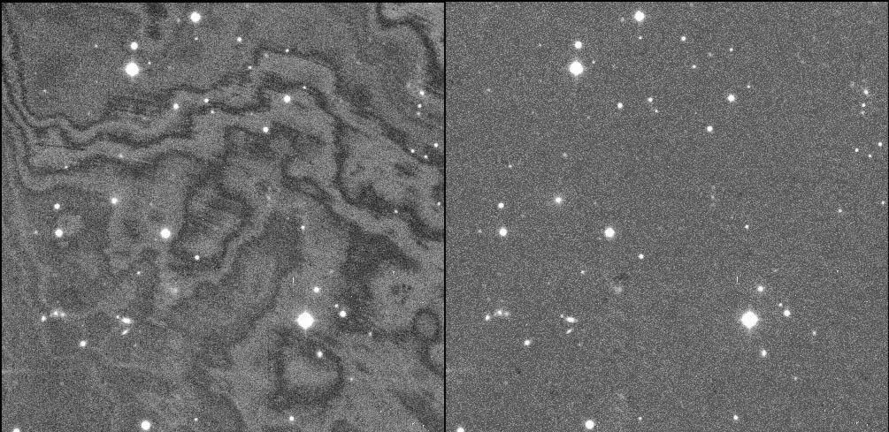
Correcting Fringing from Sky Lines
Notes:
45
CCDs are made of silicon, which becomes transparent with increasing wavelength, starting at around 700nm. In back-illuminated, thinned CCDs airglow can cause internal reflections leading to a characteristic interference pattern in the background of an image, known as fringing. The pattern itself depends mainly on the thickness of the CCD and is thus essentially unchanged over the lifetime of the detector. However, the amplitude of the fringing pattern varies as the airglow spectrum at a given position on the sky changes with time. Fringing is also present in near-IR detectors.

Slide 46
Large CCD Mosaics

Slide 47
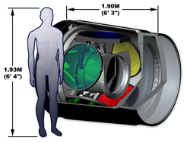
LSST Has a Big Camera

Slide 48
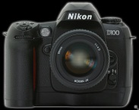
LSST Has a Big Focal Plane
Wavefront Sensors (4 locations)
Guide Sensors (8 locations)
3.5 degree Field of View (634 mm diameter)

Slide 49
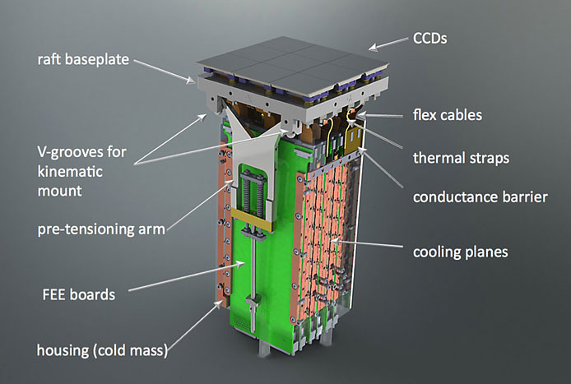
LSST CCD Raft

Slide 50
Basic CCD Camera
Thermally Electrical feed-through Vacuum Space Pressure vessel Pump Port
Insulating
Pillars
Face-plate
Telescope beam
.
.
Boil-off
.
Optical window CCD CCD Mounting Block Thermal coupling Nitrogen can Activated charcoal ‘Getter’
Focal Plane
of Telescope

Slide 51
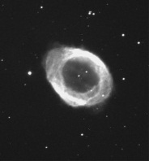
CCD calibration
If there is significant dark current present:
Science Frame
Dark Frame
Science
-Dark
-Bias
Output Image
Bias Image
Sc-Dark-Bias
Flat-Dark-Bias
Flat
-Dark
-Bias
Flat Field Image

Slide 52
CCDs for X-ray Applications
Notes:
52
Fringing can dominate the noise in the redder photometric bands, or in narrow bands, and can sometimes force us back to using thick CCDs despite the loss in RQE.

Slide 53
infrared detectors

Slide 54
History
Herschel’s detection of IR from Sun in 1800
Johnson’s IR photometry of stars (PbS) mid 60’s
Neugebauer & Leighton: 2um Sky Survey (PbS), late 60’s
Development of bolometer (Low) late 60’s
Development of InSb (mainly military) early 70’s
IRAS 1983
Arrays (InSb, HgCdTe, Si:As IBCs) mid-80’s
NICMOS, 2MASS, IRTF, UKIRT, KAO, common-user instruments, Gemini, etc.
JWST and the search for cosmic origins

Slide 55
Historical motivation
Exploration & discovery
  Neugebauer, Leighton, Low, Fazio, Townes
Technological opportunities
  Bolometer (Low)
  PbS (Neugebauer)
  balloons (Fazio)
  IR lasers & interferometry (Townes)
A few, key problems
  Bolometric luminosities (Herschel, Johnson)
  The Galactic Center (Becklin)
  Star formation

Slide 56
Current interest in infrared
High redshift objects
  λ_{obs} = λ₀ (1+z) 5000 Å → >1 μm for z > 1
  Classical problems require infrared data
Obscuration by dust
  A_{λ} ~ λ^{-1.9} → A_{2.2μm} ~ 0.1 A_{V} (Mathis 1990, ARAA, 28, 37)
  Now important for:
    Galactic nuclei, esp. AGN (unified model)
    Starburst galaxies
    Young stars
Very low mass objects & extrasolar planets
  T_{planet} ~ 50 to 500 K λ_{peak} ~ 5 – 50 μm
  T_{BD} ~ 900 – 2000 K λ_{peak} ~ 1 – 5 μm

Slide 57
Extinction by dust
  J. S. Mathis 1990, ARAA, 28, 37.

Slide 58
Infrared Hybrid Array
Infrared arrays use light-sensitive material that can detect infrared photons, wavelengths beyond ~1 um.
Therefore, silicon cannot be used as the light-sensitive layer.
This poses a problem because the readout circuit is most easily implemented in silicon.
Therefore, infrared arrays are “hybrids” – they use one material to detect light and silicon for the readout circuit.

Slide 59
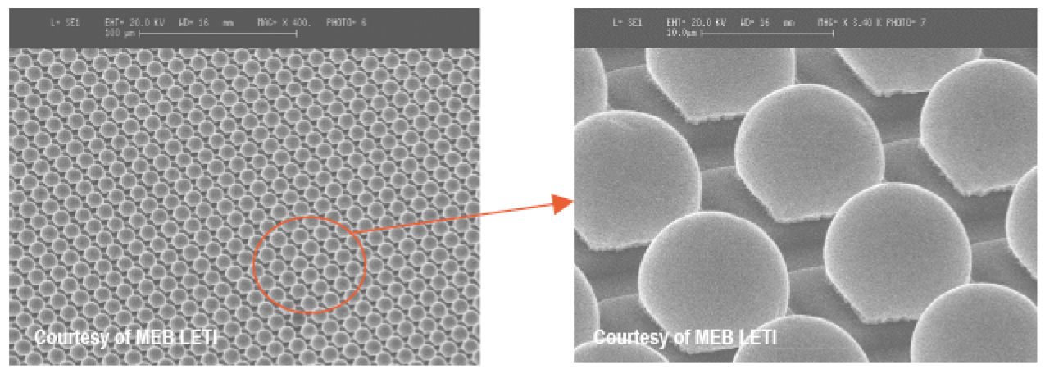
Indium Bumps

Slide 60
Pixel-level Cross Section: InSb

Slide 61
Pixel-level Cross Section: HgCdTe

Slide 62
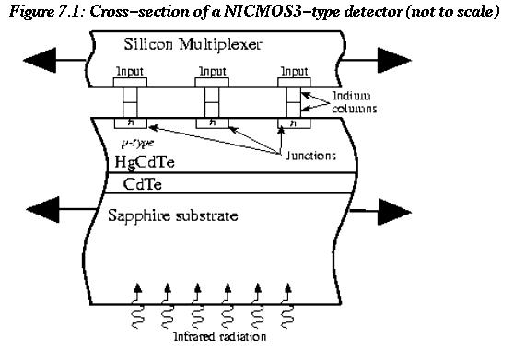
NICMOS

Slide 63

Si PIN Architecture
Si PIN devices are architecturally similar to infrared arrays, so we discuss them in this lecture even though they do not detector infrared light (they use silicon!).
A PIN is a sandwich of p-type/instrinsic/n-type layers.
These devices are usually implemented for improved response at longer wavelengths, i.e. they are thick.
In order to ensure that photogenerated charge makes it to the integrating node, there needs to be a strong electric field that depletes the intrinsic layer.
PIN diode

Slide 64
Detector Size

Slide 65
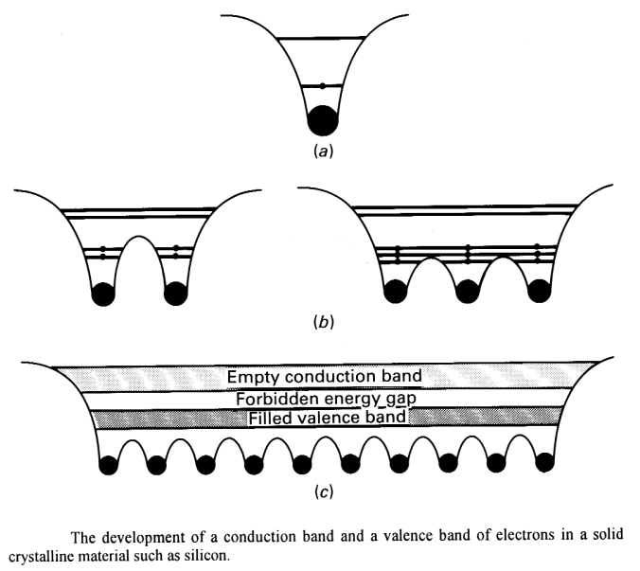
Valence & Conduction Bands in Semiconductors
When atoms (a) come together to form a crystal, the outer energy levels overlap and blend to create bands (b).
The outermost filled band is called the valence band (c).
Above the valence band, one finds a forbidden energy gap -the “band gap”, and (at higher energies) conduction bands populated by thermally excited electrons.
In metals, the valence and conduction bands overlap resulting in conduction. In insulators, the band gap is wider resulting in very poor conduction.

Slide 66
Periodic Table
Semiconductors occupy column IV of the Periodic Table
Outer shells have four empty valence states
An outer shell electron can leave the shell if it absorbs enough energy

Slide 67
Periodic Table Continued
The column number gives the number of valence electrons per atom. Primary semiconductors have 4.
Compounds including elements from neighboring columns can be formed. These alloys have semiconductor properties as well (e.g. HgCdTe & InSb).
Mercury-cadmium-telluride (HgCdTe; used in NICMOS) and indium-antimonide (InSb; used in SIRTF) are the dominant detector technologies in the near-IR.

Slide 68
The Band Gap Determines the Red Limit

Slide 69
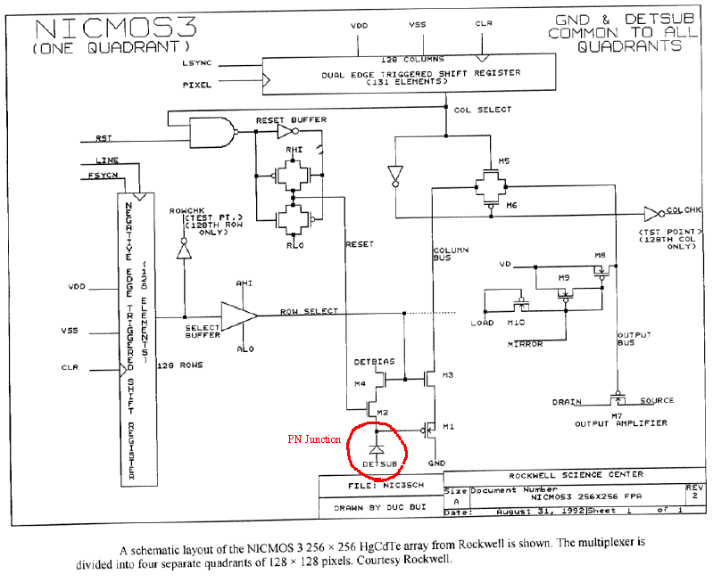
NICMOS MUX

Slide 70
Pixel Capacitance and Gain

Slide 71
Dark Current
Like a CCD, IR arrays are affected by dark current and a variety of noise mechanisms.
Dark current is the signal that is seen in the absence of any light. For the near-IR (1-2.5 μm), the dominant components are diffusion, thermal generation-recombination (G-R) of charges within the semiconductor, and leakage currents. Combining these, it can be shown that
where V is the voltage across the detector and R_{0diff} and R_{0GR} are the detector impendences at zero bias for diffusion and G-R.

Slide 72
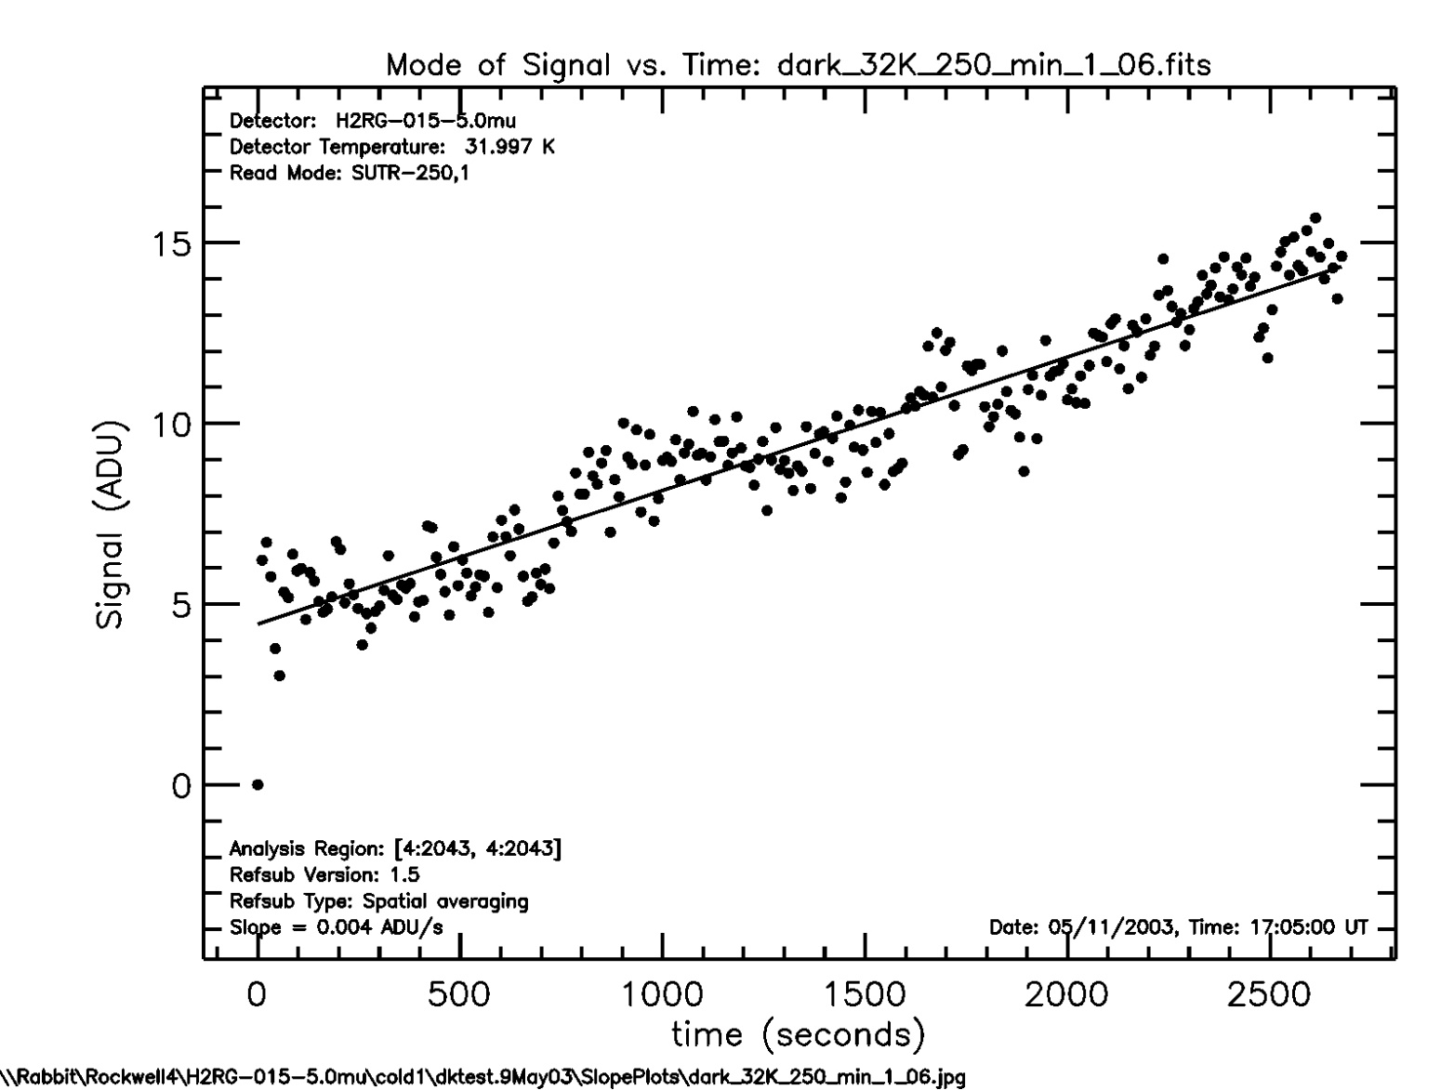
Dark Current Example

Slide 73
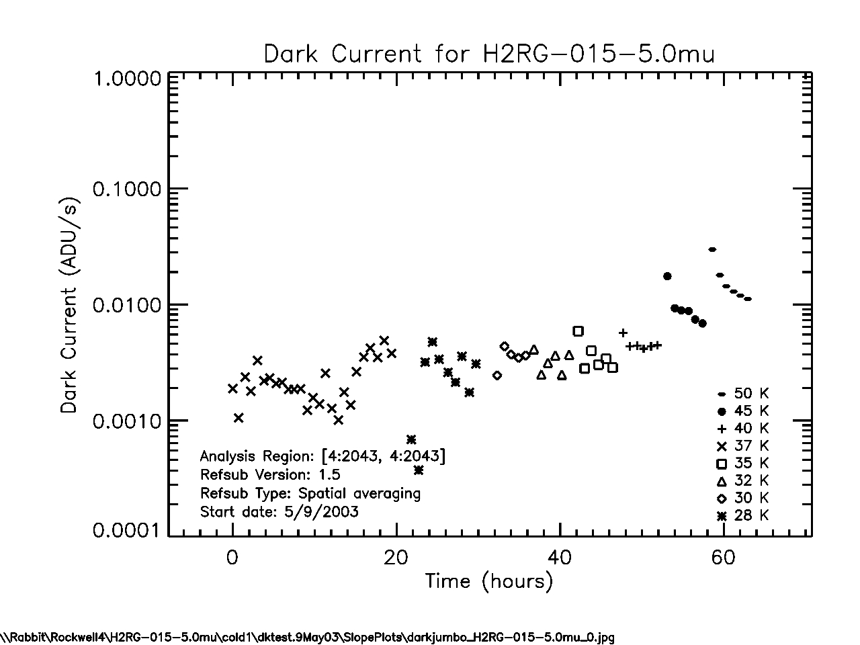
Dark Current vs. Temperature

Slide 74
kTC Noise
“kTC” noise occurs in both CCDs and IR arrays when the detector capacitor is recharged. As we will see shortly, this goes as
where k is the Boltzmann constant, T is temperature, C is capacitance, and e is the elementary charge.

Slide 75
1/f Noise
1/f noise in the multiplexer’s output field effect transistor (FET).
  In the mid-1980s, readout noise ~300 electrons was common. Better output FETs increased the number of microvolts per electron and thereby helped to reduce readout noise to <10 electrons seen today.
Other 1/f components are seen. e.g.,
  The “pedestal effect” seen in NICMOS whereby the entire exposure’s bias is seen to vary by ~75 electrons. There is some consensus that these 1/f components are thermally driven.

Slide 76
Noise Reduction Through Multiple Sampling
By being a bit clever about reading out the array, one can minimize or eliminate some of these noise modes.
During an exposure, typically each pixel is sampled several times.
The most common approaches are correlated double sampling (CDS), multiple non-destructive reads (aka “Fowler Sampling”), & fitting a line (aka “up the ramp”). We discuss these briefly.

Slide 77
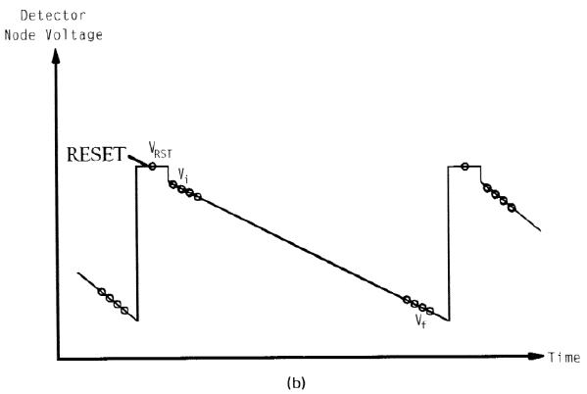
Fowler Sampling

Slide 78
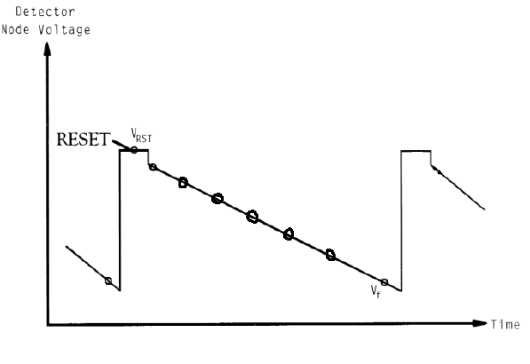
“Up the Ramp”
Fit best line to multiple non-destructive samples.
Sample spacing does not need to be uniform.
Not clear whether this or Fowler sampling is best.
This is what is done in NICMOS MULTIACCUM mode.

Slide 79
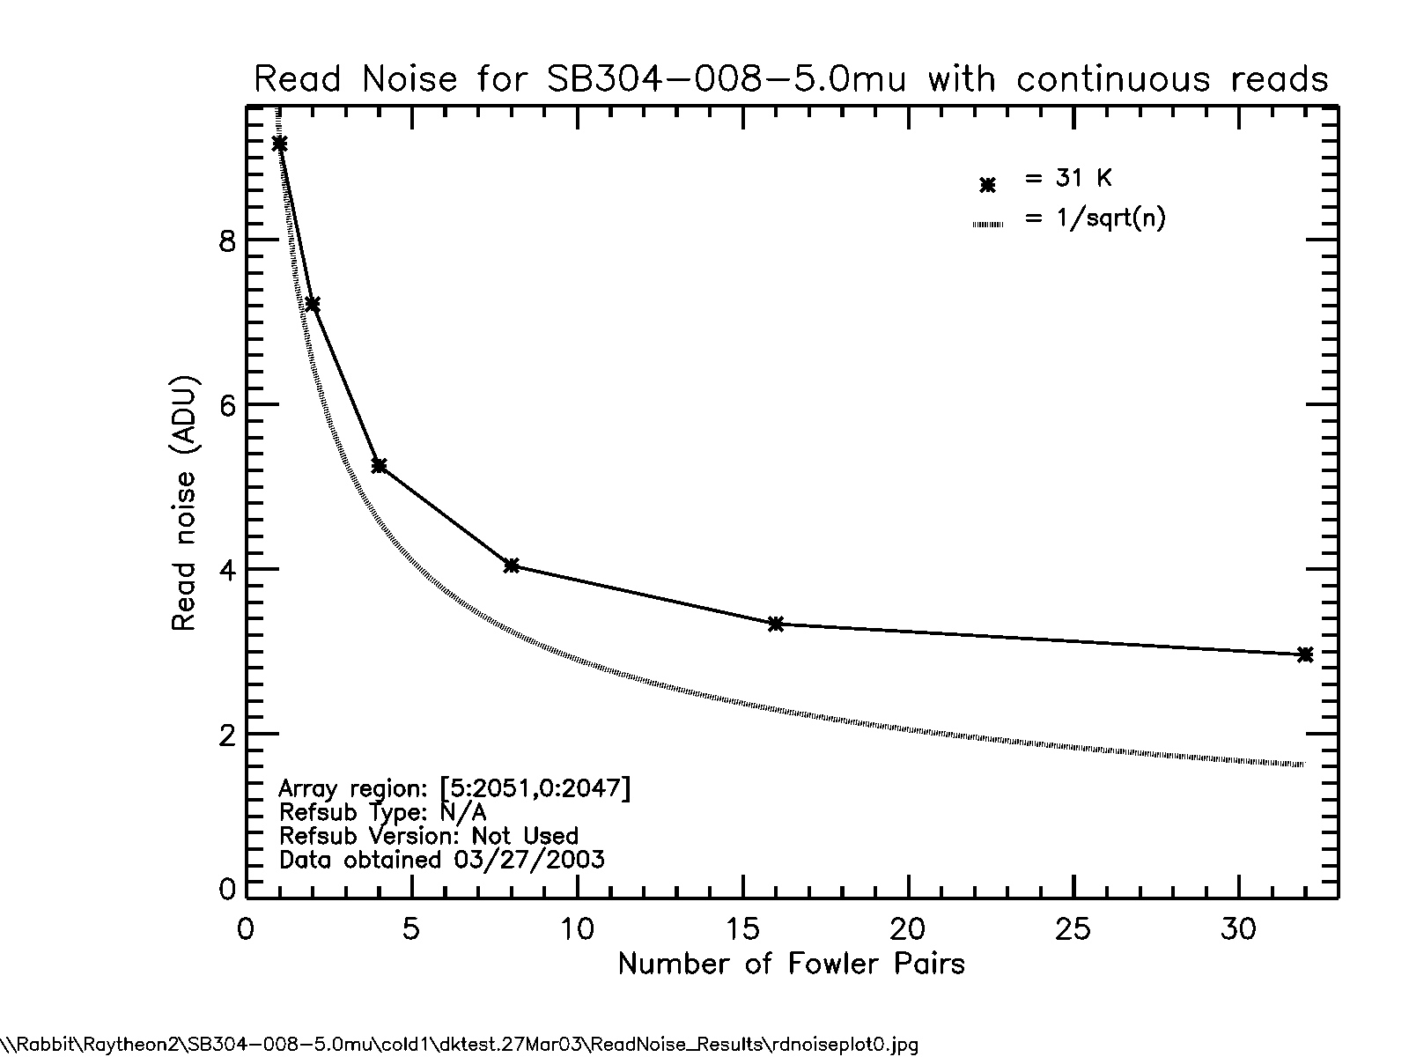
Read Noise Example

Slide 80
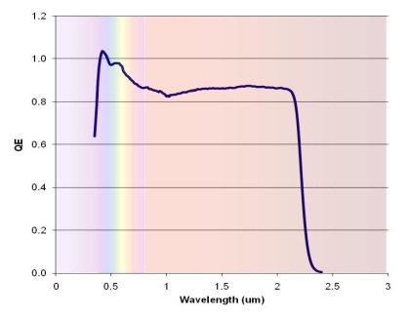
QE Example
Relative QE for Bepi-Colombo device, at 293 K, of RVS MCT array after substrate removal. High response in the UV region is due to charge gain. The QE reduces by ~8% at 190 K.

Slide 81
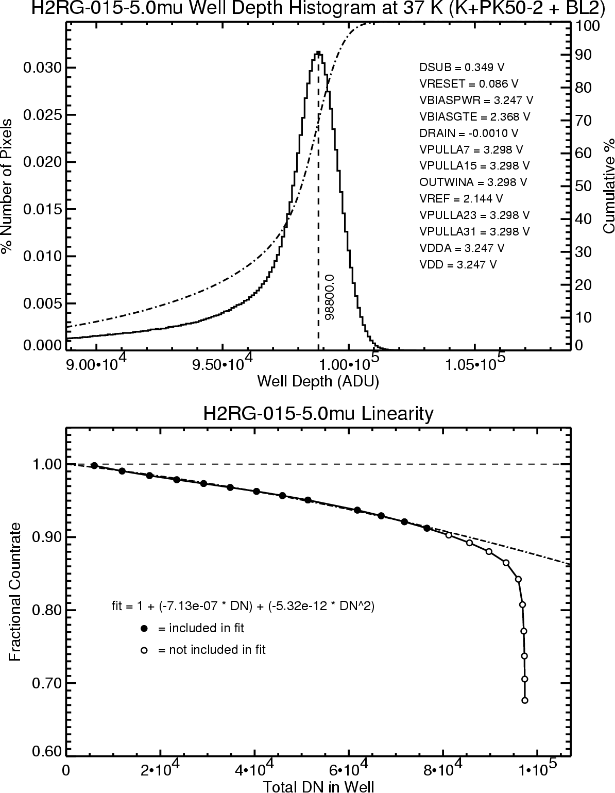
Well Depth and Non-linearity

Slide 82
Persistence
Persistence is the tendency of a detector to capture charge liberated in one exposure and then release it later in another exposure.
It is produced by charge traps.
Persistence introduces a noise source into images.

Slide 83
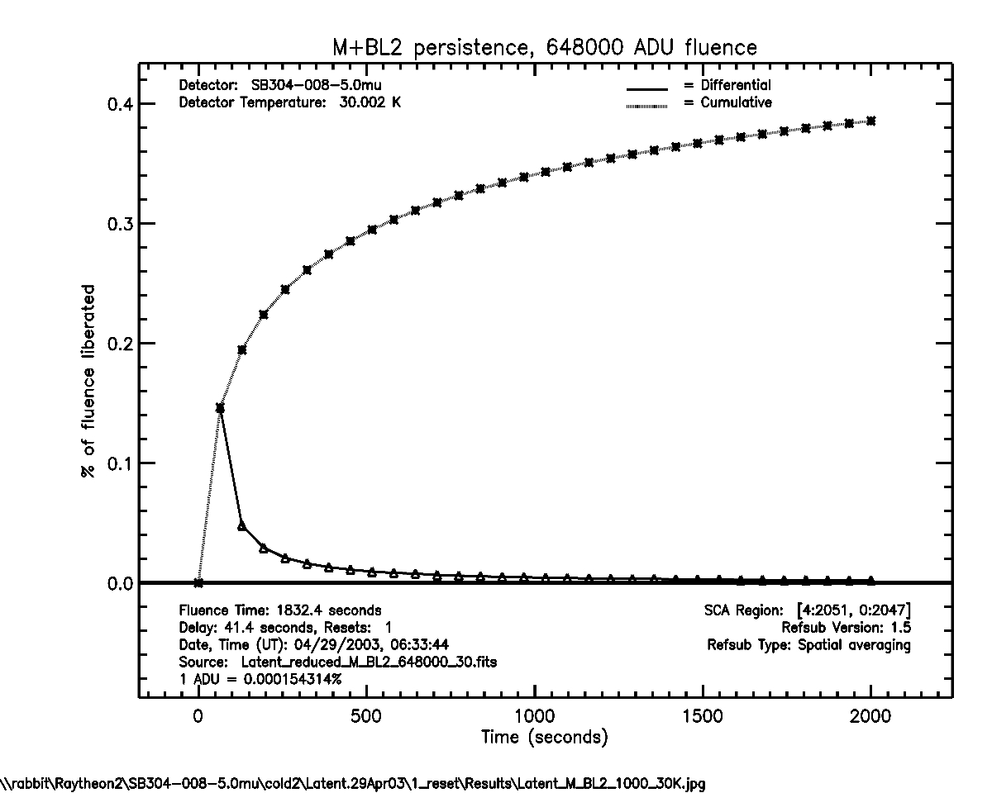
Persistence Continued

Slide 84
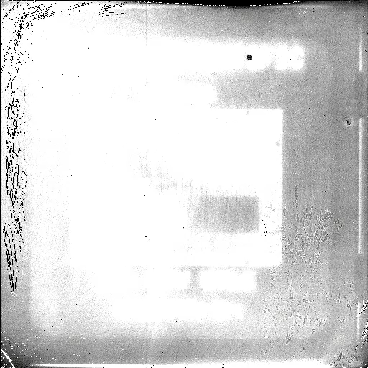
Persistence Movie

Slide 85
Pixel-to-pixel Crosstalk
Crosstalk occurs when a pixel value is influenced by its neighbors.
Charge diffusion is an important crosstalk mechanism in IR arrays and CCDs.
Once charge carriers are created, their motion is governed by charge diffusion.

Slide 86
IPC
Interpixel capacitance (IPC) is another form of crosstalk.
In this case, charge in a pixel induces a voltage change in a neighbor, just like the behavior between parallel plates in a capacitor.
The effect is to blur the point spread function.
The induced voltage does not have noise.

Slide 87
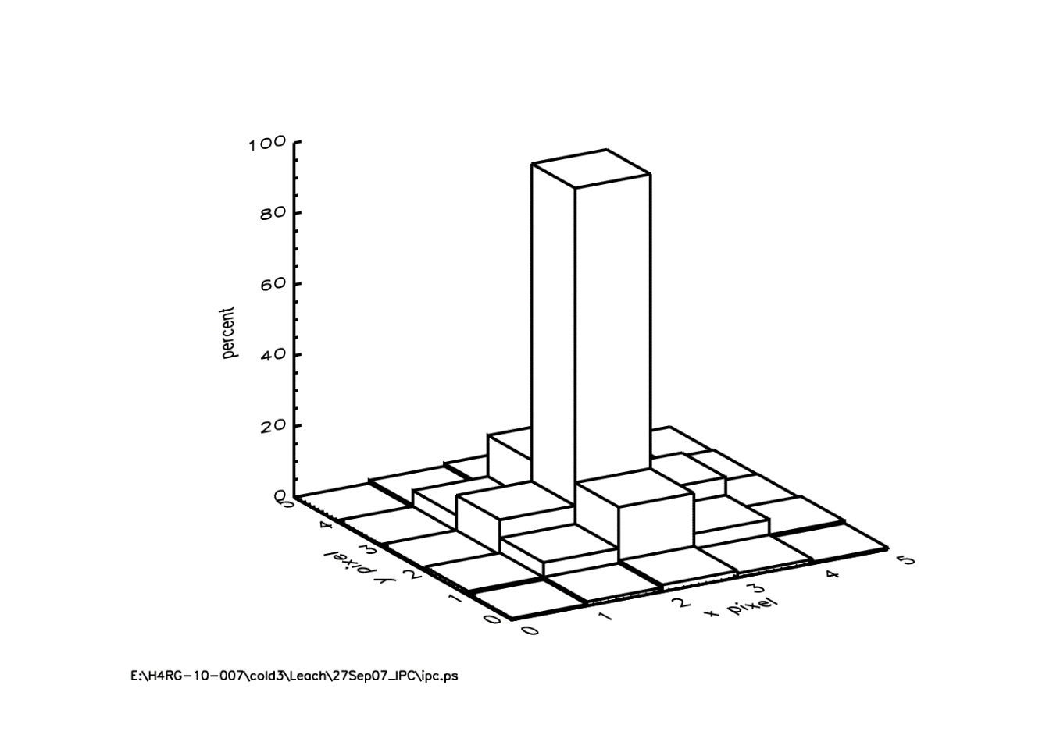
IPC
In this example, IPC is very large for the H4RG SiPIN device (10 um pixel size).

Slide 88
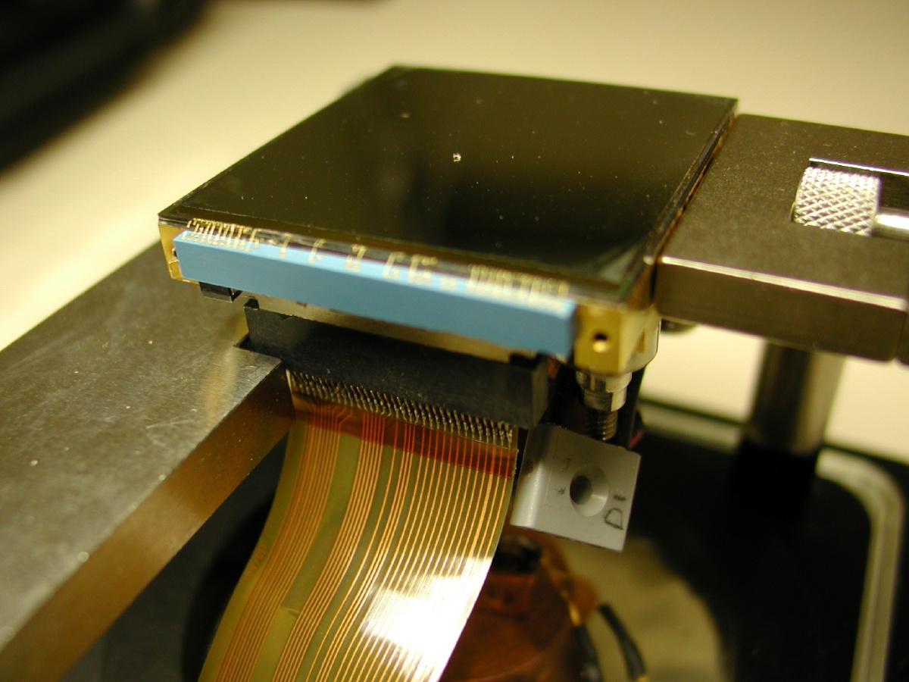
Teledyne Family Arrays
H2RG HgCdTe array

Slide 89
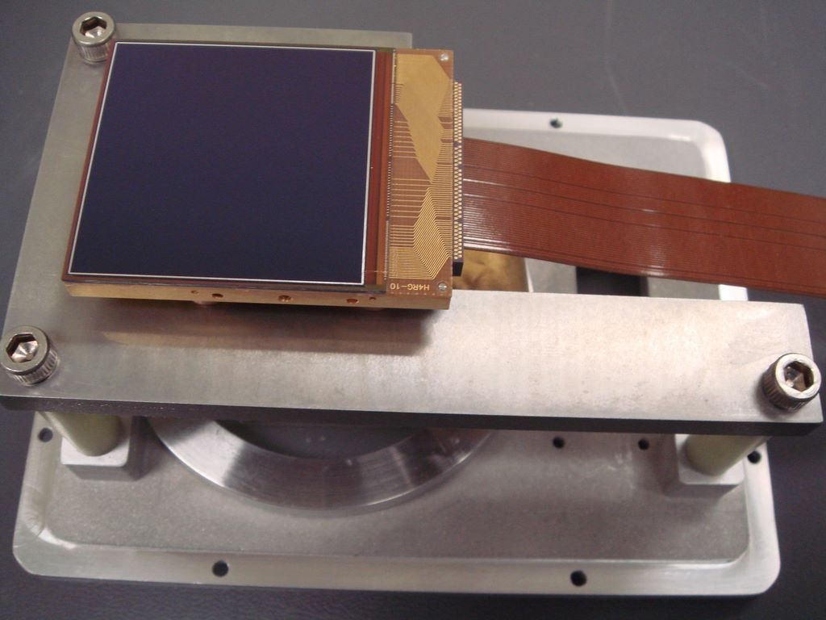
Teledyne H4RG Si PIN
This is an image of the H4RG device in the Rochester Imagingn Detector Laboratory.

Slide 90
Raytheon Family Arrays

Slide 91
MCT on Si
Design of the light-sensitive part of the pixel for the RVS SB-390 MCT on Silicon (Bornfreund et al. 2005).

Slide 92
MCT on Si

