Slide 1
University Astronomy
Professor Don Figer
Instruments and Detectors I

Slide 2
Aims for Lecture
Introduce modern Optical/NIR/UV instrumentation.
  instrument requirements
  instrument examples
Describe capabilities of commonly used instruments.
  HST
  Spitzer
  Chandra
  JWST
  ELTs
  WFIRST

Slide 3
instrument requirements

Slide 4
Instrument Science Requirements
spatial resolution
spectral resolution
wavelength coverage
sensitivity
dynamic range
field of view

Slide 5
Instrument System Requirements
spectrograph and/or camera
sampling
filters
exposure time cadence (short/long)
stability
  photometric
  spectral

Slide 6
Instrument Engineering Requirements
detector/electronics
  pixel size
  quantum efficiency
  noise
  dark current
  supported exposure times
  sampling speed
optics
  materials
  irregularity/wavefront error
  f/number
  optics efficiency
  coatings
mechanics
environment
  pressure
  temperature
  stability

Slide 7
Instrument Constraints
cost
schedule
volume
mass
power

Slide 8
Camera plate scale
red=optics
blue=rays
black=focal/pupil planes
green=optical axis
primary
prime focal plane
final focal plane
collimator
pupil plane
camera
θ_{T}
s_{T}
s_{cam}
F_{T}
F_{coll}
F_{cam}

Slide 9
Camera f/number, seeing-limited
In general, we want to ensure Nyquist sampling, so the camera f/number should be chosen such that two pixels span the FWHM of the point spread function (PSF).
If the PSF is fixed by seeing, then the size would be roughly equal for all telescope sizes.
Therefore, bigger telescopes (bigger D) will require smaller camera f/numbers in order to maintain the same plate scale.
Consider a seeing-limited 8m telescope with 10 μm pixels, f_{cam}~1.

Slide 10
Camera f/number, diffraction-limited
Consider a diffraction-limited telescope.
Now, f_{cam} is independent of telescope size.
Consider, 10 μm pixels in optical light, f_{cam}~30.

Slide 11
instrument components

Slide 12
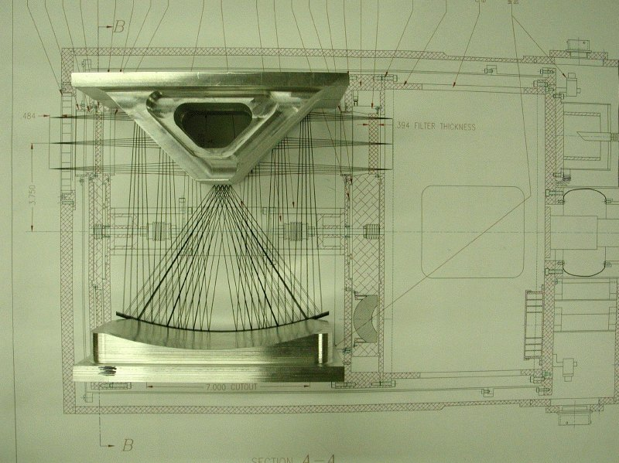
Optics: example

Slide 13
Electronics
There are many kinds of electronics in an instrument.
Detector
  control
    clock
    bias
  data acquisition
    readout multiplexer
    pre-amplifier
    digitizer
Motion control
Thermometry
Computer(s)

Slide 14
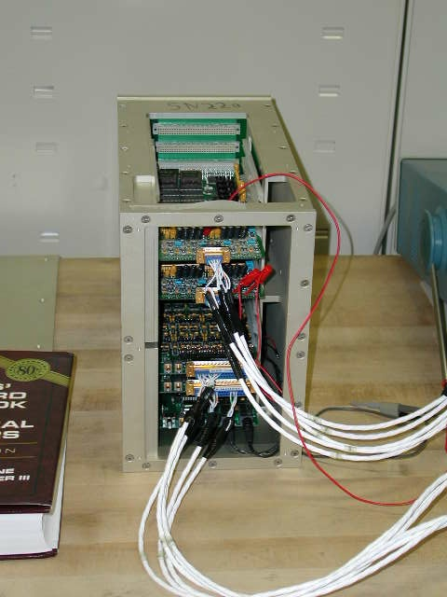
Electronics: example
Astronomical Research Cameras, Inc. (Bob Leach)
8 channels per board
1 MHz, 16-bit A/D
Clocks
Biases
Voodoo/OWL software

Slide 15
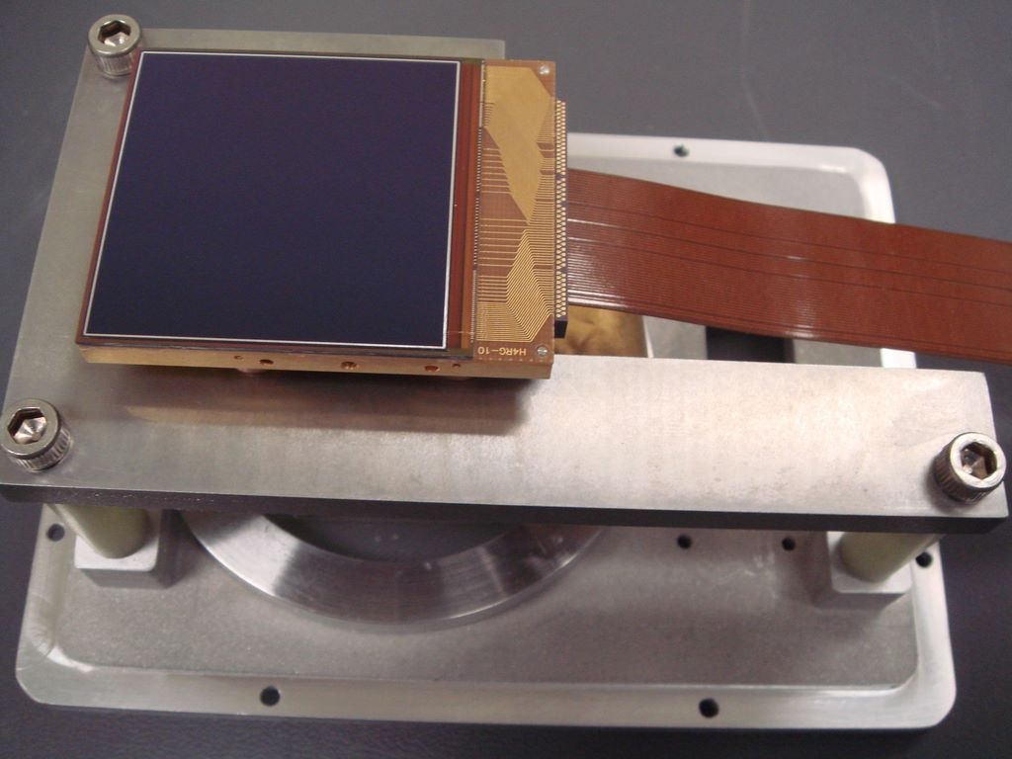
Focal Plane Assembly
The FPA contains the detector(s) and provisions for optical, mechanical, thermal, and electrical interfaces.

Slide 16
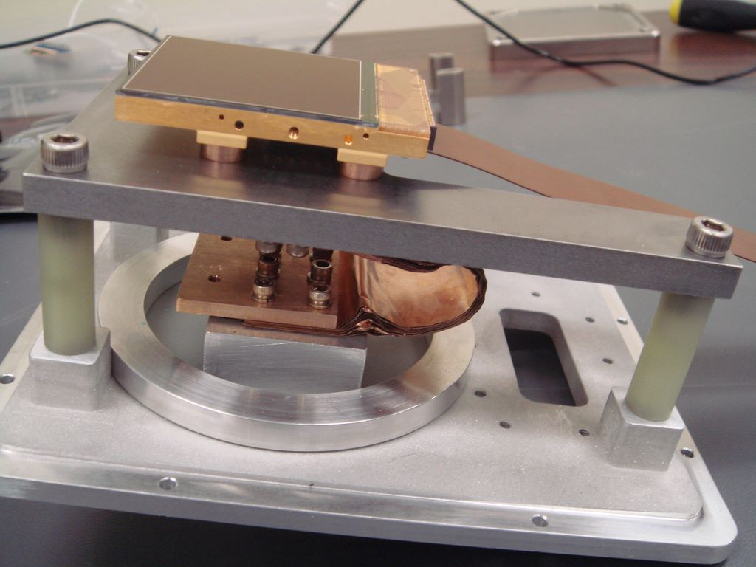
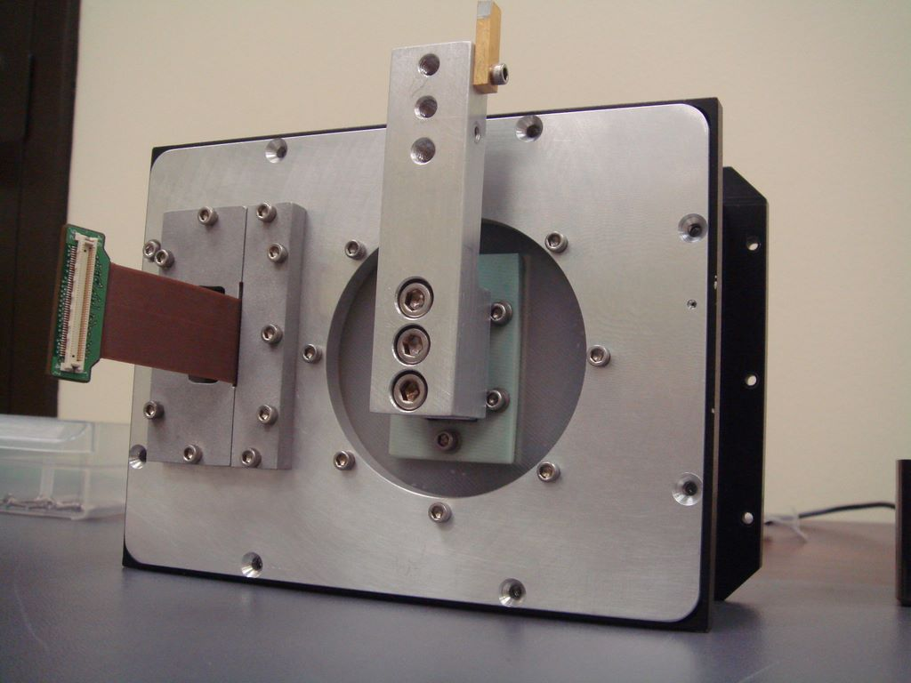
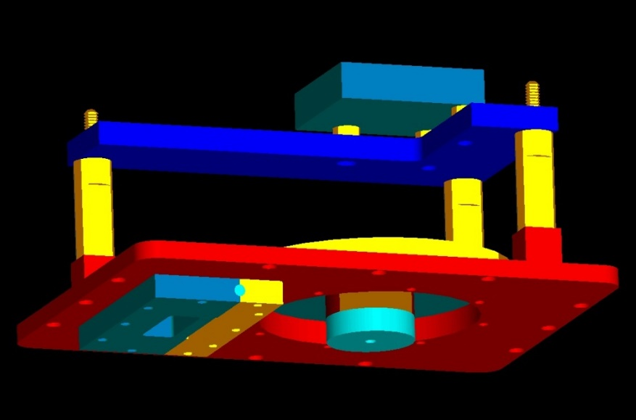
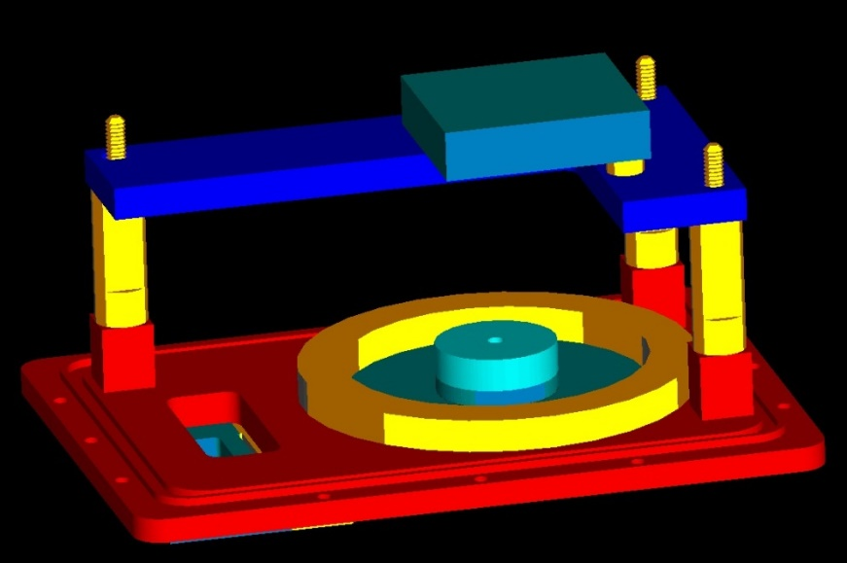
Focal Plane Assembly: example

Slide 17
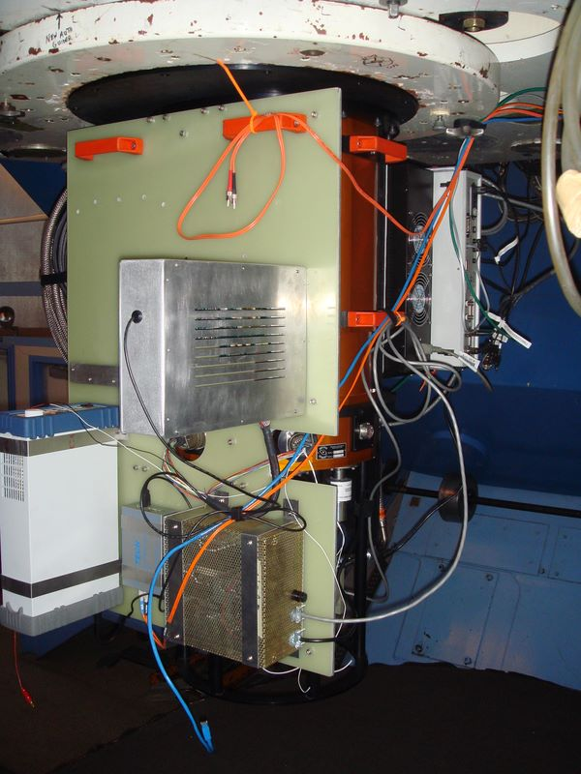
Mechanics: Telescope Interfacing

Slide 18
Software
data acquisition
control
virtual instrument
quick look
quick pipeline
data reduction pipeline
simulators

Slide 19
instrument examples - existing

Slide 20
NIRSPEC/Keck Optical Layout
Side View

Slide 21
NIRSPEC/Keck Optical Layout
Top View

Slide 22
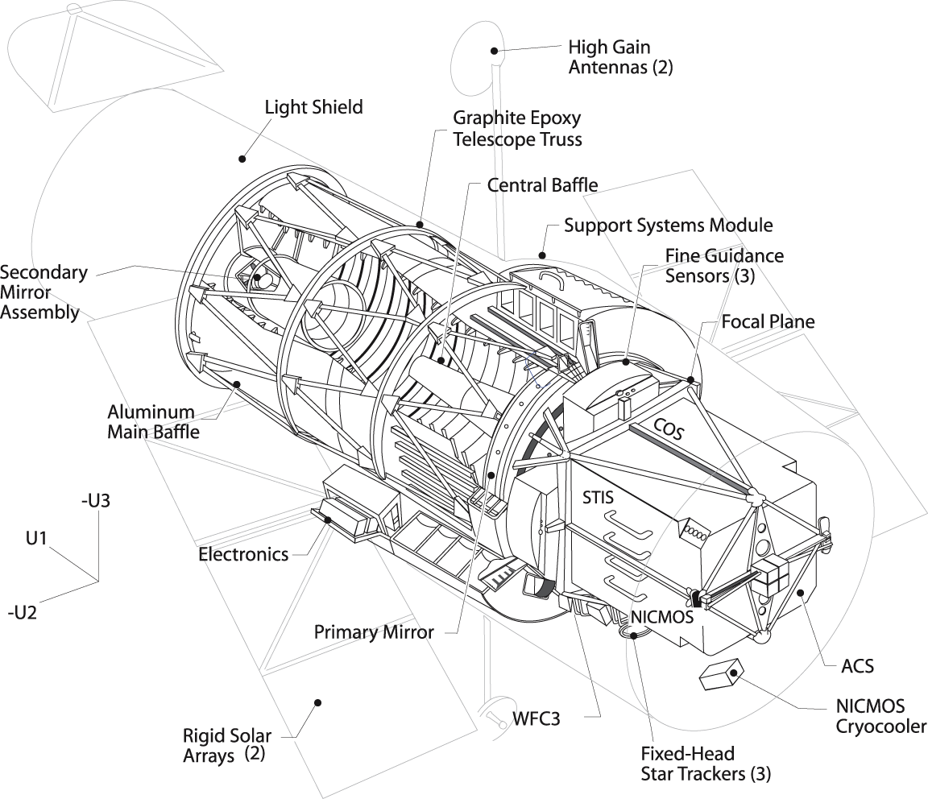
Hubble Space Telescope Cutaway

Slide 23
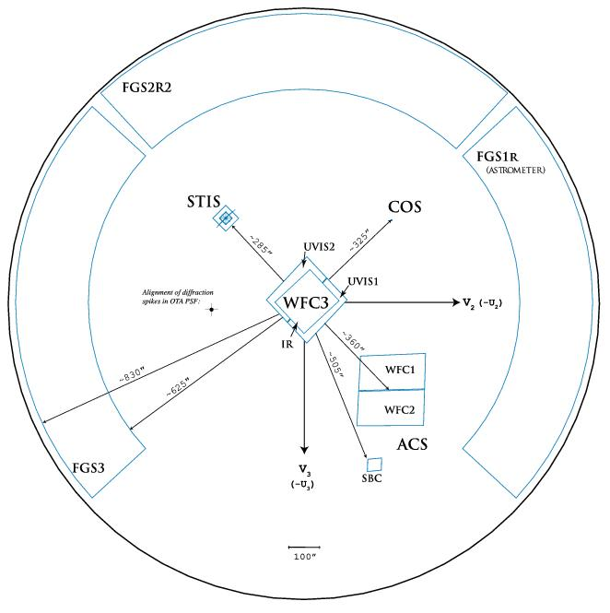
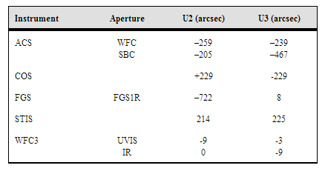
Hubble Space Telescope Field of View
WFC3
ACS
STIS
COS
FGS

Slide 24
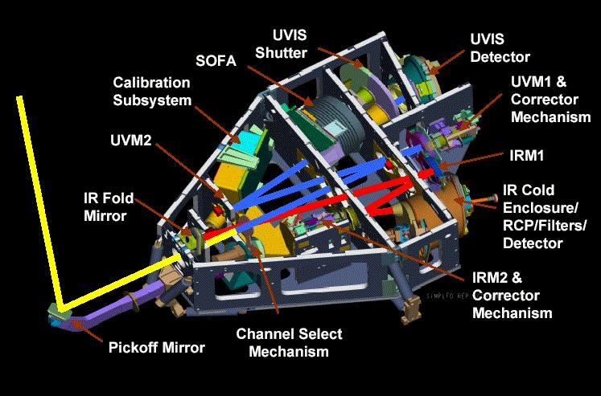
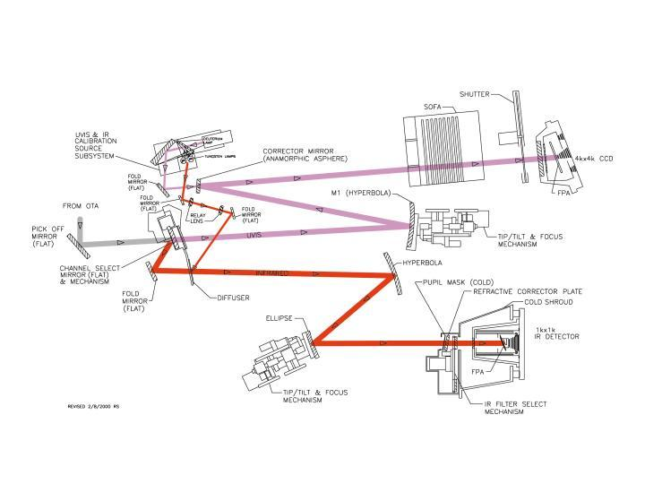
HST: WFC3

Slide 25
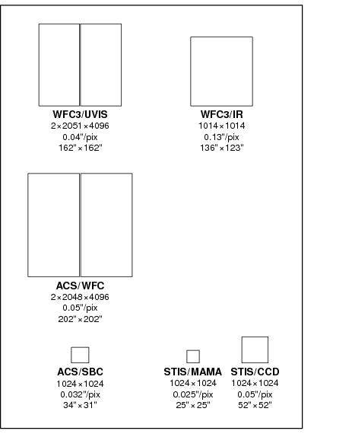
HST: WFC3

Slide 26
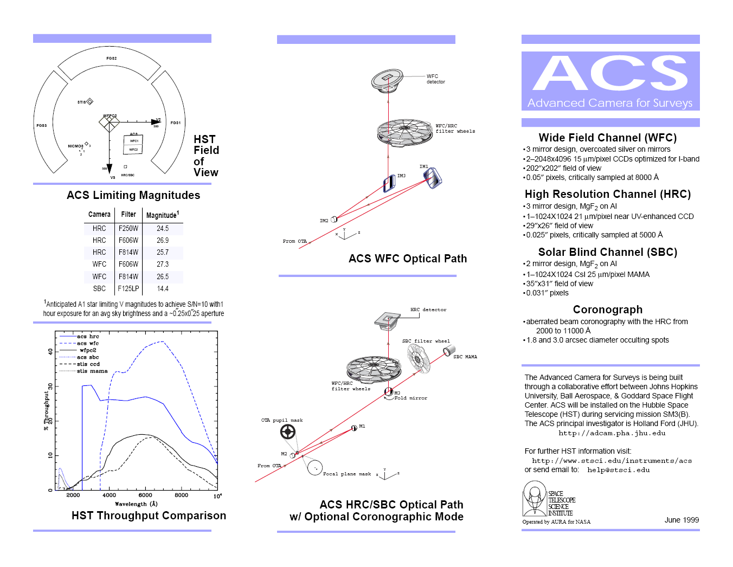
HST: ACS

Slide 27
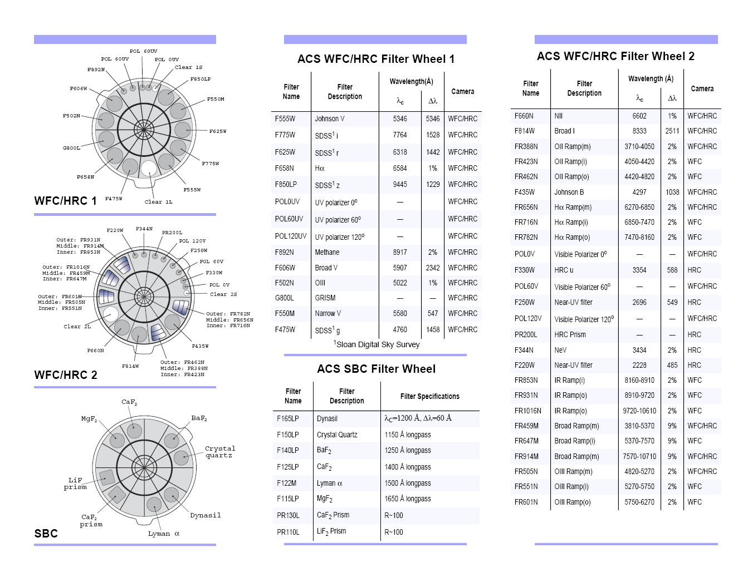
HST: ACS

Slide 28
Chandra Space Telescope
ACIS
HRC
Spectral modes
Advanced Charged Couple Imaging Spectrometer (ACIS): Ten CCD chips in 2 arrays provide imaging and spectroscopy; imaging resolution is 0.5 arcsec over the energy range 0.2 - 10 keV; sensitivity: 4x10⁻¹⁵ ergs/cm²/sec in 10⁵ s
High Resolution Camera (HRC): Uses large field-of-view mircro-channel plates to make X-ray images: ang. resolution < 0.5 arcsec over field-of-view 31x31 arc0min; time resolution: 16 micro-sec sensitivity: 4x10⁻¹⁵ ergs/cm²/sec in 10⁵ s
High Energy Transmission Grating (HETG): To be inserted into focused X-ray beam; provides spectral resolution of 60-1000 over energy range 0.4 - 10 keV
Low Energy Transmission Grating (LETG): To be inserted into focused X-ray beam; provides spectral resolution of 40-2000 over the energy range 0.09 - 3 keV

Slide 29
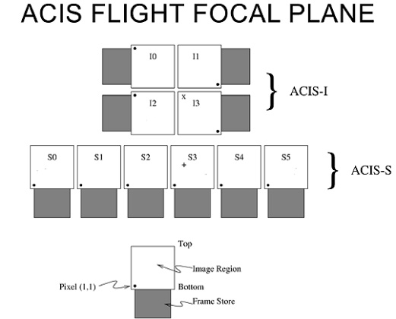
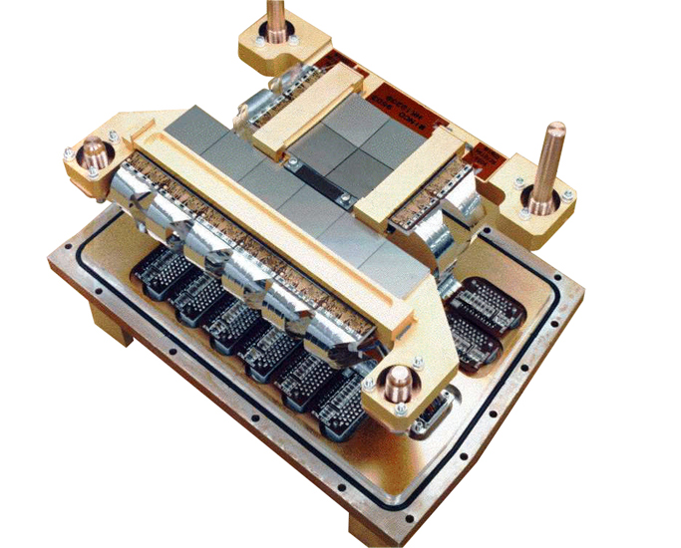
Chandra Space Telescope: ACIS

Slide 30
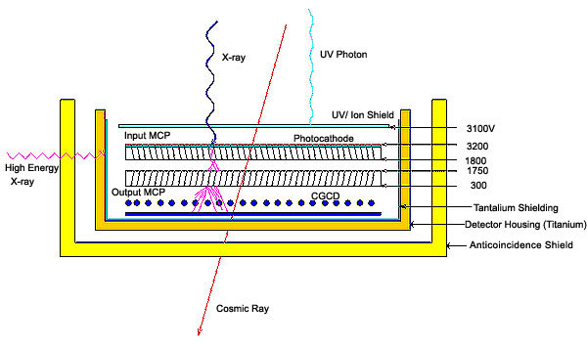
Chandra Space Telescope: HRC

Slide 31
Chandra Space Telescope: Spectroscopy
High Resolution Spectrometers - HETGS and LETGS
These are transmision gratings
  low energy: 0.08 to 2 keV
  high energy: 0.4 to 10 keV (high and medium resolution)
Groove spacings are a few hundred nm.

Slide 32
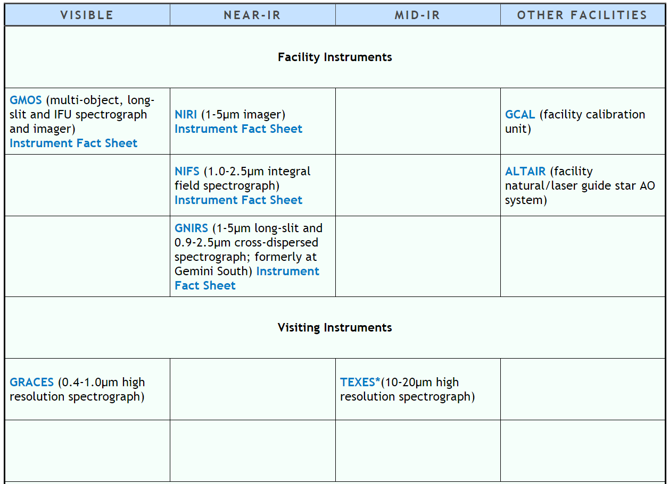
Gemini (North)

Slide 33
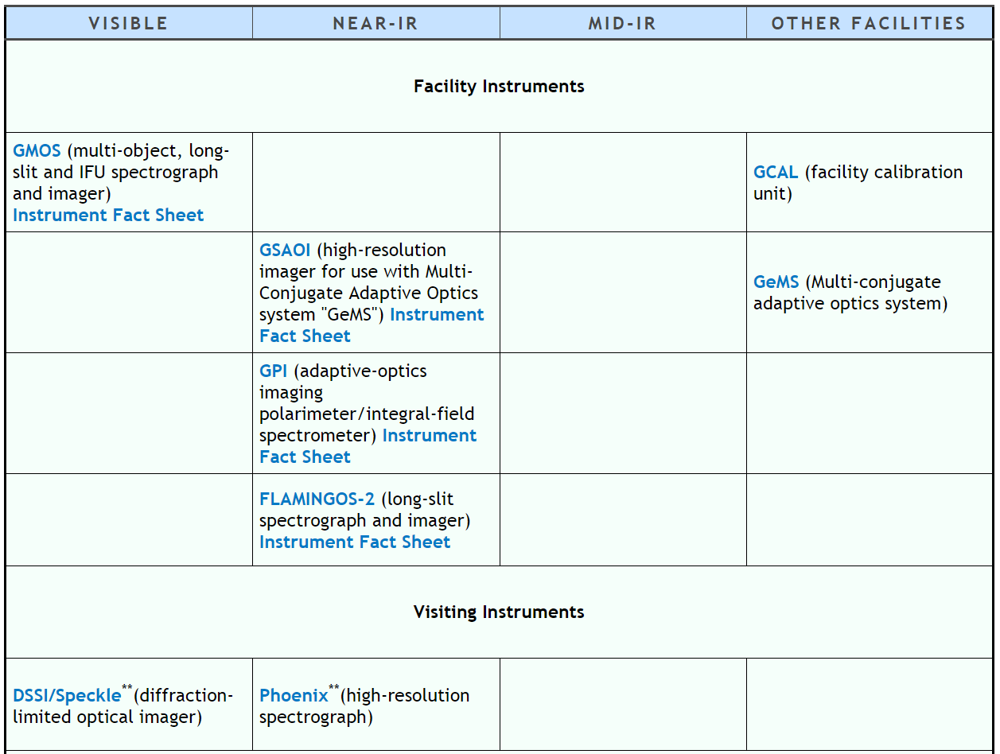
Gemini (South)

Slide 34
instrument examples - future

Slide 35
JWST
NIRCAM
NIRSPEC
MIRI

Slide 36
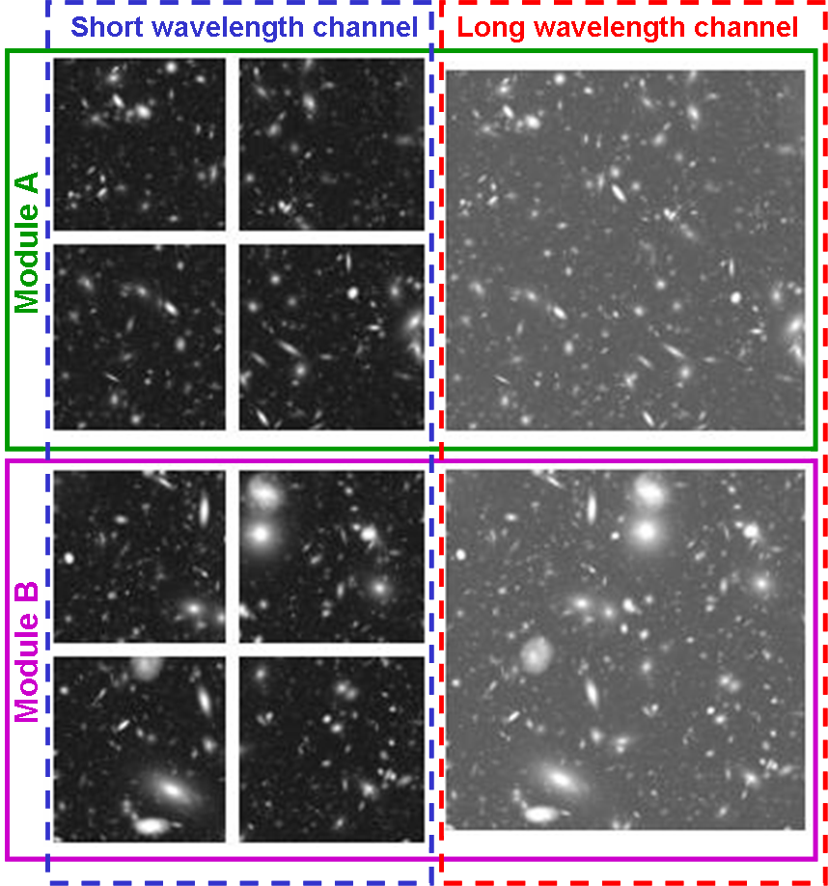
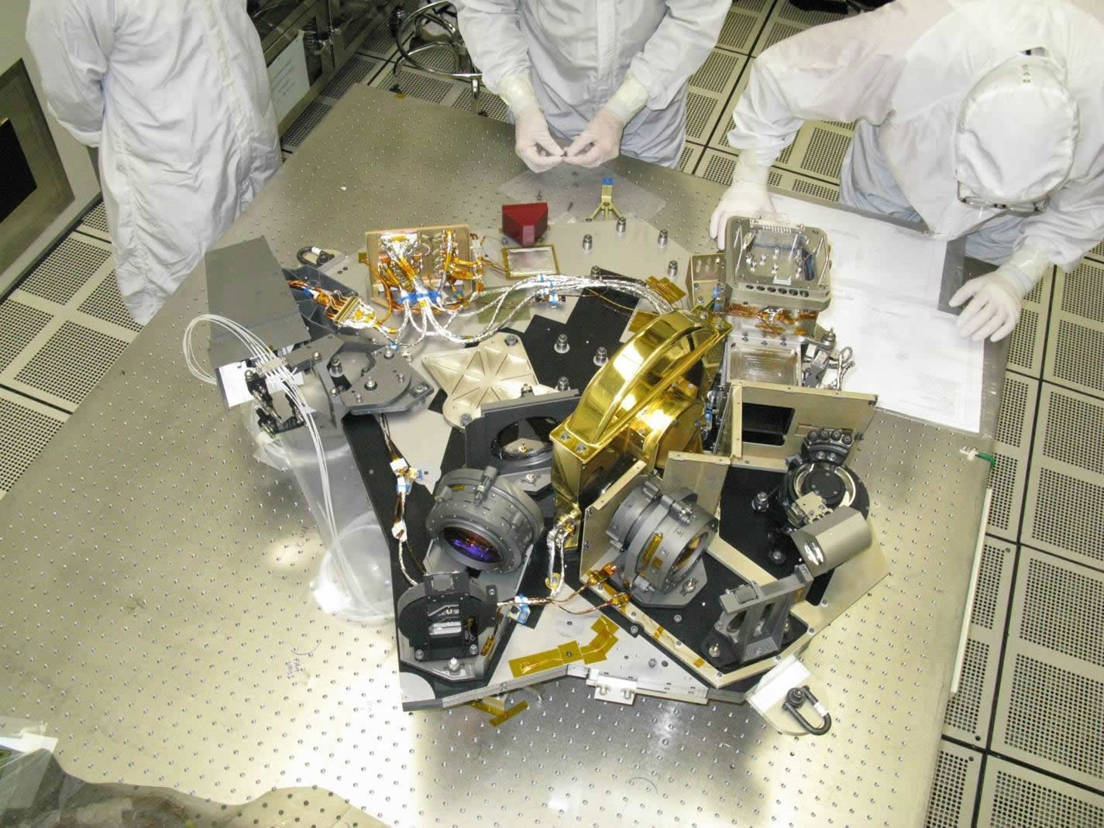
JWST: NIRCAM
Nyquist-sampled imaging at 2 and 4 microns -- short wavelength sampling is 0.032"/pixel and long wavelength sampling is 0.065"/pixel
2.2'x4.4' FOV for one wavelength provided by two identical imaging modules, two wavelength regions are observable simultaneously via dichroic beam splitters.

Slide 37
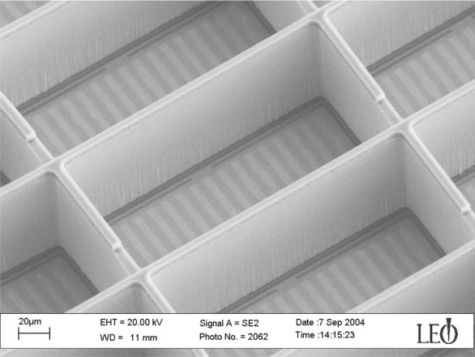
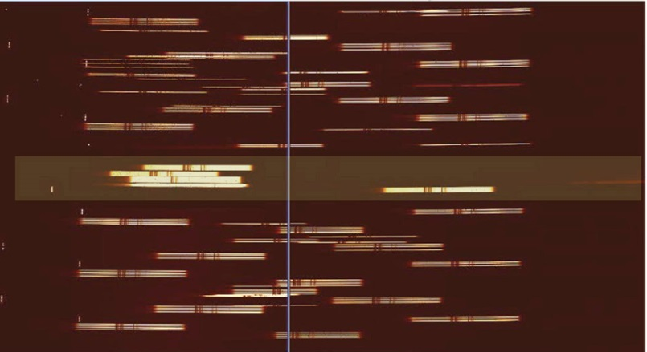
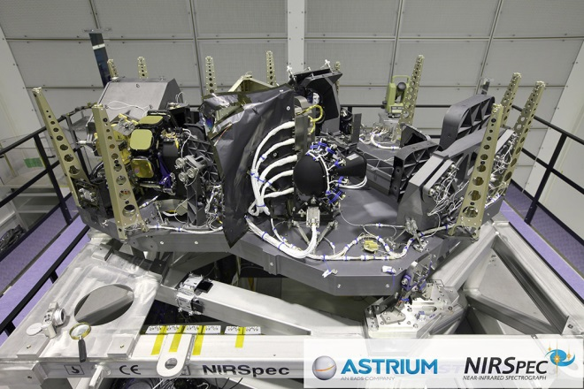
JWST: NIRSPEC
1-5 um; R=100, 1000, 3000
3.4x3.4 arcminute field
Uses a MEMS shutter for the slit

Slide 38
JWST: MIRI
5-27 micron, imager and medium resolution spectrograph (MRS)
MIRI imager: broad and narrow-band imaging, phase-mask coronagraphy, Lyot coronagraphy, and prism low-resolution (R ~ 100) slit spectroscopy from 5 to 10 micron.
MIRI will use a single 1024 x 1024 pixels Si:As sensor chip assembly. The imager will be diffraction limited at 7 microns with a pixel scale of ~0.11 arcsec and a field of view of 79 x 113 arcsec.
MRS: simultaneous spectral and spatial data using four integral field units, implemented as four simultaneous fields of view, ranging from 3.7 x 3.7 arcsec to 7.7 x 7.7 arcsec with increasing wavelength, with pixel sizes ranging from 0.2 to 0.65 arcsec. The spectroscopy has a resolution of R~3000 over the 5-27 micron wavelength range. The spectrograph uses two 1024 x 1024 pixels Si:As sensor chip assemblies.

Slide 39
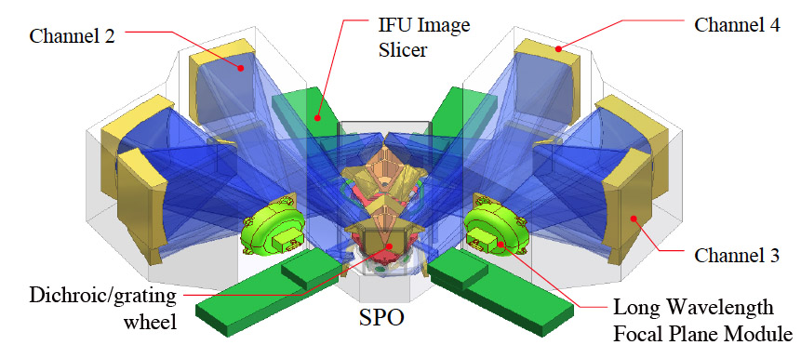
JWST: MIRI MRS

Slide 40
TMT
The Wide Field Optical Spectrometer (WFOS) will provide near-ultraviolet and optical (0.3 – 1.0 μm wavelength) imaging and spectroscopy over a more than 40 square arcminute field-of-view. Using precision cut focal plane masks, WFOS will enable long-slit observations of single objects as well as short-slit observations of hundreds of objects simultaneously. WFOS will use natural (uncorrected) seeing images.
The Infrared Imaging Spectrometer (IRIS) will be mounted on the observatory MCAO system and be capable of diffraction-limited imaging and integral-field spectroscopy at near-infrared wavelengths (0.8 – 2.5 μm).
The Infrared Multi-object Spectrometer (IRMS) will allow close to diffraction-limited imaging and slit spectroscopy over a 2 arcminute diameter field-of-view at near-infrared wavelengths (0.8 – 2.5 μm).

Slide 41
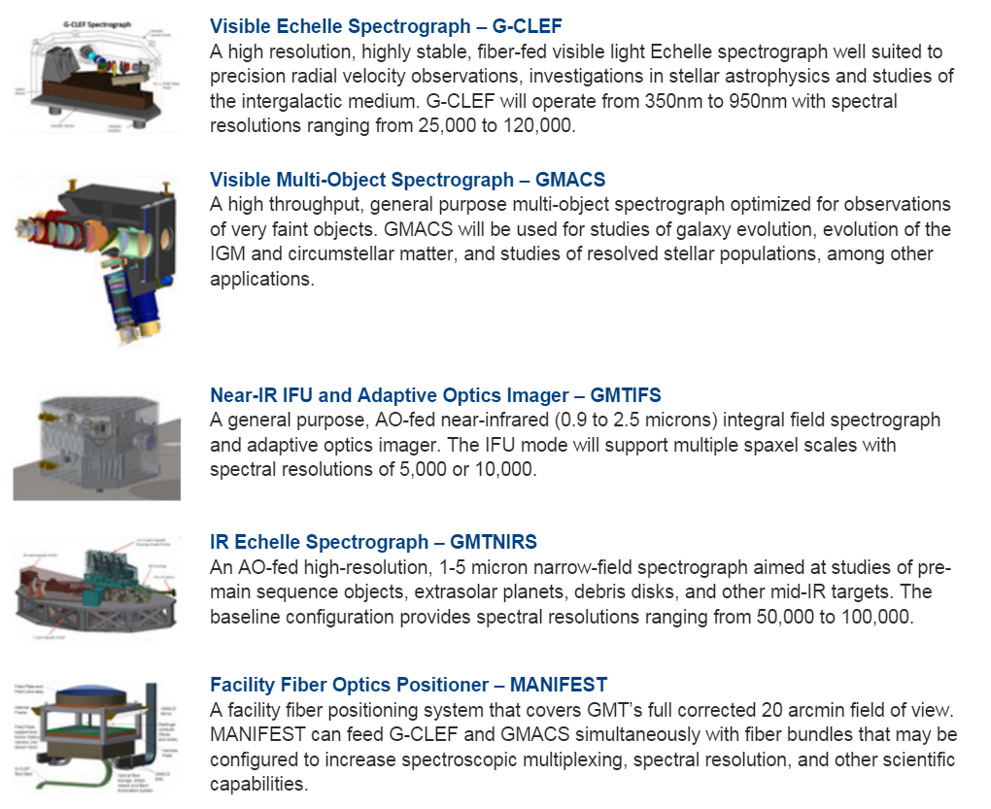
GMT

Slide 42
E-ELT
Two first-light instruments have been identified: a diffraction-limited near-infrared imager (ELT-CAM) and a single-field near-infrared wide-band integral field spectrograph (ELT-IFU), including the adaptive optics systems required to deliver their science cases.
The next three instruments, a mid-infrared imager and spectrometer (ELT-MIDIR), a high resolution spectrometer (ELT-HIRES) and a multi-object spectrometer (ELT-MOS), were considered of equal scientific importance.
Fabrication is underway with the consortia that will build ELT-IFU (HARMONI), ELT-CAM (MICADO), the MCAO system (MAORY) and ELT-MIDIR (METIS).

Slide 43
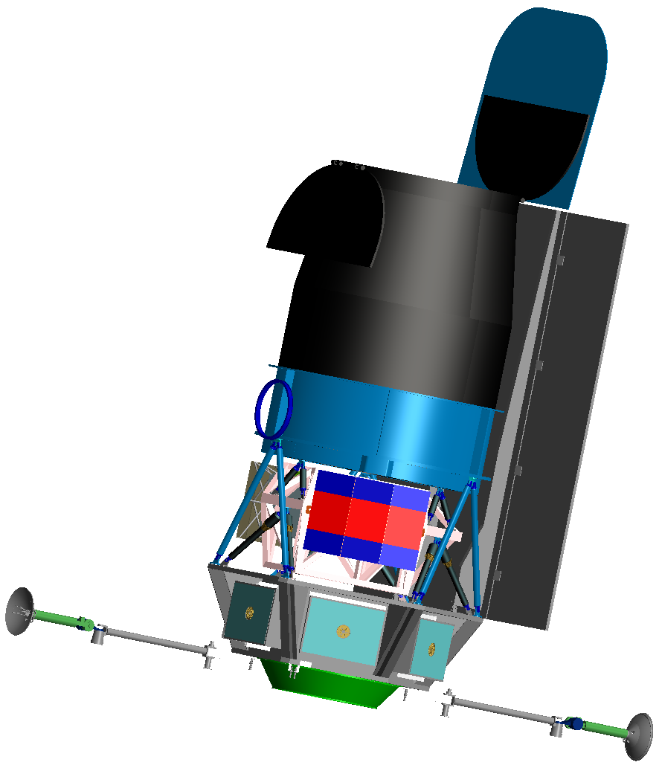
WFIRST-AFTA Observatory Concept
Key Features
Telescope: 2.4m aperture primary
Instruments
  Wide Field Imager/Spectrometer & Integral Field Unit
  Internal Coronagraph with Integral Field Spectrometer
Overall Dry Mass: ~4060 kg (CBE)
Structure: high stiffness composites; modular packaging for avionics
GN&C/Propulsion: inertial pointing, 3-axis stabilized, mono-prop system for stationkeeping & momentum unloading
Data Downlink Rate: Continuous ~600 Mbps Ka-band to dedicated ground station
C&DH: low rate bus for housekeeping and spacecraft control, high speed bus for science data
Power: ~2400 W average power (CBE)
GEO orbit
Launch Vehicle: Delta IV Heavy
GSFC: leads mission, wide field instrument, spacecraft
JPL: leads telescope, coronagraph

Slide 44
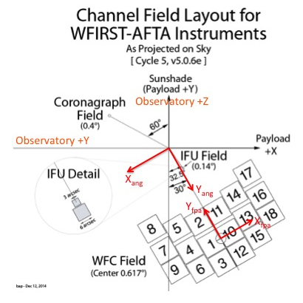
WFIRST-AFTA Field Layout

Slide 45
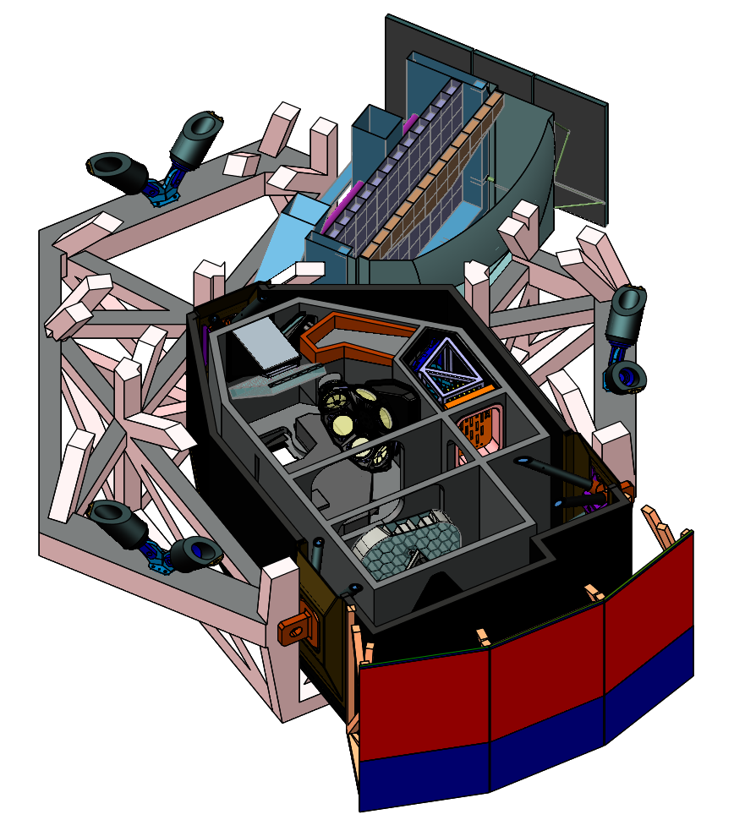
Wide Field Instrument Overview
Cold Optics Radiation Shield
Focal Plane Assembly
Key Features
Wide field channel instrument for both imaging and spectroscopy
  3 mirrors, 1 powered
  18 4k x 4k HgCdTe detectors cover 0.76 - 2.0 μm
  0.11 arc-sec plate scale
  Single element wheel for filters and grism
  Grism used for GRS survey covers 1.35 – 1.89 μm with R = 461λ (~620 – 870)
IFU channel for SNe spectra, single HgCdTe detector covers 0.6 – 2.0 μm with R between 80-120
Cold Electronics
Optical Bench
Element Wheel
Notes:
Telescope & wide field channel optical design is coaxial
Reduced fabrication and alignment risk by simplifying optics in instrument (tertiary mirror is a conic instead of anamorphic)
Field of view is arced rather than a rectangular array of 6x3 H4RG-10s; enables favorable optical interface to coronagraph
IFU is repackaged, similar elements in a much smaller overall volume
Simplifies integration by enabling parallel build and integration with wide field channel
Grism assembly simplified; all fused silica, 3 elements, with simpler surfaces; 2 instead of previous 1 diffractive surface
Cryocooler
Detector operating temperature reduced from 120K to 100K based on recent detector testing – lower temperature necessary to meet WFIRST requirements.
Low jitter Turbo Brayton cooler allows colder operational temperatures than can be achieved passively in GEO orbit while minimizing jitter.

Slide 46
WFI Filters

Slide 47
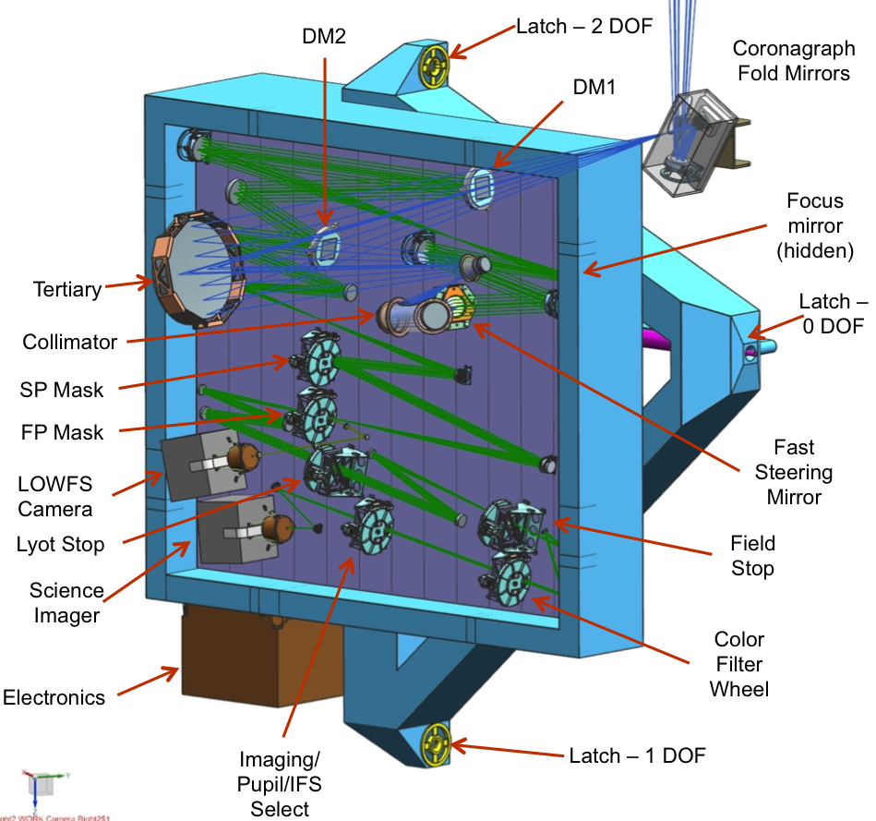
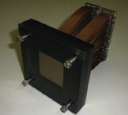


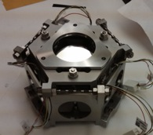
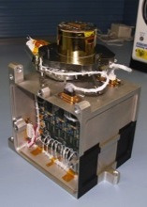
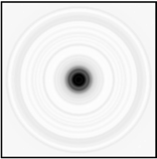
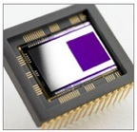
Coronagraph Instrument Overview
Temperature | 293 K for instrument
Temperature | ~165 K for cameras
Data Volume | ~30 Gbits/day
Imaging | 0.43 – 0.97 microns, 4.8" FoV 0.009" pixel scale, 1K×1K EMCCD
Integral Field Spectrograph | 0.60 – 0.97 microns R~70

