Slide 1
University Astronomy
Professor Don Figer
Dark Matter

Slide 2
Aims and outline for this lecture
define dark matter
review evidence of dark matter
describe potential sources of dark matter
discuss dark matter probes

Slide 3
what is dark matter?

Slide 4
Dark Matter
The term “dark matter” describes an unseen source that appears to affect measurements of the Universe just as does the matter that we can see.
For instance, matter that we can see, such as the Sun, affects the orbits of planets (that we can see).
Imagine that we could not see the Sun (but it was still there), but we could watch the planets orbit it. We might say that there is some mysterious “dark matter” that is causing the planets to orbit a common point.
We cannot explain some measurements in the Universe just on the basis of what we can see and our knowledge of gravity.

Slide 5
What Does “Dark” Mean?
In the context of the term “dark matter,” the word “dark” means that we do not see it.
What does “see” mean?
“See” means that we have not detected photons from it.
It could be that we aren’t looking in the right wavebands.
Maybe dark matter doesn’t emit many photons.
Maybe the effects of dark matter actually aren’t due to any kind of matter at all.
That is, maybe the effects are just an artifact of the fact that we do not understand gravity (“oh, there goes gravity”).

Slide 6
Galactic
Rotation curves

Slide 7
Galactic Rotation Curves
One way to estimate the mass of a point object is to measure the velocities of objects orbiting it.
In a system in which the point mass dominates the whole mass of the system, like the Sun and planets, we expect the orbital velocities to decrease by 1/r^{1/2}. This is called the Keplerian case.
The mass distribution in the Galaxy is a bit different.
Its mass is extended, not just in a point.
We observe that the orbital velocities do NOT decrease at all. They are roughly constant as a function of distance from the Galactic center.
The “visible” distribution of matter falls as a function of distance.
Therefore, their appears to be some “dark” matter.

Slide 8
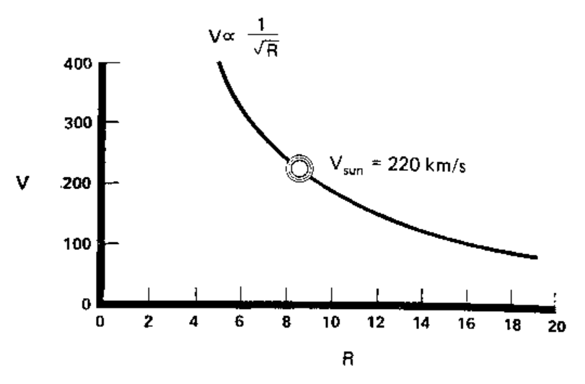
What Is Velocity Around Point Mass?

Slide 9
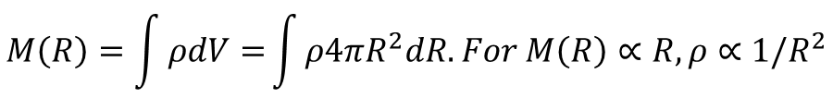
Stellar Velocities and Dark Matter
The average rotational velocity does not fall as 1/r^{1/2}, as one would expect around a point mass, e.g. as in the Keplerian case.
Instead, it appears to be constant.
$$M\left(R\right)=\frac{{v(R)}^{2}R}{G}→{v(R)}^{2}=\frac{M\left(R\right)G}{R}. For v=constant, M\left(R\right)∝R.$$
$$M\left(R\right)=\int{ρdV=}\int{ρ4πR^{2}dR. For M\left(R\right)∝R, ρ∝1/R^{2}}$$
The stellar number density is falling at a much higher rate.
Therefore, there must be some sort of matter that we cannot see in order to explain the velocities.

Slide 10
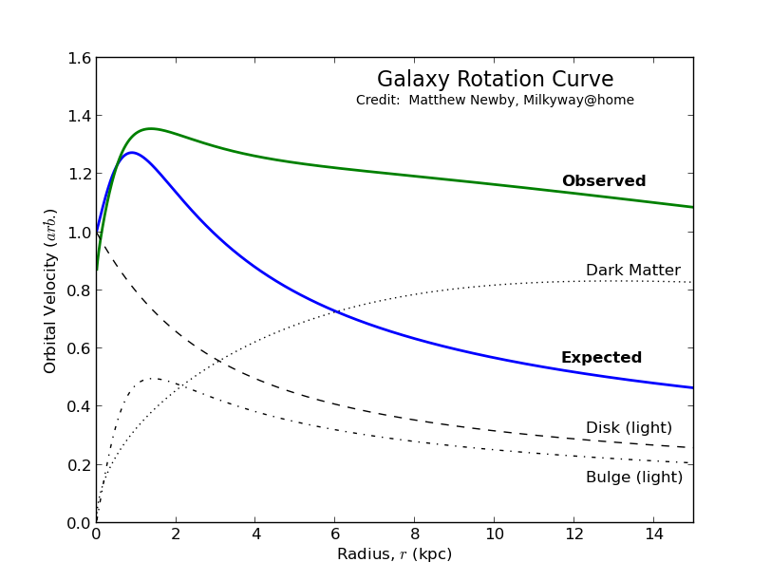
Rotation Curve

Slide 11
Galactic Rotation Curve
Flat at further distances
More and more mass is interior to objects at these distances

Slide 12
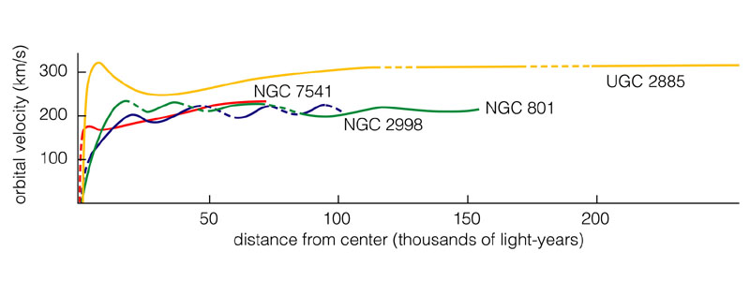
Other Spiral Galaxies
These rotation curves are flat, just like for our Milky Way.
Other galaxies also contain a lot of dark matter.

Slide 13
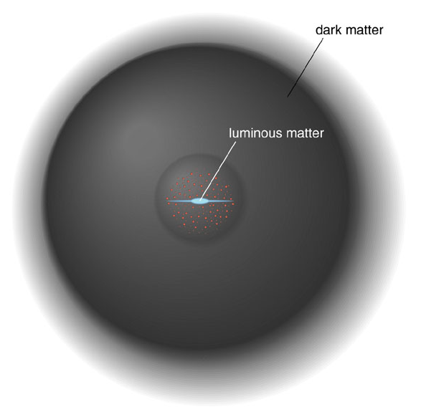
Dark Matter in the Halo

Slide 14
Galaxy clusters

Slide 15
Galaxies in Clusters
Galaxy clusters are particularly important for dark matter studies since their masses can be estimated in three independent ways:
  From the scatter in radial velocities of the galaxies within clusters.
  From X-rays emitted by hot gas in the clusters. From the X-ray energy spectrum and flux, the gas temperature and density can be estimated, hence giving the pressure; assuming pressure and gravity balance determines the cluster's mass profile.
  Gravitational lensing (usually of more distant galaxies) can measure cluster masses without relying on observations of dynamics (e.g., velocity).
These three methods are in reasonable agreement that dark matter outweighs visible matter by approximately 5 to 1.

Slide 16
Coma Cluster
Fritz Zwicky (1930s) noted that the radial velocities of the galaxies in the Coma Cluster of galaxies were much larger than what would be expected by assuming that the galaxies have the same ratio of mass to light as the Sun.
The virial theorem says that the kinetic energy is one half the potential energy for a relaxed system.
Applying the virial theorem to the observed kinetic energy indicates that the potential energy and consequently the mass of the Coma Cluster is much larger than the mass obtained by assuming a solar-like mass to light ratio.
It took thirty years for other types of measurements to confirm the existence of dark matter as convincingly as had Zwicky’s measurements of the Coma Cluster.
Zwicky and his contemporaries did not know that the Coma Cluster contains a halo of hot, ~10⁸ K gas whose mass is ~5 times larger than the mass of the stars in the galaxies. That became known some forty years later after X-ray telescopes were launched into space.

Slide 17

Fritz Zwicky

Slide 18
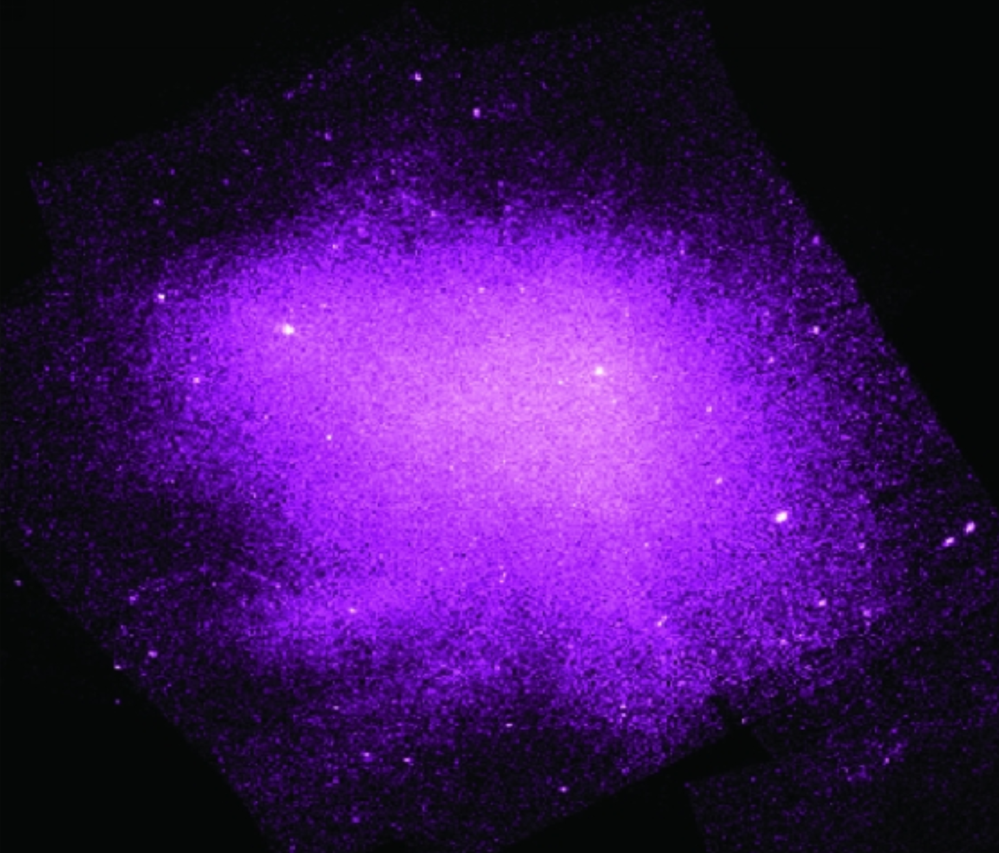
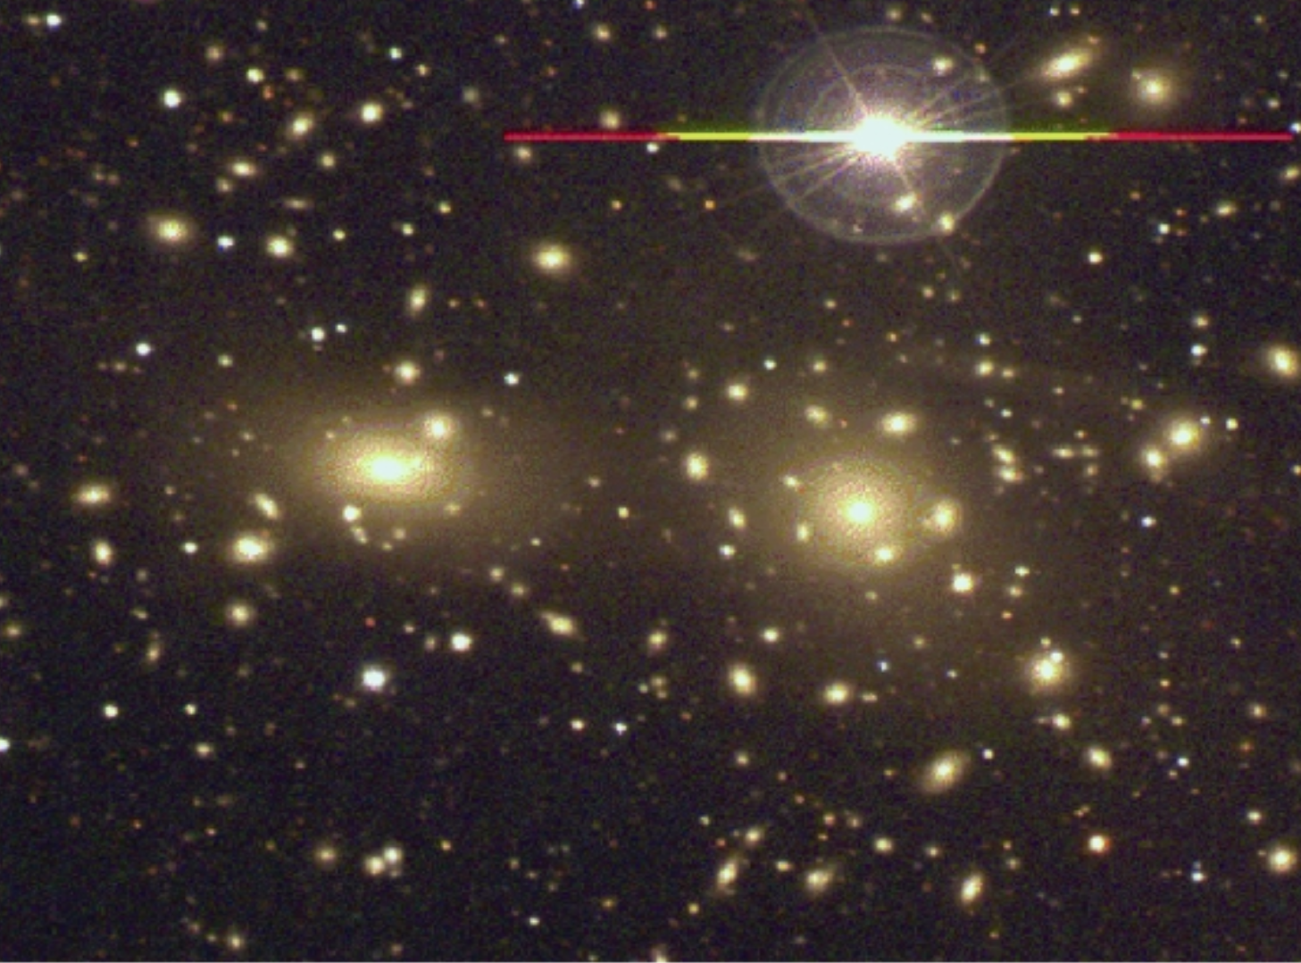
Coma Cluster
Visible
X-ray

Slide 19
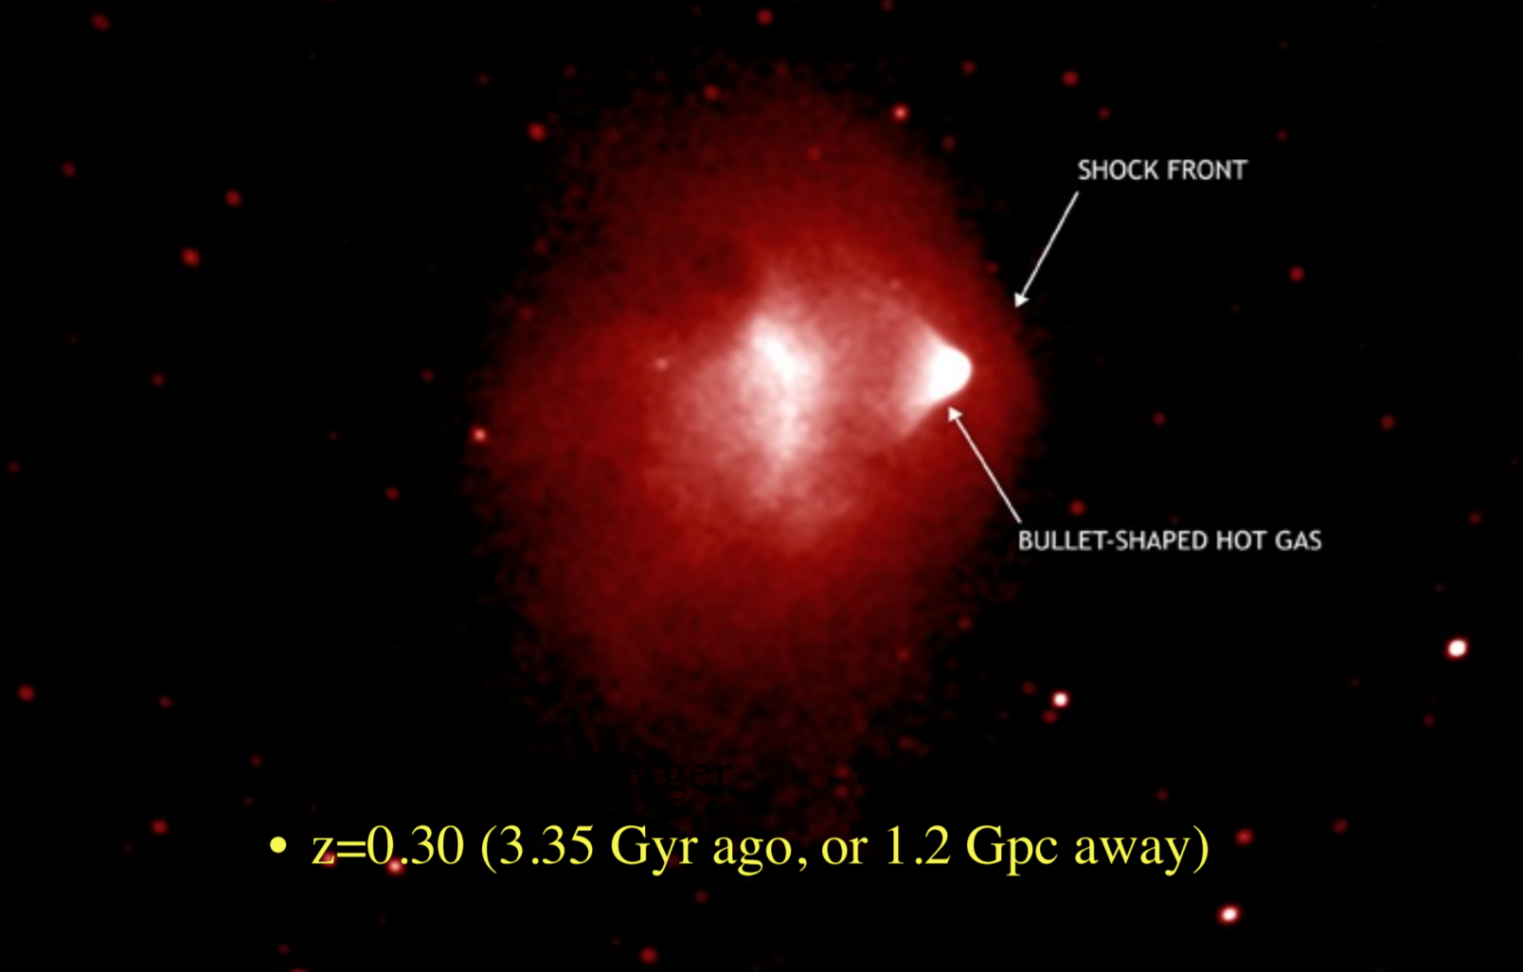
Bullet Cluster

Slide 20
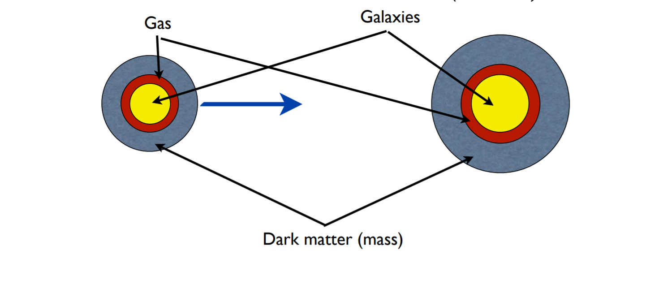
Bullet Cluster: Before

Slide 21
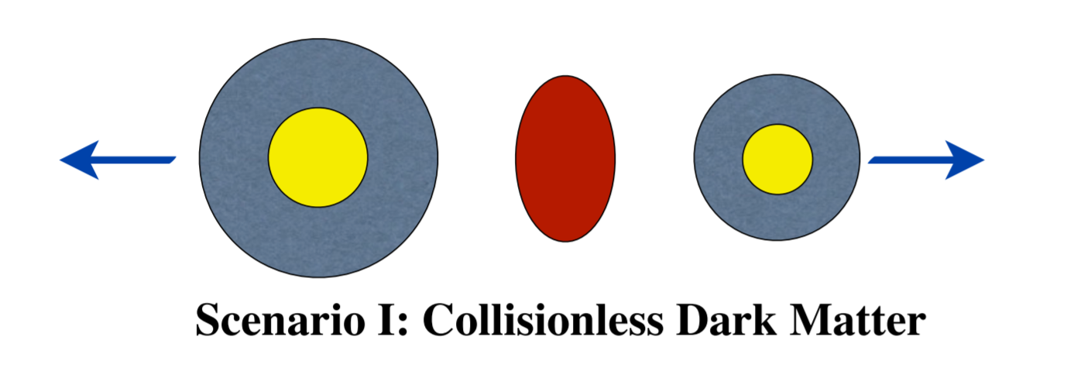
Bullet Cluster: After

Slide 22
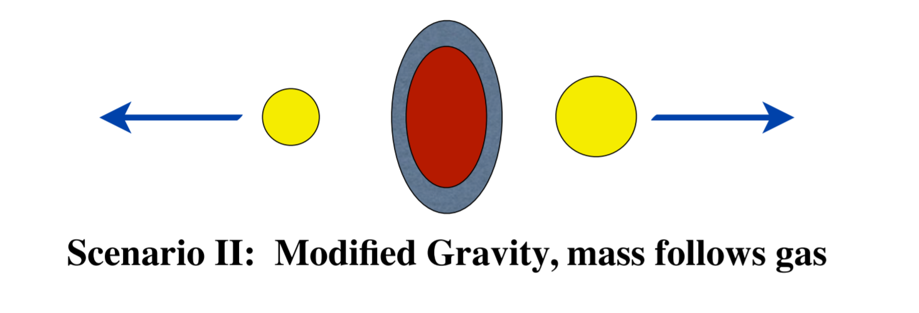
Bullet Cluster: After

Slide 23
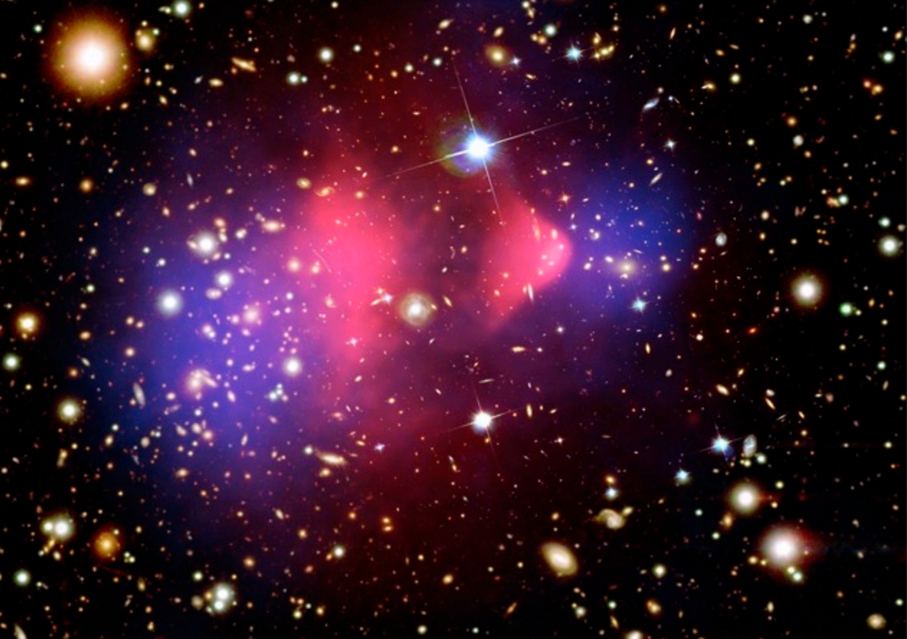
Bullet Cluster
In the picture, pink is x-ray emission from hot gas and blue is a map of dark matter reconstructed by gravitational lensing of background galaxies.
The blue splotches seem to have followed the big galaxy clusters, whereas the hot gas collided and got stuck in the middle.
This suggests that dark matter does not interact strongly with other matter.

Slide 24
hot gas around elliptical galaxies

Slide 25
M87
M87 is a giant elliptical galaxy with an extended corona of X-ray emitting hot gas and two opposing jets projecting out from a giant black hole at the center.
The mass of M87’s giant central black hole is 3(10⁹) M_{Sun}, small compared to the visible mass in M87.
X-ray measurements can be translated into pressure and temperature gradients.
Assuming hydrostatic equilibrium, one can relate the gradients into a mass distribution.
The mass far exceeds what would be expected from the observed light.
Globular cluster motions around M87 confirm.

Slide 26
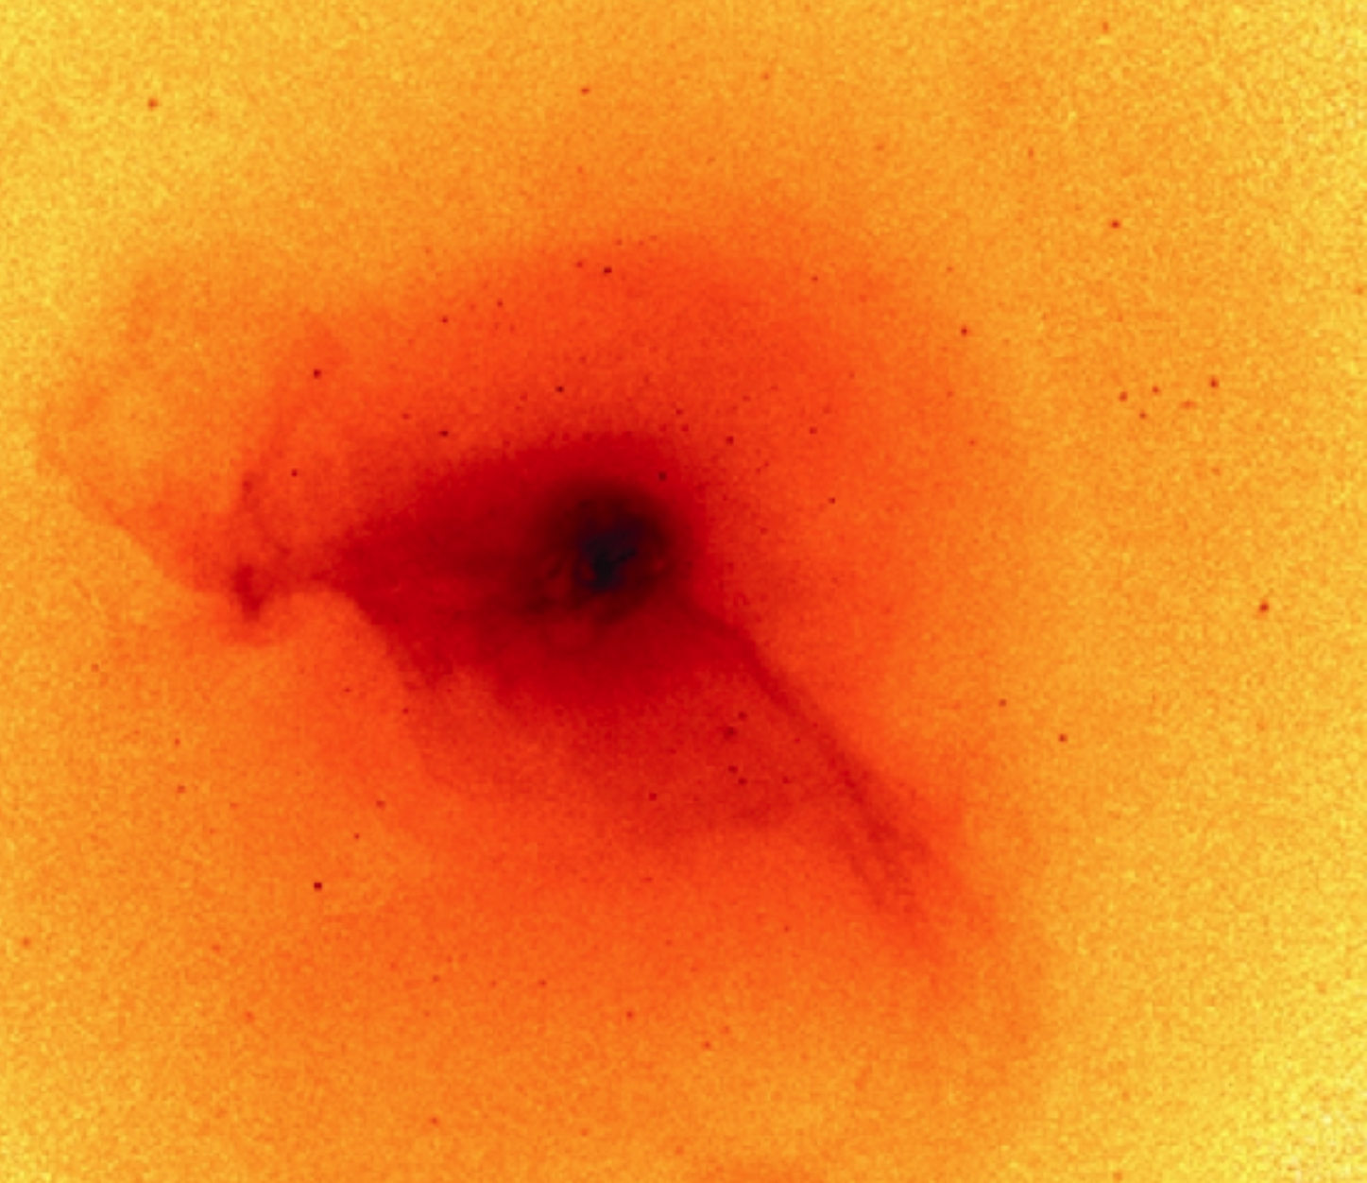
M87

Slide 27
gravitational lensing

Slide 28
Gravitational Lensing
Massive objects (such as a cluster of galaxies) lying between a more distant source (such as a quasar) and an observer should act as a lens to bend the light from this source.
The more massive an object, the more lensing is observed.
Gravitational lensing is often categorized as strong or weak.

Slide 29
Strong Lensing
Strong lensing is the observed distortion of background galaxies into arcs when their light passes through such a gravitational lens. By measuring the distortion geometry, the mass of the intervening cluster can be obtained.
In the dozens of cases where this has been done, the mass-to-light ratios obtained correspond to the dynamical dark matter measurements of clusters.
Lensing can lead to multiple copies of an image. By analyzing the distribution of multiple image copies, scientists have been able to deduce and map the distribution of dark matter around the MACS J0416.1-2403 galaxy cluster.

Slide 30
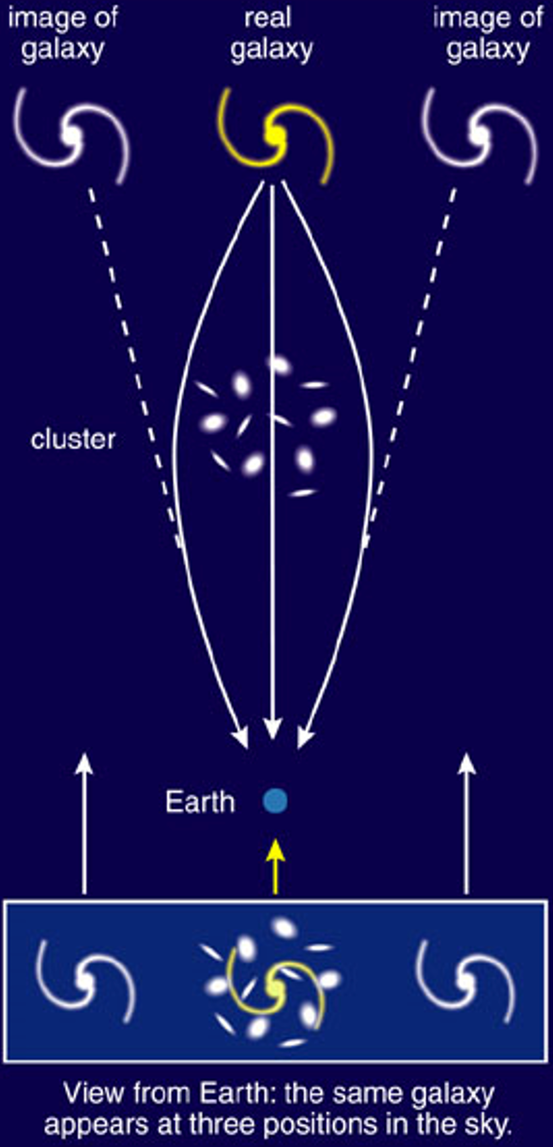
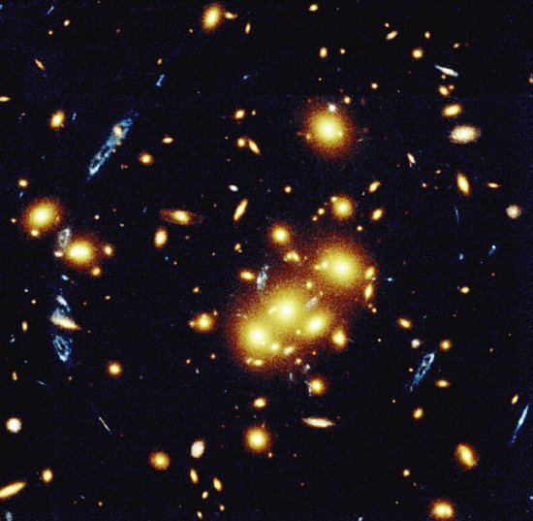
Gravitational Lensing

Slide 31
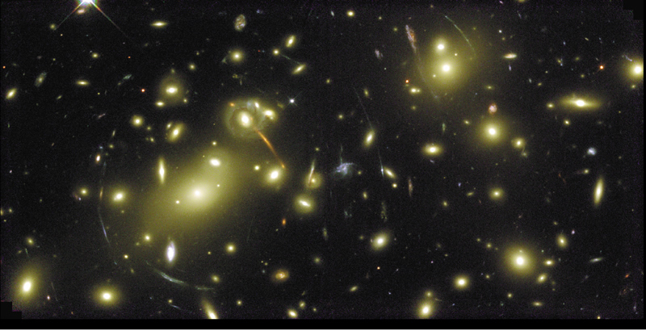
Gravitational Lensing

Slide 32
Weak Lensing
Weak gravitational lensing describes very small perturbations in the images of galaxies that are far far away….
Because the perturbations are so small, the effects are studied using statistical analyses from vast galaxy surveys.
By examining the apparent shear deformation of the adjacent background galaxies, the mean distribution of dark matter can be characterized.
This is the primary method that LSST will use to map dark matter in the Universe.

Slide 33
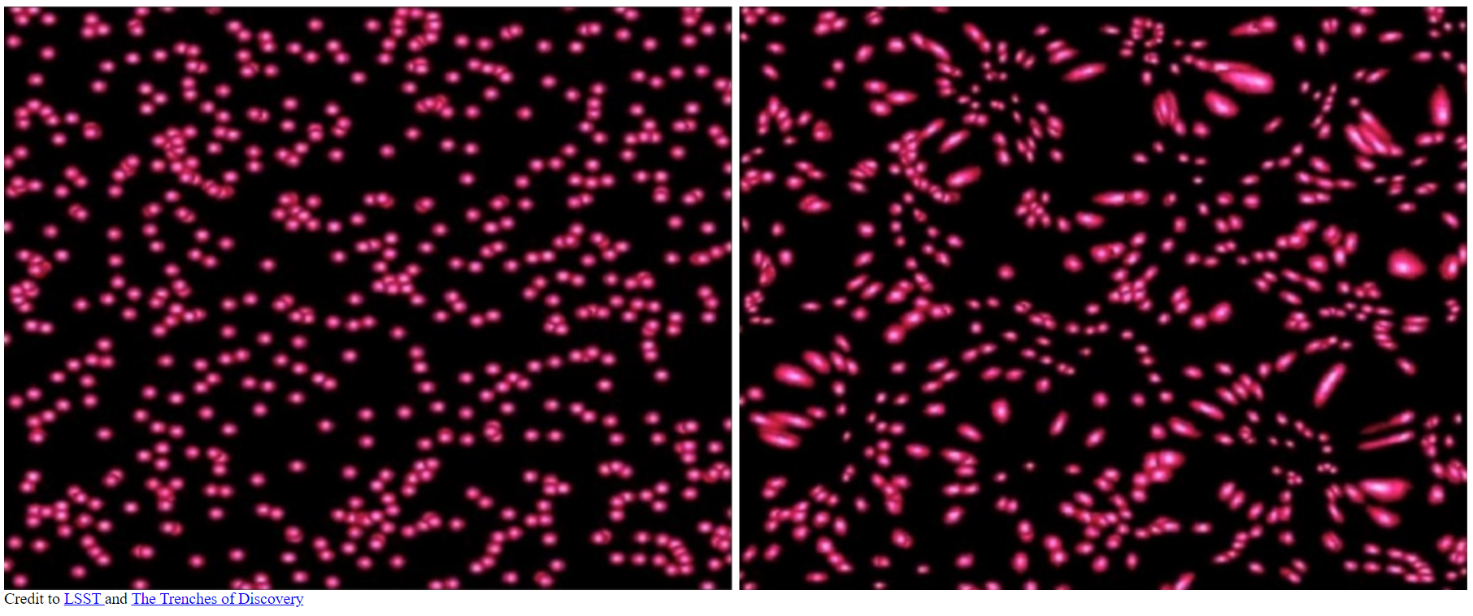
Weak Lensing

Slide 34
dark matter candidates

Slide 35
Dark Matter
Stellar Dark Matter
  black holes, rare but could make up some of dark matter
  brown dwarfs, low-mass prestellar objects, never stars
  white dwarfs, relic low mass stellar objects, no longer generating energy
  faint, low-mass red dwarfs, Hubble Space Telescope examined a globular cluster with extreme sensitivity and did not see the red dwarfs, so they are ruled out
  massive compact halo objects (MACHOs)
exotic subatomic particles
  WIMPs (Weakly interacting massive particles)
  Axions
modified law of gravity at large distances

Slide 36
Baryonic
Baryons (protons and neutrons) make up ordinary stars and planets.
However, baryonic matter also encompasses less common non-primordial black holes, neutron stars, faint old white dwarfs and brown dwarfs, collectively known as massive compact halo objects (MACHOs), which can be hard to detect.
Multiple lines of evidence suggest the majority of dark matter is not made of baryons.
Baryonic gas or dust would be visible when backlit by stars.

Slide 37
Baryonic (cont.)
The theory of Big Bang nucleosynthesis predicts the observed abundance of the chemical elements.
If there are more baryons, then there should also be more helium, lithium and heavier elements synthesized during the Big Bang.
Astronomical searches for gravitational microlensing in the Milky Way found that at most a small fraction of the dark matter may be in dark, compact, conventional objects (MACHOs, etc.).

Slide 38
Non-Baryonic
Because dark matter remains to be conclusively identified, many other hypotheses have emerged aiming to explain the observational phenomena that dark matter was conceived to explain.
The most common method is to modify general relativity. General relativity is well-tested on solar system scales, but its validity on galactic or cosmological scales has not been well proven.
A suitable modification to general relativity can conceivably eliminate the need for dark matter.

Slide 39
Non-Baryonic (cont.)
A problem with alternative hypotheses is that the observational evidence for dark matter comes from so many independent approaches (see the "observational evidence" section above).
Explaining any individual observation is possible but explaining all of them is very difficult.
The prevailing opinion among most astrophysicists is that while modifications to general relativity can conceivably explain part of the observational evidence, there is probably enough data to conclude there must be some form of dark matter.

Slide 40
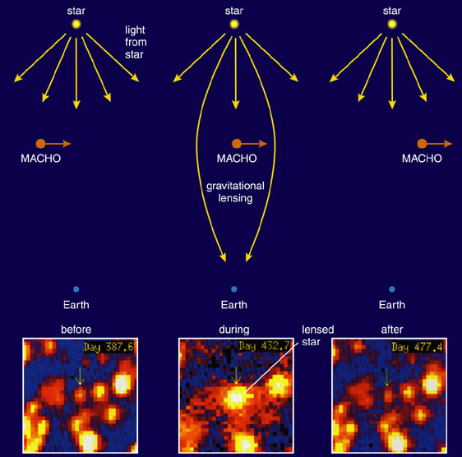
Ordinary Dark Matter
Massive Compact Halo Objects (MACHOs)
  Faint dead stars (white dwarfs, neutron stars, black holes)
  Brown dwarfs
  Planets
These can be observed indirectly through gravitational lensing

Slide 41
dark matter probes

Slide 42
Detecting Dark Matter
If dark matter is made up of sub-atomic particles, then millions, possibly billions, of such particles must pass through every square centimeter of the Earth each second.
Many experiments aim to test this hypothesis. Although WIMPs are popular search candidates, the Axion Dark Matter Experiment (ADMX) searches for axions.
These experiments can be divided into two classes:
  direct detection experiments, which search for the scattering of dark matter particles off atomic nuclei within a detector; and
  indirect detection, which look for the products of dark matter particle annihilations or decays.

Slide 43
Direct Detection
Direct detection experiments aim to observe low-energy recoils (typically a few keVs) of nuclei induced by interactions with particles of dark matter, which (in theory) are passing through the Earth.
These experiments mostly use either cryogenic or noble liquid detector technologies.
Cryogenic detectors operating at temperatures below 100 mK, detect the heat produced when a particle hits an atom in a crystal absorber such as germanium. Cryogenic detector experiments include: CDMS, CRESST, EDELWEISS, EURECA.
Noble liquid detectors detect scintillation produced by a particle collision in liquid xenon or argon. Noble liquid experiments include ZEPLIN, XENON, DEAP, ArDM, WARP, DarkSide, PandaX, and LUX, the Large Underground Xenon experiment.

Slide 44
Direct Detection (cont.)
Currently there has been no well-established claim of dark matter detection from a direct detection experiment
A special case of direct detection experiments covers those with directional sensitivity.
This is a search strategy based on the motion of the Solar System around the Galactic Center.
A low-pressure time projection chamber makes it possible to access information on recoiling tracks and constrain WIMP-nucleus kinematics.
WIMPs coming from the direction in which the Sun travels (approximately towards Cygnus) may then be separated from background, which should be isotropic. Directional dark matter experiments include DMTPC, DRIFT, Newage and MIMAC.

Slide 45
Indirect Detection
Indirect detection experiments search for the products of the self-annihilation or decay of dark matter particles in outer space.
For example, in regions of high dark matter density (e.g., the center of our galaxy) two dark matter particles could annihilate to produce gamma rays or Standard Model particle-antiparticle pairs.
Alternatively if the dark matter particle is unstable, it could decay into standard model (or other) particles.
These processes could be detected indirectly through an excess of gamma rays, antiprotons or positrons emanating from high density regions in our galaxy or others.
A major difficulty inherent in such searches is that various astrophysical sources can mimic the signal expected from dark matter, and so multiple signals are likely required for a conclusive discovery.

Slide 46
Indirect Detection Searches
A few of the dark matter particles passing through the Sun or Earth may scatter off atoms and lose energy.
Thus dark matter may accumulate at the center of these bodies, increasing the chance of collision/annihilation.
This could produce a distinctive signal in the form of high-energy neutrinos.
Such a signal would be strong indirect proof of WIMP dark matter.
High-energy neutrino telescopes such as AMANDA, IceCube and ANTARES are searching for this signal.
The detection by LIGO in September 2015 of gravitational waves, opens the possibility of observing dark matter in a new way, particularly if it is in the form of primordial black holes.

Slide 47
Indirect Detection Telescopes
Many experimental searches have been undertaken to look for dark matter annihilation or decay, examples of which follow.
The Energetic Gamma Ray Experiment Telescope observed more gamma rays in 2008 than expected from the Milky Way, but scientists concluded that this was most likely due to incorrect estimation of the telescope's sensitivity.
The Fermi Gamma-ray Space Telescope is searching for similar gamma rays.
In April 2012, an analysis of previously available data from its Large Area Telescope instrument produced statistical evidence of a 130 GeV signal in the gamma radiation coming from the center of the Milky Way. WIMP annihilation was seen as the most probable explanation.

Slide 48
Indirect Detection (cont.)
At higher energies, ground-based gamma-ray telescopes have set limits on the annihilation of dark matter in dwarf spheroidal galaxies and in clusters of galaxies.
The PAMELA experiment (launched in 2006) detected excess positrons. They could be from dark matter annihilation or from pulsars. No excess antiprotons were observed.
In 2013 results from the Alpha Magnetic Spectrometer on the International Space Station indicated excess high-energy cosmic rays that could be due to dark matter annihilation.

Slide 49
lsst

Slide 50
LSST
LSST is the Large Synoptic Survey Telescope.
It will image the sky every few days for five years.
The primary goal is to map dark matter in the Universe through weak lensing.
It is located in Chile.
RIT involvement started ~2006 when the Center for Detectors contributed to development of the detectors and then leading management of the guider system. RIT was first to get the LSST prototype detectors.
RIT continued to be involved in LSST through Center for Detectors involvement in the stellar populations science group.

Slide 51

LSST Logo is Quintuplet!

