Slide 1
University Astronomy
Professor Don Figer
Stellar Structure I

Slide 2
Reminders
Midterm #2
Wednesday, 4/1
similar format to that for midterm #1
includes material in reading assignments, lectures, and homework sets covering 2/10 through 3/6 (HW5-8)
review session next Monday, on 3/30

Slide 3
Aims and outline for this lecture
describe understanding of stellar structure
present equations that govern stellar structure
  conservation of mass
  conservation of energy
  hydrostatic equilibrium
  energy transport

Slide 4
stellar structure physics

Slide 5
What is a Star?
held together by self-gravity
stabilized from collapse
generates energy through fusion

Slide 6
Basic Assumptions
spherical and spherically symmetric
no rotation
no external forces
uniform initial composition
non-relativistic (Newtonian)
constant (d/dt~0)
no magnetic fields

Slide 7
Governing Equations
conservation of mass, m(r), mass is neither created nor destroyed
conservation of energy, L(r), change in energy flux equals the local rate of energy release
hydrostatic equilibrium, ρ(r), forces due to pressure differences balance gravity
energy transport, T(r), relates energy flux to the local gradient of temperature

Slide 8
Ingredients
equation of state, P(ρ,T)
optical depth (τ)
energy generation rate, ε(ρ,T)

Slide 9
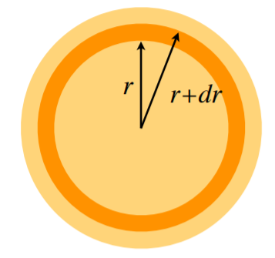

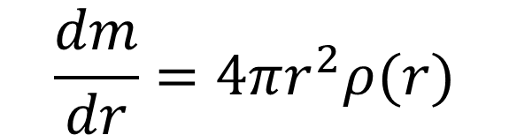
Conservation of Mass
Conservation of mass means that mass is neither created, nor destroyed.
Stars convert some mass into energy, but that can be ignored for the purposes of deriving stellar structure.
Consider the mass in a shell at a particular radius.
$$dm=4πr^{2}ρ(r)dr$$
$$\frac{dm}{dr}=4πr^{2}ρ(r)$$

Slide 10


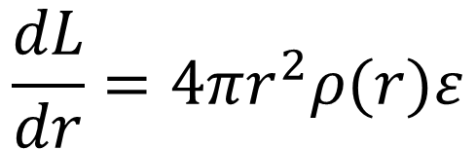
Conservation of Energy
The conservation of energy dictates that the luminous energy contributed by a mass shell is given by the energy generation rate per unit volume multiplied by the volume of the shell.
The luminosity at r is L(r) and is L(r)+dL at r+dr.
ε is energy generated per unit mass per second (W/kg).
$$dL=4πr^{2}ρ(r)dr×ε$$
$$\frac{dL}{dr}=4πr^{2}ρ(r)ε$$

Slide 11
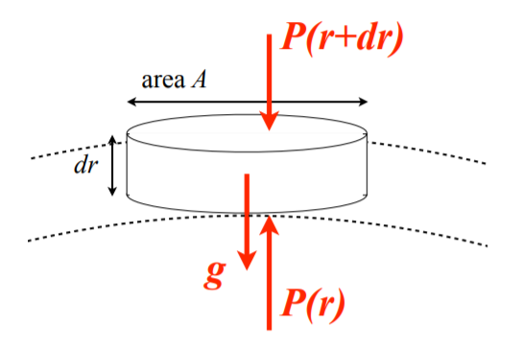
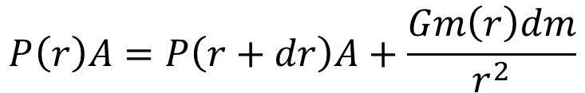
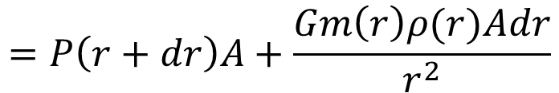
Hydrostatic Equilibrium
Hydrostatic equilibrium describes the condition in which gas is neither rising nor falling – it is “static.”
Consider a cylindrically-shaped collection of gas at radius r, area A, and thickness dr.
The outward force is due to pressure on the bottom of the cylinder. The inward force is due to pressure on the top face plus gravity.
$$P\left(r\right)A=P\left(r+dr\right)A+\frac{Gm\left(r\right)dm}{r^{2}}$$
$$=P\left(r+dr\right)A+\frac{Gm\left(r\right)ρ(r)Adr}{r^{2}}$$

Slide 12




Hydrostatic Equilibrium (cont.)
Set the inward pressure equal to the output pressure in order to maintain equilibrium.
$$P\left(r\right)A=P\left(r+dr\right)A+\frac{Gm\left(r\right)dm}{r^{2}}$$
$$\frac{P\left(r+dr\right)−P(r)}{dr}Adr=−\frac{Gm\left(r\right)ρ(r)Adr}{r^{2}}$$
$$\frac{dP}{dr}=\frac{P\left(r+dr\right)−P(r) }{dr}$$
$$\frac{dP}{dr}=\frac{P\left(r+dr\right)−P(r) }{dr}=−\frac{Gm\left(r\right)ρ\left(r\right)Adr}{r^{2}}\frac{1}{Adr}=−\frac{Gm}{r^{2}}ρ$$
$$\frac{dP}{dr}=−\frac{Gm}{r^{2}}ρ=−g_{local}ρ$$
also see: https://www.youtube.com/watch?v=b-6RCIuNU10

Slide 13
Self-Regulation
Hydrostatic equilibrium is a result of self-regulation in a star.
Consider the case if the energy generation rate suddenly increased in the center of a star.
The temperature and pressure at that location would increase, causing the core to expand.
This would reduce the density and temperature in the core.
So, the energy generation rate would decrease (due to less fusion).
This self-regulation ensures that the star is kept in balance.

Slide 14
What Happens If No Fuel?
Imagine that the core stopped producing energy (ran out of fuel for fusion).
The gas in the core would still be hot just after the turnoff.
Heat would escape the core through radiation and convection.
Because of the lost heat, the gas would compress under gravity.
The core would shrink, becoming hotter.
Then, more energy would escape.
And so on.
This is core collapse and is a result of fuel exhaustion.

Slide 15
Energy Transport
Stars shine because they are hot.
Energy transports from the centers of stars to the outer parts.
  radiation (photons)
  convection (bulk motion)
  conduction (particle collisions)
In gas that is fairly transparent, radiation transports most of the energy. This is called radiative transport.
In opaque gas, the gas blocks the photons, thus getting hotter. The hot gas pushes upward, transporting energy to higher layers (thus cooling), and then it falls back down. This is called convective transport.
Conduction is relatively inefficient in stars.
The equations of energy transport are more complicated than the other equations of stellar structure.

Slide 16
Equations of Stellar Structure
The four equations of stellar structure have four unknowns – m(r), L(r), ρ(r), and T(r).
They can be solved under the constraints of P(ρ,T), τ, and ε.
Boundary conditions:
  at r=0, M=0, L=0
  at r=R_{star}, T=T_{star}, P=0, ρ=0

Slide 17
Energy Generation
Energy is generated in a star through nuclear fusion, such as in the proton-proton chain or the CNO cycle.
The amount of energy liberated is equivalent to the change in rest mass energies of the input and output particles.
For the PP chain, the input particles consist of four protons. The output consists of one helium nucleus.
M_{4 p}=6.6905(10⁻²⁷) kg
M_{1 He}=6.6447(10⁻²⁷) kg
ΔM=0.0458(10⁻²⁷) kg
ΔMc²=4.1(10⁻¹²) J

Slide 18
Lifetime of Sun
The total amount of energy that would be generated by the Sun if it converted all of its hydrogen into helium via the PP chain is equal to the total amount of hydrogen multiplied by the amount of energy generated for each reaction.
ΔM_{4HàHe}c²*(M_{Sun}/(4m_{p}))~10⁴⁵ J
Given the luminosity of the Sun, this would take 100 Gyrs to consume.
The real lifetime is one tenth as long because only one tenth of the mass of the Sun gets burned.

Slide 19
Lifespans of Stars
Luminosity is a strong function of mass, so lower mass stars have a much lower energy generation rate.
Because of this, lower mass stars live longest.
This means that lower mass stars are more common than higher mass stars.
Another factor is that more lower mass stars form than higher mass stars.

Slide 20
equation of state and pressure

Slide 21
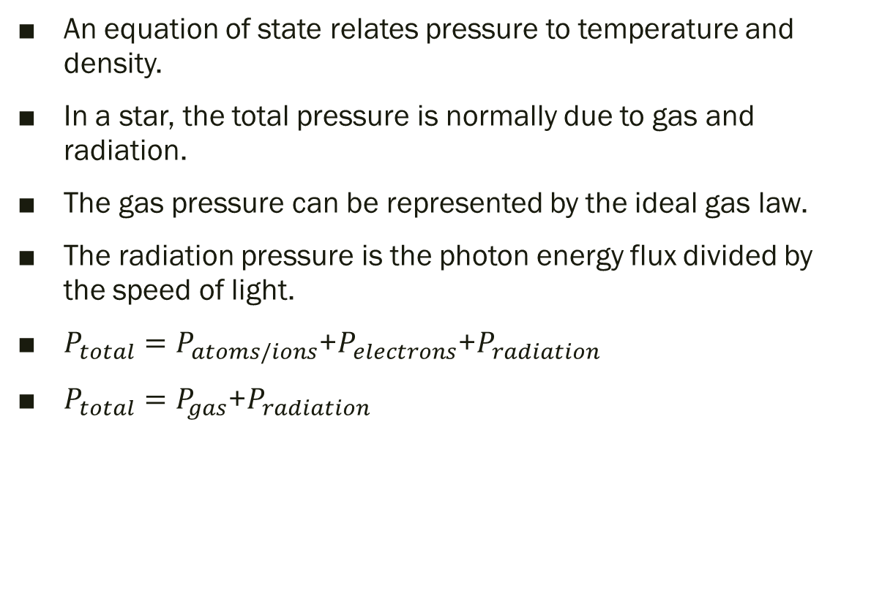
Equation of State
An equation of state relates pressure to temperature and density.
In a star, the total pressure is normally due to gas and radiation.
The gas pressure can be represented by the ideal gas law.
The radiation pressure is the photon energy flux divided by the speed of light.
$P_{total}=P_{atoms/ions}$+$P_{electrons}$+$P_{radiation}$
$P_{total}=P_{gas}$+$P_{radiation}$

Slide 22

Gas Pressure
One common form of the ideal gas law is PV=NkT, where P is pressure, V is volume, N is particle number (ions/atoms and electrons), k is Boltzmann’s constant, and T is temperature.
We can convert this to P=NkT/V.
N/V can be rewritten as ρ/m, where m is the mass per particle.
m can be rewritten as μm_{p}, where μ is the mean molecular weight (which is equal to the number of atomic mass units per particle), and m_{p} is the mass of a proton.
Using our assumption of spherical symmetry, we find:
$$P\left(r\right)=\frac{ρ\left(r\right)kT(r)}{μm_{p}}$$

Slide 23
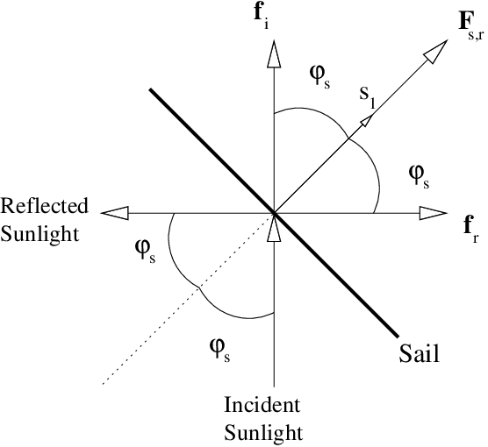
Radiation Pressure
Photons have momentum (E/c=h/λ) and can exert pressure (I/c), where I is intensity (W/m²).
The momentum is conserved when a photon strikes a particle.
The momentum along the normal direction of the interaction is transferred.
For perfect reflection, the particle attains twice the original momentum of the photon (along the normal direction).

Slide 24
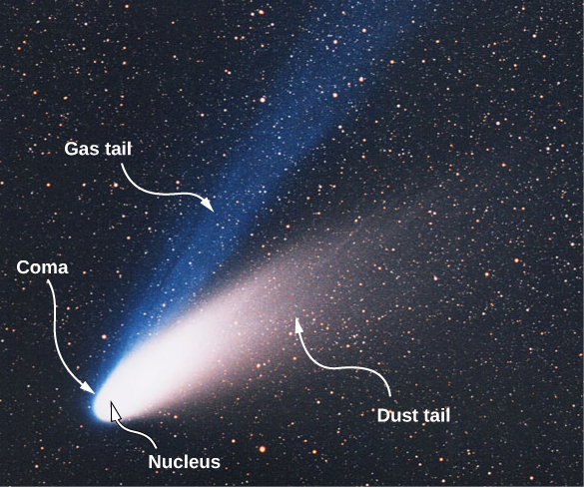
Radiation Pressure & Comets
We can see the effects of radiation pressure in many astronomical phenomena, such as the appearance of comets.
When a comet approaches the Sun, it warms up and its surface begins to evaporate.
Some of the gases and dust form tails when they leave the comet.
The ion tail (or gas tail) is composed mainly of ionized gases, and it is pushed by the charged particles in the solar wind.
The dust tail is composed of heavier and neutral particles that fall behind the comet as it moves.

Slide 25
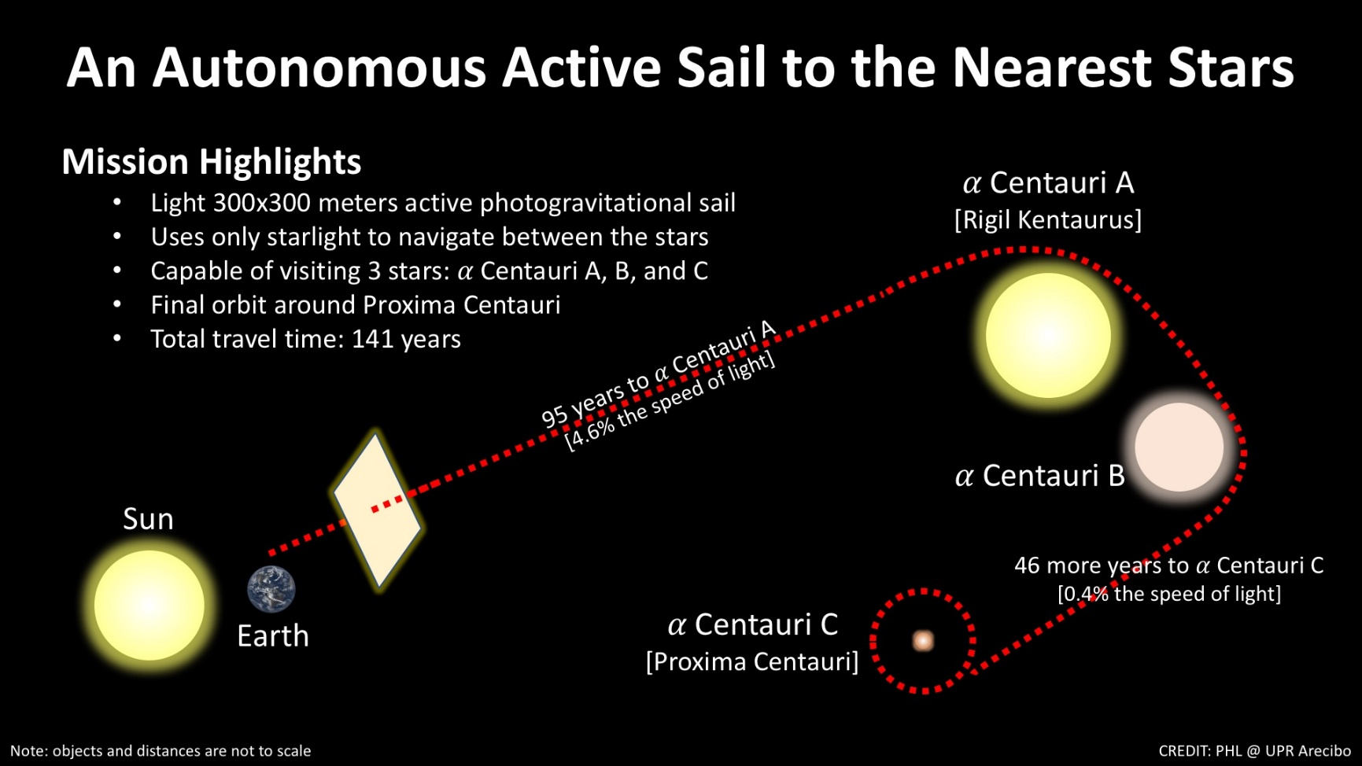
Radiation Pressure & Solar Sails

Slide 26
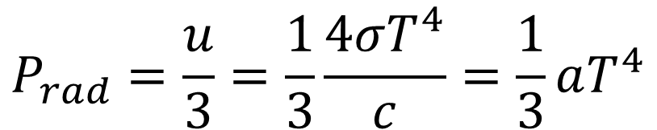
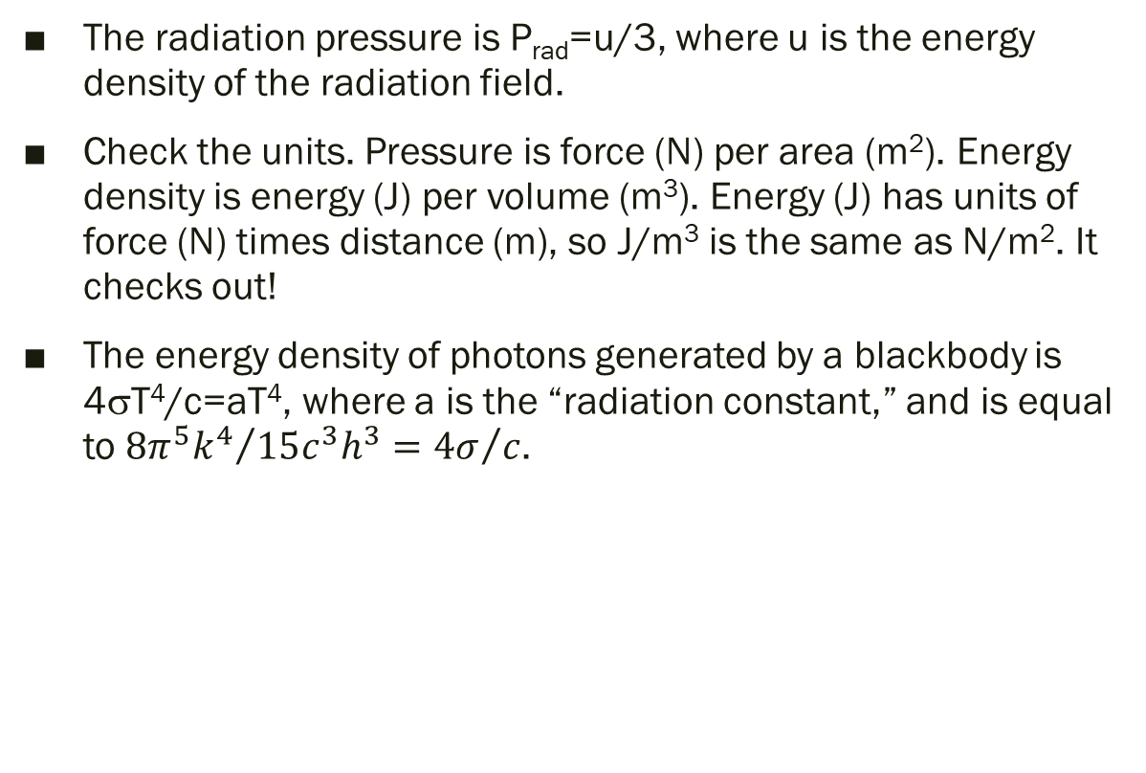
Radiation Pressure in Stars
The radiation pressure is P_{rad}=u/3, where u is the energy density of the radiation field.
Check the units. Pressure is force (N) per area (m²). Energy density is energy (J) per volume (m³). Energy (J) has units of force (N) times distance (m), so J/m³ is the same as N/m². It checks out!
The energy density of photons generated by a blackbody is 4σT⁴/c=aT⁴, where a is the “radiation constant,” and is equal to ${8π^{5}k^{4}}/{15c^{3}h^{3}={4σ}/c}$.
$$P_{rad}=\frac{u}{3}=\frac{1}{3}\frac{4σT^{4}}{c}=\frac{1}{3}aT^{4}$$

Slide 27
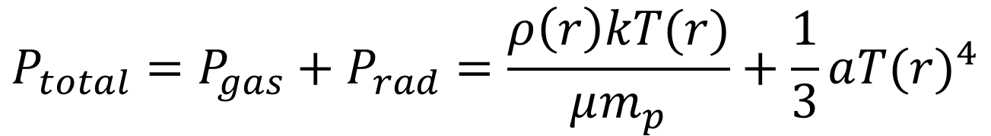
Total Pressure
$$P_{total}=P_{gas}+P_{rad}=\frac{ρ\left(r\right)kT(r)}{μm_{p}}+\frac{1}{3}a{T(r)}^{4}$$

Slide 28
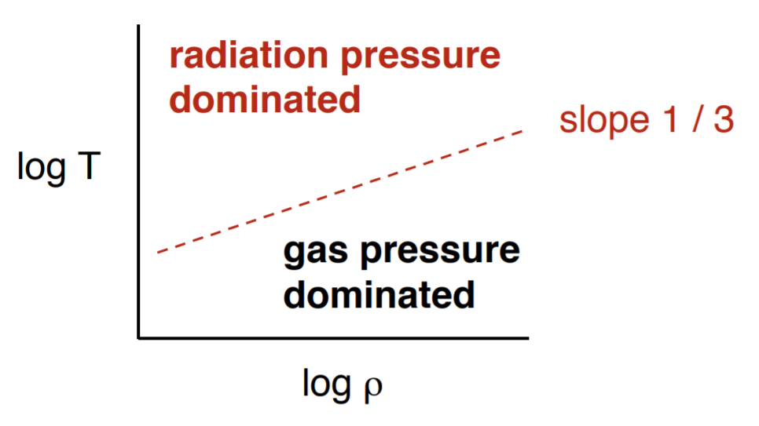
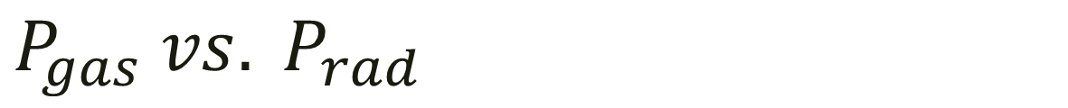
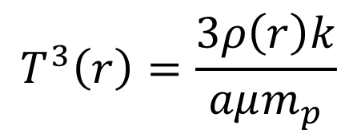
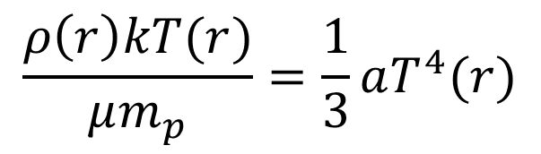
$$P_{gas} vs. P_{rad}$$
Set P_{gas} to P_{radiation} to find temperature at which they are equal.
Solve for T and take log of both sides.
Stars with high T (massive stars) will be dominated by radiation pressure whereas those with low T (low mass stars) will be dominated by gas pressure.
$$\frac{ρ\left(r\right)kT(r)}{μm_{p}}=\frac{1}{3}aT^{4}(r)$$
$$T^{3}\left(r\right)=\frac{3ρ\left(r\right)k}{aμm_{p}}$$

Slide 29
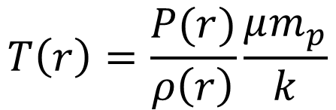
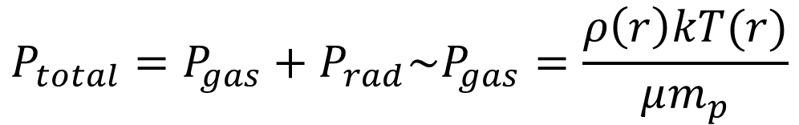
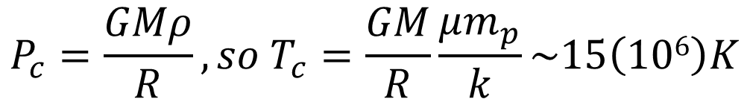
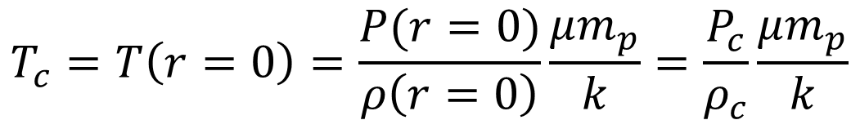
Temperature at Center of the Sun
We can combine the total pressure equation with the equation of hydrostatic equilibrium to calculate the central temperature of the Sun.
$$P_{total}=P_{gas}+P_{rad}\sim P_{gas}=\frac{ρ\left(r\right)kT(r)}{μm_{p}}$$
$$T\left(r\right)=\frac{P(r)}{ρ\left(r\right)}\frac{μm_{p}}{k}$$
$$T_{c}=T\left(r=0\right)=\frac{P(r=0)}{ρ\left(r=0\right)}\frac{μm_{p}}{k}=\frac{P_{c}}{ρ_{c}}\frac{μm_{p}}{k}$$
$$P_{c}=\frac{GMρ}{R}, so{ T}_{c}=\frac{GM}{R}\frac{μm_{p}}{k}\sim 15\left(106\right)K$$

Slide 30
homework

Slide 31
Homework 9 (due 3/30)
15.1, 15.2 (consider mass of input particles and mass of output particles), 15.3, 15.4, 15.5, 15.6

