Slide 1
University Astronomy
Professor Don Figer
Properties of Stars I

Slide 2
Aims and outline for this lecture
introduce magnitude system
review properties of stars
  color
  brightness
  luminosity
  temperature
  color-magnitude diagram
  HR diagram
discuss filter systems

Slide 3
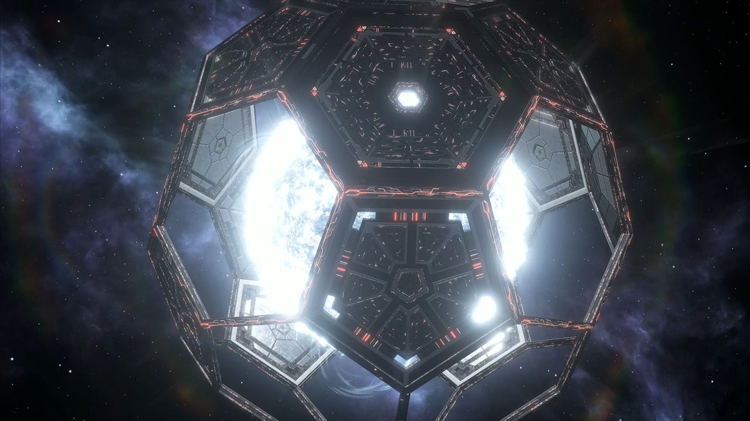
Freeman Dyson (15 December 1923 – 28 February 2020)

Slide 4
what are stars?

Slide 5
Stars in the Universe
Stars are defined as objects that burn matter through nuclear fusion as a result of intense pressure and temperature induced by the force of self-gravity.
Stars constitute a tiny fraction of the mass in the Universe, only 0.5%.
They dominate the visible Universe.
Their light can tell us physical properties, i.e. temperature, luminosity, pressure, and composition.
Stellar lifetimes are completely determined by their nuclear fuel.

Slide 6
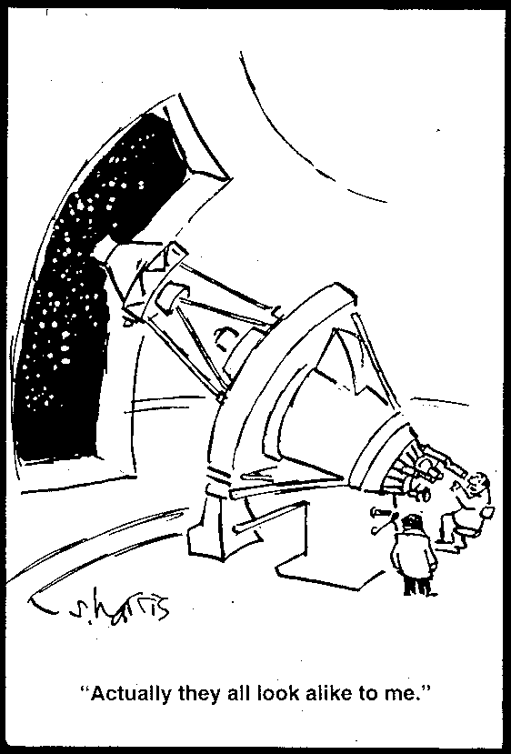
What do Stars Look Like?

Slide 7
magnitudes and luminosity

Slide 8
What is Brightness?
When we say that an object is “bright,” we are using a shorthand way of saying that our eyes detect a relatively high number of photons.
The photon rate we detect is dependent on the number of photons that pass through the pupils of our eyes.
If our pupils were bigger, we would see even more photons.
So, “brightness” is a measure of photons per area (#/m²), also known as the photon flux.
Equivalently, one can express brightness as energy received per unit area (Watts/m²).

Slide 9
Brightness and Units
The difference in photon flux for a bright object versus a faint object is huge!
If you looked at the Sun (but don’t!), your retina would receive about 10¹⁵ photons/second.
Compare that to a bright star. For Vega, your retina would receive about 10⁴ photons/second.
A faint star would generate about 500 photons/second.
These numbers are all very different.
Also, these numbers are very awkward to use.
The situation isn’t any better if we used Watts/m².

Slide 10
Use a Log Scale!
By using the log of the flux, we can have more easily manageable ways to compare the brightness of astronomical objects.
Norman Pogson created the “magnitude” scale in 1856.
He used Hipparcus’ brightness rankings to define the magnitude scale such that a star that is of 5th magnitude would be 100 times fainter than a star of 0th magnitude.
This scale assigns smaller magnitudes for brighter objects.
Astronomers still use this type of scale to refer to the brightnesses of objects.
The magnitude scale is usually set by giving Vega a magnitude of zero.

Slide 11
Magnitudes
stellar magnitudes
F, F₀ are the photon numbers received per second from object and zero magnitude reference star, respectively.
So, a star that is 100 times fainter than another is said to be 5 magnitudes fainter.
For the most common magnitude systems, the reference star is Vega, which is defined to have zero magnitude in all filters.

Slide 12
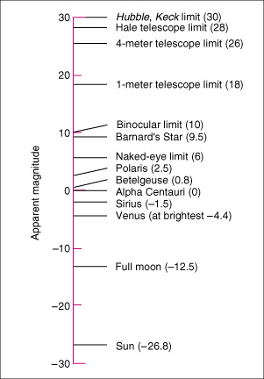
Apparent Magnitudes: Examples
Notes:
Apparent Magnitude This graph illustrates the apparent magnitudes of some astronomical objects. The original magnitude scale was defined so that the brightest stars in the night sky had magnitude 1, and the faintest stars visible to the naked eye had magnitude 6. It has since been extended to cover much brighter and much fainter objects. An increase of 1 in apparent magnitude corresponds to a decrease in apparent brightness by a factor of approximately 2.5.

Slide 13
Question
Which star on the following slide is the brightest?
Which is the most luminous?
Which is the most massive?
Notes:
Apparent Magnitude This graph illustrates the apparent magnitudes of some astronomical objects. The original magnitude scale was defined so that the brightest stars in the night sky had magnitude 1, and the faintest stars visible to the naked eye had magnitude 6. It has since been extended to cover much brighter and much fainter objects. An increase of 1 in apparent magnitude corresponds to a decrease in apparent brightness by a factor of approximately 2.5.

Slide 14
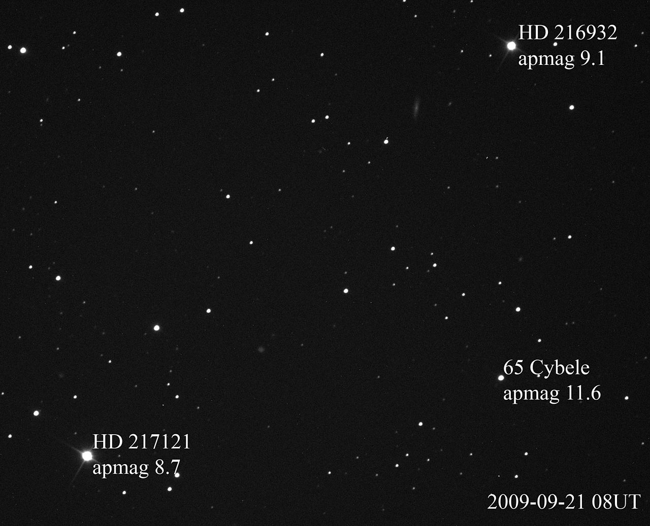
Apparent Magnitudes: Examples
Notes:
Apparent Magnitude This graph illustrates the apparent magnitudes of some astronomical objects. The original magnitude scale was defined so that the brightest stars in the night sky had magnitude 1, and the faintest stars visible to the naked eye had magnitude 6. It has since been extended to cover much brighter and much fainter objects. An increase of 1 in apparent magnitude corresponds to a decrease in apparent brightness by a factor of approximately 2.5.

Slide 15
Absolute Magnitude
“Absolute Magnitude” M is the magnitude measured at a “Standard Distance” (10 pc ≈ 33 light years)
Allows luminosities to be directly compared
  Absolute magnitude of sun ≈ +5 (pretty faint)

Slide 16
Absolute Magnitude and Distance

Slide 17

Bolometric Correction
Absolute magnitude is usually determined for a specific waveband, e.g. M_{V} is the absolute magnitude of a star in the “V” band.
One can convert from this absolute magnitude to a bolometric absolute magnitude that accounts for flux in all wavebands. Of course, this correction must depend on the waveband of the measurement and the temperature of the star.
$$M_{bolometric}=M_{waveband}+{BC}_{waveband}$$
$$M_{bolometric}=M_{V}+{BC}_{V}$$
$$M_{bolometric,Sun}=M_{V,Sun}+{BC}_{V,Sun}$$
$$M_{bolometric,Sun}=4.83−0.09=4.74$$

Slide 18
Question
Let’s say that a star has an apparent magnitude of 5 and is 100 pc away. What is its absolute magnitude?

Slide 19

Answer
$m−M=5\log\left(d\right)−5$
$M=m+5−5\log\left(d\right)$
$M=5+5−5\log\left(100\right)=0$

Slide 20
Stellar Brightness Differences
If we can determine that 2 stars are identical, then their relative brightnesses translate to relative distances.
Example: Sun vs. α Cen
  spectra are very similar ⇒ temperatures, radii almost identical (T follows from Planck function, radius R can be deduced by other means)
  ⇒ luminosities about equal
  difference in apparent magnitudes translates to relative distances
  can check using the parallax distance to α Cen

Slide 21
temperatures and color

Slide 22
Why do Stars Have Colors?
Stars have different temperatures.
Given that they radiate like blackbodies, their photon fluxes peak at different wavelengths (think of the Wein displacement law).
Our eyes perceive a color that relates to the peak wavelength of emission.
A relatively “cool” star will appear to be red.
A “hot” star will appear more blue.
You can determine the relative temperature of a star just by looking at its color!

Slide 23
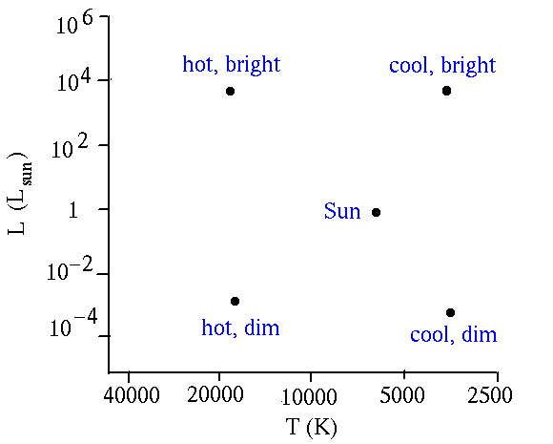
Brightness, Color, and Temperature
http://zebu.uoregon.edu/~soper/Stars/hrdiagram.html

Slide 24
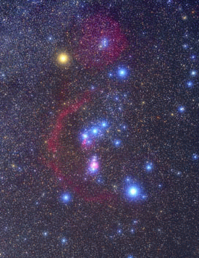
Betelguese and Rigel in Orion
Betelgeuse: 3,500 K
(a red supergiant)
Rigel: 11,000 K
(a blue supergiant)
Notes:
Consider two stars with very different temperatures.
These stars have similar luminosities, ~10^5 Lsun. (L_betelguese is actually 40% higher than this value).
Their effective radii are very different, ~71 Rsun for Rigel and 1180 Rsun for Betelguese.

Slide 25
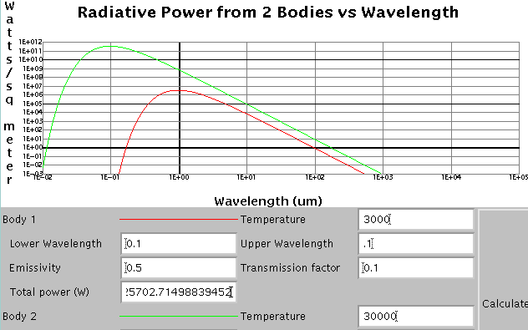
Blackbody curves for hot and cool stars

Slide 26
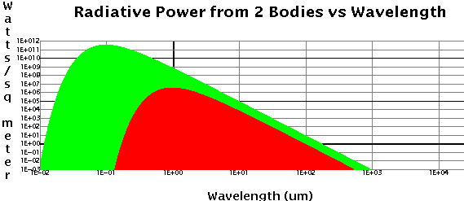
Two stars
Hotter stars emit MUCH more light per unit area ⇒ much brighter at short wavelengths.

Slide 27
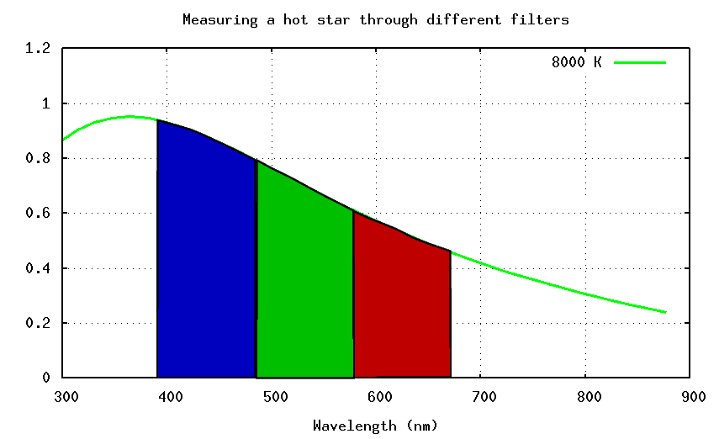
Stellar Colors for a Hot Star

Slide 28
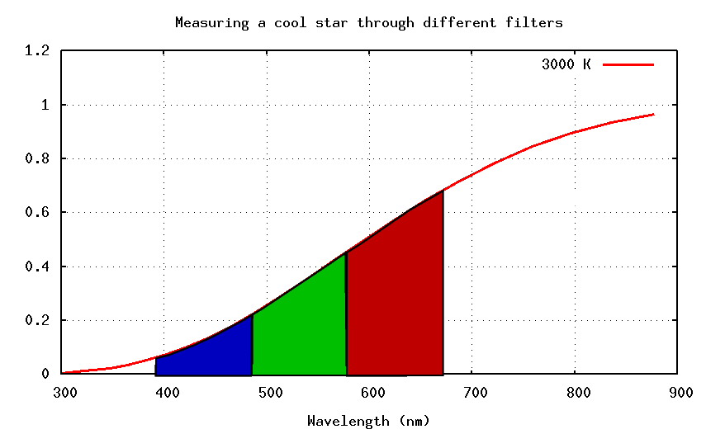
Stellar Colors for a Cool Star

Slide 29
hr diagram

Slide 30
HR Diagram: History
1911: E. Hertzsprung (Denmark) compared star luminosity to color for stars in several clusters. These stars were likely formed at the same time.
1913: Henry Norris Russell (U.S.) did same for stars in solar neighborhood. These stars were likely formed at different times.

Slide 31
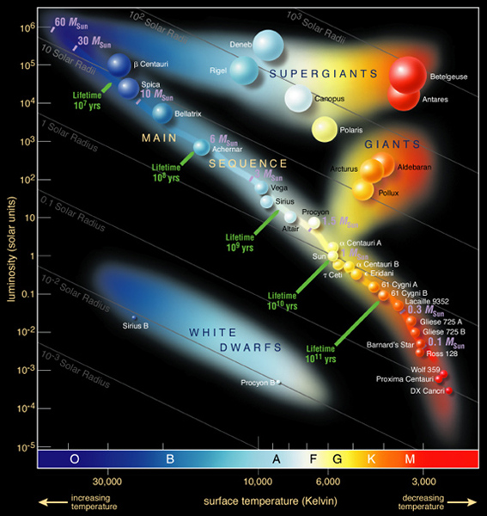
HR Diagram of Well-known Stars
Notes:
H–R Diagram of Bright Stars An H–R diagram for the 100 brightest stars in the sky. Such a plot is biased in favor of the most luminous stars—which appear toward the upper left—because we can see them more easily than we can the faintest stars. (Compare this with Figure 17.14, which shows only the closest stars.)

Slide 32
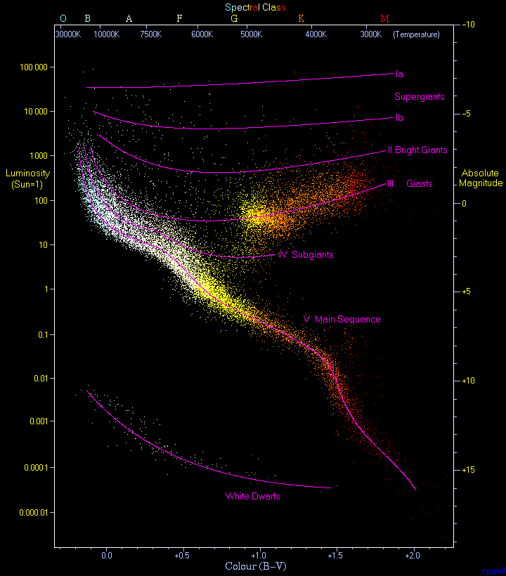
HR Diagram of Nearby Stars
Plot of 22,000 stars in Hipparcos Catalogue and Gliese Catalogue of nearby stars
Stars are not coeval – range of ages
Main sequence is easily seen – hydrogen burning stars
Red giant clump is prominent
≈90% of stars on Main Sequence
≈10% are White Dwarfs
<1% are Giants
Notes:
The most famous diagram in astronomy is the Hertzsprung-Russell diagram. This diagram is a plot of luminosity (absolute magnitude) against the colour of the stars ranging from the high-temperature blue-white stars on the left side of the diagram to the low temperature red stars on the right side.
This diagram below is a plot of 22000 stars from the Hipparcos Catalogue together with 1000 low-luminosity stars (red and white dwarfs) from the Gliese Catalogue of Nearby Stars. The ordinary hydrogen-burning dwarf stars like the Sun are found in a band running from top-left to bottom-right called the Main Sequence. Giant stars form their own clump on the upper-right side of the diagram. Above them lie the much rarer bright giants and supergiants. At the lower-left is the band of white dwarfs - these are the dead cores of old stars which have no internal energy source and over billions of years slowly cool down towards the bottom-right of the diagram.

Slide 33
HR Diagram and Cluster Age
Star clusters have stars that all formed at roughly the same time out of a collapsing cloud.
An HR Diagram of a star cluster reveals the age of that cluster.
Massive stars in a cluster die earlier than low mass stars.
Massive stars are bright and hotter than less massive stars.
A cluster that has brighter and hotter stars than another cluster is younger.
Consider the two clusters on the next slide.
The cluster with brighter stars (M67) is younger.

Slide 34
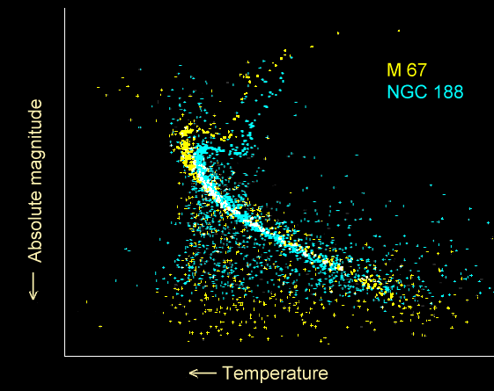
HR Diagram of Two Clusters
Notes:
The most famous diagram in astronomy is the Hertzsprung-Russell diagram. This diagram is a plot of luminosity (absolute magnitude) against the colour of the stars ranging from the high-temperature blue-white stars on the left side of the diagram to the low temperature red stars on the right side.
This diagram below is a plot of 22000 stars from the Hipparcos Catalogue together with 1000 low-luminosity stars (red and white dwarfs) from the Gliese Catalogue of Nearby Stars. The ordinary hydrogen-burning dwarf stars like the Sun are found in a band running from top-left to bottom-right called the Main Sequence. Giant stars form their own clump on the upper-right side of the diagram. Above them lie the much rarer bright giants and supergiants. At the lower-left is the band of white dwarfs - these are the dead cores of old stars which have no internal energy source and over billions of years slowly cool down towards the bottom-right of the diagram.

Slide 35
filters

Slide 36
Filters
One of the most common tasks for an astronomer is to measure the brightness of an object as a function of wavelength.
This is done by exposing a detector to light from the object within a waveband.
Light from the object is transmitted by a filter that only allows photons of a range of wavelengths.
The filters are standardized so that astronomers can compare their measurements.

Slide 37
Optical Astronomical Filter Set
There are many filter sets
  Johnson
  Kron-Cousins
  SDSS
  HST
  etc.
5 “Bessel” Filters with approximately equal “passbands”: Δλ≈ 100 nm
  U: “ultraviolet”, λ_{max} ≈ 350 nm
  B: “blue”, λ_{max} ≈ 450 nm
  V: “visible” (= “green”), λ_{max} ≈ 550 nm
  R: “red”, λ_{max} ≈ 650 nm
  I: “infrared, λ_{max} ≈ 750 nm

Slide 38
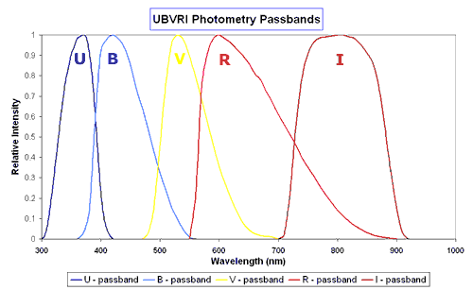
Filter Transmittances: Optical
Notes:
2
Filters for ultraviolet, visible and infrared observations are normally coloured glass, dyed plastic or gelatin or similar that only allow a narrow waveband, typically about 100 nm wide, of radiation through. Other types of optical filters use interference to produce very narrowband filters where the waveband may only be a few nanometers wide. One example is the H-$alpha filter that peaks at 652 nm. It is used for solar observations and .
The Johnson system is a standard one that uses five filters, U, B, V, R and I that have peak responses in the ultraviolet, blue, yellow-green, red and near infrared parts of the spectrum respectively. A plot showing the spectral response of the Johnson series of filters is below. It actually shows a modified form developed by M. Bessel.

Slide 39
Filter Transmittances: NIR Half-power Points
Notes:
2

Slide 40
Photometry
Photometry is the measurement of light.
The term is short for “photon” “metering.”
An astronomer makes this measurement using an instrument on a telescope.
There are many software packages that an astronomer can use to calculate the amount of light in an image for an individual astronomical object.
The reported results can be in a variety of units.
One example is “photons per second per square meter.”
Another is Watts per square meter.
Sometimes, we translate that into Janskys.

Slide 41
Photometric Units
Allen’s Astrophysical Quantities, p. 150.
Fluxes are for a star with zero magnitude.

Slide 42
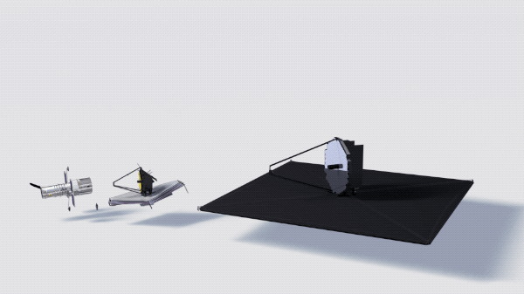
LUVOIR

Slide 43
homework

Slide 44
Homework 8
13.1, 13.2, 13.3, 13.4, 13.5, 13.8, 14.7
Using the HR Diagrams in this lecture, would you say that M67 or NGC188 is younger?
What is the power-law index, α in L∝M^{α}, that relates luminosity to mass for stars on the main sequence that are more massive than the Sun?
What stellar spectral type would a star have if its spectrum has molecular absorption?
Based on the HR diagrams shown in class, what is a typical luminosity of a supergiant in solar units (L_{Sun})?
What is the mean molecular weight of completely ionized helium?

