Slide 1
University Astronomy
Professor Don Figer
Emission Mechanisms II

Slide 2
free-free emission

Slide 3
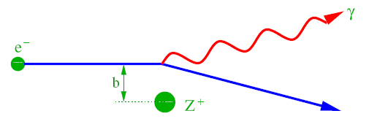
Free-free (Bremsstrahlung) Emission
Free-free emission is produced when an unbound charged particle changes trajectory (decelerates) in the presence of another charged particle.
Electron emits more radiation than the heavier particle. F_{e}=F_{Z} (Newton’s 3rd law). F=ma (Newton’s 2nd law). m_{e}<<m_{Z}, so a_{e}>>a_{Z}.
It is often observed coming from astrophysical plasmas, e.g. gas in a nebula that is irradiated by a hot source.

Slide 4
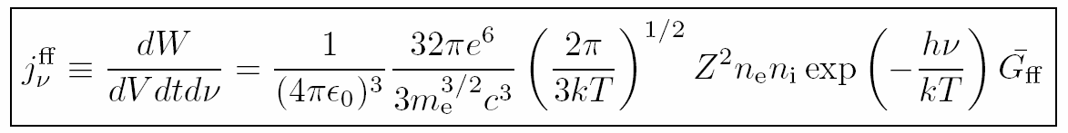
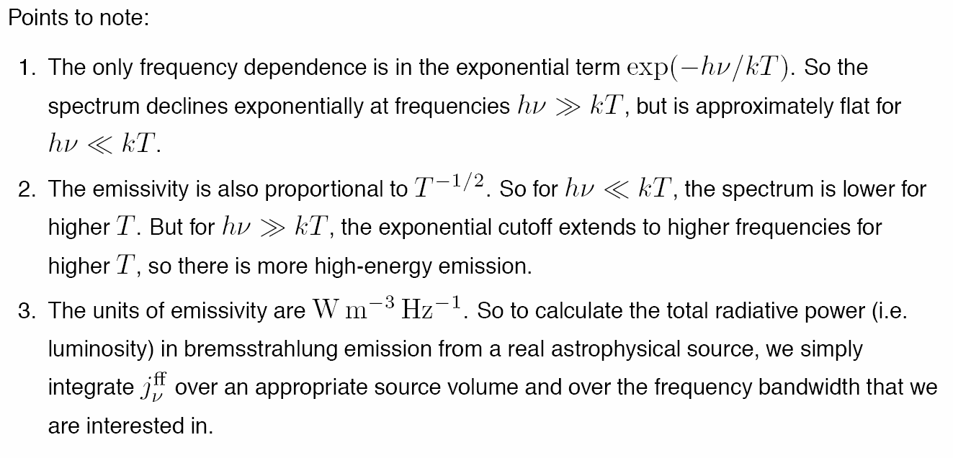
Free-free Emission: Spectrum
see following for derivation:
http://www.physics.usyd.edu.au/~kuncic/lectures/HEA_L6.pdf

Slide 5
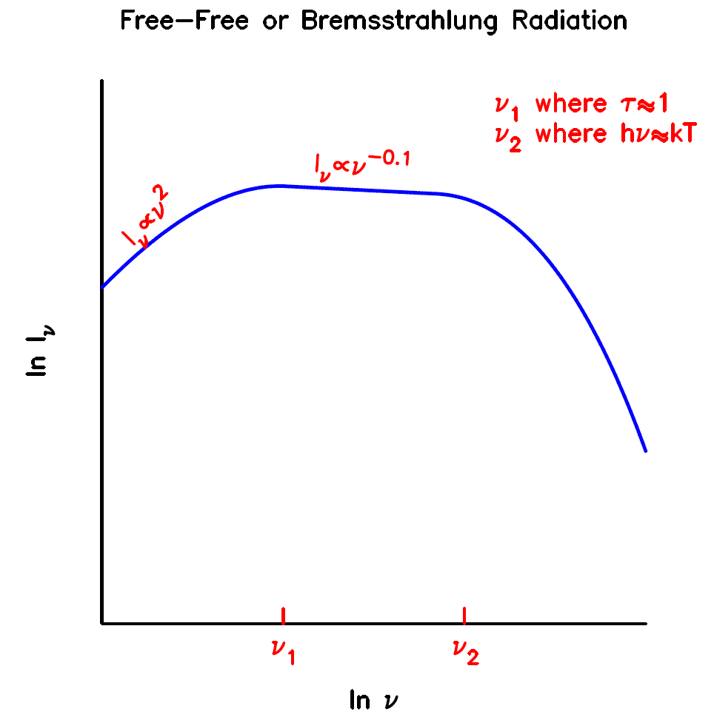
Free-free Emission: Spectrum
After accounting for self-absorption, spectrum is flat in the middle with a rollover on either side.
ν₁ corresponds to τ~1, and is at ~1 GHz (30 cm) for Orion.
ν₂ corresponds to hν~kT, where the exponential begins to dominate.
The flat slope in the middle of the curve is a key diagnostic for astronomers to determine that a source is emitting via free-free emission, sometimes called thermal emission.

Slide 6
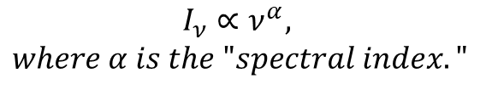
Spectral Index
Spectral index is the exponent in the equation relating intensity to frequency.
In the plot on the right, the spectral index is -0.1 on the flat part of the curve.
$$I_{ν}∝ν^{α},$$
$$where α is the "spectral index."$$

Slide 7
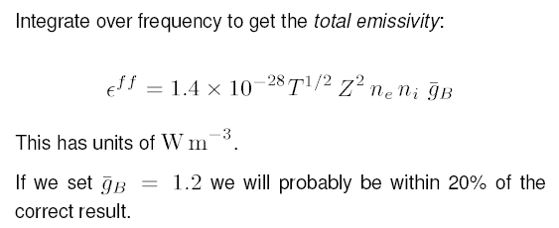
Free-free Emission: Total
This is an excellent lecture: http://www.mrao.cam.ac.uk/~kjbg1/lectures/lect3.pdf

Slide 8

Free-free Emission: Hot Stars
Hot stars are hot enough to produce a significant number of ionizing photons (E>13.6 eV for hydrogen).
For photons with higher energies, the excess energy gives the electron kinetic energy, thus leading to higher plasma temperature.
This UV radiation creates a “plasma” of free electrons surrounding the star.
A typical hot star produces approximately 10⁴⁷ ionizing photons per second.
Small hot stars, such as white dwarfs, also produce ionizing radiation, but fewer numbers of ionizing photons per second, given their small radii.
Notes:
In astrophysics, a Strömgren sphere is the sphere of ionized hydrogen (H II) around a young star of the spectral classes O or B. The most prominent example is the Rosette Nebula. It was derived by and later named after Bengt Strömgren[1].

Slide 9
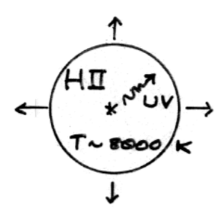
Free-free Emission: HII Regions
The region of ionized gas around a hot star is called an HII region, where the II signifies the “2nd” ionization state and “I” would mean the “1st” ionization state (which is neutral).
In the most simplistic configuration, the shape of the HII region is a sphere, and the size is limited by the total number of ionizing photons per second that the star generates.
Notes:
In astrophysics, a Strömgren sphere is the sphere of ionized hydrogen (H II) around a young star of the spectral classes O or B. The most prominent example is the Rosette Nebula. It was derived by and later named after Bengt Strömgren[1].

Slide 10

Free-free Emission: Stromgren Sphere
The sphere of ionized gas around a hot star is called a Stromgren sphere.
S* is the ionizing flux, n is the density, and beta is the total recombination coefficient.
Ionized sphere is “radiation bounded,” that is, its size is set by the amount of ionizing radiation produced by the source.
By construction, every ionizing photon will ionize an atom.
Notes:
In astrophysics, a Strömgren sphere is the sphere of ionized hydrogen (H II) around a young star of the spectral classes O or B. The most prominent example is the Rosette Nebula. It was derived by and later named after Bengt Strömgren[1].

Slide 11
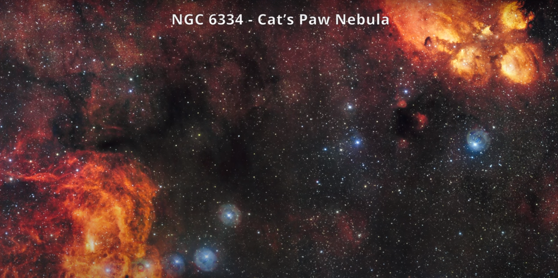
Stromgren Spheres

Slide 12
Stromgren Sphere Radius: Derivation
Notes:
In astrophysics, a Strömgren sphere is the sphere of ionized hydrogen (H II) around a young star of the spectral classes O or B. The most prominent example is the Rosette Nebula. It was derived by and later named after Bengt Strömgren[1].

Slide 13
Free-free Emission: Star Formation Region

Slide 14
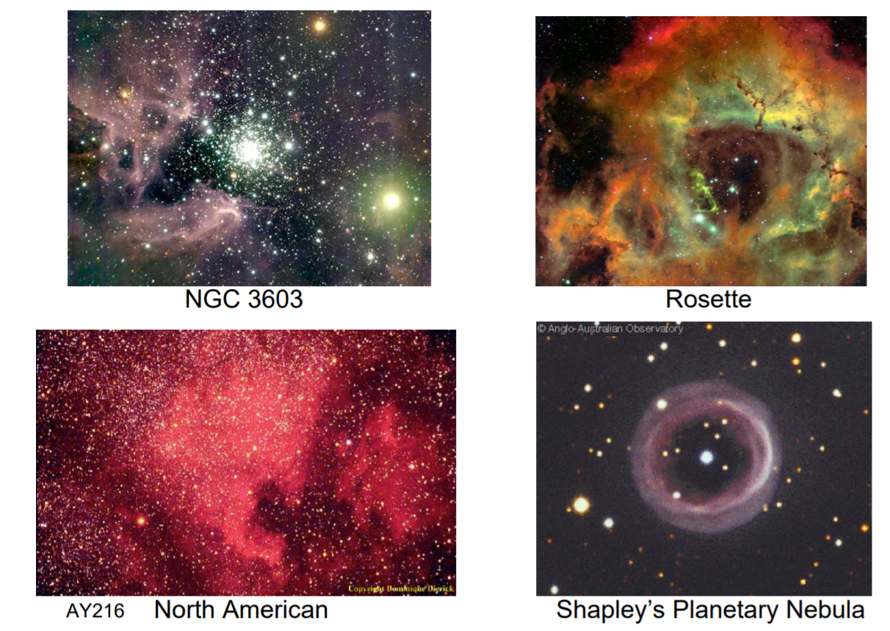
Stromgren “Spheres” Not Always Spheres

Slide 15
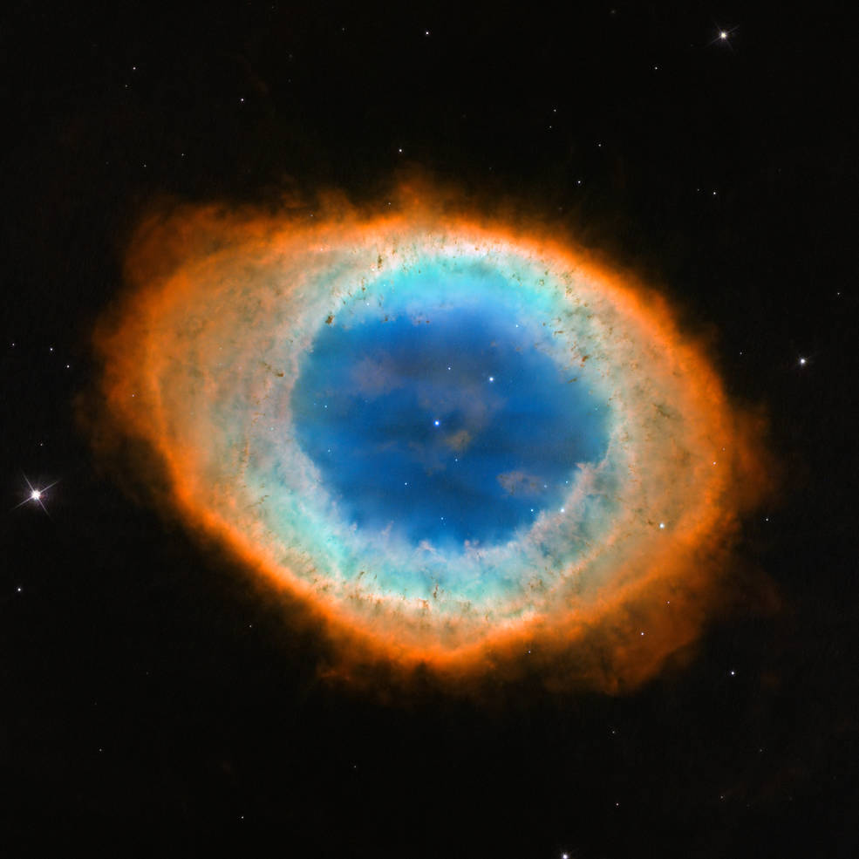
M57: The Ring Nebula

Slide 16
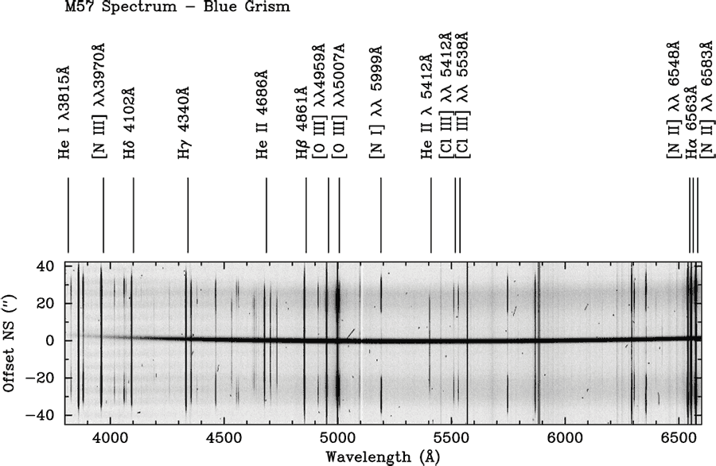
M57: Spectrum

Slide 17
Maxwell-Boltzmann Distribution
The equilibrium distribution of particles in a gas is described by the Maxwell-Boltzmann equation which gives the probability that a particle in the gas has a certain velocity.
It can also be recast as an energy distribution, given that E=mv²/2.
$F\left(v\right)dv=4π{\left(\frac{m}{2πkT}\right)}^{3/2}v^{2}e^{\left(−\frac{mv^{2}}{2kT}\right)}dv, \left\langle v\right\rangle ={\left(\frac{8kT}{πm}\right)}^{1/2}$
$$F\left(E\right)=F\left(v\right)\frac{dv}{dE}=\frac{2}{\sqrt{π}kT}{\left(\frac{E}{kT}\right)}^{1/2}e^{\left(−\frac{E}{kT}\right)}, \left\langle E\right\rangle =\frac{3}{2}kT$$
$$\left\langle E\right\rangle =\frac{3}{2}kT=\frac{1}{2}m\left\langle v^{2}\right\rangle , RMS=\sqrt{\left\langle v^{2}\right\rangle }={\left(\frac{3kT}{m}\right)}^{1/2}$$

Slide 18
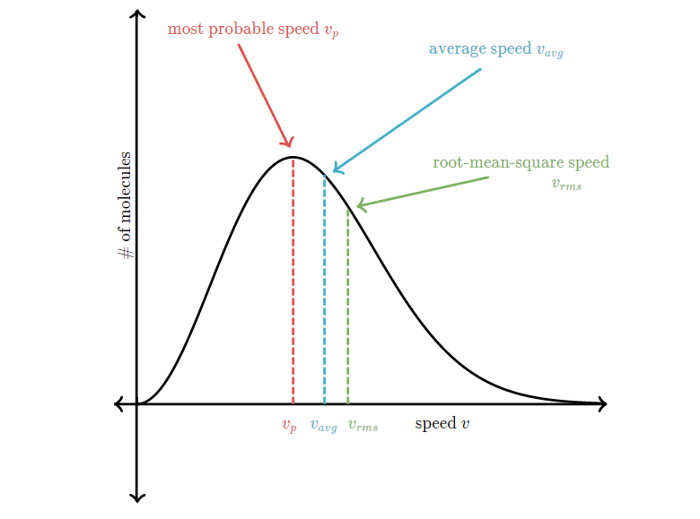
Maxwell-Boltzmann Distribution

Slide 19
synchrotron radiation

Slide 20
Synchrotron Radiation
Synchrotron radiation is emitted when a charged particle accelerates in the presence of a magnetic field.
The emitted power is a strong function of velocity, and inverse particle mass, so it is often observed in regions where there are fast electrons.
Source of energetic electrons:
  supernova remnants
  pulsar winds
  shocks
Notes:
Synchrotron radiation is electromagnetic radiation, similar to cyclotron radiation, but generated by the acceleration of ultrarelativistic (i.e., moving near the speed of light) charged particles through magnetic fields. This may be achieved artificially by storage rings in a synchrotron, or naturally by fast moving electrons moving through magnetic fields in space. The radiation typically includes radio waves, infrared light, visible light, ultraviolet light, and x-rays.
The radiation was named after its discovery in a General Electric synchrotron accelerator built in 1946 and announced in May 1947 by Frank Elder, Anatole Gurewitsch, Robert Langmuir, and Herb Pollock in a letter entitled "Radiation from Electrons in a Synchrotron"[1].

Slide 21
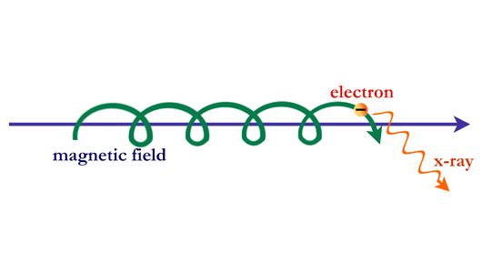
Synchrotron Radiation: Illustration
Notes:
Synchrotron radiation from cosmic sources has a distinctive spectrum, or distribution of photons with energy. The radiation falls off with energy less rapidly than does the spectrum of radiation from a hot gas. When synchrotron radiation is observed in supernova remnants, cosmic jets, or other sources, it reveals information about the high-energy electrons and magnetic fields that are present.

Slide 22
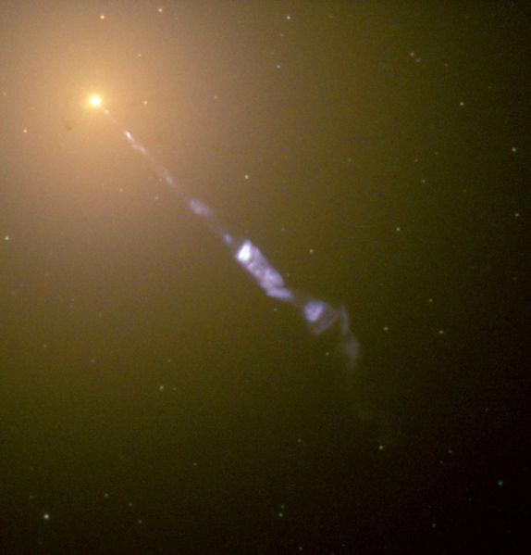
Synchrotron Radiation: M87 Jet
Notes:
Streaming out from the center of the galaxy M87 like a cosmic searchlight is one of nature's most amazing phenomena, a black-hole-powered jet of electrons and other sub-atomic particles traveling at nearly the speed of light. In this Hubble telescope image, the blue jet contrasts with the yellow glow from the combined light of billions of unseen stars and the yellow, point-like clusters of stars that make up this galaxy. Lying at the center of M87, the monstrous black hole has swallowed up matter equal to 2 billion times our Sun's mass. M87 is 50 million light-years from Earth.
The jet originates in the disk of superheated gas swirling around this black hole and is propelled and concentrated by the intense, twisted magnetic fields trapped within this matter. The light we see is produced by electrons twisting along magnetic field lines in the jet, a process known as synchrotron radiation, which gives the jet its bluish tint.

Slide 23
Synchrotron Radiation: Spectrum
low frequency radiation is scattered by electrons in plasma
high frequency radiation penetrates plasma
there is a break caused by very short lifetimes of highly energetic electrons (they radiate their energy through synchrotron radiation very quickly)
Notes:
http://www-astro.physics.ox.ac.uk/~garret/teaching/lecture6.pdf

Slide 24
Synchrotron Radiation: Spectrum
Notes:
http://www-astro.physics.ox.ac.uk/~garret/teaching/lecture6.pdf

Slide 25
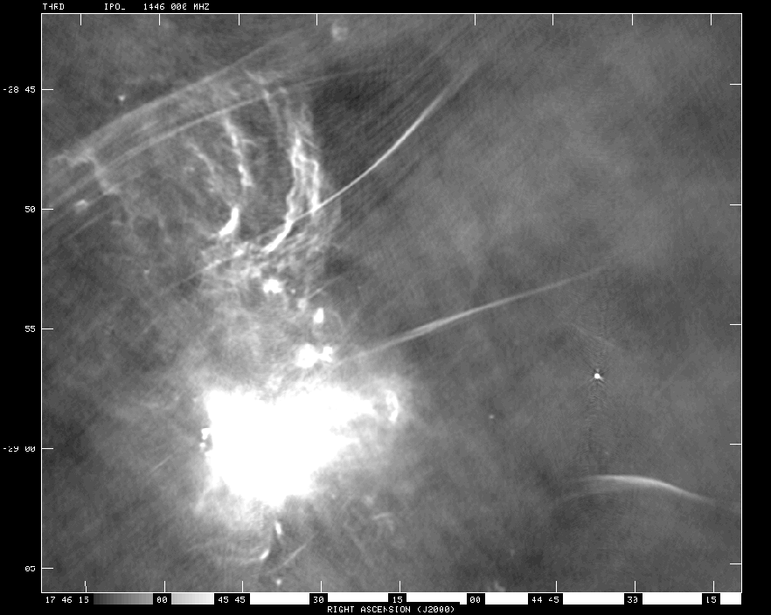
Synchrotron and Free-Free in the Galactic Center
Notes:
http://www-astro.physics.ox.ac.uk/~garret/teaching/lecture6.pdf

Slide 26
inverse-Compton radiation

Slide 27
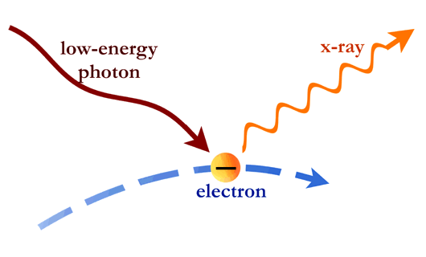
Inverse Compton Scattering
Compton scattering describes the effect of a photon losing energy when it interacts with an electron.
Inverse compton scattering is the opposite process and results in the photon being “up-scattered” to higher energies (while the electron loses energy).
Strong producers of inverse Compton scattered photons
  particles around a black hole
  up-scattered CMB photons traveling through galaxy cluster plasmas
  supernovae remnants
Notes:
The photons themselves can also collide with electrons. If the electrons have more energy than the photons, the collision can boost the energy of the photons. In this way, photons can be changed from low-energy photons to high-energy photons. This process, called Compton scattering, is thought to be important around black holes, where matter is dense and has been heated to many millions of degrees. Inverse Compton Scattering
The photons collected in space by X-ray telescopes reveal the hot spots in the universe--regions where particles have been energized or raised to high temperatures by gigantic explosions or intense gravitational fields.
Where do such conditions exist? In an astonishing variety of places, ranging from the vast spaces between galaxies to the bizarre, collapsed worlds of neutron stars and black holes.

Slide 28
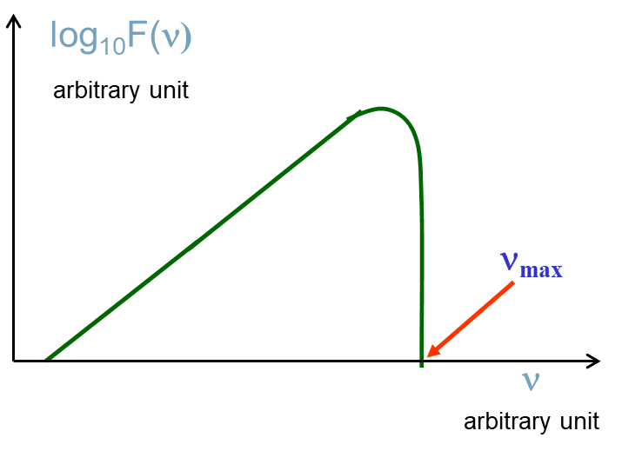
Inverse Compton Scattering: Spectrum
At low frequencies, the scattered radiation increases proportionally with frequency
At high frequencies, it drops down below a maximum frequency of 4γ² times the original frequency, where γ is the relativistic γ, and corresponds to the case where the electron is travelling at v=c.

Slide 29
molecular lines

Slide 30
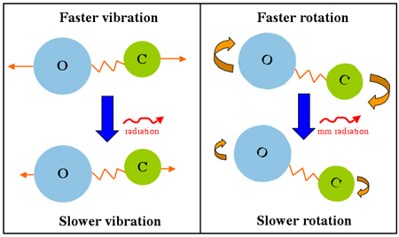
Molecular rotational-vibrational transitions

Slide 31
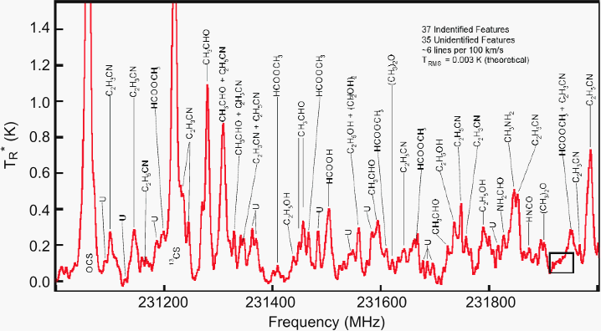
Molecular line observations
This 13 mm spectrum of the molecular cloud SgrB2(N) near the Galactic center is completely dominated by molecular lines from known and unknown (U) species (Ziurys et al. 2006, NRAO Newsletter, 109, 11).
More than 140 different molecules containing up to 13 atoms have been identified in space.
Notes:
This 13 mm spectrum of the molecular cloud SgrB2(N) near the Galactic center is completely dominated by molecular lines from known and unknown (U) species (Ziurys et al. 2006, NRAO Newsletter, 109, 11). More than 140 different molecules containing up to 13 atoms (HC11N) have been identified in space.

Slide 32
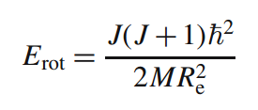
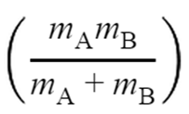
Molecular rotational energy levels
Rotational energy of a molecule is given by the expression on the upper right, where R_{e} is the distance between the nuclei and M is the reduced mass is given by the expression on the lower right.
At sufficiently high density, collisions pump molecules more frequently than spontaneous emission, leading to high flux.
Notes:
http://www.cv.nrao.edu/course/astr534/MolecularSpectra.html

Slide 33
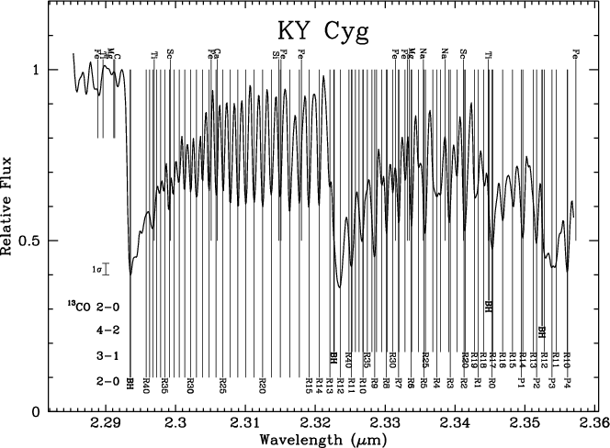
Quantization of Molecular Lines
Notes:
http://www.cv.nrao.edu/course/astr534/MolecularSpectra.html

Slide 34
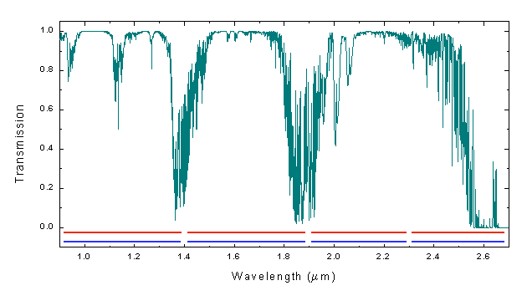
Water Bands in the Infrared
Notes:
http://www.cv.nrao.edu/course/astr534/MolecularSpectra.html

Slide 35
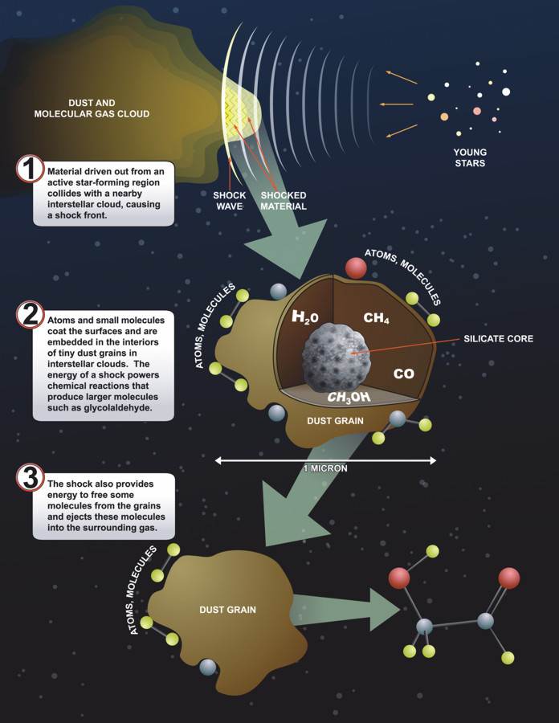
Molecules Coat Dust
Dust grains assist in the formation of complex molecules.
The Green Bank Telescope detected emission from glycoaldehyde (sugar) in SGRB2 near the galactic center.

Slide 36
composite spectrum

Slide 37
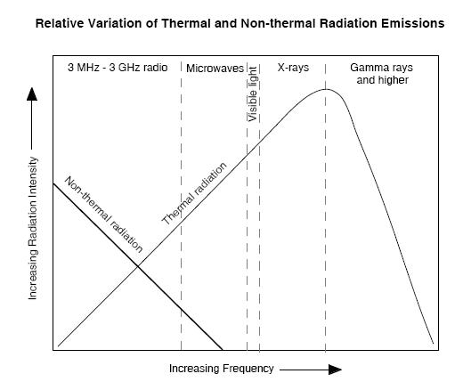
Thermal vs. Non-Thermal Radiation
Notes:
This plot shows a combination of three emission sources.

Slide 38
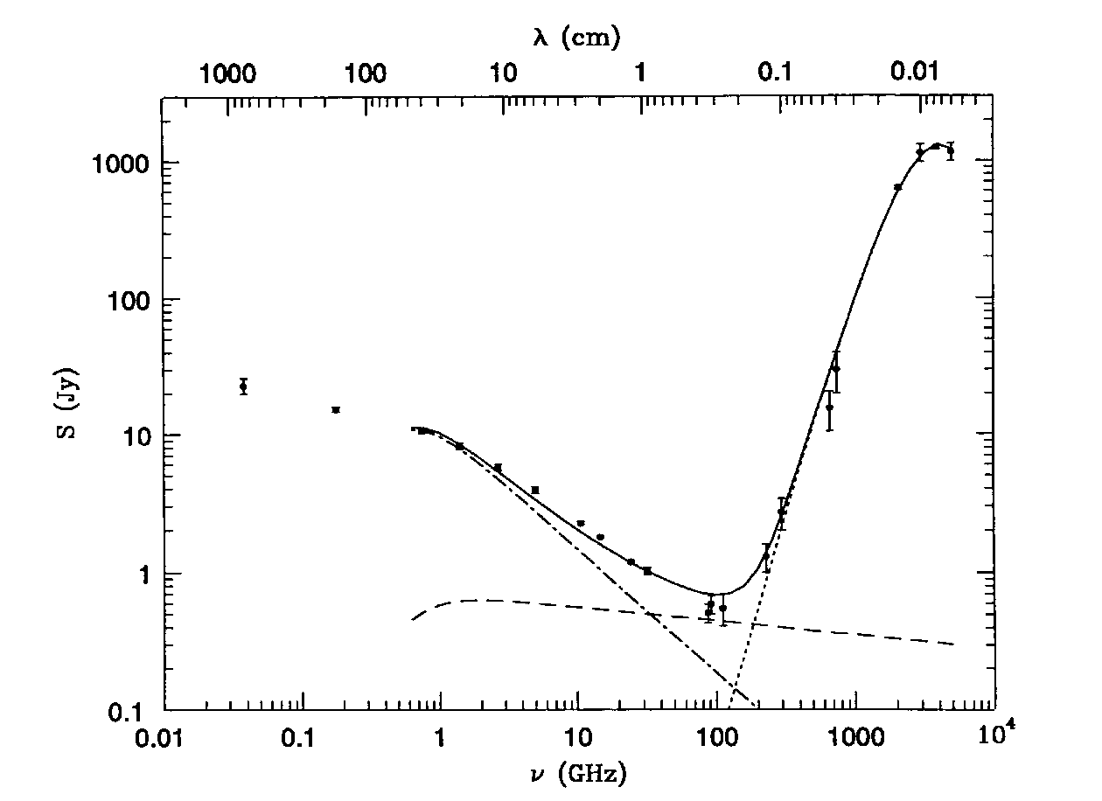
Multiwavelength Spectrum: M82
synchrotron
dust
free-free
The radio and far-infrared spectrum of the nearby starburst galaxy M82. The contribution of free-free emission is indicated by the nearly horizontal dashed line. Synchrotron and dust emission dominate at low and high frequencies, respectively. Free-free absorption from HII regions distributed throughout the galaxy flattens the overall spectrum at the lowest frequencies.
Notes:
This plot shows a combination of three emission sources.

Slide 39
Theory of Everything

