Slide 1
University Astronomy
Professor Don Figer
Emission Mechanisms I

Slide 2
Aims and outline for this lecture
describe properties of primary astronomical emission mechanisms
  blackbody
  bound-bound, bound-free, free-bound
  free-free
  synchrotron
  inverse-compton scattering
  molecular rotational-vibrational transitions
some mechanisms will not be discussed because they have more specialized application
  nuclear fusion (e.g. in stellar nucleosynthesis)
  particle/anti-particle annihilation
  pair production
  nuclear decay
  fluorescence/phosphorescence

Slide 3
blackbody radiation

Slide 4
Energy Transfer
There are three ways to transport or move energy from one location to another:
Conduction:
  particles interact with neighbors and share energy
Convection:
  bulk mixing of particles transports energy
Radiation:
  photons carry energy and are scattered/absorbed

Slide 5
Radiative Transfer
All objects radiate and receive energy.
An object hotter than its surroundings will give off more energy than it receives
  with no internal heat (energy) source, it will radiatively cool
  given enough time, the object will equilibrate at the same temperature as its surroundings (at which point it will absorb as much energy as it emits)
An object cooler than its surroundings will absorb more energy than it receives
  sunlit surface of Earth gets hotter (Sun is hotter than Earth)
  darkside surface of Earth gets cooler (Earth is hotter than space)
Notes:
http://www.lpi.usra.edu/meetings/lpsc2003/pdf/1761.pdf
http://articles.adsabs.harvard.edu/cgi-bin/nph-iarticle_query?1976Moon...15..421F&amp;data_type=PDF_HIGH&amp;whole_paper=YES&amp;type=PRINTER&amp;filetype=.pdf

Slide 6

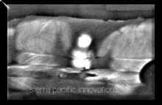
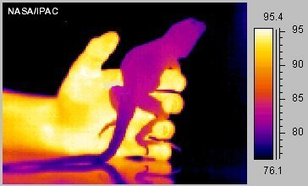
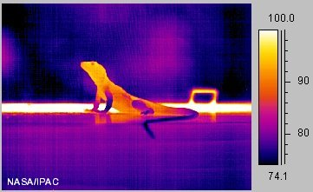
Blackbody Radiation: Objects
Thermal emission from two adults and infant, measured in mid-infrared. Note that sofa remains warm after adults leave.
These thermal infrared images of a collard lizard show a cold-blooded animal's body temperature in a cooler and warmer environment. In the image to the left, the lizard is just above room temperature, being warmed by the human hand holding it. To warm up, lizards will seek a sunny area and bask in warm sunlight, as in the image to the right.

Slide 7
Blackbody Radiation
A blackbody is a perfect emitter – it absorbs all radiation and reflects none (hence is ‘black’) and perfectly re-­emits that radiation.
Blackbody radiation is the characteristic spectrum of light emitted by blackbodies.
The spectrum of radiation is given by the Planck function, which is dependent on temperature.
It is also known as Thermal Radiation.
It is caused by jostling charged particles in a medium/body, where the “jostling” is caused by finite temperature.

Slide 8
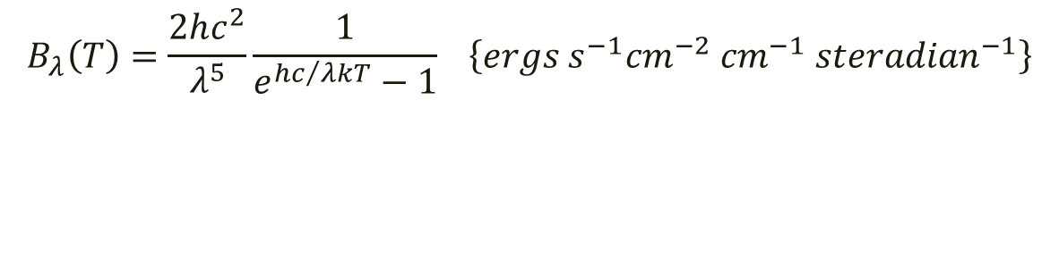
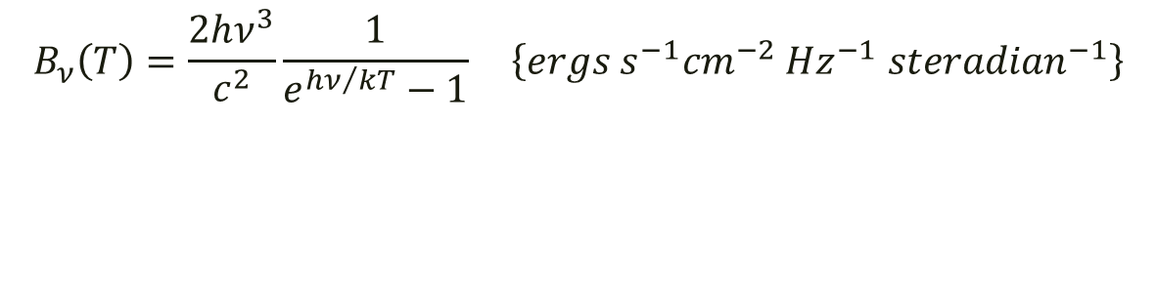
Blackbody Radiation: Planck’s Equation
$$B_{ν}\left(T\right)=\frac{2hν^{3}}{c^{2}}\frac{1}{e^{{hν}/{kT}}−1} \left\{ergs s^{−1}{cm}^{−2} {Hz}^{−1} {steradian}^{−1}\right\}$$
$$B_{λ}\left(T\right)=\frac{2hc^{2}}{λ^{5}}\frac{1}{e^{{hc}/{λkT}}−1} \left\{ergs s^{−1}{cm}^{−2} {cm}^{−1} {steradian}^{−1}\right\}$$

Slide 9
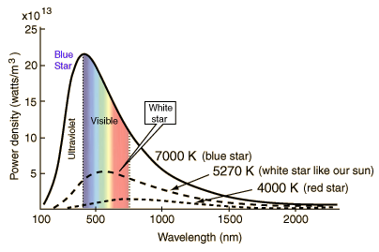
Blackbody Radiation: Curves
Notes:
Stars approximate blackbody radiators and their visible color depends upon the temperature of the radiator. The curves show blue, white, and red stars. The white star is adjusted to 5270K so that the peak of its blackbody curve is at the peak wavelength of the sun, 550 nm. From the wavelength at the peak, the temperature can be deduced from the Wien displacement law.

Slide 10
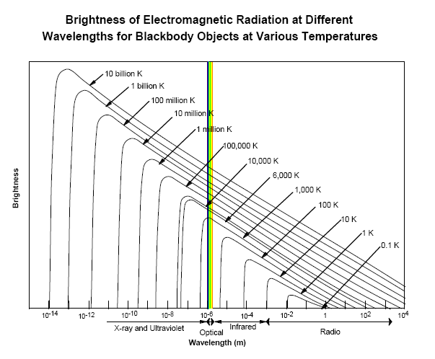
Blackbody Radiation vs. Temperature
Notes:
The wavelength of the peak of the blackbody radiation curve decreases in a linear fashion as the temperature is increased (Wien's displacement law). This linear variation is not evident in this kind of plot since the intensity increases with the fourth power of the temperature (Stefan- Boltzmann law). The nature of the peak wavelength change is made more evident by plotting the fourth root of the intensity.

Slide 11
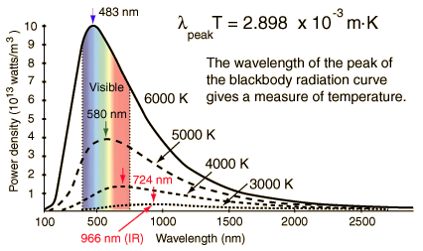
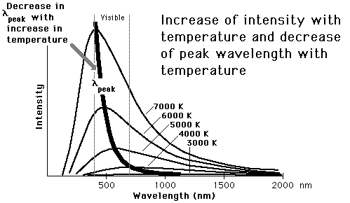
Blackbody Radiation: Peak Wavelength
The peak emission can be expressed as a function of wavelength.
This wavelength is the location where the slope becomes zero.
Hotter objects emit most of their radiation at shorter wavelengths: hence they will appear to be bluer.
Cooler objects emit most of their radiation at longer wavelengths: redder.
At any wavelength, a hotter object radiates more (is more luminous) than a cooler one.
Notes:
The wavelength of the peak of the blackbody radiation curve decreases in a linear fashion as the temperature is increased (Wien's displacement law). This linear variation is not evident in this kind of plot since the intensity increases with the fourth power of the temperature (Stefan- Boltzmann law). The nature of the peak wavelength change is made more evident by plotting the fourth root of the intensity.

Slide 12


Blackbody Radiation: Wein’s Displacement Law
The wavelength at which the flux is maximum, is given by Wein’s Displacement Law.
Example: for T~3000 K, λ_{max}~ 1 μm.
For our body, T~310 K, so λ_{max}~ 9 μm.
$$λ_{max}T=0.2898 \{cm K\}$$
$$λ_{max}T=2898 \{μm K\}$$
Notes:
The wavelength of the peak of the blackbody radiation curve decreases in a linear fashion as the temperature is increased (Wien's displacement law). This linear variation is not evident in this kind of plot since the intensity increases with the fourth power of the temperature (Stefan- Boltzmann law). The nature of the peak wavelength change is made more evident by plotting the fourth root of the intensity.

Slide 13
Question
At what wavelength does the Sun’s emission peak?
  a) 400 nm
  b) 500 nm
  c) 600 nm
  d) 700 nm
vote!

Slide 14
Answer
At what wavelength does the Sun’s emission peak?
  a) 400 nm
  b) 500 nm
  c) 600 nm
  d) 700 nm
First, we note that the temperature of the Sun is ~5800 K.
Next, we divide 2898 by 5800 to get 0.5 microns (=500 nm).

Slide 15
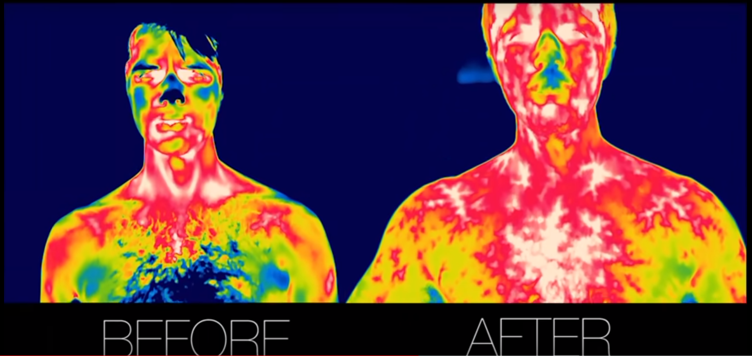
Thermal Imaging!

Slide 16


Slide 17
This class can save your life! – Just ask Arnold!
That’s why he can say, “I’ll be back.”

Slide 18
Blackbody Radiation: Stefan-Boltzmann Law
The Stefan-Boltzmann Law relates the total amount of flux emitted per unit area by a blackbody as a function of temperature.
The Stefan-Boltzmann Law is the result of integrating the blackbody function over all frequencies and solid angle.

Slide 19
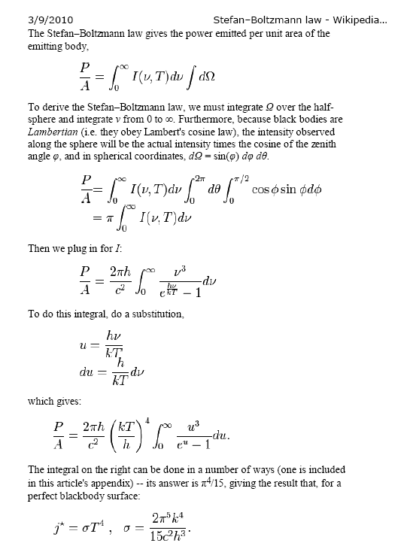
Blackbody Radiation: SB Law, derivation

Slide 20
Blackbody Radiation: Luminosity
The total “luminosity” is the total power emitted.
It is the area of the object multiplied by the emitted power per unit area (Stefan-Boltzmann law).
For a spherical blackbody, like a star or planet, the area is 4πR².

Slide 21
Question
What is the Sun’s luminosity, assuming that it emits like a blackbody and that its radius is 7(10⁸) m?

Slide 22

Answer
The Sun’s luminosity is
$4πR^{2}σT^{4}\sim 4\text{×}3.14\text{×}{\left(7\text{×}{10}^{8}\right)}^{2}\text{×}\text{5.67}\text{×}{10}^{−8}\text{×}{5800}^{4}$~4(10²⁶) W.

Slide 23
electronic transitions

Slide 24
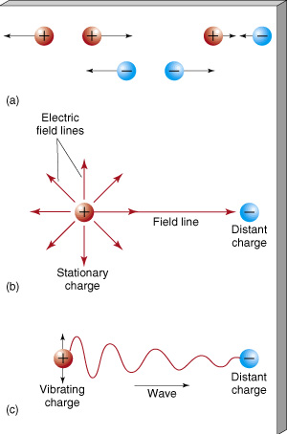
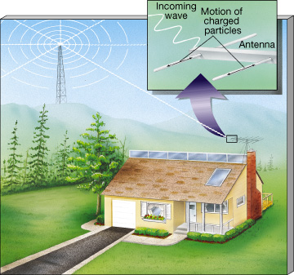
Interactions Between Charged Particles
Notes:
Charged Particles (a) Particles carrying like electrical charges repel one another, whereas particles carrying unlike charges attract. (b) A charged particle is surrounded by an electric field, which determines the particle’s influence on other charged particles. We represent the field by a series of field lines. (c) If a charged particle begins to vibrate back and forth, its electric field changes. The resulting disturbance travels through space as a wave.
Television Signal Charged particles in an ordinary household television antenna vibrate in response to electromagnetic radiation broadcast by a distant transmitter. The radiation is produced when electric charges are made to oscillate in the transmitter’s emitting antenna. The vibrations in the receiving antenna "echo" the oscillations in the transmitter, allowing the original information to be retrieved.

Slide 25
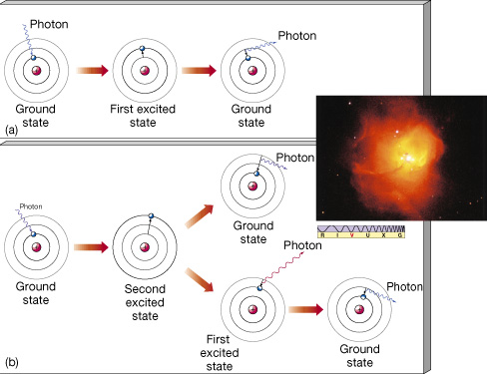
Bound-Bound Transitions
Notes:
Atomic Excitation (a) Diagram of a photon being absorbed by a hydrogen atom (left), causing the momentary excitation of that atom (center) into its first excited state. After about 10-8 s, the atom returns to its ground state, accompanied by the emission of a photon of the same energy as the original photon (right). (b) Absorption of a higher-energy photon may also boost the atom into a higher excited state, from which there may be several possible paths back to the ground state. (Remember that the sharp lines used for the orbitals here and in similar figures that follow are intended merely as a schematic representation of the electron energy levels and are not meant to be taken literally. In actuality, electron orbitals are "clouds," as shown in Figure 4.9.) As ultraviolet photons from a hot star pass through surrounding hydrogen gas, many are absorbed by the gas, boosting its atoms into excited states. Electrons in the second excited state can fall to the first excited state on their way back to the ground state (the lower path in part b). This transition produces radiation in the visible region of the spectrum—the 656.3-nm red glow that is characteristic of excited hydrogen gas. The object shown in the inset, designated N81, is an emission nebula: an interstellar cloud consisting largely of hydrogen gas excited by extremely hot star (as seen in white at the center). (Inset: NASA)

Slide 26
Transitions to/from the Free State
The “free” state is a term that describes when a particle is not physically bound to another particle.
A transition from a bound to a free state represents ionization. The electron is stripped from the atom.
A transition from a free to a bound state represents recombination.
Notes:
Atomic Excitation (a) Diagram of a photon being absorbed by a hydrogen atom (left), causing the momentary excitation of that atom (center) into its first excited state. After about 10-8 s, the atom returns to its ground state, accompanied by the emission of a photon of the same energy as the original photon (right). (b) Absorption of a higher-energy photon may also boost the atom into a higher excited state, from which there may be several possible paths back to the ground state. (Remember that the sharp lines used for the orbitals here and in similar figures that follow are intended merely as a schematic representation of the electron energy levels and are not meant to be taken literally. In actuality, electron orbitals are "clouds," as shown in Figure 4.9.) As ultraviolet photons from a hot star pass through surrounding hydrogen gas, many are absorbed by the gas, boosting its atoms into excited states. Electrons in the second excited state can fall to the first excited state on their way back to the ground state (the lower path in part b). This transition produces radiation in the visible region of the spectrum—the 656.3-nm red glow that is characteristic of excited hydrogen gas. The object shown in the inset, designated N81, is an emission nebula: an interstellar cloud consisting largely of hydrogen gas excited by extremely hot star (as seen in white at the center). (Inset: NASA)

Slide 27
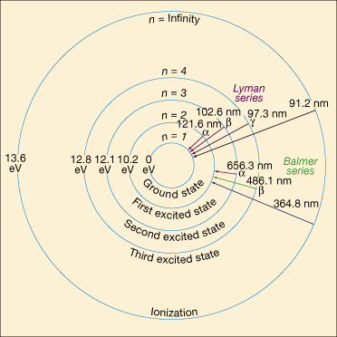
Hydrogen emission lines
Notes:
Transitions starting from or ending at the ground state (level 1) form the Lyman series. The first is Lyman alpha (Ly ), corresponding to the transition between the first excited state (level 2) and the ground state. As we have seen, the energy difference is 10.21 eV, and the Ly photon has a wavelength of 121.6 nm (1216 Å). The Ly (beta) transition, between level 3 (the second excited state) and the ground state, corresponds to an energy change of 12.10 eV and a photon of wavelength 102.6 nm (1026 Å). Ly (gamma) corresponds to a jump from level 4 to level 1, and so on. The accompanying table shows how we can calculate the energies, frequencies, and wavelengths of the photons in the Lyman series using the formulae given previously. All Lyman-series energies lie in the ultraviolet region of the spectrum.
The next series of lines, the Balmer series, involves transitions down to (or up from) level 2, the first excited state. All the Balmer series lines lie in or close to the visible portion of the electromagnetic spectrum. Because they form the most easily observable part of the hydrogen spectrum and were the first to be discovered, these lines are often referred to simply as the "Hydrogen" series and denoted by the letter H. As with the Lyman series, the individual transitions are labeled with Greek letters. An H photon (level 3 to level 2) has a wavelength of 656.3 nm and is red, Hß (level 4 to level 2) has a wavelength of 486.1 nm (green), H (level 5 to level 2) has a wavelength of 434.1 nm (blue), and so on. The most energetic Balmer series photons have energies that place them just beyond the blue end of the visible spectrum, in the near ultraviolet.
The classification continues with the Paschen series (transitions down to or up from the second excited state), the Brackett series (third excited state), and the Pfund series (fourth excited state). Beyond that point, infinitely many other families exist, moving farther and farther into the infrared and radio regions of the spectrum, but they are not referred to by any special names. A few of the transitions making up the Lyman and Balmer (Hydrogen) series are marked on the figure. Astronomically, these are the most important sequences.

Slide 28
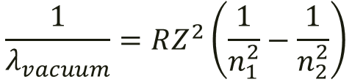


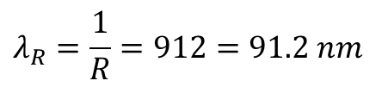

Rydberg Formula
The Rydberg formula relates electronic transitions to energy and wavelength.
Where
  λ_{vacuum} is the wavelength of the light emitted in vacuum,
  R is the Rydberg constant for hydrogen,
  n₁ and n₂ are integers such that n₁ < n₂,
  Z is atomic number
Set Z=1, n₁=1, n₂=infinity to calculate ionization energy for Hydrogen from the ground state.
$$\frac{1}{λ_{vacuum}}=RZ^{2}\left(\frac{1}{n_{1}^{2}}−\frac{1}{n_{2}^{2}}\right)$$
$$R=1.097\left({10}^{7}\right) m^{−1}$$
$$λ_{R}=\frac{1}{R}=912=91.2 nm$$
$$E_{R}=hν=\frac{hc}{λ_{R}}=hcR=2.18\left({10}^{−18}\right) J$$
$$2.18\left({10}^{−18}\right) J=13.6 eV$$
Notes:
Transitions starting from or ending at the ground state (level 1) form the Lyman series. The first is Lyman alpha (Ly ), corresponding to the transition between the first excited state (level 2) and the ground state. As we have seen, the energy difference is 10.21 eV, and the Ly photon has a wavelength of 121.6 nm (1216 Å). The Ly (beta) transition, between level 3 (the second excited state) and the ground state, corresponds to an energy change of 12.10 eV and a photon of wavelength 102.6 nm (1026 Å). Ly (gamma) corresponds to a jump from level 4 to level 1, and so on. The accompanying table shows how we can calculate the energies, frequencies, and wavelengths of the photons in the Lyman series using the formulae given previously. All Lyman-series energies lie in the ultraviolet region of the spectrum.
The next series of lines, the Balmer series, involves transitions down to (or up from) level 2, the first excited state. All the Balmer series lines lie in or close to the visible portion of the electromagnetic spectrum. Because they form the most easily observable part of the hydrogen spectrum and were the first to be discovered, these lines are often referred to simply as the "Hydrogen" series and denoted by the letter H. As with the Lyman series, the individual transitions are labeled with Greek letters. An H photon (level 3 to level 2) has a wavelength of 656.3 nm and is red, Hß (level 4 to level 2) has a wavelength of 486.1 nm (green), H (level 5 to level 2) has a wavelength of 434.1 nm (blue), and so on. The most energetic Balmer series photons have energies that place them just beyond the blue end of the visible spectrum, in the near ultraviolet.
The classification continues with the Paschen series (transitions down to or up from the second excited state), the Brackett series (third excited state), and the Pfund series (fourth excited state). Beyond that point, infinitely many other families exist, moving farther and farther into the infrared and radio regions of the spectrum, but they are not referred to by any special names. A few of the transitions making up the Lyman and Balmer (Hydrogen) series are marked on the figure. Astronomically, these are the most important sequences.

Slide 29
Hydrogen emission line series
n1 | n2 | Name | Converge toward
1 |  | Lyman series | 91.13 nm
2 |  | Balmer series | 364.51 nm
3 |  | Paschen series | 820.14 nm
4 |  | Brackett series | 1458.03 nm
5 |  | Pfund series | 2278.17 nm
6 |  | Humphreys series | 3280.56 nm
The Lyman series is in the ultraviolet while the Balmer series is in the visible and the Paschen, Brackett, Pfund, and Humphreys series are in the infrared.
Notes:
Transitions starting from or ending at the ground state (level 1) form the Lyman series. The first is Lyman alpha (Ly ), corresponding to the transition between the first excited state (level 2) and the ground state. As we have seen, the energy difference is 10.21 eV, and the Ly photon has a wavelength of 121.6 nm (1216 Å). The Ly (beta) transition, between level 3 (the second excited state) and the ground state, corresponds to an energy change of 12.10 eV and a photon of wavelength 102.6 nm (1026 Å). Ly (gamma) corresponds to a jump from level 4 to level 1, and so on. The accompanying table shows how we can calculate the energies, frequencies, and wavelengths of the photons in the Lyman series using the formulae given previously. All Lyman-series energies lie in the ultraviolet region of the spectrum.
The next series of lines, the Balmer series, involves transitions down to (or up from) level 2, the first excited state. All the Balmer series lines lie in or close to the visible portion of the electromagnetic spectrum. Because they form the most easily observable part of the hydrogen spectrum and were the first to be discovered, these lines are often referred to simply as the "Hydrogen" series and denoted by the letter H. As with the Lyman series, the individual transitions are labeled with Greek letters. An H photon (level 3 to level 2) has a wavelength of 656.3 nm and is red, Hß (level 4 to level 2) has a wavelength of 486.1 nm (green), H (level 5 to level 2) has a wavelength of 434.1 nm (blue), and so on. The most energetic Balmer series photons have energies that place them just beyond the blue end of the visible spectrum, in the near ultraviolet.
The classification continues with the Paschen series (transitions down to or up from the second excited state), the Brackett series (third excited state), and the Pfund series (fourth excited state). Beyond that point, infinitely many other families exist, moving farther and farther into the infrared and radio regions of the spectrum, but they are not referred to by any special names. A few of the transitions making up the Lyman and Balmer (Hydrogen) series are marked on the figure. Astronomically, these are the most important sequences.

Slide 30
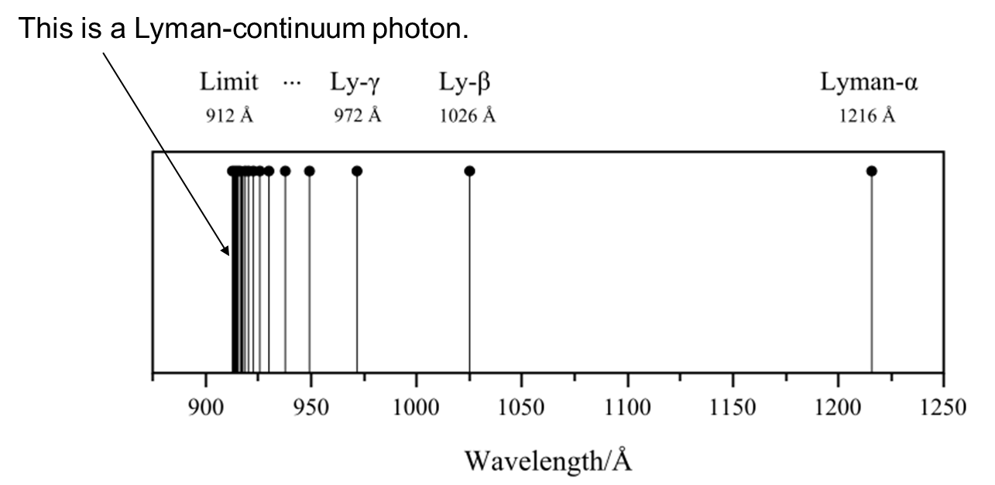
Lyman series
n | 2 | 3 | 4 | 5 | 6 | 7 | 8 | 9 | 10 | 11
Wavelength (nm) | 121.6 | 102.6 | 97.2 | 94.9 | 93.7 | 93.0 | 92.6 | 92.3 | 92.1 | 91.9 | 91.15
Notes:
Transitions starting from or ending at the ground state (level 1) form the Lyman series. The first is Lyman alpha (Ly ), corresponding to the transition between the first excited state (level 2) and the ground state. As we have seen, the energy difference is 10.21 eV, and the Ly photon has a wavelength of 121.6 nm (1216 Å). The Ly (beta) transition, between level 3 (the second excited state) and the ground state, corresponds to an energy change of 12.10 eV and a photon of wavelength 102.6 nm (1026 Å). Ly (gamma) corresponds to a jump from level 4 to level 1, and so on. The accompanying table shows how we can calculate the energies, frequencies, and wavelengths of the photons in the Lyman series using the formulae given previously. All Lyman-series energies lie in the ultraviolet region of the spectrum.
The next series of lines, the Balmer series, involves transitions down to (or up from) level 2, the first excited state. All the Balmer series lines lie in or close to the visible portion of the electromagnetic spectrum. Because they form the most easily observable part of the hydrogen spectrum and were the first to be discovered, these lines are often referred to simply as the "Hydrogen" series and denoted by the letter H. As with the Lyman series, the individual transitions are labeled with Greek letters. An H photon (level 3 to level 2) has a wavelength of 656.3 nm and is red, Hß (level 4 to level 2) has a wavelength of 486.1 nm (green), H (level 5 to level 2) has a wavelength of 434.1 nm (blue), and so on. The most energetic Balmer series photons have energies that place them just beyond the blue end of the visible spectrum, in the near ultraviolet.
The classification continues with the Paschen series (transitions down to or up from the second excited state), the Brackett series (third excited state), and the Pfund series (fourth excited state). Beyond that point, infinitely many other families exist, moving farther and farther into the infrared and radio regions of the spectrum, but they are not referred to by any special names. A few of the transitions making up the Lyman and Balmer (Hydrogen) series are marked on the figure. Astronomically, these are the most important sequences.

Slide 31
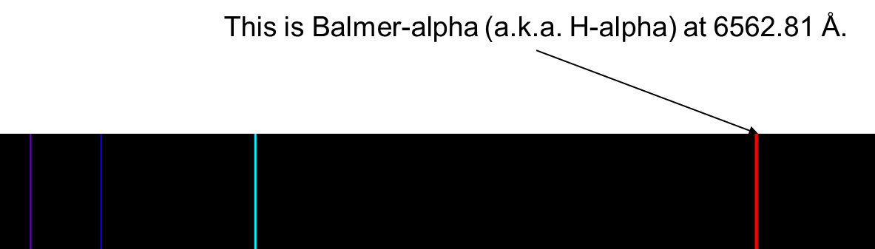
Balmer series
Transition of n | 3→2 | 4→2 | 5→2 | 6→2 | 7→2 | 8→2 | 9→2 | →2
Name | H-α | H-β | H-γ | H-δ | H-ε | H-ζ | H-η
Wavelength (nm) ^{[2]} | 656.3 | 486.1 | 434.1 | 410.2 | 397.0 | 388.9 | 383.5 | 364.6
Color | Red | Blue-green | Violet | Violet | (Ultraviolet) | (Ultraviolet) | (Ultraviolet) | (Ultraviolet)
Notes:
Transitions starting from or ending at the ground state (level 1) form the Lyman series. The first is Lyman alpha (Ly ), corresponding to the transition between the first excited state (level 2) and the ground state. As we have seen, the energy difference is 10.21 eV, and the Ly photon has a wavelength of 121.6 nm (1216 Å). The Ly (beta) transition, between level 3 (the second excited state) and the ground state, corresponds to an energy change of 12.10 eV and a photon of wavelength 102.6 nm (1026 Å). Ly (gamma) corresponds to a jump from level 4 to level 1, and so on. The accompanying table shows how we can calculate the energies, frequencies, and wavelengths of the photons in the Lyman series using the formulae given previously. All Lyman-series energies lie in the ultraviolet region of the spectrum.
The next series of lines, the Balmer series, involves transitions down to (or up from) level 2, the first excited state. All the Balmer series lines lie in or close to the visible portion of the electromagnetic spectrum. Because they form the most easily observable part of the hydrogen spectrum and were the first to be discovered, these lines are often referred to simply as the "Hydrogen" series and denoted by the letter H. As with the Lyman series, the individual transitions are labeled with Greek letters. An H photon (level 3 to level 2) has a wavelength of 656.3 nm and is red, Hß (level 4 to level 2) has a wavelength of 486.1 nm (green), H (level 5 to level 2) has a wavelength of 434.1 nm (blue), and so on. The most energetic Balmer series photons have energies that place them just beyond the blue end of the visible spectrum, in the near ultraviolet.
The classification continues with the Paschen series (transitions down to or up from the second excited state), the Brackett series (third excited state), and the Pfund series (fourth excited state). Beyond that point, infinitely many other families exist, moving farther and farther into the infrared and radio regions of the spectrum, but they are not referred to by any special names. A few of the transitions making up the Lyman and Balmer (Hydrogen) series are marked on the figure. Astronomically, these are the most important sequences.

Slide 32
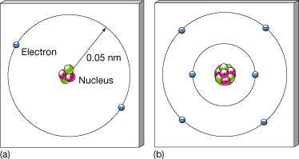
Helium and carbon atoms
Notes:
Helium and Carbon (a) A helium atom in its normal ground state. Two electrons occupy the lowest-energy orbital around a nucleus containing two protons and two neutrons. (b) A carbon atom in its normal ground state. Six electrons orbit a six-proton, six-neutron nucleus, two in an inner orbital, with the other four at a greater distance from the center.

Slide 33
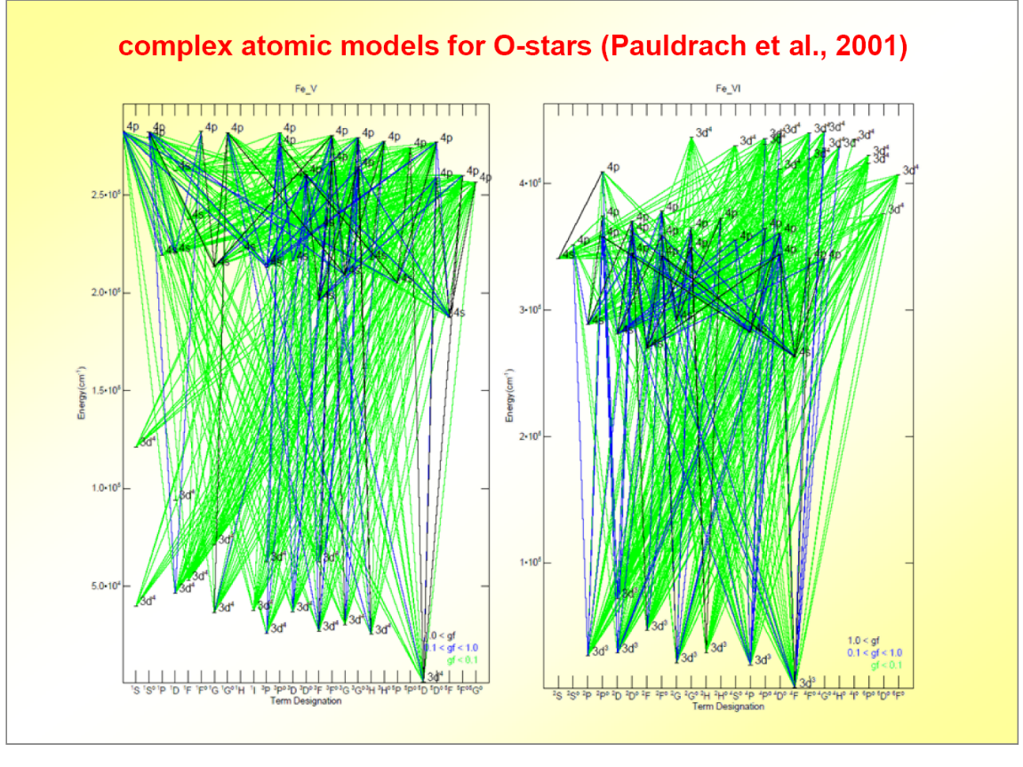
Iron
Notes:
Helium and Carbon (a) A helium atom in its normal ground state. Two electrons occupy the lowest-energy orbital around a nucleus containing two protons and two neutrons. (b) A carbon atom in its normal ground state. Six electrons orbit a six-proton, six-neutron nucleus, two in an inner orbital, with the other four at a greater distance from the center.

Slide 34
Hydrogen-like lines
These transitions are all “hydrogen-like” in that the upper-state electron “sees” a nucleus with almost one positive charge.
For example, C114β refers to a transition of an electron in carbon from n=116 to n=114.
With five electrons in low energy states, and six protons in the nucleus, the “nucleus” appears to have only one positive charge, just like hydrogen.

Slide 35
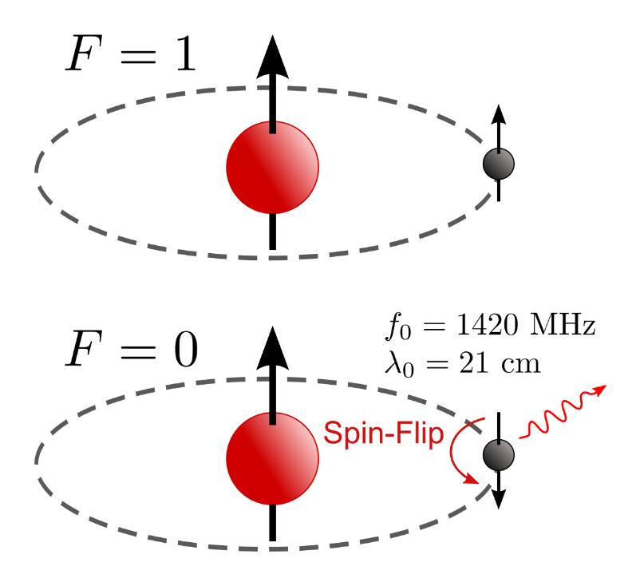
21-cm Radiation
Neutral hydrogen can be collisionally excited so that its proton and electron have aligned spins.
When the electron spontaneously flips, the atom loses a 21-cm photon.

Slide 36

Aliens and 21 cm Line

