Slide 1
Astronomical Observational Techniques and Instrumentation
Professor Don Figer
Spatial resolution and field of view, sensitivity and dynamic range

Slide 2
Aims and outline for this lecture
derive resolution and sensitivity requirements for astronomical imaging
  spatial resolution
    Rayleigh criterion and the diffraction limit
    system aberrations
  sensitivity
    shot noise from signal
    shot noise from background
    detector noise

Slide 3
Spatial Resolution
Spatial resolution is the minimum distance between two objects that can be distinguished with an imaging system.
  Note that the definition depends on the algorithm for “distinguishing” two objects.
    Rayleigh criterion
    Sparrow criterion
    model-dependent algorithms
    others?
  It can be limited by a number of factors.
    diffraction
    optical design aberrations
    optical fabrication errors
    optical scattering
    atmospheric turbulence
    detector blur (pixel-to-pixel crosstalk)
    pixel size

Slide 4
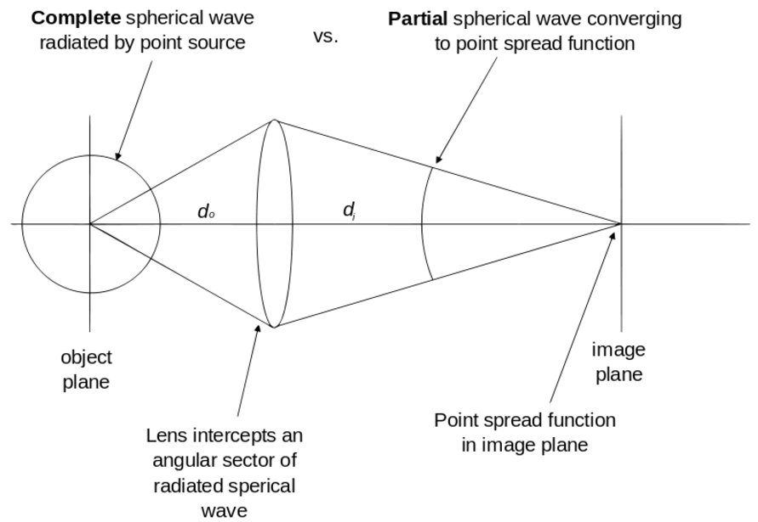
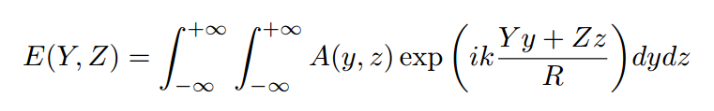
Image Formation
The electric field in the image plane (YZ) is a function of the wave-vector amplitude integrated over the pupil plane (yz). R is distance between pupil and image plane.
The electric field at the image plane is the fourier transform of the pupil.
The image intensity is the square of the amplitude of the electric field.
Notes:
Interesting derivation:
http://www.ita.uni-heidelberg.de/~dullemond/lectures/obsastro_2010/Chapter_Diffraction.pdf

Slide 5
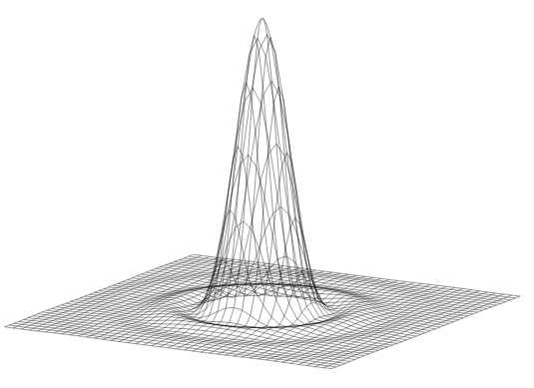
Airy Pattern
An Airy pattern is the image intensity pattern at a focal plane for an optical system that has a circular aperture.
It looks like a central peak surrounded by rings.
A central obscuration has the effect of moving some of the light from the central peak into the outer rings.

Slide 6
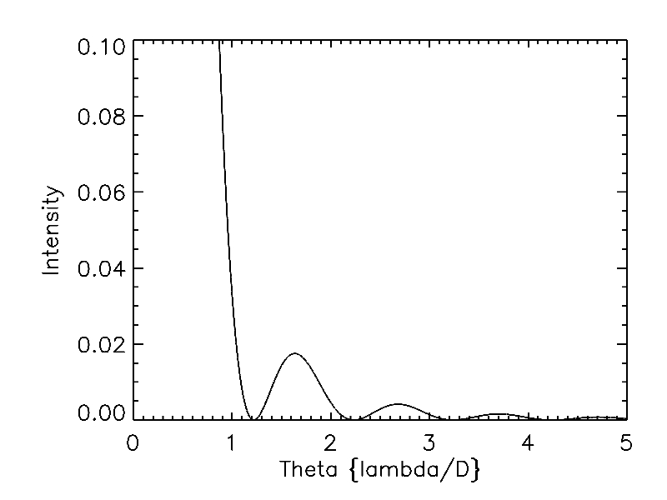
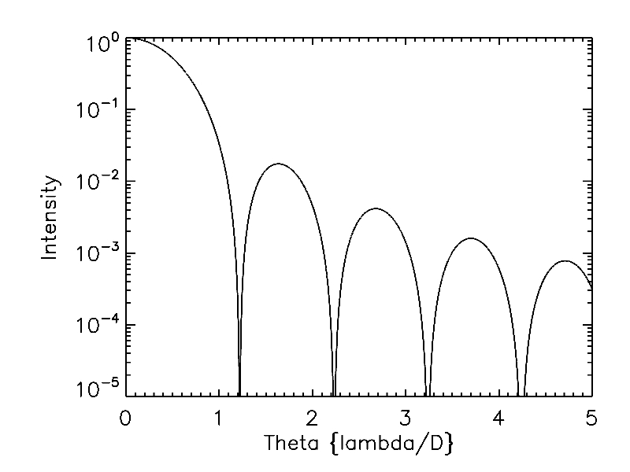
Airy Pattern
The Airy pattern is one type of point spread function (PSF) at the focal plane of an instrument for a point source.
The intensity pattern is given by the order 1 Bessel function of the first kind.
The radius of the first dark ring is 1.22 and the FWHM is at 1.028 (all in units of lambda/D).

Slide 7
Airy Pattern: IDL Code to Make Plots
lambda=1.
d=1.
npoints=10000
u=!pi*d/lambda*findgen(npoints)
set_plot, 'z'
device, set_resolution=[8000,6000]
thick=20.
plot,findgen(npoints)/1000.,airy(u/1000),/ylog,yrange=[1e-5,1],ystyle=1,xrange=[0,5],xstyle=1,$
xtitle='Theta {lambda/D}',ytitle='Intensity',background=255,color=0,thick=thick,charthick=thick,$
charsize=thick,xthick=thick,ythick=thick
jpgfile='C:\figerdev\RIT\teaching\Multiwavelength\lectures\1dairylog.jpg'
jpgimg = tvrd()
write_jpeg, jpgfile, congrid(jpgimg, 1600/2., 1200/2., /center, /interp), quality=100
set_plot, 'z'
device, set_resolution=[8000,6000]
thick=20.
plot,findgen(npoints)/1000.,airy(u/1000),yrange=[0,.1],ystyle=1,xrange=[0,5],xstyle=1,$
xtitle='Theta {lambda/D}',ytitle='Intensity',background=255,color=0,thick=thick,charthick=thick,$
charsize=thick,xthick=thick,ythick=thick
jpgfile='C:\figerdev\RIT\teaching\Multiwavelength Astronomy\Multiwavelength Astronomy 446 711 20101\lectures\1dairylin.jpg'
jpgimg = tvrd()
write_jpeg, jpgfile, congrid(jpgimg, 1600/2., 1200/2., /center, /interp), quality=100

Slide 8
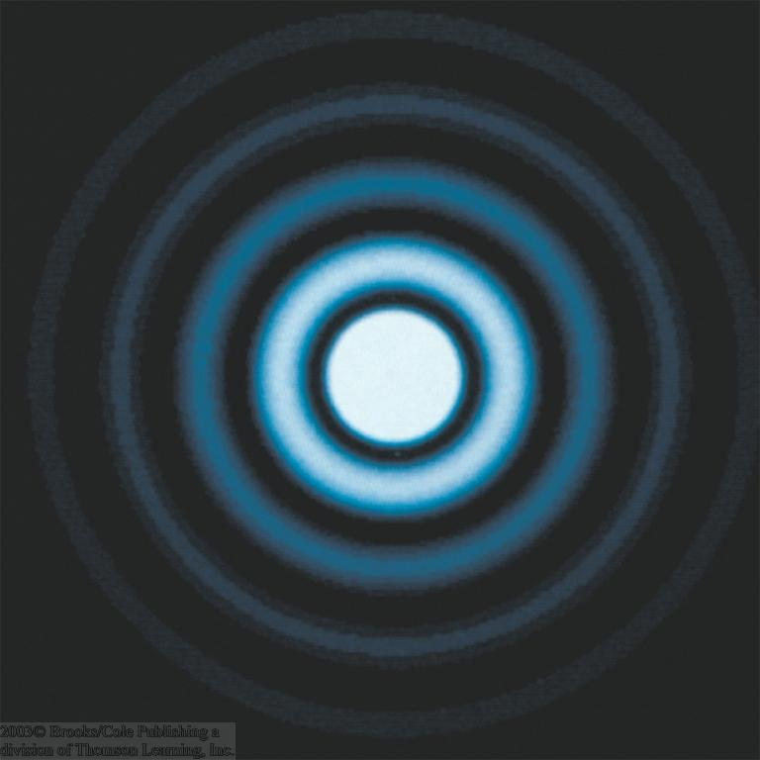
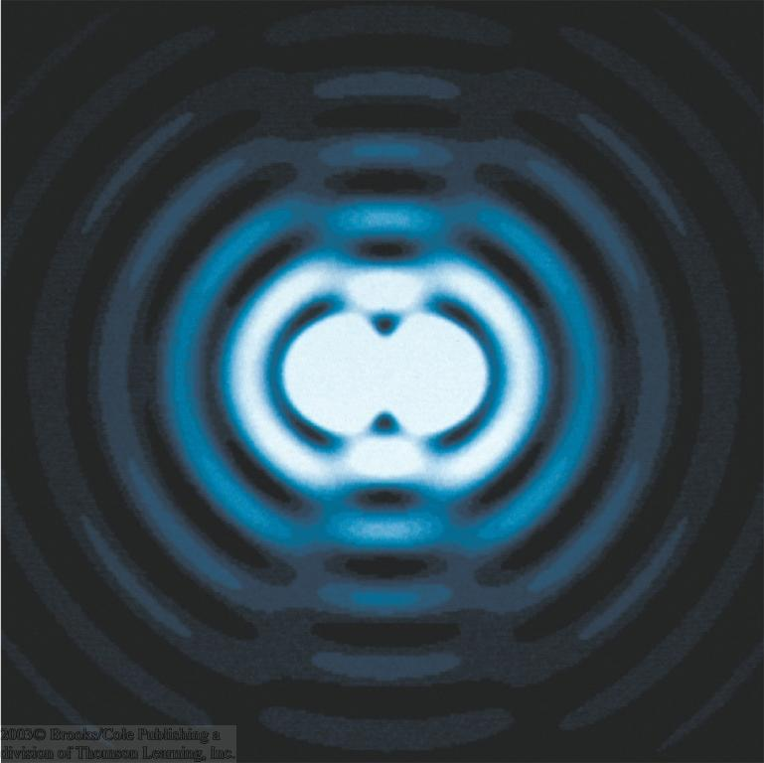
Diffraction: Rayleigh Criterion
The telescope aperture produces fringes (Airy disc) that set a limit to the resolution of the telescope.
Angular resolution is minimum angular distance between two objects that can be separated.
Rayleigh criterion is satisfied when first dark ring produced by one star is coincident with peak of nearby star.
α_{min}

Slide 9
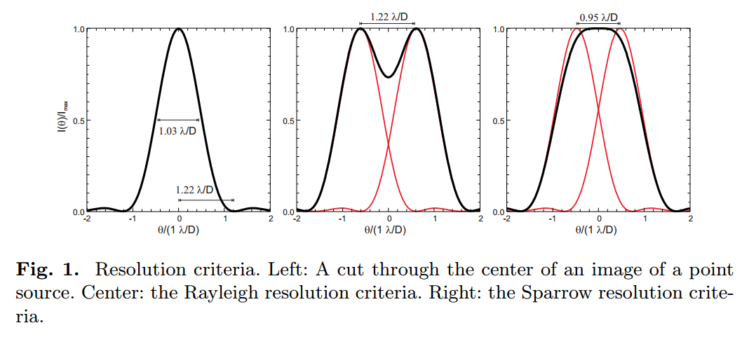
Spatial Resolution Criteria

Slide 10
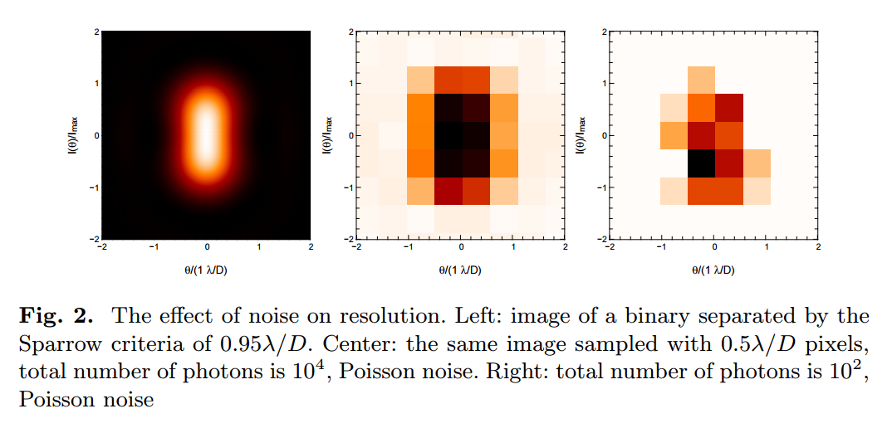
Spatial Resolution and Sampling

Slide 11
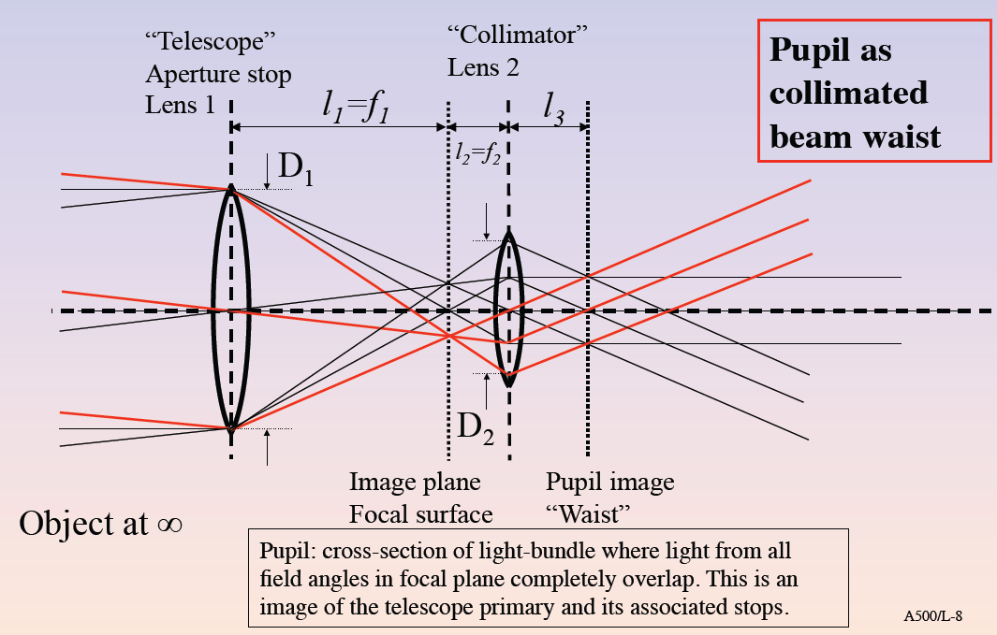
Optical System Design

Slide 12
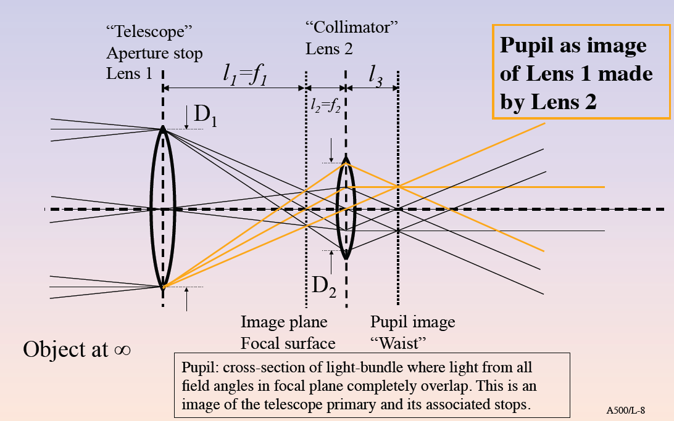
Optical System Design

Slide 13
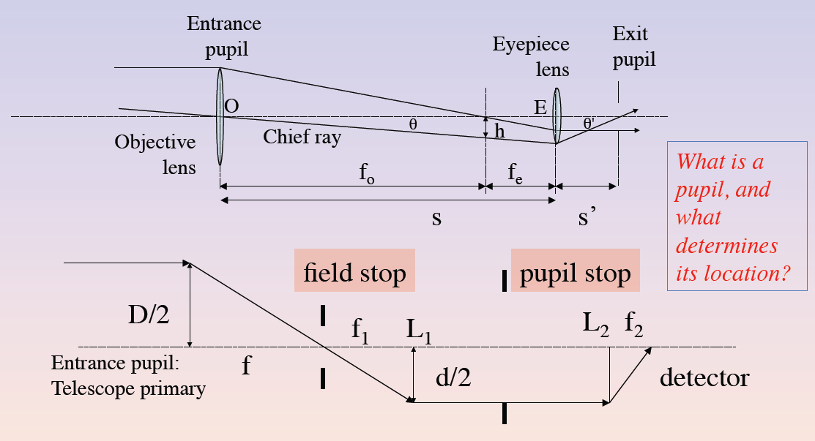
Optical System Design

Slide 14
Optical Design Aberrations
primary aberrations
  spherical (original HST)
  coma
  astigmatism
  chromatic
other aberrations (that do not affect resolution)
  distortion
  anamorphic magnification

Slide 15
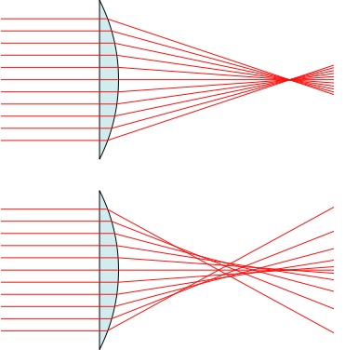
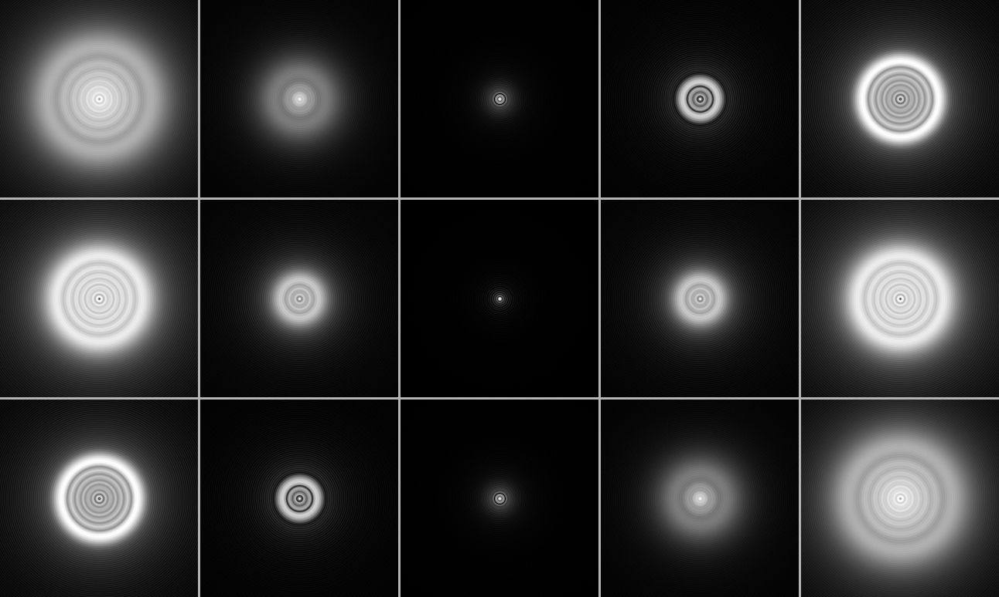
Optical Design Aberrations: Spherical
no spherical aberration
spherical aberration
A simulation of spherical aberration in an optical system with a circular, unobstructed aperture admitting a monochromatic point source. The top row is over-corrected (half a wavelength), the middle row is perfectly corrected, and the bottom row is under-corrected (half a wavelength). Going left to right, one moves from being inside focus to outside focus. The middle column is perfectly focused. Also note the equivalence of inside-focus over-correction to outside-focus under-correction.
Notes:
Conceptual ray diagrams of ideal and spherically aberrated lenses. A perfect lens (top) focuses all incoming rays to a single point on the optic axis, but a real lens with spherical surfaces (bottom) focuses different rays to different points along the optic axis, depending on the radial position of each incoming ray.
A simulation of spherical aberration in an optical system with a circular, unobstructed aperture admitting a monochromatic point source. The top row is over-corrected (half a wavelength), the middle row is perfectly corrected, and the bottom row is under-corrected (half a wavelength). Going left to right, one moves from being inside focus to outside focus. The middle column is perfectly focused. Also note the equivalence of inside-focus over-correction to outside-focus under-correction. See the corresponding longitudinal sections.

Slide 16
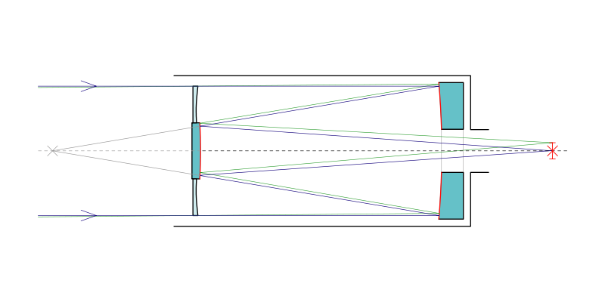
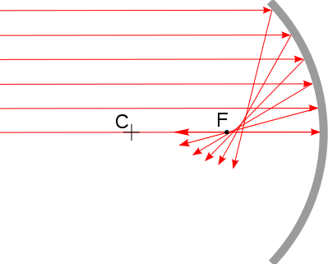
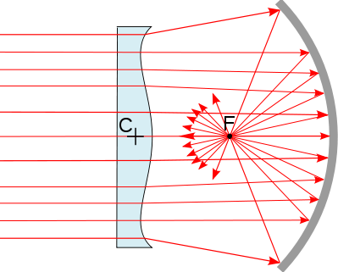
Optical Design Aberrations: Spherical, Corrector Plate
Notes:
Spherical mirrors are inexpensive to make because they can be polished with a simple rotary tool. To correct for spherical aberration, it is relatively inexpensive to add a corrector plate.

Slide 17
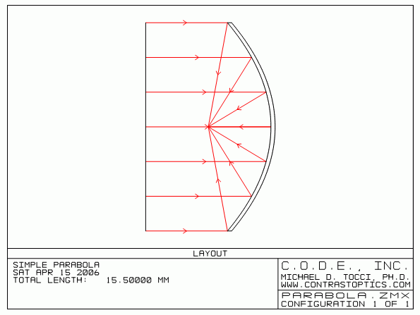
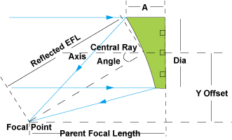
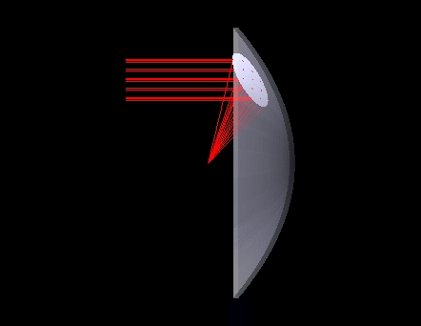
Optical Design Aberrations: Spherical, Off-axis Parabola
parabola has perfect imaging for on-axis field points
a section of a parabola will produce perfect imaging when illuminated with an off-axis beam

Slide 18
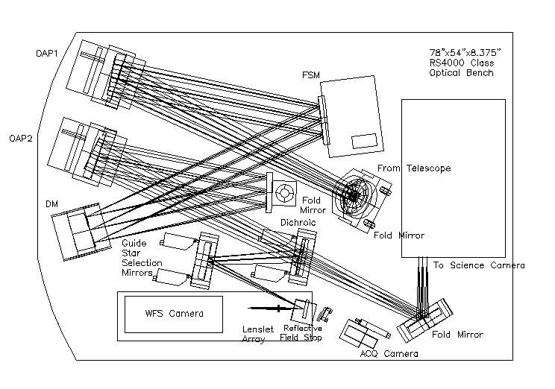
Optical Design Aberrations: Spherical, Off-axis Parabola in AO System
Notes:
OAP1 produces an image of the pupil at the DM. OAP2 focuses the beam onto the science and WFS cameras.

Slide 19
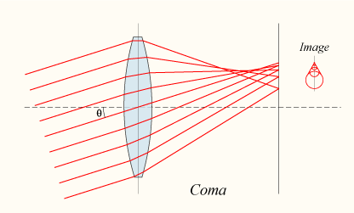
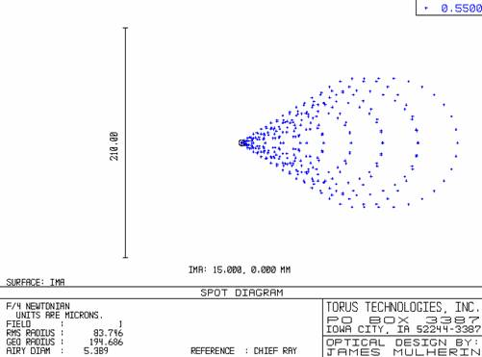
Optical Design Aberrations: Coma
Coma is defined as a variation in magnification over the entrance pupil. In refractive or diffractive optical systems, especially those imaging a wide spectral range, coma can be a function of wavelength.
Coma is an inherent property of telescopes using parabolic mirrors. Light from a point source (such as a star) in the center of the field is perfectly focused at the focal point of the mirror. However, when the light source is off-center (off-axis), the different parts of the mirror do not reflect the light to the same point. This results in a point of light that is not in the center of the field looking wedge-shaped. The further off-axis, the worse this effect is. This causes stars to appear to have a cometary coma, hence the name.
Notes:
In optics (especially telescopes), the coma (aka comatic aberration) in an optical system refers to aberration inherent to certain optical designs or due to imperfection in the lens or other components which results in off-axis point sources such as stars appearing distorted. Specifically, coma is defined as a variation in magnification over the entrance pupil. In refractive or diffractive optical systems, especially those imaging a wide spectral range, coma can be a function of wavelength.
Coma is an inherent property of telescopes using parabolic mirrors. Light from a point source (such as a star) in the center of the field is perfectly focused at the focal point of the mirror (unlike a spherical mirror, where light from the outer part of the mirror focuses closer to the mirror than light from the center--spherical aberration). However, when the light source is off-center (off-axis), the different parts of the mirror do not reflect the light to the same point. This results in a point of light that is not in the center of the field looking wedge-shaped. The further off-axis, the worse this effect is. This causes stars to appear to have a cometary coma, hence the name. Schemes to reduce spherical aberration without introducing coma include Schmidt, Maksutov and Ritchey-Chrétien optical systems.
Coma of a single lens or a system of lenses can be minimised (and in some cases eliminated) by choosing the curvature of the lens surfaces to match the application. Lenses in which both spherical aberration and coma are minimised at a single wavelength are called bestform or aplanatic lenses.

Slide 20
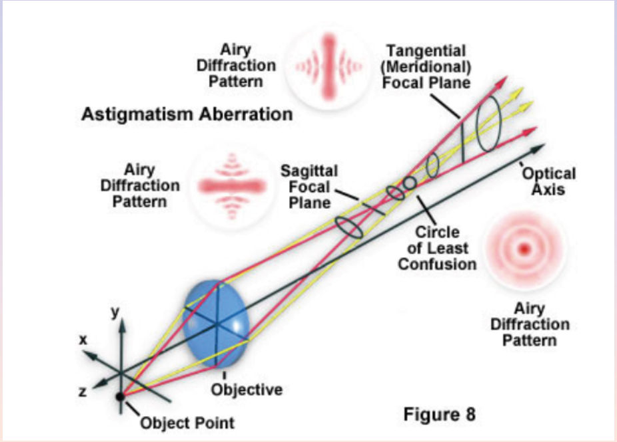
Optical Design Aberrations: Astigmatism
Notes:
In optics, astigmatism is when an optical system has different foci for rays that propagate in two perpendicular planes. If an optical system with astigmatism is used to form an image of a cross, the vertical and horizontal lines will be in sharp focus at two different distances.

Slide 21
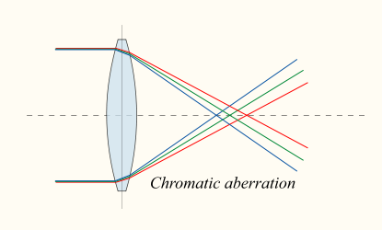
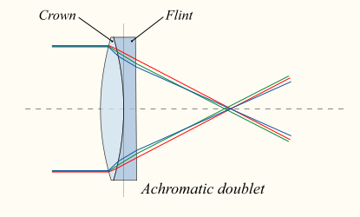
Optical Design Aberrations: Chromatic
Notes:
In optics, chromatic aberration is caused by a lens having a different refractive index for different wavelengths of light (the dispersion of the lens). The term "purple fringing" is commonly used in photography, although not all purple fringing can be attributed to chromatic aberration.

Slide 22
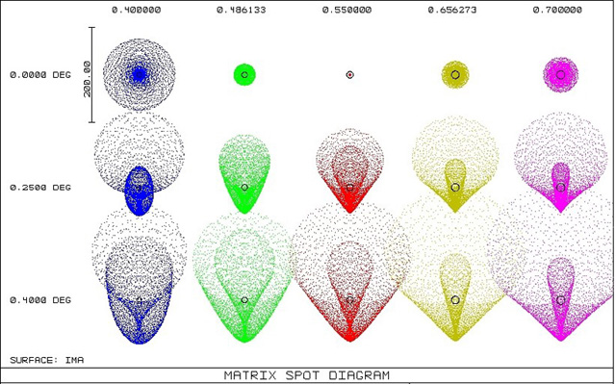
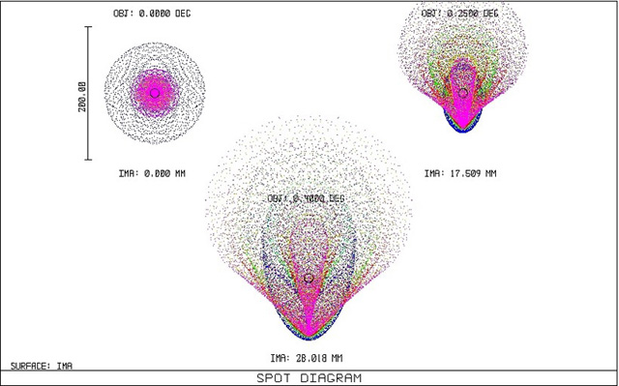
Optical Design Aberrations: Chromatic Aberration Spot Diagrams
wavelengths
field positions
Notes:
In optics, chromatic aberration is caused by a lens having a different refractive index for different wavelengths of light (the dispersion of the lens). The term "purple fringing" is commonly used in photography, although not all purple fringing can be attributed to chromatic aberration.

Slide 23
Optical Fabrication Errors
Fabrication errors are the differences between the design and the fabricated part.
These errors can be defined by their frequency across the part:
  figure errors: low frequency undulations that can sometimes be corrected by focus compensation
  mid-frequency errors: generally affect wavefront error, resulting in degraded image quality and SNR
  high-frequency errors: produce scattering, increased background, loss of contrast

Slide 24
Optical Scattering
Optical scattering is the deviation of light produced by optical material imhomogeneities.
  direction of deviation does not follow the law of reflection or refraction for the geometry of the light and the optic
  often occurs at an optical surface due to surface roughness
  general effect is to produce additional apparent background flux
Scattering scales as roughness size divided by the square of the wavelength.
BRDF is the bidirectional reflectance distribution function, and it is often used to describe optical scattering.

Slide 25
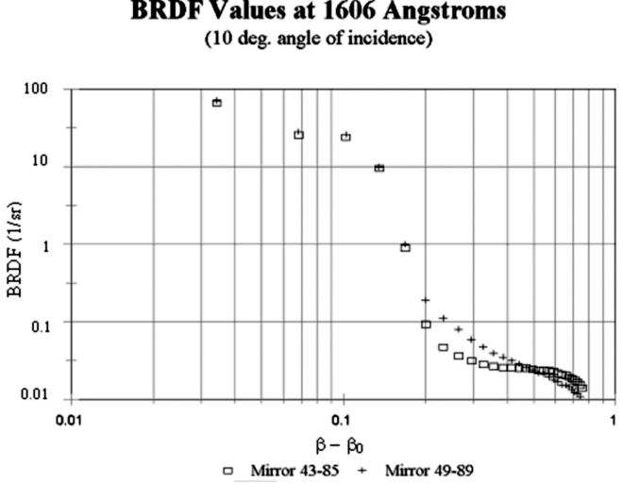
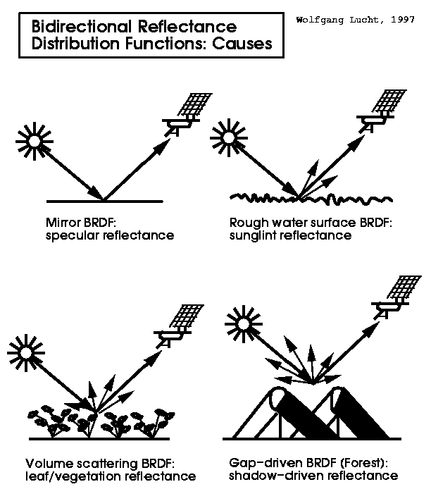
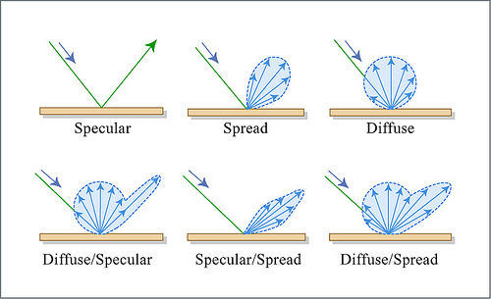
BRDF
BRDF is bi-reflectance distribution function. It gives scattered amplitude as a function of input and output angle.

Slide 26
Surface Roughness
Surface roughness can be periodic, causing a grating effect.
Polishing can reduce roughness, something that is more important for shorter wavelengths where scattering is higher.
HST is used at ultraviolet wavelengths and has very small roughness of ~a few angstroms RMS.
Surface roughness on a mirror before (above) and after (below) processing.
http://ieeexplore.ieee.org/iel5/2197/33157/01561753.pdf?arnumber=1561753
Notes:
The rms roughness of the mirror surface
profile obtained through three-dimensional imaging by
AFM is shown in Fig. 3. Figure 3a shows the threedimensional
image of the corner mirror surface as obtained
by ICPRIE and vertical striations on the corner mirror
surface are clearly visible. The rms roughness of the
corner mirror surface was approximately 12.8 nm.
Figure 3b shows a typical AFM image of the corner
mirror surface after the low-temperature UHV annealing
for 3 h. The striations disappeared and the rms roughness
of the corner mirror surface was reduced to 9.1 nm.

Slide 27
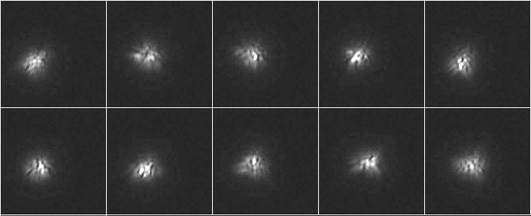
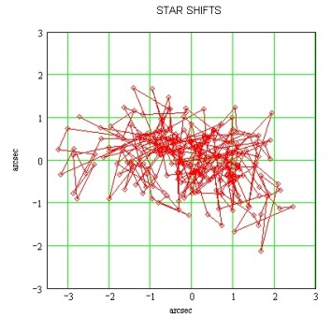
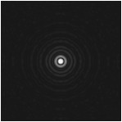
Atmospheric Turbulence
The atmosphere is an inhomegeneous medium with varying index of refraction in both time and space.
  thermal gradients
  humidity gradients
  bulk wind shear
Seeing is the apparent random fluctuation in size and position of a point spread function.
Scintillation is the apparent random fluctuation in the intensity, i.e. “twinkling.”
seeing aberration
unaberrated

Slide 28
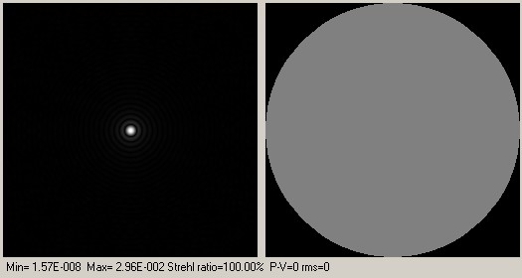
Atmospheric Turbulence: Wavefront Maps
Notes:
This section deals with software simulation. The turbulence effect can be simulated by degrading the entrance wavefront, and computing the star shape or PSF built by the telescope+wavefront. Zernikes polynoms have been used for this simulation. As shown hereafter, wavefront is the right circular shape (figure 6), the variation of image intensity within this disk shows (in Z) the wavefront phase shifts.
Very nice PSF can be calculated according the wavefront, provinding strhel ratios and L/... wavefront errors (ptv and rms)
This demonstrates quickly that Lambda/30 PTV mirrors are not really usefull (!) Lambda/5-10 ptv mirrors are good enough, and more likely, the telescope will never see calm an quiet turbulence conditions to be able to notice a difference between a L/4 and L/30 mirror.

Slide 29
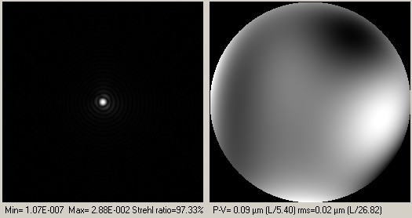
Atmospheric Turbulence: Wavefront Maps
Notes:
This section deals with software simulation. The turbulence effect can be simulated by degrading the entrance wavefront, and computing the star shape or PSF built by the telescope+wavefront. Zernikes polynoms have been used for this simulation. As shown hereafter, wavefront is the right circular shape (figure 6), the variation of image intensity within this disk shows (in Z) the wavefront phase shifts.
Very nice PSF can be calculated according the wavefront, provinding strhel ratios and L/... wavefront errors (ptv and rms)
This demonstrates quickly that Lambda/30 PTV mirrors are not really usefull (!) Lambda/5-10 ptv mirrors are good enough, and more likely, the telescope will never see calm an quiet turbulence conditions to be able to notice a difference between a L/4 and L/30 mirror.

Slide 30
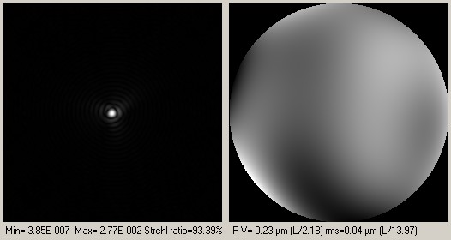
Atmospheric Turbulence: Wavefront Maps
Notes:
This section deals with software simulation. The turbulence effect can be simulated by degrading the entrance wavefront, and computing the star shape or PSF built by the telescope+wavefront. Zernikes polynoms have been used for this simulation. As shown hereafter, wavefront is the right circular shape (figure 6), the variation of image intensity within this disk shows (in Z) the wavefront phase shifts.
Very nice PSF can be calculated according the wavefront, provinding strhel ratios and L/... wavefront errors (ptv and rms)
This demonstrates quickly that Lambda/30 PTV mirrors are not really usefull (!) Lambda/5-10 ptv mirrors are good enough, and more likely, the telescope will never see calm an quiet turbulence conditions to be able to notice a difference between a L/4 and L/30 mirror.

Slide 31
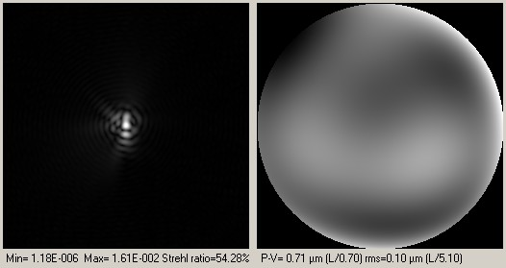
Atmospheric Turbulence: Wavefront Maps
Notes:
This section deals with software simulation. The turbulence effect can be simulated by degrading the entrance wavefront, and computing the star shape or PSF built by the telescope+wavefront. Zernikes polynoms have been used for this simulation. As shown hereafter, wavefront is the right circular shape (figure 6), the variation of image intensity within this disk shows (in Z) the wavefront phase shifts.
Very nice PSF can be calculated according the wavefront, provinding strhel ratios and L/... wavefront errors (ptv and rms)
This demonstrates quickly that Lambda/30 PTV mirrors are not really usefull (!) Lambda/5-10 ptv mirrors are good enough, and more likely, the telescope will never see calm an quiet turbulence conditions to be able to notice a difference between a L/4 and L/30 mirror.

Slide 32
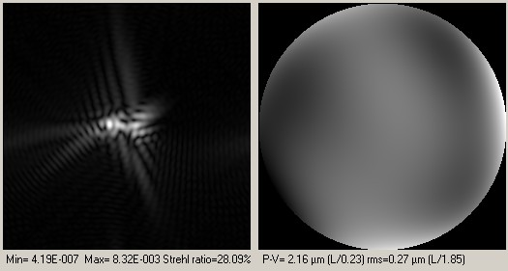
Atmospheric Turbulence: Wavefront Maps
Notes:
This section deals with software simulation. The turbulence effect can be simulated by degrading the entrance wavefront, and computing the star shape or PSF built by the telescope+wavefront. Zernikes polynoms have been used for this simulation. As shown hereafter, wavefront is the right circular shape (figure 6), the variation of image intensity within this disk shows (in Z) the wavefront phase shifts.
Very nice PSF can be calculated according the wavefront, provinding strhel ratios and L/... wavefront errors (ptv and rms)
This demonstrates quickly that Lambda/30 PTV mirrors are not really usefull (!) Lambda/5-10 ptv mirrors are good enough, and more likely, the telescope will never see calm an quiet turbulence conditions to be able to notice a difference between a L/4 and L/30 mirror.

Slide 33
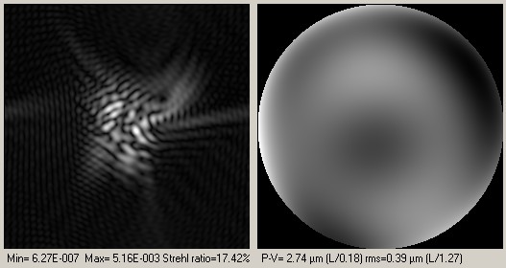
Atmospheric Turbulence: Wavefront Maps
Notes:
This section deals with software simulation. The turbulence effect can be simulated by degrading the entrance wavefront, and computing the star shape or PSF built by the telescope+wavefront. Zernikes polynoms have been used for this simulation. As shown hereafter, wavefront is the right circular shape (figure 6), the variation of image intensity within this disk shows (in Z) the wavefront phase shifts.
Very nice PSF can be calculated according the wavefront, provinding strhel ratios and L/... wavefront errors (ptv and rms)
This demonstrates quickly that Lambda/30 PTV mirrors are not really usefull (!) Lambda/5-10 ptv mirrors are good enough, and more likely, the telescope will never see calm an quiet turbulence conditions to be able to notice a difference between a L/4 and L/30 mirror.

Slide 34
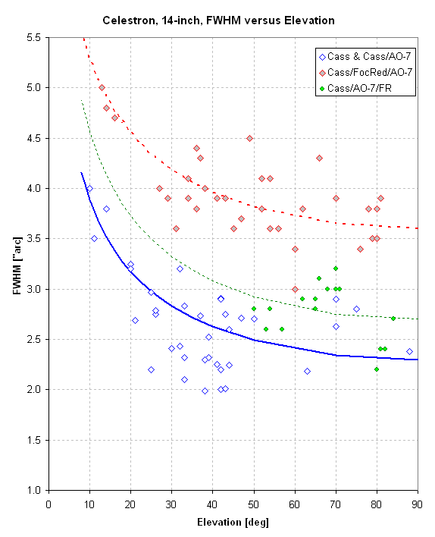
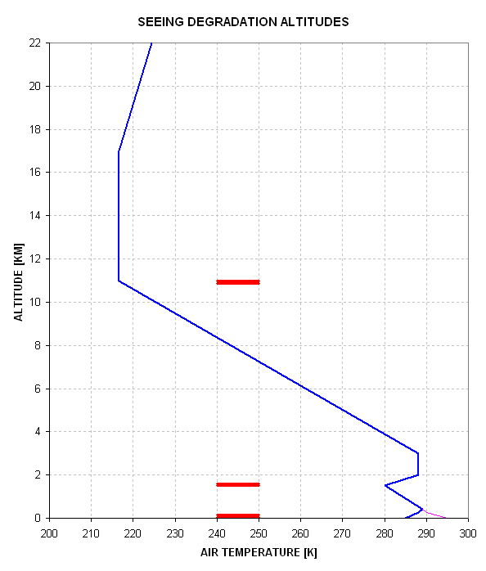
Atmospheric Turbulence: Seeing
Seeing is worse at low elevations because light traverses more turbulent atmospheric cells. Most seeing degradation is generated at the interfaces between air of different temperatures.
Scintillation is worse at low elevations for the same reason, thus twinkling stars on the horizon.
different curves represent different optical configurations (and different induced optical image smear)
Notes:
FWHM versus elevation angle for 3 Cassegrain configurations for the HAO site.

Slide 35
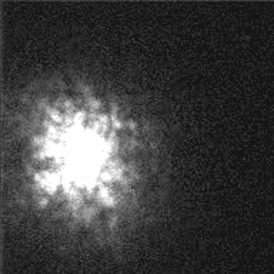
Atmospheric Turbulence: Seeing Video
Notes:
FWHM versus elevation angle for 3 Cassegrain configurations for the HAO site.

Slide 36
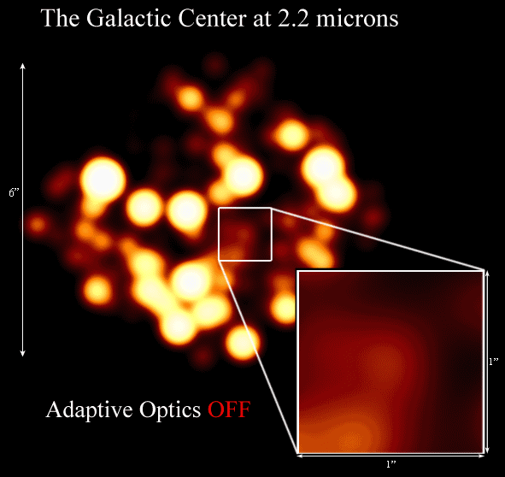
Atmospheric Turbulence: AO Movie

Slide 37
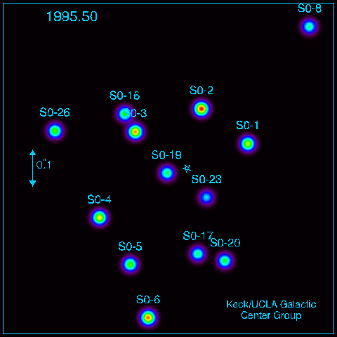
Atmospheric Turbulence: Galactic Center

Slide 38

AO System

Slide 39
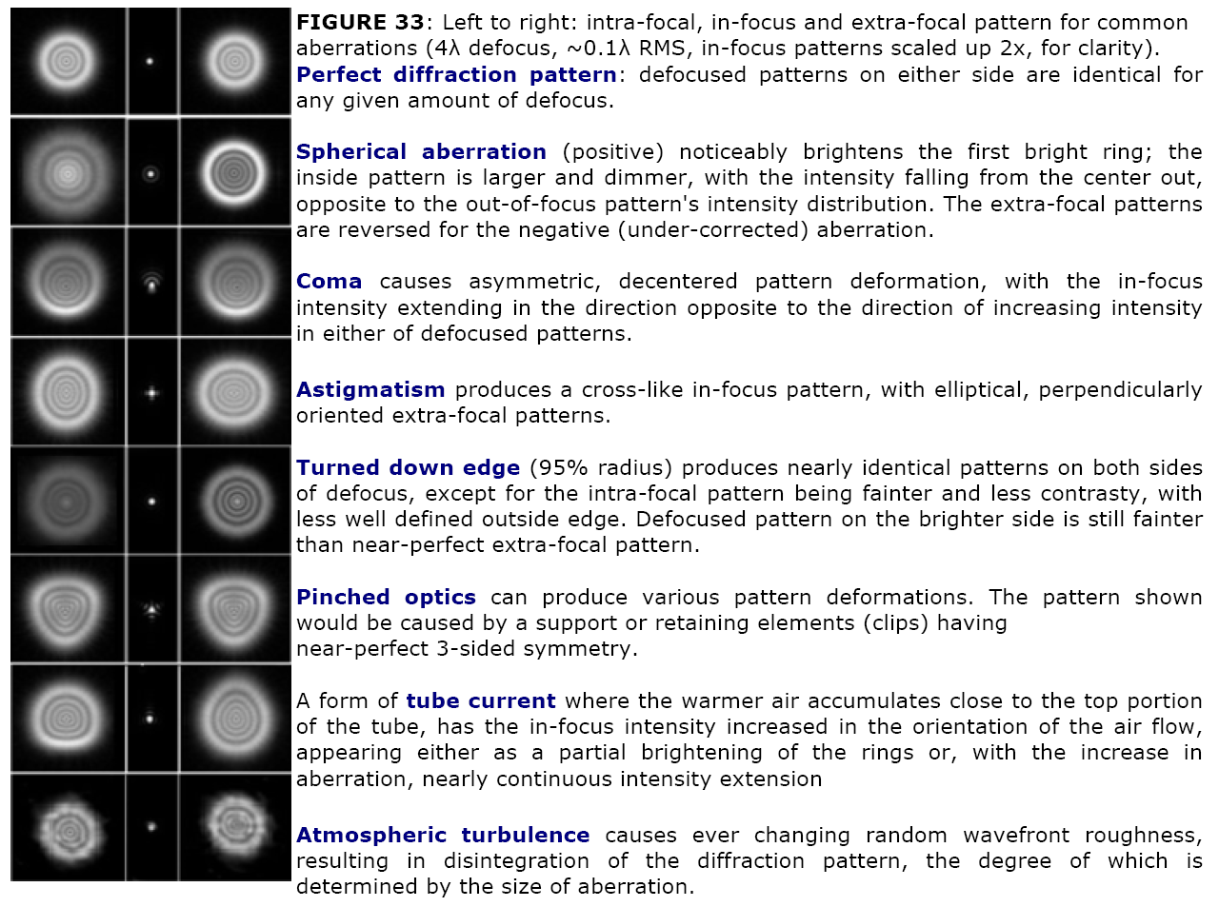
Optical Aberration Summary

Slide 40
Detector PSF
A variety of effects in the detector can cause “blurring” of the point-spread-function.
PSF versus depletion voltage in a thick CCD detector.

Slide 41
Pixel Sampling - Optimal
Optimal pixel sampling is driven by desire to cover largest field of view while resolving smallest details.
This is generally satisfied by having two pixels per resolution element.
Nyquist sampling thereom says that optimally sampling all of the information contained in an image requires about two pixels per resolution element.
  Sampling the resolution finer than this does not yield you more information and can be considered ``wasteful".
  Sampling more coarsely means you are not sensitive to all of the find detail in the picture and you are losing information.
Notes:
https://web.archive.org/web/20070903164642/http:/www.astro.virginia.edu/class/majewski/astr313/lectures/telescopes/telescopes_res.html
http://www.faculty.virginia.edu/ASTR3130/lectures/telescopes/telescopes_schmidt.html

Slide 42
Pixel Sampling – Example 1
Example 1: CCD camera with 9 µ pixels at focal plane with 112.7 arcsec/mm
  pixel scale = (0.009 mm/pixel)(112.7 arcsec/mm) = 1.01 arcsec/pixel
  if seeing is 2 arcseconds, the pixels are good match to the resolution and we can sample all of the information delivered to the focal plane
  should seeing drop to 1 arcsecond, the pixels in the camera would be too big and we would lose information (not Nyquist sampled); this is called undersampling and the image would be pixel-limited.
  if the seeing ballooned up to 5 arcseconds, the 1 arcsecond pixels would be overkill, since we would be oversampling the delivered resolution, so resolution is seeing-limited
Notes:
https://web.archive.org/web/20070903164642/http:/www.astro.virginia.edu/class/majewski/astr313/lectures/telescopes/telescopes_res.html
http://www.faculty.virginia.edu/ASTR3130/lectures/telescopes/telescopes_schmidt.html

Slide 43
Pixel Sampling – Example 2
Example 2: CCD camera with 9 µ pixels at focal plane with 20.75 arcsec/mm
  pixel scale = (0.009 mm/pixel)(20.75 arcsec/mm) = 0.19 arcsec/pixel
  pixels will generally oversample typical seeing
  one could design optics to rescale the image so that more area is covered by pixel
Notes:
https://web.archive.org/web/20070903164642/http:/www.astro.virginia.edu/class/majewski/astr313/lectures/telescopes/telescopes_res.html
http://www.faculty.virginia.edu/ASTR3130/lectures/telescopes/telescopes_schmidt.html

Slide 44
Pixel Sampling – Example 3
Example 3: HST, with 58-m focal length has plate scale of about 4 arcsec/mm.
  no atmosphereic seeing in space, so can achieve theoretical resolution limit, 1.22 (5500 Angstroms)(206265 arcsec/radian)/(2.4-m) = 0.05 arcsec.
  WFPC2 on HST undersampled, 15 micron pixels give either 0.05 arcsec/pixel (1 chip) or 0.10 arcsec/pixel (3 chips) -- so not Nyquist sampled.
  In this case the decision to not sample to the limit was dictated by desire to have a reasonable FIELD OF VIEW.
    800 x 800 pixels gives only an 80 arcsecond FOV at 0.10 arcsec/pixel.
Notes:
https://web.archive.org/web/20070903164642/http:/www.astro.virginia.edu/class/majewski/astr313/lectures/telescopes/telescopes_res.html
http://www.faculty.virginia.edu/ASTR3130/lectures/telescopes/telescopes_schmidt.html

Slide 45
What is Signal? What is Noise?

Slide 46
Sensitivity
Combination of
  signal
    brightness of source
    absorption of intervening material
      gas, dust
      atmosphere
      optics
    size of telescope
    sensitivity of detector
  noise
    detector read noise
    detector dark current
    background (zodiacal light, sky, telescope, instrument)
    shot noise from source
    imperfect calibrations

Slide 47
Sensitivity vs. Dynamic Range
Sensitivity
  ability to measure faint brightnesses
Dynamic Range
  ability to image “bright” and “faint” sources in same system
  often expressed as fluxbrightest/noise

Slide 48
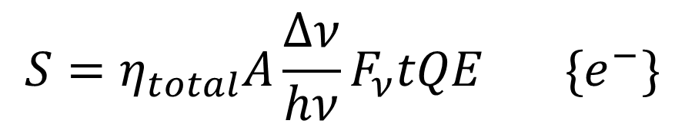
Signal: definition
Signal is that part of the measurement which is contributed by the source of interest.
where, A=area of telescope, QE=quantum efficiency of detector, F_{ν=}source flux, η_{total}=total transmission, and t=integration time
$$S=η_{total}A\frac{Δν}{hν}F_{ν}tQE \{e^{−}\}$$
$$η_{total}=η_{atmosphere}η_{telescope}η_{instrument}$$

Slide 49
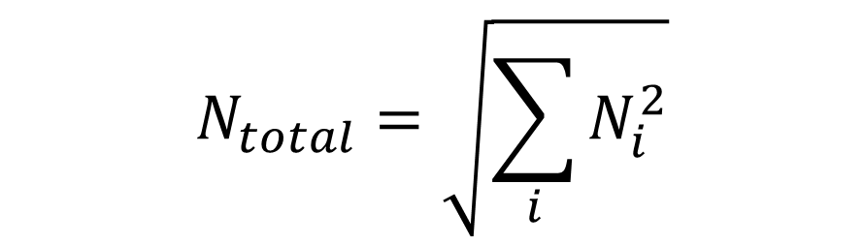
Noise - definition
Noise is uncertainty in the signal measurement.
In sensitivity calculations, the “noise” is usually equal to the standard deviation.
Random noise adds in quadrature.
$$N_{total}=\sqrt{\sum_{i}{N_{i}^{2}}}$$

Slide 50
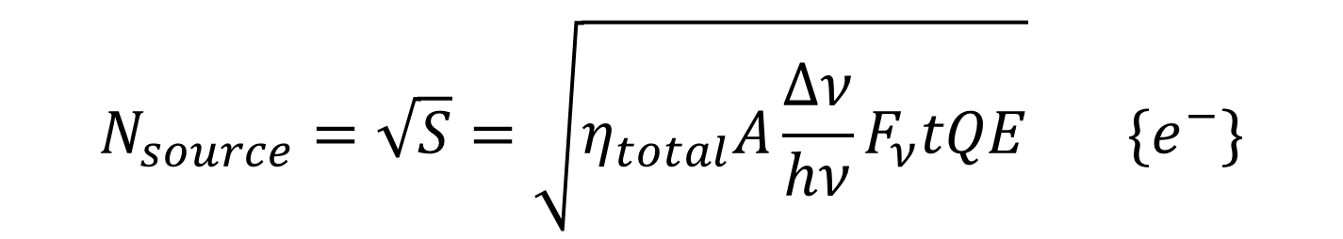
Noise - sources: Noise from source
The uncertainty in the source charge count is simply the square root of the collected charge.
Note that if this were the only noise source, then S/N would scale as t^{1/2}. (Also true whenever noise dominated by a steady photon source.)
$$N_{source}=\sqrt{S}=\sqrt{η_{total}A\frac{Δν}{hν}F_{ν}tQE} \{e^{−}\}$$

Slide 51
Noise: Read noise vs. flux noise limited
slope=1/2 (flux dominated)
slope=1 (read noise limited)

Slide 52

Noise - sources: Noise from background
Background is everything but signal from the object of interest!
$$N_{back}=\sqrt{{\dot{C}}_{back}t}=\sqrt{η_{total}A\frac{Δν}{hν}F_{back,ν}tQE} \{e^{−}\}$$

Slide 53

Signal-to-Noise Ratio
Background is everything but signal from the object of interest!
$$SNR=\frac{S}{N}=\frac{η_{total}A\frac{Δν}{hν}F_{ν}tQE}{\sqrt{\left(η_{total}A\frac{Δν}{hν}F_{ν}tQE\right)+\left(η_{total}A\frac{Δν}{hν}F_{back,ν}tQE\right)+N_{pixels}i_{dark}t+N_{pixels}N_{read}^{2}}} \{e^{−}\}$$

Slide 54
Improving SNR
Optical effects
  Throughput: bigger aperture, anti-reflection coatings
  Background: low scatter materials, cooling
Detector effects
  Dark current: high purity material, low surface leakage
  Read Noise: multiple sampling, in-pixel digitization, photon-counting
  QE: thickness optimization, anti-reflection coatings, depleted
Atmospheric effects
  Atmospheric absorption: higher altitude
  OH emission: OH suppression instruments
  Turbulence: adaptive optics
  Ultimate “fix” is to go to space!

Slide 55

Improving SNR: multiple sampling

Slide 56

Direct Imaging of Exoplanet Example
56

Slide 57
Exoplanet Example
57

Slide 58

Detectivity Metric
58

