Slide 1
Astronomical Observational Techniques and Instrumentation
Professor Don Figer
PN junction, diodes, transistors, circuits, single-element detectors

Slide 2
Aims for this lecture
describe the physics of the PN junction
describe the principles behind important electrical components for detectors
provide working knowledge of these components
give examples of the components used in detector applications

Slide 3
Lecture Outline
Theory and operation of electrical components
  semiconductors
  pn junction
  diode
  photodiode
  light emitting diode (LED)
  transistor
  field-effect transistor (FET)
  junction field-effect transistor (JFET)
  metal-oxide field-effect transistor (MOSFET)
Detector applications
  pixel photodiode
  source follower
  amplifier

Slide 4
Semiconductors

Slide 5
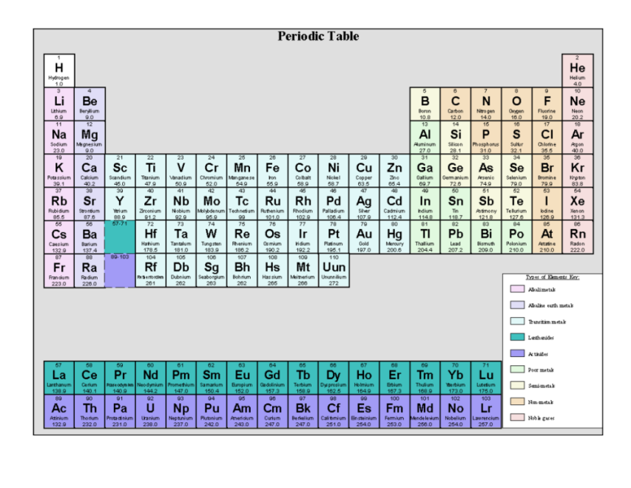
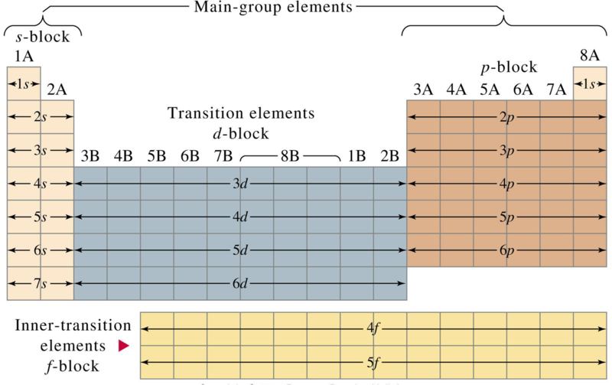
Periodic Table and Groups
Many electronic material properties depend on outer shell electrons.
Format of periodic table associates population of outer shell with columns (groups). The column number indicates the number of electrons in the outer shell.
Notes:
For semiconductor devices, we are primarily concerned with elements from groups 3, 4, and 5.

Slide 6
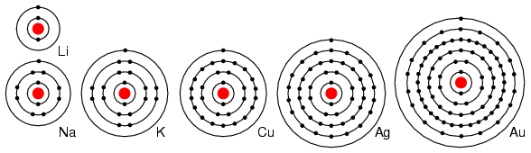
Conductors
Li, Na, K, Cu, Ag, and Au have a single valence electron. These elements all have similar chemical properties. These atoms readily give away one electron to react with other elements. The ability to easily give away an electron makes these elements excellent conductors.
Periodic table group IA elements: Li, Na, and K, and group IB elements: Cu, Ag, and Au have one electron in the outer, or valence, shell, which is readily donated. Inner shell electrons: For n= 1, 2, 3, 4; 2n² = 2, 8, 18, 32.
Notes:
http://www.allaboutcircuits.com/vol_3/chpt_2/3.html

Slide 7
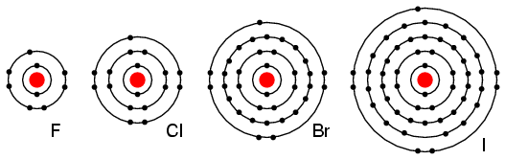
Insulators
Group VIIA elements: Fl, Cl, Br, and I all have 7 electrons in the outer shell. These elements readily accept an electron to fill up the outer shell with a full 8 electrons. (Figure below) If these elements do accept an electron, a negative ion is formed from the neutral atom. These elements which do not give up electrons are insulators.
Periodic table group VIIA elements: F, Cl, Br, and I with 7 valence electrons readily accept an electron in reactions with other elements.

Slide 8
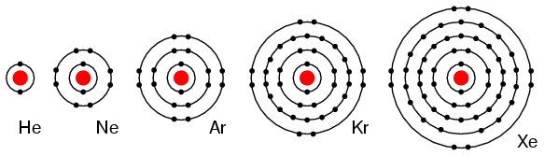
Noble (Inert) Gases
Group VIIIA elements: He, Ne, Ar, Kr, Xe all have 8 electrons in the valence shell. (Figure below) That is, the valence shell is complete and these elements neither donate, nor accept, electrons. Nor do they readily participate in chemical reactions since group VIIIA elements do not easily combine with other elements. These elements are good electrical insulators and are gases at room temperature.
Group VIIIA elements: He, Ne, Ar, Kr, Xe are largely unreactive since the valence shell is complete.

Slide 9
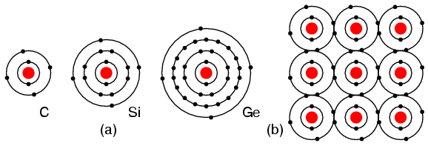
Semiconductors
Group IVA elements: C, Si, Ge, having 4 electrons in the valence shell, form compounds by sharing electrons with other elements without forming ions. This shared electron bonding is known as covalent bonding. Note that the center atom (and the others by extension) has completed its valence shell by sharing electrons. Note that the figure is a 2-d representation of bonding, which is actually 3-d. It is this group, IVA, that we are interested in for its semiconducting properties.
(a) Group IVA elements: C, Si, Ge having 4 electrons in the valence shell, (b) complete the valence shell by sharing electrons with other elements.

Slide 10
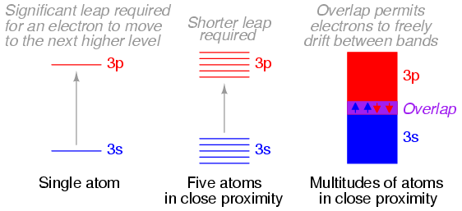
Energy Bands in Conductors
When atoms combine to form substances, the outermost shells, subshells, and orbitals merge, providing a greater number of available energy levels for electrons to assume. When large numbers of atoms are close to each other, these available energy levels form a nearly continuous band wherein electrons may move as illustrated in Figure.
Electron band overlap in metallic elements.

Slide 11
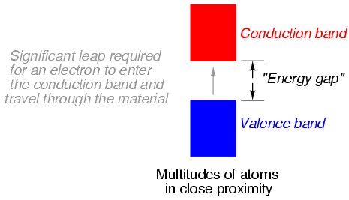
Energy Bands in Insulators
In some substances, a substantial gap remains between the highest band containing electrons (the valence band) and the next band, which is empty (the conduction band). As a result, valence electrons are “bound” to their constituent atoms and cannot become mobile within the substance without a significant amount of imparted energy. These substances are electrical insulators.
Electron band separation in insulating substances.

Slide 12
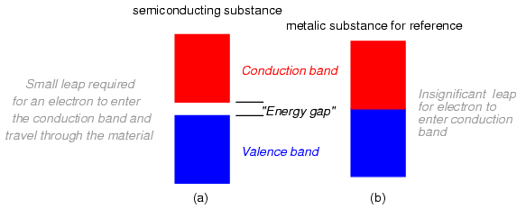
Energy Bands in Semiconductors
Materials that fall within the category of semiconductors have a narrow gap between the valence and conduction bands. Thus, the amount of energy required to motivate a valence electron into the conduction band where it becomes mobile is quite modest.
Electron band separation in semiconducting substances, (a) multitudes of semiconducting close atoms still results in a significant band gap, (b) multitudes of close metal atoms for reference.
Notes:
Energy gap on the order of energy imparted by an absorbed photon.

Slide 13
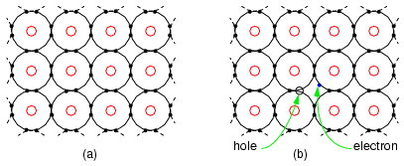
Intrinsic Semiconductors
Four electrons in the valence shell of a semiconductor form covalent bonds to four other atoms. All electrons of an atom are tied up in four covalent bonds, pairs of shared electrons. Electrons are not free to move about the crystal lattice. Thus, intrinsic, pure, semiconductors are relatively good insulators as compared to metals.
(a) Intrinsic semiconductor is an insulator having a complete electron shell. (b) However, thermal energy can create few electron hole pairs resulting in weak conduction.

Slide 14
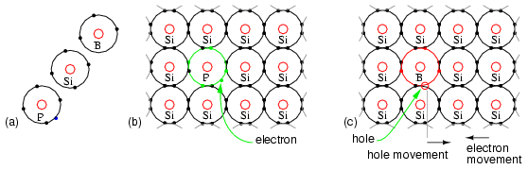
Dopants in Semiconductors
The crystal lattice contains atoms having four electrons in the outer shell, forming four covalent bonds to adjacent atoms.
The addition of a phosphorus atom with five electrons in the outer shell introduces an extra electron into the lattice as compared with the silicon atom.
The impurity forms four covalent bonds to four silicon atoms with four of the five electrons, fitting into the lattice with one electron left over.
The spare electron is not strongly bonded to the lattice as the electrons of normal Si atoms are. It is free to move about the crystal lattice.
Application of an external electric field produces strong conduction in the doped semiconductor in the conduction band. Heavier doping levels produce stronger conduction.
Thus, a poorly conducting intrinsic semiconductor has been converted into a good electrical conductor.
(a) Outer shell electron configuration of donor N-type Phosphorus, Silicon (for reference), and acceptor P-type Boron. (b) N-type donor impurity creates free electron (c) P-type acceptor impurity creates hole, a positive charge carrier.
Notes:
Even though we talk about “extra” electrons, it’s important to note that all the atoms are neutral before any carrier migration. In this case, it’s only when the phosphorous’s 5th electron or the boron’s 5th hole migrate away from the dopant atoms that there are any ions. The net charge in the lattice is still neutral, however.

Slide 15
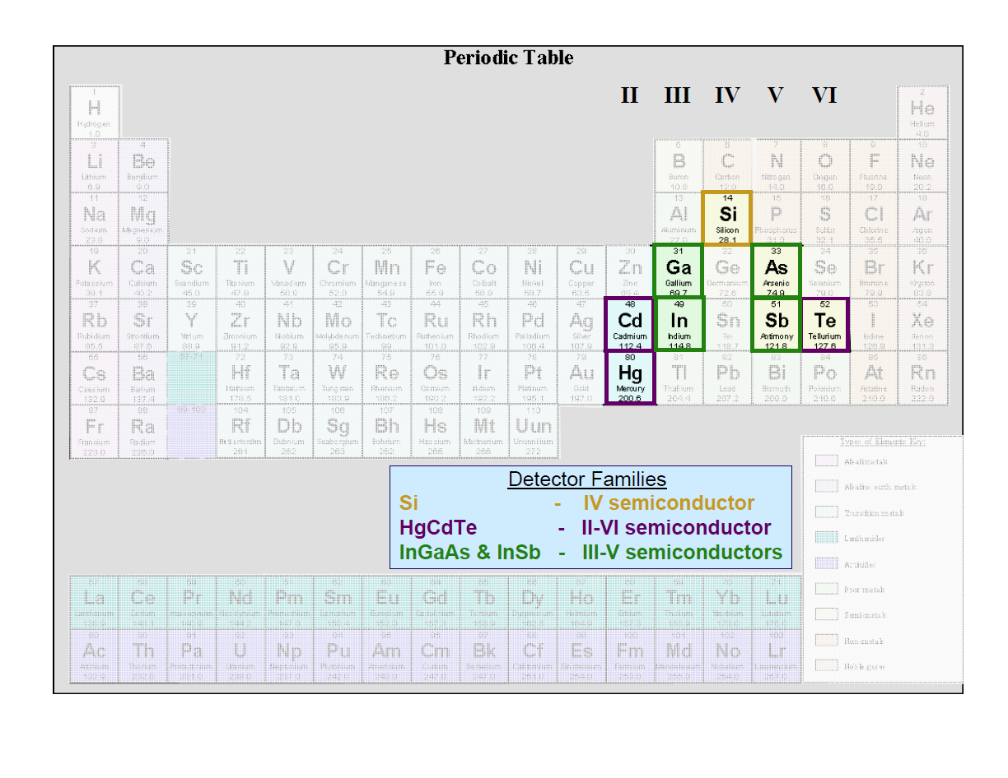
Periodic Table and Detector Material

Slide 16
PN Junction

Slide 17
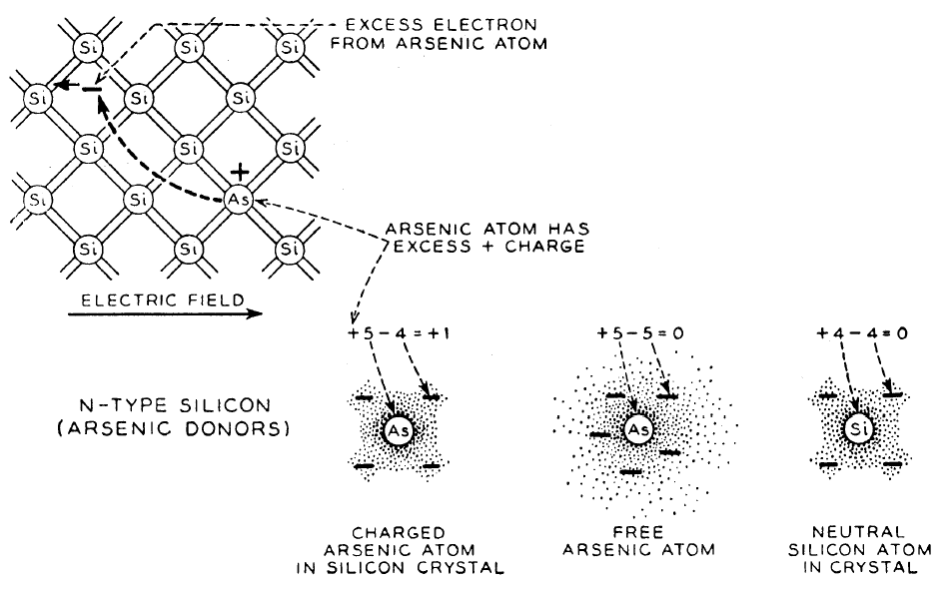
N-type
Notes:
Elements that add electrons to the lattice are called “donors.” For a group IV semiconductor, Phosphorus or Arsenic (group V) are donor (n-type) dopants.
Elements that remove electrons from the lattice (or add holes) are called “acceptors.” Boron (group III) is an acceptor (p-type) dopant.

Slide 18
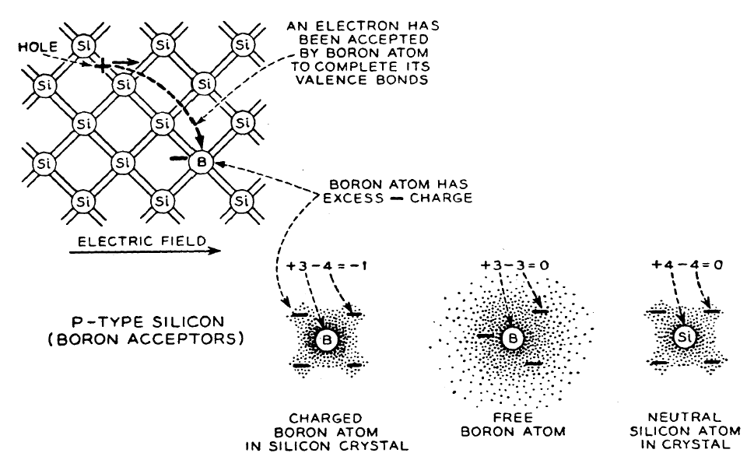
P-type

Slide 19
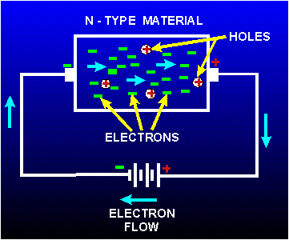
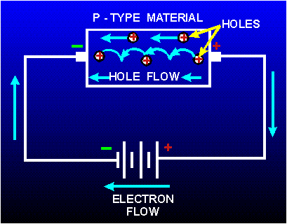
Conduction in p/n-type Semiconductors
In n-type material, excess electrons move freely in an electric field.
In p-type material, holes migrate as electrons move in an electric field.
Notes:
This slide describes carrier motion inside of a doped semiconductor.

Slide 20
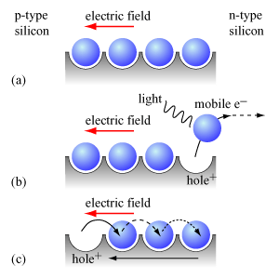
Migration of Electrons and Holes
Notes:
You can think of holes as “bubbles.” A bubble in a glass of soda could be thought of as the absence of soda. The bubbles appear to move up, but you could also say the soda is moving down, displacing the bubble as it does so. Current in a circuit goes in the direction of the holes.

Slide 21
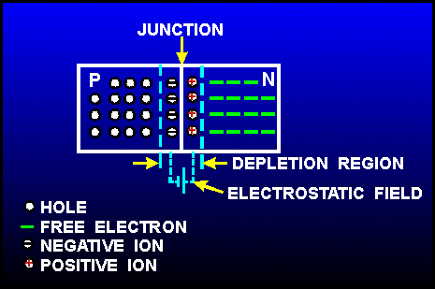
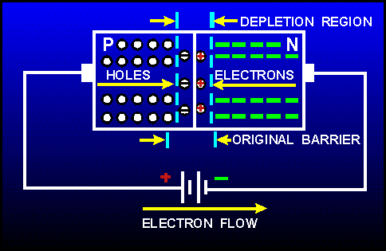
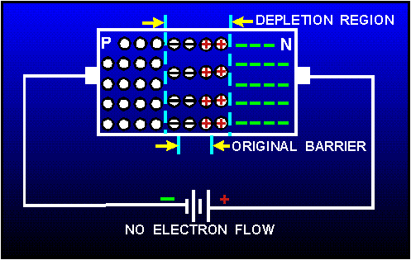
pn Junction and Biasing
A pn junction is a sandwich of p-type and n-type material.
A depletion region (free of excess charge) forms.
An intrinsic (built-in) electric field exists in this region.
An external bias can increase or decrease the width of the depletion region and the voltage difference between the p and n regions.
Notes:
There are excess holes on the p-side and excess electrons on the n-side (compared to intrinsic silicon). When placed together, the electrons and holes are attracted to each other and recombine at available sites, creating negative ions on the p-side and positive ions on the left side of the junction. This distribution of ions leads to a built-in electrostatic field going from the n-side to the p-side. Eventually, the repulsive force of the negative ions on the p-side of the junction (and the positive ions on the n-side of the junction) balance with force due to the built-in electrostatic field, resulting in equilibrium at a certain width. The central portion where there are no free carriers is called the depletion region (depleted of carriers).
Applying an external electric field from the p-side to the n-side decreases the net electric field across the depletion region, which decreases the number of carriers that will be attracted to recombine on the other side of the junction, which reduces the number of ions in the depletion width. Since the number of atoms is in constant concentration, this means that the depletion width narrows as fewer atoms become ions. This is called forward biasing. The opposite is true for an electric field applied from the n-side to the p-side (the depletion width is widened), and this condition is called reverse biasing.

Slide 22
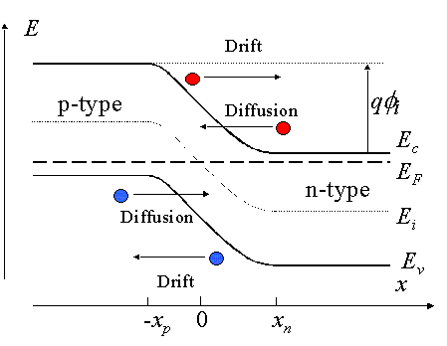
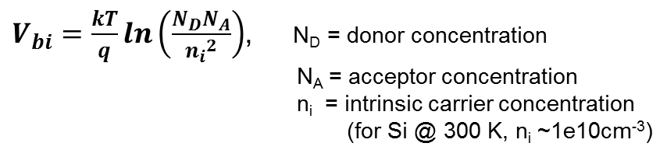
PN Junction Band Diagram
Depletion Region
This diagram shows a p-n junction under equilibrium.
Applying a positive voltage to the p-side of the junction will lower the potential barrier for the carriers so diffusion current flows more freely (and the depletion width will decrease).
Applying a positive voltage to the n-side of the junction will increase the potential barrier and the depletion width.
Drift current occurs regardless of applied bias, and is called leakage current.
p
n
Built-in
voltage
PN Junction Band Diagram (Zeghbroeck 2007)
Notes:
To derive the built-in voltage, track the electrons moving across the junction. Start with E=-dV/dx (electric field is the negative derivative of voltage with respect to position):
The integral of (E dx) across the depletion region from –xp to xn is the integral of dV from V(-xp) to V(xn), which is just V(-xp) – V(xn) = Vbi.
Under equilibrium conditions (no externally-applied bias), the current density Jn = q*mu(n)*n*E + q*Dn*dn/dx = 0 (no current is flowing).
q is the elementary charge [C], mu(n) is the mobility of the electrons [cm^2/(V*s)], n is the electron concentration [cm^(-3)], E is the electric field [V/m], Dn is the diffusion constant of the electrons [cm^2/s], and dn/dx is the change in number of electrons with respect to location [cm^(-4)].
Using the current density equation and solving for E, we find that E = -Dn/mu(n) * (dn/dx)/n
Einstein’s relationship (kinetic theory) states that D = mu*kT/q, so: E = -kT/q*(dn/dx)/n
k is Boltzmann’s constant [eV/K], T is temperature [K]
Going back to our original integral: Vbi = integral of –E*dx from –xp to xn = kT/q*(integral from n(-xp) to n(xn) of dn/n) = kT/q*ln[n(xn)/n(-xp)]
Now, we know that the electron concentration n at xn is just the donor concentration N(D).
In a semiconductor, n*p=ni^2. We now p at –xp is acceptor concentration N(A), and we know ni. Therefore: n(-xp)=ni^2/N(A)
Putting it all together: Vbi = kT/q*ln[N(D)*N(A)/ni^2]
Although it seems that Vbi is linearly proportional to T, remember that ni is a function of temperature and other material properties (see next slide).

Slide 23
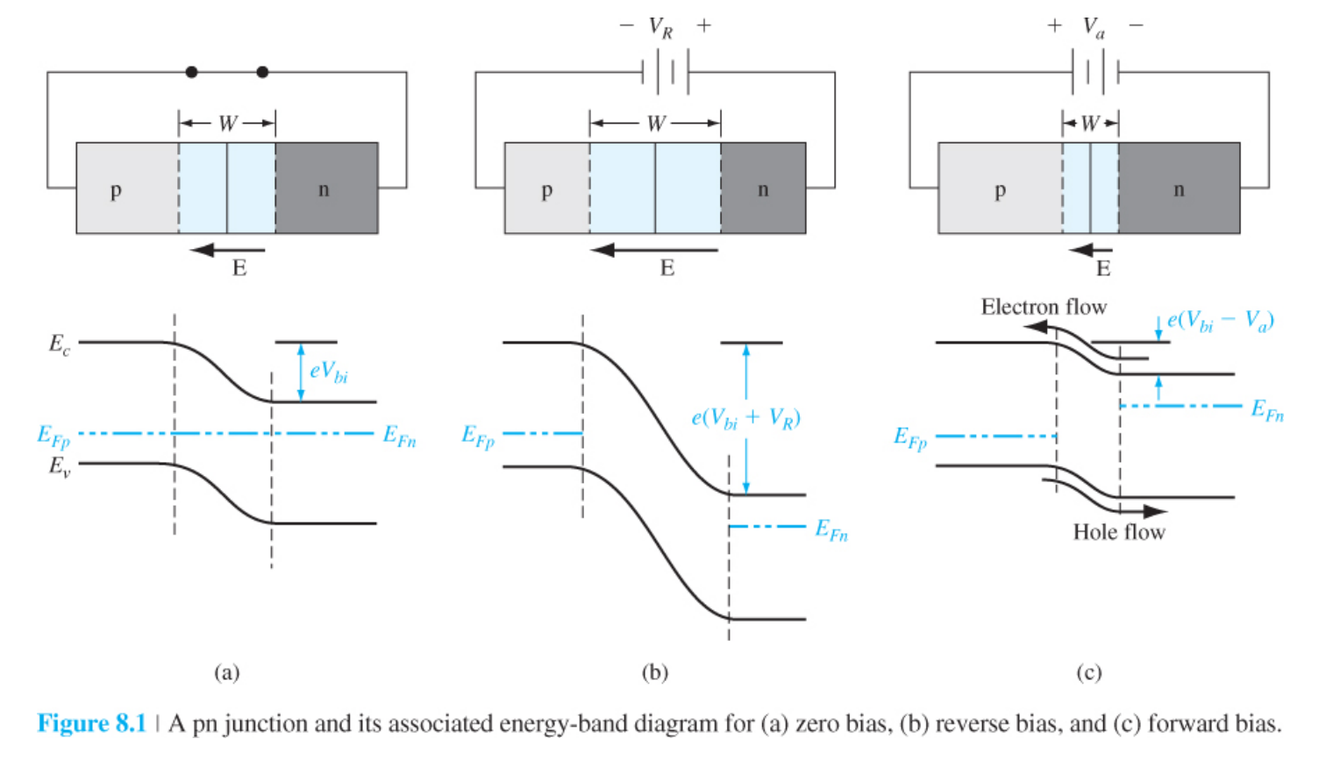
PN Junction and Biasing
Notes:
In Figure 8.1c, the total potential barrier is reduced. There will be a diffusion of holes from the p region across the space charge region where they will flow into the n region. Similarly, there will be a diffusion of electrons from the n region across the space charge region where they will flow into the p region. http://www2.ess.nthu.edu.tw/~lkschang/letter/Introduction%20to%20Solid-State%20Electronic%20Devices/Chapter%208.pdf

Slide 24
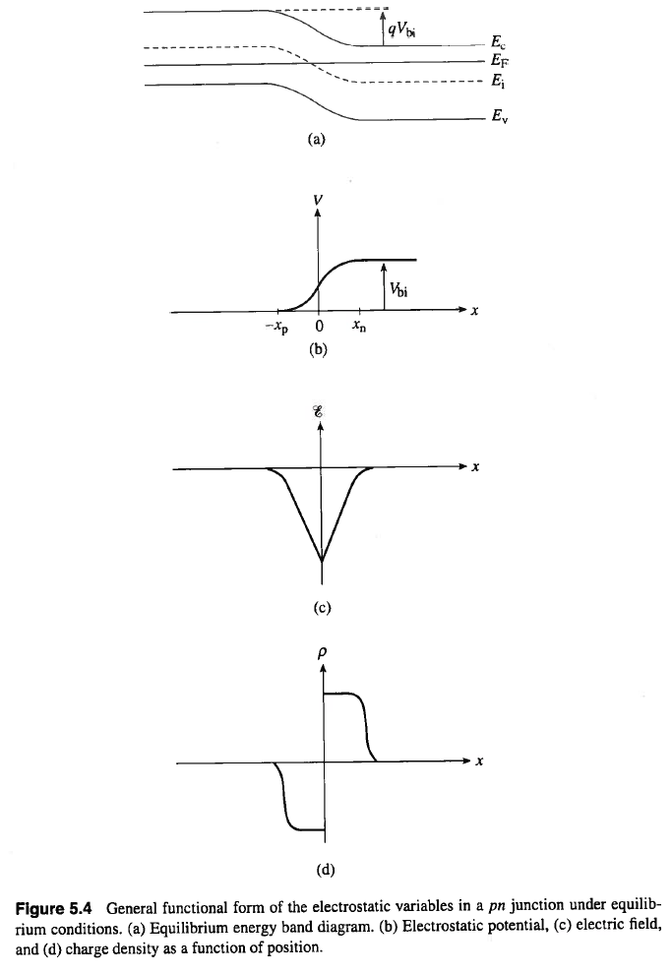
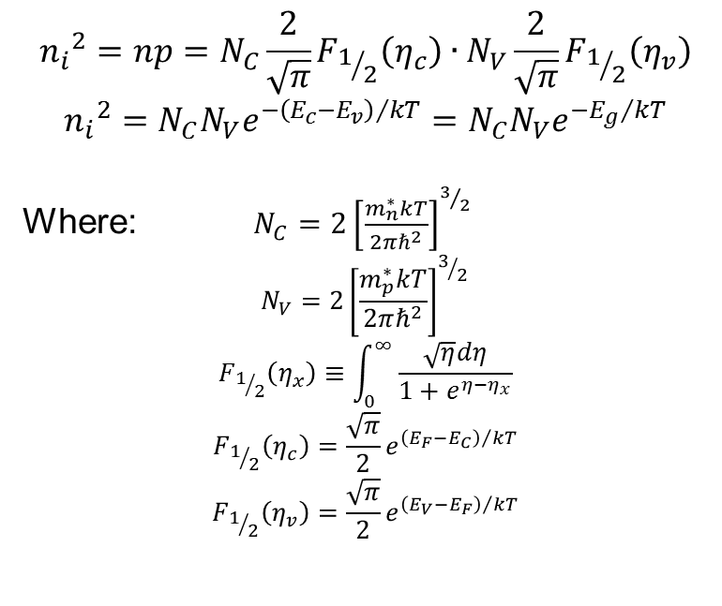
Electrostatic Variables in a pn Junction
Notes:
The equilibrium energy band diagram (a) is the same as is shown on slide 22. The electrostatic potential (voltage) across the junction is shown in (b). The curvature is inverted because (a) shows an increase in energy from right to left for an electron, which means the voltage is more positive on the right than on the left. The electric field (c) is the derivative of potential (b), since E = dV/dx. Similarly, the charge density is the derivative of electric field (negative charge density is the result of recombined holes, leading to negative ions).
The equation for ni^2 is complicated, but derived completely of material constants. eta(c) and eta(v) represent (Ef-Ec)/kT and (Ev-Ef)/kT, respectively. eta (no subscript) is (E-Ec)/kT where E is the energy level of interest in the Fermi distribution. F(1/2) is the Fermi-Dirac integral of order ½. m*n and m*p are the effective masses of electrons and holes in the semiconductor, respectively. Nc and Nv are the “effective” density of conduction band and valence band states, respectively.

Slide 25
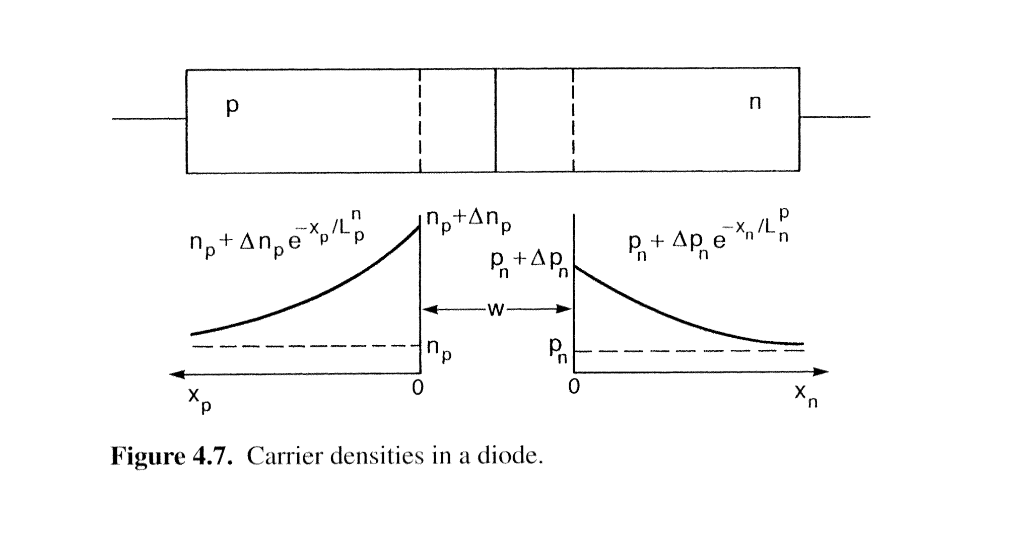
Carrier Densities
Notes:
This is under forward bias. n(p) is the equilibrium concentration of electrons on the p-side, and p(n) is the equilibrium concentration of holes on the n-side. These are called minority carriers and their concentrations determine the behavior of the device. Forward biasing increases the minority carrier concentrations near the depletion zone (delta n(p) or delta p(n)).

Slide 26
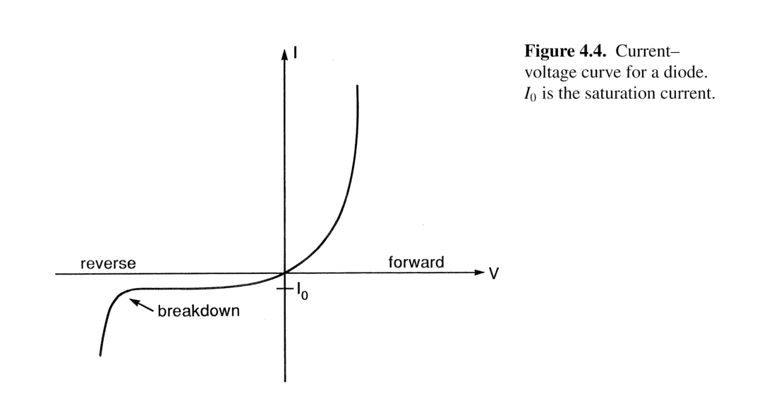
PN Junction: IV Characteristics
Current-Voltage Relationship
Forward Bias: current exponentially increases.
Reverse Bias: low leakage current equal to ~I_{o}.
Ability of p-n junction to pass current in only one direction is known as “rectifying” behavior.
Notes:
Turn-on voltage depends on carrier concentrations on either side of the junction.

Slide 27
pn Junction Review
PN junctions are fabricated in a monocrystalline piece of semiconductor with both a P-type and N-type region in proximity at a junction.
The transfer of electrons from the N side of the junction to holes on the P side of the junction produces a built-in voltage. This is usually 0.6 V to 0.7 V in silicon, and varies depending on material and dopant concentration.
Forward bias requires a positive voltage to be applied to the p-side with respect to the n-side. Reverse bias requires a positive voltage to be applied to the n-side with respect to the p-side.
A forward biased PN junction conducts a current once the built-in voltage is overcome (the diode will “turn on”). The external applied potential accelerates majority carriers across the junction where recombination takes place, allowing current flow.
A reverse biased PN junction conducts almost no current. The applied reverse bias adds to the built-in potential barrier, impeding current flow. It also increases the thickness of the non-conducting depletion region.
Reverse biased PN junctions show a temperature dependent reverse leakage current. This is less than a µA in small silicon diodes.

Slide 28
Diode

Slide 29
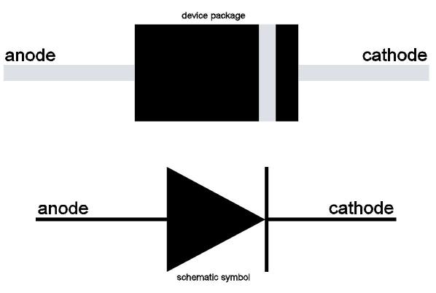
Definition of a Diode
A diode is an electronic component that
  has two terminals,
  limits current to one direction, and
  has nonlinear (non-Ohmic) behavior.
Diodes are pn junctions that “turn on” at a specific voltage.
Diodes have an anode (p-side) and a cathode (n-side).
Positive current normally flows from the anode to the cathode.
Diodes are useful for protecting circuitry from harmful voltage or current.
Diodes are a basic building block of the charge-collecting element in many detectors.

Slide 30
Photodiode

Slide 31
Definition of a Photodiode
A photodiode is a diode that converts photons into voltage or current.
When an electron absorbs a photon (of sufficient energy), the electron moves to the conduction band (creating an electron-hole pair).
In some cases, the photo-generated charge migrates to the depletion region where it recombines with ions. This changes the voltage across the depletion region; the magnitude of the change gets converted into charge and so into number of electrons.
A second way to count photo-generated charge is by monitoring the current through a reverse-biased diode. The leakage current will increase proportionately to the amount of photo-generated charge.

Slide 32
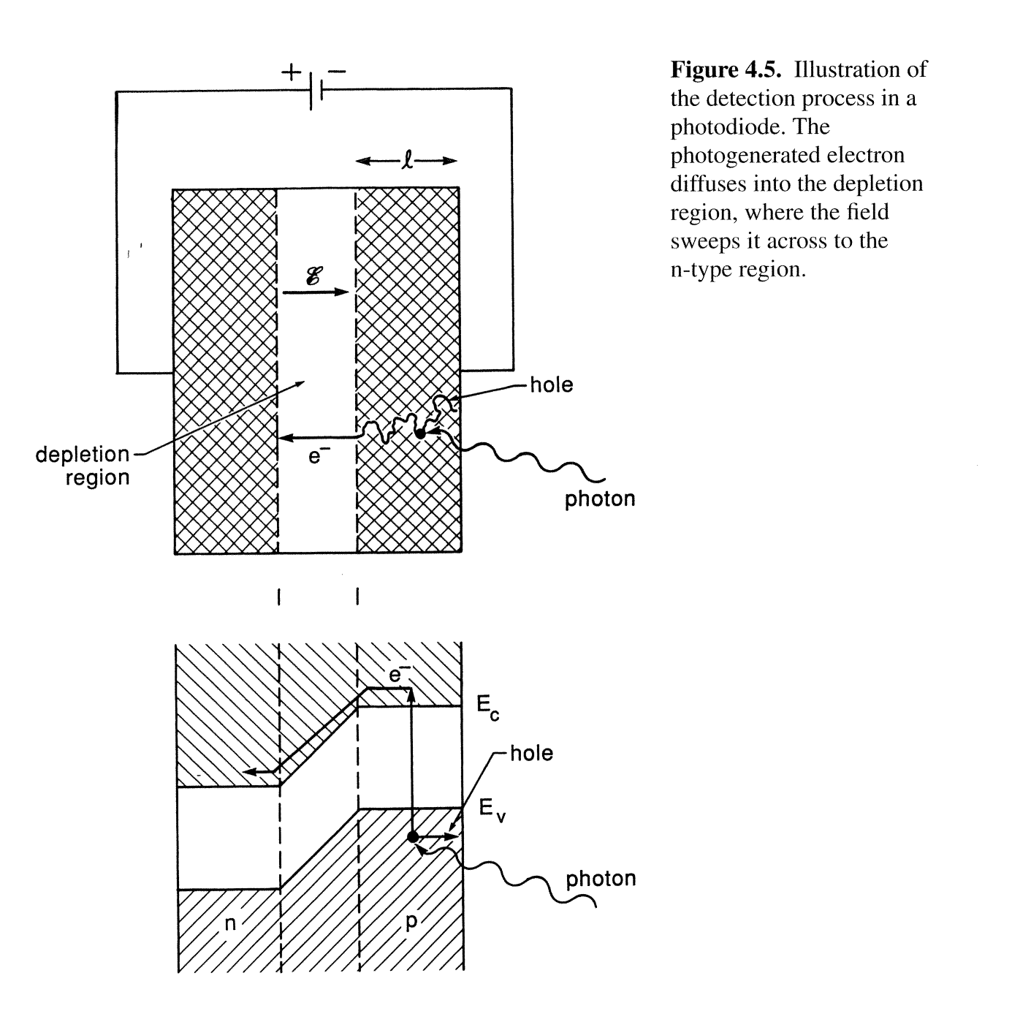
Photon Detection in Photodiode
Notes:
This is a reverse-biased p-n junction. Photon-generated carriers add to the drift (reverse bias “leakage”) current.

Slide 33
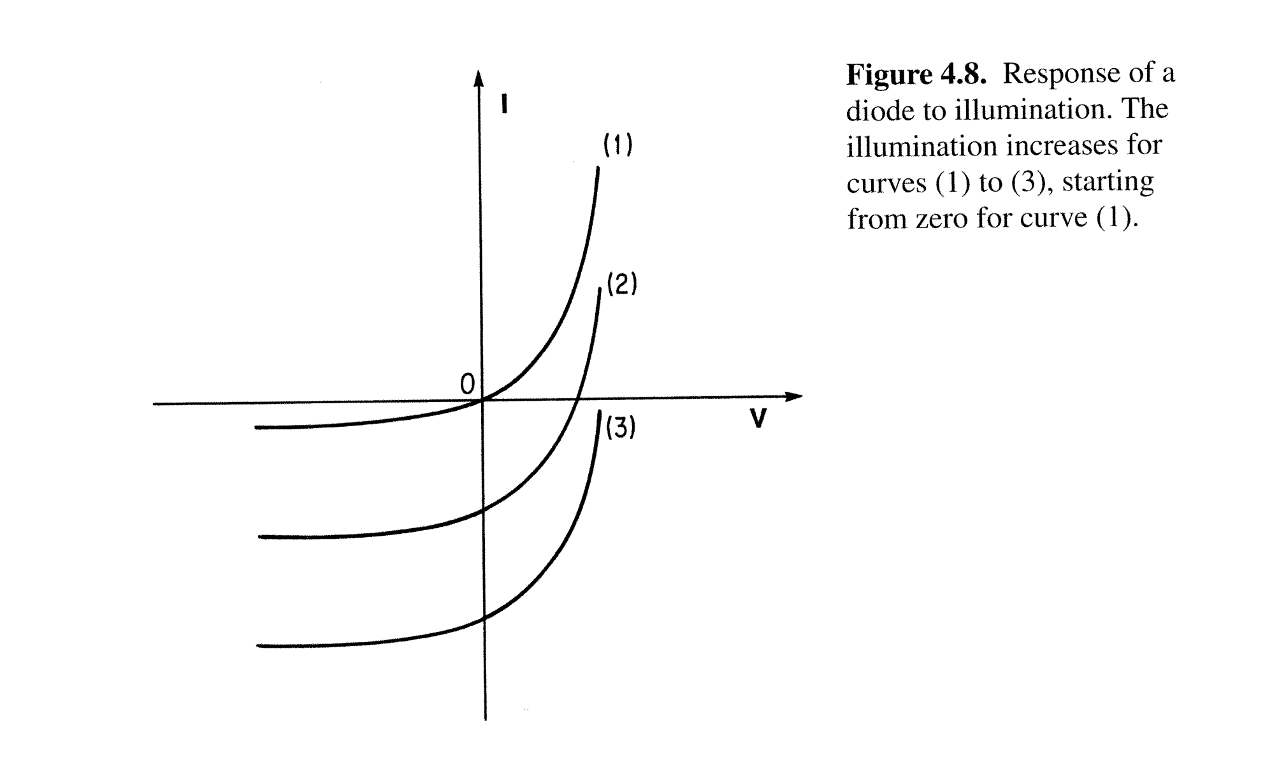
Response of Photodiode to Light

Slide 34
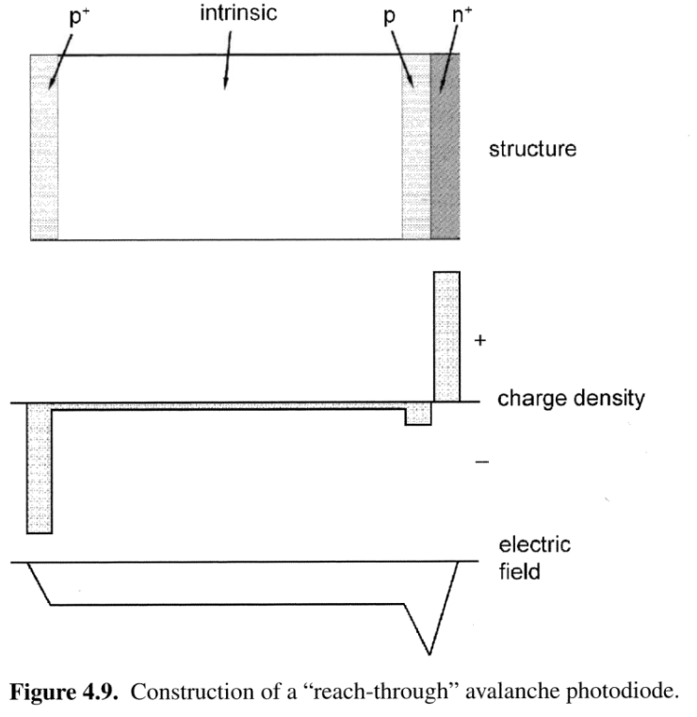
Avalanche Photodiode
This example is for a p-i-p-n diode (p-type, intrinsic, and n-type) regions.
Photons are absorbed in the intrinsic layer.
Photogenerated electrons drift to pn+ junction where they are accelerated through high field, producing more electrons through impact ionization.
Benefit: one photon gives large signal.
Notes:
This is only one type of avalanche photodiode. All that is required for an APD is that the reverse voltage be sufficient to initiate an avalanche. A standard p-n junction will breakdown eventually. This structure is engineered to have a specific breakdown voltage.

Slide 35
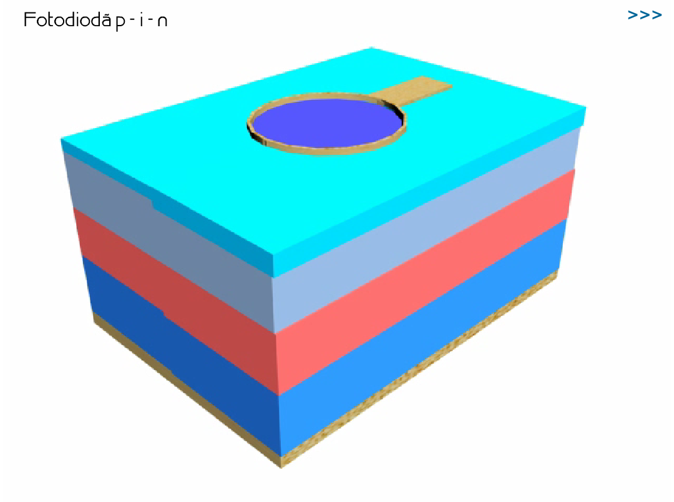
PIN Photodiode

Slide 36
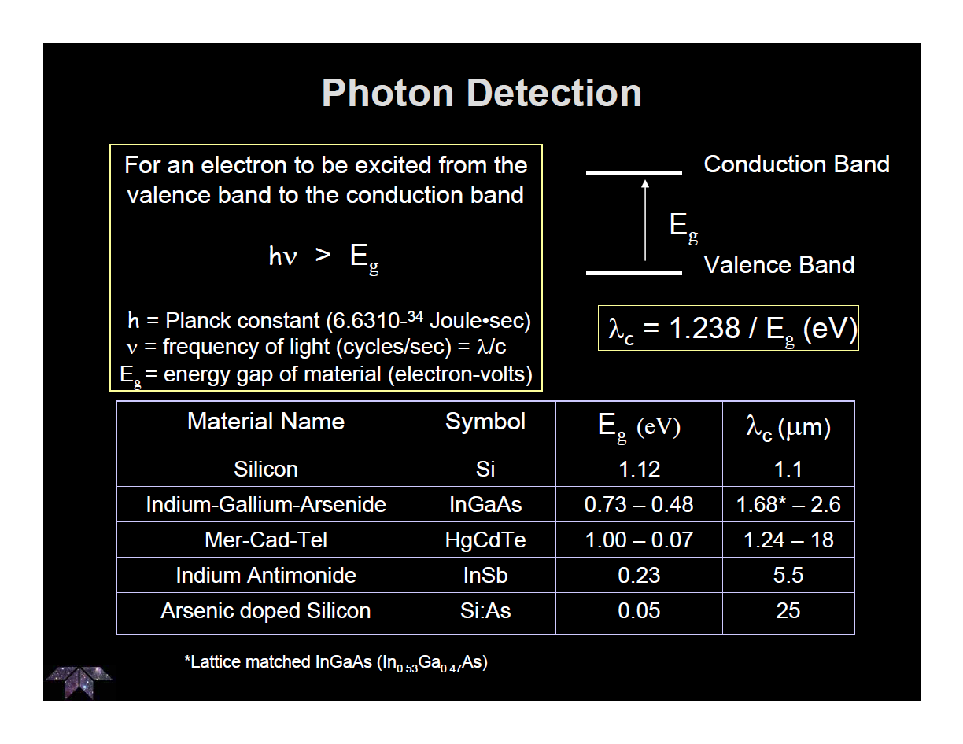
Band Gaps
Notes:
Lambda(c) is the cutoff wavelength. Photons with wavelengths longer than the cutoff wavelength do not have enough energy to excite an electron to the conduction band.

Slide 37
Light-Emitting Diode

Slide 38
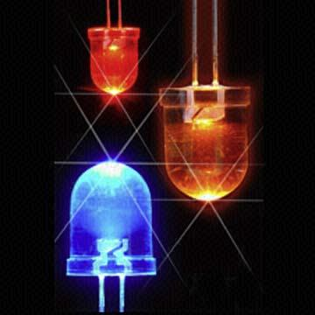
Definition of a Light Emitting Diode (LED)
A Light Emitting Diode converts electrical current into light.
LEDs are based on pn junctions under forward bias.
The wavelength of emitted light is fixed for a material and depends on the energy gap between the conduction band and the hole energy level.
LEDs tend to be more efficient for lighting applications as compared to ordinary light bulbs that convert heat into blackbody radiation (most of which cannot be seen by the human eye).

Slide 39
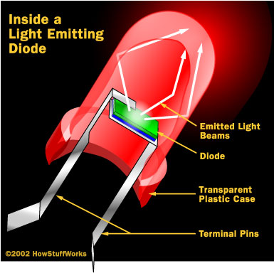
LED Cutaway

Slide 40
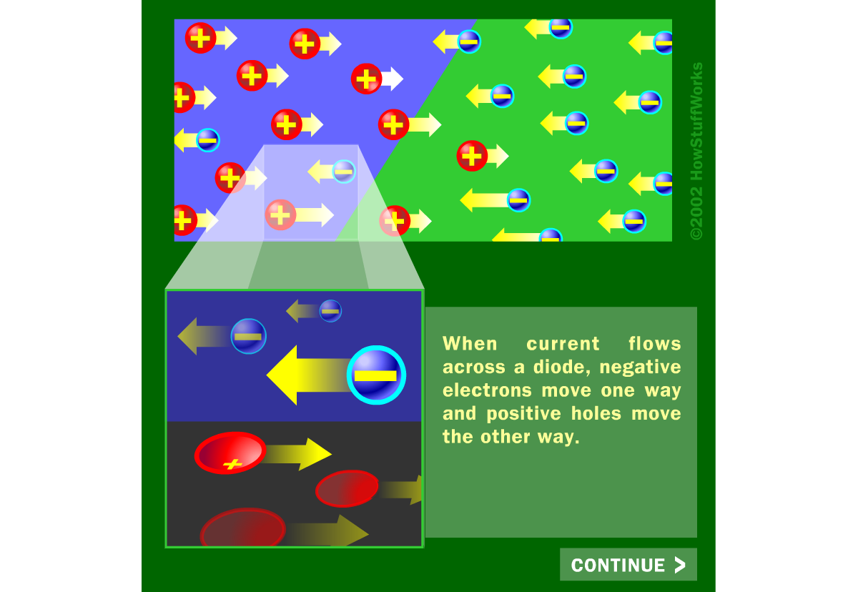
LED Animation

Slide 41
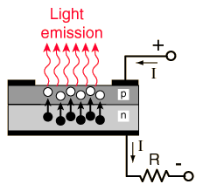
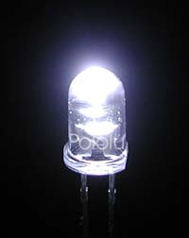
How does it work?
P-n junction
Electrical Contacts
A typical LED needs a pn junction
There are a lot of electrons and holes at the junction due to excitations
Electrons from n side need to be injected to p side to promote recombination
Junction is biased to produce even more e-h and to inject electrons from n to p for recombination to happen
Recombination produces light!!
Notes:
Just like when absorption of energy moves an electron to the conduction band, moving back to the valence band accompanies an emission of a photon of lambda=hc/Eg
Is this diode forward biased or reverse biased?

Slide 42
LED Construction
Efficient light emitter is also an efficient absorber of radiation therefore, a shallow p-n junction required.
  Must be thin enough to prevent reabsorption of photons.
The p-n junction will be forward biased with contacts made by metallisation to the upper and lower surfaces.
Output material must be transparent so photon can escape.
‘Right coloured LED’ → hc/λ = Ec-Ev = Eg
→ so choose material with the right Eg

Slide 43
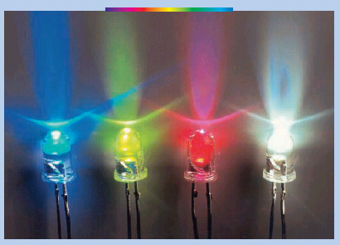
Visible LED
The band gap of the materials that we use must be in the region of visible wavelength = 390-770nm. This coincides with the energy value of 3.18eV- 1.61eV which corresponds to colors as stated below:
The band gap, E_{g} that the semiconductor must posses to emit each light
Material | Band Gap (eV)
ZnS | 3.6
ZnO | 3.2
GaP | 2.25
CdSe | 1.74
CdTe | 1.44
GaAs | 1.43
InP | 1.27
Si | 1.11
GaSb | 0.68
Ge | 0.66
Violet ~ 3.17eV
Blue ~ 2.73eV
Green ~ 2.52eV
Yellow ~ 2.15eV
Orange ~ 2.08eV
Red ~ 1.62eV

Slide 44
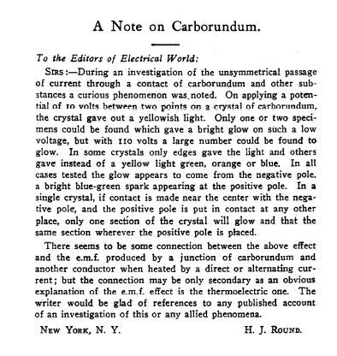
1907 Publication report on Curious Phenomenon
On applying a potential to a crystal of carborundum (SiC), the material gave out a yellowish light
H.J. Round, Electrical World, 49, 309, 1907

Slide 45
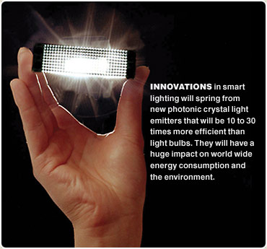

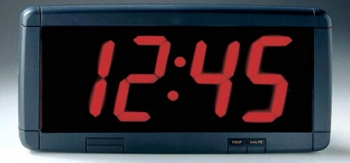

Applications of LEDs

Slide 46
Transistor

Slide 47
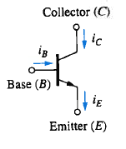


Definition of a Transistor
A transistor controls current through a circuit via an injected current, i.e. it behaves like a current-controlled resistor.
A Bipolar Junction Transistor has three terminals:
  Base (B): the control
  Collector (C): the source of the current
  Emitter (E): the destination of the current
i_{C}
Circuit Symbol
-
+
v_{BC}
collector
n
base
p
i_{B}
v_{BE}
-
+
emitter
n
i_{E}
Schematics shown are for an npn BJT, but pnp BJTs also exist.

Slide 48
BJT Transistor Operation
The BJT operation is as follows:
  apply a voltage to the base with respect to
  the emitter (forward bias the base-emitter p-n junction)
  this voltage sets up an electric field in the “body” of the device
  the electric field supports the flow of charge from collector to emitter if the base-emitter p-n junction is forward biased.
Most common (and original) form is the bipolar junction transistor (BJT), although the MOSFET has completely taken over almost all applications.

Slide 49
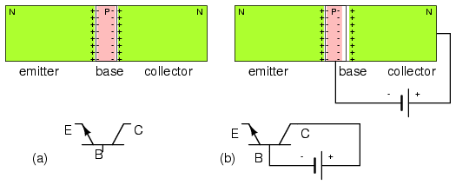
Transistor Architecture
NPN BJT has three layers with an emitter and collector at the ends, and a very thin base in between (Figure a).
Base-collector is reverse biased, increasing the width of the associated depletion region (Figure b).

Slide 50
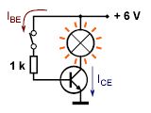
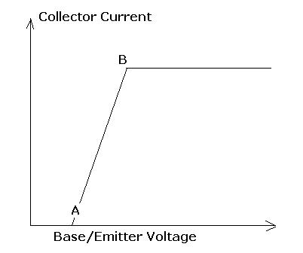
Transistor in Operation
The transistor base-emitter current controls the current from its “collector” to “emitter.”
At a certain threshold, the transistor behaves like an “on” switch.

Slide 51
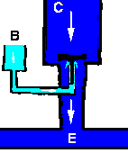
Transistor: Water Flow Model
Water flow in B raises the plunger so that water can flow from C to E.
Small flow turns on and off bigger flow.
Put signal on B, transfer signal C to E.

Slide 52
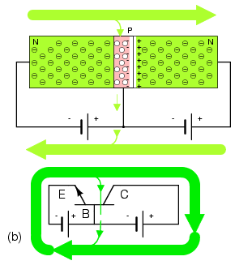
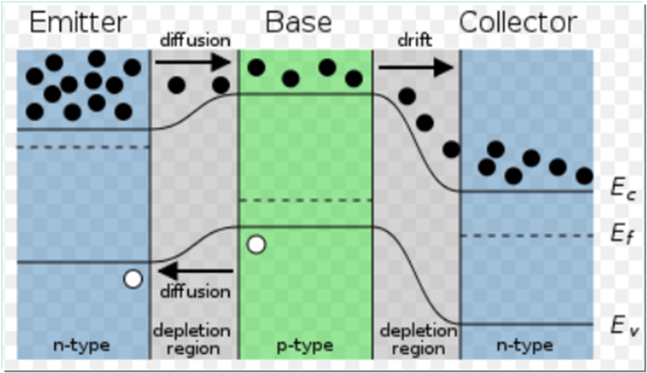
Transistor Architecture
Base-emitter is forward biased above the threshold voltage to overcome depletion field (Figure b).
Most of the electrons from the emitter diffuse through the thin base into the collector, which leads to a coupling of the E-B and C-B junction currents.
Changing the small base current produces a larger change in collector current.
If the base voltage falls below threshold, the large emitter-collector current ceases to flow.

Slide 53
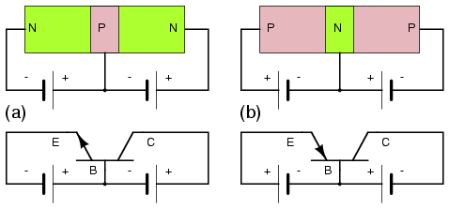
Transistor Architecture (NPN vs. PNP)
PNP transistor uses opposite polarity.
Note that for both types of transistors, the base-emitter junction is forward biased and the base-collector junction is reverse biased.

Slide 54

Common Transistor Packages

Slide 55

Historical Prediction of Transistor Effect
Effect predicted as early as 1925 by Julius Lilienfeld (“Field Effect”)
Patent issued in the 1926 and 1933
Technology at the time was not sufficiently advanced to produce doped crystals with enough precision for the effect to be seen

Slide 56

“Invention” of Transistor
Shockley, Brattain, and Bardeen tried making a field effect transistor in 1947, but got sidetracked into inventing the bipolar transistor instead (for which they won Nobel Prize).

Slide 57
Now for the rub!
Shockley's field effect transistor theory was published in 1952. However, the materials processing technology was not mature enough until 1960 when John Atalla produced a working device.
While re-invention of transistors some twenty years after the Lilienfeld's work earned Bell Telephone Laboratories three Nobel Prizes, they were forced to abandon most patent claims to the field-effect transistor (which dominates modern electronics) because of Lilienfeld's "prior art."

Slide 58
Transistor Invention History Epilogue
The three argued over patents and the team split up.
Schockley founded Silicon Valley in 1956 with money from his buddy Beckman. He eventually left physics to pursue genetics research. He was mad that everyone made money but him. (His early co-workers got fed up and started Fairchild, and then Intel).
Bardeen went to the University of Illinois. In 1957, along with post-doctoral student Leon Cooper and graduate student Bob Schrieffer, he developed the first theory on superconductivity. To this day, this theory is known as the BCS theory (for Bardeen, Cooper, and Schrieffer)
Brattain stayed at Bell Labs until he retired and then taught Physics at Whitman College.

Slide 59

Evolution of the Transistor
Notes:
The lattice spacing between silicon atoms is ~5.43 Angstroms. 30 nm is 300 Angstroms, or only about 55 atoms wide!

Slide 60
Field Effect Transistor

Slide 61
Definition of a FET
The field-effect transistor (FET) is a generic term for a device that controls current through a circuit via an applied voltage, i.e. it behaves like a voltage-controlled resistor.
There are two main varieties of FETs:
  junction FETs (JFETs)
  metal-oxide-semicondutor FETs (MOSFETs)
A FET has three terminals:
  gate (G): as in the “gate” keeper of the current
  source (S): the source of the electrons
  drain (D): the destination of the electrons
JFET (n-channel)
MOSFET (NMOS)
v_{S}
v_{G}
v_{D}
v_{S}
v_{D}
v_{G}
metal
n+
p+
n+
n+
n+
oxide
n
p+
p
v_{G}

Slide 62
FET Operation
The FET operation is as follows:
  apply a voltage to the gate
  this voltage sets up an electric field in the “body” of the device
  electric field inhibits/supports the flow of charge from source to drain
FETs can be made in n-channel or p-channel variety.
FETs are “Unipolar” (conduct either electrons or holes, not both).

Slide 63
Junction Field-Effect Transistor (JFET)

Slide 64


JFET Architecture
An n-channel JFET is composed of:
  n-type body
  p-type gate
Gate is generally reverse biased to control current flow.
Channel conducts regardless of polarity between source and drain.
Typical output transimpedance for a JFET is a few hundred Ohms.
J

Slide 65

JFET Architecture
The gate and channel form depletion regions.
A stronger reverse bias makes the depletion regions wider and closer to each other.
Therefore, voltage controls channel resistance.
N-channel JFET: (a) Depletion at gate diode. (b) Reverse biased gate diode increases depletion region. (c) Increasing reverse bias enlarges depletion region. (d) Increasing reverse bias pinches-off the S-D channel.

Slide 66

JFET Architecture
Source and drain are interchangeable.
Figure (b) shows the schematic symbol for an N-channel field effect transistor compared to the silicon cross-section at (a). The gate arrow points in the same direction as a junction diode. The“pointing” arrow and “non-pointing” bar correspond to P and N-type semiconductors, respectively.
N-channel JFET electron current flow from source to drain in (a) cross-section, (b) schematic symbol.
Large electron current flow from (-) battery terminal, to FET source, out the drain, returning to the (+) battery terminal. This current flow may be controlled by varying the gate voltage. A load in series with the battery sees an amplified version of the changing gate voltage.

Slide 67

JFET Architecture (P channel)
A P-channel JFET is similar to the N channel version, except with polarities reversed. Note that the arrow points out of the gate of the schematic symbol.
As the positive gate bias voltage is increased, the resistance of the P-channel increases, decreasing the current flow in the drain circuit.
P-channel JFET: (a) N-type gate, P-type channel, reversed voltage sources compared with N-channel device. (b) Note reversed gate arrow and voltage sources on schematic.

Slide 68

JFET Architecture
The basic architecture can be realized in a variety of geometrical relationships while still preserving the basic function.
Practically realized devices often have the contacts all on one side of the device.
Junction field effect transistor: (a) Discrete device cross-section, (b) schematic symbol, (c) integrated circuit device cross-section.

Slide 69

JFET Characteristic Curve
IV curve shows two areas of operation.
  At low drain-source voltages, it behaves like a variable resistance whose value is controlled by the applied gate-source voltage.
  At higher drain-source voltages, it passes a current whose value depends on the applied gate-source voltage. In most circuits it is used in this ‘high voltage’ region and acts as a voltage controlled current source.

Slide 70


JFET 3D Characteristic Curve
source
gate
drain

Slide 71
Advantages of JFET
controlled by the applied gate voltage, they draw very little gate current and hence present a very high input resistance to any signal source
low noise at low frequency
the reverse-biased junctions can tolerate a considerable amount of radiation damage without any appreciable change in FET operation.

Slide 72

Operating a JFET

Slide 73
JFET Review
The JFET is called “unipolar” because conduction in the channel is due to one type of carrier.
Application of reverse bias to the gate varies the channel resistance by expanding the gate diode depletion region.
With sufficient bias, the channel is pinched, and current ceases to flow.
The input impedance is high vs. BJT, but low vs. MOSFET.
JFETs are virtually obsolete in ICs, but still used in discretes.

Slide 74
Metal-Oxide Field-Effect Transistor (MOSFET)

Slide 75
Definition of Metal-Oxide FET (MOSFET)
A MOSFET is a FET with an insulated gate.
Today, most transistors are MOSFETs in digital integrated circuits.
While the MOSFET has source, gate, and drain terminals like the FET, its gate lead is not in contact with the body of the device.
The MOSFET has an higher input impedance than the JFET (10 to 100 million mega-ohms). Therefore, the MOSFET is even less of a load on preceding circuits.

Slide 76

MOSFET Architecture
The MOSFET gate is a metallic or polysilicon layer atop a silicon dioxide insulator. The gate bears a resemblance to a metal oxide semiconductor (MOS) capacitor.
When charged, the plates of the capacitor take on the charge polarity of the respective battery terminals. The lower plate is P-type silicon from which electrons are repelled by the negative (-) battery terminal toward the oxide, and attracted by the positive (+) top plate.
This excess of electrons near the oxide creates an inverted (excess of electrons) channel under the oxide. This channel is also accompanied by a depletion region isolating the channel from the bulk silicon substrate.
N-channel MOS capacitor: (a) no charge, (b) charged.

Slide 77

MOSFET Architecture
Consider a MOS capacitor between a pair of N-type diffusions in a P-type substrate. With no charge on the capacitor and no bias on the gate, the N-type diffusions (the source and drain) remain electrically isolated.
A positive bias charges the capacitor.
The P-type substrate below the gate takes on a negative charge.
An inversion region of electrons forms below the gate oxide, connecting source and drain.
One type of charge carrier is responsible for conduction (unipolar).
N-channel MOSFET (enhancement type): (a) 0 V gate bias, (b) positive gate bias.

Slide 78

MOSFET Architecture
The cross-section of an N-channel discrete MOSFET is shown in the figure:
  The N+ indicates that the source and drain are heavily N-type doped. This minimizes resistive losses in the high current path from source to drain.
  The N-indicates light doping.
  The P-region under the gate, between source and drain can be inverted by application of a positive bias voltage.
N-channel MOSFET (enhancement type): (a) Cross-section, (b) schematic symbol.

Slide 79
MOSFET Review
MOSFET's are unipoar conduction devices, conduction with one type of charge carrier, like a JFET, but unlike a BJT.
A MOSFET is a voltage controlled device like a JFET. A gate voltage input controls the source to drain current.
The MOSFET gate draws no continuous current, except leakage. However, a considerable initial surge of current is required to charge the gate capacitance.

Slide 80
JFET versus MOSFET
The MOSFET has the advantage of extremely low gate current because of the insulating oxide between the gate and channel.
JFET has higher transconductance than the MOSFET.
JFET has low noise at low frequency.

