Slide 1
Astronomical Observational Techniques and Instrumentation
Professor Don Figer
Observations

Slide 2
Aims and outline for this lecture
introduce observations of visible matter in the Universe
introduce IDL

Slide 3
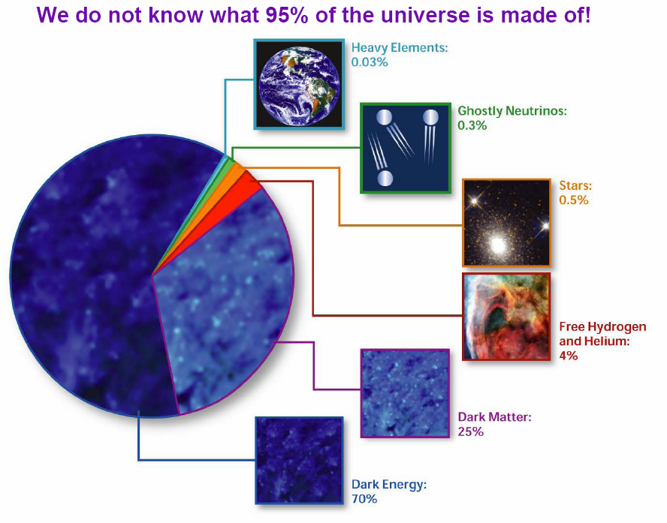
Constituents in the Universe

Slide 4
Stars in the Universe
Stars are defined to be those objects that burn matter through nuclear fusion as a result of intense pressure and temperature induced by the force of self-gravity.
Stars constitute a tiny fraction of the mass in the Universe, only 0.5%.
They dominate the visible Universe.
Their light can tell us physical properties, i.e. temperature, luminosity, pressure, and composition.
Stellar lifetimes are completely determined by their nuclear fuel.

Slide 5
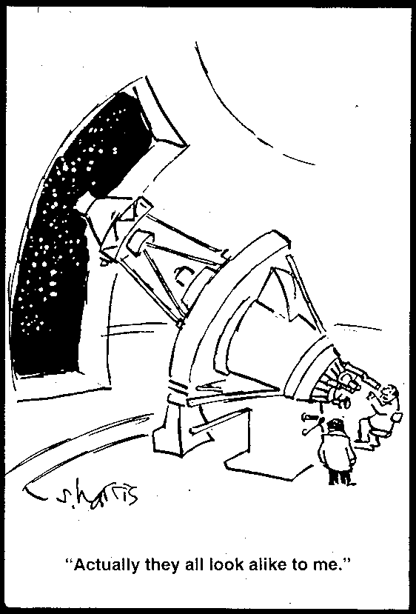
What do Stars Look Like?

Slide 6
Magnitudes
stellar magnitudes
F, F₀ are the photon numbers received per second from object and zero magnitude reference star, respectively.
So, a star that is 100 times fainter than another is said to be 5 magnitudes fainter.

Slide 7
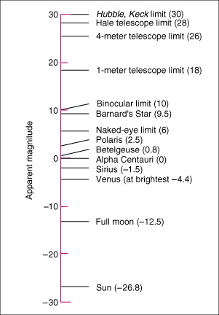
Apparent Magnitudes: Examples
Notes:
Apparent Magnitude This graph illustrates the apparent magnitudes of some astronomical objects. The original magnitude scale was defined so that the brightest stars in the night sky had magnitude 1, and the faintest stars visible to the naked eye had magnitude 6. It has since been extended to cover much brighter and much fainter objects. An increase of 1 in apparent magnitude corresponds to a decrease in apparent brightness by a factor of approximately 2.5.

Slide 8
Absolute Magnitude
“Absolute Magnitude” M is the magnitude measured at a “Standard Distance” (10 pc ≈ 33 light years)
Allows luminosities to be directly compared
  Absolute magnitude of sun ≈ +5 (pretty faint)

Slide 9
Absolute Magnitude and Distance

Slide 10
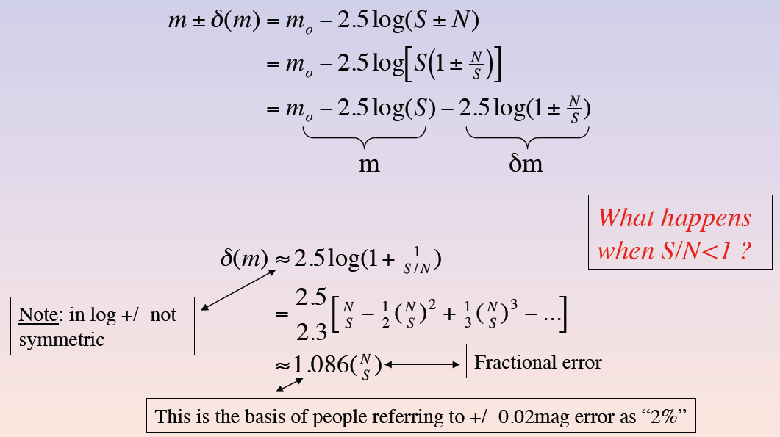
Magnitude Errors (Bershady)

Slide 11
Stellar Brightness Differences
If we can determine that 2 stars are identical, then their relative brightnesses translate to relative distances
Example: Sun vs. α Cen
  spectra are very similar ⇒ temperatures, radii almost identical (T follows from Planck function, radius R can be deduced by other means)
  ⇒ luminosities about equal
  difference in apparent magnitudes translates to relative distances
  can check using the parallax distance to α Cen

Slide 12
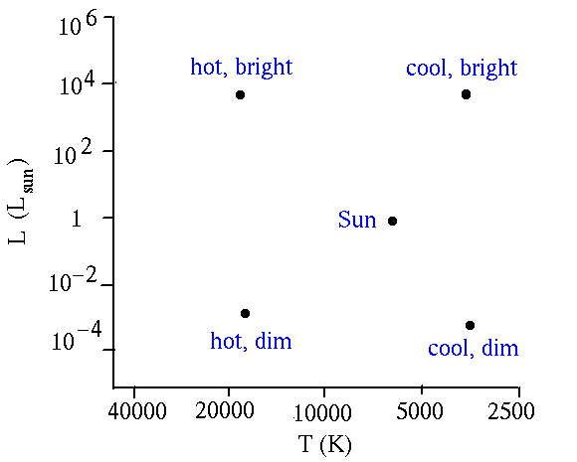
Brightness and Temperature
http://zebu.uoregon.edu/~soper/Stars/hrdiagram.html

Slide 13
H-R Diagram: History
1911: E. Hertzsprung (Denmark) compared star luminosity with color for several clusters
1913: Henry Norris Russell (U.S.) did same for stars in solar neighborhood

Slide 14
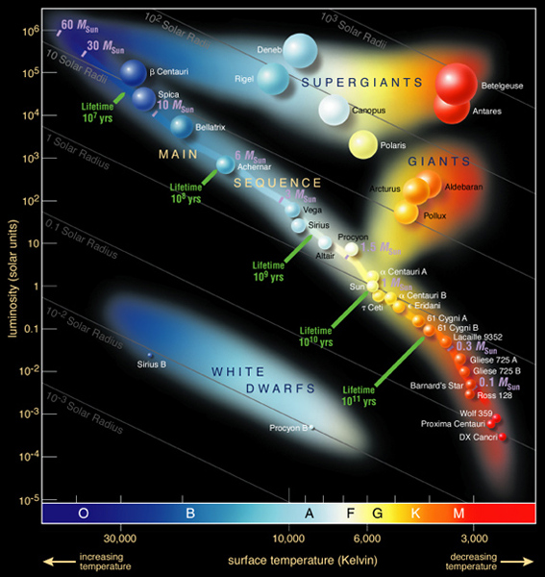
HR Diagram of Well-known Stars
Notes:
H–R Diagram of Bright Stars An H–R diagram for the 100 brightest stars in the sky. Such a plot is biased in favor of the most luminous stars—which appear toward the upper left—because we can see them more easily than we can the faintest stars. (Compare this with Figure 17.14, which shows only the closest stars.)

Slide 15
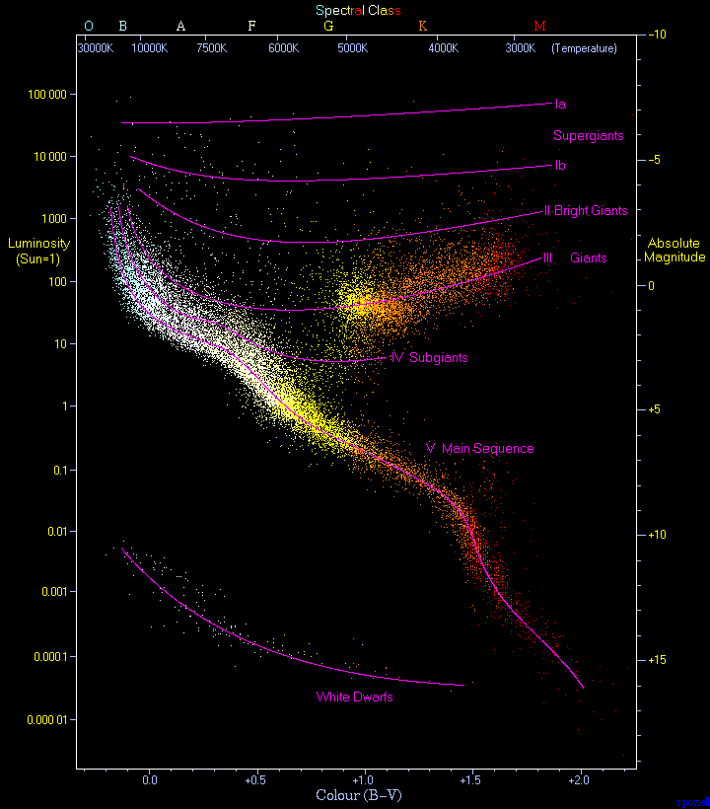
HR Diagram of Nearby Stars
Plot of 22,000 stars in Hipparcos Catalogue and Gliese Catalogue of nearby stars
Stars are not coeval – range of ages
Main sequence is easily seen – hydrogen burning stars
Red giant clump is prominent
≈90% of stars on Main Sequence
≈10% are White Dwarfs
<1% are Giants
Notes:
The most famous diagram in astronomy is the Hertzsprung-Russell diagram. This diagram is a plot of luminosity (absolute magnitude) against the colour of the stars ranging from the high-temperature blue-white stars on the left side of the diagram to the low temperature red stars on the right side.
This diagram below is a plot of 22000 stars from the Hipparcos Catalogue together with 1000 low-luminosity stars (red and white dwarfs) from the Gliese Catalogue of Nearby Stars. The ordinary hydrogen-burning dwarf stars like the Sun are found in a band running from top-left to bottom-right called the Main Sequence. Giant stars form their own clump on the upper-right side of the diagram. Above them lie the much rarer bright giants and supergiants. At the lower-left is the band of white dwarfs - these are the dead cores of old stars which have no internal energy source and over billions of years slowly cool down towards the bottom-right of the diagram.

Slide 16
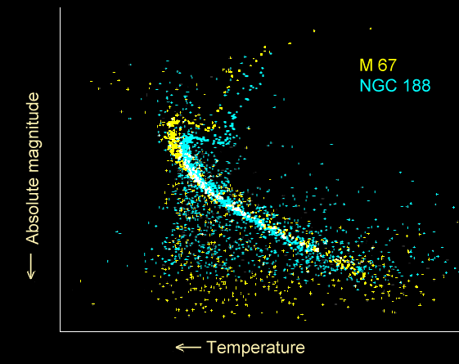
HR Diagram of Two Clusters
Notes:
The most famous diagram in astronomy is the Hertzsprung-Russell diagram. This diagram is a plot of luminosity (absolute magnitude) against the colour of the stars ranging from the high-temperature blue-white stars on the left side of the diagram to the low temperature red stars on the right side.
This diagram below is a plot of 22000 stars from the Hipparcos Catalogue together with 1000 low-luminosity stars (red and white dwarfs) from the Gliese Catalogue of Nearby Stars. The ordinary hydrogen-burning dwarf stars like the Sun are found in a band running from top-left to bottom-right called the Main Sequence. Giant stars form their own clump on the upper-right side of the diagram. Above them lie the much rarer bright giants and supergiants. At the lower-left is the band of white dwarfs - these are the dead cores of old stars which have no internal energy source and over billions of years slowly cool down towards the bottom-right of the diagram.

Slide 17
Spectral Classification
Spectral classification includes nomenclature for temperature and luminosity.
The temperature scale (Harvard classification) is estimated using absorption features: OBAFGKM (from hot to cool)
The luminosity scale (Morgan-Keenan) is determined using absolute magnitude: I, II, III, IV, V
As an example, the Sun has a spectral classification of G2V.
Notes:
2
Stellar Spectra
Comparison of spectra observed for seven different stars having a range of surface temperatures. The hottest stars, at the top, show lines of helium and multiply ionized heavy elements. In the coolest stars, at the bottom, helium lines are not seen, but lines of neutral atoms and molecules are plentiful. At intermediate temperatures, hydrogen lines are strongest. The actual compositions of all seven stars are about the same. ><*Recently, some astronomers have proposed the addition of two new spectral classes—L and T—for low-mass, low-temperature stars whose odd spectra distinguish them from the M-class stars in the current scheme. For now, at least, the new classification has not been widely adopted. Astronomers are still uncertain whether these new objects are “true” stars, fusing hydrogen into helium in their cores, or if they are “brown dwarfs” that never achieved high enough central temperatures for fusion to begin.

Slide 18
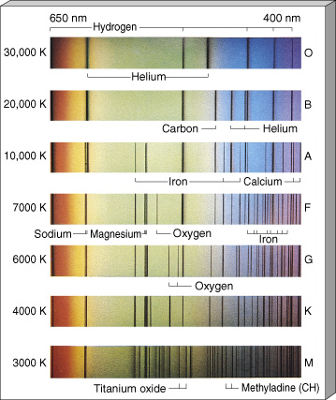
Stellar Spectroscopy
Notes:
2
Stellar Spectra
Comparison of spectra observed for seven different stars having a range of surface temperatures. The hottest stars, at the top, show lines of helium and multiply ionized heavy elements. In the coolest stars, at the bottom, helium lines are not seen, but lines of neutral atoms and molecules are plentiful. At intermediate temperatures, hydrogen lines are strongest. The actual compositions of all seven stars are about the same. ><*Recently, some astronomers have proposed the addition of two new spectral classes—L and T—for low-mass, low-temperature stars whose odd spectra distinguish them from the M-class stars in the current scheme. For now, at least, the new classification has not been widely adopted. Astronomers are still uncertain whether these new objects are “true” stars, fusing hydrogen into helium in their cores, or if they are “brown dwarfs” that never achieved high enough central temperatures for fusion to begin.

Slide 19
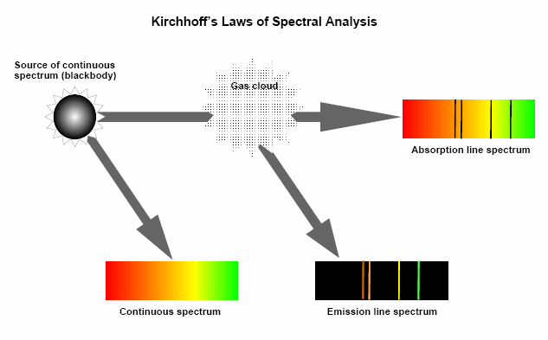
Emission/Absorption Lines

Slide 20
Optical Astronomical Filter Set
There are many filter sets
  Johnson
  Kron-Cousins
  SDSS
  HST
  etc.
5 “Bessel” Filters with approximately equal “passbands”: Δλ≈ 100 nm
  U: “ultraviolet”, λ_{max} ≈ 350 nm
  B: “blue”, λ_{max} ≈ 450 nm
  V: “visible” (= “green”), λ_{max} ≈ 550 nm
  R: “red”, λ_{max} ≈ 650 nm
  I: “infrared, λ_{max} ≈ 750 nm

Slide 21
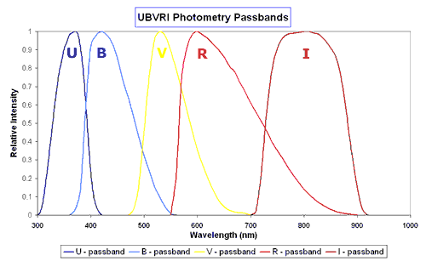
Filter Transmittances: Optical
Notes:
2
Filters for ultraviolet, visible and infrared observations are normally coloured glass, dyed plastic or gelatin or similar that only allow a narrow waveband, typically about 100 nm wide, of radiation through. Other types of optical filters use interference to produce very narrowband filters where the waveband may only be a few nanometers wide. One example is the H-$alpha filter that peaks at 652 nm. It is used for solar observations and .
The Johnson system is a standard one that uses five filters, U, B, V, R and I that have peak responses in the ultraviolet, blue, yellow-green, red and near infrared parts of the spectrum respectively. A plot showing the spectral response of the Johnson series of filters is below. It actually shows a modified form developed by M. Bessel.

Slide 22
Filter Transmittances: NIR Half-power Points
Notes:
2

Slide 23
Photometric units
Allen’s Astrophysical Quantities, p. 150.
Fluxes are for a star with zero magnitude.

Slide 24
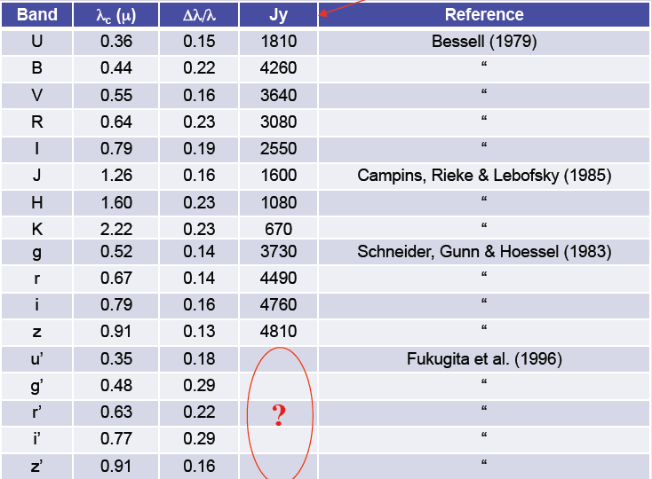
Photometric units – alternate values

Slide 25
Gas and Dust
The interstellar medium (ISM) is filled with gas and dust, making up most of the known Universe.
This material is often influenced by nearby energy sources:
  hot stars produce ionizing radiation that ionizes atoms
  stars emit radiation that heats molecular clouds
  stars emit radiation that reflects off of nearby dust
  jets shock gas
Observations allow us to determine temperature, density, and composition of gas and dust.
Principal Constituents of the Galactic ISM
 | Total Mass (M ) | "Cloud" Mass (M ) | Density (cm⁻³) | Temperature (K)
HI gas | ~5 x 10⁹ |  | 0.1-10 | 100-1000
H₂ gas | 1-5 x 10⁹ | 10⁵-10⁶ | 10³-10⁵ | ~10
Dust | ~5 x 10⁷ |  |  | ~40
HII gas |  | 100-1000 | 10³-10⁴ | 10,000
Notes:
The table shows that gas and dust comprise a significant fraction of mass of the Galaxy, maybe equal to stars.
http://cassfos02.ucsd.edu/physics/ph7/ISM.html

Slide 26
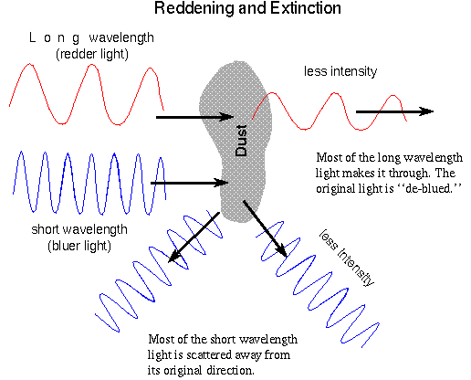
Extinction by Dust: Wavelength Dependence
Notes:
Blue light scatters more strongly than red light.

Slide 27
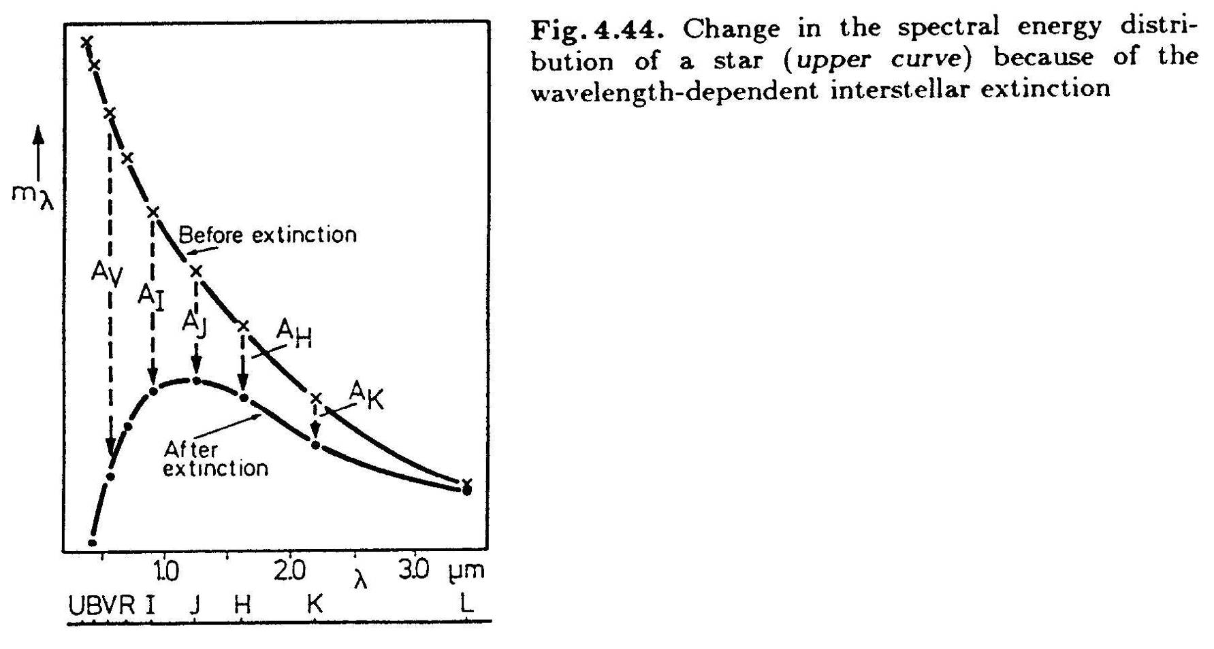
Extinction by Dust: Effect on Spectrum
Notes:
Dust will tend to redden a spectral energy distribution from a star.

Slide 28
Extinction by dust
  J. S. Mathis 1990, ARAA, 28, 37.

Slide 29
Proof of Extinction by dust
Existence of dust controversial until ~100 years ago.
William Herschel showed that star counts were fewer in some directions.
Barnard’s images showed reduction in star counts.
Trumpler conclusively demonstrated interstellar absorption by observing star clusters and estimated 2 mag/kpc in V-band.
Starlight is polarized in regions of high extinction with one polarization state selectively removed by scattering from small elongated conducting or dielectric particles aligned in the galactic magnetic field.

Slide 30
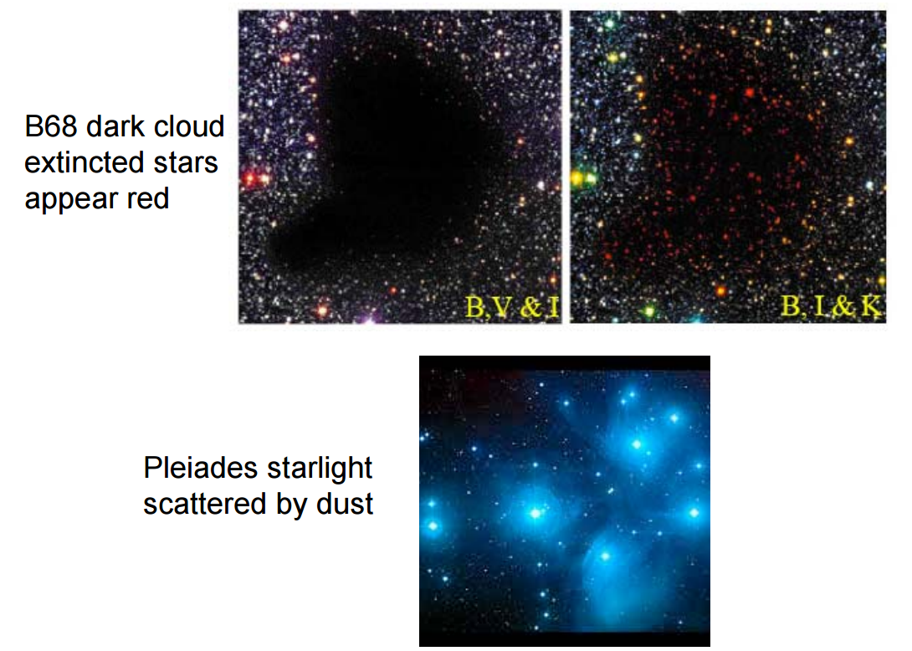
Examples of the Effects of Dust

Slide 31
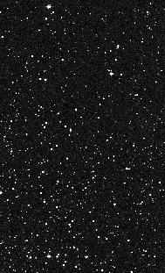
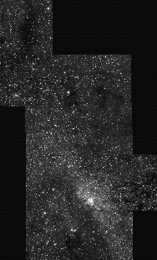
Where is the Center of the Galaxy?
optical
infrared
Digitized Sky Survey
Figer 1995

Slide 32
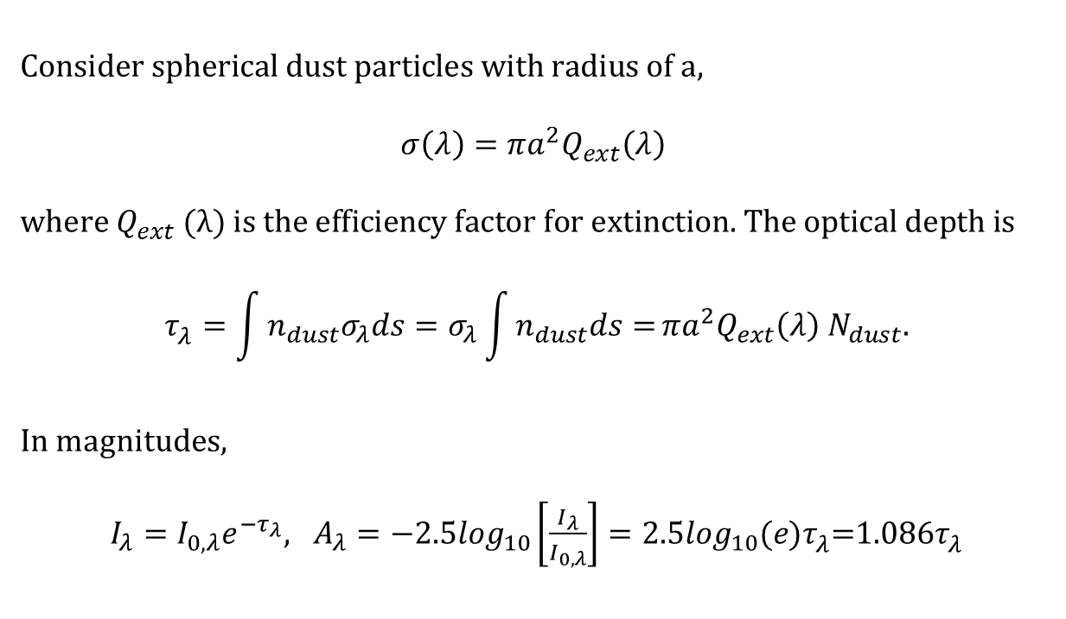
Magnitudes vs. Optical Depth
$$\text{Consider} \text{spherical} \text{dust} \text{particles} \text{with} \text{radius} \text{of} \text{a}\text{,}$$
$$σ\left(λ\right)=πa^{2}Q_{ext}\left(λ\right)$$
$$\text{where} Q_{ext}\text{ (}λ\text{) }\text{is} \text{the} \text{efficiency} \text{factor} \text{for} \text{extinction}\text{. }\text{The} \text{optical} \text{depth} \text{is}$$
$$τ_{λ}^{}=\int{n_{dust}σ_{λ}ds=σ_{λ}\int{n_{dust}ds=}}πa^{2}Q_{ext}\left(λ\right) N_{dust}.$$
In magnitudes,
$I_{λ}=I_{0,λ}e^{−τ_{λ}}, A_{λ}=−2.5\log_{10}\left[\frac{I_{λ}}{I_{0,λ}}\right]=2.5\log_{10}(e)τ_{λ}^{}$=1.086$τ_{λ}^{}$

Slide 33
Magnitudes and Extinction

Slide 34
Silicates and Ices in Interstellar Medium: W3
Notes:
Complete 2.4-25 um SWS flux spectrum of W33A. The observations were made in mode S01 (speed 4) with a resolving power of 500 1000. The principal identified and unidentified spectral features are labelled. Detections of NH3 and CH3OH features near 10 m are reported in § 4.
http://www.journals.uchicago.edu/ApJ/journal/issues/ApJ/v536n1/50933/50933.html

Slide 35
Gas and Dust Life Cycle
Notes:
http://www.strw.leidenuniv.nl/~dave/ISM/lecture1.pdf

Slide 36
Galactic Baryon Mass Budget
Notes:
http://www.strw.leidenuniv.nl/~dave/ISM/lecture1.pdf

Slide 37
Ionized Gas
Ionized gas is usually ionized by radiation from hot stars.
An ionized hydrogen gas cloud is called an HII region.
It emits free-free radiation at radio wavelengths and recombination line radiation from optical to radio wavelengths.
Observed line ratios can give the relative abundances of various atomic species and the gas temperature.

Slide 38
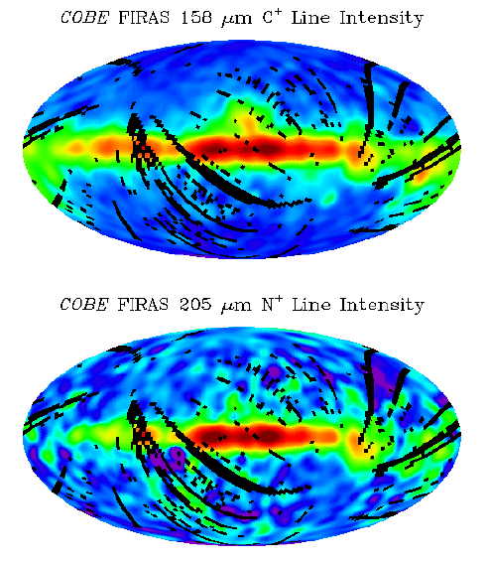
Ionized Gas: Galactic scale
²P_{3/2}->²P_{1/2}
E_{ip}=11.3 eV
³P₁->³P₀
E_{ip}=14.5 eV

Slide 39
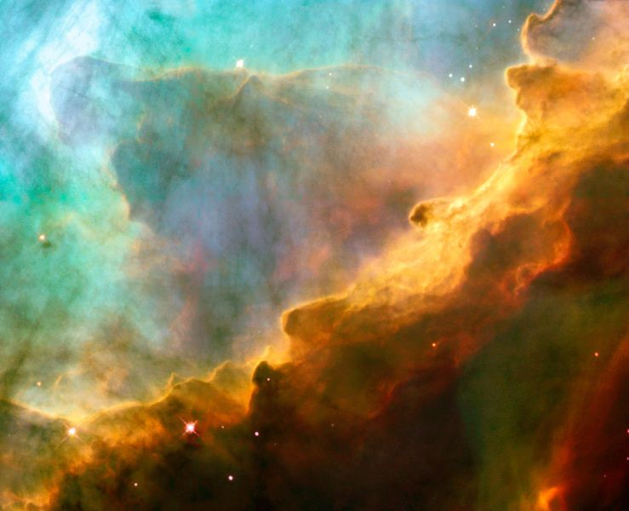
Ionized Nebulae: Omega Nebula
Notes:
The wave-like patterns of gas have been sculpted and illuminated by a torrent of ultraviolet radiation from young, massive stars, which lie outside the picture to the upper left. The glow of these patterns accentuates the three-dimensional structure of the gases. The ultraviolet radiation is carving and heating the surfaces of cold hydrogen gas clouds.
The warmed surfaces glow orange and red in this photograph. The intense heat and pressure cause some material to stream away from those surfaces, creating the glowing veil of even hotter greenish gas that masks background structures. The pressure on the tips of the waves may trigger new star formation within them.

Slide 40
Ionized Nebulae: Omega Nebula, multiwavelength
Notes:
http://coolcosmos.ipac.caltech.edu/cosmic_classroom/multiwavelength_astronomy/multiwavelength_museum/m17.html

Slide 41
Reflection Nebulae
Reflection nebulae are clouds of dust that are visible because they reflect light from nearby energy sources, i.e. stars.
They have spectra that are similar to the exciting source, except with absorption lines produced by the material in the nebulae.

Slide 42
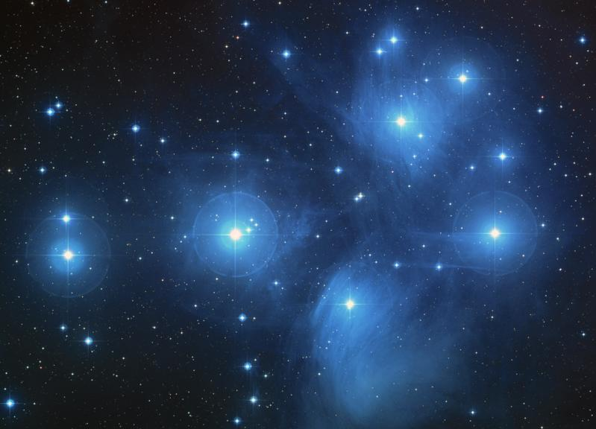
Reflection Nebulae: Pleiades
Notes:
The brilliant stars seen in this image are members of the popular open star cluster known as the Pleiades, or Seven Sisters. The Hubble Space Telescope's Fine Guidance Sensors refined the distance to the Pleiades at about 440 light-years. The Fine Guidance Sensors are at the periphery of Hubble's field-of-view. They trace a circumference that is approximately the angular size of the Moon on the sky. They are overlaid on this image to give a scale to Hubble's very narrow view on the heavens.
Hubble Fine Guidance Sensors measured slight changes in the apparent positions of three stars within the cluster when viewed from different sides of Earth's orbit. Astronomers took their measurements six months apart over a 2 1/2-year period. About 1,000 stars comprise the cluster, located in the constellation Taurus.
The color-composite image of the Pleiades star cluster was taken by the Palomar 48-inch Schmidt telescope. The image is from the second Palomar Observatory Sky Survey, and is part of the Digitized Sky Survey. The Pleiades photo was made from three separate images taken in red, green, and blue filters. The separate images were taken between Nov. 5, 1986 and Sept. 11, 1996.
Dust is responsible for the blue haze around the Pleiades star cluster (Messier Database, (Web Nebulae); this nebulosity is called a reflection nebula resulting from blue light from the hot B-stars being scattered toward us from dust surrounding the cluster stars.

Slide 43
Reflection Nebulae: Pleiades, multiwavelength

Slide 44
Planetary Nebulae
Planetary nebulae form from the gaseous shells that are ejected from low-mass red giants when they transform into white dwarfs.
These are emission nebulae.
Technically, they are a type of HII region because the majority of hydrogen will be ionised. However, planetary nebulae are denser and more compact.
Planetary nebulae are so called because the first astronomers who observed these objects thought that the nebulae resembled the disks of planets, although they are not at all related to planets.

Slide 45
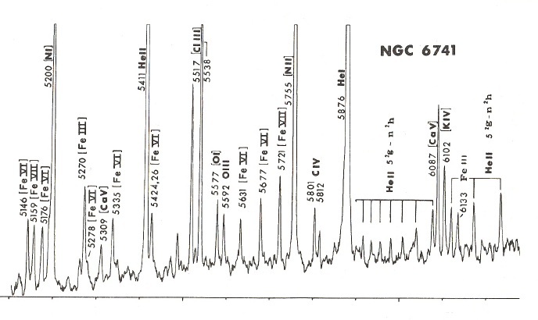
Planetary Nebulae: NGC6741

Slide 46
Nebular Ejecta from a Dying Star
Some nebulae are produced by ejecta from a dying star.
They are primarily emission nebulae.

Slide 47
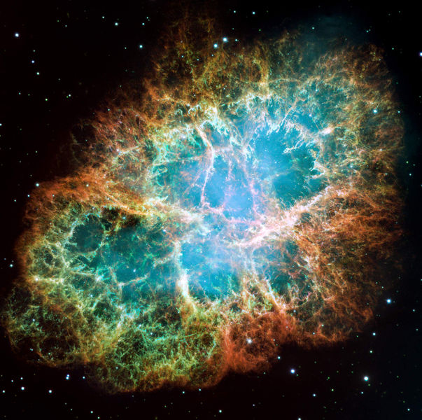
Nebular Ejecta from a Dying Star: Crab
Notes:
This is a mosaic image, one of the largest ever taken by NASA's Hubble Space Telescope of the Crab Nebula, a six-light-year-wide expanding remnant of a star's supernova explosion. Japanese and Chinese astronomers recorded this violent event nearly 1,000 years ago in 1054, as did, almost certainly, Native Americans.
The orange filaments are the tattered remains of the star and consist mostly of hydrogen. The rapidly spinning neutron star embedded in the center of the nebula is the dynamo powering the nebula's eerie interior bluish glow. The blue light comes from electrons whirling at nearly the speed of light around magnetic field lines from the neutron star. The neutron star, like a lighthouse, ejects twin beams of radiation that appear to pulse 30 times a second due to the neutron star's rotation. A neutron star is the crushed ultra-dense core of the exploded star.
The Crab Nebula derived its name from its appearance in a drawing made by Irish astronomer Lord Rosse in 1844, using a 36-inch telescope. When viewed by Hubble, as well as by large ground-based telescopes such as the European Southern Observatory's Very Large Telescope, the Crab Nebula takes on a more detailed appearance that yields clues into the spectacular demise of a star, 6,500 light-years away.
The newly composed image was assembled from 24 individual Wide Field and Planetary Camera 2 exposures taken in October 1999, January 2000, and December 2000. The colors in the image indicate the different elements that were expelled during the explosion. Blue in the filaments in the outer part of the nebula represents neutral oxygen, green is singly-ionized sulfur, and red indicates doubly-ionized oxygen.

Slide 48
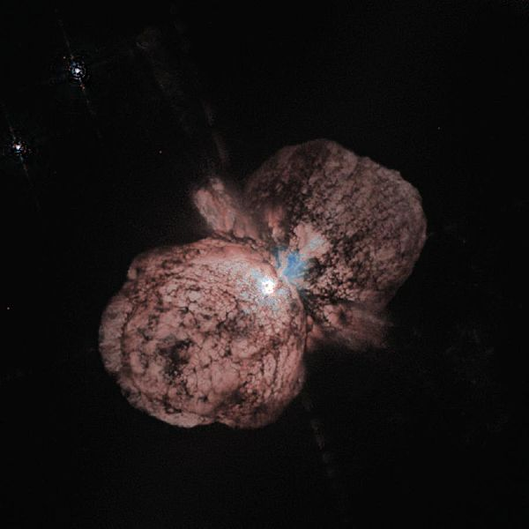
Nebular Ejecta from a Dying Star: Eta Car
Notes:
A huge, billowing pair of gas and dust clouds is captured in this stunning Hubble telescope picture of the super-massive star Eta Carinae.
Even though Eta Carinae is more than 8,000 light-years away, features 10 billion miles across (about the diameter of our solar system) can be distinguished. Eta Carinae suffered giant outburst about 150 years ago, when it became one of the brightest stars in the southern sky. Though the star released as much visible light as a supernova explosion, it survived the outburst. Somehow, the explosion produced two lobes and a large, thin equatorial disk, all moving outward at about 1.5 million miles per hour. Estimated to be 100 times heftier than our Sun, Eta Carinae may be one of the most massive stars in our galaxy.

Slide 49
Molecular Clouds
Giant Molecular Clouds are larger versions of the dark clouds and may contain thousands of times the mass of the Sun in gas.
Dark nebulae are small molecular clouds that absorb/blocks light (so, they are seen in projection).
Both types of clouds are made of molecular hydrogen gas and dust (n~10³⁻⁵ cm⁻³).
They often fragment into self-gravitating clumps that eventually form stars.
Notes:
Vast assemblages of molecular gas with masses of 104–106 times the mass of the sun are called Giant molecular clouds (GMC). The clouds can reach tens of parsecs in diameter and have an average density of 102–103 particles per cubic centimetre (the average density in the solar vincinty is one particle per cubic centimetre). Substructure within these clouds is a complex pattern of filaments, sheets, bubbles, and irregular clumps.[4]
The densest parts of the filaments and clumps are called "molecular cores", whilst the densest molecular cores are, unsurprisingly, called "dense molecular cores" and have densities in excess of 104–106 particles per cubic centimeter. Observationally molecular cores are traced with carbon monoxide and dense cores are traced with ammonia. The concentration of dust within molecular cores is normally sufficient to block light from background stars such that they appear in silhouette as dark nebulae.[6]
GMCs are so large that "local" ones can cover a significant fraction of a constellation such that they are often referred to by the name of that constellation, e.g. the Orion Molecular Cloud (OMC) or the Taurus Molecular Cloud (TMC). These local GMCs are arrayed in a ring around the sun called the Gould Belt. [7]The most massive collection of molecular clouds in the galaxy, the Sagittarius B2 complex, forms a ring around the galactic centre at a radius of 120 parsec. The Sagittarius region is chemically rich and is often used as an exemplar by astronomers searching for new molecules in interstellar space.[8]
A dark nebula is a type of interstellar cloud that is so dense that it obscures the light from the background emission or reflection nebula (e.g., the Horsehead Nebula) or that it blocks out background stars (e.g., the Coalsack Nebula).
The extinction of the light is caused by interstellar dust grains located in the coldest, densest parts of larger molecular clouds. Clusters and large complexes of dark nebulae are associated with Giant Molecular Clouds. Isolated small dark nebulae are called Bok globules.
The form of such dark clouds is very irregular: they have no clearly defined outer boundaries and sometimes take on convoluted serpentine shapes. The largest dark nebulae are visible to the naked eye, appearing as dark patches against the brighter background of the Milky Way.
In the inner regions of dark nebulae important events take place, such as the formation of stars and masers.

Slide 50
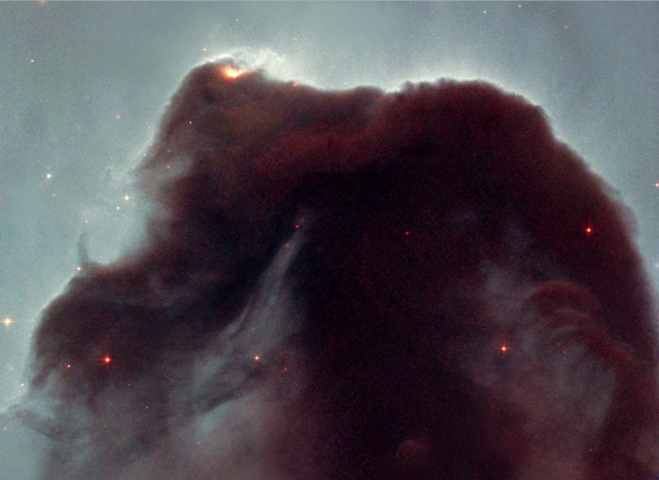
Dark Clouds: Horsehead Nebula
Notes:
The Horsehead is a cold, dark cloud of gas and dust, silhouetted against the bright nebula, IC 434. The bright area at the top left edge is a young star still embedded in its nursery of gas and dust. But radiation from this hot star is eroding the stellar nursery. The top of the nebula also is being sculpted by radiation from a massive star located out of Hubble's field of view.

Slide 51
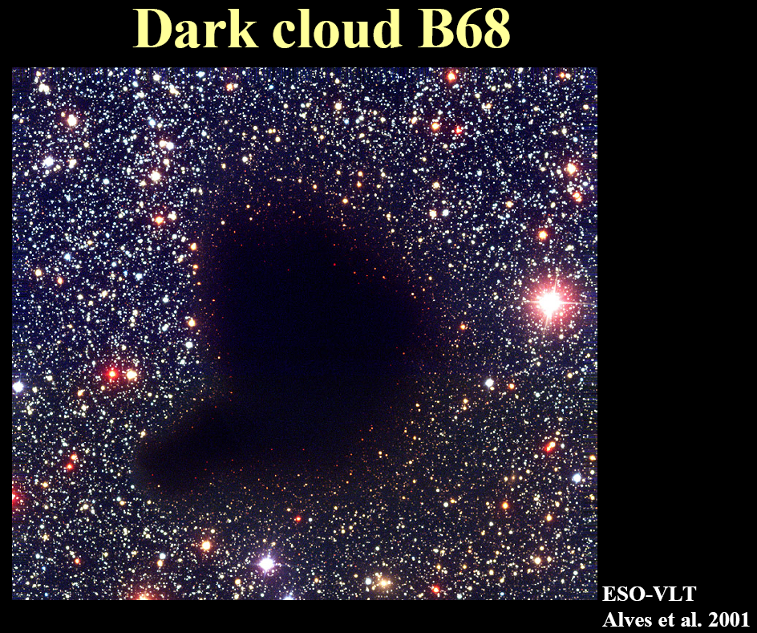
Dark Clouds: Barnard 68

Slide 52
Dark Clouds: Collapse and Jean’s Mass

Slide 53
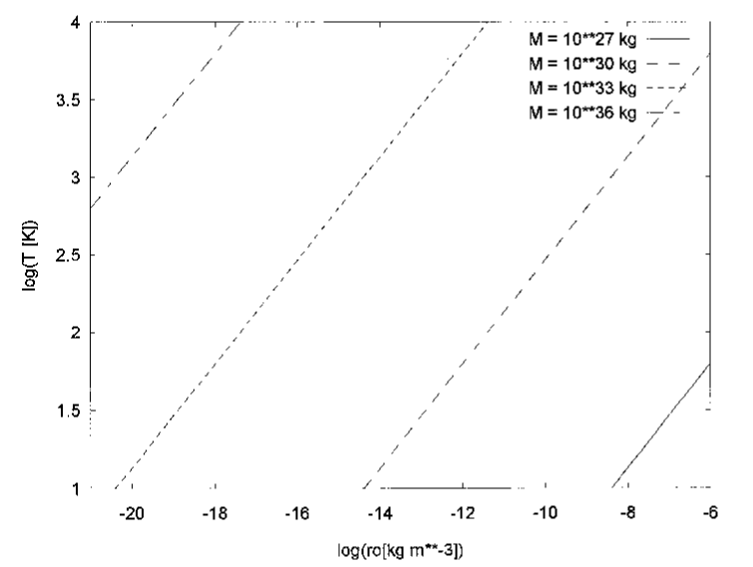
Dark Clouds: Jean’s Mass Examples
For a globular cluster, M~10⁶ M_{Sun}~10³⁶ kg. Assuming an ionized gas state during the epoch of the early Galaxy, T~10⁴ K. So, ρ~10⁻¹⁸ kg/m³=10⁻²¹ g/cm³, or about a thousand times the density of the present-day ISM.
For the Sun, the density needs to be about a million times greater still, assuming T~50 K.
For Jupiter, the density needs to be ~10⁻⁷ kg/m³, or 10¹⁴ particles cm⁻³, assuming T~30 K.

Slide 54
Galaxies
Galaxies are large self-gravitating collections of millions of stars.
The average galaxy contains a few hundred billion stars.
Broadly categorized into
  spiral
  elliptical
  irregular
  interacting

Slide 55
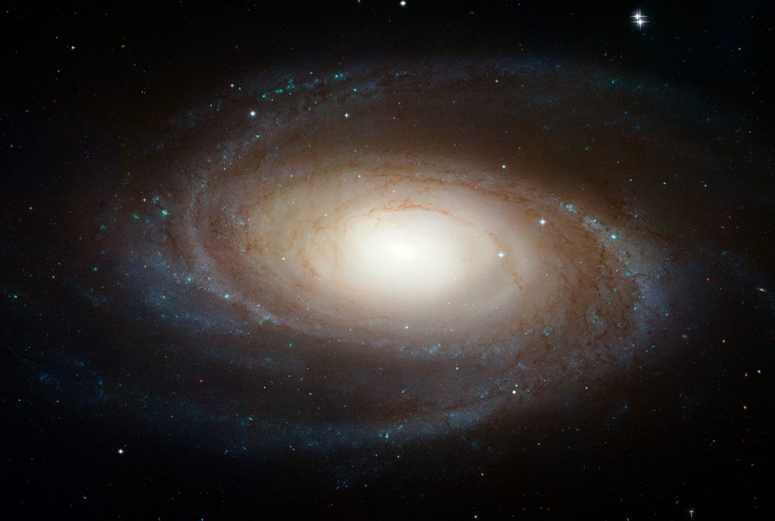
Galaxies: M81 Spiral Galaxy
Notes:
The sharpest image ever taken of the large "grand design" spiral galaxy M81 is being released today at the American Astronomical Society Meeting in Honolulu, Hawaii.
This beautiful galaxy is tilted at an oblique angle on to our line of sight, giving a "birds-eye view" of the spiral structure. The galaxy is similar to our Milky Way, but our favorable view provides a better picture of the typical architecture of spiral galaxies. Though the galaxy is 11.6 million light-years away, NASA Hubble Space Telescope's view is so sharp that it can resolve individual stars, along with open star clusters, globular star clusters, and even glowing regions of fluorescent gas.
The spiral arms, which wind all the way down into the nucleus, are made up of young, bluish, hot stars formed in the past few million years. They also host a population of stars formed in an episode of star formation that started about 600 million years ago. The greenish regions are dense areas of bright star formation. The ultraviolet light from hot young stars are fluorescing the surrounding clouds of hydrogen gas. A number of sinuous dust lanes also wind all the way into the nucleus of M81.
The galaxy's central bulge contains much older, redder stars. It is significantly larger than the Milky Way's bulge. A black hole of 70 million solar masses resides at the center of M81. The black hole is about 15 times the mass of the Milky Way's black hole. Previous Hubble research shows that the size of the central black hole in a galaxy is proportional to the mass of a galaxy's bulge.
M81 may be undergoing a surge of star formation along the spiral arms due to a close encounter it may have had with its nearby spiral galaxy NGC 3077 and a nearby starburst galaxy (M82) about 300 million years ago. Astronomers plan to use the Hubble image to study the star formation history of the galaxy and how this history relates to the neutron stars and black holes seen in X-ray observations of M81 with NASA's Chandra X-ray Observatory.
M81 is one of the brightest galaxies that can be seen from the Earth. It is high in the northern sky in the circumpolar constellation Ursa Major, the Great Bear. At an apparent magnitude of 6.8 it is just at the limit of naked-eye visibility. The galaxy's angular size is about the same as that of the Full Moon.
The Hubble data was taken with the Advanced Camera for Surveys in 2004 through 2006. This color composite was assembled from images taken in blue, visible, and infrared light.

Slide 56
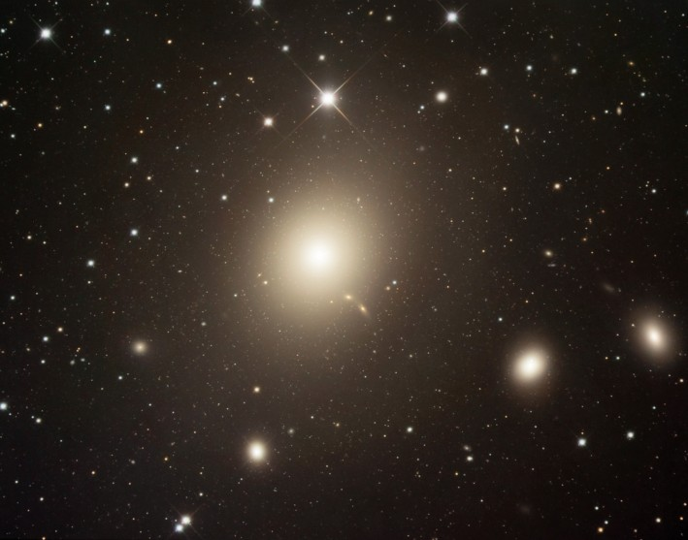
Galaxies: M87 Elliptical Galaxy
Notes:
In spiral galaxies, majestic winding arms of young stars and interstellar gas and dust rotate in a flat disk around a bulging galactic nucleus. But elliptical galaxies seem to be simpler. Lacking gas and dust to form new stars, their randomly swarming older stars, give them an ellipsoidal (egg-like) shape. Still, elliptical galaxies can be very large. Over 120,000 light-years in diameter (larger than our own Milky Way), elliptical galaxy M87 is the dominant galaxy at the center of the Virgo Galaxy Cluster, some 50 million light-years away. M87 is likely home to a supermassive black hole responsible for the high-energy jet of particles emerging from the giant galaxy's central region.

Slide 57
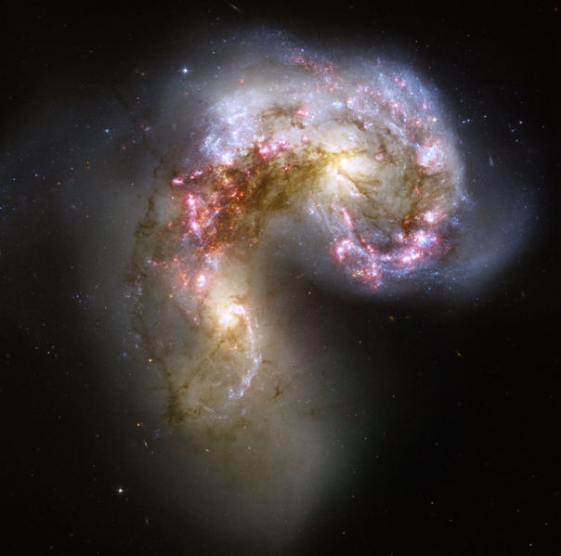
Galaxies: Antennae Interacting Galaxies
Notes:
This new NASA Hubble Space Telescope image of the Antennae galaxies (NGC 4038 & 4039) is the sharpest yet of this merging pair of galaxies. During the course of the collision, billions of stars will be formed. The brightest and most compact of these star birth regions are called super star clusters.
The two spiral galaxies started to interact a few hundred million years ago, making the Antennae galaxies one of the nearest and youngest examples of a pair of colliding galaxies. Nearly half of the faint objects in the Antennae image are young clusters containing tens of thousands of stars. The orange blobs to the left and right of image center are the two cores of the original galaxies and consist mainly of old stars criss-crossed by filaments of dust, which appear brown in the image. The two galaxies are dotted with brilliant blue star-forming regions surrounded by glowing hydrogen gas, appearing in the image in pink. Source: http://imgsrc.hubblesite.org/hu/db/2006/46/images/a/formats/full_jpg.jpg

Slide 58
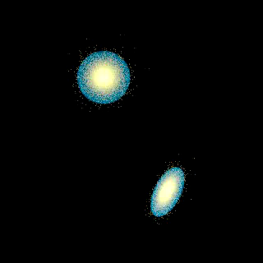
Notes:
This new NASA Hubble Space Telescope image of the Antennae galaxies (NGC 4038 & 4039) is the sharpest yet of this merging pair of galaxies. During the course of the collision, billions of stars will be formed. The brightest and most compact of these star birth regions are called super star clusters.
The two spiral galaxies started to interact a few hundred million years ago, making the Antennae galaxies one of the nearest and youngest examples of a pair of colliding galaxies. Nearly half of the faint objects in the Antennae image are young clusters containing tens of thousands of stars. The orange blobs to the left and right of image center are the two cores of the original galaxies and consist mainly of old stars criss-crossed by filaments of dust, which appear brown in the image. The two galaxies are dotted with brilliant blue star-forming regions surrounded by glowing hydrogen gas, appearing in the image in pink. Source: http://imgsrc.hubblesite.org/hu/db/2006/46/images/a/formats/full_jpg.jpg

Slide 59
Galaxies: Antennae, multiwavelength

Slide 60
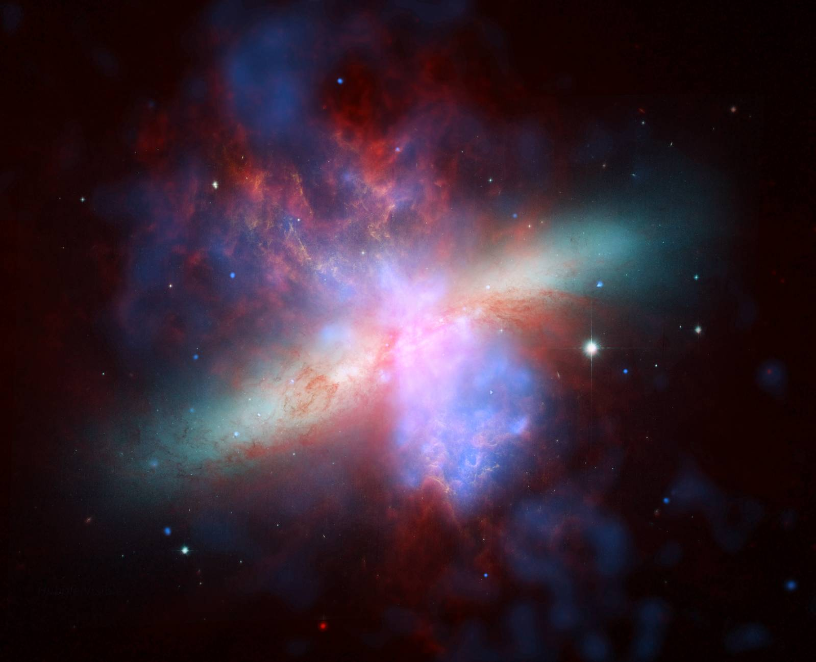
Galaxies: M82 (optical, IR, and x-ray)
Composite of Chandra, HST and Spitzer images. X-ray data recorded by Chandra appears in blue; infrared light recorded by Spitzer appears in red; Hubble's observations of hydrogen emission appear in orange, and the bluest visible light appears in yellow-green.
Notes:
This mosaic image is the sharpest wide-angle view ever obtained of M82. The galaxy is remarkable for its bright blue disk, webs of shredded clouds, and fiery-looking plumes of glowing hydrogen blasting out of its central regions.
Throughout the galaxy's center, young stars are being born 10 times faster than they are inside our entire Milky Way Galaxy. The resulting huge concentration of young stars carved into the gas and dust at the galaxy's center. The fierce galactic superwind generated from these stars compresses enough gas to make millions of more stars.
In M82, young stars are crammed into tiny but massive star clusters. These, in turn, congregate by the dozens to make the bright patches, or "starburst clumps," in the central parts of M82. The clusters in the clumps can only be distinguished in the sharp Hubble images. Most of the pale, white objects sprinkled around the body of M82 that look like fuzzy stars are actually individual star clusters about 20 light-years across and contain up to a million stars.
The rapid rate of star formation in this galaxy eventually will be self-limiting. When star formation becomes too vigorous, it will consume or destroy the material needed to make more stars. The starburst then will subside, probably in a few tens of millions of years.
Located 12 million light-years away, M82 appears high in the northern spring sky in the direction of the constellation Ursa Major, the Great Bear. It is also called the "Cigar Galaxy" because of the elliptical shape produced by the oblique tilt of its starry disk relative to our line of sight.
The observation was made in March 2006, with the Advanced Camera for Surveys' Wide Field Channel. Astronomers assembled this six-image composite mosaic by combining exposures taken with four colored filters that capture starlight from visible and infrared wavelengths as well as the light from the glowing hydrogen filaments.

Slide 61
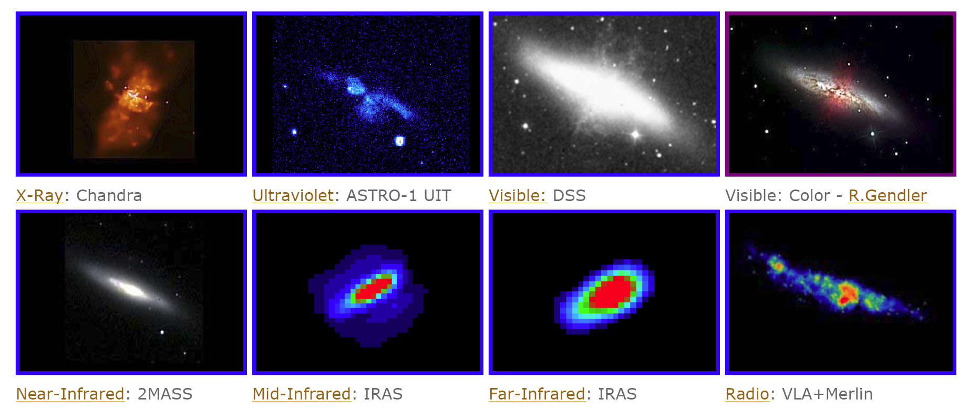
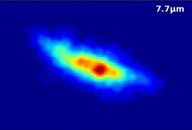
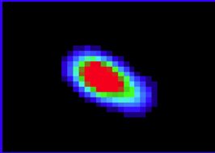
Galaxies: M82, multiwavelength
Notes:
M82. http://coolcosmos.ipac.caltech.edu//cosmic_classroom/multiwavelength_astronomy/multiwavelength_museum/m82.html

Slide 62
Galaxies: Cen A
Notes:
Centaurus A, also known as NGC 5128, is a peculiar galaxy in the constellation of Centaurus. It is gravitationally bound into a group of galaxies which also contains Messier 83. Its common name derives from the early days of radio astronomy (1940s and 1950s), when astronomers named radio sources by letter (A,B,C), with "A" designating the strongest source in a given constellation.

Slide 63
Star Clusters
Star clusters are collections of (usually) gravitationally bound stars.
Stars cluster because they are born that way.
Clusters tend to lose members over time through tidal stripping.
Some process created the population of rich globular clusters, each having 10⁵⁻⁶ stars.
Present-day young clusters have 10²⁻⁵ solar masses in stars.
Notes:
Optical and 6cm image of Cen A.

Slide 64
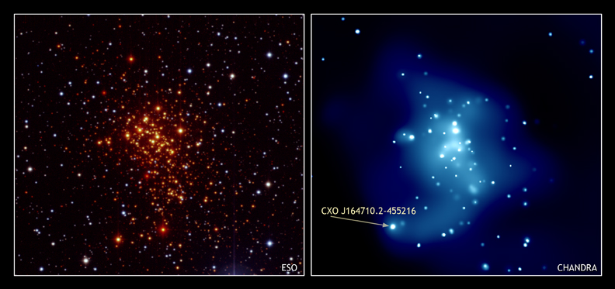
Star Clusters: Westerlund 1
Notes:
The optical image (left) of Westerlund 1 shows a dense cluster of young stars, several with masses of about 40 suns. Some astronomers speculated that repeated collisions between such massive stars in the cluster might have led to formation of an intermediate-mass black hole, more massive than 100 suns. A search of the cluster with Chandra (right) found no evidence for this type of black hole. Instead they found a neutron star (CXO J164710.2-455216), a discovery which may severely limit the range of stellar masses that lead to the formation of stellar black holes.

Slide 65
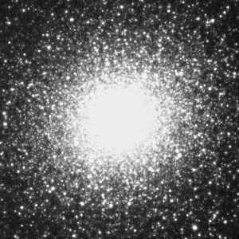
Star Clusters: M13
Notes:
Perhaps the most familiar of globular star clusters, Messier 13 is found in the constellation of Hercules and contains more than 100,000 stars that are bound by gravity into a spherical configuration.

Slide 66
Star Clusters and IR Observations
Infrared observations allow one to see “deeper” into the Galaxy.
Most known young star clusters are near the Sun. The sample is woefully incomplete.
Imaging and spectroscopy can yield a great deal of information, especially when placed within the context of multi-wavelength observations.

Slide 67

Lick 3-m (1994)

Slide 68
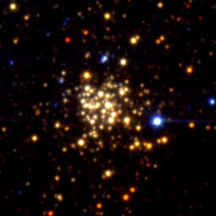
Keck 10-m (1997)

Slide 69
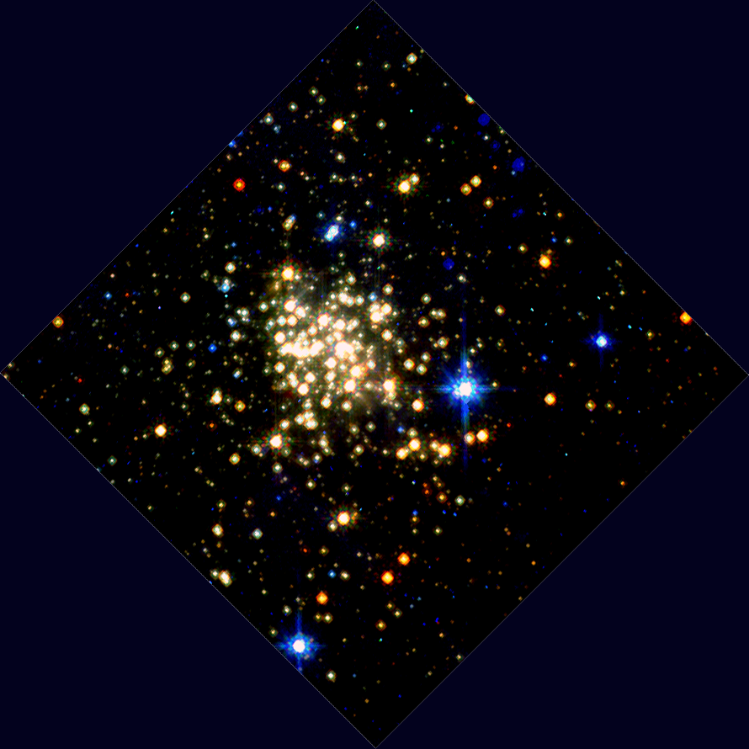
HST/NICMOS (1997)

Slide 70
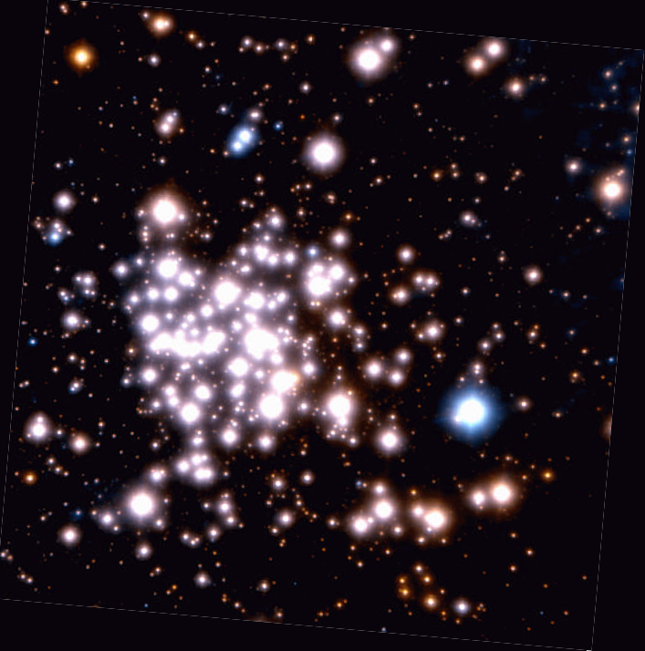
VLT/AO (2002)

Slide 71
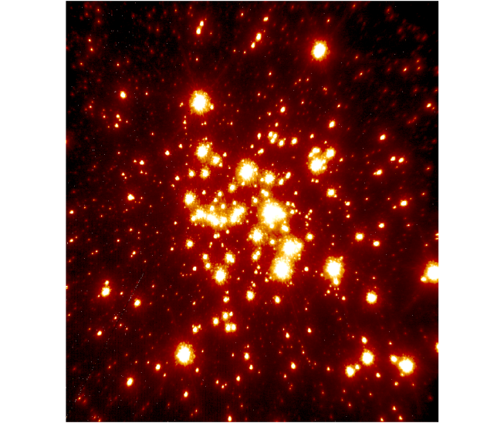
Keck/LGSAO (2006)

Slide 72
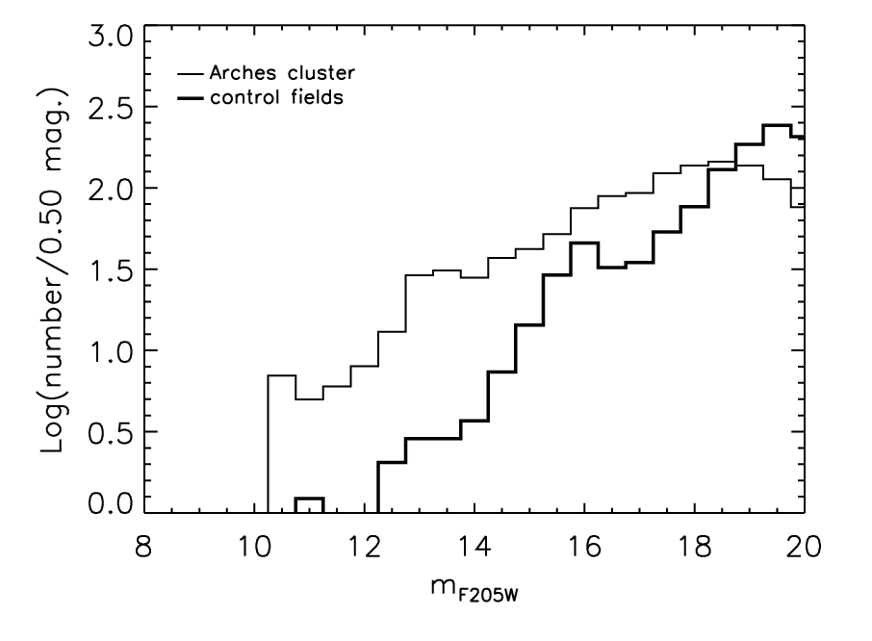
Luminosity function

Slide 73
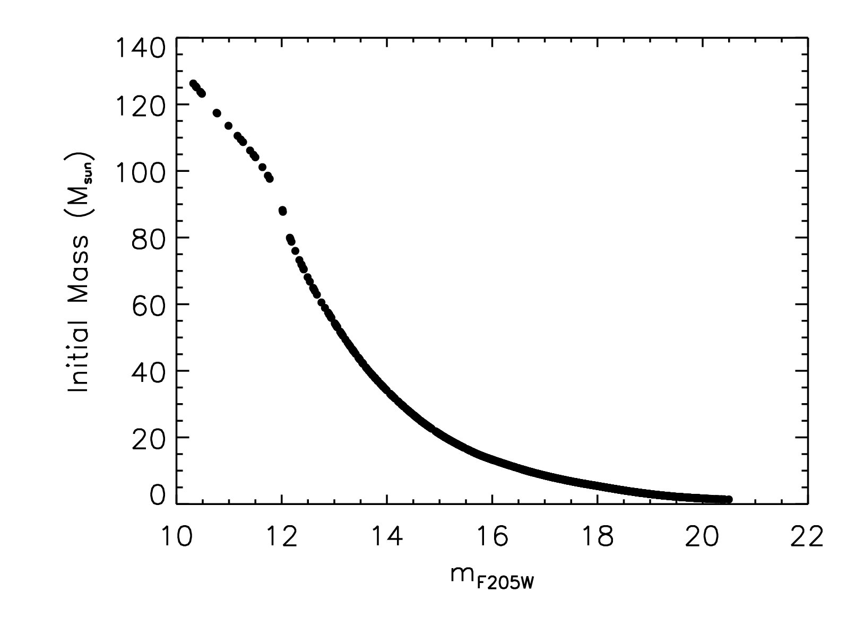
Mass vs. magnitude for t=2 Myr

Slide 74
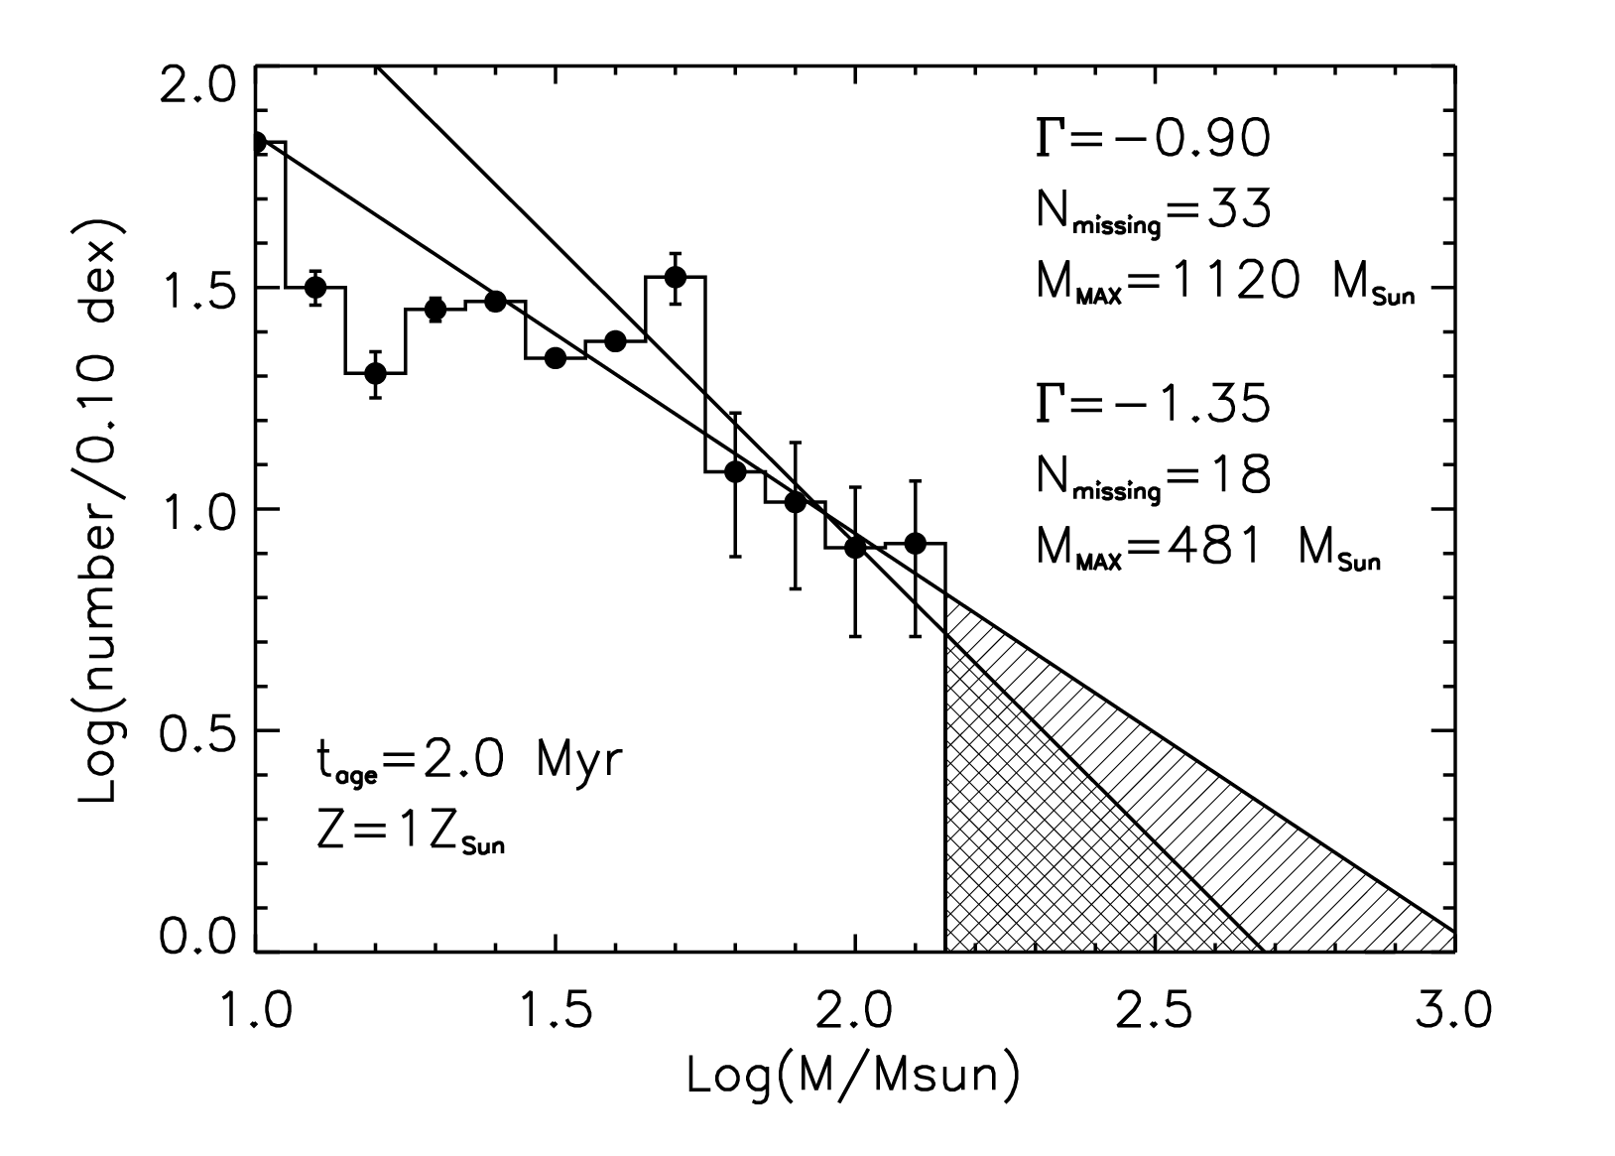
Initial mass function

Slide 75
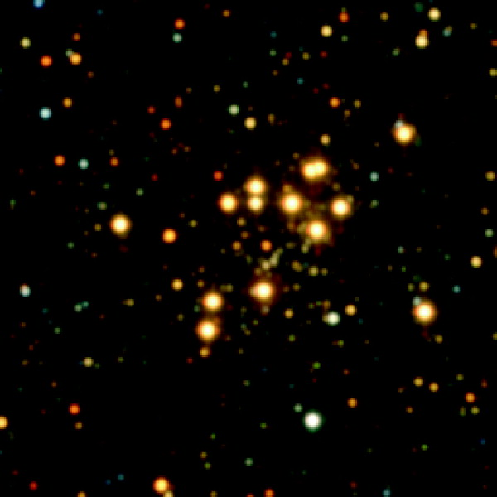
Red Supergiant Cluster #1: 2MASS

Slide 76
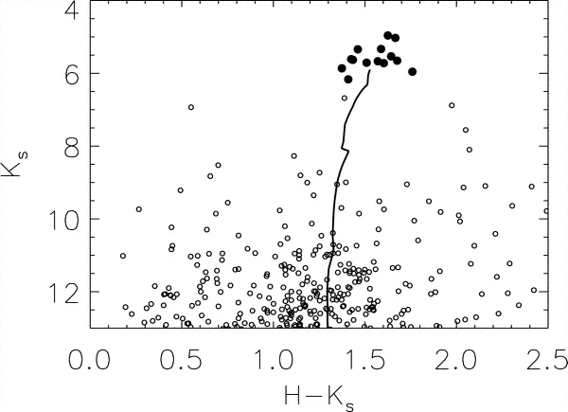
Red Supergiant Cluster #1: CMD
2MASS CMD of stars within 3’ of the center of the RSG cluster showing the RSGs (filled circles) and the fainter field stars (open circles). A 10 Myr isochrone is overplotted, assuming the Geneva models with solar metallicity (Schaerer et al. 1993), a distance of 5.8 kpc, A_{Ks}= 2.74, and the reddening law of Rieke et al. (1989). The color spread for the RSGs scales roughly with inferred spectral type; i.e., later types areredder. The sample has been culled of stars with reported errors greater than 0.1 mag in K_{s}.

Slide 77
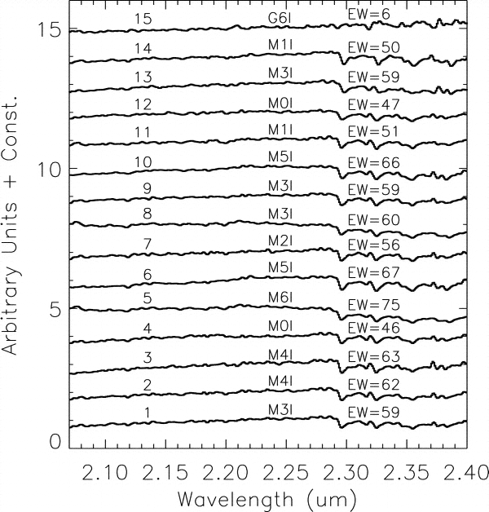
Red Supergiant Cluster #1: K-band Spectra
IRMOS spectra of RSG cluster stars. The equivalent width of the 12CO band head, in angstroms, and the corresponding spectral subtype are given. Note that all spectra show deep CO absorption, except for object 15, which is the next brightest star after the 14 brightest stars in the cluster. Fromits spectrum and photometric color we suggest that this star is a G-type supergiant.

Slide 78
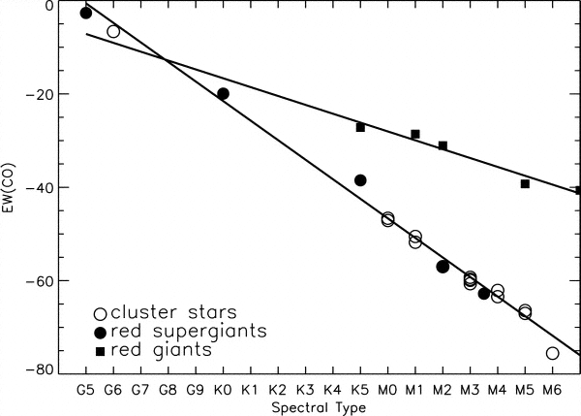
Red Supergiant Cluster #1: CO Bandhead
Relation between 12CO equivalent width, as defined in the text, and spectral subtype for cluster stars (open circles), template RSGs (filled circles), and template red giants (squares). Lines are drawn through the best fits between equivalent width and subtype for the template stars.

Slide 79
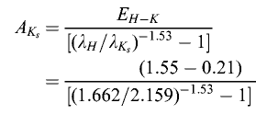
Red Supergiant Cluster #1: Extinction
We estimate extinction by adopting average intrinsic colors for M supergiants of H-K = 0.21 and J-K = 0.89 (Elias et al. 1985) and comparing these to the average colors of the RSGs in the cluster.We identify the difference between the two as the color excess and convert it into A_{K} using the relation in Rieke et al. (1989), finding from E_{H-K}. In this example, the K-band extinction is 2.73.
Notes:
Dear Students,
Here is the derivation of the relation between extinction and color excess. It clarifies the meaning of the terms that are used.
The "color excess" is the difference between the observed and intrinsic color, where "color" is defined to be the difference in brightness in two different bands. Using H and K, then, the color excess is:
E(H-K) = (H - K) - (H - K)_0
where the zero subscript indicates the intrinsic color.
Rearranging terms, the color excess can be expressed as the difference in extinction in the two wavebands:
E(H-K) = (H - H_0) - (K - K_0) = A_H - A_K
Dividing both sides of the equation by A_K, one finds:
E(H-K)/A_K = (A_H - A_K)/A_K = A_H/A_K - 1
Solving for A_K,
A_K = E(H-K)/(A_H/A_K - 1)
The ratio of extinctions is given by the extinction law
A(lambda_1) = A(lambda_2)*(lambda_1/lambda_2)^alpha
so,
A_K = E(H-K)/((lambda_H/lambda_K)^alpha - 1)
The central wavelengths of the wavebands are:
lambda_H = 1.66 um
lambda_K = 2.20 um
For a typical extinction law,
alpha -1.53
So,
A_K = E(H-K)/((1.65/2.20)^-1.53 - 1) = 1.8E(H-K)
By examining the slides regarding the red supergiant cluster, one can see that the observed color is approximately 1.55 in H-K. Knowing that the stars are red supergiants, the intrinsic color is 0.21.
So,
A_K = 1.8*(1.55 - 0.21) = 2.5
Note that this is slightly different than the result found on slide 73 of the lecture because the K_s filter was used and it has a central wavelength that is slightly less than the K filter.

Slide 80
Estimating Extinction from Color Excess
The "color excess" is the difference between the observed and intrinsic color, where "color" is defined to be the difference in brightness in two different bands. Using H and K, then, the color excess is:
E(H-K) = (H - K) - (H - K)_0
where the zero subscript indicates the intrinsic color.
Rearranging terms, the color excess can be expressed as the difference in extinction in the two wavebands:
E(H-K) = (H - H_0) - (K - K_0) = A_H - A_K
Dividing both sides of the equation by A_K, one finds:
E(H-K)/A_K = (A_H - A_K)/A_K = A_H/A_K - 1
Solving for A_K,
A_K = E(H-K)/(A_H/A_K - 1)
The ratio of extinctions is given by the extinction law
A(lambda_1) = A(lambda_2)*(lambda_1/lambda_2)^alpha
so,
A_K = E(H-K)/((lambda_H/lambda_K)^alpha - 1)
The central wavelengths of the wavebands are:
lambda_H = 1.66 um
lambda_K = 2.20 um
For a typical extinction law,
alpha -1.53
So,
A_K = E(H-K)/((1.65/2.20)^-1.53 - 1) = 1.8E(H-K)
By examining the slides regarding the red supergiant cluster, one can see that the observed color is approximately 1.55 in H-K. Knowing that the stars are red supergiants, the intrinsic color is 0.21.
So,
A_K = 1.8*(1.55 - 0.21) = 2.5
Notes:
Dear Students,
Here is the derivation of the relation between extinction and color excess. It clarifies the meaning of the terms that are used.
The "color excess" is the difference between the observed and intrinsic color, where "color" is defined to be the difference in brightness in two different bands. Using H and K, then, the color excess is:
E(H-K) = (H - K) - (H - K)_0
where the zero subscript indicates the intrinsic color.
Rearranging terms, the color excess can be expressed as the difference in extinction in the two wavebands:
E(H-K) = (H - H_0) - (K - K_0) = A_H - A_K
Dividing both sides of the equation by A_K, one finds:
E(H-K)/A_K = (A_H - A_K)/A_K = A_H/A_K - 1
Solving for A_K,
A_K = E(H-K)/(A_H/A_K - 1)
The ratio of extinctions is given by the extinction law
A(lambda_1) = A(lambda_2)*(lambda_1/lambda_2)^alpha
so,
A_K = E(H-K)/((lambda_H/lambda_K)^alpha - 1)
The central wavelengths of the wavebands are:
lambda_H = 1.66 um
lambda_K = 2.20 um
For a typical extinction law,
alpha -1.53
So,
A_K = E(H-K)/((1.65/2.20)^-1.53 - 1) = 1.8E(H-K)
By examining the slides regarding the red supergiant cluster, one can see that the observed color is approximately 1.55 in H-K. Knowing that the stars are red supergiants, the intrinsic color is 0.21.
So,
A_K = 1.8*(1.55 - 0.21) = 2.5
Note that this is slightly different than the result found on slide 73 of the lecture because the K_s filter was used and it has a central wavelength that is slightly less than the K filter.

Slide 81
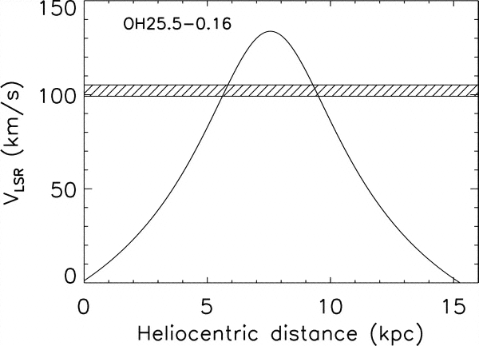
Red Supergiant Cluster #1: Distance
Plot of VLSR vs. distance along the line of sight to the cluster, assuming the Galactic rotation curve in Brand & Blitz (1993). The crosshatched region represents the velocity of the OH 25.5-0.16 maser associated with the envelope of one of the RSGs in the cluster (star No. 9). The distance to the cluster is taken to be 5.8 kpc, corresponding to the "near-side" solution. Note that the "far-side" solution would require anomalously high luminositiesfor the RSGs.

Slide 82
Red Supergiant Cluster #1: Results
Observations give:
  fluxes
  spectral features
  spectral types
Analyses give:
  distance
  luminosities
  masses
  ages

Slide 83
IDL
IDL (Interactive Data Language) is a software environment often used for astronomical data reduction and analysis.
It is the most pervasive data reduction and analysis language for astronomy.
It is sold by ITT.
It was originally developed for analyzing data from NASA missions.
It is most similar to FORTRAN.
IDL can be run in compiled and interpretive mode.
It is vectorized.
It has powerful features that allow debugging, e.g. breakpoints.
Many astronomy programs have been written and are publicly available, e.g. the “astron” package.
IDL is available to you on CIS computers.
Notes:
IDL is vectorized, numerical, and interactive, and it is commonly used for interactive processing of large amounts of data (including image processing). The syntax includes many constructs from Fortran and some from C.
IDL originated from early VAX/VMS/Fortran.

Slide 84
IDL and Vectorization (from Wikipedia)
IDL can operate on vectors
x = findgen(100)/10
y = sin(x)/x
plot,x,y
(The findgen function in the above example returns a one-dimensional array of floating point numbers, with values equal to a series of integers starting at 0.)
Note that the operation in the second line applies in a vectorized manner to the whole 100-element array created in the first line, analogous to the way general-purpose array programming languages (such as APL or J) would do it. This example contains a divide by zero; IDL will report an arithmetic overflow, and store a NaN value in the corresponding element of the y array (the first one), but the other array elements will be finite. The NaN is excluded from the visualisation generated by the plot command.
As most other array programming languages, IDL is very fast doing vector operations (sometimes as fast as a well-coded custom loop in FORTRAN or C) but quite slow if elements need processing individually. Hence part of the art of using IDL (or any other array programming language, for that matter) for numerically heavy computations is to make use of the inbuilt vector operations.DL (Interactive Data Language) is a software environment often used for astronomical data reduction and analysis.
Notes:
IDL is vectorized, numerical, and interactive, and it is commonly used for interactive processing of large amounts of data (including image processing). The syntax includes many constructs from Fortran and some from C.
IDL originated from early VAX/VMS/Fortran.

Slide 85
IDL Features (from Wikipedia)
As a computer language, IDL:
  is dynamically typed.
  has a single namespace.
  was originally single threaded but now has many multi-threaded functions and procedures.
  has all function arguments passed by reference ("IN-OUT"); but see "problems", below.
  has named parameters called keywords which are passed by reference.
  provides named parameter inheritance in nested routine calls, by reference or value.
  does not require variables to be predeclared.
  provides only COMMON block declarations to share global values among routines.
  implements a persistent, global heap of pointer and object variables.
  provides a simple and efficient index slice syntax to extract data from large arrays.
  provides various integer sizes, as well as single and double precision floating point real and complex numbers.
  provides composite data types such as character strings, homogeneous-type arrays, and simple (non-hierarchical) record structures of mixed data types.
Notes:
IDL is vectorized, numerical, and interactive, and it is commonly used for interactive processing of large amounts of data (including image processing). The syntax includes many constructs from Fortran and some from C.
IDL originated from early VAX/VMS/Fortran.

