Slide 1
Astronomical Observational Techniques and Instrumentation
Professor Don Figer
Emission mechanisms

Slide 2
Aims and outline for this lecture
describe properties of primary astronomical emission mechanisms
  blackbody
  bound-bound, bound-free, free-bound
  free-free
  synchrotron
  inverse-compton scattering
  molecular rotational-vibrational transitions
some mechanisms will not be discussed because they have more specialized application
  nuclear fusion (e.g. in stellar nucleosynthesis)
  particle/anti-particle annihilation
  pair production
  nuclear decay
  fluorescence/phosphorescence

Slide 3
Blackbody Radiation: Energy Transfer
There are three ways to transport or move energy from one location to another:
Conduction:
  particles interact with neighbors and share energy
Convection:
  bulk mixing of particles transports energy
Radiation:
  photons carry energy and are scattered/absorbed

Slide 4
Blackbody Radiation: Heat Transfer
All objects radiate and receive energy.
An object hotter than its surroundings will give off more energy than it receives
  with no internal heat (energy) source, it will radiatively cool
  given enough time, the object will equilibrate at the same temperature as its surroundings (at which point it will absorb as much energy as it emits)
An object cooler than its surroundings will absorb more energy than it receives
  sunlit surface of Earth gets hotter (Sun is hotter than Earth)
  darkside surface of Earth gets cooler (Earth is hotter than space)
Notes:
http://www.lpi.usra.edu/meetings/lpsc2003/pdf/1761.pdf
http://articles.adsabs.harvard.edu/cgi-bin/nph-iarticle_query?1976Moon...15..421F&amp;data_type=PDF_HIGH&amp;whole_paper=YES&amp;type=PRINTER&amp;filetype=.pdf

Slide 5

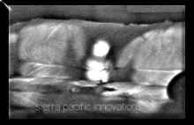
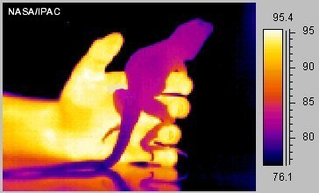
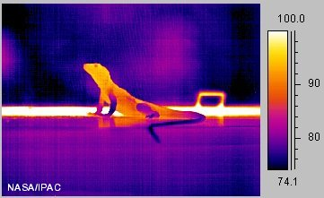
Blackbody Radiation: Objects
All objects emit radiation, although cooler objects emit radiation at wavelengths too long for our eyes to see.
Thermal emission from two adults and infant, measured in mid-infrared. Note that sofa remains warm after adults leave.
These thermal infrared images of a collard lizard show a cold-blooded animal's body temperature in a cooler and warmer environment. In the image to the left, the lizard is just above room temperature, being warmed by the human hand holding it. To warm up, lizards will seek a sunny area and bask in warm sunlight, as in the image to the right.

Slide 6
Blackbody Radiation: Planck’s Equation
Planck’s blackbody equation is:
For a star, this equation must be integrated over the outward hemisphere to get the radiated stellar flux, or brightness:

Slide 7
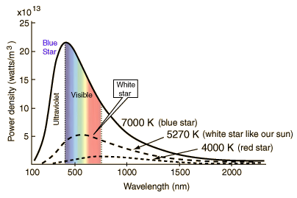
Blackbody Radiation: Curves
Notes:
Stars approximate blackbody radiators and their visible color depends upon the temperature of the radiator. The curves show blue, white, and red stars. The white star is adjusted to 5270K so that the peak of its blackbody curve is at the peak wavelength of the sun, 550 nm. From the wavelength at the peak, the temperature can be deduced from the Wien displacement law.

Slide 8
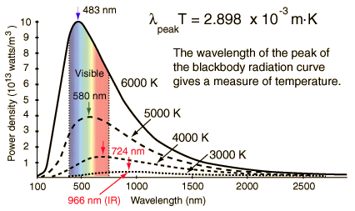
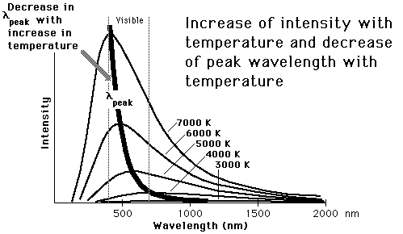
Blackbody Radiation: Wein’s Displacement Law
The wavelength at which the flux is maximum, is given by:
Notes:
The wavelength of the peak of the blackbody radiation curve decreases in a linear fashion as the temperature is increased (Wien's displacement law). This linear variation is not evident in this kind of plot since the intensity increases with the fourth power of the temperature (Stefan- Boltzmann law). The nature of the peak wavelength change is made more evident by plotting the fourth root of the intensity.

Slide 9
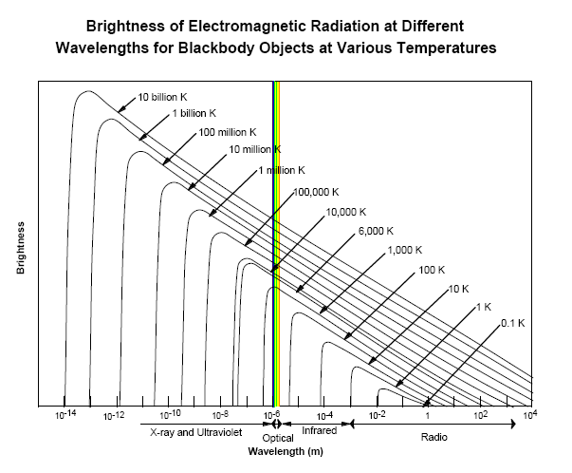
Blackbody Radiation: Wein’s Displacement Law
Notes:
The wavelength of the peak of the blackbody radiation curve decreases in a linear fashion as the temperature is increased (Wien's displacement law). This linear variation is not evident in this kind of plot since the intensity increases with the fourth power of the temperature (Stefan- Boltzmann law). The nature of the peak wavelength change is made more evident by plotting the fourth root of the intensity.

Slide 10
Blackbody Radiation: Stefan-Boltzmann Law

Slide 11
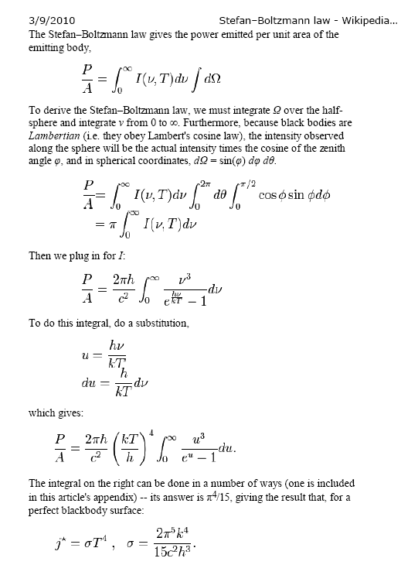
Blackbody Radiation: SB Law, derivation

Slide 12
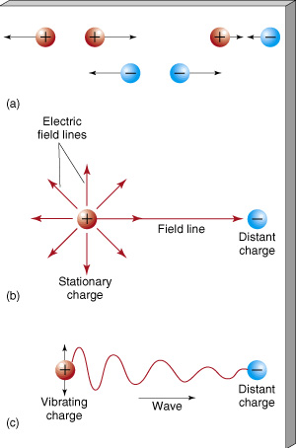
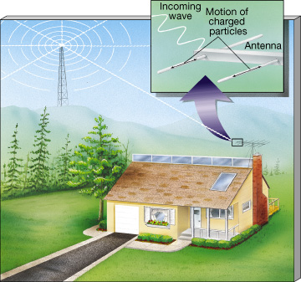
Interactions Between Charged Particles
Notes:
Charged Particles (a) Particles carrying like electrical charges repel one another, whereas particles carrying unlike charges attract. (b) A charged particle is surrounded by an electric field, which determines the particle’s influence on other charged particles. We represent the field by a series of field lines. (c) If a charged particle begins to vibrate back and forth, its electric field changes. The resulting disturbance travels through space as a wave.
Television Signal Charged particles in an ordinary household television antenna vibrate in response to electromagnetic radiation broadcast by a distant transmitter. The radiation is produced when electric charges are made to oscillate in the transmitter’s emitting antenna. The vibrations in the receiving antenna "echo" the oscillations in the transmitter, allowing the original information to be retrieved.

Slide 13
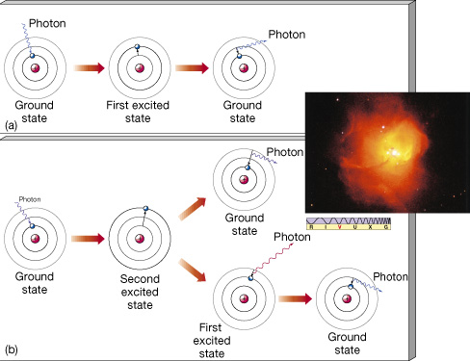
Bound-Bound Transitions
Notes:
Atomic Excitation (a) Diagram of a photon being absorbed by a hydrogen atom (left), causing the momentary excitation of that atom (center) into its first excited state. After about 10-8 s, the atom returns to its ground state, accompanied by the emission of a photon of the same energy as the original photon (right). (b) Absorption of a higher-energy photon may also boost the atom into a higher excited state, from which there may be several possible paths back to the ground state. (Remember that the sharp lines used for the orbitals here and in similar figures that follow are intended merely as a schematic representation of the electron energy levels and are not meant to be taken literally. In actuality, electron orbitals are "clouds," as shown in Figure 4.9.) As ultraviolet photons from a hot star pass through surrounding hydrogen gas, many are absorbed by the gas, boosting its atoms into excited states. Electrons in the second excited state can fall to the first excited state on their way back to the ground state (the lower path in part b). This transition produces radiation in the visible region of the spectrum—the 656.3-nm red glow that is characteristic of excited hydrogen gas. The object shown in the inset, designated N81, is an emission nebula: an interstellar cloud consisting largely of hydrogen gas excited by extremely hot star (as seen in white at the center). (Inset: NASA)

Slide 14
Transitions to/from the Free State
A transition from a bound to a free state represents ionization.
A transition from a free to a bound state represents recombination.
Notes:
Atomic Excitation (a) Diagram of a photon being absorbed by a hydrogen atom (left), causing the momentary excitation of that atom (center) into its first excited state. After about 10-8 s, the atom returns to its ground state, accompanied by the emission of a photon of the same energy as the original photon (right). (b) Absorption of a higher-energy photon may also boost the atom into a higher excited state, from which there may be several possible paths back to the ground state. (Remember that the sharp lines used for the orbitals here and in similar figures that follow are intended merely as a schematic representation of the electron energy levels and are not meant to be taken literally. In actuality, electron orbitals are "clouds," as shown in Figure 4.9.) As ultraviolet photons from a hot star pass through surrounding hydrogen gas, many are absorbed by the gas, boosting its atoms into excited states. Electrons in the second excited state can fall to the first excited state on their way back to the ground state (the lower path in part b). This transition produces radiation in the visible region of the spectrum—the 656.3-nm red glow that is characteristic of excited hydrogen gas. The object shown in the inset, designated N81, is an emission nebula: an interstellar cloud consisting largely of hydrogen gas excited by extremely hot star (as seen in white at the center). (Inset: NASA)

Slide 15
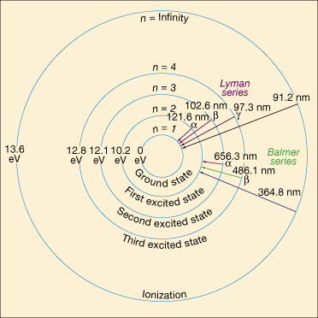
Hydrogen emission lines
Notes:
Transitions starting from or ending at the ground state (level 1) form the Lyman series. The first is Lyman alpha (Ly ), corresponding to the transition between the first excited state (level 2) and the ground state. As we have seen, the energy difference is 10.21 eV, and the Ly photon has a wavelength of 121.6 nm (1216 Å). The Ly (beta) transition, between level 3 (the second excited state) and the ground state, corresponds to an energy change of 12.10 eV and a photon of wavelength 102.6 nm (1026 Å). Ly (gamma) corresponds to a jump from level 4 to level 1, and so on. The accompanying table shows how we can calculate the energies, frequencies, and wavelengths of the photons in the Lyman series using the formulae given previously. All Lyman-series energies lie in the ultraviolet region of the spectrum.
The next series of lines, the Balmer series, involves transitions down to (or up from) level 2, the first excited state. All the Balmer series lines lie in or close to the visible portion of the electromagnetic spectrum. Because they form the most easily observable part of the hydrogen spectrum and were the first to be discovered, these lines are often referred to simply as the "Hydrogen" series and denoted by the letter H. As with the Lyman series, the individual transitions are labeled with Greek letters. An H photon (level 3 to level 2) has a wavelength of 656.3 nm and is red, Hß (level 4 to level 2) has a wavelength of 486.1 nm (green), H (level 5 to level 2) has a wavelength of 434.1 nm (blue), and so on. The most energetic Balmer series photons have energies that place them just beyond the blue end of the visible spectrum, in the near ultraviolet.
The classification continues with the Paschen series (transitions down to or up from the second excited state), the Brackett series (third excited state), and the Pfund series (fourth excited state). Beyond that point, infinitely many other families exist, moving farther and farther into the infrared and radio regions of the spectrum, but they are not referred to by any special names. A few of the transitions making up the Lyman and Balmer (Hydrogen) series are marked on the figure. Astronomically, these are the most important sequences.

Slide 16

Hydrogen emission line series
Rydberg formula for hydrogen
Where
  λ_{vac} is the wavelength of the light emitted in vacuum,
  R_{H} is the Rydberg constant for hydrogen,
  n₁ and n₂ are integers such that n₁ < n₂,
  Z is atomic number
By setting n₁ to 1 and letting n₂ run from 2 to infinity, the spectral lines known as the Lyman series converging to 91nm are obtained, in the same manner:
n₁ | n₂ | Name | Converge toward
1 |  | Lyman series | 91.13 nm
2 |  | Balmer series | 364.51 nm
3 |  | Paschen series | 820.14 nm
4 |  | Brackett series | 1458.03 nm
5 |  | Pfund series | 2278.17 nm
6 |  | Humphreys series | 3280.56 nm
The Lyman series is in the ultraviolet while the Balmer series is in the visible and the Paschen, Brackett, Pfund, and Humphreys series are in the infrared.
Notes:
Transitions starting from or ending at the ground state (level 1) form the Lyman series. The first is Lyman alpha (Ly ), corresponding to the transition between the first excited state (level 2) and the ground state. As we have seen, the energy difference is 10.21 eV, and the Ly photon has a wavelength of 121.6 nm (1216 Å). The Ly (beta) transition, between level 3 (the second excited state) and the ground state, corresponds to an energy change of 12.10 eV and a photon of wavelength 102.6 nm (1026 Å). Ly (gamma) corresponds to a jump from level 4 to level 1, and so on. The accompanying table shows how we can calculate the energies, frequencies, and wavelengths of the photons in the Lyman series using the formulae given previously. All Lyman-series energies lie in the ultraviolet region of the spectrum.
The next series of lines, the Balmer series, involves transitions down to (or up from) level 2, the first excited state. All the Balmer series lines lie in or close to the visible portion of the electromagnetic spectrum. Because they form the most easily observable part of the hydrogen spectrum and were the first to be discovered, these lines are often referred to simply as the "Hydrogen" series and denoted by the letter H. As with the Lyman series, the individual transitions are labeled with Greek letters. An H photon (level 3 to level 2) has a wavelength of 656.3 nm and is red, Hß (level 4 to level 2) has a wavelength of 486.1 nm (green), H (level 5 to level 2) has a wavelength of 434.1 nm (blue), and so on. The most energetic Balmer series photons have energies that place them just beyond the blue end of the visible spectrum, in the near ultraviolet.
The classification continues with the Paschen series (transitions down to or up from the second excited state), the Brackett series (third excited state), and the Pfund series (fourth excited state). Beyond that point, infinitely many other families exist, moving farther and farther into the infrared and radio regions of the spectrum, but they are not referred to by any special names. A few of the transitions making up the Lyman and Balmer (Hydrogen) series are marked on the figure. Astronomically, these are the most important sequences.

Slide 17
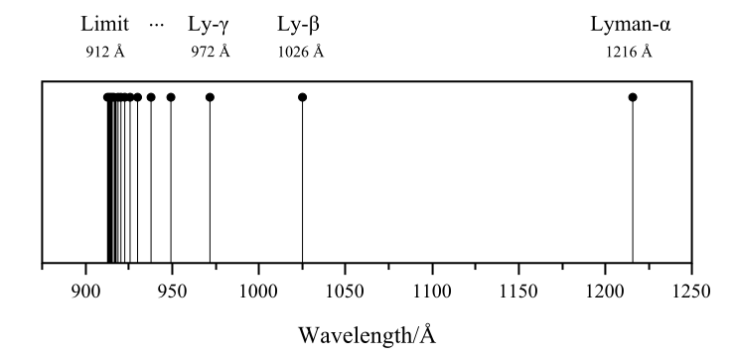
Lyman series
This is a Lyman-continuum photon.
n | 2 | 3 | 4 | 5 | 6 | 7 | 8 | 9 | 10 | 11
Wavelength (nm) | 121.6 | 102.6 | 97.2 | 94.9 | 93.7 | 93.0 | 92.6 | 92.3 | 92.1 | 91.9 | 91.15
Notes:
Transitions starting from or ending at the ground state (level 1) form the Lyman series. The first is Lyman alpha (Ly ), corresponding to the transition between the first excited state (level 2) and the ground state. As we have seen, the energy difference is 10.21 eV, and the Ly photon has a wavelength of 121.6 nm (1216 Å). The Ly (beta) transition, between level 3 (the second excited state) and the ground state, corresponds to an energy change of 12.10 eV and a photon of wavelength 102.6 nm (1026 Å). Ly (gamma) corresponds to a jump from level 4 to level 1, and so on. The accompanying table shows how we can calculate the energies, frequencies, and wavelengths of the photons in the Lyman series using the formulae given previously. All Lyman-series energies lie in the ultraviolet region of the spectrum.
The next series of lines, the Balmer series, involves transitions down to (or up from) level 2, the first excited state. All the Balmer series lines lie in or close to the visible portion of the electromagnetic spectrum. Because they form the most easily observable part of the hydrogen spectrum and were the first to be discovered, these lines are often referred to simply as the "Hydrogen" series and denoted by the letter H. As with the Lyman series, the individual transitions are labeled with Greek letters. An H photon (level 3 to level 2) has a wavelength of 656.3 nm and is red, Hß (level 4 to level 2) has a wavelength of 486.1 nm (green), H (level 5 to level 2) has a wavelength of 434.1 nm (blue), and so on. The most energetic Balmer series photons have energies that place them just beyond the blue end of the visible spectrum, in the near ultraviolet.
The classification continues with the Paschen series (transitions down to or up from the second excited state), the Brackett series (third excited state), and the Pfund series (fourth excited state). Beyond that point, infinitely many other families exist, moving farther and farther into the infrared and radio regions of the spectrum, but they are not referred to by any special names. A few of the transitions making up the Lyman and Balmer (Hydrogen) series are marked on the figure. Astronomically, these are the most important sequences.

Slide 18

Balmer series
This is Balmer-alpha (a.k.a. H-alpha) at 6562.81 Å.
Transition of n | 3→2 | 4→2 | 5→2 | 6→2 | 7→2 | 8→2 | 9→2 | →2
Name | H-α | H-β | H-γ | H-δ | H-ε | H-ζ | H-η
Wavelength (nm) ^{[2]} | 656.3 | 486.1 | 434.1 | 410.2 | 397.0 | 388.9 | 383.5 | 364.6
Color | Red | Blue-green | Violet | Violet | (Ultraviolet) | (Ultraviolet) | (Ultraviolet) | (Ultraviolet)
Notes:
Transitions starting from or ending at the ground state (level 1) form the Lyman series. The first is Lyman alpha (Ly ), corresponding to the transition between the first excited state (level 2) and the ground state. As we have seen, the energy difference is 10.21 eV, and the Ly photon has a wavelength of 121.6 nm (1216 Å). The Ly (beta) transition, between level 3 (the second excited state) and the ground state, corresponds to an energy change of 12.10 eV and a photon of wavelength 102.6 nm (1026 Å). Ly (gamma) corresponds to a jump from level 4 to level 1, and so on. The accompanying table shows how we can calculate the energies, frequencies, and wavelengths of the photons in the Lyman series using the formulae given previously. All Lyman-series energies lie in the ultraviolet region of the spectrum.
The next series of lines, the Balmer series, involves transitions down to (or up from) level 2, the first excited state. All the Balmer series lines lie in or close to the visible portion of the electromagnetic spectrum. Because they form the most easily observable part of the hydrogen spectrum and were the first to be discovered, these lines are often referred to simply as the "Hydrogen" series and denoted by the letter H. As with the Lyman series, the individual transitions are labeled with Greek letters. An H photon (level 3 to level 2) has a wavelength of 656.3 nm and is red, Hß (level 4 to level 2) has a wavelength of 486.1 nm (green), H (level 5 to level 2) has a wavelength of 434.1 nm (blue), and so on. The most energetic Balmer series photons have energies that place them just beyond the blue end of the visible spectrum, in the near ultraviolet.
The classification continues with the Paschen series (transitions down to or up from the second excited state), the Brackett series (third excited state), and the Pfund series (fourth excited state). Beyond that point, infinitely many other families exist, moving farther and farther into the infrared and radio regions of the spectrum, but they are not referred to by any special names. A few of the transitions making up the Lyman and Balmer (Hydrogen) series are marked on the figure. Astronomically, these are the most important sequences.

Slide 19
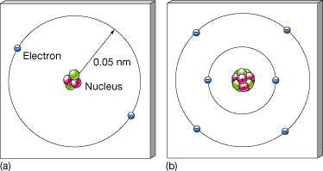
Helium and carbon atoms
Notes:
Helium and Carbon (a) A helium atom in its normal ground state. Two electrons occupy the lowest-energy orbital around a nucleus containing two protons and two neutrons. (b) A carbon atom in its normal ground state. Six electrons orbit a six-proton, six-neutron nucleus, two in an inner orbital, with the other four at a greater distance from the center.

Slide 20
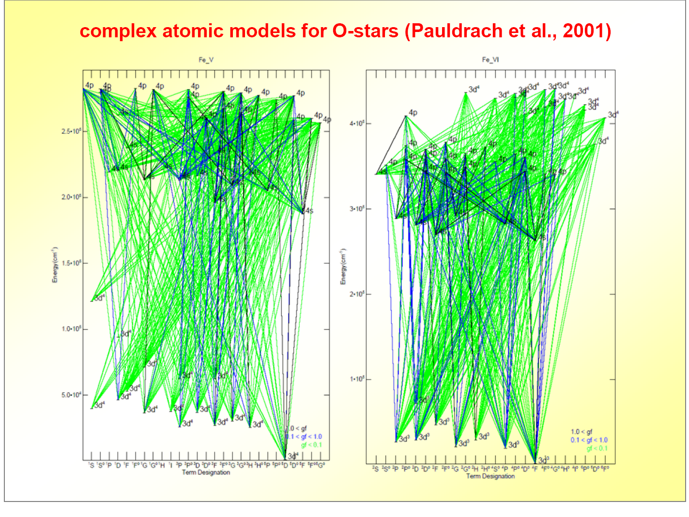
Iron
Notes:
Helium and Carbon (a) A helium atom in its normal ground state. Two electrons occupy the lowest-energy orbital around a nucleus containing two protons and two neutrons. (b) A carbon atom in its normal ground state. Six electrons orbit a six-proton, six-neutron nucleus, two in an inner orbital, with the other four at a greater distance from the center.

Slide 21
Hydrogen-like lines
These transitions are all “hydrogen-like” in that the upper-state electron “sees” a nucleus with almost one positive charge.

Slide 22
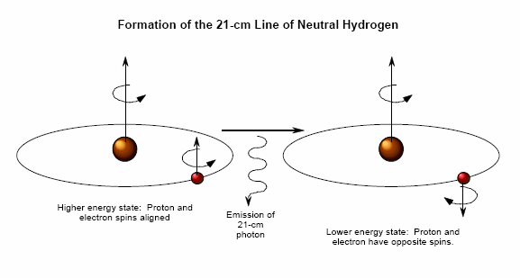
21-cm Radiation
Neutral hydrogen can be collisionally excited so that its proton and electron have aligned spins.
When the electron spontaneously flips, the atom loses a 21-cm photon.

Slide 23
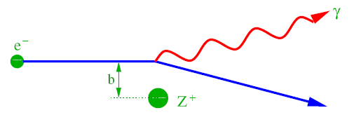
Free-free (Bremsstrahlung) Emission
Free-free emission is produced when an unbound charged particle changes trajectory (decelerates) in the presence of another charged particle.
Electron emits more radiation than the heavier particle.
It is often observed coming from astrophysical plasmas, e.g. gas in a nebula that is irradiated by a hot source.

Slide 24
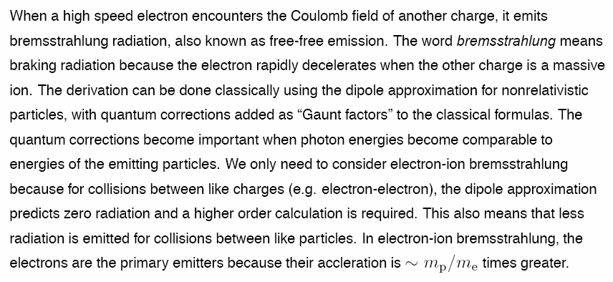
Bremsstrahlung Emission: Notes
“Bremsstrahlung” means “stopping” or “breaking” radiation.
Electron is primary emitter because it is lighter than most other particles.

Slide 25
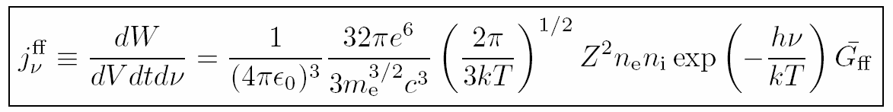
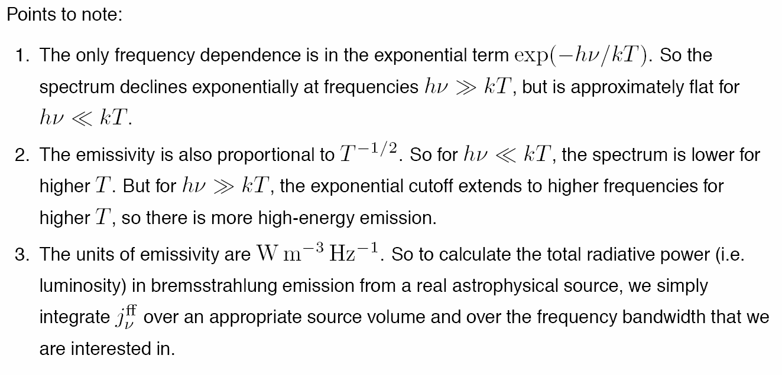
Free-free Emission: Spectrum
see following for derivation:
http://www.physics.usyd.edu.au/~kuncic/lectures/HEA_L6.pdf

Slide 26
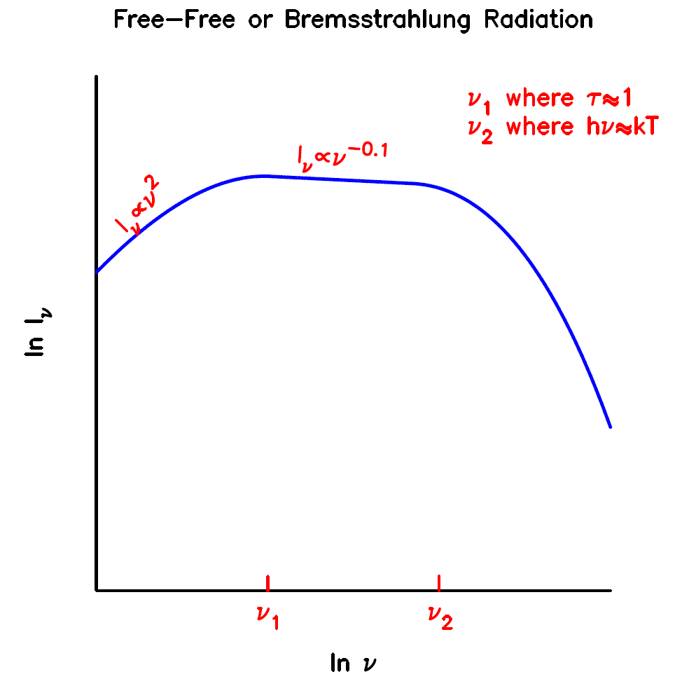
Free-free Emission: Spectrum
After accounting for self-absorption, spectrum is flat in the middle with a rollover on either side.
ν₁ corresponds to τ~1, and is at ~1 GHz (30 cm) for Orion.
ν₂ corresponds to hν∼kT.

Slide 27
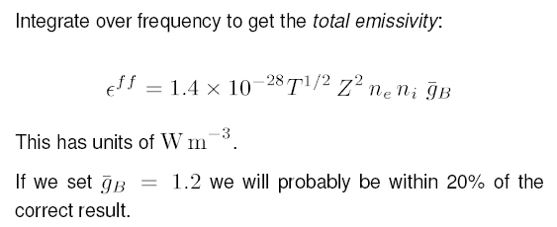
Free-free Emission: Total
This is an excellent lecture: http://www.mrao.cam.ac.uk/~kjbg1/lectures/lect3.pdf

Slide 28

Free-free Emission: Stromgren Sphere
S* is the ionizing flux, n is the density, and beta is the total recombination coefficient.
Ionized sphere is “radiation bounded,” that is, its size is set by the amount of ionizing radiation produced by the source.
By construction, every ionizing photon will ionize an atom.
Notes:
In astrophysics, a Strömgren sphere is the sphere of ionized hydrogen (H II) around a young star of the spectral classes O or B. The most prominent example is the Rosette Nebula. It was derived by and later named after Bengt Strömgren[1].

Slide 29
Stromgren Sphere Radius: Derivation
Notes:
In astrophysics, a Strömgren sphere is the sphere of ionized hydrogen (H II) around a young star of the spectral classes O or B. The most prominent example is the Rosette Nebula. It was derived by and later named after Bengt Strömgren[1].

Slide 30
Recombination Timescale: Derivation
Notes:
In astrophysics, a Strömgren sphere is the sphere of ionized hydrogen (H II) around a young star of the spectral classes O or B. The most prominent example is the Rosette Nebula. It was derived by and later named after Bengt Strömgren[1].

Slide 31
Free-free Emission: Star Formation Region

Slide 32
Free-free Emission: Galaxy Cluster

Slide 33
Synchrotron Radiation
Synchrotron radiation is emitted when a charged particle accelerates in the presence of a magnetic field.
The emitted power is a strong function of velocity, and inverse particle mass, so it is often observed in regions where there are fast electrons.
Source of energetic electrons:
  supernova remnants
  pulsar winds
  shocks
Notes:
Synchrotron radiation is electromagnetic radiation, similar to cyclotron radiation, but generated by the acceleration of ultrarelativistic (i.e., moving near the speed of light) charged particles through magnetic fields. This may be achieved artificially by storage rings in a synchrotron, or naturally by fast moving electrons moving through magnetic fields in space. The radiation typically includes radio waves, infrared light, visible light, ultraviolet light, and x-rays.
The radiation was named after its discovery in a General Electric synchrotron accelerator built in 1946 and announced in May 1947 by Frank Elder, Anatole Gurewitsch, Robert Langmuir, and Herb Pollock in a letter entitled "Radiation from Electrons in a Synchrotron"[1].

Slide 34
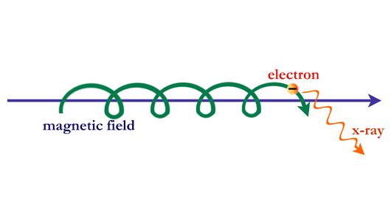
Synchrotron Radiation: Illustration
Notes:
Synchrotron radiation from cosmic sources has a distinctive spectrum, or distribution of photons with energy. The radiation falls off with energy less rapidly than does the spectrum of radiation from a hot gas. When synchrotron radiation is observed in supernova remnants, cosmic jets, or other sources, it reveals information about the high-energy electrons and magnetic fields that are present.

Slide 35
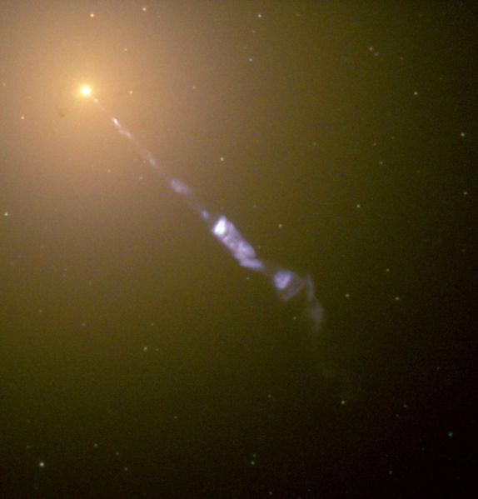
Synchrotron Radiation: M87 Jet
Notes:
Streaming out from the center of the galaxy M87 like a cosmic searchlight is one of nature's most amazing phenomena, a black-hole-powered jet of electrons and other sub-atomic particles traveling at nearly the speed of light. In this Hubble telescope image, the blue jet contrasts with the yellow glow from the combined light of billions of unseen stars and the yellow, point-like clusters of stars that make up this galaxy. Lying at the center of M87, the monstrous black hole has swallowed up matter equal to 2 billion times our Sun's mass. M87 is 50 million light-years from Earth.
The jet originates in the disk of superheated gas swirling around this black hole and is propelled and concentrated by the intense, twisted magnetic fields trapped within this matter. The light we see is produced by electrons twisting along magnetic field lines in the jet, a process known as synchrotron radiation, which gives the jet its bluish tint.

Slide 36
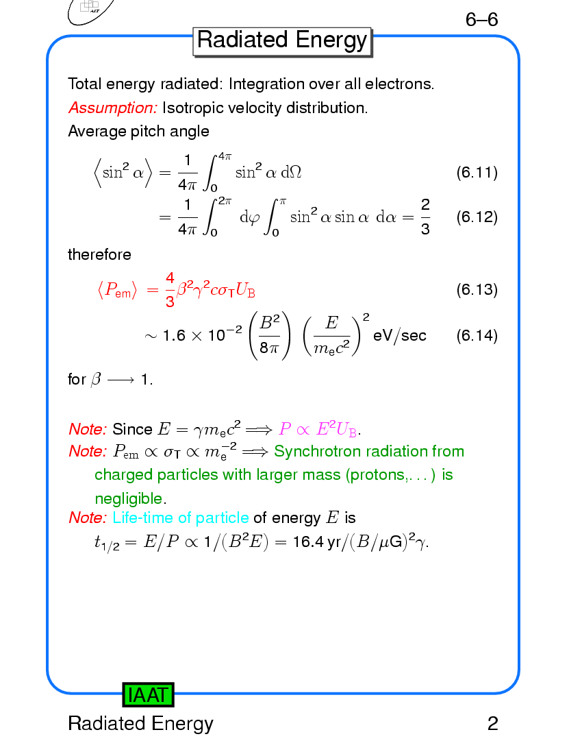
Synchrotron Radiation: Relations
Charged particle gyrates under magnetic force:
Gyration radius of electron is:
Lorentz factor is (ν_{c} is emitting freq.):
Emitted power is:
http://astro.uni-tuebingen.de/~wilms/teach/radproc/radproc0102.html
Notes:
The first equation is relativistic version of F=ma. Unites are esu-cgs, such that e is in statcoulombs.

Slide 37
Synchrotron Radiation: Spectrum
Synchrotron spectrum
  low frequency radiation is scattered by electrons in plasma
  high frequency radiation penetrates plasma
  break is caused by very short lifetimes of highly energetic electrons (they radiate their energy through synchrotron radiation very quickly)
Notes:
http://www-astro.physics.ox.ac.uk/~garret/teaching/lecture6.pdf

Slide 38
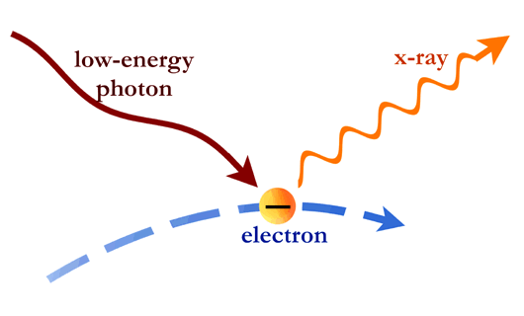
Inverse Compton Scattering
Compton scattering describes the effect of a photon losing energy when it interacts with an electron. Inverse compton scattering is the opposite process and results in the photon being “up-scattered” to higher energies (while the electron loses energy).
Strong producers of inverse Compton scattered photons
  particles around a black hole
  up-scattered CMB photons traveling through galaxy cluster plasmas
  supernovae remnants
Notes:
The photons themselves can also collide with electrons. If the electrons have more energy than the photons, the collision can boost the energy of the photons. In this way, photons can be changed from low-energy photons to high-energy photons. This process, called Compton scattering, is thought to be important around black holes, where matter is dense and has been heated to many millions of degrees. Inverse Compton Scattering
The photons collected in space by X-ray telescopes reveal the hot spots in the universe--regions where particles have been energized or raised to high temperatures by gigantic explosions or intense gravitational fields.
Where do such conditions exist? In an astonishing variety of places, ranging from the vast spaces between galaxies to the bizarre, collapsed worlds of neutron stars and black holes.

Slide 39
Inverse Compton Scattering: Spectrum
At low frequencies, the scattered radiation increases proportionally with frequency, while at high frequencies, it drops down below a maximum frequency of γ² times the original frequency (where γ² refers to the electron).
log₁₀F(ν) _{arbitrary unit}
ν_{max}
ν
_{arbitrary unit}

Slide 40
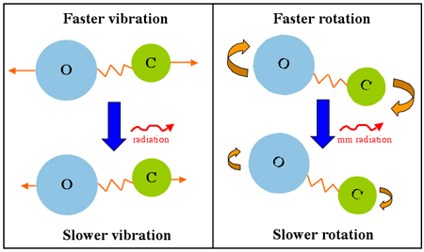
Molecular rotational-vibrational transitions

Slide 41
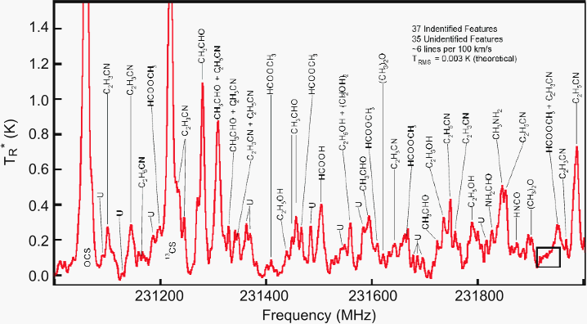
Molecular line observations
This 13 mm spectrum of the molecular cloud SgrB2(N) near the Galactic center is completely dominated by molecular lines from known and unknown (U) species (Ziurys et al. 2006, NRAO Newsletter, 109, 11). More than 140 different molecules containing up to 13 atoms (HC11N) have been identified in space.
Notes:
This 13 mm spectrum of the molecular cloud SgrB2(N) near the Galactic center is completely dominated by molecular lines from known and unknown (U) species (Ziurys et al. 2006, NRAO Newsletter, 109, 11). More than 140 different molecules containing up to 13 atoms (HC11N) have been identified in space.

Slide 42
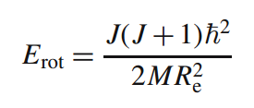
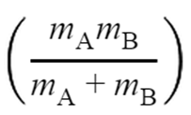
Molecular rotational energy levels
Rotational energy of a molecule is:
where R_{e} is the distance between the nuclei and M is the reduced mass:
At sufficiently high density, collisions pump molecules more frequently than spontaneous emission, leading to high flux.
Notes:
http://www.cv.nrao.edu/course/astr534/MolecularSpectra.html

Slide 43

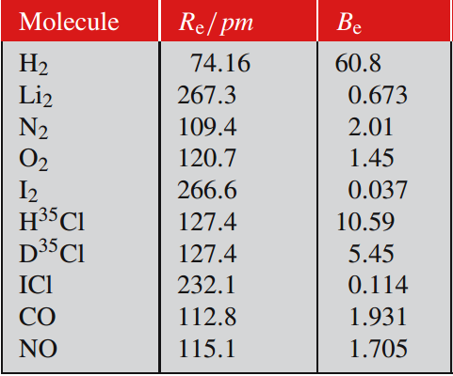

Molecular rotational contant
It is useful to define a “rotataional constant”:
so that the energy levels are :
Example: H₂ for J=3 to 1 gives a line at ~17 μm.
$$E=J\left(J+1\right)hcB_{e}$$
Notes:
http://www.dsf.unica.it/~sandro/Materiale_Corso/Molec/Demtroeder_rotovibrazioni.pdf

Slide 44
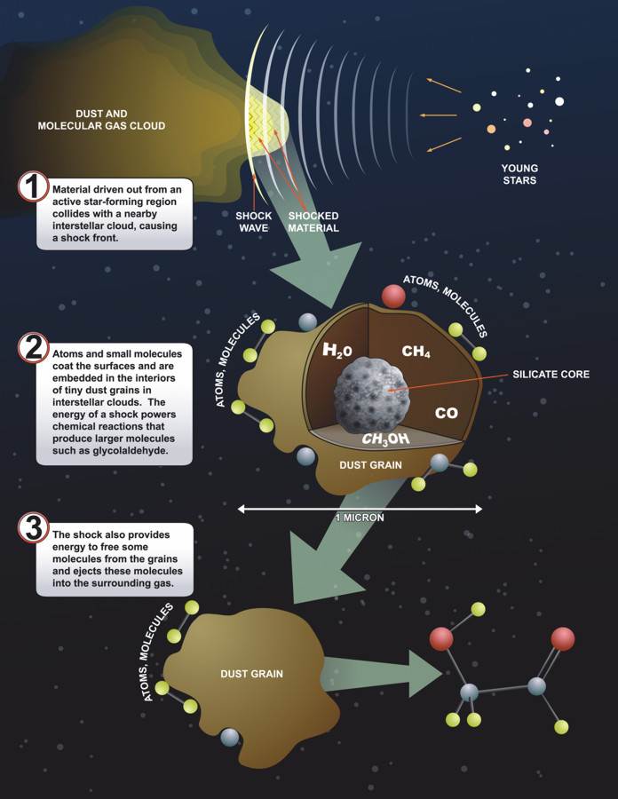
Molecules Coat Dust
Dust grains assist in the formation of complex molecules. The GBT detected emission from glycoaldehyde (sugar) in Sagittarius B2 near the galactic center.

Slide 45
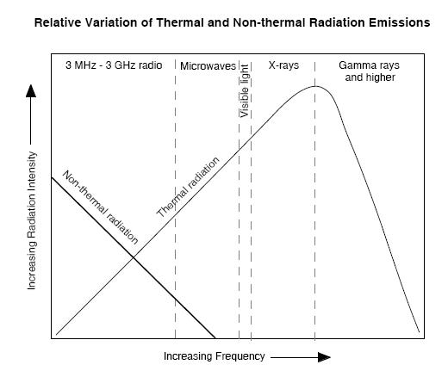
Thermal vs. Non-Thermal Radiation
Notes:
This plot shows a combination of three emission sources.

Slide 46
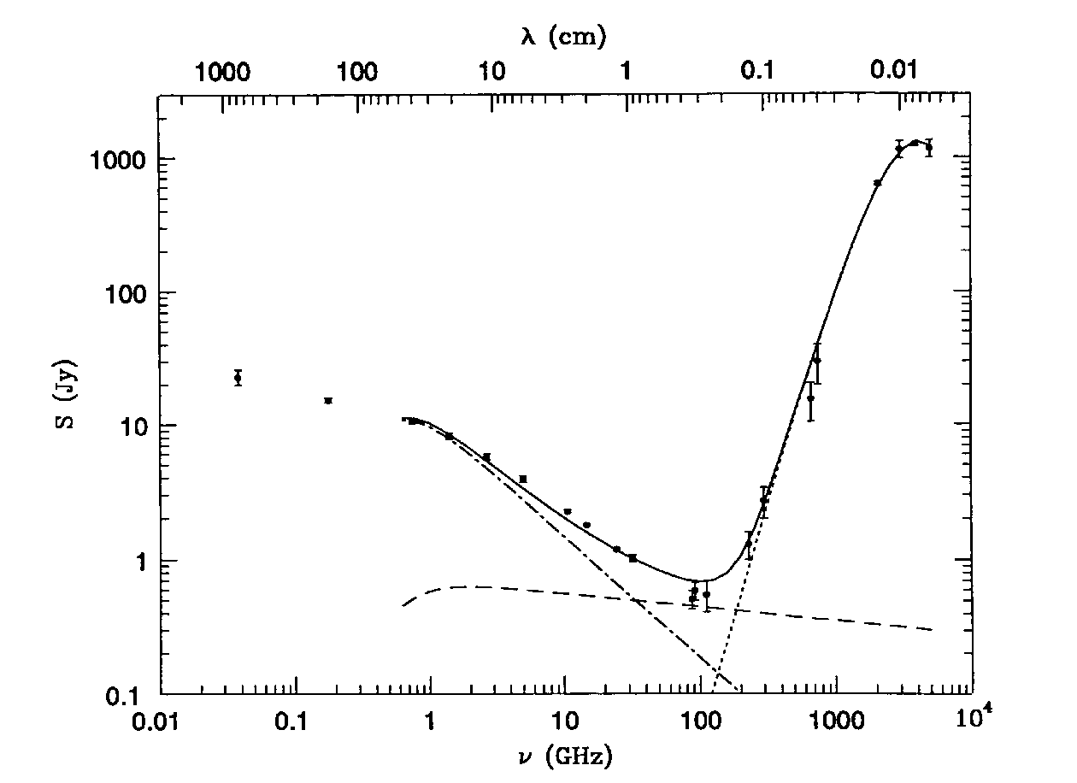
Multiwavelength Spectrum: M82
http://www.cv.nrao.edu/course/astr534/FreeFreeEmission.html
synchrotron
dust
free-free
The radio and far-infrared spectrum of the nearby starburst galaxy M82. The contribution of free-free emission is indicated by the nearly horizontal dashed line. Synchrotron and dust emission dominate at low and high frequencies, respectively. Free-free absorption from HII regions distributed throughout the galaxy flattens the overall spectrum at the lowest frequencies.
Notes:
This plot shows a combination of three emission sources.

Slide 47
Theory of Everything

