Slide 1
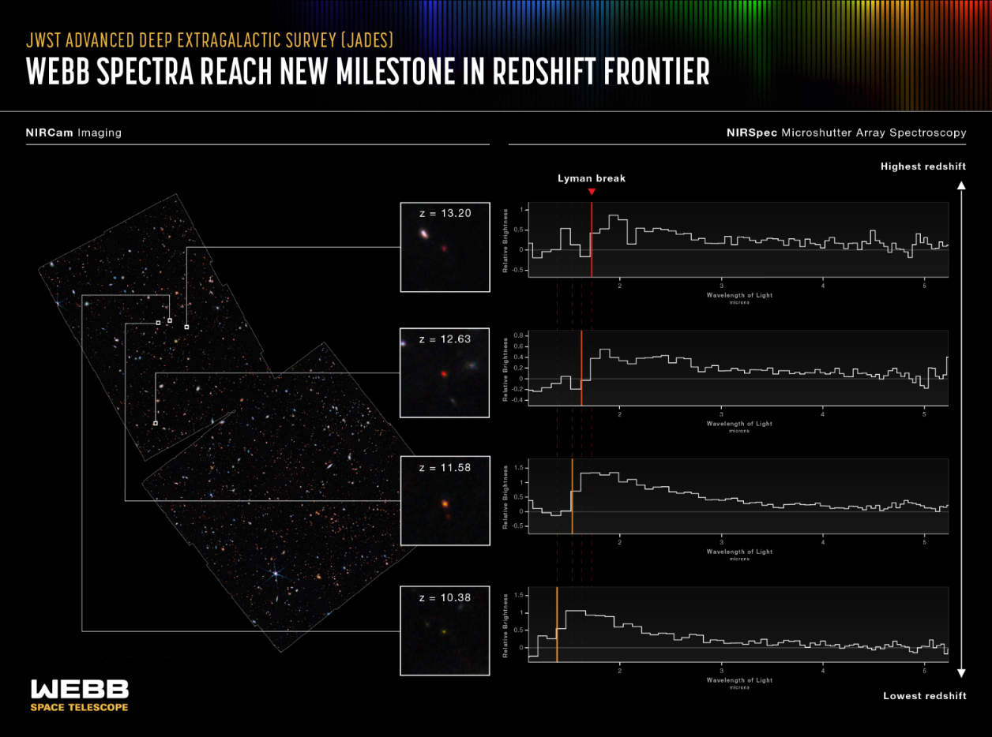
Webb Spectra Reach New Milestone in Redshift Frontier
An infographic titled “JWST Advanced Deep Extragalactic Survey, JADES; Webb Spectra Reach New Milestone in Redshift Frontier; NIRCam Imaging and NIRSpec Microshutter Array Spectroscopy.” The infographic shows the redshift of four distant galaxies. At left is a NIRCam image of the field, which is filled with galaxies of different colors, shapes, and sizes. Four galaxies from this image are highlighted, and labeled: z = 13.20, z = 12.63, z = 11.58, and z = 10.38, to indicate their redshifts. In inset images, these galaxies appear blurry and have red areas. To the right are four line graphs corresponding to the four highlighted galaxies. These are labeled NIRSpec Microshutter Array Spectroscopy. They show the shift in the position of a spectral feature called the Lyman break to longer wavelengths as the redshift increases. Please reference the extended text description for more details.
https://webbtelescope.org/contents/media/images/01GKRX20YPY9XSXRWX31H57P2A

Slide 2
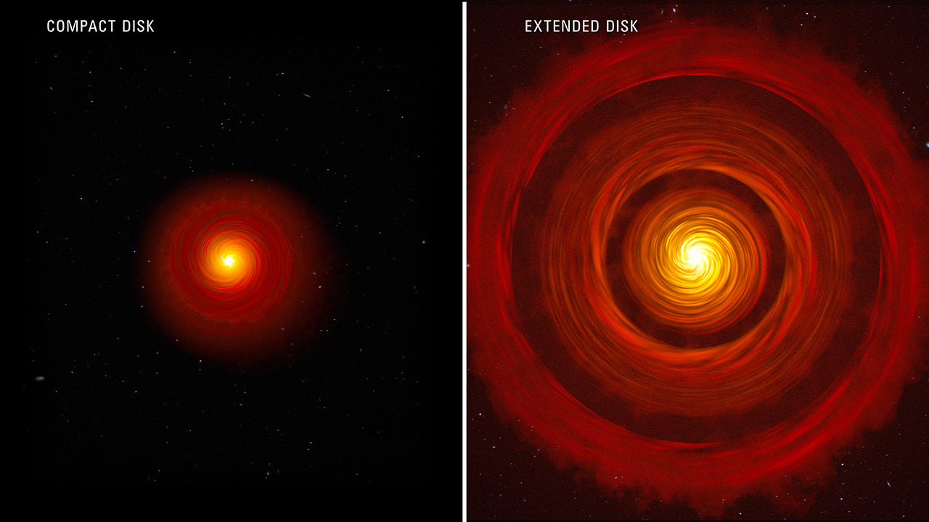
NASA's Webb Findings Support Long-Proposed Process of Planet Formation
This artist's concept compares two types of typical, planet-forming disks around newborn, Sun-like stars. On the left is a compact disk, and on the right is an extended disk with gaps. Scientists using Webb recently studied four protoplanetary disks — two compact and two extended. The researchers designed their observations to test whether compact planet-forming disks have more water in their inner regions than extended planet-forming disks with gaps. This would happen if ice-covered pebbles in the compact disks drift more efficiently into the close-in regions nearer to the star and deliver large amounts of solids and water to the just-forming, rocky, inner planets.Current research proposes that large planets may cause rings of increased pressure, where pebbles tend to collect. As the pebbles drift, any time they encounter an increase in pressure, they tend to collect there. These pressure traps don't necessarily shut down pebble drift, but they do impede it. This is what appears to be happening in the large disks with rings and gaps. This also could have been a role of Jupiter in our solar system — inhibiting pebbles and water delivery to our small, inner, and relatively water-poor rocky planets.
https://webbtelescope.org/contents/media/images/2023/144/

Slide 3
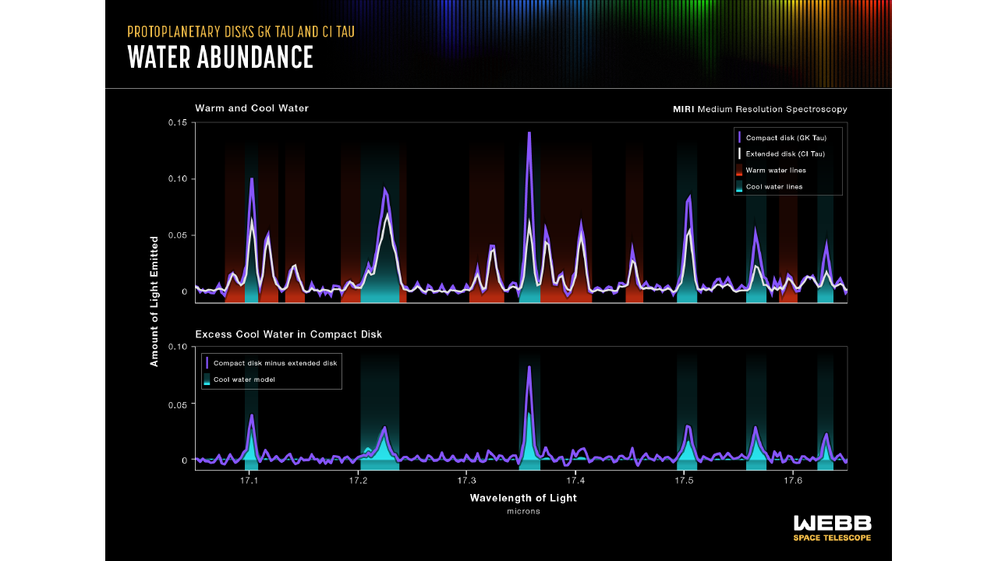
NASA's Webb Findings Support Long-Proposed Process of Planet Formation
This graphic compares the spectral data for warm and cool water in the GK Tau disk, which is a compact disk without rings, and extended CI Tau disk, which has at least three rings on different orbits. The science team employed the unprecedented resolving power of MIRI’s MRS (the Medium-Resolution Spectrometer) to separate the spectra into individual lines that probe water at different temperatures. These spectra, seen in the top graph, clearly reveal excess cool water in the compact GK Tau disk, compared with the large CI Tau disk. The bottom graph shows the excess cool water data in the compact GK Tau disk minus the cool water data in the extended CI Tau disk. The actual data, in purple, are overlaid on a model spectrum of cool water. Note how closely they align.
https://webbtelescope.org/contents/media/images/2023/144/01HD

Slide 4
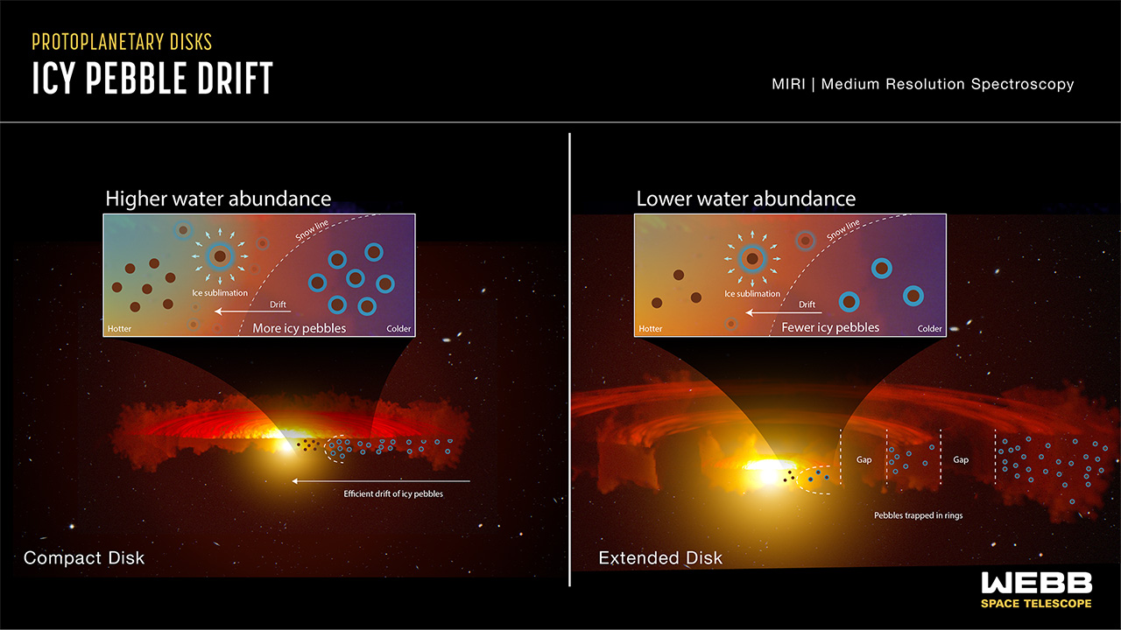
NASA's Webb Findings Support Long-Proposed Process of Planet Formation
This graphic is an interpretation of data from Webb’s MIRI, the Mid-Infrared Instrument, which is sensitive to water vapor in disks. It shows the difference between pebble drift and water content in a compact disk versus an extended disk with rings and gaps. In the compact disk on the left, as the ice-covered pebbles drift inward toward the warmer region closer to the star, they are unimpeded. As they cross the snow line, their ice turns to vapor and provides a large amount of water to enrich the just-forming, rocky, inner planets. On the right is an extended disk with rings and gaps. As the ice-covered pebbles begin their journey inward, many become stopped by the gaps and trapped in the rings. Fewer icy pebbles are able to make it across the snow line to deliver water to the inner region of the disk.
https://webbtelescope.org/contents/media/images/2023/144/01HEA

Slide 5
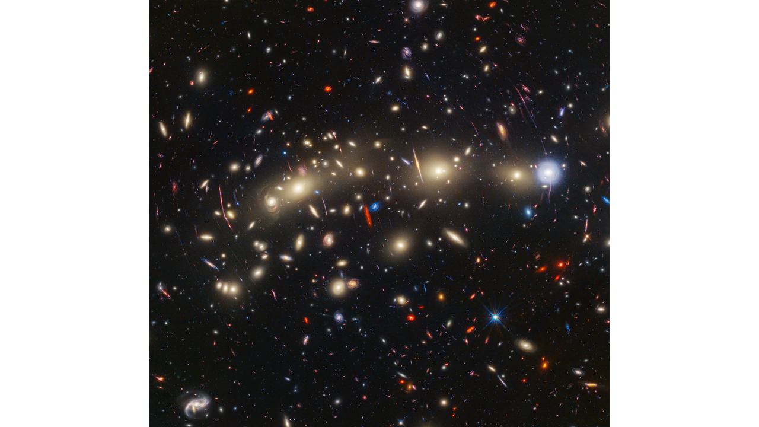
NASA's Webb, Hubble Combine to Create Most Colorful View of Universe
This panchromatic view of galaxy cluster MACS0416 was created by combining infrared observations from NASA’s James Webb Space Telescope with visible-light data from NASA’s Hubble Space Telescope. To make the image, in general the shortest wavelengths of light were color-coded blue, the longest wavelengths red, and intermediate wavelengths green. The resulting wavelength coverage, from 0.4 to 5 microns, reveals a vivid landscape of galaxies that could be described as one of the most colorful views of the universe ever created. MACS0416 is a galaxy cluster located about 4.3 billion light-years from Earth, meaning that light we see now left the cluster shortly after the formation of our solar system. This cluster magnifies the light from more distant background galaxies through gravitational lensing. As a result, the research team has been able to identify magnified supernovae and even very highly magnified individual stars. Those colors give clues to galaxy distances: The bluest galaxies are relatively nearby and often show intense star formation, as best detected by Hubble, while the redder galaxies tend to be more distant, or else contain copious amount of dust, as detected by Webb. The image reveals a wealth of details that are only possible to capture by combining the power of both space telescopes. In this image, blue represents data at wavelengths of 0.435 and 0.606 microns (Hubble filters F435W and F606W); cyan is 0.814, 0.9, and 1.05 microns (Hubble filters F814W, and F105W and Webb filter F090W); green is 1.15, 1.25, 1.4, 1.5, and 1.6 microns (Hubble filters F125W, F140W, and F160W, and Webb filters F115W and F150W); yellow is 2.00 and 2.77 microns (Webb filters F200W, and F277W); orange is 3.56 microns (Webb filter F356W); and red represents data at 4.1 and 4.44 microns (Webb filters F410M and F444W).
https://webbtelescope.org/contents/media/images/2023/146/01HDHATAQXM532HCNQN6BQ79BC?news=true

Slide 6
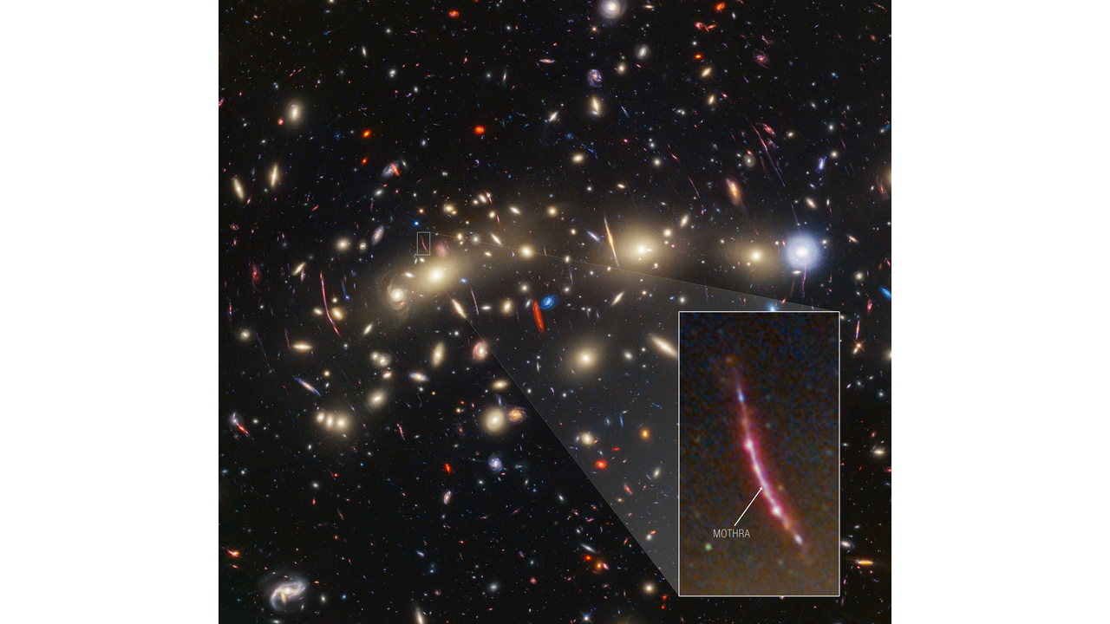
NASA's Webb, Hubble Combine to Create Most Colorful View of Universe
This image of galaxy cluster MACS0416 highlights one particular gravitationally lensed background galaxy, which existed about 3 billion years after the big bang. That galaxy contains a transient, or object that varies in observed brightness over time, that the science team nicknamed “Mothra.” Mothra is a star that is magnified by a factor of at least 4,000 times. The team believes that Mothra is magnified not only by the gravity of galaxy cluster MACS0416, but also by an object known as a “milli-lens” that likely weighs about as much as a globular star cluster.
https://webbtelescope.org/contents/media/images/2023/146/01HDHHJ07K7Q299138S7QM6SQZ?news=true

Slide 7
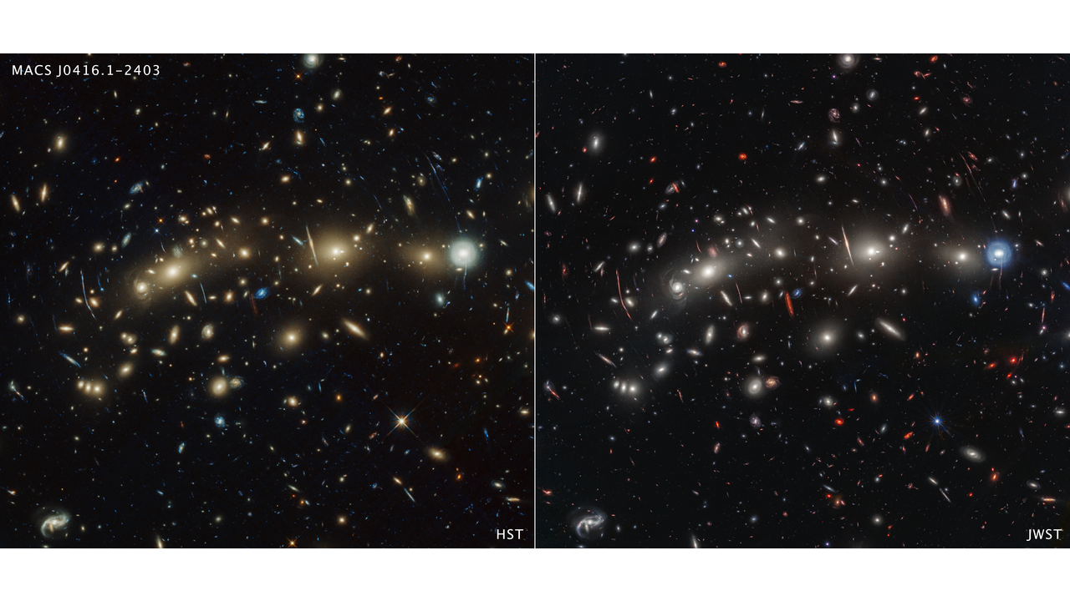
NASA's Webb, Hubble Combine to Create Most Colorful View of Universe
This side-by-side comparison of galaxy cluster MACS0416 as seen by the Hubble Space Telescope in optical light (left) and the James Webb Space Telescope in infrared light (right) reveals different details. Both images feature hundreds of galaxies, however the Webb image shows galaxies that are invisible or only barely visible in the Hubble image. This is because Webb’s infrared vision can detect galaxies too distant or dusty for Hubble to see. (Light from distant galaxies is redshifted due to the expansion of the universe.) The total exposure time for Webb was about 22 hours, compared to 122 hours of exposure time for the Hubble image.
https://webbtelescope.org/contents/media/images/2023/146/01HDHHRZ9KTFXH9Z94EDAYD9VE?news=true

Slide 8
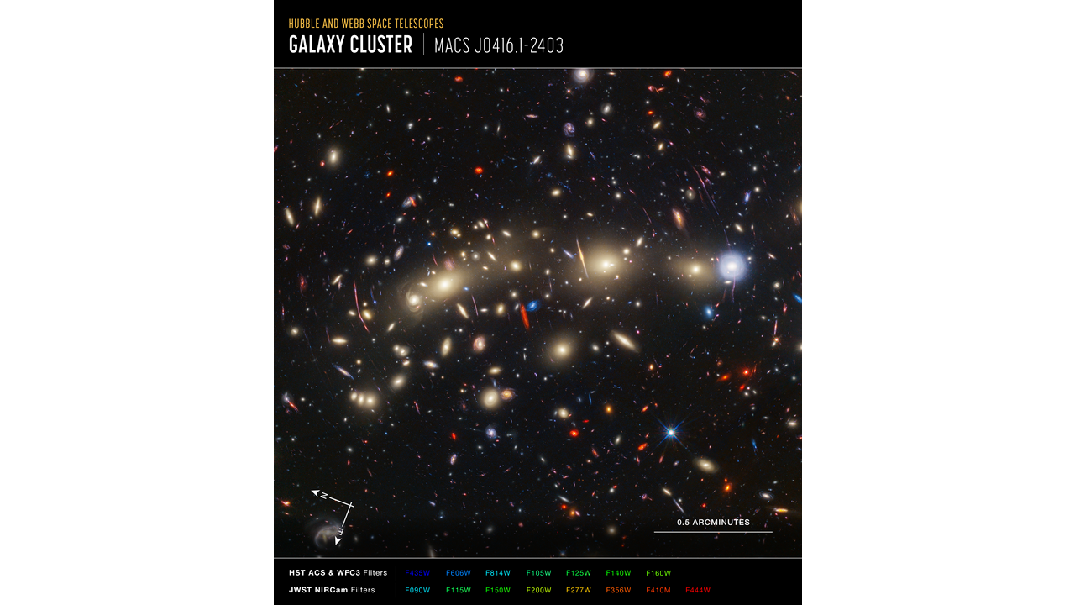
NASA's Webb, Hubble Combine to Create Most Colorful View of Universe
Image of galaxy cluster MACS0416 captured in visible light by Hubble’s ACS and WFC3 and in infrared light by Webb’s NIRCam, with compass arrows, scale bar, and color key for reference. The north and east compass arrows show the orientation of the image on the sky. Note that the relationship between north and east on the sky (as seen from below) is flipped relative to direction arrows on a map of the ground (as seen from above). The scale bar is labeled in arcminutes, which is an angle on the sky equivalent to one-60th of a degree. (The scale bar is half an arcminute long.) The full image is approximately 2.2 acrminutes across. This image shows visible and near-infrared wavelengths of light that have been translated into colors. The color key shows which Hubble ACS and WFC3 and Webb NIRCam filters were used when collecting the light. The color of each filter name is the visible light color used to represent the light that passes through that filter.
https://webbtelescope.org/contents/media/images/2023/146/01HDHHNW3YK65D9913JAM8N5E9?news=true

Slide 9
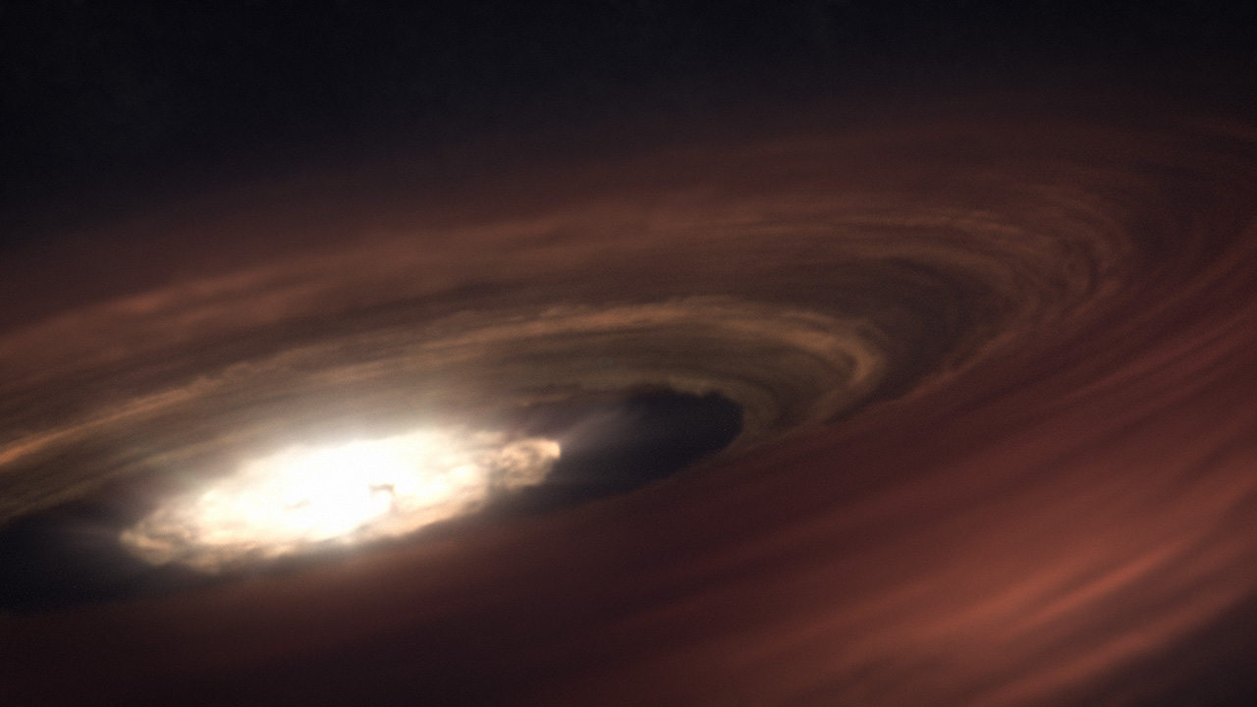
Webb Follows Neon Signs Toward New Thinking on Planet Formation
In this artist concept, the young star SZ Chamaeleontis (SZ Cha) is surrounded by a disk of dust and gas with the potential to form a planetary system. Once our solar system looked something like this, before planets, moons, and asteroids formed. The raw ingredients, including those for life on Earth, were present in the Sun’s protoplanetary disk. SZ Cha emits radiation in multiple wavelengths which are evaporating the disk. Planets are in a race against time to form before the disk of material is evaporated completely. NASA’s James Webb Space Telescope observed typical conditions in the disk – it was being bombarded primarily by X-rays. However, when NASA’s Spitzer Space Telescope observed the disk in 2008, it saw a different scene, dominated by extreme ultraviolet (EUV) light, indicated by the presence of a specific type of neon in the disk. These differences are significant because planets would have more time to form from a disk dominated by EUV. Astronomers are investigating the cause of the difference between Webb and Spitzer’s readings, and think it may be due to the presence (or not) of a strong wind that, when active, absorbs EUV, leaving X-rays to hit the disk.
https://webbtelescope.org/contents/media/images/2023/142/01HEQM0T66VEGT7Y90K85TN4KC?news=true

Slide 10
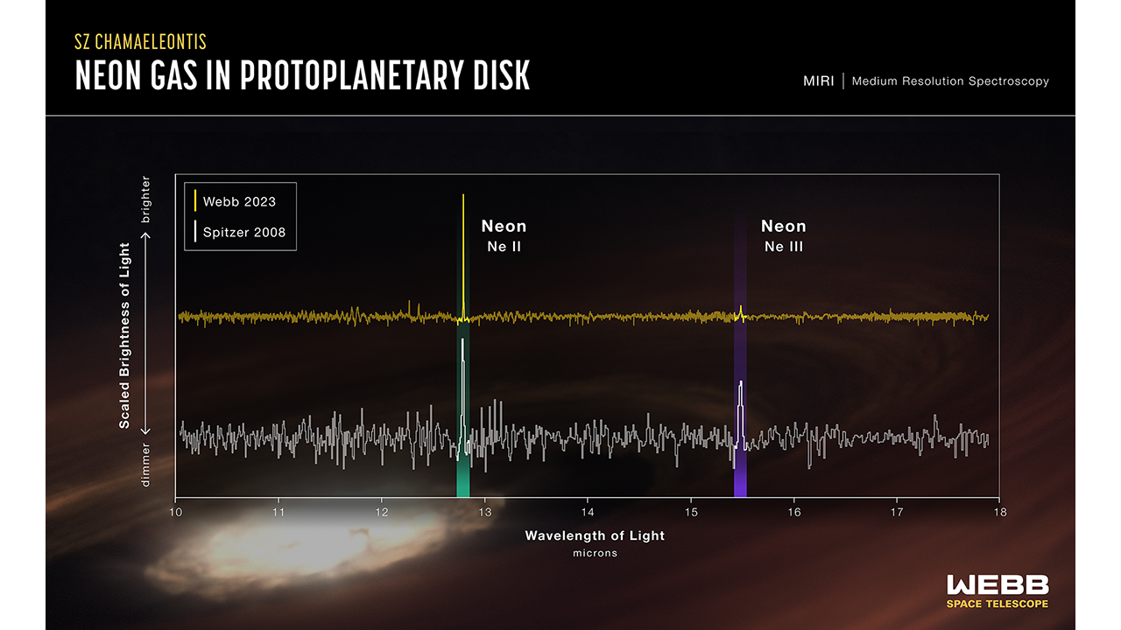
Webb Follows Neon Signs Toward New Thinking on Planet Formation
Contrasting data from NASA’s James Webb and Spitzer space telescopes show change in the disk surrounding the star SZ Chamaeleontis (SZ Cha) in just 15 years. In 2008, Spitzer’s detection of significant neon III made SZ Cha an outlier among similar young protoplanetary disks. However, when Webb followed up on SZ Cha in 2023, the ratio of neon II to III was within typical levels. All of this is significant because protoplanetary disks are the stuff of future planetary systems – and those potential planets are in a race against time. Astronomers use neon as an indicator of the dominant radiation hitting the disk and causing it to evaporate. When extreme ultraviolet light is dominant, there is more neon III. That is the unusual circumstance that Spitzer observed in 2008. Typically, a disk is dominated by X-ray radiation, which evaporates the disk more quickly, leaving planets less time to form. Researchers think the dramatic differences in neon detections are the result of a wind that, when present, absorbs ultraviolet light and leaves X-rays to pummel the disk. They will continue using Webb to find other examples of variability in disk conditions, working toward a better understanding of how planetary systems develop around Sun-like stars.
https://webbtelescope.org/contents/media/images/2023/142/01HEQMET2S7F07C20TDE8X5GNG?news=true

Slide 11
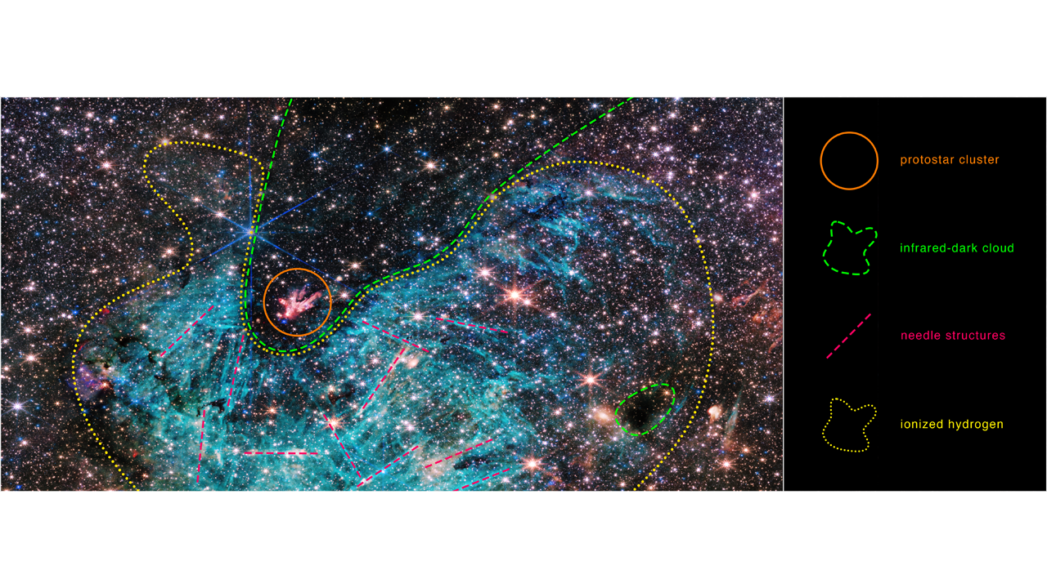
NASA's Webb Reveals New Features in Heart of Milky Way
The full view of the James Webb Space Telescope’s NIRCam (Near-Infrared Camera) instrument reveals a 50 light-years-wide portion of the Milky Way’s dense center. An estimated 500,000 stars shine in this image of the Sagittarius C (Sgr C) region, along with some as-yet unidentified features. A vast region of ionized hydrogen, shown in cyan, wraps around an infrared-dark cloud, which is so dense that it blocks the light from distant stars behind it. Intriguing needle-like structures in the ionized hydrogen emission lack any uniform orientation. Researchers note the surprising extent of the ionized region, covering about 25 light-years. Approximate outlines help to define the features in the Sagittarius C (Sgr C) region. Astronomers are studying data from NASA’s James Webb Space Telescope to understand the relationship between these features, as well as other influences in the chaotic galaxy center.
https://webbtelescope.org/contents/media/images/2023/148/01HFCHTV5R95E0MAJ36GD2HC4F?news=true

Slide 12
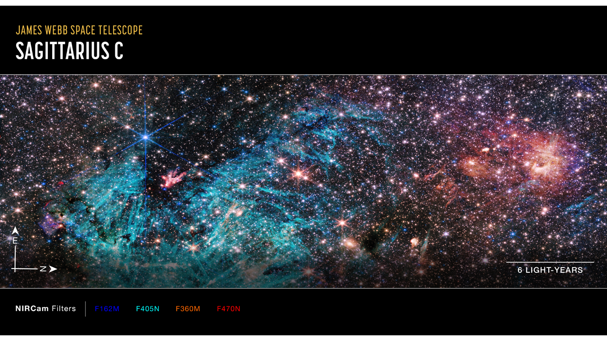
NASA's Webb Reveals New Features in Heart of Milky Way
This image of Sagittarius C (Sgr), captured by Webb’s Near-Infrared Camera (NIRCam), shows compass arrows, scale bar, and color key for reference. The north and east compass arrows show the orientation of the image on the sky. Note that the relationship between north and east on the sky (as seen from below) is flipped relative to direction arrows on a map of the ground (as seen from above). The scale bar is labeled in light-years, which is the distance that light travels in one Earth-year. (It takes 6 years for light to travel a distance equal to the length of the scale bar.) One light-year is equal to about 5.88 trillion miles or 9.46 trillion kilometers. The field of view shown in this image is approximately 50 light-years long. This image shows invisible near-infrared wavelengths of light that have been translated into visible-light colors. The color key shows which NIRCam filters were used when collecting the light. The color of each filter name is the visible light color used to represent the infrared light that passes through that filter.
https://webbtelescope.org/contents/media/images/2023/148/01HF9HN8H1P3E53N5QZJBMH8VQ?news=true

Slide 13
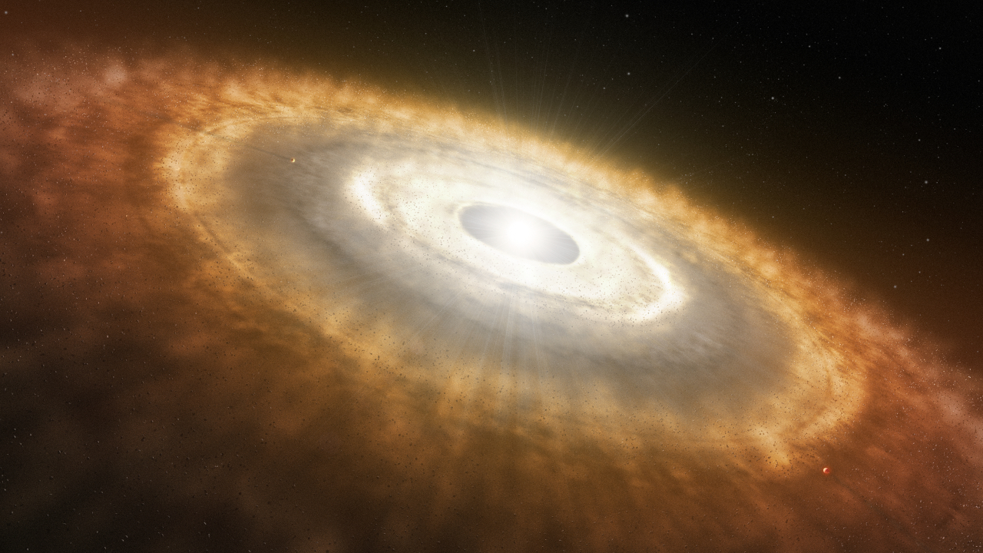
Webb Study Reveals Rocky Planets Can Form in Extreme Environments
This is an artist’s impression of a young star surrounded by a protoplanetary disk in which planets are forming. An international team of astronomers have used NASA’s James Webb Space Telescope to provide the first observation of water and other molecules in the highly irradiated inner, terrestrial-planet forming regions of a disk in one of the most extreme environments in our galaxy. These results suggest that the conditions for rocky-planet formation, typically found in the disks of low-mass star-forming regions, can also occur in massive-star-forming regions and possibly a broader range of environments than previously thought.
https://webbtelescope.org/contents/media/images/2023/152/01HFQ5Y7W3Y9DVXM067T9FJJZW?news=true

Slide 14
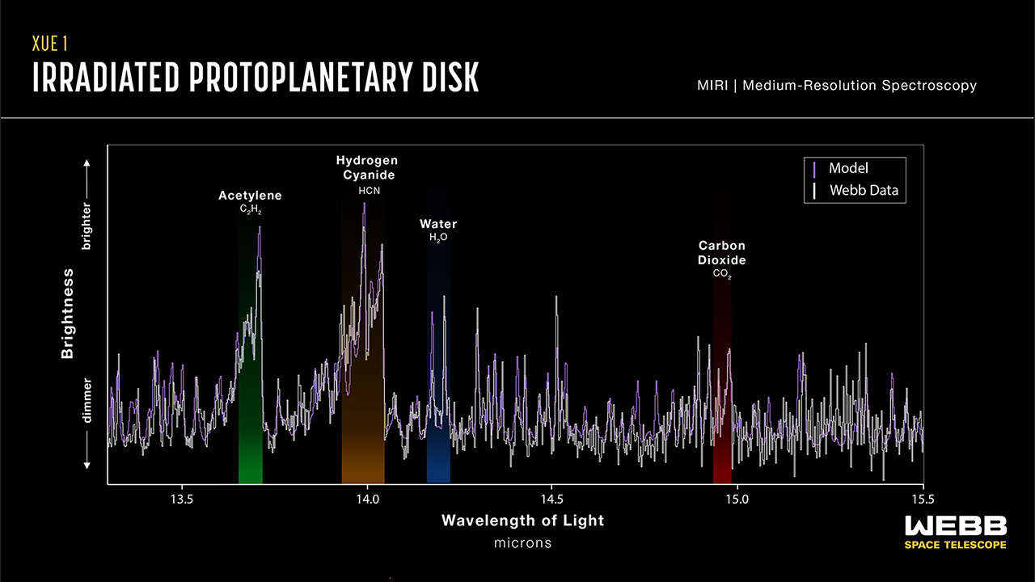
Webb Study Reveals Rocky Planets Can Form in Extreme Environments
This graphic presents some of the first results from the eXtreme UV Environments (XUE) James Webb Space Telescope program. Astronomers focused on rocky-planet-forming regions of disks in the Lobster Nebula using Webb’s Medium Resolution Spectrometer (MRS) of the Mid-Infrared Instrument (MIRI). This first result focuses on the protoplanetary disk termed XUE 1, which is located in the star cluster Pismis 24. The inner disk around XUE 1 revealed signatures of water (highlighted here in blue and centered around 14.2 microns), as well as acetylene (C2H2, highlighted in green; centered around 13.7 microns), hydrogen cyanide (HCN, highlighted in brown; centered around 14.0 microns), and carbon dioxide (CO2, highlighted in red; centered around 14.95 microns). As indicated, some of the emission detected was weaker than some of the predicted models, which might imply a small outer disk radius.
https://webbtelescope.org/contents/media/images/2023/152/01HFPT66E25VD28E2GR6749AJF?news=true

Slide 15
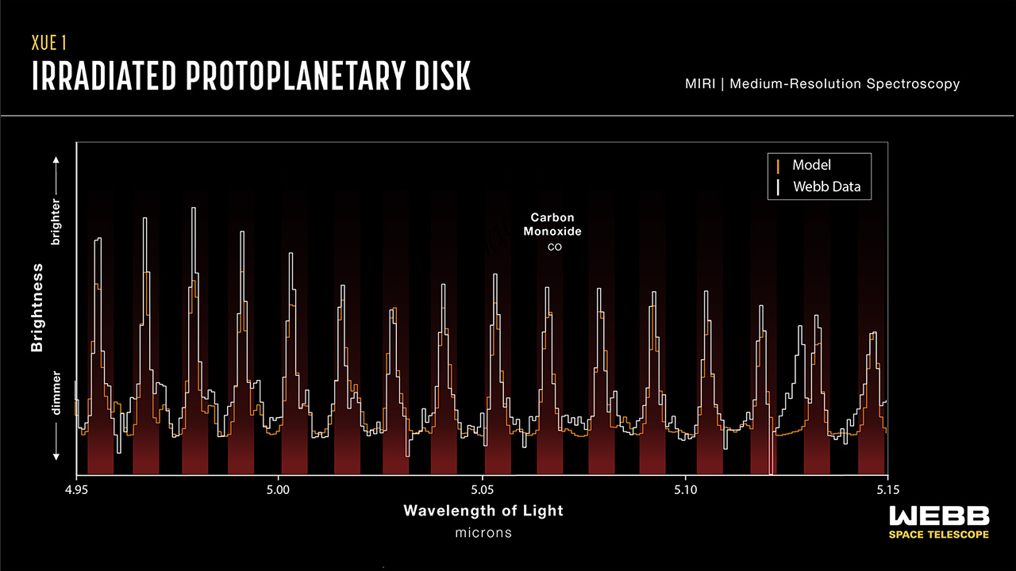
Webb Study Reveals Rocky Planets Can Form in Extreme Environments
This graphic presents some of the first results from the eXtreme UV Environments (XUE) James Webb Space Telescope program. Astronomers focused on rocky-planet-forming regions of disks in the Lobster Nebula using Webb’s Medium Resolution Spectrometer (MRS) of the Mid-Infrared Instrument (MIRI). This first result focuses on the protoplanetary disk termed XUE 1, which is located in the star cluster Pismis 24. This graphic features the observed signatures of carbon monoxide spanning 4.95 to 5.15 microns.
https://webbtelescope.org/contents/media/images/2023/152/01HFPT98RKZYQKV2YP2S6HNDZ3?news=true

