Slide 1
Avalanche Photodiodes
Kim Kolb
02/24/15

Slide 2
Outline
Review of Solid State Physics
  Band Theory
  The PN Junction
  I-V Characteristics of a Diode
  Breakdown and the Avalanche Mechanism
Avalanche Photodiodes
  Linear Mode vs Geiger Mode
  Practical Design
  Performance Metrics (LM-APD)
  Performance Metrics (GM-APD)
  Integrated Operation (GM-APDs)
    Detection / Clocking Cycle
    Quenching
    Dead Time
  Applications
    Scientific / Commercial Uses
    Currently Available

Slide 3
Review of Solid State Physics

Slide 4
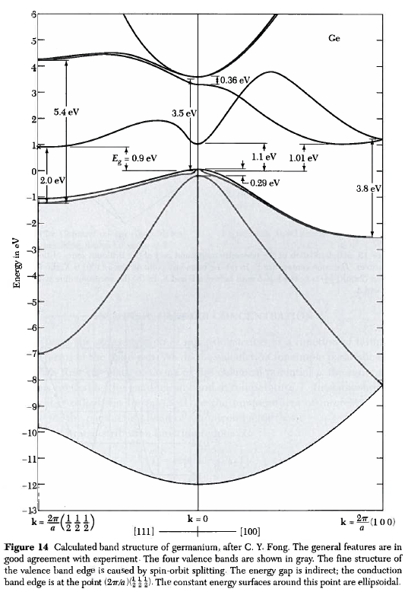
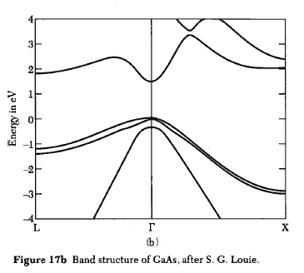
Band Theory
E_{g}

Slide 5
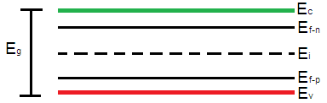
Band Theory
Energy Band Diagram for a Semiconductor
Intrinsic Fermi Energy Level
Free Electrons
E_{g}
Fermi Energy Levels due to Dopant Concentration

Slide 6
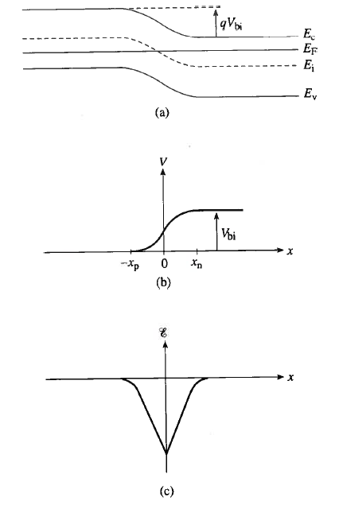
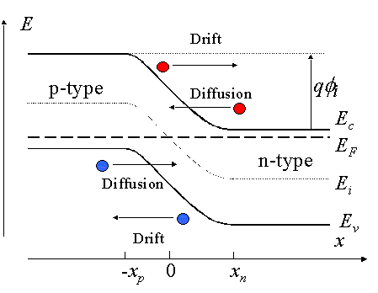
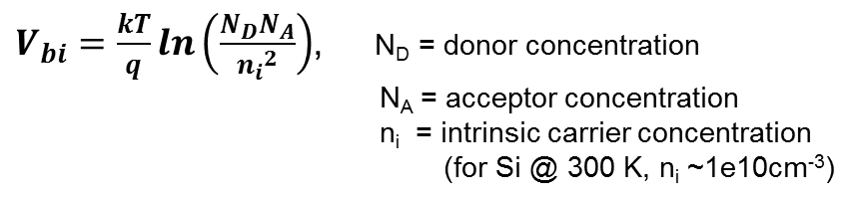
The PN Junction
Depletion Region
p
n
Built-in
voltage
PN Junction Band Diagram (Zeghbroeck 2007)
Notes:
What is the built-in voltage for a pn junction with N_{D} = 1e15 cm⁻³ and N_{A} = 1e17 cm⁻³ at room temperature (300 K)? (First, which side is more highly doped in the picture?)
k = 8.6173423 × 10⁻⁵ eV/K
kT/q = 0.025 V
N_{D}*N_{A}/n_{i} = 1e12 ; ln(1e12) = 27.63
V_{bi} = 0.025 [V] * 27.63
V_{bi} = 0.72 V

Slide 7
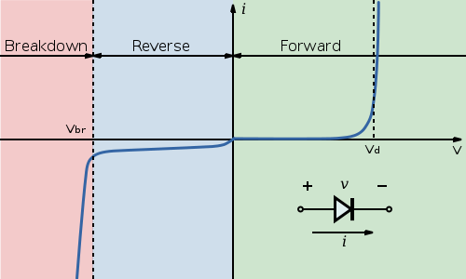
I-V Characteristics of a Diode
(v_{d} = v_{bi})
, (3 < m < 6)
(Pierret 1996)

Slide 8
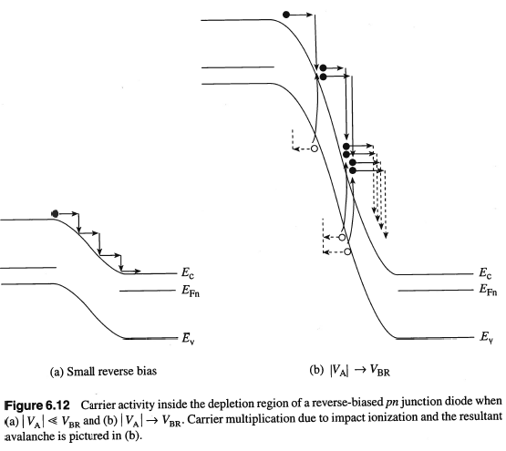
Breakdown and the Avalanche Mechanism

Slide 9
Avalanche Photodiodes

Slide 10
Linear Mode vs Geiger Mode
Once an avalanche has begun, a competition develops between the rate at which electron-hole pairs are generated and the rate at which they are collected at the device terminals.
Linear mode:
At biases below but near the breakdown voltage, collection dominates, causing the avalanche current to decay and ultimately stop. In this mode, the gain is finite and predictable (to within some degree of uncertainty based on material properties). Because the gain is finite, it is possible to distinguish between a single photon or multiple photons arriving simultaneously, though distinguishing between large numbers of photons (i.e., > 5) is statistically degenerate since the gain per electron is probabilistic.
Linear mode APDs can be used as single photon counting devices (low flux levels) or as photodiodes with a built-in gain at higher flux levels.

Slide 11
Linear Mode vs Geiger Mode
(Once an avalanche has begun, a competition develops between the rate at which electron-hole pairs are generated and the rate at which they are collected at the device terminals.)
Geiger mode:
In the case where the bias is above V_{BR}, multiplication outpaces collection. Initially, this causes exponential growth of the current. After some length of time, electrons and holes accumulate at the n- and p-sides of the depletion region, respectively, creating an internal electric field in opposition to the applied bias (arresting the growth of the current). The device remains in an on state, however, until the circuit reduces the applied bias (quenches the device), allowing the APD to turn off. In this mode, the gain would be infinite if the bias were held above breakdown. It is important to note that in this mode, an electrical event resulting from a single incident photon is indistinguishable from one initiated by a larger number of photons arriving simultaneously.

Slide 12
Practical Design
hν
Cathode Contact
The guard ring implant (heavily doped region) reduces edge breakdown effects (when the edge of the device has a lower magnitude breakdown voltage than the center).
n
p-
p+
Guard Ring (n+)
Anode Contact
The cathode is biased such that the voltage over the PN junction is greater than the breakdown voltage.

Slide 13
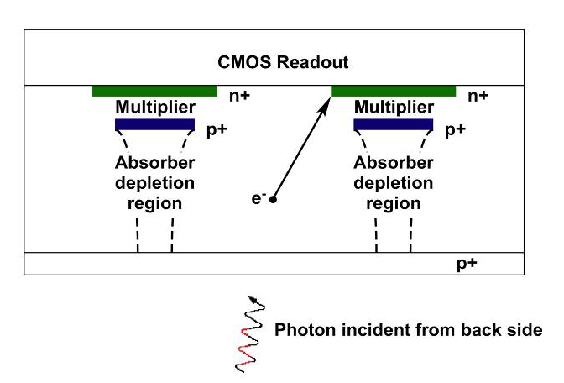
Practical Design
The relatively small multiplier region (< 1 μm) facilitates a higher electric field across at lower voltages. This allows for higher gain at lower voltages than the standard structure APD. This particular device is designed for Geiger-mode operation and breaks down at about 28 V reverse bias.

Slide 14
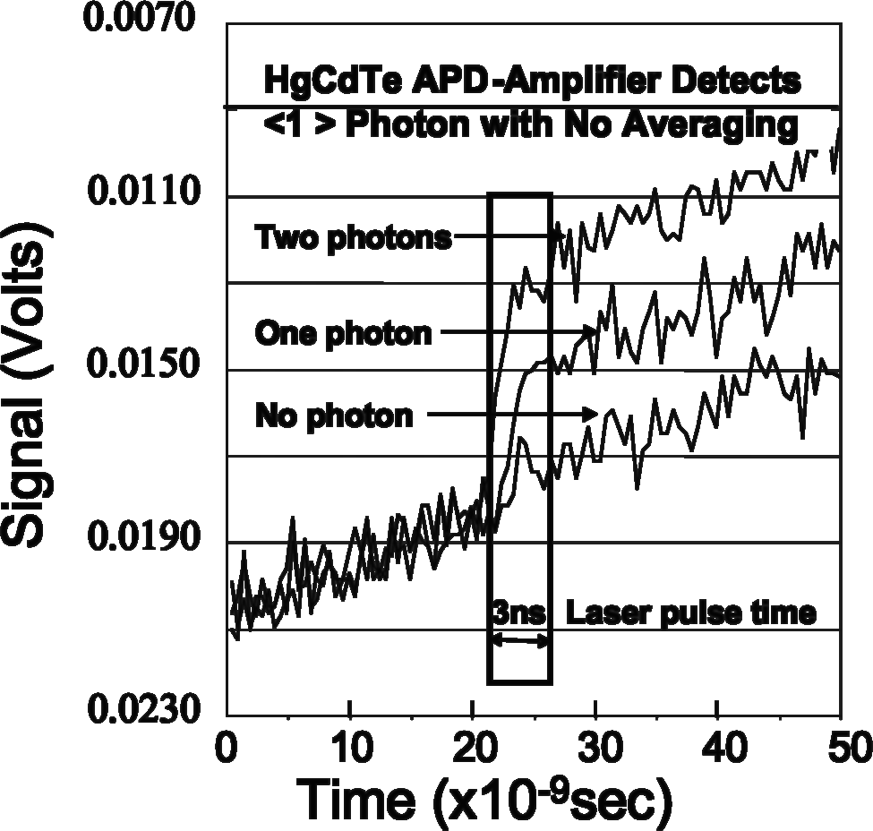
Performance Metrics (LM-APD)
Leakage Current (un-multiplied dark current)
  Not all dark carriers are multiplied. Some travel to the cathode without going through the multiplication region. These carriers will add to the integrated charge, introducing a constant slope to the ideal step function.
Slope is un-multiplied charge leakage current
Raytheon HgCdTe “e-APD”: a linear mode APD

Slide 15
Performance Metrics (LM-APD)
Dark Count Rate
  Dark current carriers can be multiplied just like photo-generated carriers.
  Practically, it is impossible to distinguish between the photo-generated signal and the dark (thermal) carrier noise. Therefore, the number of expected dark counts is subtracted from the final signal (though the variation from the noise will remain, decreasing SNR).
Laser
LM-APD Output
Dark Count
Voltage
Photon Detection
time

Slide 16
Performance Metrics (LM-APDs)
Excess Noise Factor
  The ratio of electron and hole impact ionization rates (k) affects the uncertainty in the gain per avalanche. This is a material property. The excess noise factor (F) is a function of the mean gain and k:
  F=kM+(1-k)(2-M⁻¹)
  Therefore, even the ideal shot-noise limited case is affected:
  SNR = S/sqrt(S*F)
  Silicon has a k-value of ~0.06 or less.
  HgCdTe is special in that it has an excess noise factor of 1 when injecting electrons.
  Some companies or researchers choose to use a slightly different notation:
  M^{x}=kM+(1-k)(2-M⁻¹)
  In these cases, the quoted “excess noise factor” (or excess noise figure) is denoted as x instead of F.

Slide 17
Performance Metrics (GM-APD)
Avalanche Initiation Probability (→ PDE)
The probability that a carrier in a sufficiently high electric field will initiate a self-sustaining avalanche is the “avalanche initiation probability.”
It is a function of:
  the strength of the electric field (specifically, how much the region is biased past the breakdown voltage, or the overbias)
  the location of the carrier in the electric field region
  the electron / hole ionization rates (depending on how the device is set up, either electrons or holes will initiate the avalanche)
Along with external and internal QE, the avalanche initiation probability defines the Photon Detection Efficiency (PDE), which is a standard metric for characterizing APDs.

Slide 18
Performance Metrics (GM-APD)
Dark Count Rate (DCR)
Dark count rate in Geiger mode APDs is similar to that in linear mode APDs. Thermally-generated dark carriers are multiplied and are indistinguishable from signal. The dark count rate must be characterized to account for the expected number of dark counts when taking data.

Slide 19
Performance Metrics (GM-APD)
Afterpulsing
Imperfections in the silicon lattice cause “trap” sites, which generate trap states (energy levels) into which carriers can “fall.”
Traps have characteristic de-trapping lifetimes depending on type (lattice mismatch, surface termination / interface imperfections, foreign materials like metals, etc.). Once a carrier enters a trap state, the length of time it remains in that state has an exponential decay probability function.
Traps are filled during the avalanche surge, and when the carriers are released later on in the detection cycle, they can cause another avalanche at random.

Slide 20
Performance Metrics (GM-APDs)
Afterpulsing (self re-triggering)
A second type of afterpulsing arises from the emission of photons by carriers participating in an avalanche.
A silicon APD avalanche has an emission spectrum roughly equivalent to a black body at 4200 K, which has a substantial contribution at wavelengths that can be absorbed by silicon.
These photons are absorbed elsewhere inside the detector (perhaps in a neighboring pixel or in the same pixel), and can cause afterpulsing and optical crosstalk.

Slide 21
Integrated Operation (GM-APD)
Quenching
Passive Quenching:
A passive quenching circuit uses an in-series resistor to limit the current flow and decrease the voltage across the APD.
  Before an avalanche, the circuit is biased so that the reverse bias voltage across the APD is above breakdown. No current flows, so the supply voltage level drops completely across the APD.
  When an avalanche occurs, high current is drawn, though limited by the resistor. As the current drawn by the APD increases, the voltage drop across the resistor increases. This, in turn, decreases the voltage across the APD, eventually decreasing it below breakdown and the avalanche ceases.
  Current continues to flow through the resistor to charge the APD (which acts as a capacitor under reverse bias when not avalanching) until the voltage across the APD returns to the supply voltage level.

Slide 22
Integrated Operation (GM-APD)
Quenching
Active Quenching:
An active quench circuit senses the increase in current through the circuit (usually by a drop in voltage across an in-series resistor) and actively pins the voltage across the APD to below breakdown voltage for a set period.
  The avalanche is sensed by the active quenching circuit and the APD voltage is immediately decreased below breakdown. This quenching voltage is held for a predetermined amount of time to evacuate all the avalanching carriers from the multiplication region.
  At the end of the quench time, the voltage is either allowed to increase via RC recharge through a resistor (passive recharge), or it is actively set above breakdown voltage (active recharge).

Slide 23
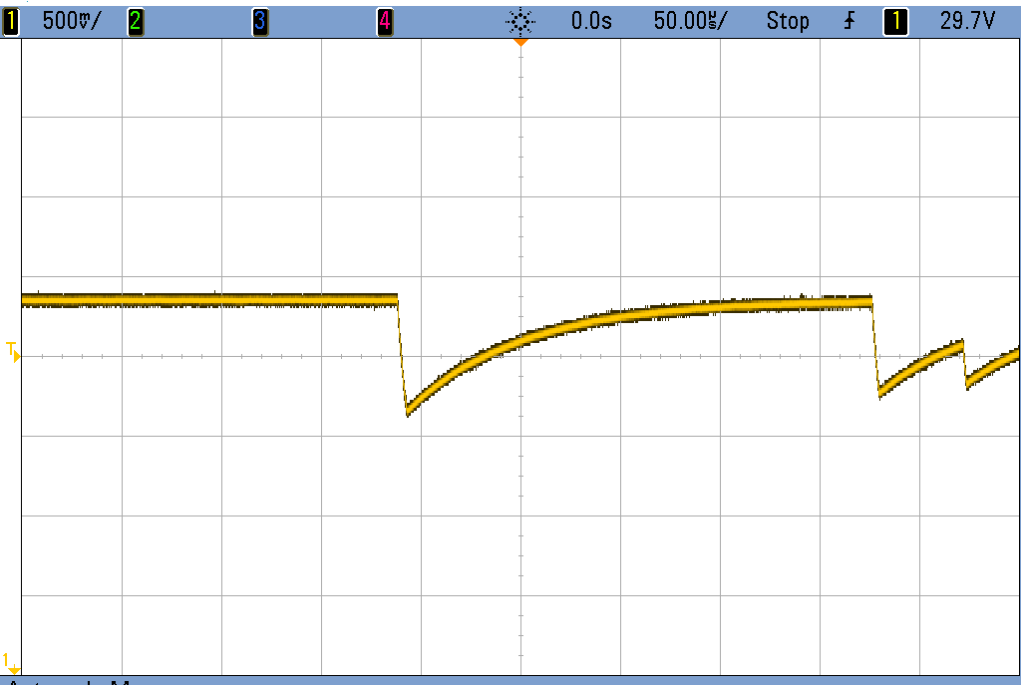
Integrated Operation (GM-APD)
Detection / Clocking Cycle (passive quenching)
V_{br}+ΔV
V(RC)=V_{BR}+0.632*(ΔV)
ΔV
V_{BR}
RC

Slide 24
Integrated Operation (GM-APD)
Detection / Clocking Cycle (active quenching)
Linear Regime
Geiger
Mode
on
on
Linear
quench
mode
Current
avalanche
off
off
arm
V_{dc} + DV
V
V
br
br
Voltage
Voltage

Slide 25
Integrated Operation (GM-APD)
Dead Time
Dead time refers to the period of the clocking cycle when the detector cannot register a photon event.
Generally, dead time includes quench time and the active reset time. Increased dead time reduces SNR and requires longer integration times to offset the loss of signal for constant sensitivity.

Slide 26
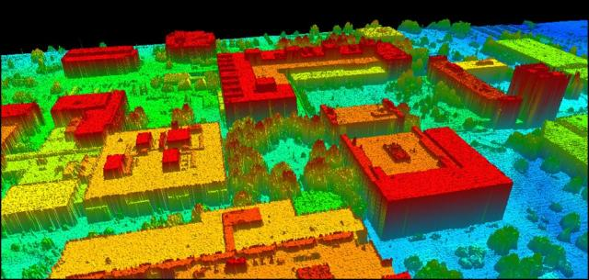
Applications
LIDAR
LIDAR (LIght Detection and Ranging) uses the time of flight from a transmitter laser to calculate the distance to and placement of distant objects in three-dimensional space, most commonly in airborne applications.
3D LIDAR Image of a Portion of the RIT Campus

Slide 27
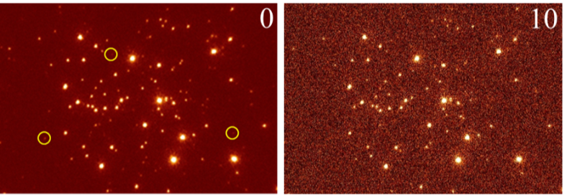
Applications
Imaging
Both linear mode and Geiger mode APDs have strengths and weaknesses when it comes to imaging.
  GM-APDs can be implemented with zero read noise (often the limiting factor in state-of-the-art imaging systems) when designed with an in-pixel counter. This makes the entire detection process digital.
  GM-APDs cannot distinguish between one or more photons arriving simultaneously, while that information is maintained in a LM-APD.
  LM-APDs have effectively no dead time, which this is a limiting factor in GM-APD performance.
  LM-APDs must be reset periodically to remove the charge accumulated by leakage current or the detector quickly becomes saturated, while this is not a problem with GM-APDs.
0 and 10 electrons read noise for images with simulated shot noise

Slide 28
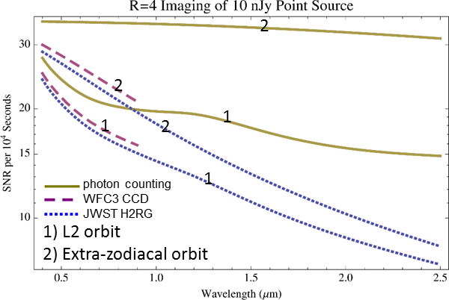
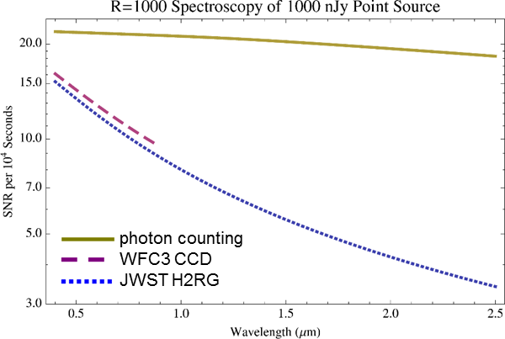
Applications
Imaging (single photon counting)
Figures Courtesy of Don Hall (University of Hawaii)

Slide 29
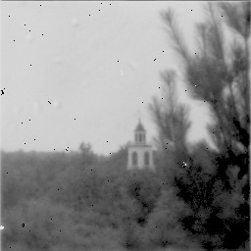
Applications
Imaging (GM-APD)
This image taken with a prototype GM-APD imager by researchers at Lincoln Laboratory (MIT).
Image courtesy of Don Figer.
Notes:
The detector that took this picture counts single photons!
Given what you know about GM-APDs and how they count photons, what must be true about the flux at the detector? In broad daylight, about how many photons per second would hit the detector? How fast would the detector have to be read out to match one photon per read? What’s a reasonable read rate for a GM-APD?

Slide 30

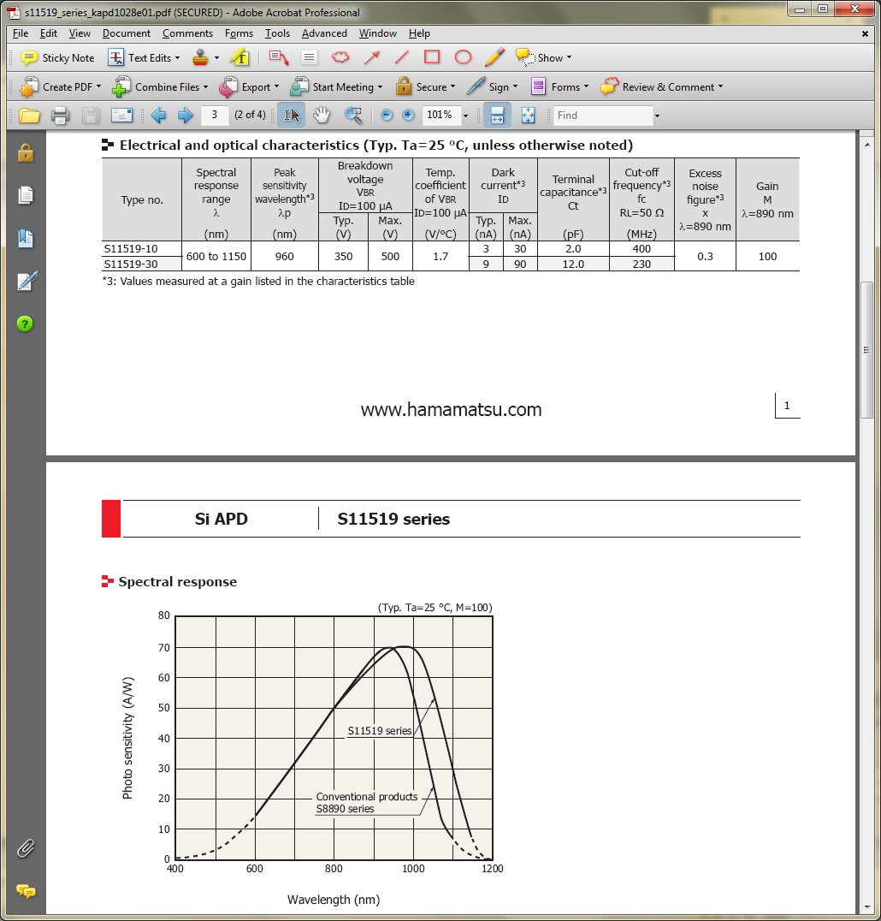
Applications
Currently Available
Hamamatsu S11519 Series
  M^{x}=kM+(1-k)(2-M⁻¹)
Notes:
How might you use this APD? Judging by the ratings and characteristics listed, is this linear-mode or geiger mode? Is it being used as a photon-counter or as an amplifier?
Based on the Electrical and Optical Characteristics table, what would the typical breakdown voltage be at 253 K? (note: breakdown voltage decreases with temperature)
What is the value of k for this device? (note, this company has used the M^{x} metric)

Slide 31
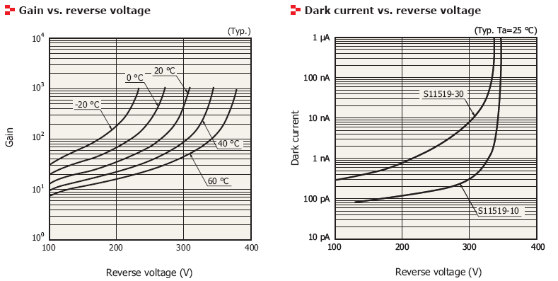
Applications
Currently Available
Hamamatsu S11519 Series
Notes:
Suppose you biased your S11519-30 to 300 V and exposed it to a filtered signal of wavelength 1 um. The device is operating at 25 degrees C. You measure a signal of 30 nA. What is the flux on the detector in photons/s?
Find the appropriate dark current from the Dark current vs. reverse voltage graph (9 nA).
Find the correct sensitivity on the Spectral response plot (70 A/W).
Subtract your dark current from your measured current (30 nA – 9 nA = 21 nA).
Convert your answer from (3) into watts (21 nA / (70 A/W) = 0.3 nW)
Convert your wattage into photons per second (0.3e-9 J/s * 1 photon/(hc/1000 nm) = 1.51e9 photons/s)

