Slide 1

Sensors and Detectors for Physical and Chemical Sciences – Finding Aliens
Don Figer
College of Science, Professor
Future Photon Initiative, Director
Center for Detectors, Director
October 29, 2025

Slide 2
Outline
Speaker Bio
Sensors & Detectors: A History of Discovery
CMOS Imaging Detectors and Life in the Universe
Future Photon Initiative, Center for Detectors, and CHIPS-related Activities at RIT
Back to the Future: Chips to the Cosmos

Slide 3
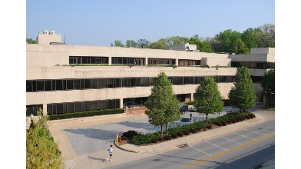
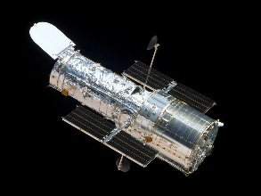
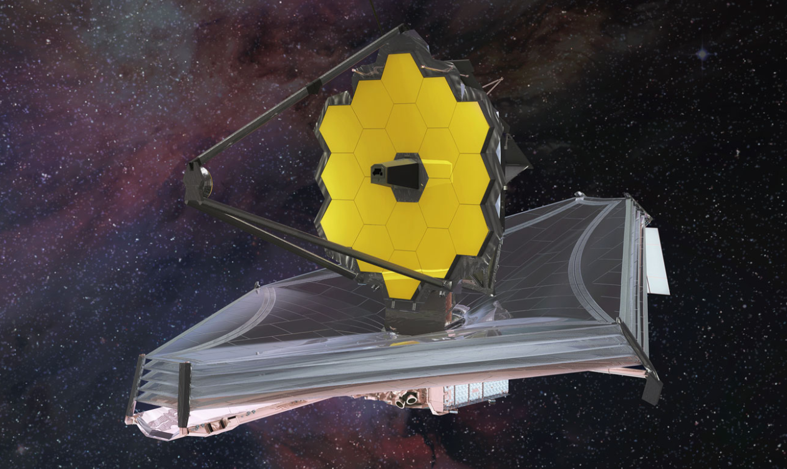
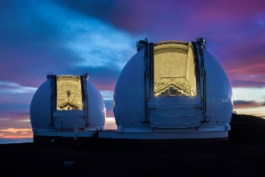
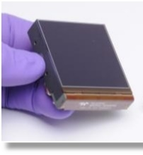
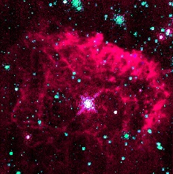
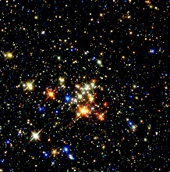
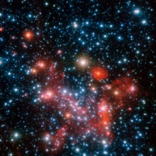
Don Figer - Speaker Bio
Professor in College of Science at RIT
Professor in Astrophysical Sciences and Technology Graduate Program
Director of the Center for Detectors
Director of the Future Photon Initiative
At RIT since 2006
Previously
Space Telescope Science Institute (operates Hubble and JWST)
UCLA (designed optics for infrared spectrograph on Keck)
Research Interests: Detectors, Massive Stars, Massive Star Clusters, Galactic Center

Slide 4
Sensors & Detectors: A History of Discovery

Slide 5
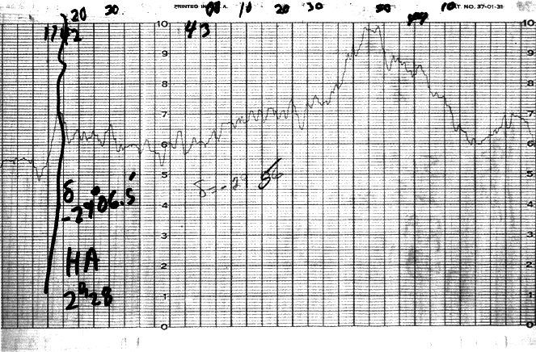
The Galactic Center with One Pixel (PbS)!

Slide 6
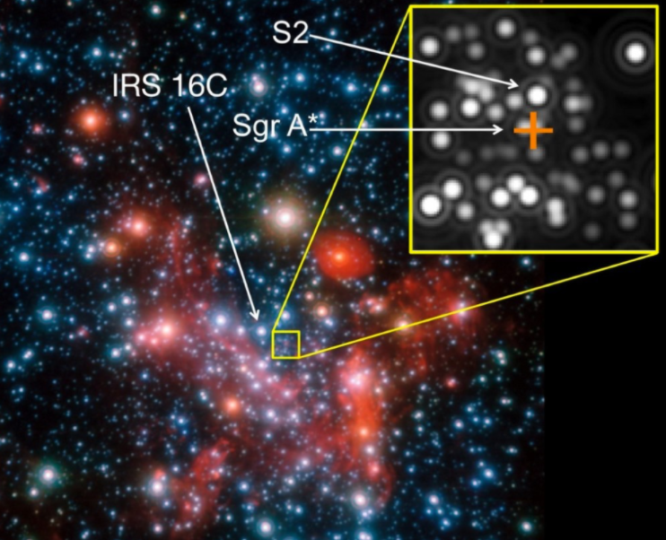
From One Pixel to Megapixels

Slide 7
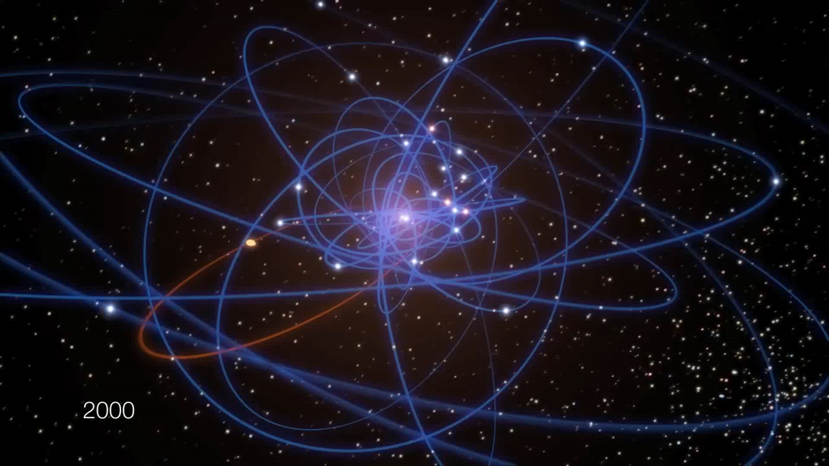
Supermassive Black Hole – 2020 Nobel Prize

Slide 8
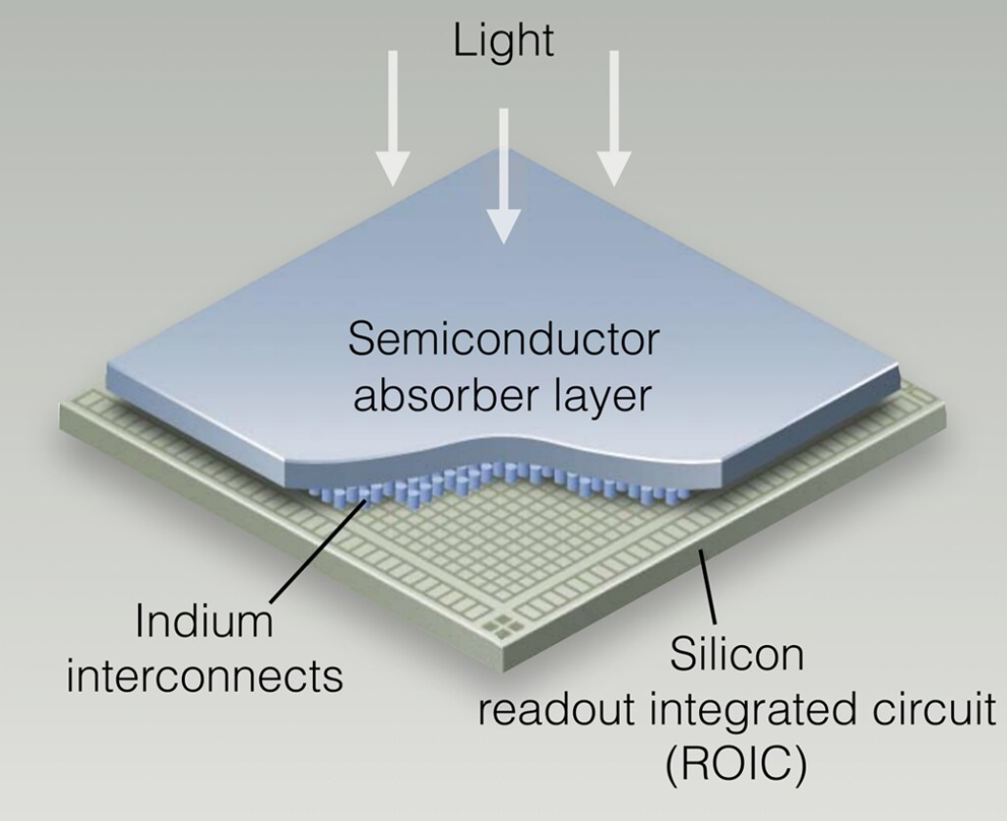
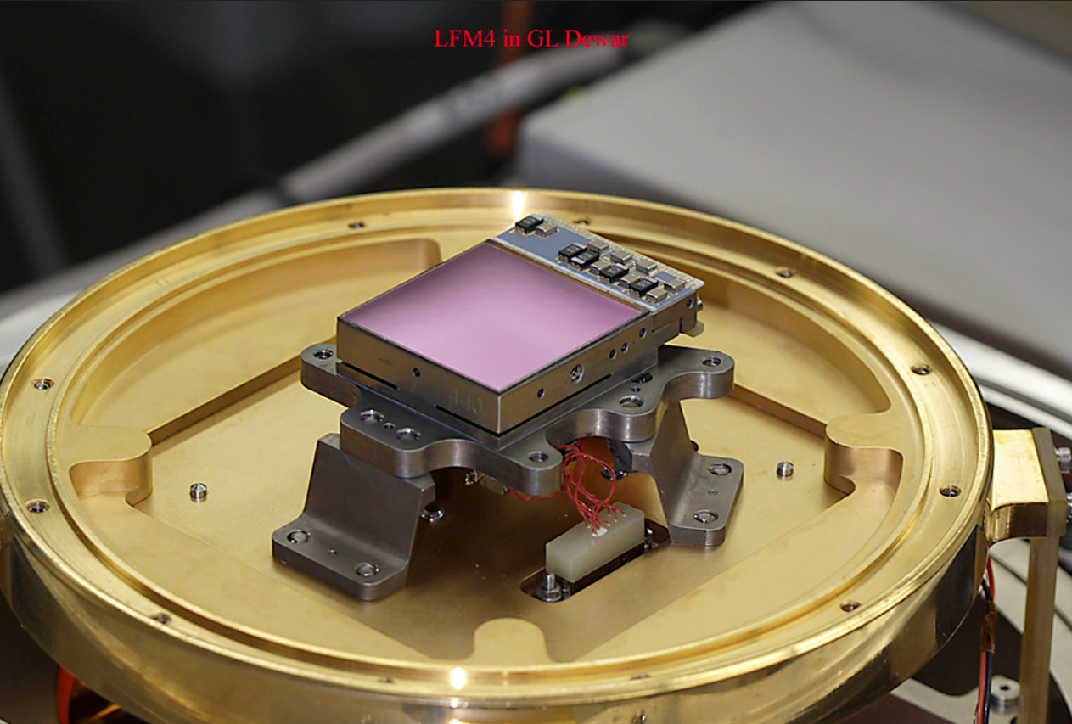
Infrared Hybrid Detectors
light-sensitive material that detects infrared photons (wavelengths > ~1 µm)
silicon readout integrated circuit
detector material (e.g., HgCdTe) optimized for infrared sensitivity
“hybrid” design: infrared detector layer bonded to a silicon readout integrated circuit (ROIC) using indium bump bonds
James Webb Space Telescope prototype infrared detector on a mechanical mount affixed to a plate in a cryogenic dewar

Slide 9
Detectors and Discovery
Charles Townes (Nobel, Laser, IR instruments)
Penzias & Wilson (Nobel, radio receiver)
Pulsars (radar)
Boyle & Smith (Nobel, CCDs)
Becklin & Neugebauer (Galactic Center in IR)
Dark Matter (image intensifiers)
Dark Energy (Nobel, CCDs)
Cosmic Microwave Background (Nobel, COBE/detectors)
Neutrinos (Nobels, PMTs)
Reinhard Genzel (Nobel, IR instruments)
James Webb Space Telescope
Hubble Space Telescope
Basically, almost every astrophysics discovery is due to new detectors and/or instrumentation.

Slide 10
CMOS Imaging Detectors and Life in the Universe

Slide 11

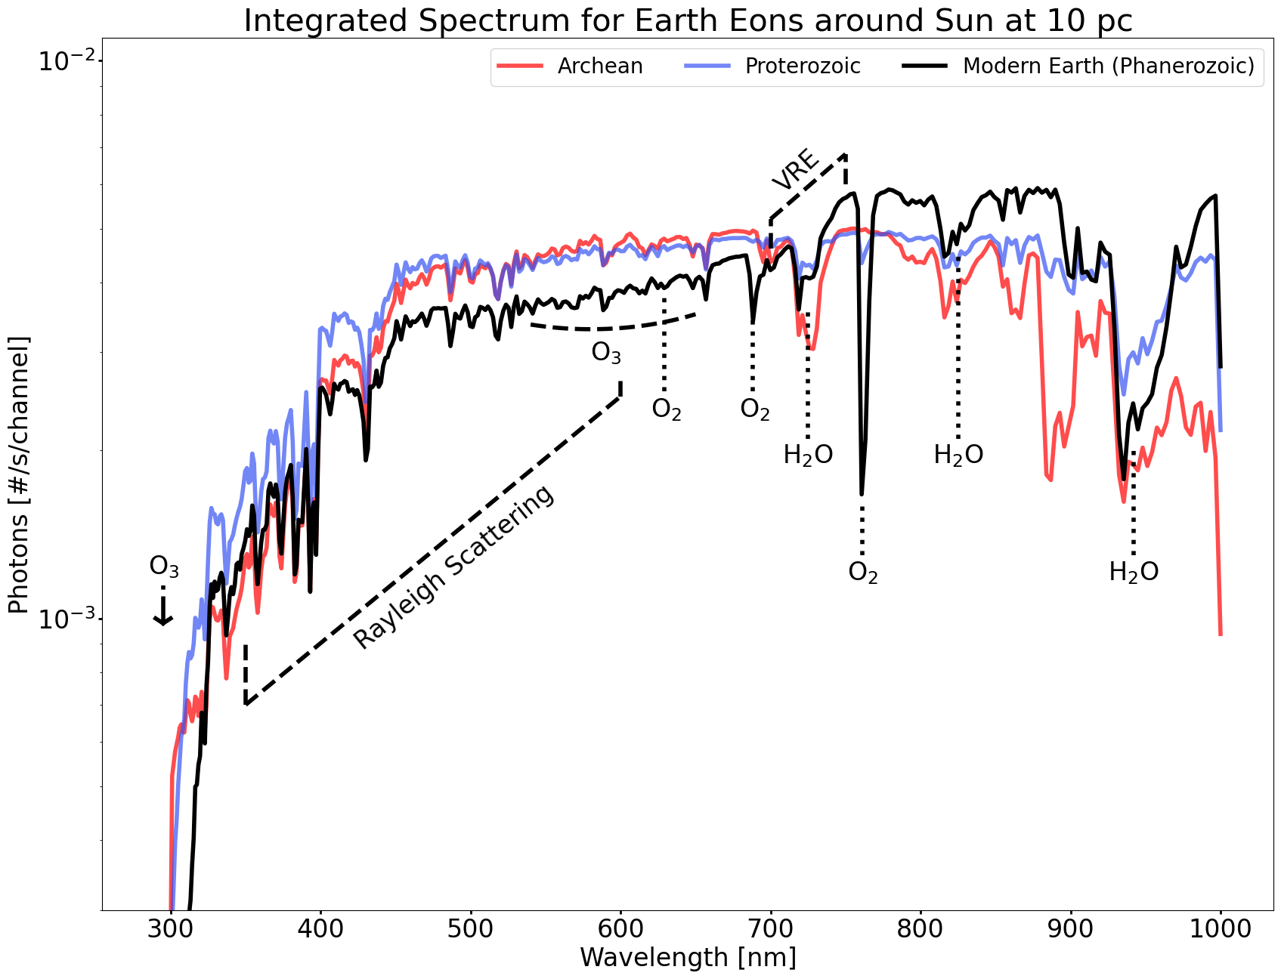
Life in the Universe - Biosignatures

Slide 12
Finding Life Outside the Solar System
The coexistence of methane (CH₄) and oxygen (O₂) in a planet’s atmosphere suggests potential alien life.
CH₄ and O₂ are highly reactive and cannot persist together without continuous replenishment.
On Earth, microbes generate CH₄ while plants and algae produce O₂, sustaining disequilibrium.
Detecting both gases elsewhere may indicate biology at work.
Spectroscopy reveals the composition of exoplanet atmospheres.
Key strategy is to look for gas combinations in disequilibrium (e.g., CH₄ + O₂, N₂O, PH₃).
Future observatories (HWO, Extremely Large Telescopes, JWST successors) will expand the search.

Slide 13
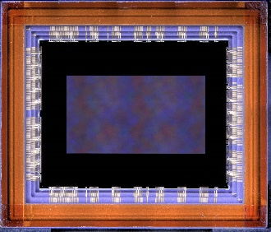
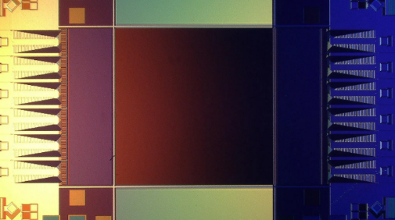
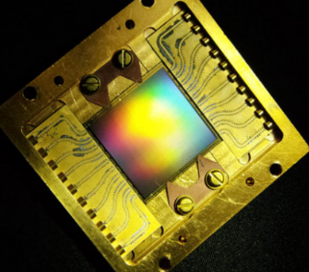
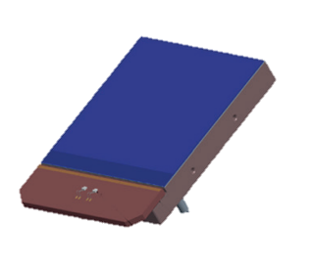
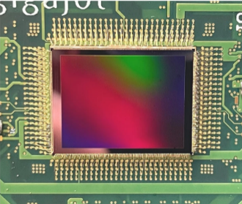
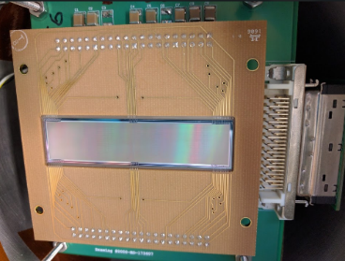
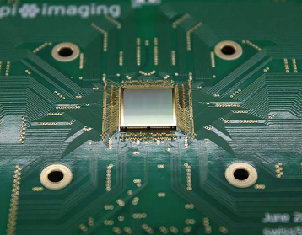
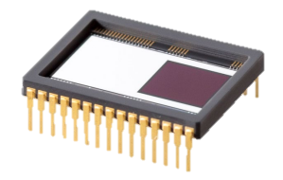
State of the Art Detector Candidates for Future Missions
challenging for life finding
single-photon sensing
low dark current
near-zero read noise
multiple candidate detectors
CMOS: 9.4 Mpix
FI HWK4123
SNSPD: 0.4 Mpix (Adam McCaughan/NIST)
MKID: 20 Kpix (Mazin Lab, Breckenridge 2021)
CMOS: Teledyne e2v CIS301/302
EMCCD: Teledyne e2v CCD351-00
CMOS: 163 Mpix QIS (Ma et al. 2022)
Skipper CCD: 3.5 Mpix (SENSEI Collaboration)
SPAD: Pi Imaging SPAD 512² (Antolovic et al. 2022)

Slide 14
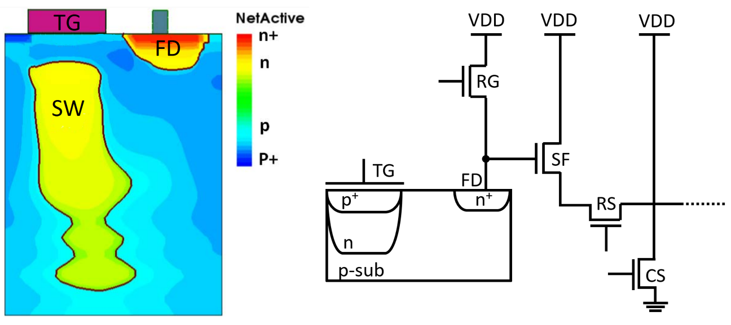

Single Photon CMOS Detector Pixel

Slide 15
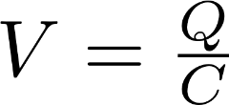
Single Photon CMOS Detectors
low-capacitance floating diffusion sense node
high-gain response of >320 μV/e-
exceeds electronics read noise
correlated double/multiple sampling
discrete photoelectron peaks
Ma, J. et al. Ultra-high-resolution quanta image sensor with reliable photon-number-resolving and high dynamic range capabilities. Sci Rep 12, 13869 (2022). https://doi.org/10.1038/s41598-022-17952-z

Slide 16
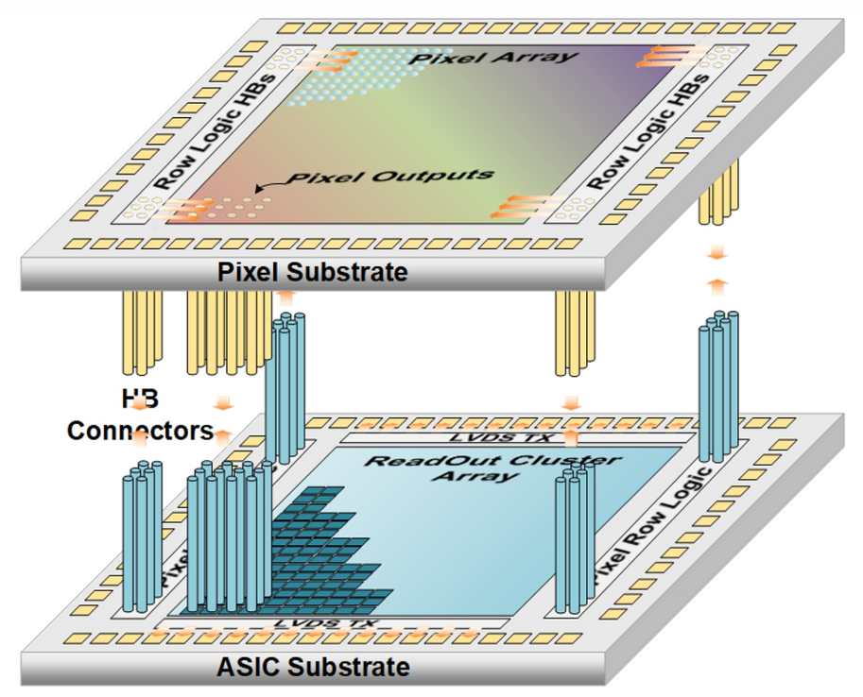
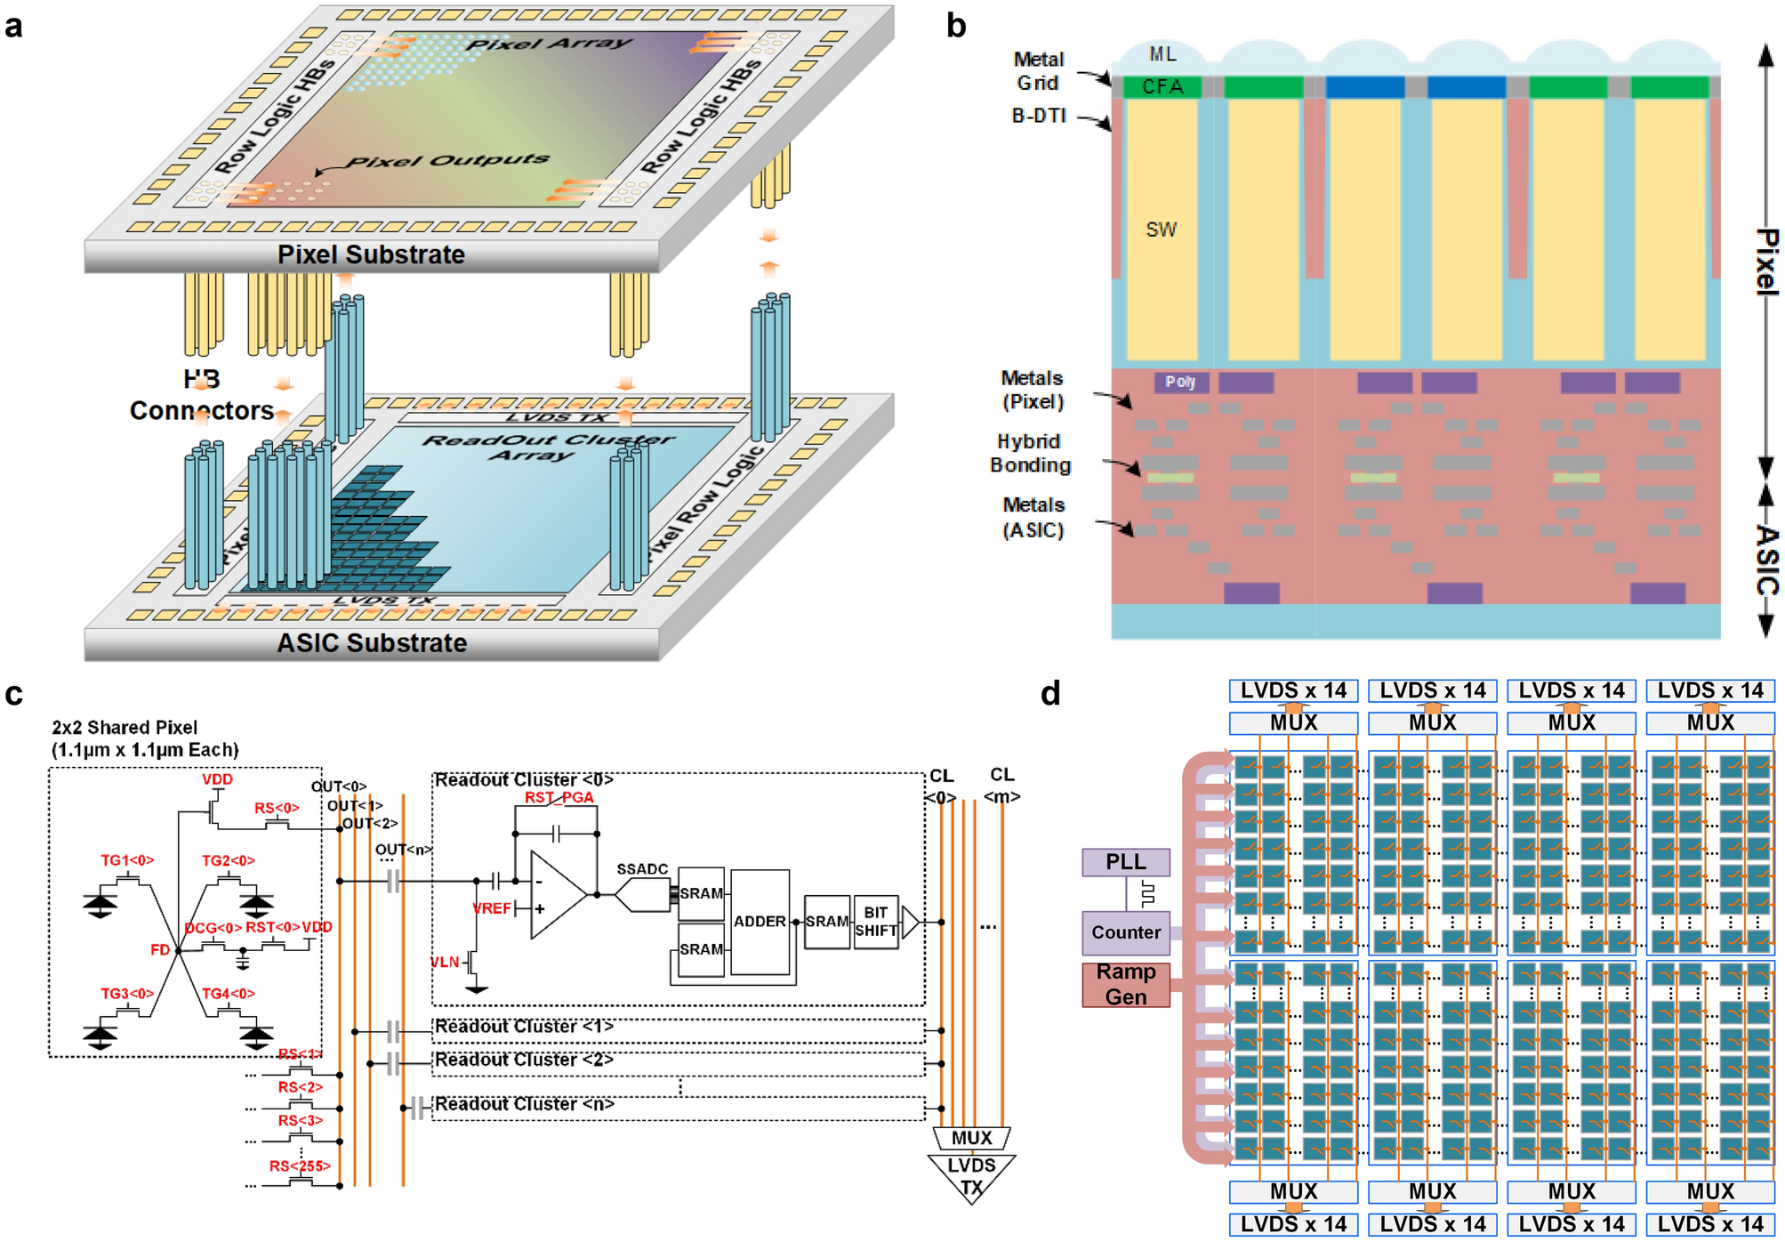
Single Photon CMOS Detector Bonding
45 nm
65 nm

Slide 17
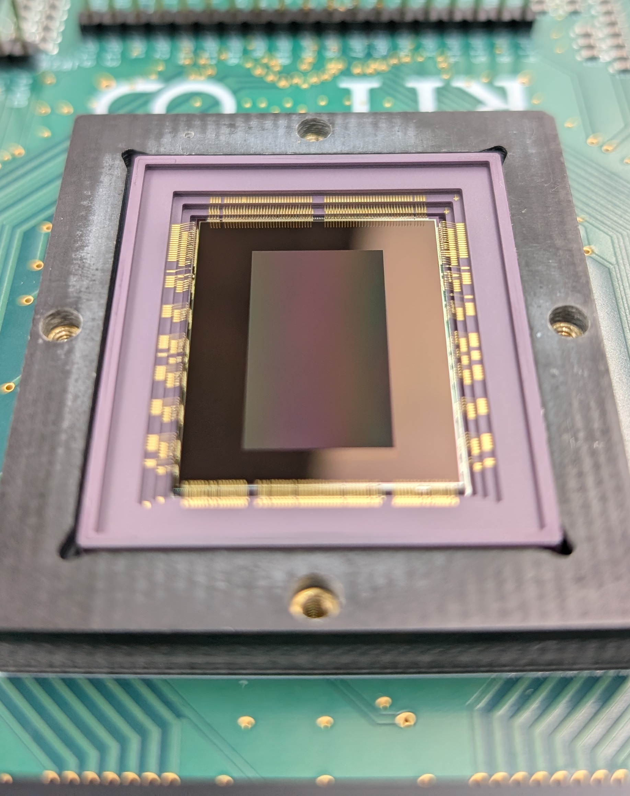
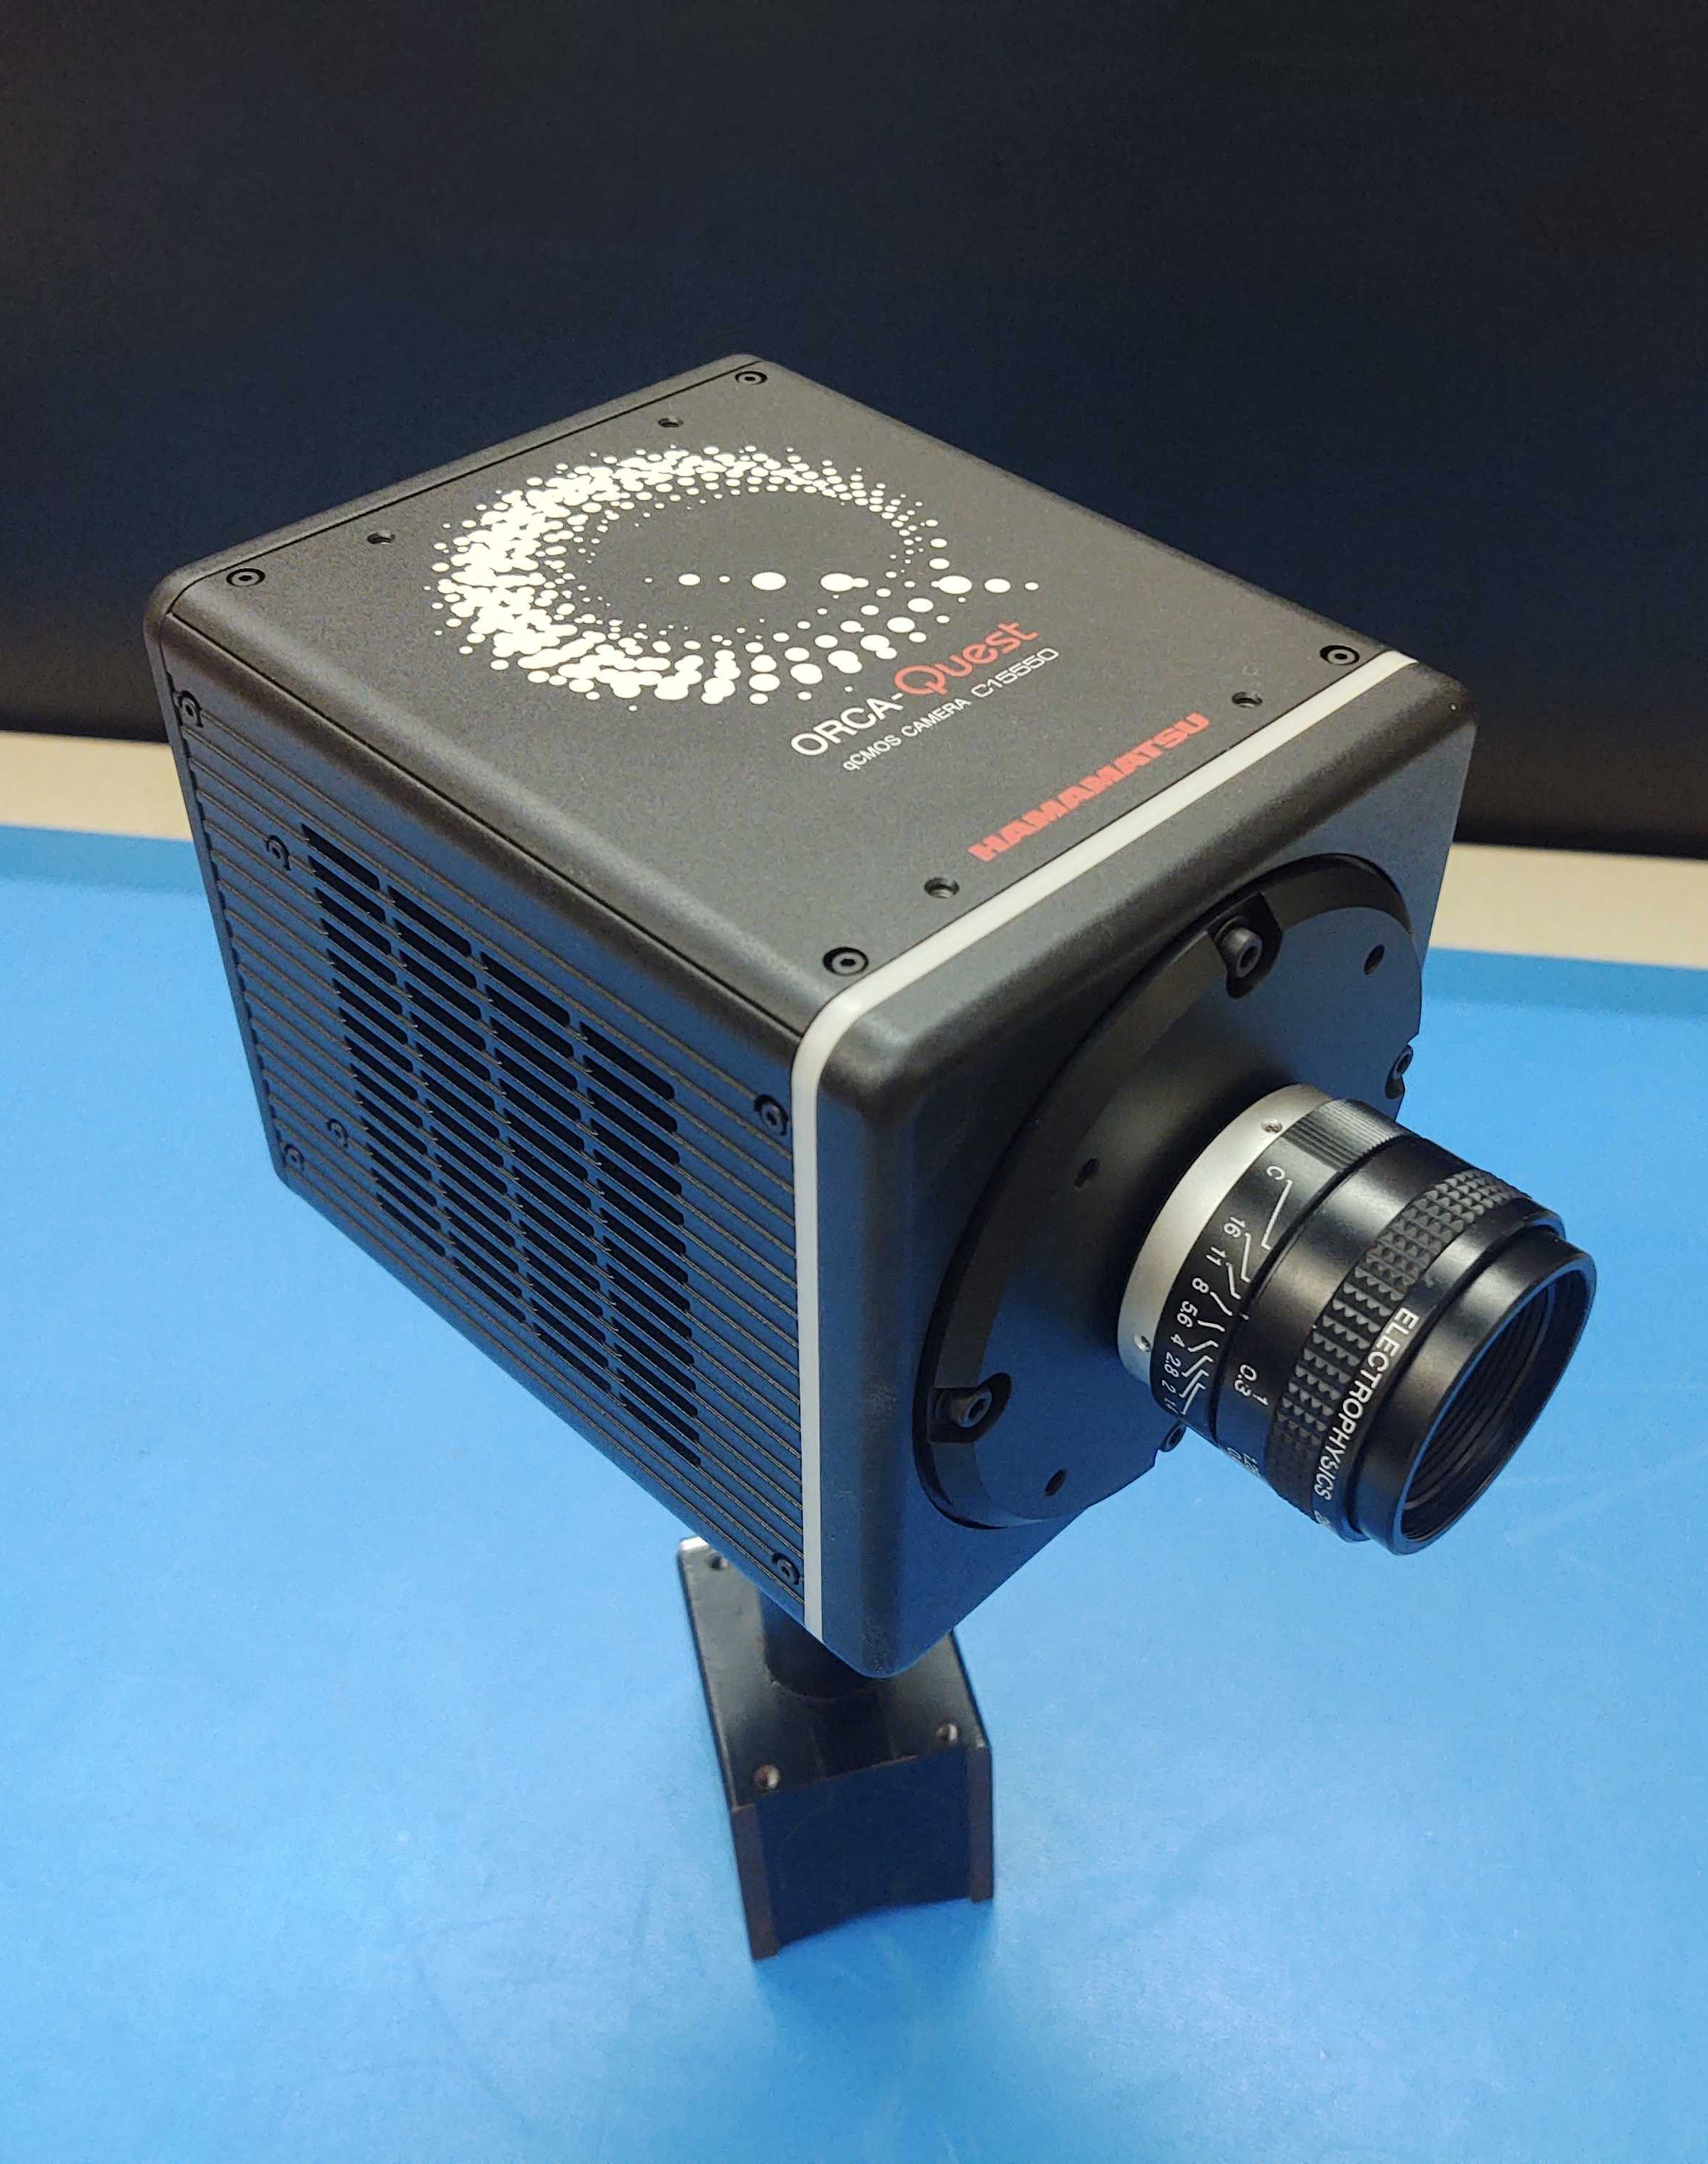
Single-Photon CMOS Image Sensors
QIS CMOS
1 Megapixel Sensors
1.1 μm pixels
HWK4123
9.4 Megapixel
4.6 μm pixels
ORCA-QUEST
HWK4123

Slide 18
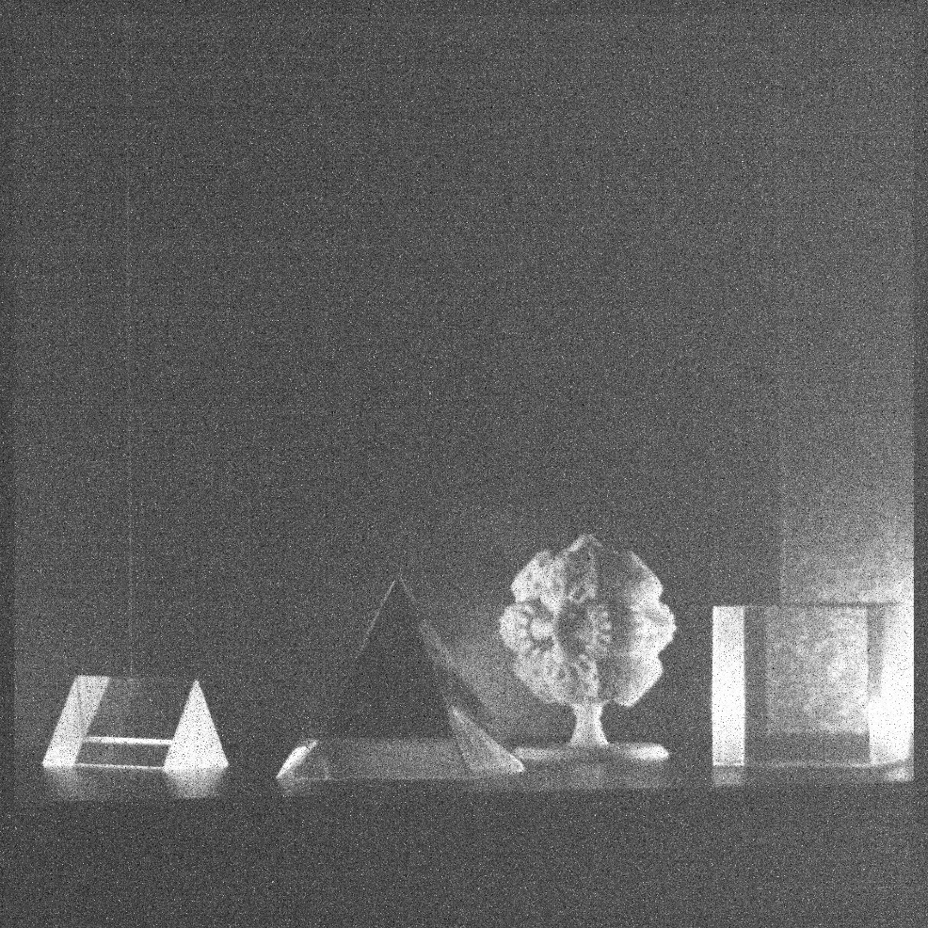
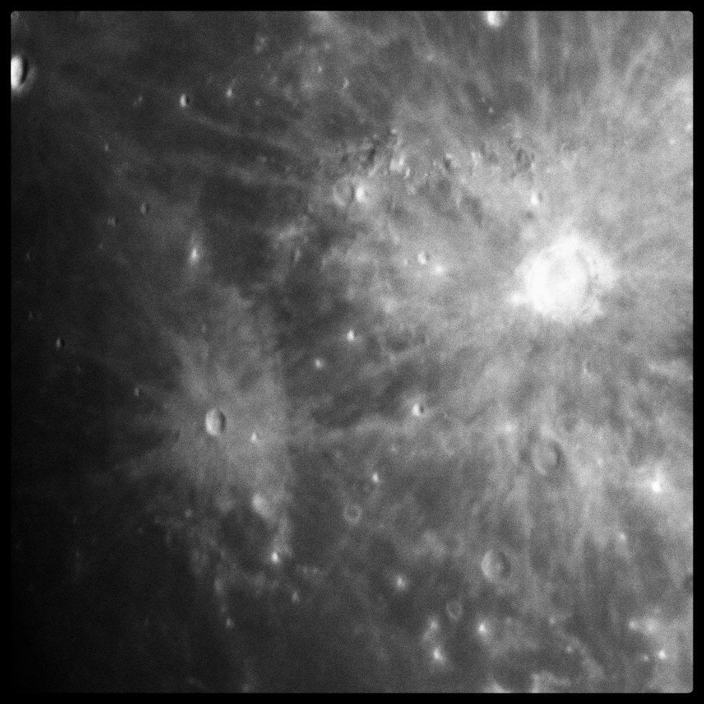
Single Photon Images
e⁻
e⁻
e⁻
e⁻
e⁻
e⁻
e⁻
e⁻
Gallagher, J., Buntic, L., Figer, D. F., and Deng, W. 2022, “Characterization of single-photon sensing and photon-number resolving CMOS image sensors,” SPIE Astronomical Telescopes and Instrumentation, Montreal, Paper 12191-28

Slide 19
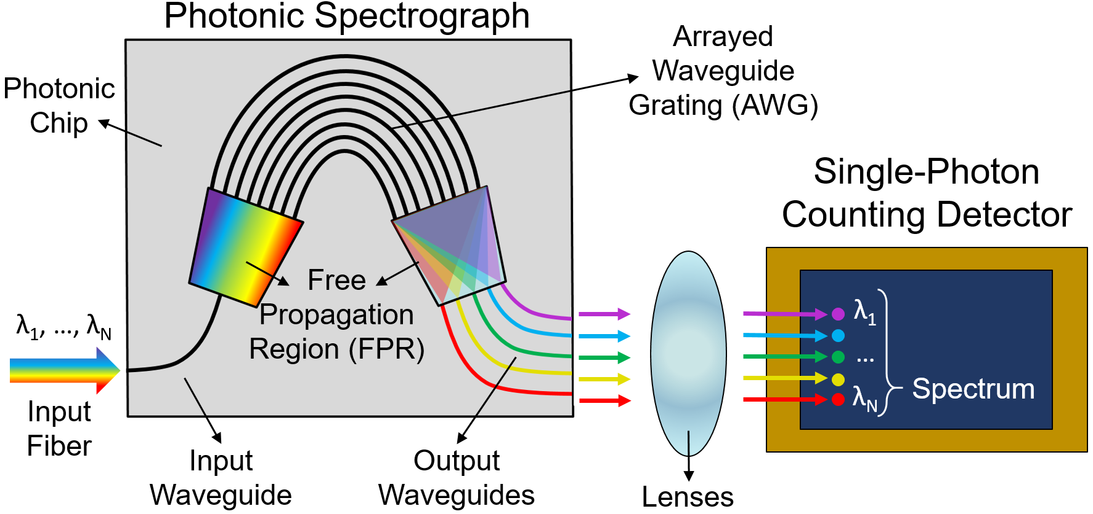
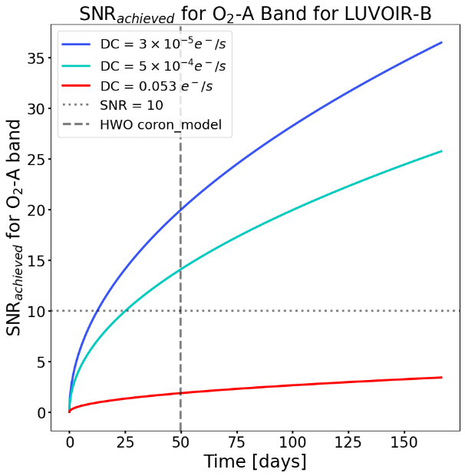
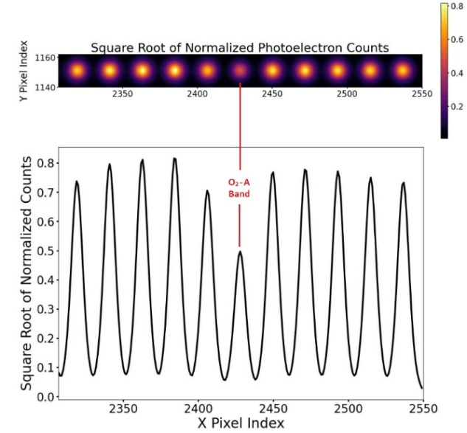
Single Photon Counting Photonic Spectrograph
combine single photon counting detector with photonic spectrograph
reduce SWaP
detect biosignatures in exoplanets
simulate performance and compare to HWO simulator
design prototype in visible range (500-800nm)

Slide 20
Future Photon Initiative Center for Detectors CHIPS-related Activities at RIT

Slide 21
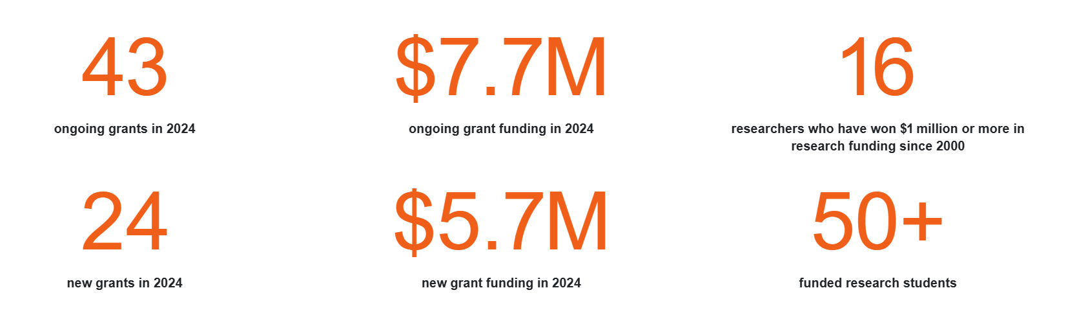
Future Photon Initiative
Future Photon Initiative: develops photonic devices in pursuit of answers to grand questions, leveraging efforts of existing RIT research groups using the generation, transmission, manipulation, absorption, and detection of
solar energy, biophotonics, high performance imaging, astrophysics, quantum, and communication.
Eight groups: Center for Detectors, Integrated Photonics Group, Nanolithography Research Lab, NanoPower Research Labs, Photonic Systems Lab, Photonics and Optics Workforce Education Research, Semiconductor Nanofabrication Lab, and the Simone Center for Innovation and Entrepreneurship.
43 ongoing grants with $7.7M funding

Slide 22
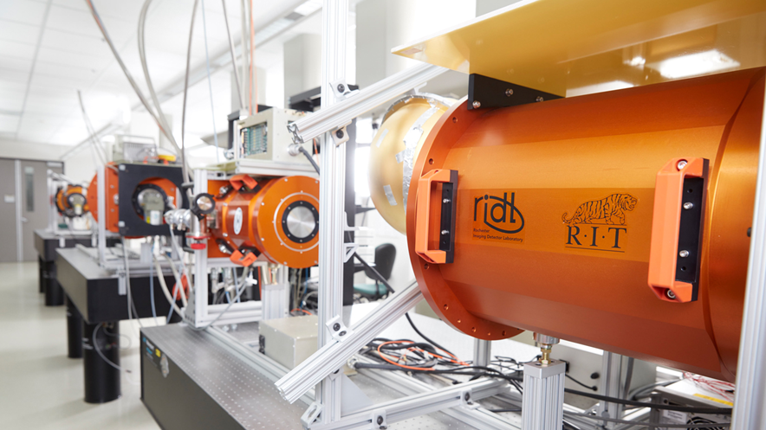
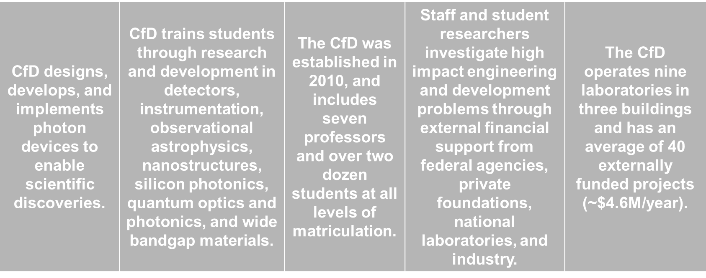
Center for Detectors

Slide 23
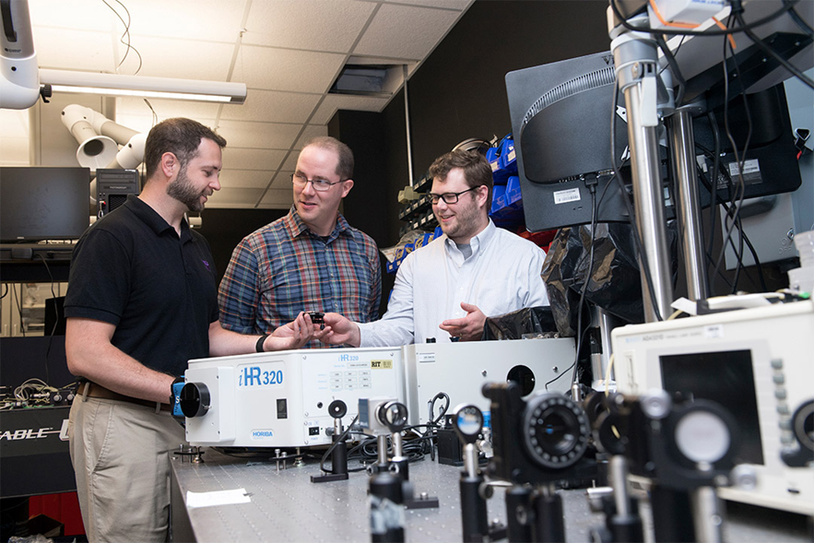
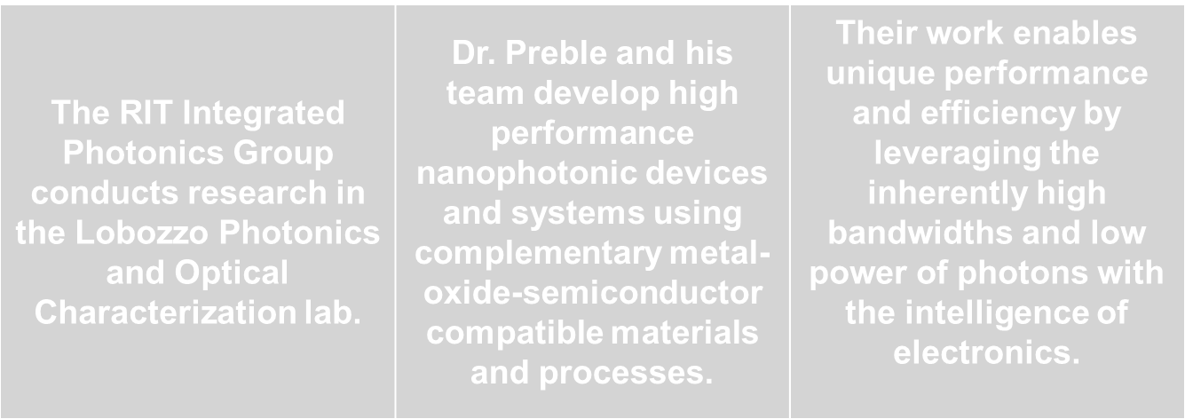
Integrated Photonics Group

Slide 24
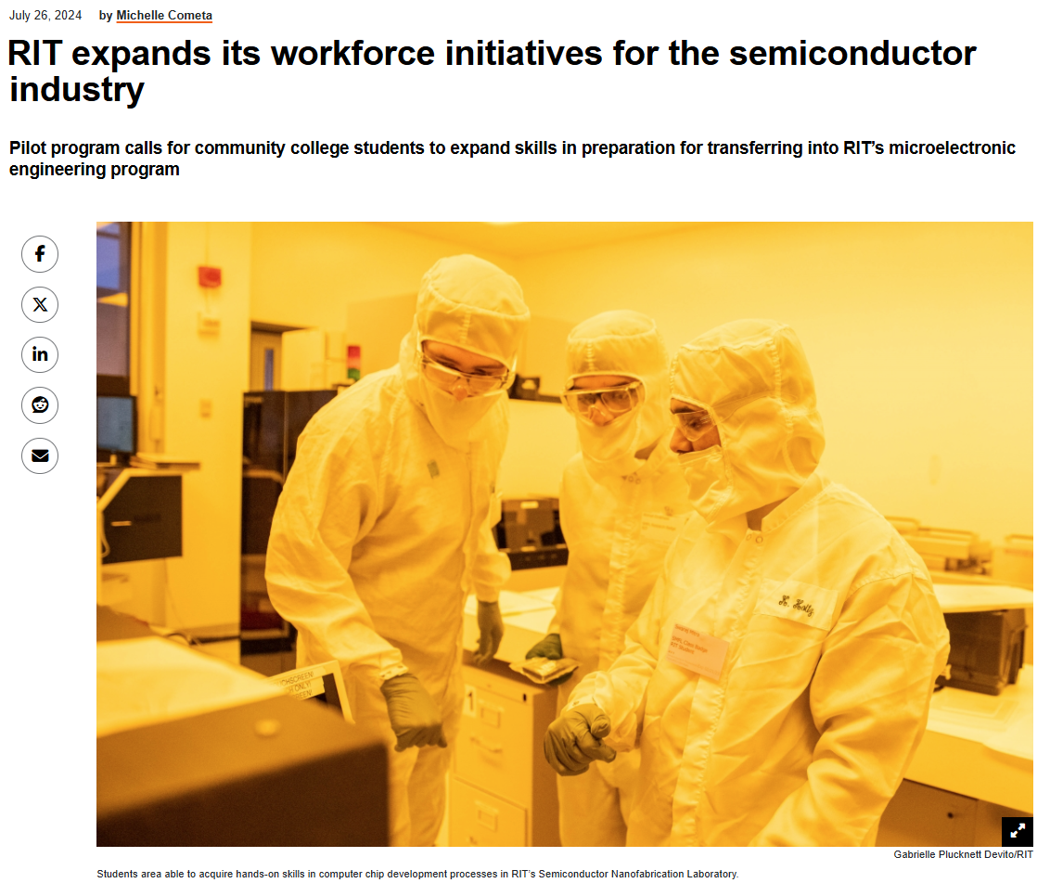

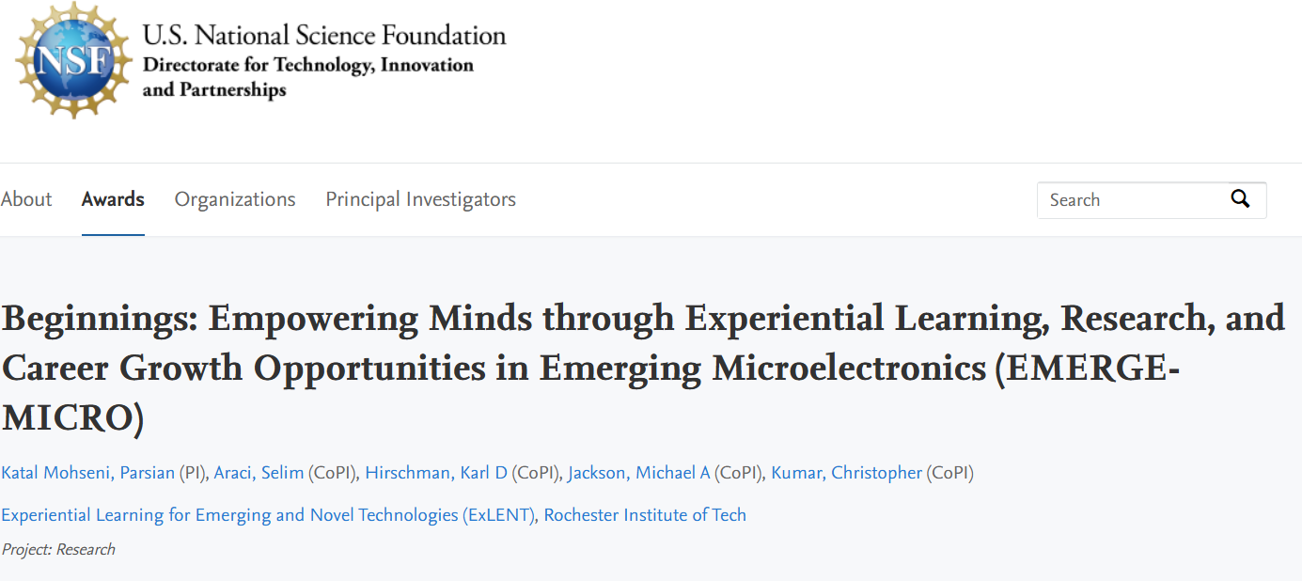
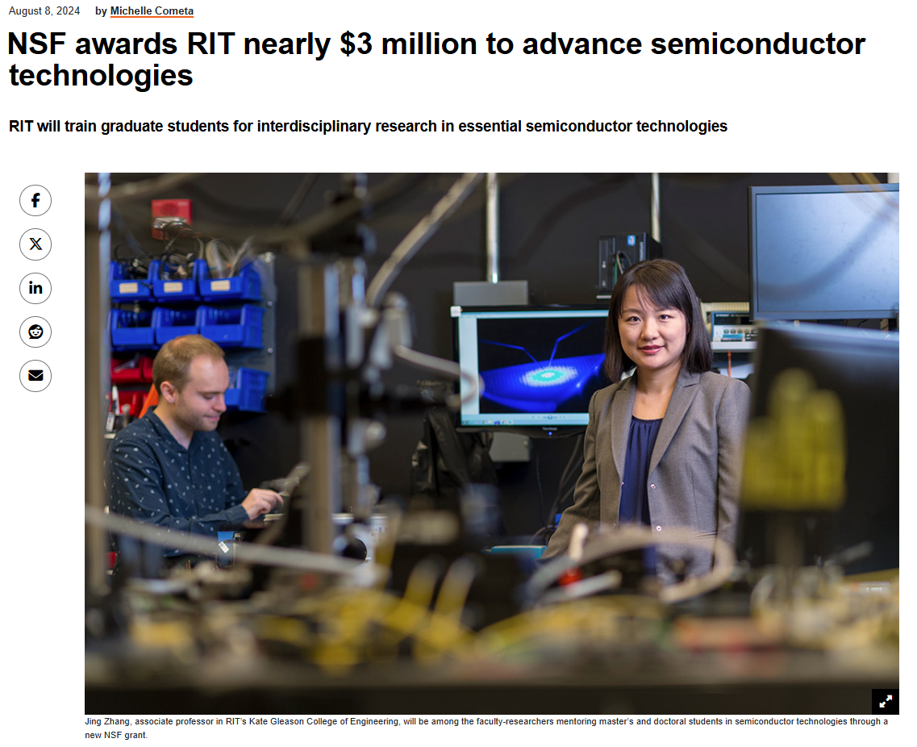
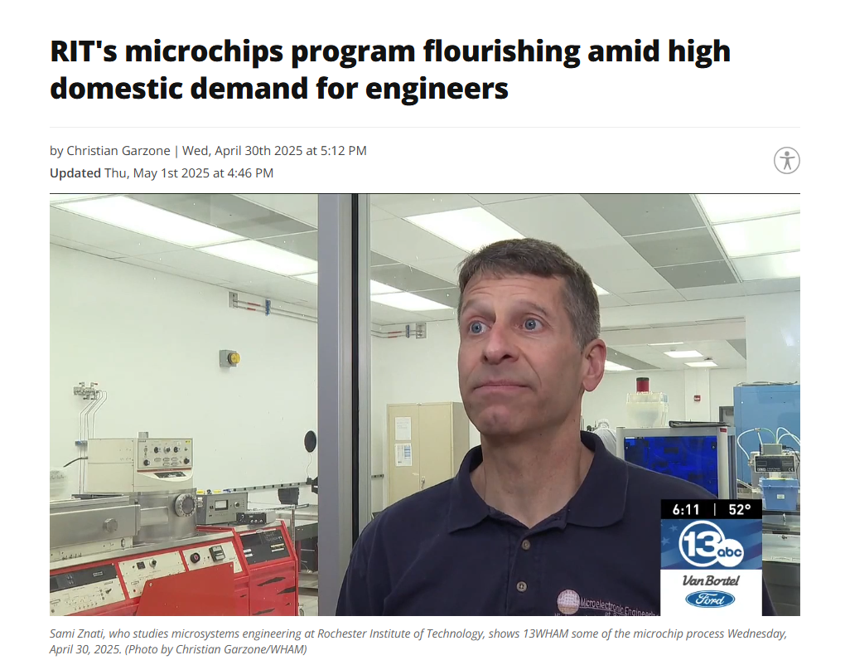
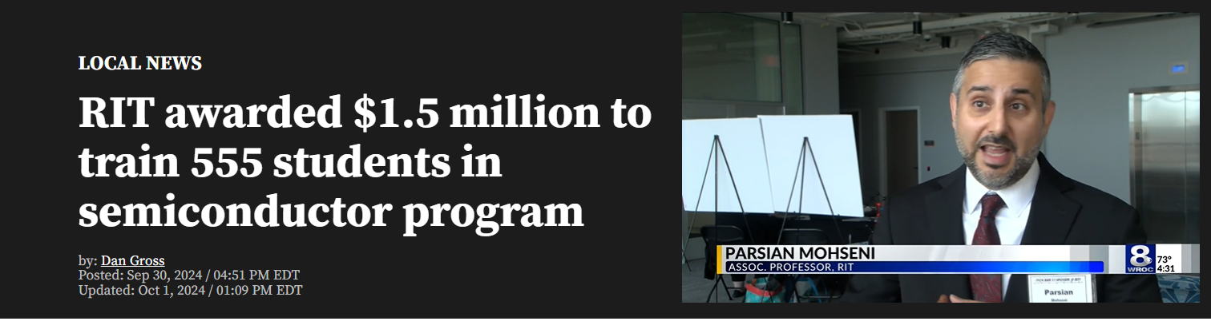
RIT CHIPs-related Activities

Slide 25
Back to the Future: Chips to the Cosmos

Slide 26
Back to the Future: Chips to the Cosmos
Semiconductors don’t just power our economy — they give us the power to see the WHOLE Universe!
Need on-shore foundry capability.
The Challenge: Detecting extraterrestrial signatures—chemical, biological, or technological—demands extreme sensitivity and specificity.
The Technological Frontier: Next-generation sensors combine photonics, quantum-limited performance, and 3D heterogeneous integration.
Mature-node processes (45 nm / 65 nm) remain relevant when hybridized through advanced packaging and 3D stacking.
The Opportunity: Cross-disciplinary innovation—semiconductors, photonics, materials science, and AI—is reshaping how we detect faint or ambiguous signals. “Finding aliens” becomes a proxy for the ultimate sensitivity test of human technology.
The Message: The same breakthroughs that may reveal life elsewhere will also revolutionize sensing here on Earth—environmental monitoring, medical diagnostics, and quantum communications.

Slide 27
Questions

Slide 28
Backup Slides

Slide 29
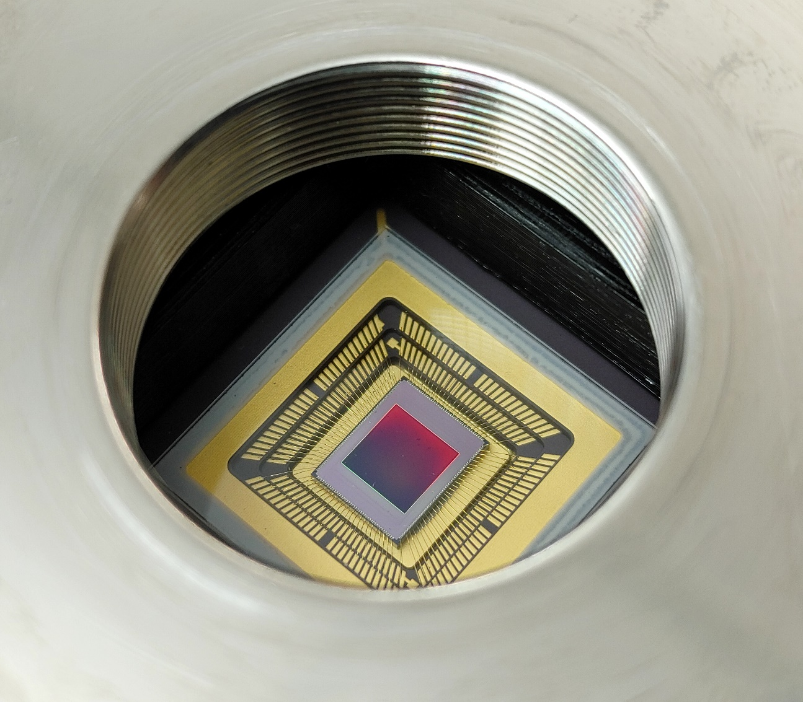
Summary
challenging science
observe low photon flux sources
detect biosignatures on exoplanets
develop detector technologies for HWO single-photon sensing in UV, optical, and NIR
Recent Publications:
Gallagher, J. P., Buntic, L., Deng, W., Fossum, E. R., and Figer, D. F. 2024, Radiation tolerance of a single-photon counting complementary metal-oxide semiconductor image sensor, J. Astron. Telesc. Instrum. Syst. 10(3), 036003, doi: 10.1117/1.JATIS.10.3.036003.
Gallagher, J. P., Buntic, L., Alexani, E., Bouthsarath, K., and Figer, D. F. 2024, Characterizing radiation-tolerant single photon resolving CMOS detectors, Proceedings Volume 13103, X-Ray, Optical, and Infrared Detectors for Astronomy XI; 131030S, Yokohama, Japan, https://doi.org/10.1117/12.3019105.
Gallagher, J. P., Buntic, L., Figer, D. F., Deng, W. 2024, Characterization of single-photon sensing and photon-number resolving CMOS image sensors, Proc. SPIE 12191, X-Ray, Optical, and Infrared Detectors for Astronomy X, Montreal, Canada, https://doi.org/10.1117/12.2629006

Slide 30
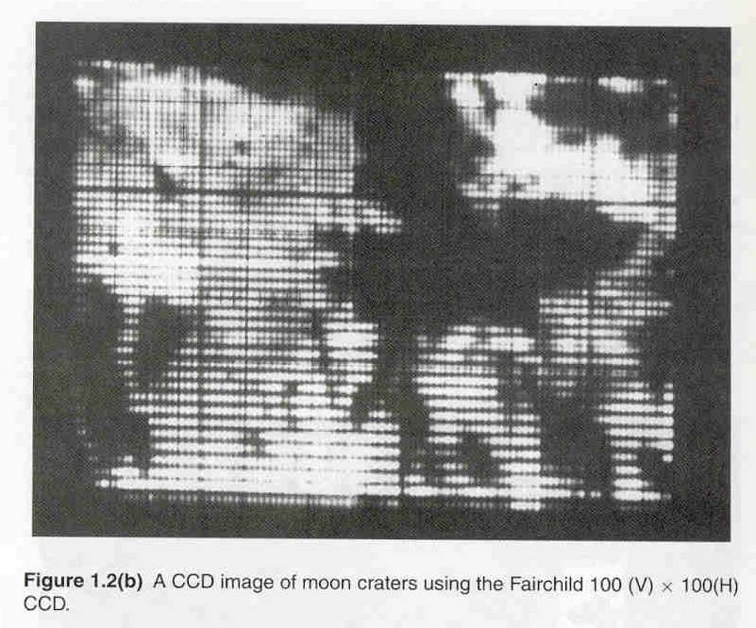
First Astronomical CCD Image

Slide 31
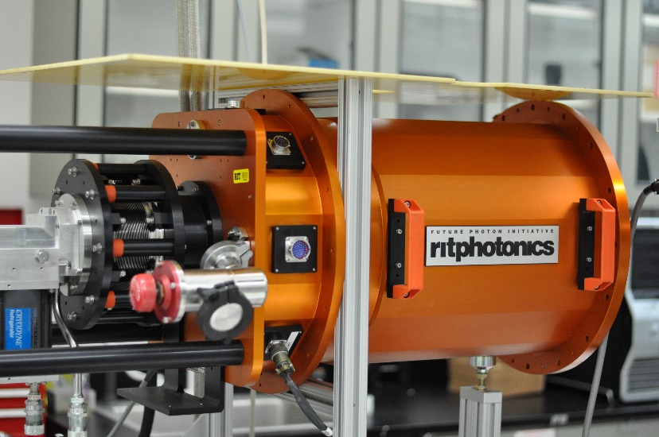
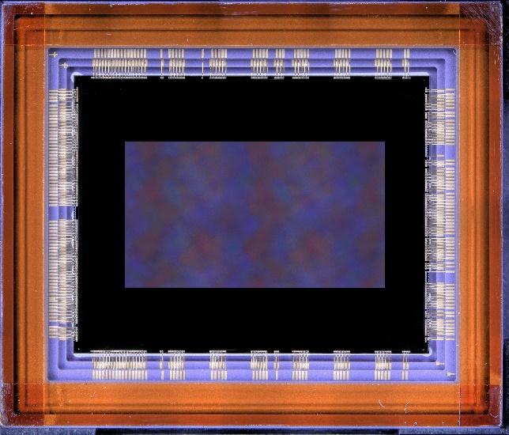
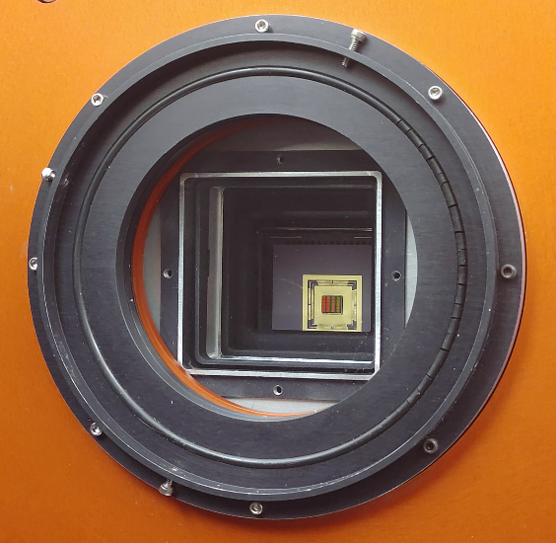

Slide 32





RIT CHIPS-Related Programs
NSF ExLENT: EMERGE-MICRO
Sponsor: NSF TIP & EDU Funding: ~$1M | 2024 – 2027
Develop a pilot pipeline for community college students through A.S. → B.S. in Microelectronic Engineering.
Hands-on cleanroom training, co-op placements, and industry-guided research.
Collaborators: MCC, FLCC, GlobalFoundries, Micron, University of Rochester evaluator.
NSF NRT: CMOS+X Graduate Training
Sponsor: NSF NRT Funding: ~$3M | 2024 – 2029
Provide graduate (M.S. & Ph.D.) fellowships (~20 doctoral) in interdisciplinary semiconductor research.
Focus areas: CMOS + AI, biomedical, optoelectronic, photonic, nanoelectronics, quantum, packaging.
Goal: Train 170+ next-gen engineers & scientists, emphasizing technical and professional development components.
NSF: UPWARDS for the Future
Sponsor: NSF | (UW lead) Funding: ~$10M | 2023 – 2028
U.S.–Japan university partnership engaging six U.S. and five Japanese universities.
Activities: Student exchanges, faculty visiting programs, certification, curriculum development, focused semiconductor and memory-centric research.
Objective: Build a globally connected, skilled microelectronics workforce aligned with industry needs.
DoC: BRIDGE for Microelectronics
Sponsor: Dept of Commerce/NIST CHIPS Act Funding: ~$1.5M | 2025 – 2027
Build graduate education program to train 555 students across bachelor’s, master’s, and certificate tracks in microelectronics.
Includes new online certificate offerings, industry collaboration, and student support.
Part of NSTC Workforce Partner Alliance under CHIPS Act, scaling semiconductor workforce ecosystem.
Industry Partners: Micron, GlobalFoundries, Northrop Grumman

Slide 33
RIT-CHIPS News
This list includes NSF public records and RIT/local news releases about our CHIPS-related workforce efforts here:
NSF ExLENT:
https://nsf.elsevierpure.com/en/projects/beginnings-empowering-minds-through-experiential-learning-researc
https://www.rit.edu/news/rit-expands-its-workforce-initiatives-semiconductor-industry
NSF NRT:
https://www.nsf.gov/awardsearch/showAward?AWD_ID=2345983&HistoricalAwards=false
https://www.rit.edu/news/nsf-awards-rit-nearly-3-million-advance-semiconductor-technologies
NSF UPWARDS for the Future:
https://nsf.elsevierpure.com/en/projects/us-japan-university-partnership-for-workforce-advancement-and-res
https://www.rochesterfirst.com/development/inside-upwards-at-rit-an-international-semiconductor-education-exchange-program/
Department of Commerce BRIDGE for Microelectronics Program:
https://www.nist.gov/chips/rochester-institute-technology-rit-rochester
https://www.nist.gov/news-events/news/2024/09/biden-harris-administration-launches-nstc-workforce-center-excellence
https://www.rochesterfirst.com/news/local-news/rit-awarded-1-5-million-to-train-555-students-in-semiconductor-program/
You can find a full list of RIT CHIPS news here: https://www.rit.edu/news/semiconductor-chips

Slide 34
Sensors and Detectors All Around Us
Everyday applications
phones
cars
defense
medicine
Cutting edge applications
high energy physics
astrophysics
quantum information science and technology
Semiconductors as enablers

Slide 35
CMOS Imaging Detectors in Astrophysics
CMOS imaging detectors transformative for Astrophysics
HST, JWST, Rubin, Roman, HWO
United States world leader in CMOS imaging detectors, although threats are constant

Slide 36
Infrared Hybrid Array
light-sensitive material that detects infrared photons (wavelengths > ~1 µm)
silicon readout integrated circuit
detector material (e.g., HgCdTe) optimized for infrared sensitivity
“hybrid” design: infrared detector layer bonded to a silicon readout integrated circuit (ROIC) using indium bump bonds

Slide 37
Alien Life
The coexistence of methane (CH₄) and oxygen (O₂) in a planet’s atmosphere suggests potential alien life.
CH₄ and O₂ are highly reactive and cannot persist together without continuous replenishment.
On Earth, microbes generate CH₄ while plants and algae produce O₂, sustaining disequilibrium.
Detecting both gases elsewhere may indicate biology at work.

Slide 38
Beyond CH₄ + O₂
Additional chemical reactions may hint at life or habitability:
CO₂ + H₂ → CH₄ (geological or biological)
N₂ + O₂ imbalance (linked to biological cycling)
Trace gases like NH₃ or PH₃ that require active replenishment.
These broaden the search beyond methane and oxygen alone.

Slide 39
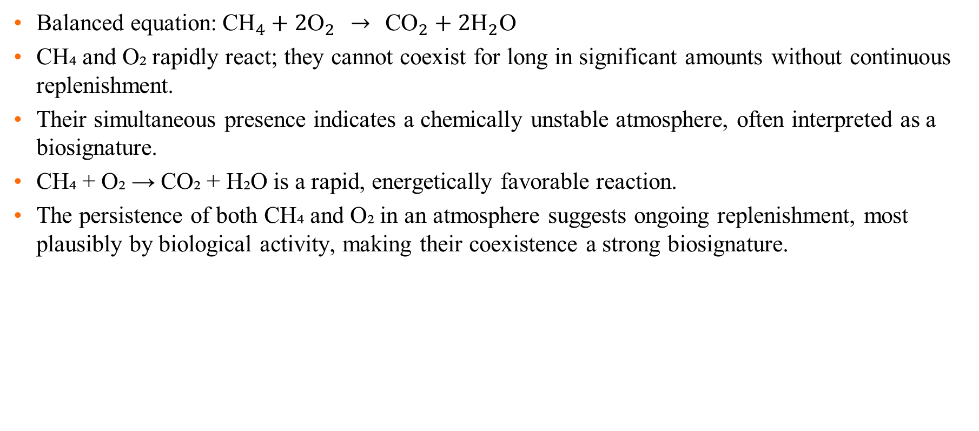
Life and CH₄ + O₂ Reaction
Balanced equation:${\text{CH}}_{4}+2{\text{O}}_{2} → {\text{CO}}_{2}+2{\text{H}}_{2}\text{O}$
CH₄ and O₂ rapidly react; they cannot coexist for long in significant amounts without continuous replenishment.
Their simultaneous presence indicates a chemically unstable atmosphere, often interpreted as a biosignature.
CH₄ + O₂ → CO₂ + H₂O is a rapid, energetically favorable reaction.
The persistence of both CH₄ and O₂ in an atmosphere suggests ongoing replenishment, most plausibly by biological activity, making their coexistence a strong biosignature.

Slide 40
Very Low Light Level - ExoPlanet Imaging
The exposure time required to achieve SNR=1 is dramatically reduced for a zero read noise detector, as compared to detectors with state of the art read noise.
Notes:
The table gives exposures times to produce SNR=1 for a typical planet detection space mission. Note the dramatic reduction in time required for a zero noise detector. R=100 is assumed, and the effective planet flux is about 10 photons/hour per pixel. The nearby starlight is suppressed at the 10^-10 level by optical nulling. Zodiacal light contributes about 0.0015 electrons/s/pixel.

Slide 41
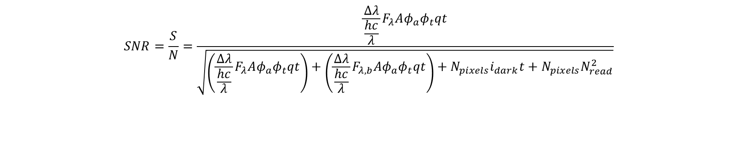
Signal-to-noise Ratio (SNR)
discoveries
better detector, higher SNR
In some cases, SNR is dominated by the source itself.
Longer integrations increase SNR!
$$SNR=\frac{S}{N}=\frac{\frac{Δλ}{\frac{hc}{λ}}F_{λ}Aφ_{a}φ_{t}qt}{\sqrt{\left(\frac{Δλ}{\frac{hc}{λ}}F_{λ}Aφ_{a}φ_{t}qt\right)+\left(\frac{Δλ}{\frac{hc}{λ}}F_{λ,b}Aφ_{a}φ_{t}qt\right)+N_{pixels}i_{dark}t+N_{pixels}N_{read}^{2}}}$$

Slide 42


Detector Mounted for Radiation (left) and Optical (right) Testing

Slide 43


3.2 Gigapixel Focal Plane in LSST
Large Synoptic Survey Telescope 3.2 Gpixel focal plane with 220 CCDs
4-side buttable, highly integrated focal plane rafts
future technologies and enhanced capabilities

