Slide 1

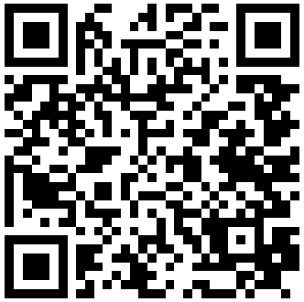
The
Center
for
Detectors
Check us out online at: ridl.cfd.rit.edu
NOW HIRING
Executive Assistant
The Center for Detectors is looking for smart and dedicated students to be Executive Assistants to Director and Professor Don Figer.
Job Functions
Skills Needed
Complete tasks on schedule, ordering lab components, mailing packages, and documenting work
Perform account reconciliations utilizing Oracle Financial and Excel applications
Mastery of Excel, Word, and PowerPoint
High level of personal responsibility
Excellent communication skills
Technical background preferred in:
  Marketing
  Communications
  Graphic design
Must be available 10-20 hours per week.
This position can also be a co-op.
If you are interested, apply on Career Connect by scanning the QR code or email your resume along with the names and contact information for three professional references and your unofficial transcripts to dcbfpi@rit.edu

Slide 2
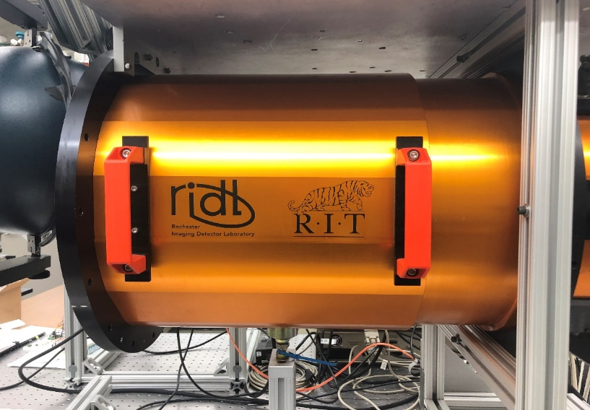
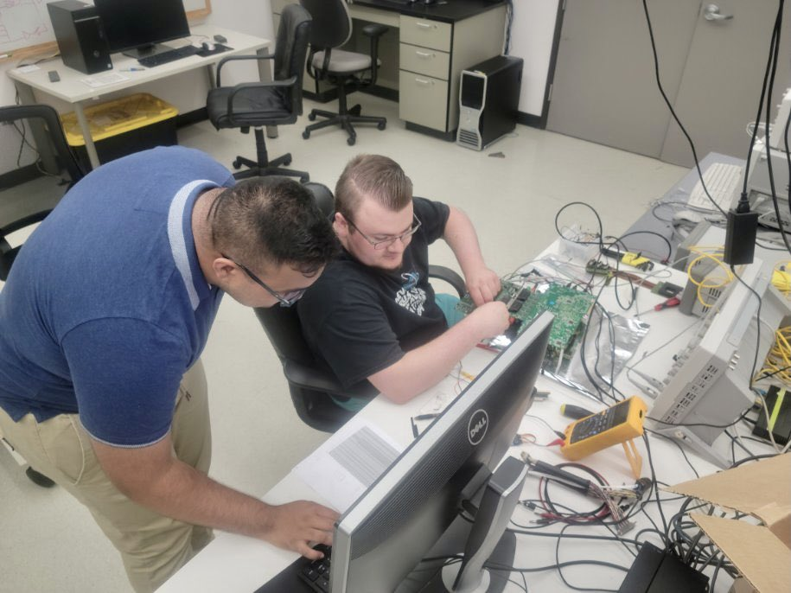
WE ARE HIRING!
Center for Detectors
Executive Assistant
This position can also be a
co-op.
The Center for Detectors is looking for smart and dedicated students to be Executive Assistants to Director and Professor Don Figer.
Job Functions
Skills Needed
Complete tasks on schedule, order lab components, mail packages, and document work
Perform account reconciliations utilizing Financial applications
Other tasks assigned based on experience/major
Mastery of Excel, Word, and PowerPoint
High level of personal responsibility
Excellent communication skills
Technical background preferred in: •Marketing •Communications •Graphic design
Must be available 10-20 hours per week.
To apply:
Visit Career Connect 23131 or email your resume along with three professional references and your unofficial transcripts to
dcbfpi@rit.edu
BETTER PICTURE THAN THIS ONE

Slide 3



We're hiring!
Center for Detectors
Executive Assistant
Job Functions
Skills Needed
Complete task on schedule, ordering lab components, mailing packages and documenting work,
Perform account reconciliations utilizing Financial applications.
Other task assigned based on experience/ major.
Mastery of Excel, Word, and PowerPoint
High level of personal responsibility
Excellent communication skills
Technical background preferred in:
•Marketing •Communications
•Graphic design
Must be available 10-20 hours per week.
If you are interested, apply on Career Connect 23131 or email your resume along with three professional references and your unofficial transcripts to dcbfpi@rit.edu

Slide 4
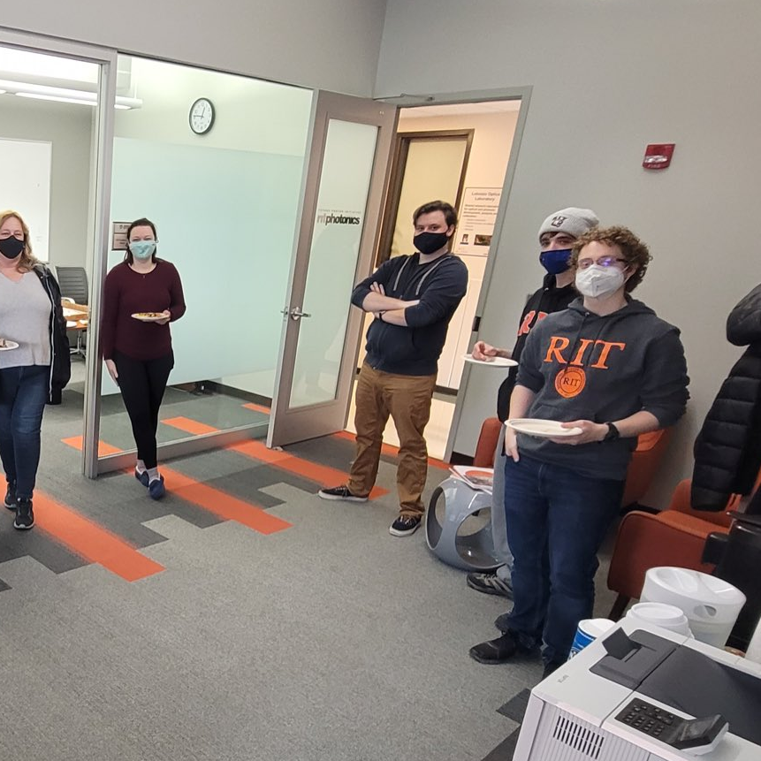
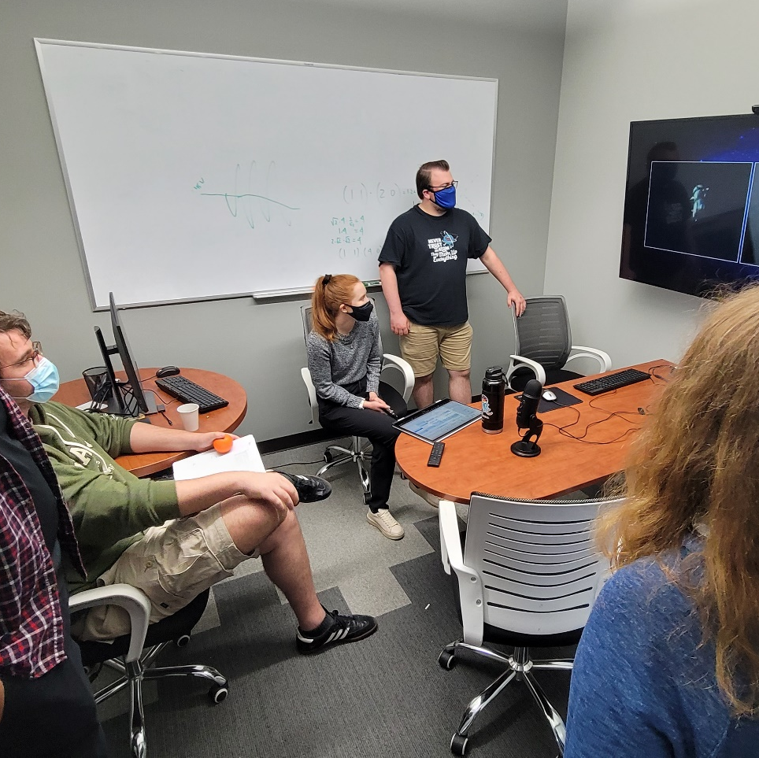

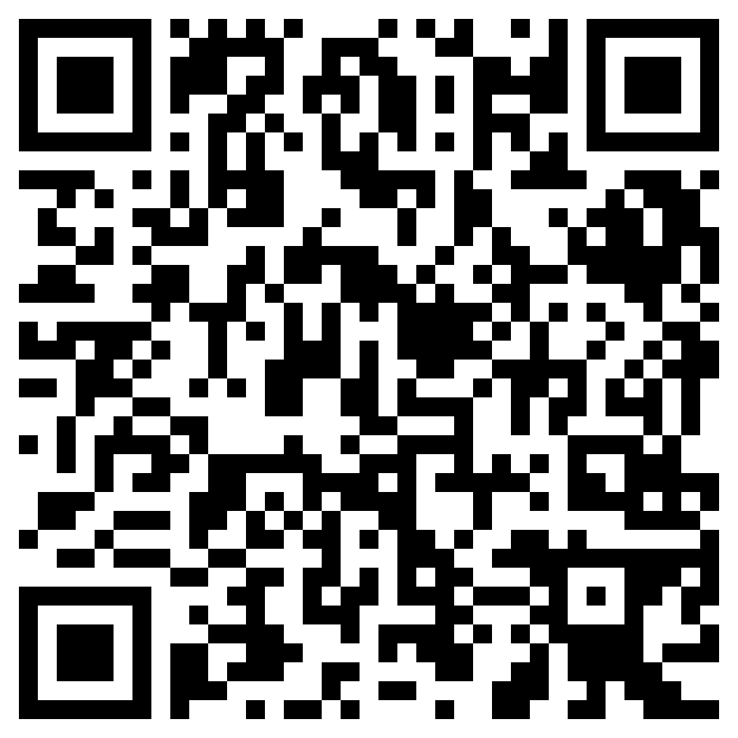
We're hiring!
Center for Detectors
Executive Assistant
This position can also be a co-op.
Contact Us
Job Functions
Job ID: 23131
Email your resume along with three professional references and your unofficial transcripts to
dcbfpi@rit.edu
Complete task on schedule, ordering lab components, mailing packages and documenting work,
Perform account reconciliations utilizing Financial applications.
Other task assigned based on experience/ major.
rit-csm.symplicity.com/students/

Slide 5
We're hiring!
Center for Detectors
Executive Assistant
This position can also be a co-op.
Contact Us
Job Functions
Online Career Connect
Job ID:
23131
Email your resume along with three professional references and your unofficial transcripts to
dcbfpi@rit.edu
Complete task on schedule, ordering lab components, mailing packages and documenting work,
Perform account reconciliations utilizing Financial applications.
Other task assigned based on experience/ major.

