Slide 1
Transmission Measurement
Basic Outline

Slide 2
Transmission Curve
Describes the percentage of a signal that is transmitted through an object (filter) over a range of wavelengths or frequencies.
What could be analyzed between the incident beam and the transmitted beam:
- power
- changes in frequency/wavelength
- difference in velocities
- intensity

Slide 3
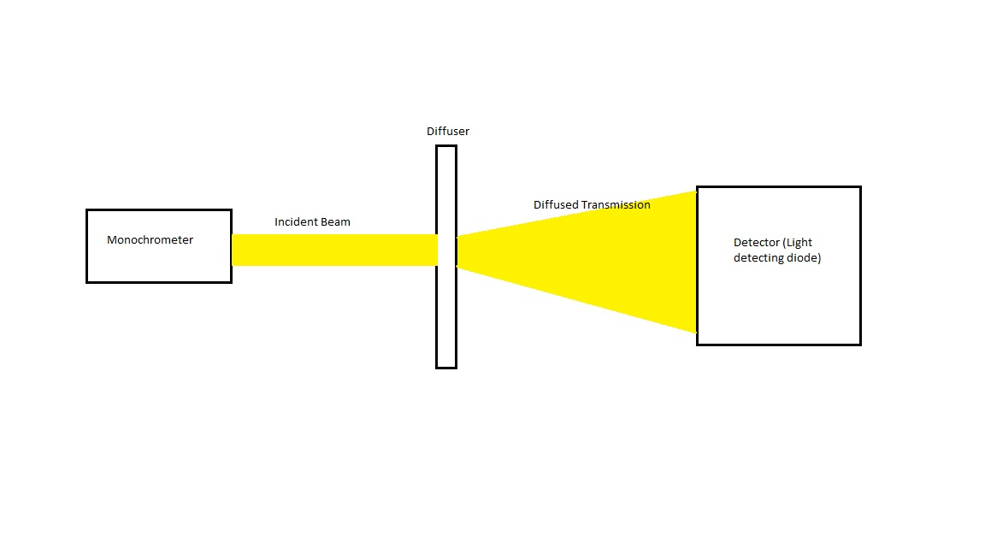
Simple Block Diagram of Setup

Slide 4
Measuring
Baseline: Measure light from monochromator without the use of the diffuser. By using a fiber optic cable, the monochromatic light can be focused onto the detector with minimal loss of intensity.

Slide 5
Measuring (cont.)
Two solutions to measuring data:
Simple: Reduce the distance between the output of the monochromator, the diffuser, and the detector so that the most amount of light rays are gathered. (See Slide 3).
Complex: Use two fiber optic cables. One between the monochromator and diffuser, and one between the diffuser and detector.

Slide 6
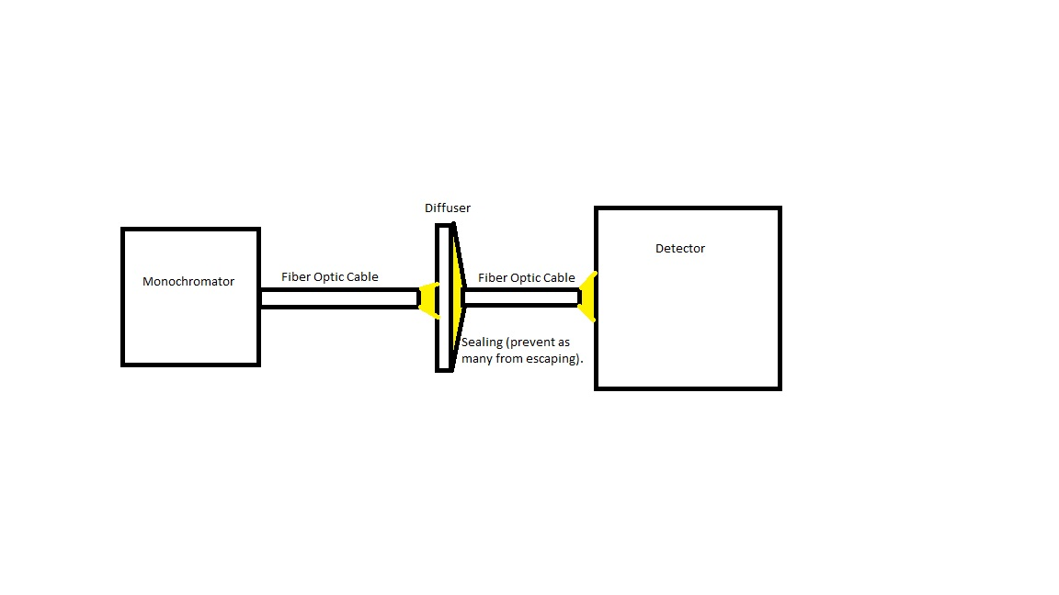
Complex Solution

Slide 7
Complex Solution (cont.)
The difficulty of this solution will be the section where the diffused rays are gathered back into a fiber optic cable. There will be a need for some sort of sealing mechanic for this.
The monochromator has a plate which will allow for a fiber optic to be connected at the focal point of the output.

Slide 8
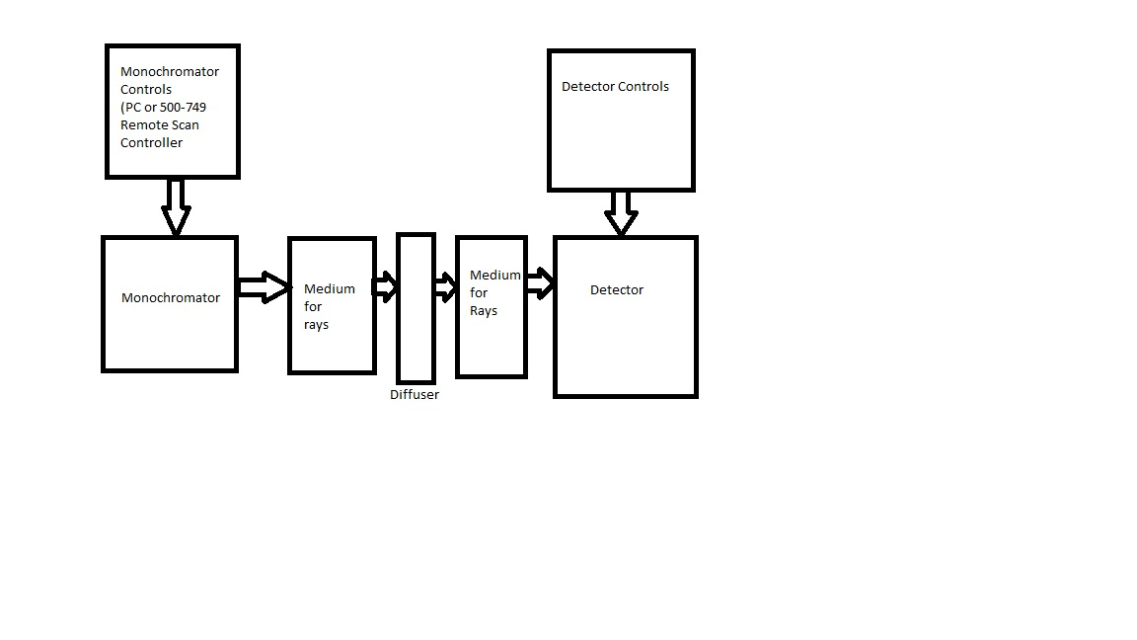
Full Setup

Slide 9
Full Setup (cont.)
Monochromator Controls will allow the user to determine which wavelength is selected in the monochromator.
The mediums for the rays can be fiber optics, lens for focusing the rays to a focal point, or simply nothing.
The detector controls will allow the user to read the measurement results.

